Slide 1
LCLS-II CM Ambient Magnetic Field Management
Tesla Technology Collaboration Meeting, Saclay
July 5, 2016

Slide 2
Magnetic scope, specifications & sources
First large CW project where magnetic shielding being analyzed stringently, especially longitudinal component of magnetic field
B_{avg} ↓ → R_{s} ↓ → Q₀ ↑ → P_{diss}↓ → $_{capital & oper} ↓
LCLS-II specification [1]:
B_{avg}<5 mG to reach Q >2.7E10 at 2 K, 16 MV/m
Major magnetic field sources: vacuum vessel, components, earth
B_{vessel}< 3 G [2]
B_{components}~ 1 G
B_{earth}≈ 483 mG at SLAC [3]
B_{//,beamline}≈ 150 mG [4]
Most analyses done assuming SLAC tunnel magnetic fields
[1] “1.3 GHz Superconducting RF Cryomodule,” Functional Requirements Document, LCLSII-4.5-FR-0053.
[2] A. Crawford, arXiv:1507.06582v1.
[3] National Oceanic and Atmospheric Administration, 2014--2019 World Magnetic Model.
[4] S. Anderson, ”Tunnel Background Field Measurement in Linac Sectors 2-10 and in the LCLS Undulator Hall.”

Slide 3
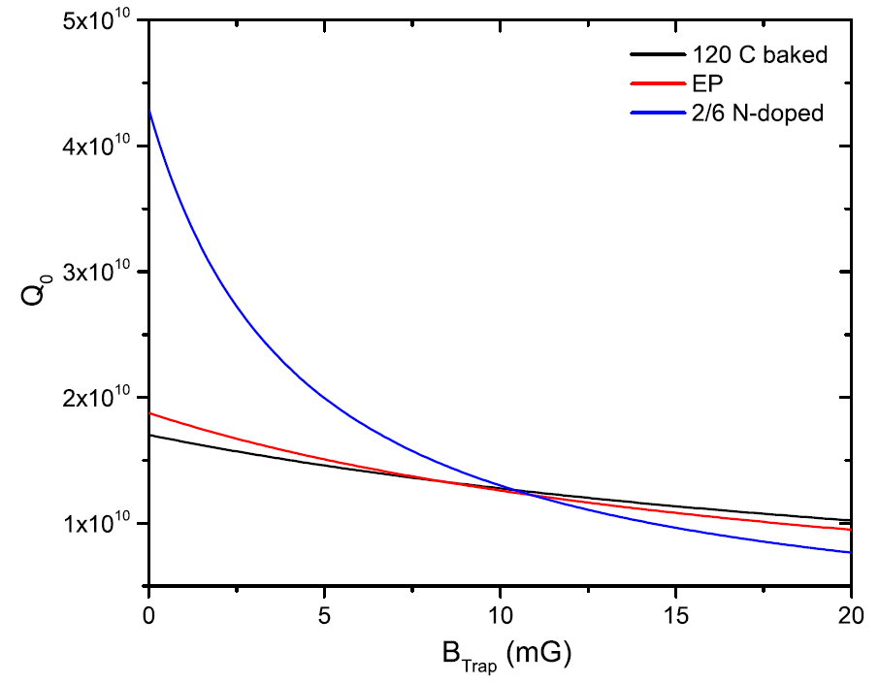
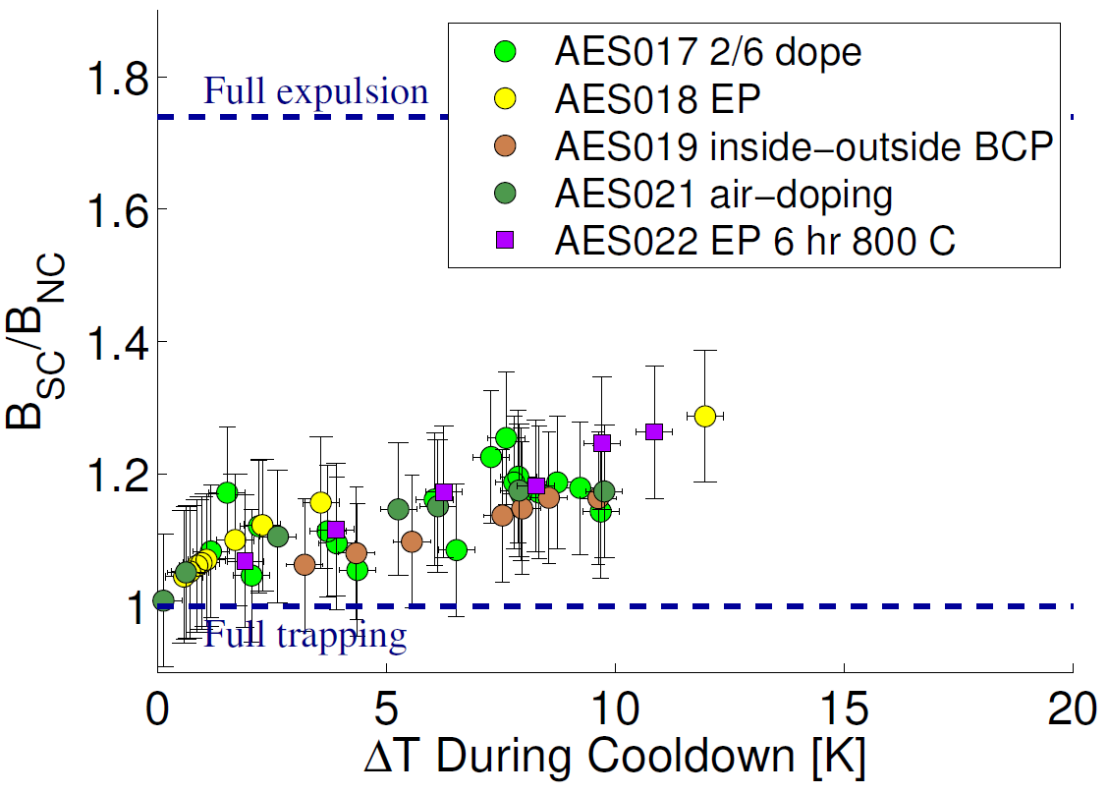
Trapped Magnetic Flux & Q₀
↓B → ↑ ↑Q₀
S. Posen et al., J. Appl.
Phys. 119, 213903 2016
M. Martinello et al., IPAC 2016
Smaller ambient magnetic fields beneficial
For high Q & for low flux expelling material
Q₀>2.7 x 10¹⁰ may be realized for trapped B<3 mG
For N-doped

Slide 4
Ambient Magnetic Field Management Methods
2-layer passive magnetic shielding
Manufactured from Cryoperm 10
Strict magnetic hygiene program
Material choices
Inspection & demagnetization of components near cavities
Demagnetization of vacuum vessel
Demagnetization of assembled cryomodule / vessel
Active longitudinal magnetic field cancellation

Slide 5
Fluxgates in pCM cavities
4 cavities instrumented with fluxgates inside helium vessel
Cavities 1, 4, 5, 8
2 fluxgates per cavity
#1: 45°to cavity axis, in vertical plane of cavity
#2: 90°to cavity axis

Slide 6
Longitudinal fluxgates outside cavities
5 fluxgates
Cavities 1, 2, 5, 7, 8
Mounted between the two layers of magnetic shields
Parallel to cavity axis

Slide 7
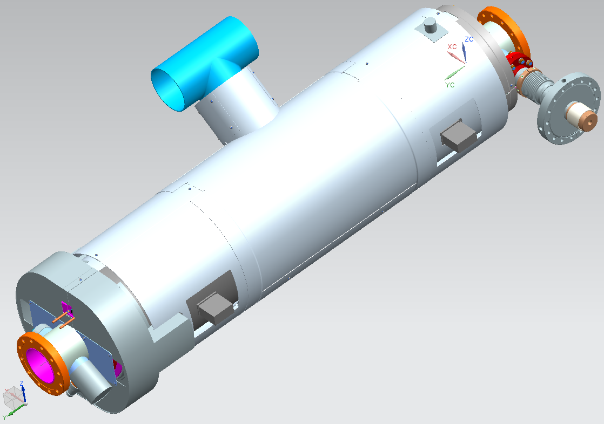
2-layer magnetic shields
Manufactured from Cryoperm 10

Slide 8
Magnetic hygiene program - Components
Materials in close proximity to cavities controlled
Non magnetic materials preferred
If stainless steel needed, 316LN or 316L preferred
All stainless steel & other magnetic components checked for residual magnetic fields
Residual fields at cavity RF surface distance should be ≤5 mG
Invar rod subject to this requirement too
Checked & demagnetized after final welding & grinding

Slide 9
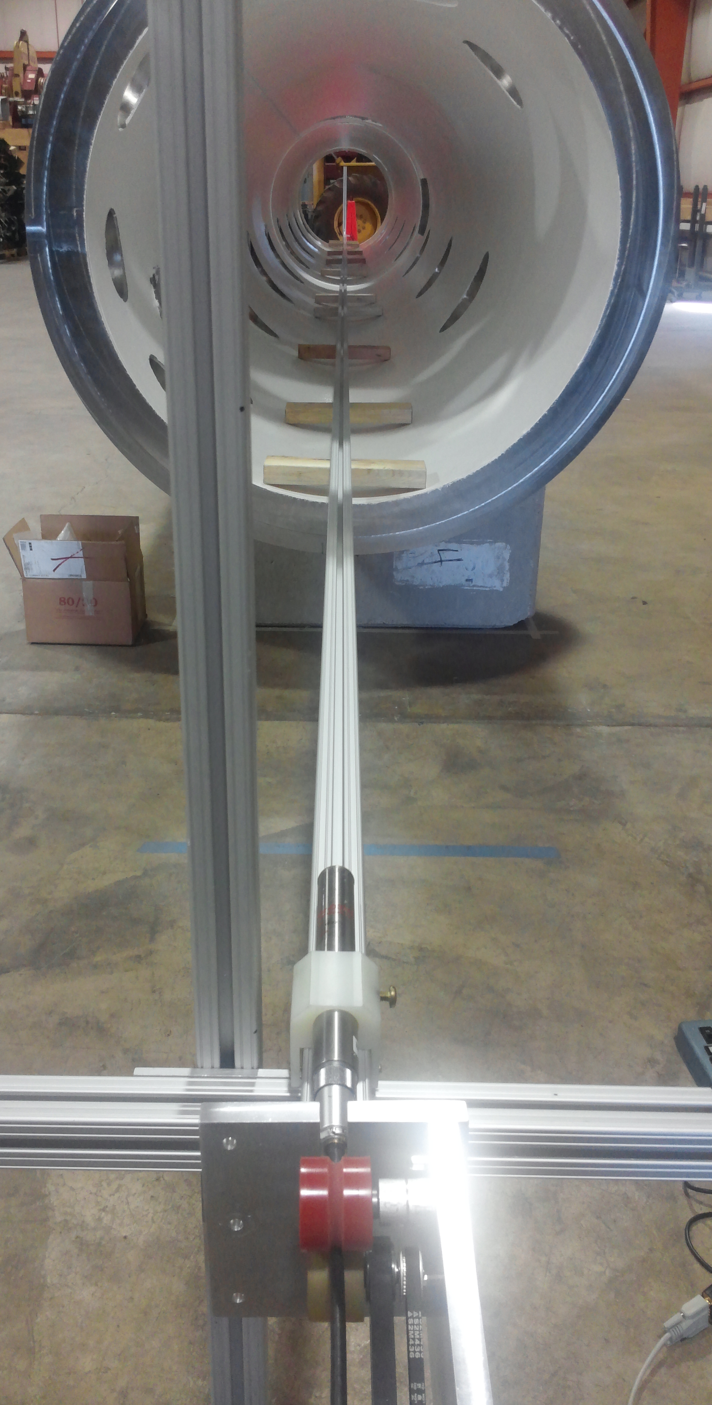
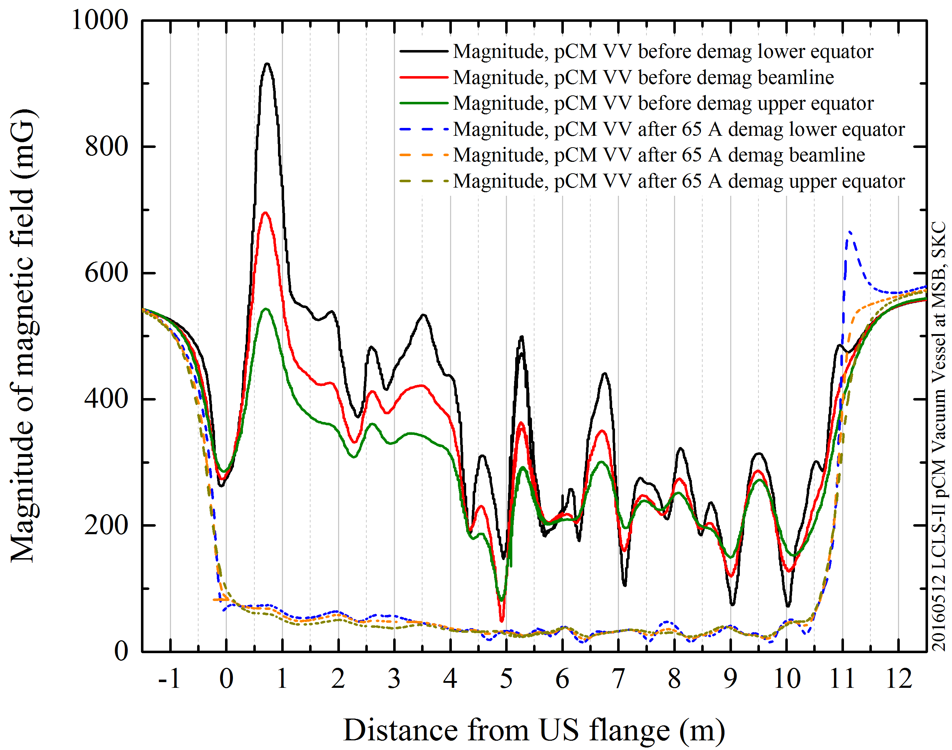
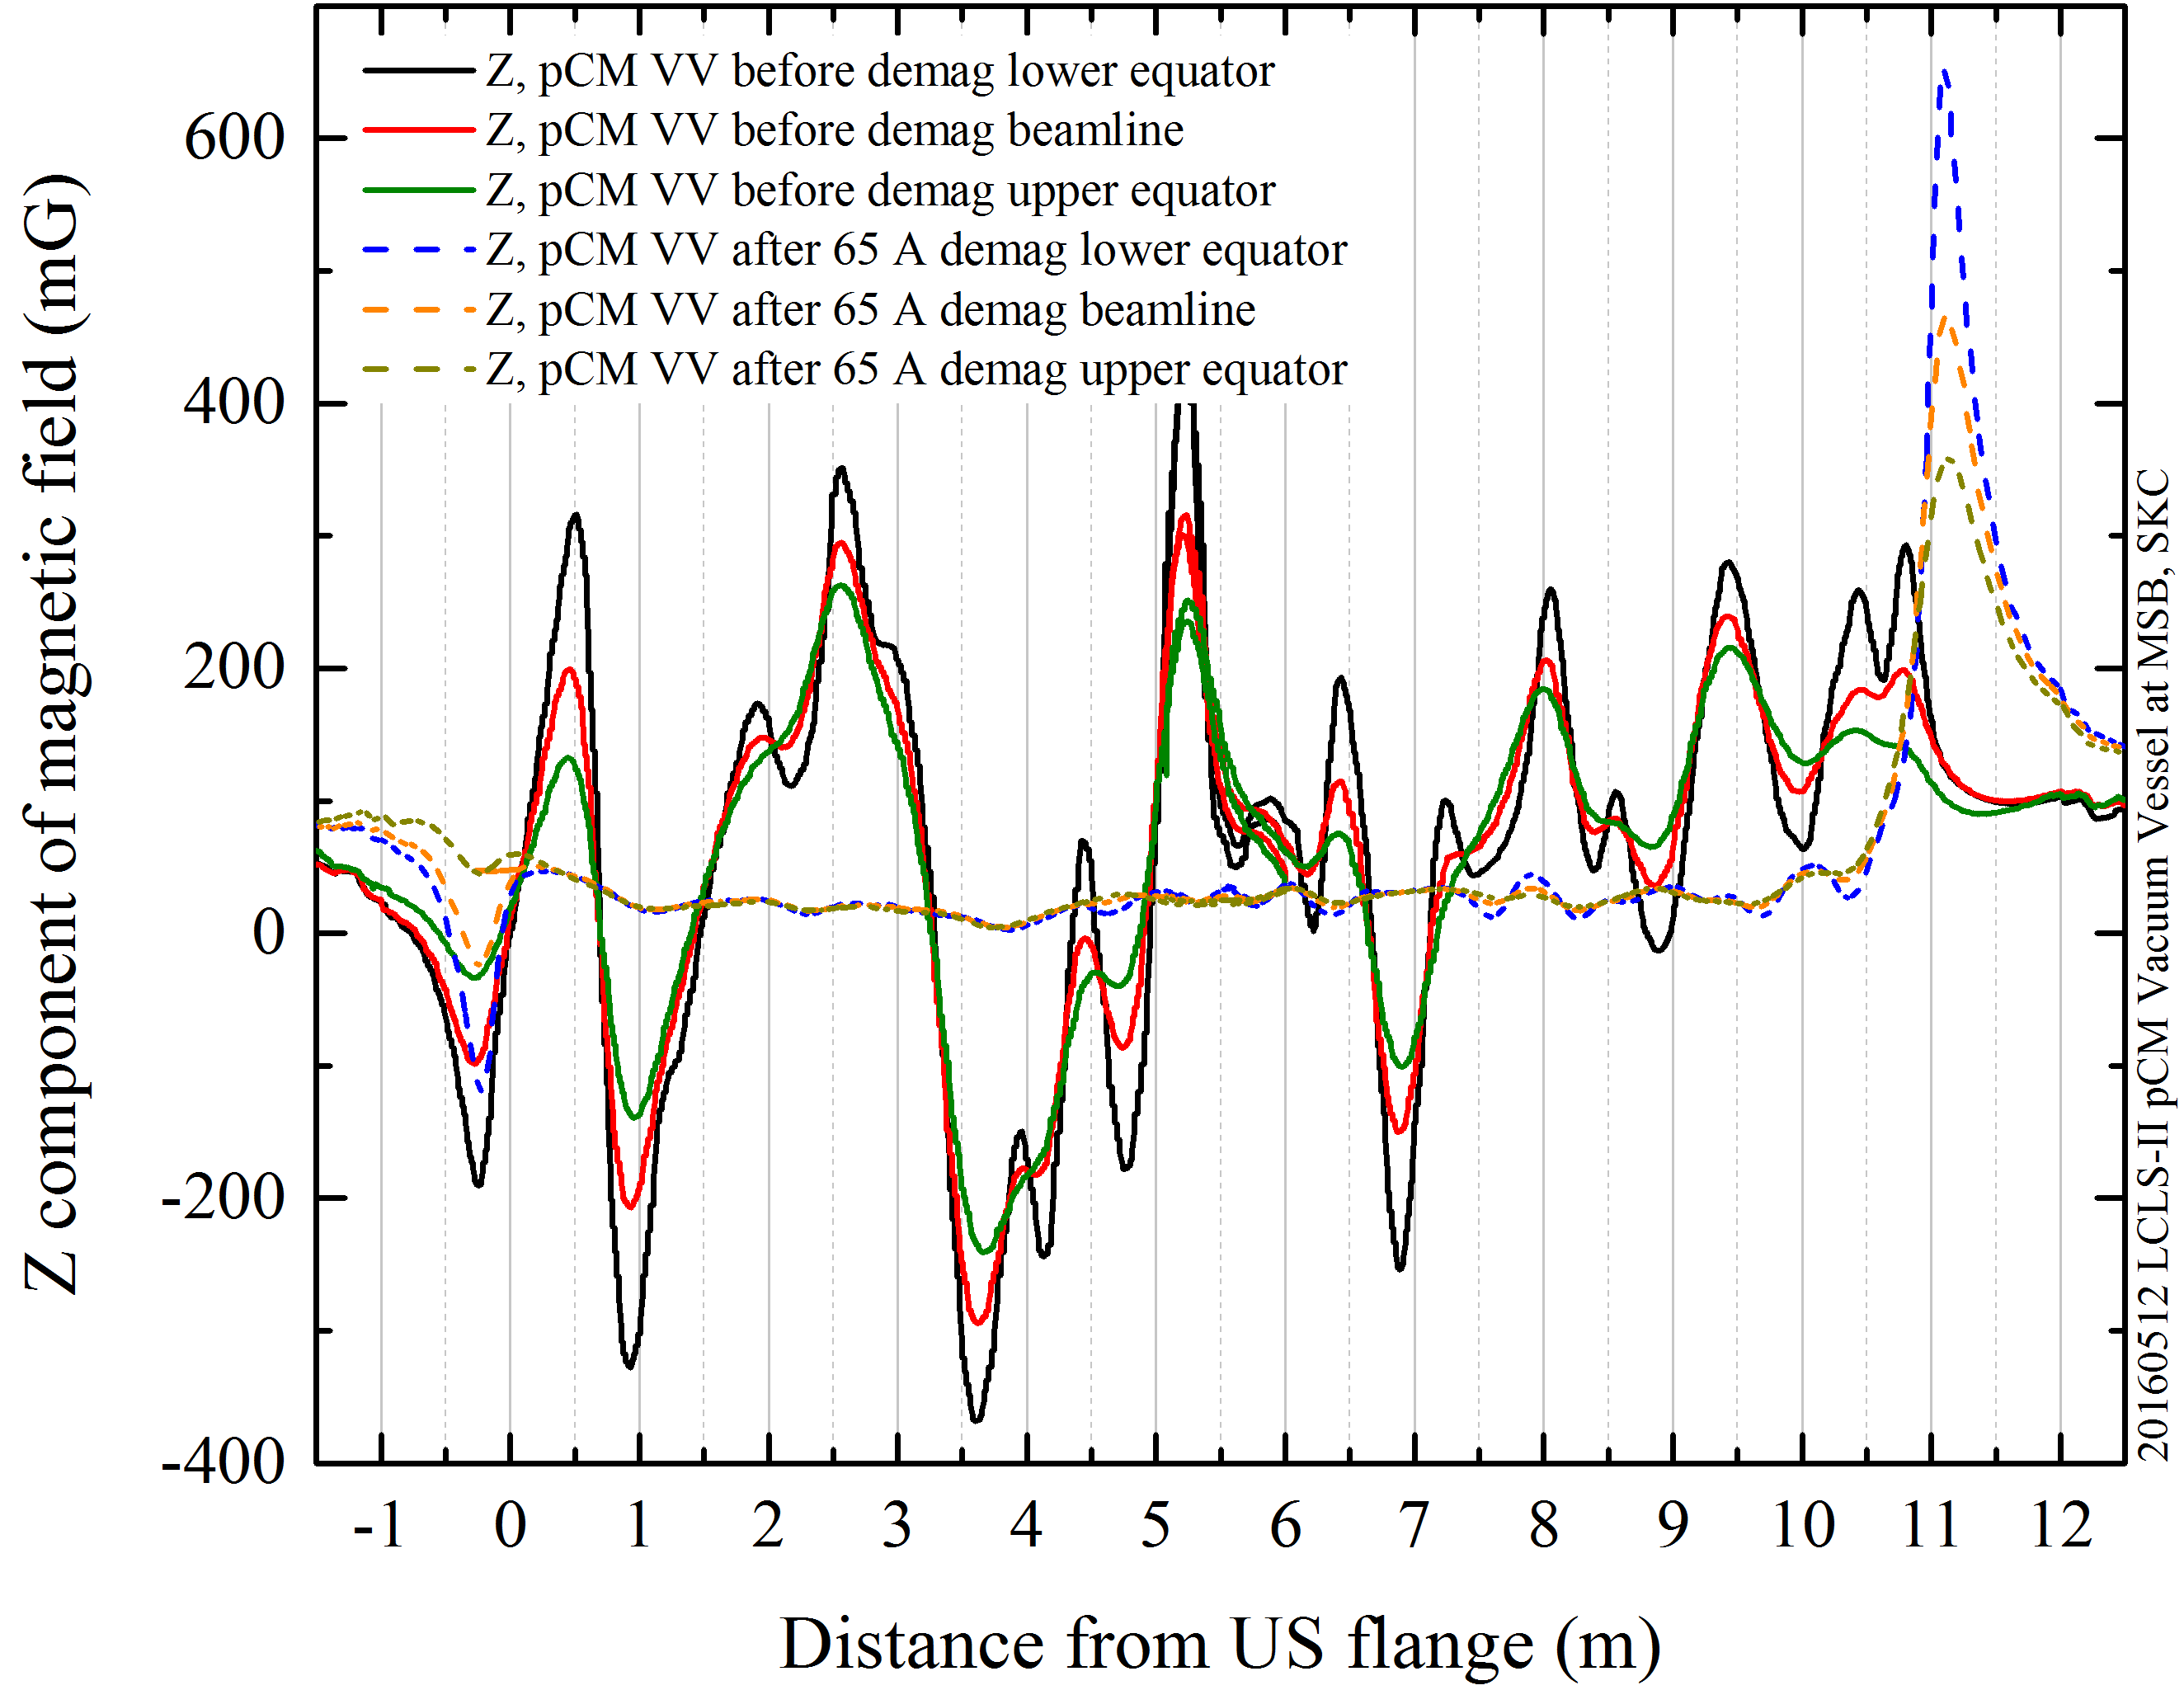
Magnetic hygiene program – Vacuum Vessel
Helmholtz coils wound onto vessel directly
Residual mag field at beamline, top & bottom equators
B_{z} > 300 mG
↓
<50 mG & uniform
B_{avg} > 500 mG
↓
<50 mG & uniform

Slide 10
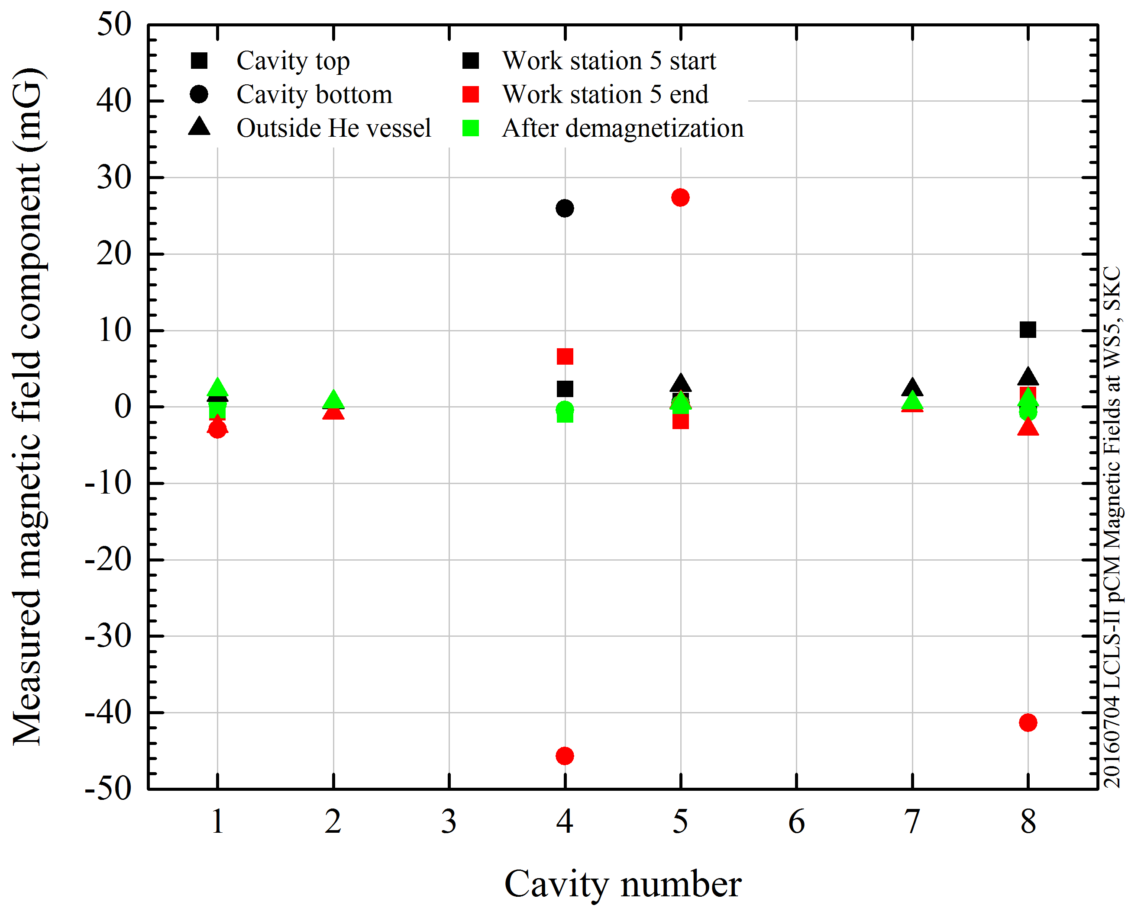
Magnetic fields as assembly progresses
Fields up to 46 mG discovered after major assembly work
Cryo-piping welds, warm coupler install, etc.
Investigation performed & ruled out several sources
Vacuum vessel deduced to be magnetized
Cryomodule successfully demagnetized using in-place coils

Slide 11
Summary
First large scale project where
Magnetic hygiene very strictly enforced
Cryomodule instrumented to monitor magnetic environment
2-layer magnetic shielding of cavities
Fluxgates monitored during cryomodule assembly
Helmholtz coils outside vacuum vessel
Able to demagnetize vessel & cryomodule in-situ

