Slide 1
PIP-II SSR1 Cryomodule
Technical Issues
Leonardo Ristori
TTC Meeting
CEA Saclay, 5-8 July 2016

Slide 2
Topics
The Fermilab SSR1 Cryomodule
Study on vacuum manifold
Study on cool-down for alignment
String Assembly Challenges
Cryomodule Assembly Strategy
Spoke Tuner
  Requirements
  Prototype
  Production
Coupler
  Requirements
  Prototype Test to Failure
  Production
  Electro-deposited bellows
  Low pressure gap window

Slide 3
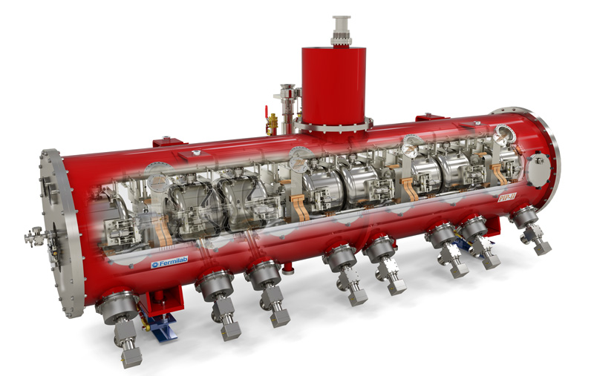
SSR1 Cryomodule
Segmented approach
2 K operation
2 bar relief
8 SRF Cavities + Couplers
4 SC Magnets
4 BPMs

Slide 4
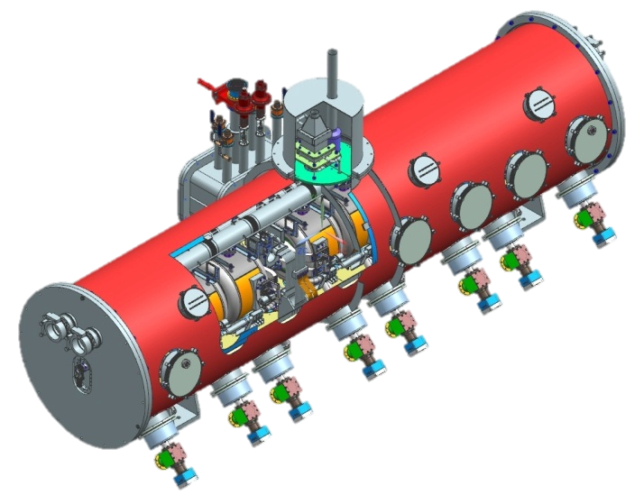
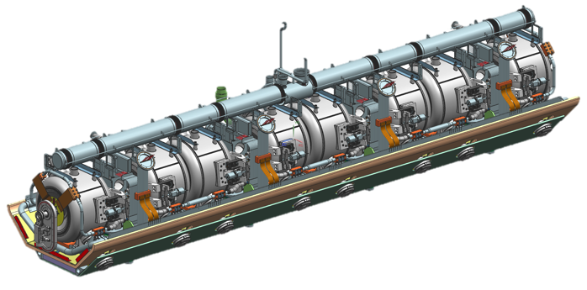
SSR1 Cryomodule
L. Ristori, T. Nicol, Y. Orlov, D. Passarelli, M. Parise
http://accelconf.web.cern.ch/AccelConf/PAC2013/papers/thpma09.pdf
Current leads
Tuner access ports
Alignment
viewports
Couplers
5.2 m long
8 Cav + 4 Magnets
Bottom-supported elements with warm strongback

Slide 5
SSR1 Cryomodule R&D Goals
Validate new spoke cavity cryomodule design concepts
  Room temperature strongback
  Individual support posts to control axial motion
  Conduction cooled magnet current leads (not new, but new to us)
  Single-window coaxial input coupler
  Integral beam instrumentation
  Determine the practicality of tuner access ports
Validate alignment concepts
  Gain experience with the required alignment tolerances
  Verify alignment stability during cooldown
Verify static and dynamic heat load estimates
Clean-Room assembly in New Facility (Lab 2)
  Gain experience with strings of spoke cavities, solenoids, and beam instrumentation, e.g. cleanroom operations, shipping and handling, etc.

Slide 6
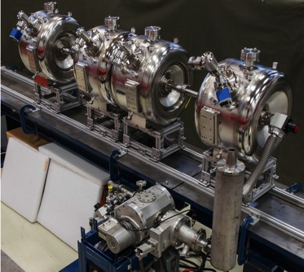
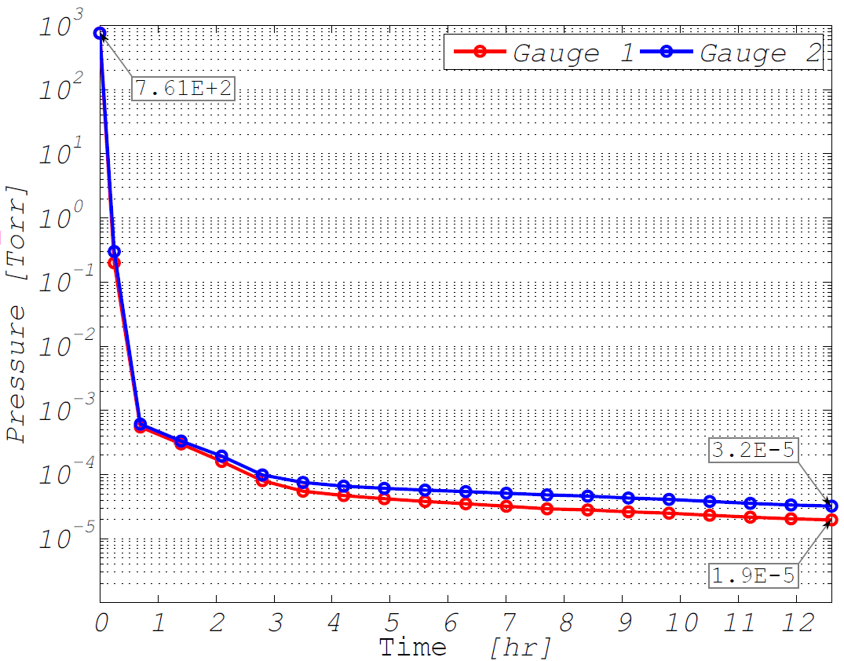
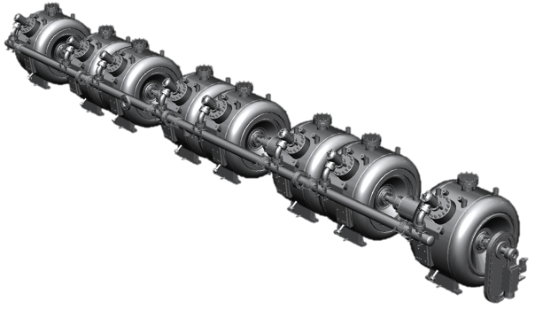
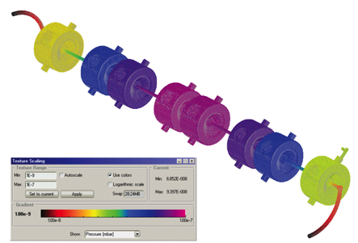
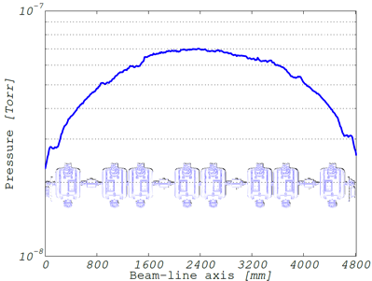
SSR1 String Assembly: Beam-line vacuum
Work by M. Parise
High vacuum level (< 5E-5 Torr) is needed inside the beam line volume before the introduction of liquid helium.
Maximum acceptable time set to 12 hours
Measurements (very conservative conditions, moisture in cavities)
Pressure Gauges
Ultimate pressure is below 5e-5 Torr
Vacuum Manifold is not needed!
Vacuum Pump
Vacuum simulation (ideal scenario)
The high-vacuum level at room temperature can be achieved pumping down by the beam ports only. Furthermore, simulations performed on the entire string with clean components show that the achievable pressure would be of 7E−8 Torr pumping from both ends.
Ultimate pressure is below 1e-7 Torr
High-vacuum Simulations and Measurements on the SSR1 Cryomodule Beam-line, D. Passarelli et al., Proceedings of SRF2015, Whistler, BC, Canada

Slide 7
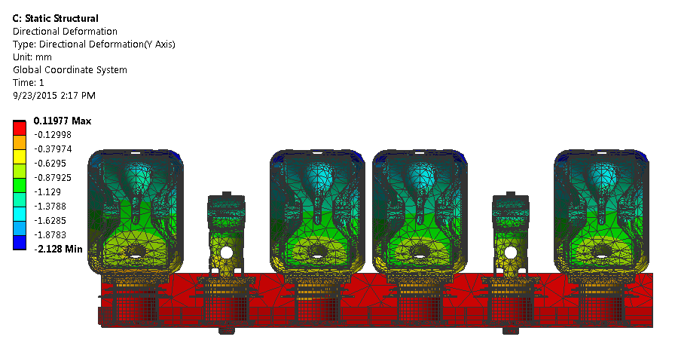
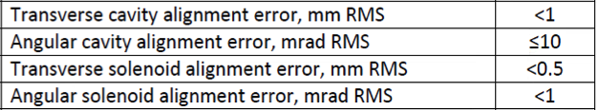
Cool-down displacements
Thanks to strong-back at room temperature, no longitudinal displacements.
Vertical displacements of magnets and cavities are the same, since the supporting structures are made of same material (→ same thermal contraction)
Predicted beamline shift: ⬇down ~1mm, will be pre-set

Slide 8
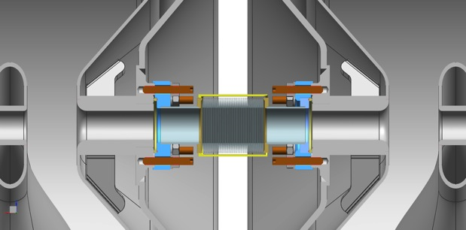
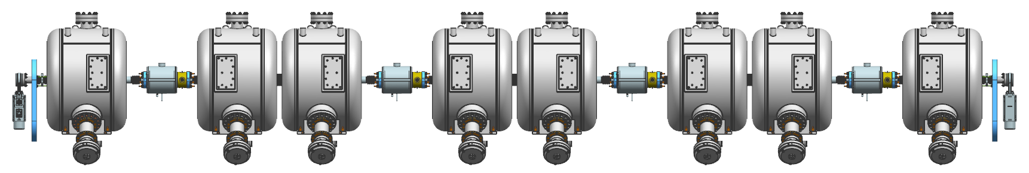
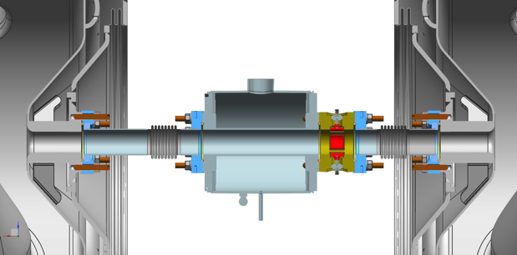
SSR1 String Assembly: design features
Interconnection cavity-cavity
20mm
Edge-welded bellows assembly
Al-diamond seals
SiBr set screws
316L stainless nuts and washers
SSR1
Type A
SSR1 Type B
SSR1
Type A
SSR1 Type B
SSR1
Type A
SSR1 Type B
SSR1
Type A
SSR1 Type B
Gate Valve
Gate Valve
Coupler
(cold-end)
Solenoid
BPM
Interconnection cavity-magnet-BPM-cavity
Hydro-formed bellows assemblies
Al-diamond seals
SiBr set screws
316L stainless nuts and washers

Slide 9
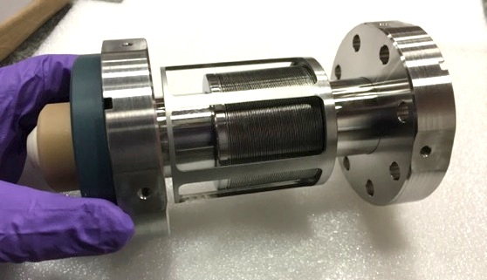
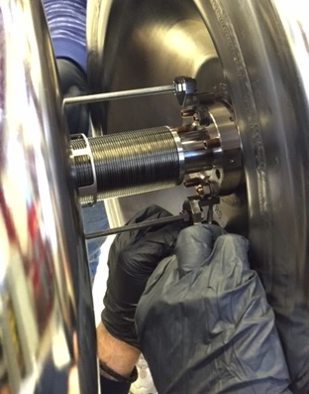
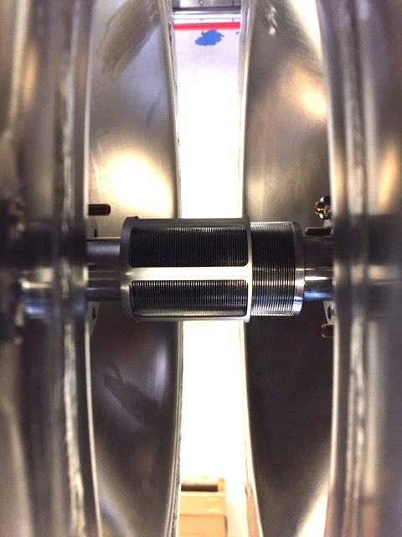
Cavity-Cavity Connection
Bellows allow enough room to perform the assembly (tested outside the cleanroom)
extended
Cleanliness?
Edge-welded bellows were subjected to cleaning and extensive testing in cleanroom.
Results were excellent and repeatable.
US cleaning sufficient, HPR better.
compressed

Slide 10
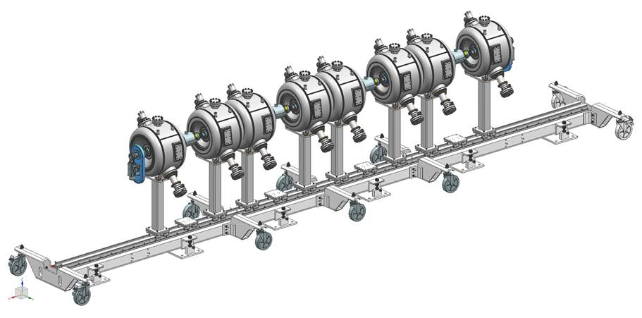
Cavity-Magnet String on Rail System
String Assembly....
To purge or not to purge?
Purging seems the better approach in this case
Re-entrant shape of cavity endwalls prone to turbulence
Vicinity of connections to high e-field regions, high risk
First cleanroom assembly for new facility
First non 9-cell cryomodule at Fermilab
Work by D. Passarelli – M. Parise

Slide 11
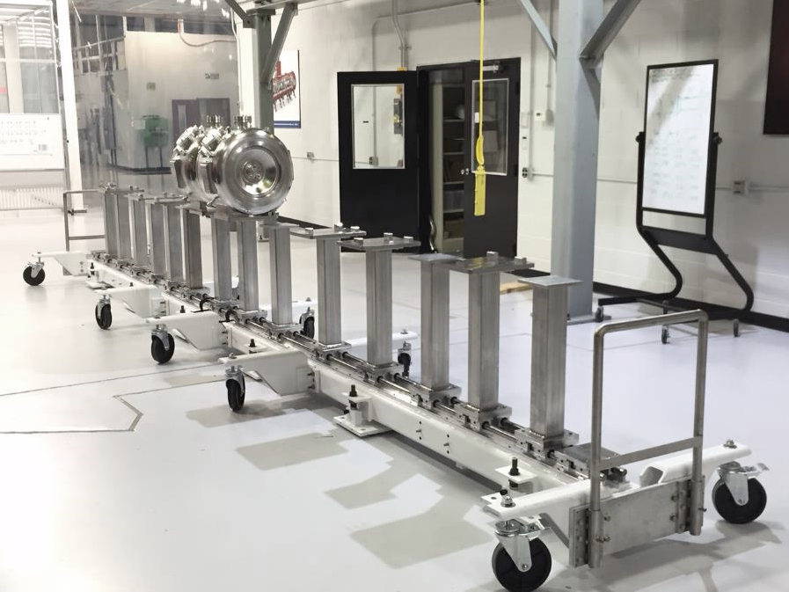
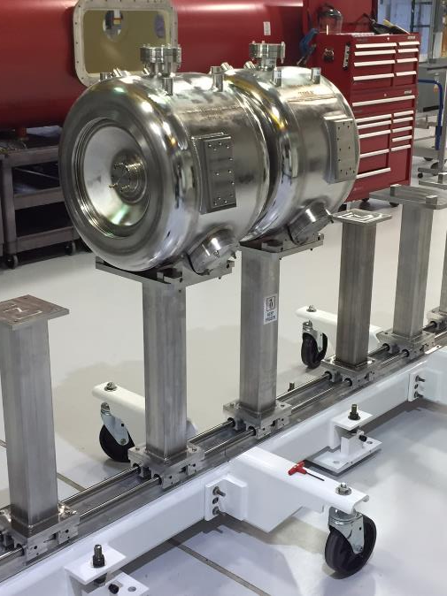
Rail System – staged outside cleanroom

Slide 12
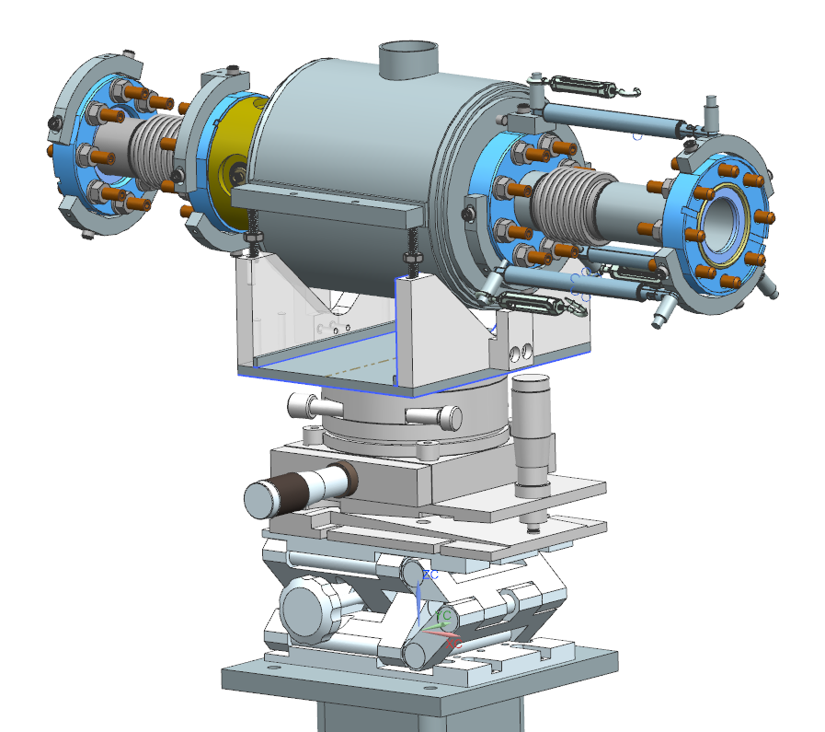
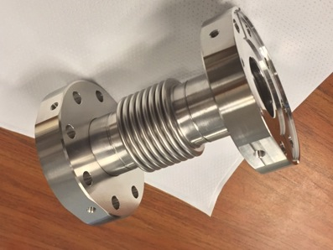
Magnet-BPM Installation Tool
Work by M. Parise
Magnet, BPM, 2 bellows, assembled and HPR washed prior to installation
Aligned using modular system employing independent devices for each DOF
Bellow alignment braces still not finalized
Tension Wires
Gas Springs (Compression)
Modular alignment system

Slide 13
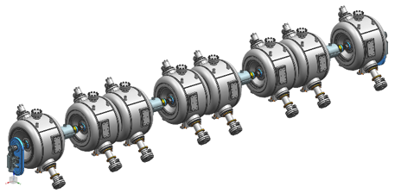
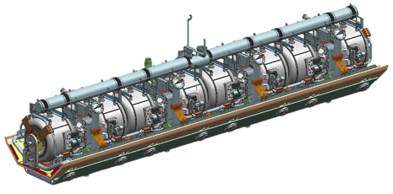
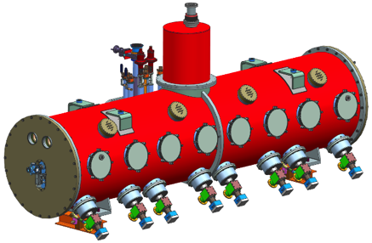
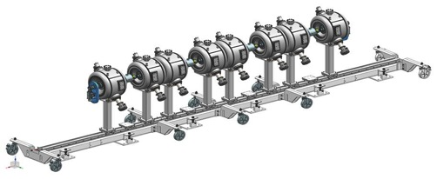
Cryomodule Assembly Strategy (not finalized)
In cleanroom, Rough alignment done, clocking is fixed. String with rail system comes out of cleanroom.
String is made rigid by tooling (not pictured) and lifted by crane
String is lowered on strongback assembly, on 2nd rail system
Cold mass assembly is completed (tuners, 2-phase, current leads, piping, MLI). Final alignment is done.
Cold mass inserted in vacuum vessel (rollers not pictured). Alignment is checked.
2
3
1
4
5

Slide 14
SSR1 Tuner: Requirements

Slide 15
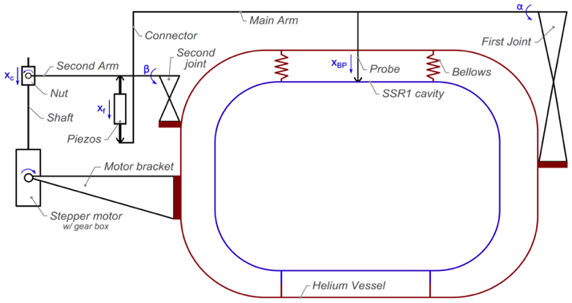
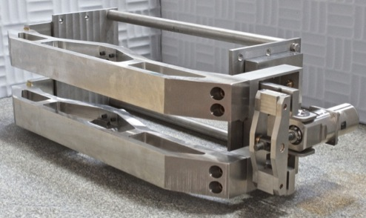
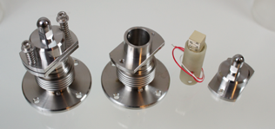
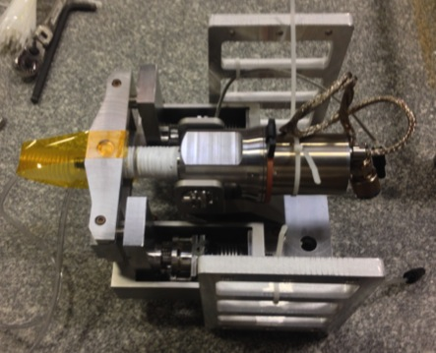
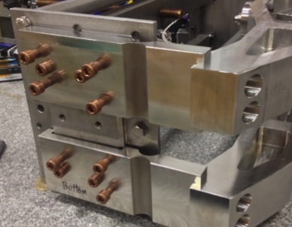
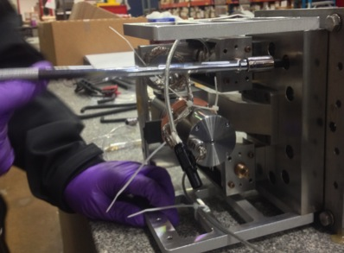
Prototype Tuner
D. Passarelli
Cartridge with motor and piezos
Alignment system for main arms
Installation of cartridge

Slide 16
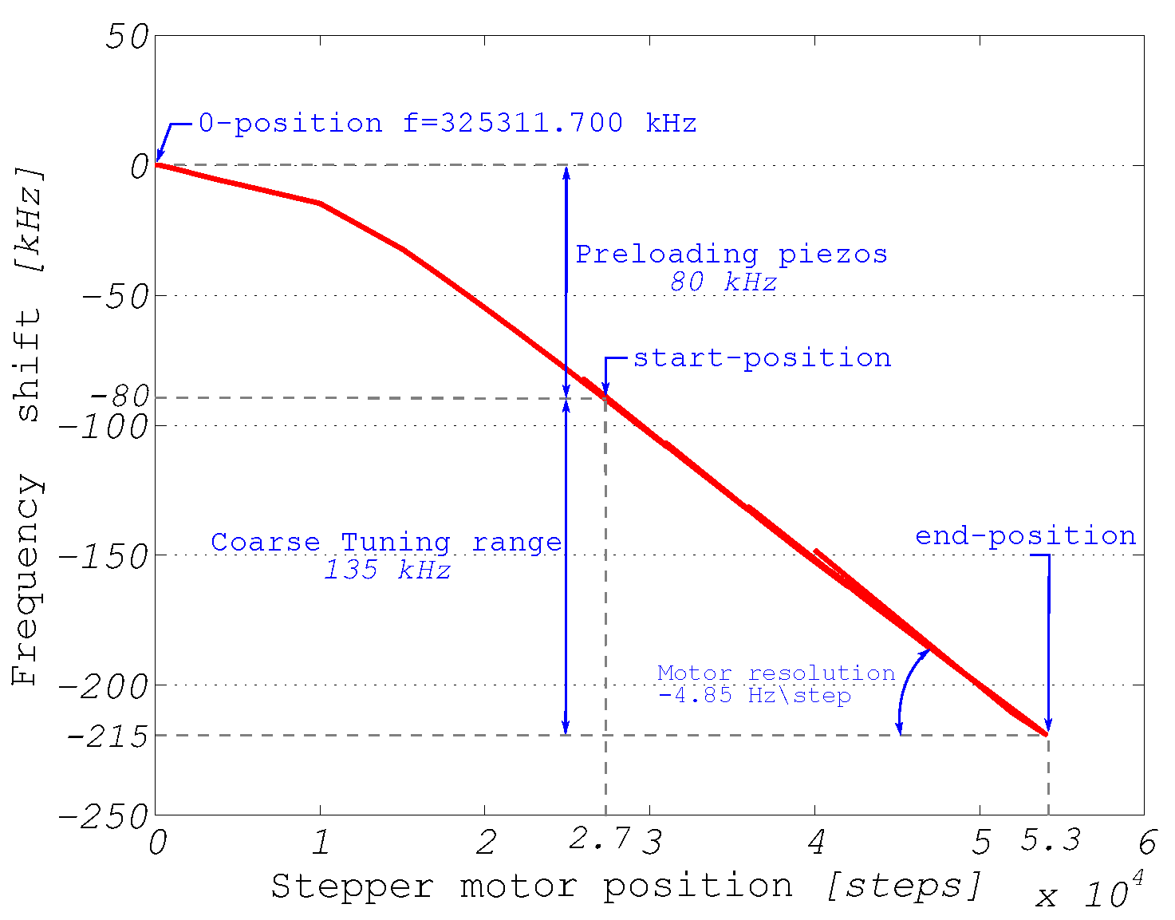
SSR1 Tuner: Testing
Tuning is achieved with cavity always under compression
Spec is > 135kHz range
Motor and Piezos are in series
Preload of Piezos is achieved by engaging the motor up to 80 kHz shift
Studies of microphonics control of the SSR1 cavity have being carried out using this tuner mechanism.
Performance of the Tuner mechanism for SSR1 Resonators During Fully Integrated Tests at Fermilab, D. Passarelli et. al., Proceedings of SRF2015, Whistler, Canada, THPB061

Slide 17
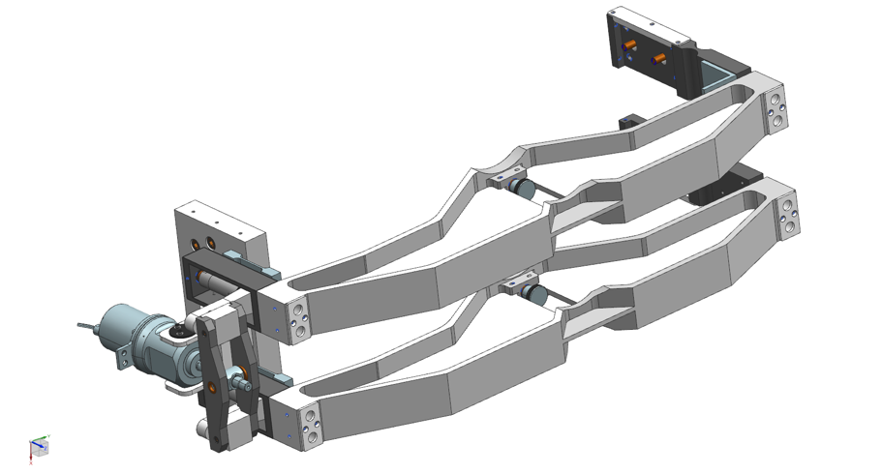
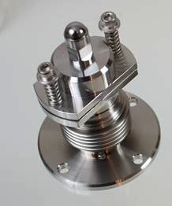
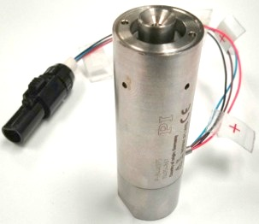
Production SSR1 Tuner
Work by D. Passarelli
Based on the experiences gained assembling and testing the prototype tuner we’re updating the design of the tuner for the production version.
Main changes:
  Clearance with beam connections
  Integration of commercial encapsulated piezos stack (same used for LCLS-II). Replacing the “homemade” ones which are considered less reliable.
  Easier installation: improve connections among parts
  Easier handling: reduce the overall weight of components without loosing stiffness (efficiency)
Notes:
Add image of new tuner

Slide 18
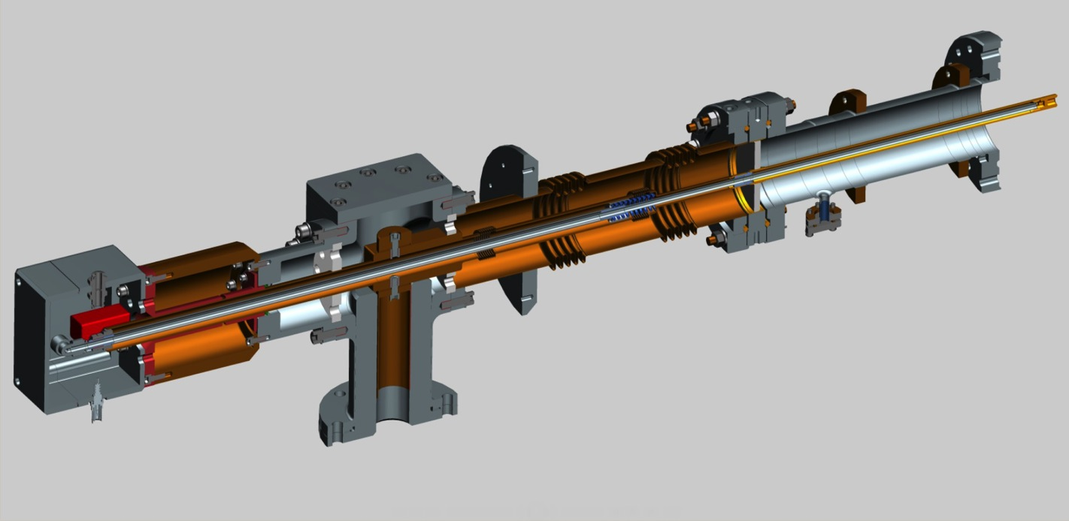
325 MHz Power Coupler
Work by S. Kazakov
Thermal design
Parameters | Value
Thermal intercepts (nominal) | 5 K and 80 K
Temperature at 5 K intercept | < 15 K
Temperature at 80 K intercept | < 125 K
2K heat load (30 kW) | < 1 W
5K heat load (30 kW) | < 6 W
80K heat load (30 kW) | < 11 W
Antenna tip temperature (30 kW) | < 330 K
Antenna cooling media | Air
Air flow rate (30 kW) | < 2 g/s
Max cooling air pressure drop | < 1.0 bar
Electro-magnetic design
Parameter | Value
Frequency | 325 MHz
Pass band (S₁₁<0.1) | > 1 MHz
PIP-II Operating power (CW reflection) | 15 kW
Acceptance Testing power | 30 kW
HV bias | ~ 4kV

Slide 19
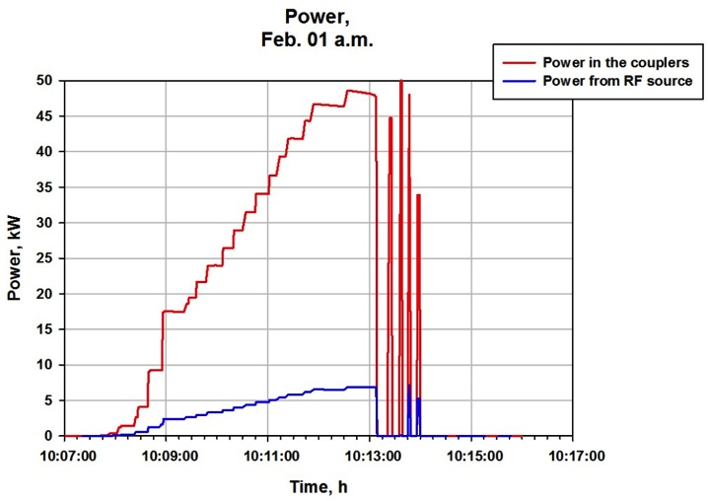
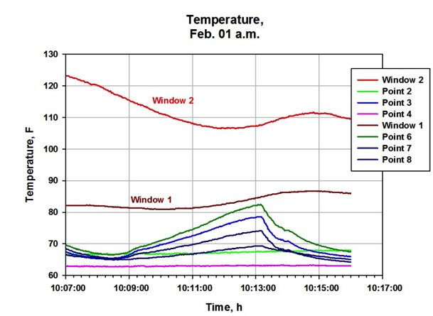
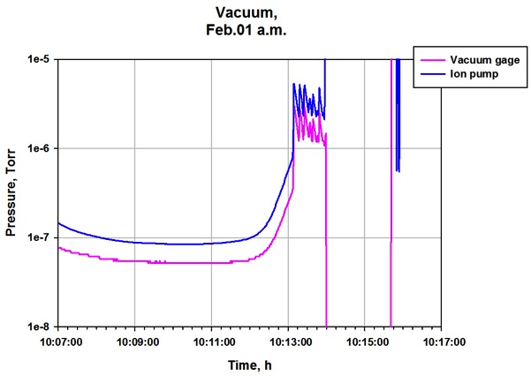
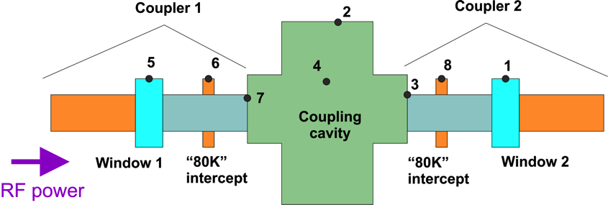
1 Prototype Tested to Failure (reached 47 kW, successful)
Work by S. Kazakov

Slide 20
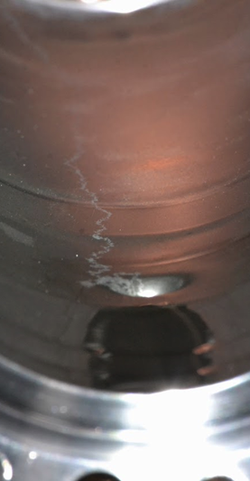
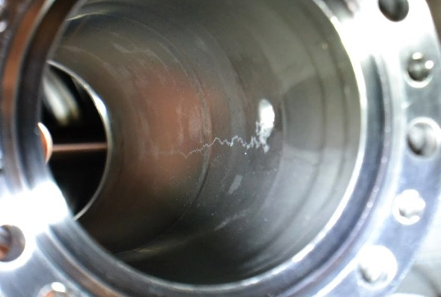
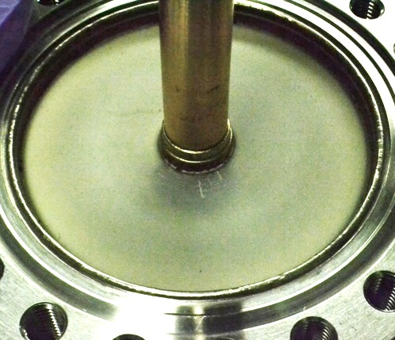
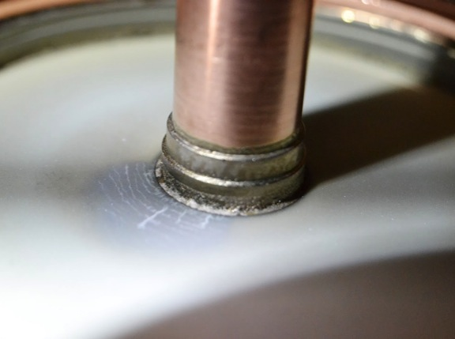
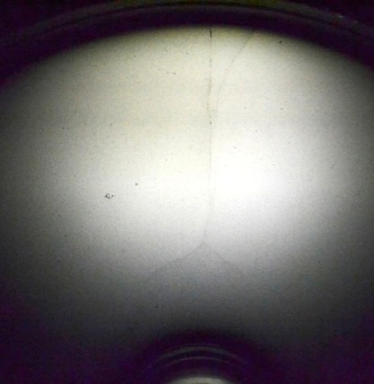
Failed Coupler
Work by S. Kazakov

Slide 21
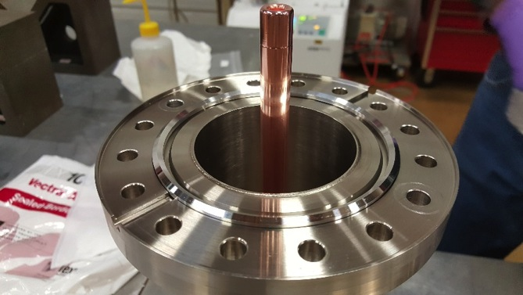
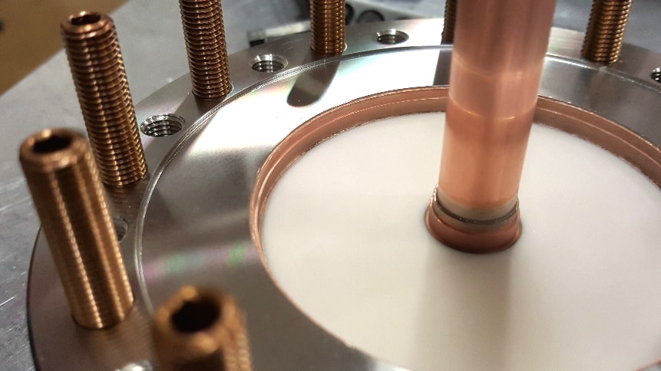
Production Couplers
Work by S. Kazakov
Much better quality visually than prototypes
High Power Tests this month

Slide 22
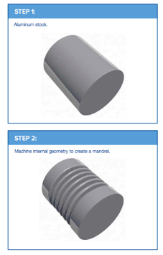
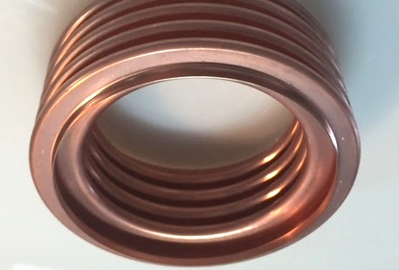
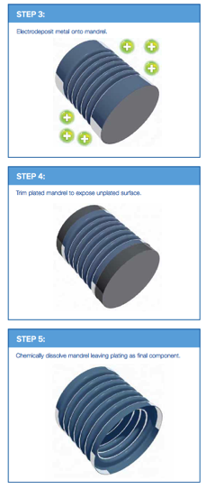

Electro-Deposited Bellows
Work by O. Pronitchev
Alternative to copper-plating (which has lots of potential issues)
PROS
Flexible and elastic
Vacuum integrity
Flawless internal finish
Very tight tolerance on shape
CONS
25um internal layer of Nickel is slightly magneti, not a problem for PIP-II
limited suppliers

Slide 23

Ceramic Window with Low Pressure Gap
Low pressure gas is kept between windows
Advantages:
  reliability as two windows
  compact as single window (antenna can be easily cooled)
  lower bending forces on window, compared to single window of same total thickness
Occurrence leaks can be detected: decrease of pressure in gap indicates of crack in inner window, increasing pressure in gap indicates of crack in outer window.
Any single crack is not fatal for accelerator.

