Slide 1

Welcome to TTC workshop
ACCESS, BUS, CANTEEN, MAP, SHUTTLE

Slide 2
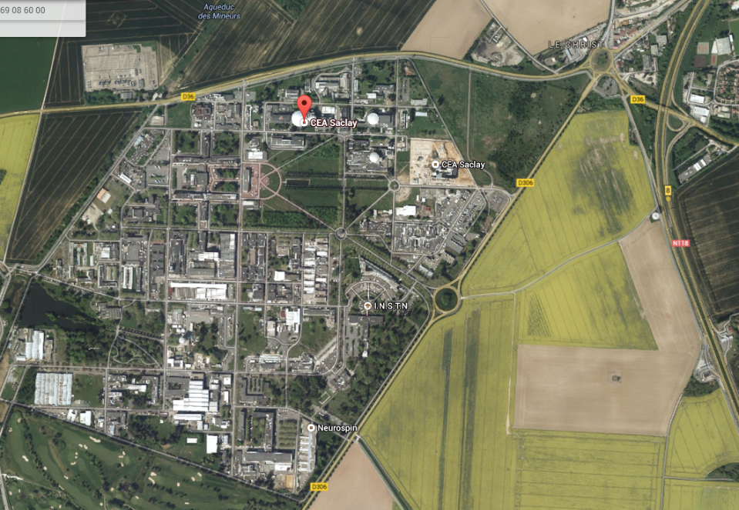
INSTN (TTC meeting)
Bus stop
Canteen 2
Lab tour – Bldg. 124/126
http://www.albatrans.net/

Slide 3
Internet access
When registering on Tuesday morning, you will have to sign two copies of instruction for internet access and return one signed copy to Catherine Desailly.
You can also use Eduroam.

Slide 4
Canteen 2
Please note that all cashiers take cash.
Only one cashier takes credit cards.

Slide 5
GROuP PHOTO at 13h45 in the stairs

Slide 6
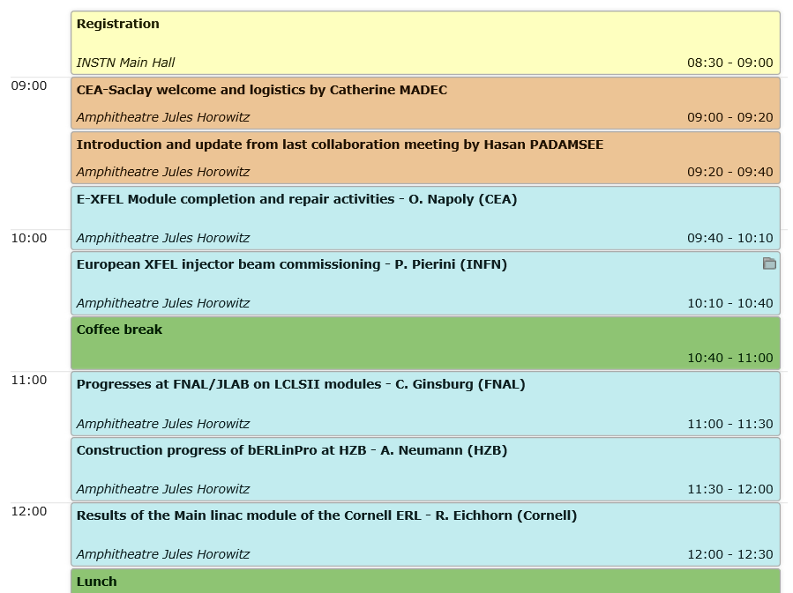
Agenda Tuesday Morning

Slide 7
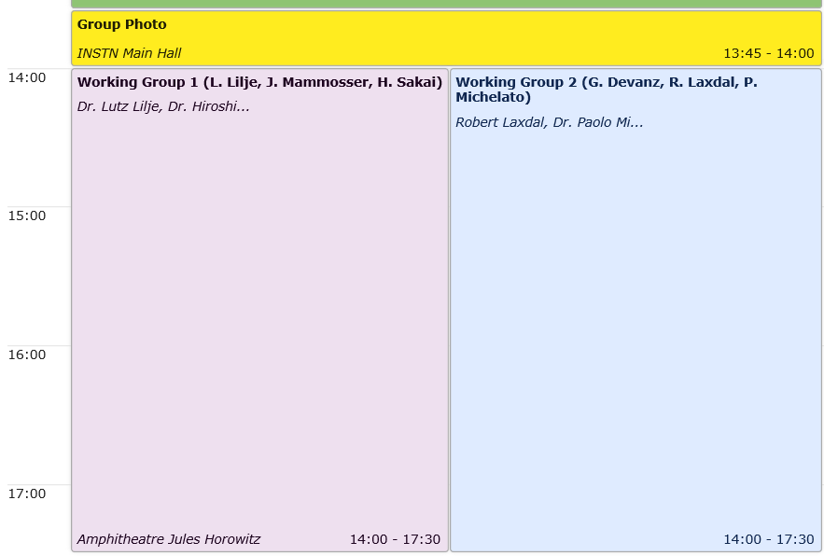
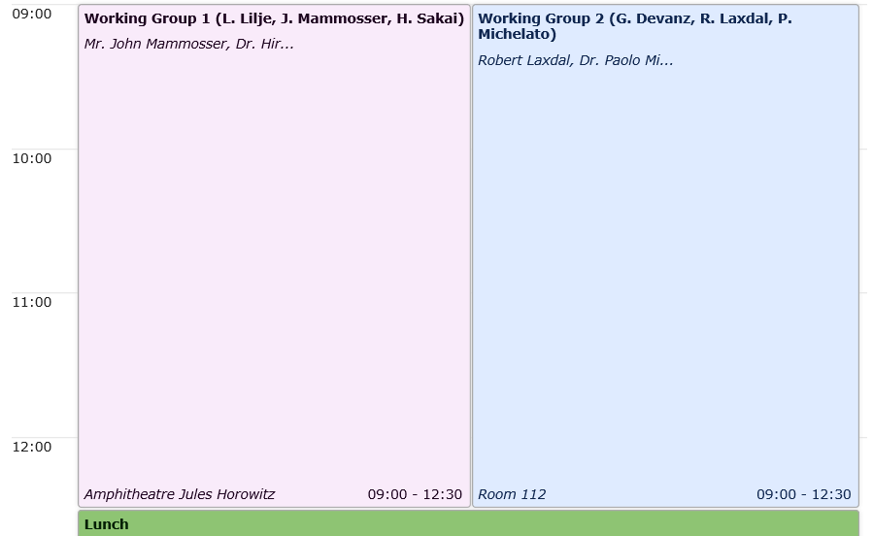
Tuesday Afternoon & Wednesday morning
WG1-WG2 Parallel session

Slide 8
WG1 & WG2
WG1: Performance Degradation and Cures (L. Lilje, J. Mammosser, H. Sakai)
The general aim of WG1 is to gather and analyze the recorded degradations (or improvements) between vertical cavity tests and cryomodule performance for major accelerator projects (both high and low beta). Also gather data on any further degradation (or improvement) in the beam line and over time.
Questions :
What are the dominant limiting aspects - field emission, quench, Q-degradation, administrative limits, something else?
What measures have been tried to cure the degradations, and how successful are these attempts?
What efforts are underway or recommended to minimize contamination during cryomodule assembly and during connection to the beam line, such as particle-free vacuum components next to cold linac sections ?
WG2: Protons and Ions Accelerators (G. Devanz, R. Laxdal, P. Michelato)
Major initiatives are well underway for ion accelerators for nuclear astrophysics, such as FRIB, RAON and others. With the success of SNS, high intensity proton accelerator projects are progressing, such as ESS, PIP-II, IndianSNS, along with ADS ambitions, such as CADS and IADS. The aim of WG2 is to address the major on-going issues for each type of accelerator, how these issues are being addressed, as well as the needed developments. Demonstrated and needed advances in couplers and tuners for both accelerator classes should be included.

Slide 9
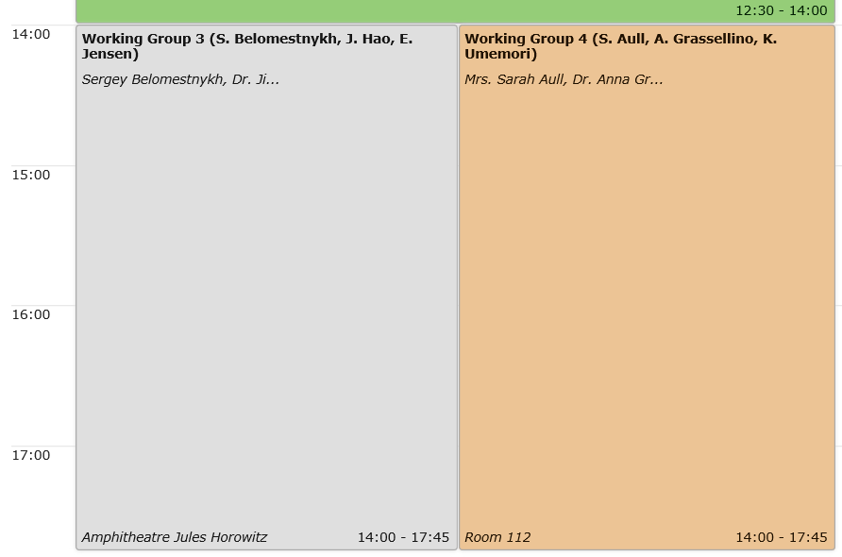
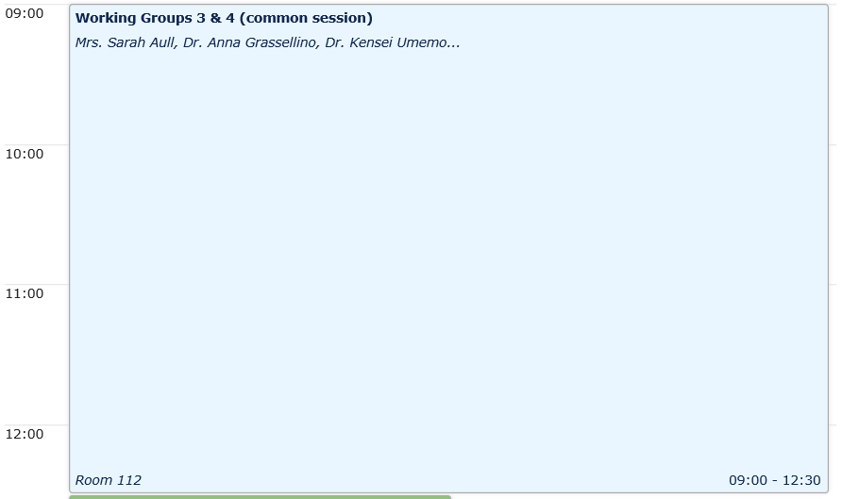
Wednesday afternoon & Thursday morning
WG3-WG4 Parallel session

Slide 10
WG 3 & WG4
WG3: High current and CW accelerators (S. Belomestnykh, J. Hao, E. Jensen)
With growing interest in a future Higgs factory e+ e- collider - either via the ILC path or the FCC-ee path - co-chairs should identify the key issues for SRF for such accelerators, and encourage short presentations that address these issues. Similarly SRF for CW light sources such as ERLs have seen significant advances, so that major issues for this topic should be addressed. Include storage rings light sources issues as appropriate. Demonstrated and needed advances in couplers and tuners for both accelerator classes should be included.
WG 4: The Performance Frontier (S. Aull, A. Grassellino, K. Umemori)
Three working groups have been active under the TTC umbrella: High Q for cryogenic cost reduction for CW accelerators at medium gradients, High Gradients with Nb and Nb3Sn, and Thin film Nb-Cu for cost reduction. Please include on-going efforts on composite Nb-Cu. Explorations at these frontiers will benefit medium-term and far-term future accelerators under discussion. Co-chairs should encourage presentations that will lead to a summary of on-going efforts underway for the three active WGs. Breakthroughs in these areas should get special attention. In your final summary please make an assessment of the probability of success for improved understanding, and highlight results for high Q, gradients > 50 MV/m and successful elimination of the Q-slope in Nb-Cu.

Slide 11
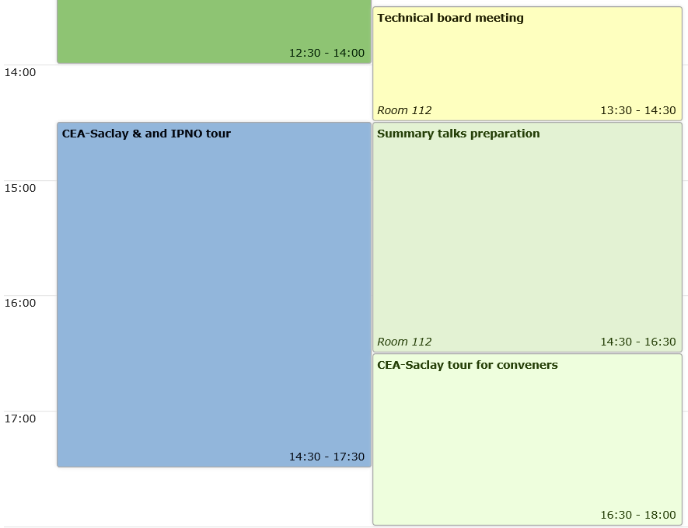
Thursday afternoon

Slide 12
Lab tour on Thursday, July 7th
When registering on Tuesday morning, please indicate if you will be attending the lab tour on Thursday afternoon.
The tour includes CEA/Saclay and IPNO SRF infrastructures.

Slide 13
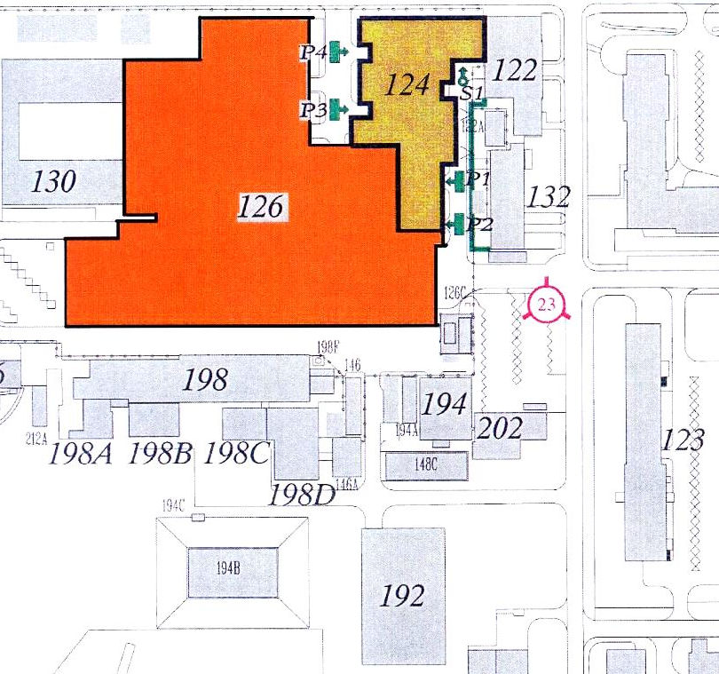
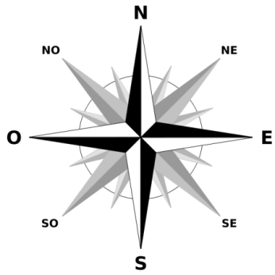
XFEL Village and IPNO visit
07/07/2016 afternoon
BUS
4
5
3
2
1
6
50 m

Slide 14
XFEL Village
Clean rooms
7
6
4
Bldg 124 North
25x15 m²
CourtYard
3
2
Assembly halls
Bldg 126 North
40x11 m²
5
1
8
Bldg 126 South 30x17 m²
Offices
6
Warehouse
©GoogleMap
XFel Village ~ 1350 m2

Slide 15
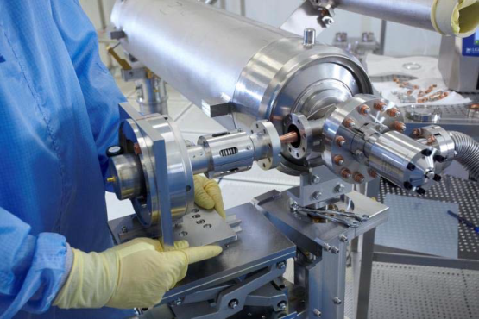
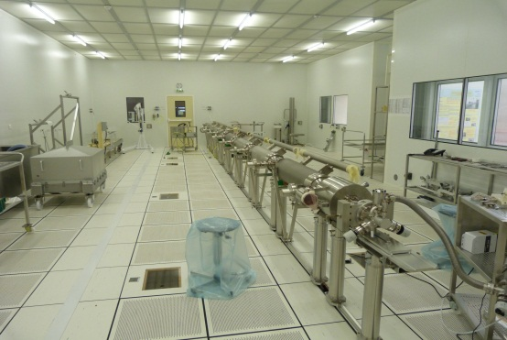
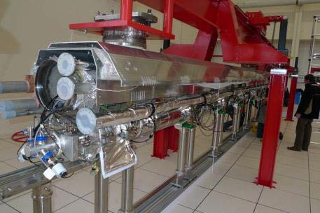
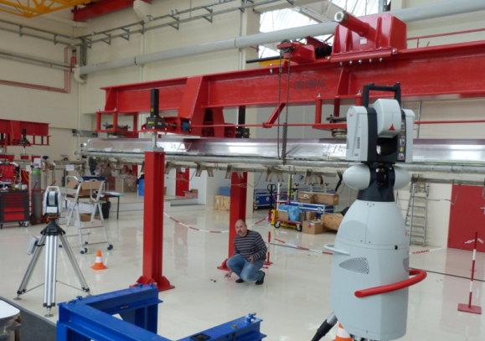
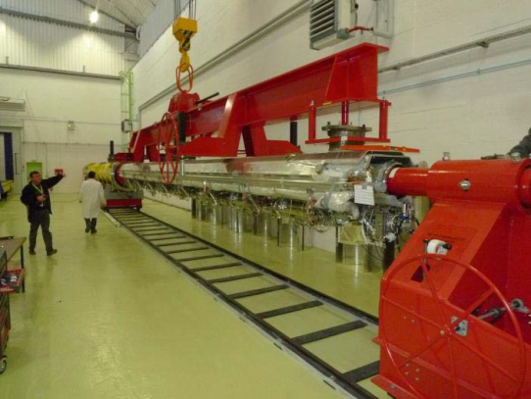
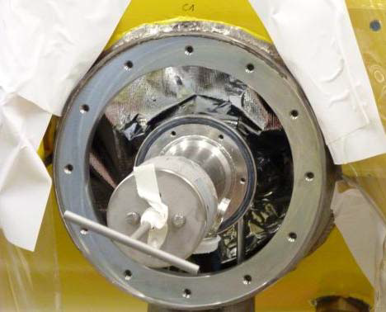
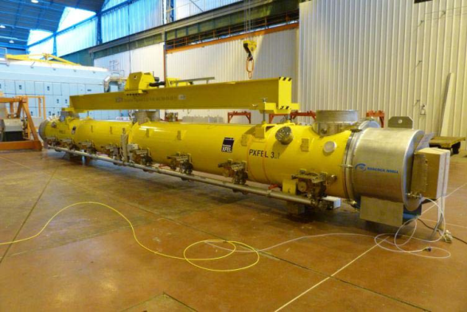
XFEL Village details
Coupler assembly
String assembly
Roll out
Alignment
Cantilever
Warm coupler
Final checks Shipment

Slide 16
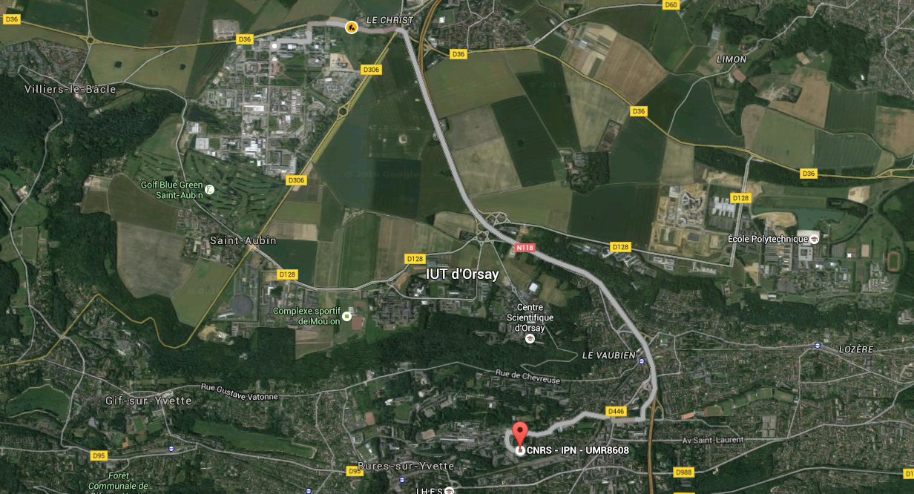
IPN Orsay Visit

Slide 17
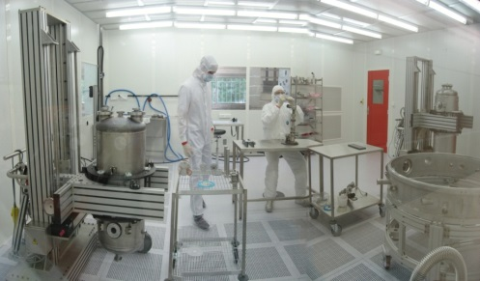
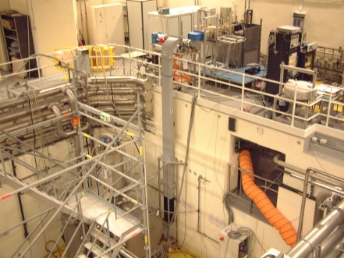
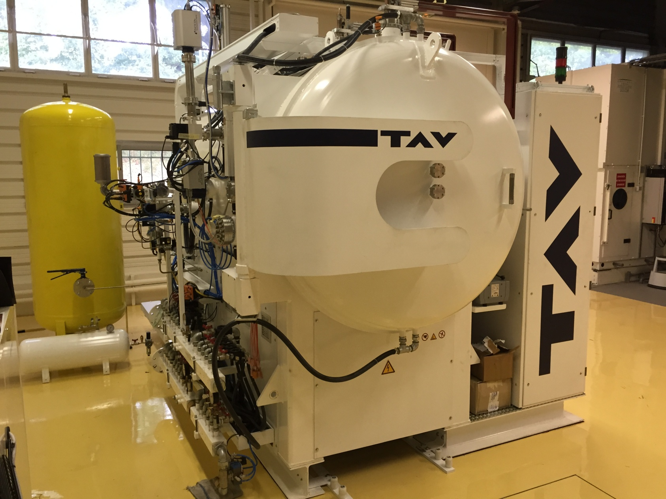
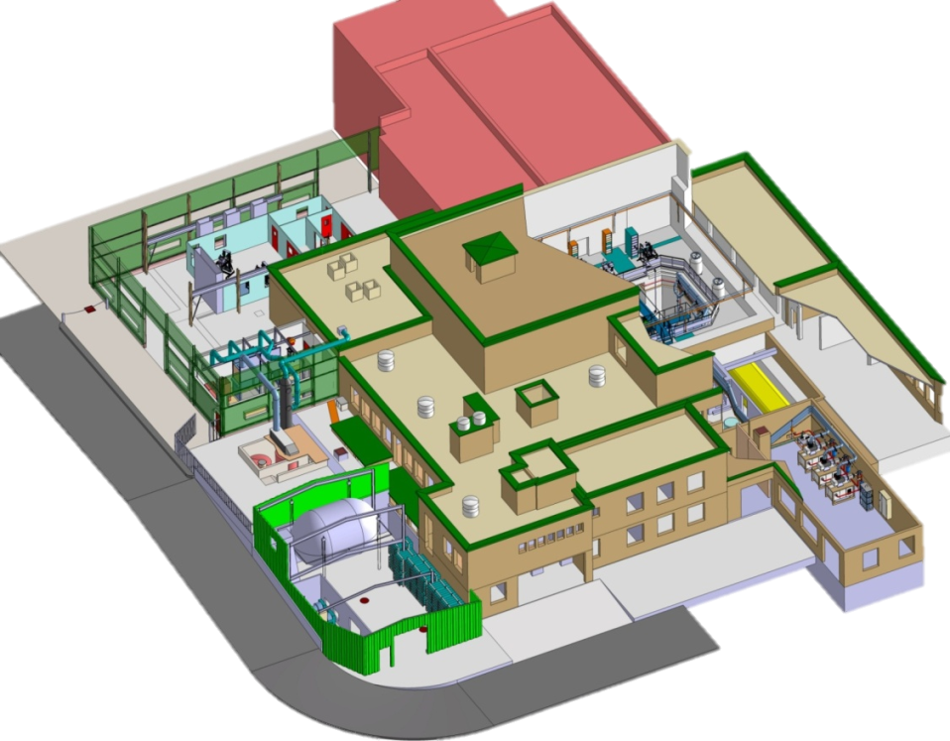
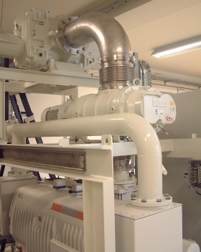
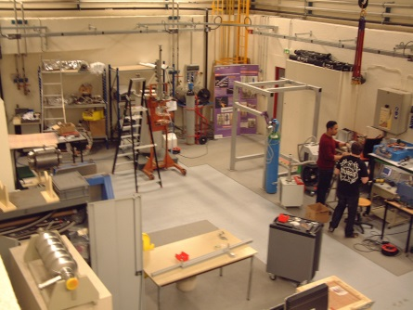
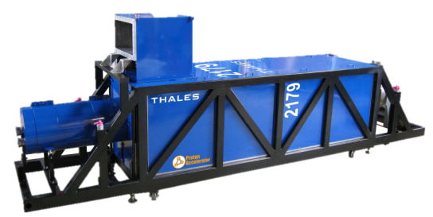
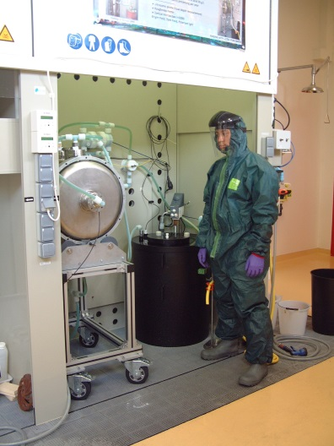
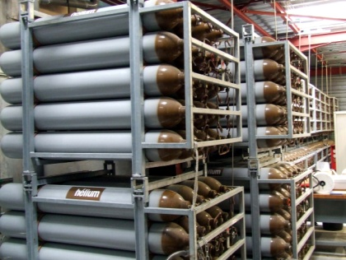
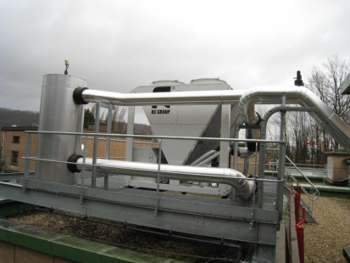
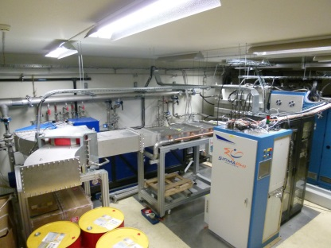
SupraTech Technological Platform
ISO 4 clean room
Vacuum furnace
Cryogenic test hall
Assembly hall
Helium pumping system
352 MHz RF Source
Helium gas recovery & compression
400 kW water cooling
production
Chemical etching lab

Slide 18
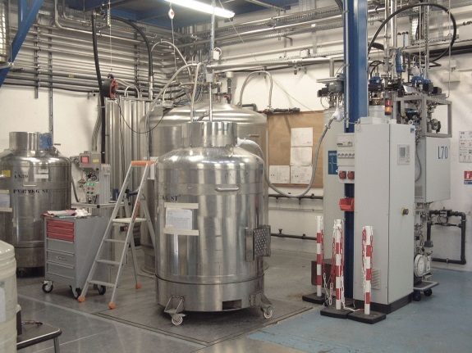
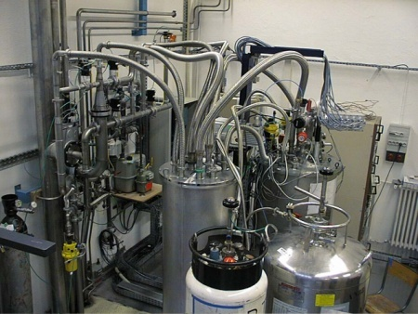
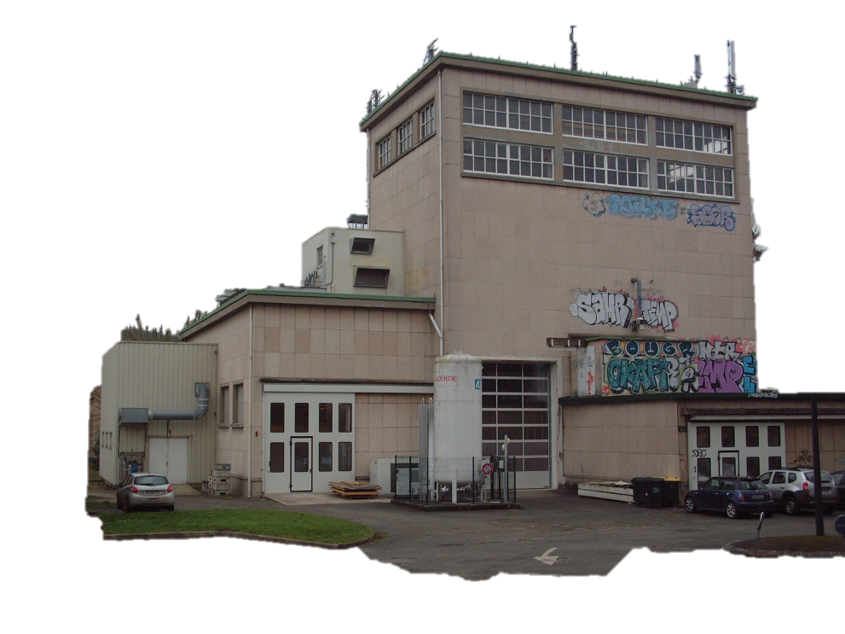
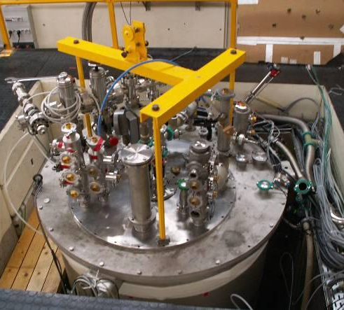
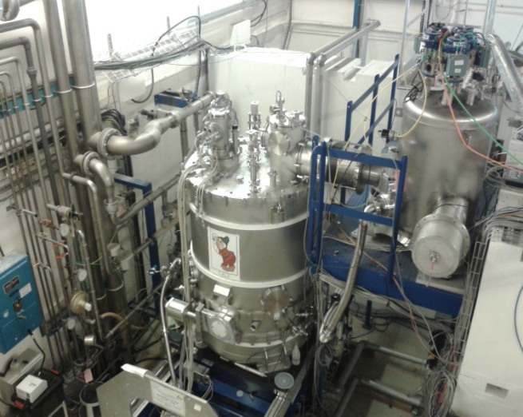
SupraTech Technological Platform
Helium liquefier
Cryogenic temperature sensor
calibration station
Cryogenic experimental hall

Slide 19

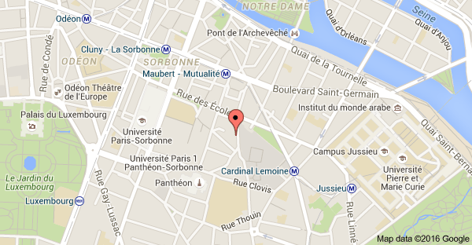
Dinner on THURSDAy, July 7th, 2016
at 20:45
Dinner will take place at
« Au Bistrot de la Montagne » restaurant
38 & 40 rue de la Montagne Sainte-Geneviève, 75005 Paris
Nearest RER B station: Luxembourg (11 minutes walking)
Nearest Metro station: Maubert Mutualité (3 minutes walking)

Slide 20
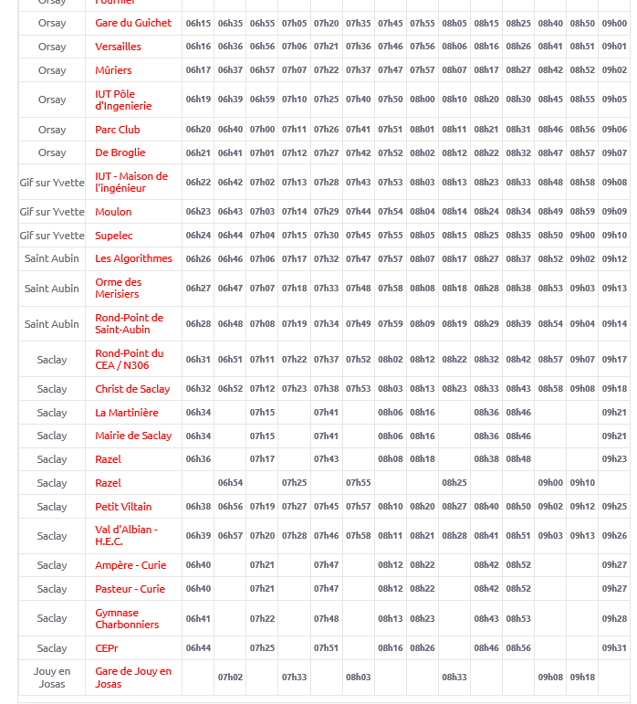
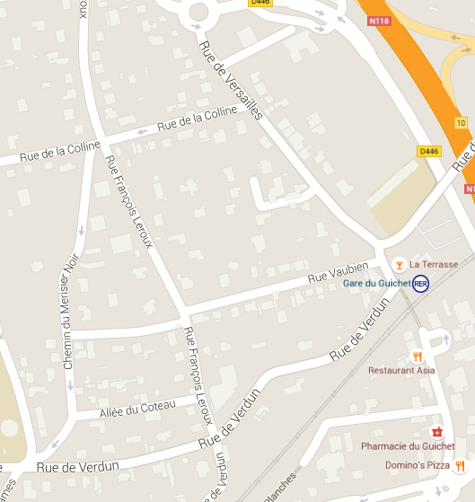
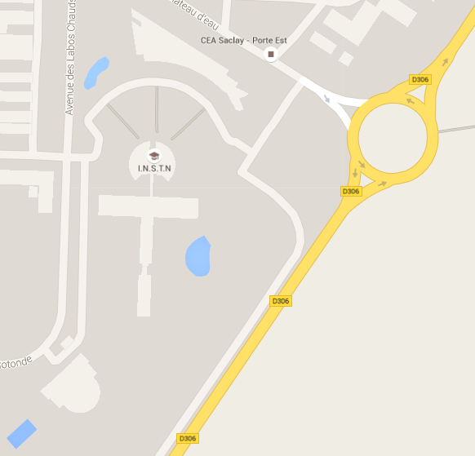
City buses (LINE 9) From Gare du Guichet
At Le Guichet
Bus station
At CEA
Hotel

Slide 21
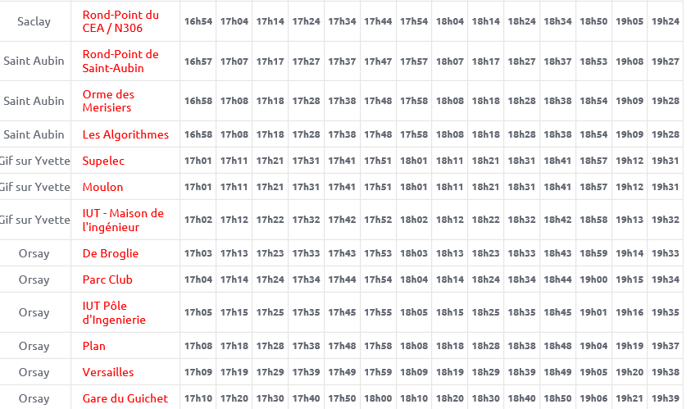
City buses (LINE 9) TO Gare du Guichet

Slide 22
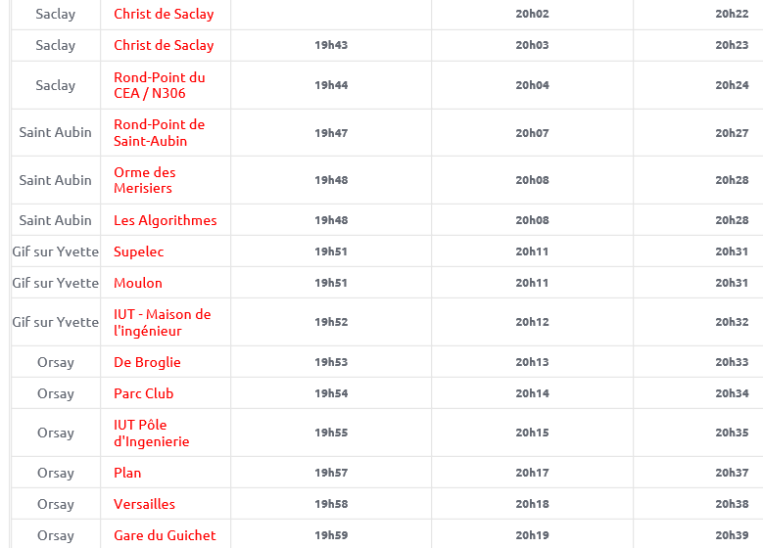
City buses (LINE 9) TO Gare du Guichet

Slide 23
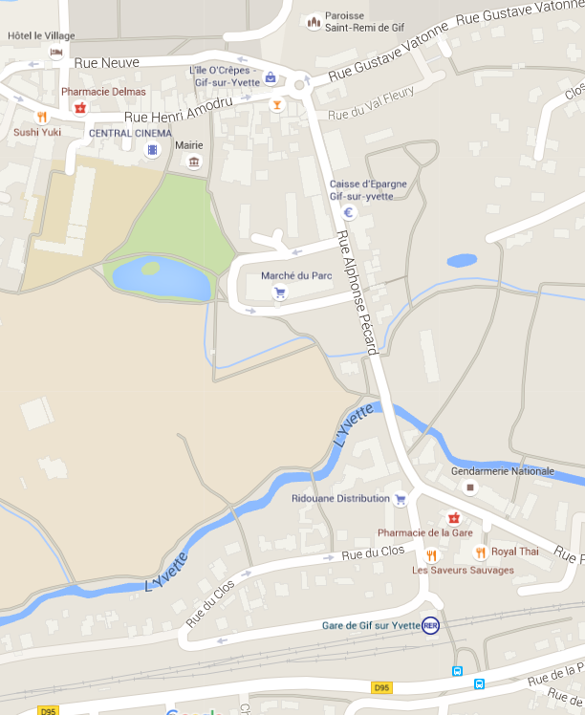
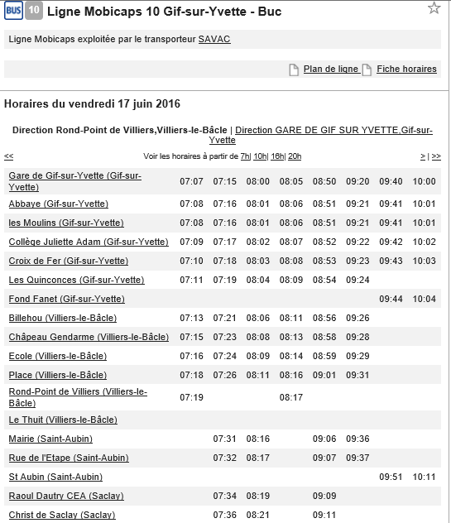
CITY BUSES From Gif Sur Yvette : line 10
Buses start from RER Gif sur Yvette station and stops at Raoul Dautry

Slide 24
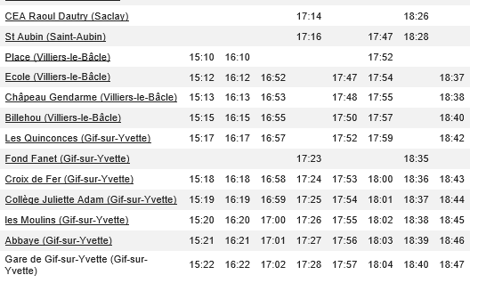
City buses from CEA to Gif sur Yvette

Slide 25
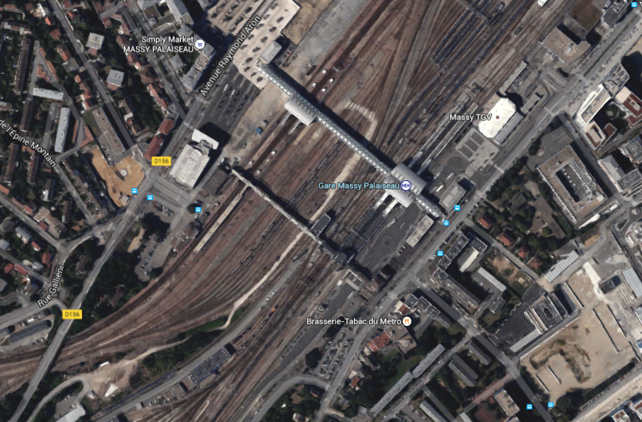
Gare Massy Palaiseau
Bus sttation at Massy Palaiseau

Slide 26
At CEA

Slide 27
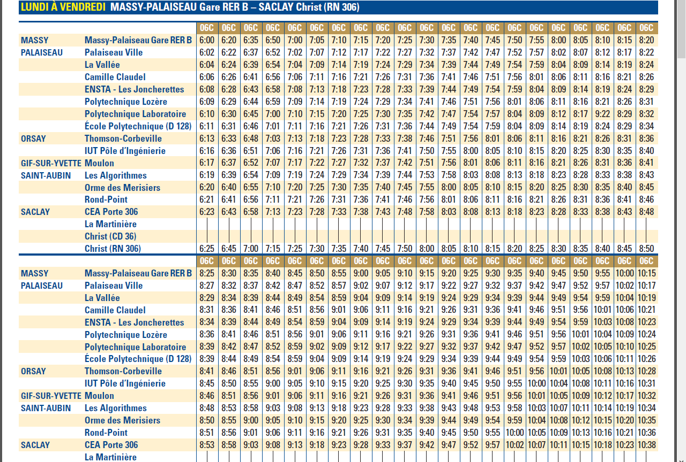
line 91.06 FROM GARE RER Massy-PALAISEAU

Slide 28
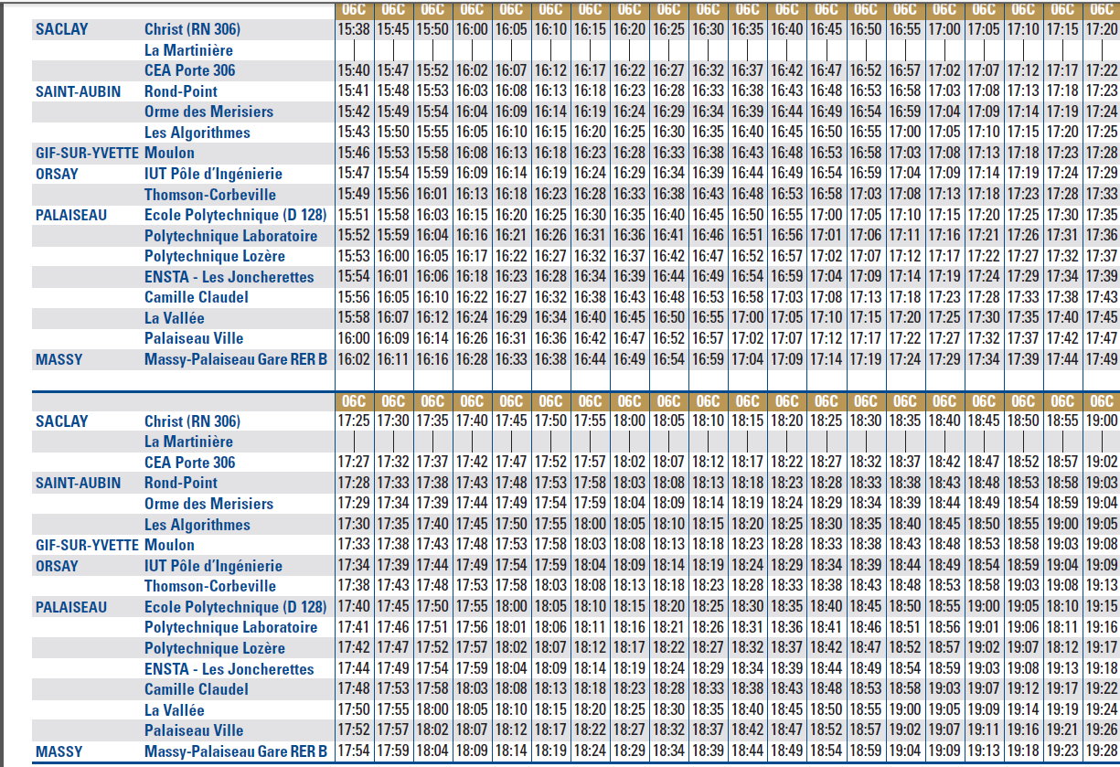
LINE 91.06 To GARE RER Massy-PALAISEAU

