Slide 1


SKIROC2–CMS for the CMS HGCAL
Ludovic Raux
June 1st, 2016

Slide 2

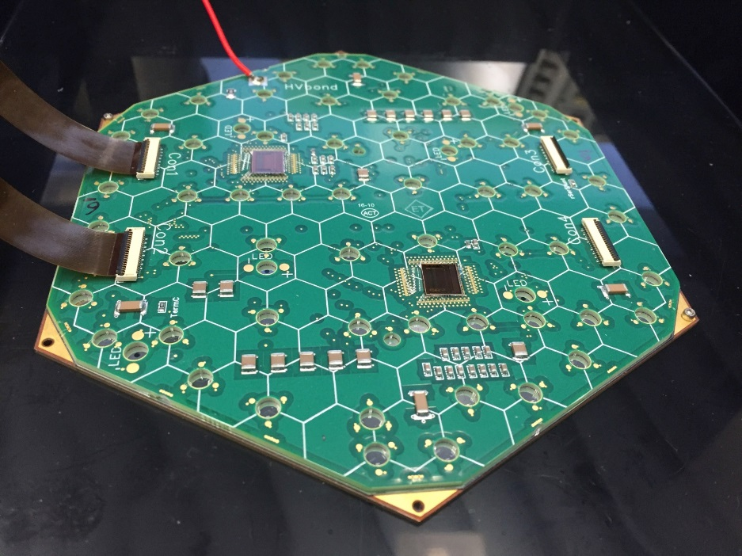
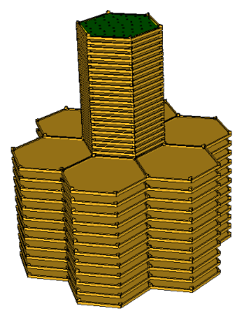
SKIROC2-CMS: Electronics for testbeam
Testbeam electronics
  Use SKIROC2 to exercise system issues (low noise, large range)
  Complex front-end boards designed at UCSB : delicate routing
  Evolutive readout designed at FNAL
Development of SKIROC2-CMS
  Optimized version for CMS test beams, pin to pin compatible
  Dual polarity charge preamplifier
  Faster slow shaper (25ns instead of 200ns)
  SCA in roll mode (sampling of slow shapers @ 40MHz, depth = 300ns)
  ToT for high input charge
  TDC (TAC) for ToA (~20 ps binning, ~50ps jitter)
  Will replace SKIROC2 on modules for timing and ToT studies
This “little” setup has ~14k ch. to read out !

Slide 3
Specifications
Stringent requirements for Front-End Electronics
  Low power (~5 mW for analogue channel)
  Low noise: <2000 e- (0,32 fC)
  MIP: 10k – 20k e- (1,5 – 3 fC)
  Dynamic range up to 2000 MIP (10 pC), 17 bits required with 0,1 fC resolution
  High radiation (200 Mrad, 10¹⁶ N)
  Detector capacitance 40-60pF
  Detector leakage: up to 10 µA
  System on chip (digitization, processing…)
  High speed readout (5-10 Gb/s)
  ~ 92,000 FE chips

Slide 4
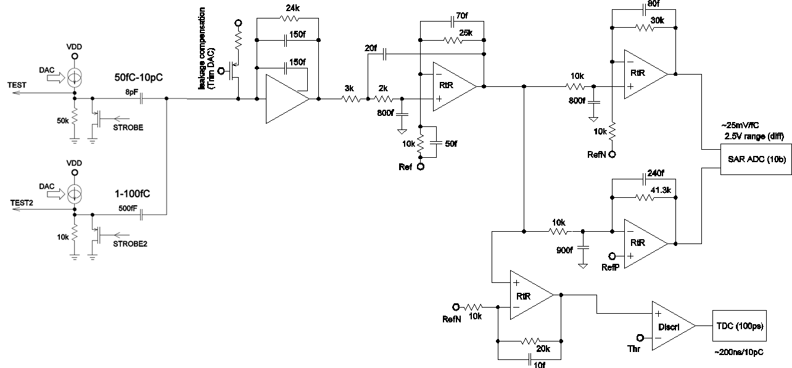
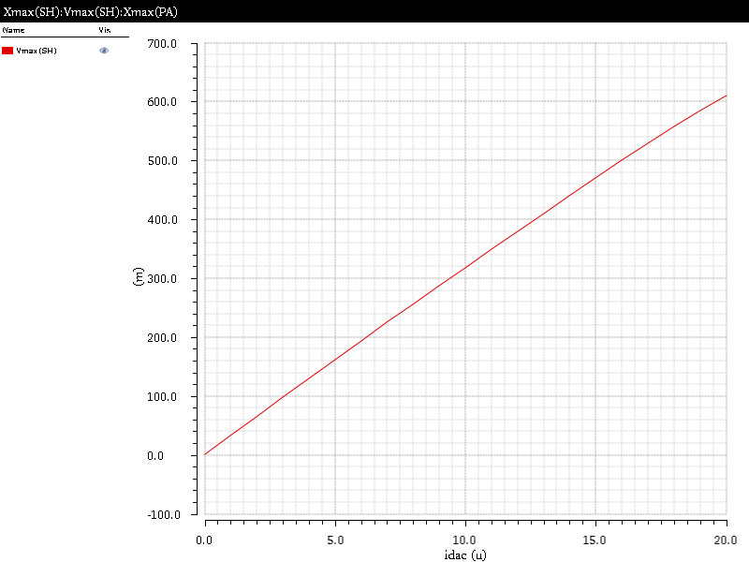
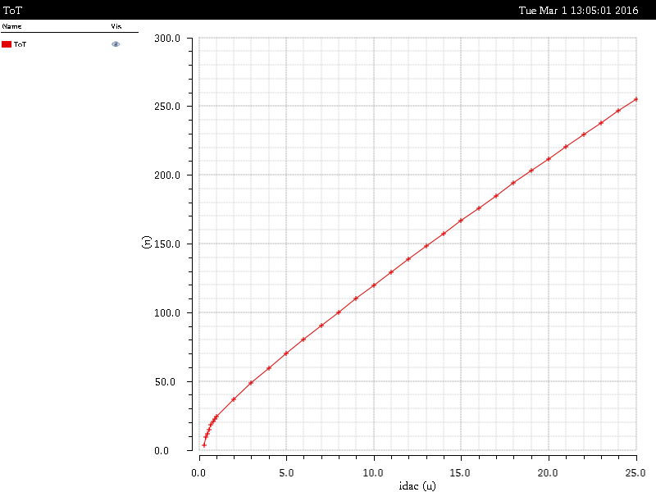
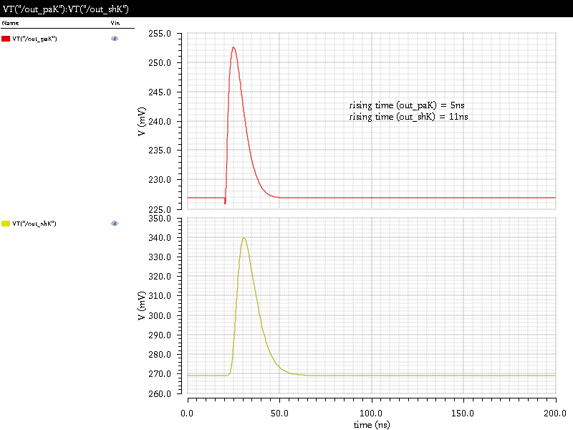
Baseline architecture (Technical Proposal)
PA+ToT (CERN J.Kaplon)
Preamplifier and shaper DC coupled to detector, no reset, fast shaping (15ns peaking time)
Analog gain around 25mV/fC (quantization noise negligible)
Preamplifier linear range 100 fC => ADC conversion
Above 80fC and after preamp saturation => ToT conversion
RtR output linearity
(up to 100fC)
Preamp output
RtR output ToT
(up to 10pC)
RtR output

Slide 5
Milestones for electronics
15-Feb-16 | Submit v0 FE chip (SKIROC2-CMS) in 0,35 µm
Mid-May-16 | Submit FE test vehicles in TSMC130 nm technology
Jun-16 | 1st Comprehensive Review
30-Sep-16 | 1st results from FE test vehicles and second test vehicle submission
31-Oct-16 | Confirm choice of front-end electronics (130 nm)
15-Dec-16 | Define architecture & specs for LV/HV supply
15-Dec-16 | Define location of DC-DC converters
15-Dec-16 | Define location of electrical/optical links
31-Mar-17 | Submit V1 ASIC
31-Mar-17 | Choice of Si sensors type: all n-on-p or mixed (i.e. n-on-p and p-on-n)
1-Jun-17 | 2nd Comprehensive Review
30-Sep-17 | 1st results from tests of V1 ASIC
1-Nov-17 | Submit TDR
30-Jun-18 | Submit V2 ASIC
⇒ First 32/64 ch ASIC with full functionnality

Slide 6
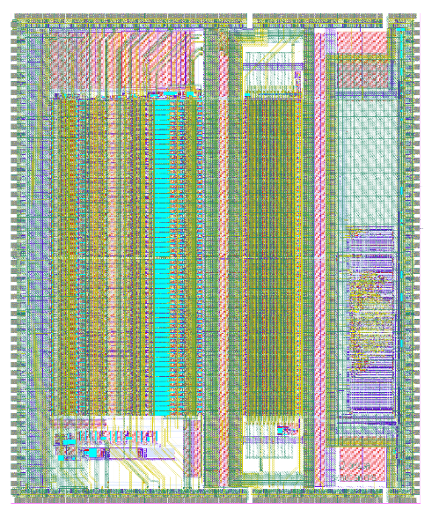
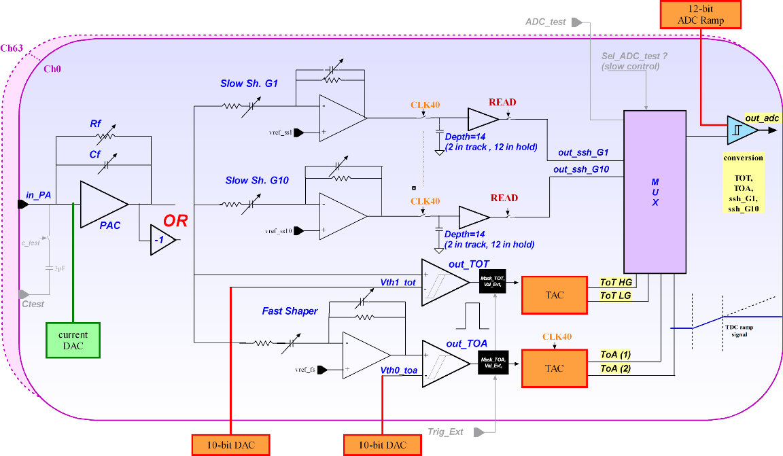
SKIROC2-CMS analogue architecture
Input DAC and 3pF calibration Cap.
Versatile preamplifier
  Dual polarity: single first stage with input PMOS transistor (available NMOS are directly on substrate), one feedback for each polarity (likely better for positive input charge), high dynamic range optimization
  60 dB Open loop gain, 4 GHz GBWP
  Variable Rf: global 8 bits, from 10k to 2,55M
  Variable Cf: global 6 bits, from 62fF to 4pF
Charge measurement in 12 deep SCA
  Slow shapers: gain 1 and 10, CRRC2; variable shaping time: global 4 bits, from 10ns to 150ns; output buffer
  2 measurements by BX, HG and LG
  Nominal: roll mode @ 40MHz; custom mode: managed by external trigger
Charge measurement with ToT for signal after peamp saturation
  Discriminator connected to the preamp output
  Fast ramp dedicated to the special study of the non-linear part
  Slow ramp for the entire range (up to 10pC)
  ToT data are memorized into the feedback capacitance of the integrator, rising edge starts the ramp and falling edge stop it
Time measurement
  Fast shaper: CRRC, gain 6, shaping time: 3bits, 1,25 to 9ns
  Fast discri
  Ramp: 35ns, rising edge starts the ramp
  Time SCA: 2 holds done on rising and falling edges of the 40MHz
Analogue to digital conversion
  12 bits Wilkinson ADC, common ramp
POWER CONSUMPTION
SKIROC2-CMS
Preamplifiers (positive / negative) | 5,3 mW / 5,6 mW
Slow shapers | 1,94 mW
ToT | 0,1 mW
ToA | 2,6 mW
TDC | 1,93 mW
Total analog (/channel) | 12 – 13 mW
Assuming 20mW power dissipation for the digital part, we expect 850 mW for the entire chip (<15mW/channel)

Slide 7
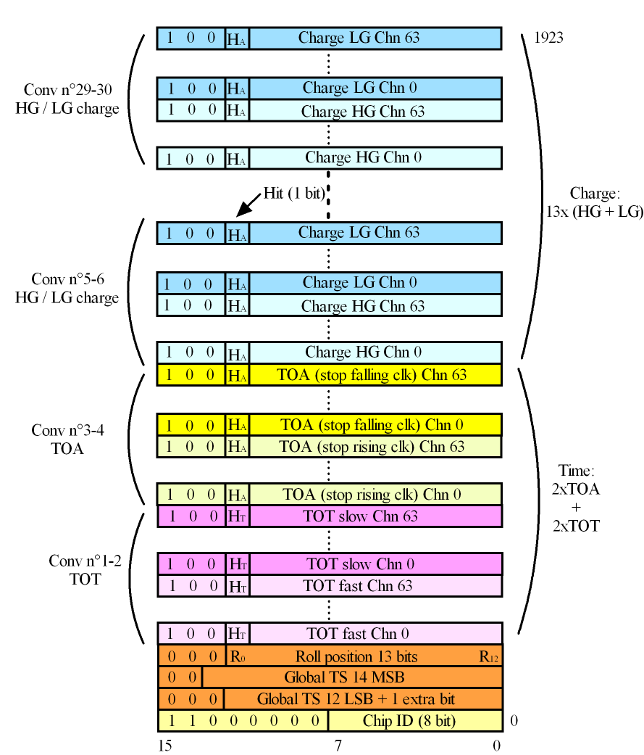
Digital readout scheme
Based on Calice chips readout scheme
- Roll mode @ 40MHz
- depth 12x25ns=300ns
- 12-bit Wilkinson ADC, starts on external Trigger
- 2 ToT (fast & slow); 2 ToA; 2x13 HG & LG Charge
- Duration (worst case)=2¹² x 25n x 30 = 3 ms
- OC @ 5MHz (SK2) to LVDS @ 40MHz (SK2-CMS)
- Cst. 1924x16x25 ns= 770µs

Slide 8
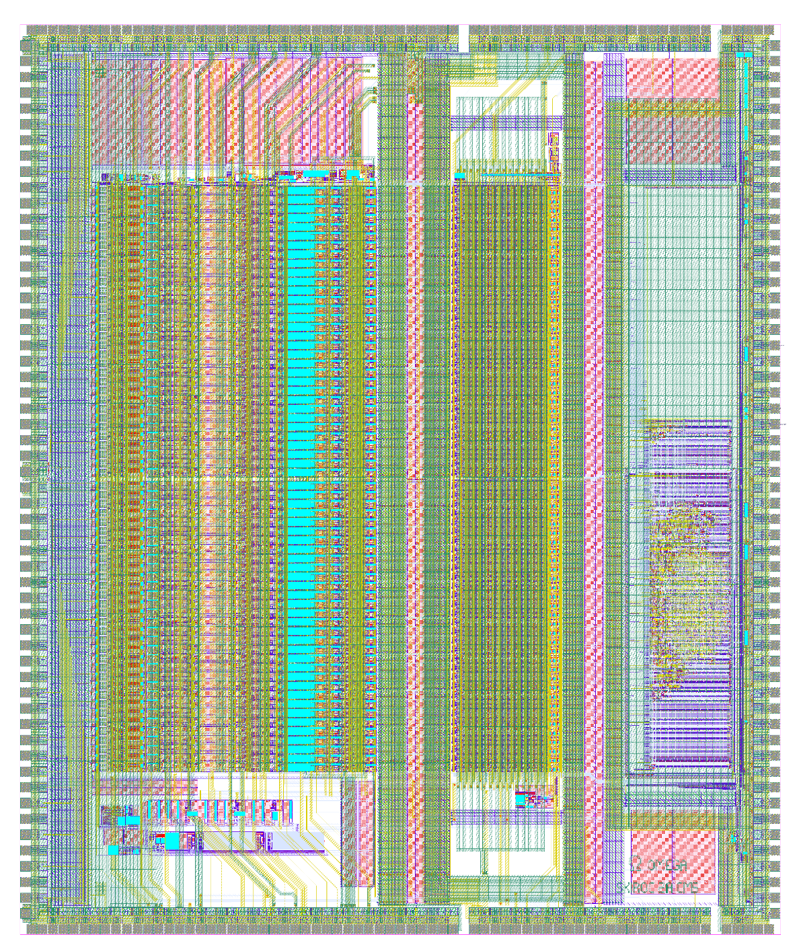
Skiroc2-CMS floorplan
Same guardring as SKIROC2
(1) 64 analog channels
  Pure analog
  Mixed signal
(2) DACs, bandgap
(3) 12-bits Wilkinson ADC
(4) pure digital part
(5) 4k bytes RAM
(6) decoupling capacitance
6
1
5
Technology: AMS 0,35um SiGe
Submission in February 2016
Delivery in May 2016
Area: ~60mm²
4
3
2

Slide 9
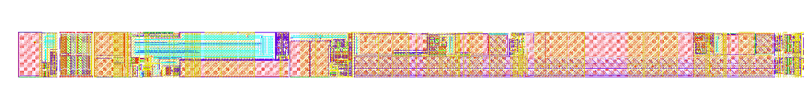
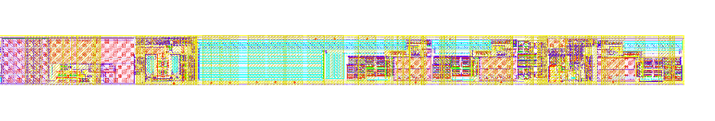
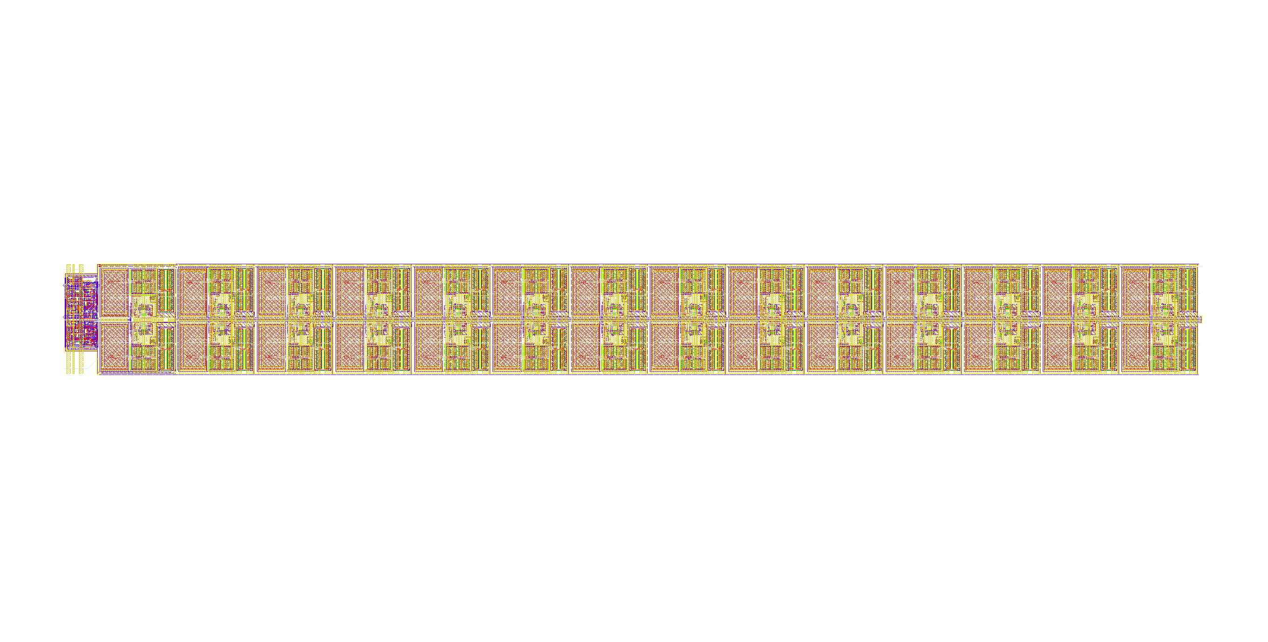
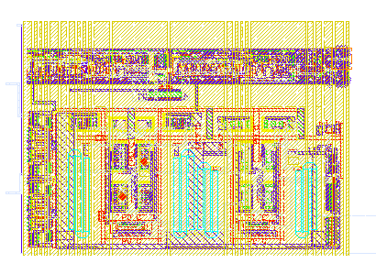
SKIROC2-CMS: one channel layout
3 pF Calibration Cap.
Input DAC
Preamplifier: 60dB OL gain, GBP=4GHz
Positive and input signal
Cf: 6 bits, 60fF to 4pF
Rf: 8 bits, 10K to 2,5M
Slow shapers
High gain: CRRC2, gain 10,4 bits, 10ns to 150ns, output buffer
Low gain: CRRC2, gain 1, 4 bits, 10ns to 150ns, output buffer
Fast shaper
CRRC, Gain 6
Shaping time: 3bits, 1,25ns to 9ns
Charge measurement with ToT
Discri ToT
Fast ramp: dedicated to the special study of the non-linear part
Slow ramp: ToT measurement on the entire range of the input signal (up to 10pC)
ToTs are memorized into the feedback capacitance of the integrator, leading edge starts the ramp and falling one stops it
Time measurement
Fast discri
ramp: 35ns
Leading edge starts the ramp
Time SCA
Two holds done on leading and falling edges of the 40MHz clock
700μm isolation space
13 deep Charge SCA
2 measurements by BX, HG and LG
Nominal: roll mode @ 40MHz
Custom mode: managed by external trigger
Discri conversion
- Common ramp
(Analog and digital probes have been added on the main signals)

Slide 10
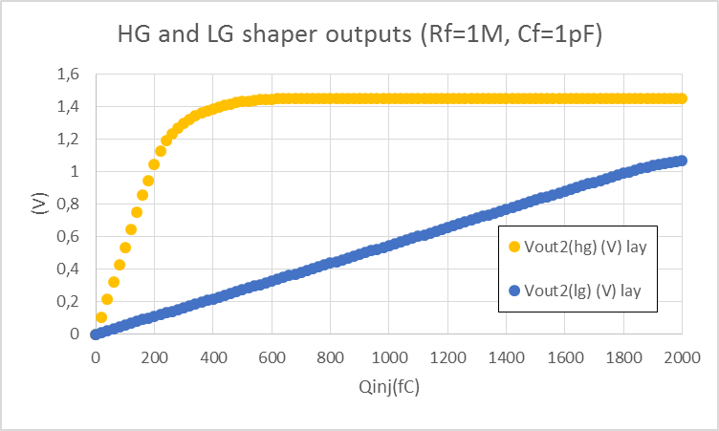
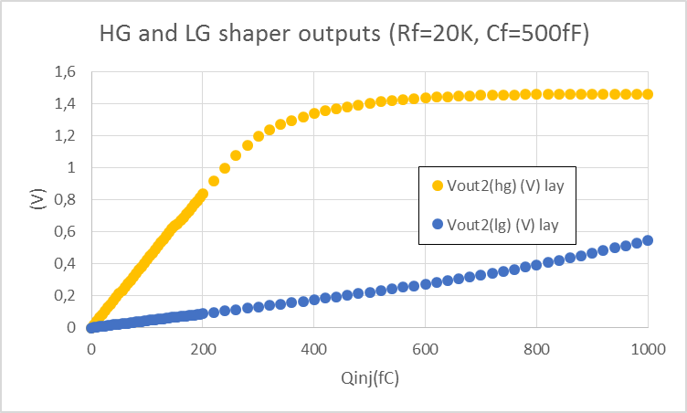
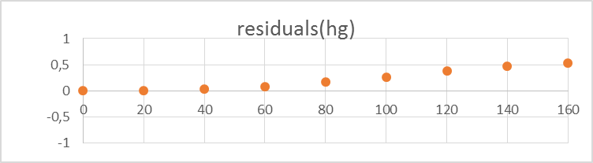
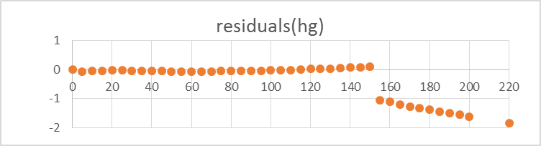
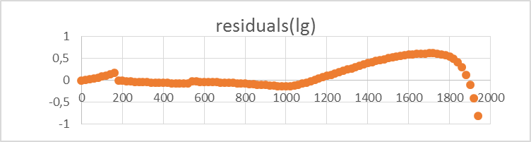
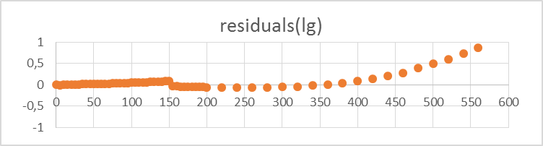
SKIROC2-CMS, Negative input: HG and LG linearity post-layout simulations
Preamp: Rf=1M, Cf=1pF
Preamp: Rf=20k, Cf=500fF
HG linearity: from 0 to 160 fC
LG linearity: from 0 to 1950 fC
HG linearity: from 0 to 220 fC
LG linearity: from 0 to 600 fC

Slide 11
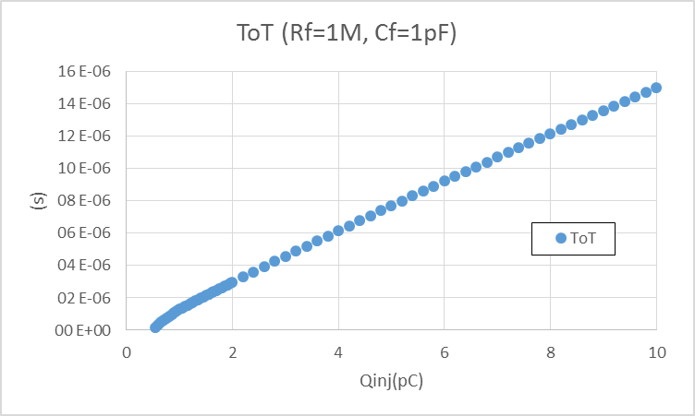
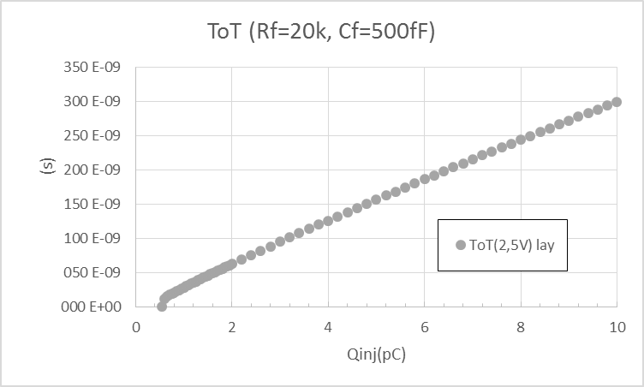
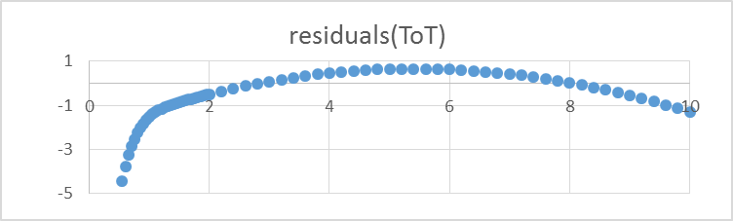
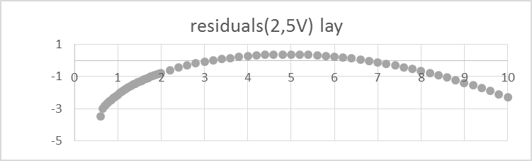
SKIROC2-CMS, Negative input: ToT post-layout simulations
Preamp: Rf=1M, Cf=1pF
Preamp: Rf=20k, Cf=500fF
Threshold @ 750 fC
ToT linearity: from 1,2 pC to 10 pC
Threshold @ 500 fC
ToT linearity: from 1,7 pC to 10 pC

Slide 12
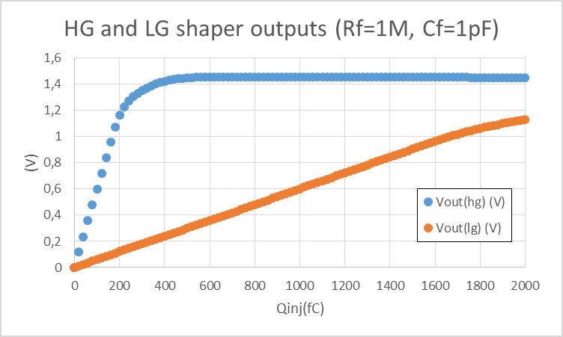
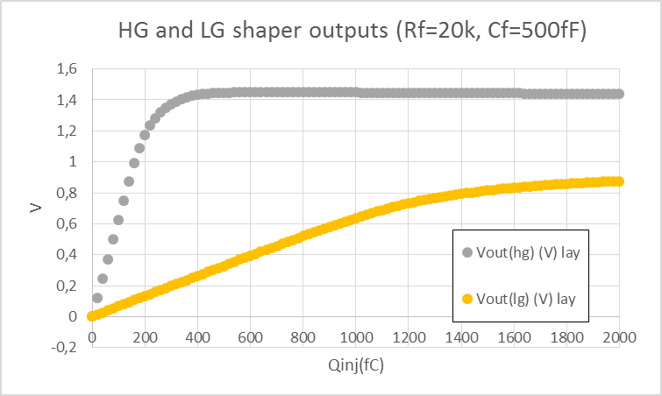
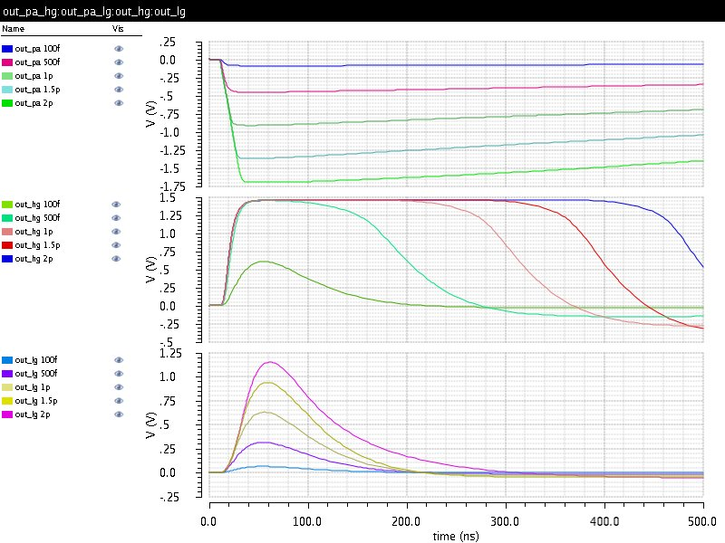
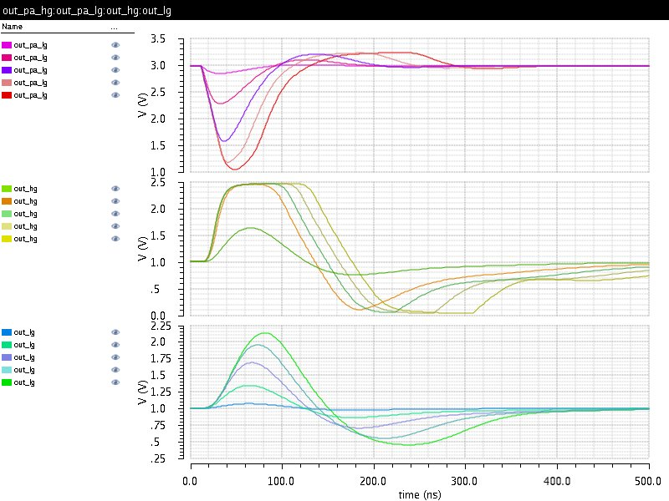
Positive input: HG and LG linearity post-layout simulations
Charge PA
Rf=1M, Cf=1pF
Current PA
Rf=20k, Cf=500fF
Preamp output
HG shaper output
LG shaper output
HG linearity: from 0 to 180 fC
LG linearity: from 0 to 1700 fC
HG linearity: from 0 to 160 fC
LG linearity: from 0 to 950 fC

Slide 13
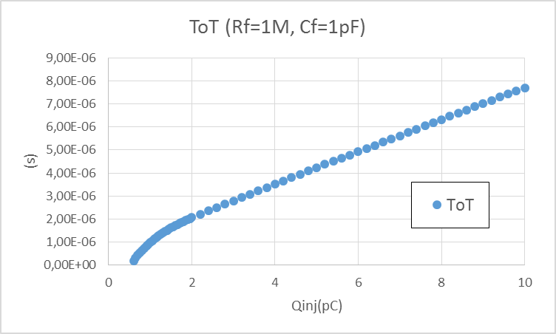
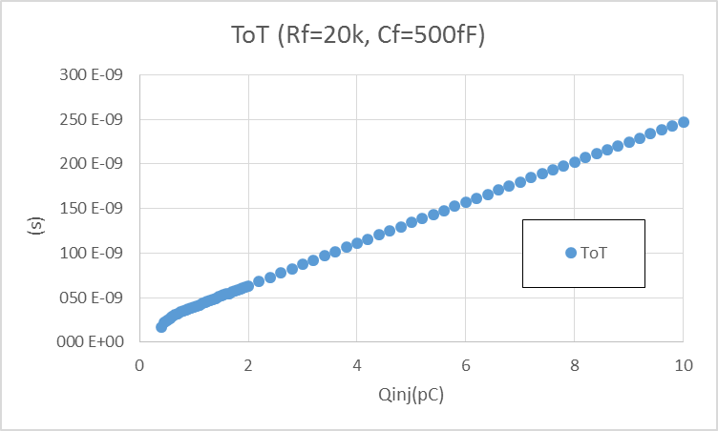
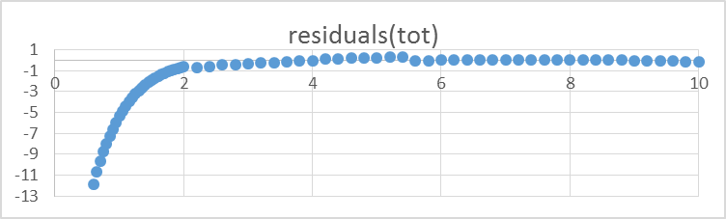
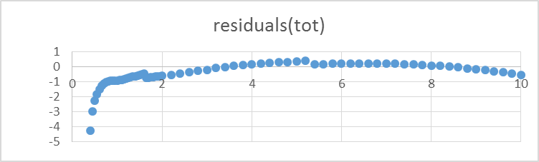
Positive input: ToT post-layout simulations
Charge PA
Rf=1M, Cf=1pF
Current PA
Rf=20k, Cf=500fF
Threshold @ 700 fC
ToT linearity: from 800 fC to 10 pC
Threshold @ 450 fC
ToT linearity: from 1,7 pC to 10 pC

Slide 14
SKIROC2-CMS: Crosstalk and power consumption
CROSSTALK
POWER CONSUMPTION
Signal | Crosstalk | Crosstalk
Preamp output | 0,34% | 0,35%
HG shaper | 0,3% | 0,7%
LG shaper | 0,34% | 0,35%
Fast shaper | 0,62% | 3%⁽¹⁾
Preamplifiers (positive / negative) | 5,3 mW / 5,6 mW
Slow shapers | 1,94 mW
ToT | 0,1 mW
ToA | 2,6 mW
TDC | 1,93 mW
Total analog (/channel) | 12 – 13 mW
(1) Neighboring channels trigger when hit channel is saturating
Assuming 20mW power dissipation for the digital part, we expect 850 mW for the entire chip

Slide 15
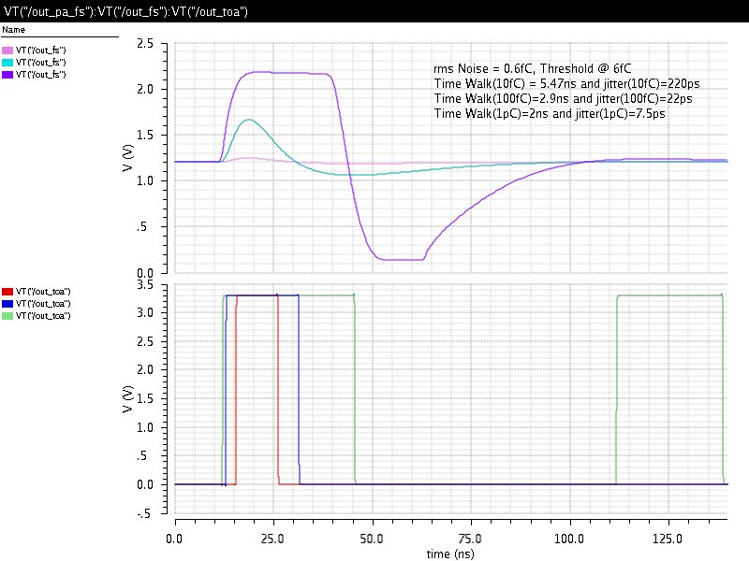
ToA: Time walk and jitter
Rms Noise = 0,6fC
Threshold @ 6fC
Qinj(fC) | Time walk (ns) | Jitter (ps)
10 | 5,47 | 220
100 | 2,9 | 22
1000 | 2 | 7,5

Slide 16
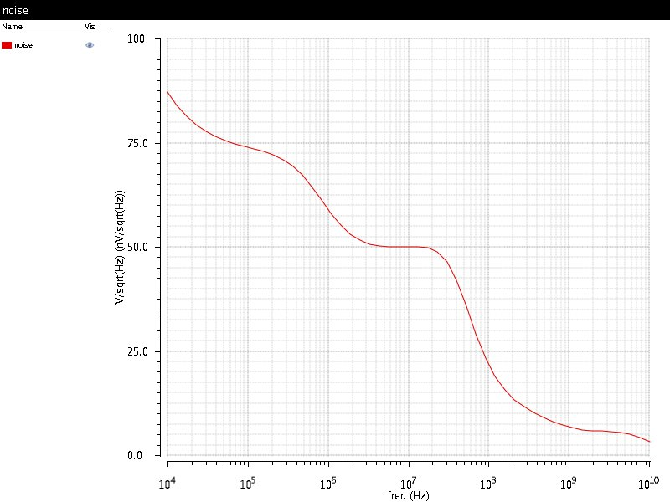
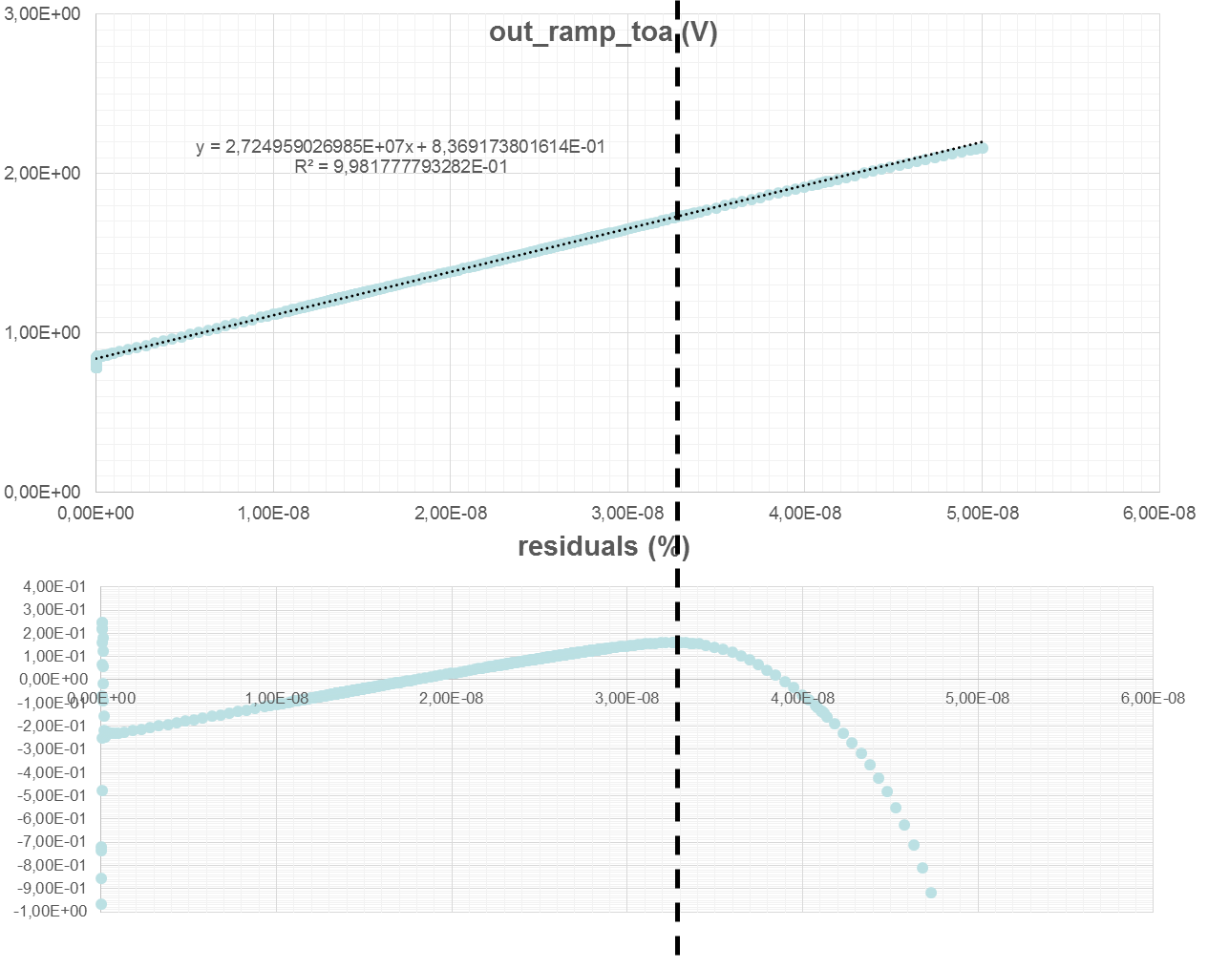
SKIROC2-CMS: ramp ToA
Noise RMS=840µV

Slide 17
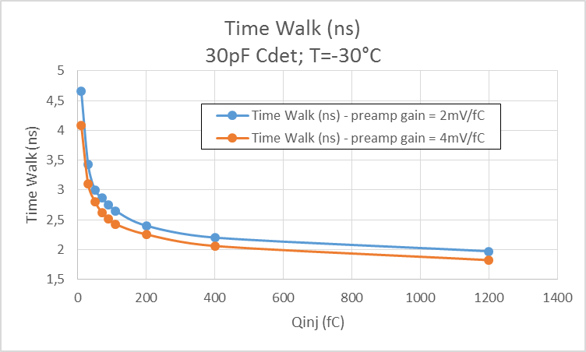
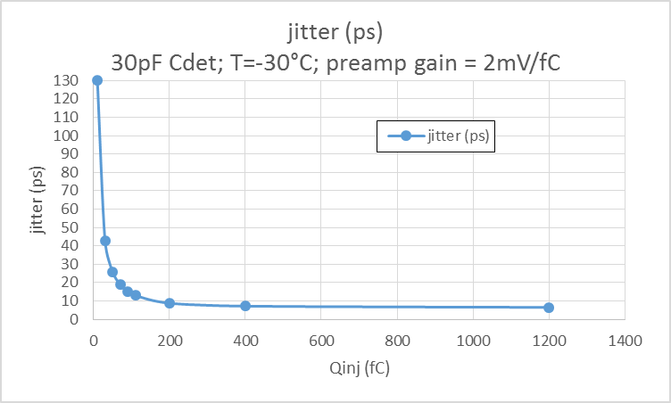
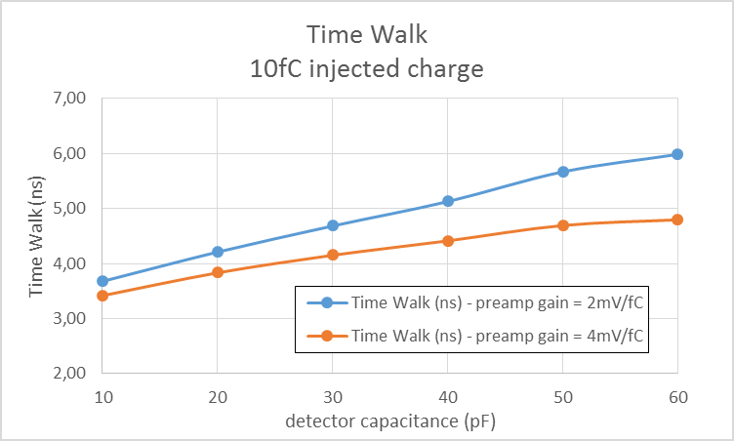
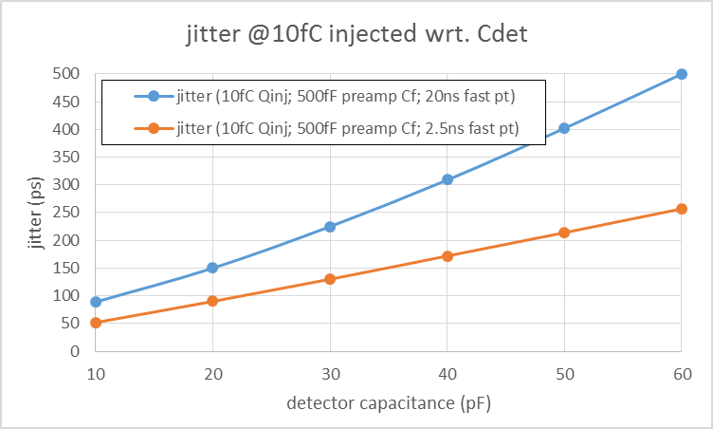
Some time simulations

Slide 18
SKIROC2-CMS: Noise simulations
Cd = 50pF, T=-30°C, noise after HG shaper, no leakage current
Noise after HG shaper is dominated by input PMOS transistor below the required 2000e- (~0.5nV/.sqrt(Hz))
ENC | Rf=1M, Cf=1pF | Rf=20k, Cf=500fF
Positive input | 0,2fC (1250 e-) | 0,25fC (1560 e-)
Negative input | 0,23fC (1440 e-) | 0,3fC (1875 e-)

Slide 19
Conclusion
Landing of SKIROC2(-CMS)
Designed at UCSB
HGC targeted Skiroc2-CMS chip variant with
  n-on-p as well as p-on-n read-out
  LHC-like ~ 20ns shaping time
  Leakage current compensation for irradiated sensors
  Key features and variants of HGC FE architecture
    Including TDC for precision timing and ToT
  Pin-to-pin compatible
    Design submitted, expect chips back in Spring
SKIROC2-CMS aims
  ToT scheme non linear in region 100-200fC: needs precise calibration and demonstration in Test-beam
  Will be studied with SKIROC2-CMS and test vehicle
    Backup with bi-gain and ToT above 1-2 pC or dynamic gain switching
January 2016: first fully functional Si-HGC modules equipped with existing SKIROC2 chips
  Skiroc2 designed for p-on-n sensors, but too slow shaping time, readout based on Calice requirements
Spring 2016: test beams at FNAL with Si-HGC EE slice equipped with Skiroc2
  Enable tests of EM calorimetric response
  Prepare for more detailed studies using modules equipped with Skiroc2-CMS
Fall 2016: test beams at CERN with Si-HGC EE and FH slice equipped with Skiroc2-CMS
  Enable detailed studies of calorimetric response and performances of baseline architecture and variants
  Aim for timing studies of EM and Hadronic shower evolution with ~50ps calorimeter cell timing resolution

Slide 20
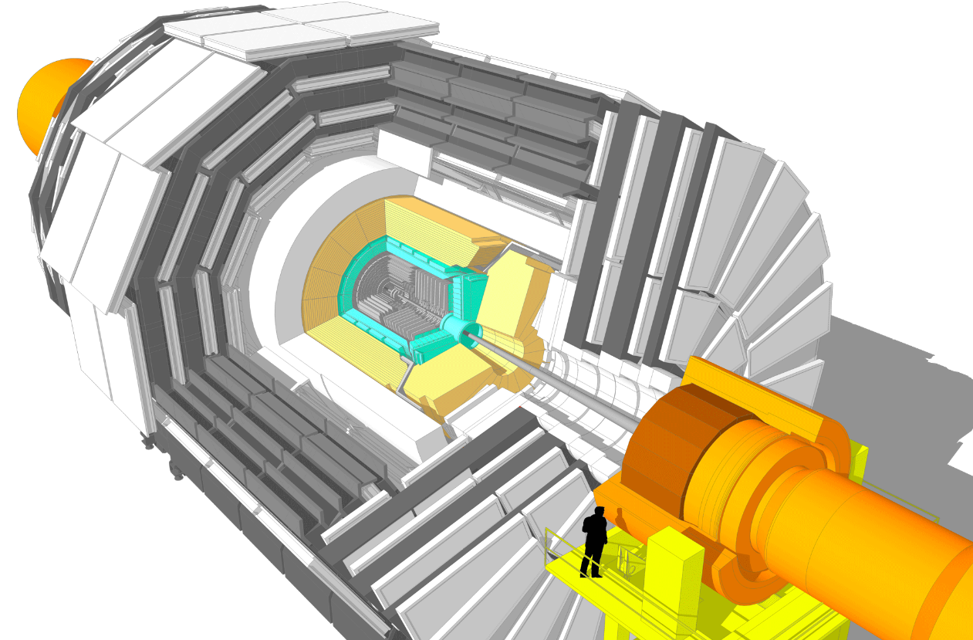
CMS Phase-II upgrades
Barrel EM calorimeter
New FE/BE electronics with improved time resolution
Lower operating temperature (8∘)
Trigger/HLT/DAQ
Track information in Trigger (hardware)
Trigger latency 12.5 µs - output rate 750 kHz
HLT output 7.5 kHz
Muon systems
New DT & CSC FE/BE electronics
Complete RPC coverage 1.6 < η < 2.4
Muon tagging 2.4 < η < 3
New Tracker
Rad. tolerant - increased granularity - lighter
40 MHz selective readout in Outer Tracker for Trigger
Extended coverage to η ≃ 3.8
New Endcap Calorimeters
Rad. tolerant
High Granularity: increased transverse and longitudinal segmentation
precise timing capability
Two major motivations for the upgrade
Unprecedented radiation dose => replace End Cap Calorimeters
Much higher data flows => replace most of the readout systems

Slide 21
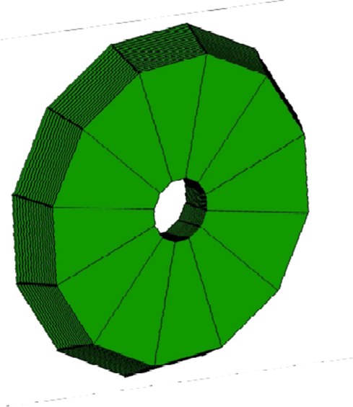
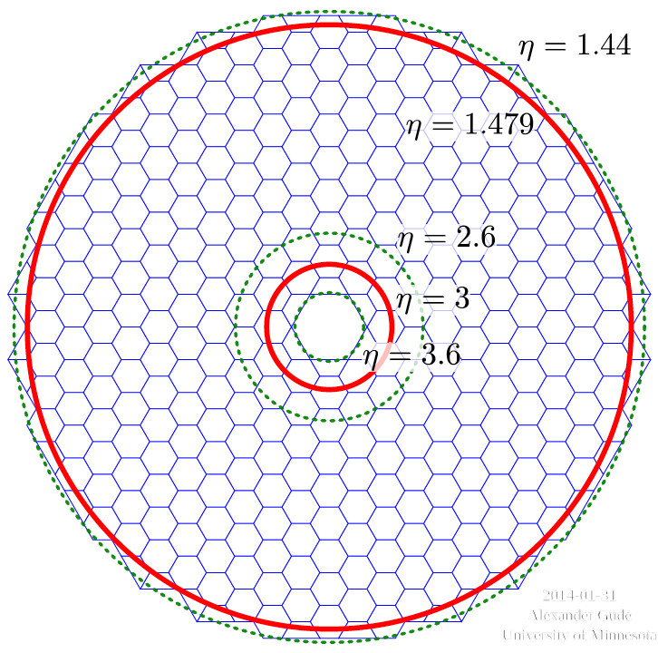
Modules, Cassettes and Mechanics (technical proposal)
Modules
With 2x 6 - 8” Hexagonal Si sensors,
PCB, FE chip, on W/Cu baseplate
Modules mounted on Cu Cooling plate with embedded pipe
=> Cassettes
Cassette inserted in mechanical structure (containing absorber)
Replaced EndCap (maintained at -30°C
12 Cassettes mounted together to form the ECAL (EE) and Front HCal (FH)
3 sensor active thicknesses 100-200-300 µm
0.5(1) cm² pads for 100(200/300) µm

Slide 22
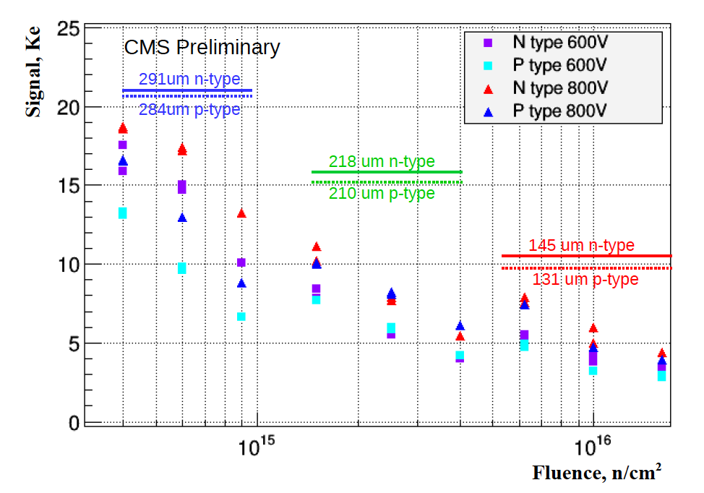
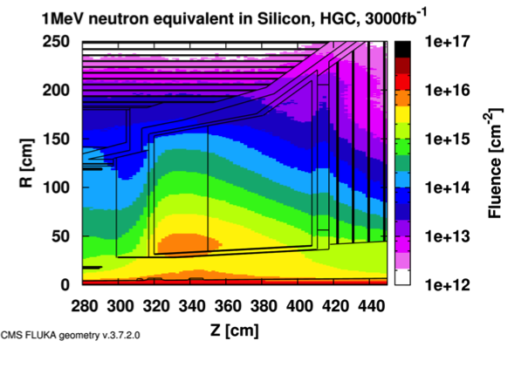
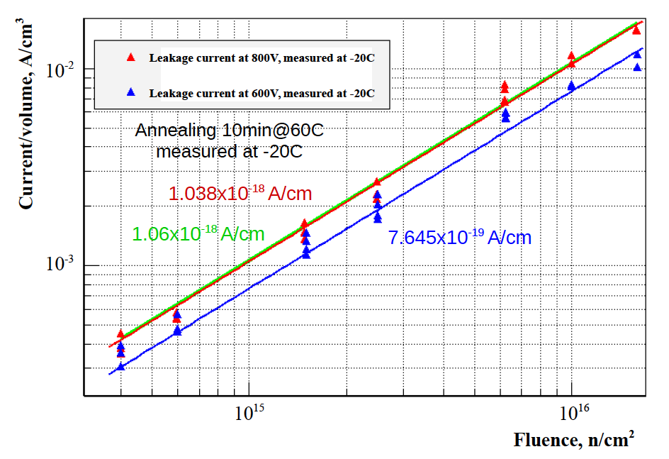
Basic Silicon sensor R&D
Essential results documented in TP
300um
200um
100um
Slide From M. Mannelli, ACES Workshop

Slide 23

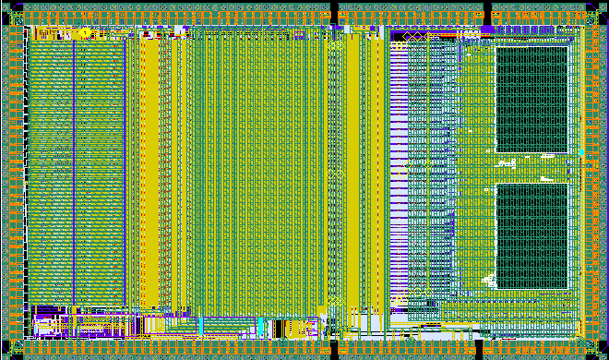
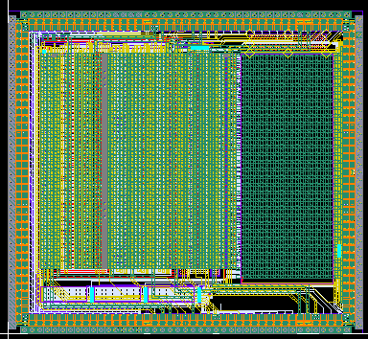


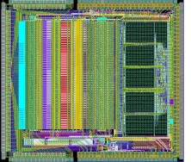
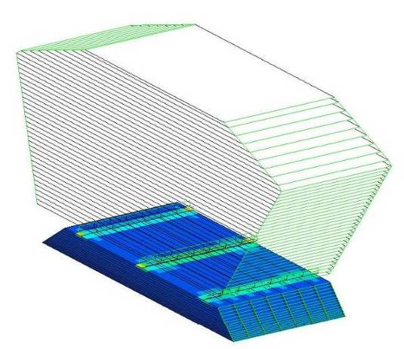
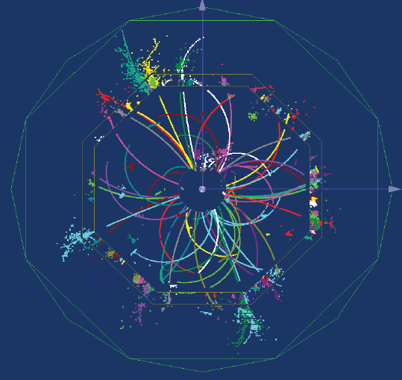








ROC chips for ILC prototypes
SPIROC2
Analog HCAL (AHCAL)
(SiPM)
36 ch. 32mm²
June 07, June 08, March 10, Sept 11
ROC chips for technological prototypes: to study the feasibility of large scale, industrializable modules (Eudet/Aida funded)
Requirements for electronics
  Large dynamic range (15 bits)
  Auto-trigger on ½ MIP
  On chip zero suppress
  10⁸ channels
  Front-end embedded in detector
  Ultra-low power : 25µW/ch
HARDROC2 and MICROROC
Semi Digital HCAL (sDHCAL)
(RPC, µmegas or GEMs)
64 ch. 16mm²
Sept 06, June 08, March 10
SKIROC2
ECAL
(Si PIN diode)
64 ch. 70mm²
March 10

Slide 24

SKIROC2 Simplified schematic
64 channels
Trigger less mode (auto trigger from 1fC up to 10pC)
12 bits for Q measurement
12 bits for coarse time (BCID)
Power pulsing mode

Slide 25




Linearity of Shaper (High + Low + Fast)
Noise = 630 µV
1 Mip gives 5.7 mV
S/N=9
SS10@20 MIP
Rms =1.16 ADC U=600µV
MEASUREMENTS using SCA and internal ADC
Autotrigger mode
1 MIP ( 4fC) threshold
« Real » Pedestal=167 DAC Units
1 Mip ≈4 fC = 20 DAC Units
Noise= 2 DAC Units
Minimum Threshold= 5 σ noise= 0.5 Mip
5σ Noise limit
1 MIP ≈ 4fC
25
25

Slide 26


POWER PULSING in SK2
Requirement:
  25 µW/ch with 0.5% duty cycle
  500 µA for the entire chip
Power pulsing:
  Bandgap + ref Voltages + master I: switched ON/OFF
  Shut down bias currents with vdd always ON
SK2 power consumption measurement:
  123 mA x 3.3V ≈ 40 mW => 0.6 mW/ch
4 Power pulsing lines : analog, conversion, dac, digital
Each chip can be forced on/off by slow control
Measurements
Acquisition | 88 mA , 290 mW | Duty Cycle =0.5%, 1.45 mW
Conversion | 27.3 mA, 90 mW | Duty Cycle =0.25%, 0.225 mW
Readout | 8.0 mA, 26.4 mW | Duty Cycle =0.25%, 0.066 mW
  Skiroc2 power consumption with Power pulsing: 1.7 mW ie 27 µW/ch
26

Slide 27


From 2nd generation…
2nd generation chips for ILD
  Auto-trigger, analog storage and/or digitization
  Token-ring readout (one data line activated by each chip sequentially)
  Common DAQ
  Power pulsing : <1 % duty cycle

Slide 28



…To 3rd generation
3rd generation chips for ILD
  Technology used ? (depending on funding…)
    If within 2 years , still 0.35µm AMS SiGe …
  No major change in the analogue part
    MIP over Noise Ratio @ lower gain = 10
    TDC scheme will change (PETIROC like)
    Few optimization (Crosstalk, AutoGain, 4-bit DACs, external triggers, power consumption…)
  PLL provides the Fast Clock (mainly used for digitization) from the Slow Clock
    No Fast Clock to be provided to the ASICs !
  Independent channels (zero suppress)
    Huge change in digital part !!
    Digital part power consumption and size (+30 to 50% )
  I2C link (@IPNL) for Slow Control parameters and triple voting
  - configuration broadcasting
  - geographical addressing
256 P-I-N diodes
0.25 cm2 each
18 x 18 cm2 total area

