Slide 1

Probing Inflation with Future Galaxy Surveys
Roland de Putter
Caltech
IPA 2016, Orsay 7/9/2016

Slide 2
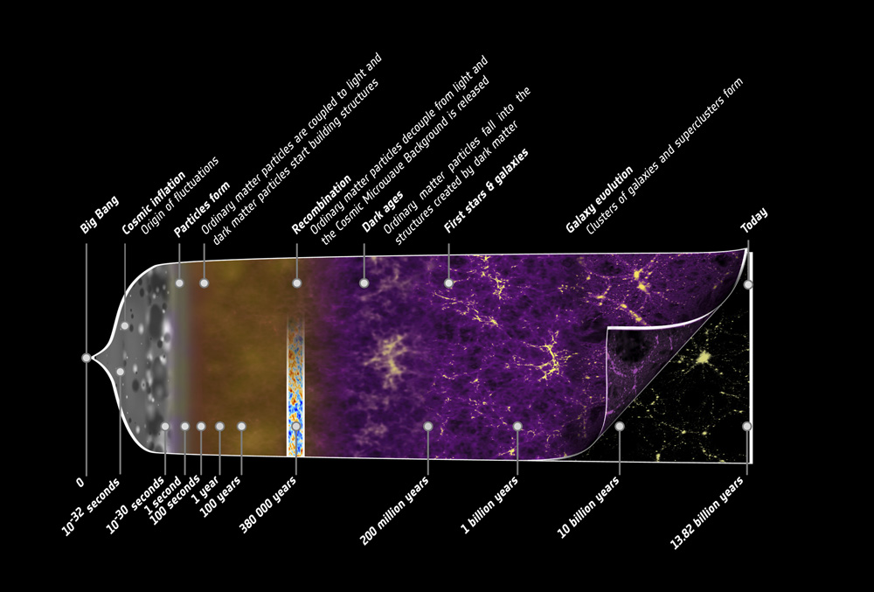
What is the Physics behind Inflation?
2. radiation domination
4. dark energy domination
1. Inflation
3. matter domination
E ≈ 10¹⁵ GeV (?)
t ≈ 13.8 Gyr
(today)
t ≈ 10⁻³² s
t ≈ 75,000 yr
t ≈ 9.5 Gyr

Slide 3
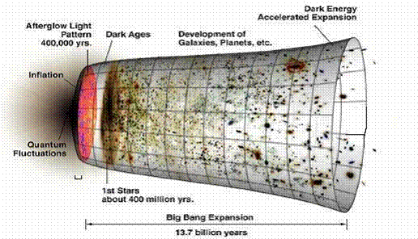
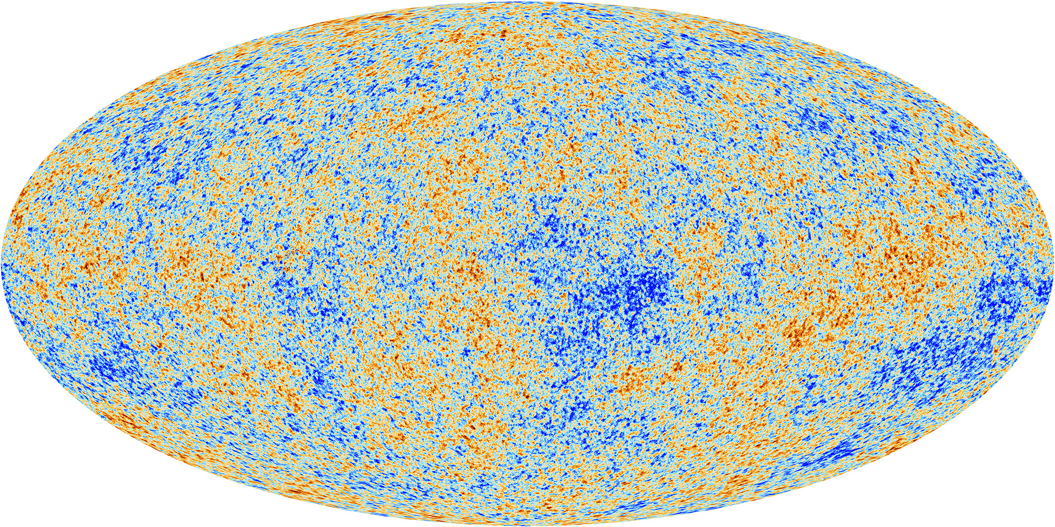
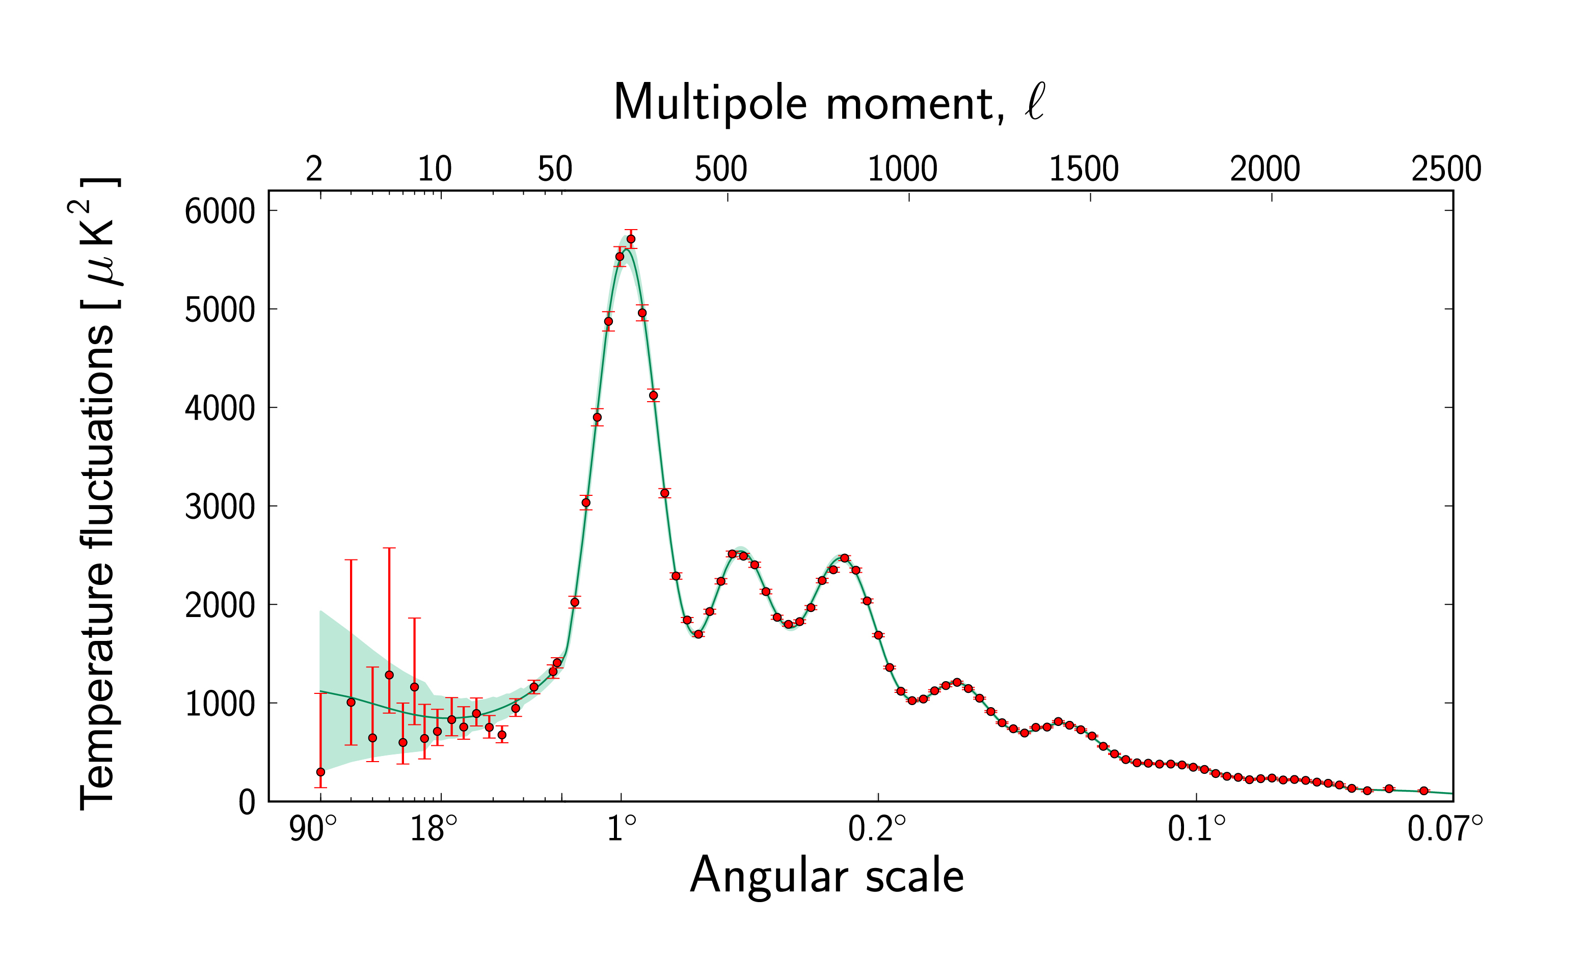
Primordial density fluctuations are a powerful probe of Inflation
BUT: small deviations from Gaussianity expected
Primordial non-Gaussianity gives crucial information on Inflationary Lagrangian!
Gaussian fluctuations characterized by primordial power spectrum

Slide 4
Local Primordial non-Gaussianity
Simple form:
Distinguishes between single- and multi-field Inflation

Slide 5
Local non-Gaussianity: modulation of small-scale perturbations by long mode: “mode coupling”
Φ_{S}
Φ_{S}
Φ_{L}

Slide 6
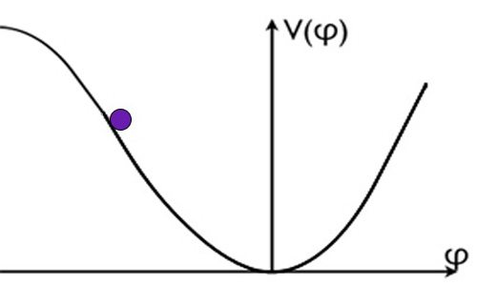
Single-field consistency condition predicts zero mode coupling
Single-Field Inflation
Maldacena 2003,
Creminelli & Zaldarriaga 2004
Φ_{S}
Φ_{S}
Φ_{L}

Slide 7
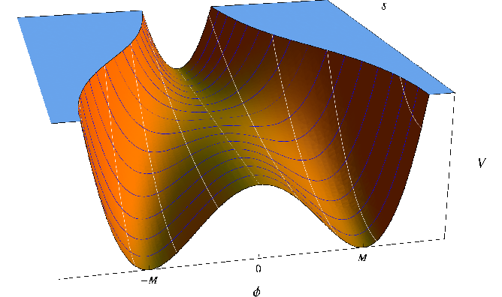
Multifield Inflation allows large mode coupling
Multi-Field Inflation
e.g. Lyth et al 2003,
Zaldarriaga 2004
Φ_{S}
Φ_{S}
Φ_{L}

Slide 8
Current best constraints from CMB bispectrum
Planck 2015, paper XVII
Planck2015 Temperature + Polarization Bispectrum:
f_{NL} = 0.8 +/- 5.0 (68% CL)

Slide 9
Future constraint at σ(f_{NL}) ~ 1 may distinguish between single- and multi-field Inflation
e.g. Alvarez,…, de Putter, et al (arXiv:1412.4671)
Single-Field Inflation:
Single-field consistency condition
by Maldacena (2003):
Multi-Field Inflation:
Curvaton models, modulated reheating, etc:

Slide 10
CMB constraint can only improve by factor ~ 2
future
Current Planck bispectrum: σ( f_{NL}) = 5 σ( f_{NL}) ~ 3
Baumann et al 2009

Slide 11
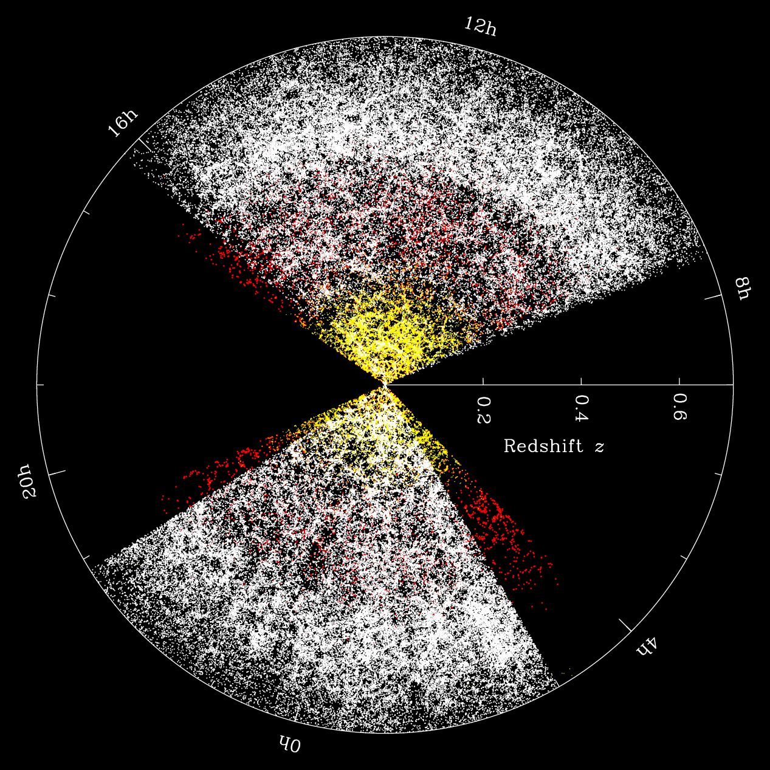
Galaxy clustering can strongly improve primordial non-Gaussianity constraints
Halo bias:
Halo bias:
(Galaxy Clustering in BOSS)

Slide 12
In absence of primordial non-Gaussianity, large-scale halo bias is scale-independent
Φ_{S}
Φ_{S}
Φ_{L}

Slide 13
Primordial non-Gaussianity leads to scale-dependent halo bias
Dalal, Doré, Huterer & Shirokov 2008
Φ_{S}
Φ_{S}
Φ_{L}

Slide 14
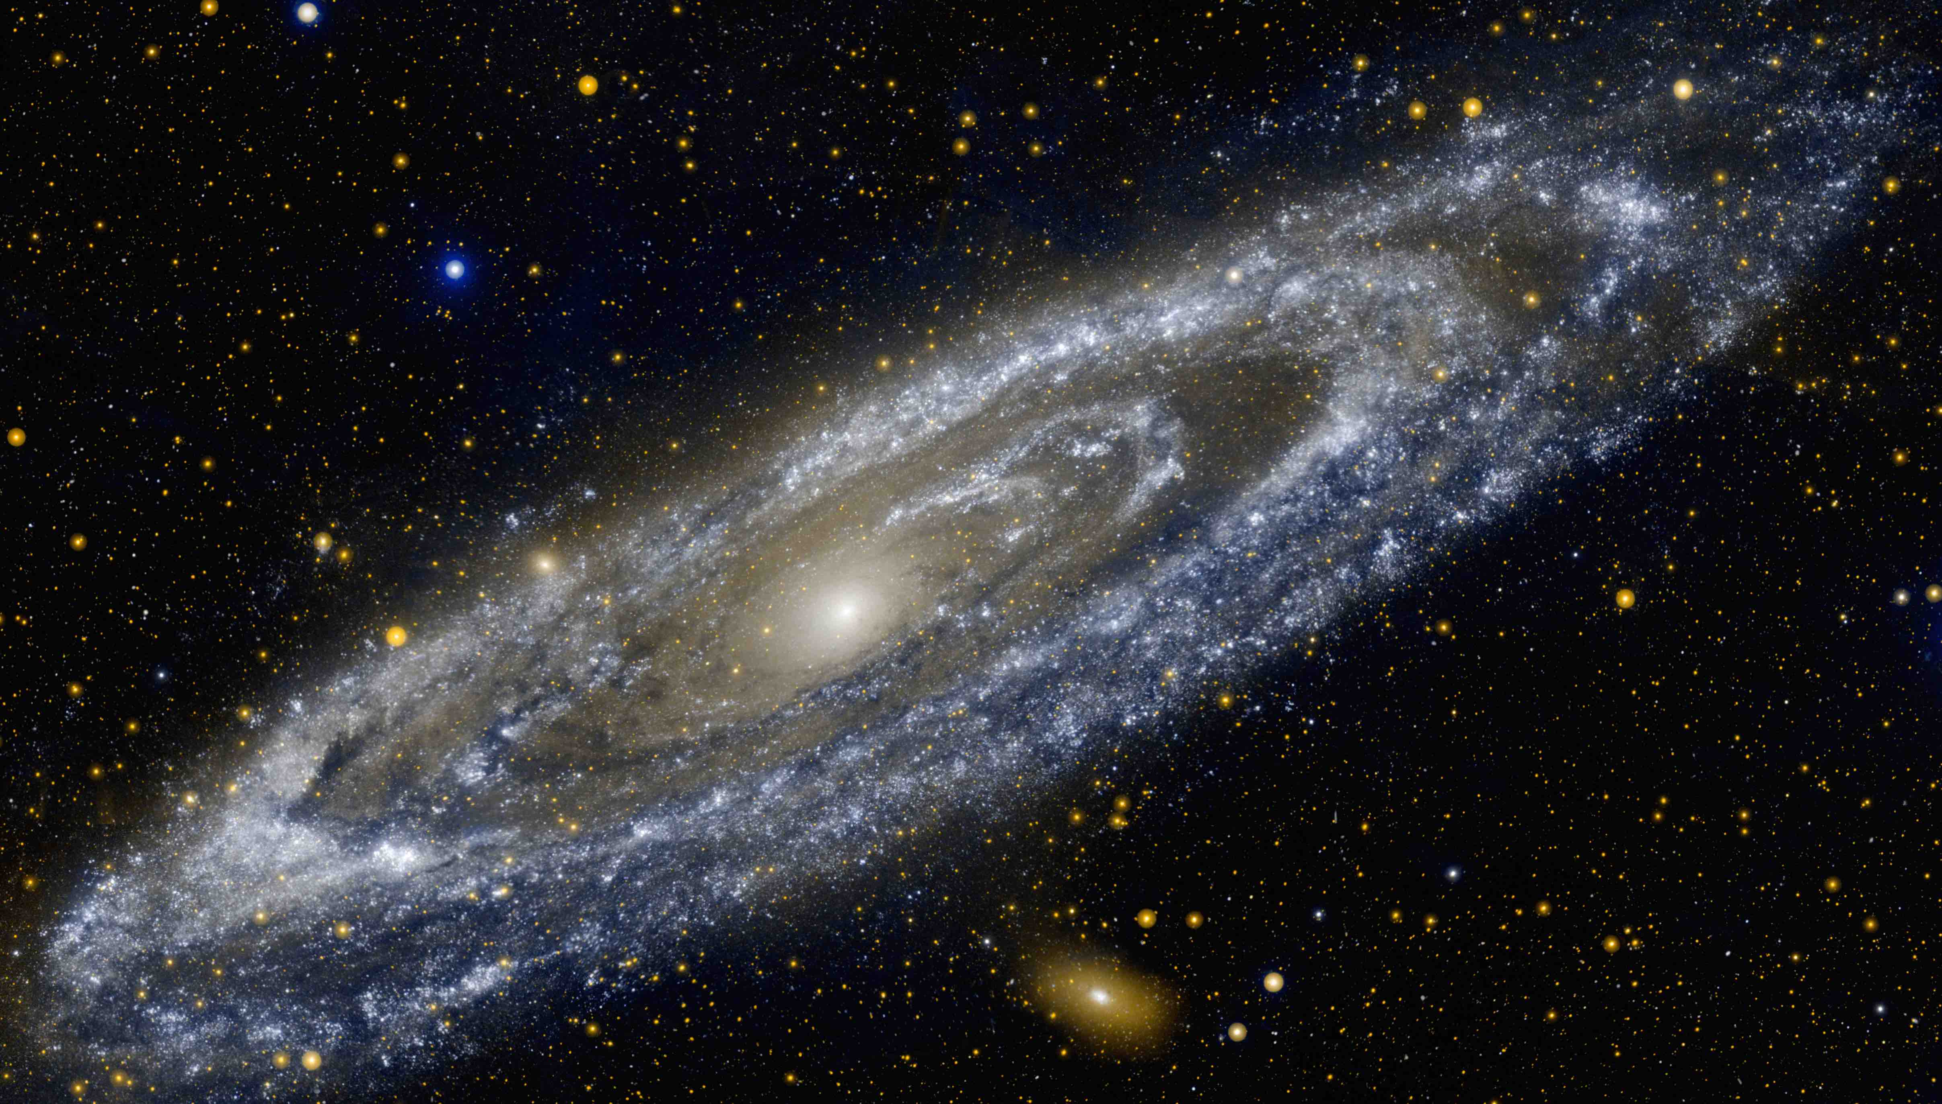
Primordial non-Gaussianity leads to scale-dependent halo bias
Dalal, Doré, Huterer & Shirokov 2008
δn_{h}< 0
δn_{h}> 0
Φ_{L}

Slide 15
Primordial non-Gaussianity leads to scale-dependent halo bias
Dalal, Doré, Huterer & Shirokov 2008
δn_{h}< 0
δn_{h}> 0
Φ_{L}

Slide 16
Primordial non-Gaussianity leads to scale-dependent halo bias
Dalal, Doré, Huterer & Shirokov 2008
δn_{h}< 0
δn_{h}> 0
Φ_{L}

Slide 17
Primordial non-Gaussianity leads to scale-dependent halo bias
Dalal, Doré, Huterer & Shirokov 2008
δn_{h}< 0
δn_{h}> 0
Φ_{L}
Unique signal:
Requires Ultra-Large Scales:

Slide 18
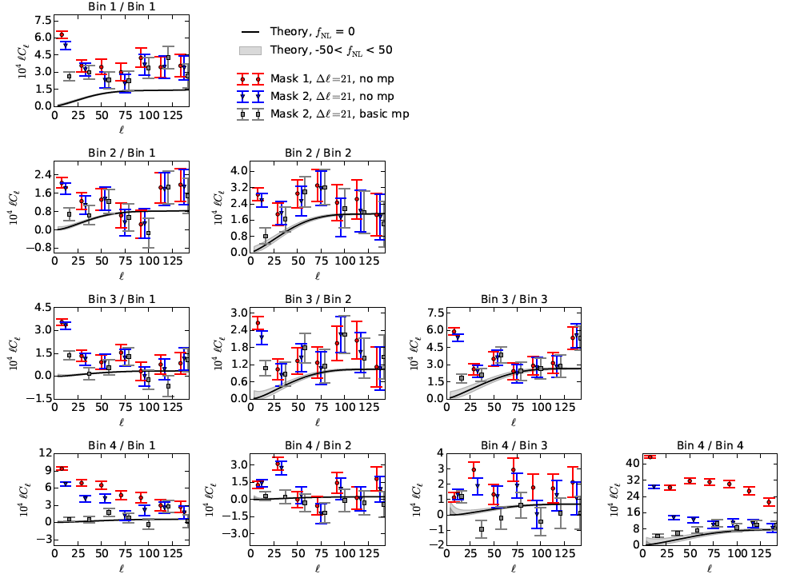
Current strongest bound from photometric quasars: -49 < f_{NL} < 31 (95 % CL)
Leistedt & Peiris 2014, Leistedt, Peiris & Roth 2014
See also:
Giannantonio et al 2014, Ross et al 2013
Leistedt, Peiris & Roth 2014

Slide 19
Is there Scale-Dependent Bias in Single-Field Inflation?
de Putter, Doré & Green 2015
Dai, Pajer & Schmidt 2015
Φ_{L}
When properly treat GR “gauge effects”, no physical scale-dependent bias remains

Slide 20
Galaxy Clustering on ultra-large scales:
what does it take to reach σ(f_{NL}) ~ 1?
de Putter & Doré 2014
Survey volume
V = many 100’s (h⁻¹ Gpc)³ for σ(f_{NL})~1
Redshift accuracy
High redshift accuracy NOT needed

Slide 21
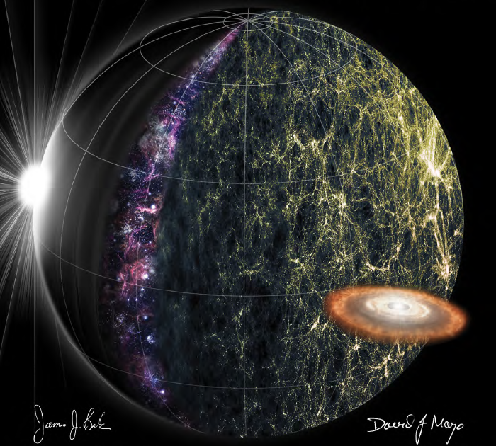
SPHEREx: an All-Sky Spectral Survey
Doré, Bock,…, de Putter, et al (1412.4872)
spherex.caltech.edu
Bla
Bla

Slide 22
SPHEREx: an All-Sky Spectral Survey
Doré, Bock,…, de Putter, et al (1412.4872)
spherex.caltech.edu
λ = 0.75 – 5 μm
Resolution R = 41.5
Full-Sky
Pixel Size 6.2’’
Aperture 20cm
FoV 3.5° x 7°
Bla
Bla

Slide 23
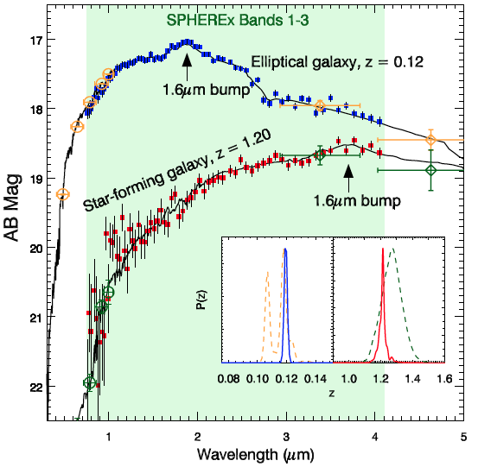
SPHEREx enables low-res spectroscopic redshifts for > 300M galaxies
Pan-Starrs
WISE

Slide 24
SPHEREx galaxy clustering can reach σ(f_{NL})< 1

Slide 25
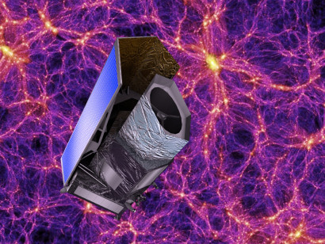
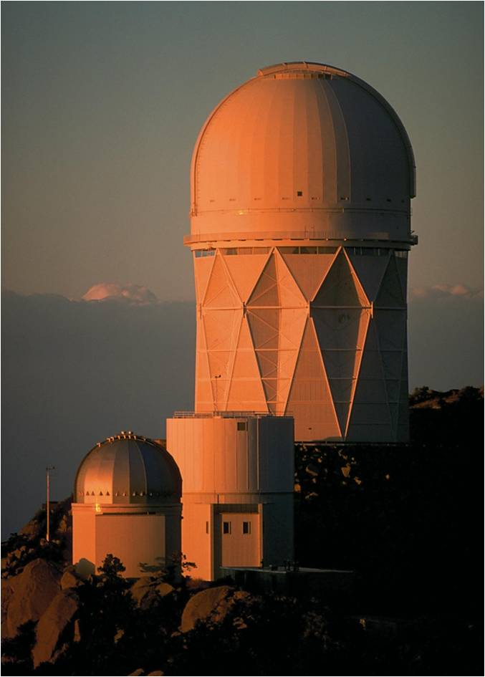
BOSS -> eBOSS -> DESI
EUCLID
www.euclid-ec.org
DESI
Levi et al, 2013 (1308.0847)
SPHEREx
spherex.caltech.edu (1412.4872)
Bla
Bla

Slide 26

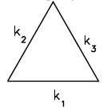
Beyond local non-Gaussianity: types characterized by Bispectrum
Local:
multifield
(squeezed)
Equilateral:
non-canonical
kinetic terms,…

Slide 27
Scale-dependent bias beyond local non-Gaussianity
Gleyzes, Green, Doré, de Putter in prep
Local Non-Gaussianity:
Equilateral Non-Gaussianity:
Can this be distinguished from
non-local and non-linear halo bias?

Slide 28
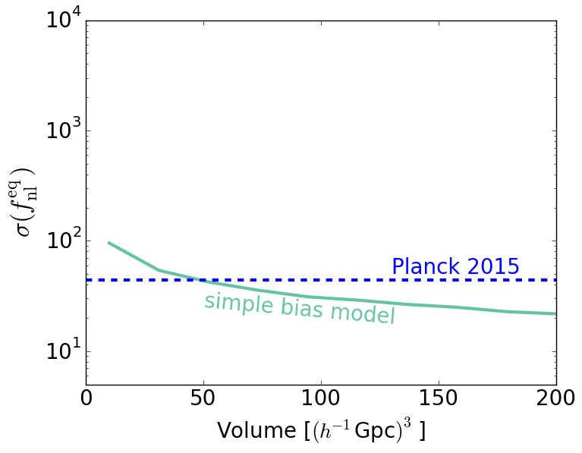
Scale-dependent bias from equilateral non-Gaussianity
Gleyzes, Green, Doré, de Putter in prep
PRELIMINARY

Slide 29
Scale-dependent bias from equilateral non-Gaussianity
Gleyzes, Green, Doré, de Putter in prep
PRELIMINARY

Slide 30
More Inflation from galaxy clustering
Primordial non-Gaussianity from the halo bispectrum
Equilateral: σ(f_{NL}) ~> 10
Local: σ(f_{NL}) < 1
Spectral index, n_{s}, and running α_{s}
EUCLID: σ(n_{s})= 0.006 -> 0.002
σ(α_{s})= 0.009 -> 0.003
Features in the primordial power spectrum
Sefusatti et al 2006, Baldauf et al 2011, Baldauf et al 2016, Doré et al 2015, …
Amendola et al 2016
Chen et al 2016, Ballardini et al 2016,…

Slide 31
SPHEREx galaxy clustering can reach σ(f_{NL})< 1

Slide 32
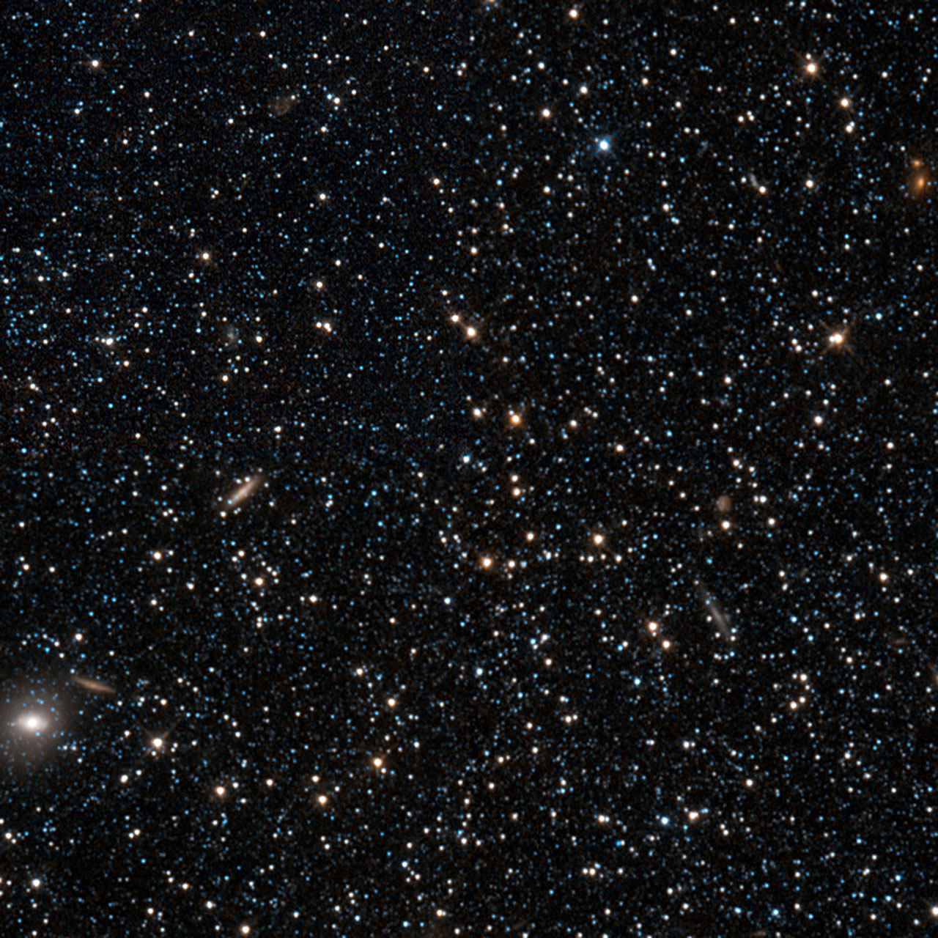
Summary
Local Primordial non-Gaussianity (PNG) strong probe of physics of Inflation: single- vs. multifield
Scale-dependent bias in galaxy clustering from e.g. SPHEREx will allow constraints beyond capability of CMB
Other types of PNG also cause scale-dependent bias, but more degenerate with non-primordial biasing
Through scale-dependent bias and more, galaxy surveys will play key role in unraveling physics of Inflation

Slide 33
Extra Slides

Slide 34
Single-field consistency condition predicts zero mode coupling (modulo gradients)
Single-Field Inflation
Maldacena 2003,
Creminelli & Zaldarriaga 2004
Φ_{L}

Slide 35
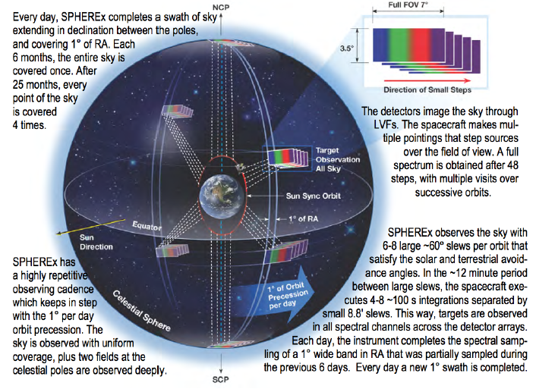
SPHEREx: An All-Sky Spectral Survey
Doré et al (1412.4872)

Slide 36
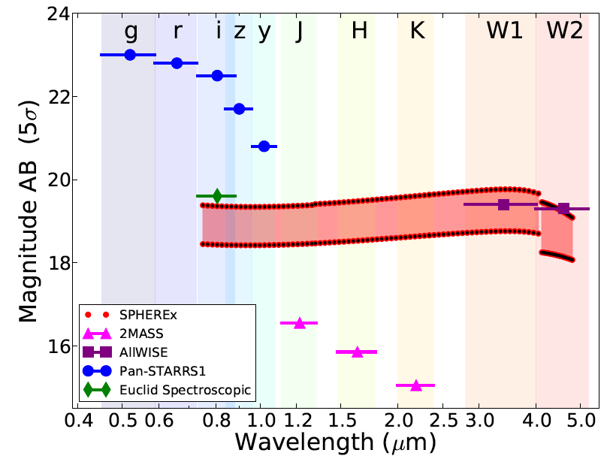
SPHEREx covers wide range of wavelengths with resolution R~40

Slide 37
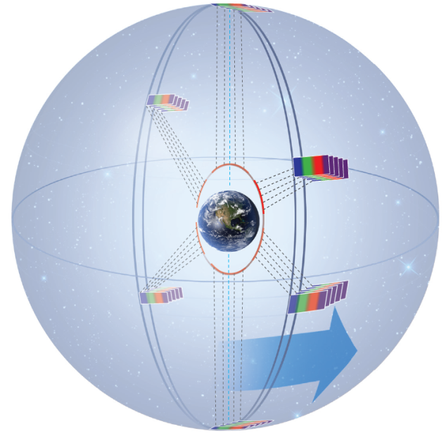
Mapping the Full Sky with SPHEREx
All-Sky Coverage
Designed for uniform coverage
after 25 months of observations
with 4 independent surveys.
Deep Surveys at Poles
Except for two 100 sq. degree regions
At the poles with are ~30x deeper.
An opportunity for unique science
SPHEREx observes the sky simply by pointing the spacecraft
over multiple orbits to obtain complete spectra.

Slide 38
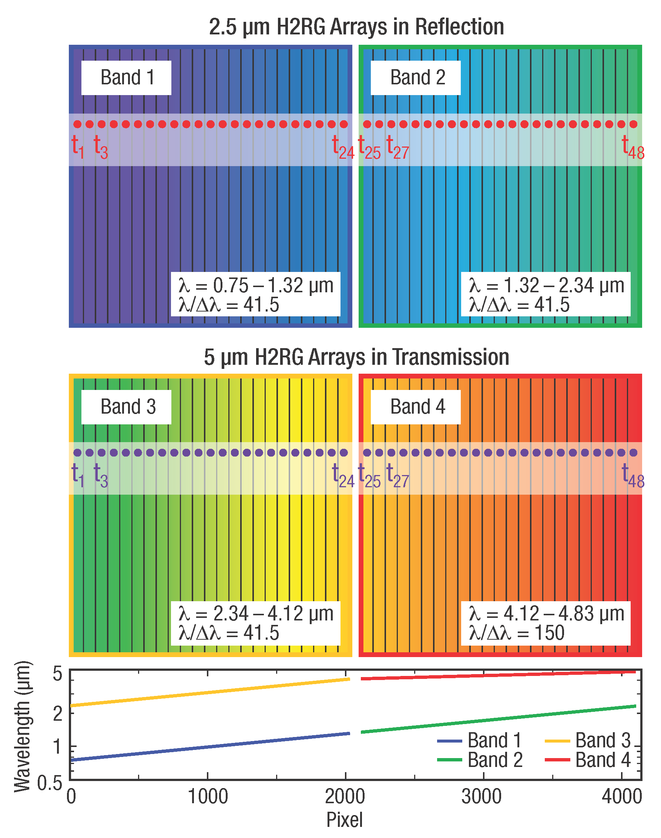
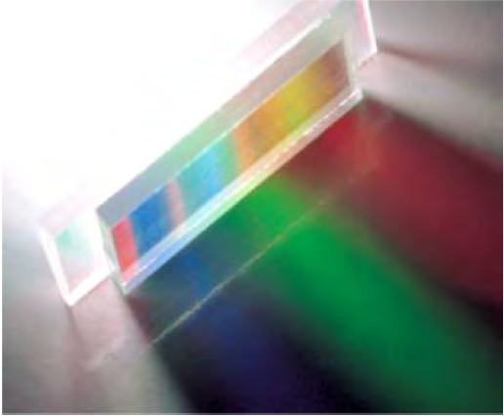
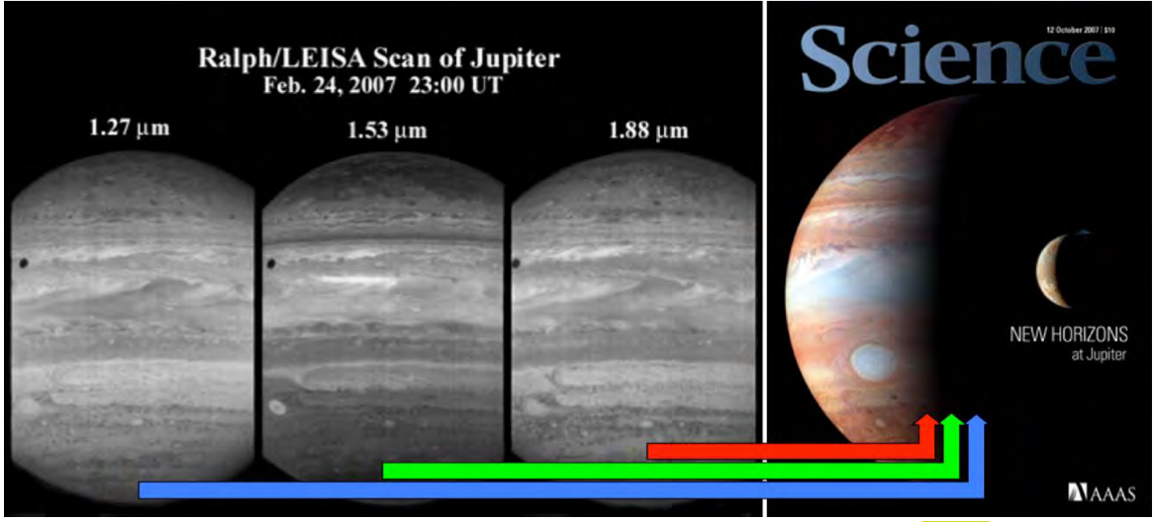
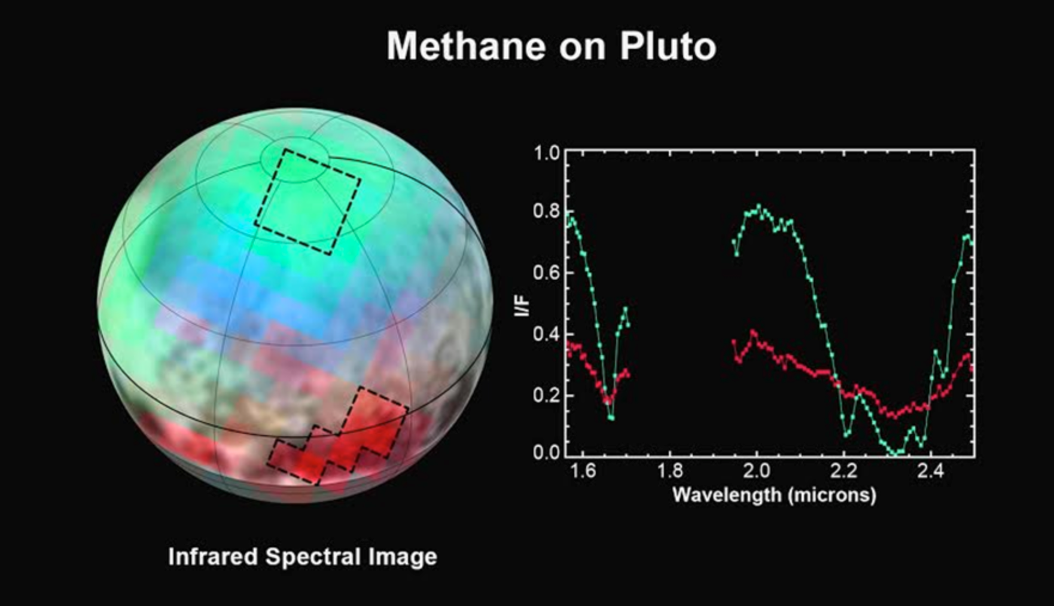
High-Throughput LVF Spectrometer
Linear Variable Filter
Focal Plane Assembly
Methane on Pluto
1.0
0.8
0.6
I/F
0.4
0.2
0.0
1.6 1.8 2.0 2.2 2.4
Infrared Spectral Image
Wavelength (μm)
LVFs used on ISOCAM, HST-WFPC2,
New Horizons LEISA, & OSIRIX-Rex (2016 launch)
Spectra obtained by stepping source over the
FOV in multiple images: no moving parts

Slide 39
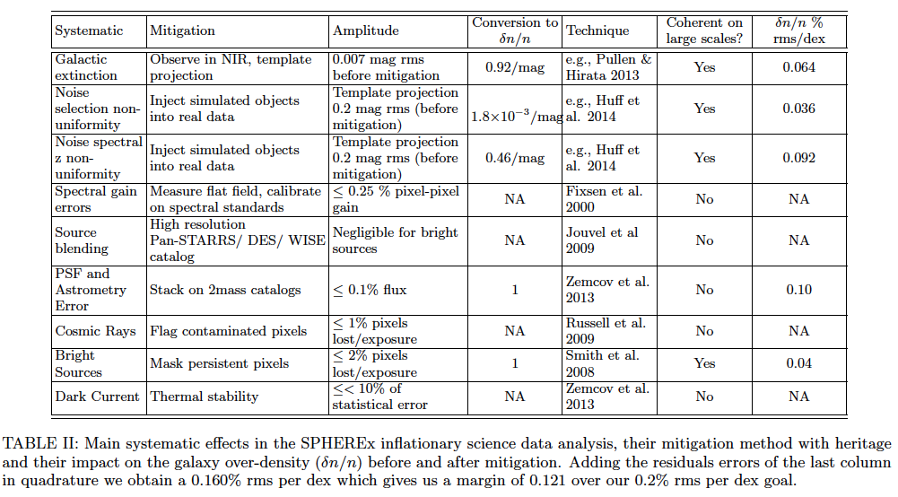

Slide 40
