Slide 1
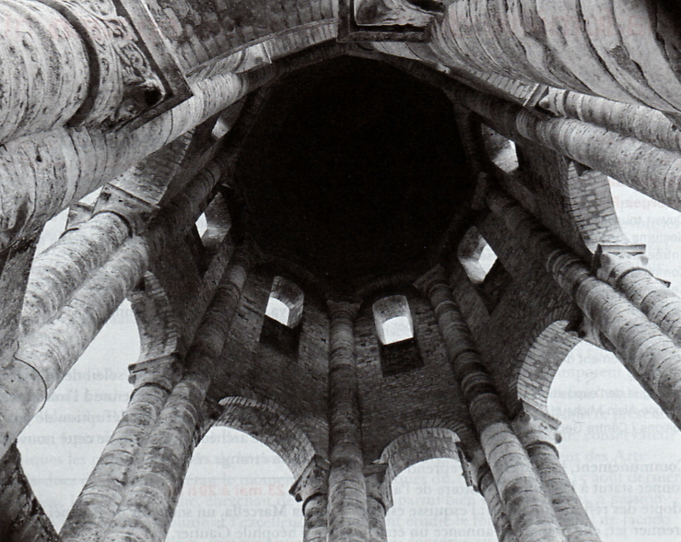
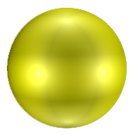
Metal ions in Biomimetic Cavities
M^{n+}
Prof. Olivia Reinaud
Group of Supramolecular Bioinorganic Chemistry
Université Paris Descartes – CNRS UMR 8601

Slide 2
Cu-Peptidylglycyl α-Hydroxylating Mono-oxygenase

Slide 3
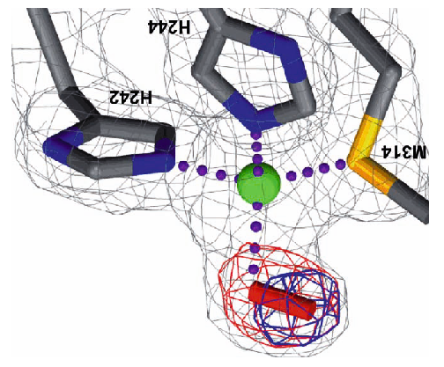
A precatalytic complex :
Amzel et al., Science, 2004
Modeling the active site of non-heme metallo-enzymes
A supramolecular
approach
Classical strategy

Slide 4
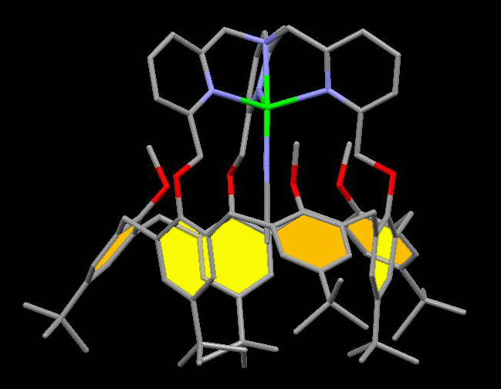
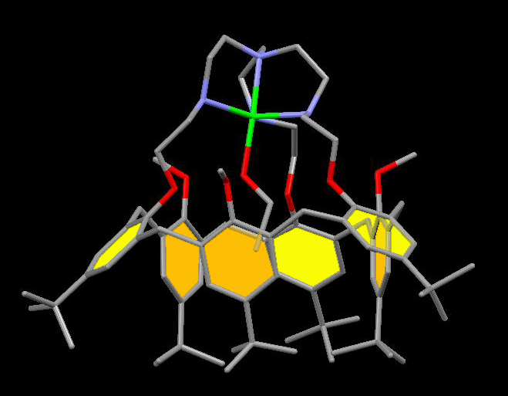
Cu(II) complexes
TMPA
TREN
Open access to the metal center
No exo-binding
Well-defined second coordination sphere
MeCN
EtOH
The Metal-Ligand interaction is fully controlled by the calix-cryptand
PNAS, 2005, 102, 6831 - Chem Commun. 2007, 810 - J. Am. Chem. Soc. 2009, 131, 17800
Notes:
Week interactions can have big (major) consequenses

Slide 5
Functionalization of electroactive surfaces

Slide 8
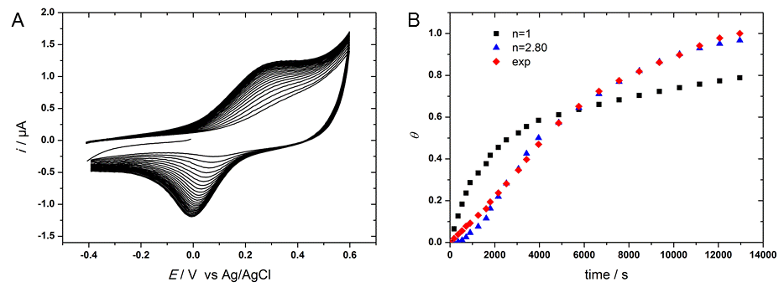
Electro-grafting a Funnel complex
v = 0.1 V/s
E /V vs Ag/AgCl
30 cycles
H₂O/KNO₃ 0.1 M + HEPES 0.05 M (pH = 9.4)

Slide 9
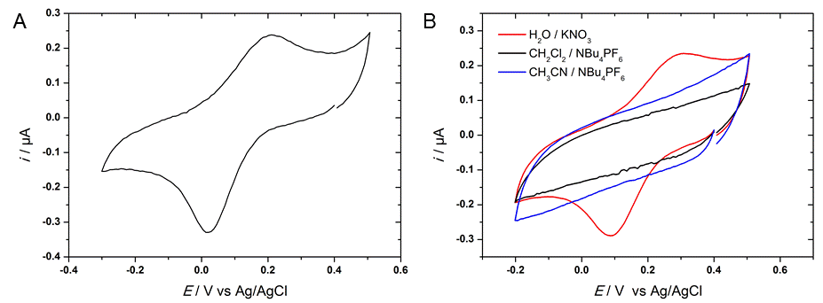
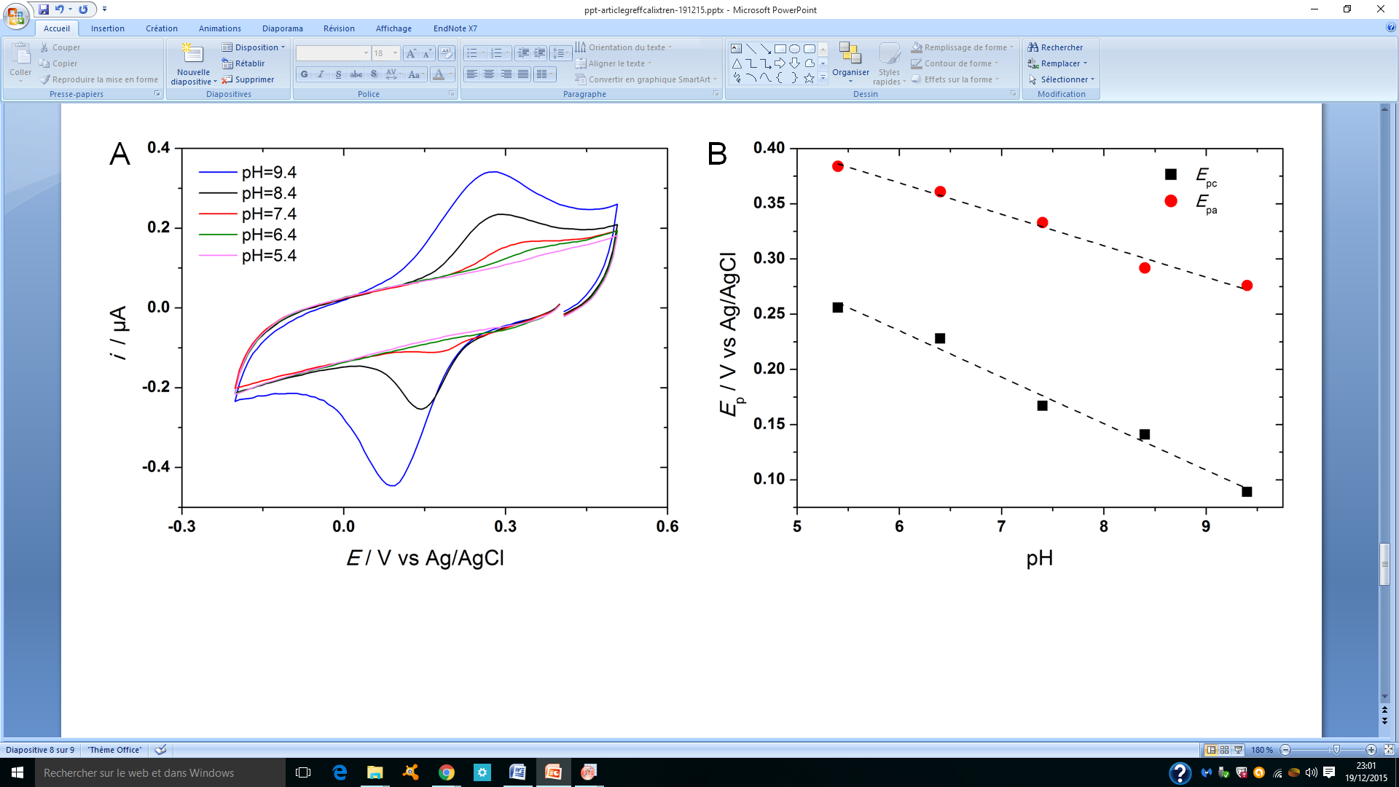
Grafted decanethiol modified gold electrode
CV (v = 0.05 V/s) in H₂O/KNO₃
0.1 M + HEPES 0.05 M (pH = 9.4)
B) CVs (v = 0.1 V/s)
in CH₂Cl₂/NBu₄PF₆ 0.2 M (black)
in CH₃CN/NBu₄PF₆ 0.1 M (blue)
in H₂O/KNO₃ 0.1 M (red, pH = 9.4)
CVs (v = 0.1 V/s, E /V vs Ag/AgCl) in H₂O/KNO₃ 0.1 M + HEPES buffer 0.1 M at different pH values
B) Plots of E_{pa} (red circles) and E_{pc} (black squares) vs pH.

Slide 10
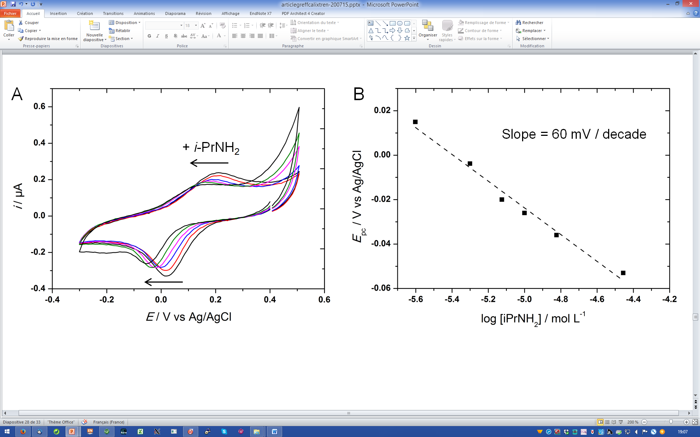
Response to i-PrNH₂
[iPrNH₂]: 2.5 µM < C < 35 µM.
in H₂O/KNO₃ 0.1 M + HEPES buffer 0.1 M (pH = 9.4)

Slide 11
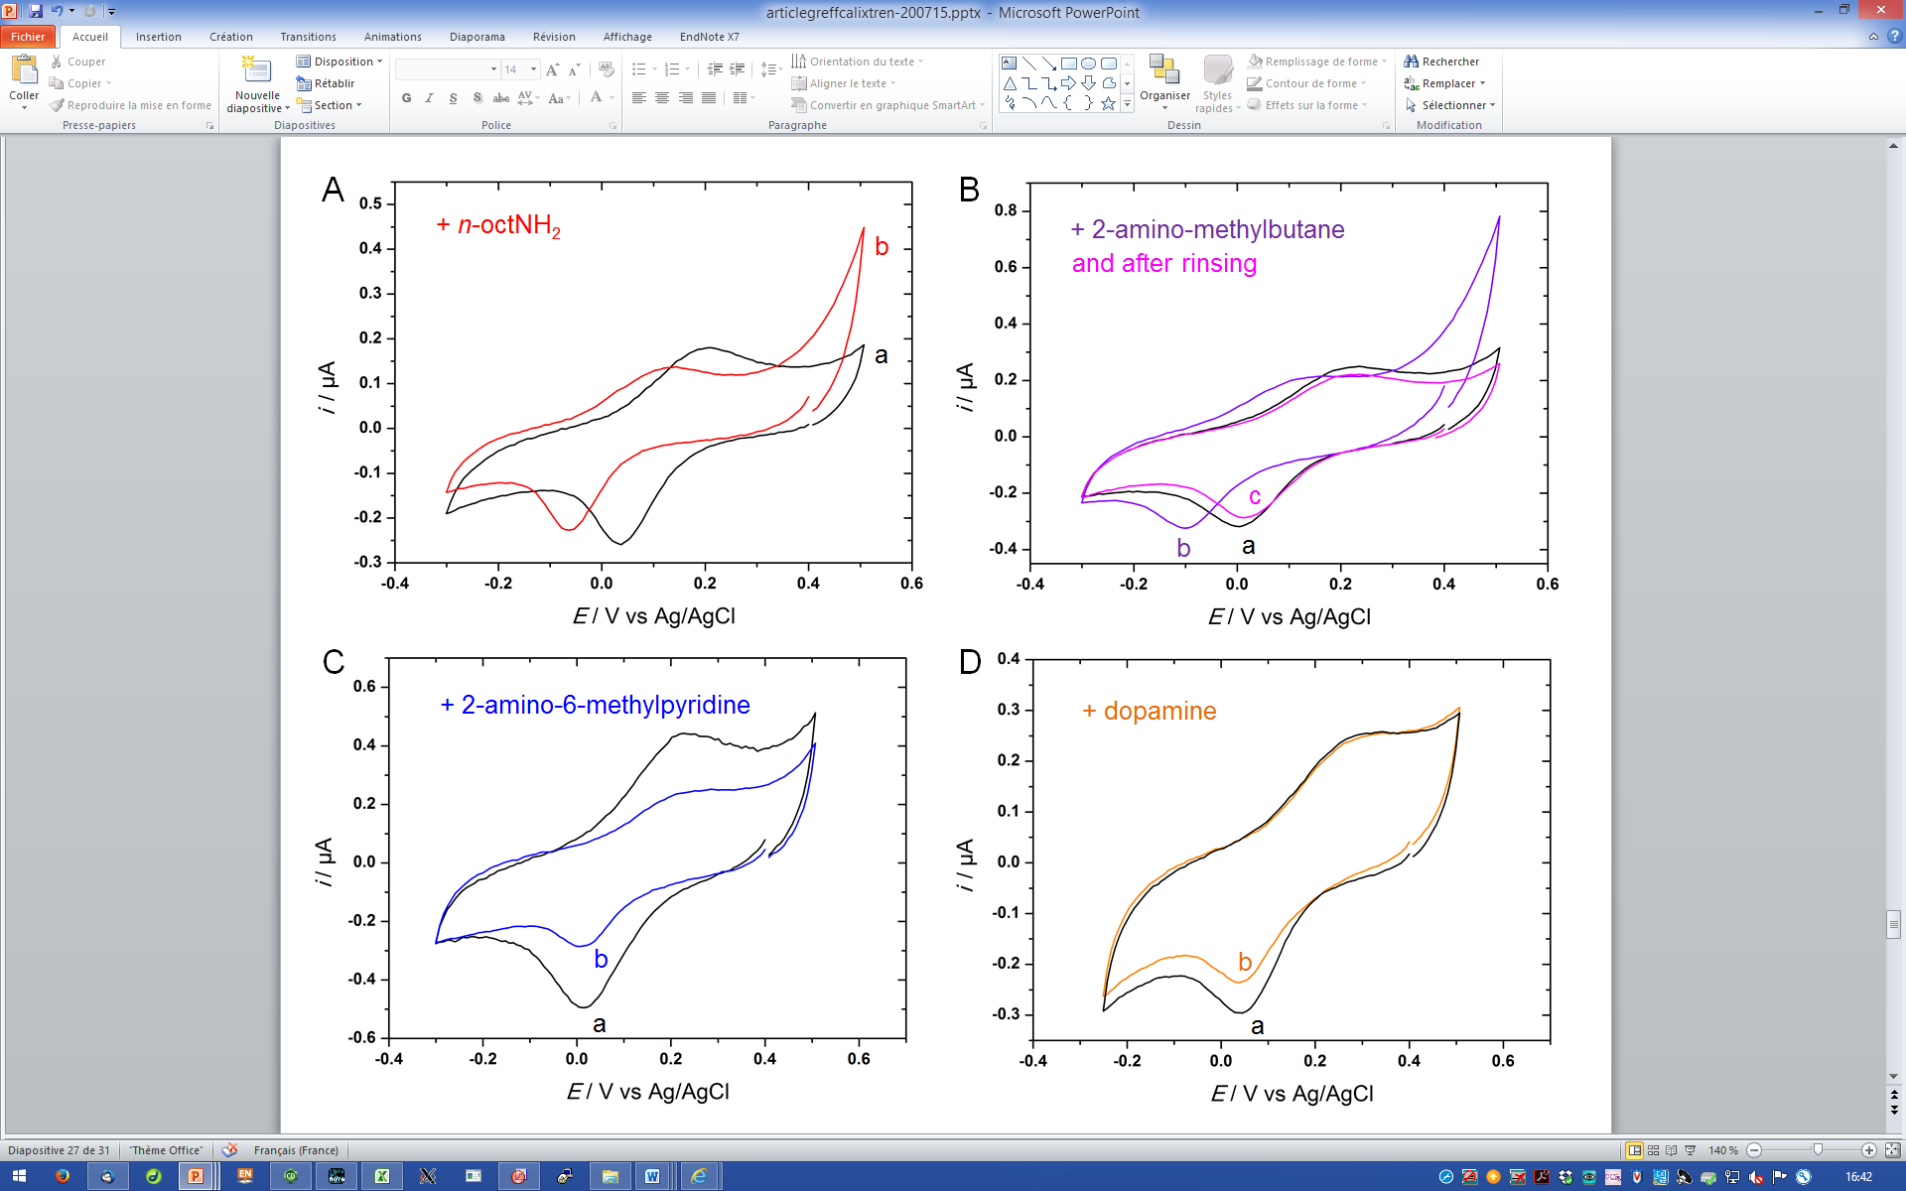
Selective detection of primary alkylamines in water
20 µM
2-aminomethyl-
butane
20 µM
n-OctNH₂
50 µM
2-amino-
6-methylpyridine
50 µM
dopamine
CVs in H₂O/KNO₃ 0.1 M + HEPES buffer 0.1 M
pH = 9.4 for A, B, and C, pH = 10.4 for D
before (a, black) and after addition of amine (b, colored)

Slide 12
Selective detection of primary alkylamines in water

Slide 13
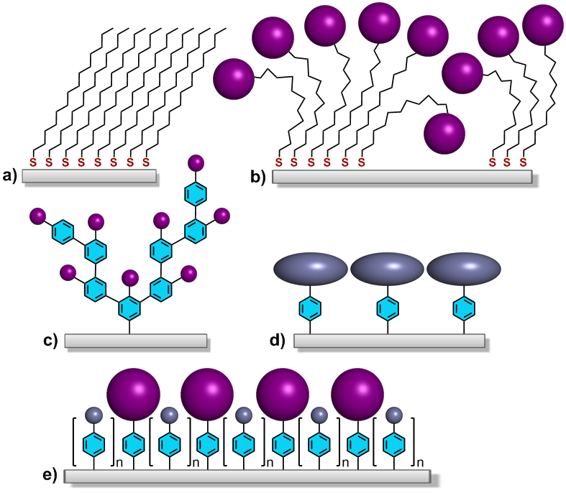
Schematized strategies based on thiols and diazoniums for grafting organic layers onto surfaces
Compact
Robust
Functional
Mono-layer
Dream :

Slide 14
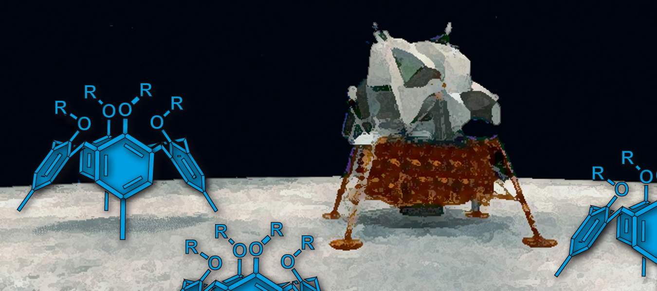
Solid
Rigid
Functional
Radical-proof
Nature comm. 2012

Slide 15
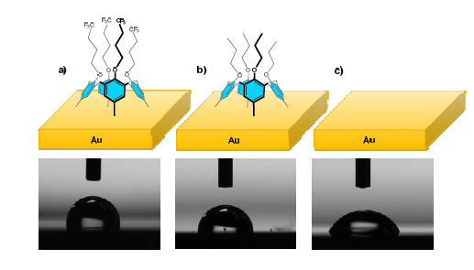
Robust mono-layer, very few defects
High density of functional groups, homogeneous
Cyclic voltammetry of glassy carbon electrodes modified with calixarenes and post-functionalized with ferrocene . CH₂Cl₂ + 0.2 M NBu₄PF₆ Scan rate varied from 0.1 to 3 V. s⁻¹.

Slide 16
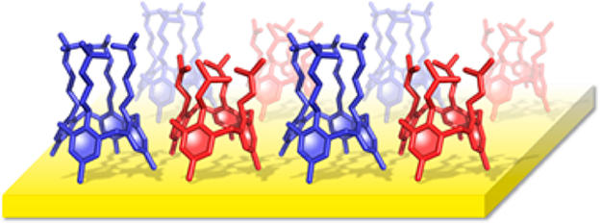
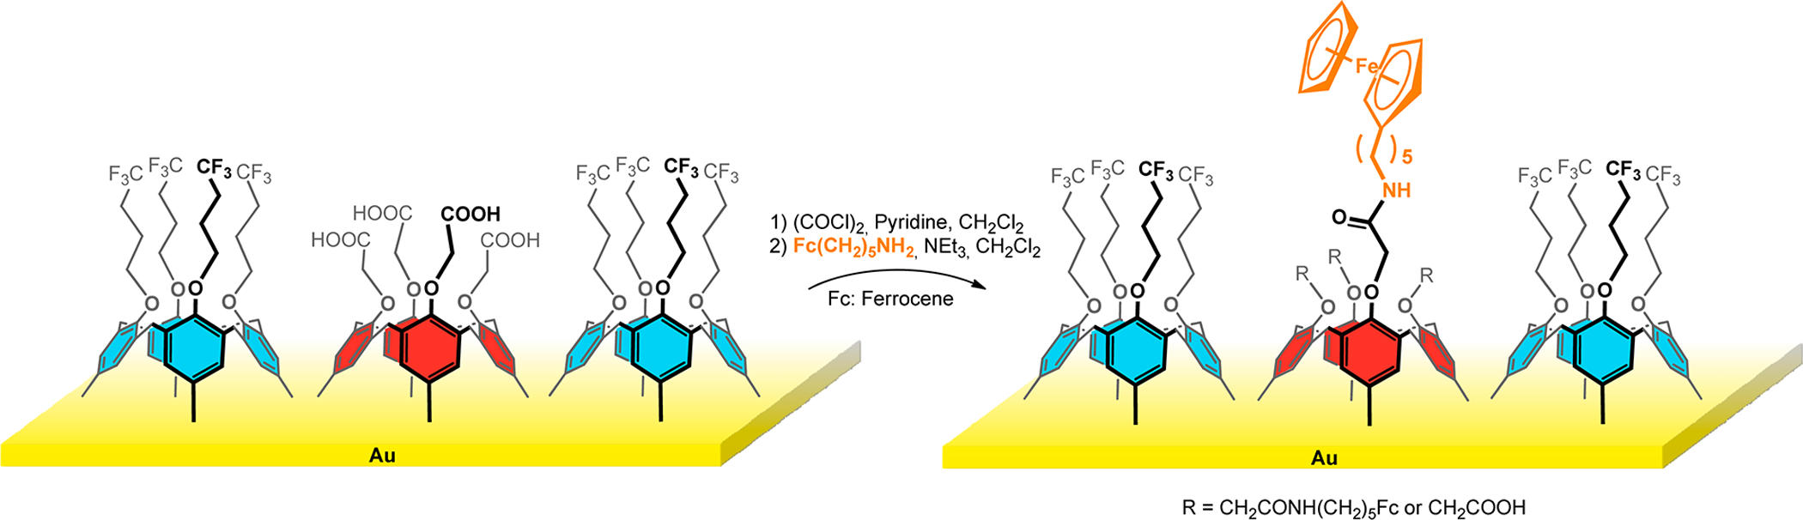
Mixed monolayers
Postfunctionalization of mixed monolayers
J. Phys. Chem. C 2014, 118, 15919

Slide 17
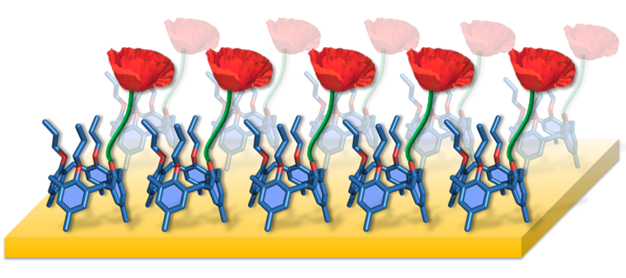
Perspectives
Cu⁺
Patent + Spin off ULB, A. Matuzzi IJ,PH, OR
Poster
A. Brugnara (PhD)
Cu⁺

Slide 18
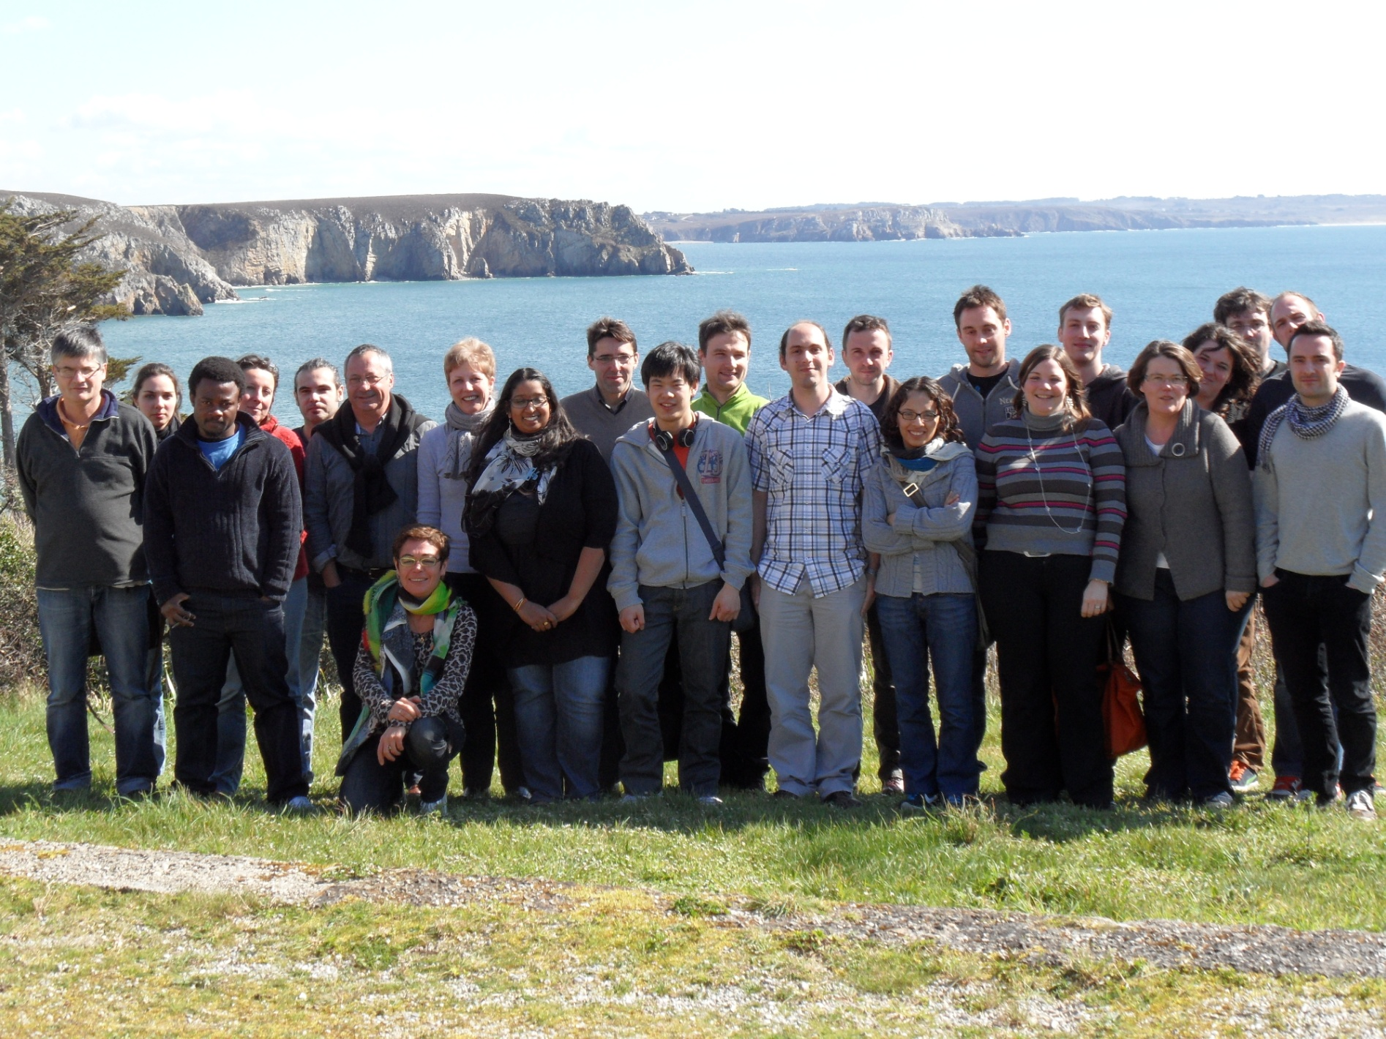
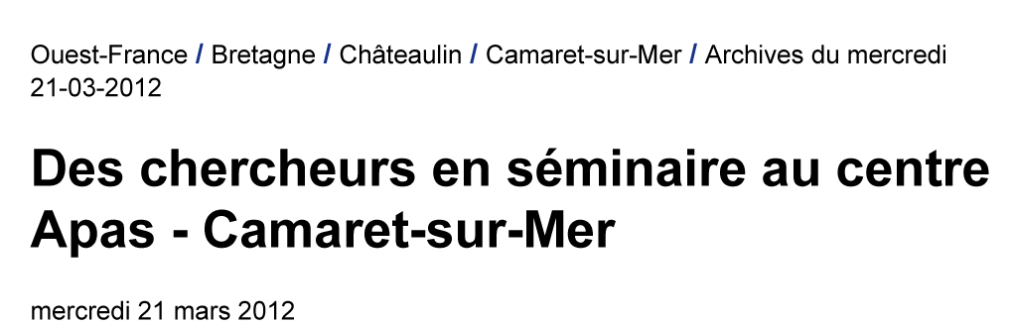

Gael de Leener
Corinne Lagrost
Diana Over
Nicolas Le Poul
2005
2000
1998
ANR « Calixzyme » 2005‐09, ANR « Cavity‐zyme (Cu) » 2010‐14
Y. Le Mest, P. Hapiot, I. Jabin, O. Reinaud

Slide 19
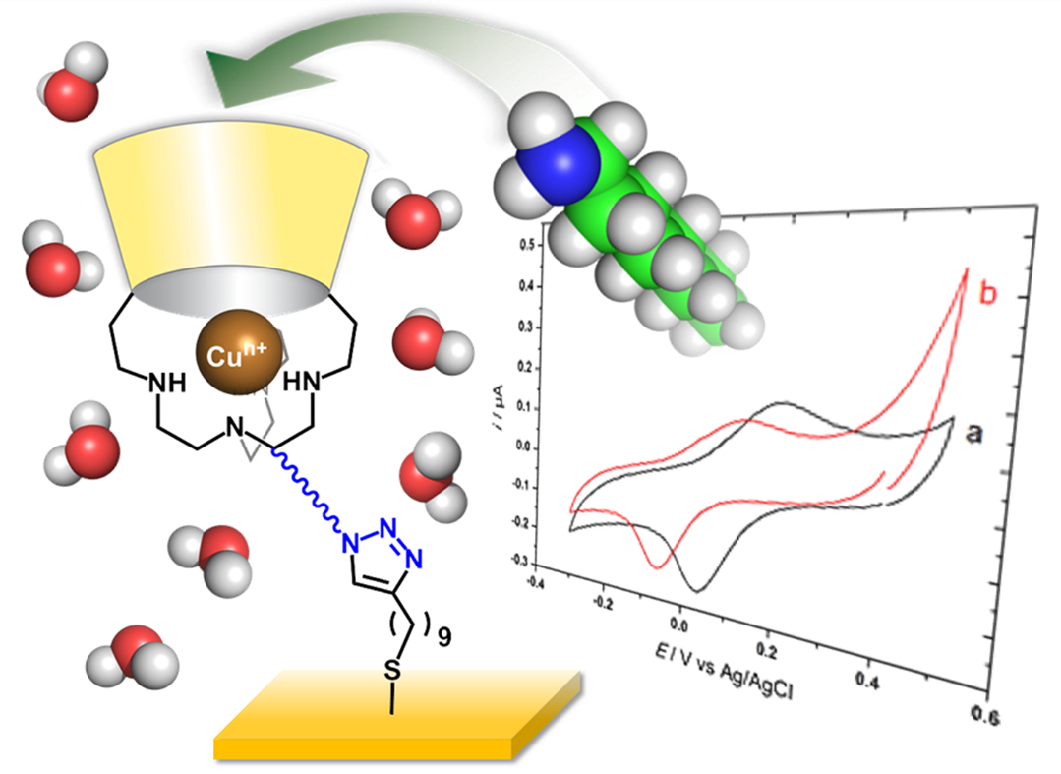

Slide 20
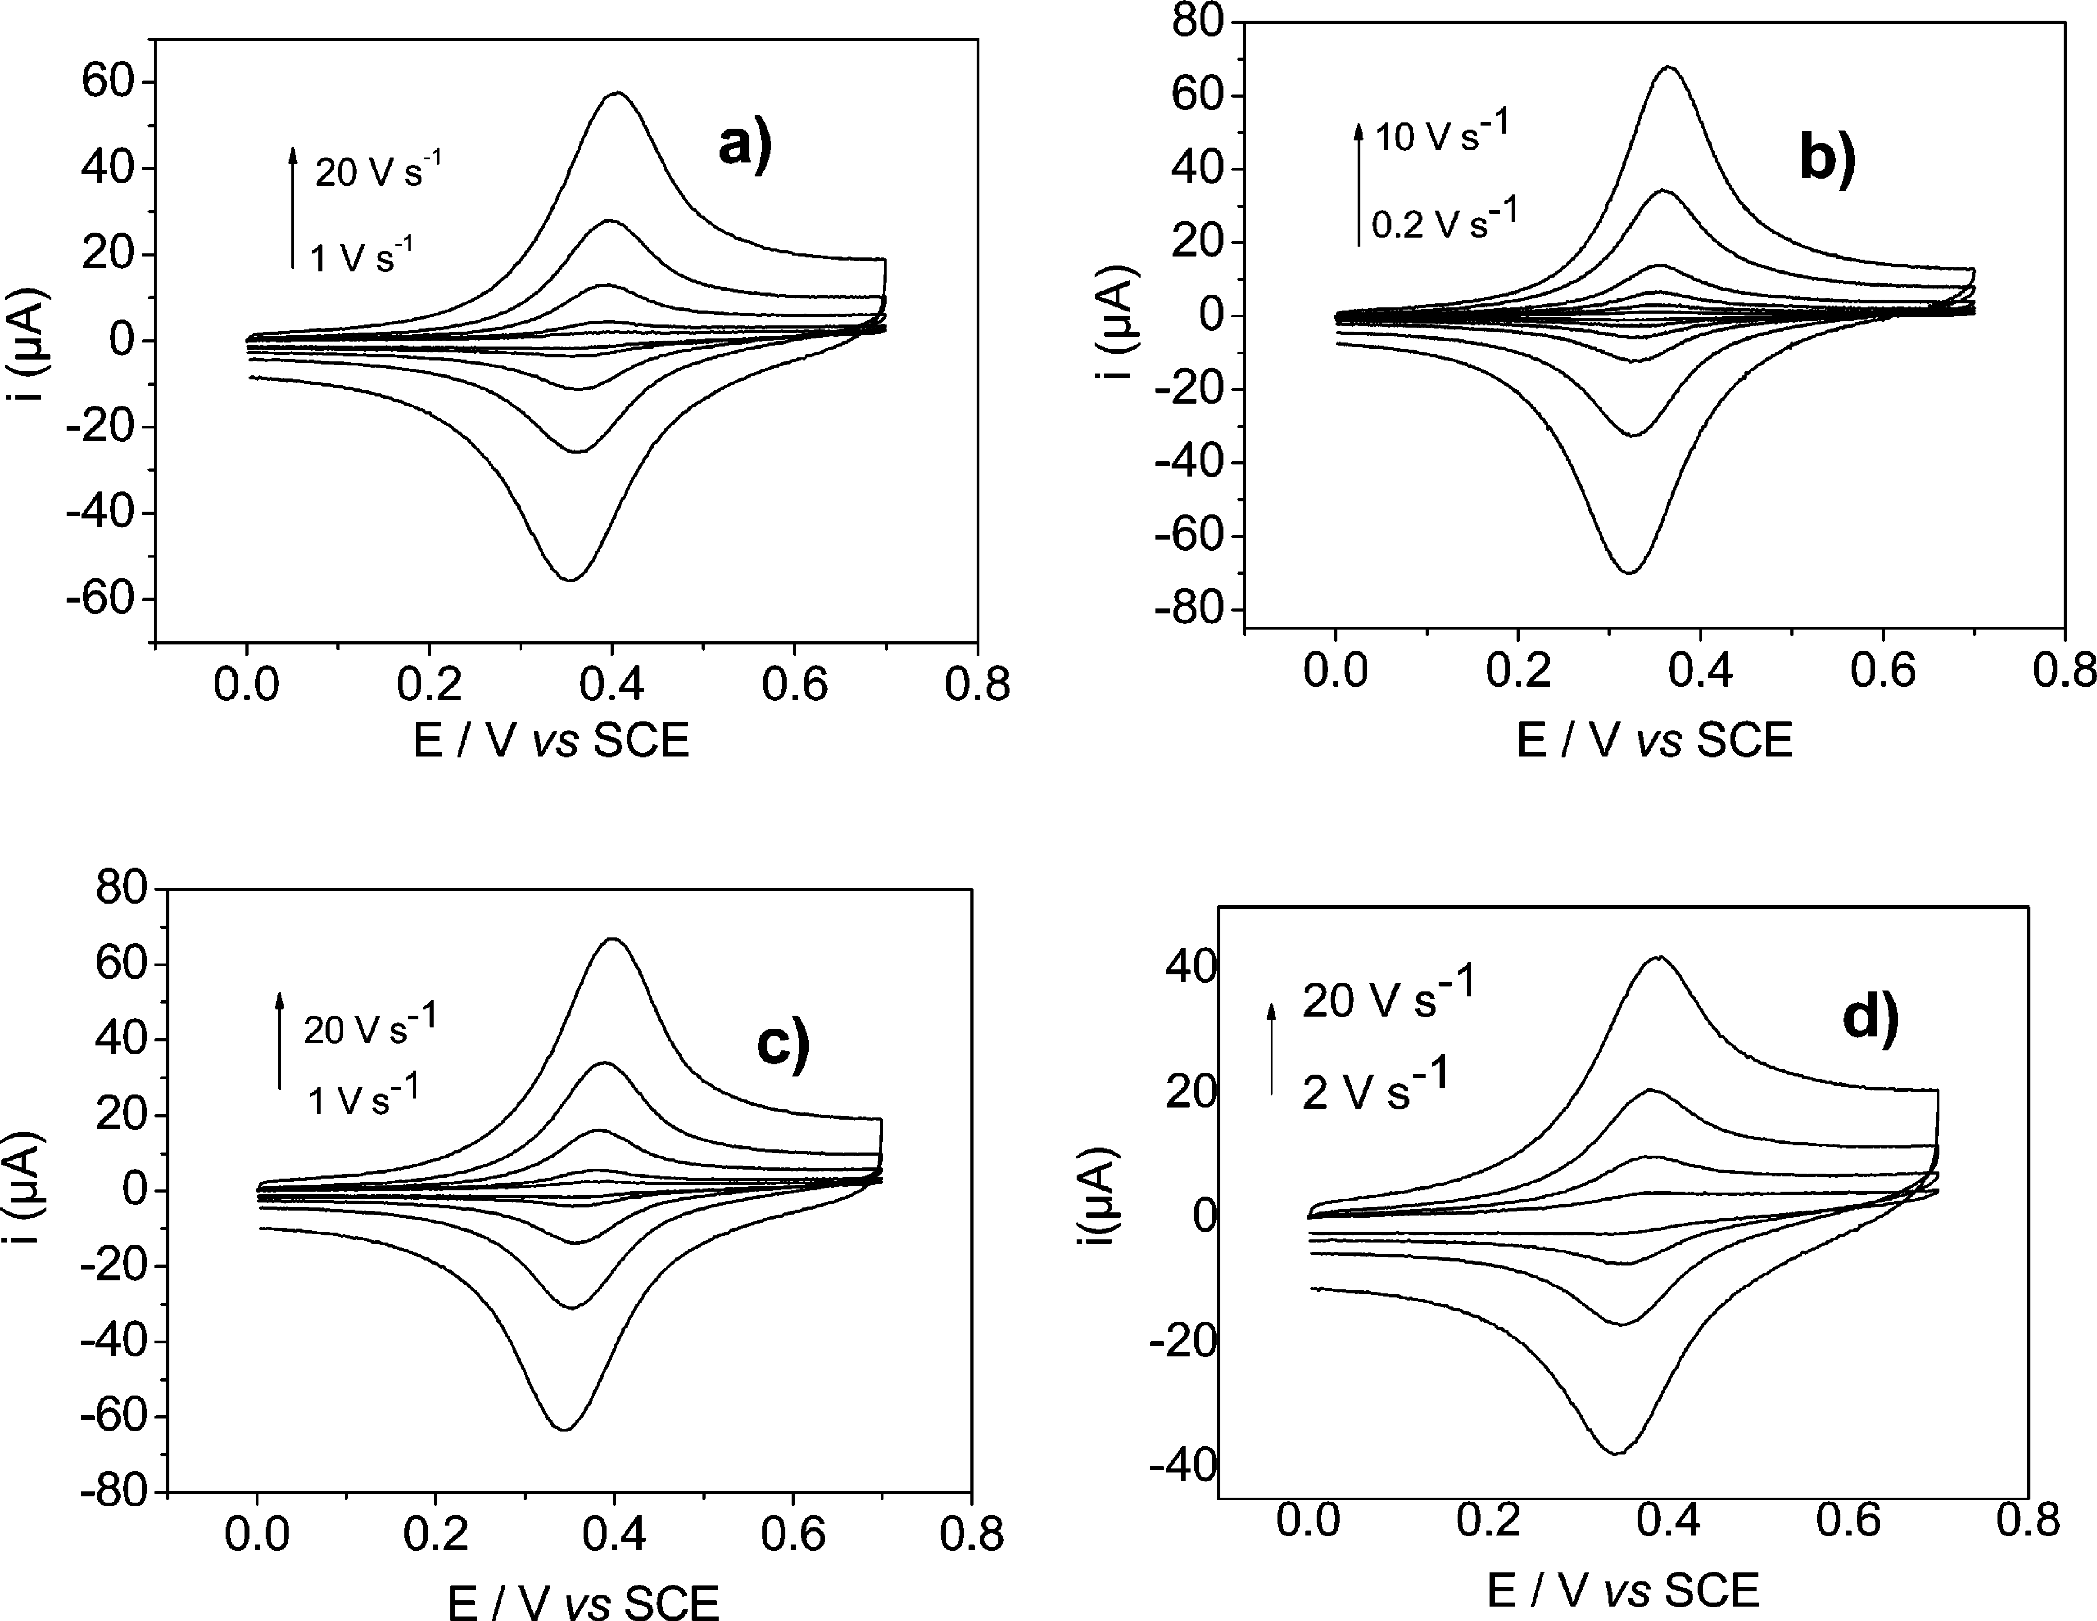
Cyclic voltammetry in CH2Cl2 containing 0.2 M Bu4NPF6 of gold electrodes modified with calix[4]arenes and postfunctionalized with Fc-C5H10-NH2. The modified surfaces were obtained from the electrografting of diazonium cations in situ generated from (a) a pure solution of 3, (b) a pure solution of 4, (c) a 50/50 mix solution of 2 and 4, and (d) a 90/10 mix solution of 2 and 4.

Slide 21
Strategy for electroclick grafting of [3.Cu(H₂O)]²⁺ as monolayers on alkyne-terminated calix[4]arene modified gold electrodes.

Slide 22
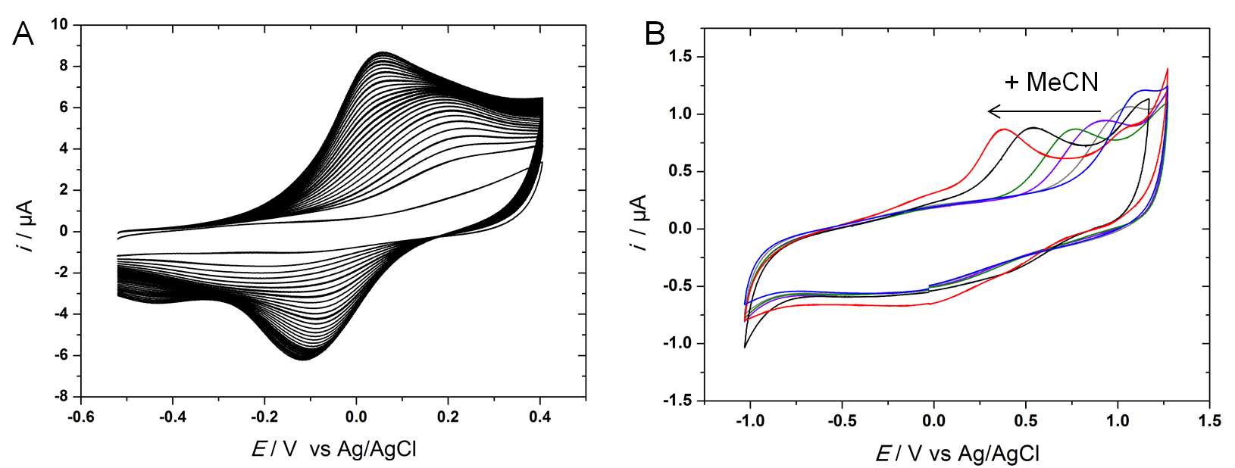
A ) CVs (v = 0.1 V/s, E /V vs Ag/AgCl, 25 cycles) obtained during the grafting of [3.Cu(H₂O)]²⁺ on an alkyne-terminal calix[4]arene modified gold electrode in CH₂Cl₂/NBu₄PF₆ 0.1 M + 18 µM [Cu(6-BrTMPA)(H₂O)]²⁺ + 6 µM of [3.Cu(H₂O)]²⁺. B) CVs (v = 0.1 V/s, E /V vs Ag/AgCl) at a [3.Cu(H₂O)]²⁺-grafted calix[4]arene modified gold electrodes in CH₂Cl₂/NBu₄PF₆ 0.2 M upon successive addition of acetonitrile (blue to red, max 4% vol.). Pas cité dans le texte ?

Slide 23
Grafting of [3.Cu(H₂O)]²⁺ on an alkyne-terminal decanethiol modified gold electrode under Ar) in H₂O/KNO₃ 0.1 M + HEPES 0.05 M (pH = 9.4) + 20 µM [Cu(6-BrTMPA)(H₂O)]²⁺ + 20 µM of [3.Cu(H₂O)]²⁺. A) Successive CVs during the grafting process (v = 0.1 V/s, E /V vs Ag/AgCl, 30 cycles). B) Monitoring of the surface coverage θ as a function of time obtained during the grafting: experimental (red) and simulated (blue and black) plots for: n = 1 (black) and n = 2.8 (blue) with k = 1.35 10⁻⁴ s⁻¹.

Slide 24
Experimental surface concentration was determined by integration of the current signal at low scan rates (G = 1.3 × 10⁻¹⁰ mol/cm²). For comparison, theoretical surface concentration (G = 8.8 × 10⁻¹¹ mol/cm²) value was calculated by assuming an optimized compact alignment of the molecules onto the surface with the complex being an ellipse of S = 188 Å² surface area
Figure 6. A) CV (v = 0.05 V/s) of the [3.Cu(H₂O)]²⁺ decanethiol modified electrode in H₂O/KNO₃ 0.1 M + HEPES 0.05 M (pH = 9.4). B) CVs (v = 0.1 V/s, E /V vs Ag/AgCl) at a [3.Cu(H₂O)]²⁺ decanethiol modified electrode in CH₂Cl₂/NBu₄PF₆ 0.2 M (black), CH₃CN/NBu₄PF₆ 0.1 M (blue) and in H₂O/KNO₃ 0.1 M (red, pH = 9.4)

