Slide 1
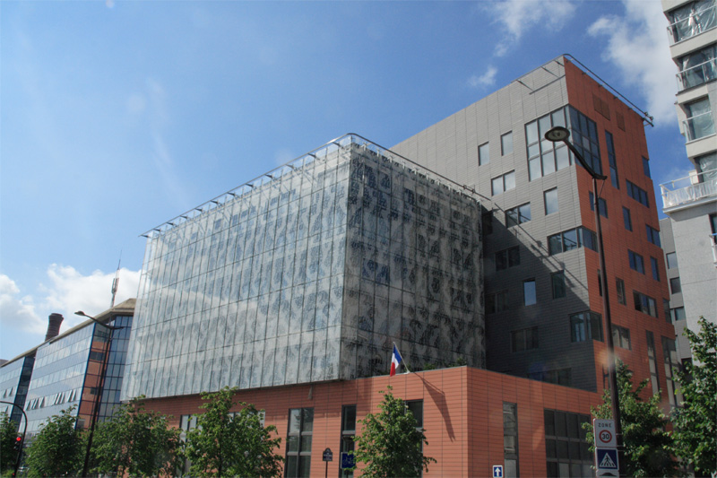


Matériaux et Phénomènes Quantiques
Quantum materials & Phenomena
Joint Unity of Research UMR 7162
Director: C. Sirtori
Deputy Director : M.L. Della Rocca

Slide 2
Matériaux et Phénomènes Quantiques
Searching for the fundamental aspects of matter to exploit for future applications and new technologies
Connecting material properties (electronic, structural, optical,…) with quantum devices (sources and detectors of light, magnetic spin memories,...)
Magnetism
Electronics
Optics
Transport
Spintronics
Quantum Optoelectronics
Coherent Quantum devices
Material characterisation – Processing technology

Slide 3
Our research objectives
Quantum engineering (low dimensional structures)
Exploring new phases of matter
Nano-optical systems (beyond classical approximation)
Sensing the quantum world

Slide 4
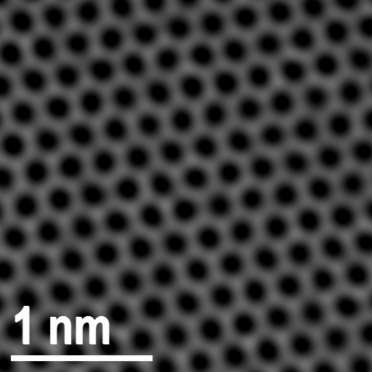

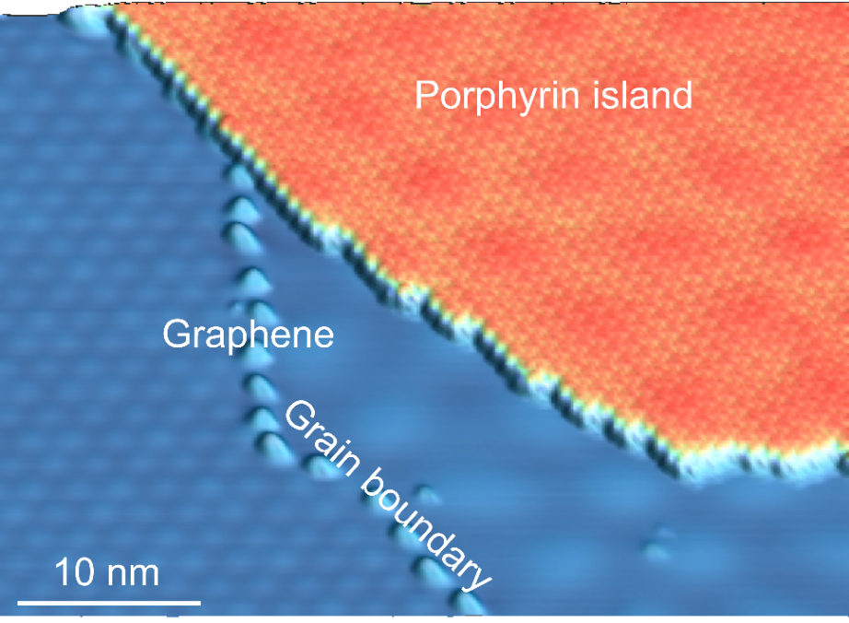
Quantum engineering (low dimensional structures)
Exploring/exploiting the interfaces
Heterostructure materials
Nitrogen
doped site
Heterostructure materials
Graphene
Artificial potentials for electrons and photons for the realisation of
quantum metamaterials and devices
Microscopical vision of the matter
TEM (transmission electron microscope)
STM (scanning tunnelling microscope)

Slide 5
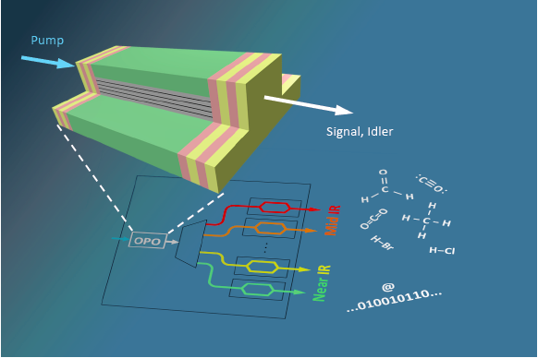
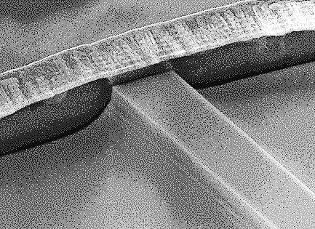
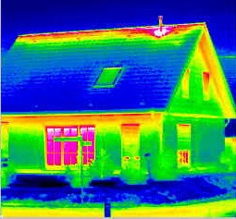
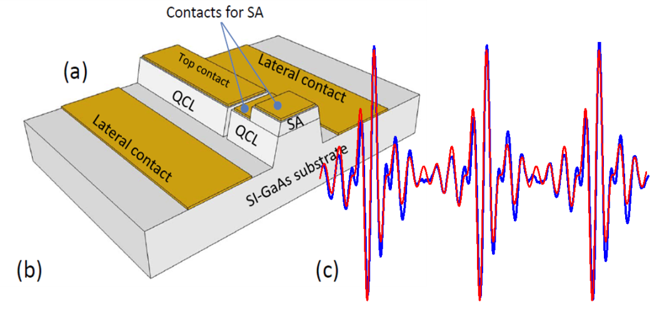

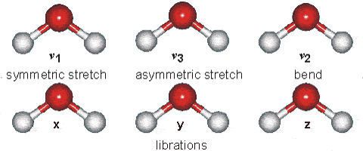
Quantum engineering (low dimensional structures)
Quantum optoelectronic devices (QC lasers, integrated OPOs, detectors):
environmental sensing, energy harvesting, thermal/night vision
Antenna coupled detectors
M. Savanier et al., APL (2013)
Non-linear integrated devices
Quantum cascade lasers

Slide 6
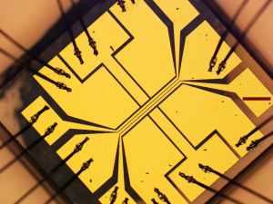
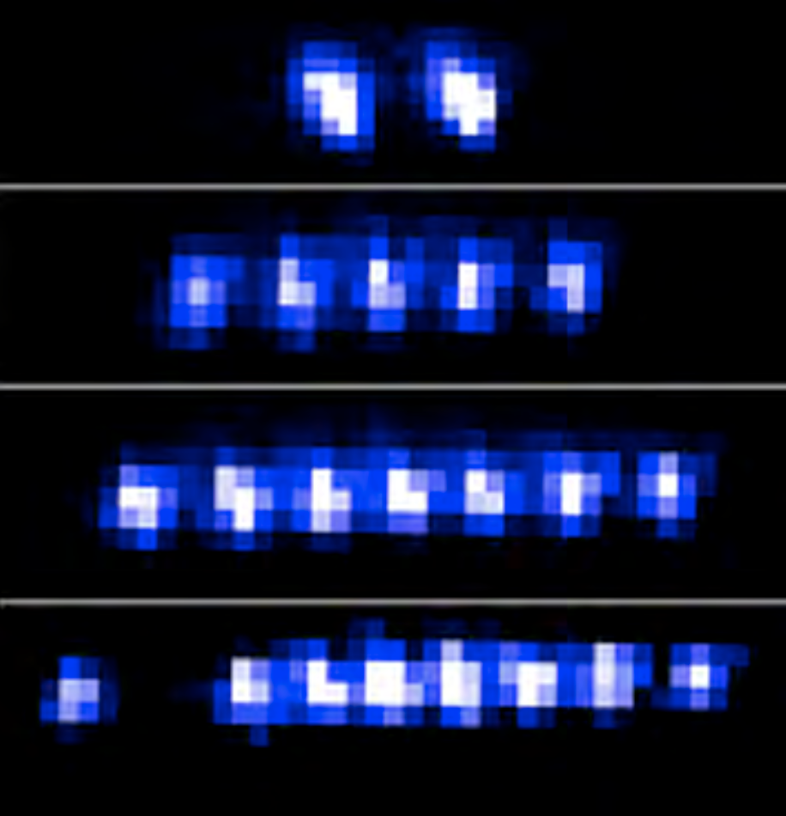
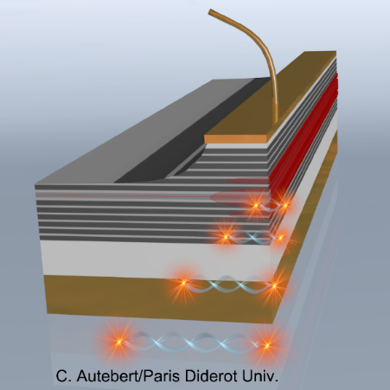
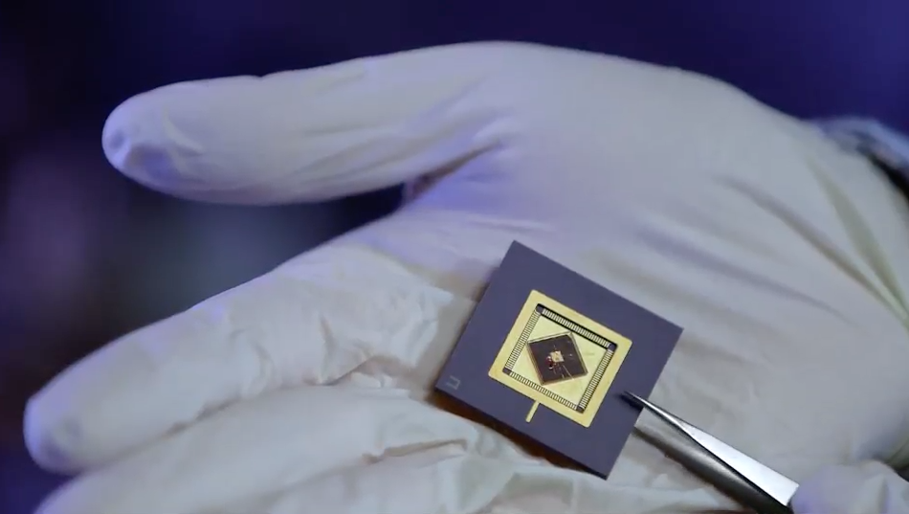
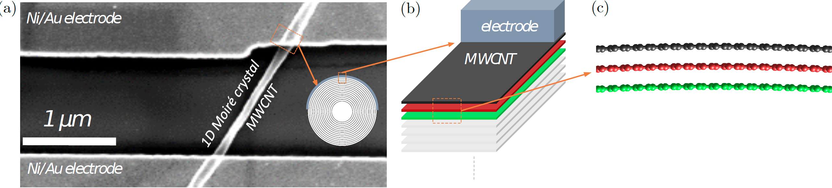
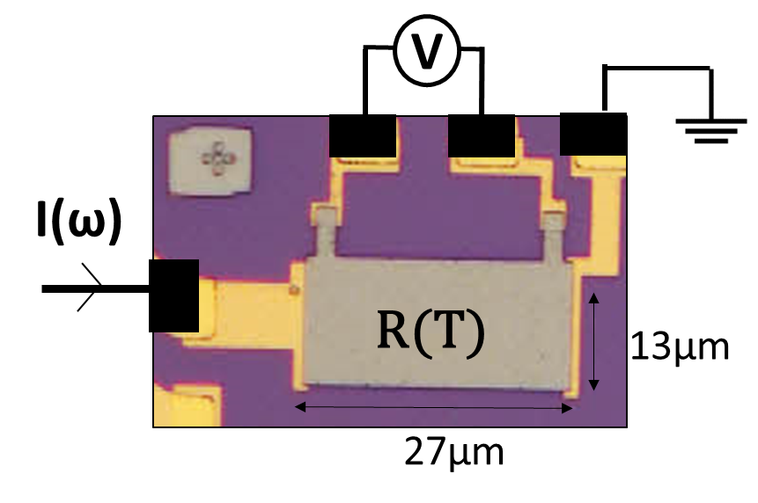
Quantum engineering
Integrated devices and protocols for controlling non-classical states of light and matter
quantum cryptography and information, quantum simulators
Ion chains trapped on a chip
Electrically injected photon pair source
Hybrid organic/inorganic material and devices:
information storage, spintronics, energy harvesting
molecular layer
multiwall carbon nanotube contacted by ferromagnetic electrodes for organic spintronics
V
I
heater
micro heater for measuring thermoelectricity of molecular layers
1 nm

Slide 7
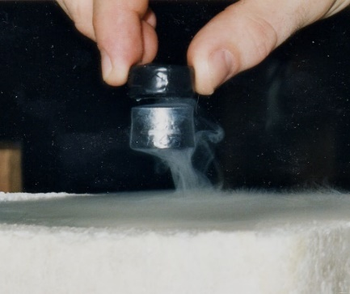
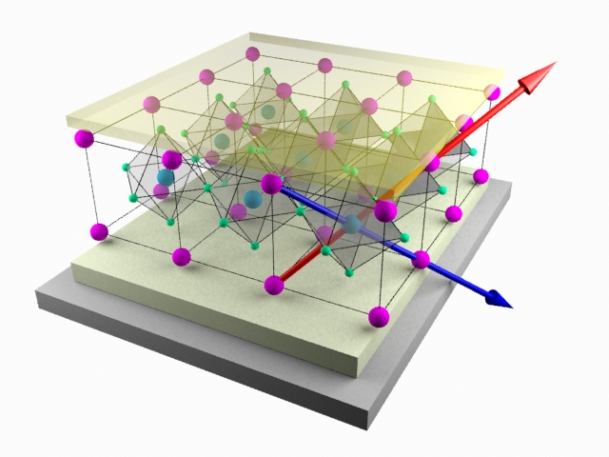
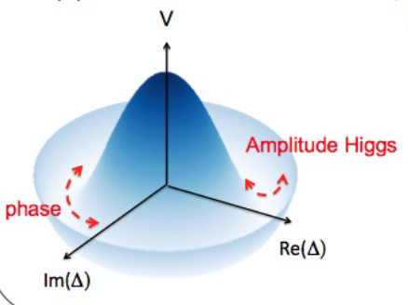
Exploring new phases of matter
Superconductivity, multiferroics material, quantum fluids of light
energy saving, reduced consumption
Superfluid polaritons
Orders in competition, Nematicity
in High-Tc Superconductors
(Cuprates pnicitides)
Spintronics in Mutiferroics
Higgs in superconductors

Slide 8
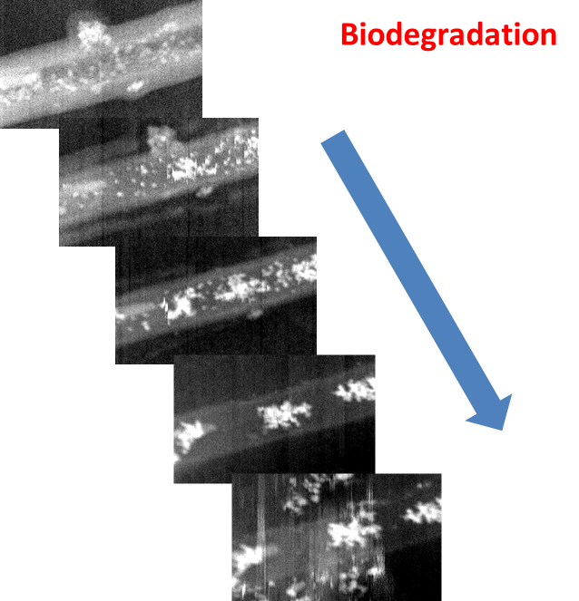
Exploring new phases of matter
Nano-particles, nano-alloys, nano-crystals
pollution control, sustainable development, green tech
CuAu//TiO₂
nano/medicine (natox, nano-life-cycle)
Iron oxide nanoparticles for localized
heat treatment by magnetic hyperthermia
life-cycle of
iron-oxide nanoparticles
in biological environment

Slide 9
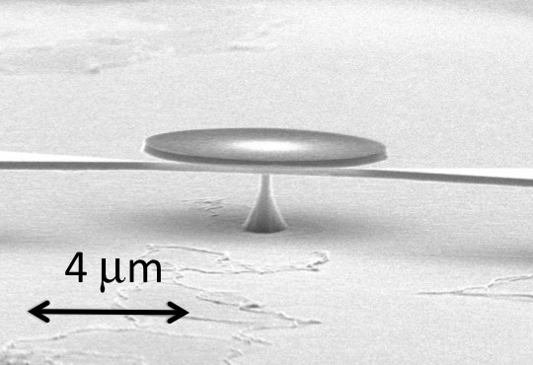
Nano-optical systems (beyond classical approximation).
Nano-optomechanics, optomechanical sensors
Ultrasensitive detection (masses and distances)
Nano-electronics, nano-antenna, nano-plasmonic
Microwave devices operating in new frequency widows (100GHz – 10THz )
LC THz-resonators
150 nm
<<λ/2n
Dielectric nano-antennas for
giant nonlinear field enhancement
C
L
capacitors

Slide 10
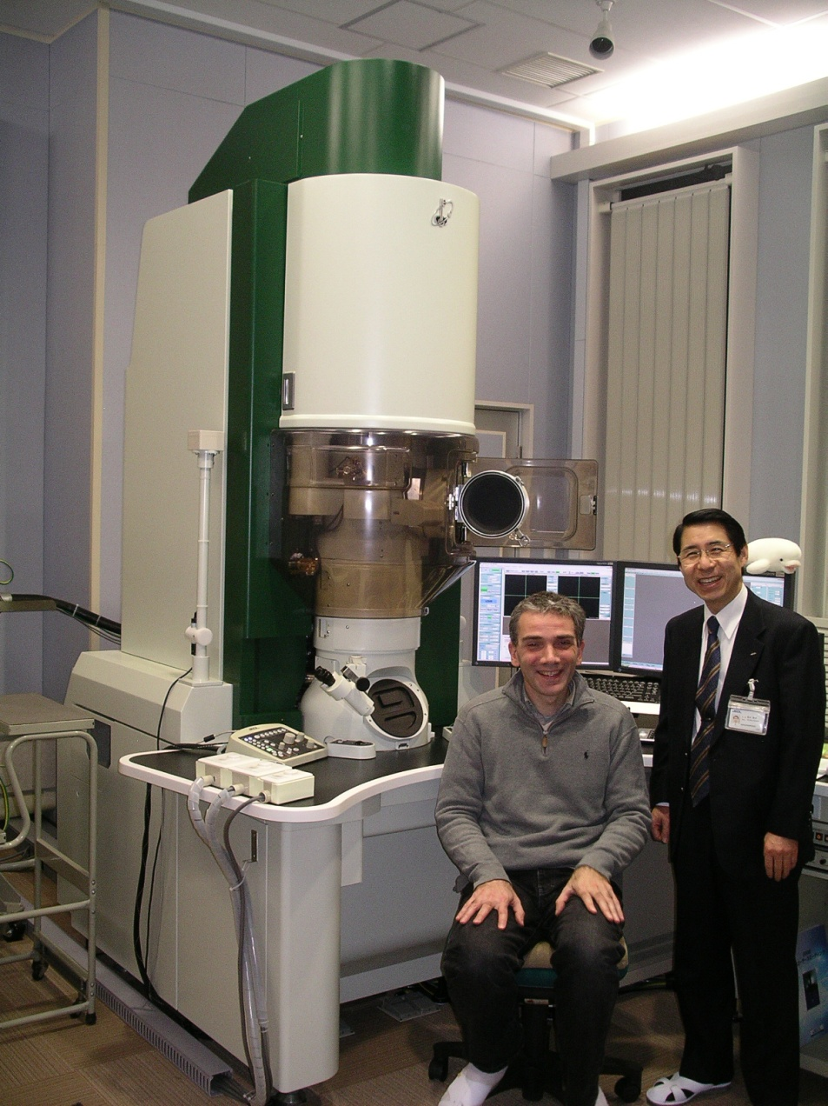
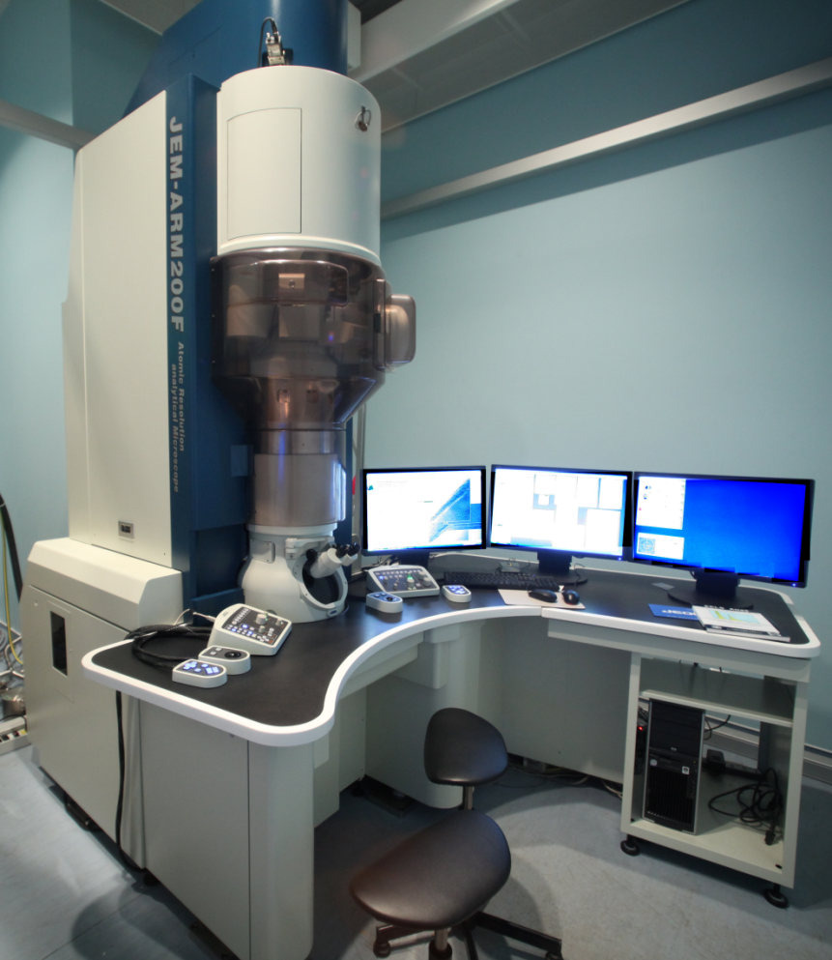
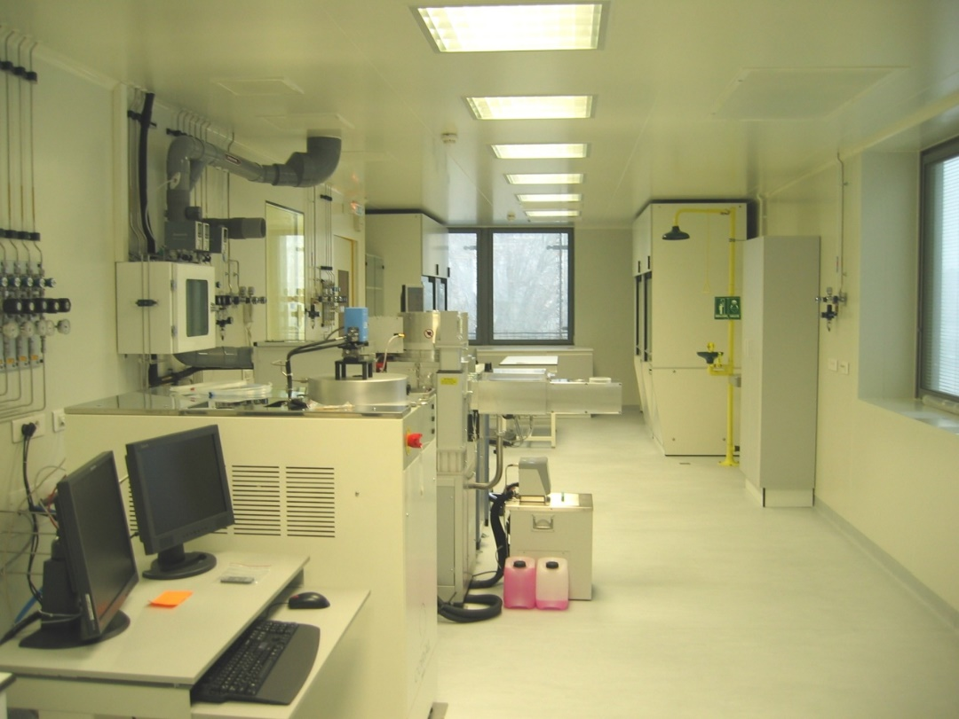

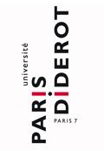




Sensing the quantum world
Stretch the limits of sensitivity for measuring:
Current, Photons, Distances, Frequencies, Spins
High Resolution TEM
The clean room at Paris-Diderot
The Consortium Salle Blanche Paris Centre

Slide 11


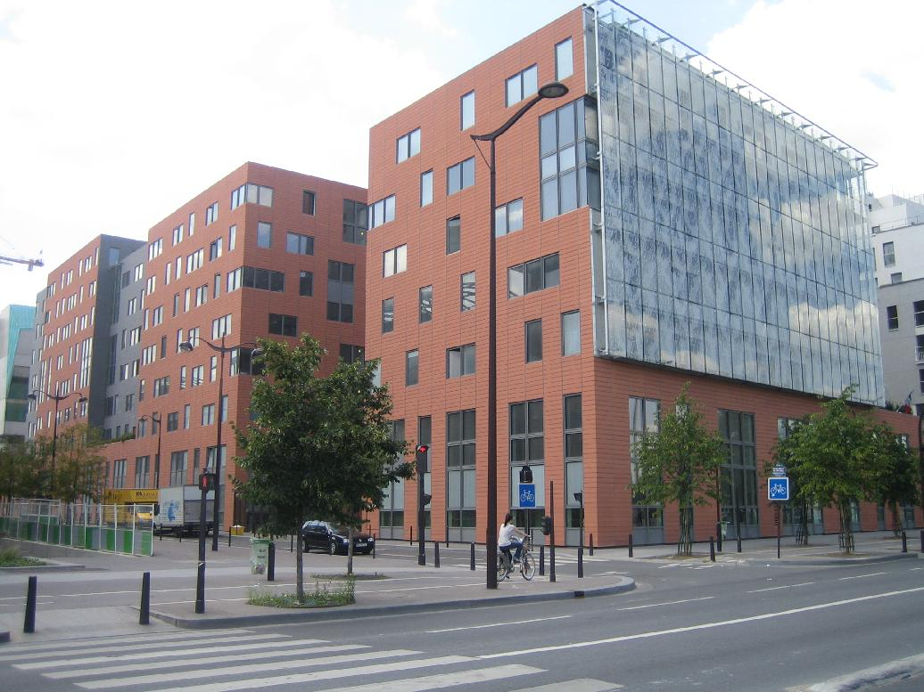
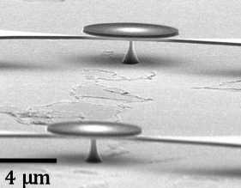
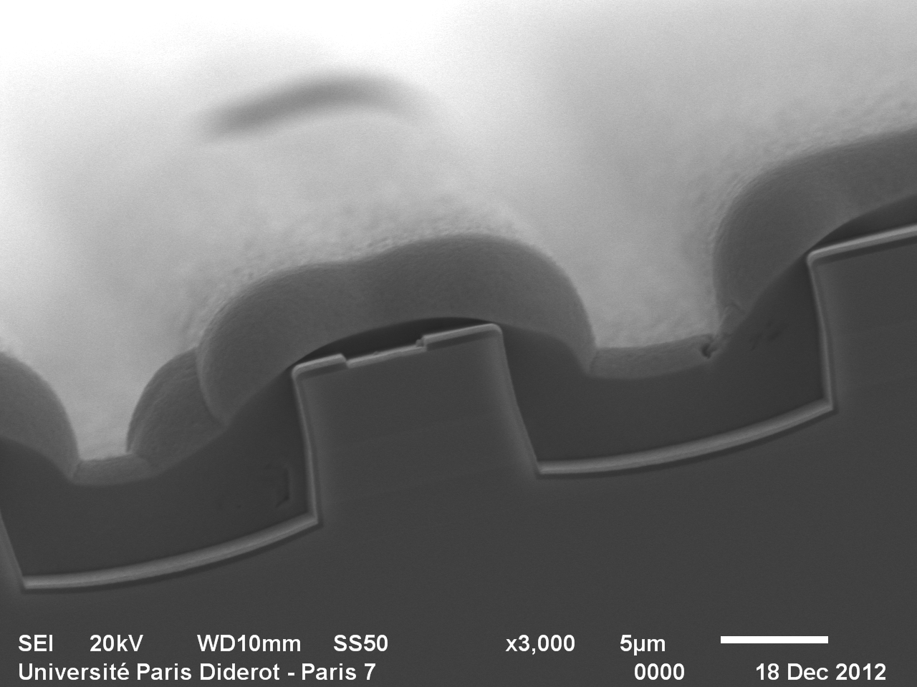
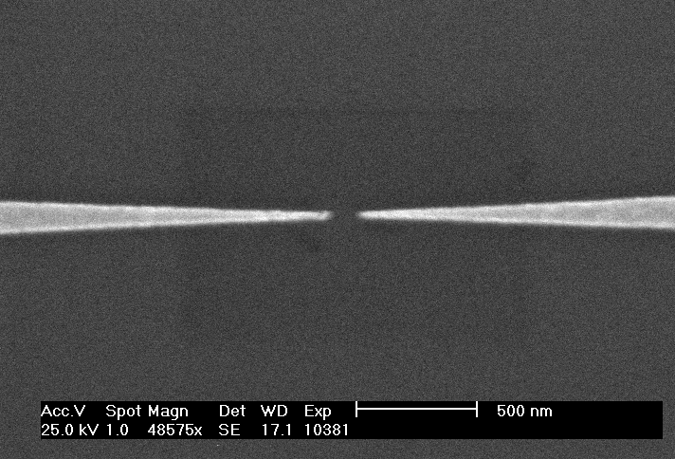
The clean room at Paris-Diderot
The Consortium
Salle Blanche Paris Centre
160m² of Class 10.000 and 1.000
UV lithography
E-beam lithography
ICP dry etching
Metal and dielectric deposition
Dry etched gold eletroplated
QC laser at λ = 9 μm
Nanogaps obtained by electromigration

Slide 12


Matériaux et phénomènes quantiques
QUAsi-Particules
Spectroscopy
Nonlinear optical integrated devices
STM
Electronic transport
and molecular electronics
Quantum physics and devices
Advanced Electronic Microscopy and Nano-Structures
Quantum information with trapped ions
Theory

Slide 13
Staff @ MPQ
51 Staff:
39 = 26 P7 + 13 CNRS C + EC
13 = 8 CNRS + 5 P7 ITA + BIATTS
32 PhD stdents
14 post-docs and visiting scientists
MPQ oct. 2015
~100 personnes
Croissance des effectifs 2002-2012
Enseignants-chercheurs | 26
Chercheurs CNRS | 13
ITA/IATOS + Cnano | 13 + 3
Thésards | 32
Post-doc | 14
TOTAL | 102
CDD

Slide 14
Merci de votre attention

