Slide 1


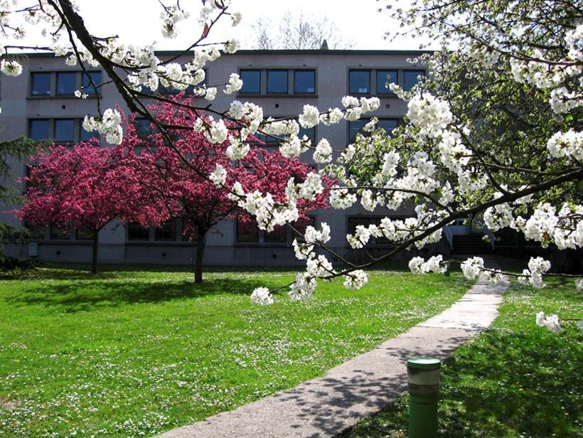
Particle-core couplings in the vicinity
of neutron rich doubly magic nuclei
Silvia Leoni
Università degli Studi di Milano e INFN sez. Milano
nu-ball hybrid spectrometer
workshop 2016
Orsay, 19-20 May, 2016

Slide 2
  INTRODUCTION
  Models aimed at describing Excited States
        SHELL Model and Particle-Phonon Coupling Model
        Limitation and Future Perspectives for Unified Picture
  RECENT γ – spectroscopy RESULTS
  around DOUBLY MAGIC NUCLEI
  1. ⁴⁸Ca – Multinucleon Transfer, (n,γ)
  2. ¹³²Sn – Neutron Induced Fission
  3. ²⁰⁸Pb – (n,γ)
  4. semi magic Ni chain
  Possibilities with FAST-Neutrons (LICORNE, NFS, …)

Slide 3
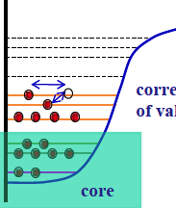
The SHELL MODEL Approach
SHELL GAPS
as Truncation Scheme
LIMITATIONS
Only VALENCE nucleons interactions:
excitations restricted to
ONE-TWO oscillator SHELLS
CORE excitations NOT fully included
  NOT always doable
  few nucleons only
  MOST EXTENDED calculations
  limited to A ≤ 60
VALENCE
Nucleons
Frozen CORE
doubly magic nucleus
⁴He, ¹⁶O, ⁴⁰Ca,
¹³²Sn, ²⁰⁸Pb
→ CORE Excitations are very relevant around Doubly Magic Nuclei

Slide 4
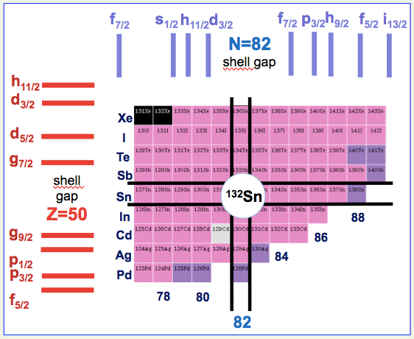
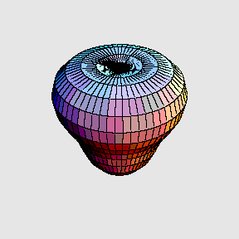
Relevance of CORE Excitations
  Complex, collective excitations dominate
  Low Lying states in DOUBLY MAGIC Nuclei
  2⁺, 3⁻,4⁺, … PHONONS
The Structure of Nuclei with
one or two valence particles
is influenced by
Particle-PHONON couplings
Quenching of Spec. Factors,
Anharmonicity of vibrational spectra,
Damping of Giant Resonances,
…
3⁻
Limited Experimental Information
PHENOMENOLOGICAL models (Bohr-Mottelson)
MICROSCOPIC models (Dobaczewski, Sagawa, Colò, …)

Slide 5
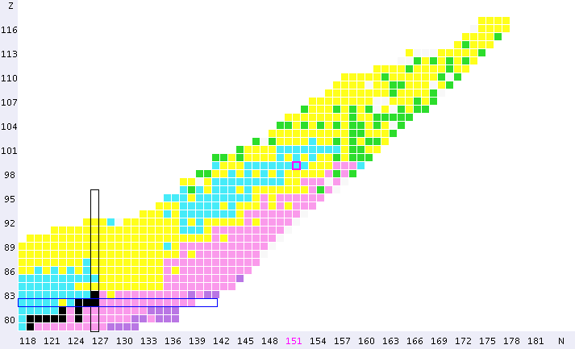
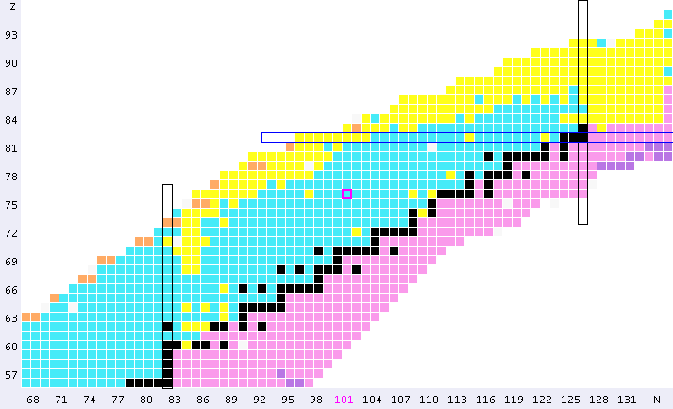
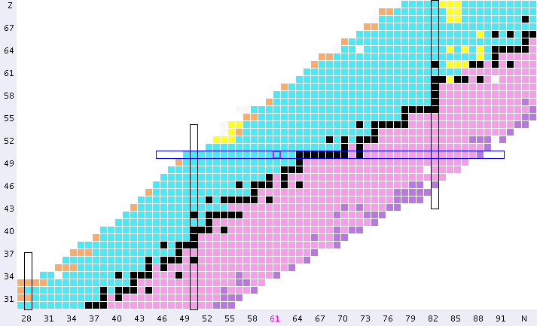
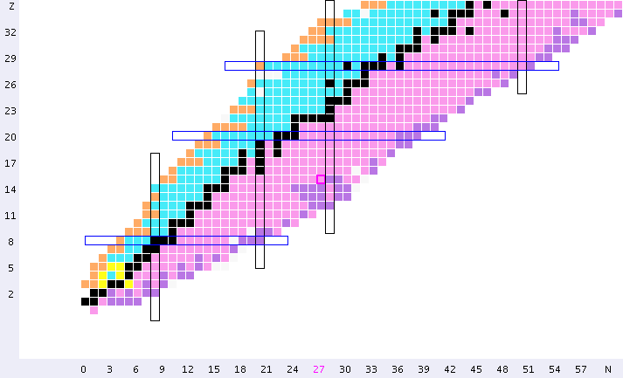
  RECENT γ – spectroscopy RESULTS
  around DOUBLY MAGIC NUCLEI
Motivation for new
development in THEORY
82
126
50
Unfeasible
by Large
Shell
Model
Proton number Z
terra incognita
¹³²Sn
82
28
(n,f): ¹³³Sb
ILL-Grenoble
50
20
8
28
2
20
2
8
Neutron number N

Slide 6
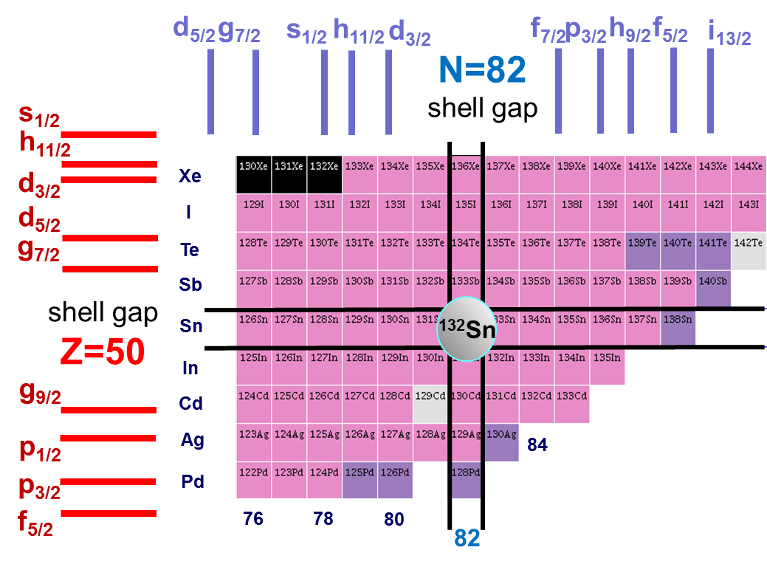
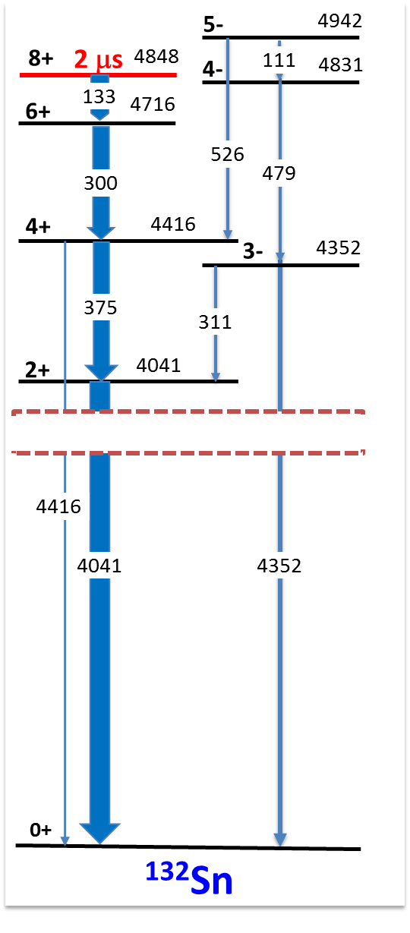
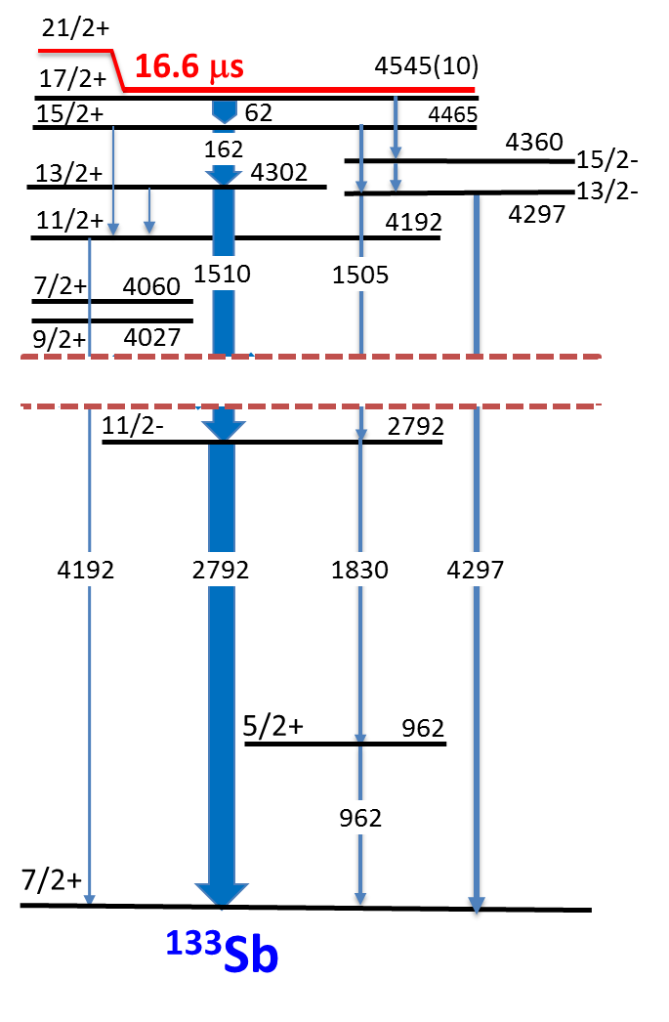
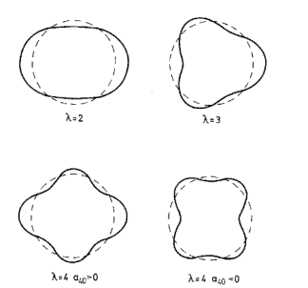
¹³³Sb: ¹³²Sn + 1π
    Single particle levels
    Couplings between
    particle and phonons
132
133
130
88
W. Urban et al., PRC79(2009)037304
86
Double
SHELL CLOSURE
away from Valley
of Stability
B(Eλ)
≈7 W.u.
long-lived
microsecond
isomers
Limited
yrast spectroscopic studies

Slide 7
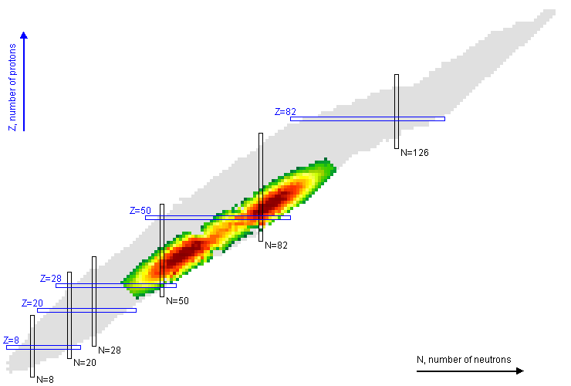
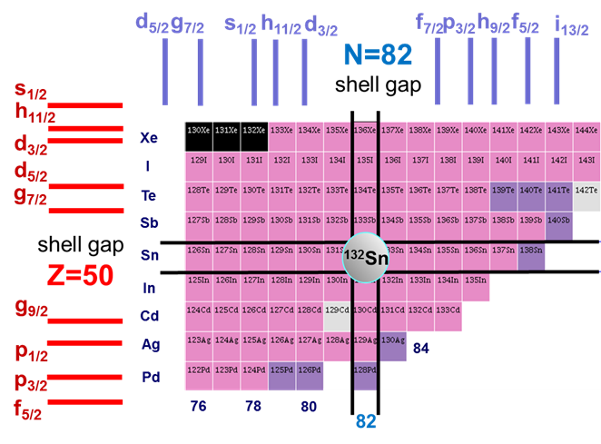

New Data on ¹³³Sb from the EXILL Campaign
133
Neutron-induced
FISSION
n + ²³⁵U
n + ²⁴¹Pu
¹³³Sb: ¹³²Sn + 1 π
G. Bocchi, S. Leoni , B. Fornal, … (Milano, Krakow)

Slide 8
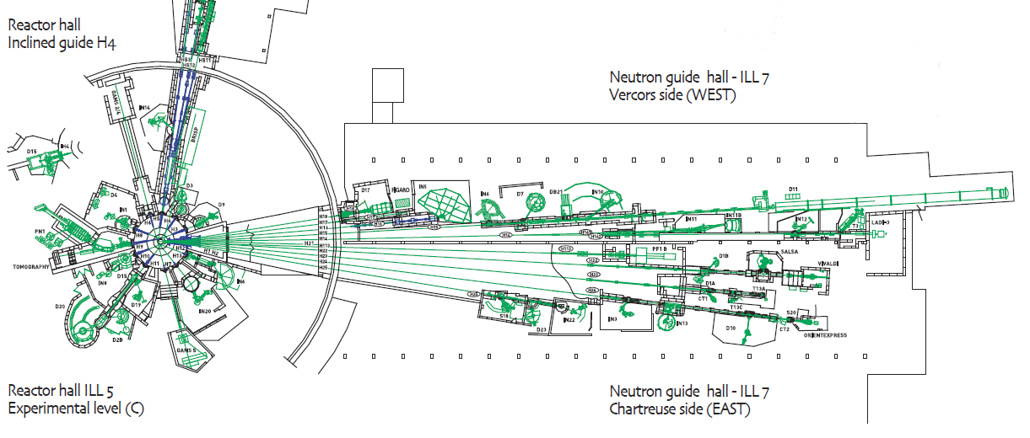
The γ-spectroscopy campaign @ ILL-Reactor (Grenoble)
2012-2013: 100 days, 95% DATA taking
EXILL
Array
58 MW
World brightest
continuum
neutron source
In pile
Φ_{n} = 5×10¹⁴ n cm⁻² s⁻¹
Dedicated ballistic neutron guide
highly collimated beam (1 cm²)
cold neutrons (meV)
Φ_{n} = 2×10⁸ n cm⁻² s⁻¹

Slide 9
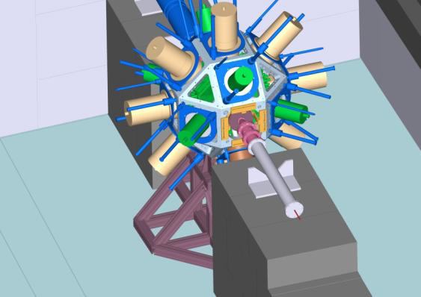
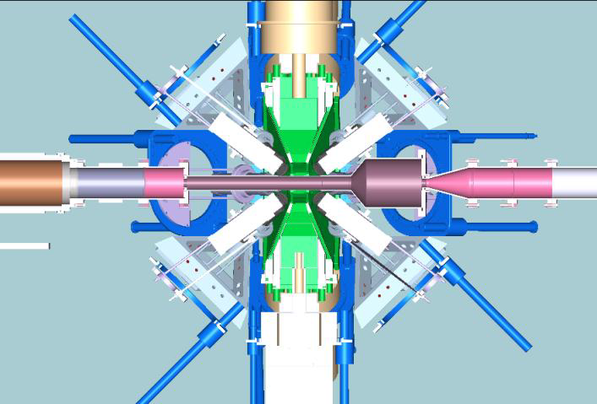
First time a large HPGe array (up to 52 Ge crystals)
installed around a highly collimated cold-neutron beam
SETUP 1
SETUP 2
γ – spectroscopy
lifetime measurement
10 EXOGAM – Clovers + 6 Ge GASP
6% efficiency
8 EXOGAM – Clovers + 16 LaBr3
FATIMA ARRAY
LaBr3
LaBr3
LaBr3
LaBr3
Autumn
2012
Spring
2013
15 (n,γ) and cold-neutron induced fission on ²³⁵U and ²⁴¹Pu
ACQUISITION SYSTEM
fully digital approach, TRIGGERLESS
>10 kHz/crystal, >600 kHz total, 10 ns clock
Unique opportunity for γ-coincidences over several μs time window

Slide 10
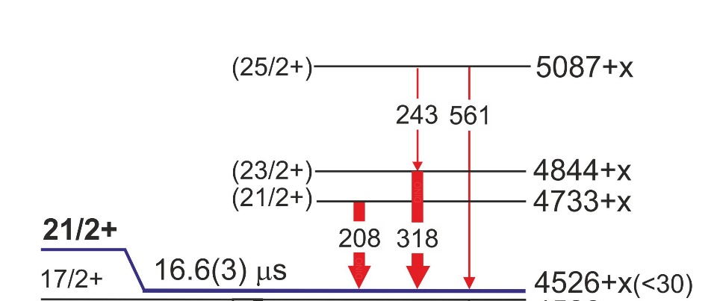
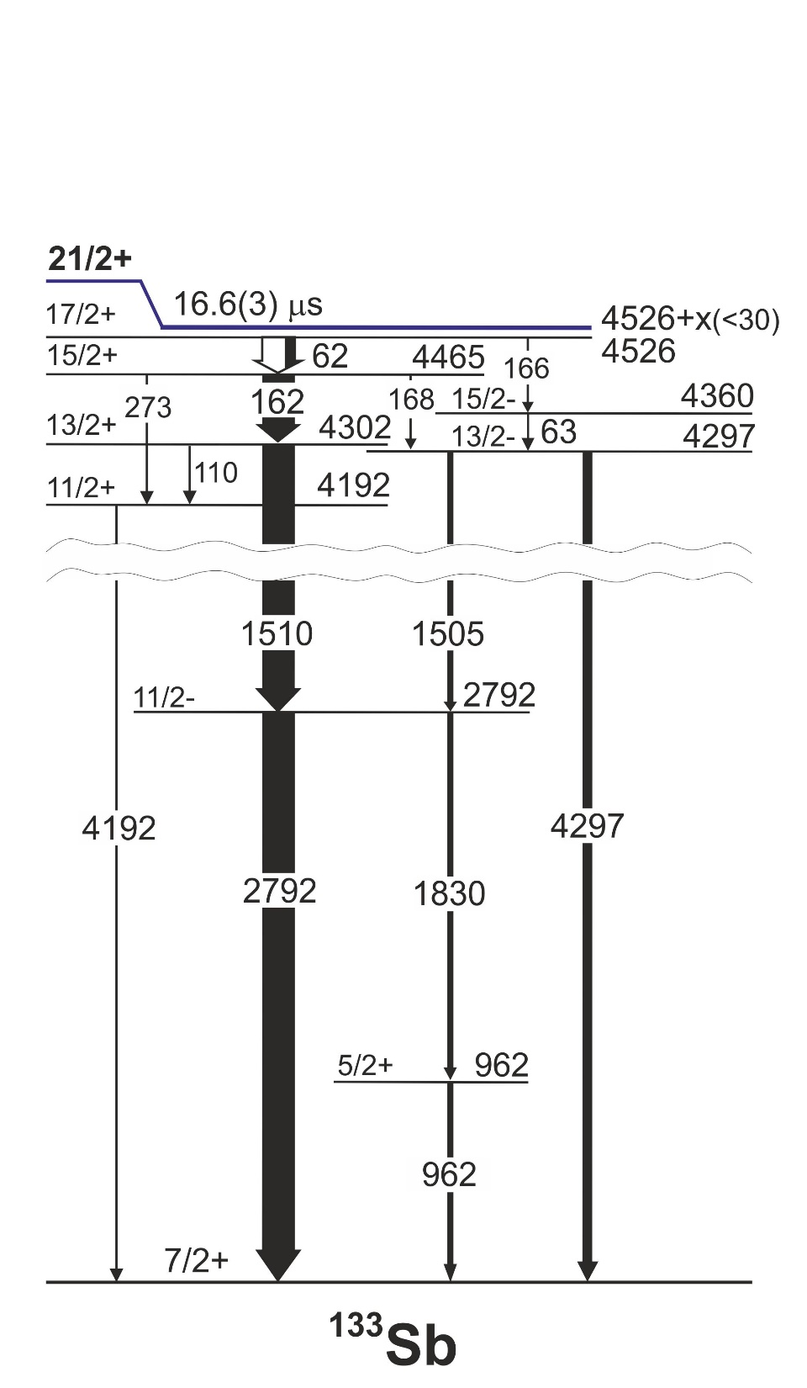
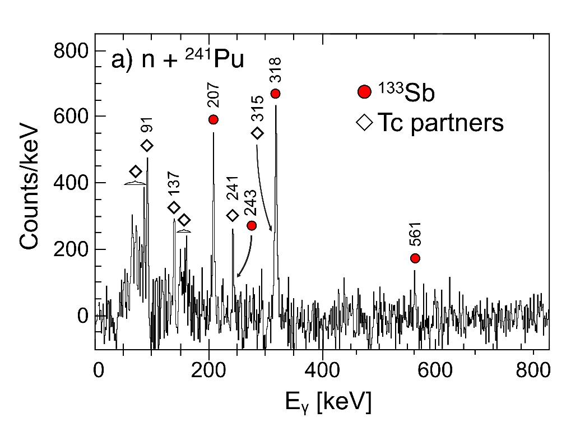
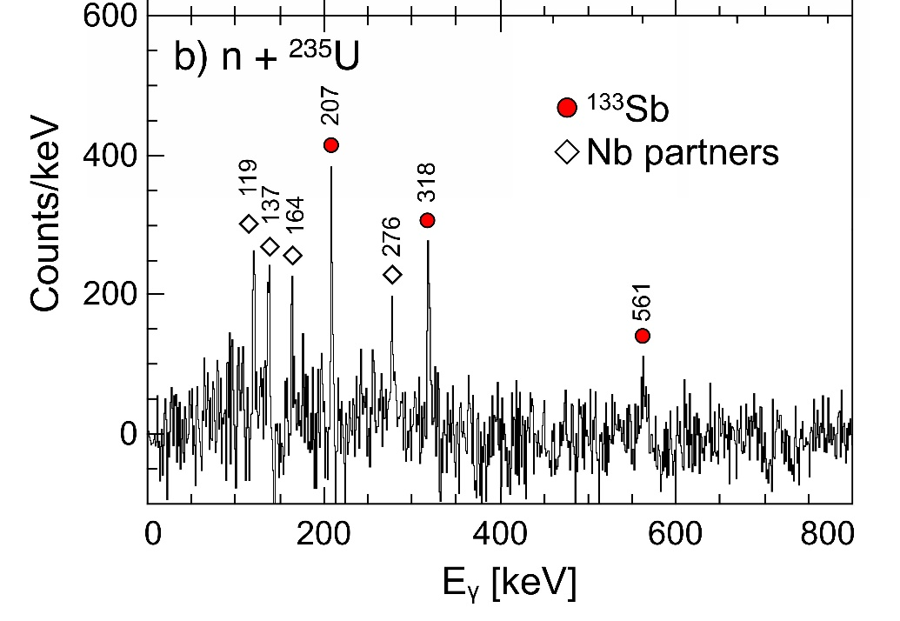
FEEDING of the ISOMER
Prompt-delayed coincidences
over μs time range
up to 25/2+
From Lifetimes
B(M1) [W.u.]
16.6 μs
0.24
0.004
Not Simple
Configurations
SHELL Model
Calculations
NOT possible:
Too Large
Space !!
.. weeks for
3p-3h calc.
with 10⁶ processors

Slide 11
The New “HYBRID” Model (G. Colò, P.F. Bortignon - Milano)
Extended Microscopic Particle-Vibration Coupling Model
6
5
4
3
2
1
0
¹³³Sb: ¹³²Sn + 1π
¹³²Sn CORE Excitations
RPA (Skyrme X)
Proton Single particle states
Hartree-Fock (Skyrme X)
E* < 5.5 MeV
2-
9+
7+
5+
8+
6+
E [MeV]
4+
3-
2+
Coupling
⊗
1/2⁺
B(Eλ)
≈7 W.u.
11/2⁻
3/2⁺
17 states
J^{π} < 11^{(+,-)}
5/2⁺
7/2⁺
0+
→ Coupling matrix elements between SINGLE PARTICLE and CORE excitations
are consistently calculated with the same SkX interaction – NO FREE PARAMETERS

Slide 12
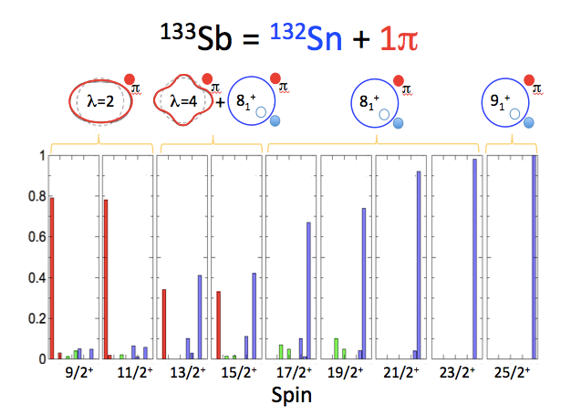
The New “HYBRID” Model (G. Colò, P.F. Bortignon - Milano)
¹³³Sb -MAIN Results
¹³³Sb = ¹³²Sn + 1π
8
7
6
5
4
3
2
1
0
S_{n}
¹³²Sn CORE
Excitations
< 5.5 MeV
(phonons and
non-collective):
RPA - Skyrme X
E [MeV]
MIXED STATES
17μs
Phonon Mixing
⊗
ν(f_{7/2}h⁻¹_{11/2}) ⊗ π(g_{7/2}) > 90%
Spec. Factor
0.92
Proton Single particle states
Hartree-Fock
Skyrme X
0.8
π = +
Single
Particle
states
THEORY
0.94
EXP
0.96
1/2 3/2 5/2 7/2 9/2 11/2 13/2 15/2 17/2 19/2 21/2 23/2 25/2
SPIN

Slide 13
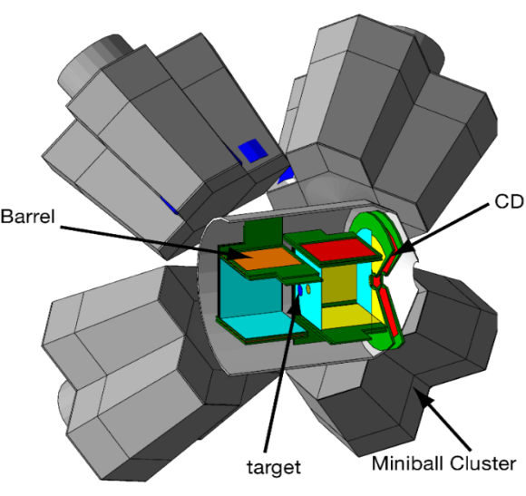
The New “HYBRID” Model (G. Colò, P.F. Bortignon - Milano)
¹³³Sb -MAIN Results
FUTURE INVESTIGATION at ISOLDE
Autumn 2016
¹³³Sb
Off Yrast States
¹³³Sb = ¹³²Sn + 1π
8
7
6
5
4
3
2
1
0
S_{n}
¹³²Sn + ⁷Li →
^{135-x}Sb + α+xn
¹³²Sn CORE
Excitations
< 5.5 MeV
(phonons and
non-collective):
RPA - Skyrme X
4 MeV/A – HIE-ISOLDE
MIXED STATES
E [MeV]
17μs
Phonon Mixing
⊗
ν(f_{7/2}h⁻¹_{11/2}) ⊗ π(g_{7/2}) > 90%
Spec. Factor
0.92
Proton Single particle states
Hartree-Fock
Skyrme X
0.8
π = +
Single
Particle
states
THEORY
Tested reaction
(Cluster-Transfer)
@ REX-ISOLDE
S.Bottoni et al., PRC92(2015)024322
0.94
EXP
0.96
1/2 3/2 5/2 7/2 9/2 11/2 13/2 15/2 17/2 19/2 21/2 23/2 25/2
SPIN

Slide 14
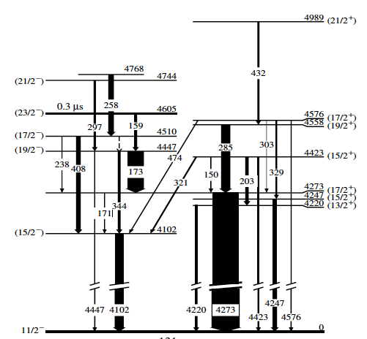
PRESPECTIVES: Investigations of CORE excitations around ¹³²Sn
Validation of Hybrid Model
Tagging on isomers (T_{1/2} ≈ 10²-10³ ns)
300 ns
Pulsed Beam
Thick Target
→ LICORNE
Sensitivity Limit
5 x 10⁻⁵
 | Spin | T_{1/2} [μs] | Yield [E_{n}=0.5 MeV] | Yield [E_{n}=2 MeV] | Yield [E_{n}=14 MeV]
¹³⁰Sn | 10+ | 1.1 | 8.4 10⁻³ | ≈ 10⁻² | 1.4 10⁻²
¹³¹Sn | 23/2- | 0.3 | 1.1 10⁻² | ≈ 10⁻² | 1.3 10⁻²
¹³⁴Sn | 6+ | 0.08 | 1.4 10⁻³ | ≈ 10⁻³ | 6.3 10⁻⁴
¹³¹In | 17/2+ | 0.6 | 1.0 10⁻³ | ≈ 10⁻³ | 1.4 10⁻³
¹²⁸Cd | 5- | 0.3 | 6.3 10⁻⁷ | ? | 9.2 10⁻⁴
¹³⁰Cd | 8+ | 0.2 | 2.0 10⁻⁸ | ? | 1.2 10⁻⁴
¹³¹Sn = ¹³²Sn-1ν
feeding of the isomer ?
ν(f_{7/2}h⁻¹_{11/2}) ⊗ ν(h⁻¹_{11/2})
up to 29/2-
Lifetimes of π = − ,+
n induced
fission
of ²³²Th
(JAEA)

Slide 15
  PERSPECTIVES in
  Other Mass Regions
82
126
²⁰⁸Pb
(n,γ): ²¹⁰Bi
ILL-Grenoble
50
Unfeasible
by Large
Shell
Model
Proton number Z
terra incognita
¹³²Sn
82
28
(n,f): ¹³³Sb
ILL-Grenoble
50
20
⁴⁸Ca
8
28
Region at the limit
for SHELL MODEL
2
20
Multi Nuc. Transf: ⁴⁹Ca
LNL – Italy
(n,γ) ILL-Grenoble
2
8
Neutron number N

Slide 16
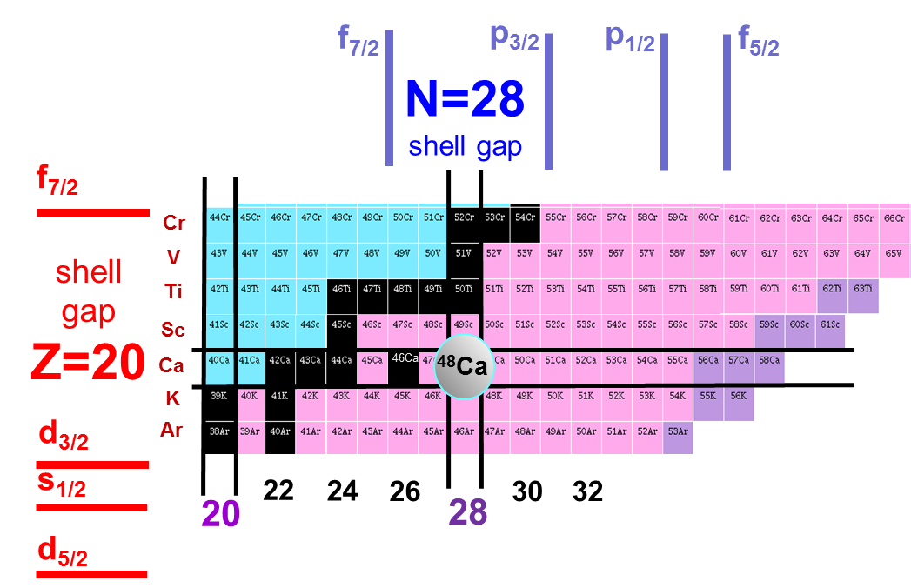
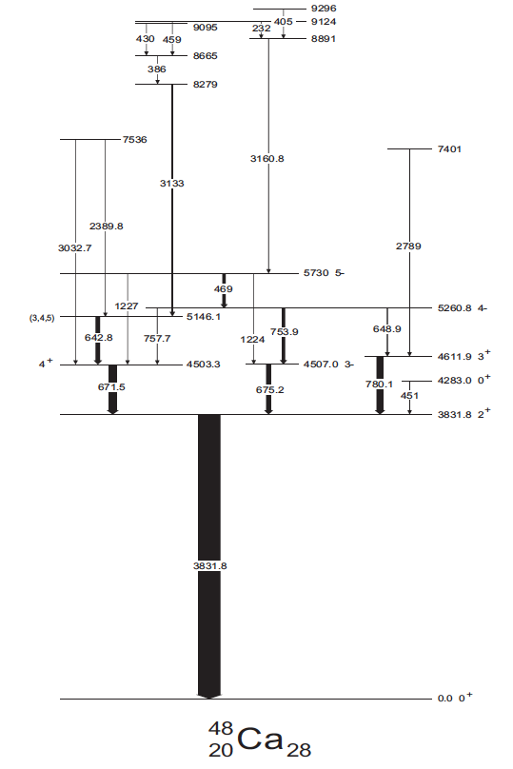
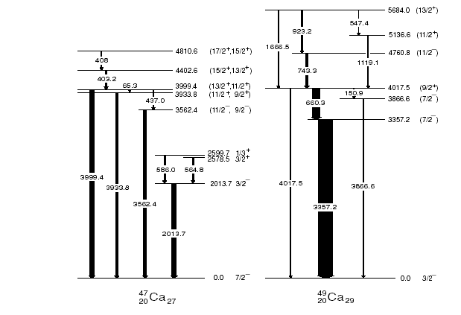
⁴⁹Ca: ⁴⁸Ca + 1ν
    Single particle levels
    Couplings between
    particle and phonon
49
Double SHELL CLOSURE
at theValley of Stability
3⁻
CANDIDATE 3⁻⊗ p_{3/2}
Nuclei hard-to-reach
for yrast spectroscopic studies
Multi nucl. transfer with
THICK targets
2⁺
9/2⁺
B(E2)<2 Wu
3586 5/2-
B(E3) = 7 Wu
2023 1/2-
Krakow group: R. Broda, B. Fornal et al., …
⁴⁸Ca
⁴⁹Ca

Slide 17
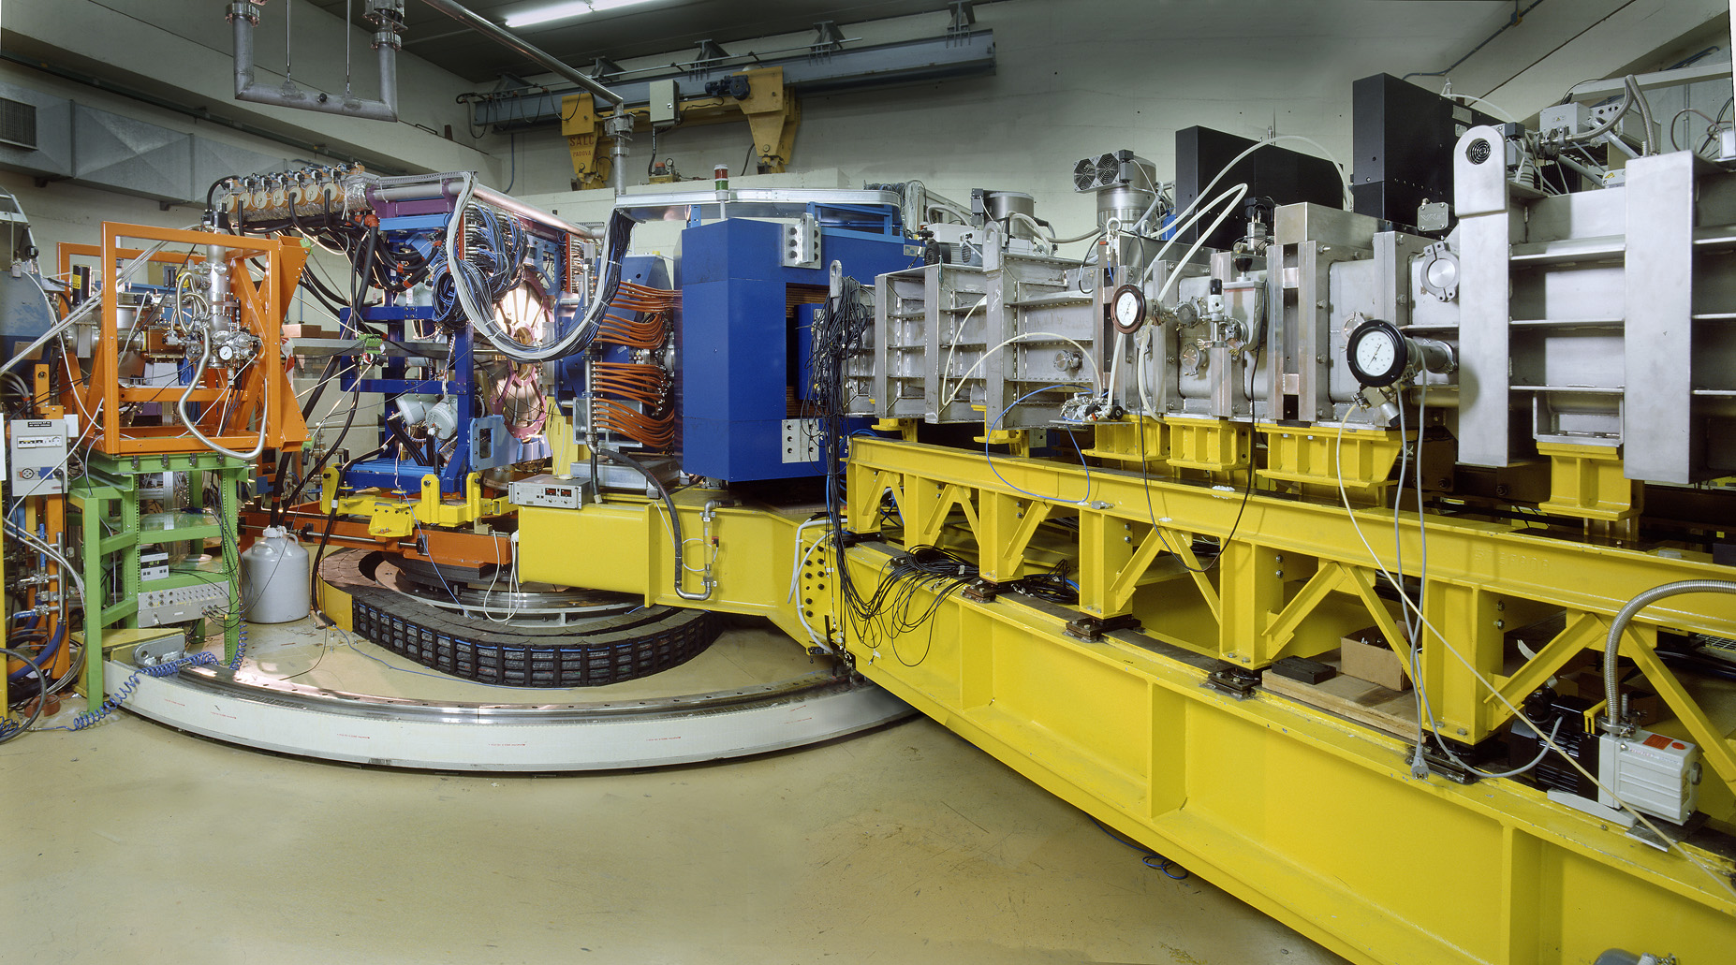
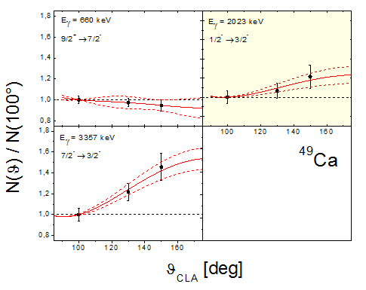
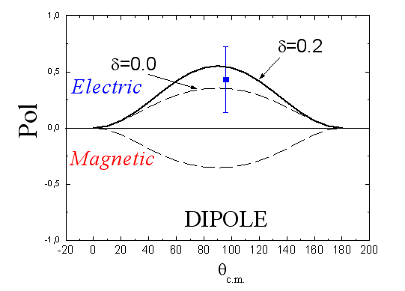
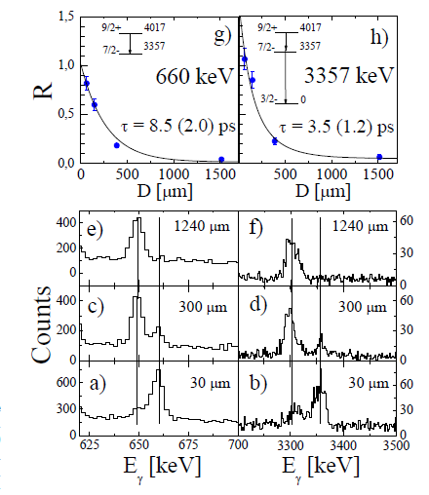
Spectroscopy of ⁴⁹Ca: Spin, Parity and Lifetimes
3⁻⊗p_{3/2}
⁴⁸Ca+⁶⁴Ni @ 6 MeV/A
9/2⁺
4017 (9/2+)
5/2-
E1
660
3586 5/2-
3357 (7/2-)
7/2⁻
CLARA-PRISMA - LNL
4017
3586
Angular Distribution
Polarization
Lifetime - Plunger
3357
Dipole
ΔI=1
[4% ΔI=2]
E2
2023 1/2-
0 3/2-
E = 4017.5 keV I^{π} = 9/2⁺
⁴⁹Ca
B(E3) = 7.9 ± 2 Wu similar to B(E3) of 3⁻ in ⁴⁸Ca
3⁻⊗p_{3/2} = 9/2+, 7/2+, 5/2+, 3/2+
D. Montanari, S. Leoni et al., PLB697 (2011) 288

Slide 18
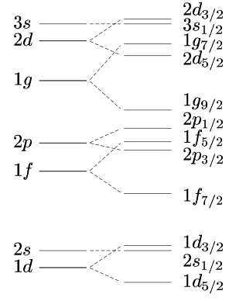
Interpretation of 9/2+ state of ⁴⁹Ca
Particle-Vibration Coupling
Weak coupling
Phenom. Model Bohr-Mottelson
Large Scale SHELL Model
FULL sd-pf-sdg shell still NOT possible
Truncation scheme sd+pf+sdg (2.515.437 conf)
Theory
3⁻ 4.507
7/2⁺ 4.41
5/2⁺ 4.33
Other Multiplet
Members ?
3/2⁺ 4.19
5/2^{+,} 7/2⁺
9/2+ 4.017
9/2⁺ 4.00
3/2⁺
9/2⁺ 3.80
RPA Calculation
B(E3)_{TH} ≈ 7 _{WU}
3 components
(64, 29, 2%)
3⁻ ⊗ p_{3/2}
3⁻ ⊗ p_{3/2}
B(E3)_{TH} ≈ 7 _{WU}
B(E3)_{TH} ≈ 6.2 _{WU}
N = 28
1 ħω
N = 20
B(E3)_{EXP}
≈ 7 _{WU}
B(E3)_{EXP}
≈ 7.9 (2) _{WU}
//
SPEC. FACTOR (9/2+)
SHELL MODEL = 0.42
EXP ≈ 0.27
//
0⁺
3/2⁻
A. Gade et al.,
PRC 93, 031601R (2016)
⁴⁸Ca
⁴⁹Ca
G. Colò, P.F. Bortignon, … (Milano)
Y. Utsuno, T. Ostuka, … (Japan)

Slide 19
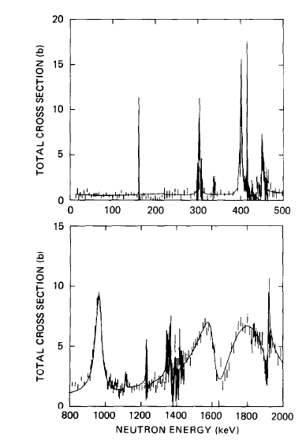
EXILL: ⁴⁸Ca(n_{COLD},γ)⁴⁹Ca
n capture with
FAST neutrons
Only NEGATIVE Parity States
1/2⁻, 3/2⁻ at 4 MeV
populated by primary transitions
Capture into resonance states
γ-decay to bound states
(positive and negative parity)
Very Low Binding Energy
complete Low-Spin
γ-spectroscopy ⁴⁹Ca
1/2⁺
ORELA – Oak Ridge
⁴⁸CaCO₃ target (10 g)
B.E.= 5146 keV
1.2-1.3 MeV
1.9
3/2-
⁴⁹Ca
G. Bocchi et al., Milano Univ., ILL-Data, preliminary
R.F. Carlton et al., NPA 465, 274 (1987)

Slide 20
  Research Line:
  COMPLETE LOW-Spin
  γ-Spectroscopy
  n capture
  into resonances
  →Thick targets
82
126
50
Proton number Z
82
Ni isotopes
28
Region at the limit
for SHELL MODEL
50
Ca isotopes
20
State-of-the-art
ab-initio
predictions
8
28
Light Nuclei: C, Be, B, O ..
2
20
2
8
Neutron number N

Slide 21
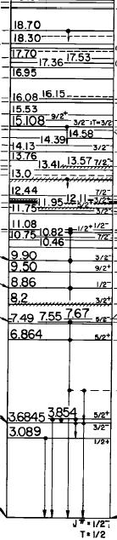
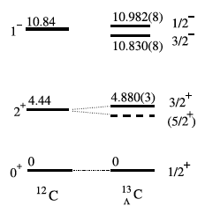
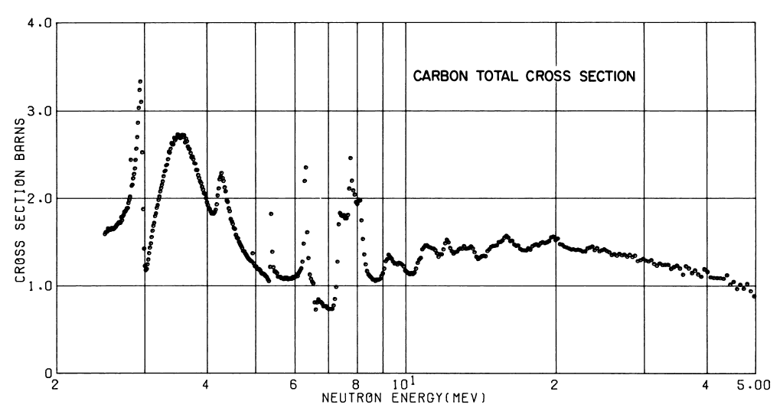
γ-decay from Narrow Resonances in C isotopes
4
EM decay: Stringent Test
of ab-initio calculations
An intriguing case: ¹²C(1-)  ν(1p_{1/2})
Γ= 2- 50keV
Γ_{γ}/Γ = 10⁻²-10⁻⁴
only 0.15 MeV
Spin-orbit splitting
In hypernucleus ¹³C
In normal nucleus
¹³C ?
¹²C + n
4.9 MeV
σ(n+¹²C)
σ = 1 b
¹³C
A first attempt in Oslo in 2012 with ¹²C(d,p)
σ ≈1-10 mb, THIN Target

Slide 22
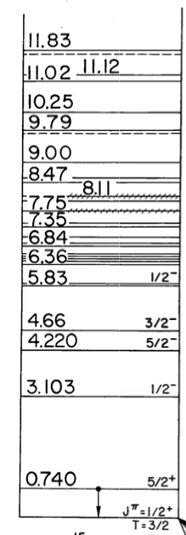
γ-decay from Narrow Resonances in C isotopes
4
EM decay: Stringent Test
of ab-initio calculations
All resonances
are narrow !!
Possible Reactions:
n + ¹⁴C (σ = 1 b, radioactive target! )
¹⁴C + d → ¹⁵C + p
¹⁴C + ⁹Be → ¹⁵C + 2α
Γ≈ 10- 60keV
Γ_{γ}/Γ₌ 10⁻²-10⁻⁴
Additional Detectors:
High Energy Detectors
(PARIS, Large LaBr₃, …)
Particle detectors
¹⁴C + n
1.2 MeV
¹⁵C

Slide 23
Conclusions
Studies of COUPLINGS between
PARTICLE and CORE excitations around double shell closures
  SURVEY of RECENT γ-spectroscopy DATA near doubly magic nuclei
      ⁴⁹Ca – Multinucleon Transfer, (n,γ)
      ¹³³Sb – Neutron Induced Fission
      ²¹⁰Bi – (n,γ) and Cu data
  from ILL, Legnaro-Laboratory and Bucharest
  New Microscopic Approach: The Hybrid Model
  Description of Complex excitations around semi-magic and doubly magic cores
  Perspectives with ν-ball
      γ-spectroscopy by Isomer tagging (T_{1/2} ≈ 10²-10³ ns) around ¹³²Sn
      n capture and ¹⁴C beam reactions leading to narrow resonances in ^{13,15}C
    fragmentation of single particle strength, damping phenomena, …
    Not Doable description by SHELL MODEL for A > 50
Collaboration →

Slide 24

The Collaborations
INFN- ITALY
Milano University and INFN
A. Bracco, G. Benzoni, N. Blasi, F. Camera, F. Crespi, S. Leoni, B. Million, O. Wieland,
R. Avigo, S. Bottoni, G. Bocchi, S. Ceruti, A. Giaz, R. Nicolini, L. Pellegri,
P.F. Bortignon, G.Colò, et al.
Legnaro INFN Laboratory
G. DeAngelis, D. Napoli, J.J. Valiente-Dobon, L. Corradi, E. Fioretto, A. Stefanini et al.
Padova University and INFN
D. Bazzacco, E. Farnea, S. Lenzi, S.Lunardi, D. Mengoni, G. Montagnoli, F. Recchia, F. Scarlassara, C.Ur, et al.
Firenze INFN
A. Nannini, B.Melon et al.
MAIN INTERNATIONAL COLLABORATORS
IFJ-PAN, Krakow, Poland
A. Maj, B. Fornal, N. Cieplicka, P. Bednarczyk,, M. Ciemala, M. Kmiecik, M. Krzysiek, B. Szpak , et al.
IFIN-HH Bucharest
N. Marginean, D. Bucurescu, C. Mihai, C. Nita et al.
KU Leuven
R. Raabe et al.
EXILL
G. DeFrance, A. Blanc, U. Koster, M. Jentschel, C. Michelagnoli, P. Mutti, G. Simpson, J.M. Regis, W. Urban et al.

Slide 25
Backup SLides

Slide 26
HYBRID Model – ¹³³Sb Spectrum
8
7
6
5
4
3
2
1
0
S_{n}
positive parity
Mixed States
negative parity
Experiment
17μs
E [MeV]
Phonon Mixing
ν(f_{7/2}h⁻¹_{11/2}) ⊗ π(g_{7/2})
> 90%
Spec. Factor
0.76
0.92
0.8
Single
Particle
states
0.94
0.96
1/2 3/2 5/2 7/2 9/2 11/2 13/2 15/2 17/2 19/2 21/2 23/2 25/2
SPIN
Notes:
Scrivi „positive parity..” , ma dopo fai vedere anche lo stato con parita’ negativa 13/2-

Slide 27
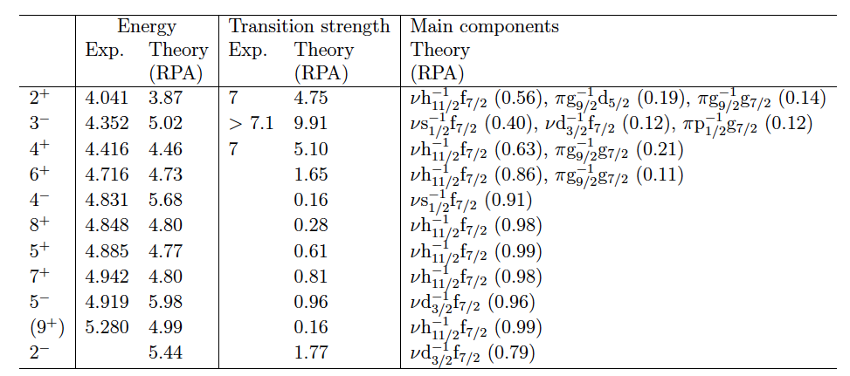
HYBRID Model – Main ingredients
Phonons
¹³²Sn
CORE Excitations
E* < 5.5 MeV
J^{π} < 11^{(+,-)}
RPA (Skyrme X)
Phonons
Other Excitations
¹³³Sb
Single particle states
Hartree-Fock (Skyrme X)
g_{7/2} d_{5/2} d_{3/2} h_{11/2} s_{1/2}
0 0.587 2.439 2.831 2.97 [MeV]
→ Coupling matrix elements between single particle and RPA states
are consistently calculated with the same SkX interaction
G. Colò, P.F. Bortignon (Milano)

Slide 28
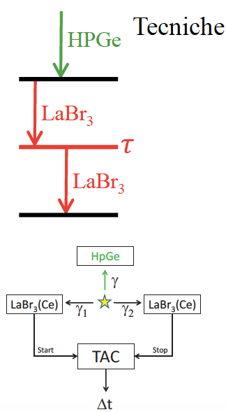
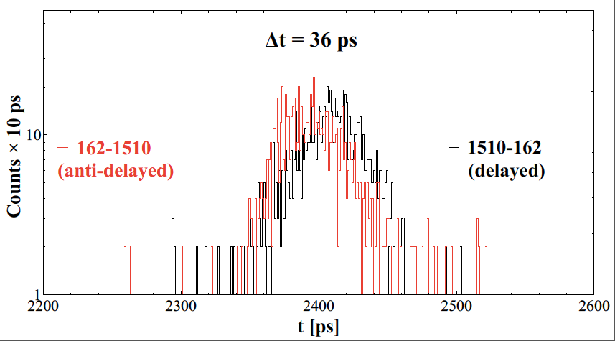
Lifetimes Analysis by FAST-TIMING:
Nature of particle-CORE coupled states
(25/2+)
243
(23/2+)
(21/2+)
13/2⁺ @ 4302 keV
21/2+
318
561
17/2+
16.6 μs
75
²³⁵U: τ = 36(12) ps
²⁴¹Pu: τ = 37(15) ps
15/2+
62
75
162
15/2-
13/2+
4302
4297
13/2-
11/2+
1510
1505
11/2-
2792
16 ps
4192
4297
1830
2792
5/2+
962
15/2⁺ @ 4464 keV
962
²³⁵U: τ = 9(15) ps < 30 ps
²⁴¹Pu: τ = 11(20) ps < 30 ps
7/2+
¹³³Sb

Slide 29
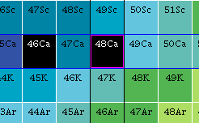
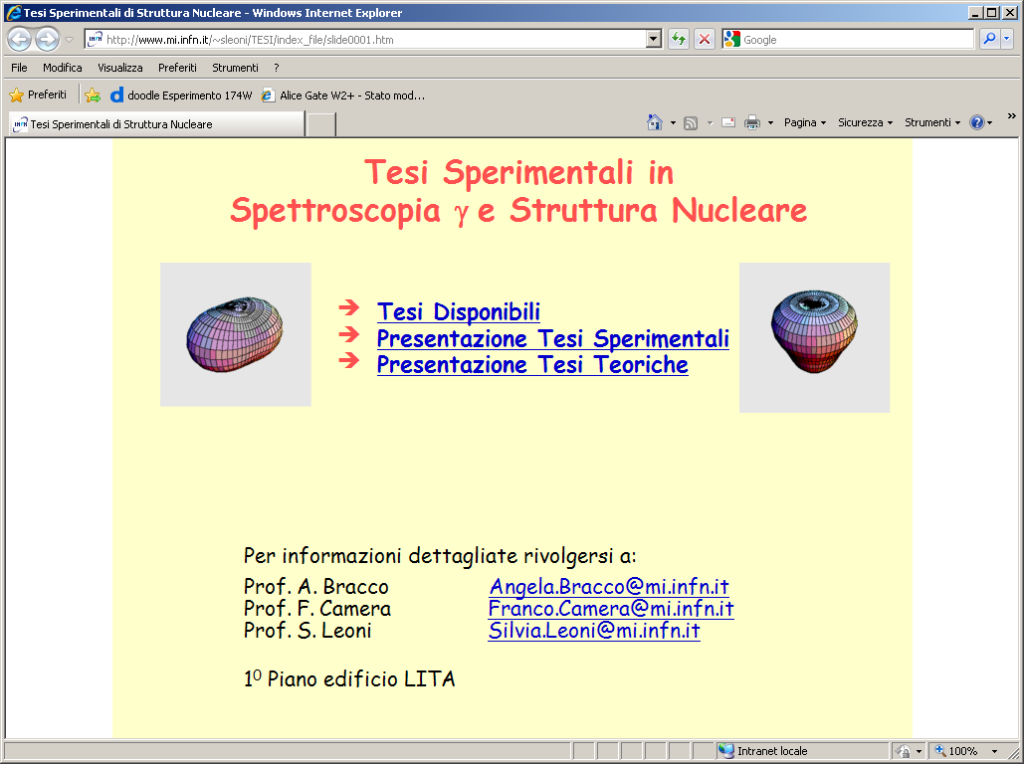
Experimental Signature
Multiplet of States: |l-j| ≤ I ≤ l+j
B(Eλ) of phonon
3⁻ 4.507
Energy Split:
Coupling strength
Nuclear Force
7/2⁺
5/2⁺
3/2⁺
4
9/2⁺
3⁻ ⊗ p_{3/2}
⁴⁸Ca
(Z=20,N=28)
E [MeV]
B(E3)
6.8 ^{± 1.0} _{Wu}
Angular distributions
Polarizations
Lifetimes
to firmly establish
I^{π} and B(E/Mλ)
7 _{Wu}
3
⁴⁸Ca+⁶⁴Ni @ 6MeV/A
Ge Array (CLARA)
Spectrometer (PRISMA)
⁴⁸Ca
⁴⁹Ca
2
D. Montanari, S. Leoni et al.,
PLB697(2011)288
D. Montanari, S. Leoni et al.,
PRC85, (2012)044301
0
0⁺ 0.0
3/2- 0.0

Slide 30
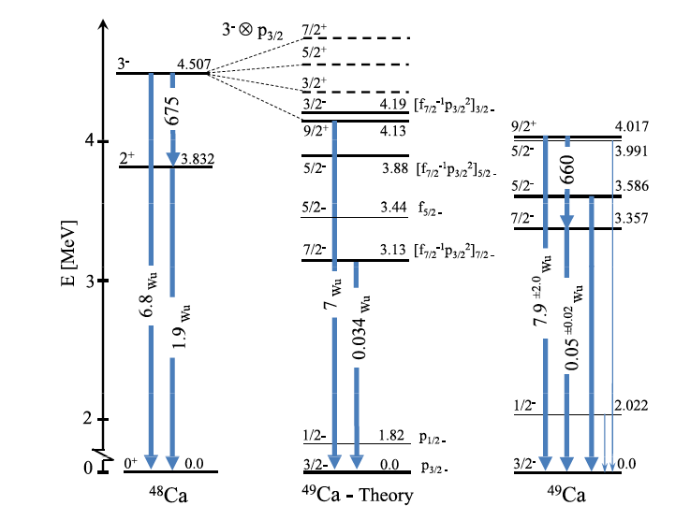
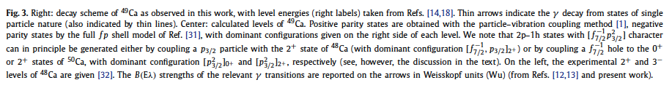
⁴⁹Ca
D. Montanari, S. Leoni et al., PLB697 (2011) 288

Slide 31
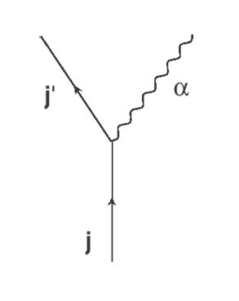
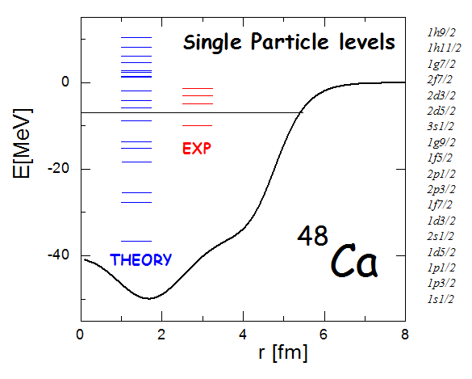
Theoretical Description
PHENOMENOLOGICAL
Particle-phonon
WEAK coupling calculations
(Bohr & Mottelson)
MICROSCOPIC
Calculations based on
SELF-CONSISTENT Scheme
(Colò, Bortignon, Sagawa, …)
3⁻ ⊗ p_{3/2}
[λ ⊗ j₁]_{I}
RPA
⁴⁹Ca
microscopic V_{ph}
Multiplet of States 9/2⁺, 7/2⁺, 5/2⁺, 3/2⁺
Energy Shift
Hartee-Fock with V_{eff}
→ short-range correlations included
Particle-Vibration coupling on top
→ same Hamiltonian or EDF
NO approximation in the vertex
EXACT treatment of COUPLING
use of WHOLE phonon wave function
ω_{λ} , B(Eλ)
→ Exp. Values/Theory
s.p. Energies
ε(j₁), ε(j₂)
→ HF – SkX
matrix element
h(j₂,j₁,λ)
→ Bohr & Mott.
Need for More Experimental Input
G. Colò, H. Sagawa, P.F. Bortignon, PRC 82, 064307 (2010).

Slide 32
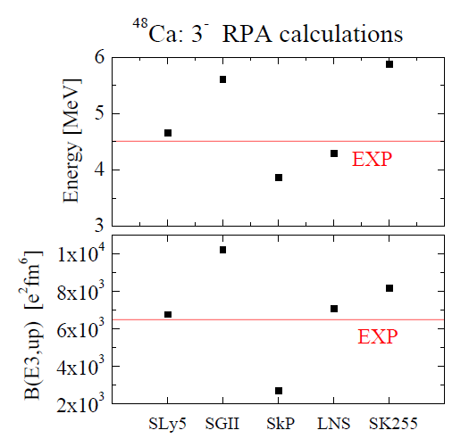
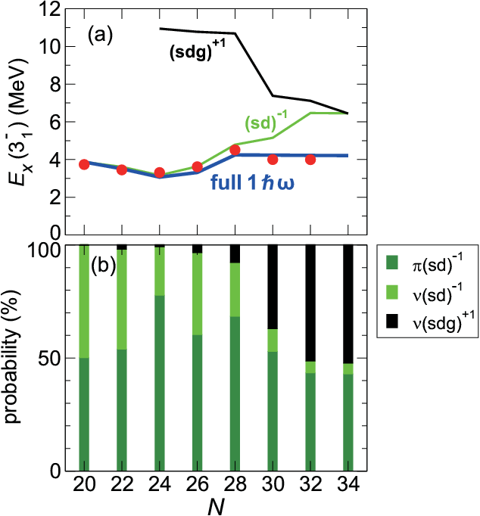
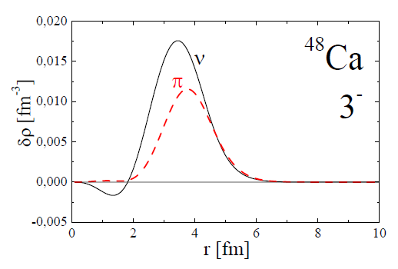
Large Scale SHELL Model
for Ca Isotopes
FULL sd-pf-sdg shell still NOT possible
Truncation scheme (2.515.437 conf) with V_{MU} interaction
⁴⁸Ca: 3⁻ RPA calculations
N = 28
N = 20
SLy5 - LNS
π 1d_{3/2}→ 1f_{7/2} 0.82 0.64
2s_{1/2}→ 1f_{7/2} 0.13 0.29
ν 1f_{7/2}→ 1g_{9/2} 0.01 0.02
3- in Ca isotopes
3 components MIXING
Transition Densities
NO sd to pf
“SIMPLE”
↓
MACROSCOPIC
CORE
Vibration
NO pf to sdg
Y. Utsuno, T. Ostuka, … (Japan)

Slide 33
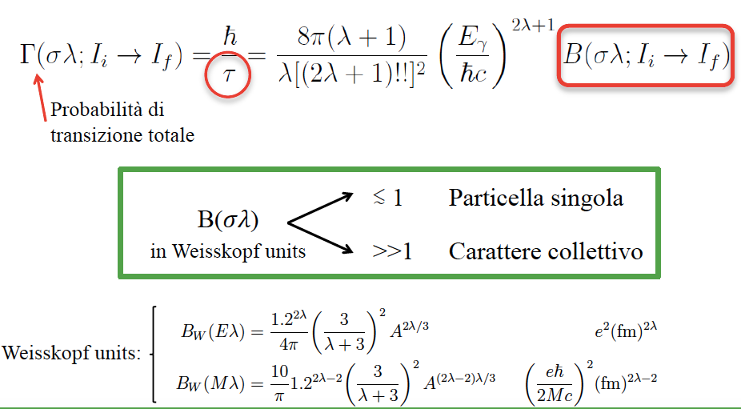
Total Transition
Probability
Single Particle
Collective

Slide 34








Neutron Beam: dedicated collimation system (5 m)
Sequence of apertures made from High Absorbing Materials (+5 cm Pb): ¹⁰B, ⁶LiF
Φ = 2×10¹⁰ n/(cm s)
ΔΘ = 7 mrad
20 x 6 cm²
Borated plastics + ⁶LiF
5 cm Pb
1cm B₄C ceramics
5 cm Pb
On TARGET:
Collimated
Beam
Φ = 10⁸ n/(cm² s)
1 x 1 cm²

Slide 35

TARGETS: Two Dedicated Chambers
REQUIREMENTS: Optimal Conditions for γ-Spectroscopy
Minimum absorbing material for γ’s : Al pipe, Ø = 50 mm, 2mm thick
Low n-capture rate
Close positioning of detectors
²⁴¹Pu (n,f)
Electrovalve
100 μm Zr-foil, diam. 32 mm
Internal chamber
- Independent -
Vacuum gauge
External chamber
²³⁵U (n,f)
(n,γ)
Target
Target holder

Slide 36







TARGETS for (n,γ): 15 different samples
MORE than 6 orders of magnitude in variation of Capture Cross Section
²⁰⁹Bi
_{th}= 0.023 b
Metal cylinder
⁹⁵Mo
_{th} = 13.4 b
Metal foil
⁴⁶Ca(NO₃)₂
_{th}= 0.7 b
Powder/lump
¹⁹⁴Pt
_{th}= 1.1 b
Metal balls
TARGETS for FISSION: 3 different samples
Targets sandwiched between dense backings
for rapid stopping of fission fragments.
²³⁵UO₂
_{f} = 586 b
Layer sandwiched between Zr or Be backing
²⁴¹PuO₂
_{f} = 1010 b
Layer sandwiched between Be backing
Chamber in glove box
²³⁵UO₂ : 99.7% enriched (525 μg), 15 μm thick Zr backing
²³⁵UO₂ : 99.7% enriched (675 μg), 25 μm thick Be backing
²⁴¹PuO₂ : 78.6% enriched (300 μg), 25 μm thick Be backing

Slide 37



Ge Array coupled to a Magnetic Spectrometer
CLARA
Ge Array
⁴⁸Ca (6 MeV/A) + ⁶⁴Ni
⁴⁸Ca
⁴⁹Ca
Legnaro Laboratory - INFN
MASS spectra
spectra
⁶⁴Ni
⁶³Ni
Ti
⁵⁰Ca
Beam-like
Ions
PRISMA
Beam-like
FULLY
IDENTIFIED
Sc
⁴⁹Ca
Large acceptance Magnetic Spectrometer
Ca
⁴⁸Ca
ΔΩ = 80 msr
ΔZ/Z ≈ 1/60
ΔA/A ≈ 1/190
Energy acceptance ±20%
Bρ = 1.2 Tm
K
⁴⁷Ca
Trajectory Reconstruction Ion identification
A [a.m.u.]
Particle – γ coincidences

Slide 38

¹³³Sb = ¹³²Sn + 1π
π
π
π
π
π
λ=2
λ=4
+
8₁⁺
8₁⁺
9₁⁺
9/2⁺
11/2⁺
13/2⁺
15/2⁺
17/2⁺
19/2⁺
21/2⁺
23/2⁺
25/2⁺
Spin

Slide 39

²⁰⁹Bi: ²⁰⁸Pb + 1π
The only known
COMPLETE MULTIPLET
3⁻⊗ π(h_{9/2})
82
126
²⁰⁸Pb
50
Proton number Z
terra incognita
3⁻ phonon
E_{x} = 2.6 MeV,
B(E3) = 34 W.u
82
28
²⁰⁹Bi
²⁰⁹Bi(d,d’), ²⁰⁹Bi(α,α’), …
1970
Bohr-Mottelson
Particle-Phonon Model
50
20
8
28
2
20
2
8
Neutron number N

Slide 40


New Data on ²¹⁰Bi from the EXILL Campaign
lo
Neutron
CAPTURE
²⁰⁹Bi (n,γ)²¹⁰Bi
82
r-process path
Low
spins
126
50
terra incognita
82
28
50
20
8
28
210
2
20
2
8
²¹⁰Bi: ²⁰⁸Pb + 1 π + 1 ν
N. Cielicka, B. Fornal, S. Leoni, … (Milano, Krakow)

Slide 41




²⁰⁹Bi(n,γ)²¹⁰Bi ILL Grenoble
S_{n}
3081
64 primary transitions (40 new)
4605.2(1) keV
4-,5-
70 excited states (33 new)
530
674
320
320
Gate 3081 keV
Angular Correlations
Multipolarities of γ-decay
Spin (Parity) of States
530
674
3081
[chns]

Slide 42

Complete Low Spin
Spectroscopy of ²¹⁰Bi
PARTIAL
Comparison with SHELL Model
considering
²⁰⁸Pb + 1𝜋 + 1𝜈
(4+)
frozen
CORE
VALENCE
Particles
(3)
1898
3+
12 Low-Spin States
2 < E < 3 MeV
NOT described by SHELL Model
Couplings with CORE Excitations ?
E_{x}(3⁻) = 2.6 MeV, B(E3) = 34 W.u.
New Hybrid Model ?
3 10⁶ y
9-
0-
1-
3⁻
Experiment
SHELL Model

Slide 43



Slide 44


Slide 45



Challenges in MODERN NUCLEAR PHYSICS
Quest for a UNIFIED DESCRIPTION of ALL Nuclei
Shell Structure
for p and n
Configuration Space
6 ħω
126
5 ħω
Number of ways to distribute
A nucleons over K orbitals
82
4 ħω
N=Z
Number of
configurations
50
44 ⁸⁸Ru ≈ 10²⁸
3 ħω
28
28 ⁵⁶Ni ≈ 10¹⁰
20
24 ⁴⁸Cr ≈ 10⁷
2 ħω
22 ⁴⁴Ti ≈ 10⁴
8
1 ħω
2
0 ħω
MICROSCOPIC Structure of Nuclei:
a computational challenge …

Slide 46
Challenges in MODERN NUCLEAR PHYSICS
Quest for a UNIFIED DESCRIPTION of ALL Nuclei
Shell Structure
for p and n
Configuration Space
6 ħω
126
5 ħω
Number of ways to distribute
A nucleons over K orbitals
82
4 ħω
N=Z
Number of
configurations
50
44 ⁸⁸Ru ≈ 10²⁸
SHELL Model
Large Scale Calculations
with Frozen CORE
A up to ≈ 100
Around Closed shell
3 ħω
28
28 ⁵⁶Ni ≈ 10¹⁰
AB-INITIO
NN, NNN
(EFT, QCD)
20
24 ⁴⁸Cr ≈ 10⁷
2 ħω
22 ⁴⁴Ti ≈ 10⁴
8
1 ħω
2
0 ħω
MICROSCOPIC Structure of Nuclei:
a computational challenge …

