Slide 1
Applications of LaBr₃ Gamma-ray Arrays for Nuclear Spectroscopy and Radionuclide Assay
Paddy Regan
Department of Physics, University of Surrey, Guildford, UK p.regan@surrey.ac.uk
&
Radioactivity Group, National Physical Laboratory, Teddington, TW11 0LW, UK paddy.regan@npl.co.uk

Slide 2
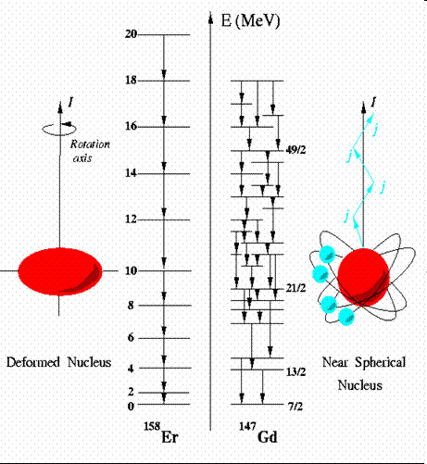
Some nuclear observables?
Masses and energy differences
Energy levels
Level spins and parities
EM transition rates between states
Magnetic properties (g-factors)
Electric quadrupole moments?
Essence of nuclear structure physics
……..
How do these change as functions
of N, Z, I, Ex ?
What are the most useful
‘signatures’ of nuclear
structural evolution?

Slide 3
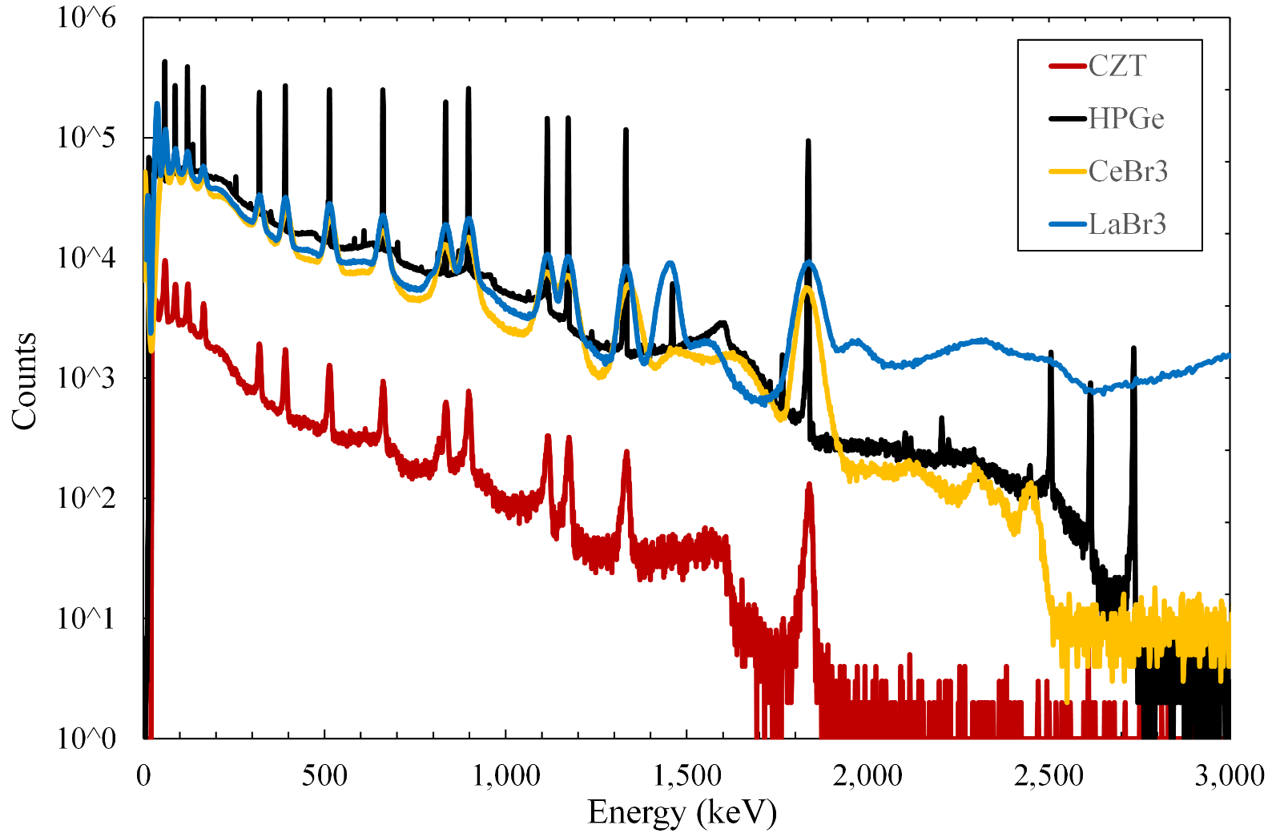
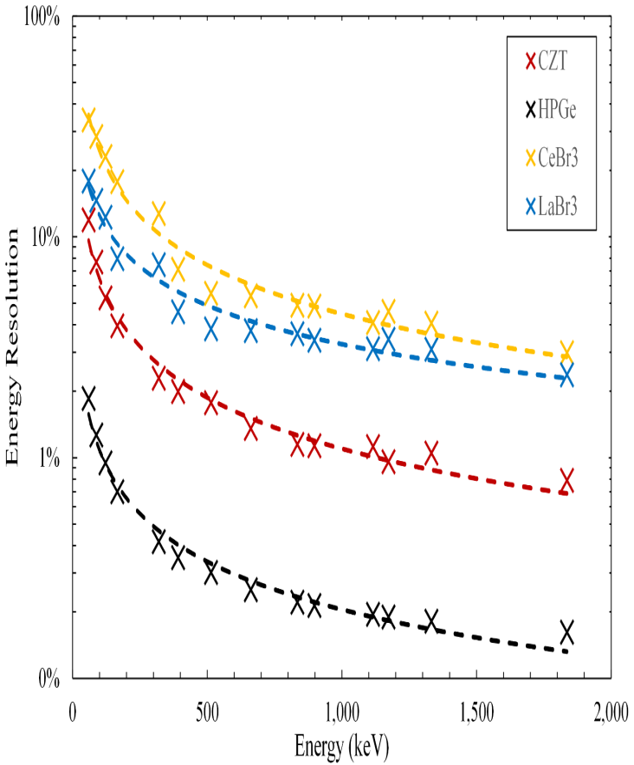
Why use LaBr₃(Ce) (for gamma-ray spectrometry) ?
Good (enough) energy resolution.
Fast (enough) timing response
Good (enough) full-energy peak efficiency.
S.J.Bell et al., CTBT: Science and Technology conference, Vienna, June 2015.

Slide 4
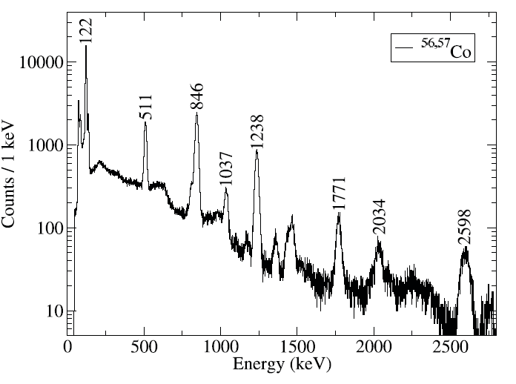

Slide 5
The FAst TIMing Array for DESPEC:
(FATIMA)

Slide 6
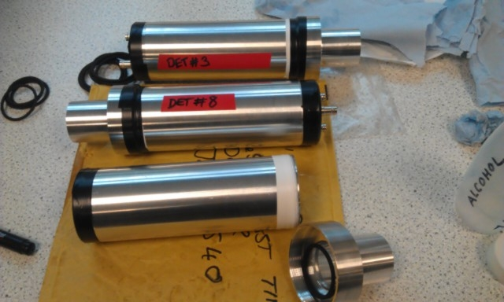
FATIMA detector module
1.5” x 2” LaBr₃(Ce) crystal, coupled to a fast-timing PMT. Housed in aluminium can.

Slide 7
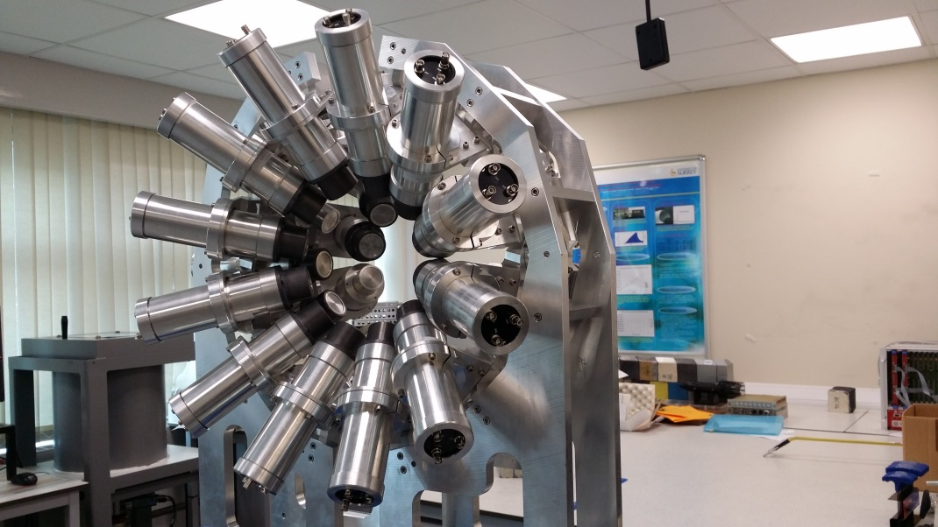
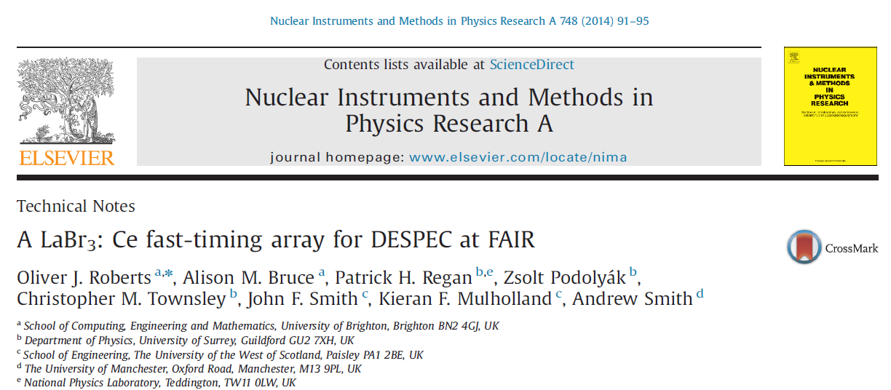
FATIMA for DESPEC
FATIMA = FAst TIMing Array = State of the art array for precision measurements of nuclear structure in the most exotic and rare nuclei.
36 individual LaBr₃(Ce) detectors in 3 concentric rings of 12 detectors.
  Energy resolution better than 3% at 1 MeV.
  Detection efficiency of ~ 5% Full-energy peak at 1 MeV.
  Excellent timing qualities (~ 200 ps, depends on gamma-ray energy).
Use to measure lifetimes of excited nuclear states & provide precision tests of nuclear structure, uses a fully-digitised DAQ (CAEN 1 GHz digitizers).

Slide 8
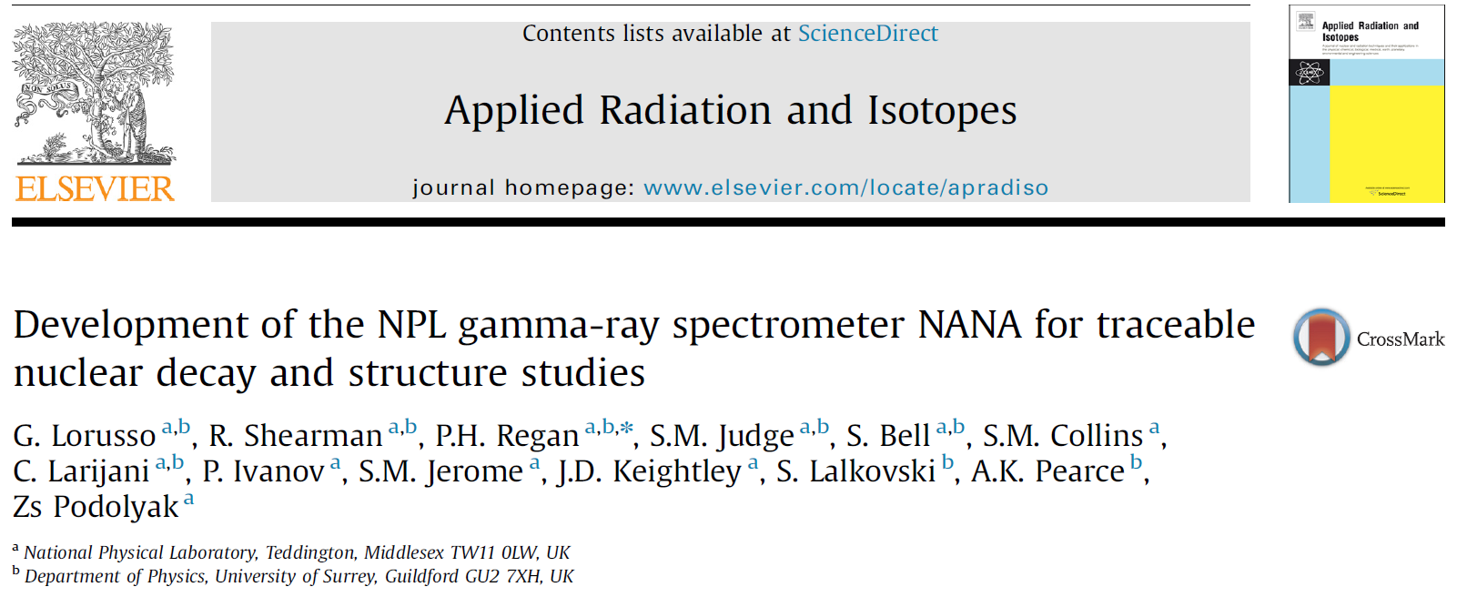
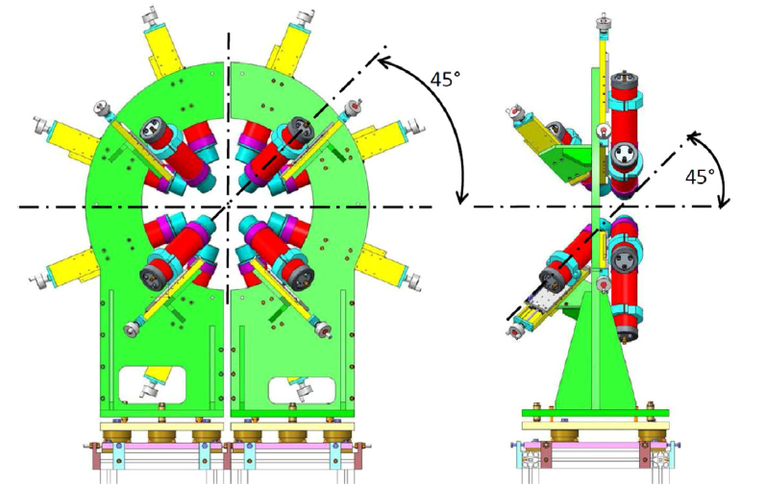
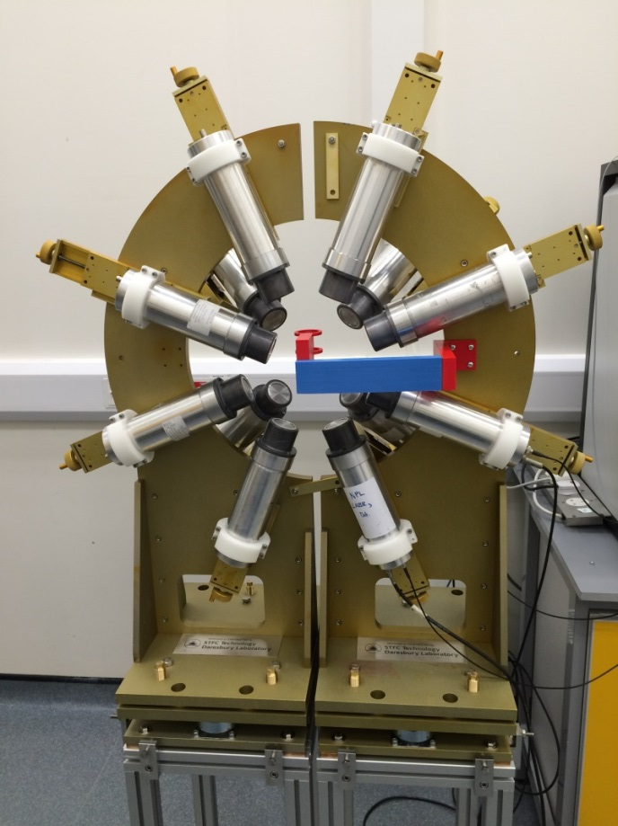

Slide 9

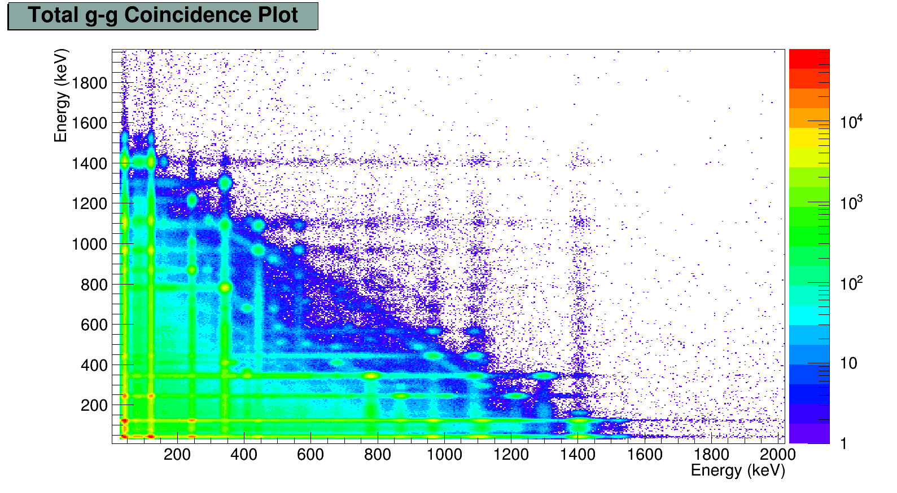
Energy gating
{122,964}
964.1 keV
{964,122}
244.7 keV
121.8 keV
Notes:
As a quick aside this spectrometer can be used industrially to jdeconvolute messy spectrum that could be seen in fission fragment s and also in waste. By creating a simple 2d matrix it and gating it is very clear that the 2 possible decay modes can be separated simply and easily as well showing the presence of an isomer on the gated transition for the beta day branch.

Slide 10
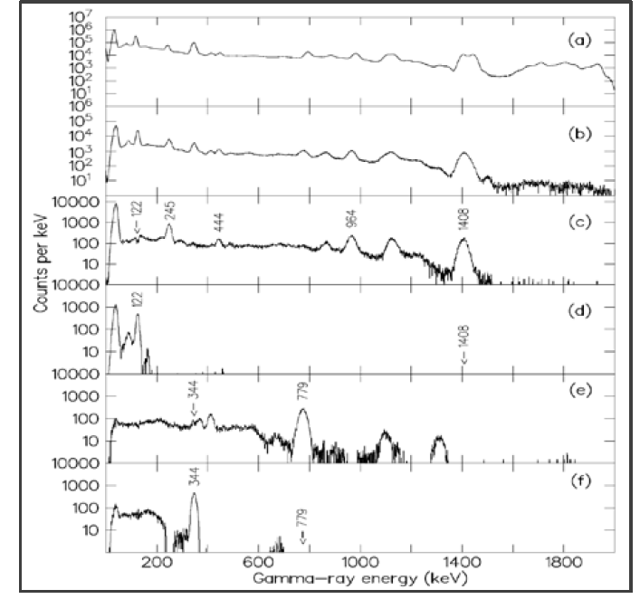
Coincidence gamma-ray energy gating with a ¹⁵²Eu source.
964.1 keV
244.7 keV
121.8 keV
Notes:
As a quick aside this spectrometer can be used industrially to jdeconvolute messy spectrum that could be seen in fission fragment s and also in waste. By creating a simple 2d matrix it and gating it is very clear that the 2 possible decay modes can be separated simply and easily as well showing the presence of an isomer on the gated transition for the beta day branch.

Slide 11
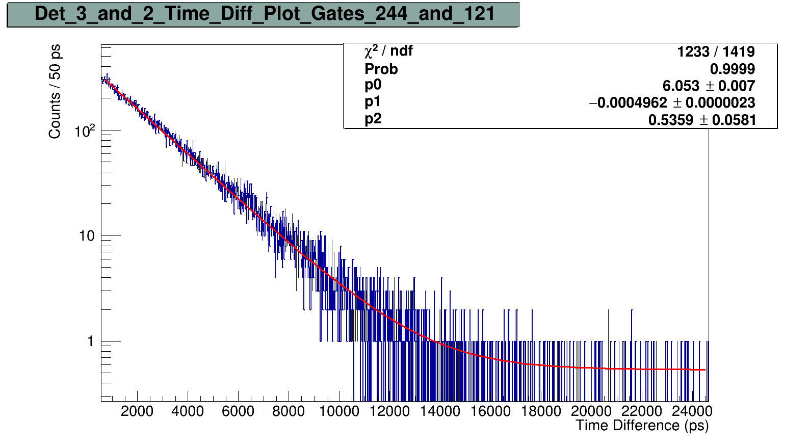
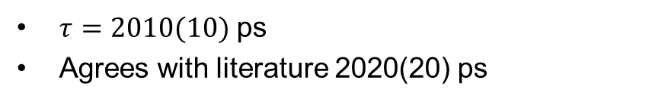
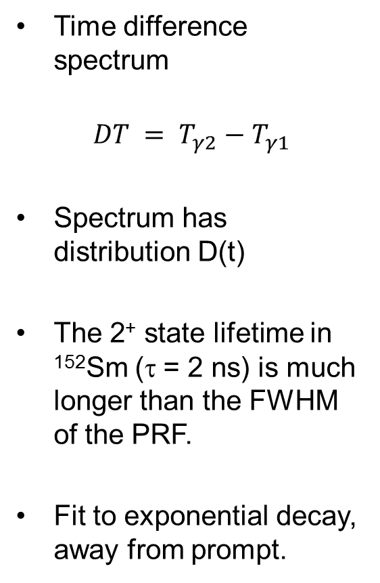
Time difference spectrum
$$DT = T_{γ2}−T_{γ1}$$
Spectrum has distribution D(t)
The 2⁺ state lifetime in ¹⁵²Sm (τ = 2 ns) is much longer than the FWHM of the PRF.
Fit to exponential decay, away from prompt.
$τ=2010(10)$ ps
Agrees with literature 2020(20) ps
www.nndc.bnl.gov

Slide 12
Potential impact of this technology outside nuclear structure research?
Radionuclide assay and standardisations.
  Waste Management.
  Radiopharmaceutical characterisation and standardisations.
  Nuclear forensics; CTBT-related work.
  Environmental Radioactivity (NORMs) evaluation.

Slide 13
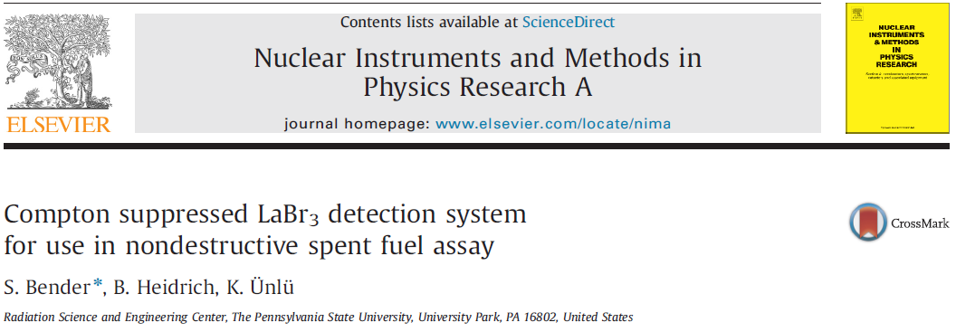
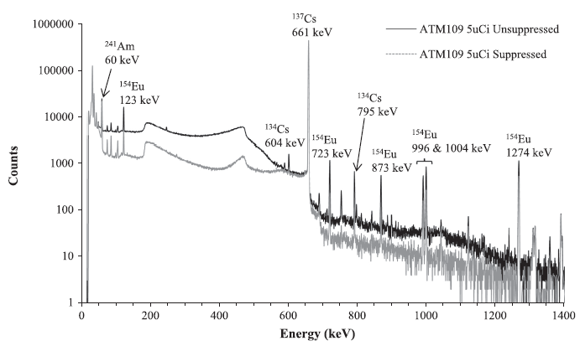
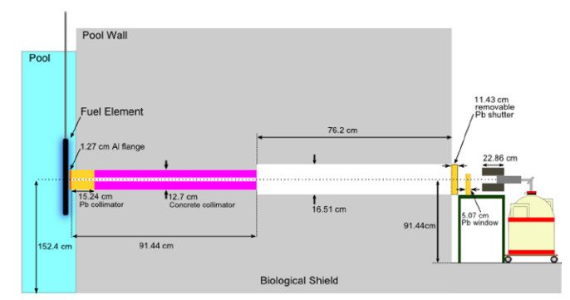
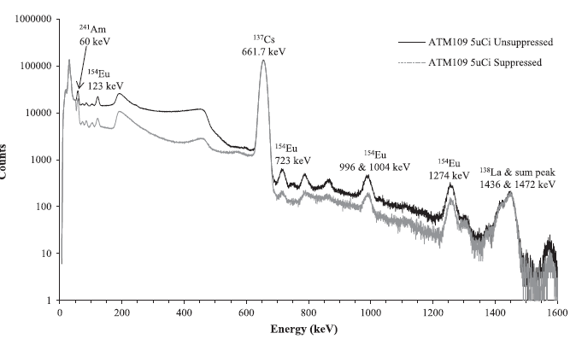
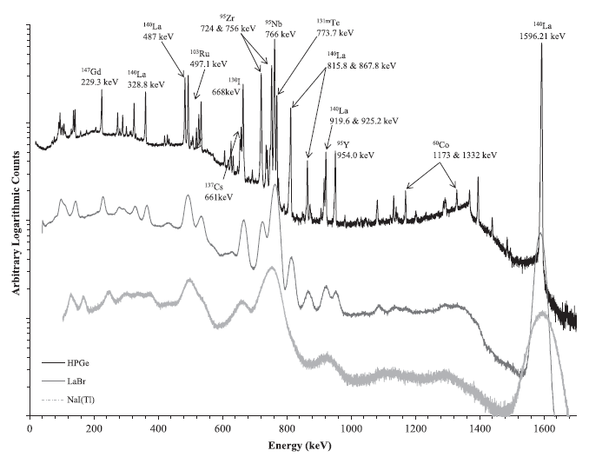
LaBr₃(Ce) being used in spent fuel assay…

Slide 15
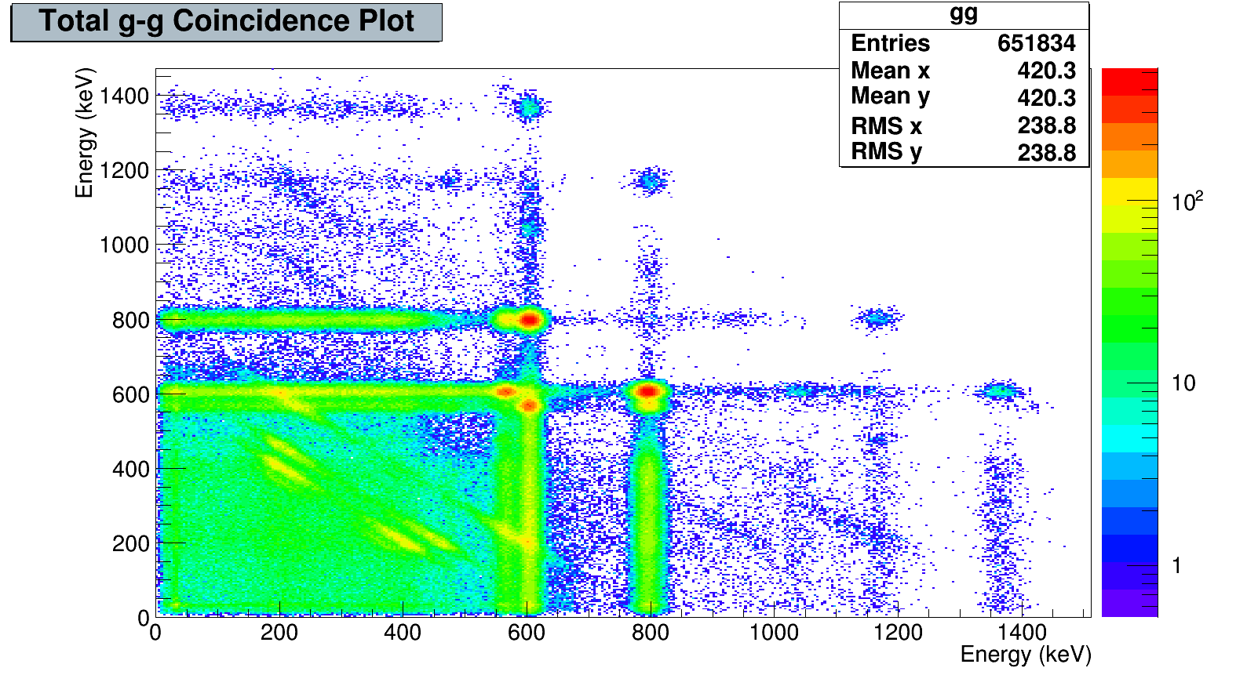
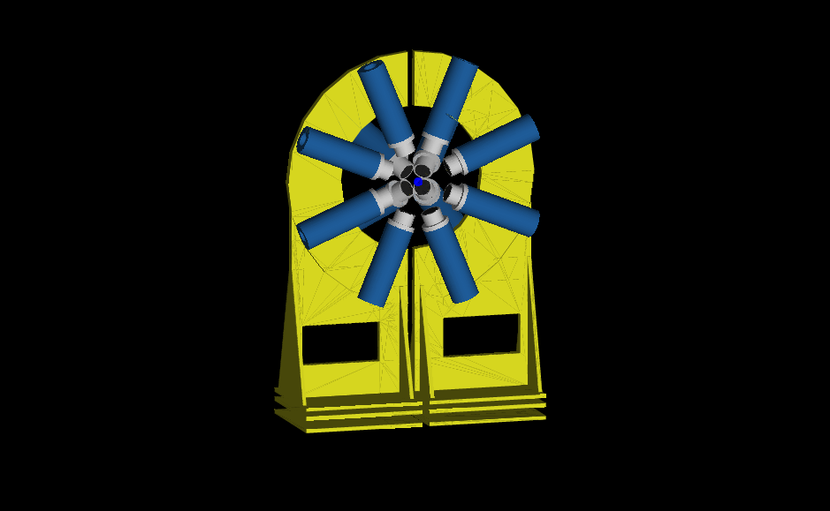
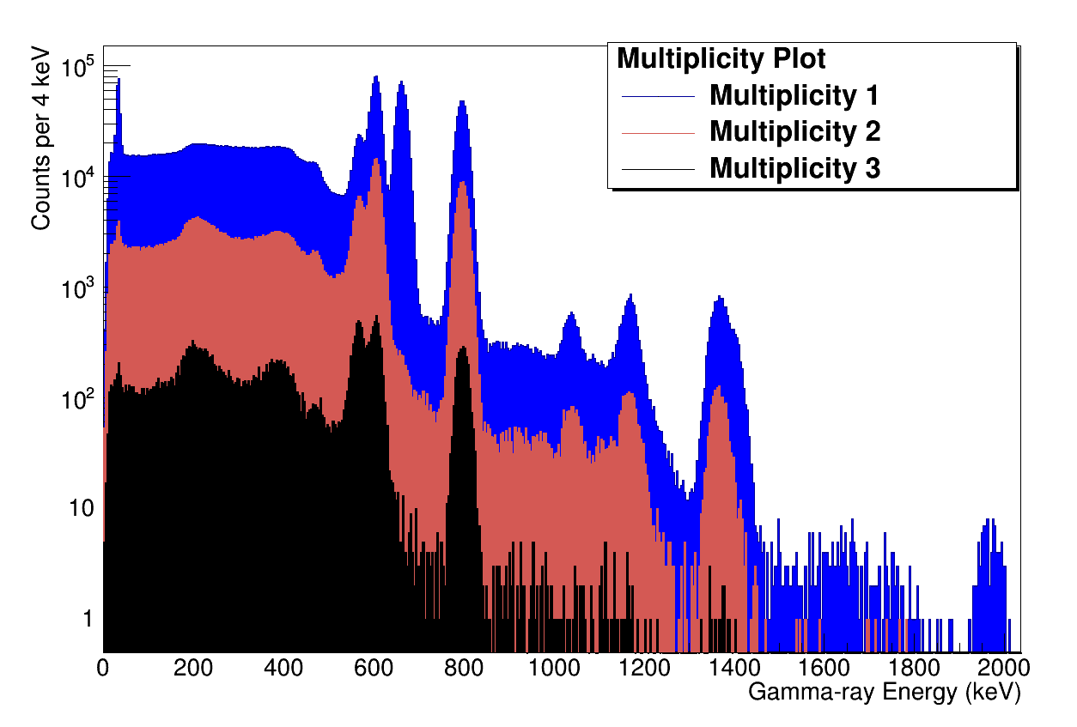
Can use coincidence mode to assay/separate out ¹³⁴Cs from ¹³⁷Cs in nuclear waste (Geant 4)

Slide 16
Measuring Nuclear Excited State Lifetimes using LaBr₃(Ce) arrays

Slide 17
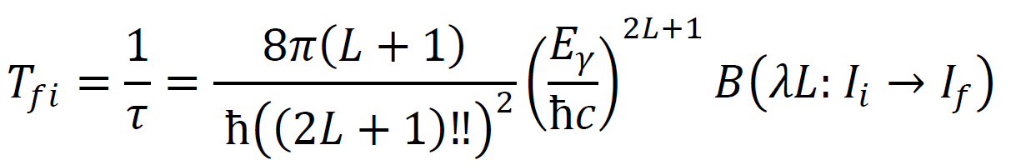
Nuclear EM transition rates between excited states are underpinning observables in nuclear structure.
The reduced matrix elements, B(λL) give insights into structure e.g.,
Single particle / shell model-like: ~ 1 Weisskopf unit (Wu).
Deformed / collective: faster lifetimes, ~10s to 1000s of Wu
Highlight underlying symmetries, quantum numbers and related nuclear decay selection rules such as K-isomerism: MUCH slower decay rates ~ 10⁻³ →10 ⁻⁹ Wu and slower.

Slide 18
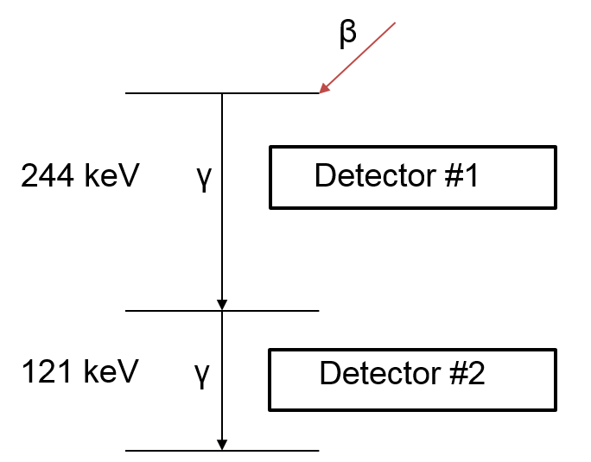
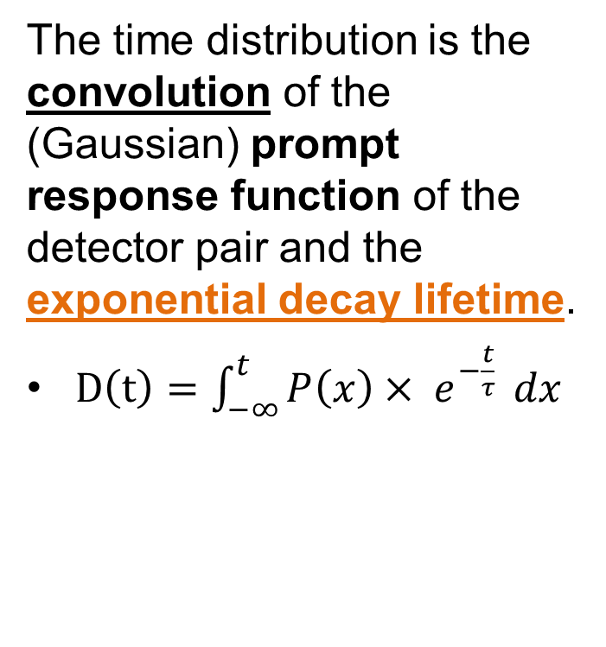
Measuring the lifetime of nuclear states
The time distribution is the convolution of the (Gaussian) prompt response function of the detector pair and the exponential decay lifetime.
$D\left(t\right)=\int_{−∞}^{t}{P\left(x\right)× e^{−\frac{t}{τ}}} dx$
See e.g., Z. Bay, Phys. Rev. 77 (1950) p419;
T.D. Newton, Phys. Rev. 78 (1950) p490;
J.M.Regis et al., EPJ Web of Conf. 93 (2015) 01014
Notes:
Once we have, a time distribution between two transitions of interest can be created. This time distribution is a function of two functions the exponential decay of the lifetime itself and the near Gaussian response of the detector pair used. In thesi9mple case where the decay lifetime is far longer than the PRF FWHM (500 ps) then it is allowed to fit the exponential of with a backround past the centroid or centre of mas of the distribution.

Slide 19
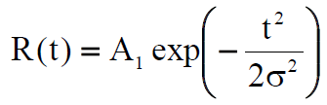
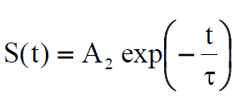
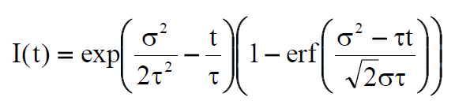
If the instrument Prompt (time) Response Function R(t) is a Gaussian of width σ,
and If the intermediate state decays with a mean lifetime τ, then
The deconvolution integral for a single state lifetime is given by (ignoring the normalisation coefficients).
1-erf(x) is the complementary
error function of x.

Slide 21
HPGe γ−γ−Δt coincidences struggle to measure direct coincidence lifetimes much less than 1 ns.
LaBr₃(Ce) coincidences allow lifetimes to be determined down to the tens of picoseconds using centroid shift analysis of time difference distribution.

Slide 22
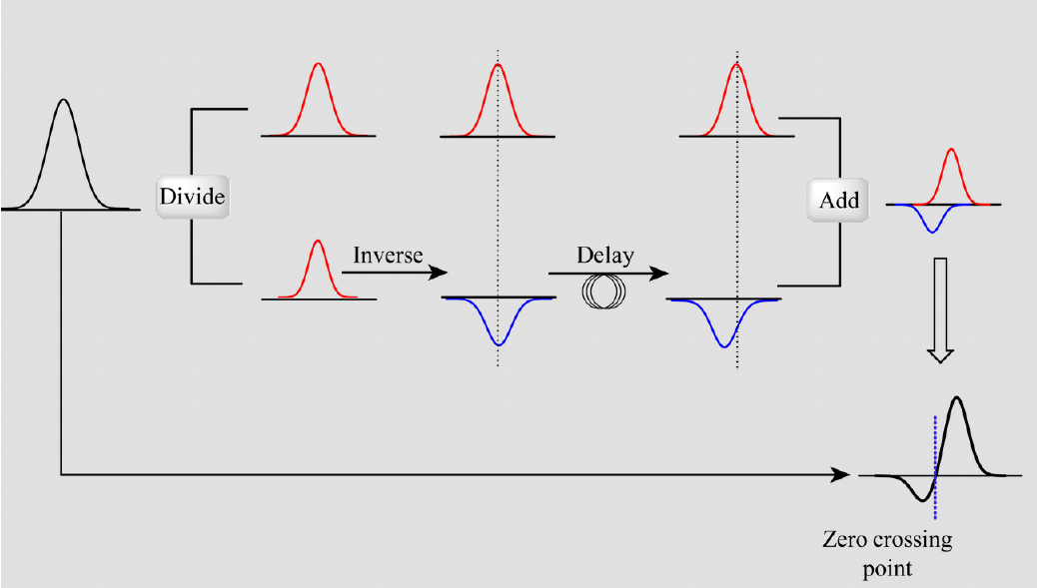
Constant Fraction Discrimination.

Slide 23
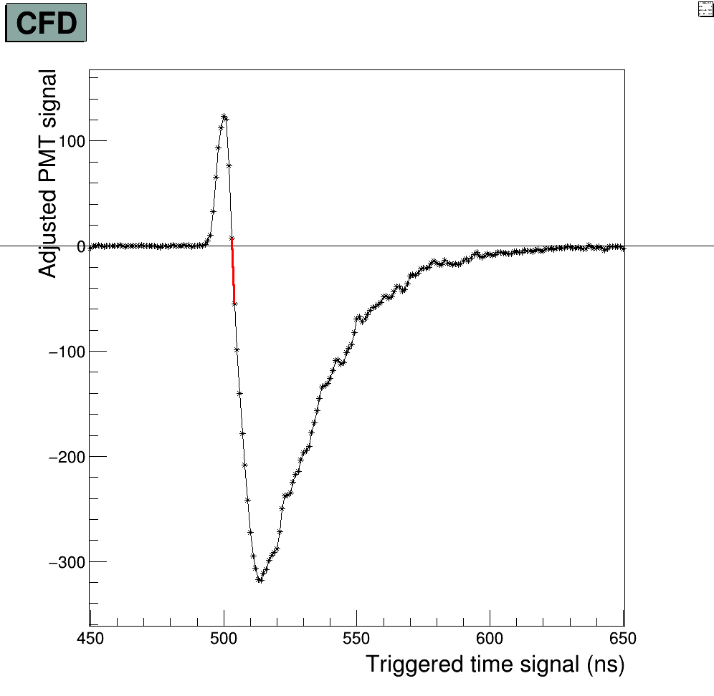
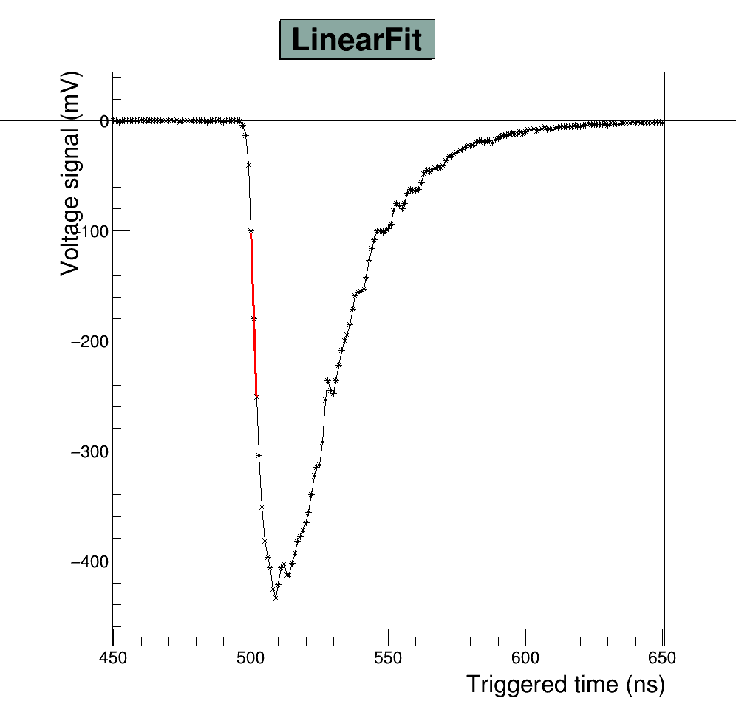
dCFD and direct linear fit
Two ways to pick off time
The digitizer outputs the quantized signal. From this, different signal manipulations can be performed for time pickoff.
Notes:
A digitized waveform also allows for time to be pic,ked off by other means such as a linear fit. In both cases CFD time is picked off using the intercept of the straight line created using the last positive and first negative point around the zero crossing, and the baseline. And the linear fit searches across the negative slope of the pulse searching for the largest absolute gradient before the intercept with the calculated baseline, a chi squared analysis can be used as a sanity check"

Slide 24
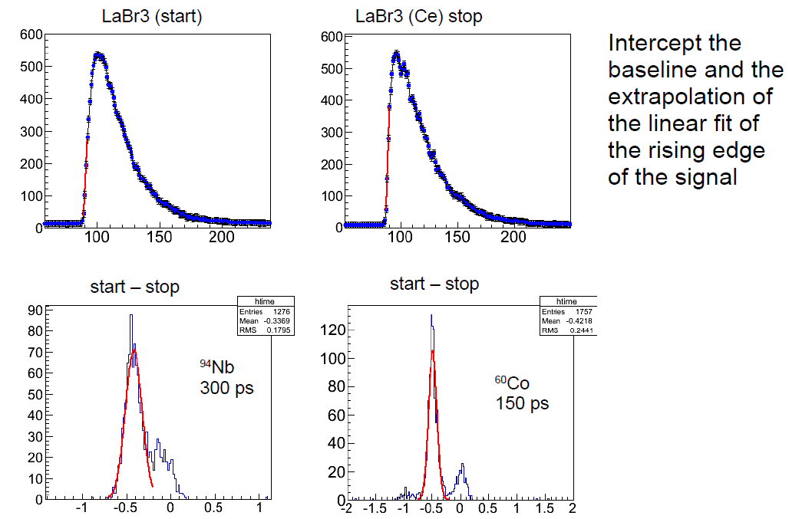
getting the timing right….

Slide 25
Hybrid HPGe – LaBr₃(Ce) Arrays –
The best of both worlds!
1) Use HPGe for enhanced, highly selective channel / decay path isolation. and
2) Use additional LaBr₃(Ce) coincidences for ‘gated’, sub-nanosecond lifetime measurements.

Slide 26
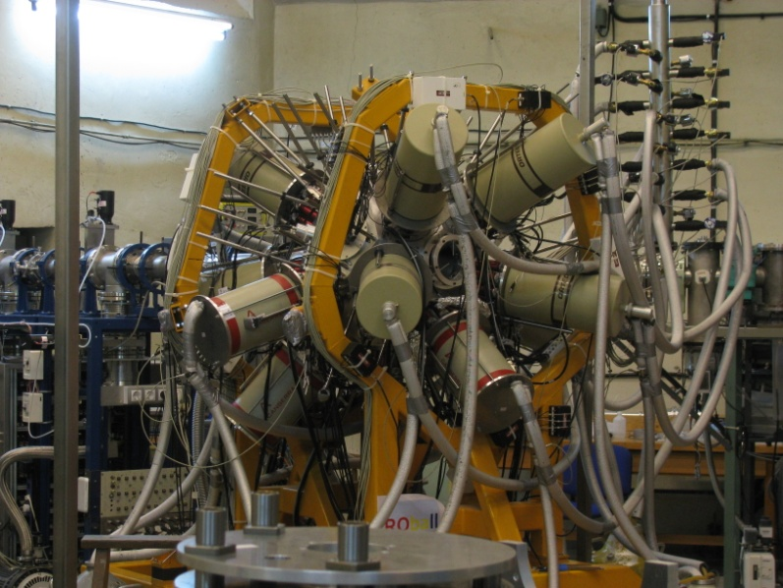
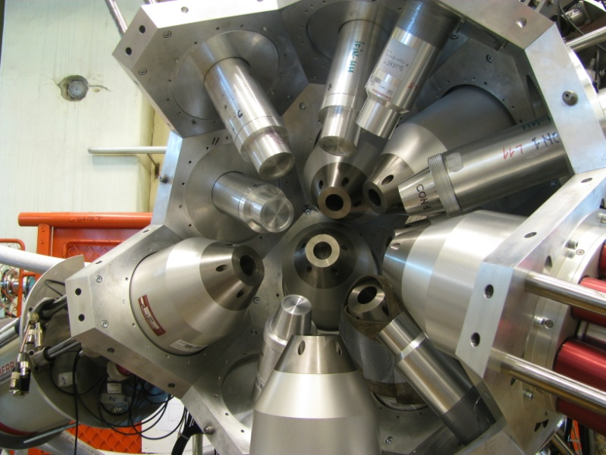
ROmanian array for SPectroscopy in HEavy ion Reactions – ROSPHERE at IFIN-HH Bucharest
14 HPGe detectors (with Anti-Compton shields) are used to detect coincident γ rays as ‘gates/selection’:
  7x HPGe dets. @ 37º
  4x HPGe dets. @ 64º
  3x HPGe dets. @ 90º
11 LaBr₃(Ce:5%) detectors used for fast-timing measurements
  7x ø2”x2” and 4x ø1.5”x2” (UK) (Cylindrical) @ 37, 64 and 90º w.r.t. the beam axis.

Slide 27
An experimental example:
¹³⁸Ce₈₀

Slide 28
N=80 Isotones
N = 80 isotones above Z = 50 display 10⁺ seniority isomers from coupling of (νh_{11/2})⁻²
6⁺ level decays also usually ‘hindered’ e.g., in ¹³⁶Ba, T_{1/2} = 3.1(1)ns.
Thought to be due to change in configuration and seniority.
isomer
(νh_{11/2})⁻² only
10⁺
8⁺
6⁺
Primarily
(πg_{7/2})²
4⁺
2⁺
Primarily
(πd_{5/2})²
0⁺

Slide 29
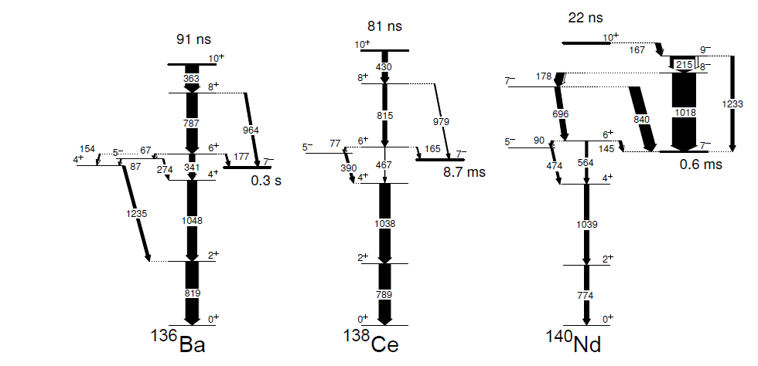
N=80 Isotones
Neighbouring N=80 nuclei, ¹³⁸Ce and ¹⁴⁰Nd expected to show similar 6⁺ → 4⁺ hindrance.
Competing transitions to negative parity states
  E1 decays, forbidden in truncated shell model space.

Slide 30
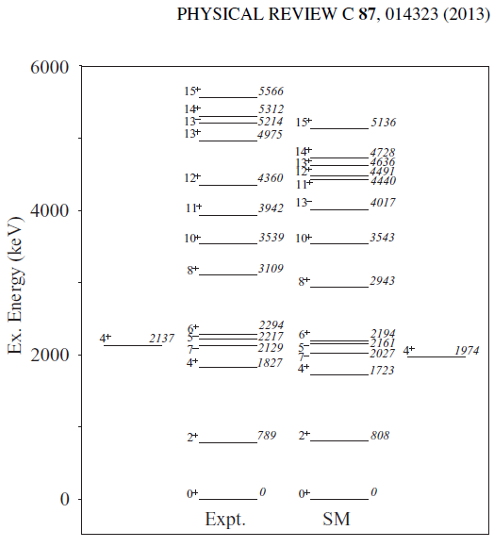
Restricted basis SM calculations
give reasonable comparison with experimental (near-yrast) states in ¹³⁸Ce.
What about transition rates?

Slide 31
¹³⁰Te(¹²C,4n)¹³⁸Ce @56 MeV

Slide 32
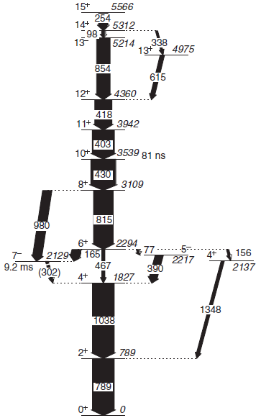
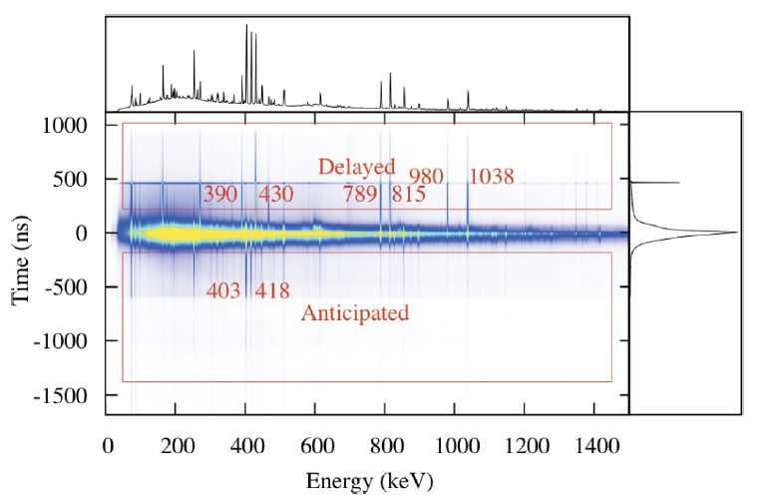
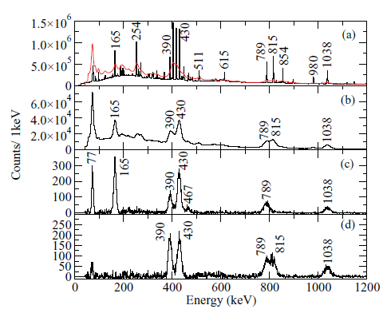
¹³⁸Ce₈₀
T.Alharbi et al., Phys. Rev. C87 (2013) 014323

Slide 33
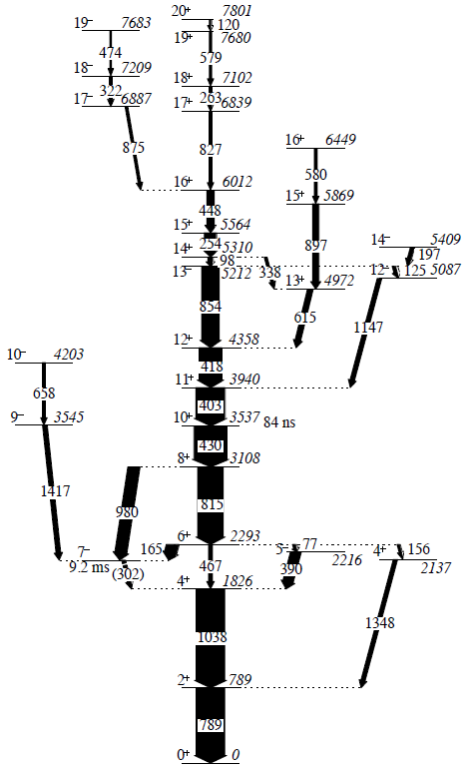
¹³⁸Ce₈₀

Slide 34
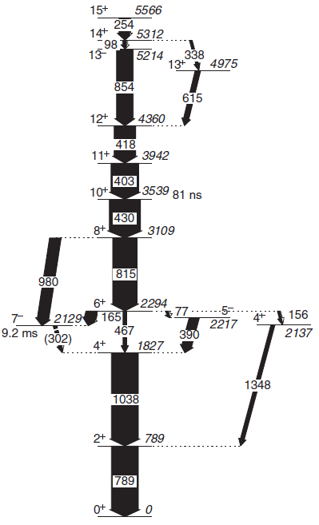
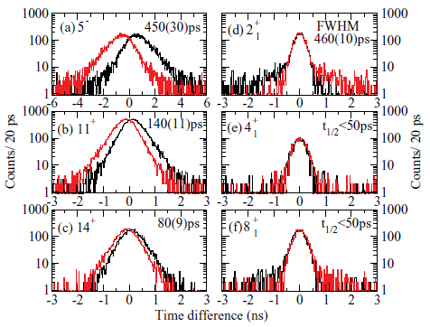
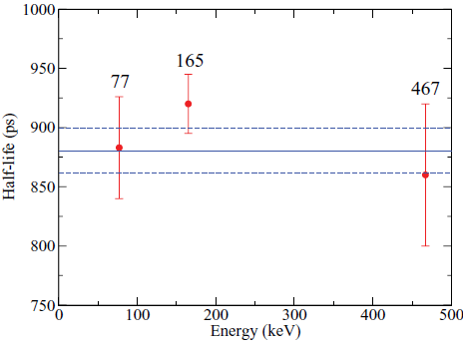
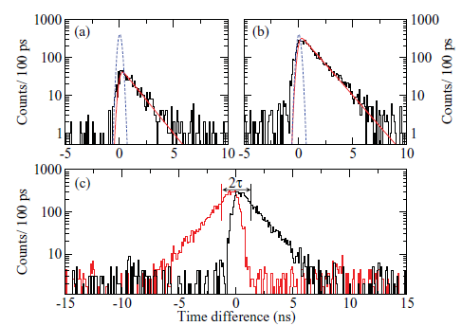

Slide 35
Examples of recent ROSPHERE physics results
Single particle shell model structure around the N=20 nuclear closed shell (³⁴P₁₉).
Understanding ‘transitional’ nuclei between ‘shell model’ and ‘deformed’ (¹³⁶Ce₇₈).
B(E2:2⁺ →0⁺) in ¹⁸⁸W, tests of nuclear shape evolution.
Testing the ‘simplest’ nuclear shell model structures (²⁰⁹Bi₁₂₆).

Slide 36
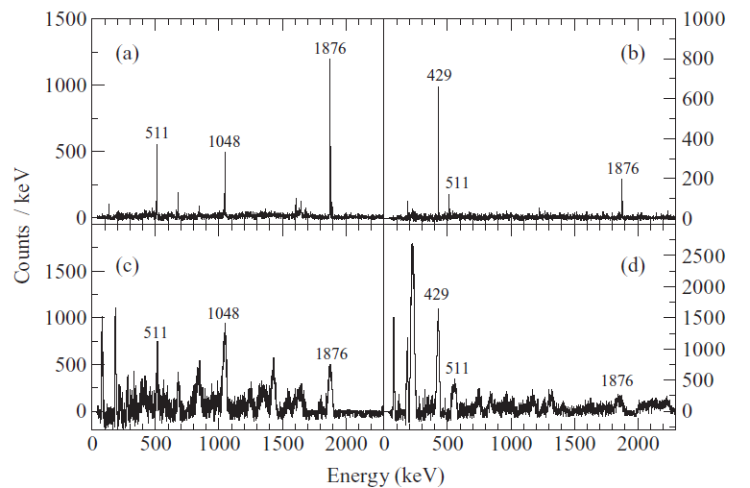
4⁻

Slide 37
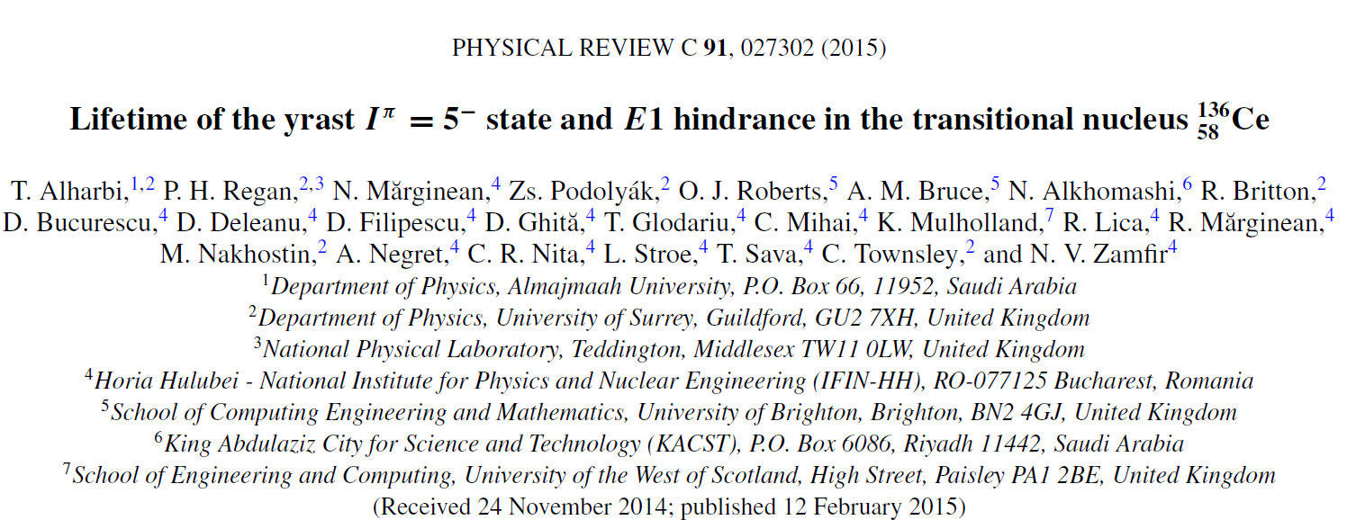
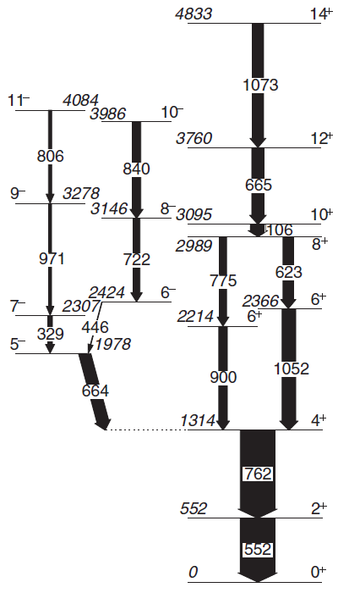
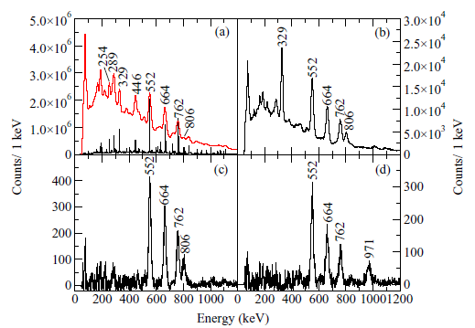
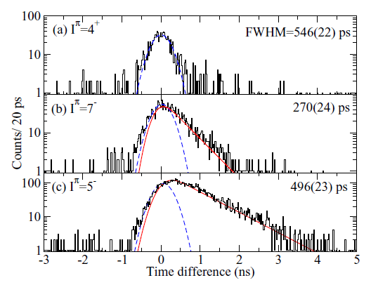

Slide 38




T_{1/2}=0.87(12) ns
Sum of time differences between
143-keV (2⁺→ 0⁺) transition and any
higher lying feeding transition.

Slide 39




Slide 40
Other LaBr₃ (Ce) + HPGe hybrid arrays…

Slide 41




EURICA + FATIMA (RIBF-Japan)
Hybrid LaBr₃ (18) + HPGe ‘Clusters’
(12x7=84) array at the focal plane
of BigRIPS separator, RIKEN, Japan

Slide 42


F. Browne, A.M.Bruce, T. Sumikama et al., EURICA + FATIMA, Phys. Lett. B750 (2015) p448-452.

Slide 43





EXILL + FATIMA array
consisting of:
a) ) 8 x EXOGAM clovers
(32 HPGe crystals total)
+
b) 16 x LaBr₃(Ce) crystals
¹⁰⁰Zr populated in ²³⁵U(n,f) and ²⁴¹Pu(n,f) reactions at ILL, gammas with EXILL+FATIMA

Slide 44


GAMMASPHERE + FATIMA; Argonne National Lab:
Dec. 2015 - Feb . 2016
Nuclei produced in ²⁵²Cf fission using a fixed source.

Slide 45



Existing Gammasphere half – opposite half withdrawn
1020 mm

Slide 46


LaBr₃(Ce) Focal Plane Array at JYFL
A test measurement of ¹³⁸Gd sub-isomer 2⁺ →0⁺ transition was carried out in Jyväskylä , Finland, in Autumn 2015.
This was the first fast timing measurement using the GREAT focal plane DSSD as a distributed source.
Michael Mallaburn, David Cullen et al., – University of Manchester

Slide 47
Near-future hybrid arrays for nuclear structure research.
AGATA+FATIMA.
NuBALL (HPGe clovers and FATIMA & IPN-Orsay)

Slide 48
NuBALL
Up to 24 HPGe Clovers (from Loan pool) and up to 36 LaBr₃ detectors (from UK and other FATIMA) in high-efficiency, high granularity array.
Aim to be at IPN Orsay from ~Jan to ~Sept. 2017.
Physics problems attacked with NuBall (discuss today/tomorrow), might include:
  Prompt, pulsed neutron-induced studies using LICORNE; e.g., ²³⁸U(n,f) ; ²³²Th(n,f) spectroscopy of fission fragments using ~1ns beam-pulsing.
    Does this do ‘better’ than EXILL+FATIMA for some cases?
  Fusion/Fission reaction to make medium-neutron rich A~120 ~(symmetric) nuclei; Eγ₁-(Eγ₂)-LaBr₃-LaBr₃-ΔT ?
  HI-fusion evaporation residues in ‘complex’ shell model systems to high spins;
    use ~1 ns beam pulsing to separate out decays between/below isomers; e.g., shape coexistence studies in neutron-deficient Os/Hg/Pb/Po ; N~20; 50; 82 ; 126 shell model systems ?
  DIC studies / nucleon transfer reactions with heavy-ion beams on heavy targets.
  Decay spectroscopy of reaction residues produced using the Orsay Tandem.
  Transfer reactions (¹⁸O,¹⁶O) for B(E2) values and shape evolution in stable+2n systems.
  Decay spectroscopy of separated/transported ALTO sources, e.g., around N~50 →60?

Slide 49
(some) Acknowledgements
STFC (for NUSTAR / DESPEC funding).
UK National Measurement office (NANA funding)
NDA (funding for UK PhD student Rob Shearman)
Robert Shearman (PhD student; GEANT4 etc.)
Giuseppe Lorusso (NPL, PSA and timing).
Nicu Marginean, Raluca Marginean et al., IFIN-Bucharest (ROSPHERE)
Zsolt Podolyak, Alison Bruce, Oliver Roberts, Christina Nita, Robert Carroll, Peter Mason, Stefan Lalkovski, Chantal Nobs, Thamer Alharbi, Terver Daniel, Laila Gurgi et al., (Surrey/Brighton fast-timing group).
Jon Wilson et al., IPN Orsay.

Slide 50



FATIMA with AGATA @ GANIL (Late 2017)
22 LaBr₃(Ce) coupled to the Advance
Gamma Tracking Array
(AGATA).

