Slide 1



LICORNE & ν-ball
A technique for production and study of the most exotic neutron-rich nuclei
M. Lebois, J.N. Wilson, L. Qi
ALTO/ ν-ball hybrid spectrometer workshop 2016

Slide 2
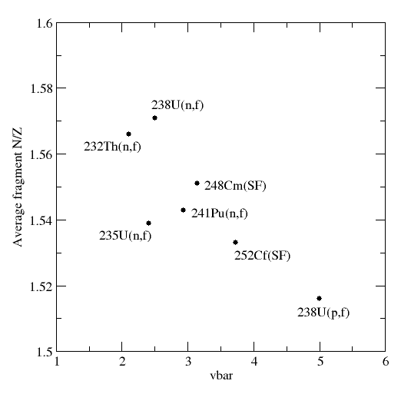
Production of exotic neutron rich nuclei via fission
Spontaneous Fission
²⁵²Cf(SF), ²⁴⁸Cm(SF)
(Gammasphere, Euroball)
Exoticity
Fission induced by thermal neutrons
²³⁵U(n_{th},f) ²⁴¹Pu(n_{th},f) (EXILL Exogam@ILL)
Fission induced by fast 1.5 MeV neutrons
²³⁸U(n,f), ²³²Th(n,f)
(LICORNE @ IPN Orsay)

Slide 3
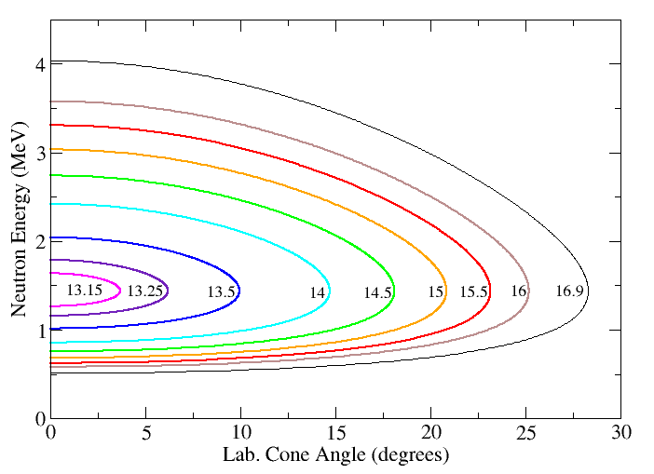
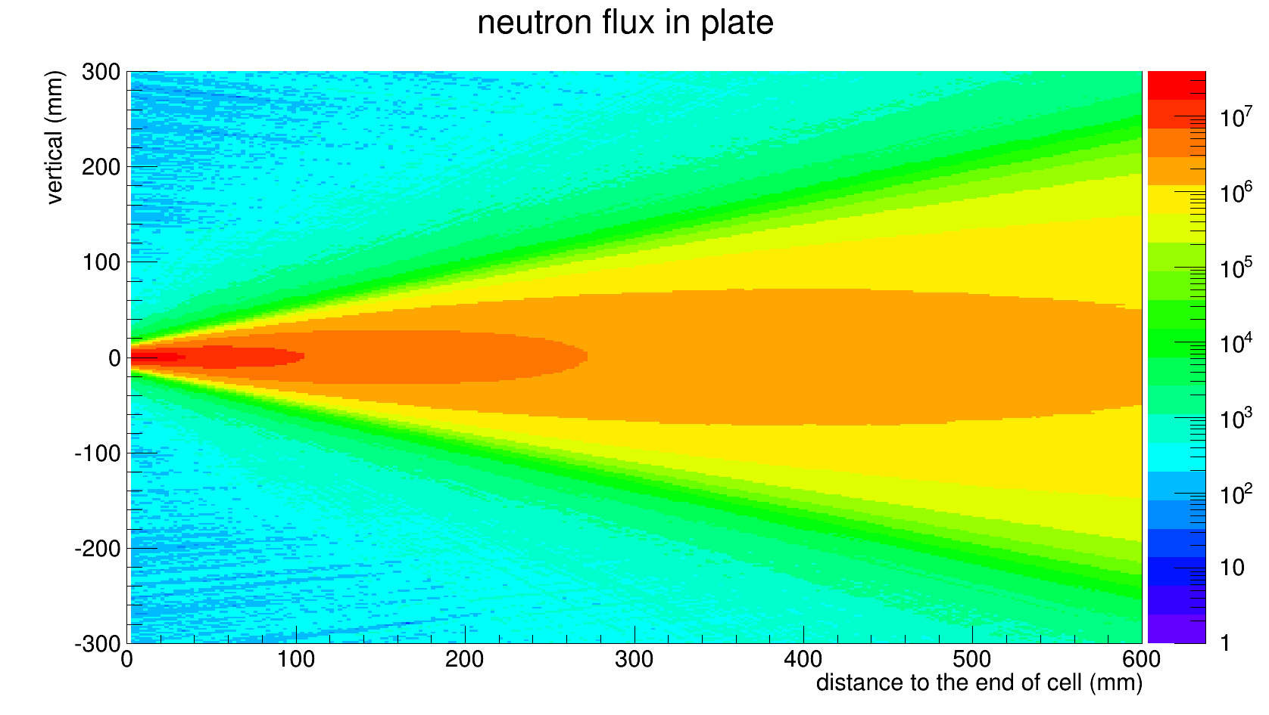
Neutron Flux Calculations for LICORNE
Lithium Inverse Cinematiques ORsay Neutron source
H target
γ
Intensely focused
monoenergetic
neutron source:
n
n
n
100 nA (DC) ⁷Li
13-17 MeV
Neutron Flux
10⁷ n/s/steradian
Neutron Energy
E_{n}=0.5 – 4 MeV
n
γ
Actinide Target
Or 250 MHz (2ns wide) AC
Q. Liqiang, PhD thesis

Slide 4
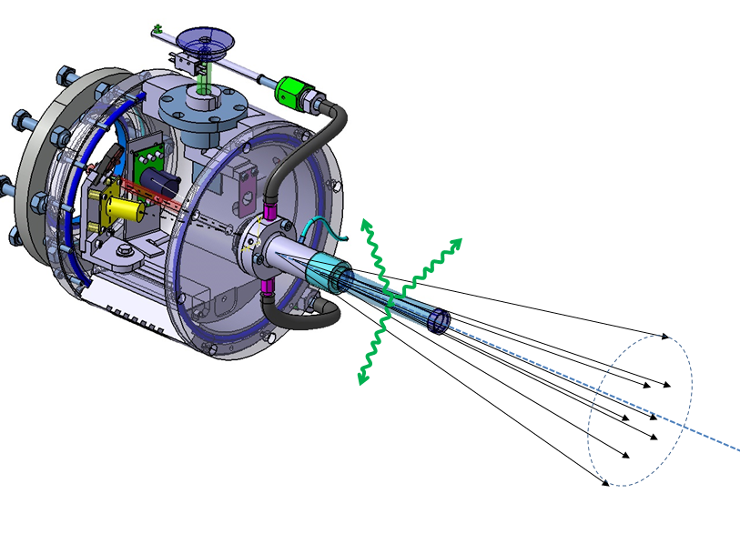
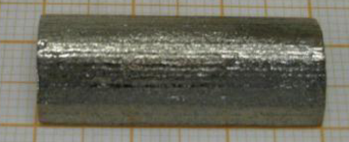
Experiment in March 2015
30nA (AC) ⁷Li
16.75 MeV
30g Uranium metal target
(ITU Karlsruhe)
3cm
3.5 cm gas cell
@1.5 atm
⁷Li Kinetic Energy
After Ta: 14.79 ± 0.05 MeV
End of Gas cell: 13.09 ± 0.08 MeV
Cone opening = 19.8°

Slide 5
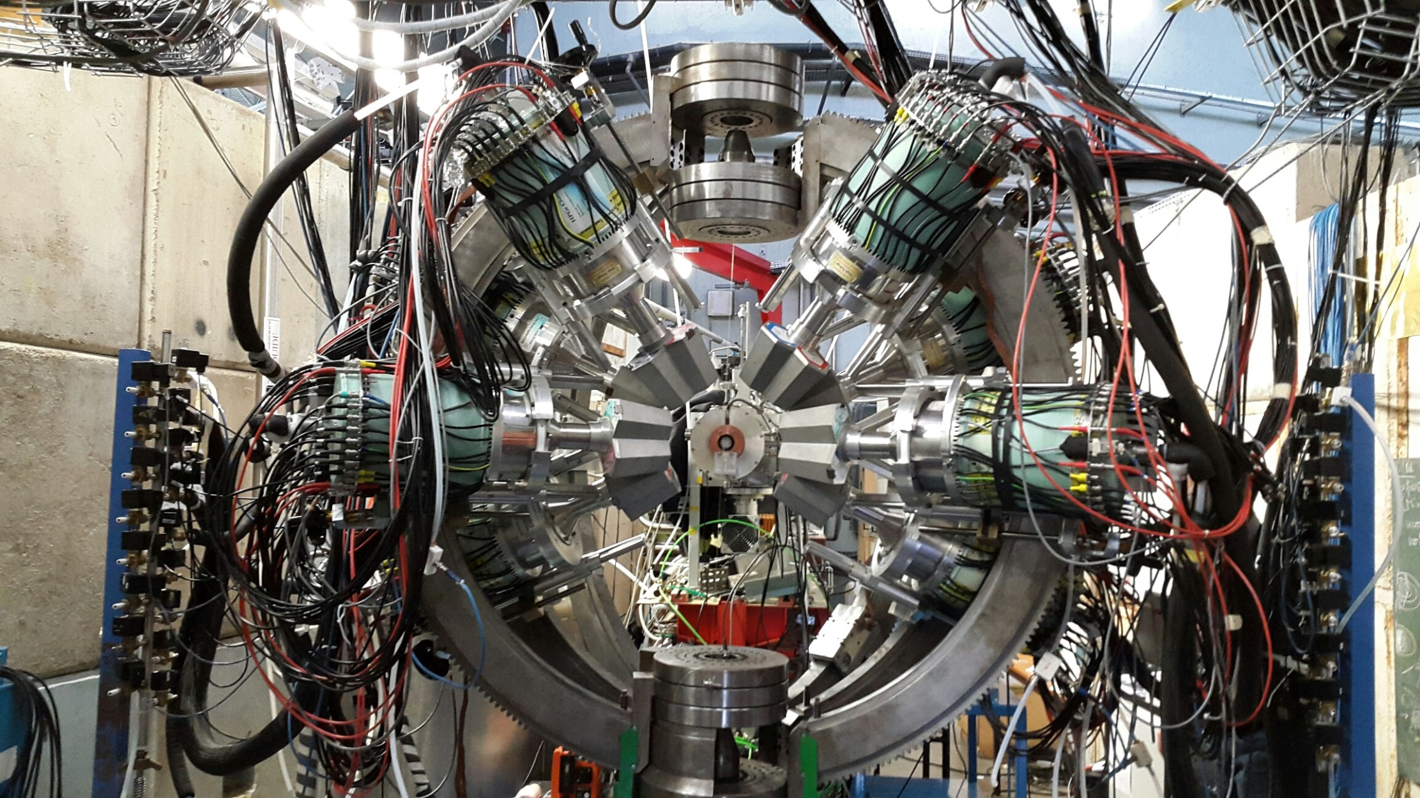
LICORNE + MINIBALL (March 2015)

Slide 6
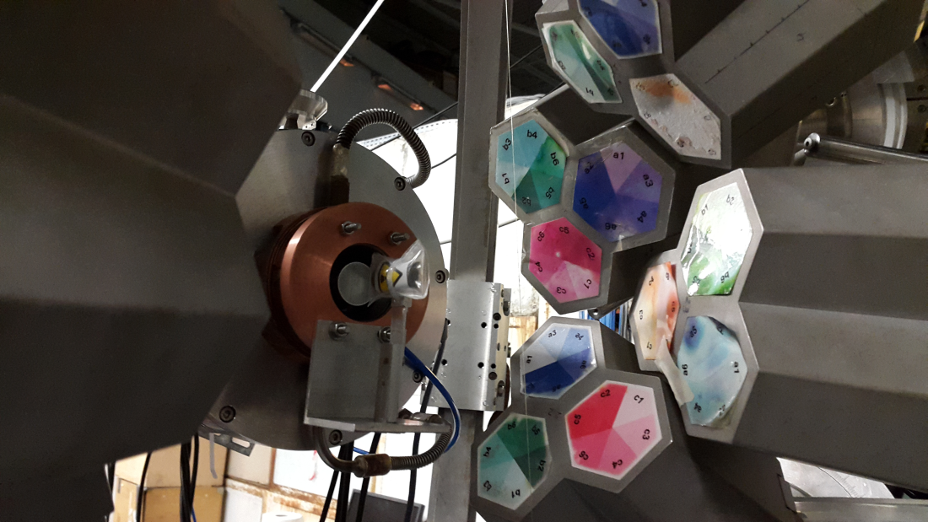
LICORNE + Miniball (March 2015)
Ge singles rates
~ 8kHz
3 weeks of beam time: ~ 3 × 10⁹ events with M_{γ} >= 3

Slide 7
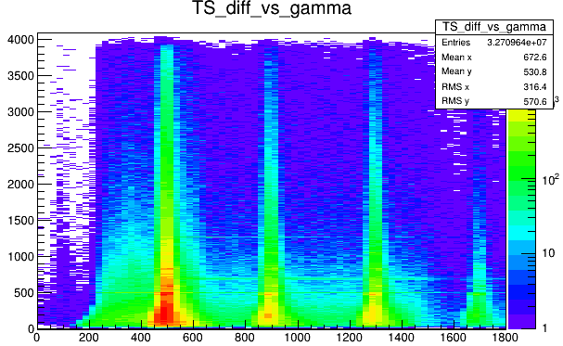
Selection of prompt gamma rays
Prompt fission gamma rays
Energy (keV)
Time (ns)

Slide 8
Selection of delayed gamma rays
400 ns
Energy (keV)
Time (ns)

Slide 9
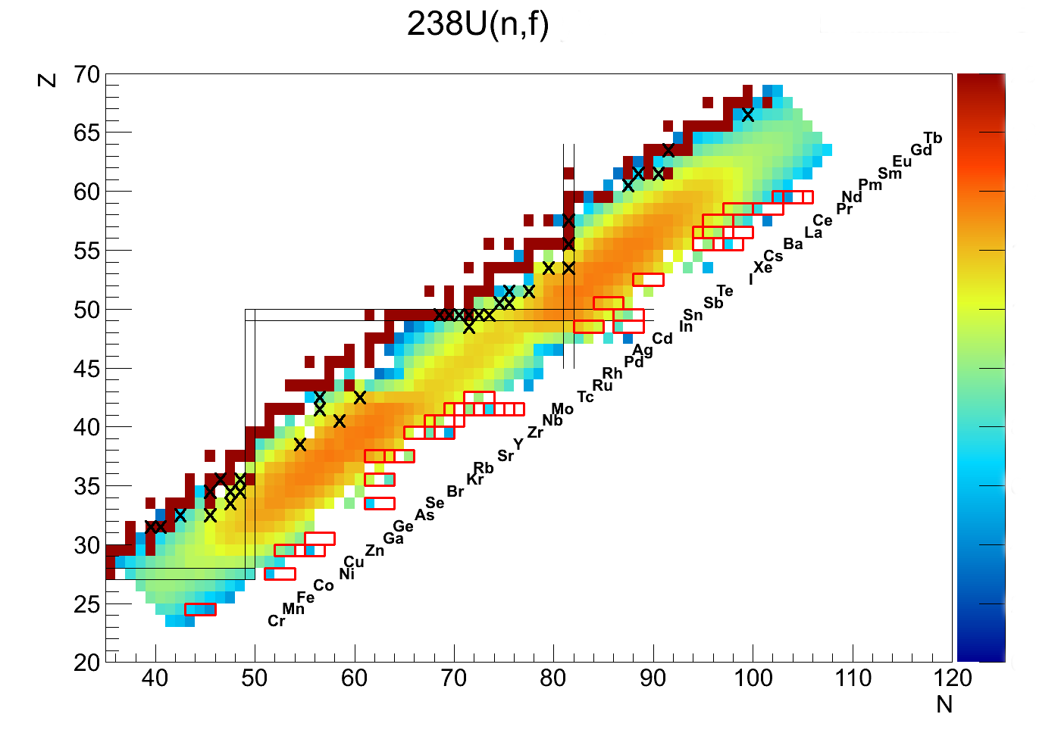
TIPS – Tagging Isomer PartnerS
Notes:
In principle by selecting, one isomeric transition in one fragment close to stability, and by g-g-g correlation with this isomeric transition we should be able to get gamma spectroscopy for the complementary exotic fission fragment.
On this nuclear chart, crosses represent known isomers, and red rectangles the corresponding exotic fission fragment.

Slide 10
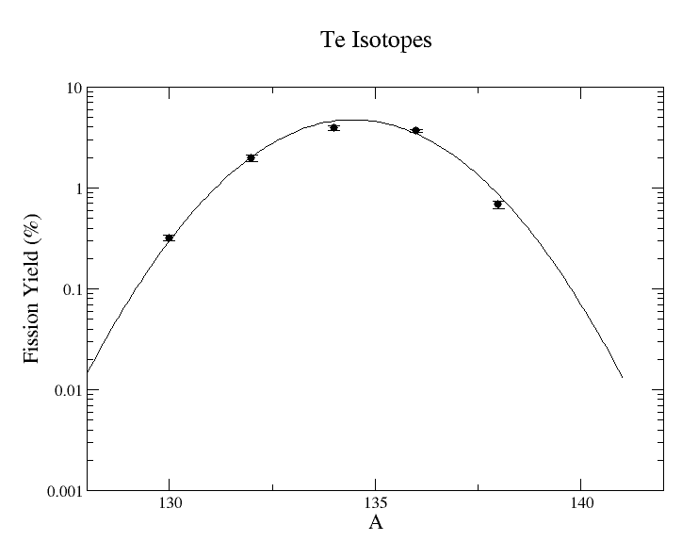
Is there any new physics?
Te isotope yields from Miniball experiment
Beta decay of ¹³⁸Sb @ RIKEN
Phys. Rev. C 92, 044320,
October 2015
^{139,140}Te are observable!!
Current miniball observational limit
P/T Ratio improvement
Fission tag
Time Resolution (Detectors/buncher)
Target/Beam
Observational limit with escape suppressed array

Slide 11
Experiment in March 2015:
Neutron Flux and fission Rate
Half-cylinder
D=1.2cm
Thickness=3cm,
d = 19.1 g/cm³
Tilted about 5 degrees
Estimated fission rate during experiment: 25 kHz
Calculated fission rate for MINIBALL target (30 nA ⁷Li): 36 kHz
Q. Liqiang, PhD thesis

Slide 12
Experiment in March 2015: ²³⁸U Target Improvment
Cylinder:
R=1.5 cm
Thickness=3 cm
d = 1 g/cm³
fission rate (100 nA of ⁷Li): 37 kHz
Autoprotection of the target : negligible
Production/manipulation of pure ²³⁸U powder
Q. Liqiang, PhD thesis

Slide 13
Experiment in March 2015: ²³⁸U Target Improvment
4 disks
R=1.2 cm
Thickness=1 mm
d = 19.1 g/cm³
Δd= 1 cm
fission rate (100 nA of ⁷Li):
95 kHz
Autoprotection of the target : small
Q. Liqiang, PhD thesis

Slide 14
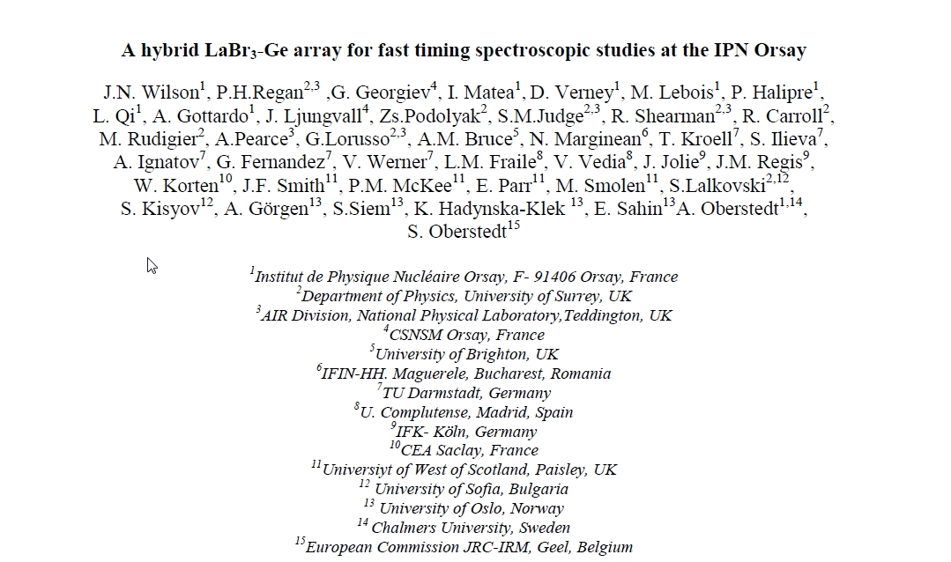

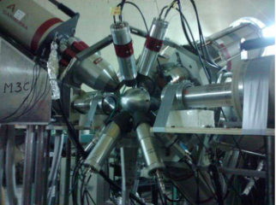
ν-ball: hybrid LaBr₃-Ge array for fast timing spectroscopic studies
Construction of a hybrid Ge + LaBr₃ array @ IPN Orsay
24 French/UK
Clovers
+
BGO Shields
⊕
FATIMA
36 LaBr₃
EUROGAM
LOI (2015) signed by 43 scientists from 17 different institutions
Experimental Campaign planned for 2017-2018

Slide 15
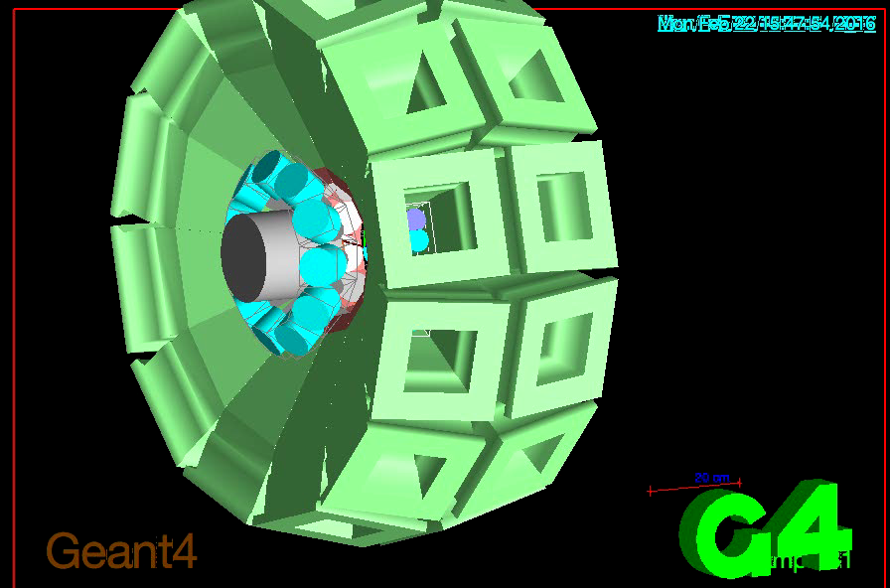
ν-ball: spectrometer properties
GEANT4 Simulation of Major Parameters for this array:
efficiency, Peak-to-total ratio, compton suppression
24 Clovers around 90°
d_{center} = 20.88 cm
Δθ = 10.35°
32 LaBr₃ 1.5”x2”
d_{center} = 15.2 cm
Δθ = 14.3°

Slide 16
ν-ball: spectrometer properties
Independent crystals
Add-back in Clovers
CS Independent crystals
CS Add-back in Clovers
5.1% @1MeV
44.7% @1MeV
3.8% @1MeV
18% @1MeV

Slide 17
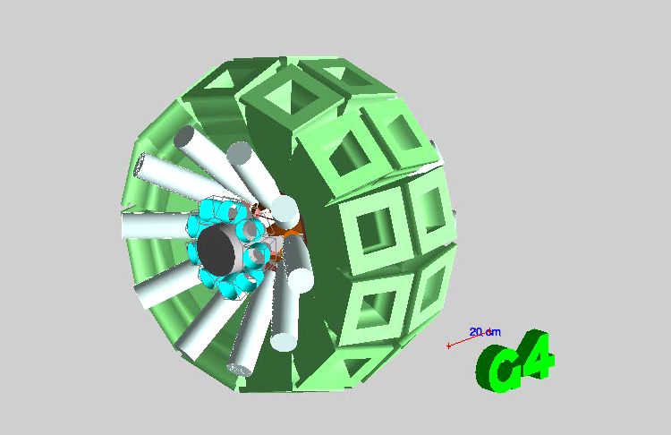
ν-ball: spectrometer properties
Needs for PhaseI detectors (“OUPS like” experiments, see J. Ljunvall’s talk)
24 Clovers around 90°
d_{center} = 20.88 cm
Δθ = 10.35°
19 LaBr₃ 1.5”x2”
d_{center} = 24.2 cm
Δθ = 9°
20 PhaseI HPGe
d_{center} = 18 cm
Δθ = 20.1°

Slide 18
ν-ball: spectrometer properties
Independent crystals
Add-back in Clovers
CS Independent crystals
CS Add-back in Clovers
53% @1MeV
7% @1MeV
5.6% @1MeV
19.8% @1MeV

Slide 19
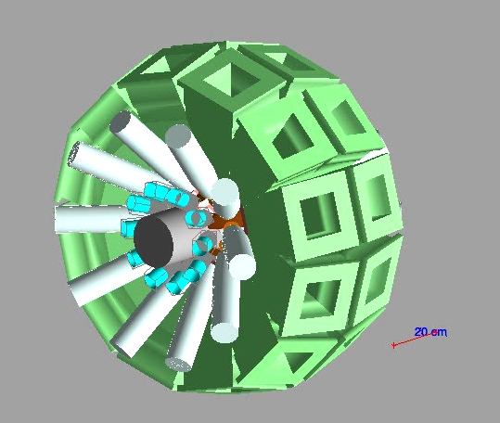
ν-ball: spectrometer properties
Improvement of LaBr3 efficiency: use of the 2”x2” crystals/PM
24 Clovers around 90°
d_{center} = 20.88 cm
Δθ = 10.35°
20 LaBr₃ 2”x2”
d_{center} = 24.2 cm
Δθ = 9°
20 PhaseI HPGe
d_{center} = 18 cm
Δθ = 20.1°

Slide 20
ν-ball: spectrometer properties
Independent crystals
Add-back in Clovers
CS Independent crystals
CS Add-back in Clovers
52% @1MeV
7.4% @1MeV
5.9% @1MeV
20% @1MeV

Slide 21
ν-ball Fission TAG: “Calorimeter MODE”
Selection of fission event
γ emission in ²³⁸U fission
Parasitic processes
Approximation
Elastic scattering: 1-2 γ/TE 2MeV
Average multiplicity: 8 γ/fission
Fold 3 trigger
Inelastic scattering: 2-3 γ/TE 2-3 MeV
Average γ energy : 800 keV
β decay: 2-3 γ/TE 2-4 MeV
Total γ energy : 7 MeV
(n, γ) decay: 2-3 γ/TE 2-5 MeV
High multiplicity

Slide 22
ν-ball Fission TAG: “Calorimeter MODE”
Selection of fission event
γ emission in ²³⁸U fission
Parasitic processes
Approximation
Elastic scattering: 1-2 γ/TE 2MeV
Average multiplicity: 8 γ/fission
Inelastic scattering: 2-3 γ/TE 2-3 MeV
Average γ energy : 800 keV
β decay: 2-3 γ/TE 2-4 MeV
Total γ energy : 7 MeV
(n, γ) decay: 2-3 γ/TE 2-5 MeV
High multiplicity & High Energy
Fission selection possible

Slide 23
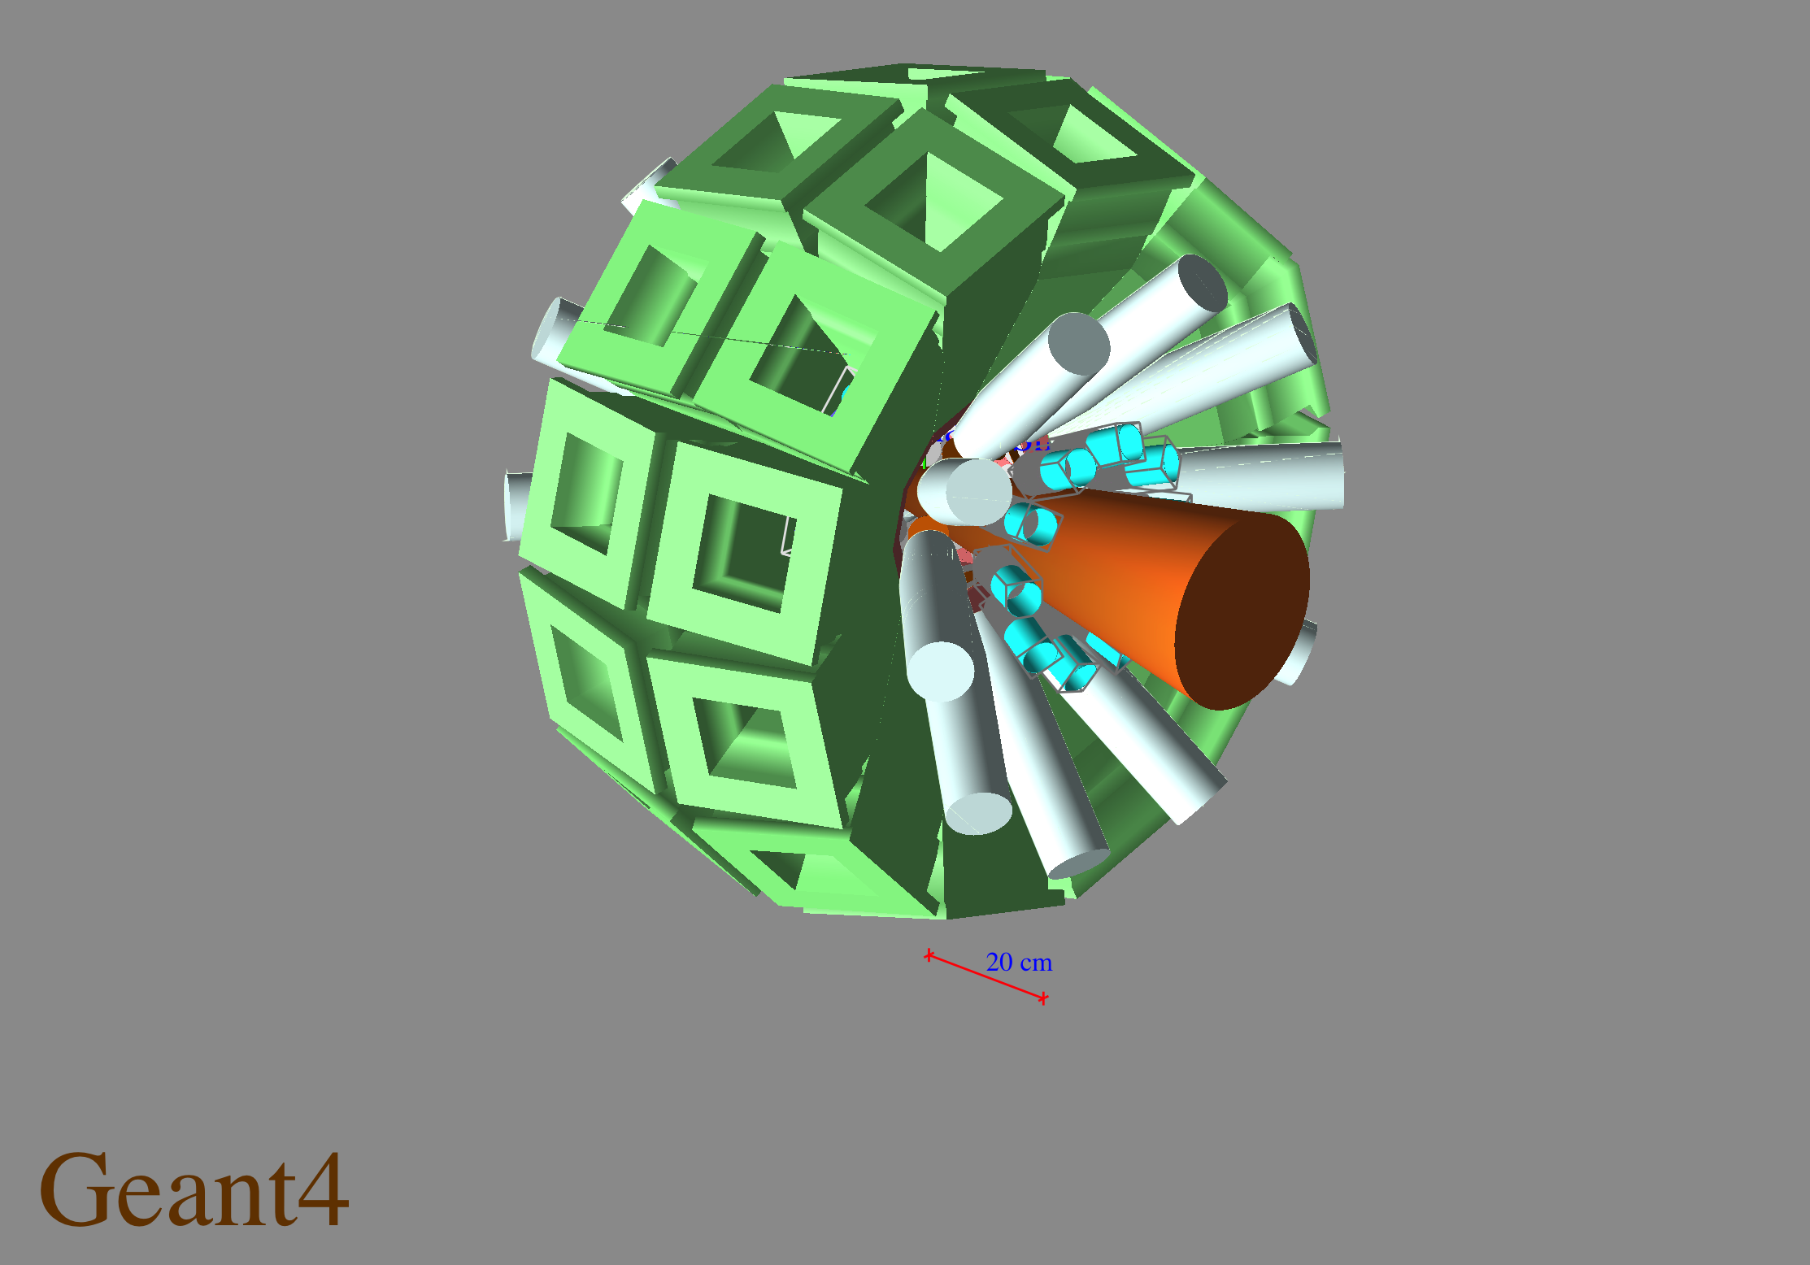
ν-ball: A hybrid LaBr₃-Ge array for fast timing spectroscopic studies
Construction of a hybrid Ge + LaBr₃ array @ IPN Orsay
>7% total gamma photopeak efficiency; > 50 P/T ratio
24 France/UK Clover detectors + 20 PhaseI France/UK loan pool
+ 20 FATIMA collaboration LaBr₃
Improved fission tag thanks to calorimetry
LOI (2015) signed by 43 scientists from 17 different institutions
Other possible geometries -> Experimental Campaign planned for 2017-2018

Slide 24
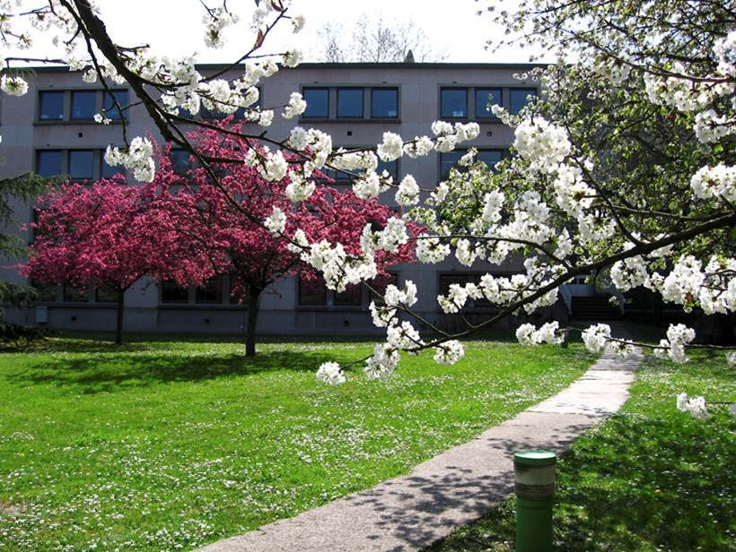
ALTO/ ν-ball hybrid spectrometer workshop 2016
Thank you

Slide 25
LICORNE & ν-ball
A technique for production and study of the most exotic neutron-rich nuclei
M. Lebois, J.N. Wilson, L. Qi,
Stephan Oberstedt, Andreas Oberstedt,Robert Shearman,Robert Carroll,Patrick Regan,Wilton Catford,Zsolt Podolyak,Giuseppe Lorusso,Velte Ingeberg,Fabio Zesier,Sunniva Rose,Sunniva Siem,Kasia Hadynske-Klek,Eda Sahin,Gry Tveten,Radomira Lozeva,Magdelana Zielinska,Daniel Doherty,Thomas Materna,Stefano Panebianco,Nigel Warr,Rachel Eloirdi,Pedro Amador-Celdran,Amanda Porta,Jose Briz,Paola Marini,Ludovic Matthieu,Gavin Smith,Darren Bleuel,Joa Ljungvall,David Verney,Iolanda Matea,Araceli Lopez-Martens,Karl Hauschild,Kseniia Resynkina,Andrea Gottardo,Georgi Georgiev

