Slide 1



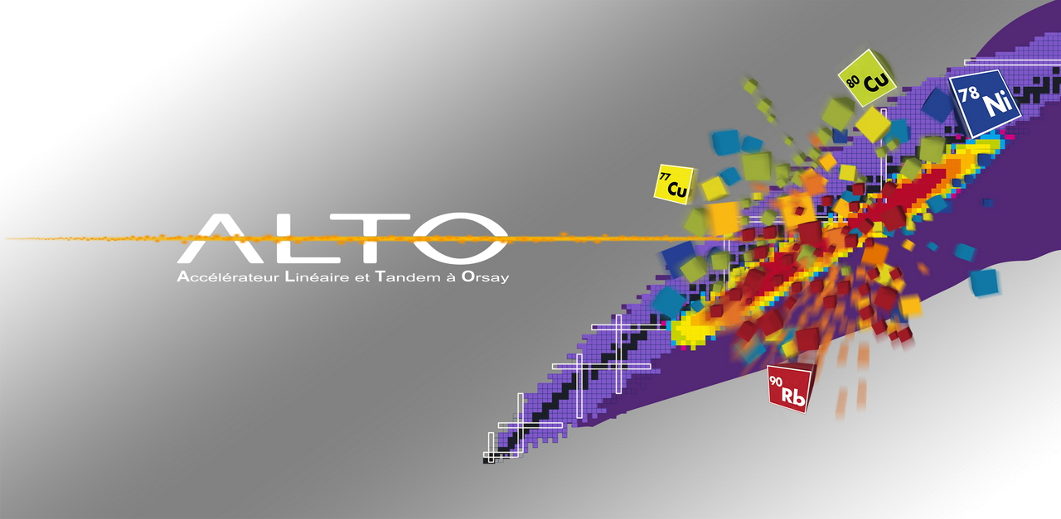
The ALTO facility
G. Georgiev

Slide 2
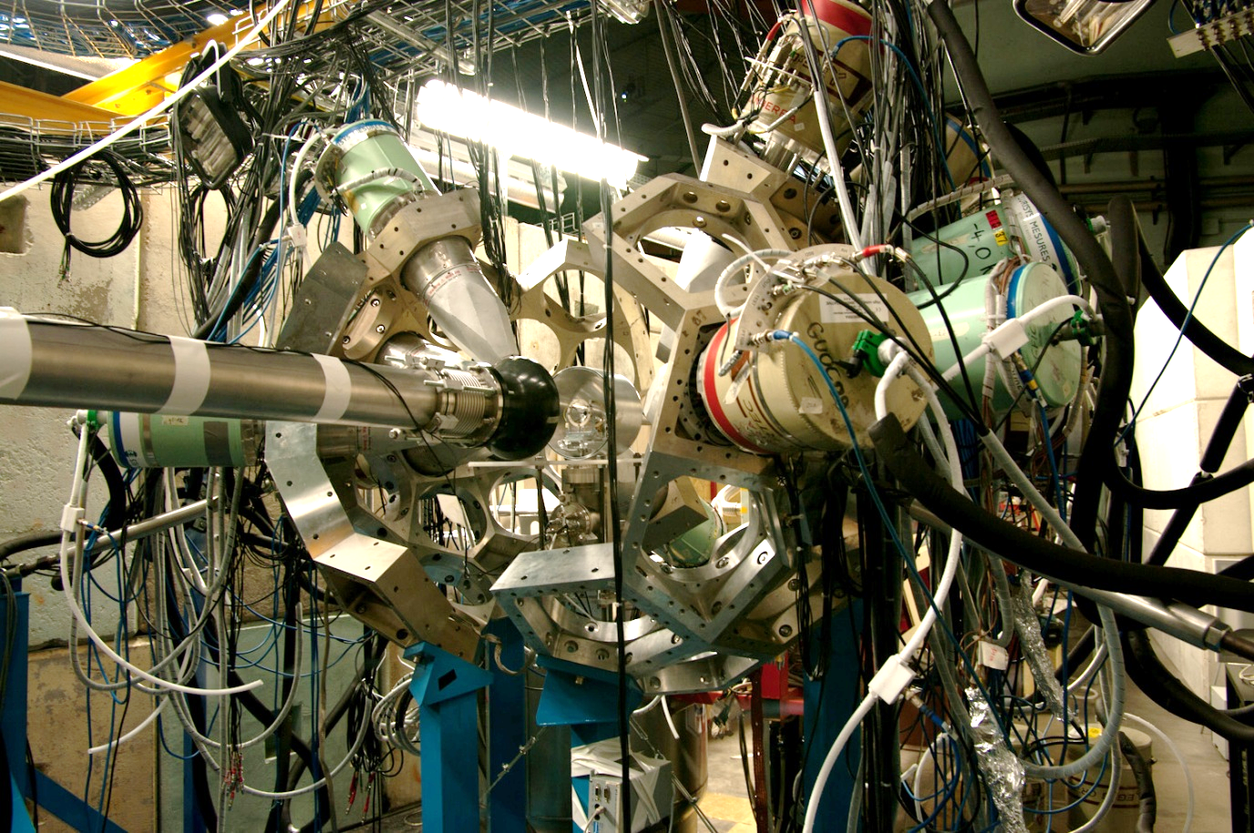

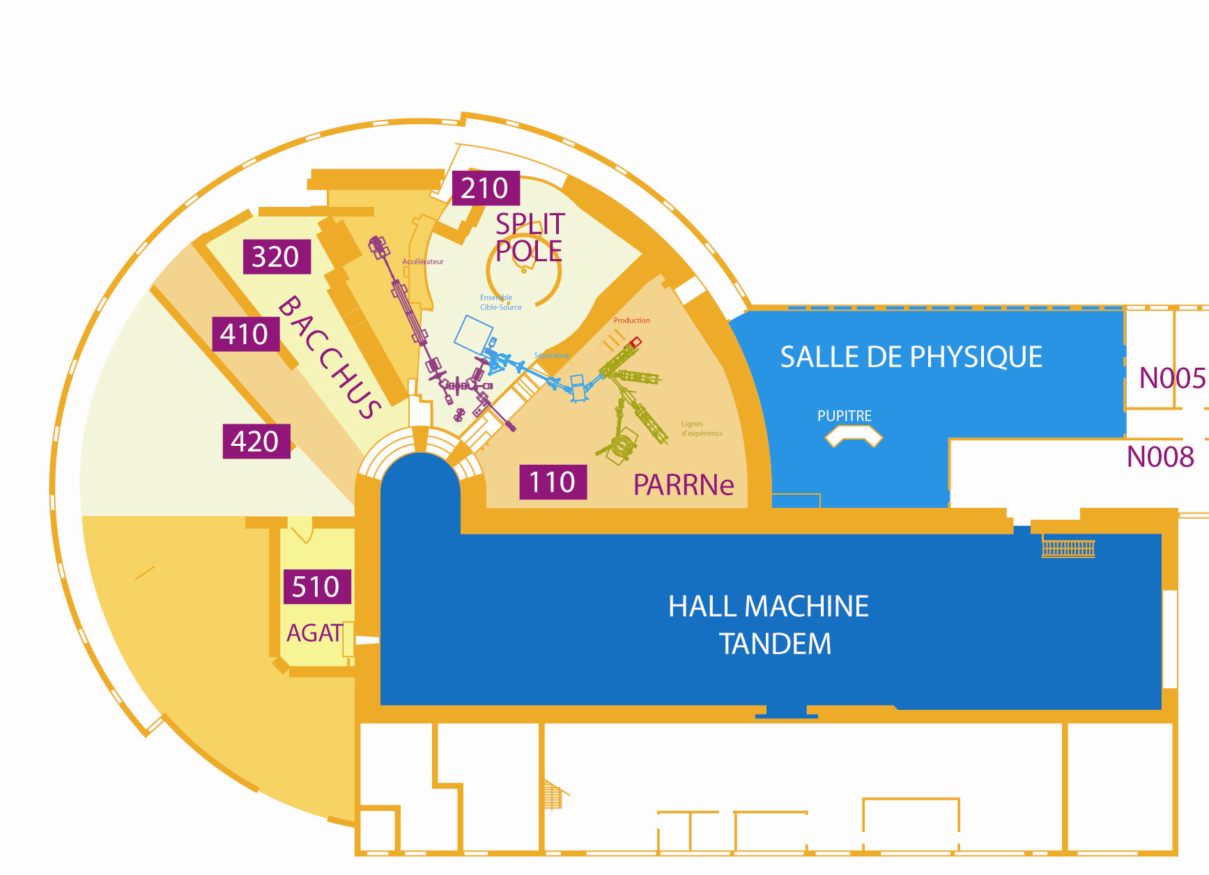
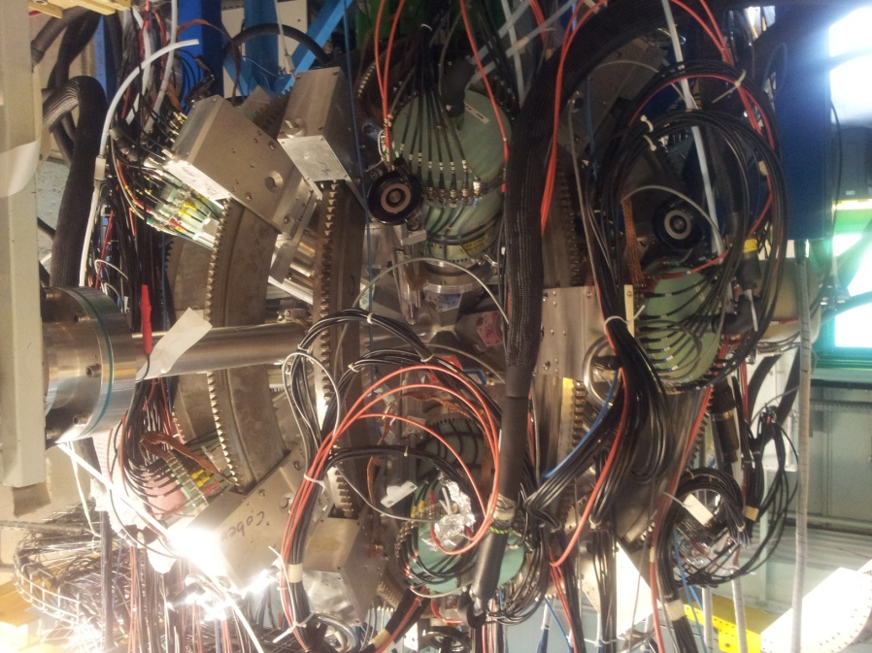
Experimental areas
γ-spectroscopy
Bacchus
Split-Pole
spectrometer
ISOL
production cave
ORGAM
ISOL
experimental cave
(~100 m²)
ISOL installation
e LINAC
MINORCA
Radioactive beam lines
Stable beam w/o spectrometer
cluster,
molecular &
droplets beams
Stable beam with spectrometer

Slide 3
Stable beams from the ALTO Tandem
http://ipnwww.in2p3.fr/Available-beams
Standard Tandem beams
- from H, ³He, ⁴He, ..., ¹⁴C, ... up to ¹²⁷I
- terminal voltage: from < 1 MV up to 14.5 MV
- beam pulsing: pulse width 1 – 2 ns; repetition rate – 200 ns or more
- new ions source purchased for higher intensity of difficult beams (Mg, Ca)
How to get the beamtime? → the ALTO PAC
Richard Casten, Yale, USA, Chair; Dimiter Balabanski, ELI-NP, Romania;
Emmanuel Balanzat, CIMAP/GANIL, France; Marcella Grasso, IPN Orsay, France; Stéphane Grévy, Bordeaux-Gradignan, France; Adam Maj, IFJ PAN Kraków, Poland;
Paddy Regan, Univ. Surrey, UK; Peter Reiter, Univ. Koeln, Germany;
Berta Rubio, CSIC-Univ. Valencia, Spain; Jean-Charles Thomas, GANIL, France;
Christina Trautmann, GSI, Germany; Aurora Tumino, LNS-INFN Catania, Italy
Call for proposals once a year

Slide 4
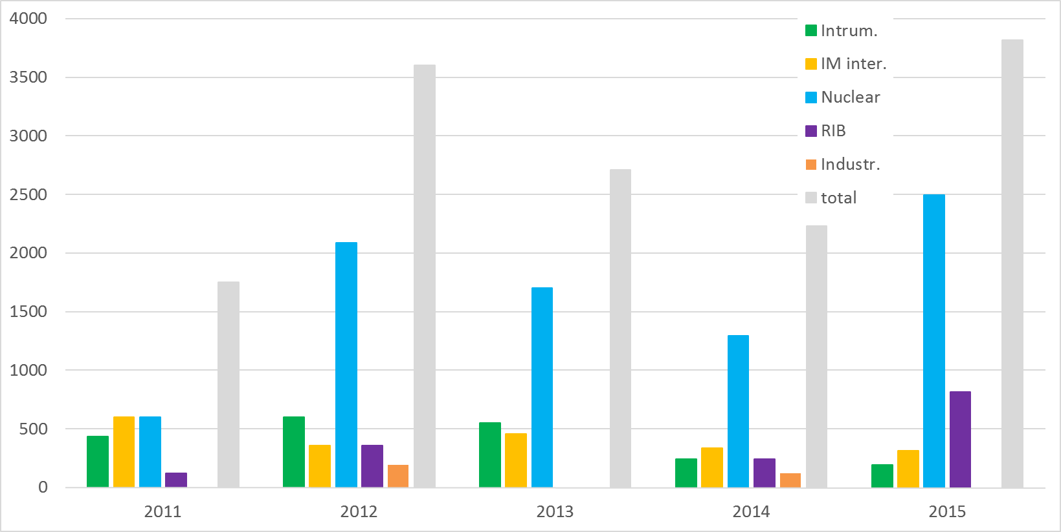


Beam-time and users (2011 – 2015)
2011 2012 2013 2014 2015
Users ~120 ~240 200 135 246
Beam-time 1752 h 3600 h 2712 h 2232 h 3816 h
219 UT 450 UT 339 UT 279 UT 477 UT
ALTO - TNA within ENSAR and ENSAR2

Slide 5
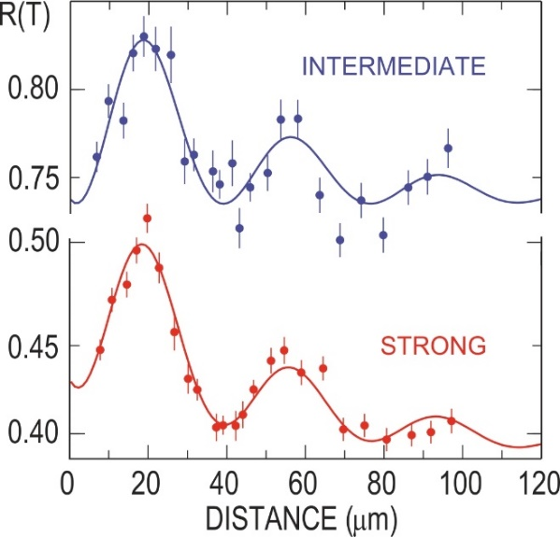
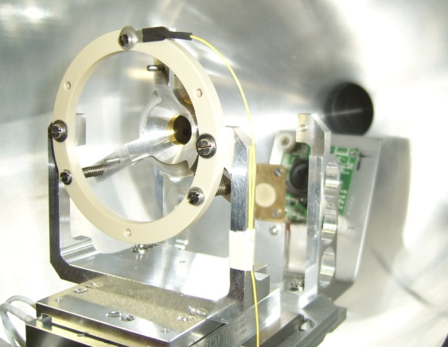
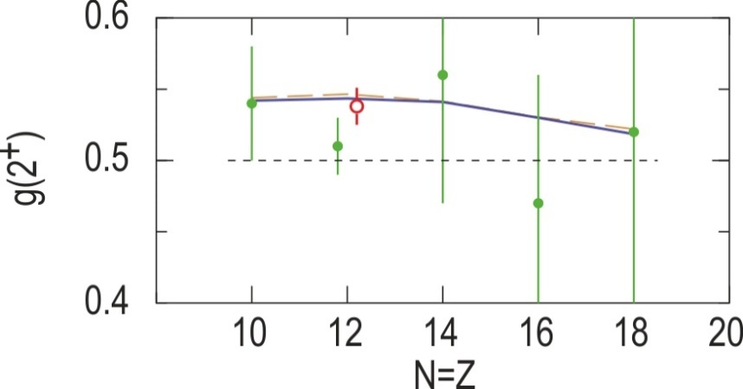

Gamma-ray spectroscopy with ORGAM
TDRIV on H-like ions in RIB geometry: ²⁴Mg
$B_{ns}=16.7\frac{Z^{3}}{n^{3}}\left[1+{(Z/{84})}^{2.5}\right]$ [T]
beam: ²⁴Mg @120 MeV (5 MeV/u)
target: 2.4 mg/cm² ⁹³Nb
reset Foil: 1.7 mg/cm² ¹⁹⁷Au
ORGAM
OUPS
Previous measurement:
|g(2⁺)| = 0.51 (2)
R.F. Horstman et al., NPA 248, 291 (1975)
Our result:
|g(2⁺)|= 0.538 (13)
A. Kusoglu et al. PRL 114, 062501 (2015)
²⁴Mg 2⁺ state USD shell model: g(2⁺)=0.544

Slide 6
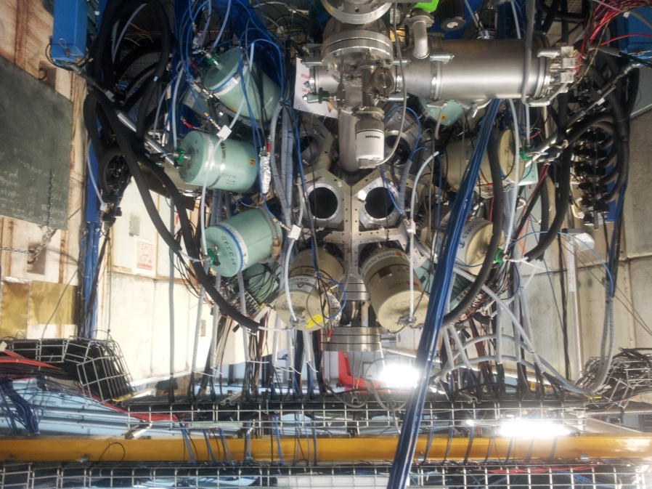
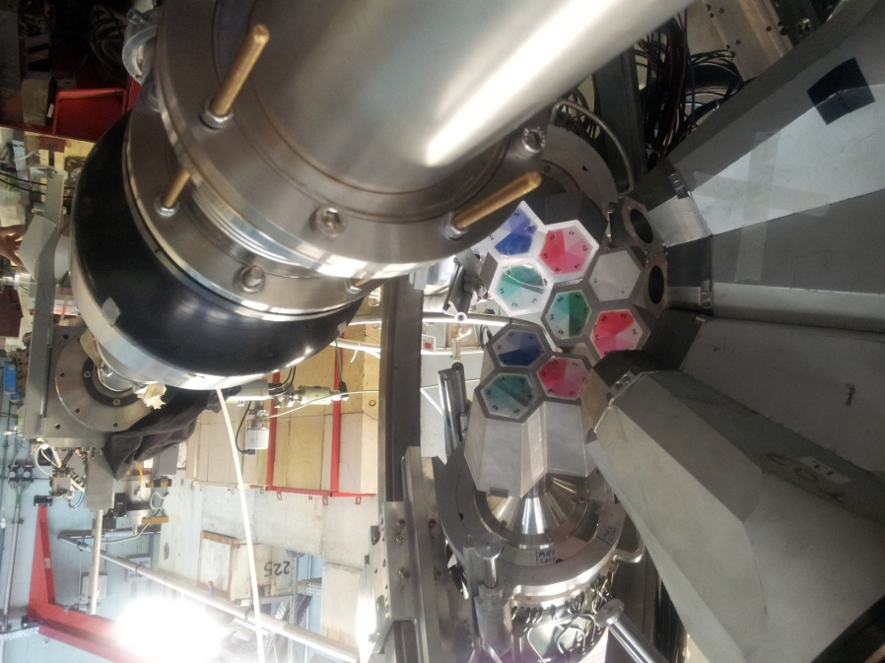
MINORCA at ALTO (June 2014 – March 2015)
12 ORGAM CS HPGe x 0.1%
8 Miniball TC at ~14 cm from target
7.3% efficiency @ 1.33 MeV
ancillary detectors:
- Orsay plunger (OUPS)
- particle detector
- DSSD
Campaign managers: I. Matea and G.G.

Slide 7
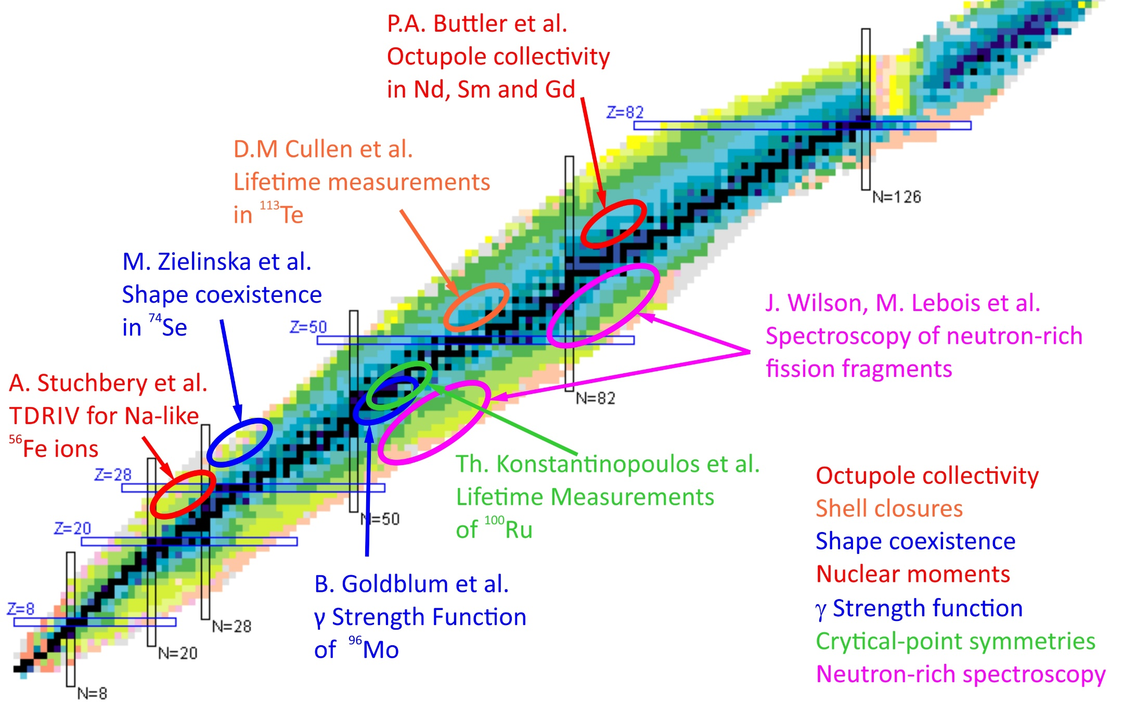
MINORCA physics cases
Campaign managers: I. Matea and G.G.

Slide 8
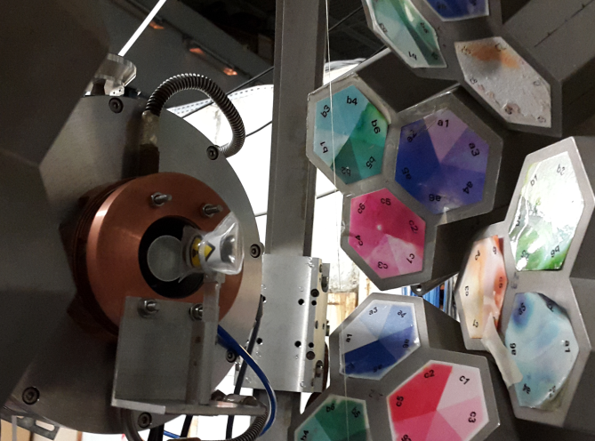
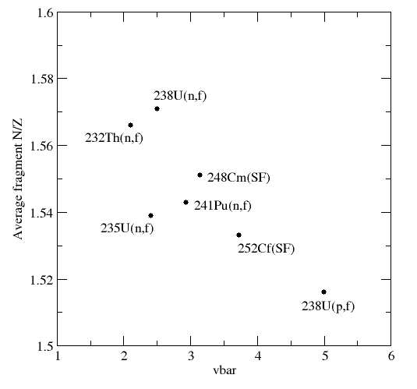
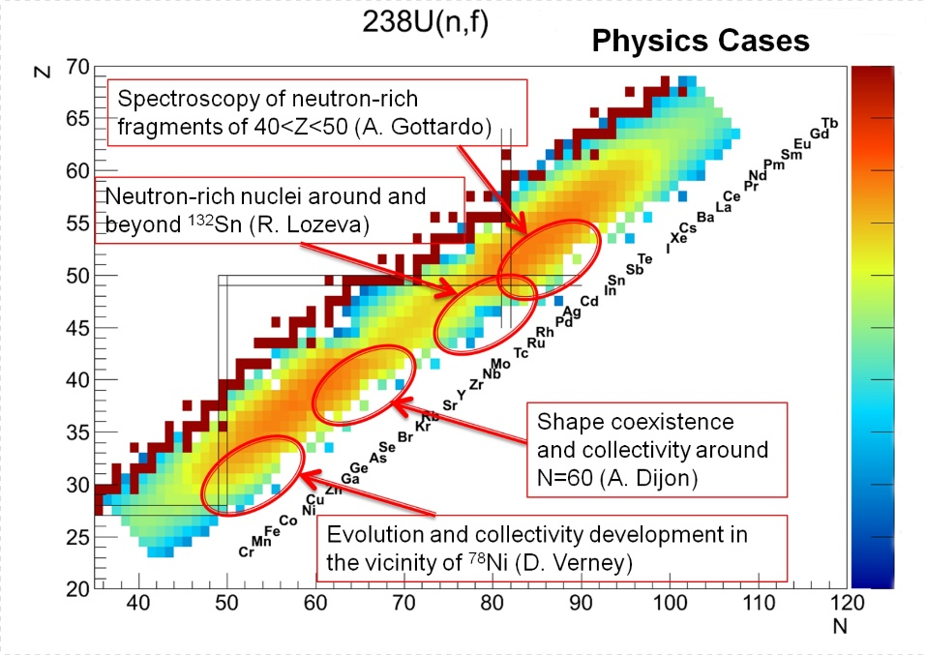
Lithium Inverse Cinematics ORsay NEutron source
Sample
+MINORCA
H target
γ
n-induced fission of ²³⁸U
n
n
n
n
TIPS – tagging of
isomer partners
100nA ⁷Li
13-17 MeV
γ
10⁷ n/s/cm²
LICORNE
Exoticity
EXILL
SF
J. Wilson, M. Lebois et al.
Testing ground for NFS@SPIRAL2

Slide 9
Is ¹⁰⁰Ru an E(5) nucleus?
T. Konstantinopoulos et al.
⁸⁸Sr(¹⁴C, 2n)¹⁰⁰Ru : 200 mbarn @ 42 MeV
¹⁴C beam @ <1.5 pnA
Orsay Universal Plunger System (OUPS)
RDDS (2⁺, 4⁺, 6⁺) :
DSAM (8⁺) :
* 12 plunger dist. from 1 um to 1 mm
6.5*10⁸ γ−γ coincidences collected

Slide 10
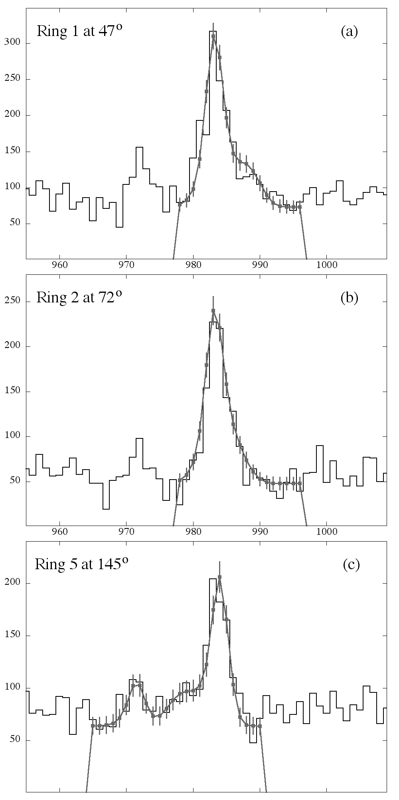
DSAM for the 8⁺
Fit with DSAM code for
3 different detector angles
T. Konstantinopoulos et al.
Preliminary!
“¹⁰⁰Ru not confirmed
as E(5) nucleus”

Slide 11
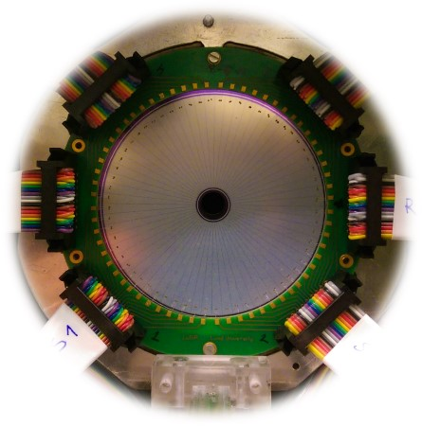
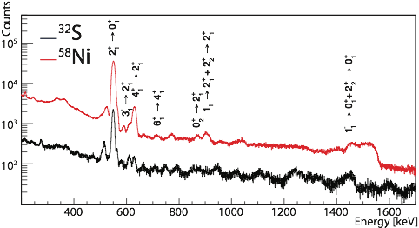
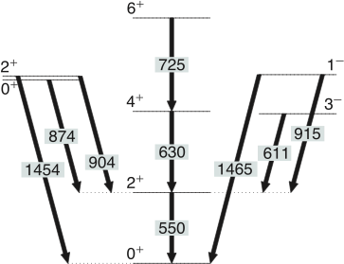
Pear-shaped nuclei in the N~88 region
Octupole collectivity in ¹⁴⁶Nd and ¹⁴⁸Sm
P. Butler, M. Zielinska et al.
Coulex
¹⁴⁸Sm
Courtesy M. Komorowska

Slide 12
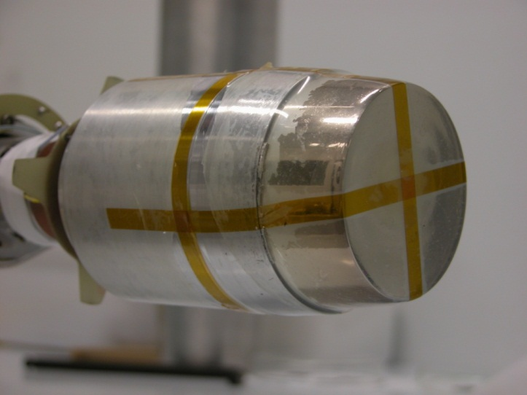
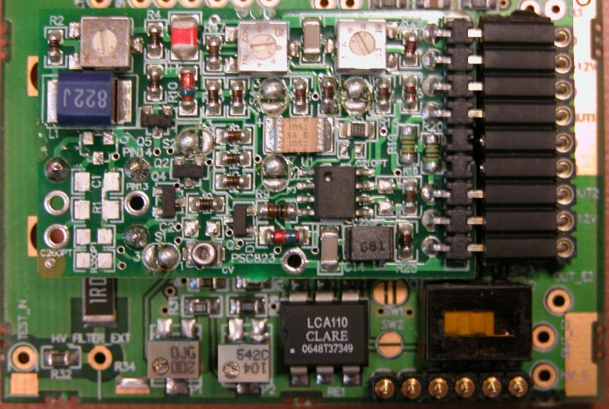
Ge detectors maintenance at IPNO
At present
Canberra PSC 823 CM charge preamplifier
Detector calibration, potentially 3 in parallel
Failure diagnostic and maintenance (no crystal processing) on coaxial detectors
Manpower:
  1 technician, 100 % FTE
  1 engineer, 15 % FTE
  Support from the electronics department
Currently acquiring the ability to routinely manage students on detector calibration and instrumental issues
Courtesy B. Genolini

Slide 13
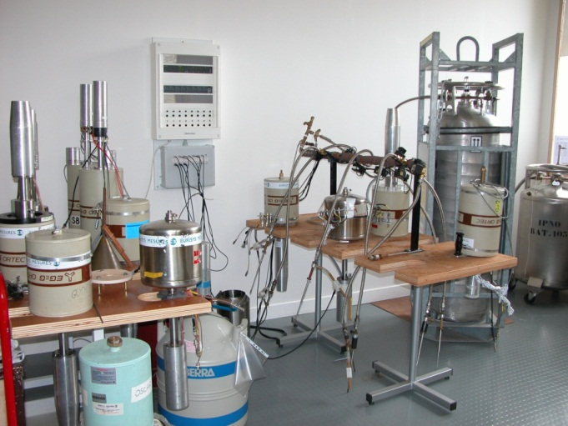
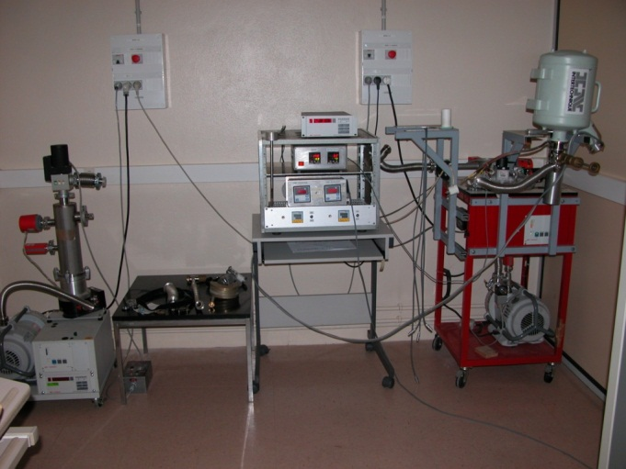
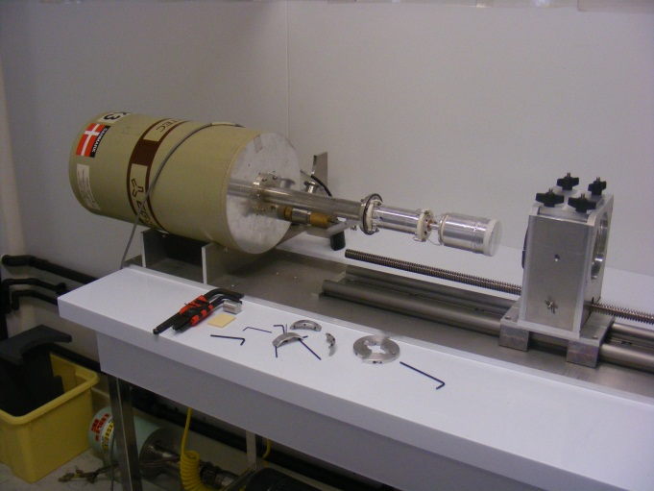
Hardware resources
single-channel analog spectroscopy chain + analysis software (ORTEC MCA + Maestro)
2-channel high-voltage power supply (ISEG NHQ 226L)
1 digitizing oscilloscope
2-channel digital spectroscopy chain (CAEN DT5780, 100 MSPS, 14 bits) (validated with ⁶⁰Co): oscilloscope, charge spectrum; equipped with high voltage power supplies (two channels) to be validated.
1 additional digital spectroscopy chain to be validated
Pumping/annealing bench
Clean room for FET replacement, including tooling
Possibility to cool 7 detectors simultaneously
Pumping/annealing bench
Tooling in clean room
Courtesy B. Genolini

Slide 14
Qualifications
Know-how (maintain coaxial detectors)
Failure diagnostic
Pumping
Annealing (80°C)
FET replacement
HV filter replacement
Charge preamplifier test and replacement
Replace ORTEC’s obsolete preamplifier by Canberra material
Training / experience
at Canberra on coaxial detectors (3 days in January 2016) (N. Hammoudi, B. Genolini, G. Brulin)
N. Hammoudi:
  24-year experience in vacuum and cryogenic technologies
  3-year experience in calibration and first-level maintenance on coaxial detectors, with experienced instrumentalists and engineers
B. Genolini:
  electronics/instrumentation engineer
  20-year experience in nuclear physics instrumentation
  10-year experience in detector signal processing, contacts with CAEN engineers
G. Brulin: electronics test, soldering, EMC
Courtesy B. Genolini

Slide 15
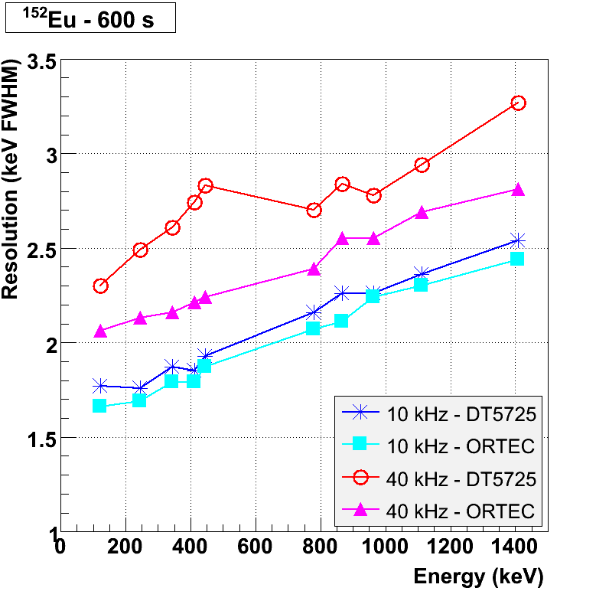
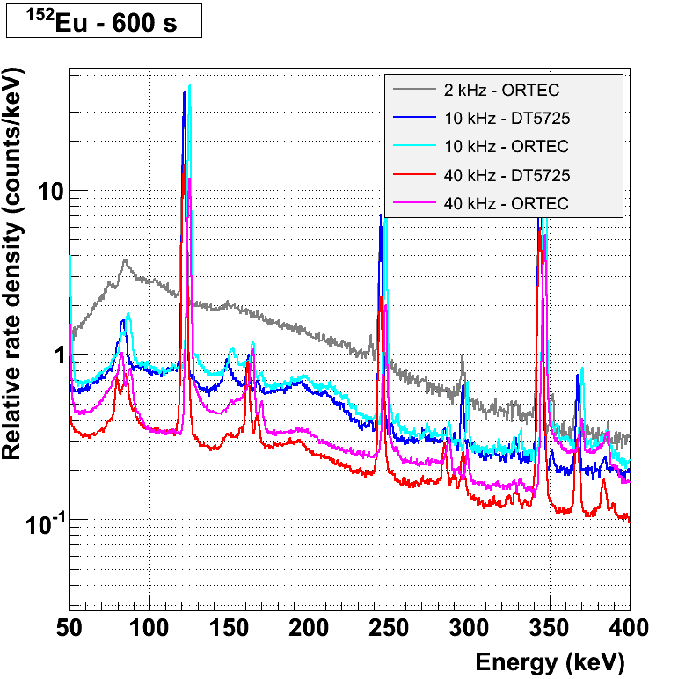
Schedule for 2016
Coaxial detectors
Apply the techniques learnt at Canberra on the gamma and loan pools
Improve the test procedures (e.g. efficiency, calibration and settings at different rates) (report in June 2016)
Train N. Hammoudi on digital chains to understand their parameters (resolution, pile-up rejection): CAEN and FASTER digitizers (to start in June 2016)
Clover detectors
Calibration
Specific training at Canberra – foreseen during S2/Q3 2016
Automate the biasing, monitoring and data analysis
  at present: 4 Clovers/week
  aim – double to triple this capacity using FASTER @ ALTO
Result of Automated data analysis for the comparison of a digital and analog spectroscopy chain: measurement with a ¹⁵²Eu source
Courtesy B. Genolini

Slide 16
Conclusions
Gamma-ray spectroscopy has been providing strong physics contributions to the nuclear structure studies at ALTO
On the technical side we have a considerable knowledge and we are getting further trained prepared specifically for the Clover detectors.

Slide 17
Thank you!

