Slide 1

Decay spectroscopy with LaBr₃(Ce)
detectors at RIKEN and GSI
Zsolt Podolyák
University of Surrey

Slide 2
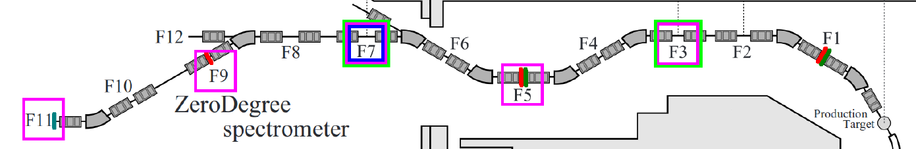
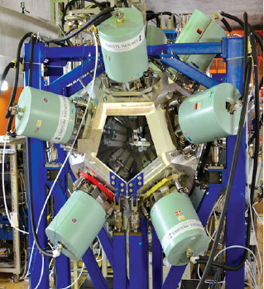
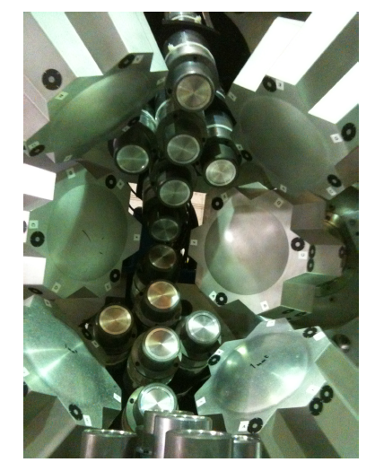
Decay spectroscopy following fragmentation
²³⁸U fission at 345 MeV/u
+ Very sensitive
Isomeric or beta decay

Slide 3
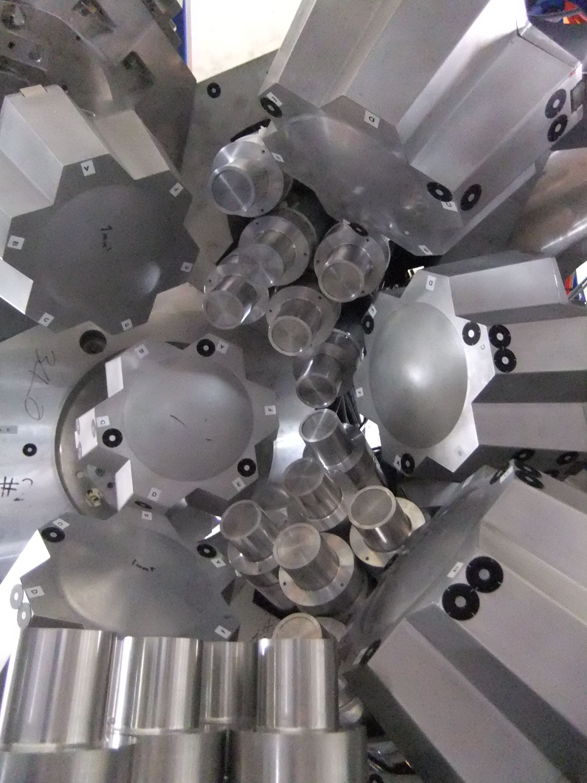
EURICA + fast-timing
12 Ge clusters + 18 LaBr3(Ce)

Slide 4
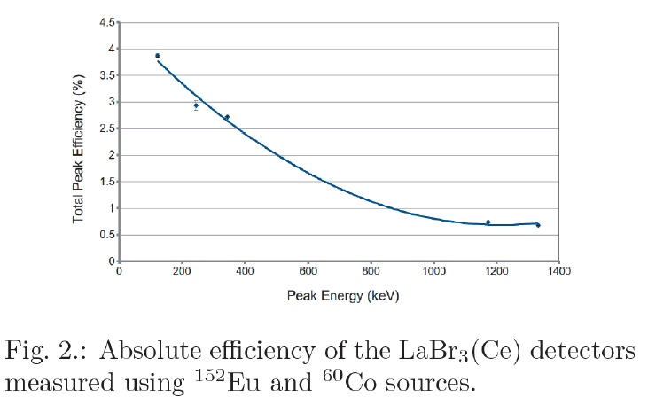
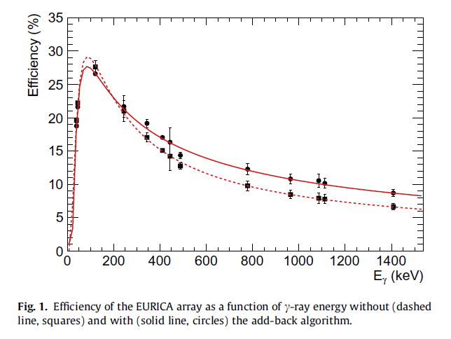
Gamma-ray detection efficiencies
4%
2%
Z. Patel et al., RIKEN
Accel. Prog. Rep. 47, 13 (2014)
P.-A. Soderstrom et al,
NIM B 317, 649 (2013)

Slide 5
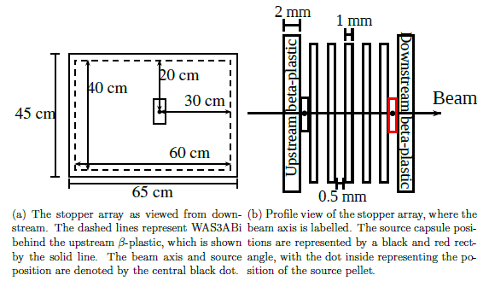
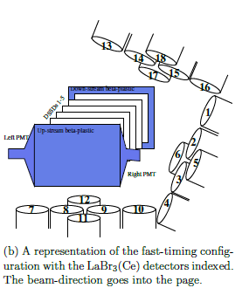
Beta-gamma timing
F. Browne, PhD thesis, University of Brighton (2016)

Slide 6
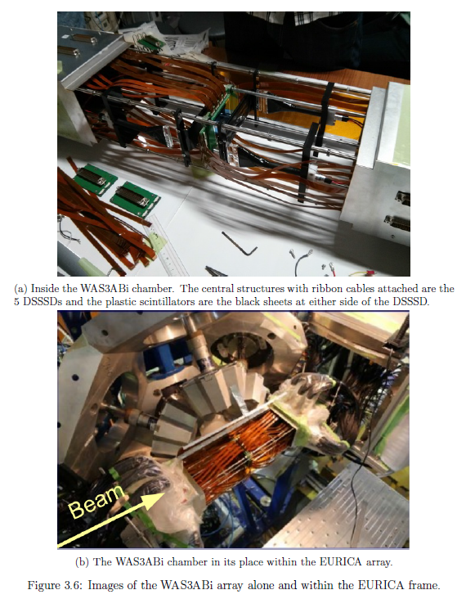
WAS3ABi with
two plastic scintillators
F. Browne, PhD thesis,
University of Brighton (2016)

Slide 7
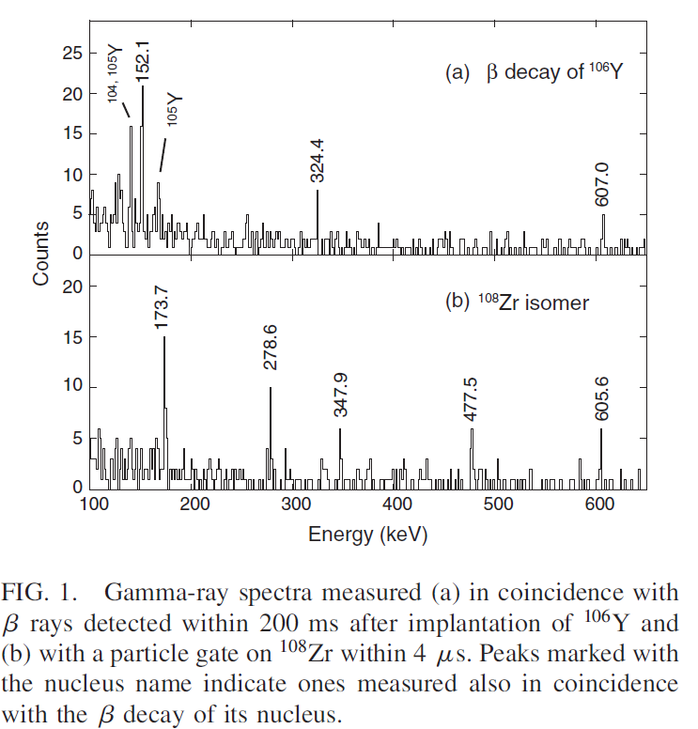
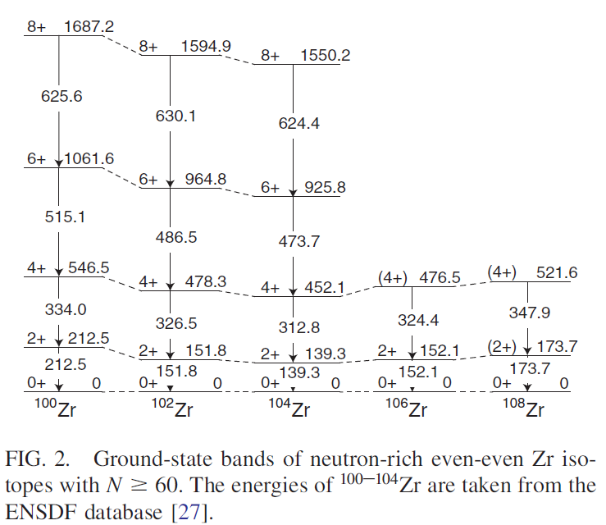
Shape evolution: neutron-rich Zr isotopes
T. Sumikama et al., Phys. Rev. Lett. 106, 202501 (2011)

Slide 8
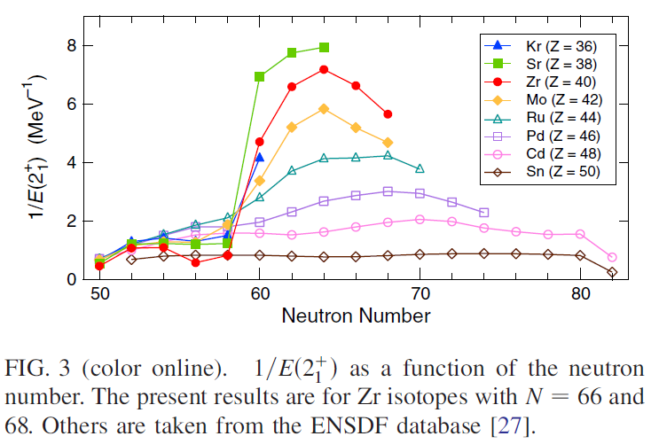
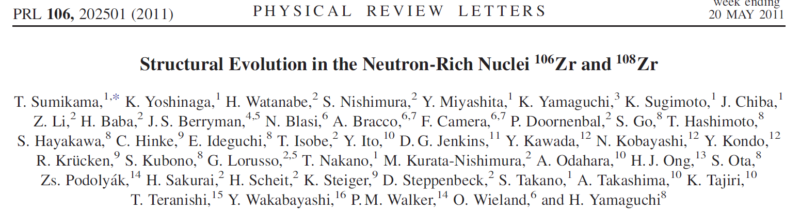
Shape evolution: neutron-rich Zr isotopes
T. Sumikama et al., Phys. Rev. Lett. 106, 202501 (2011)

Slide 9
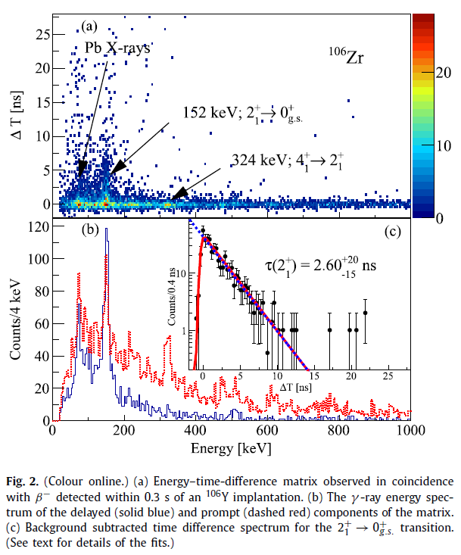
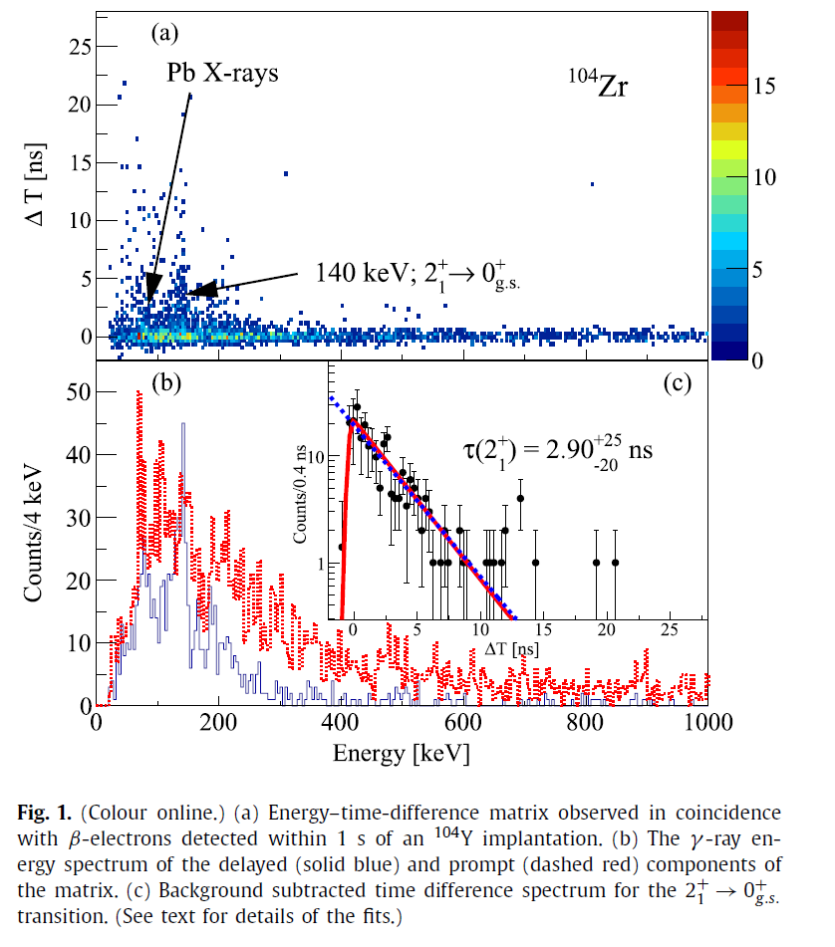
Fast-timing results
4x10⁵ ¹⁰⁴Y
6x10⁵ ¹⁰⁶Y
F. Browne et al., Phys. Lett. B 750 (2015) 448

Slide 10
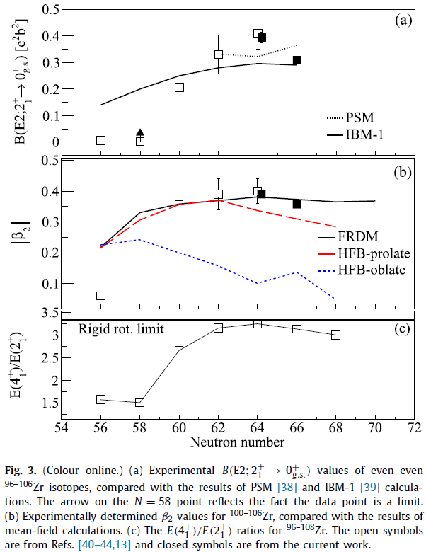
F. Browne et al., Phys. Lett. B 750 (2015) 448

Slide 11
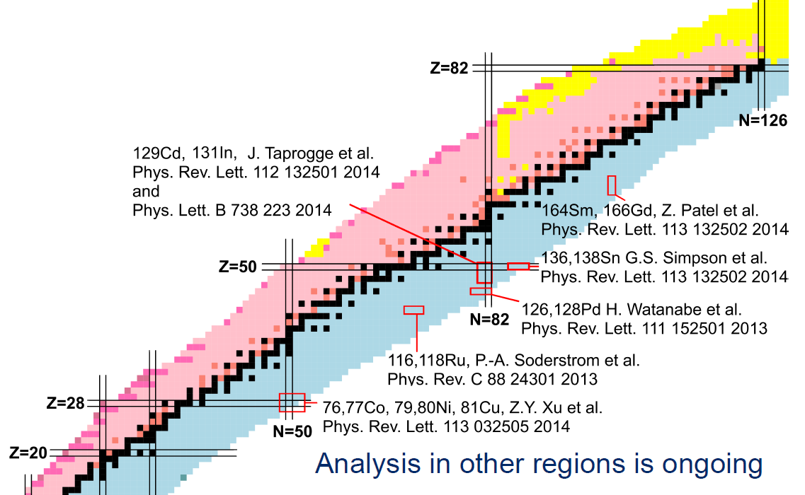
Future at RIKEN?
Neutron-rich nuclei at EURICA

Slide 12
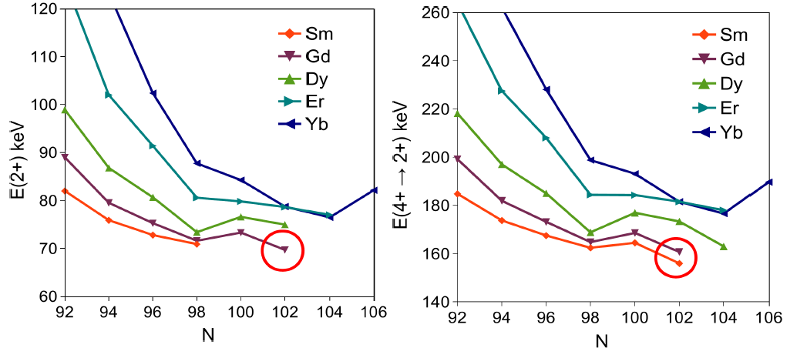
Around 170Dy: energy systematics
E(2+)
E(4+)-E(2+)
Excitation energies: kink at N=100
β₂ deformation calculations, always smooth change: no kink
Z. Patel et al., Phys, Rev. Lett. 113, 262502 (2014)

Slide 13
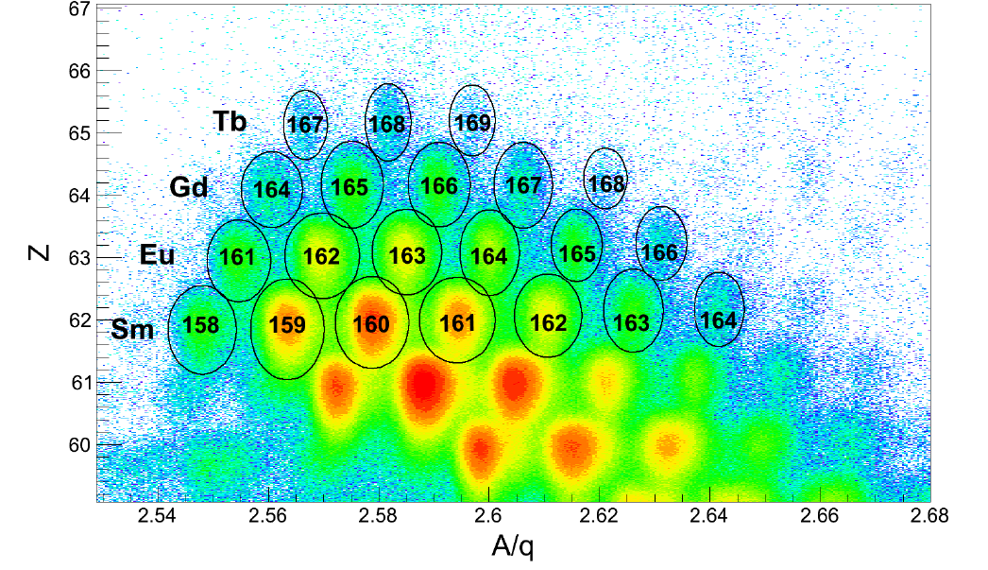
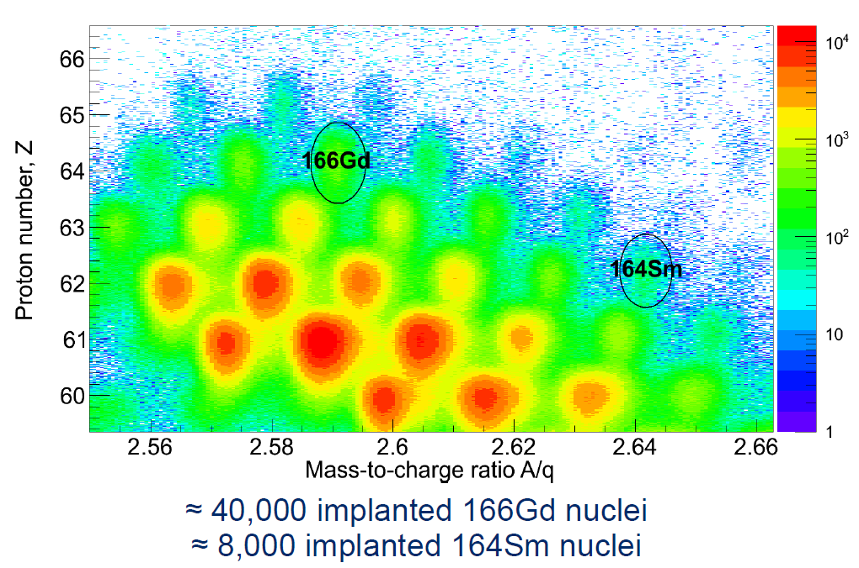
Identification
Z. Patel, PhD thesis, University of Surrey (2016)

Slide 14
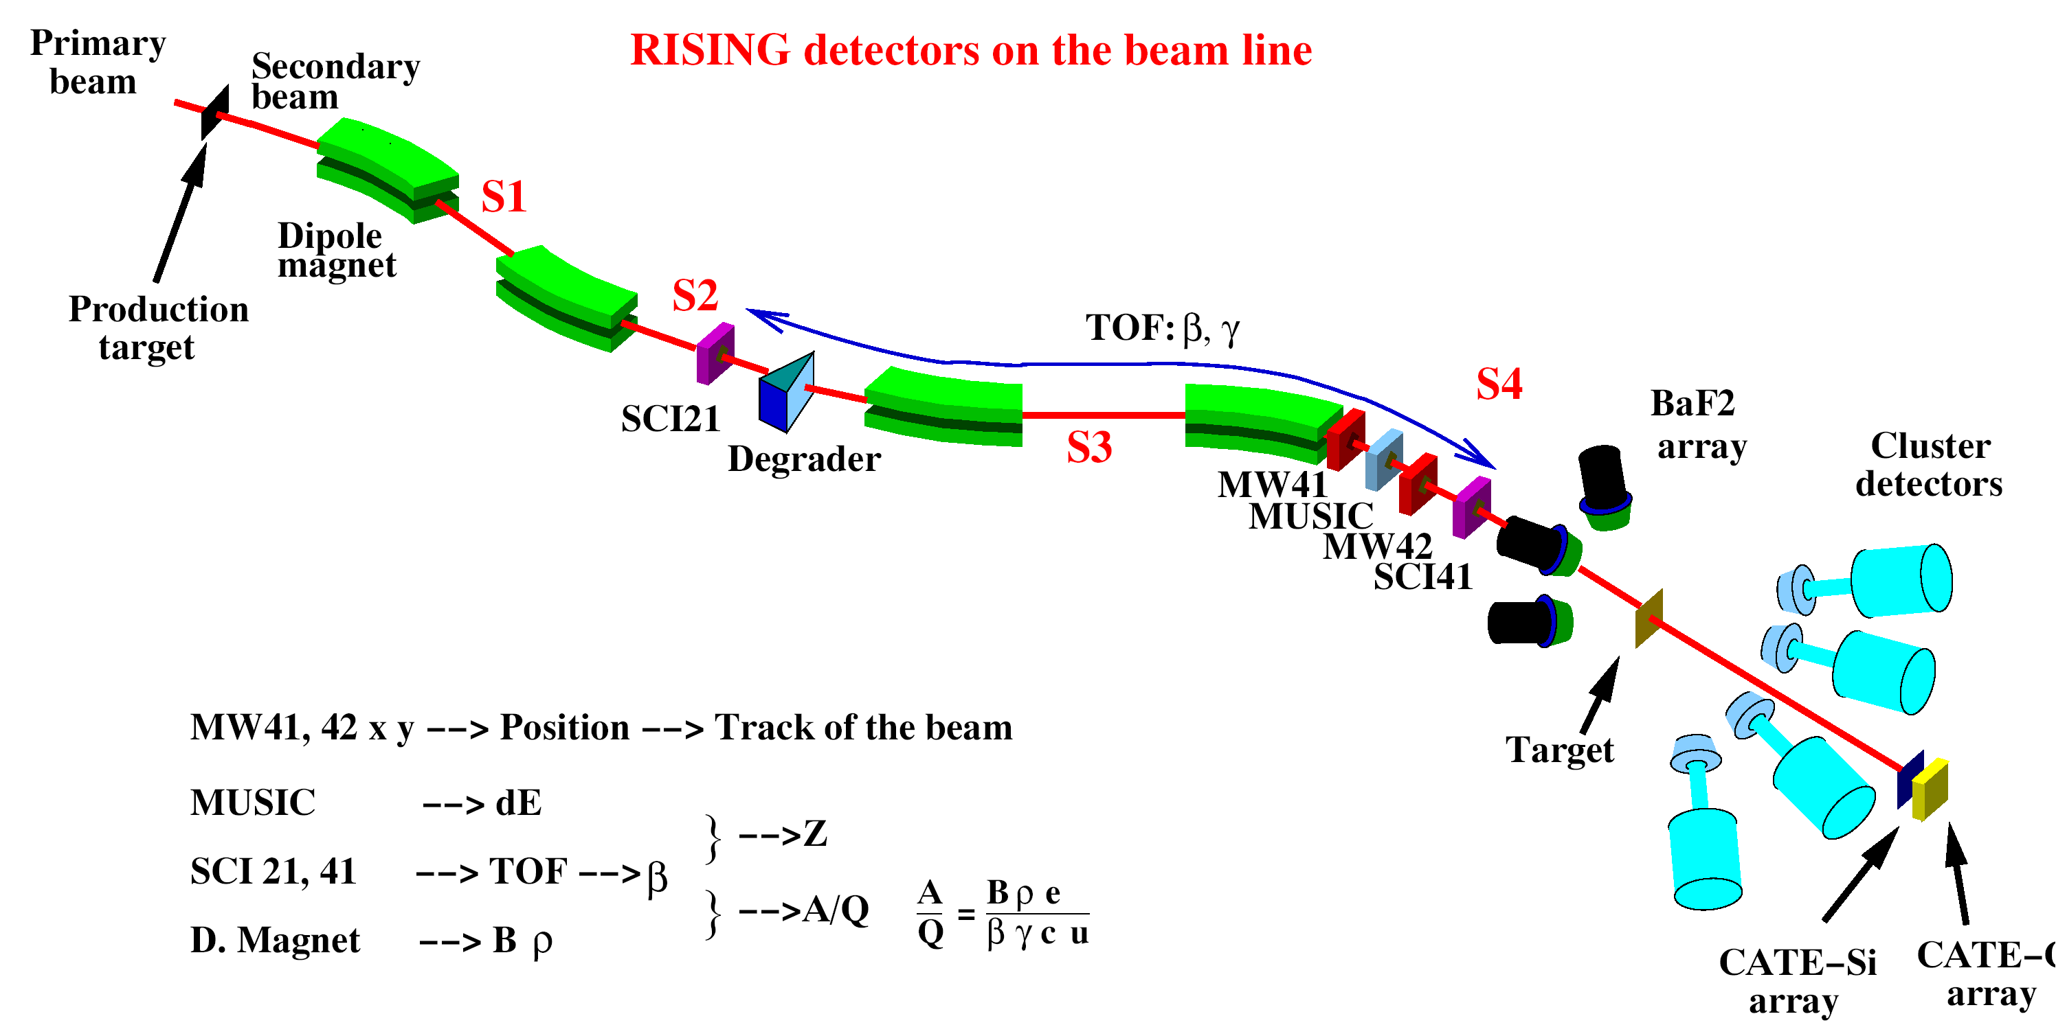
Decay spectroscopy at the Fragment Separator
DESPEC from 2018
Time from production to spectroscopic analysis: ~ 300 ns
fragmentation
fission
Isomers: - ‘special’ states
- tool to study exotic nuclei
Charged particle decays
Very sensitive method

Slide 15
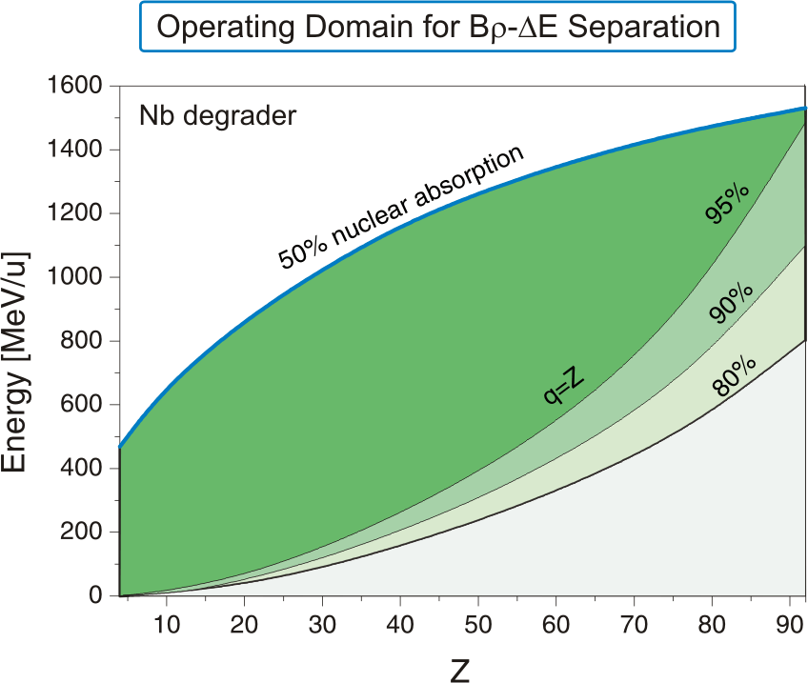
In-Flight Fragment Separation

Slide 16
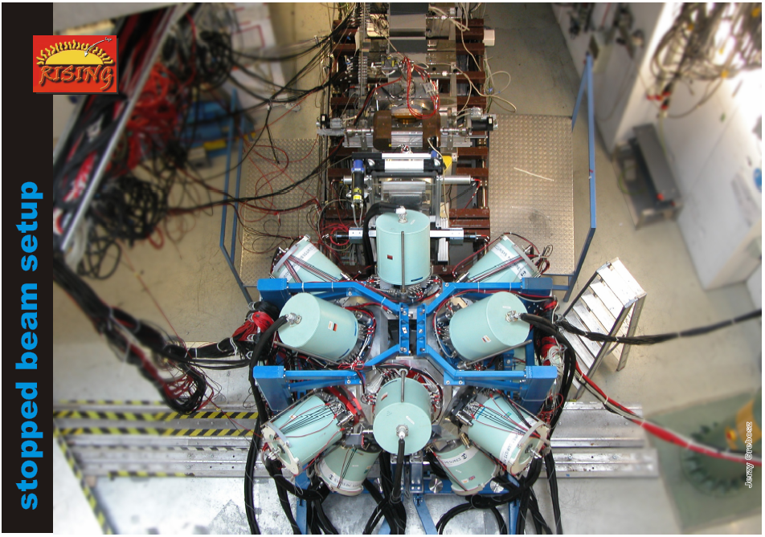
Stopped Rising Array @ GSI: 15 x 7 element CLUSTERs
ε_{γ} =11% at 1.3 MeV, 20% at 550 keV, 35% at 100 keV
flight time ~300ns

Slide 17
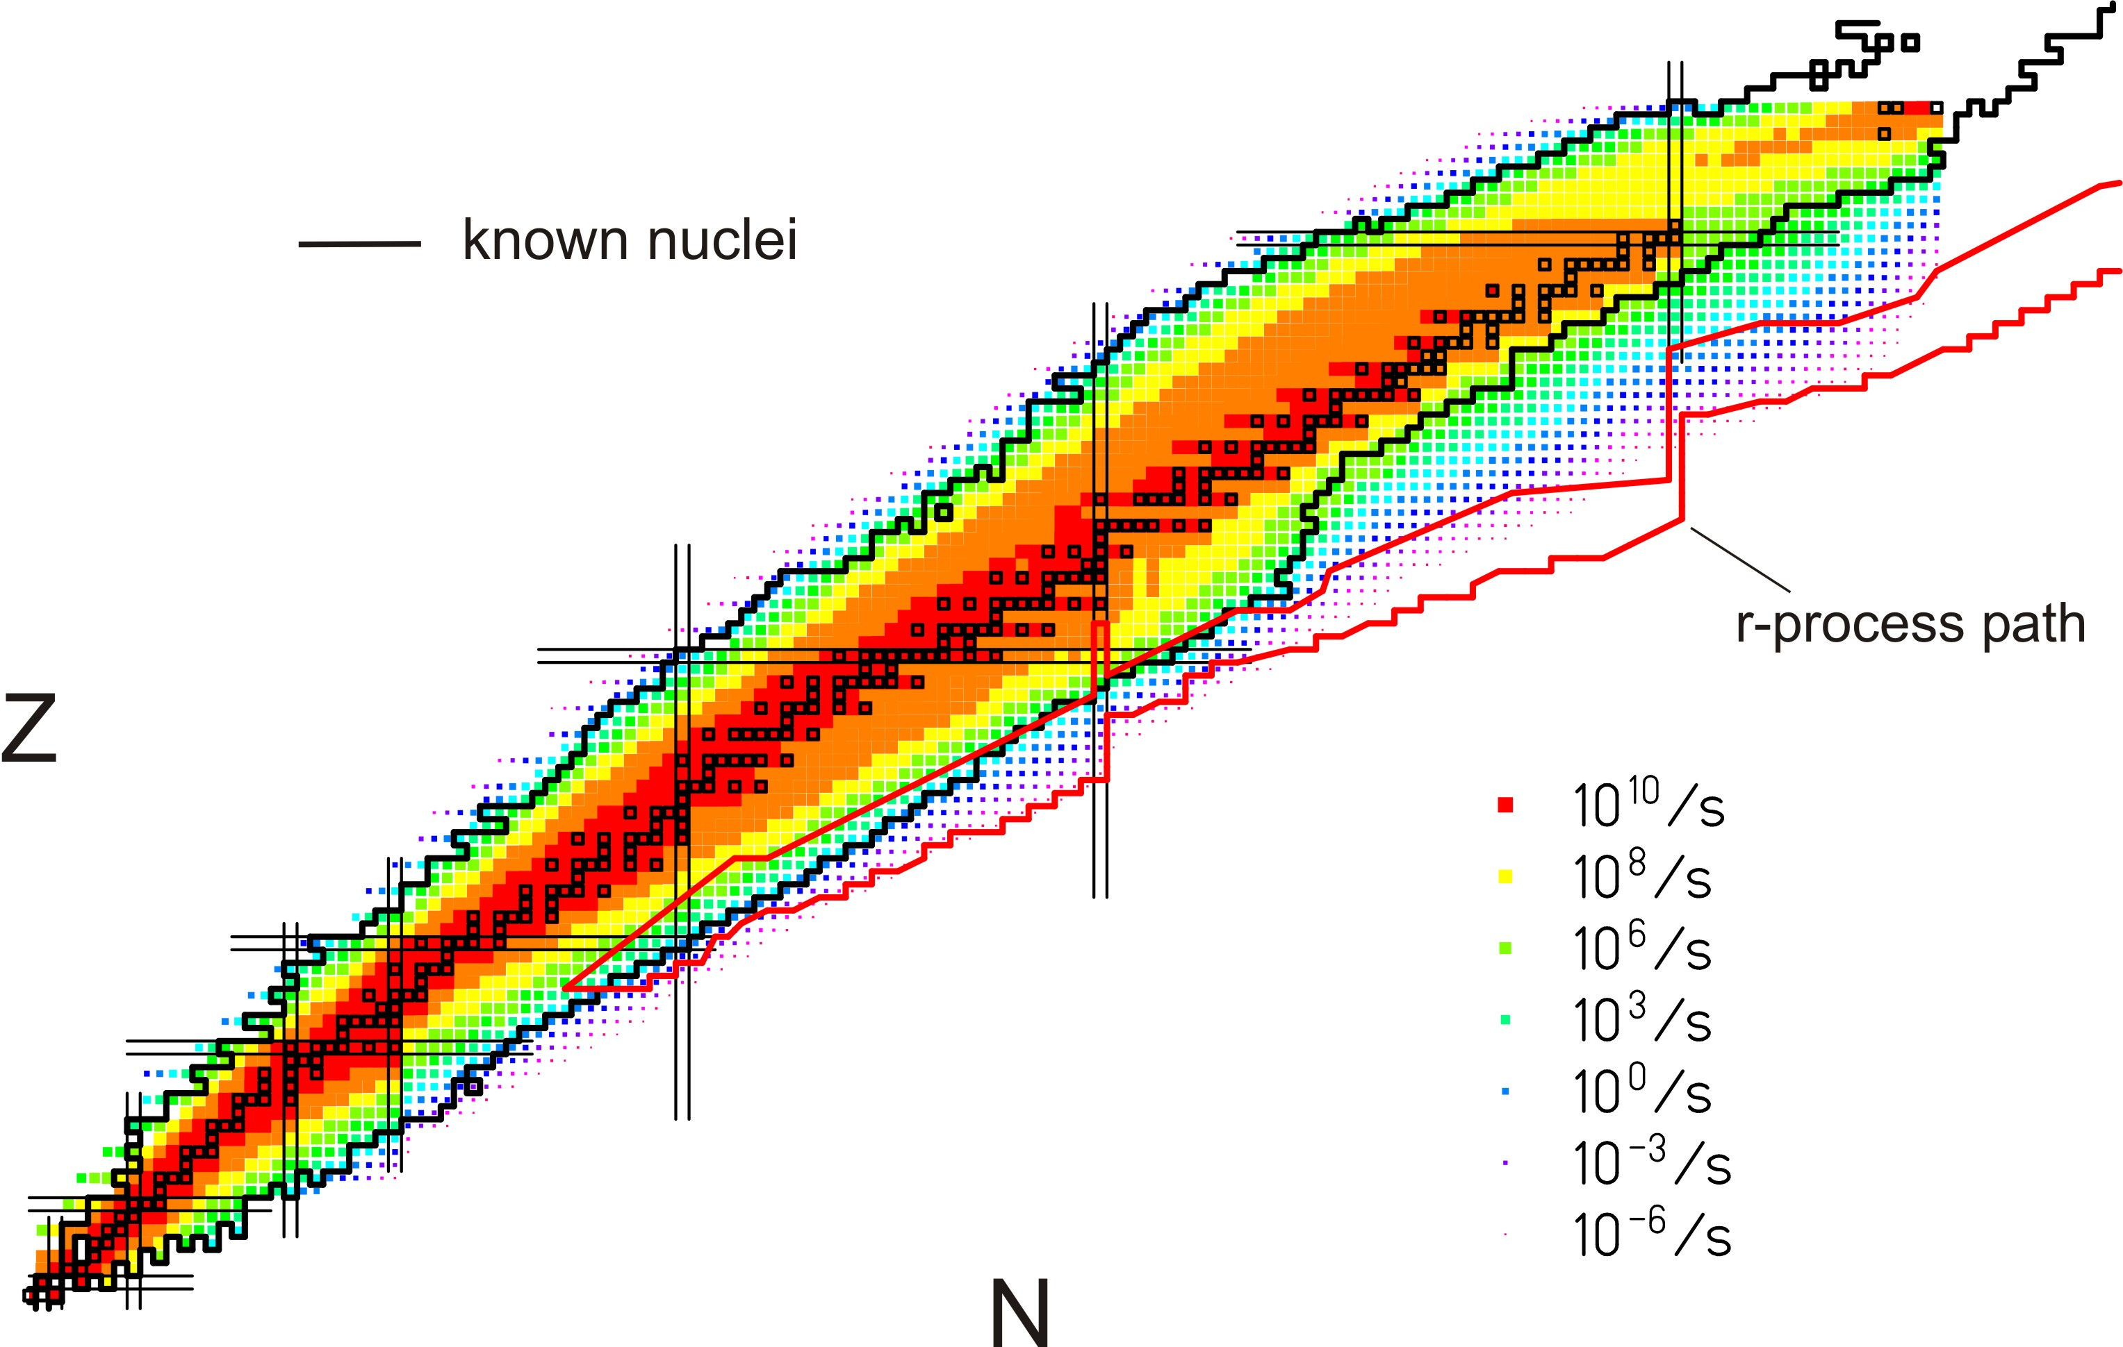
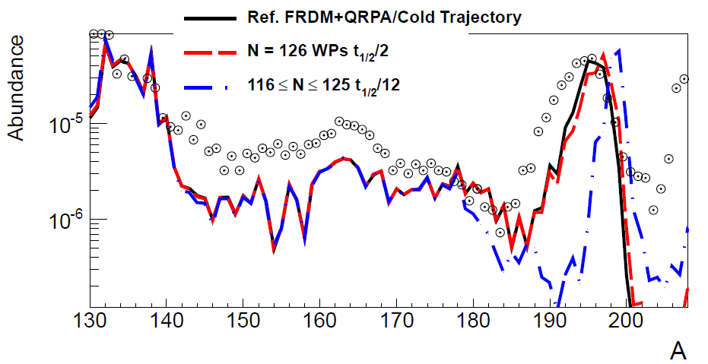
DESPEC in 2018-2020
Z~82/ N~126; r-process nuclei
Previous GSI measurements contradict earlier β-lifetime predictions!
→ Mass abundances not understood!!
GSI
Phase-0
old T_{1/2} predictions
new T_{1/2} predictions
Phase-1
Phase-2
3rd. waiting point
β-lifetimes
r-process path
Mass abundances depend on the detailed structure
of N=126 nuclei around the 3rd. r-process waiting point
NUSTAR will measure all relevant
-masses
-β-lifetimes
-neutron-branchings
-strength distributions
-level structure

Slide 18
Beam time at GSI
SIS-18 upgrade and UNILAC renovation, Operation of UNILAC (experiments) and SIS (tests) for 12 and 7 weeks, respectively
2017: SIS-18 upgrade and shielding enforcement
Q3-4: SIS-18 commissioning
2018: 4-5 months, FAIR preparations and experiments
2019: 5-6 months, FAIR preparations and experiments
2020: 5-6 months, FAIR preparations and experiments
Experiments 2018-- : DESPEC, R3B, (ILIMA)
DESPEC physics workshop: 27 September 2016, York

Slide 19
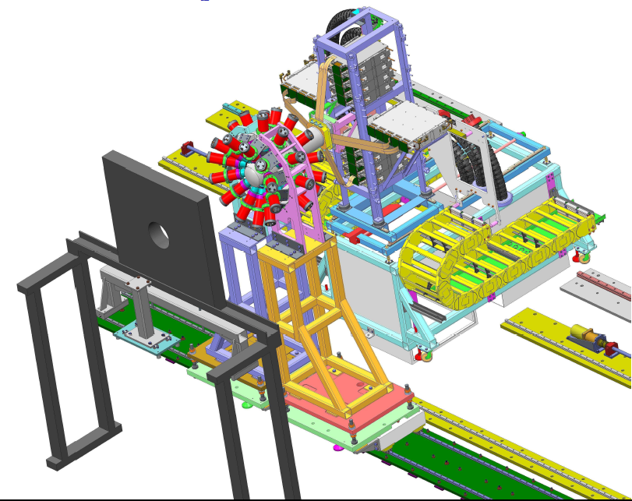
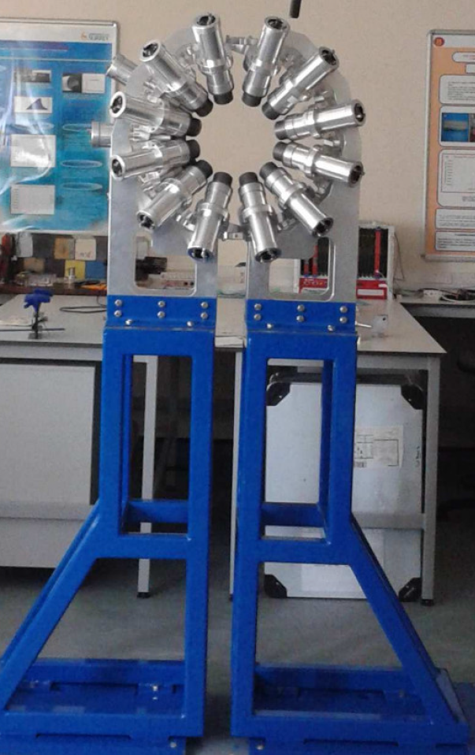
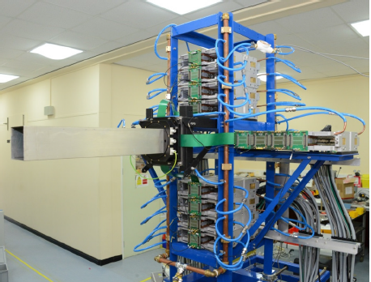
AIDA+LaBr₃(Ce) array
2018 onwards at GSI

Slide 20
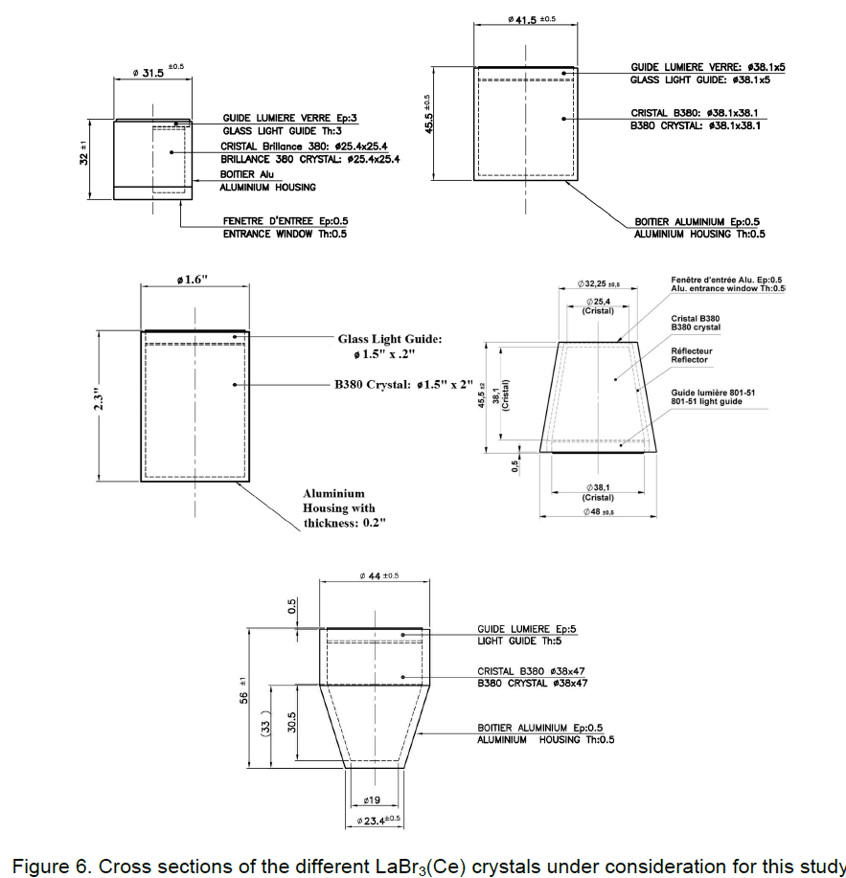
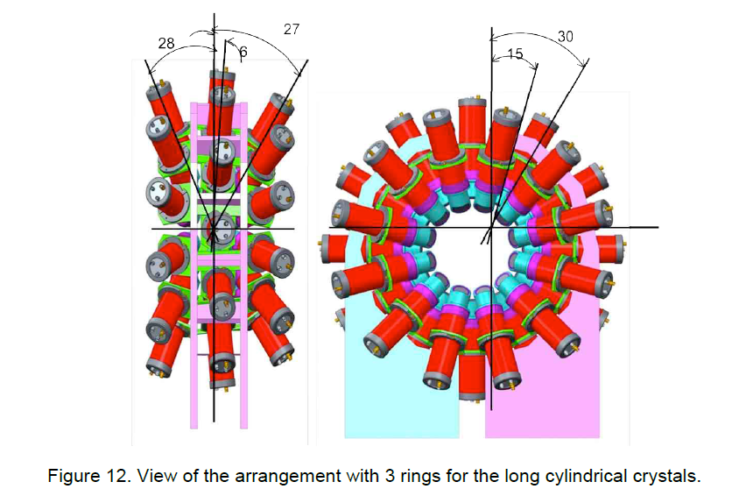
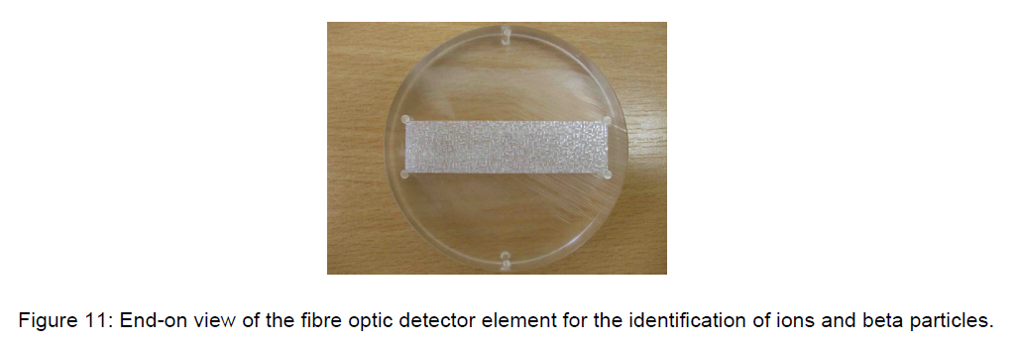
FATIMA Technical Design Report (L.M. Fraile et al., 2015)
O. Roberts et al., NIM A 748, 91 (2014)

Slide 21
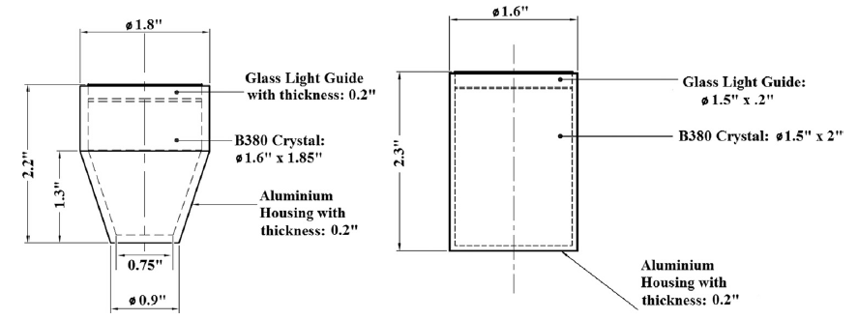
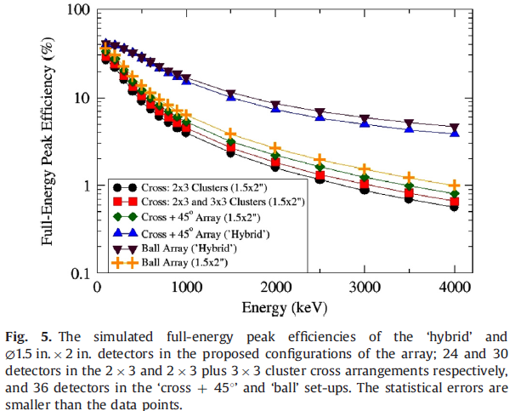
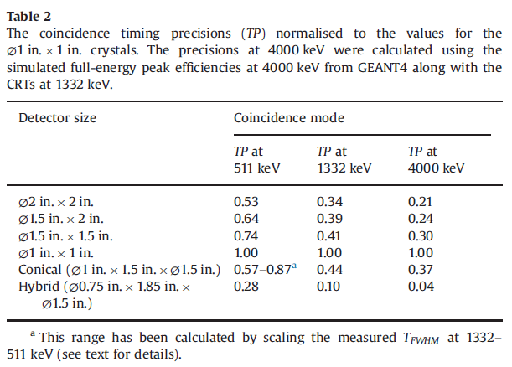
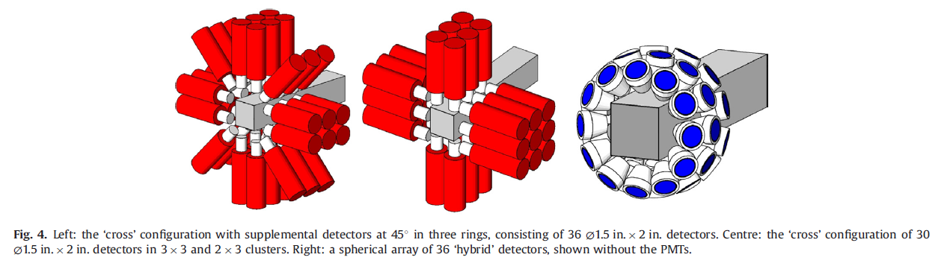
Simulations
O. Roberts et al., NIM A 748, 91 (2014)

Slide 22
Simulations
O. Roberts et al., NIM A 748, 91 (2014)

Slide 23
Existing frame (36 detectors)
A fourth ring can be added at forward angle

Slide 24
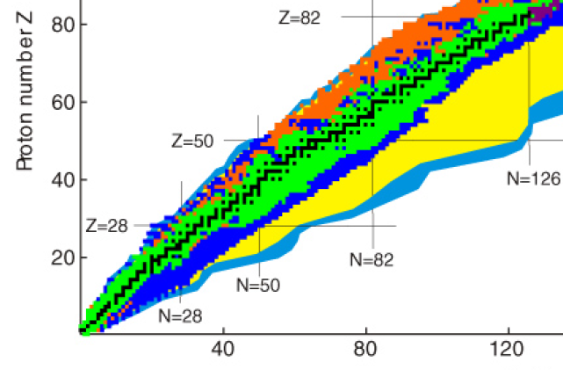
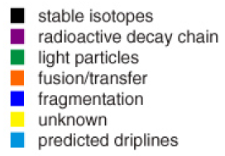
Summary
Fast-timing used at RIKEN (Zr nuclei)
Future: dedicated setup for fast-timing
high gamma (and beta/alpha) efficiency
Physics case?
for RIKEN (fission products?)
for GSI (heavy nuclei?)
/fission

Slide 25

Summary
-recently large amount of new experimental info
on neutron-rich N>126 nuclei
-excited states and lifetimes from fragmentation
-ideal testing ground for allowed vs FF beta decay
-role of FF transitions in nucleosynthesis
-future: fragmentation and/or multi-nucleon transfer
-future: setups dedicated to heavy neutron-rich nuclei
Thanks!

Slide 26
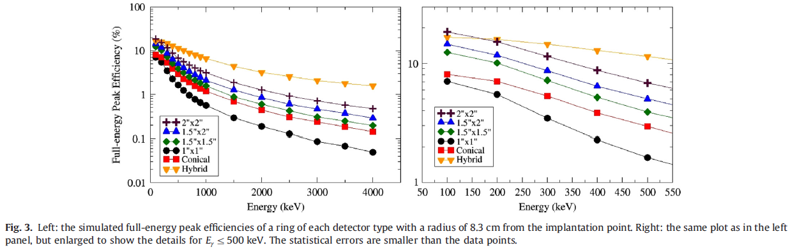
O. Roberts et al., NIM A 748, 91 (2014)

Slide 27
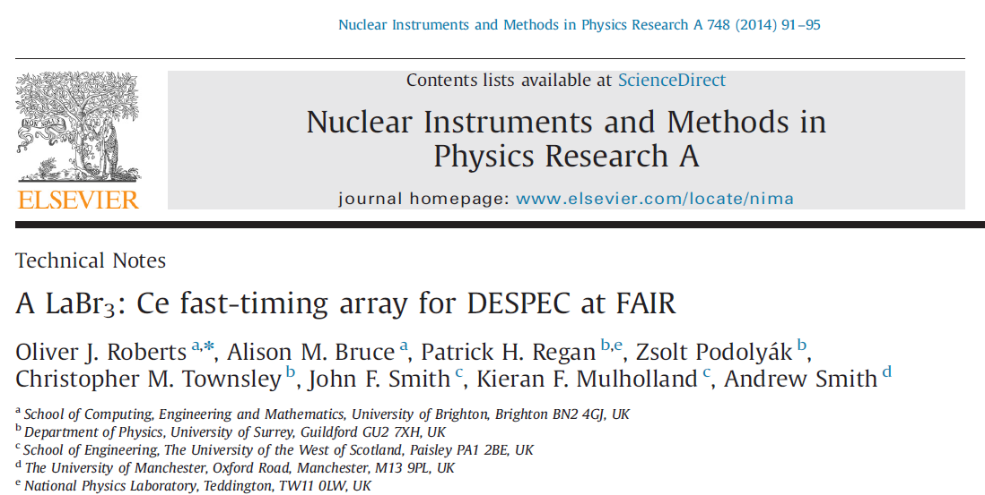
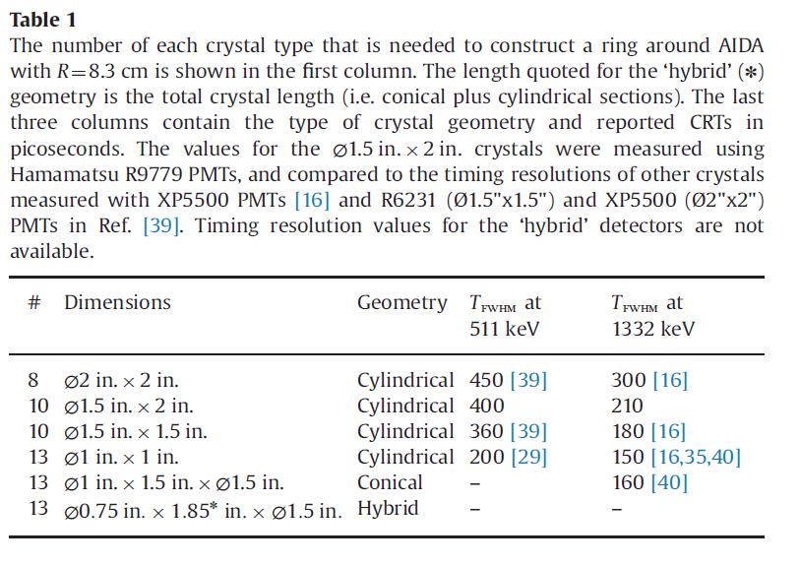
O. Roberts et al., NIM A 748, 91 (2014)

Slide 29
Z. Patel et al., RIKEN Accel. Prog. Rep. 47, 13 (2014)

Slide 30
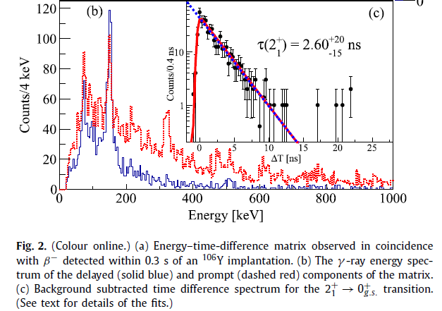
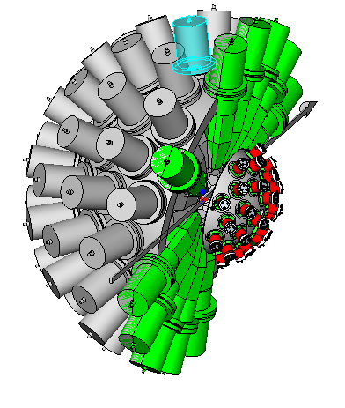
DESPEC fast-timing
RIKEN
2⁺ lifetimes in ^{104,106}Zr
F. Browne et al., Phys. Lett. B 750 (2015) 448
Argonne
Commissioning of the system (including EDAQ) was done:
Argonne National Laboratory (Dec. 2015-Jan. 2016)
(Gammasphere coupled to FATIMA detectors)

Slide 31
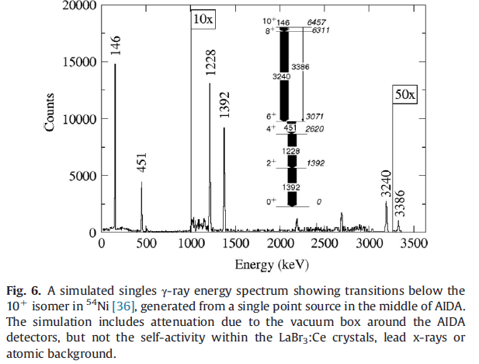

Slide 32
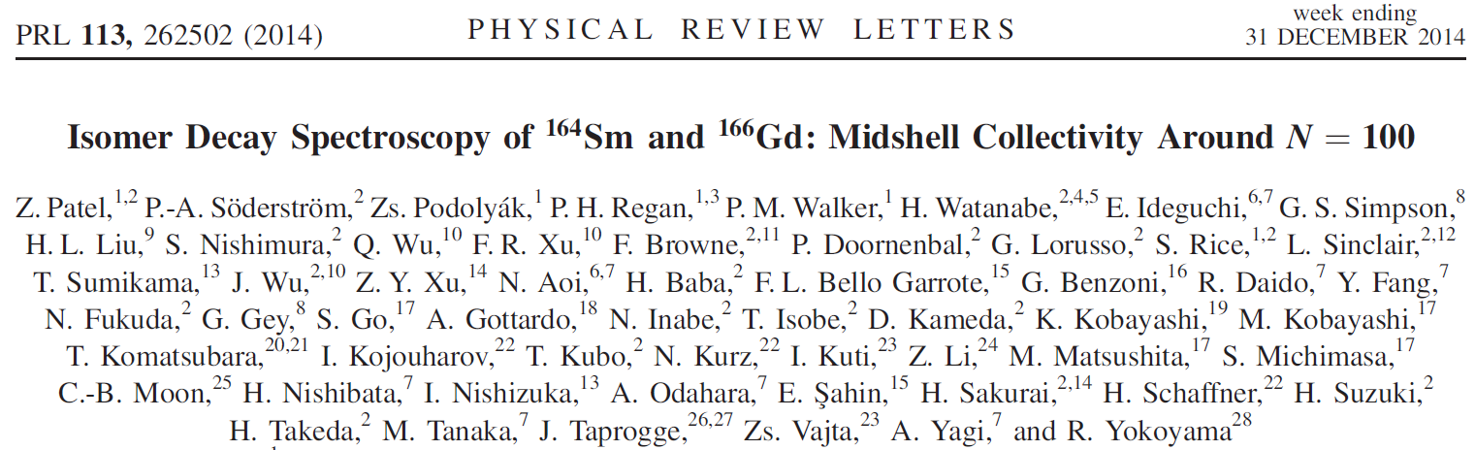
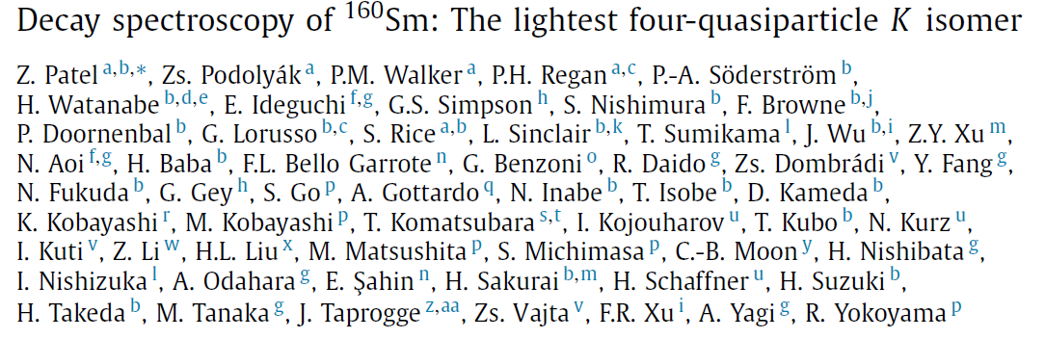
Thesis work of Zena Patel

Slide 33
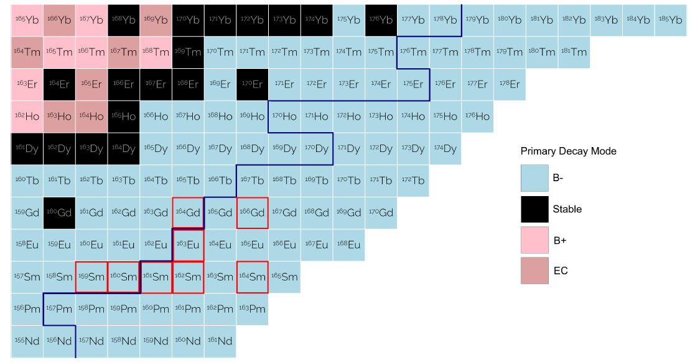
The double midshell region
Limit with known excited states
N=102
¹⁷⁰Dy (Z=66, N=104) double midshell nucleus

Slide 34
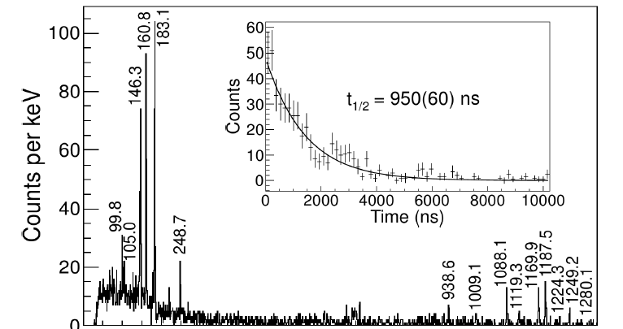

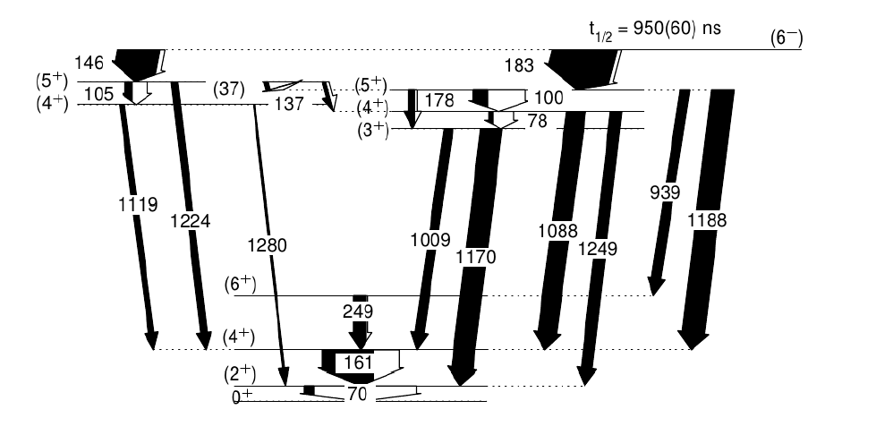

¹⁶⁶Gd
γ band

Slide 35
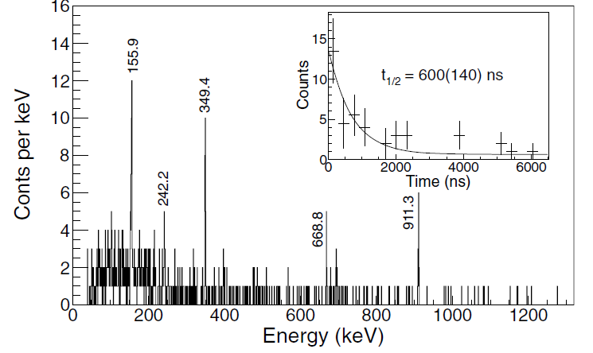

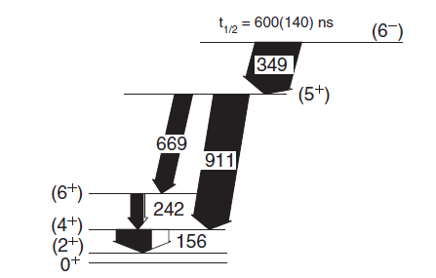

¹⁶⁴Sm
PES calculation: β₂, β₄, γ, (β₆)

Slide 36


Deformed sub-shell closure at N=100?
Sm
L. Sapathy, S.K. Patra, Nucl. Phys. A722, C24 (2003)

Slide 37


Rare-earth r-process peak
Related to: N=82 ? N=126

Slide 38




Rare-earth peak and deformation
N=83
S_{n}
S_{n}
Kink mimics closed shell
Smooth S_{n}
Just before freeze-out
kink in S_{n}
=> Mass measurements needed
R. Surman et al, Phys. Rev. Lett. 79, 1809 (1997)

Slide 39





¹⁶⁰Sm
Below 5-:

Slide 40


The role of the hexacontatetrapole (β₆)deformation
Highest β₆ predicted for ~¹⁶⁴Sm (P. Moller et al.)
Sm
β₆ K^{π}=6⁻ -> 5⁻
~150 keV effect
Calc. by Honliang Liu

Slide 41



Reduced hindrance systematics

Slide 42

¹⁶⁰Sm: lightest 4 quasi-particle K isomer?
Blocked-BCS calculations (ε₂, ε₄)
Z=56-64; N=90-102
(Ba, Ce, Nd, Sm, Gd)
¹⁶⁰Sm is the best candidate,
next best are ¹⁵⁸Sm and ¹⁶²Sm
(2-qp isomers observed)

Slide 43

Next: new experiment performed in 2015
with active stopper

Slide 44

¹⁶⁶Eu -> ¹⁶⁶Gd (preliminary)
6+
249
161
70
4+
=> Spin of β parent is I=(5)
2+
0+
Tom Berry, University of Surrey

Slide 45
Conclusions
¹⁶⁶Gd, ¹⁶⁴Sm K^{π}=6⁻ isomers
Kink at N=100 in the E(2+) and E(4+)-E(2+) systematics
N=100 deformed shell closure?
¹⁶⁰Sm four-quasiparticle isomer
Lightest 4-qp isomer?
Role of β₆

Slide 47

166Eu -> 166Gd

