Slide 1
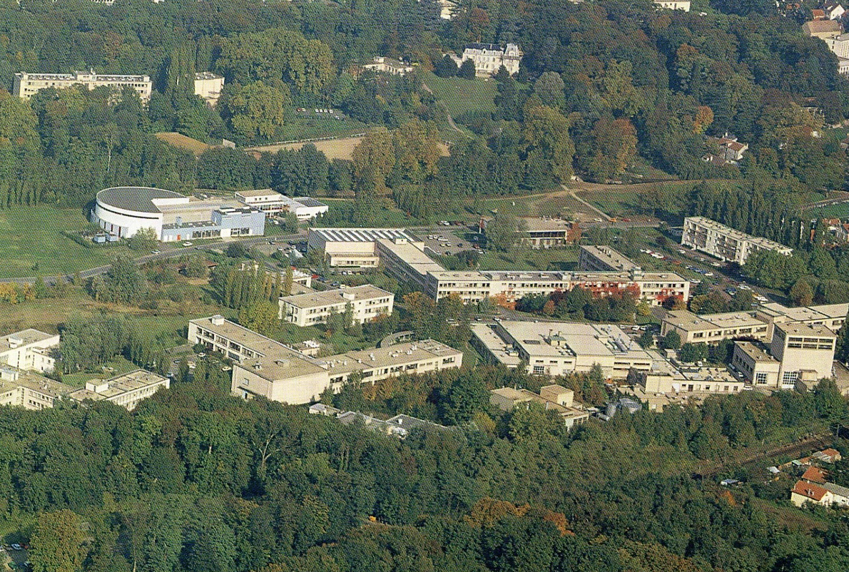
Search for nanosecond isomers in neutron-induced fission products with 50<N<60
Bogdan Fornal
ALTO
IFJ PAN Krakow, Poland
nu-Ball Hybrid Spectrometer Workshop 2016
Paris-Orsay, May 19-20, 2016

Slide 2
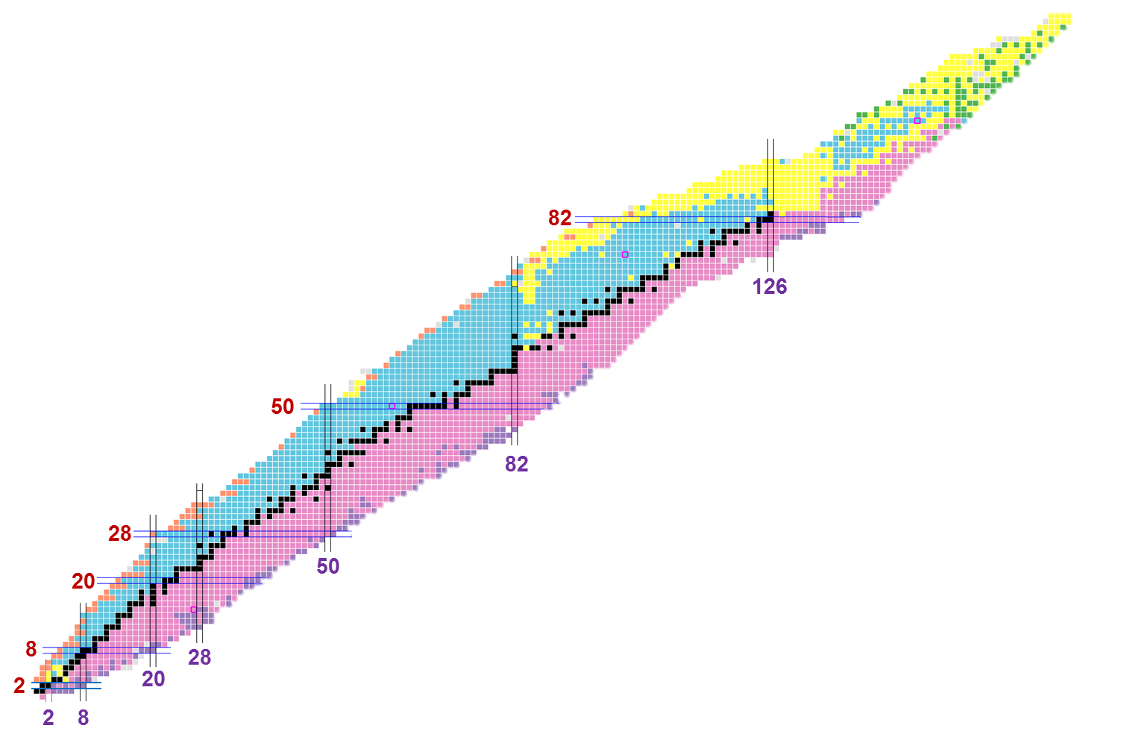
Nuclear isomers – states with half-lives ranging from
nanoseconds to years - make key contributions to the understanding of nuclear structure physics.
~3000 discovered
²⁰⁸Pb
248 stable
126
terra incognita
Proton number Z
¹⁰⁰Sn
¹³²Sn
82
> 6000 expected
⁵⁶Ni
⁷⁸Ni
50
⁴⁰Ca
⁴⁸Ca
G.D. Dracoulis, P.M. Walker, F.G. Kondev
Review of Metastable States in Heavy Nuclei
Reports on Progress in Physics (in print)
¹⁶O
⁴He
Neutron number N

Slide 3
Occurrence of nano-second isomers
in the known nuclei
²⁰⁸Pb
Proton number
¹³²Sn
⁷⁸Ni
A.K. Jain, B. Maheshwari, S. Garg, M. Patial, and B. Singh
ATLAS OF NUCLEAR ISOMERS
Nuclear Data Sheets 128 (2015) 1–130
Neutron number

Slide 4
Occurrence of micro-second isomers
in the known nuclei
²⁰⁸Pb
Proton number
¹³²Sn
expected yrast high-spin isomers
⁷⁸Ni
A.K. Jain, B. Maheshwari, S. Garg, M. Patial, and B. Singh
ATLAS OF NUCLEAR ISOMERS
Nuclear Data Sheets 128 (2015) 1–130
Neutron number

Slide 5
Nuclear processes
used for the gamma-ray spectroscopy studies of excited states
in neutron-rich nuclei
FRAGMENTATION,
FISSION
spontaneous or induced
by low-energy projectiles
FISSION
at relativistic energies
β-decay
DEEP-INELASTIC
low-lying
selected states
ISOMER
yrast and non-yrast
spectroscopy
PROMPT and ISOMER
yrast spectroscopy

Slide 6
D. Kameda et al., PHYSICAL REVIEW C 86, 054319 (2012)
Observation of new microsecond isomers among fission products
from in-flight fission of 345 MeV/nucleon 238U
RIKEN Nishina Center RI Beam Factory
¹³²Sn
⁷⁸Ni
Region
of interest

Slide 7
Nuclear processes
used for gamma-ray spectroscopy studies of excited states
in neutron-rich nuclei
FRAGMENTATION,
FISSION
spontaneous or induced
by low-energy projectiles
FISSION
at relativistic energies
β-decay
DEEP-INELASTIC
low-lying
selected states
microsecond ISOMER
yrast and non-yrast
spectroscopy
PROMPT and ISOMER
yrast spectroscopy

Slide 8
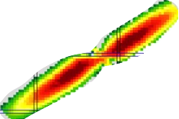
Yields of products
from the spontaneous fission
of ²⁴⁸Cm
²⁴⁸Cm
Proton number Z
Neutron number N

Slide 9
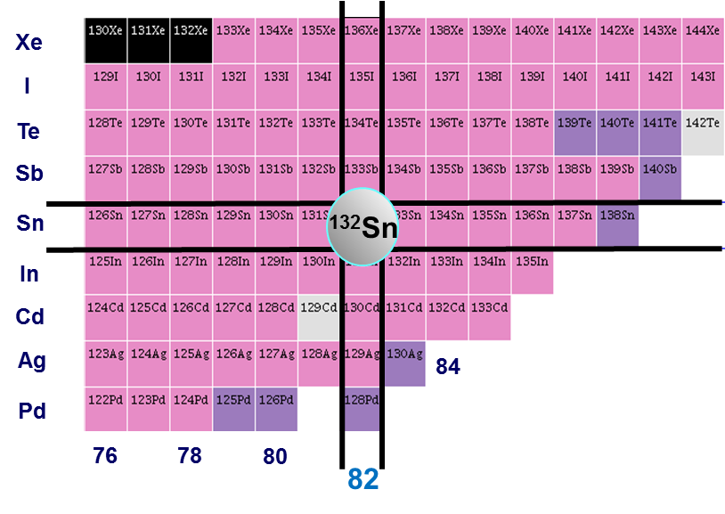
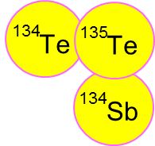
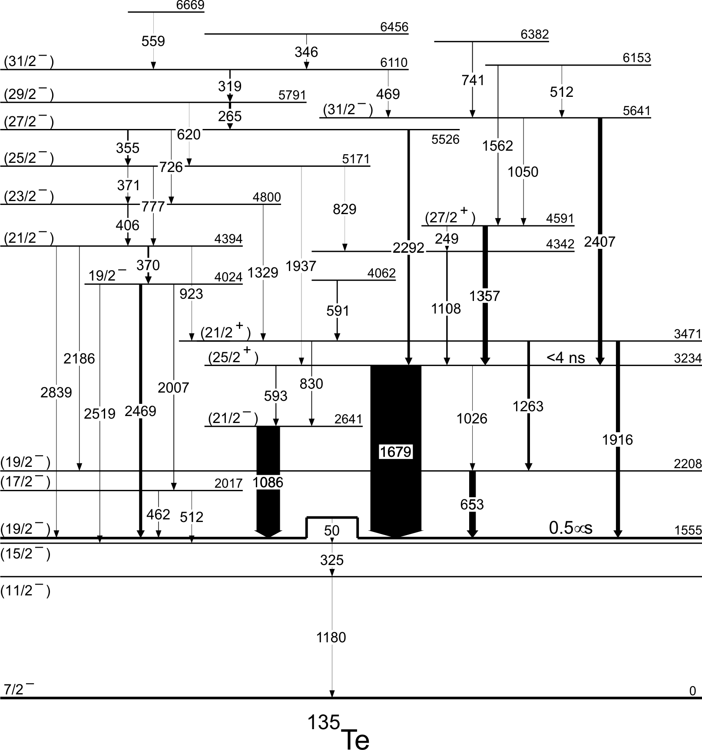
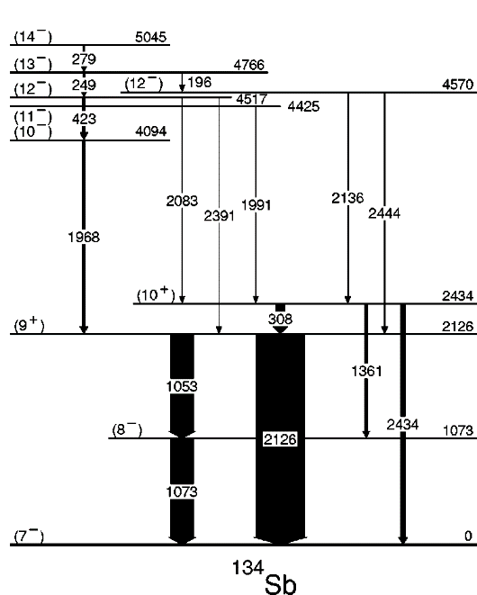
Structure of neutron-rich nuclei around ¹³²Sn produced in the spontaneous fission
of ²⁴⁸Cm
studied by using γ−γ−γ coincidence
thick-target technique
with GAMMASPHERE (USA)
132
Sn
(15+)
(31/2-)
(14-)
¹³¹Sn
¹³⁴Te
¹³⁴Sb
¹³⁵Te
¹³⁴Sn
¹³⁵Te
4 B. F. et al., PRC 63, (2001)
4 C.T. Zhang et al., PRL 77, (1996)
4 B. F. et al., PRC 63, (2001)

Slide 10
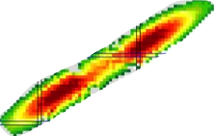
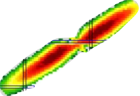
Accessing high-spin states in neutron-rich nuclei for gamma-ray spectroscopy studies.
Yields of products
from the thermal-neutron
induced fission of ²³⁵U
n + ²³⁵U
²³⁵U
²⁴⁸Cm
Proton number
Yields of products
from the spontaneous fission
of ²⁴⁸Cm
Neutron number

Slide 11
To be able to resolve prompt gamma rays from high-spin states
in the fission products, one has to apply efficient germanium gamma-ray arrays.
Two approaches are possible:
THIN TARGET
γ - fission product
coincidence technique
THICK TARGET
γ−γ coincidence technique

Slide 12
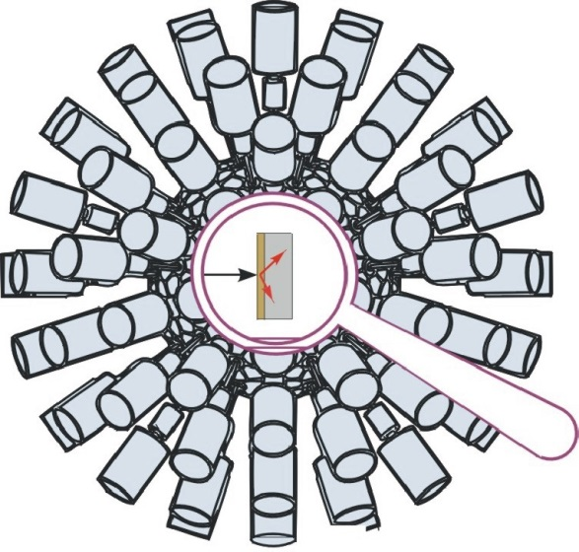
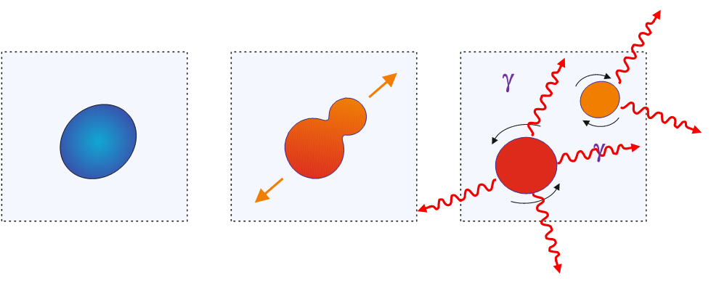
Discrete gamma-ray spectroscopy of neutron-rich nuclei
by usings n-induced fission and the thick target technique
neutron
neutron

Slide 13
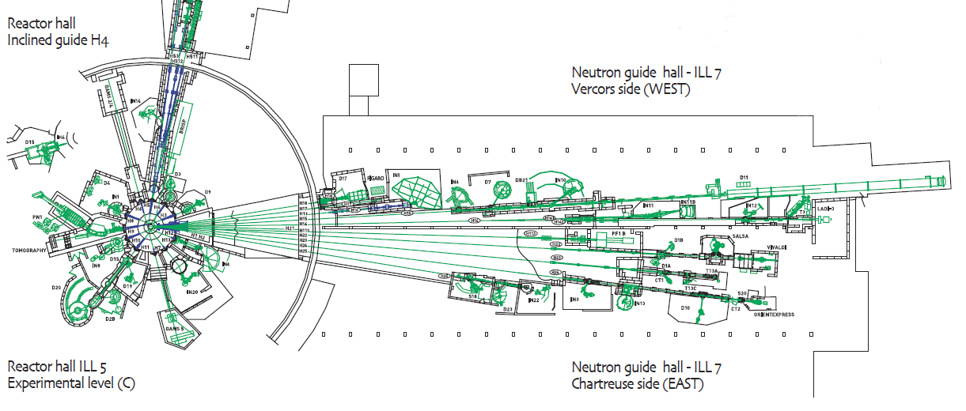
The γ-spectroscopy campaign @ ILL-Reactor (Grenoble)
2012-2013: 100 days, 95% DATA taking
EXILL
World brightest
continuum
neutron source.
In pile
Φ_{n} = 5×10¹⁴ n cm⁻² s⁻¹
Dedicated ballistic neutron guide;
highly collimated beam (1 cm²);
cold neutrons (meV);
Φ_{n} = 2×10⁸ n cm⁻² s⁻¹

Slide 14
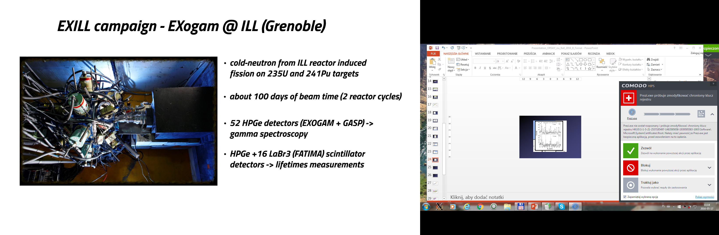
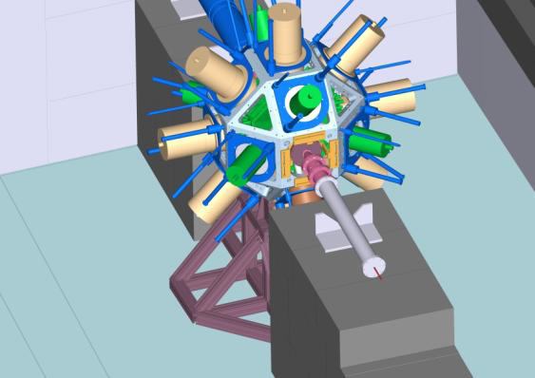
First time a large HPGe array (52 Ge crystals)
installed around a highly collimated cold-neutron beam
EXILL – EXogam@ILL
SETUP 1
γ – spectroscopy
10 EXOGAM Clovers + 6 Ge GASP
6% efficiency
Autumn
2012
→ cold-neutron induced fission on ²³⁵U and ²⁴¹Pu

Slide 15
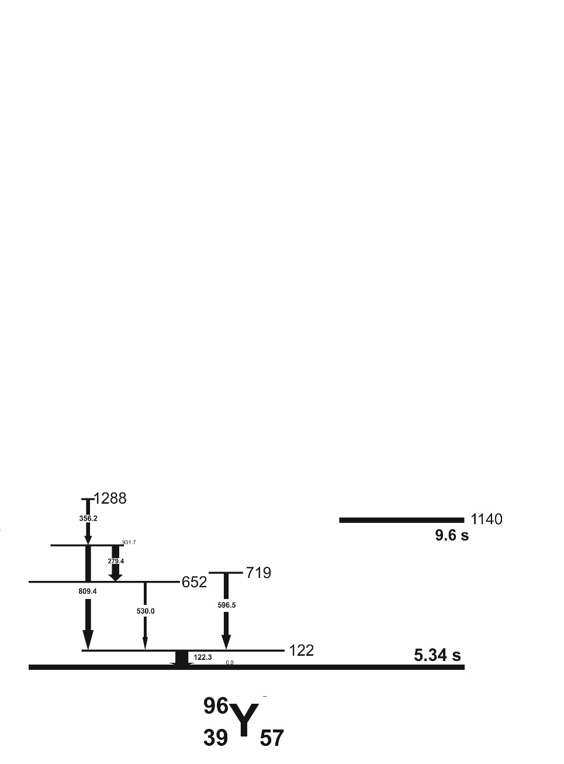
Yields of products
from the thermal-neutron
induced fission of ²³⁵U
n + ²³⁵U
²³⁵U
Proton number
⁹⁶Y
N=60
Neutron number

Slide 16
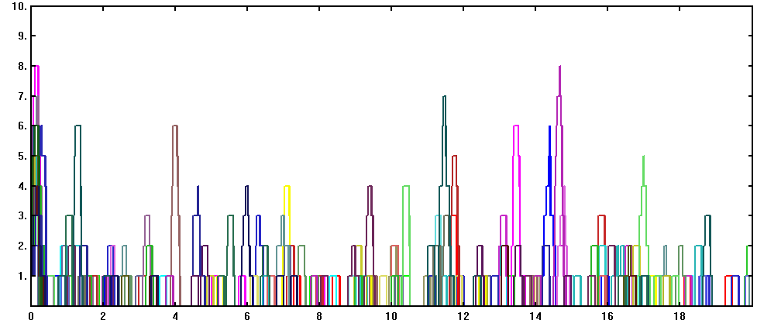
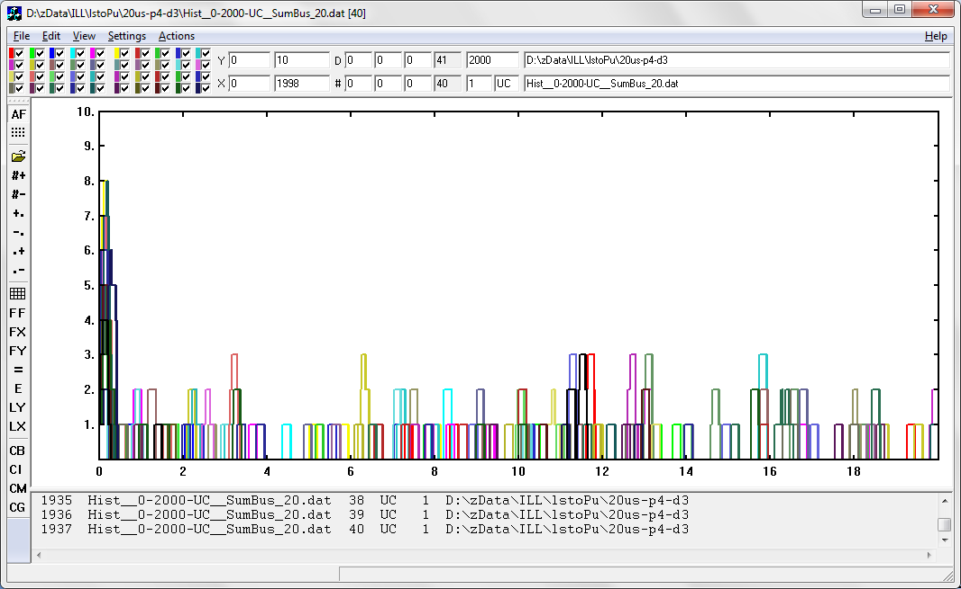
The „prompt-prompt”, „delayed-delayed” and „prompt-delayed”
coincidences with TRIGGERLESS DATA
PROMPT: Fold≥4
DELAYED: Fold<4
Fold
0
10 μs
20 μs
time
PROMPT: Fold≥4
DELAYED: Fold<4
Fold
0
10 μs
20 μs
time

Slide 17
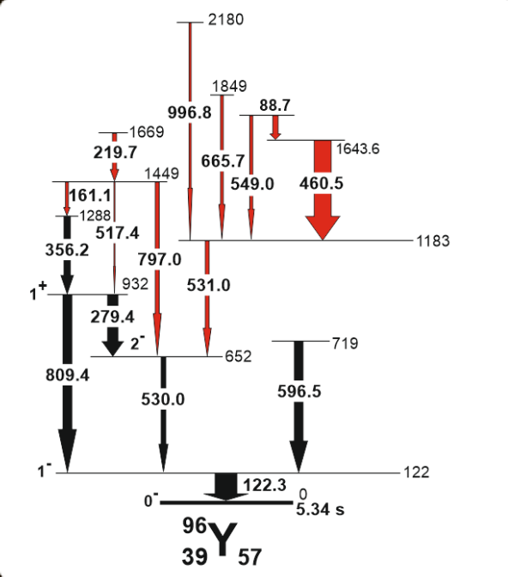
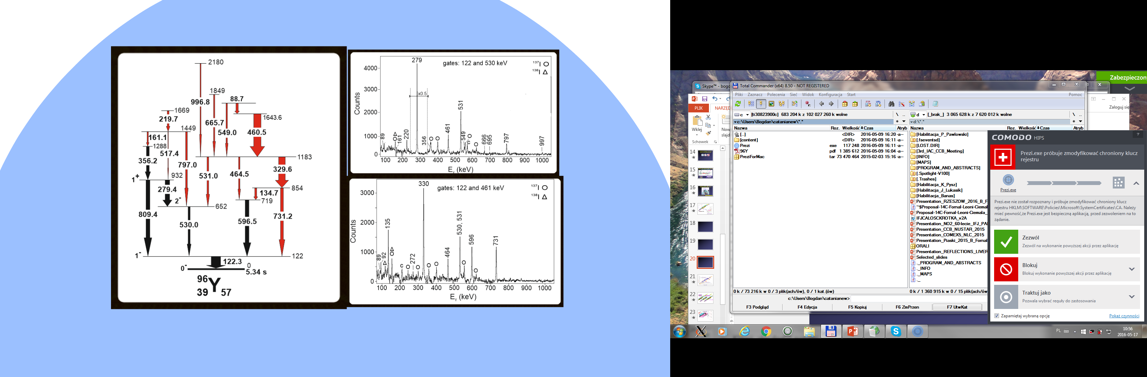
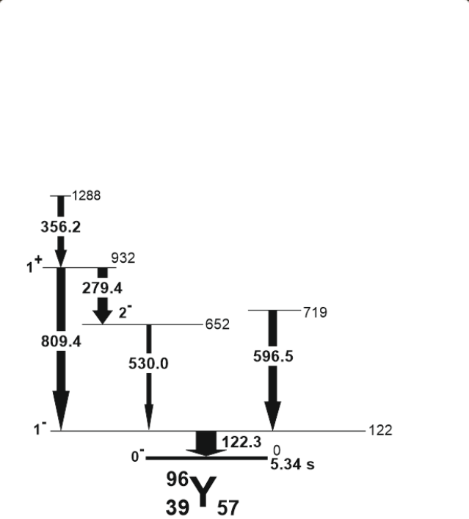
Building the level scheme of ⁹⁶Y based on prompt γ−γ−γ coincidences

Slide 18
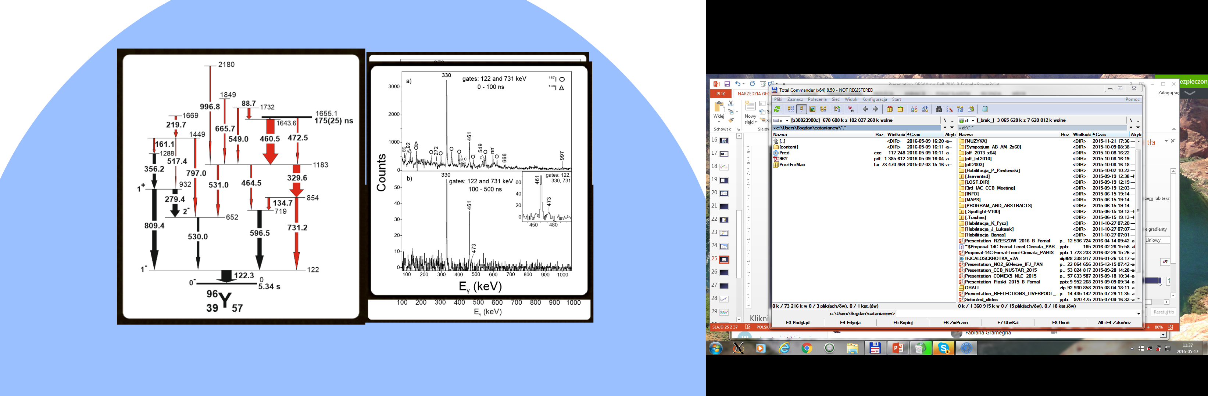
PROMPT
Fold ≥ 4
Building the level scheme of ⁹⁶Y
based on prompt and delayed
γ−γ−γ coincidences
Fold
DELAYED
Fold < 4
time
0
1 μs
2 μs
1655
175(25) ns
prompt-prompt
delayed-delayed

Slide 19
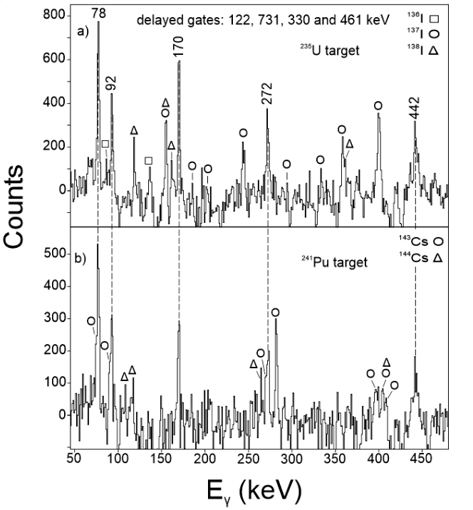
PROMPT
Fold ≥ 4
Fold
DELAYED
Fold < 4
time
0
1 μs
2 μs
272
442
prompt - delayed
92
170
²³⁵U target
78
175(25) ns
prompt - delayed
²⁴¹Pu target

Slide 20
175(25) ns
(8+)
1140 (30)
9.6 s
β

Slide 21
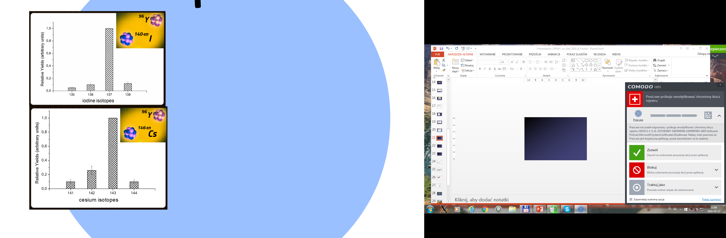
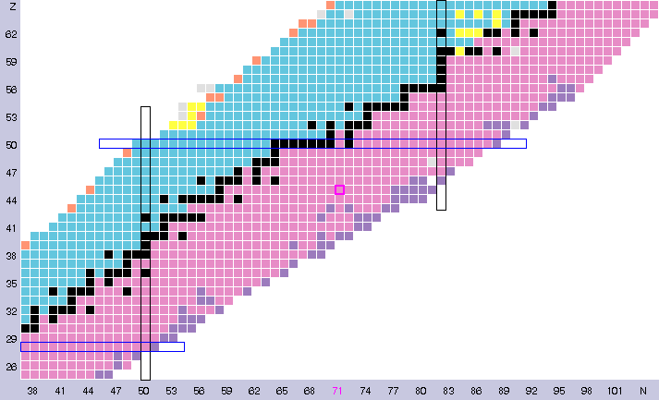
²³⁵U target
¹³⁷I
Z=50
¹⁴³Cs
N=82
²⁴¹Pu
target
⁹⁶Y
Z=50
N=50

Slide 22
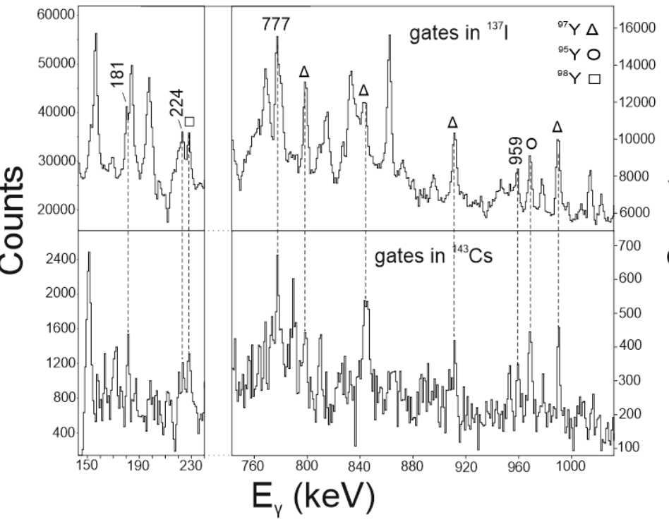
²³⁵U
target
¹³⁷I
²⁴¹Pu
target
²³⁵U target
¹⁴³Cs
¹³⁷I
²⁴¹Pu target
⁹⁶Y
¹⁴³Cs

Slide 23
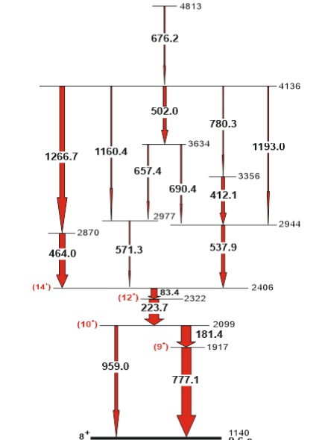
175(25) ns
(8+)
1140 (30)
9.6 s
9.6 s
β
β

Slide 24
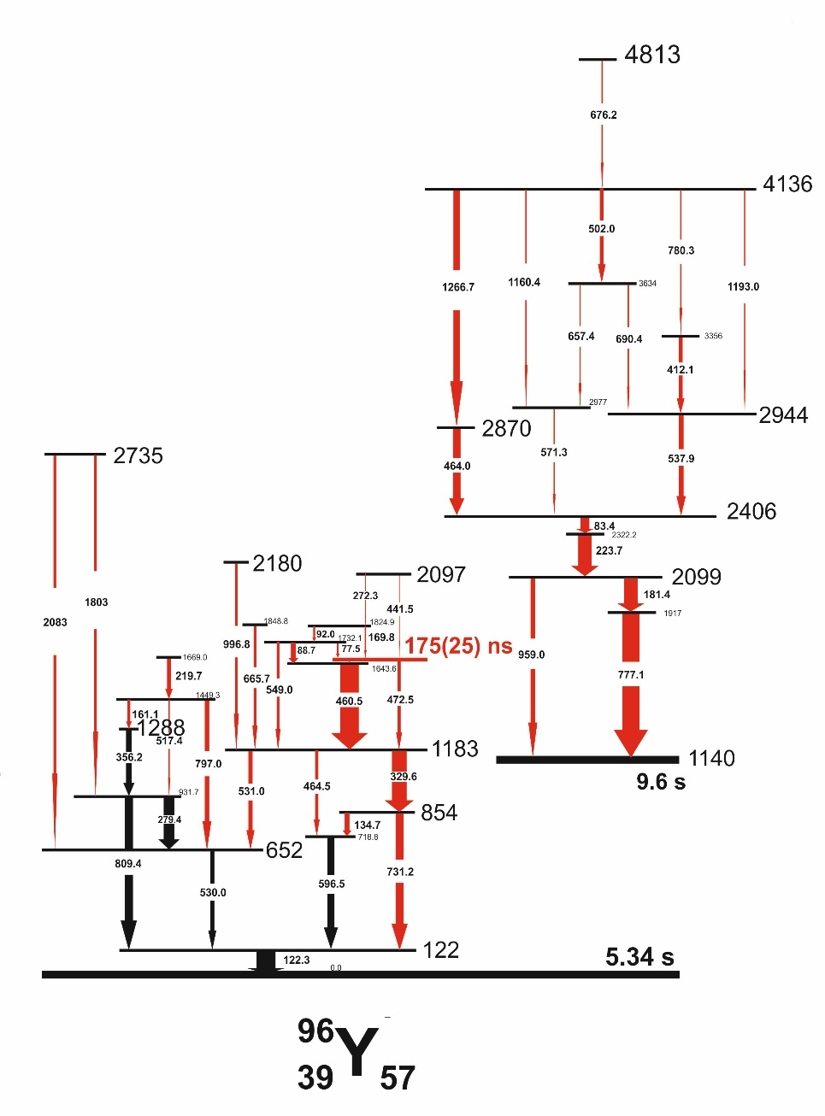
Ł. Iskra et al., (article in preparation)

Slide 25
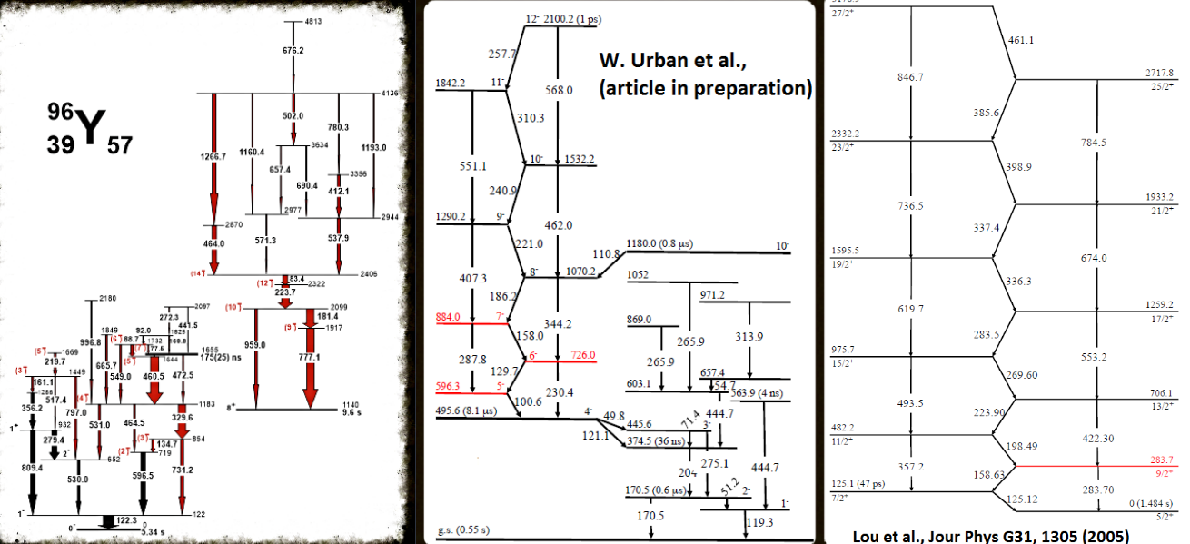
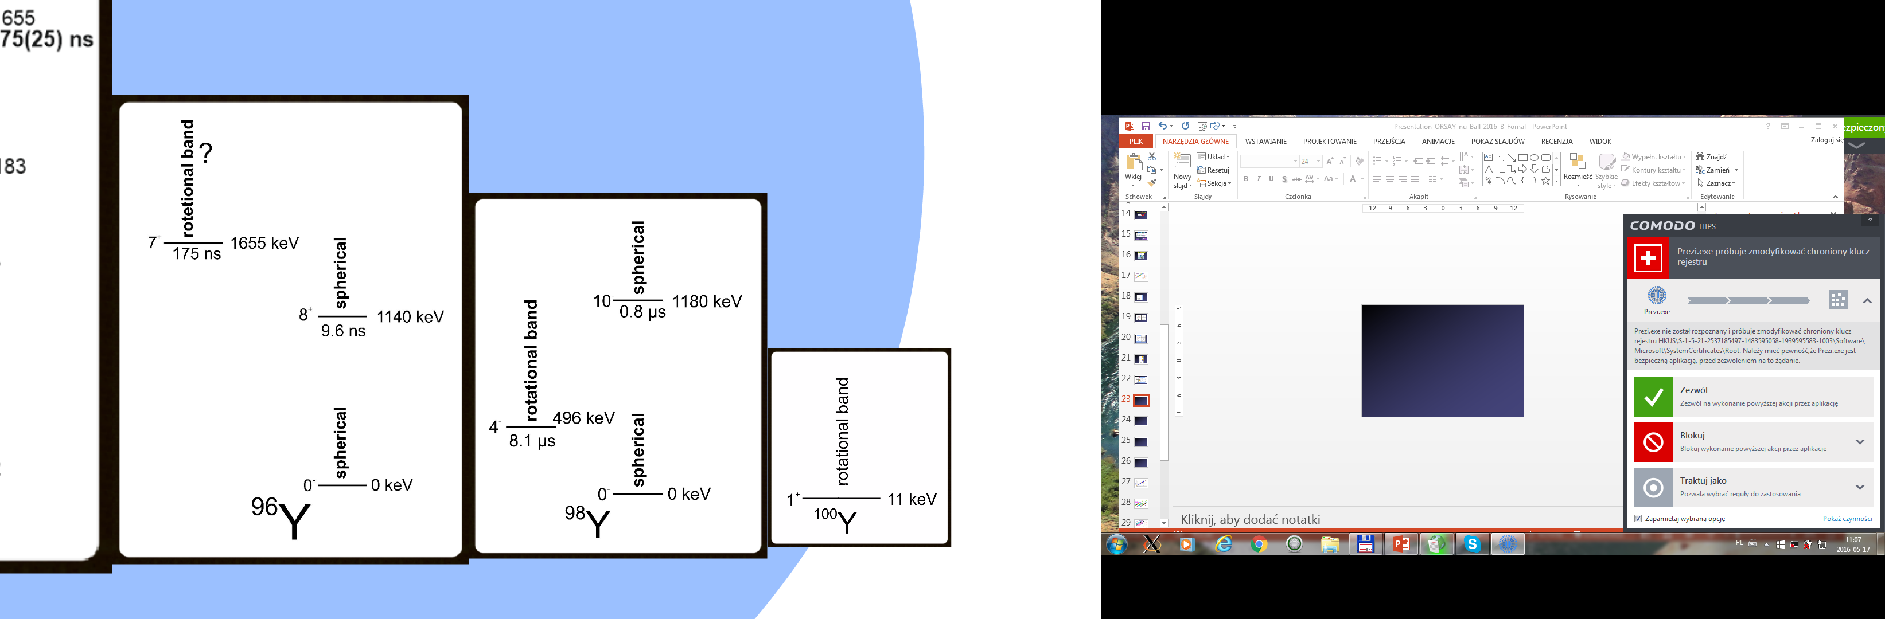
175 ns
⁹⁶Y₅₇
⁹⁸Y₅₉
¹⁰⁰Y₆₁

Slide 26
Advantages at LICORNE:
Beam pulsing with the repetition period of 400 ns.
Population of new, unexplored regions.
PROMPT: Fold≥4
DELAYED: Fold<4
continous beam
- EXILL
Fold
0
10 μs
20 μs
PROMPT
DELAYED
pulsed beam –
LICORNE

Slide 27
Occurence of microsecond isomers
in the known nuclei
²⁰⁸Pb
Proton number
¹³²Sn
expected yrast spin isomers
⁷⁸Ni
Neutron number

Slide 28

Yields of products
from the 14 MeV-neutron
induced fission of ²³²Th
n(14 MeV) + ²³²Th
²³²Th
Thermal neutron induced fission
of ²³⁵U
Spontaneous fission of ²⁴⁸Cm

Slide 29
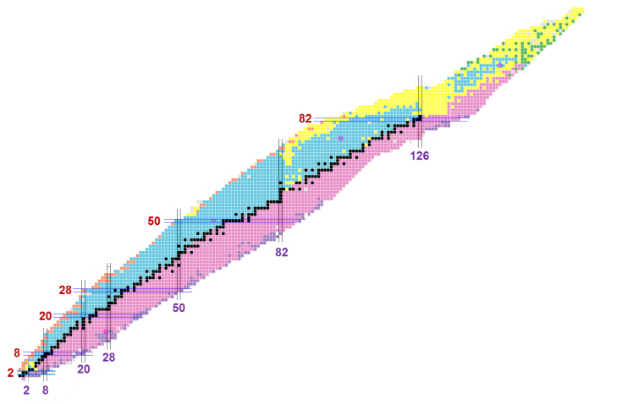
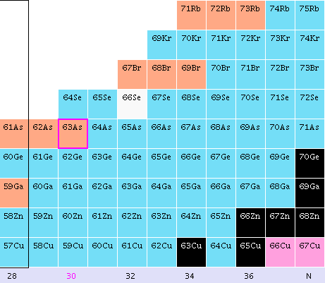
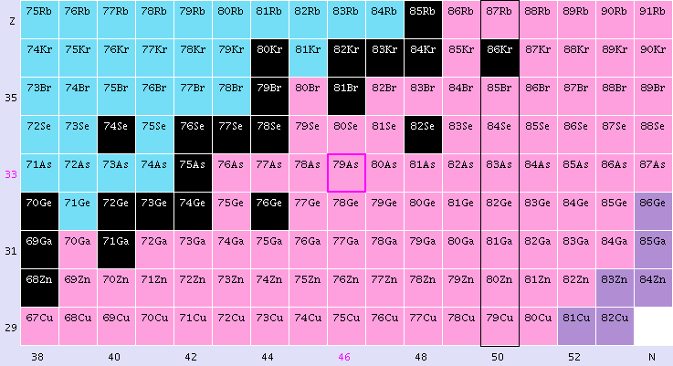
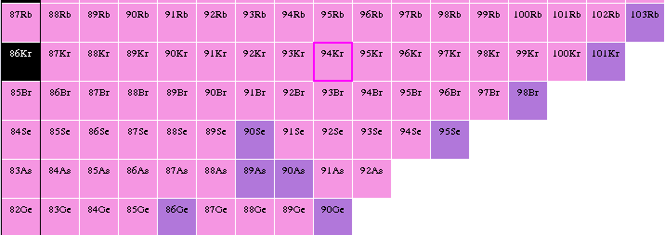
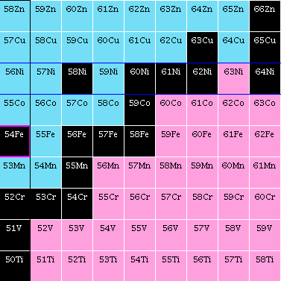
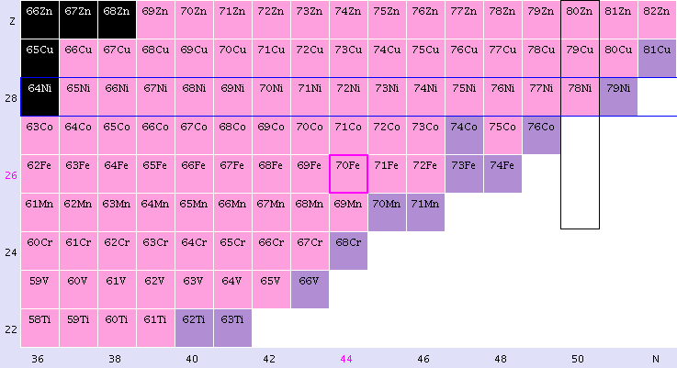
Yields of products from the neutron
induced fission in the region
of interest
n(therm) + ²³⁵U
n(0.5,14 MeV) + ²³²Th
²³²Th, 0.5 MeV
Rb
Kr
Br
Se
As
Ge
Ga
²³²Th, 0.5 MeV
Zn
70Zn
Cu
Ni
⁷⁸Ni
Co
Fe
50
Mn
48
Cr
46
V
44
Ti
42
28
30
32
34
36
38
40
²³²Th, 0.5 MeV

Slide 30
n(2 MeV) + ²³²Th
¹⁴⁵⁻¹⁴⁷Ce
Z=50
N=82
Z=50
⁸⁴Ge
N=50

Slide 31

Conclusions and Outlook
Discrete in-beam gamma-ray spectroscopy of products from the thermal-neutron induced fission is efficient in identifying yrast and near yrast high-spin states, including yrast short-lived isomers, in hard-to-reach neutron-rich nuclei in the shape transition region at N=60.
Fission induced by fast (ca. few MeV) neutrons on a ²³²Th target is most promising in populating very neutron-rich nuclei around the ⁷⁸Ni doubly magic nucleus. In that region yrast high-spin isomers are expected – their lifetimes might be in the range of tens of nano-seconds.
ν-BALL@LICORNE, with its pulsed beam of a few-MeV neutrons, will be a place where one could locate many of these isomers in the ⁷⁸Ni neighborhood.

Slide 32
Collaborators
Studies with the EXILL array, using cold-neutron induced fission at ILL
L. Iskra, N. Cieplicka-Orynczak, B. Szpak, B. Fornal IFJ PAN Krakow, Poland
S. Leoni, G. Bocchi, G. Colo’, S. Bottoni, N. Cieplicka-
Orynczak, F.C.L. Crespi, A. Bracco et al. University and INFN, Milano, Italy
D. Bazzacco, D. Mengoni, C. Ur et al. Univ. and INFN Padova, LNL Legnaro
G. De France, C. Michelagnoli et al. GANIL, Caen, France
M. Jentschel, U. Koster, A. Blanc, P. Mutti,
G. Simpson, T. Soldner et al. ILL Grenoble, France
W. Urban et al. Univ. of Warsaw, Poland
J.-M. Regis et al. Univ. of Koeln, Germany

Slide 33
Collaborators
Studies with the EXILL array, using cold-neutron induced fission at ILL
L. Iskra, N. Cieplicka-Orynczak, B. Szpak, B. Fornal IFJ PAN Krakow, Poland
S. Leoni, G. Bocchi, G. Colo’, S. Bottoni, N. Cieplicka-
Orynczak, F.C.L. Crespi, A. Bracco et al. University and INFN, Milano, Italy
D. Bazzacco, D. Mengoni, C. Ur et al. Univ. and INFN Padova, LNL Legnaro
G. De France, C. Michelagnoli et al. GANIL, Caen, France
M. Jentschel, U. Koster, A. Blanc, P. Mutti,
G. Simpson, T. Soldner et al. ILL Grenoble, France
W. Urban et al. Univ. of Warsaw, Poland
J.-M. Regis et al. Univ. of Koeln, Germany

Slide 34
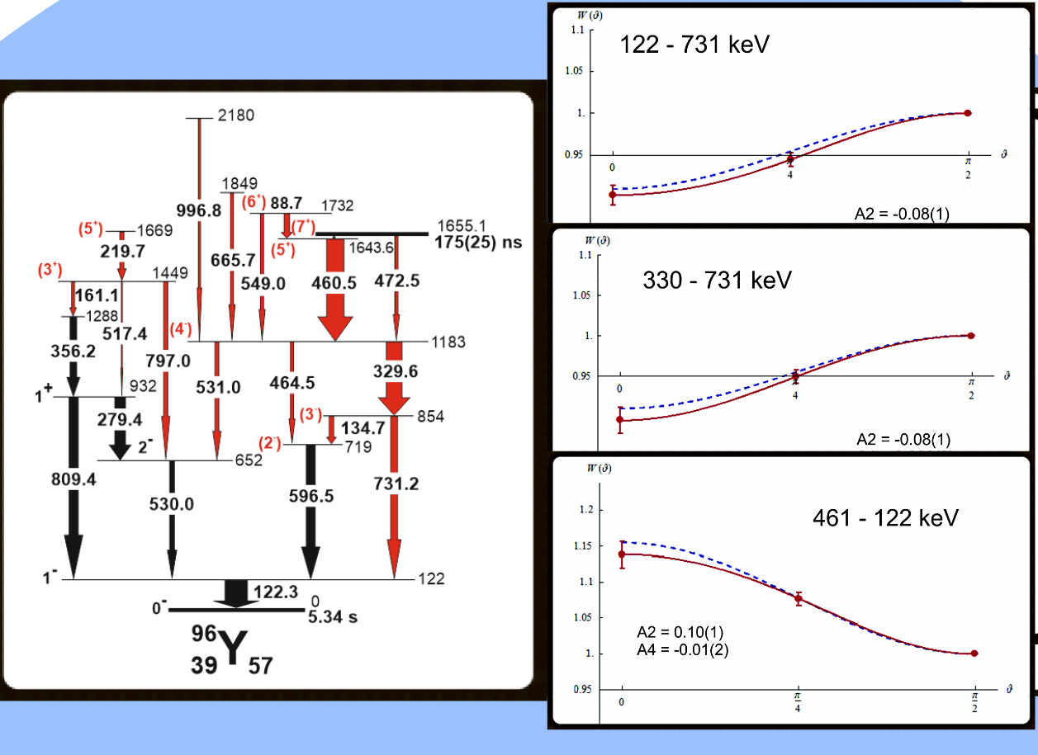

Slide 36
LOHENGRIN spectrometer
at ILL
Ge array
Reactor
Refocusing
magnet
Dipole
magnet
Target
Condenser
4 xxxxxxxxi et al.,
Nucl. Phys. A701, 217c (2002)
4 xxxxxxxxxxx.,
Eur. Phys. J. A 20, 193 (2004).

Slide 37
Yields of products
from the 14 MeV-neutron
induced fission of ²³²Th
n(14 MeV) + ²³²Th
²⁰⁸Pb
Proton number
¹³²Sn
⁷⁸Ni
Neutron number

Slide 38
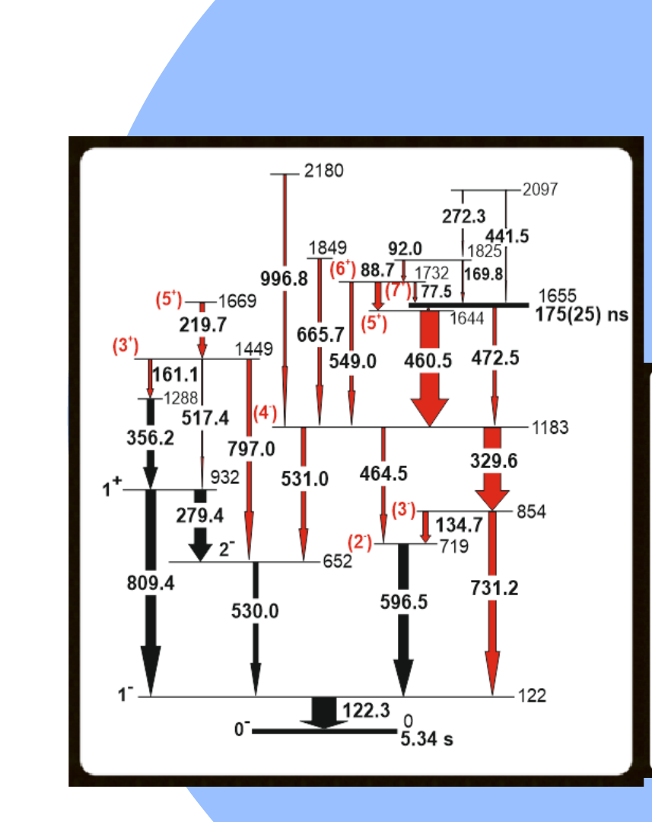

Slide 39
Yields of products
from the thermal-neutron
induced fission of ²³⁵U
n + ²³⁵U
²³⁵U
Proton number
⁹⁶Y
Neutron number
Ł. Iskra et al., (article in preparation)

Slide 40
Accessing high-spin states in neutron-rich nuclei for gamma-ray spectroscopy studies.
Yields of products
from the spontaneous fission
of ²⁴⁸Cm
²⁴⁸Cm
Proton number Z
Neutron number N

Slide 41
Nuclear isomers – states with half-lives ranging from
nanoseconds to years - make key contributions to the understanding of nuclear structure physics.
126
terra incognita
82
50

Slide 42
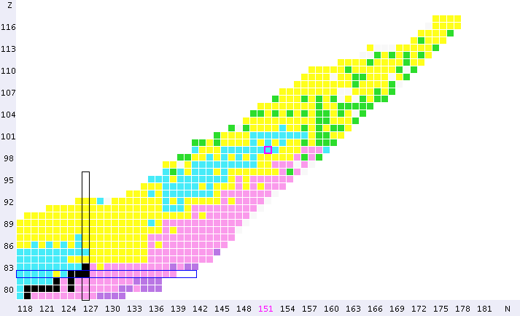
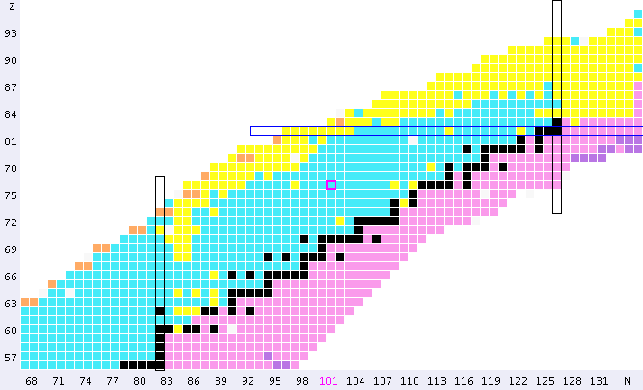
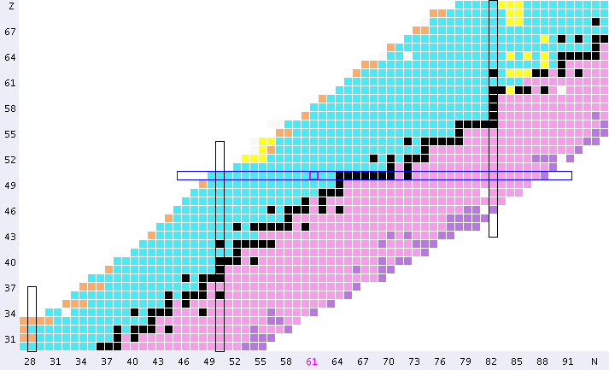
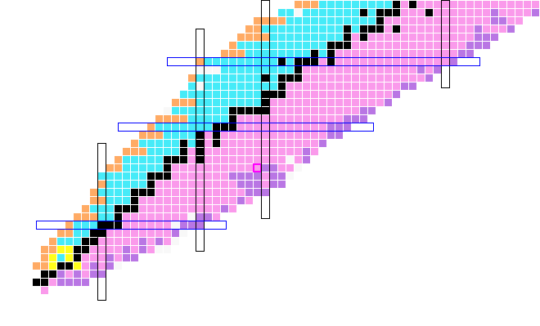
Experimental techniques used to access high-spin states in neutron-rich nuclei
82
126
terra incognita
50
82
28
fission: spontaneous or induced
of actinide nuclei:
  yrast prompt γ-ray spectroscopy
  high-spin isomer spectroscopy
50
20
8
28
2
20
2
8

Slide 44
The “Prompt-Delayed” Coincidences
with Triggerless DATA
Long lists of time-stamped events
(in steps of 10 ns)
Fold
Fold >= 4
High probability of a second fission event
in a 20 μs time window
0
t
20 μs
Software Definition
of FISSION Trigger
PROMPT
Clean – DELAYED
Fold
PROMPT ➔ (Fold)_{P} >= 4 in Δt = 200 ns
Fold <= 3
DELAYED ➔ (Fold)_{D} <= 3 for 200 ns < Δt < 20 μs
15% of a second fission event
0
t
20 μs
Possibility of performing PROMPT – DELAYED γ-coincidences
over several μs Time-window
Courtesy of Dino Bazzacco

Slide 45
FIPPS version for the IFMIF beam
(see talk of Aurelien Blanc)
Ge array
with neutron detectors
neutron
beam

