Slide 1
Reaction dynamics around the barrier :
The opportunity of NuBall@IPNO
... What is realistically feasible and in time ?
(my) Selection :
✓ Dynamics of HI collisions at barrier energies: fusion and quasi-fission
✓ Competition neutron/γ–ray emission and energetics of fission
✓ Mystery about a « saw-tooth » γ–ray multiplicity
nuclear
technology
concern
ALTO NuBall Hybrid Spectrometer Workshop 2016 Ch. Schmitt, GANIL

Slide 2
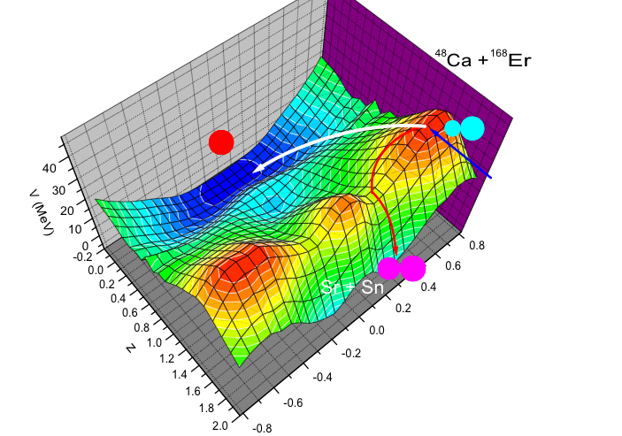
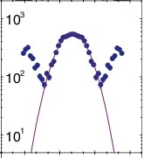
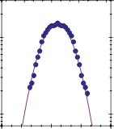
Fusion and Quasi-fission dynamics in HI collisions (1)
 What’s the point ?
Elastic, quasi-elastic,
deep-inelastic interactions
HI collision 
Fusion evaporation
Capture  formation of equilibrated CN
Quasi-fission fission
re-separation due to Coulomb
asymmetry
elongation
Y.Aritomo
Competition fusion/QF = f (Z_{p}.Z_{t}, P/T structure and deformation, E/B , L, viscosity, …)
⁴⁸Ca + ¹⁵⁴Sm
⁴⁸Ca + ¹⁴⁴Sm
E* ~ 48MeV
V I V I D L Y
D E B A T E D
☞ What drives QF ?
☞ Role of shells in fusion-fission fragments?
N=82
Z=28
Fission-fragment mass
Knyazheva et al., PRC 75(2007) 064602
ALTO NuBall Hybrid Spectrometer Workshop 2016 Ch. Schmitt, GANIL

Slide 3
Fusion and Quasi-fission dynamics in HI collisions (2)
Challenge: Discriminate between different mechanisms or model assumptions.
Need of high(er)-fold correlations and/or new observables
 How ?
NuBall@IPNO for tracking Quasi-Fission
✓ Heavy-ion beams from C to Br with E_{beam} ~[3-7] AMeV: ideal to probe onset of QF
¹²C + ²⁰⁴Pb → ²¹⁶Ra
⁴⁰Ca + ¹⁴⁴Sm → ¹⁸⁴Pb
⁸¹Br + ¹³⁶Xe → ²¹⁷Ac
I N N O V A T I V E A T T E M P T
✓ Coincident measurement of fission-fragments and prompt γ–rays (discrete E_{γ} and M_{γ})
CORSET detector for FF mass and TKE distribution
Asset of NuBall:
- 24*4 Ge’s for discrete γ–ray transitions and M _{γ}
- 36 LaBr₃ for M _{γ}
Trigger
Evidence QF region
DOPPLER correction
(A,Z): which shell effects in QF?
Level density/nuclear structure
ALTO NuBall Hybrid Spectrometer Workshop 2016 Ch. Schmitt, GANIL

Slide 4
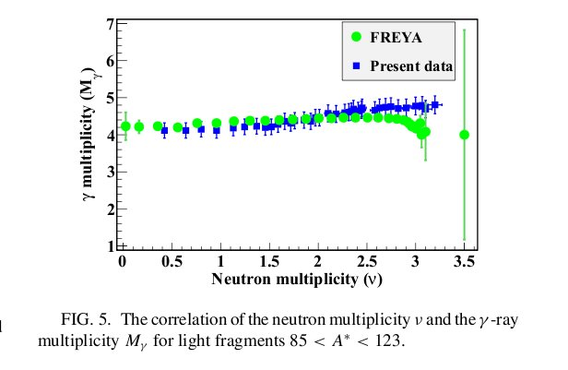
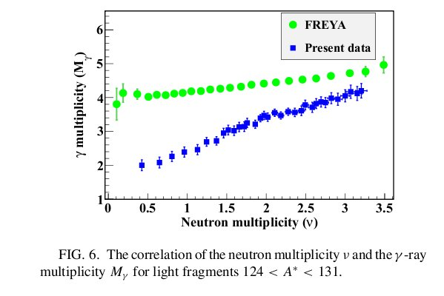
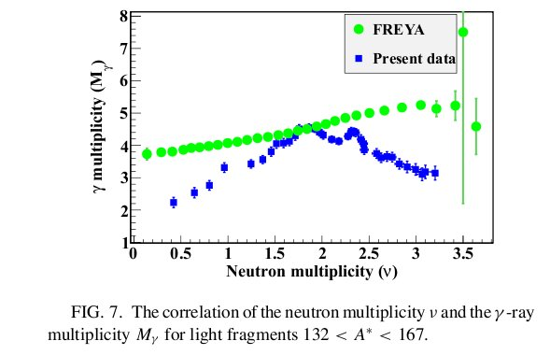
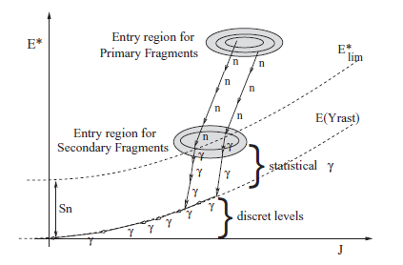
Relationship between n and γ-ray emission in fission (1)
DATA
 What’s the point ?
Wang, PRC(2016)
Scint. (n) + Ge (γ)
²⁵²Cf spontaneous fission
CALC
At scission: Emission of two fragments
with E*~(10-40)MeV and L~10h each.
Released by
1) neutrons (→ E*),
2) statistical γ‘s (→ E*)
3) discrete γ‘s along Yrast line (→ L)
85<A<123
Nifenecker, NPA(1972)
Single Gd loaded det.
Glässel, NPA(1989)
Array of NaI’s
124<A<131
132<A<167
Decay pattern
= f (how E* and L
are shared among the fragments)
n-γ correlation: positive, weak, A-dependent?
No guide from theory 
ALTO NuBall Hybrid Spectrometer Workshop 2016 Ch. Schmitt, GANIL

Slide 5
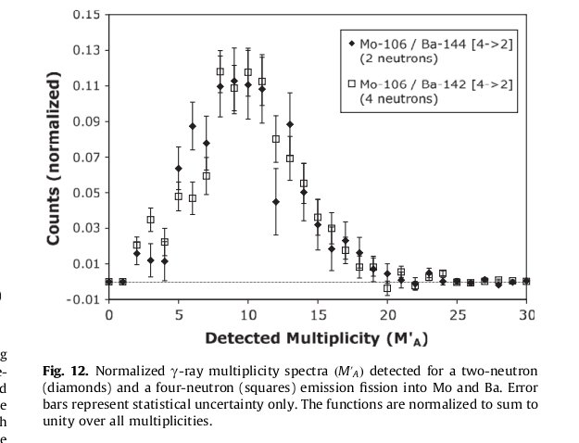
Relationship between n and γ-ray emission in fission (2)
 How ?
NuBall@IPNO for tracking n/γ (anti-)correlation
→ Study γ’s for specific (x n) splits
✓ Proton ~[2-6] AMeV + actinide target :
p + ²³²Th → ²³³Pa low-energy fission
p + ²³⁸U → ²³⁹Np (E* from 5 to 12MeV)
Bleuel,
NIMA(2010)
8*[Ge+BGO]’s
I N N O V A T I V E A T T E M P T
✓ Coincident measurement of specific fragment pairs
and prompt γ–rays (E_{γ} and M_{γ})
Asset of NuBall:
- 24*4 Ge’s for discrete γ–ray transitions and M _{γ}
- 36 LaBr₃ for M _{γ}
CORSET detector
- fission trigger,
- selectivity,
- Doppler correction
General scope:
- neutron decay-width
- γ strength
ALTO NuBall Hybrid Spectrometer Workshop 2016 Ch. Schmitt, GANIL

Slide 6
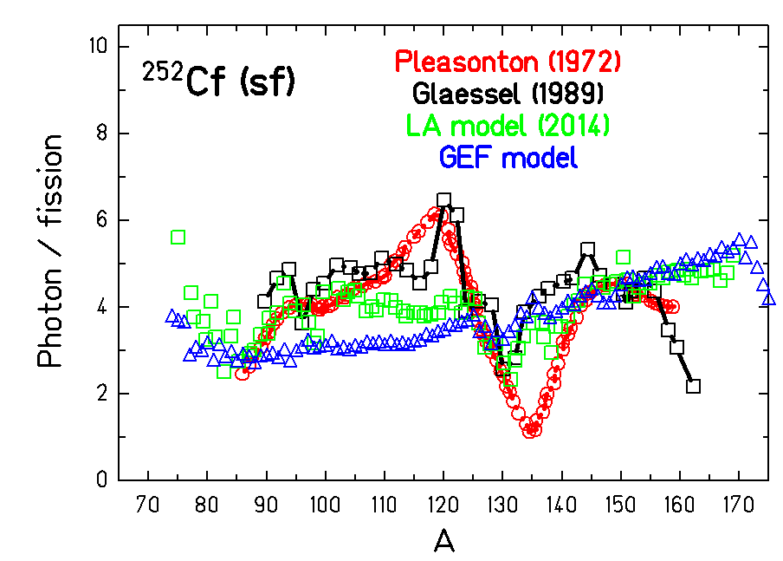
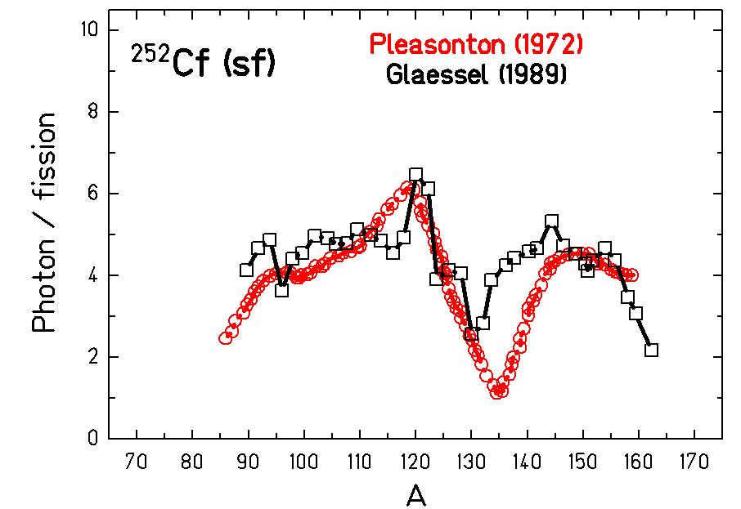
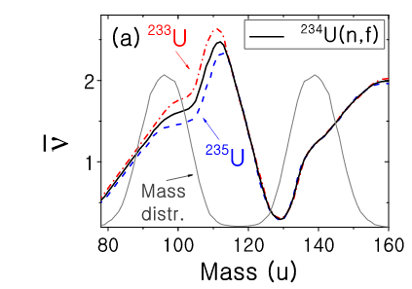
The saw-tooth γ-ray multiplicity enigma (1)
 What’s the point ?
Debated “saw-tooth” γ-ray multiplicity
Well established “saw-tooth” n multiplicity
(→ fragment E*/deformation at scission)
Issue of isomers (possible traps?)
Strongly populated fragments (Rb, Nb, Sn,
Sb, I, Te, Xe, Cs...) have isomeric states
“Prompt” radiations do
not include transitions
below the isomer
Saw-tooth γ-ray:
“real” but artefact?
☞ Challenge: Sort M _{γ} according to A_{FF}
(Uncertain; Shape depends on exptal
setting [time and E windows, etc])
☞ Critical controversies: L sharing, Spin
population in closed- vs. off-shell fragments
☞ No consistent model available at day
Prompt
Trap !
Delayed
ALTO NuBall Hybrid Spectrometer Workshop 2016 Ch. Schmitt, GANIL

Slide 7
The saw-tooth γ-ray multiplicity enigma (2)
 How ?
NuBall@IPNO for inspecting a saw-tooth γ-ray multiplicity
Priority: Probe the possible connection of the saw-tooth shape and the occurrence of
population of (above-) isomeric states at scission
Simultaneous measurement
of prompt and delayed γ radiations
Is the saw-tooth dip ‘delay-dependent’?
Is there a different L population near magicity ?
I N N O V A T I V E A T T E M P T
✓ Proton ~2 AMeV + actinide target :
ex: p + ²³⁸U → ²³⁹Np (E* as low as possible, around B_{f})
✓ Expertise available at IPNO for prompt/delayed γ-rays in fission (expt by J.N.Wilson)
Asset of NuBall:
- 24*4 Ge’s for discrete γ–rays from below and above isomer
- 36 LaBr₃ for additonnal efficiency in counting M _{γ}
CORSET-like: trigger, timing, selectivity, Doppler correction
 remove randoms (after β decay) in the delayed γ spectrum
A T T E M P T T O S O R T A C C O R D I N G T O M A S S
ALTO NuBall Hybrid Spectrometer Workshop 2016 Ch. Schmitt, GANIL

Slide 8
Conclusions
NuBall@IPNO:
Clear opportunity for innovative studies of reactions dynamics at V_{B}
♣ Suited set of beams (light to heavy ions, protons)
♣ Hybrid high-efficiency γ-array (E_{γ} and ~M_{γ})
M. Kmiecik
S. Oberstedt
Feasibility at « shortest»-term (first « bunch » of experiments)
♣ CORSET successfully used at IPNO
♣ Methods/analysis: expertise available on site
Further/deeper at « short/mid »-term (second « bunch » of experiments)
♣ Combine PARIS clusters to NuBall
♣ Go to LI/BICORNE neutron beam line
ALTO NuBall Hybrid Spectrometer Workshop 2016 Ch. Schmitt, GANIL

Slide 9
T H A N K Y O U
ALTO NuBall Hybrid Spectrometer Workshop 2016 Ch. Schmitt, GANIL

Slide 10
EXTRAS
M. Kmiecik
S. Oberstedt
ALTO NuBall Hybrid Spectrometer Workshop 2016 Ch. Schmitt, GANIL

Slide 11
Fission time scales
ALTO NuBall Hybrid Spectrometer Workshop 2016 Ch. Schmitt, GANIL

Slide 12
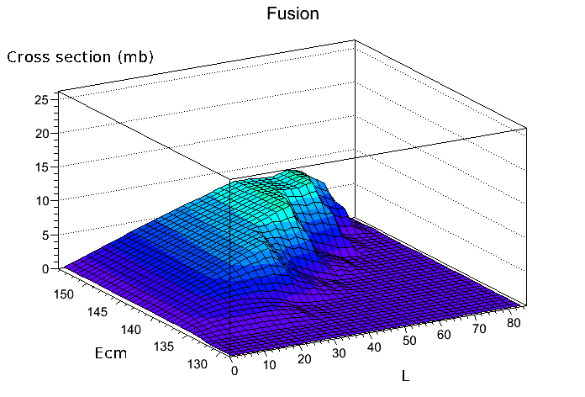
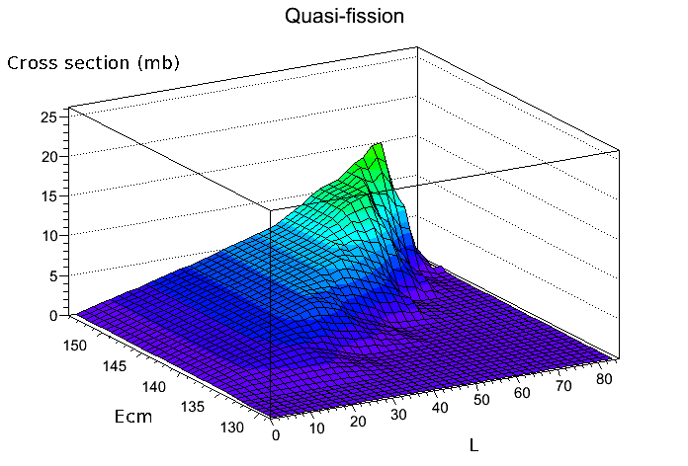
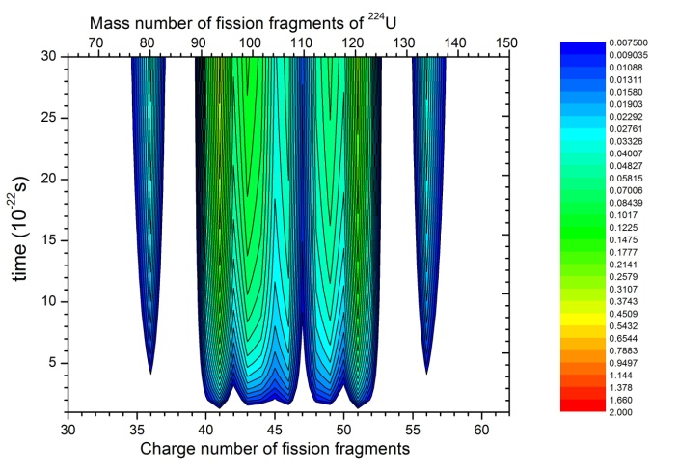
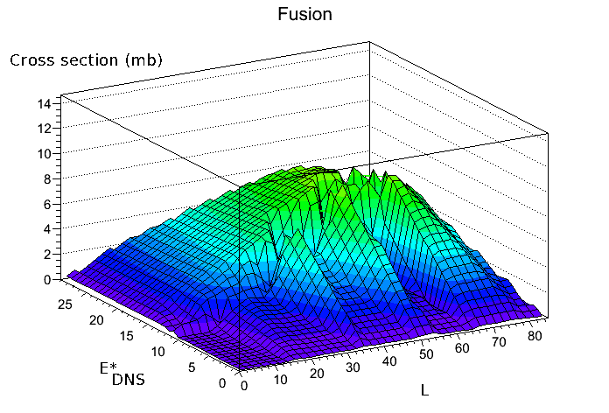
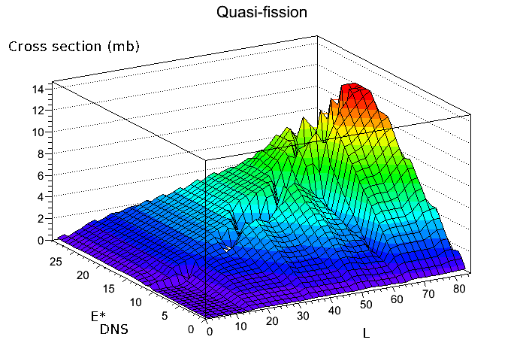
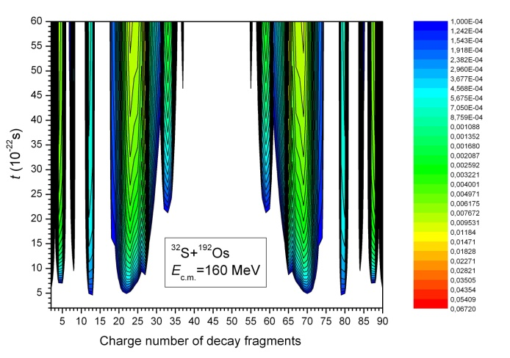
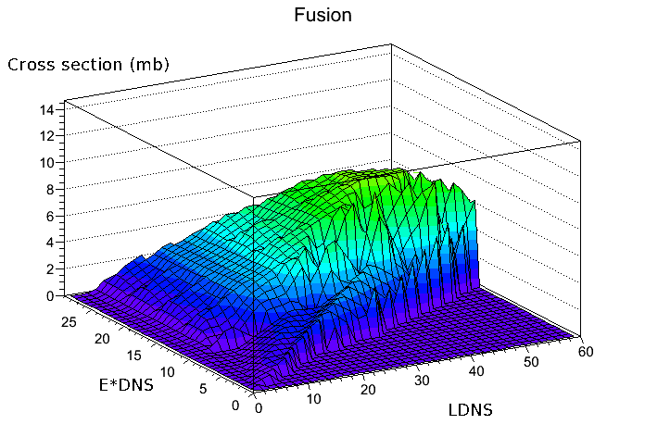
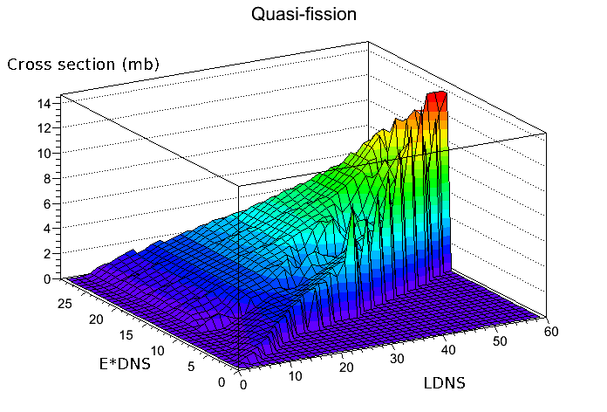
Theoretical predictions within the DNS model(1)
A. Nasirov, Dec. 2013
Calculated fragment-charge distribution for CNF (top)
and QF (bottom events as a function of reaction time
for ³²S + ¹⁹²Os → ²²⁴U at E_{cm} ~ 1.1.V_{B}
Correlation between initial angular momentum L and
center-of-mass energy (top row), between L and E*DNS
of the DNS (middle row), and between the LDNS of the
DNS and E*DNS the DNS (bottom row), for fusion (left)
and QF events in ³²S + ¹⁹²Os collisions
ALTO NuBall Hybrid Spectrometer Workshop 2016 Ch. Schmitt, GANIL

Slide 13
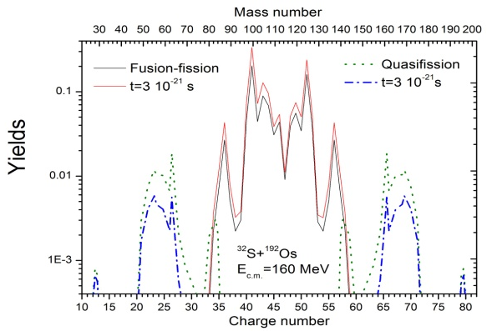
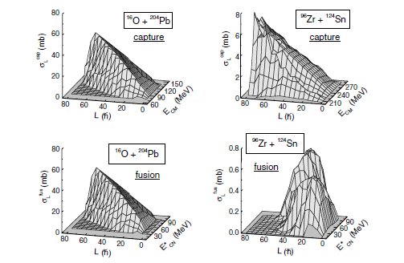
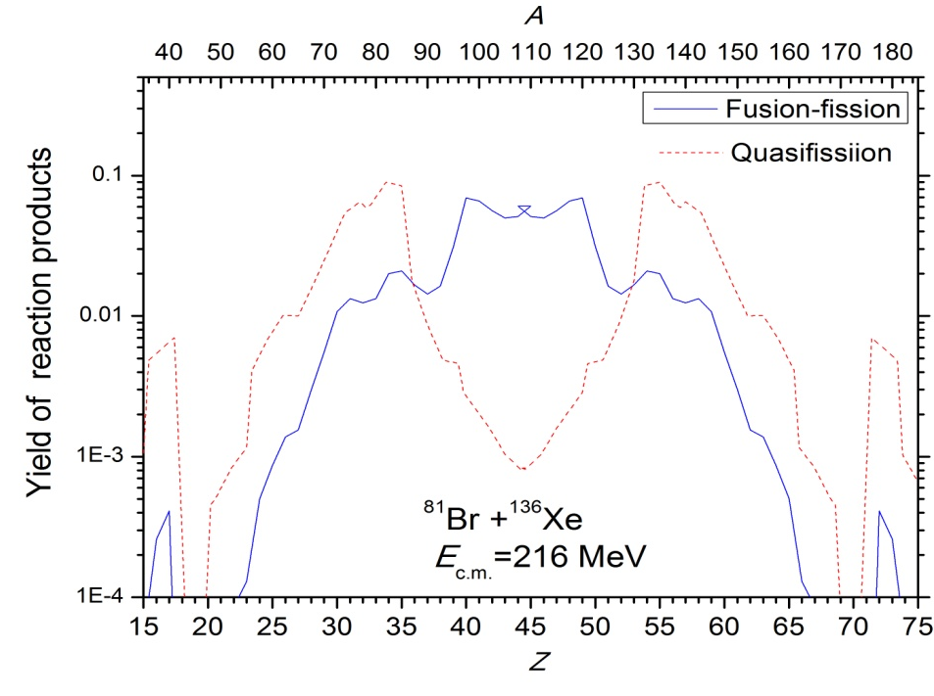
Theoretical predictions within the DNS model(2)
(E*,L) phase space population
Y. Fazio, Eur. Phys. J A 22 (2004) 75
A. Nasirov, Dec. 2013
ALTO NuBall Hybrid Spectrometer Workshop 2016 Ch. Schmitt, GANIL

Slide 14
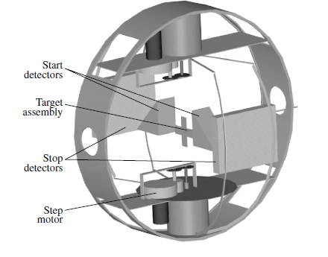
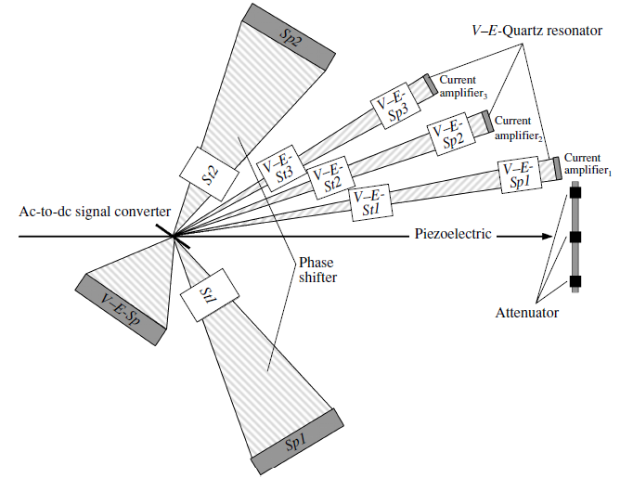
CORSET fission-fragment detector
E. Kozulin et al., Instruments and Experimental Techniques 51 (2008) 44
Reaction chamber
ALTO NuBall Hybrid Spectrometer Workshop 2016 Ch. Schmitt, GANIL

Slide 15
Fusion-QF competition in the medium-A systems with CORSET
Courtesy of E. Kozulin
Z=28
Z=50
N=82
N=50
Z₁Z₂=492 1360
α ~ 0,888 0,555
PRC 67 (2003) 011603(R)
ALTO NuBall Hybrid Spectrometer Workshop 2016 Ch. Schmitt, GANIL
Notes:
We have studied mass and energy distributions (MED) of fission fragments using two projectile-target combinations ¹²C + ²⁰⁴Pb and ⁴⁸Ca + ¹⁶⁸Er leading to the same compound nucleus 216Ra* at the same compound nucleus excitation energy Eq_{n} ~ 40 MeV . It has been found that the contribution of the asymmetric fission mode in the case of the former reaction is 1.5%, and it is as large as 30% in the case of the latter one. We connect such a sharp increase in the yield of asymmetric products in the ⁴⁸ Ca + ¹⁶⁸ Er reaction with the quasi-fission process, where MED have a clearly expressed shell structure. The properties of the fission fragment MED allow an interpretation by analogy with the low-energy fission of heavy nuclei as a manifestation of an independent mode of nuclear decay competing with the classical fusion-fission (FF) process. The quasi-fission component might be closely related to a suppression of the fusion cross section in the ⁴⁸Ca + ¹⁶⁸Er reaction.

Slide 16
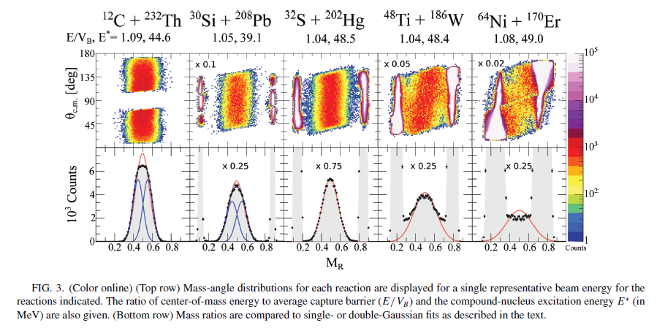
Mass-Angle correlation in QF-fusion discrimination
Williams et al., Phys. Rev. C 88 (2013) 034611
ALTO NuBall Hybrid Spectrometer Workshop 2016 Ch. Schmitt, GANIL

Slide 17
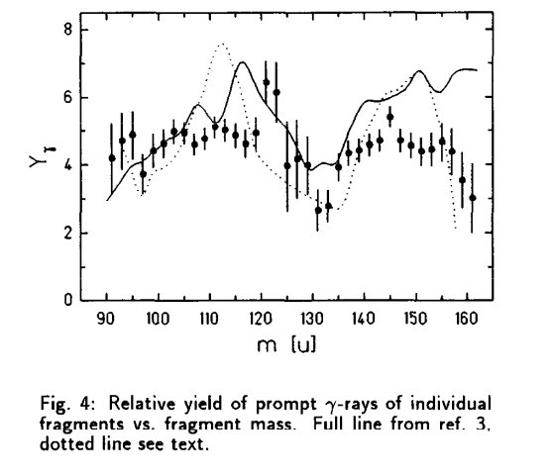
Saw-tooth γ-ray multiplicity
Total γ-ray multiplicity Uncertainty – experimental bias
Kniajeva et al., NPA(2004) Glässel et al., NPA(1989)
ALTO NuBall Hybrid Spectrometer Workshop 2016 Ch. Schmitt, GANIL

Slide 18
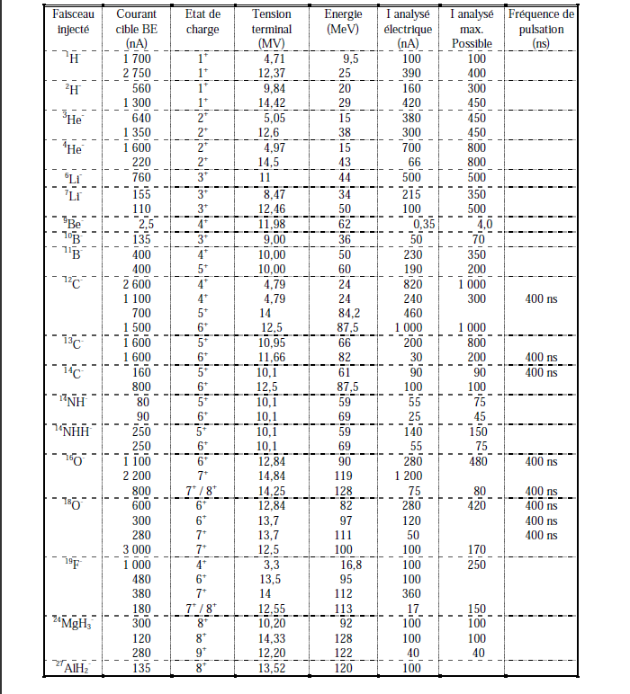
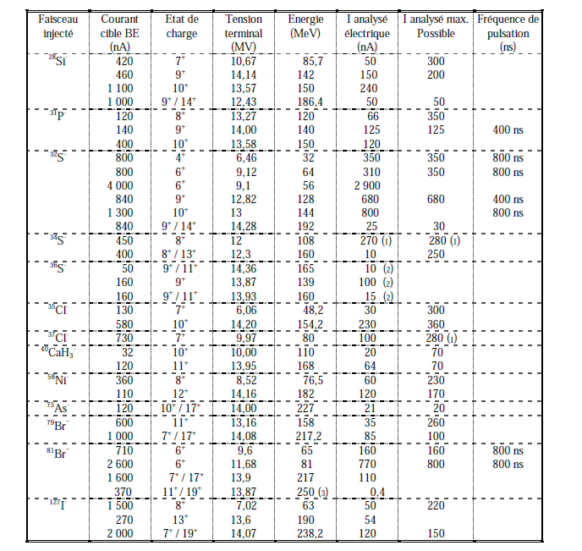
Beams@IPNO
ALTO NuBall Hybrid Spectrometer Workshop 2016 Ch. Schmitt, GANIL

Slide 19
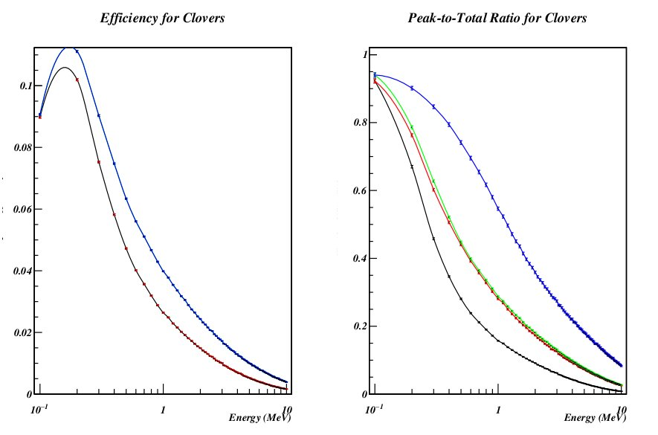
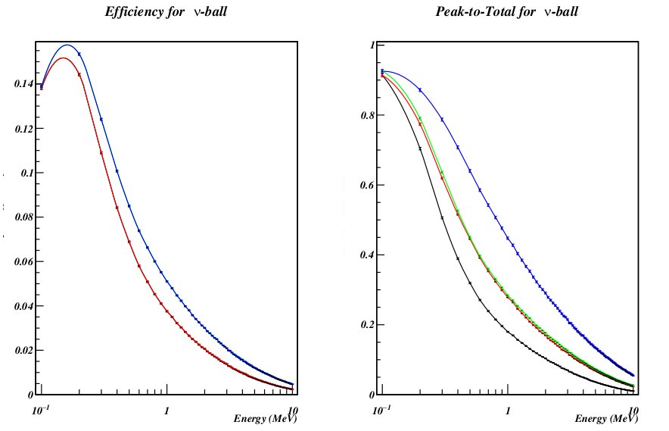
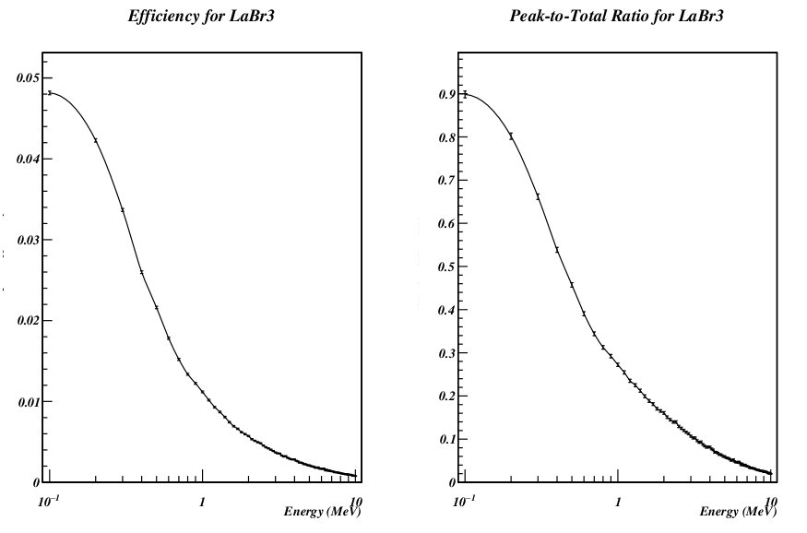
NuBall efficiency
Courtesy Matthieu Lebois
ALTO NuBall Hybrid Spectrometer Workshop 2016 Ch. Schmitt, GANIL

Slide 20
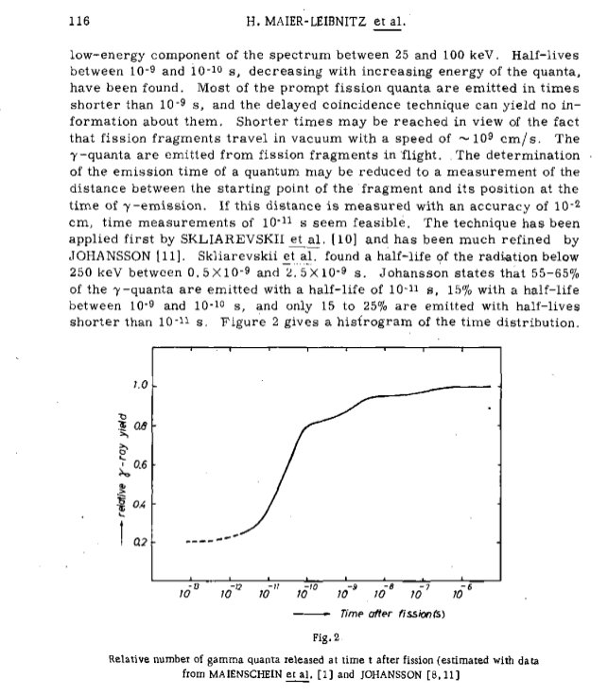
Time dependent γ–ray yield
H. Maier-Leibnitz et al. , Proceedings of a Symposium , Salzburg, 1965
ALTO NuBall Hybrid Spectrometer Workshop 2016 Ch. Schmitt, GANIL

Slide 21
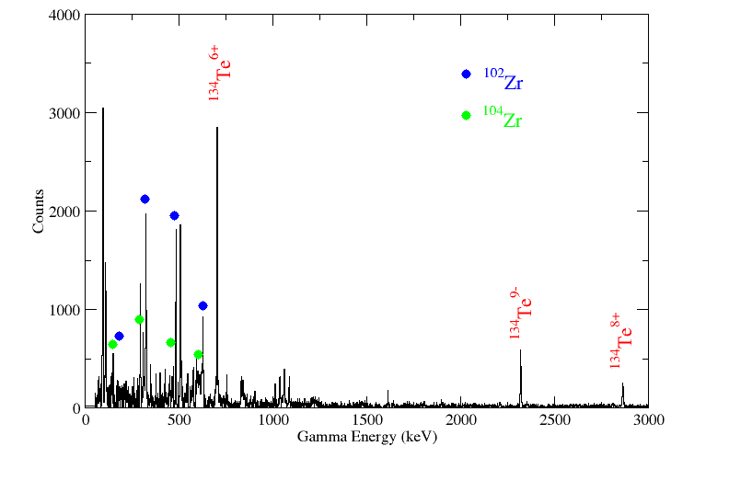
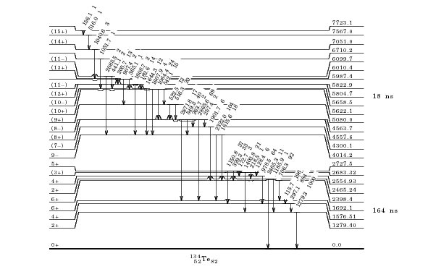
Prompt/Delayed fission γ-rays data @ IPNO
Courtesy Jon N. Wilson
238U(n,f)
ALTO NuBall Hybrid Spectrometer Workshop 2016 Ch. Schmitt, GANIL

Slide 22
Some numbers, rates, etc
Topic 1
A. Nasirov (2014)
Capture
Fusion
Quasi-fission
Topics 2/3
p [2-10MeV] +actinide
CN formation cross section ~ 1 up to few barns
Fission probability ~ 0.3 to 1 around to above threshold
→ Fission cross section above 100mbarns
10 gamma /fission
ALTO NuBall Hybrid Spectrometer Workshop 2016 Ch. Schmitt, GANIL

