Slide 1

Static and dynamic moments in Nu-Ball:
Tracking the emergence of nuclear collectivity
Andrew Stuchbery
Department of Nuclear Physics, ANU

Slide 2
Overview: Mind Map
Nature and emergence of nuclear collectivity
Systematics
Weakly collective nuclei
Odd-A Cd isotopes
The Te isotopes
Nuclear Structure activity at ANU
Systematics
Shell model
Questions
Electron and γ spectroscopy
LaBr3 timing applications
Magnetic moments
E0 transitions
NuBall ideas
Fast timing LaBr3
Plunger - TDRIV
Moments – Perturbed DCOs

Slide 3
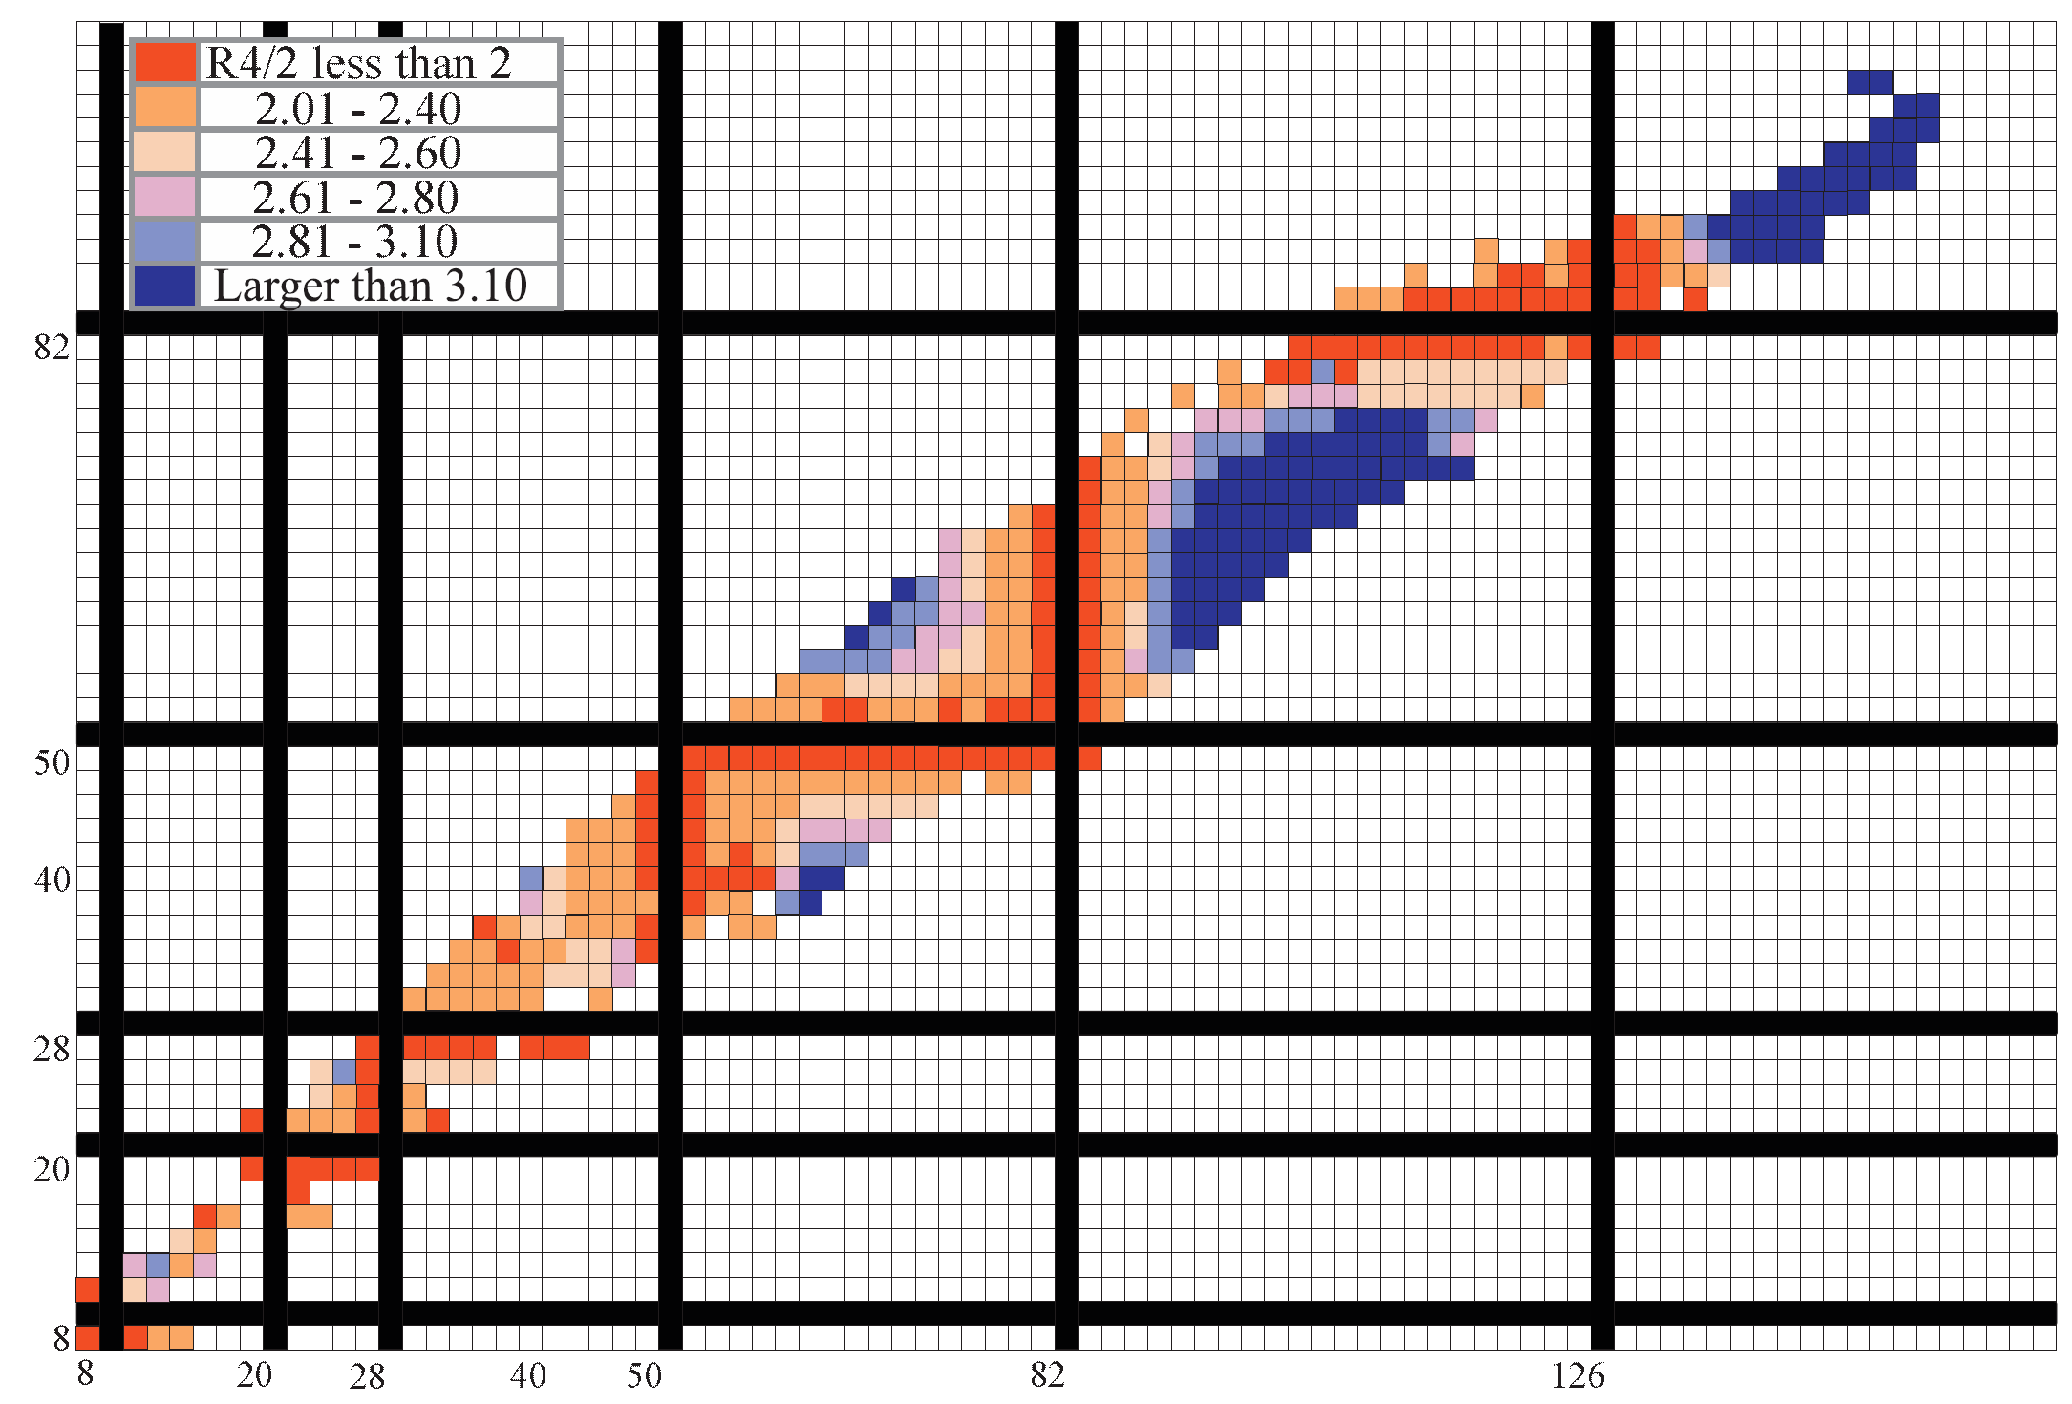
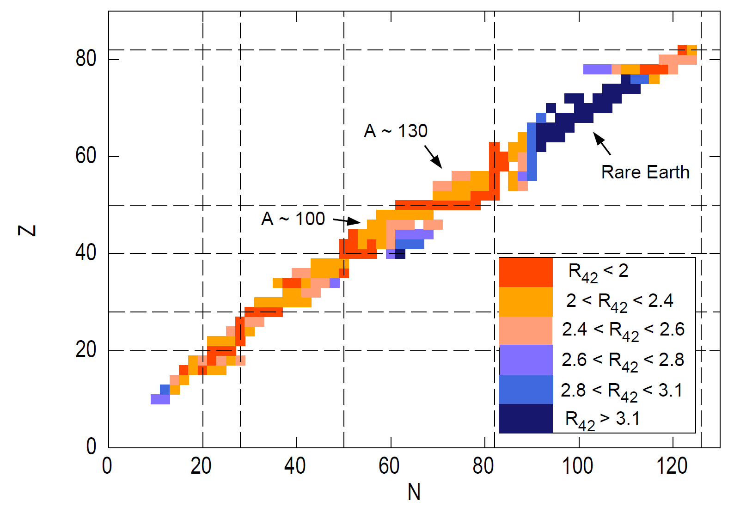
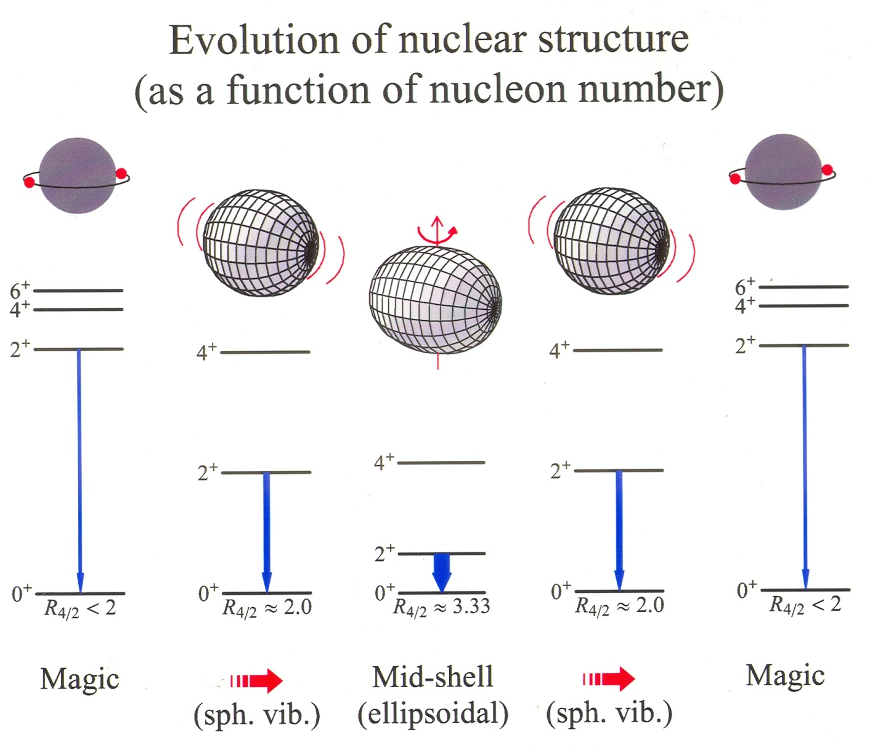
Nuclear Collectivity
R(E(4⁺) / E(2⁺)) Systematics plot from Burcu Cakirli
g factor data for first 2⁺ states

Slide 4
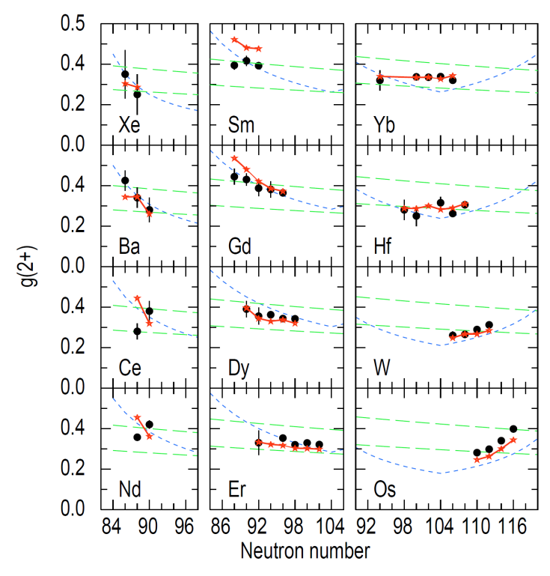
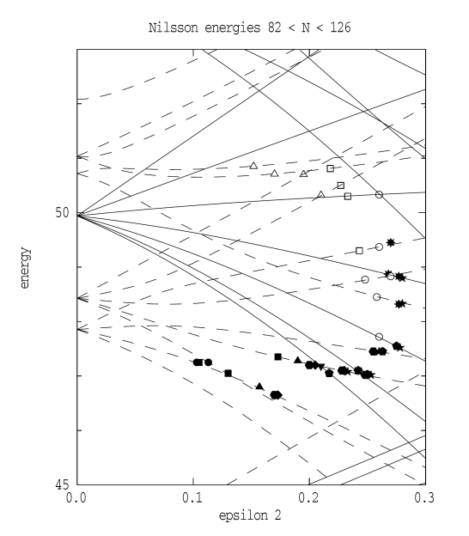
Collective g factors
Stefan Frauendorf - Cranking model
g factor data for first 2⁺ states
- data hug valley of stability
Position of high-spin intruder determines systematics

Slide 5
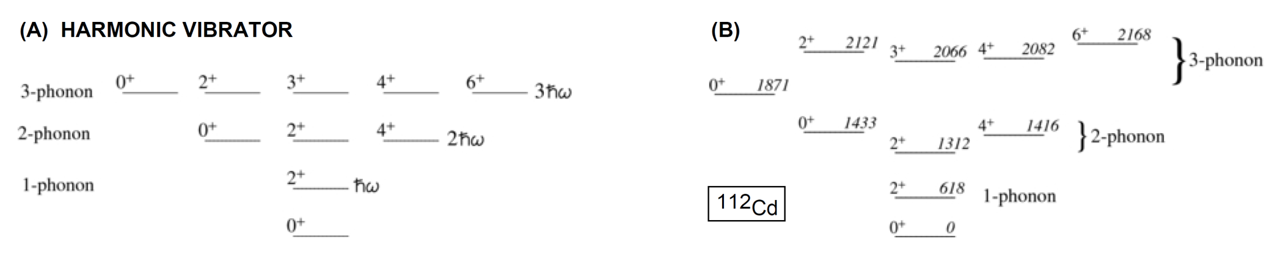
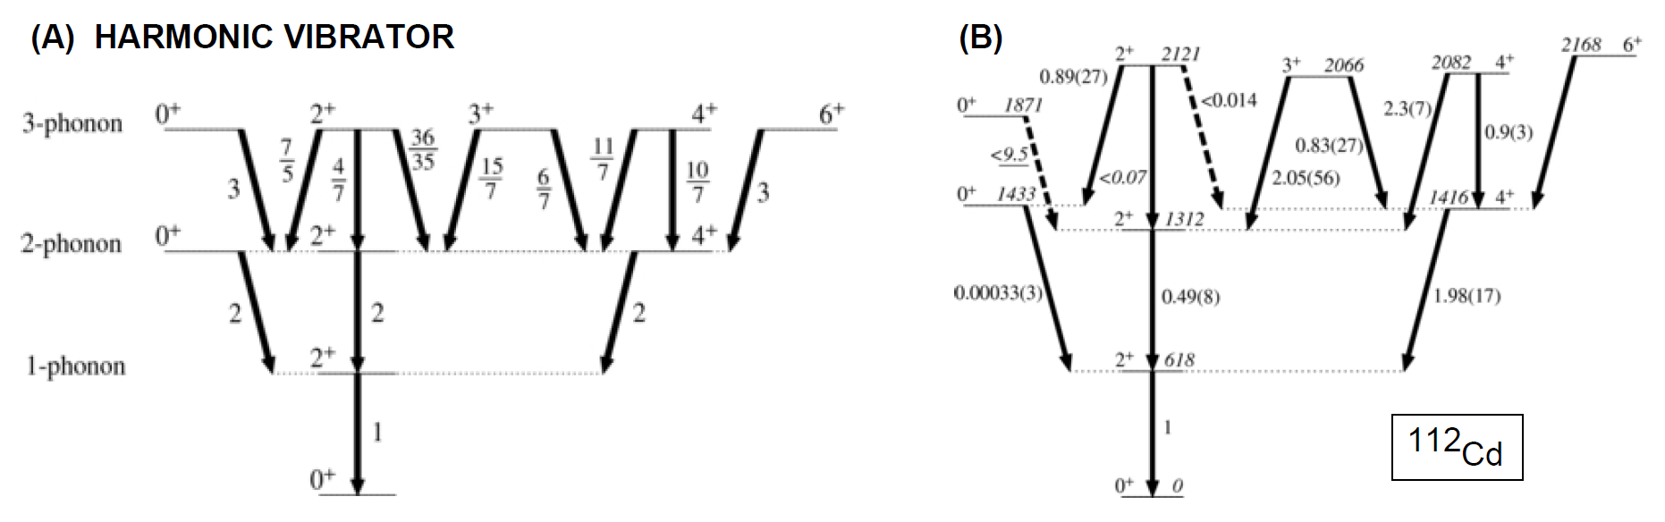
Weak nuclear collectivity
Nature and emergence of nuclear collectivity [Garrett & Wood J.Phys.G 37,064028]
Cd isotopes: energies look vibrational but E2 strengths are not
– intruder configurations
1). Do nuclei vibrate? 2). If not vibrators, then what? (γ soft rotor?)

Slide 6
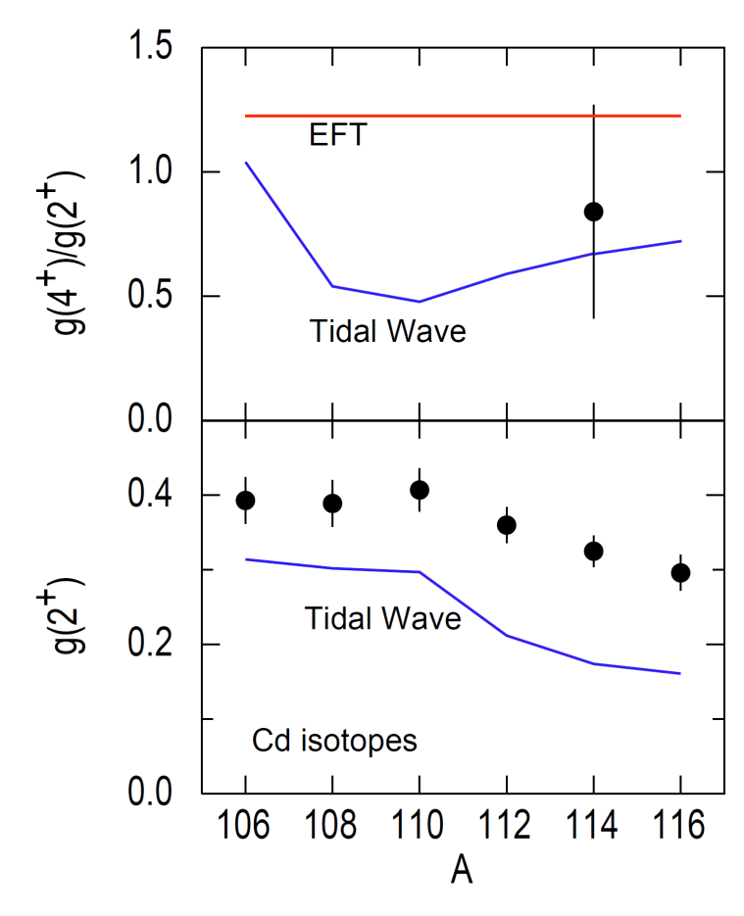
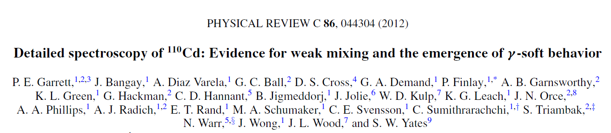
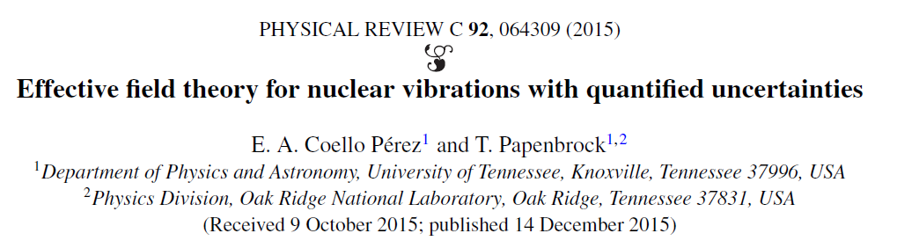
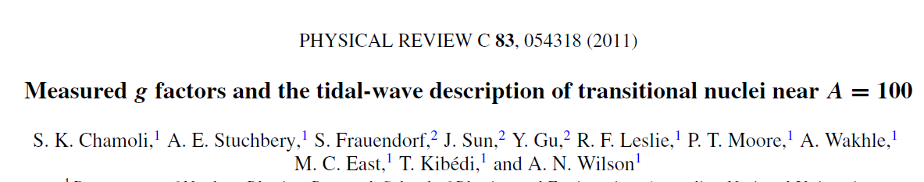
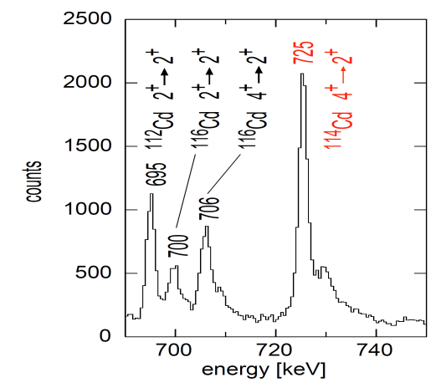
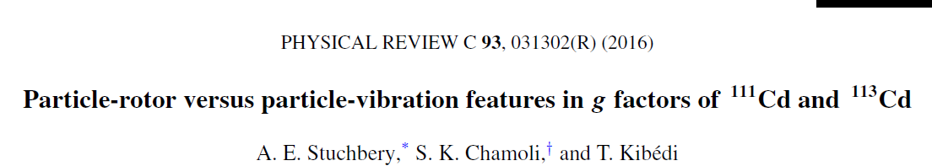
Cd controversy & g factors

Slide 7
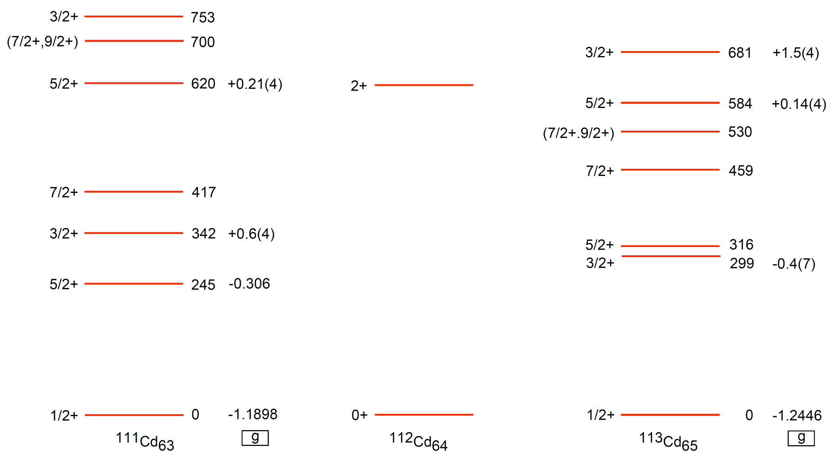
Odd-A Cd isotopes: ^{111,113}Cd
Core excitation

Slide 8
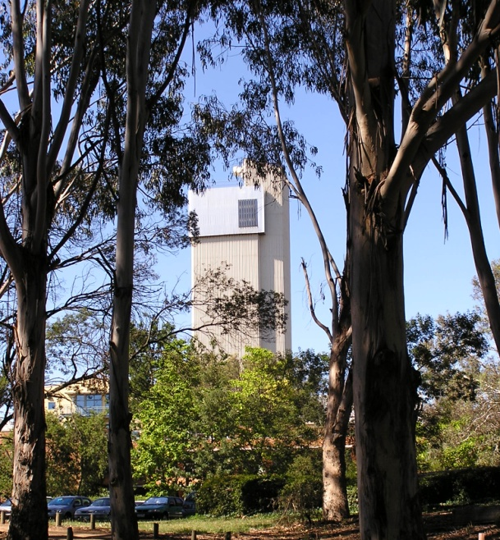
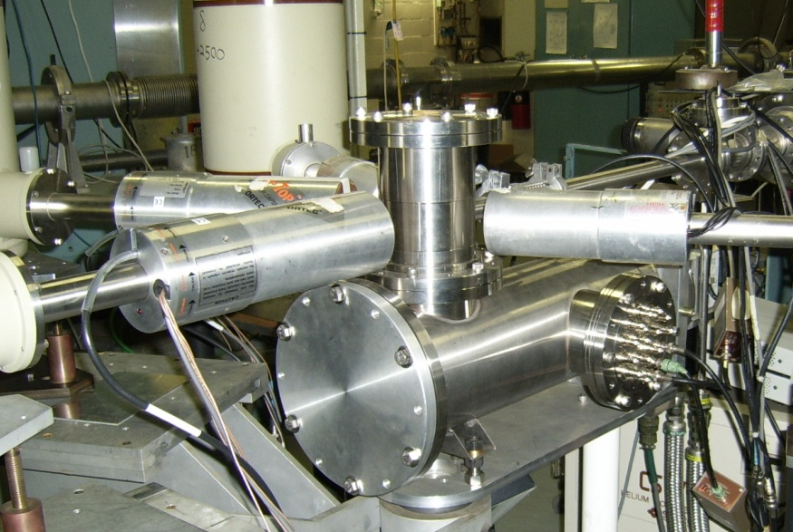
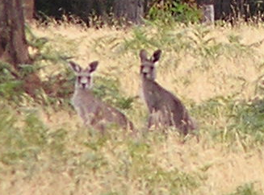
Odd-A Cd isotopes: ^{111,113}Cd
New transient-field
g-factor measurements

Slide 9
Weak coupling model
3/2⁺
5/2⁺
3/2⁺
5/2⁺
1/2⁺
1/2₁⁺ and 5/2₂⁺ states must be mixed

Slide 10
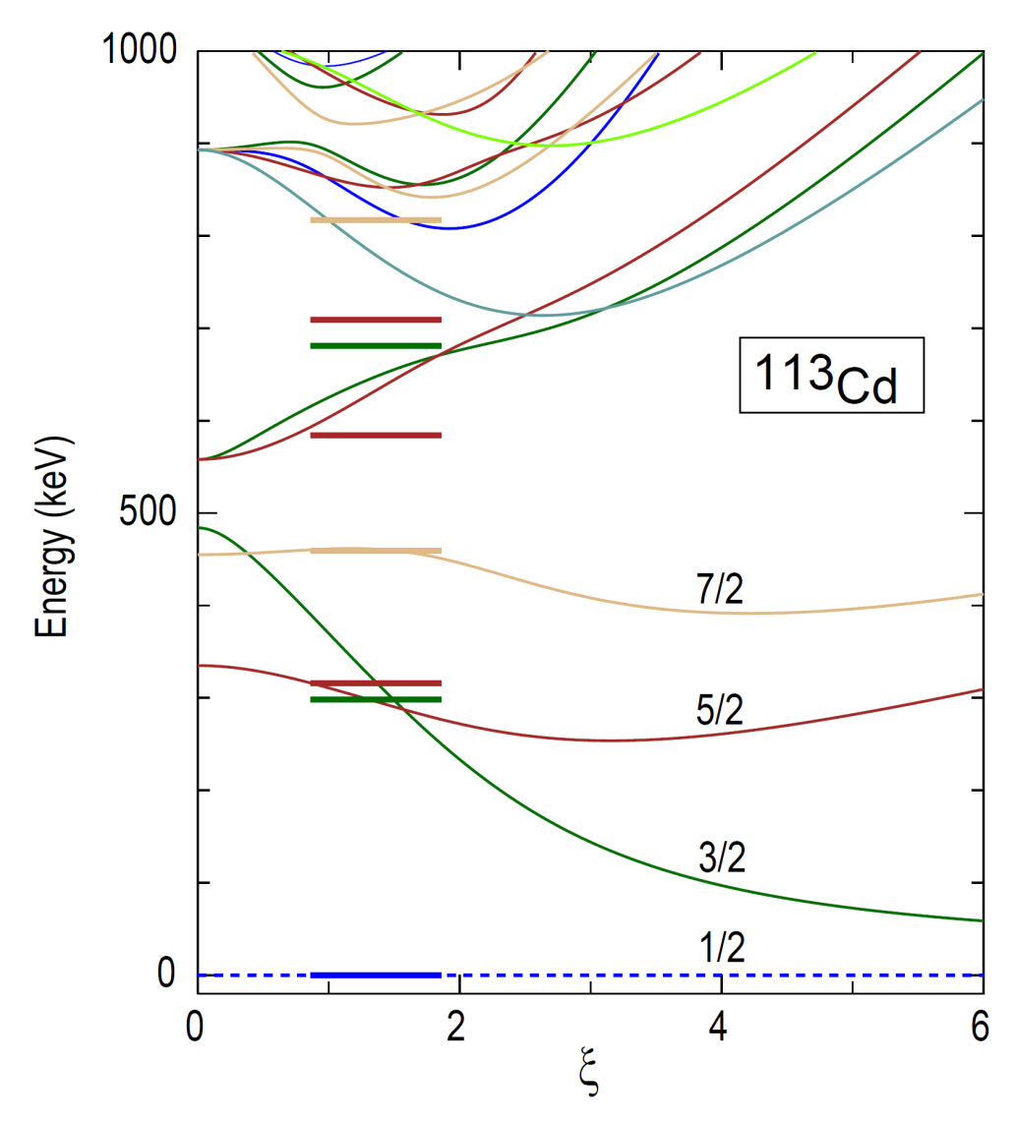
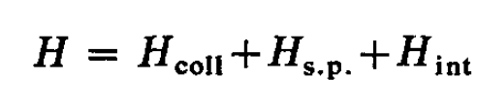
Particle-vibration model
1-3 phonons ⊗ ν s_{1/2}, d_{3/2}, d_{5/2}, g_{7/2}
Parameter ξ determines coupling between odd nucleon and core vibration
Heyde & Brussard,
NPA 104, 81 (1967)
Purrington,
CPC 58, 211 (1990)
Fit to energy levels in ¹¹³Cd

Slide 11
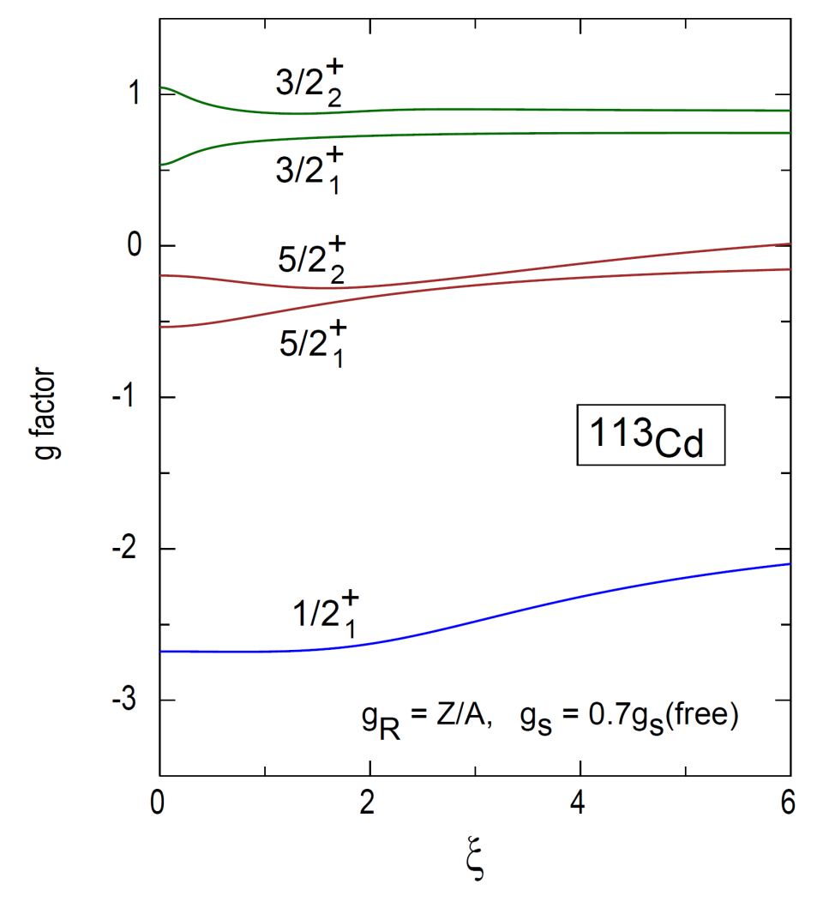
g factors & PV coupling
g(5/2⁺) never becomes positive
1/2⁺ insensitive to ξ
& factor of 2 too negative

Slide 12
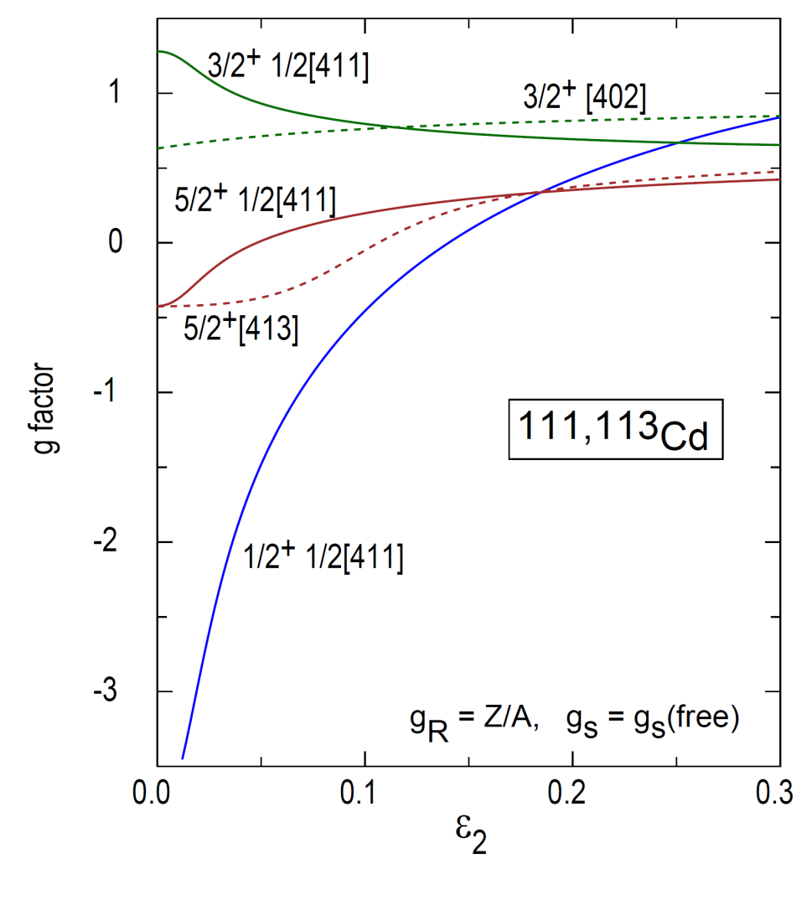
Vibration vs Rotation
Particle + vibration
Particle + rotor
PV coupling
Deformation

Slide 13
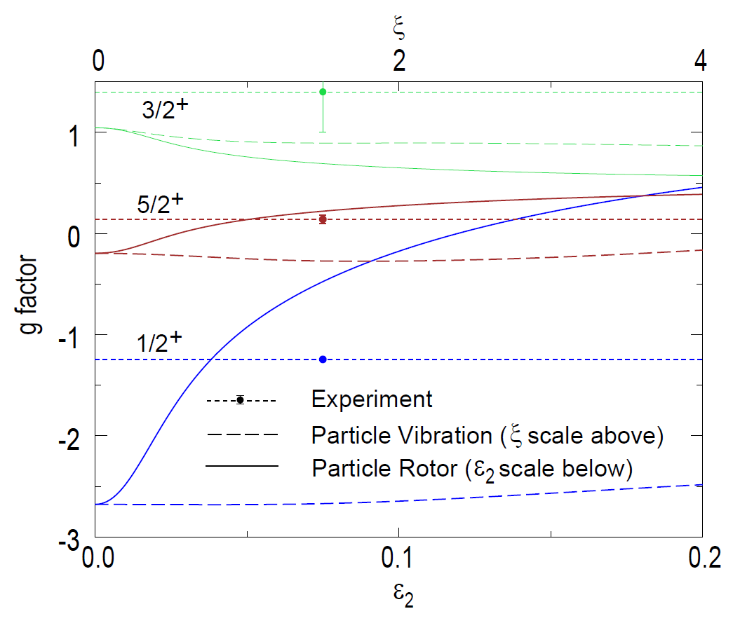
PV & PR “start the same”!

Slide 14
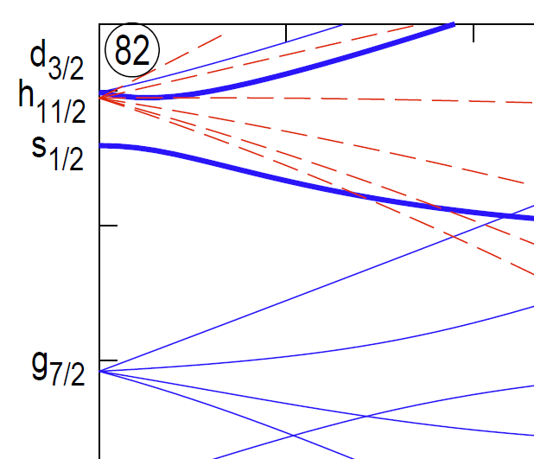
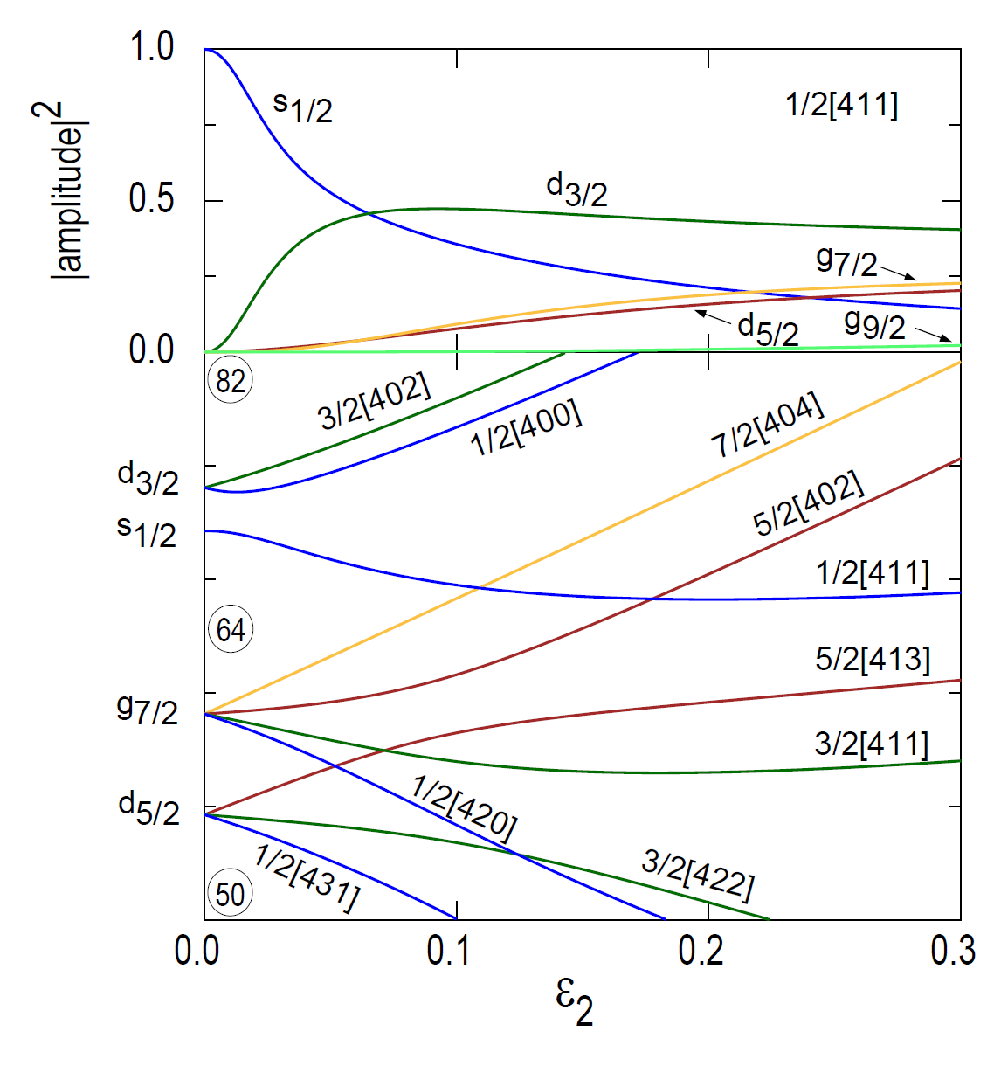
Deformation: correct mixing
1/2[400]
1/2[411]
Quadrupole deformation mixes s_{1/2} and d_{3/2} orbits:
brings g factors into better agreement with experiment.

Slide 15
Odd-A Cd Summary
Odd-A Cd isotopes: the nature of core collectivity, and the path to the onset of deformation
  Sensitive to the nature of the core collectivity in ways E2 rates are not
  Particle-vibration and particle-rotor models reduce to same limit for j=1/2 orbits
  Deformation mixes s_{1/2} with d_{3/2}, particle-vibration coupling mixes d_{5/2}
  Must consider M1 observables along with E2 in mapping the path to collectivity

Slide 16
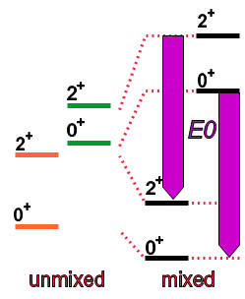
Electromagnetic observables
E2 moments & transitions:
          Quantify quadrupole collectivity
          Track evolution of collectivity
          Distinguish alternative models (possibly)
          Elucidate nature/origin of collectivity
M1 observables (g factors):
          Sensitive to microscopic structure
          Window on drivers of emergent collectivity
E0 transitions:
          Identify and quantify shape co-existence

Slide 17
Overview: Mind Map
Nature and emergence of nuclear collectivity
✓
Systematics
Weakly collective nuclei
Odd-A Cd isotopes
✶
The Te isotopes
Nuclear Structure activity at ANU
Systematics
Shell model
Questions
Electron and γ spectroscopy
E0 transitions
LaBr3 timing applications
Magnetic moments
NuBall ideas
Fast timing LaBr3
Plunger - TDRIV
Moments – Perturbed DCOs

Slide 18
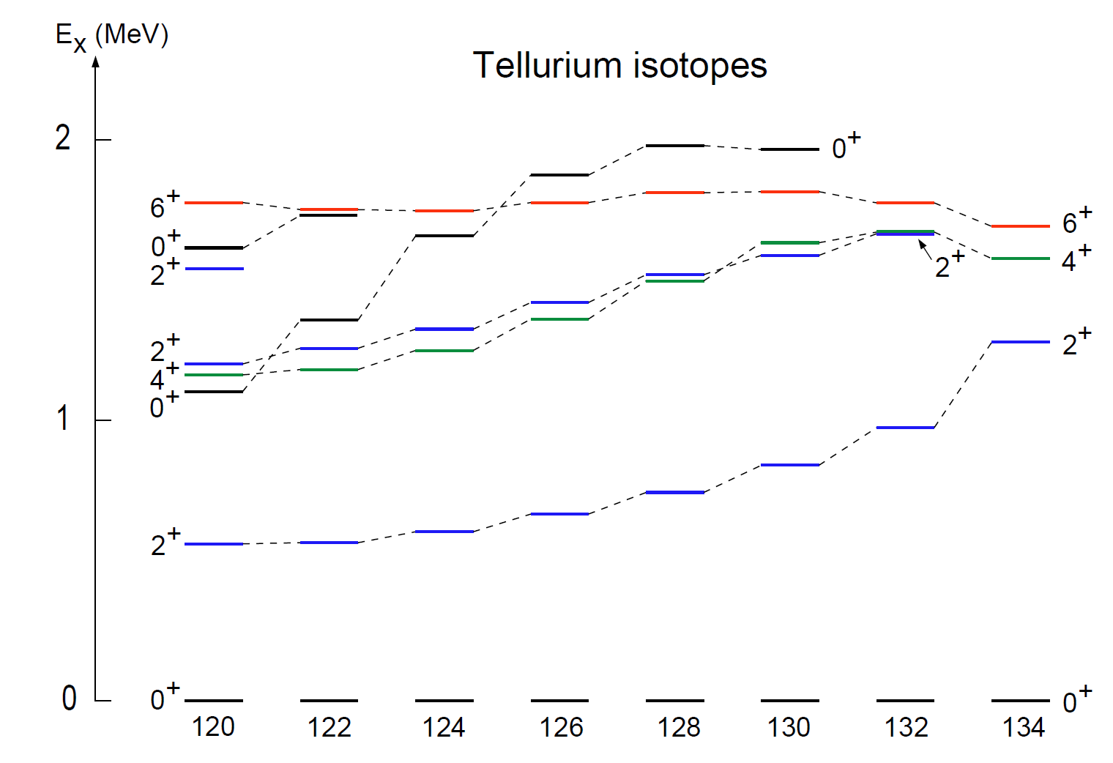
Emerging nuclear collectivity

Slide 19
Shape coexistence in the even-Hg isotopes:
NOTE characteristic parabolic energy trend
Slide from John Wood
mid-shell
₈₀Hg
Figure from J. Elseviers et al.
PR C84 034307 2011

Slide 20
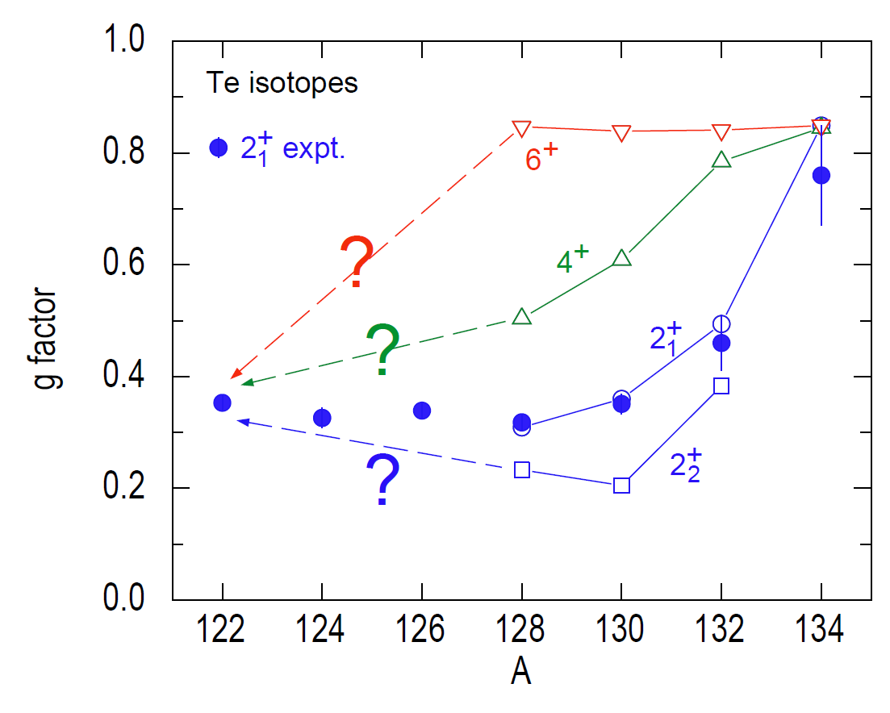
g factors & collectivity
π (g_{7/2})²
Questions
Need data!
E0, M1, E2
e.g. 6⁺ g factors
Nushellx with interactions from Alex Brown – PRC 71, 044317 (2005)
Data: ANU & ORNL: PRL 94, 192501 (2005); PRC 76, 034306 (2007);
PRC 76, 034307 (2007); PRC 88, 051304(R) (2013)

Slide 21
Overview: Mind Map
Nature and emergence of nuclear collectivity
✓
Systematics
Weakly collective nuclei
Odd-A Cd isotopes
✶
The Te isotopes
Nuclear Structure activity at ANU
✓
Systematics
Shell model
Questions
Electron and γ spectroscopy
E0 transitions
LaBr3 timing applications
Magnetic moments
NuBall ideas
Fast timing LaBr3
Plunger - TDRIV
Moments – Perturbed DCOs

Slide 22
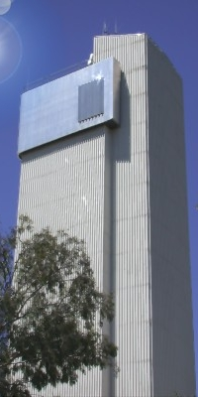
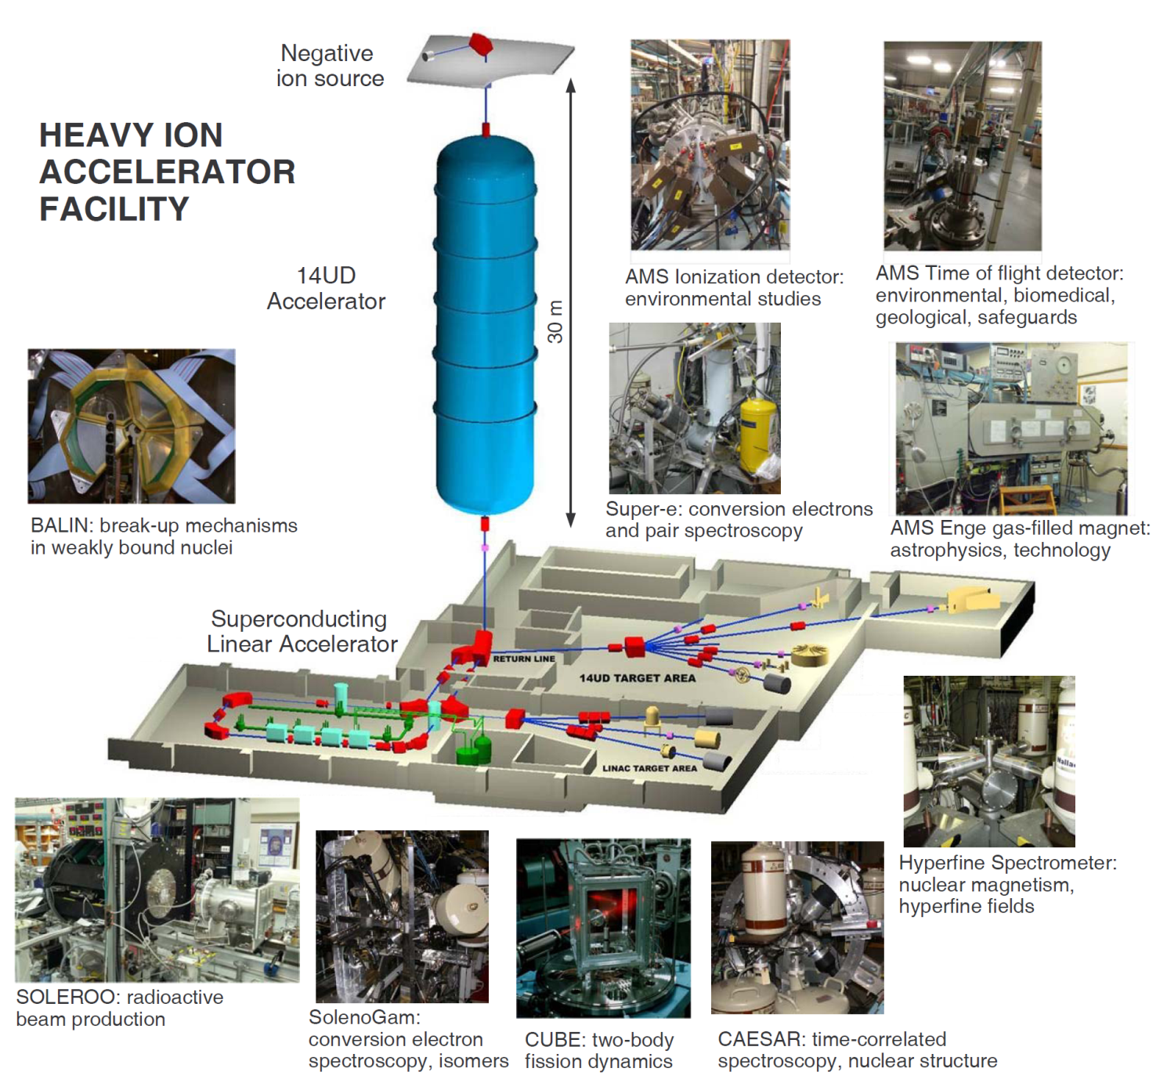
Heavy Ion Accelerator Facility
Notes:
What we have.
Unique capabilities
None off the shelf

Slide 23
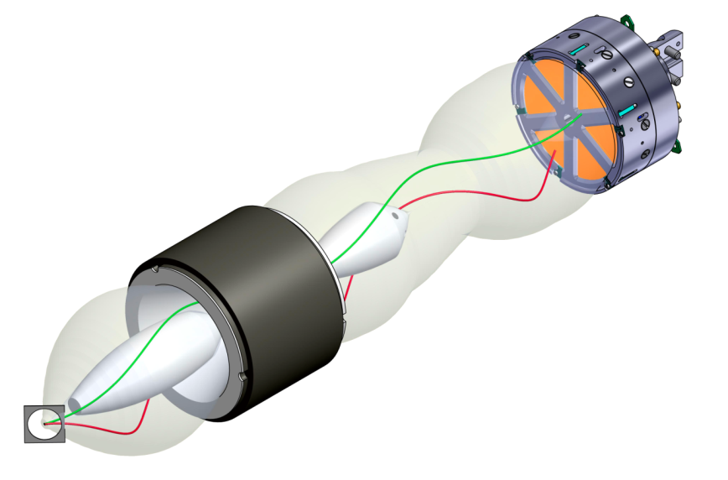
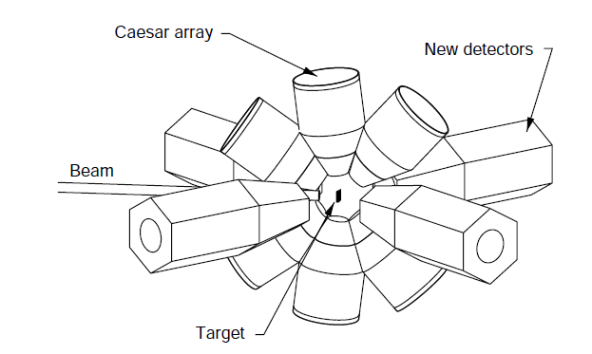
Electron and γ spectroscopy
Super-e
CE
e⁺e⁻
CAESAR array
E₋
Higher efficiency detectors
E₊
Θ
Si(Li) array of six detectors
Thickness: 9 mm
Area: 236 mm²
FWHM ≈ 2.5 keV
Semikon GmBh

Slide 24
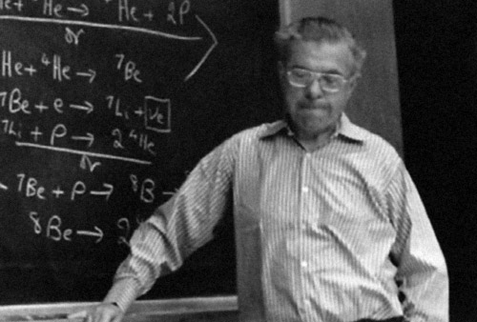
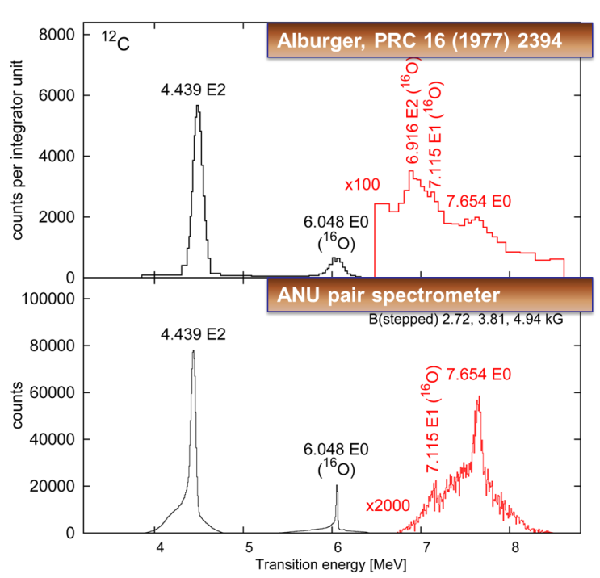
Pair spectroscopy of the Hoyle State
Triple-α reaction in helium burning stars produces carbon in the universe
α
¹²C
Carbon production (0.04%)
⁸Be
0⁺
Hoyle state
7.65 MeV
α
E2
E0
2⁺
4.44 MeV
Sir Fred Hoyle (1915-2001)
α
α-decay
(99.96%)
E2
0⁺
Our first ¹²C pair spectrum from the Hoyle state:

Slide 25
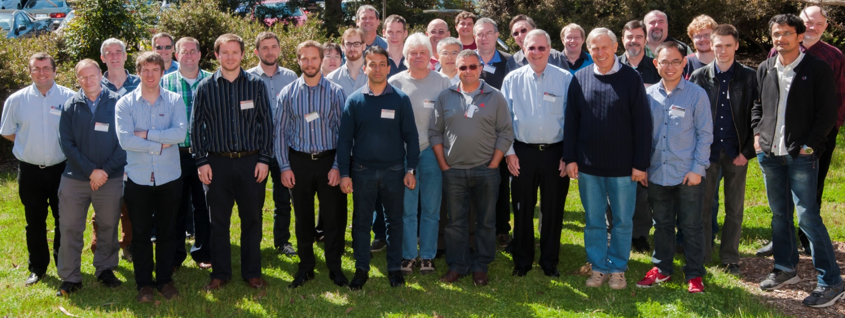
E0 Workshop
11-12 September 2015
  new instruments/facilities/results
  physics opportunities/exotic beams
  shape co-existence & E0 transitions
  Auger electrons - the “forgotten” child of IC
Ongoing: E0 working group (Tibor Kibedi, John Wood)
Wiki: https://en.wikiversity.org/wiki/Monopole

Slide 26


E0 transition rate
Measure T(E0):
I_{ce} or I_{π} (e/π spectroscopy)
T_{1/2} (e or γ timing spectroscopy)
δ(E2/M1) (γ-ray angular correlations)
Monopole transition rate:
Electronic factor Ω(κ):
Atomic physics
Resurrect CATAR program (HC Pauli)
Make Ω(κ) available with BrIcc soon
http://bricc.anu.edu.au/

Slide 27
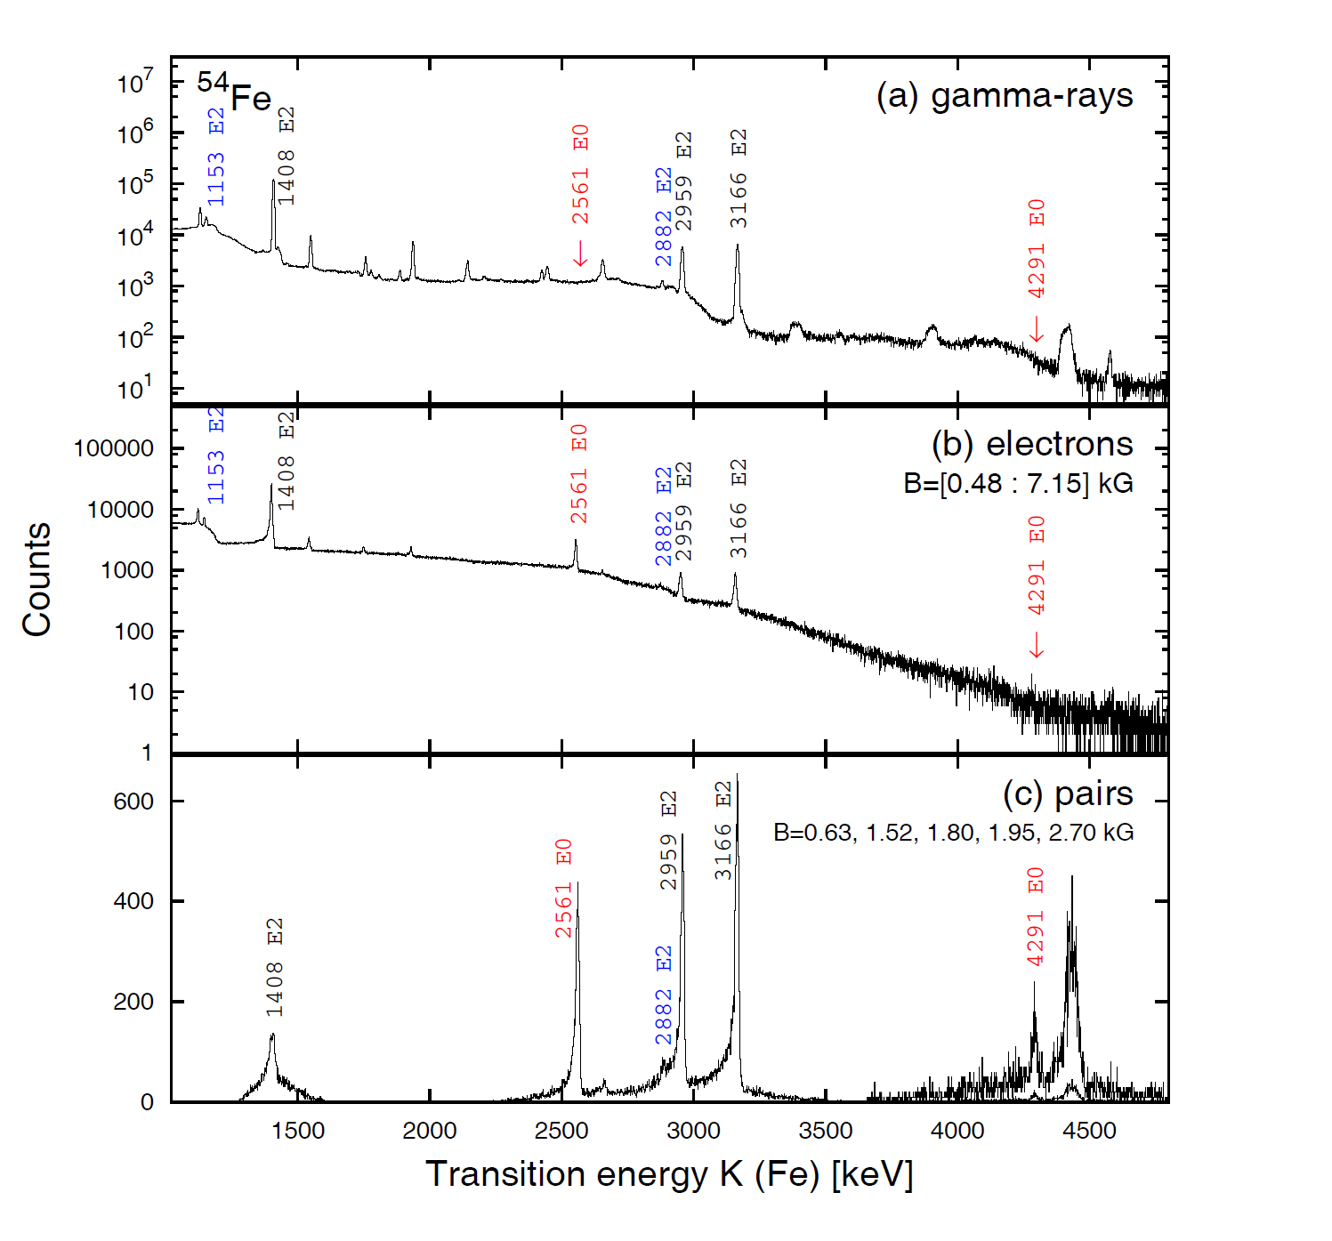
0⁺ states and E0 in Fe, Ni
Tibor Kibedi, Adam Garnsworthy + several students
Electron spectroscopy with Super-e: CE and pairs
Gamma spectroscopy with CAESAR (δ and γγ)
(p,p’) reaction
Note: Can do angular distributions with (p,p’) - there is alignment! (s-wave scattering?)

Slide 28
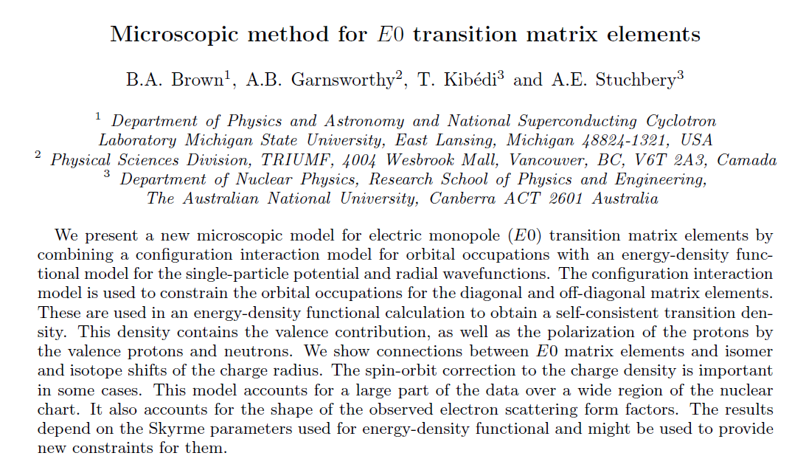
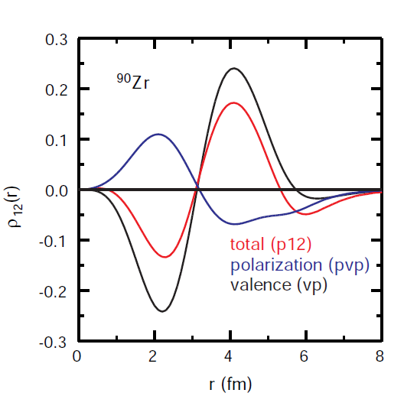

New theory for E0 transitions
Effective charges – limited meaning for E0
Use shell model + EDF to evaluate changes in average proton radius
Connection with isotope shifts and charge radii
Submitted

Slide 29
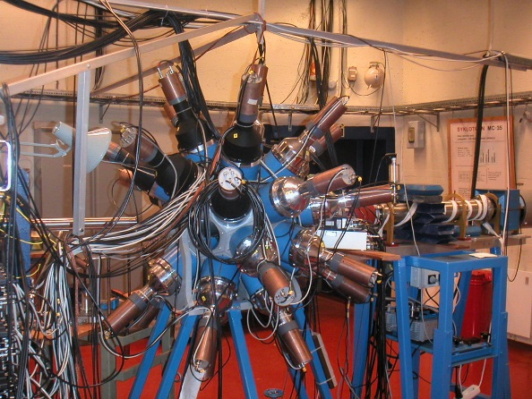
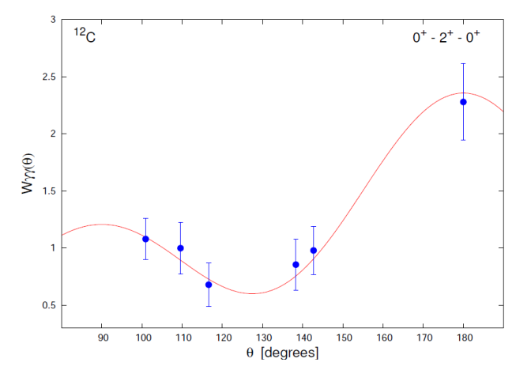
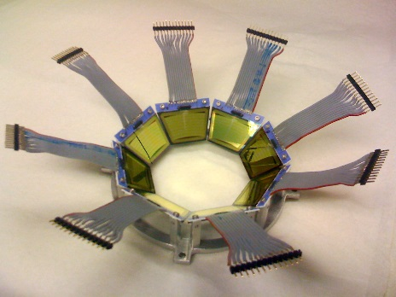
Gamma decay of the Hoyle State
Γ_{rad}/Γ from pγγ/p rates
Oslo Cyclotron Laboratory @10.7 MeV
0⁺
Hoyle state
7.65 MeV
E2
γ ray 3.21 MeV
2⁺
4.44 MeV
CACTUS: 26 5” by 5” NaI
E2
γ ray 4.44 MeV
0⁺
2.6E+8 singles proton &
~1.0E+3 pγγ triple coincidence events
SiRi: 64 ΔE-E telescopes
Intensity
θ degrees
Badriah Alshahrani PhD thesis
First incontrovertible proof that Hoyle state is 0⁺ (?)

Slide 30
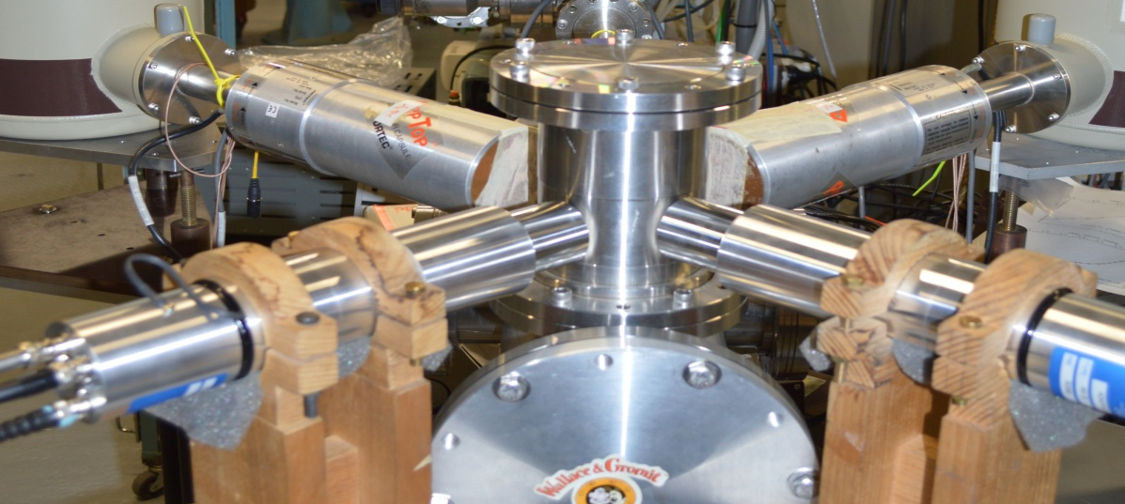



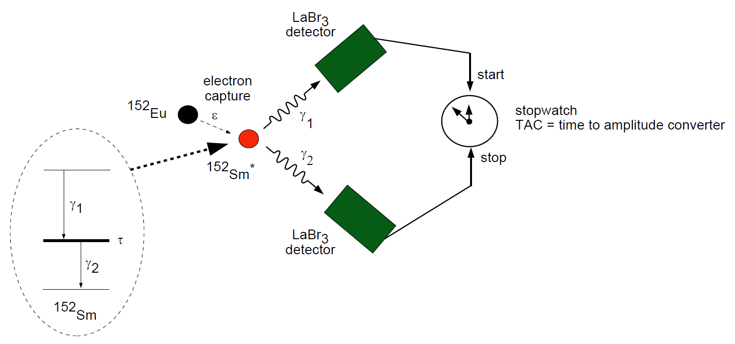
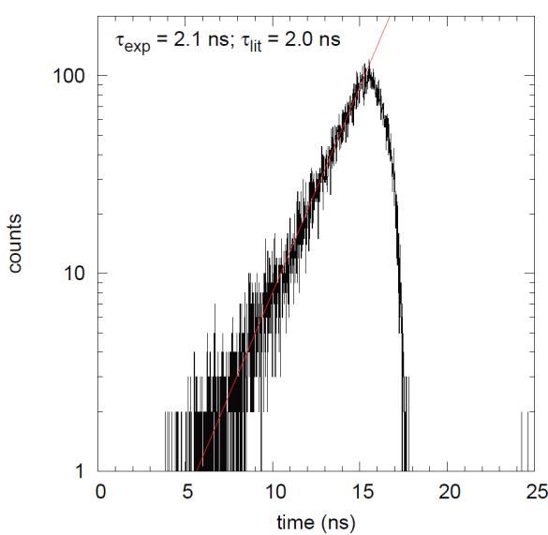
Dr Matthew Reed
LaBr₃ detectors -
Fast Timing of
nuclear states
Leia
Luke

Slide 31
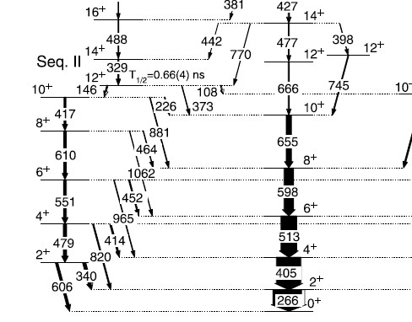
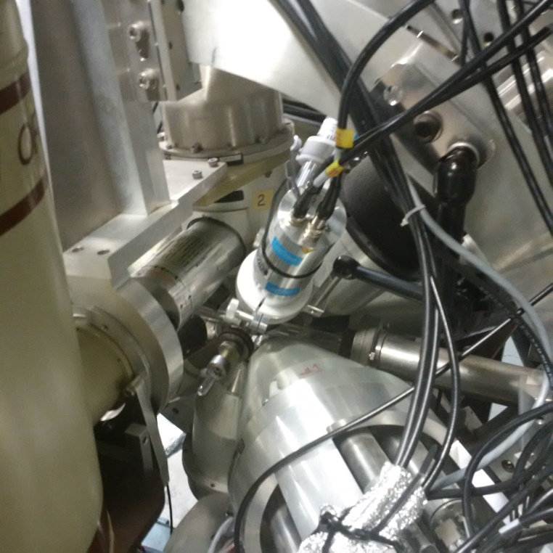
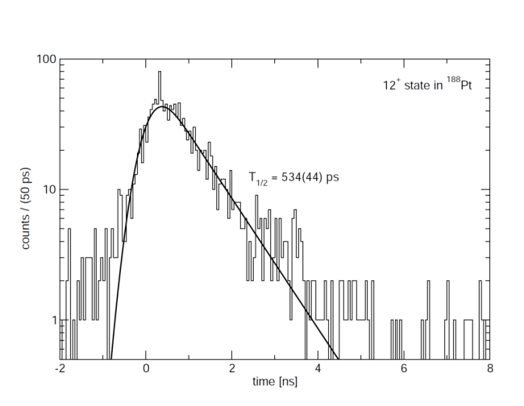
LaBr₃ detectors -
Fast Timing of
nuclear states
Excited-state wavefunctions
Nuclear shapes, collectivity
Unprecedented energy and time resolution (>50 ps)
¹⁷⁶Yb(¹⁶O,4n)¹⁸⁸Pt
4 LaBr₃ in CAESAR
25 ps/channel TDC
Aqeel Akber: Honours project 2015

Slide 32
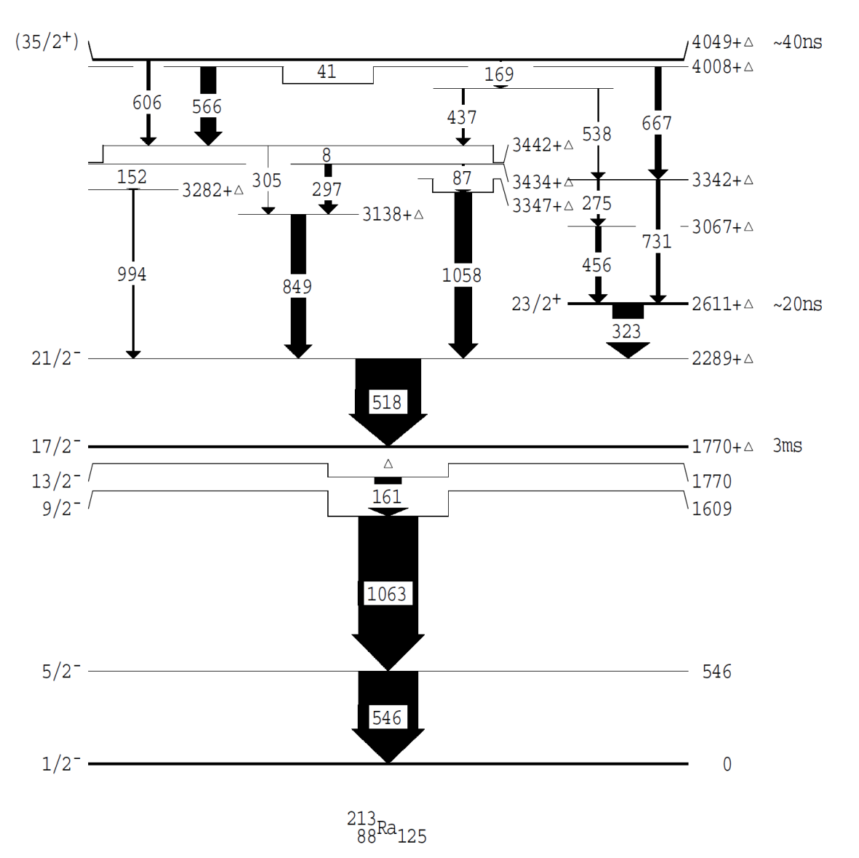




LaBr₃ detectors -
Fast Timing of
nuclear states
5/2⁻
570
213Ra
T_{1/2} = 131 ps
570
²⁰⁴Pb(¹³C,4n)
1/2⁻
0
²⁰⁷Pb
$π{(h}_{9/2})6 ν{(f}_{5/2})$⁻¹
$π{(h}_{9/2})6 ν{(p}_{1/2})$⁻¹
Related nuclear structure
Lifetimes now accessible
$π{(h}_{9/2})6 ν{(f}_{5/2})$⁻¹
$π{(h}_{9/2})6 ν{(p}_{1/2})$⁻¹
²¹³Ra = ²⁰⁷Pb + 6p
Thomas Palazzo: Honours project 2015

Slide 33
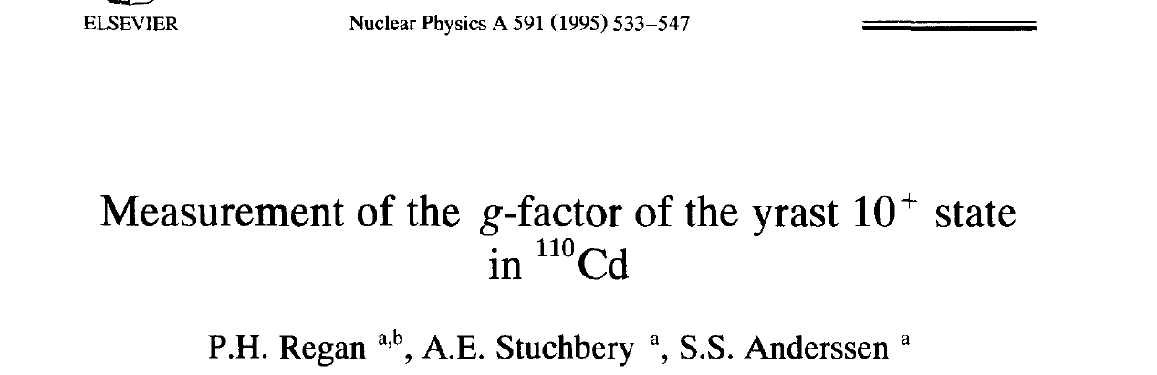
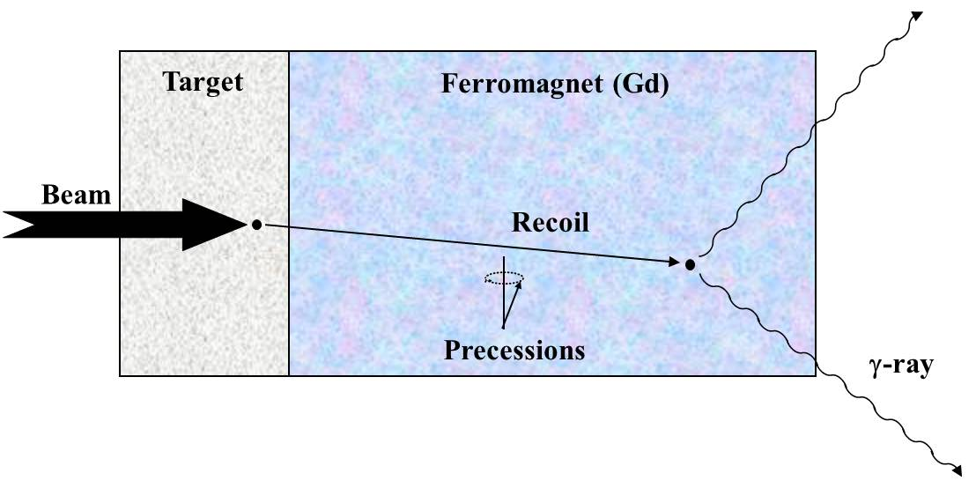
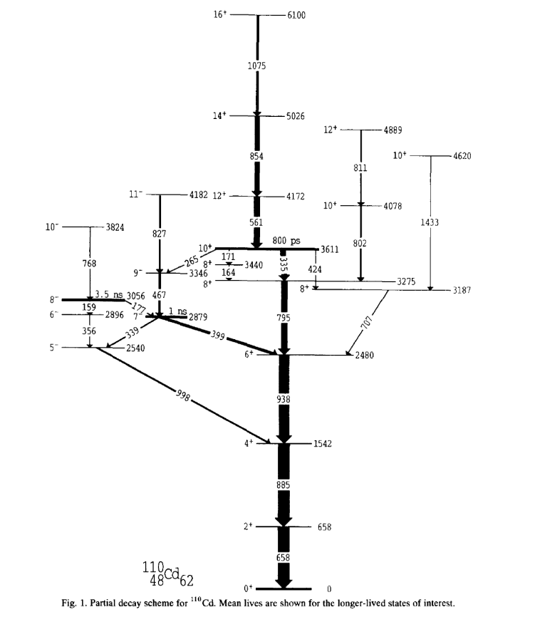

LaBr₃ and g factors: ¹¹⁰Cd
¹⁰⁰Mo(¹³C,3n)¹¹⁰Cd 45 MeV
g(10⁺) = -0.09(3)
Expected g ~ -0.2 for ν(h_{11/2})²
Integral perturbed angular correlations

Slide 34


¹⁰⁷Cd isomers known g
¹⁰⁰Mo(¹²C,5n)¹⁰⁷Cd 65 MeV
g ~ 0.8
g ~ -0.2
We observed the 11/2⁻ and 21/2⁺ isomers but could not resolve spin precessions with HPGe detectors
Can revisit and solve problem with LaBr₃
Level scheme from NPA 228, 112

Slide 35


Time resolution in R(t)
30 kTesla hyperfine field
Pure magnetic interaction
Could not see this oscillation with HPGe
Periods within time resolution of LaBr₃

Slide 36




LaBr₃ 48h test run
⁵⁶Fe(¹⁶O, 2pn)⁶⁹Ge
398 keV 9/2⁺ T_{1/2} = 2.8 μs T~45 ns
Fe is target and host
⁵⁴Fe(¹⁶O, 2pn)⁶⁷Ge T~45 ns
⁴⁵Sc(¹²C,p2n)⁵⁴Fe
10⁺ T_{1/2} = 0.525 μs Ni host
T~10 ns

Slide 37


E6 transition in ⁵³Fe
Higher efficiency detectors
³²S + ²⁴Mg
Cycle beam on and off
100
counts
0
Out of beam spectrum

Slide 38
Overview: Mind Map
Nature and emergence of nuclear collectivity
✓
Systematics
Weakly collective nuclei
Odd-A Cd isotopes
The Te isotopes
Nuclear Structure activity at ANU
✓
✓
Systematics
Shell model
Questions
Electron and γ spectroscopy
E0 transitions
LaBr3 timing applications
Magnetic moments
✶
NuBall ideas
Fast timing LaBr3
Plunger - TDRIV
Moments – Perturbed DCOs

Slide 39
LaBr₃: 0⁺, 4⁺, 6⁺ lifetimes
A: | 120 | 122 | 124 | 126 | 128 | 130 | 132 | 134
T_{1/2}(6+): | ? | ? | ? | 68 ps | 0.45 ns | 9.8 ns | 145 ns | 164 ns
Te isotopes

Slide 40





High precision g-factor measurements
Plunger
Orgam array
Plastic scintilator
Plunger “O U P S”

Slide 41

Mg isotopes toward ³²Mg
²⁶Mg @ Orsay
²⁶Mg
E(2⁺) says YES
Neutron d_{5/2} subshell closure at N=14 ??
³²Mg
g(2⁺) says NO
?
USD shell model says YES
²⁶Mg g factor from Speidel et al PLB 1981
(α,α’) reaction, Δθ ≈ 1.5 mrad = tough measurement

Slide 42

²⁶Mg transient field measurement
magnetic
scattered ²⁶Mg detected
magnetic
field
field
beam
Δθ ≈ 15 mrad
beam
²⁶Mg beam
E(2⁺) says YES
Gd
Gd
silicon
target
silicon
target
(10 mg/cm²)
sensors
g(2⁺) says YES
(photodiodes)
³²Mg
✗
Neutron d_{5/2} subshell closure at N=14
Australian National University

Slide 43


²⁸Mg
NuBall array – ideal geometry
TIGRESS array + Plunger (TIP)
Simulated data:
At 10⁷ pps a g-factor measurement with precision ~±5% is feasible in ~8 days

Slide 44



Transient-Field g factors
Conventional wisdom: need detectors near 65°
BUT
2
3
Break azimuthal symmetry in particle detection. These detectors become useful for TF type g-factor measurements.
4
1
5
Possible application:
g(2⁺)/g(4⁺) in Cd and Te isotopes

Slide 45

Sensitivity at θ_{γ} = 45°, 90°
5
4
2
3
4
2
1
5
1

Slide 46

Sensitivity at θ_{γ} = 45°, 90°
Sensitivity
@ 45° and 90°
Sensitivity
@ 45° and 90°
Sensitivity
@ 45° and 90°

Slide 47

New double ratios

Slide 48


Extending g(2⁺) systematics
(HI,xn) reactions
Magnetic field along beam
γγ correlations around ring
Isolates intermediate state
Magnet poles
beam
target
Bozorth, Ferromagnetism

Slide 49


Extending g(2⁺) systematics
beam

Slide 50


Extending g(2⁺) systematics
Many possibilities in proton-rich nuclei
Yrast states in ¹²⁰Te ¹¹⁰Pd(¹³C,3n)¹²⁰Te
For Cd in Fe: ωτ ~ 16 mrad for τ ~ 10 ps
NIM A 485 (2002) 753 and A 489 (2002) 469

Slide 51
Overview: Mind Map
Nature and emergence of nuclear collectivity
✓
Systematics
Weakly collective nuclei
Odd-A Cd isotopes
The Te isotopes
Nuclear Structure activity at ANU
✓
✓
Systematics
Shell model
Questions
Electron and γ spectroscopy
E0 transitions
LaBr3 timing applications
Magnetic moments
✓
NuBall ideas
Fast timing LaBr3
Plunger - TDRIV
Moments – Perturbed DCOs

Slide 52




Acknowledgments
Staff and students of Department of Nuclear Physics at ANU
A great bunch of folks to work with!
Tibor Kibedi
Greg Lane
Matt Reed
Tim Gray

Slide 53
End

Slide 54

Recoil in Vacuum: H-like Mg ions
D=νT
γ-detector array
2.4 mg/cm² ⁹³Nb
1.7 mg/cm²
¹⁹⁷Au
²⁴Mg@120 MeV
Particle detector
Reset foil
F = I + J
J electron spin
randomly oriented
More than 40% of ions are H-like, i.e. single 1s electron:
ω_{FF’} ∝ |g|
I nuclear spin
aligned by reaction

Slide 55


Measurement concepts
θ_{γ} ≈ 90°
Angular correlations as a function of plunger separation for the 8 particle segments around the azimuthal angle

Slide 56

Shell model interpretation
²⁰Ne
²⁴Mg
²⁸Si
³²S
³⁶Ar
²⁴Mg 2⁺ state
USD shell model:
g(2⁺)=0.543
g(2⁺) = 0.538(13)
Proton orbital angular momentum gives g = 0.5
  + Spin contributions (0.013)
  + Isospin mixing (0.008)
  + Core polarization and Meson Exchange Currents (0.016)

