Slide 1
Muon stopping target optimization
Mark Wong, Osaka University

Slide 2
contents
Background of the COMET Phase-I experiment
ICEDUST
Monte Carlo production
MC3b run
Phase-I construction status
Stopping target geometry
Low-level analysis
Stopped muons
Momentum distributions
CDC occupancy
Track Finding

Slide 3
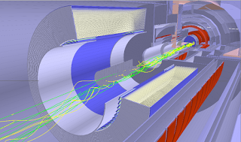
Comet phase-I
Phase-I Muon to electron conversion experiment aiming for O(-15) physics sensitivity.
Currently under construction in KEK, Japan.
Continual software development using ICEDUST, still a lot of work to do.

Slide 4
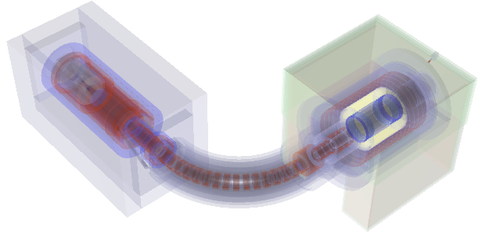
icedust
ICEDUST Can Easily Do Useful Software Things or
Integrated Comet Experimental Data User Software Toolkit
Inherited from the T2K ND280 framework.
Uses GEANT4 to construct geometry which is useful for physics simulations.
Useful for geometry optimizations before actual construction.

Slide 5
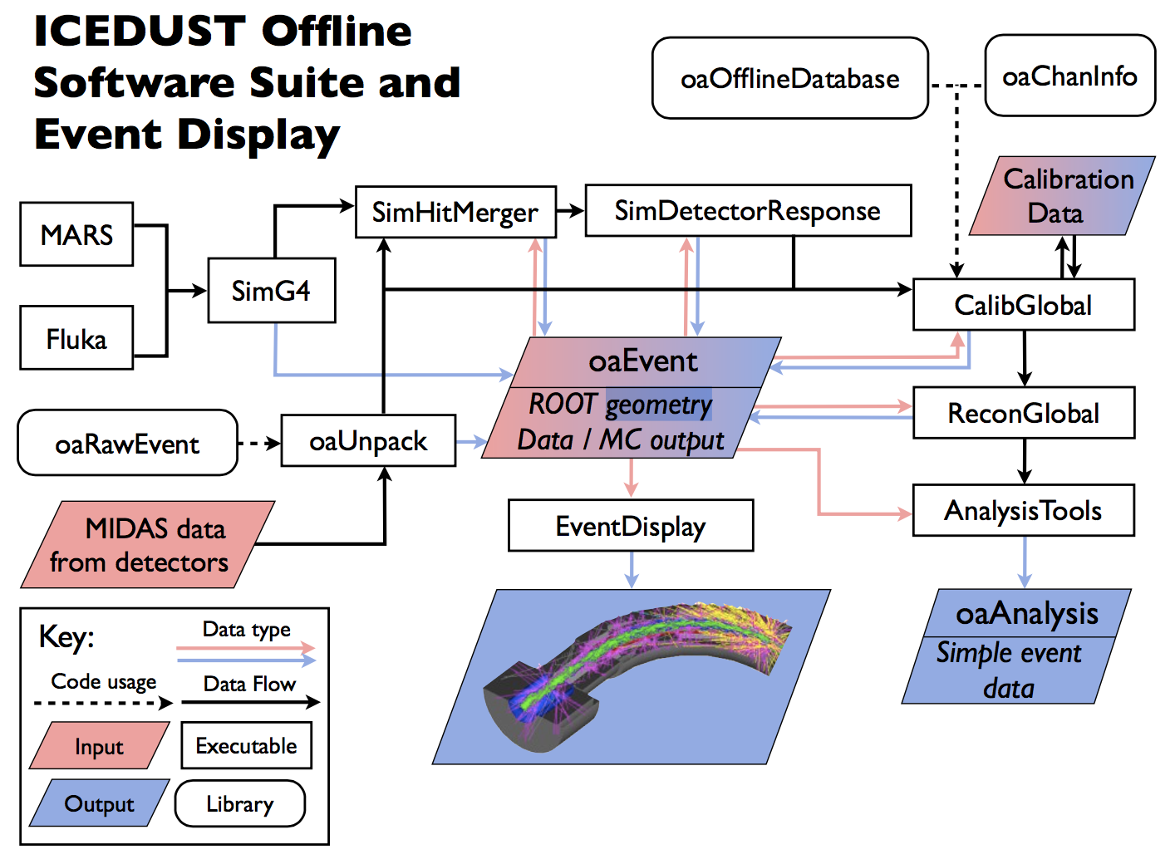
ICEDUST
Full software suite

Slide 6
Simulation flow
Software simulation flow
Detector Construction
Geometry optimization
Detector Response
Detector Hit
Digitization
Track Finding
Track Fitting

Slide 7
Simulation approach
POT : Proton on Target Event
8E6 POTs in one bunch
SimG4 produces :
oaEvent data files
Rootracker checkpoint files
Three Main Sections
Production Target
Muon Beam Transport
Detector Section
Use different random seeds
Restart the simulation with a new seed after production section five times
Do the same after the muon beam section
1POT in Production Target is simulated through 25 times
POT events may be correlated
More varied approach than simply resampling
Ignore particles that hit the beam dump
Simulation runs twice as fast

Slide 8
Icedust monte carlo production
Currently three major runs for analysis use. Latest one (MC3b) used in this presentation.
Uses CCIN2P3, DIRAC and IHEP.
MC files are generated up to the Detector Response level.
Stored in the cloud (IRODS).
Currently it is used for detector design analysis.
2,500 bunches in the CyDet section, with 8E6 POT per bunch, totaling 2E10 POT events.
Totals around 2 TB.

Slide 9
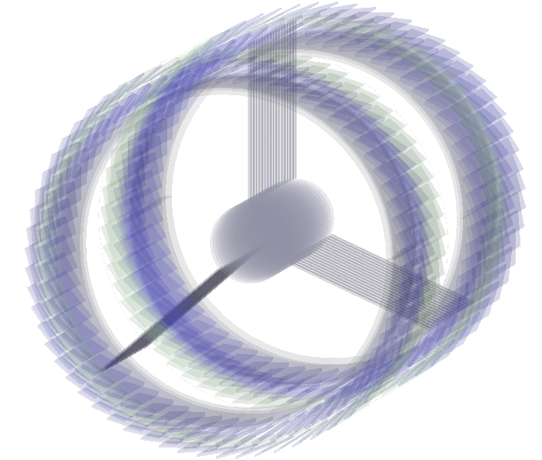
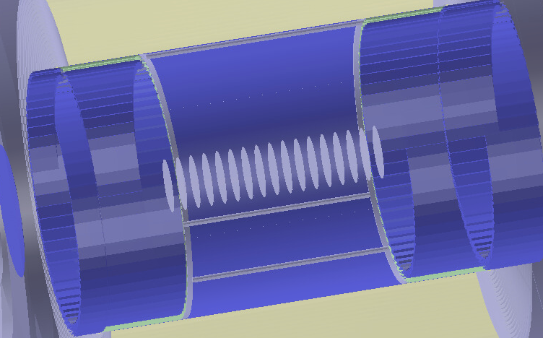
Muon stopping target geometry
ICEDUST geometry was updated for the MC3b run. Aluminium stopping targets (17 discs, 50mm apart) are now connected with steel spokes and rims.

Slide 10
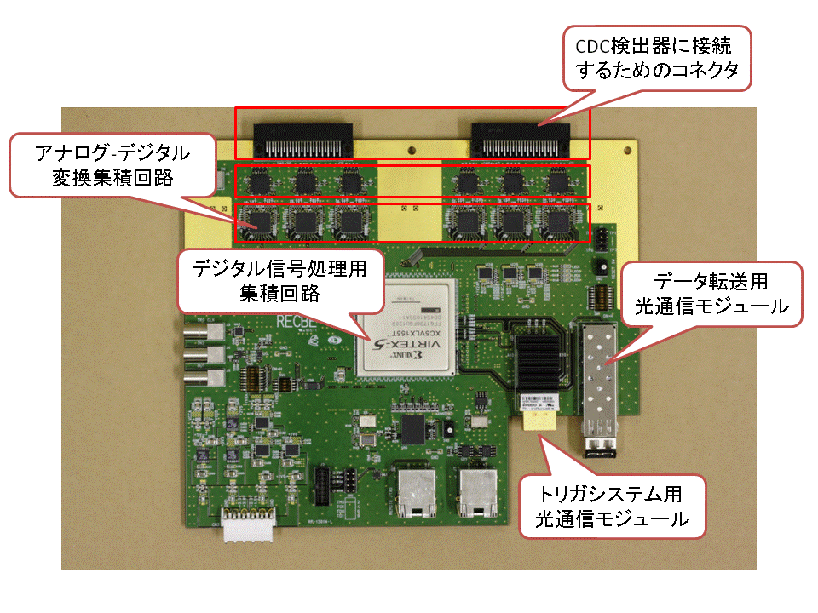
simulation analysis
The latest MC run (MC3) is with the Detector Response module.
It is still under active development, especially the readout electronics digitization part.
The detector response simulation is run on the bunch train.
No time cut is taken here – all bunches are included.
No time cut is made on this analysis.
I studied 1E6 protons on target (POT) events.

Slide 11
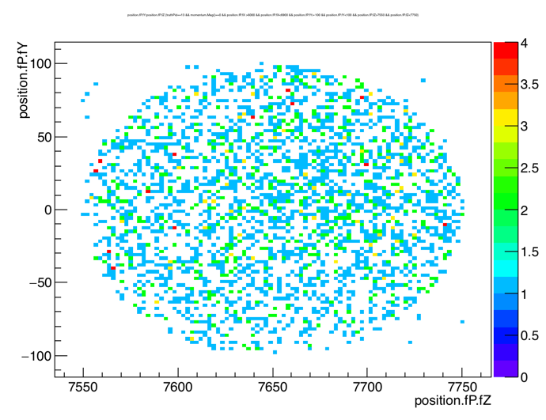
Stopped muon distribution (i)
In general the number of stopped muons are consistent with previous MC1 and MC2 studies.
End position of Geant4 trajectory is used as the position of the stopped muon.
Below is the sum of the stopped muon distribution perpendicular to the beam direction. There are 2858 stopped muons, ~0.3% of protons.

Slide 12
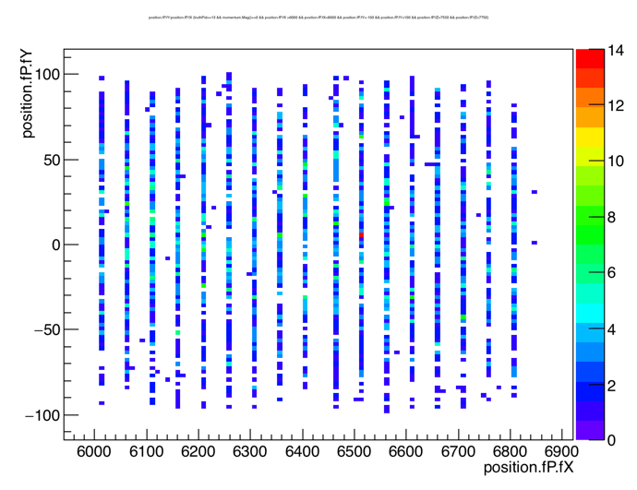
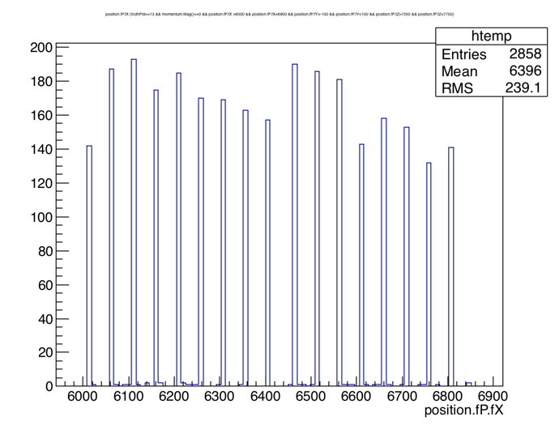
Stopped muon distibution (ii)
Distribution along the beam direction.

Slide 13
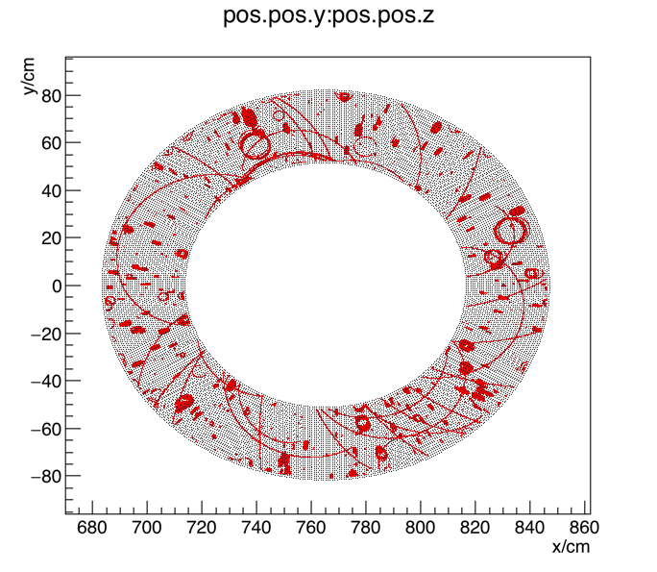
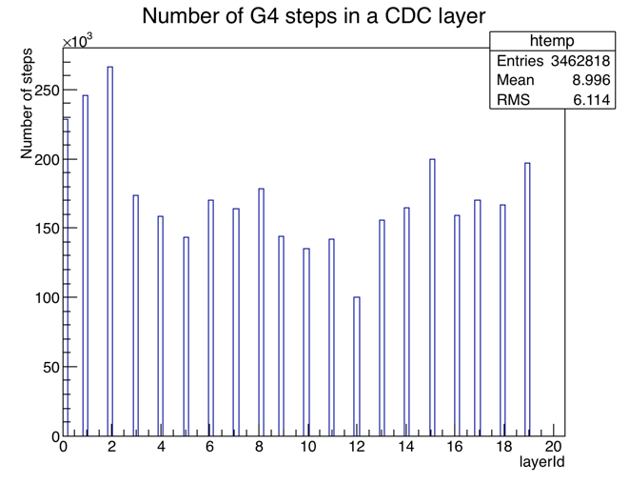
Effect on the cdc occupancy
CDC occupancy here is due to particles from the stopping target and beam. We see many gamma induced pair produce electrons.
First three layers of the CDC are a lot more occupied by noise.

Slide 14
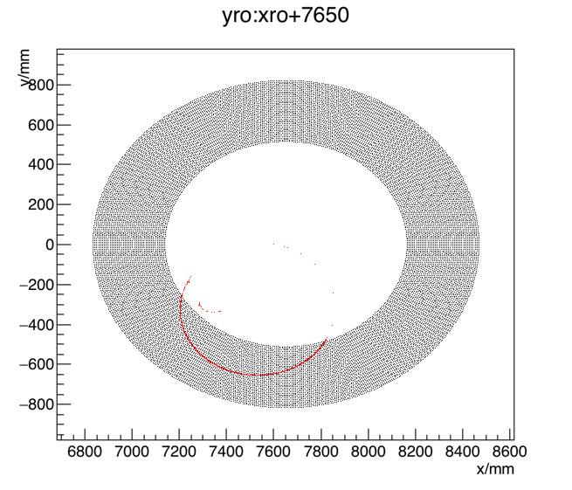
Track finding
Simple Track Finding algorithm available in ICEDUST.
Using the GEANT4 part of the ICEDUST (SimG4) an electron originating from the target region is created with an energy of 104.5MeV.
Here you see the 104.5MeV Monte Carlo signal track being identified with a simple algorithm.

Slide 15
next steps
Test the Track Fitting algorithm with GENFIT2 in ICEDUST with Gaussian smearing and noise hits.
Once I have the full flow running, I can try to change the geometry and see the effects on the momentum resolution.

Slide 16
summary
ICEDUST is a full software suit currently being designed to handle full detector simulation and track reconstruction.
Using it to try to optimize the muon stopping target design.

