Slide 1
Dark Sectors for and anomalies
Phys.Rev. D92 (2015) 5, 055021
Phys.Rev. D92 (2015) 5, 055021
Cédric Delaunay
CNRS/LAPTh
Annecy-le-Vieux
France
G. Bélanger, CD, S. Westhoff:
Phys.Rev. D92 (2015) 5, 055021
G.Bélanger, CD:
arXiv:1603.03333 [hep-ph]
LPNHE seminar
25-04-2015 | Paris

Slide 2
Outline
/ → dark matter +
Models for muon-philic DM
DM relic density
Collider signatures

Slide 3
Signs of DM
in B/ physics?

Slide 4
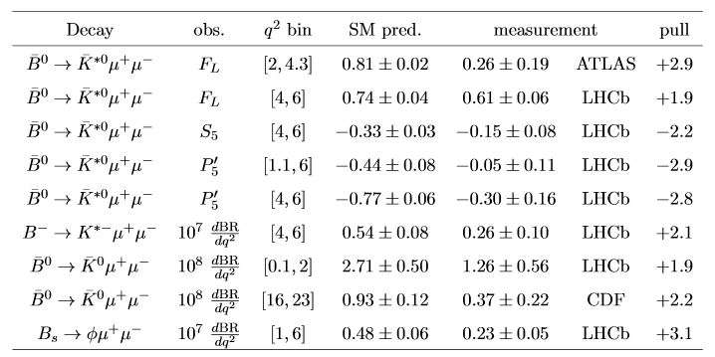
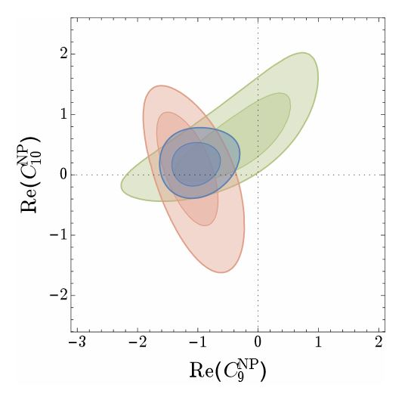
anomalies
2 favored simple
NP structure:
or
TH favored

Slide 5
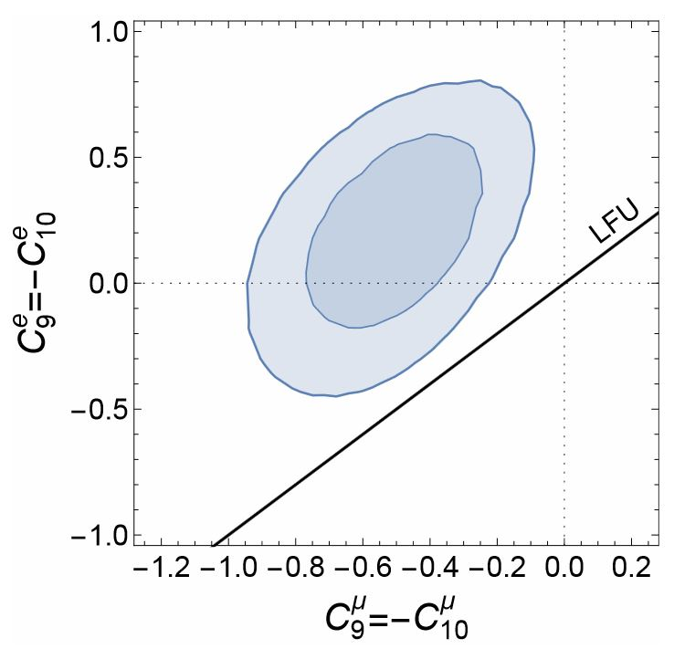
anomaly
Adding electron data, in particular
global fits indicate violation of
Lepton Flavor Universality

Slide 6
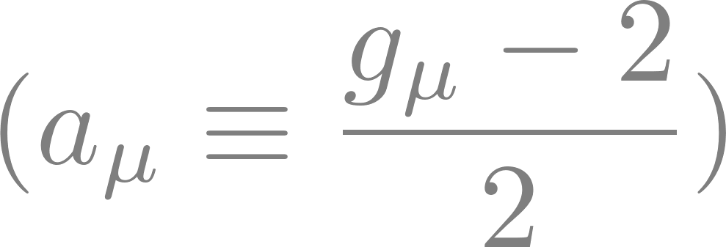
anomaly
Long story with many bounces between TH and EXP,
But current status still anomalous:
If discrepancy originates from one-loop new physics, weak scale/coupling are favored

Slide 7
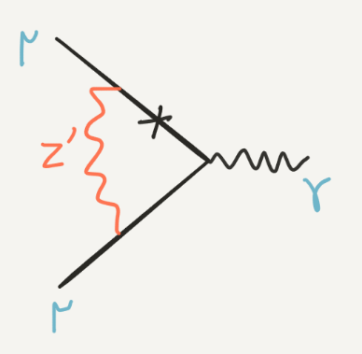
A hint for DM?
Tree-level explanations of typically yields a too small contribution to :
If arises at one-loop, in the right ballpark.
A simple way with a : seclude it from SM, break DM + candidates

Slide 8
Dark Matter Models
For Muon Anomalies

Slide 9
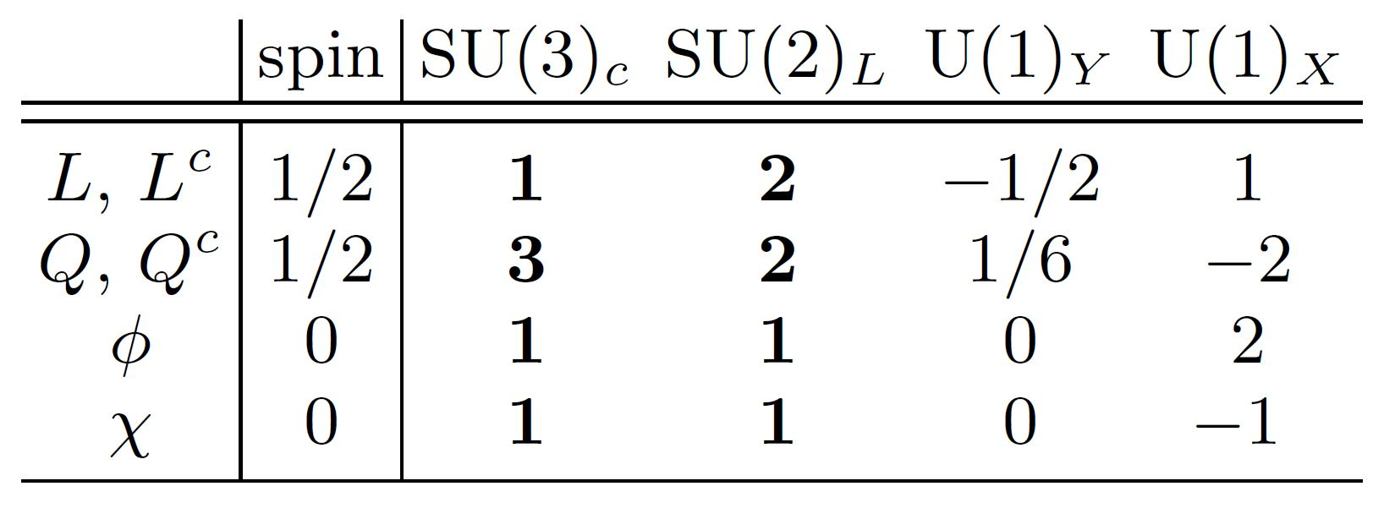
U(1)’ toy models
Dark field, SM carry no charge,
Dark sector fields:
mediators to
SM fermions
U(1) breaking
750GeV scalar
Dark Matter

Slide 10
U(1)’ toy models
hypercharge portal
Higgs portal
~closed
~closed
‘Yukawa’ portal
mass mixing = ‘‘partial darkness’’
The charge assignment forbids tree-level coupling,
makes DM leptophilic, explaining direct detection null results

Slide 11
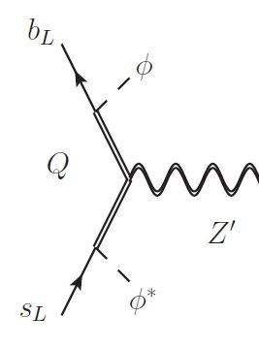
coupling to SM fermions
Quarks: partial darkness
switching on couplings to 2-3
generations only:
mixing constraint*:
*NP<0.1SM

Slide 12
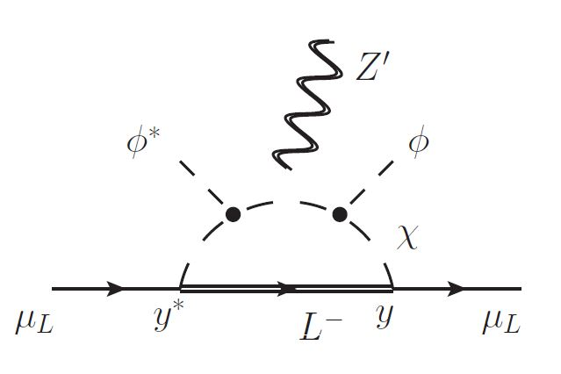
coupling to SM fermions
Leptons: not allowed one-loop
For , , -insertion needed
significant DM-DM’ splitting

Slide 13
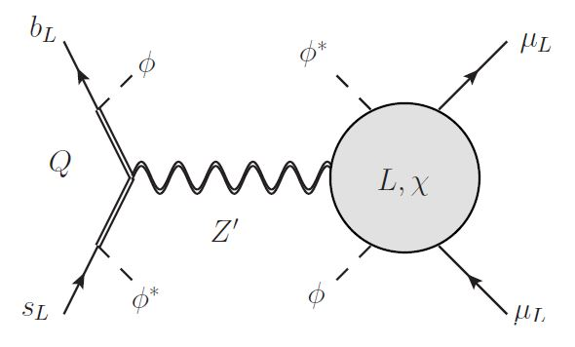
Explaining anomalies
Under constraint,
explaining LHCb requires:
In turns, one needs: , a light
and

Slide 14
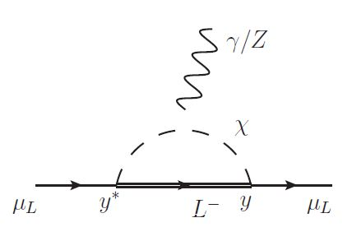
Accomodating sets DM mass
further constrains the parameter space:
2 limiting
scenarios:

Slide 15
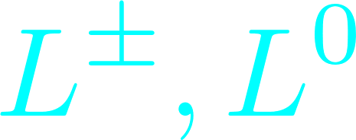
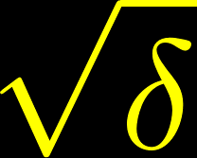
So, muon anomalies favors:
Large needs tuning in the dark scalar potential:
which guarantees DM is scalar (see relic later)
Dark Matter

Slide 16
Predictions for
DM relic density

Slide 17
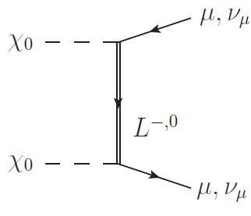
Scalar DM annihilation
At freeze-out dominant process is d-wave:
Thus DM relic also favors large ,
for weak scale

Slide 18
Relic density prediction
Note that:
Hence:
and
with
Muon anomalies yields DM relic
in the right ballpark!

Slide 19
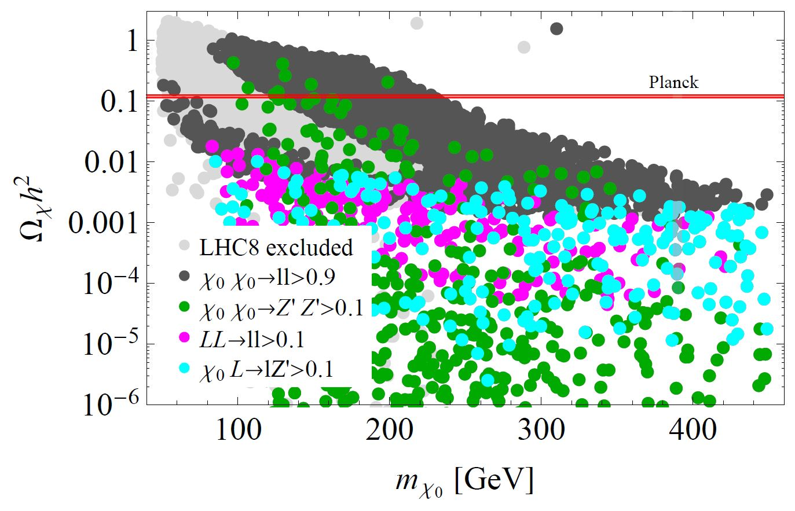
How robust is the relic prediction?
Sniffing around the
parameter space with
micrOMEGAs,
under the anomalies
constraints
Relatively robust, except in peculiar corners with:
1) strong coannihilation
and/or
2) open Z’ channel

Slide 20
750GeV Diphoton
excess at ATLAS/CMS

Slide 21
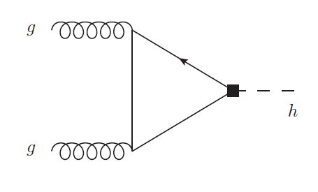
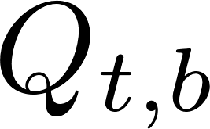
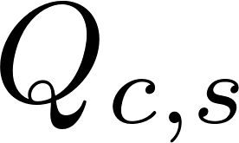
750GeV scalar production at LHC
breaking scalar = 750GeV resonance
Main production through loops of :

Slide 22
Diphoton Branching Ratio
One needs
Diphoton width also through loops of :
Works if width dominated by
Implies as well as 3-body
decays are forbidden

Slide 23
Signatures
of the model at colliders

Slide 24
Resonant Z’ production
has coupling to heavy quarks:
(assuming )
with large dijet signal
Yet the is rather broad with and difficult to dig out of the QCD bkg.

Slide 25
Z’ to top pairs
Tension with correlated signal in top pairs:

Slide 26
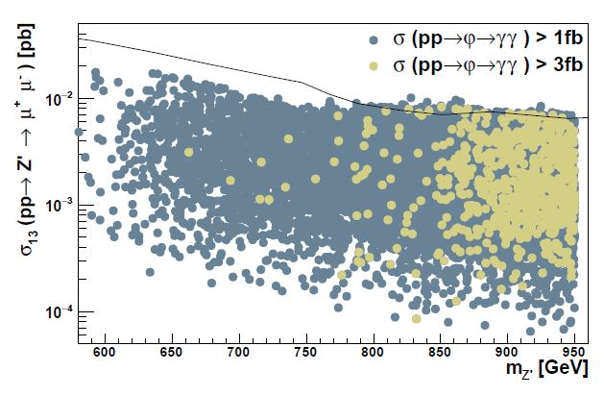
Z’ to muon pairs
Cleaner but loop-induced:

Slide 27
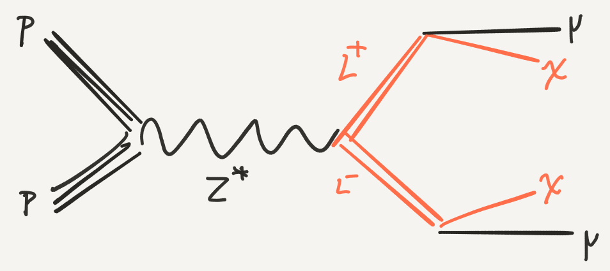
Heavy lepton searches at LHC
Recasting SUSY searches for smuons:
unless
where missing is missing

Slide 28
Conclusions

Slide 29
Conclusions
Loop-induced couplings to SM allow to simultaneously address and
The breaking sector generically implies DM and diphoton candidates.
750GeV resonance can be further explained
If diphoton signal is a (cruel) fluctuation, DM can be a thermal relic, otherwise it’s underabundant

