Slide 1


Multivariate Analysis (Machine Learning) … in HEP
IN2P3 School of Statistics 2016
Helge Voss
MAX-PLANCK-INSTITUT FÜR KERNPHYSIK IN HEIDELBERG

Slide 2
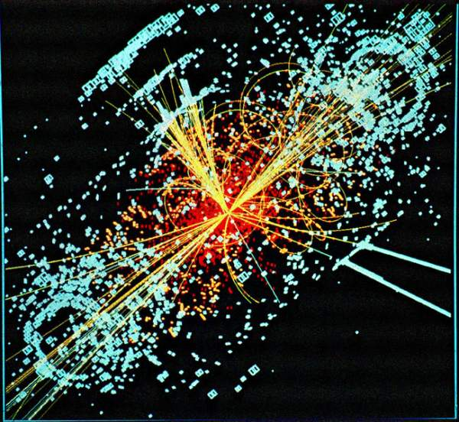
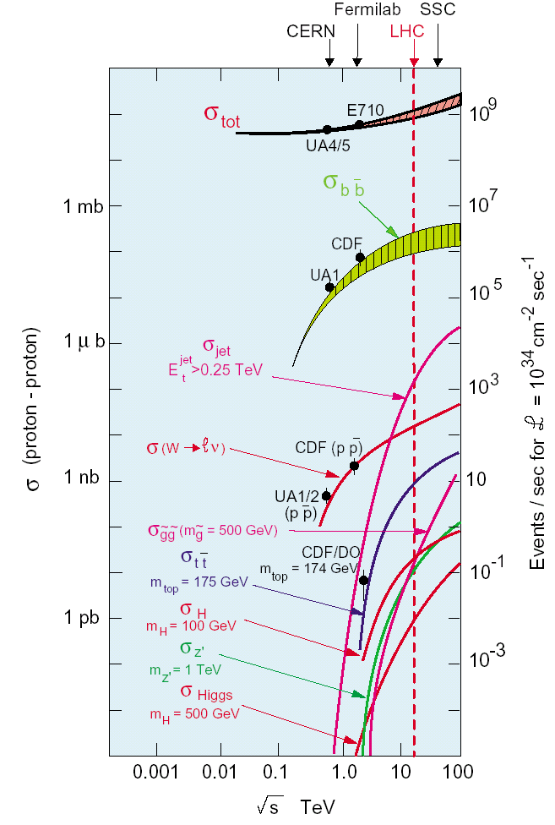
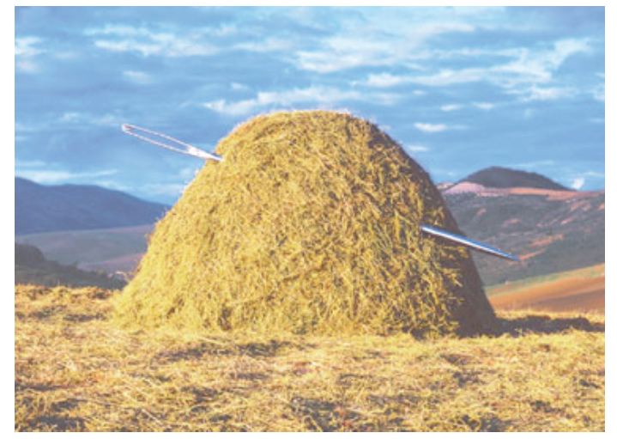
HEP Experiments: Simulated Higgs Event in CMS
That’s how a “typical” higgs event looks like: (underlying ~23 ‘minimum bias’ events)
And not only this: These event happen only in a tiny fraction of the collisions O(10⁻¹¹)

Slide 3
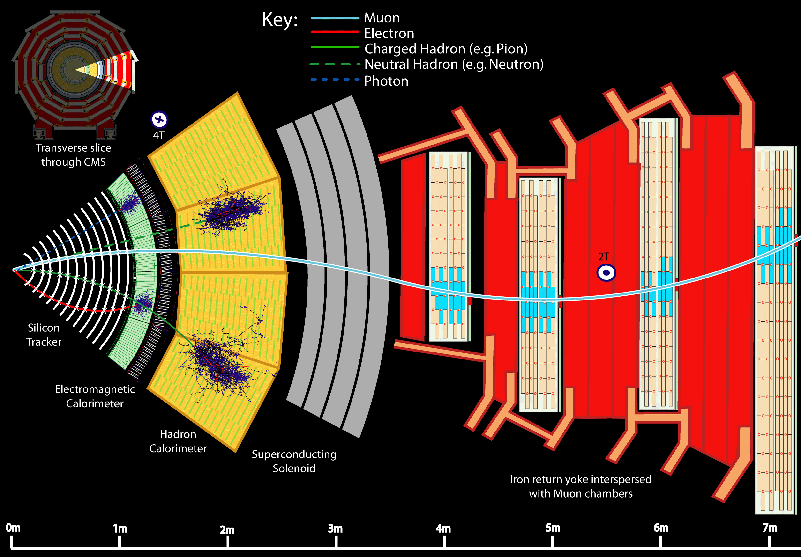

HEP Experiments: Event Signatures in the Detector
the needle in the hay-stack is already “one piece” … but:
  (Higgs-) particles need to be reconstructed from decay products
  decay products need to be reconstructed from detector signatures
  etc..

Slide 4
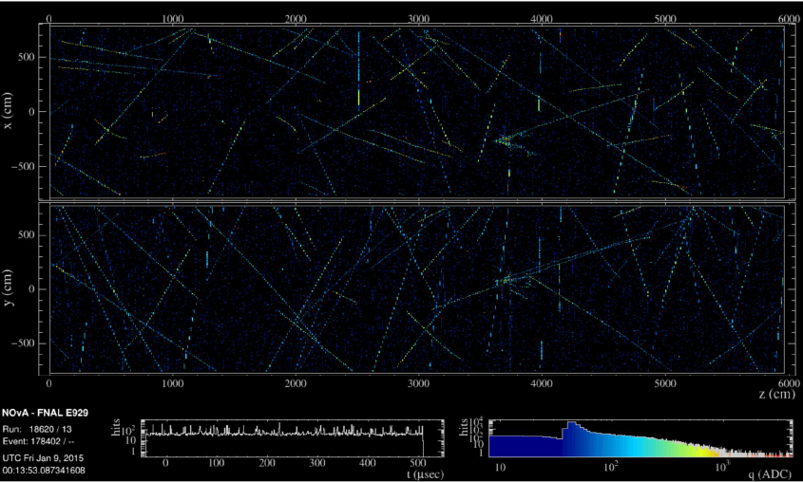
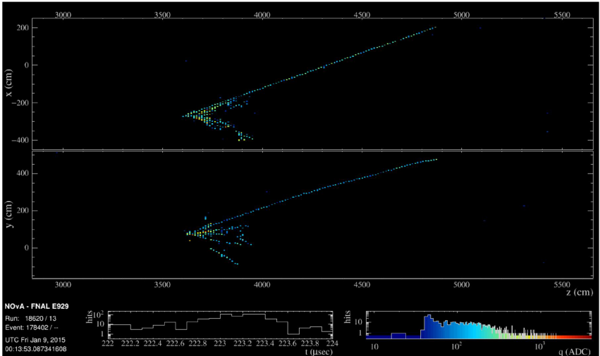
NOνA long baseline oscillation exp.
(ν_{μ})/ν_{e} (dis-)/appearance
O(100k) background, O(100) ν_{μ} , O(10) ν_{e} per year

Slide 5
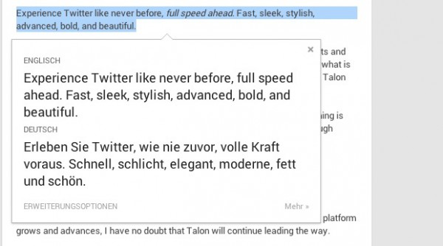

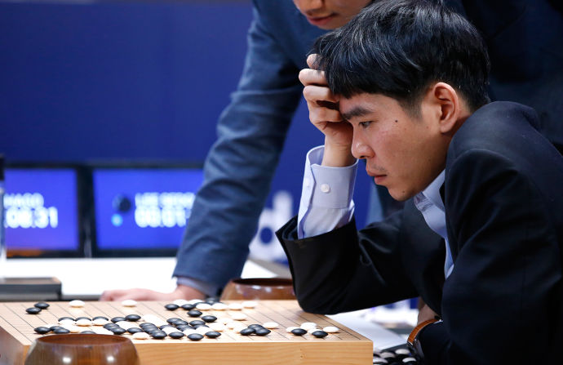
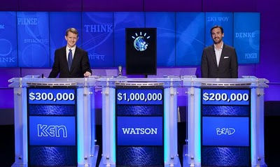
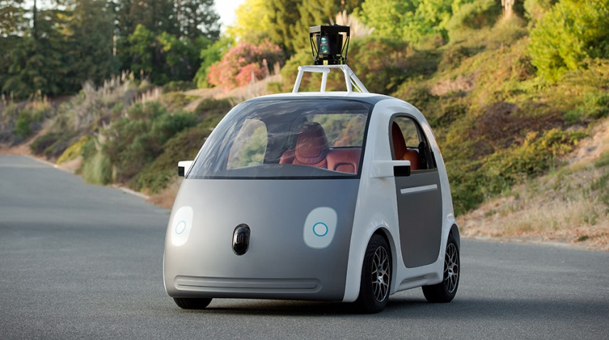

Machine Learning ‘elsewhere’
…. is ‘everywhere’

Slide 6

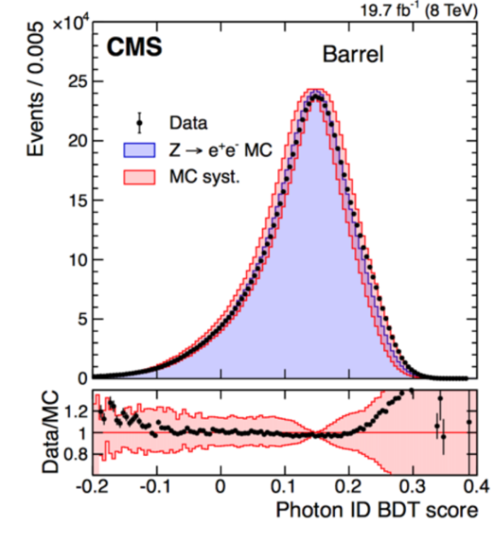

Outline
What is: Machine Learning (ML) & Multivariate Analysis/Technique (MVA)
  Basics (classification, regression)
  ROC-curve
  generative vs predictive models
MVA/ML algorithms
  Naïve Basian, KNN,
  Linear discriminators, SVM
  model fitting – gradient decent and loss function
  General comments about MVAs
  BDT (Yann Coadou) this afternoon)
  Neural Networks (tomorrow)

Slide 7
What is Machine Learning
“[Machine Learning is the] field of study that gives computers the ability to learn without being explicitly programmed.” Arthur Samuel (1959)
“A computer program is said to learn from experience E with respect to some task T and some performance measure P, if its performance on T, as measured by P, improves with experience E.” Tom Mitchell, Carnegie Mellon University (1997)
I suggest: forget about ‘fancy definitions’:
‘understanding/modeling your data’ …
and if you cannot do it in multi-dimensions on “analytic first principles” let the computer help ☺

Slide 8
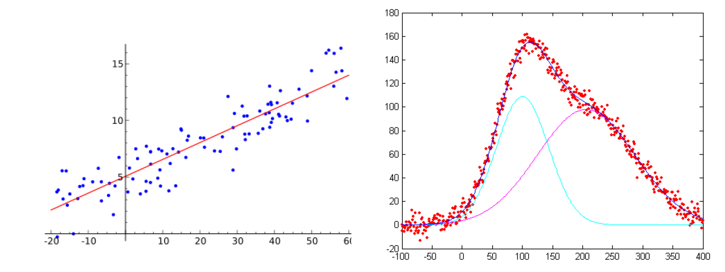
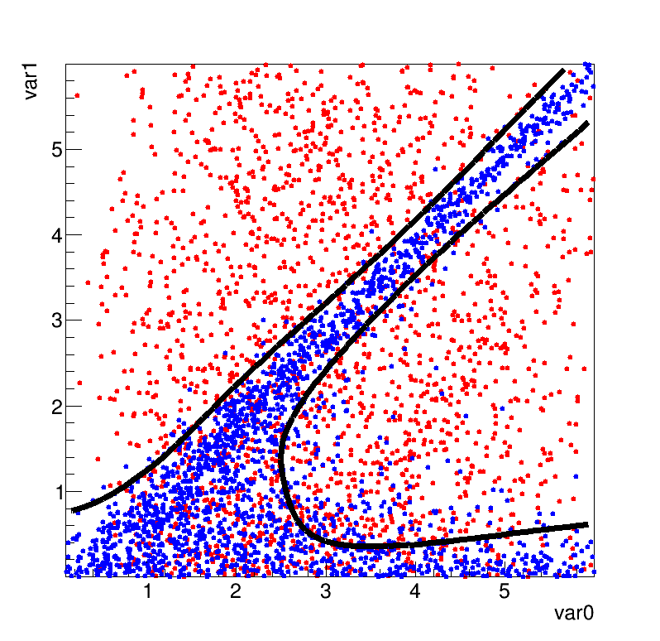
What are Multivariate Techniques
Many things … starting from “linear regression” …
to multivariate event classification
f(x)
x₂
x
Background
or w/o prior ‘analytic’ model
typically “multivariate”
  Parameters depend on the ‘joint distribution’ f(x₁, x₂)
‘learning from experience’ → known data points
Signal
x₁

Slide 9
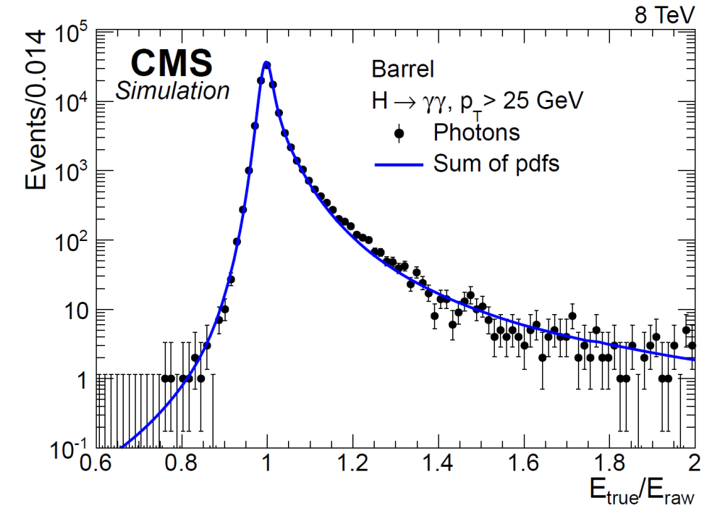
Machine Learning -
Multivariate Techniques
fitted (non-)analytic function may approximate:
  target value → ‘regression’
    ( e.g. calorimeter calibration/correction function)
MC sample: γ +jets
Raw energy in crystals, η, Φ
Cluster shape variables
Local cluster position variables (energy leakage)
Pile-up estimators
→ predict energy correction (i.e. parameters in crystal-ball: pdf for energy measurement)

Slide 10


Event Classification
Signal and Background
  discriminating observed variables x₁, x₂, …
  → decision boundary ?
Rectangular cuts?
A linear boundary?
A nonlinear one?
x₂
S
x₂
S
x₂
S
B
B
B
x₁
x₁
x₁
Low variance (stable), high bias methods
High variance, small bias methods

Slide 11
Regression
‘known measurements” → model “functional behaviour”
e.g. : photon energy as function “D”-variables: ECAL shower parameters + …
constant ?
linear?
non - linear?
f(x)
f(x)
f(x)
Energy
x
x
x
Cluster Size
known analytic model (i.e. nth -order polynomial) → Maximum Likelihood Fit)
no model ?
  “draw any kind of curve” and parameterize it?
seems trivial ?
seems trivial ? → human brain has very good pattern recognition capabilities!
what if you have many input variables?

Slide 12
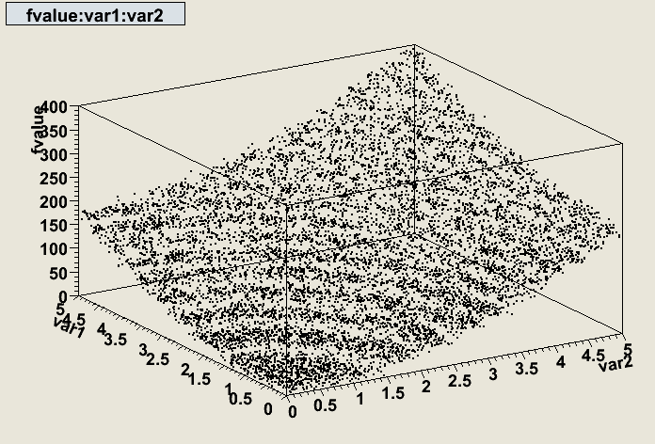
Regression → model functional behaviour
f(x₁, x₂)
x₂
x₁
“standard” regression → fit a known analytic function
  e.g. f(x) = ax₁²+bx₂²+c
BUT most times: don’t have a reasonable “model” ? → need something more general:
  e.g. piecewise defined splines, kernel estimators, decision trees to approximate f(x)
Note: we are not interested in the ‘fitted parameter(s)’, it is not: “Newton deriving F=m·a”
→ just provide prediction of function values f(x) for new measurements x

Slide 13
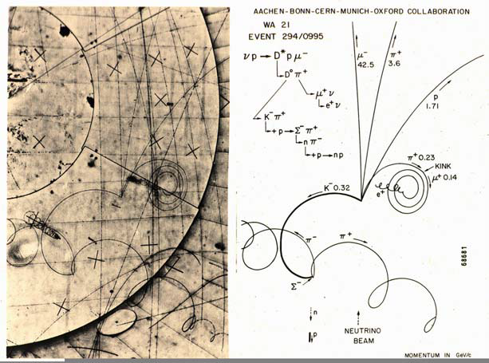
HEP: Everying startet Multivariate
intelligent “Multivariate Pattern Recognition” used to identify particles

Slide 14
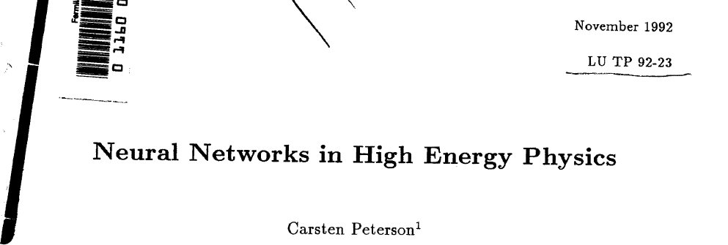
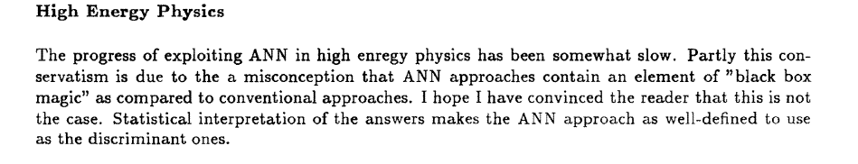
Machine Learning in HEP
Later: ‘MVAs got out of fashion’ → replaced by
  if (..) then … ; → ‘cuts on individual variables’
    Fear of “black box fears” or because it is easier to program?
  Some ‘Fisher discriminants’, Naïve Bayesian (Likelihood) even NNs…. have always been around before becoming mainstream again ☺

Slide 15
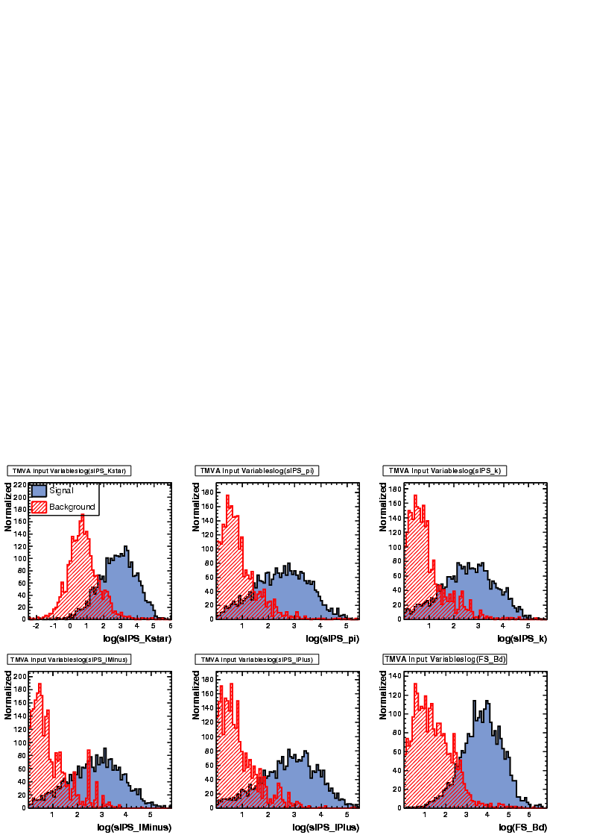
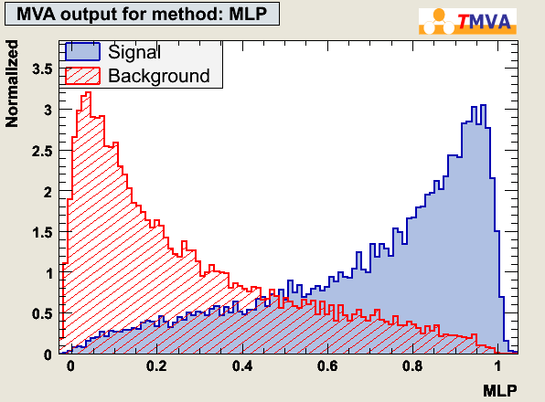
Event Classification
Each event, if Signal or Background, has “D” measured variables.
Find a mapping from D-dimensional input-observable (”feature” space)
to one dimensional output → class label
^{D}
“feature
space”
Test statistic:
y(x): R^{D}→R:
most general form
y = y(x); x ^{D}
x={x₁,….,x_{D}}: input variables

plotting (histogramming) the resulting y(x) values:
y(x)

Slide 16
Event Classification
Each event, if Signal or Background, has “D” measured variables.
Find a mapping from D-dimensional input/observable/”feature” space
to one dimensional output
→ class labels
y(B) → 0, y(S) → 1
^{D}
“feature
space”
Test statistic:
y(x): R^{D}→R:

y(x)
distributions of y(x): PDF_{S}(y) and PDF_{B}(y)
used to set the selection cut!
> cut: signal
= cut: decision boundary
< cut: background
y(x):
efficiency and purity
overlap of PDF_{S}(y) and PDF_{B}(y) → separation power , purity
y(x)=const: surface defining the decision boundary.

Slide 17
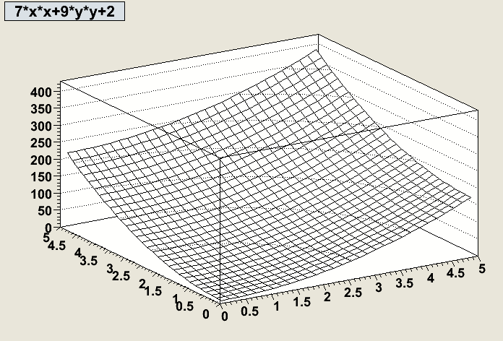
Classification ↔ Regression
Classification:
y(x): R^{D}→R: “test statistic” in D-dimensional space of input variables
y(x)=const: surface defining the decision boundary.
y(B) → 0, y(S) → 1
y(x): R^{D}→R:
y(x)
Regression:
“D” measured variables + one function value
(e.g. cluster shape variables in the ECAL + particles energy)
y(x): R^{D}→R “regression function”
y(x)=const → hyperplanes where the
target function is constant
Now, y(x) needs to be build such that it
best approximates the target, not such
that it best separates signal from bkgr.
f(x₁,x₂)
X₂
X₁

Slide 18
Event Classification
PDF_{B}(y). PDF_{S}(y):
y(x): R^{D}→R:
→ Probability densities for y given background or signal
1.5
e.g.: for an event with y(x) = 0.2
0.45
→ PDF_{B}(y(x)) = 1.5 and PDF_{S}(y(x)) = 0.45
y(x)
f_{S} ,f_{B} : fraction of S and B in the sample:
is the probability of an event with measured x={x₁,….,x_{D}} that gives y(x) to be of type signal

Slide 19
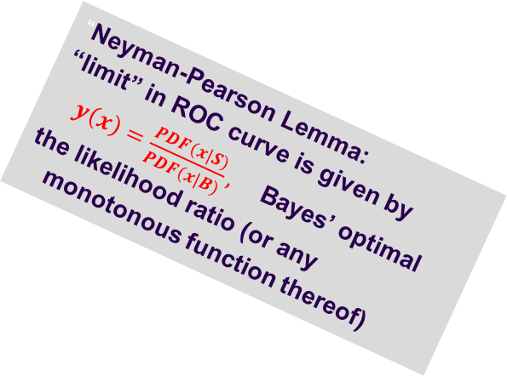
Receiver Operation Charactersic (ROC) curve
“Neyman-Pearson Lemma:
“limit” in ROC curve is given by $y\left(x\right)=\frac{PDF(x|S)}{PDF(x|B)},$ Bayes’ optimal
the likelihood ratio (or any monotonous function thereof)
Signal(H₁) /Background(H₀)
discrimination:
which one of those
two blue ones is the better??
1
y(B) → 0, y(S) → 1
y’(x)
1- ε_{backgr.}
y’’(x)
large purity
small efficiency
large efficiency
small purity
y(x)
0
0
ε_{signal}
1

Slide 20
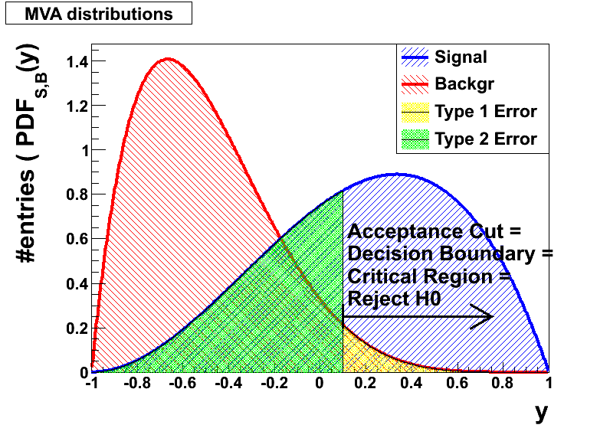
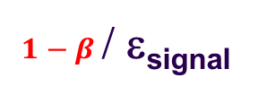

Receiver Operation Charactersic (ROC) curve
Signal(H₁) /Background(H₀)
“Neyman-Pearson Lemma:
“limit” in ROC curve is given by $y\left(x\right)=\frac{PDF(x|S)}{PDF(x|B)},$ Bayes’ optimal
the likelihood ratio (or any monotonous function thereof)
1
y’(x)
$1−α /$1- ε_{backgr.}
y’’(x)
Type-1 error small
Type-2 error large
Type-1 error large
Type-2 error small
0
0
$1−β$/ ε_{signal}
1
Type 1 error: reject H₀ (i.e. the ‘is bkg’ hypothesis) although it would haven been true
  → background contamination
Type 2 error: accept H₀ although false
  → loss of efficiency

Slide 21
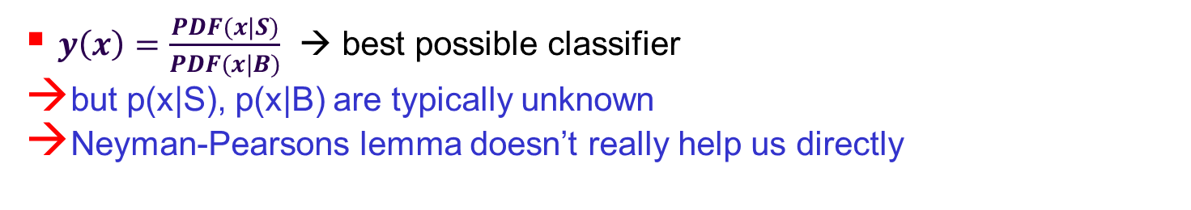
Event Classification → finding the mapping function y(x)
$y\left(x\right)=\frac{PDF(x|S)}{PDF(x|B)}$ → best possible classifier
but p(x|S), p(x|B) are typically unknown
Neyman-Pearsons lemma doesn’t really help us directly
use already classified “events” (e.g. MonteCarlo) to:
  estimate p(x|S) and p(x|B): (e.g. the differential cross section folded with the detector influences) and use the likelihood ratio
    e.g. D-dimensional histogram, Kernel density estimators, …
    (generative algorithms)
  OR
  approximate the “likelihood ratio” (or a monotonic transformation thereof).
    find a y(x) whose hyperplanes* in the “feature space”:
    (y(x) = const) optimally separate signal from background
    e.g. Linear Discriminator, Neural Networks, …
    (discriminative algorithms)
* hyperplane in the strict sense goes through the origin. Here I mean “affine set” to be precise

Slide 22
Machine Learning Categories
supervised: - training “events” with known type (i.e. Signal or Backgr, target value)
un-supervised: - no prior notion of “Signal” or “Background”
- cluster analysis: if different “groups” are found → class labels
- principal component analysis:
find basis in observable space with biggest hierarchical differences in the variance
→ infer something about underlying substructure
reinforcement-learning:
- learn from “success” or “failure” of some “action policy”
(i.e. a robot achieves his goal or does not / falls or does not fall/ wins or looses the game)
This lecture: supervised learning

Slide 23
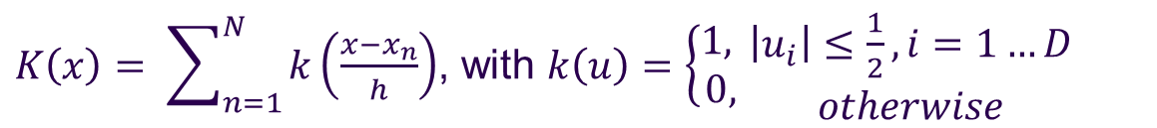
Kernel Density Estimator
“events” distributed according to P(x)
estimate probability density P(x) in D-dimensional space:
The only thing at our disposal is our “training data”
x₂
h
Say we want to know P(x) at “this” point “x”
One expects to find in a volume V around point “x” N*∫P(x)dx events from a dataset with N events
V
“x”
→ K-events:
x₁
$K\left(x\right)= \sum_{n=1}^{N}{k\left(\frac{x−x_{n}}{h}\right)}$, with $k\left(u\right)=\left\{\begin{matrix}1, \\ 0,\end{matrix}\right.\begin{matrix}\left|u_{i}\right|≤\frac{1}{2}, i=1…D \\ otherwise\end{matrix}$
k(u): is called
a Kernel function:
→K(x)/N: estimate of average P(x) in the volume V
→ Kernel Density estimator of the probability density
Classification: Determine
PDF_{S}(x) and PDF_{B}(x)
likelihood ratio as classifier!

Slide 24
Kernel Density Estimator
estimate probability density P(x) in D-dimensional space:
The only thing at our disposal is our “training data”
“events” distributed according to P(x)
x₂
h
Say we want to know P(x) at “this” point “x”
One expects to find in a volume V around point “x” N*∫P(x)dx events from a dataset with N events
V
“x”
→ K-events:
x₁
$K\left(x\right)= \sum_{n=1}^{N}{k\left(\frac{x−x_{n}}{h}\right)}$, with $k\left(u\right)=\left\{\begin{matrix}1, \\ 0,\end{matrix}\right.\begin{matrix}\left|u_{i}\right|≤\frac{1}{2}, i=1…D \\ otherwise\end{matrix}$
k(u): is called
a Kernel function:
→K(x)/N: estimate of average P(x) in the volume V
Regression: If each events with (x₁,x₂) carries a “function value” f(x₁,x₂) (e.g. energy of incident particle) →
i.e.: the average function value

Slide 25
K-Nearest Neighbour
“events” distributed according to P(x)
kNN : k-Nearest Neighbours
relative number events of the various classes amongst the k-nearest neighbours
x₂
keep K fixed → variable window size
automatically ‘adapt’ resolution to the available data
“x”
x₁
→ may replace “window” by “smooth” kernel function (i.e. weight events by distance via Gaussian)

Slide 26
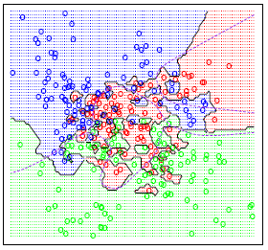
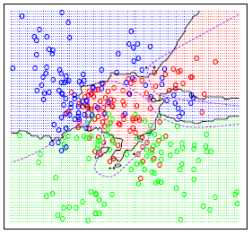
Kernel Density Estimator
: a general probability density estimator using kernel K
K or h: “size” of the Kernel → “smoothing”
  too small: overtraining/overfitting
  too large: not sensitive to features in P(x)
K=1
Kernel types: window/Gaussian …
which metric for the Kernel ?
  normalise all variables to same range
  include correlations ?
    Mahalanobis Metric: x*x → xV⁻¹x
(Elements of statistical learning)
a drawback of Kernel density estimators:
Evaluation for any test events involves ALL TRAINING DATA → typically very time consuming
K=15
Bayes’ optimal decision boundary

Slide 27
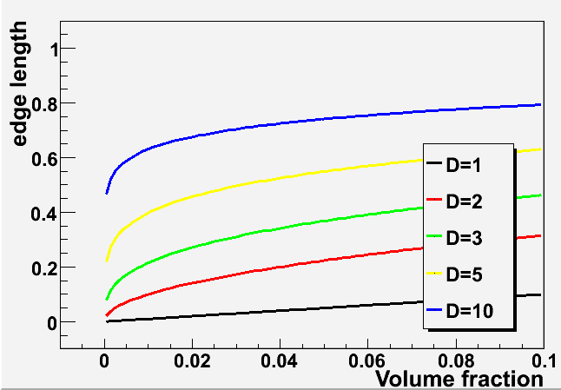
“Curse of Dimensionality”
Bellman, R. (1961), Adaptive Control Processes: A Guided Tour, Princeton University Press.
We all know:
Filling a D-dimensional histogram to get a mapping of the PDF is typically unfeasable due to lack of Monte Carlo events.
Shortcoming of nearest-neighbour strategies:
higher dimensional cases K-events often are not in a small “vicinity” of the space point anymore:
consider: total phase space volume V=1^{D}
for a cube of a particular fraction of the volume:
10 dimensions: capture 1% of the phase space
→ 63% of range in each variable necessary → that’s not “local” anymore..☹
develop all the alternative classification/regression techniques

Slide 28
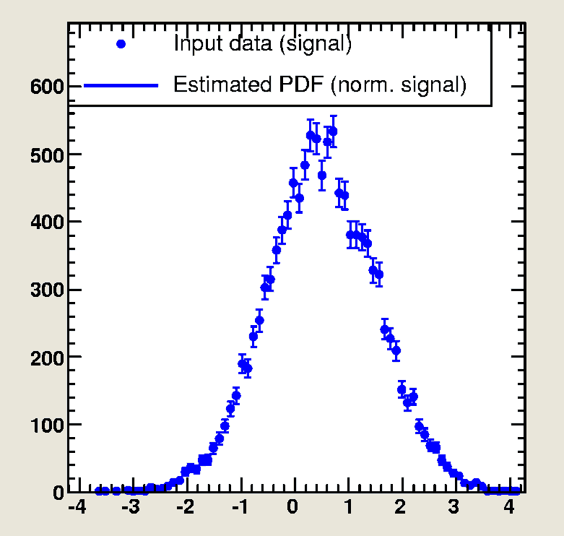
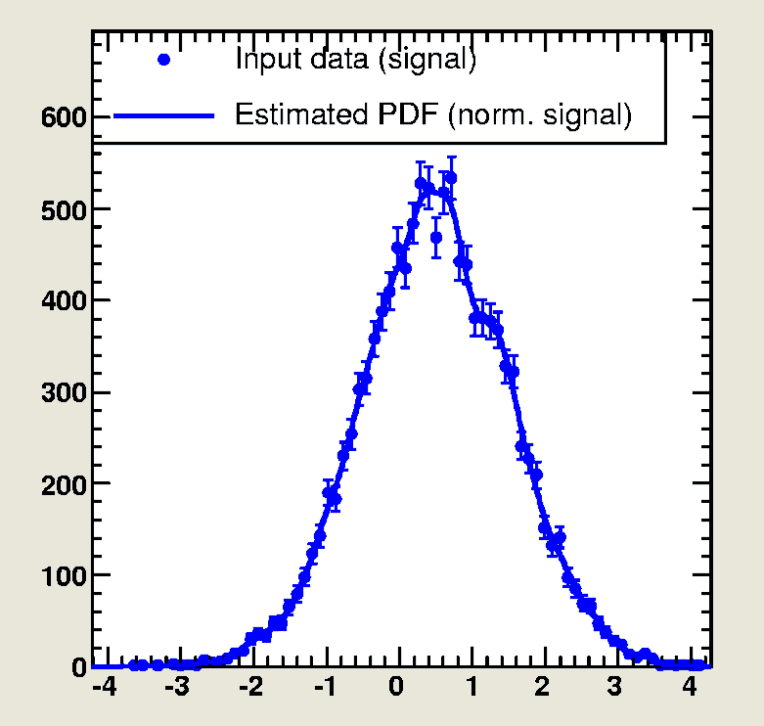
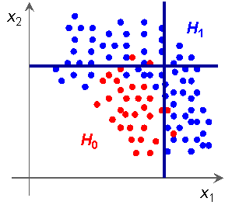
Naïve Bayesian Classifier
(projective Likelihood Classifier)
Multivariate Likelihood (k-Nearest Neighbour)
→ estimate the full D-dimensional joint probability density
Naïve Bayesian
→ ignore correlations
product of marginal PDFs
(1-dim “histograms”)
pdf: histogram + smoothing
No hard cuts on individual variables → “fuzzy”,
optimal method if correlations == 0
  try to “eliminate” correlations
(a very signal like variable may counterweigh another, less signal like variable)
“fuzzy cuts”

Slide 29
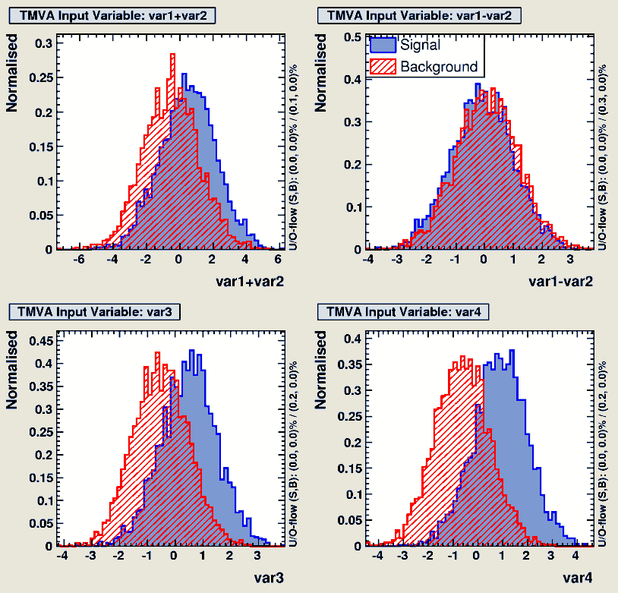
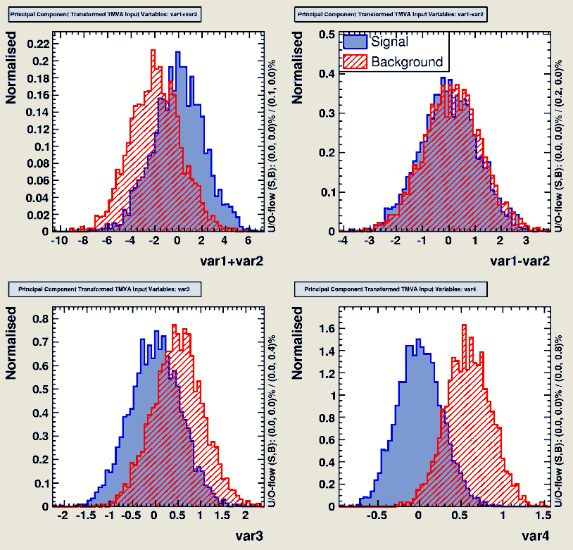
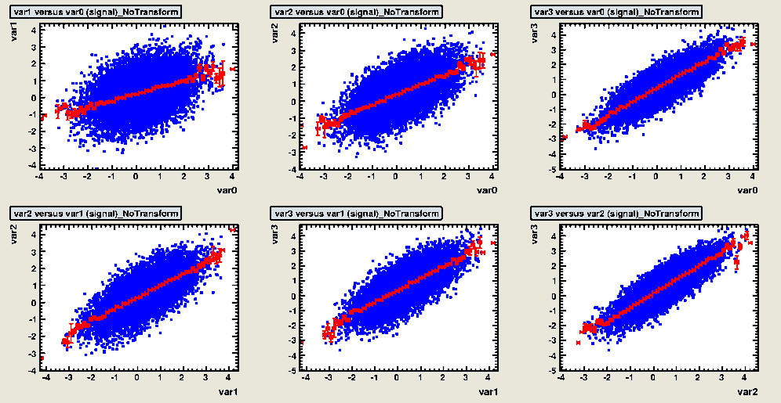
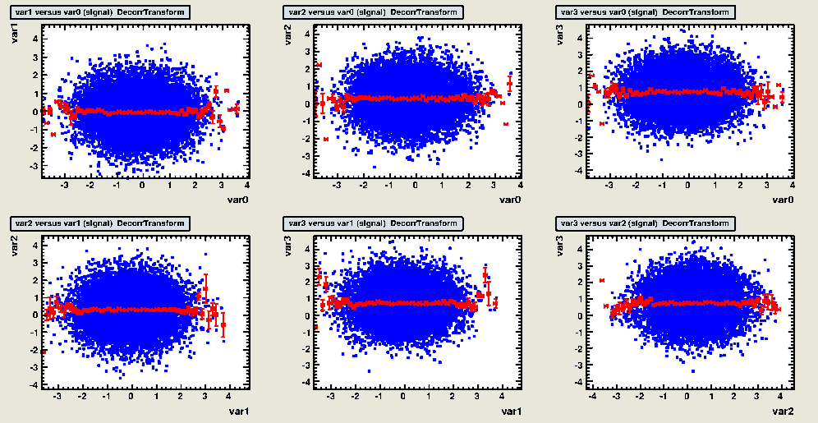
De-Correlation
Find variable transformation that diagonalises the covariance matrix
Determine square-root C ′ of correlation matrix C, i.e., C = C ′C ′
  compute C ′ by diagonalising C:
  transformation from original (x) in de-correlated variable space (x′) by: x′ = C ′−1x
Attention: eliminates only linear correlations!!

Slide 30
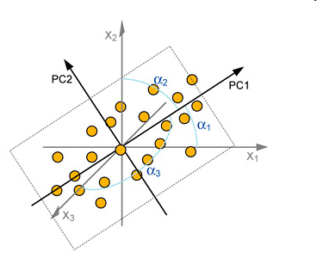
De-Correlation via PCA
(Principal Component Analysis)
PCA (unsupervised learning algorithm)
  reduce dimensionality of a problem
  find most dominant features in a distribution
Eigenvectors of covariance matrix → “axes” in transformed variable space
  large eigenvalue → large variance along the axis (principal component)
→ PCA eliminates correlations!

Slide 31
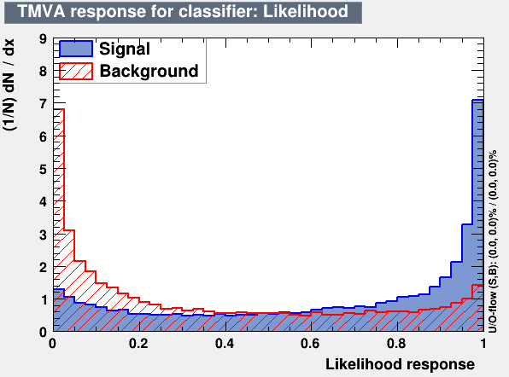
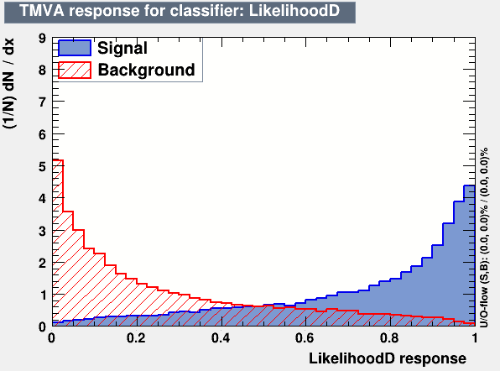
Decorrelation at Work
Example: linear correlated Gaussians → de-correlation works to 100%
1-D Likelihood on de-correlated sample give best possible performance
compare also the effect on the MVA-output variable!
correlated variables: after decorrelation
Watch out! Things might look very different for non-linear correlations!

Slide 32
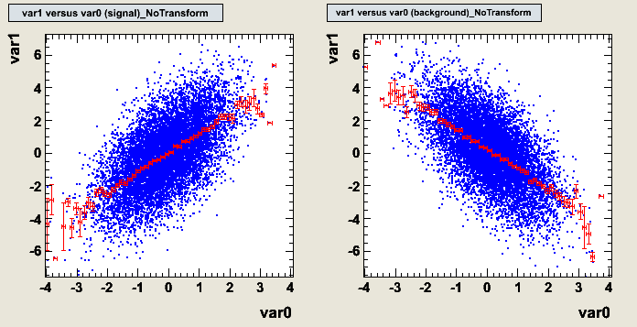
Limitations of the Decorrelation
in cases with non-Gaussian distributions and/or nonlinear correlations, the decorrelation needs to be treated with care
How does linear decorrelation affect cases where correlations between signal and background differ?
Original correlations
Signal
Background

Slide 33
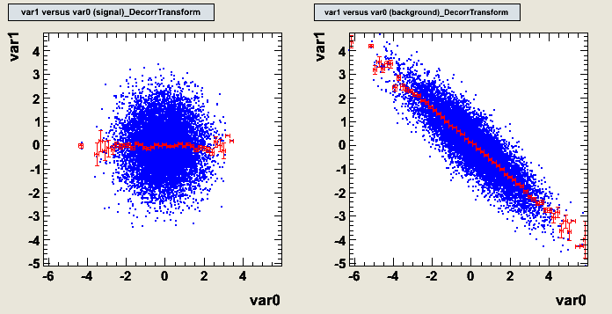
Limitations of the Decorrelation
in cases with non-Gaussian distributions and/or nonlinear correlations, the decorrelation needs to be treated with care
How does linear decorrelation affect cases where correlations between signal and background differ?
SQRT decorrelation
Signal
Background

Slide 34
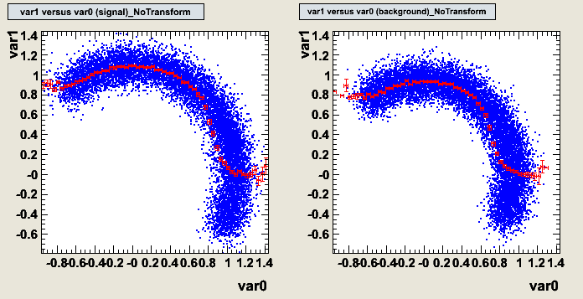
Limitations of the Decorrelation
in cases with non-Gaussian distributions and/or nonlinear correlations, the decorrelation needs to be treated with care
How does linear decorrelation affect strongly nonlinear cases ?
Original correlations
Signal
Background

Slide 35
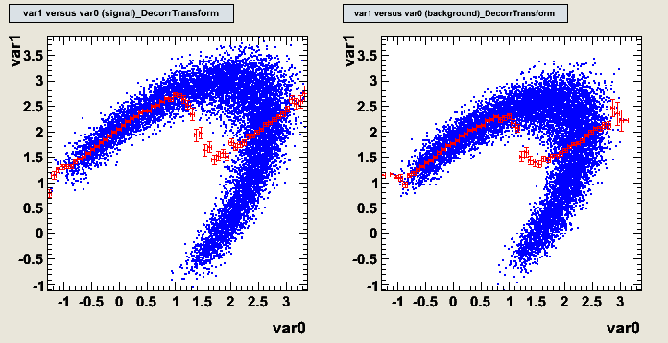
Limitations of the Decorrelation
in cases with non-Gaussian distributions and/or nonlinear correlations, the decorrelation needs to be treated with care
How does linear decorrelation affect strongly nonlinear cases ?
SQRT decorrelation
Signal
Background
Watch out before using decorrelation “blindly”!!
Perhaps “de-correlate” only a subspace!

Slide 36
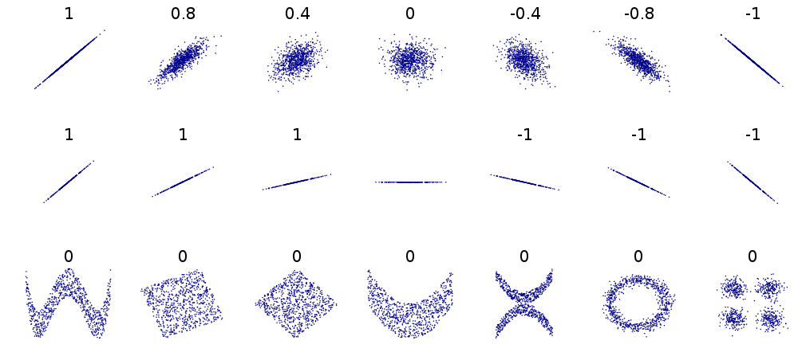
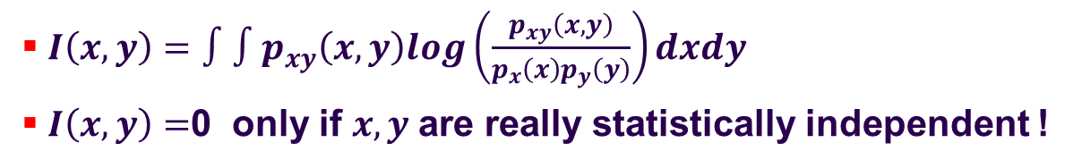
Correlation Coefficients
‘correlations’ , ‘linear-correlations’, ‘interaction/dependence’
phsicist’s slang often different from statistitans’ !
http://en.wikipedia.org/wiki/Correlation_and_dependence
to capture “non-linear correlations” → mutual information
$I\left(x,y\right)=∫∫p_{xy}\left(x,y\right)log\left(\frac{p_{xy}\left(x,y\right)}{p_{x}\left(x\right)p_{y}\left(y\right)}\right)dxdy$
$I\left(x,y\right)=$0 only if $x, y$are really statistically independent !

Slide 37
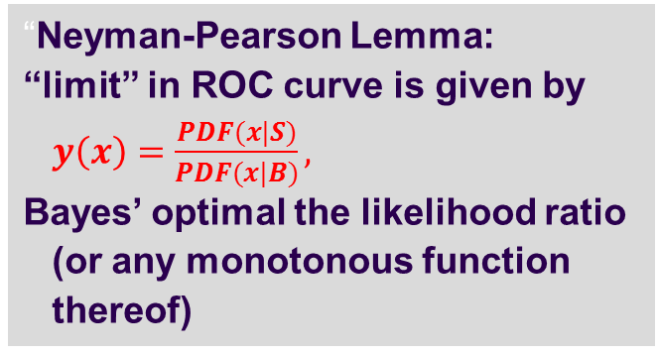
Discriminative Classifiers
KNN and Naïve Bayesian (Multi-dimensional and Projective Likelihood)
  generative methods - estimate the pdf
discriminative methods
  impose model-specific restrictions (i.e. linear decision boundaries)
  fit directly the decision boundaries
“Neyman-Pearson Lemma:
“limit” in ROC curve is given by $y\left(x\right)=\frac{PDF(x|S)}{PDF(x|B)},$
Bayes’ optimal the likelihood ratio (or any monotonous function thereof)
in the limit, a ‘perfect’ discriminative classifier y(x) parametrizes the likeihood ratio (or a monotonic function thereof)
use as ‘event weights’
arXiv:1506.02169 for a ‘more theoretical’ analysis

Slide 38
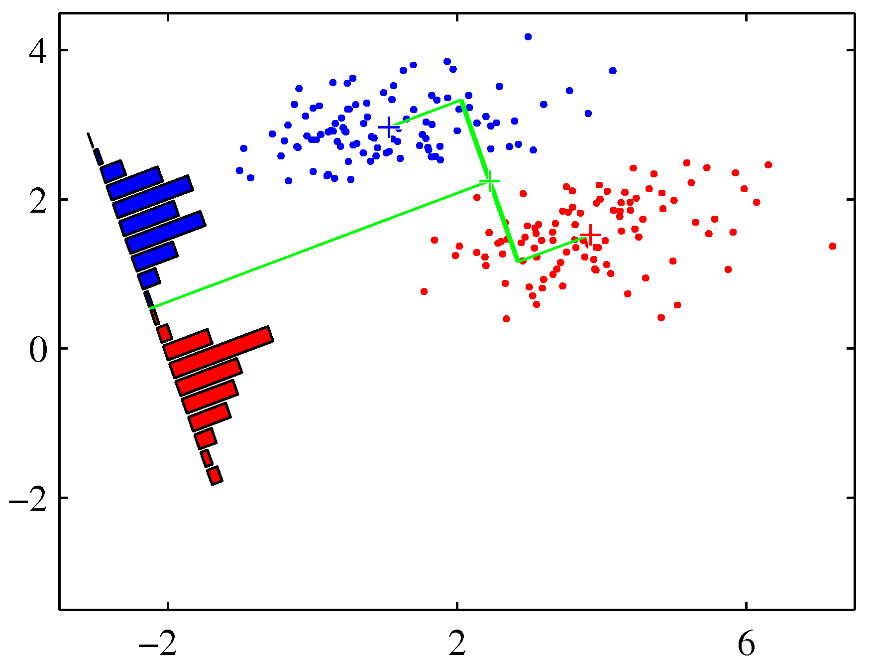
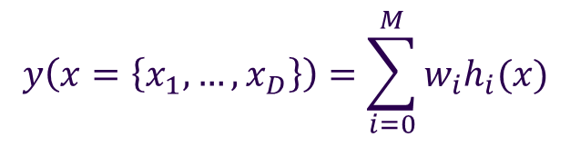
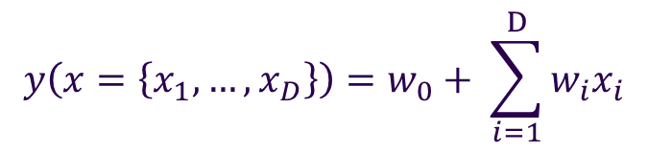
Linear Discriminant
$$y\left(x=\left\{x_{1},…,x_{D}\right\}\right)=\sum_{i=0}^{M}{w_{i}h_{i}(x)}$$
General:
$$y\left(x=\left\{x_{1},…,x_{D}\right\}\right)=w_{0}+ \sum_{i=1}^{D}{w_{i}x_{i}}$$
Linear Discriminant:
i.e. any linear function of the input variables: → linear decision boundaries
x₂
H₁
PDF of the test statistic y(x)
→ determine the “weights” w that separate “best” PDF_{S} from PDF_{B}
H₀
x₁

Slide 39
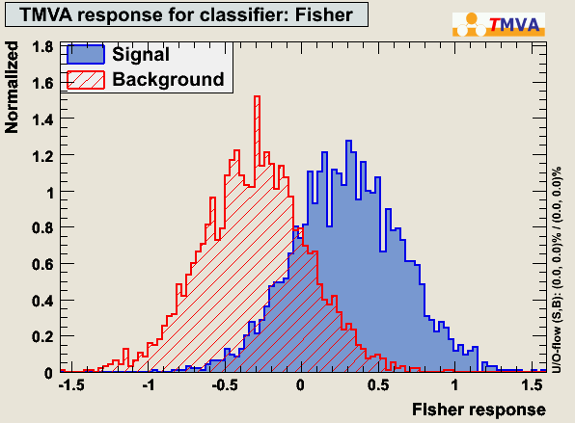



Fisher’s Linear Discriminant
$$y(x,w)=w_{0}+ \sum_{i=1}^{D}{w_{i}x_{i}}$$
determine the “weights” w that do “best”
Maximise “separation” between the S and B
→ minimise overlap of the distributions of y_{S} and y_{B}
  maximise the distance between the two mean values of the classes
  minimise the variance within each class
y_{B}
y_{S}
y
→ maximise
$J\left(\vec{w}\right)= \frac{{\left(E\left[y_{B}\right]−E[y_{S}]\right)}^{2}}{σ_{y_{B }}^{2}+σ_{y_{S}}^{2}}=\frac{{\vec{w}}^{T}B\vec{w}}{{\vec{w}}^{T}W\vec{w}}=\frac{\text{"}\text{in} \text{between}\text{"} \text{variance}}{"within" variance }$
$\vec{∇_{w}}$ $J\left(\vec{w}\right)=0⇒ \vec{w}∝W^{−1}({\left\langle \vec{x}\right\rangle }_{S}−{\left\langle \vec{x}\right\rangle }_{B})$
the Fisher coefficients
note: these quantities can be calculated from the training data

Slide 40


Linear Discriminant and non linear correlations
assume the following non-linear correlated data:
the Linear discriminant obviously doesn’t do a very good job here:
Of course, these can easily be de-correlated:
  here: linear discriminator works perfectly on de-correlated data

Slide 41



Linear Discriminant with Quadratic input:
A simple to “quadratic” decision boundary:
  var0
  var1
while:
  linear decision boundaries in var0,var1
‘feature engineering’
  var0 * var0
  var1 * var1
  var0 * var1
  quadratic decision boundaries in var0,var1
Performance of Fisher Discriminant:
Performance of Fisher Discriminant
with quadratic input:
Fisher
Fisher with decorrelated variables
Fisher with quadratic input

Slide 42


Classifier Training and Loss-Function
What about a more ‘general approach’ than ‘constructing $J\left(\vec{w}\right)$’ ?
→ minimize the expectation value of a “Loss function” $L(y^{train},y\left(x\right))$
$L(y^{train},y\left(x\right))$ : penalizing prediction errors for training events
Regression:
  $E[L]=E{\left[{\frac{1}{2}(y}^{train}−y\left(x \right)\right)}^{2}]$ squared error loss
Classification:
  $E\left[L\right]=E[y_{i}^{train}\log\left(y\left(x_{i}\right)\right)+\left(1−y_{i}^{train}\right)\log\left(1−y\left(x_{i}\right))\right]$ binomial loss
regression: $y_{i}^{train}$ = the functional value of training event $i$ which happens to have the measured observables $x_{i}$
classification: $y_{i}^{train}$=1 for signal, =0 (-1) background

Slide 43

Classifier Training and Loss-Function
Regression: $y_{i}^{train}$ : Gaussian distributed around a mean value
  Remember: Maximum Likelihood estimatior
  Maximise: log probability of the observed training data:
$$L=−\log{\prod_{i}^{events}{P\left(y_{i}^{train}|y(x_{i})\right)} }=−\sum_{i}^{events}{log⁡(P(y_{i}^{train}|y\left(x_{i}\right))}= \sum_{i}^{events}{{\left(y_{i}^{train}−y\left(x_{i}\right)\right)}^{2}}$$
  $E[L]=E{\left[\frac{1}{2}{(y}^{train}−y\left(x \right)\right)}^{2}]$ squared error loss (regression)
Classification: now: $y_{i}^{train}$ (i.e. is it ‘signal’ or ‘background’) is Bernoulli distributed
$$L=−\sum_{i}^{events}{log⁡(P(y_{i}^{train}|y\left(x_{i}\right))}=−\sum_{i}{log⁡(P{\left(S | x_{i}\right)}^{y_{i}^{train}}P{\left(B | x_{i}\right)}^{1−y_{i}^{train} })}$$
If we now say y(x) should simply parametrize P(S|x); P(B|x)=1-P(B|x) →
  $E\left[L\right]=E[y_{i}^{train}\log\left(y\left(x_{i}\right)\right)+\left(1−y_{i}^{train}\right)\log\left(1−y\left(x_{i}\right))\right]$ binomial loss

Slide 44


Logistic Regression*
*although called ‘regression’ it is a ‘classification’ algorithm!
Fisher Discriminant:
equivalent to Linear Discriminant with ‘squared loss function’
Ups: didn’t we just show that “classification” would naturally use ‘binomial loss’ ?
build a linear classifier that maximizes ‘binomial loss’:
  y(x) to parameterize P(S|x), we clearly cannot ‘use a linear function for ‘y(x)’
  ‘squeeze’ any linear function $w_{0}+∑w_{j}x^{j}$ = Wx into the proper interval $0≤y(x)≤1$ using the ‘logistic function’ (i.e. sigmoid function)
  $y\left(x\right)=P\left(S | x\right)=sigmoid\left(Wx\right)= \frac{1}{1+e^{−Wx}}$
  $Log\left(Odds\right)=Log\left(\frac{P\left(S | x\right)}{P\left(B | x\right)}\right)=Wx$ is linear!
Logistic Regression
Note: Now y(x) has a ‘probability’ interpretation. y(x) of the Fisher discriminant was ‘just’ a discriminator.

Slide 45

Logistic Regression
  $y\left(x\right)=P\left(S | x\right)=sigmoid\left(Wx\right)= \frac{1}{1+e^{−Wx}}$
1D example:
y(x) =sigm(wx)
y(x) =wx
x
Note: decision boundaries are still ‘linear’, just the ‘contour lines’ (y(x)=const) are non-linear, parametrizing the probability of the event being y=0 or y=1 as ‘distance’ from the boundary….

Slide 46
Logistic Regression
Difference between ‘linear classifier’ and ‘logistic regression’
→ distribution of decision boundaries
a ‘monotonous’ transformation of y(x)
does not change ‘relative overlap’ for pdfs of y_{S} and y_{B}
Does not change performance

Slide 47



(Stochastic) Gradient Decent SDG
minimize the “loss function” → “W” ?
e.g. $E\left[L(W)\right]=E[y_{i}^{train}\log\left(y\left(x_{i}\right)\right)+\left(1−y_{i}^{train}\right)\log\left(1−y\left(x_{i}\right))\right]$
with $y\left(x\right)= \frac{1}{1+e^{−Wx}} ;$
learning rate
$W → W−η\frac{∂E(L)}{∂w}$ : gradient decent
and if you don’t want to evaluate the expectation value every time for the whole sample:
$W → W−η\frac{∂L}{∂w}$: stochastic gradient decent
mostly: something in between → mini-batches

Slide 48
Support Vector Machine
There are methods to create linear decision boundaries using only measures of distances (= inner (scalar) products)
  → leads to quadratic optimisation problem
The decision boundary in the end is defined only by training events that are closest to the boundary
suitable variable transformations into a higher dimensional space may allow separation with linear decision boundaries non linear problems
→Support Vector Machine

Slide 49
Support Vector Machines
hyperplane that separates S from B
x₂
support vectors
Linear decision boundary
Best separation: maximum distance (margin) between closest events (support) to hyperplane
ξ₁
Non-separable data
ξ₂
Separable data
optimal hyperplane
If data non-separable add misclassification cost parameter C·Σ_{i}ξ_{i} to minimisation function
ξ₃
ξ₄
Solution of largest margin depends only on inner product of support vectors (distances)
→ quadratic minimisation problem
margin
x₁

Slide 50
Support Vector Machines
hyperplane that separates S from B
Linear decision boundary
Best separation: maximum distance (margin) between closest events (support) to hyperplane
Non-separable data
Separable data
If data non-separable add misclassification cost parameter C·Σ_{i}ξ_{i} to minimisation function
φ(x₁,x₂)
largest margin - inner product of support vectors (distances) → quadratic minimisation problem
Non-linear cases:
Transform variables into higher dimensional feature space where again a linear boundary (hyperplane) can separate the data

Slide 51
Support Vector Machines
x₃
Find hyperplane that best separates signal from background
x₂
x₂
Linear decision boundary
Best separation: maximum distance (margin) between closest events (support) to hyperplane
Non-separable data
Separable data
If data non-separable add misclassification cost parameter C·Σ_{i}ξ_{i} to minimisation function
φ(x₁,x₂)
largest margin - inner product of support vectors (distances) → quadratic minimisation problem
x₁
x₁
x₁
Non-linear cases:
non linear variable transformation → linear separation in transformed feature space
no explicit transformation specified → Only its “scalar product” x·x → Ф(x)·Ф(x) needed.
  certain Kernel Functions can be interpreted as scalar products between transformed vectors in the higher dimensional feature space. e.g.: Gaussian, Polynomial, Sigmoid
Choose Kernel and fit the hyperplane using the linear techniques developed above
Kernel size paramter typically needs careful tuning! (Overtraining!)

Slide 52

Support Vector Machines
How does this “Kernel” business work?
Kernel function == scalar product in “some transformed” variable space
standard: $\vec{x}∙\vec{y}=\sum{x_{i}^{}y_{i}}=\left|x\right|\left|y\right|∗cos(θ)$
  large if : $\vec{x}∙\vec{y}$ are in the same “direction”
  zero if : $\vec{x}∙\vec{y}$ are orthogonal (i.e. point along different axes / dimension)
e.g. Gauss kernel: $Φ\left(\vec{x}\right)∙Φ\left(\vec{y}\right)=K\left(\vec{x},\vec{y}\right)=exp(−\frac{{\left(\vec{x}−\vec{y}\right)}^{2}}{2σ^{2}})$
  zero if points: $\vec{x} and \vec{y}$ “far apart” in original data space
  large only in “vicinity” of each other
  $σ<$ distance between training data points:
    each data point is “lifted” into its “own” dimension
    full separation of “any” event configuration with decision boundary along coordinate axis
    well, that would of course be: overtraining

Slide 53

Overtraining
x₂
S
Classifier is too flexible
→ overtraining
classificaion error
True performance (independent test sample)
B
training sample
training cycles
$$α_{optimal}$$
x₁
α
Or
?
Bias if ‘performance’ is estimated from the training sample
x₂
S
possible overtraining is concern for every “tunable parameter” α of classifiers: Smoothing parameter, n-nodes…
verify on independent “test” sample
B
x₁

Slide 54



Regularisation
Minimize loss function: e.g. $via W → W−η\frac{∂L}{∂w}$: SDG
Include prior distribution on ‘weights’/’parameters’ w:
$$L=\log{(\prod_{i}^{events}{P\left(y_{i}^{train}|y(x_{i})\right)} ∗p\left(w\right) ) }$$
$=\sum_{i}^{events}{log⁡(P(y_{i}^{train}|y\left(x_{i}\right))}+\log\left(p\left(w\right)\right)$
often (e.g if y = polynomial or y = neural network)
w “small” → model is less ‘flexible’
reasonable prior $p\left(w\right)$would be: Gaussian with mean zero
$L=L+\frac{1}{2}α∑w^{2}$ α: factor of ‘how much you want to penalize”

Slide 55


Digression
Kolmogorov Smirnov Test:
Tests if two sample distributions are compatible with coming from the same parent distribution
Statistical test: if they are indeed random samples of the same parent distribution, then the KS-test gives an uniformly distributed value between 0 and 1 !!
Note: that means an average value of 0.5 !!
Please: don’t misunderstand the
title of this plot as:
$$KS= \left\{\begin{matrix}\sim 1: & ok \\ else: & trouble\end{matrix}\right.$$
Was meant as quick sanity check ONLY!!

Slide 56
Cross Validation
parameters “α” → control performance
  #training cycles, #nodes, #layers, regularisation parameter (neural net)
  smoothing parameter h (kernel density estimator)
  ….
more training data → better training results
division of data set into “training” and “test” and “validation” sample? ☹
Cross Validation: divide the data sample into say 5 sub-sets
Test
Test
Test
Test
Test
Train
Train
Train
Train
Train
Train
Train
Train
Train
Train
Train
Train
Train
Train
Train
Train
Train
Train
Train
Train
Train
Train
Train
train 5 classifiers: y_{i}(x,α) : i=1,..5,
i-th classifier is trained without the i-th sub sample → used as ‘test/validation’
calculate the test error:
use α for which CV(α) is minimum → train the final classifier using all data

Slide 57
General Advice for (MVA) Analyses
no magic in MVA- or ML-Methods:
  no “artificial intelligence” ☹ … just “fitting decision boundaries” in a given model
most important: finding good observables
  good separation power between S and B
  little correlations amongst each other → have ‘new information’
  no correlation with the parameters you try to measure in your signal sample!
combination of variables → feature engineering !
  eliminate correlations: you are MUCH more intelligent than the algorithm
scale features to similar numeric range
apply pure pre-selection cuts yourself.
avoid “sharp features” → numerical problems, binning loss
  often simple variable transformations (i.e. log(variable) ) do the trick
treat regions with different features “independent”
  Introduces unnecessary correlations, ‘kinks’ in decision boundaries

Slide 58



MVA Categories
one classifier per ‘region’
‘regions’ in the detector (data) with different features treated independent
  improves performance
  avoids additional correlations where otherwise the variables would be uncorrelated!
Recover optimal performance after splitting into categories
|eta| > 1.3
Example: var4 depends on some variable “eta”
|eta| < 1.3

Slide 59

About Systematic Errors

Slide 60
About Systematic Errors
Typical worries are:
  What happens if the estimated “Probability Density” is wrong ?
  Can the Classifier, i.e. the discrimination function y(x), introduce systematic uncertainties?
  What happens if the training data do not match “reality”
Any wrong PDF leads to imperfect discrimination function
  Imperfect (calling it “wrong” isn’t “right”) y(x) → loss of discrimination power
  that’s all!
  classical cuts face exactly the same problem, however:
    in addition to cutting on features that are not correct, now you can also “exploit” correlations that are in fact not correct
Systematic error are only introduced once “Monte Carlo events” with imperfect modeling are used for
  efficiency; purity
  #expected events
same problem with classical “cut” analysis
use control samples to test MVA-output distribution (y(x))
Combined variable (MVA-output, y(x)) might “hide” problems in ONE individual variable more than if looked at alone → train classifier with few variables only and compare with data

Slide 61

MVA and Systematic Uncertainties
Multivariate Classifiers THEMSELVES don’t have systematic uncertainties → even if trained on a “phantasy Monte Carlo sample”
  there are only “bad” and “good” performing classifiers !
    OVERTRAINING is NOT a systematic uncertainty !!
    difference between two classifiers resulting from two different training runs DO NOT CAUSE SYSTEMATIC ERRORS
  same as with “well” and “badly” tuned classical cuts
  MVA classifiers: → only select regions in observable space
Efficiency estimate (Monte Carlo) → statistical/systematic uncertainty
  involves “estimating” (uncertainties in ) distribution of $PDF_{y_{S(B)}}$
    statistical “fluctuations” → re-sampling (Bootstrap)
    “smear/shift/change” input distributions and determine $PDF_{y_{S(B)}}$
  estimate systematic error/uncertainty on efficiencies
Only involves “test” sample..
  systematic uncertainties have nothing to do with the training !!

Slide 62
Summary
MVA or ML algorithms
  → parametrize likelihood ratio (or a monotonic function thereof)
    decision boundaries or ‘event weights’
  Parametrize the ‘target function’
    ‘regression’
Generative or discriminative algorithms
  Multidimensional/projective Likelihood (rec. pdf)
  (Linear) discriminators etc. → minimize a loss function
Take care in training, validation and testing
  Don’t want over/’under’-training but the best classifier!

Slide 63
Backup

Slide 64
MVA and Systematic Uncertainties
Don’t be afraid of correlations!
  typically “kinematically generated” → easily modeled correctly
  “classical cuts” are also affected by “wrongly modeled correlations”
  MVA method let’s you spot mis-modeled correlations!
    “projections” of input variables
    + the combined MVA test statistic “y(x)” !

Slide 65




Systematic “Error” in Correlations
Use as training sample events that have correlatetions
  optimize CUTs
  train an propper MVA (e.g. Likelihood, BDT)
Assume in “real data” there are NO correlations → SEE what happens!!

Slide 66


Systematic “Error” in Correlations
Compare “Data” (TestSample) and Monte-Carlo
(both taken from the same underlying distribution)

Slide 67


Systematic “Error” in Correlations
Compare “Data” (TestSample) and Monte-Carlo
(both taken from the same underlying distributions that differ by the correlation!!! )
Differences are ONLY visible in the MVA-output plots
(and if you’d look at cut sequences….)

Slide 68
Robustness against systematic Uncertainties
minimize “systematic” uncertainties (robustness)
“classical cuts” : do not cut near steep edges, or in regions of large sys. uncertainty
hard to translate to MVAs:
  artificially degrade discriminative power (shifting/smearing) of systematically “uncertain” observables IN THE TRAINING
    remove/smooth the ‘edges’ → MVA does not try to exploit them
Signal
Background
Note: if I KNEW about the error, I’d correct for it. I’m talking about ‘unknown’ systematics

Slide 69


How does this look in 2D?
MVA-decision boundaries
Looser MVA-cut → wider boundaries in BOTH variables
You actually want a boundary like THIS
  Tight boundaries in var1
  Loose boundaries in var0
→ train MVA algorithm with ‘problematic variables’ transformed to make them less discriminant:
YES it works !

Slide 70


Another example..
Hmm… also here, I’d still say it does exactly what I want it to do
  The difficulty is to ‘evaluate’ or ‘estimate’ the advantage (reduction in systematic ←→ loss in performance)
bad decsision boundary
better

Slide 71


other examples..
bad decsision boundary
better
  Seems to work but:
  difficult to ‘evaluate’ or ‘estimate’ the advantage (reduction in systematic ←→ loss in performance)

Slide 72
How does this look in 2D?
MVA-decision boundaries
Looser MVA-cut → wider boundaries in BOTH variables
What if you are sure about the peak’s position in var1, but less sure about var0 ?
You actually want a boundary like THIS
  Tight boundaries in var1
  Loose boundaries in var0

Slide 73

Reduce information content
Looking for a general tool to ‘force’ any MVA algorithm, not to rely too much on exact feature:
  Similar: early stopping techniques in Neural networks to avoid overtraining
→ reduce difference between “signal” and “background”
→ or reduce information content in each, “signal” and “background”
Here: one would for example “shift” such that signal and backgr. are less separated
However, that’s not “universal”

Slide 74
Reduce information content
Looking for a general tool to ‘force’ any MVA algorithm, not to rely too much on exact feature:
  Similar: early stopping techniques in Neural networks to avoid overtraining
→ reduce difference between “signal” and “background”
→ or reduce information content in each, “signal” and “background”
shift
smear
turn

Slide 75


Back to my “complicated” 3D example

Slide 76

ROC Cuve - Zoom
compare: difference between red (what you think you have) and black (what your algorithm applied to nature might actually provide)
do this for solid (smeared) and dashed (unsmeared) classifiers
76

Slide 77


Boosted Decision Trees
Decision Tree: Sequential application of cuts splits the data into nodes, where the final nodes (leafs) classify an event as signal or background
Each branch → one standard “cut” sequence
  easy to interpret, visualised
Disadvatage → very sensitive to statistical fluctuations in training data
Boosted Decision Trees (1996): combine a whole forest of Decision Trees, derived from the same sample, e.g. using different event weights.
  overcomes the stability problem
  increases performance
→ became popular in HEP since MiniBooNE, B.Roe et.a., NIM 543(2005)

Slide 78
Boosting
Training Sample
classifier
C⁽⁰⁾(x)
re-weight
Weighted Sample
classifier
C⁽¹⁾(x)
re-weight
Weighted Sample
classifier
C⁽²⁾(x)
re-weight
Weighted Sample
classifier
C⁽³⁾(x)
re-weight
Weighted Sample
classifier
C^{(m)}(x)

Slide 79

Adaptive Boosting (AdaBoost)
Training Sample
classifier
C⁽⁰⁾(x)
AdaBoost re-weights events misclassified by previous classifier:
re-weight
$$\frac{1−f_{err}}{f_{err}} ;f_{err}=\frac{misclassified}{all events}$$
Weighted Sample
classifier
C⁽¹⁾(x)
re-weight
Weighted Sample
classifier
C⁽²⁾(x)
re-weight
Weighted Sample
classifier
C⁽³⁾(x)
re-weight
→
Weighted Sample
classifier
C^{(m)}(x)
y(x)

Slide 80
Boosted Decision Trees
Are very popular in HEP
  Robust and easy to train,
  get good results
But: when we adopted BDTs,
  In 2006 ANNs just started their big breakthrough in the ML community with remarkable advances in DEEP Learning !
→ Let’s move on to Neural Networks

Slide 81

Machine Learning -
Multivariate Techniques
if we do not know that ‘straight line’ or ‘polynomial’ is a good model (particularly in higher dimension) ?
→ general, simple, piecewise models
→ fit non-analytic → computer → machine learning

Slide 82


Machine Learning -
Multivariate Techniques
fitted non-analytic function may approximate:
  Likelihood ratio:
$$y\left(x\right)=\frac{PDF(x|S)}{PDF(x|B)} ; x=\left(\begin{aligned}var0 \\ var1 \\ . \\ . \\ .\end{aligned}\right)$$
Background
Signal
$$y\left(x\right)=const$$
→ decision boundary

Slide 83

Event Classification
P(Class=C|x) (or simply P(C|x)) : probability that the event class is of C, given the measured observables x={x₁,….,x_{D}} → y(x)
Probability density distribution according to the measurements x and the given mapping function
Prior probability to observe an event of “class C”
i.e. the relative abundance of “signal” versus “background” → $P\left(C\right)=f_{C}=\frac{n_{C}}{n_{tot}}$
Posterior probability
Overall probability density to observe the actual measurement y(x). i.e.
It’s a nice “exercise” to show that this application of Bayes’ Theorem gives exactly the formula on the previous slide !

Slide 84



Neyman Pearson Lemma
Kyle Cranmer
$$\frac{P\left(x | H_{1}\right)}{P\left(x | H_{0}\right)}<k_{α}$$
graphical proof of Neyman Pearson’s Lemma:
(graphics/idea taken from Kyle Cranmer)
the critical region W^{C} given by the likelihood ratio $\frac{P\left(x | H_{1}\right)}{P\left(x | H_{0}\right)}$
for each given size $α$ (risk of e.g. actually making a false discovery)
the statistical test with the largest power $1−β$(chances of actually discovering something given it’s there)

Slide 85


Neyman Pearson Lemma
Kyle Cranmer
$$W_{c}: \frac{P(x|H_{1})}{P(x|H_{2})}>k_{α}$$
assume we want to modify/find another “critical” region with same size (α) i.e. same probability under H₀

Slide 86

Neyman Pearson Lemma
Kyle Cranmer
$$W_{c}: \frac{P(x|H_{1})}{P(x|H_{2})}>k_{α}$$
$$α=\int_{C}{P\left(x | H_{0}\right)dx}$$
… as size (α) is fixed

Slide 87

Neyman Pearson Lemma
Kyle Cranmer
$$W_{c}: \frac{P(x|H_{1})}{P(x|H_{2})}>k_{α}$$
outside “critical region” given by LL-ratio

Slide 88

Neyman Pearson Lemma
Kyle Cranmer
$$W_{c}: \frac{P(x|H_{1})}{P(x|H_{2})}>k_{α}$$
outside “critical region” given by LL-ratio
inside “critical region” given by LL-ratio

Slide 89


Neyman Pearson Lemma
Kyle Cranmer
$$W_{c}: \frac{P(x|H_{1})}{P(x|H_{2})}>k_{α}$$
$$β=\int_{!C}{P\left(x | H_{1}\right)dx}$$

Slide 90

Neyman Pearson Lemma
Kyle Cranmer
$$W_{c}: \frac{P(x|H_{1})}{P(x|H_{2})}>k_{α}$$
“acceptance” region
(accept H₀ (reject H₁)
“critical” region
(reject H₀)
The NEW “acceptance” region has less power! (i.e. probability under H₁ ) q.e.d

