Slide 1
LHC Experimental Physics
Lecture 7
Jon Butterworth
University College London
Vietnam School of Physics
Quy Nhon
September 2016

Slide 2
Outline
Introduction
First measurements
Jets and boosted objects
Higgs Discovery and Measurement
Measurements and Model Independence
Searches and the future

Slide 3
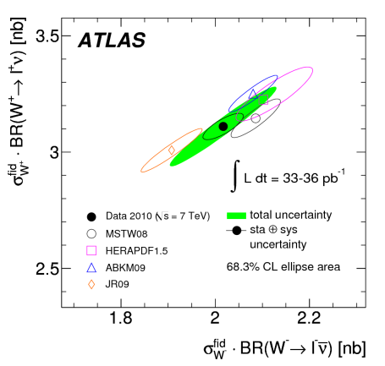
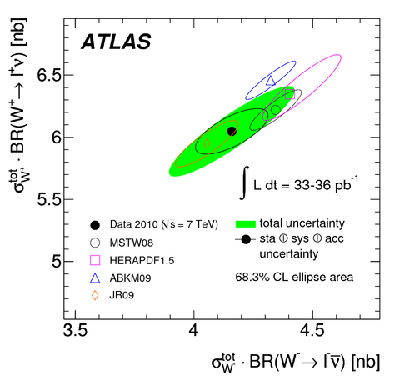
Real example: ATLAS W & Z cross sections (to e, μ), 7 TeV

Slide 4
Real example: ATLAS WW cross section (to e, μ), 7 TeV
Efficiency/detector corrections to obtain fiducial cross section: 0.4-0.7 (defined in terms of lepton kinematics)
Acceptance (accessible phase space compared to include WW): 0.07-0.16
That missing 90% is stuff we don’t measure
The efficiency/detector efficiency won’t change much at 13 TeV, but the acceptance may well drop further

Slide 5
Real example: Top cross section
Total cross section measurements extrapolate to 4π, 4 TeV>p_{T}>0
Often not even possible to extract the acceptance from the papers (convoluted with efficiencies and migrations)
Means for some, non-trivially-different, regions of phase space, we are just buying the theory
Will be even more of a problem at higher beam energies.

Slide 6
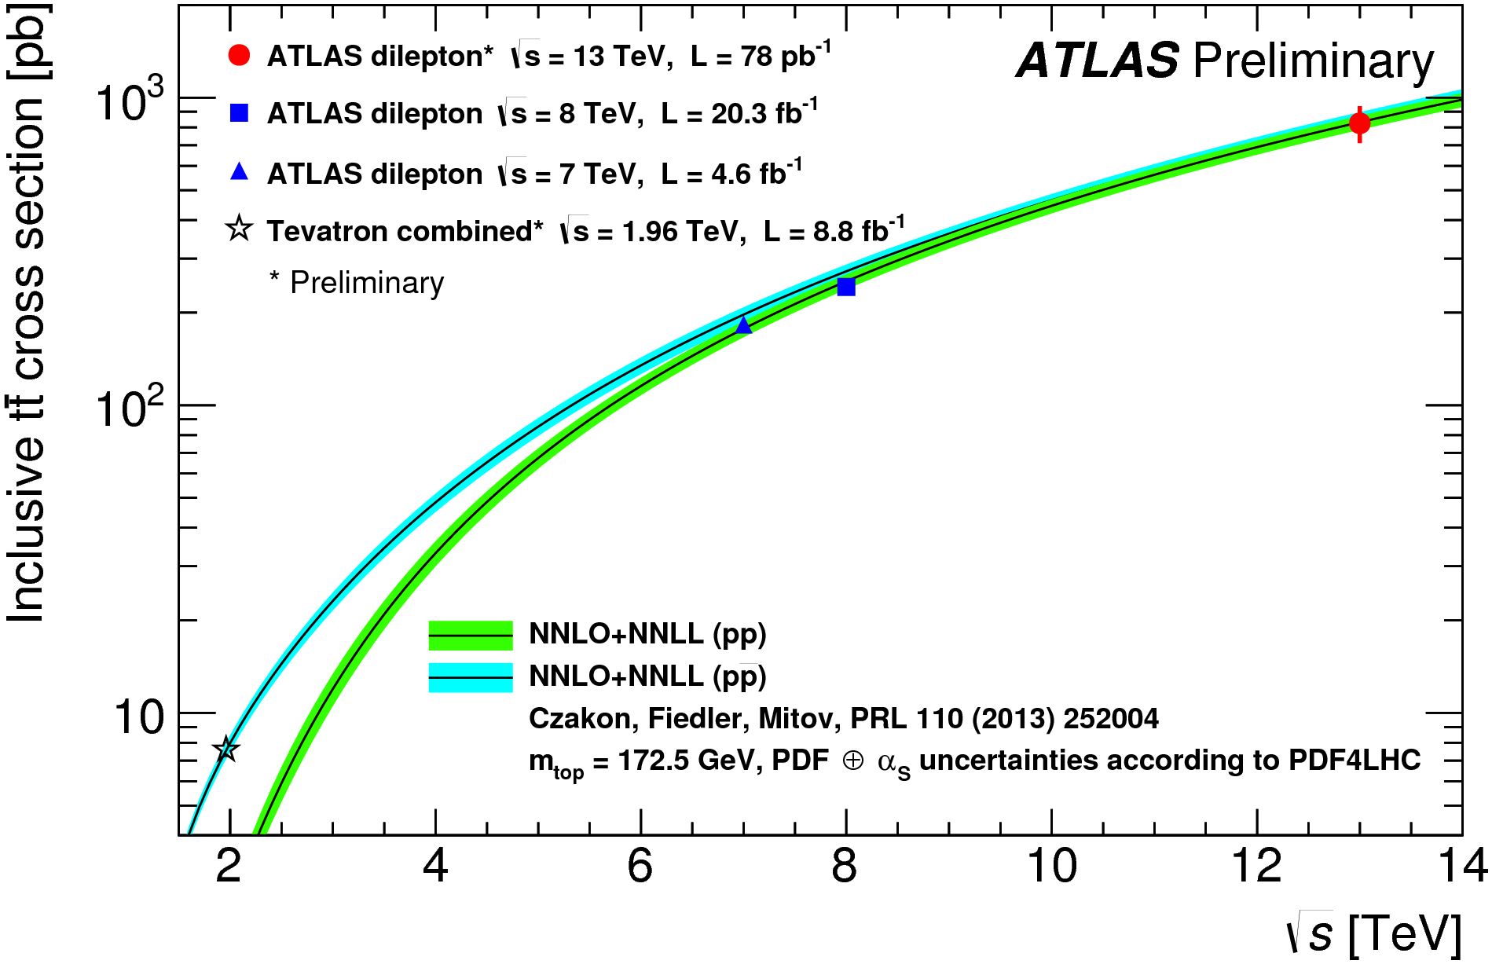
Top
ATLAS-CONF-2015-033

Slide 7
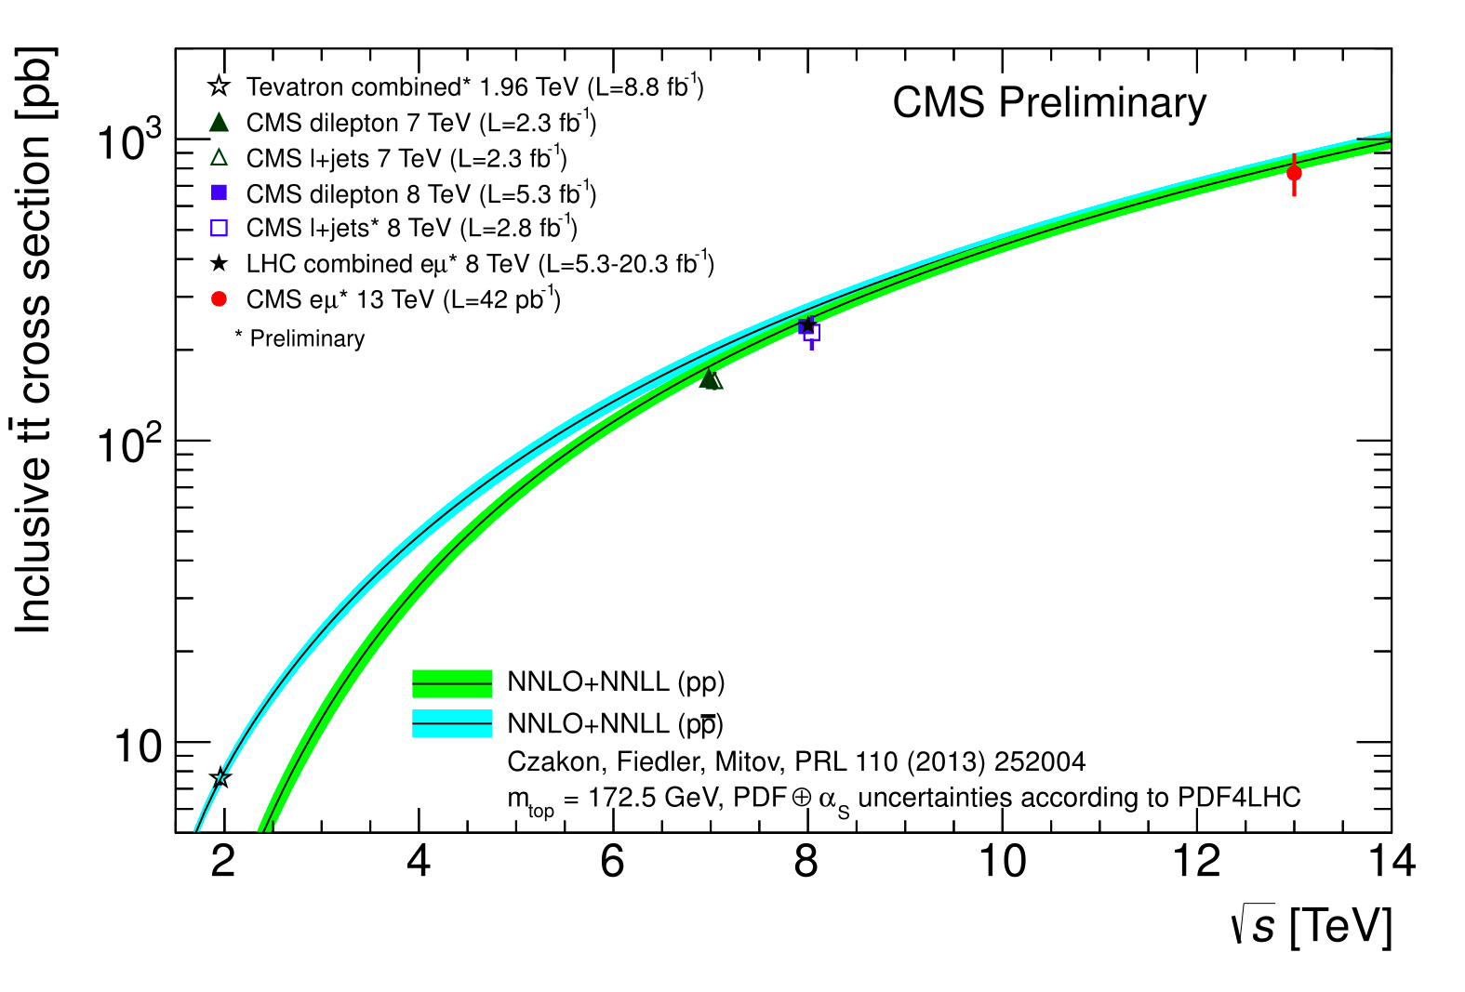
Top
CMS PAS TOP-15-003

Slide 8
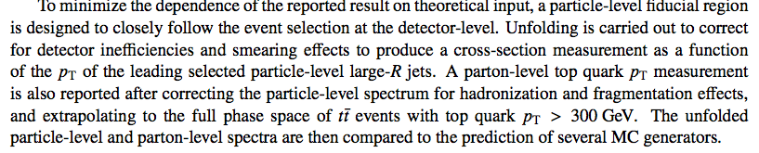
Top
Many precision measurements.
Starting to include fiducial & differential results:
  Build cross sections out of final-state particles
  Top-jet cross sections from ATLAS & CMS
arXiv:1502.05923
ATLAS-CONF-2014-057

Slide 9
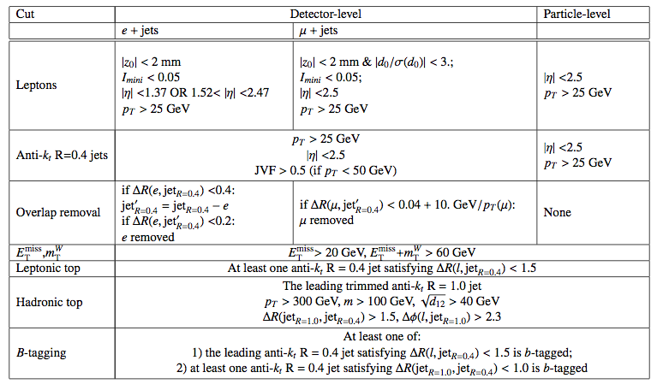
Top
arXiv:1502.05923
ATLAS-CONF-2014-057

Slide 10
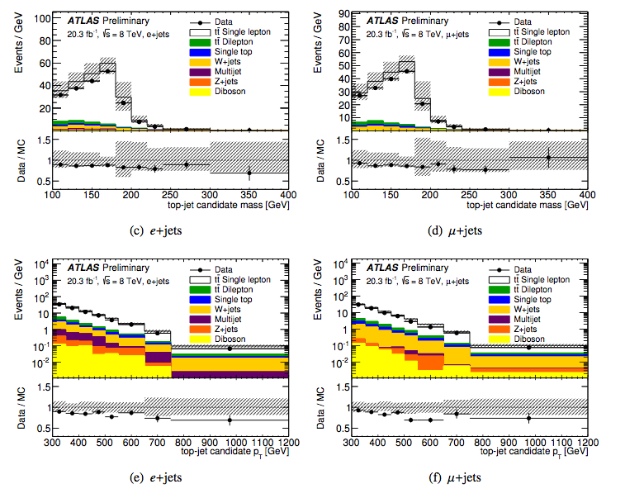
Top
arXiv:1502.05923
ATLAS-CONF-2014-057

Slide 11
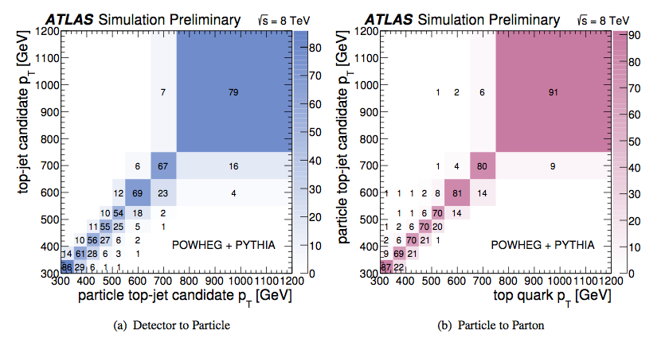
Top
arXiv:1502.05923
ATLAS-CONF-2014-057

Slide 12
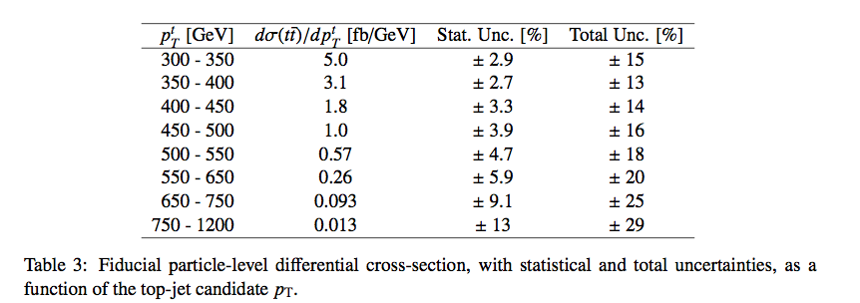
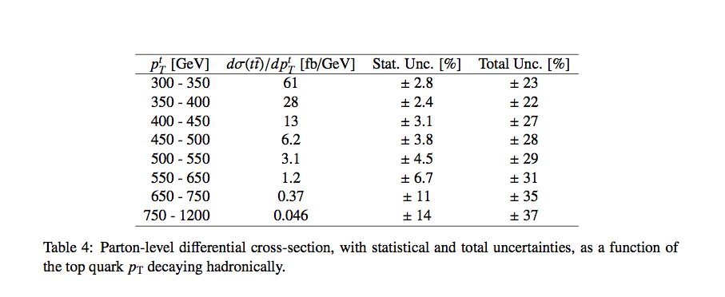
Top
ATLAS-CONF-2014-057

Slide 13
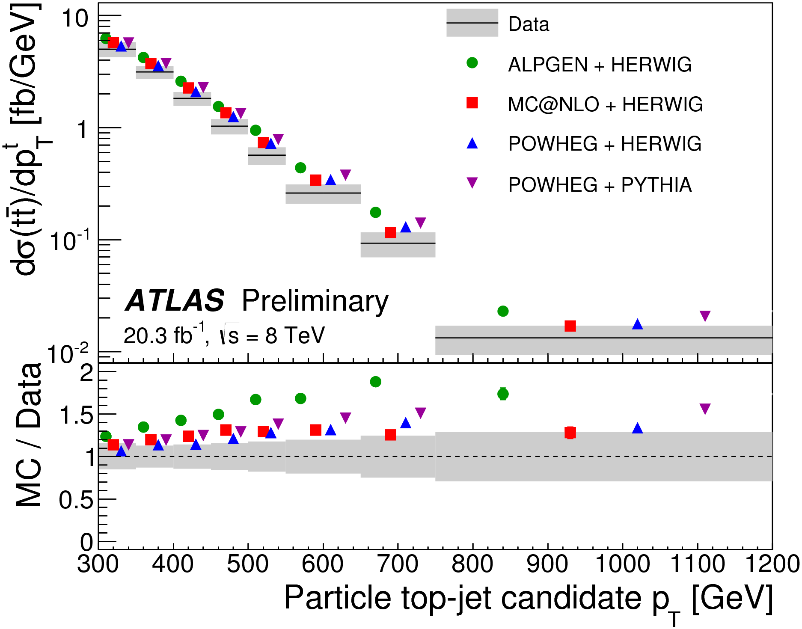
Top
Boosted top-jet cross sections from ATLAS & CMS
Particle-level fiducial definition
Uses “fat jets”, trimmed, with subjet cuts.
arXiv:1502.05923

Slide 14
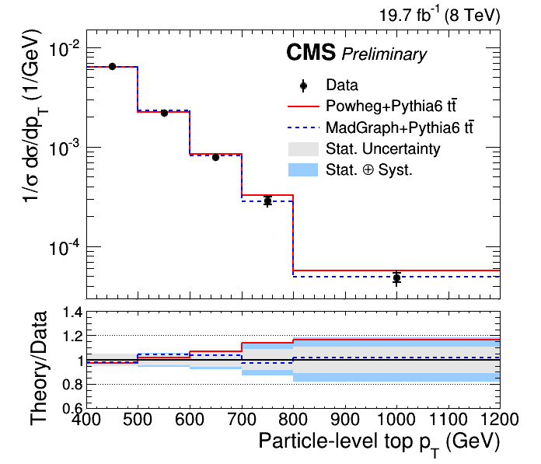
Top
Boosted top-jet cross sections from ATLAS & CMS
Particle-level fiducial definition
Uses “fat jets”, trimmed, with subjet cuts.
CMS PAS TOP-14-012

Slide 15
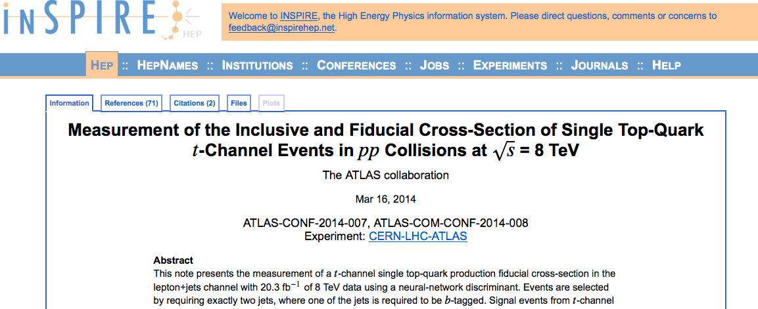

Slide 16
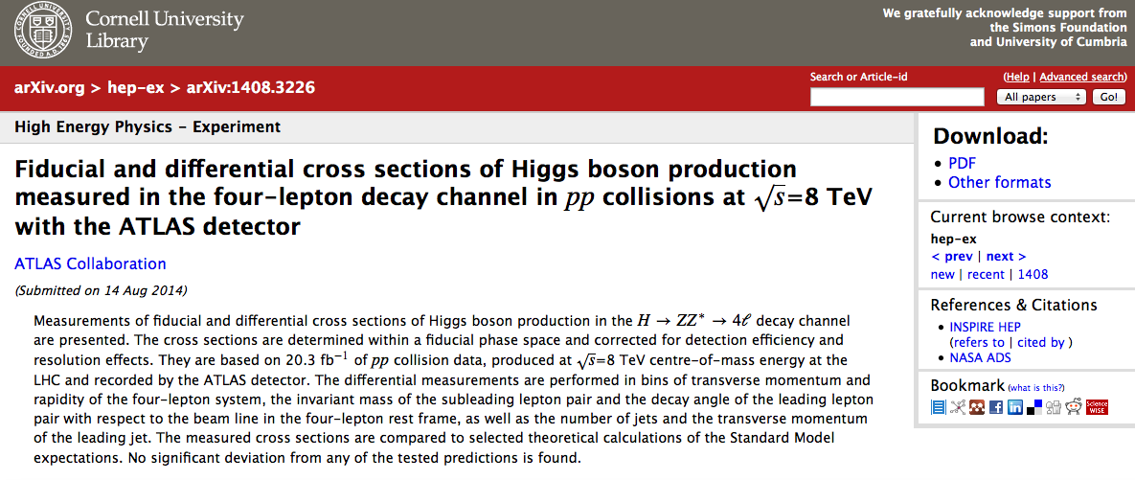

Slide 17
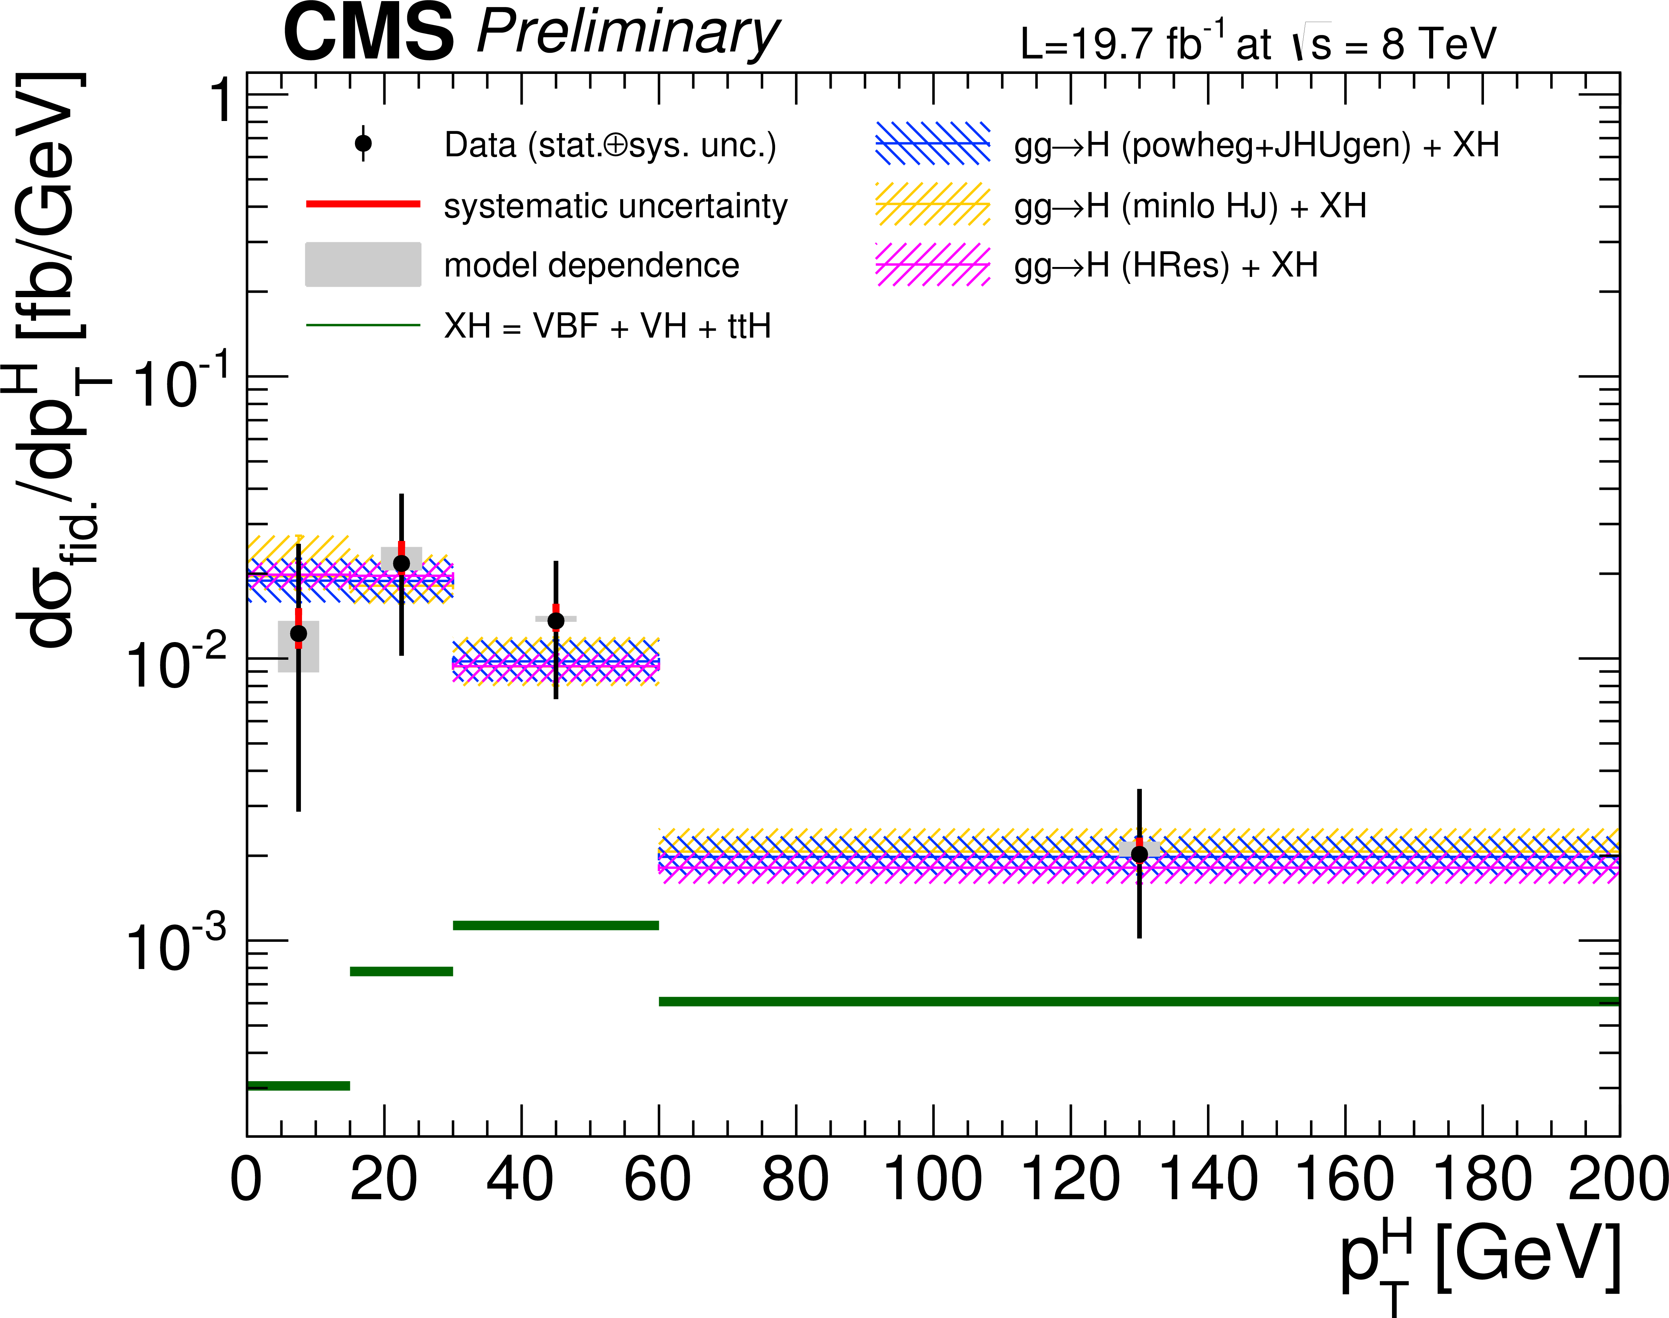
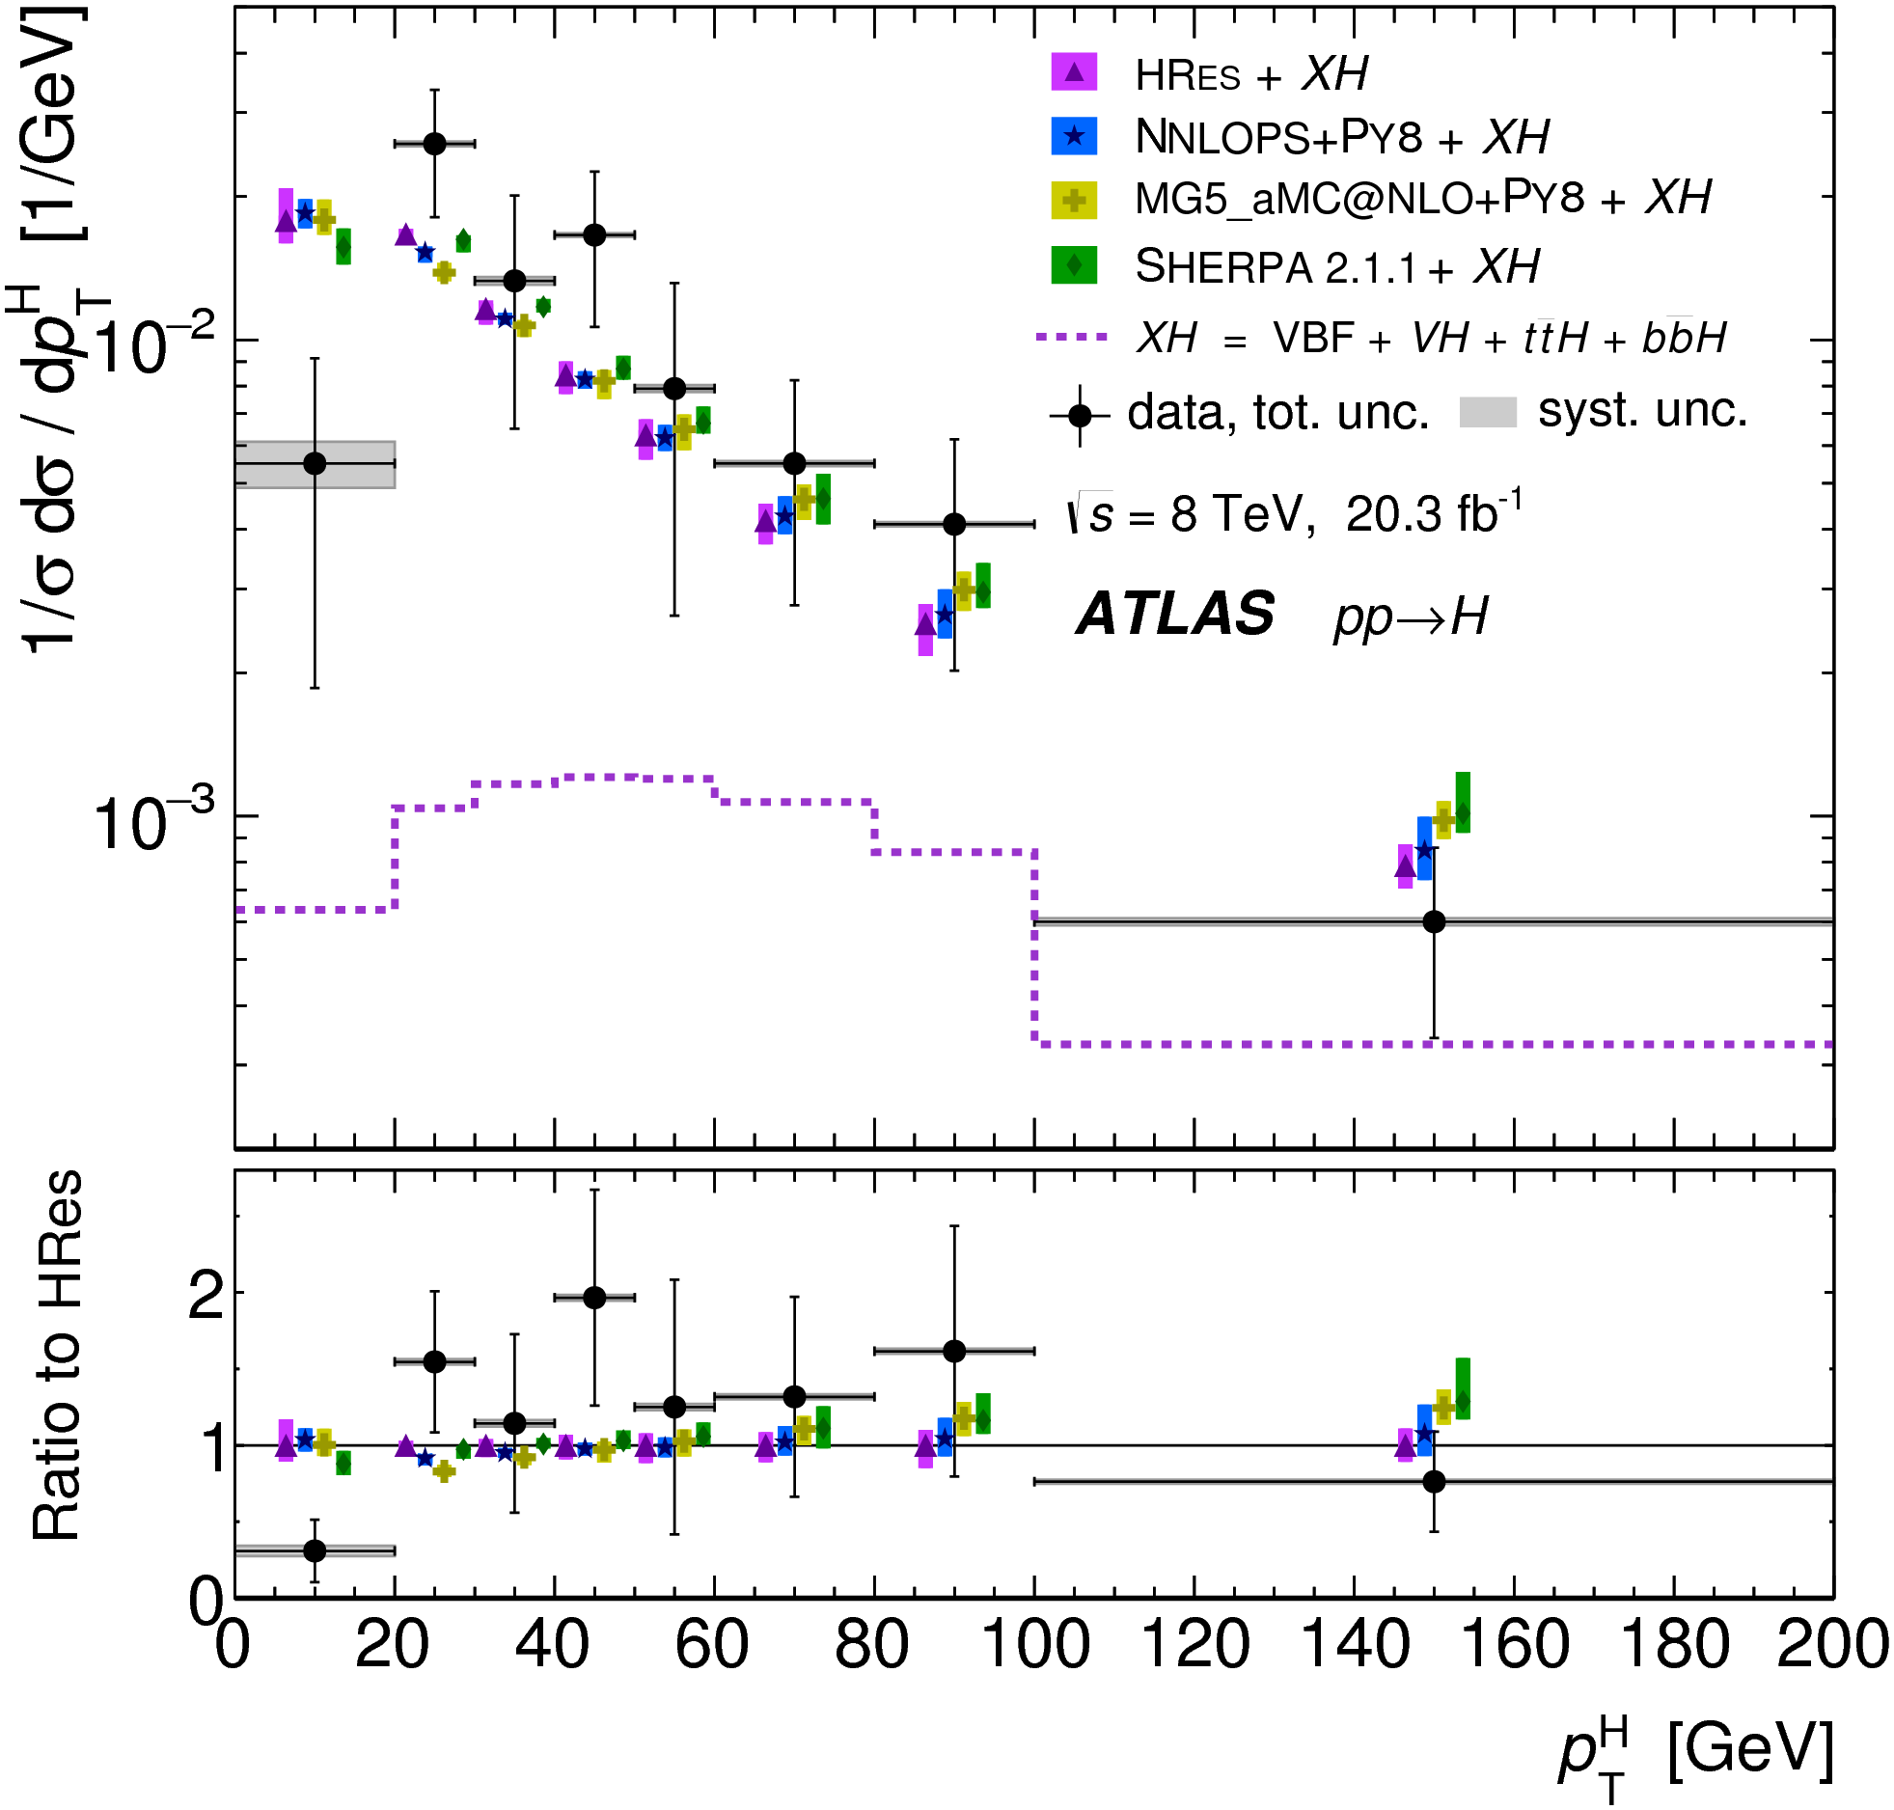
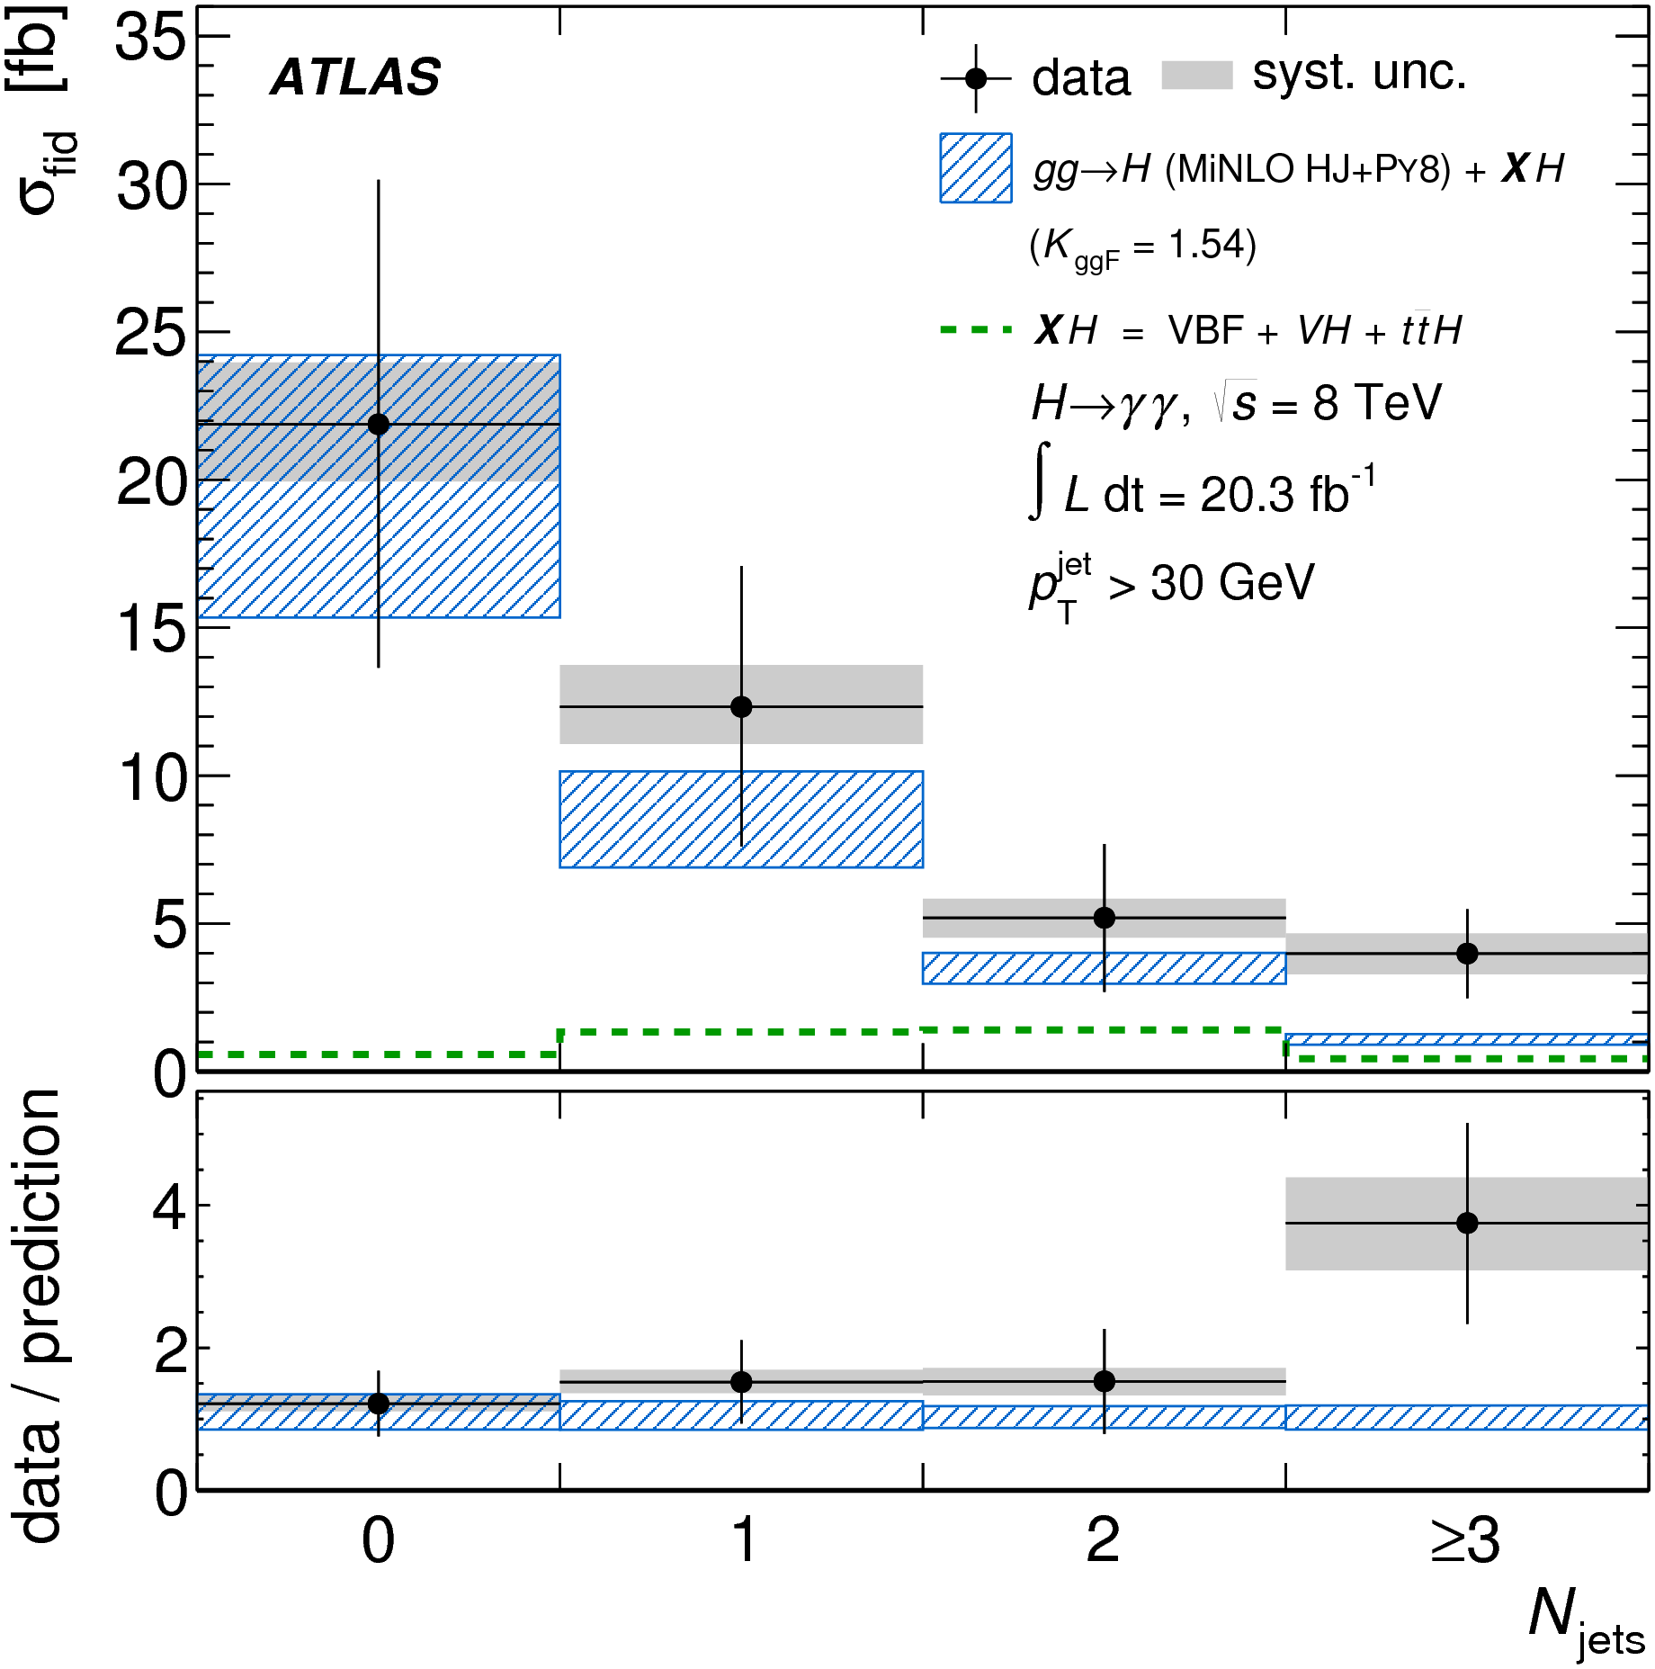
Higgs
Differential and fiducial cross sections
CMS PAS HIG-14-028
arXiv:1407.4222
arXiv:1408.3226
arXiv:1504.05833

Slide 18
Garbage in, garbage out

Slide 19
THEORY in, THEORY out
… so the experiment is a waste of time

Slide 20
Important considerations
Will be residual model dependence in any measurement, but experimentalists should minimise it, make assumptions clear, and control it as far possible within some given systematic uncertainty
Theorists should look for measurements of physical final states and where possible calculate them
Of course we all want to learn about the underlying theory by interpreting what we see, but try to keep interpretation separate from measurement: interpretations can, and do, change, but we won’t build an LHC (Tevatron, LEP, HERA…) again.

Slide 21
What do we actually measure?
The final state!
  Quantum mechanics says so!
Clearly we can’t, even in principle, tell the difference between amplitudes with different final states
If your measurement can’t be defined in such terms, worry!
  Model dependence
  Physical meaning!
See also… RIVET
https://rivet.hepforge.org/
Notes:
Add isolated photons, dressed leptons, jet algorithms

Slide 22
Outline
Introduction
First measurements
Jets and boosted objects
Higgs Discovery and Measurement
Measurements and Model Independence
Searches and the future

Slide 23
Searches and the future
With thanks to Nahn V Tran (and of course many other colleagues too!)

Slide 24
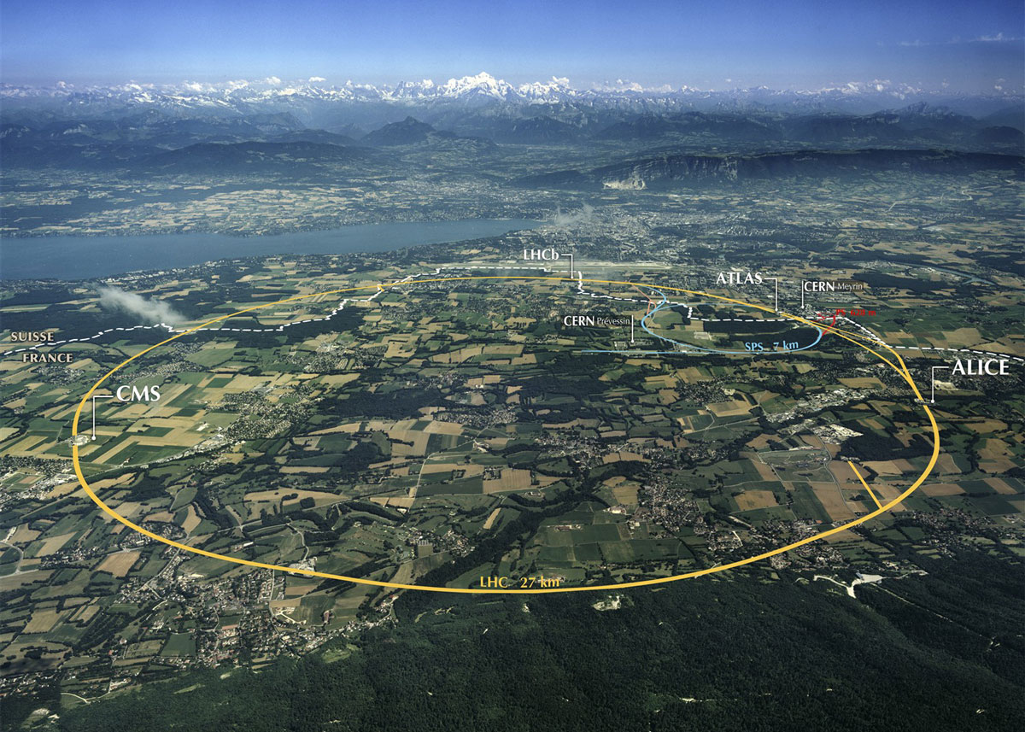
Where are we now?
Notes:
Protons collisions at 14,000,000,000,000 eV
(eventually – currently at 7,000,000,000,000 eV)
Two “general purpose” experiments: ATLAS and CMS will detect the products of the collisions.
Why does it have to be so big? (weight on string)

Slide 25


Slide 26
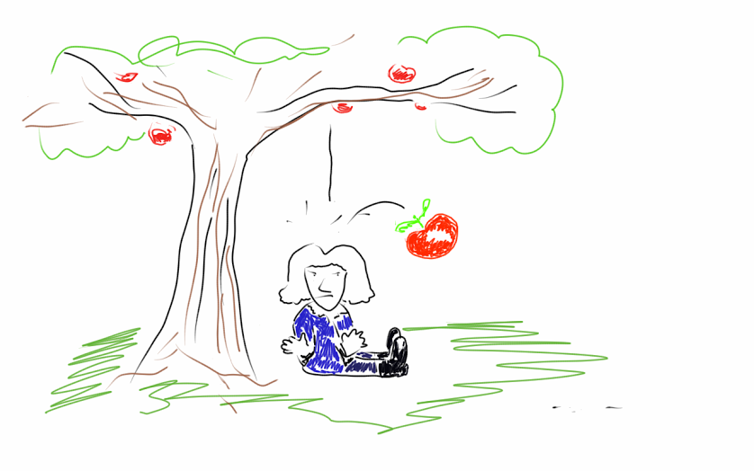
Beyond the Standard Model!

Slide 27

Beyond the Standard Model and General Relativity!

Slide 28
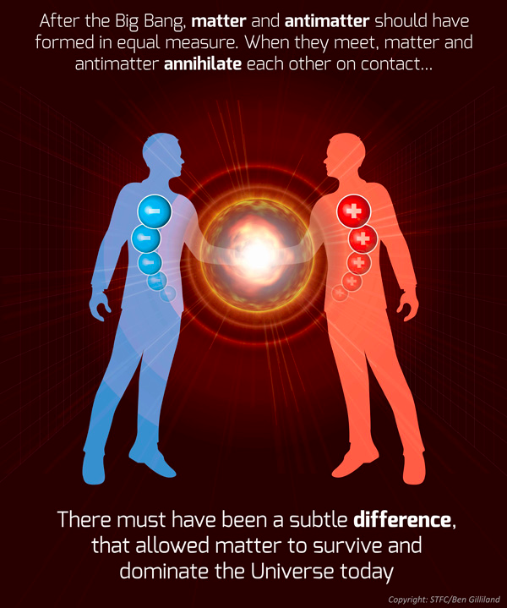
Notes:
Not enough CP asymmetry in the SM to explain the universe. LHCb. Neutrinos. Majorana?

Slide 29
And so onward...
Notes:
Protons collisions at 14,000,000,000,000 eV
(eventually – currently at 7,000,000,000,000 eV)
Two “general purpose” experiments: ATLAS and CMS will detect the products of the collisions.
Why does it have to be so big? (weight on string)

Slide 30
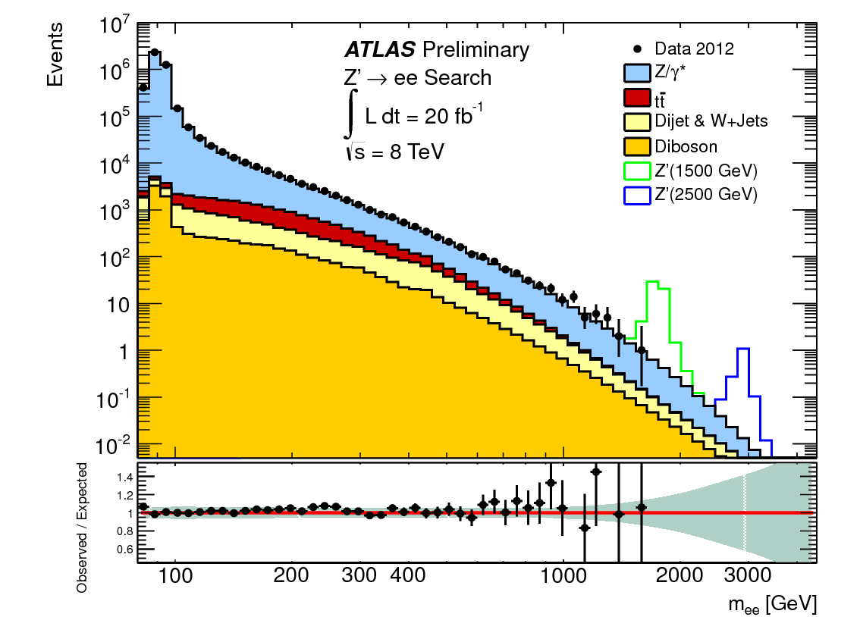
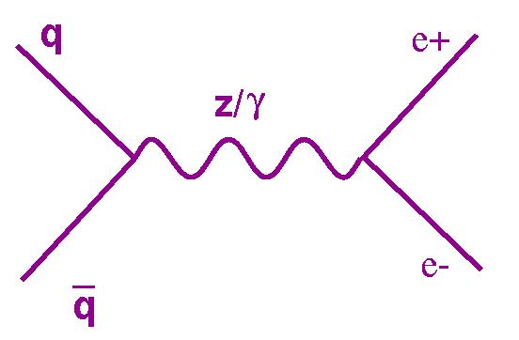

Slide 31
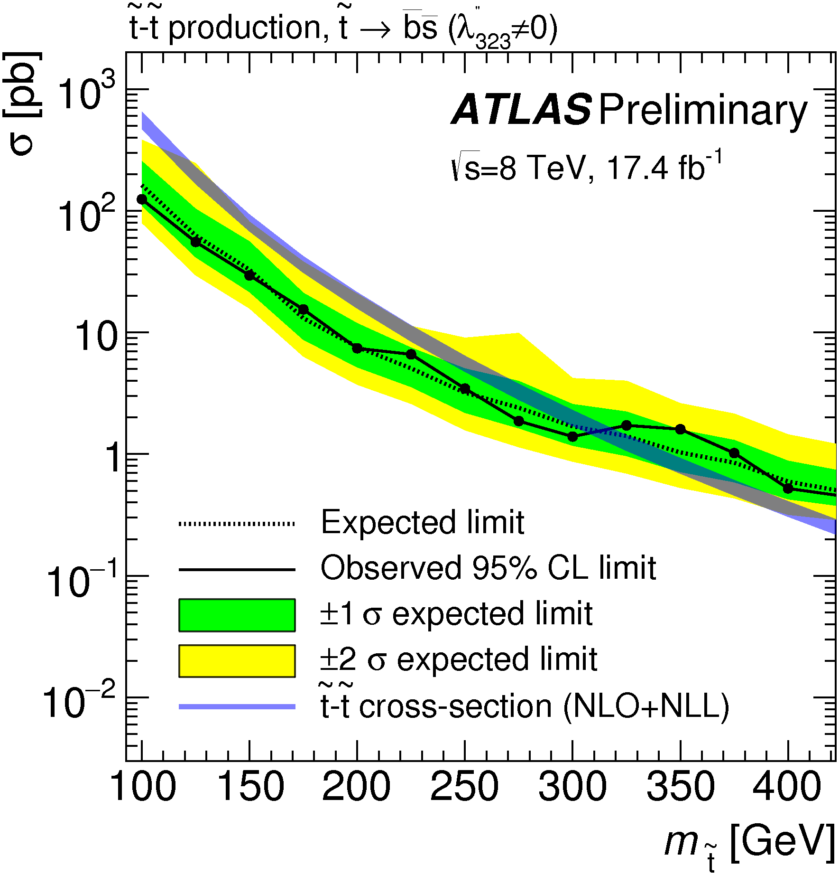
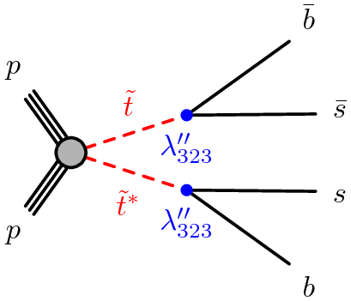
Many searches for SUSY and other BSM signatures
Example, using jet substructure:
ATLAS-CONF-2015-026

Slide 32
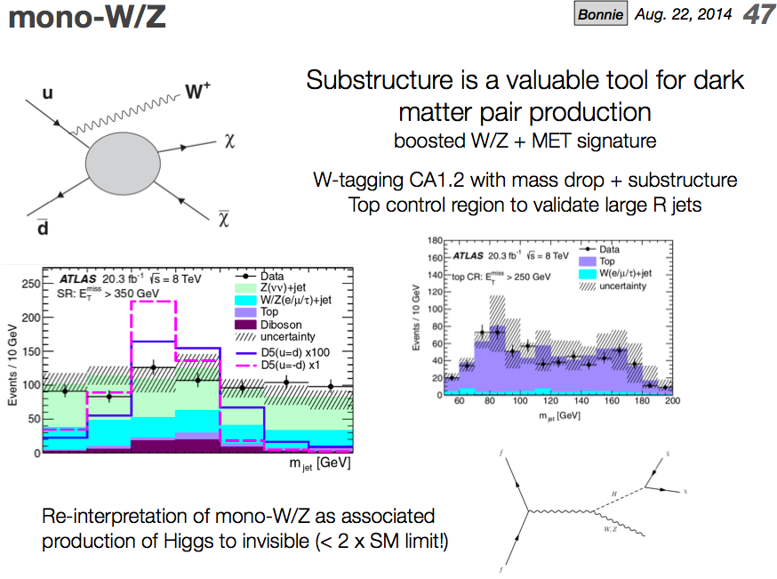
N. Tran

Slide 33
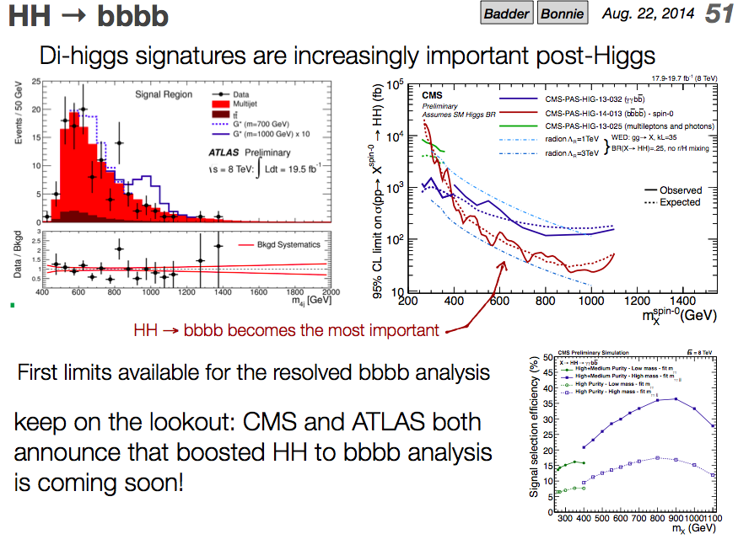
N. Tran

Slide 34
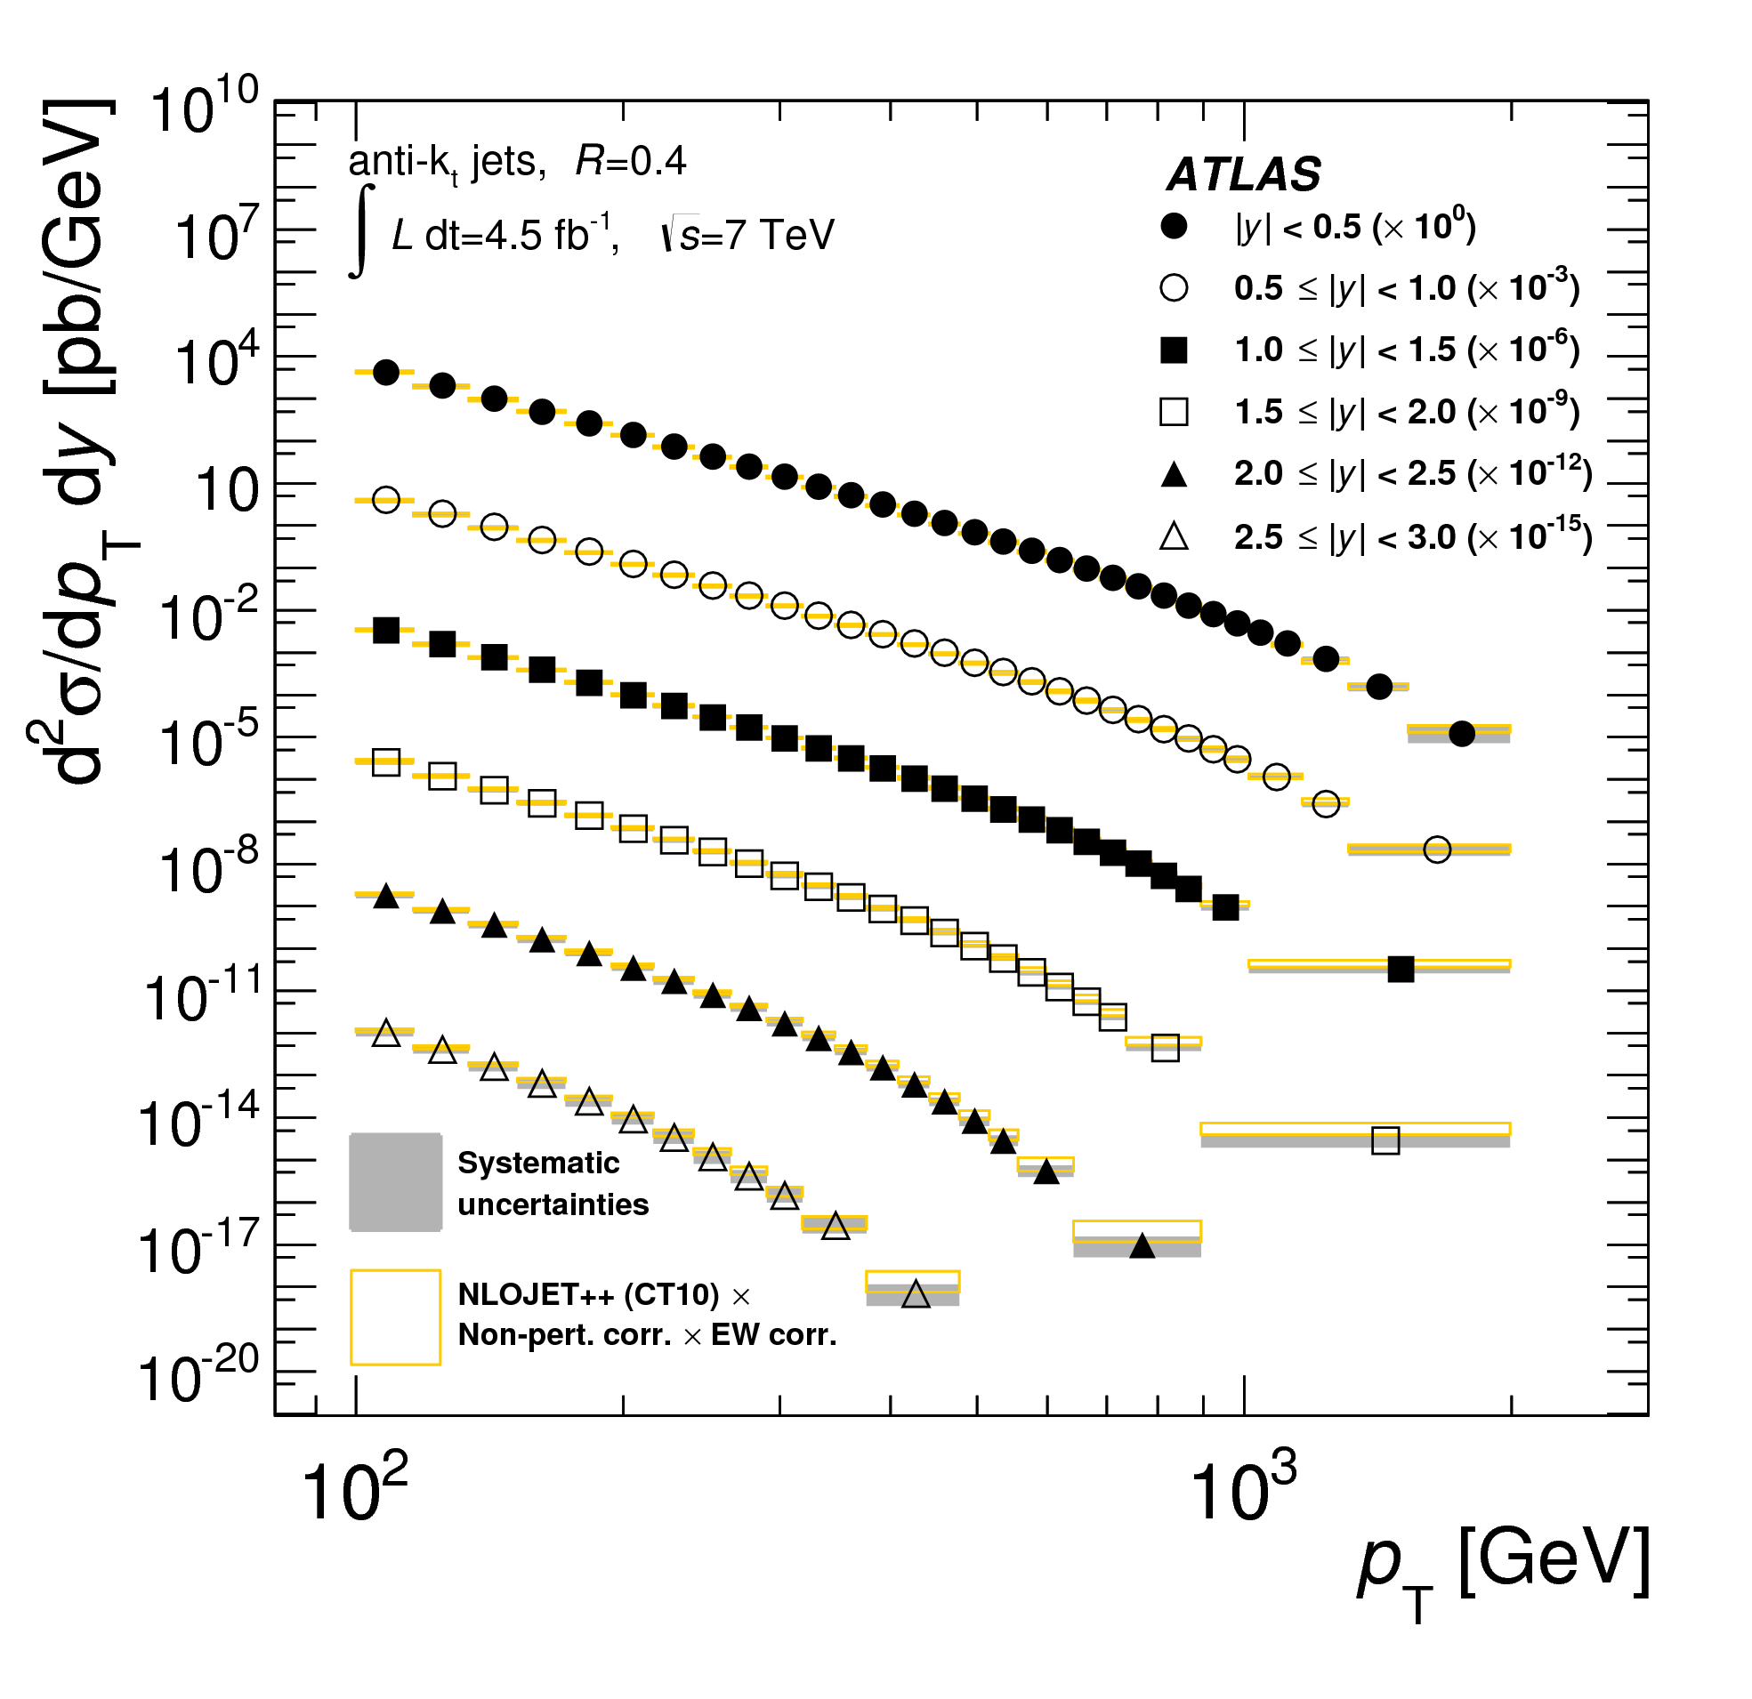
Precision ‘Standard Model’ Measurements
They should not (and mostly do not) assume the SM
They agree with the SM
Thus they can potentially exclude extensions

Slide 35
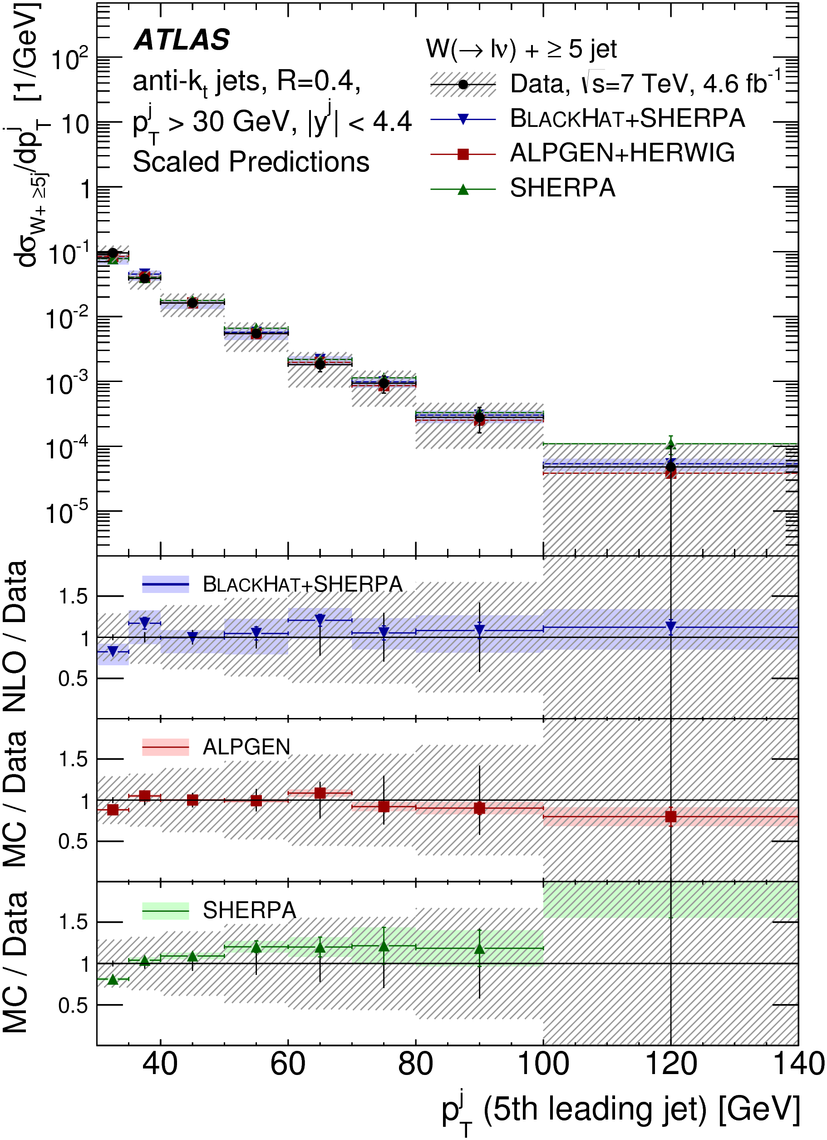
Precision ‘Standard Model’ Measurements
They should not (and mostly do not) assume the SM
They agree with the SM
Thus they can potentially exclude extensions

Slide 36
Constraining BSM (Simplified) models with SM measurements
JMB, David Grellscheid (IPPP), Michael Krämer (Aachen), David Yallup

Slide 37

Simplified Model(s)
Effective lagrangian including minimal new couplings and particles
Our starter example: leptophobic Z’ with vector coupling to u,d quarks, axial vector to a DM candidate ψ.

Slide 38
Key tools:
UFO interface
BSM Model in FeynRules
Final State Particles
New processes in Herwig7
Exclusion
Rivet, and data from HepData

Slide 39
Strategy
Use measurements shown to agree with the Standard Model
  Not a search! Guaranteed not to find anything
  Will be slower, but more comprehensive and model independent
  Assume the data = the background!

Slide 40
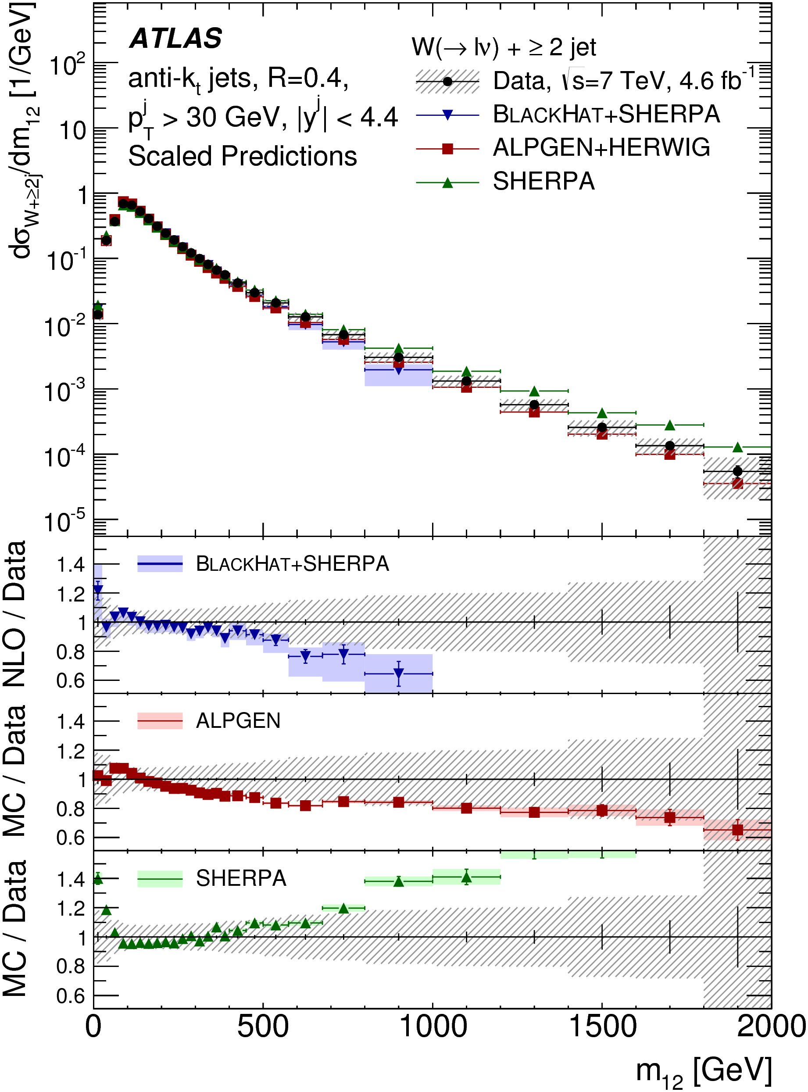
Will miss this kind of thing…

Slide 41
Strategy
Use measurements shown to agree with the Standard Model
  Not a search! Guaranteed not to find anything
  Will be slower, but more comprehensive and model independent
  Assume the data = the background!
Key for constraining new models if there is a signal (unintended consequences)
Key for constraining scale of new physics if there is no signal

Slide 42
Statistics
Construct likelihood function using
  BSM signal event count
  Background count (from central value of data points)
  Gaussian assumption on uncertainty in background count, from combination of statistical and systematic uncertainties
  BSM signal count error from statistics of generated events (small!)
Make profile likelihood ratio a la Cowan et al (Asimov data set approximation is valid)
Present in CL_{s} method (A. Read)
Systematic correlations not fully treated - take only the most significant deviation in a given plot (conservative)

Slide 43
Dynamic data selection
SM measurements of fiducial, particle-level differential cross sections, with existing Rivet routines
Classify according to data set (7, 8, 13 TeV) and into non-overlapping signatures
Use only one plot from each given statistically correlated sample
Jets, W+jets, Z+jets, γ, γ+jets, γγ, ZZ, W/Z+γ
Sadly no Missing E_{T}+jets, not much 8 TeV, no 13 TeV yet, though much is on the way… Also can use suitably model-independent Higgs and top measurements in future.
Most sensitive measurement will vary with model and model parameters

Slide 44
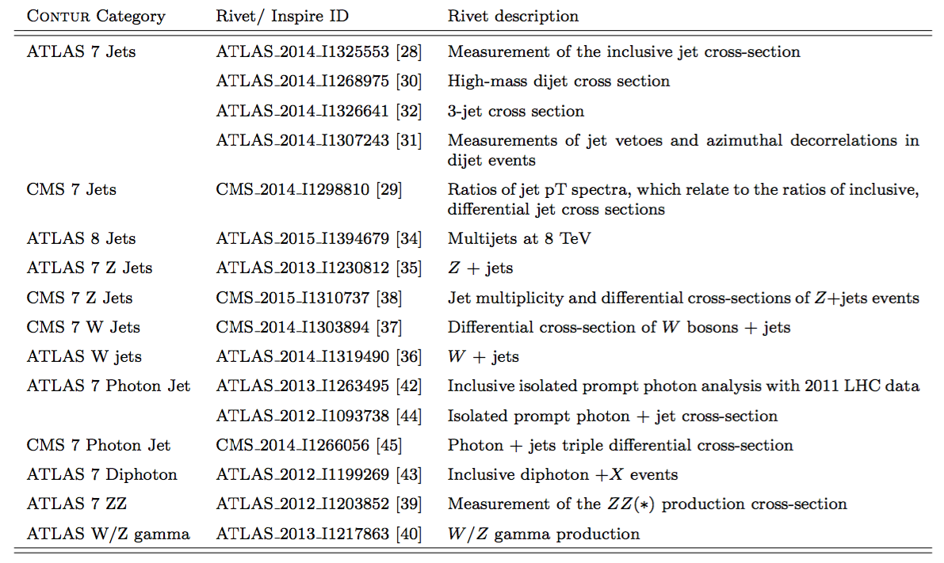

Slide 45
Key tools:
Constraints On New Theories Using Rivet
UFO interface
BSM Model in FeynRules
Final State Particles
New processes in Herwig7
Exclusion
Rivet, and data from HepData

Slide 46
Key tools:
Constraints On New Theories Using Rivet
UFO interface
BSM Model in FeynRules
Final State Particles
New processes in Herwig7
Exclusion
Rivet, and data from HepData
C O N T U R
https://contur.hepforge.org/
https://contur.hepforge.org/

Slide 47
Parameter Choices
Scan in M_{DM} and M_{Z’}
Four pairs of couplings:
  Challenging: g_{q} = 0.25; g_{DM} = 1
  Medium: g_{q} = 0.375; g_{DM} = 1
  Optimistic: g_{q} = 0.5; g_{DM} = 1
  DM-suppressed g_{q} = 0.375; g_{DM} = 0.25

Slide 48
Data Comparisons

Slide 49
Data Comparisons

Slide 50
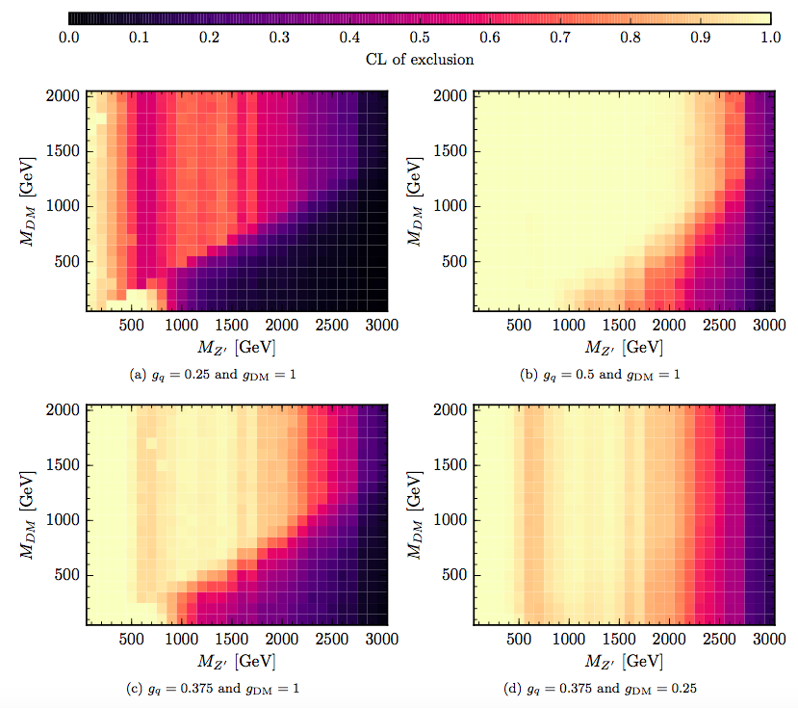
Heat Maps

Slide 51
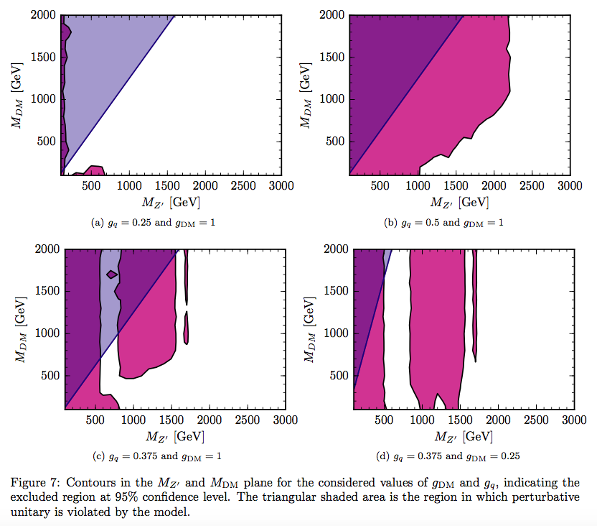
95% CL_{s} Contour

Slide 52
Conclusions
Particle-level measurements not only measure what is happening in our collisions, they constrain what is not happening.
Limit-setting procedure developed; even with conservative treatment of correlations, limits are competitive with those from dedicated searches using comparable data-sets
General framework developed:
  consider all new processes in a given (simplified) model
  consider all available final states. (e.g. V+jet shows previously unexamined sensitivity to the model considered)
Highly scaleable to other models & new measurements – plan continuous rolling development
See arXiv (and references therein), and hepforge.org/contur

Slide 53
And maybe it’s not all about limits?
Notes:
Protons collisions at 14,000,000,000,000 eV
(eventually – currently at 7,000,000,000,000 eV)
Two “general purpose” experiments: ATLAS and CMS will detect the products of the collisions.
Why does it have to be so big? (weight on string)

Slide 54
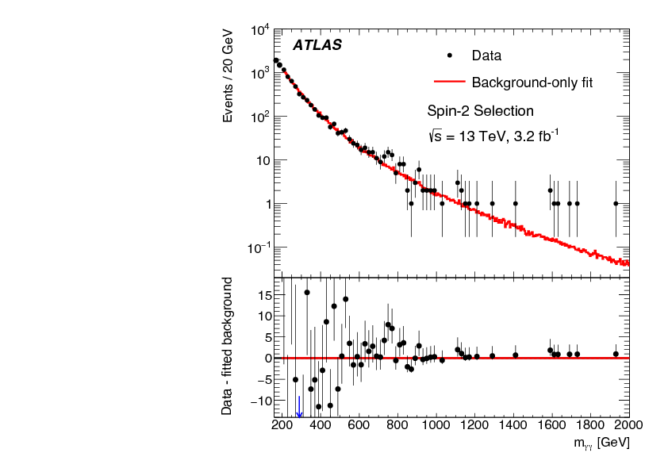
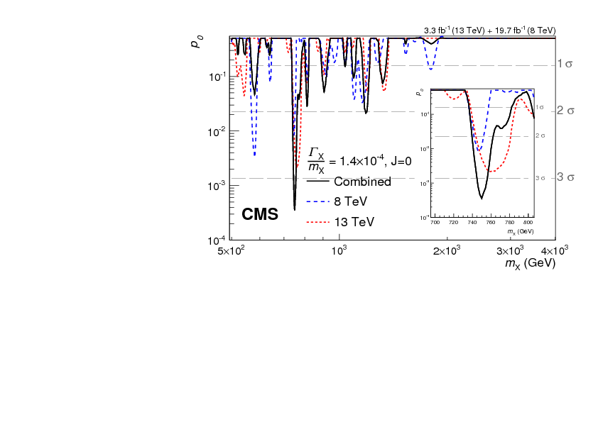

Slide 55
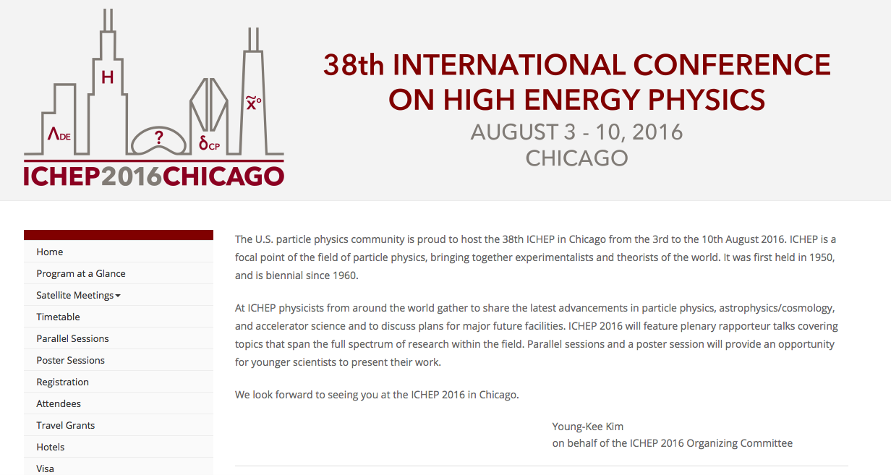

Slide 56
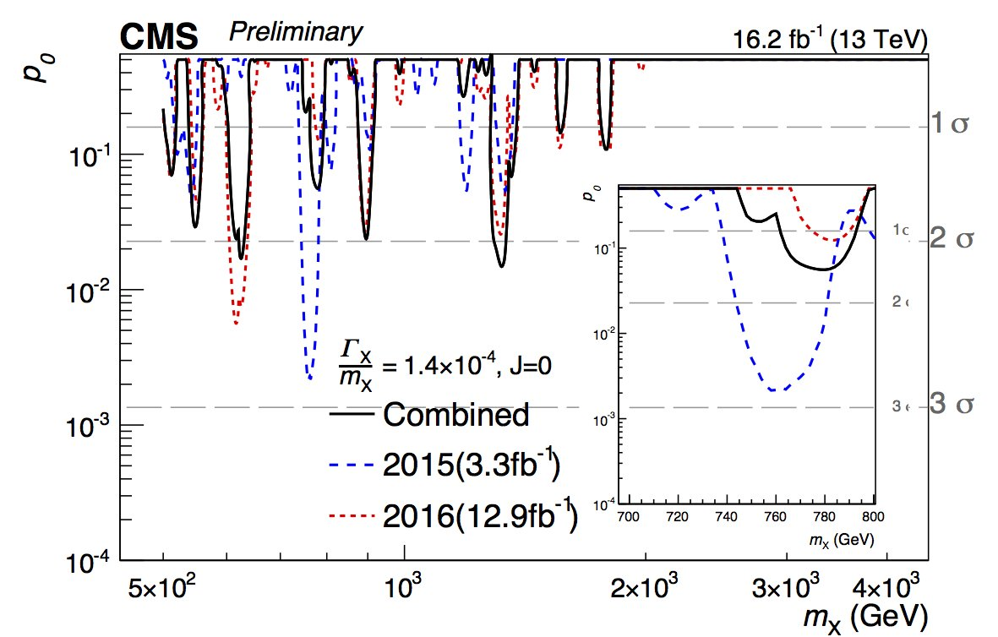

Slide 57
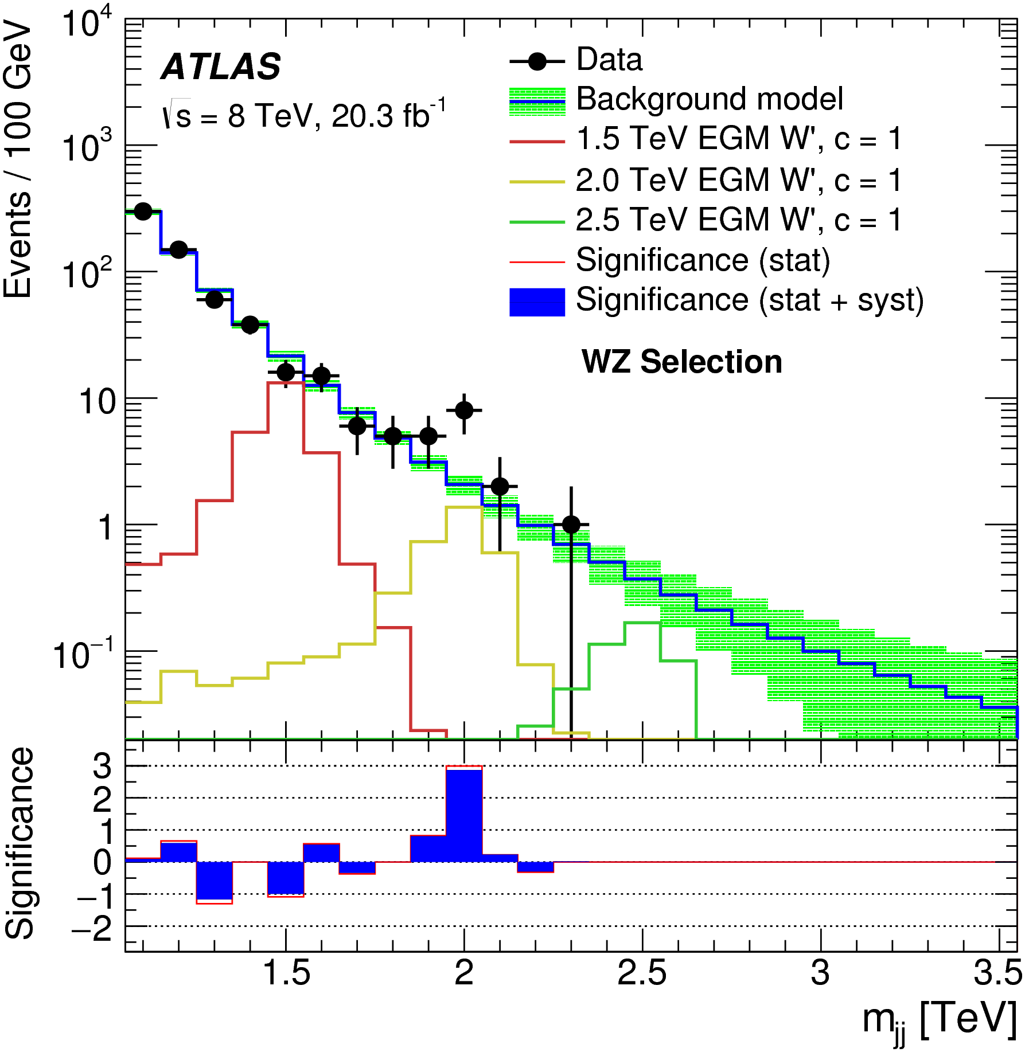
Example – fully hadronic, boosted WW/WZ/ZZ
Hints also from CMS, but also some tension with (semi-leptonic results)
arXiv:1506.00962
Notes:
Combination?

Slide 58
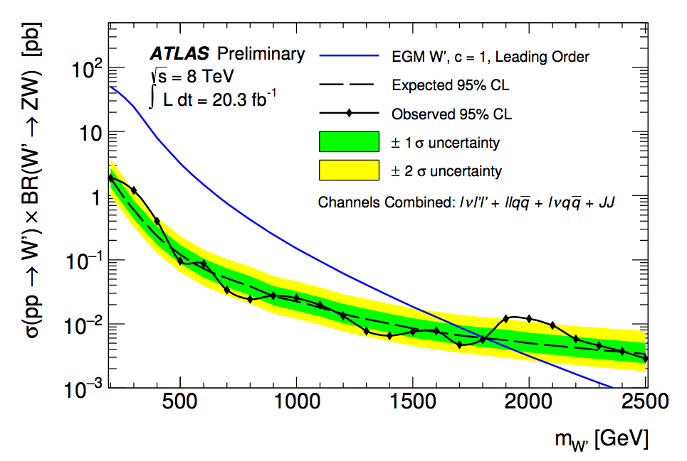
Example – fully hadronic, boosted WW/WZ/ZZ
Hints also from CMS, but also some tension with (semi-leptonic results)
New ATLAS combination with (semi)leptonic channels
ATLAS-CONF-2015-045
Notes:
Combination?

Slide 59
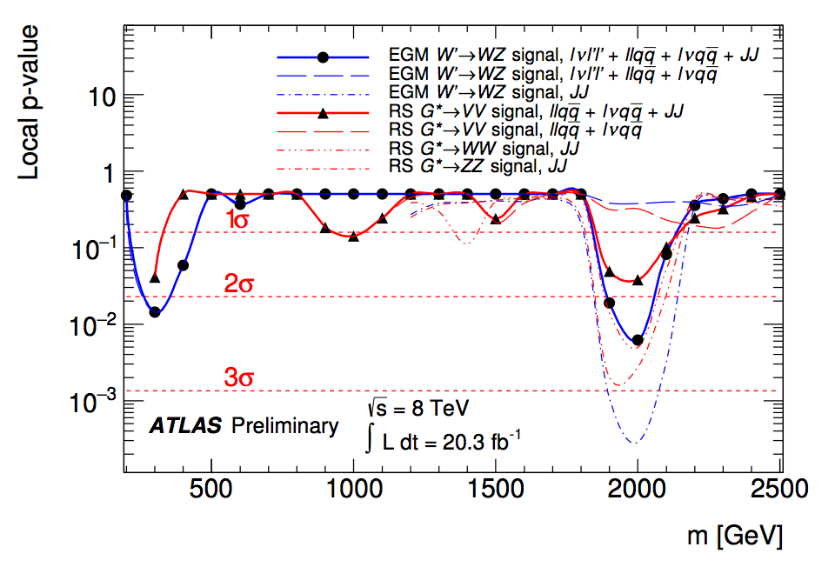
Example – fully hadronic, boosted WW/WZ/ZZ
Hints also from CMS, but also some tension with (semi-leptonic results)
New ATLAS combination with (semi)leptonic channels
A provocative reminder… we are in unknown territory!
ATLAS-CONF-2015-045
Notes:
Combination?

Slide 60
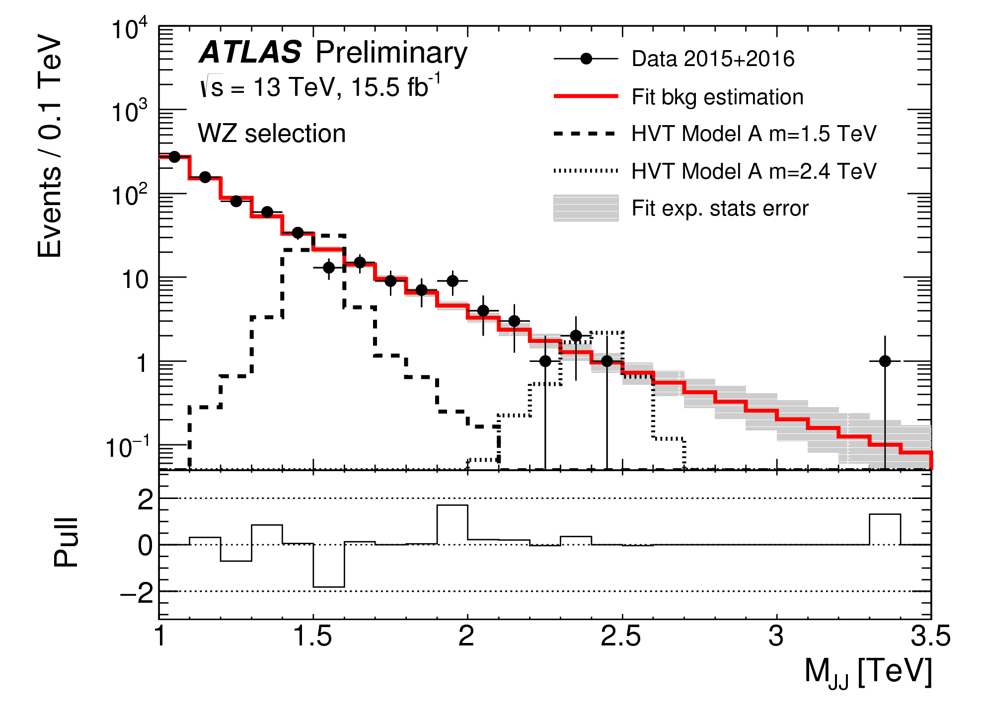

Slide 61
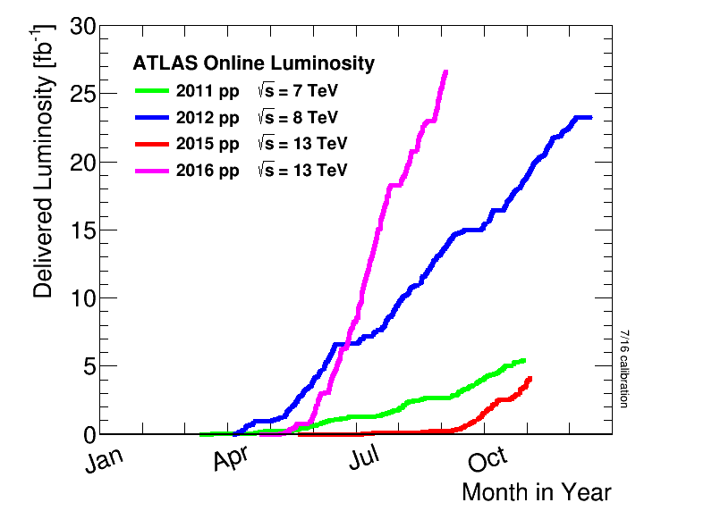

Slide 62
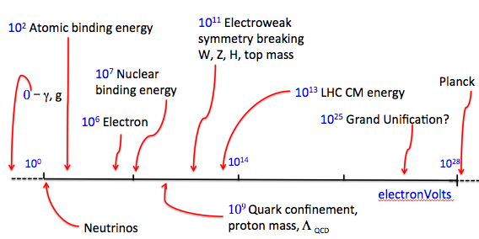
Explore, extend…
Have we really mined the Standard Model for all its physics?
  DM candidates? Symmetries & naturalness? CP…?

Slide 63
Explore, extend…
Many “Beyond the Standard” Models.
  Minimal neutrino, supersymmetry, extra dimensions, compositeness, generic approaches…

Slide 65
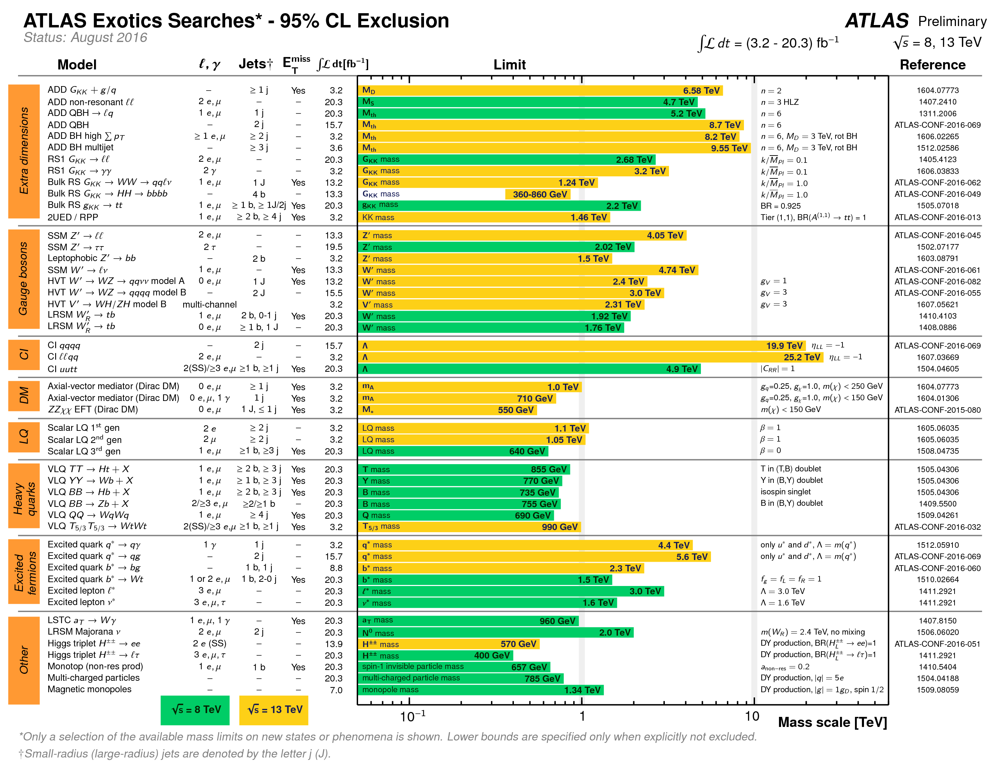

Slide 66
Explore, extend…
Into the unknown…
  High energies, high luminosities, low backgrounds …
  Carry clarity and precision with us, keep our eyes open…

Slide 67

Explore, extend…
Into the unknown…
  High energies, high luminosities, low backgrounds …
  Carry clarity and precision with us, keep our eyes open…
Here be dragons

Slide 68

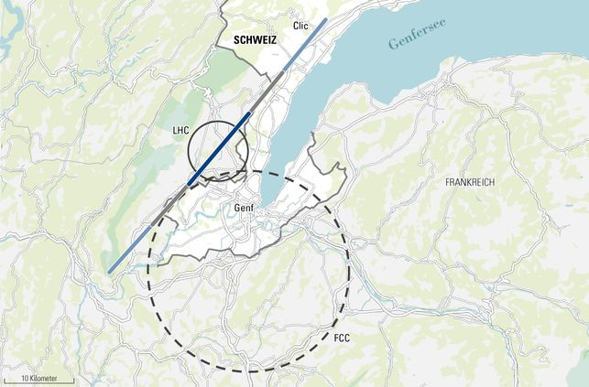

Slide 69
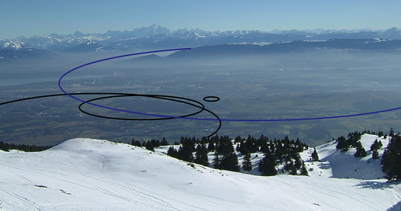


Slide 70
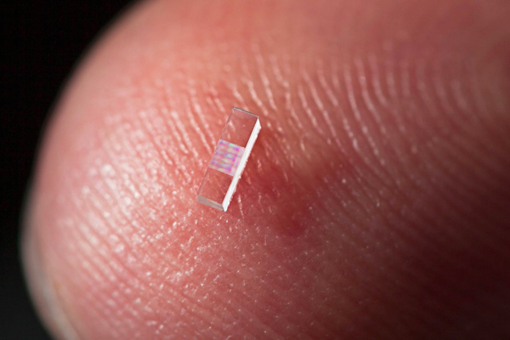
SLAC/Stanford

Slide 71
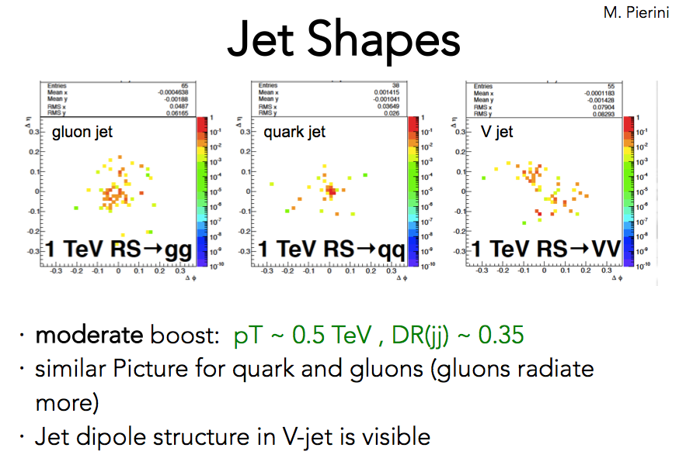
M.Selvaggi

Slide 72
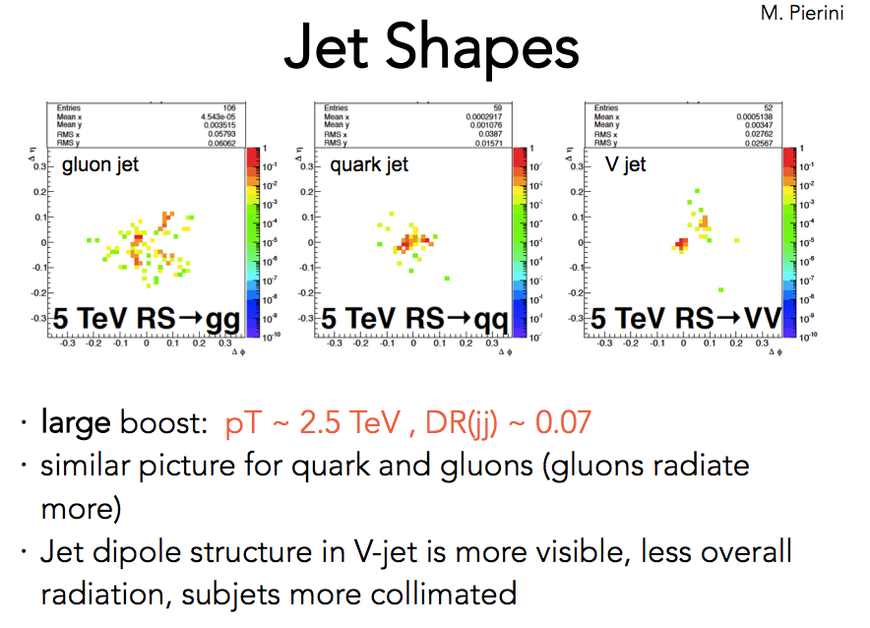
M.Selvaggi

Slide 73
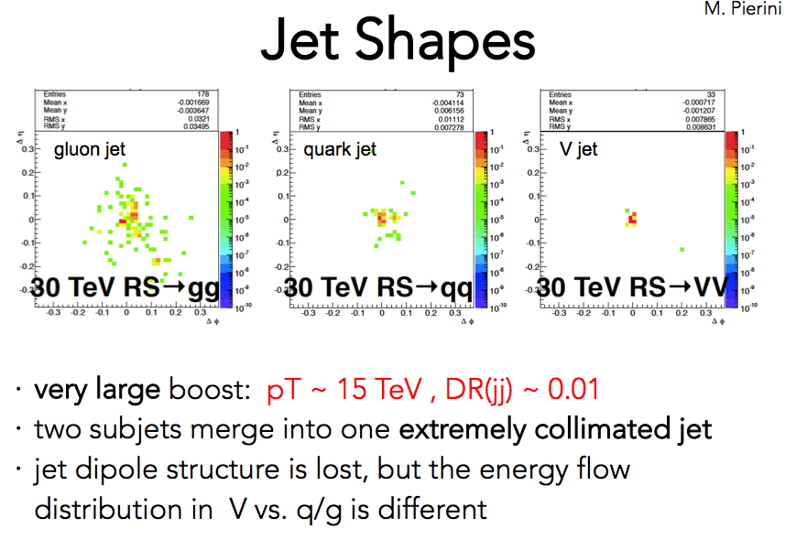
M.Selvaggi

Slide 74
Some concluding thoughts
The energy frontier stretches before us, with big questions left to answer
Many people (including but not only us) are excited by this
Technology enables science, and vice versa
Recording, surveying measuring the new territory revealed by the LHC will take time, ingenuity and dedication
This is our first precise and general look above the electroweak symmetry-breaking scale. Minimise our theoretical assumptions, maximise theoretical ideas!

Slide 75
Extras

