Slide 1
LHC Experimental Physics
Lecture 6
Jon Butterworth
University College London
Vietnam School of Physics
Quy Nhon
September 2016

Slide 2
Outline
Introduction
First measurements
Jets and boosted objects
Higgs Discovery and Measurement
Measurements and Model Independence
Searches and the future

Slide 3
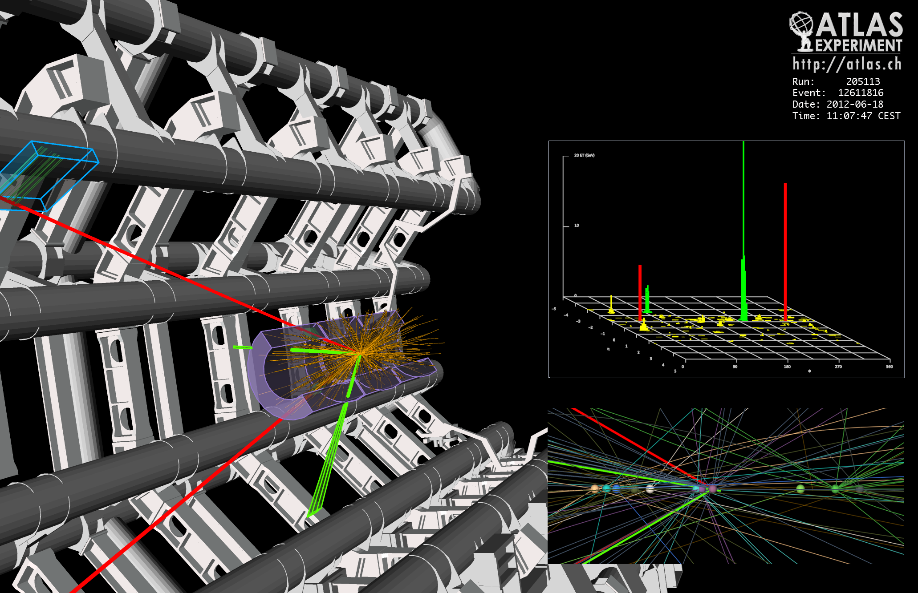

Slide 4
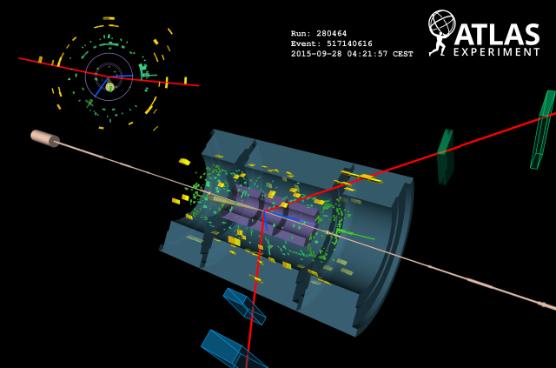

Slide 5
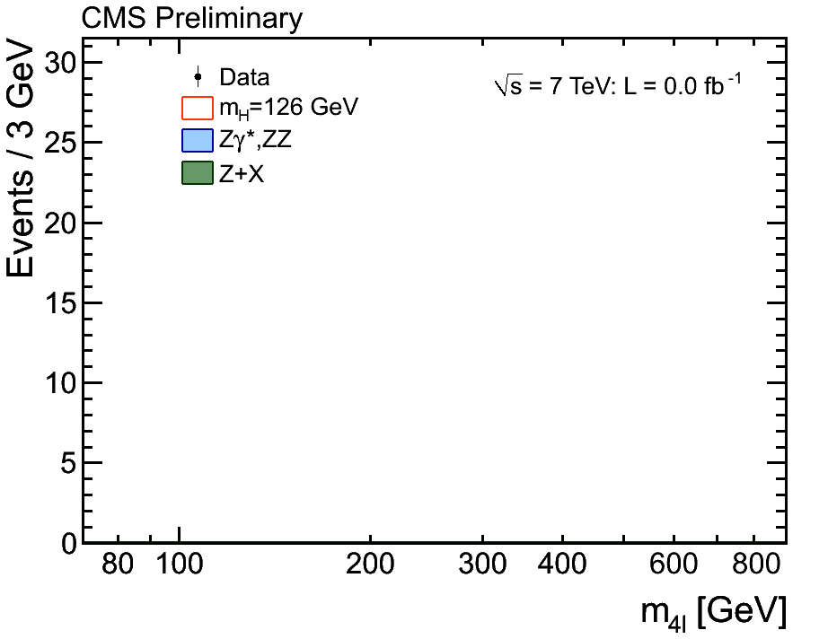

Slide 6

Pre 2012
Notes:
Fundamental!! → Mass and the BEH field, Higgs boson.

Slide 7
Post 2012
Notes:
Fundamental!! → Mass and the BEH field, Higgs boson.

Slide 8
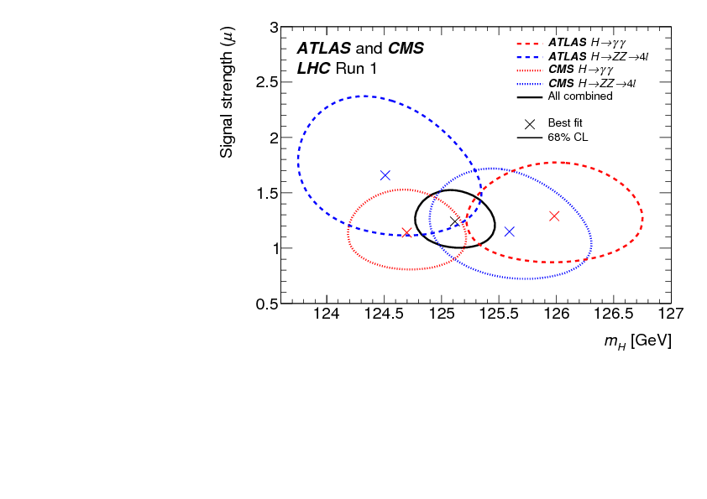
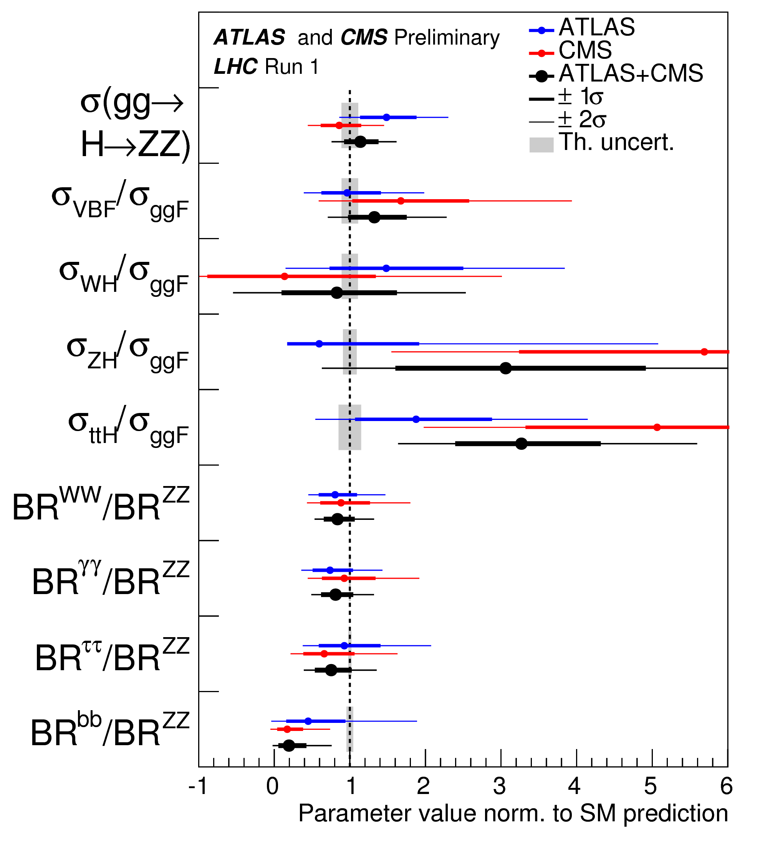
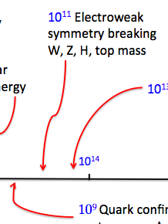
Precision Higgs

Slide 9
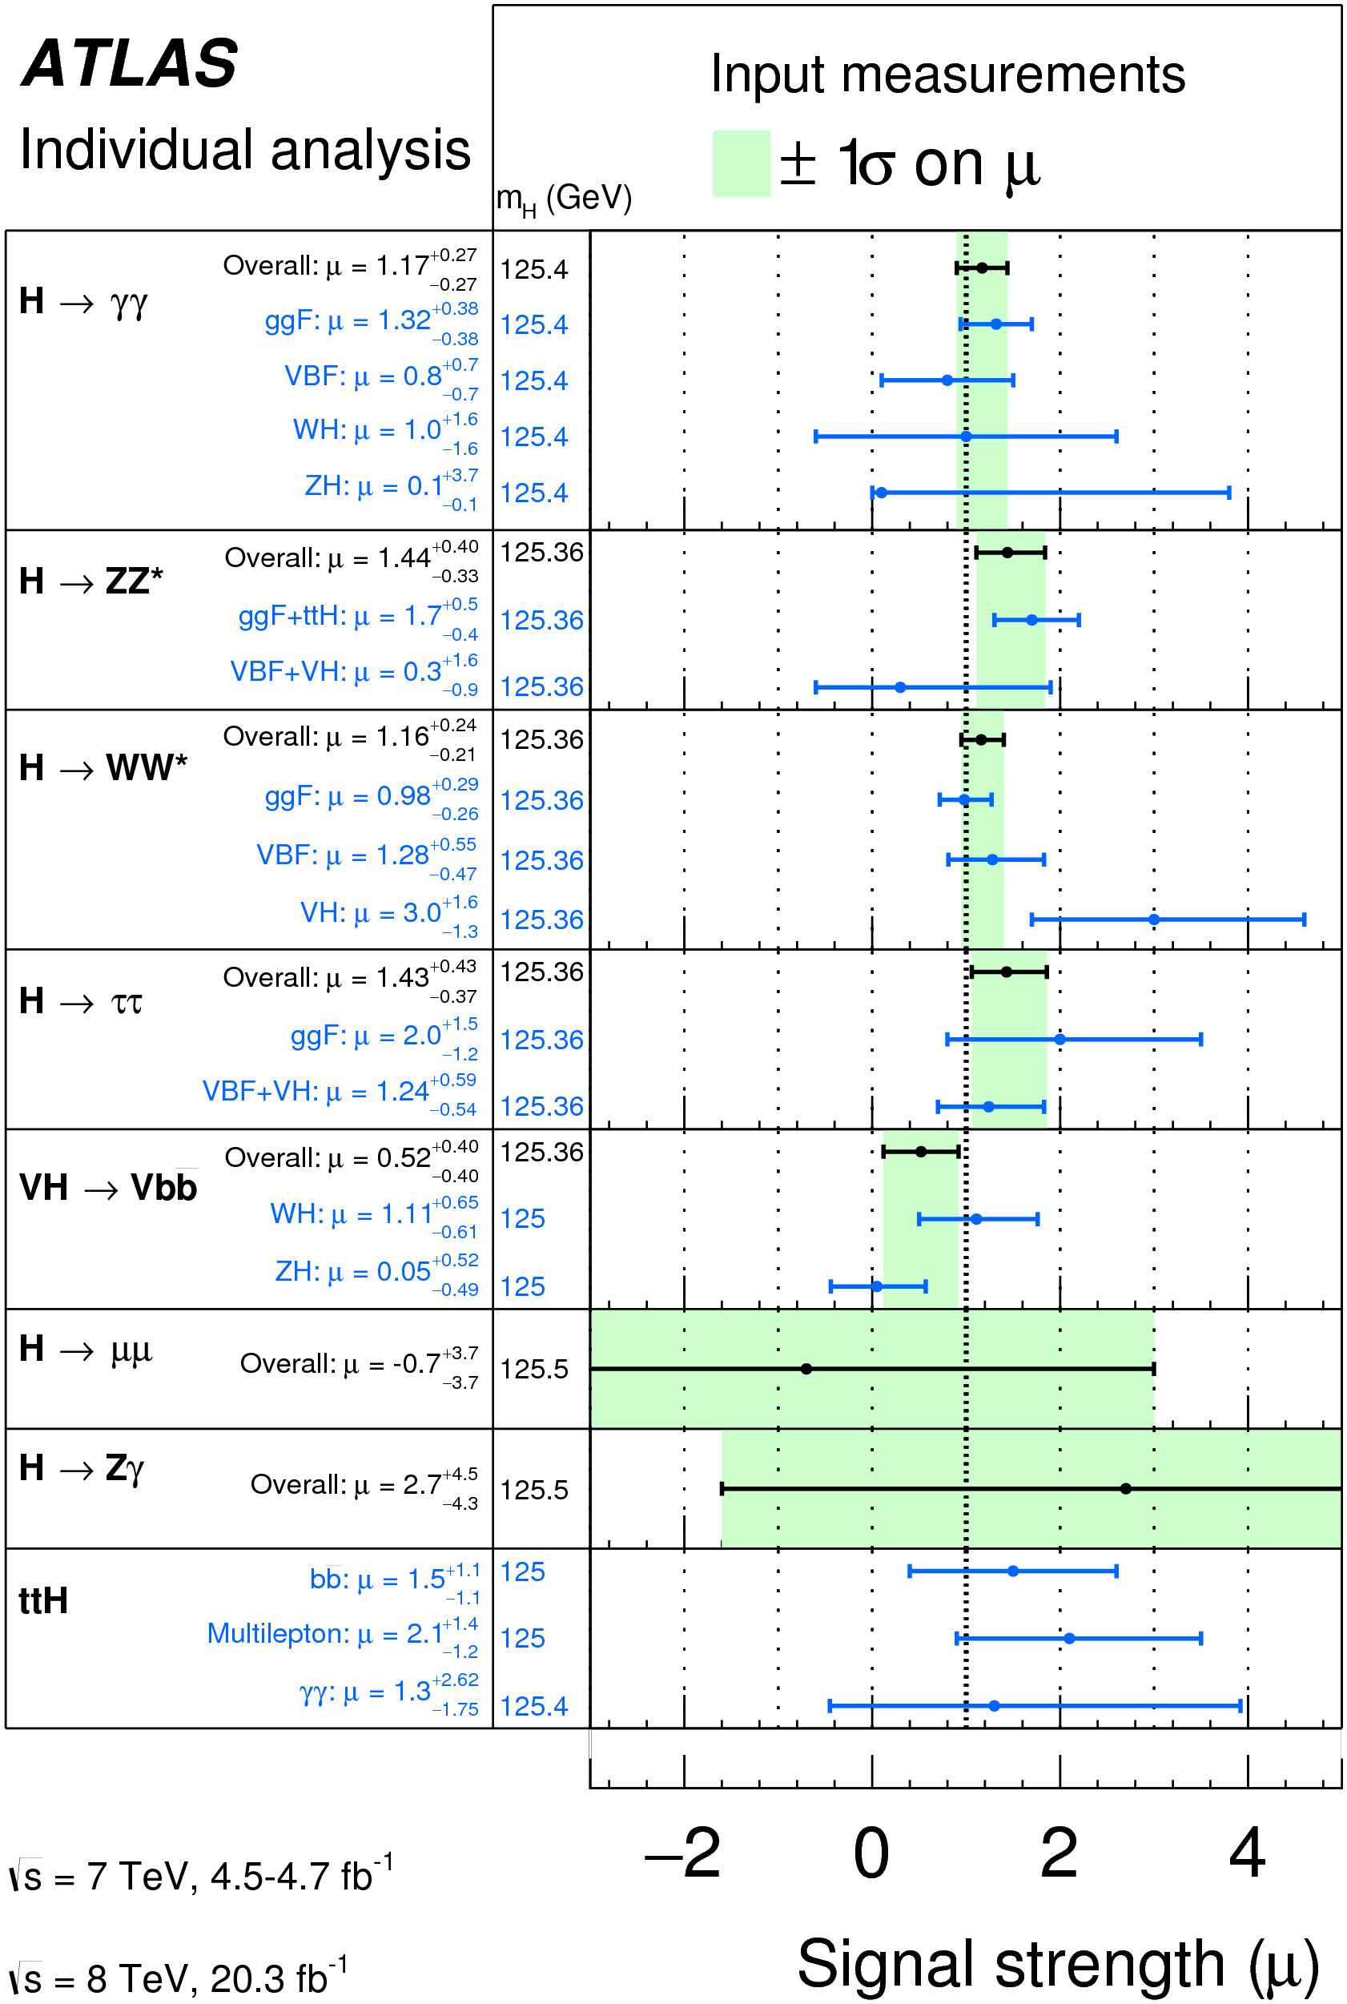
Couplings/decay rates
arXiv:1412.8662
arXiv:1507.04548
Notes:
To be replaced by combination if ready

Slide 10
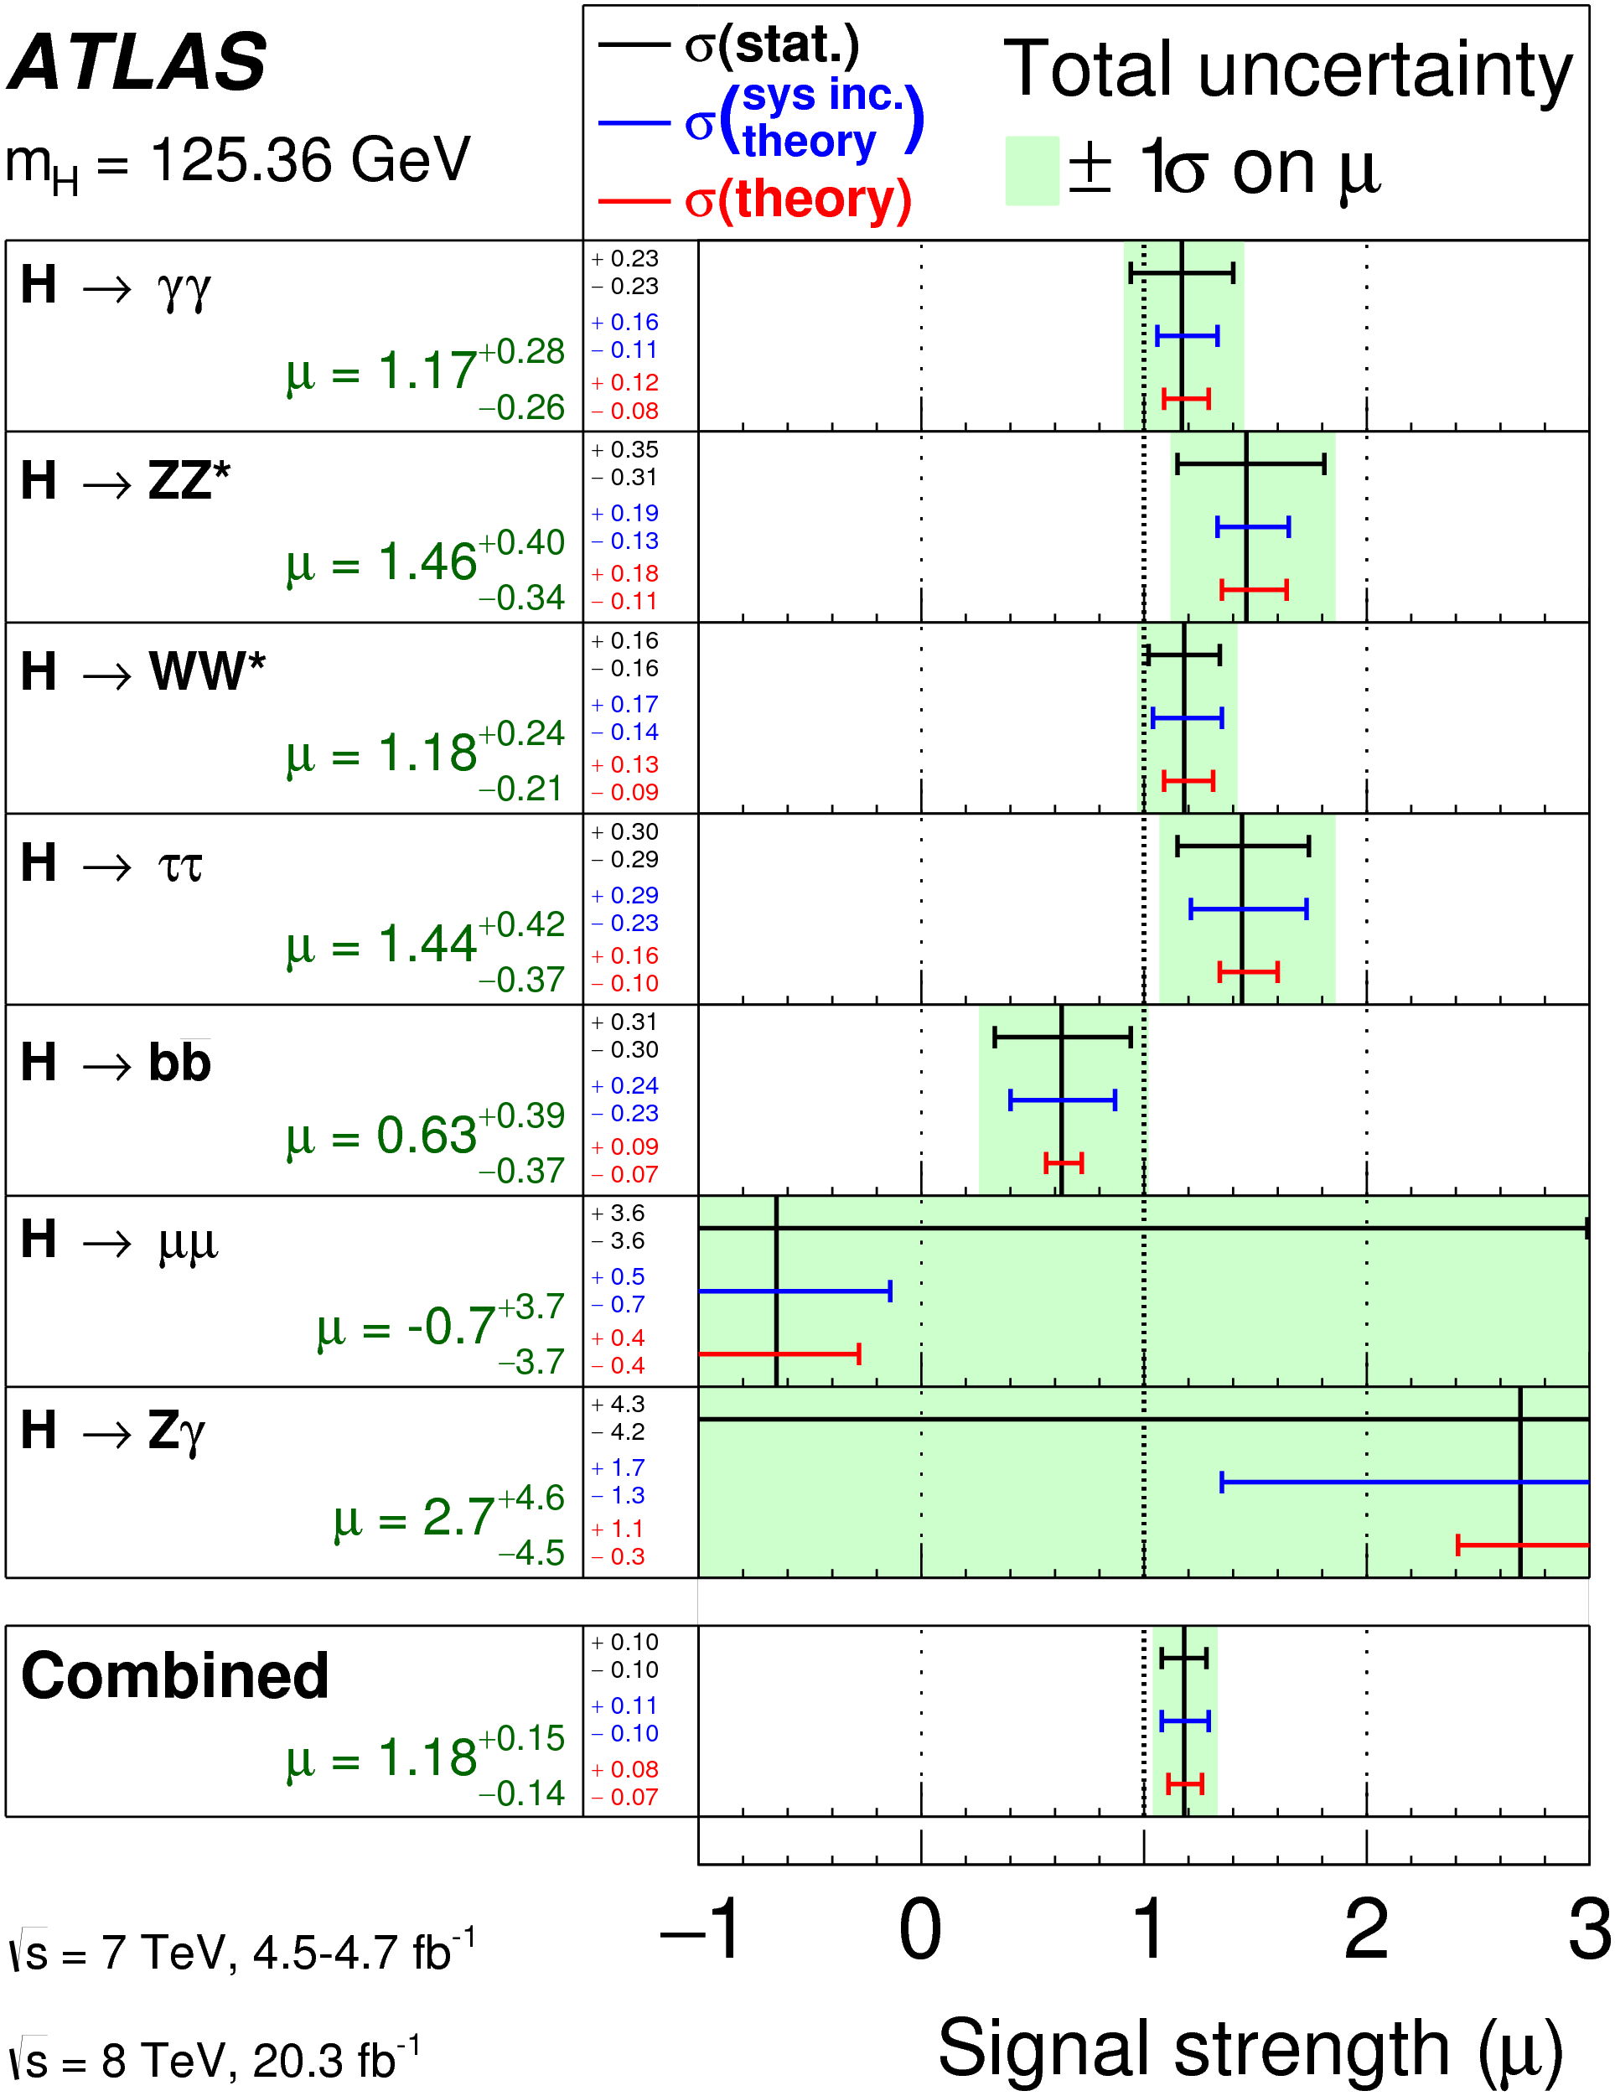
Couplings/decay rates
arXiv:1412.8662
arXiv:1507.04548
Notes:
To be replaced by combination if ready

Slide 11
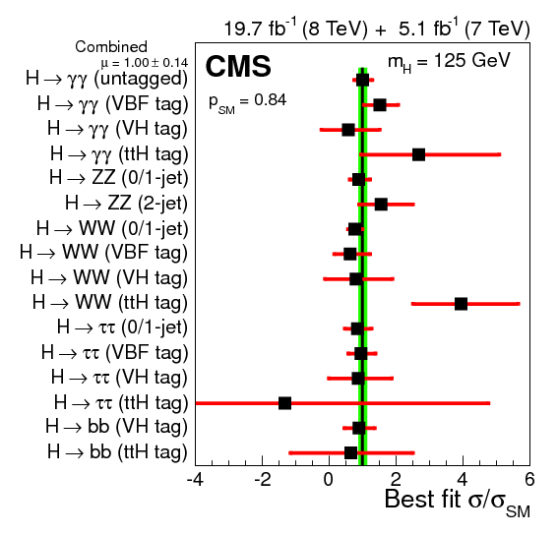
Couplings/decay rates
arXiv:1412.8662
arXiv:1507.04548
Notes:
To be replaced by combination if ready.

Slide 12
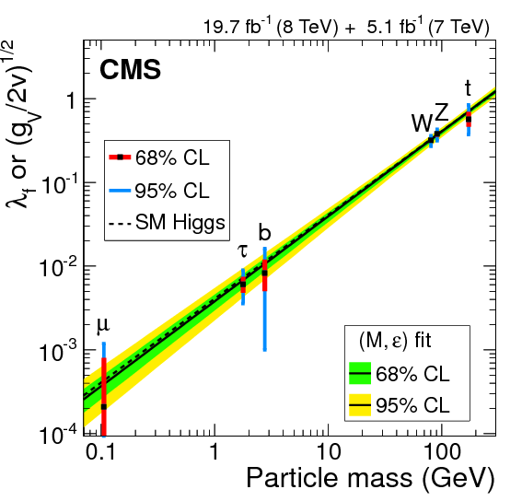
Couplings/decay rates
arXiv:1412.8662
arXiv:1507.04548
Notes:
To be replaced by combination if ready. Or CMS on right. Check two ATLAS plots together (small differences)

Slide 13
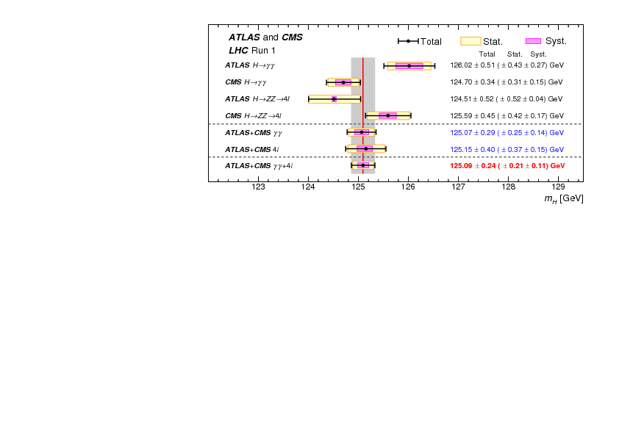
Couplings/decay rates
Mass
arXiv:1503.07589

Slide 14
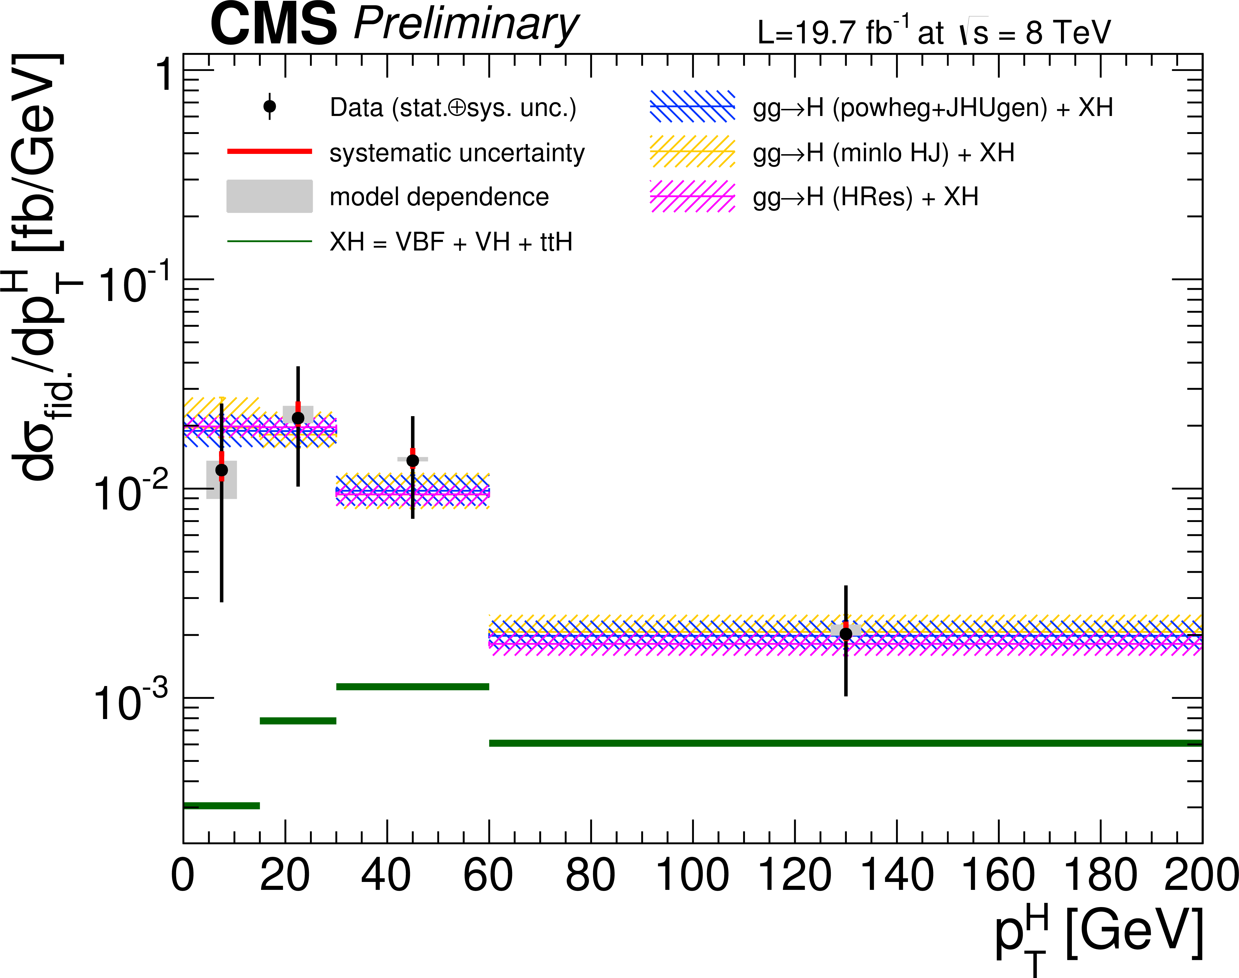
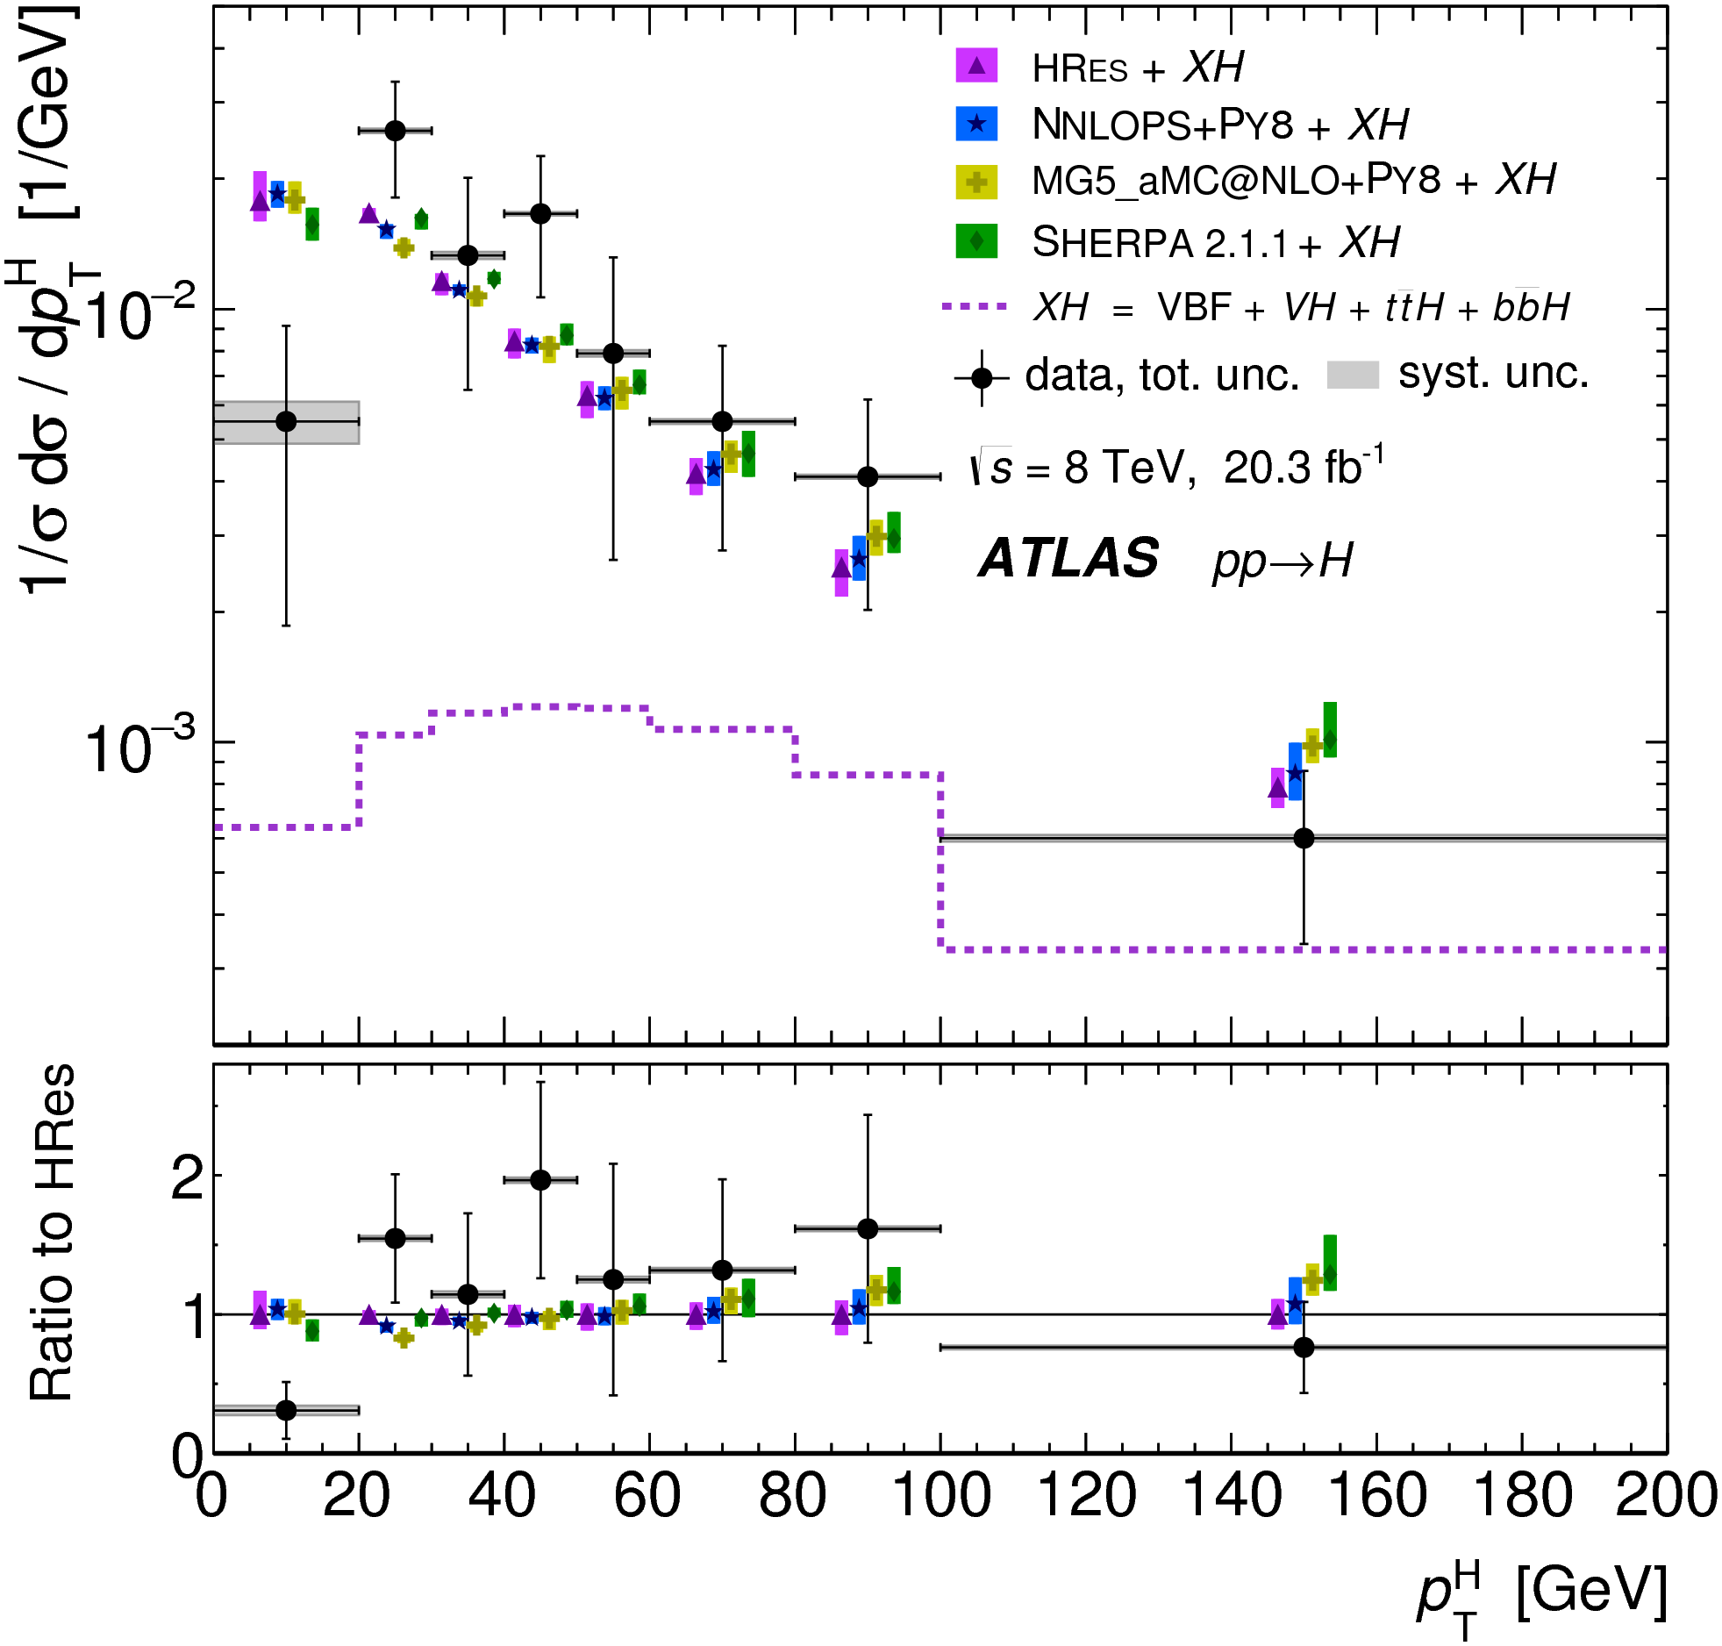
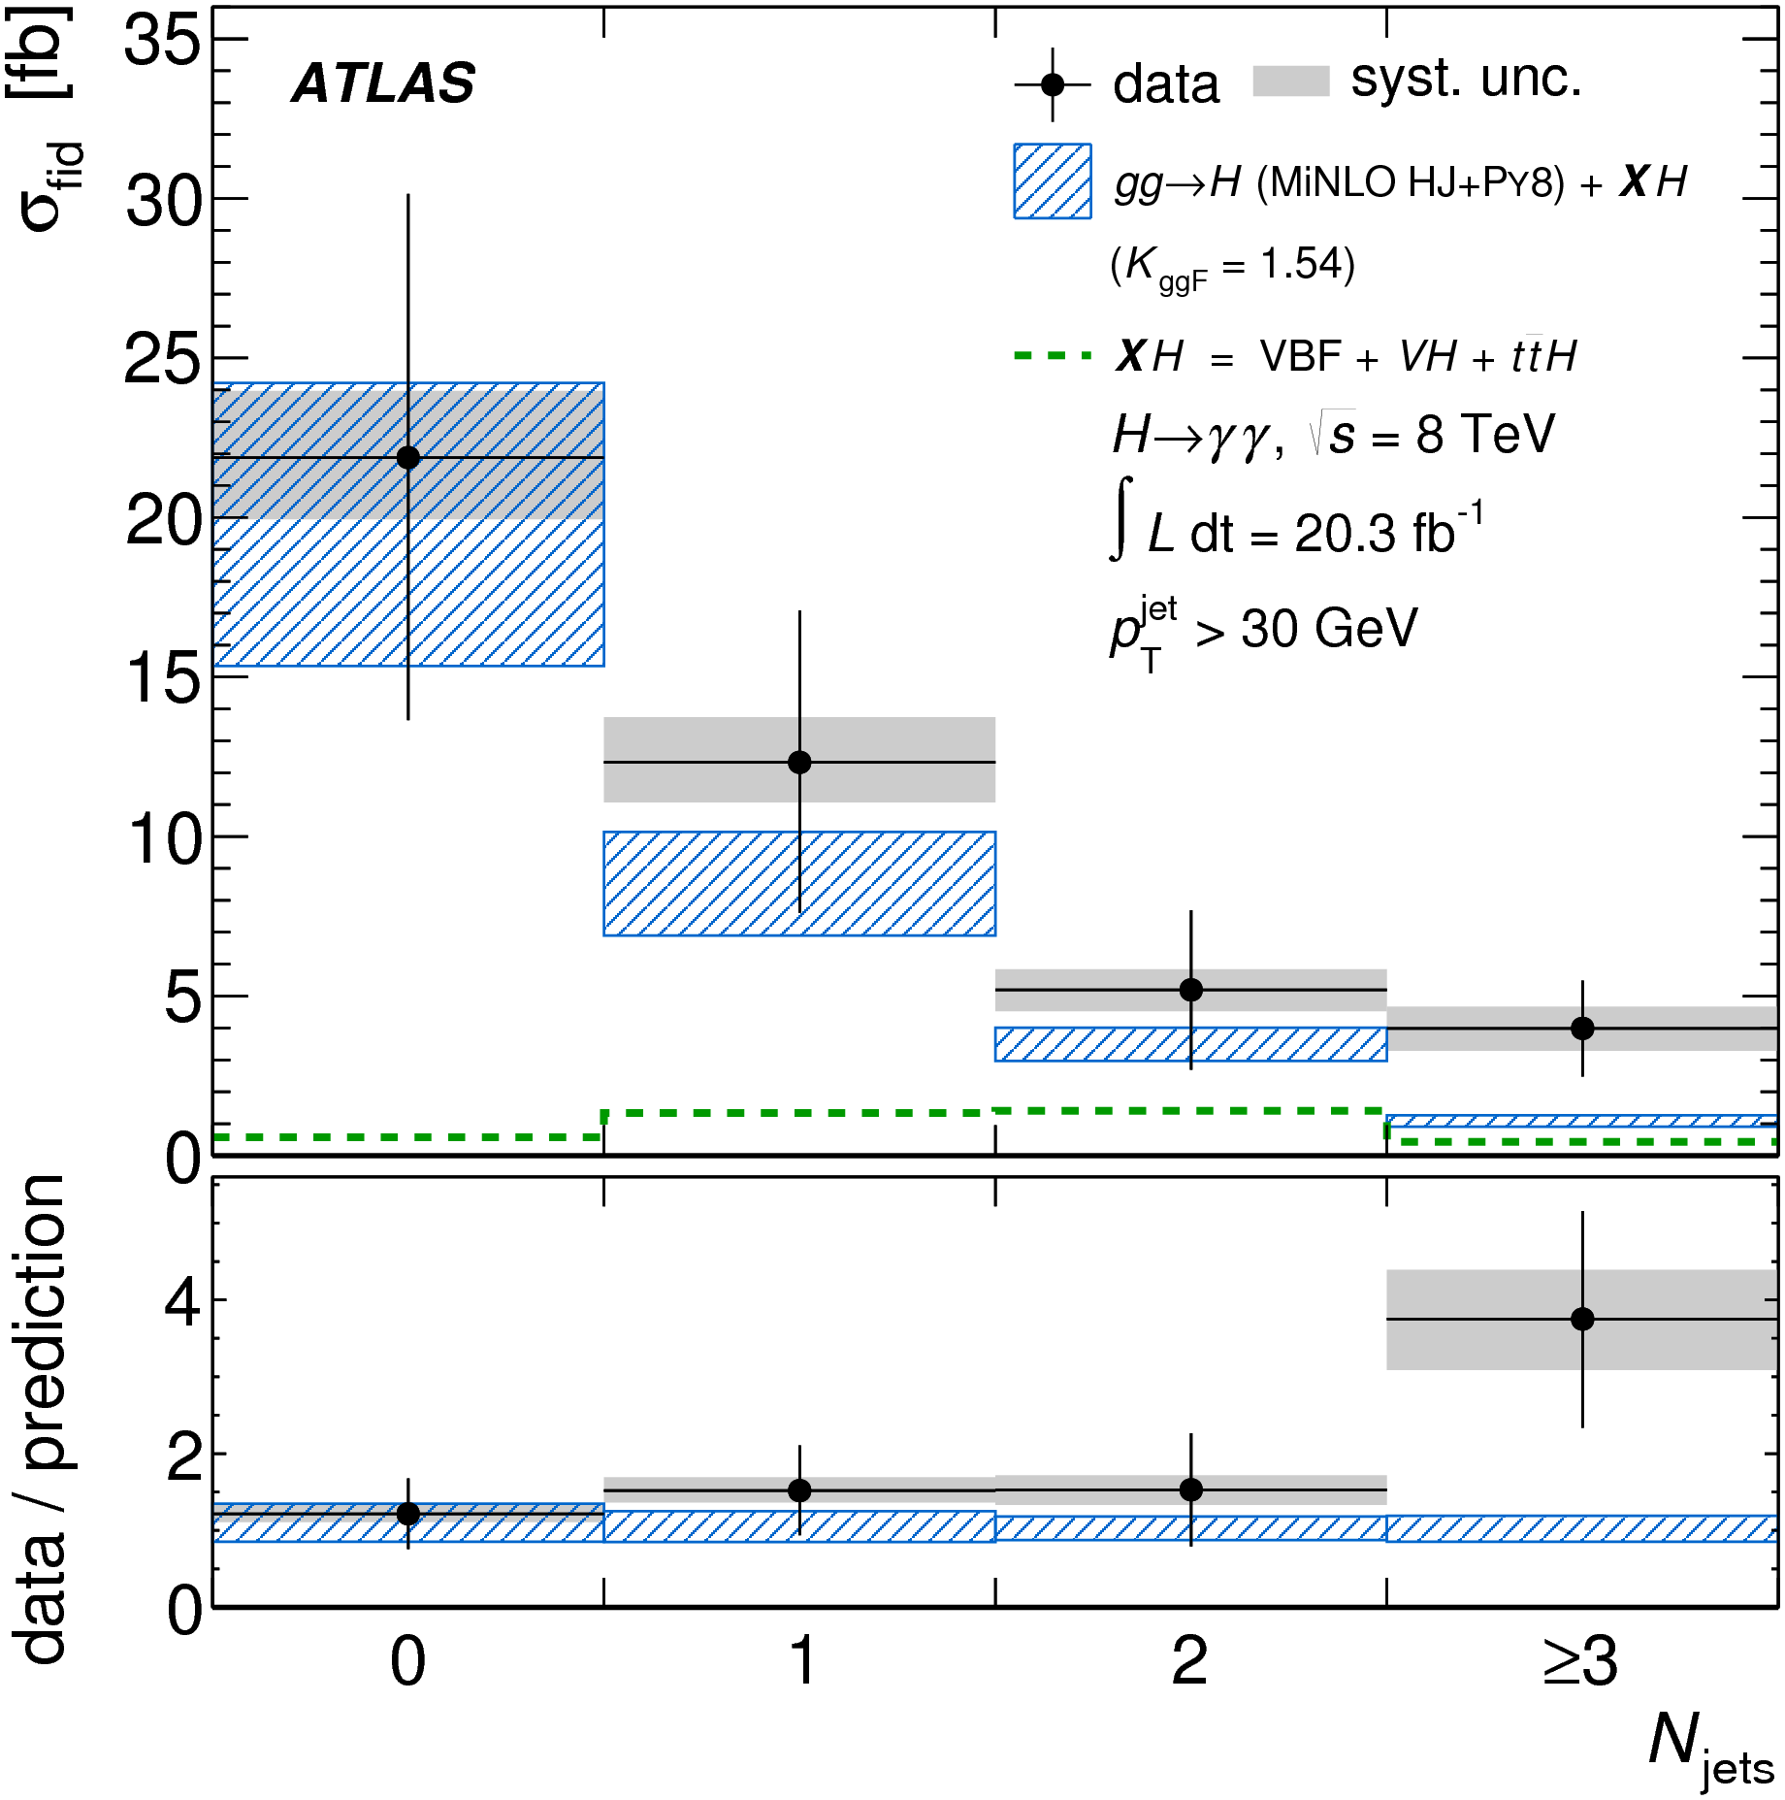
Couplings/decay rates
Mass
Differential and fiducial cross sections
CMS PAS HIG-14-028
arXiv:1407.4222
arXiv:1408.3226
arXiv:1504.05833
Notes:
Which channels??

Slide 15
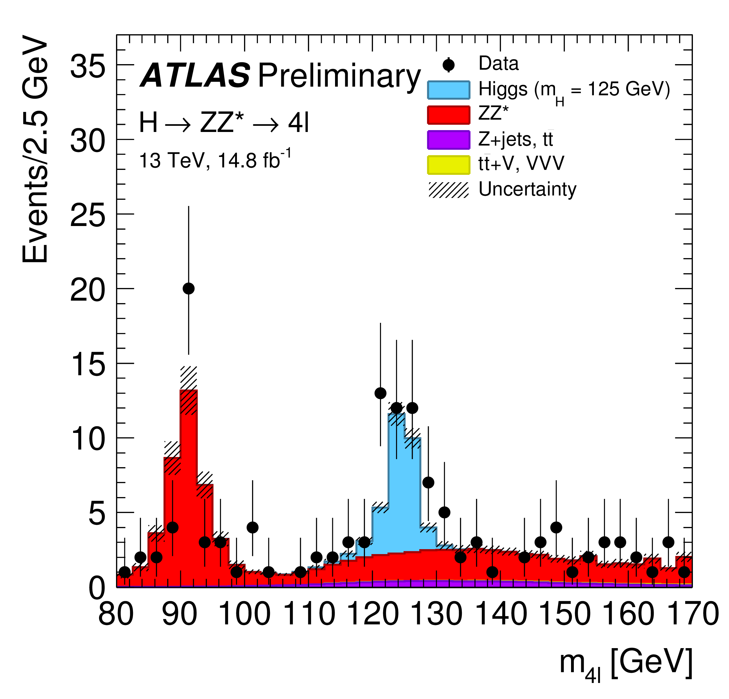
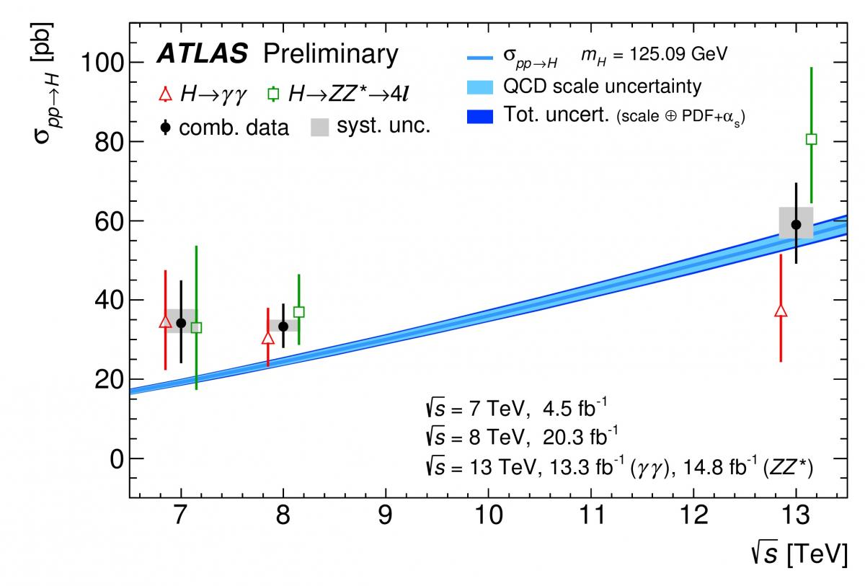
All about that Higgs
Couplings/decay rates
Mass
Differential and fiducial cross sections
Spin, CP, etc…
Searches for more bosons
Di-Higgs searches
Notes:
Which channels??

Slide 16
Outline
Introduction
First measurements
Jets and boosted objects
Higgs Discovery and Measurement
Measurements and Model Independence
Searches and the future

Slide 17
Measurements and Model Independence

Slide 18
Measurements, Model Independence & Monte Carlo
What are event generators for?
  Event generators and theory
  Event generators and simulation
What do we actually measure?
  The final state
  “Truth” particle definitions
  Fiducial or not?
Real Examples

Slide 19
Event Generators and Theory
Mainly, see Jean-Philippe’s lectures. But briefly:
  In a collider or fixed-target experiment, the underlying theory (typically short distance physics), is usually embedded in a more complex “event”
  This will include known and/or lower energy physics

Slide 20
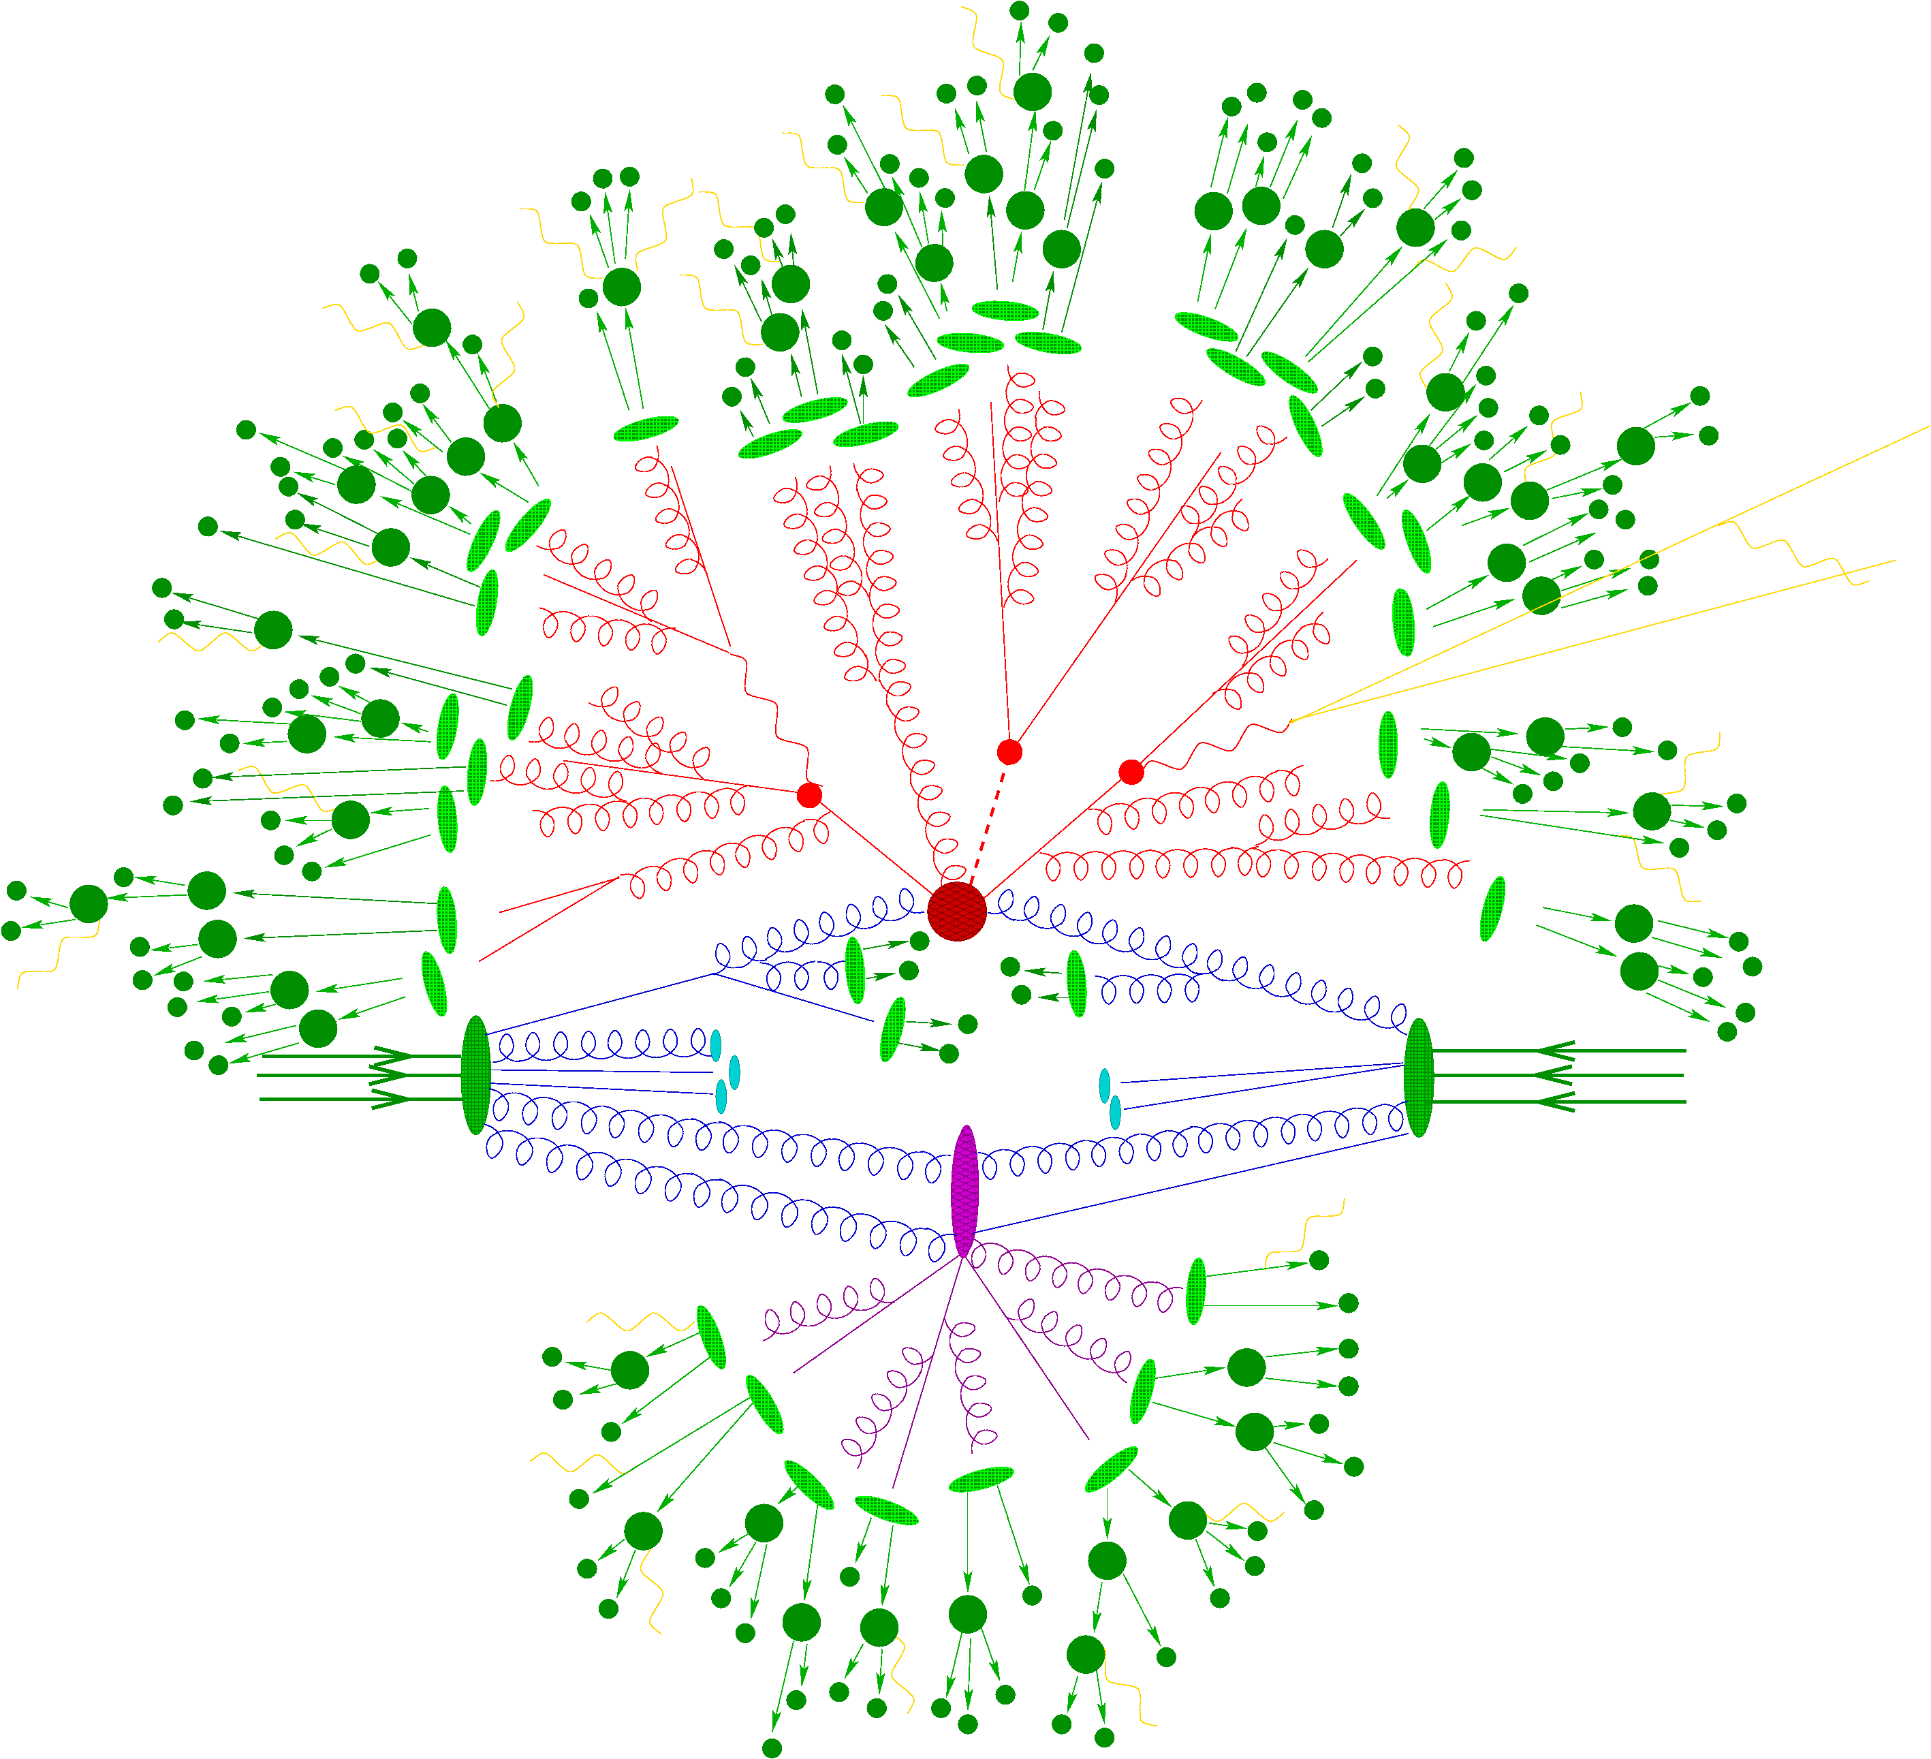
©Frank Krauss/Sherpa

Slide 21
Event Generators and Theory
Event generators can embed state-of-the-art calculation or the short-distance physics in a realistic and complete collision, and predict the final state
Different levels of precision and modelling can be combined and tested

Slide 22
Event Generators and Simulation
“Simulation” in the experimental context usually means “detector simulation”
Detailed software model of detector(s) in GEANT
Particles (from the generator) propagate step-by-step through
  Electromagnetic fields: they can curve, radiate, pair-produce
  Material (with which they interact): scattering, absorption, more pair-production, energy loss…
  Time: That is, quasi-stable particles can be decayed (may include some short distance physics)

Slide 23
Event Generators and Simulation
Simulation of readout
  Digitisation, truncation, saturation etc
  Pile up (in-time and out-of-time)
  Trigger readout simulated seperately
Provide “as data” input to reconstruction algorithms
Retain knowledge of what “really” happened: MC truth

Slide 24
Simulation and Experiment
Particle Four-Vectors
MC Event Generator
Digitized Readout
Detector & Trigger Simulation
Data for Analysis
Event Reconstruction

Slide 25
Simulation and Experiment
Particles
Collider!
Digitized Readout
Detector & Trigger
Data for Analysis
Event Reconstruction

Slide 26
Simulation and Experiment
Particle Four-Vectors
MC Event Generator
Digitized Readout
Detector & Trigger Simulation
Data for Analysis
Event Reconstruction
Unfolding & Data Correction: Test and evaluate

Slide 27
Simulation and Experiment
Particles
Collider!
Digitized Readout
Detector & Trigger
Data for Analysis
Event Reconstruction
Unfolding & Data Correction: Make the measurement!

Slide 28
What do we actually measure?
The final state!
  Quantum mechanics says so
Clearly we can’t, even in principle, tell the difference between amplitudes with identical final states
If your measurement can’t be defined in such terms, you should worry!
  Model dependence
  Physical meaning!

Slide 29
Tension between
“universal measurement” with meaning beyond that particular experiment and “universal measurement” with meaning beyond that particukar theory
“We counted charged particles in this particular region of phase space with these particular beams and this particular detector”
“We extracted the top mass under the assumption that this particular version of this MC is true”

Slide 30
What do we actually measure?
Experimentalists: don’t publish a paper in which all the results are valid only in a particular theory or model
Theorists: don’t trust them if they do (even if it is your theory or model!)
At least the first stage of a measurement or search should be stated, in terms of “truth” final-state particle definitions where possible (and if it’s not possible… why not?)

Slide 31
What is your final state?
Quarks, gluons? (top?)
W, Z, H?
Taus?
Hadrons? (lifetime cut? Do they propagate in B-field? In material?)
Jets (what are the input objects?)
Neutrinos? All of them? Missing E_{T}
Photons? Isolated photons?
Electrons, muons? (what about FSR?)

Slide 32
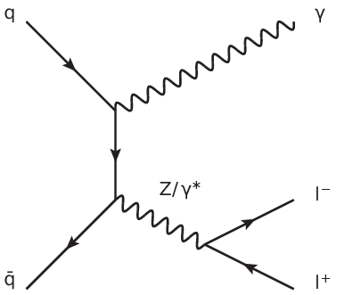
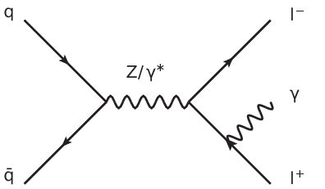
When is a lepton a lepton plus some photons?

Slide 33
What is your final state?
Quarks, gluons? (top?)
W, Z, H?
Taus?
Hadrons? (lifetime cut? Do they propagate in B-field? In material?)
Jets (what are the input objects?)
Neutrinos? All of them? Missing E_{T}
Photons? Isolated photons?
Electrons, muons? (what about FSR?)

Slide 34
Important considerations (for searches too)
What is your final state?
  A common choice is place a lifetime cut at 10ps, and where necessary to draw further distinction, draw the line at hadronisation.
  Stable objects (hadrons, leptons, photons) can be combined algorithmically to give well-defined objects (jets, dressed leptons, isolated photons, missing E_{T}…)
  Remember, this is about defining “truth”, i.e. what we correct back to, within some systematic uncertainty

Slide 35
Simulation and Experiment
Particles
Collider!
Digitized Readout
Detector & Trigger
Data for Analysis
Event Reconstruction
Unfolding & Data Correction: Make the measurement!

Slide 36
Calibration
How we know what our detector is doing
  (and so can account for it, and to some extent reverse it)
Recent examples… (13 TeV!)

Slide 37
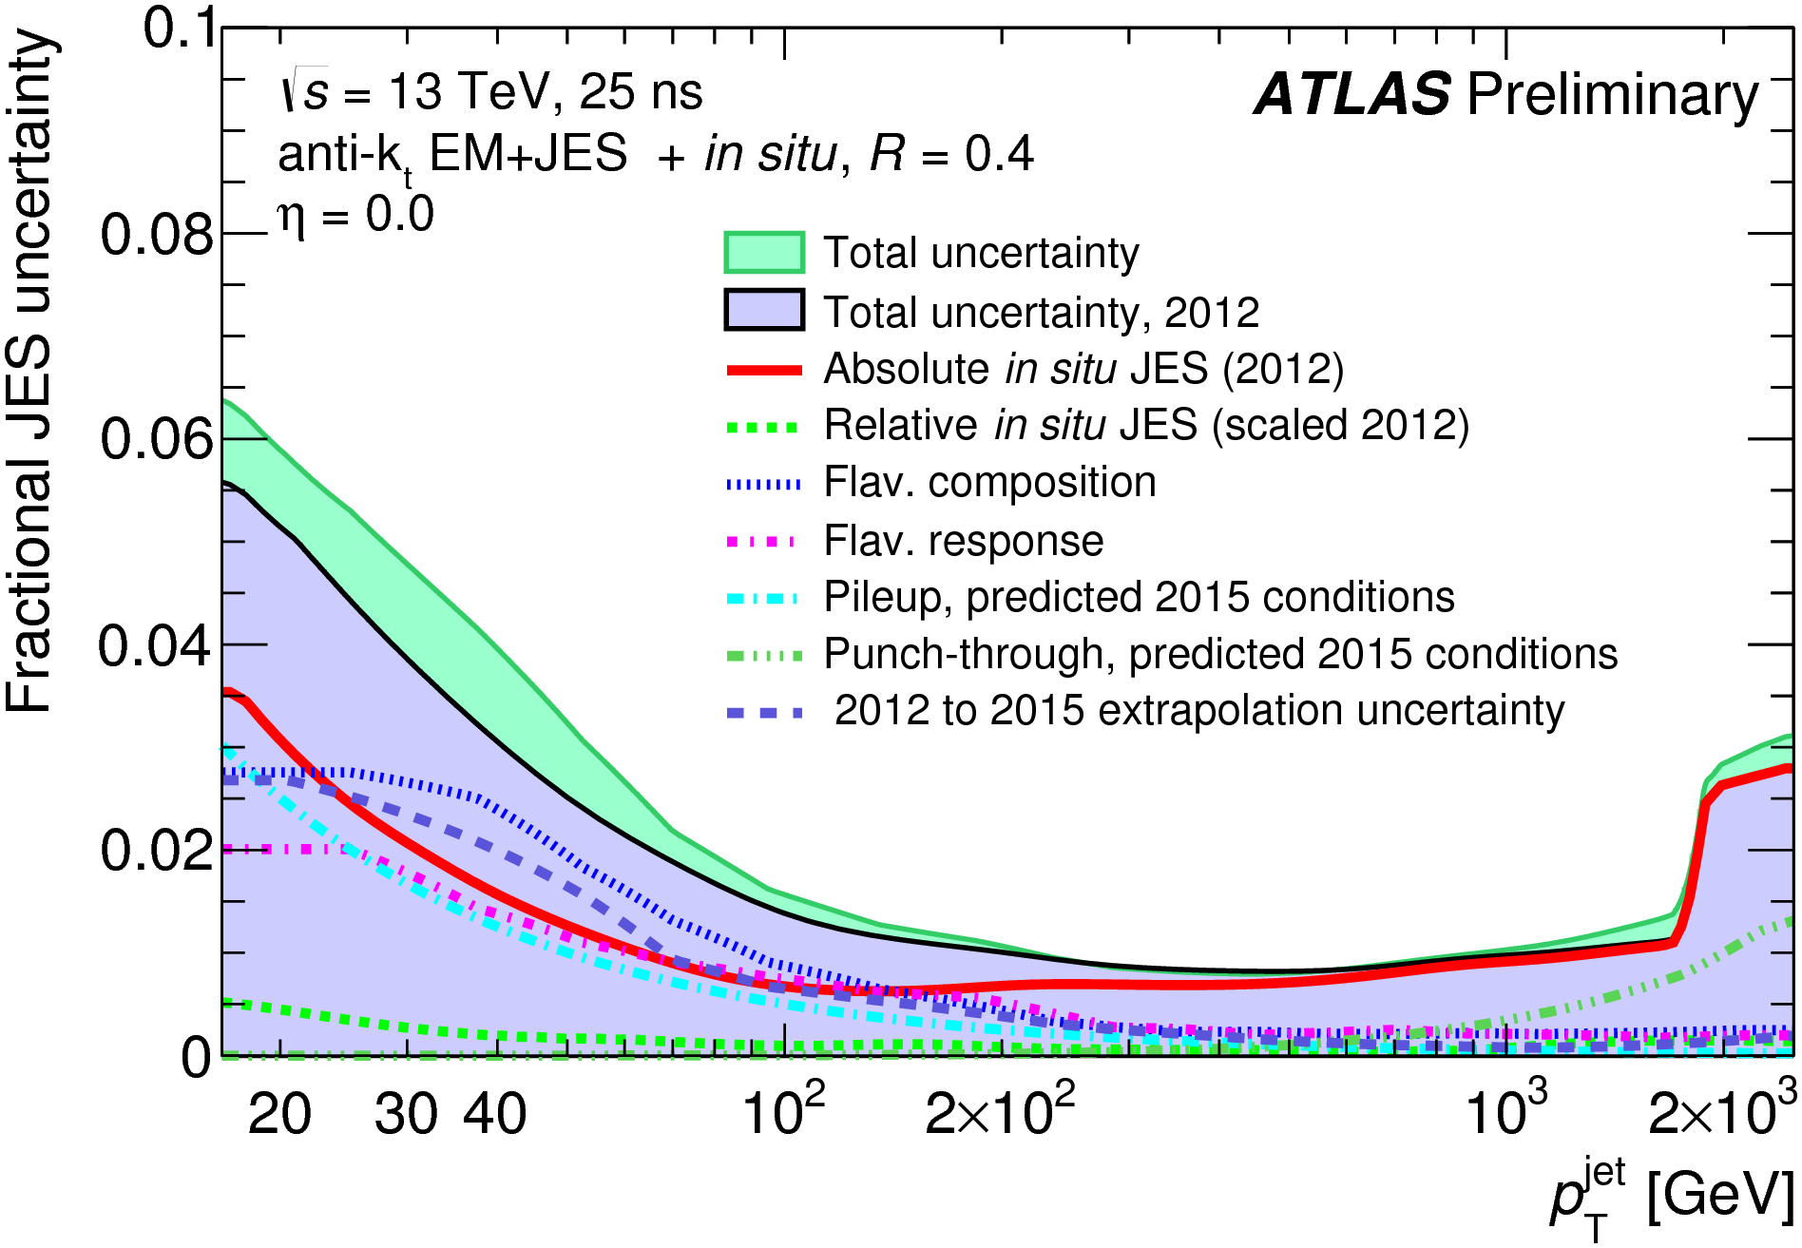
Jet Energy Scale
Calibration & uncertainty estimated with 2012 data
  Uncertainty: ~1-6%, depends on p_{T} and η
Uses
  Test beam input
  in-situ energy-balance (tracks; electrons, muons, photons for central region, central jets vs forward jets)
  Used to improve detector software model
Tested vs MC for 2015 data
ATL-PHYS-PUB-2015-027
ATL-PHYS-PUB-2015-015

Slide 38
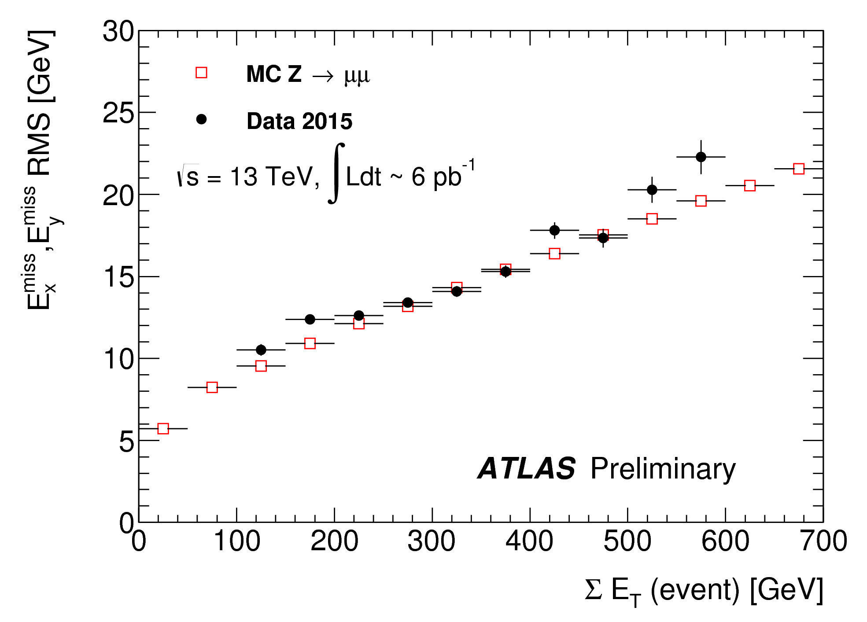
E_{T}^{miss} Resolution
E_{T}^{miss} Resolution
  measured in minimum bias & Z candidate events
  Good agreement between data and MC
ATL-PHYS-PUB-2015-027
ATL-PHYS-PUB-2015-015

Slide 39
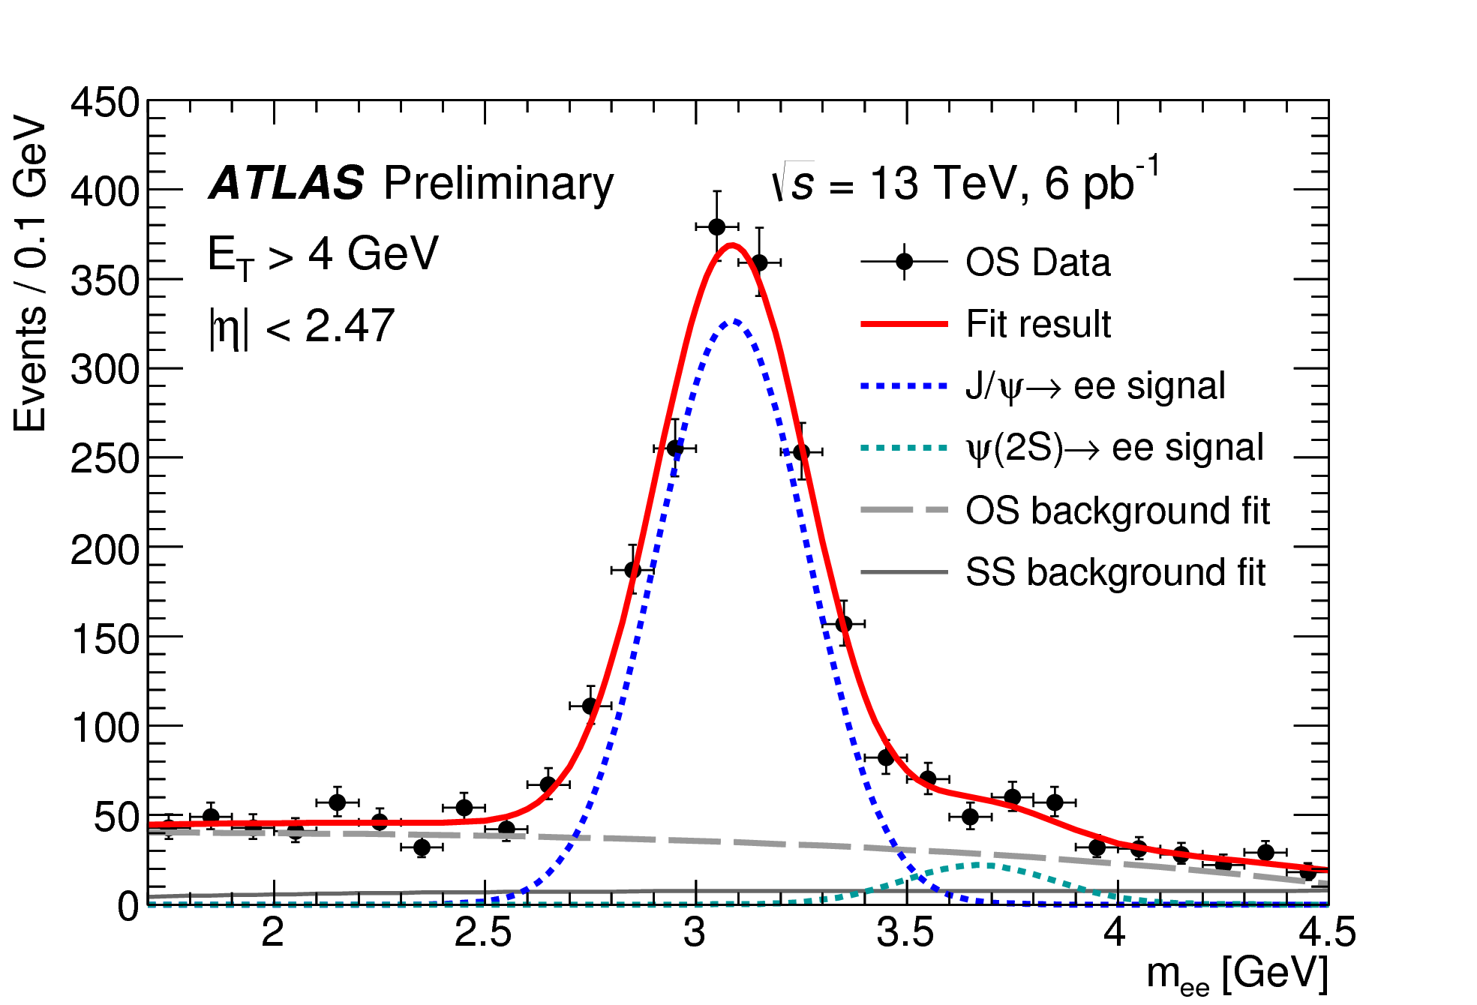
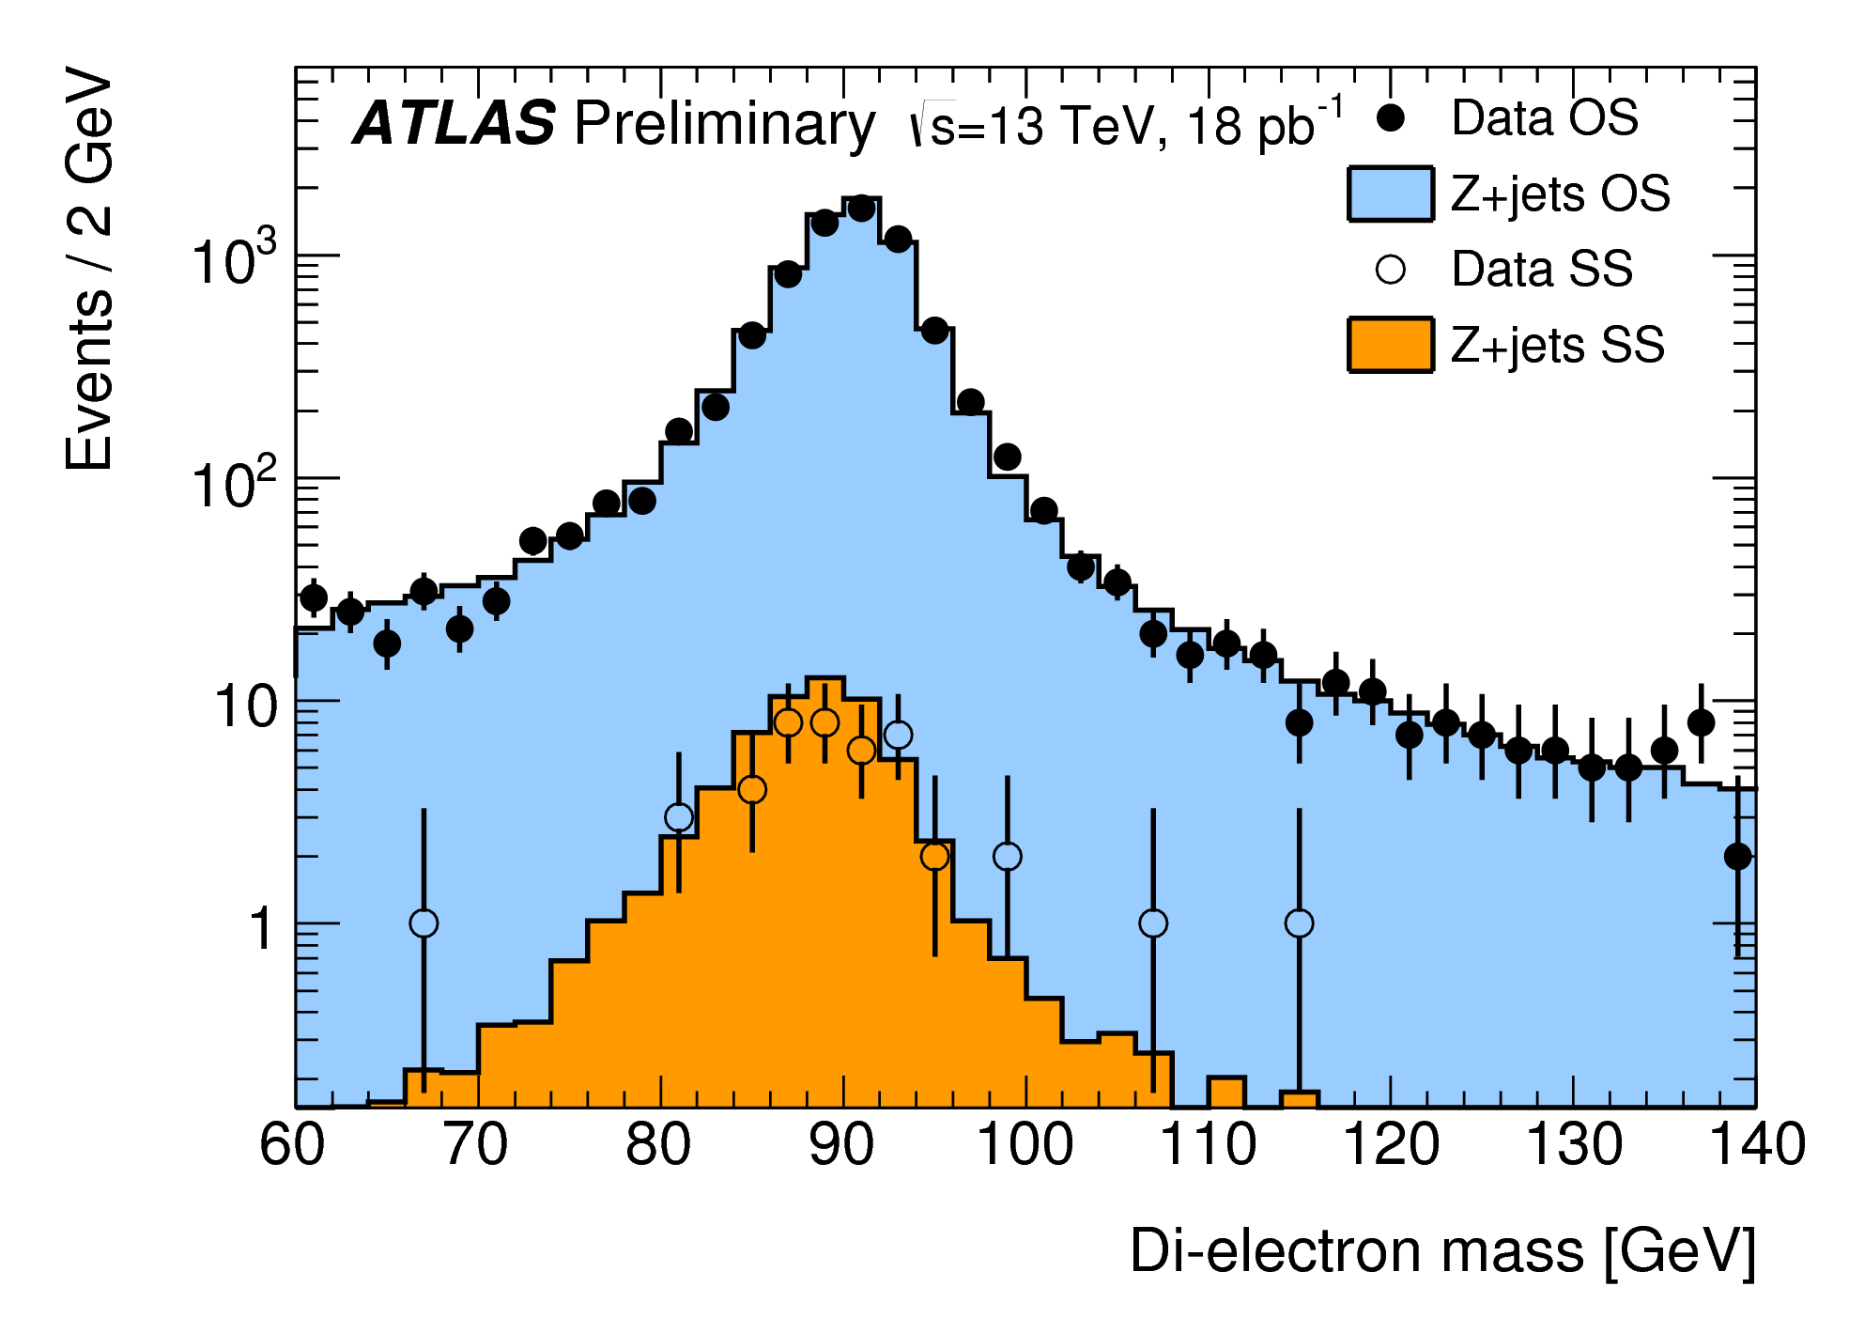
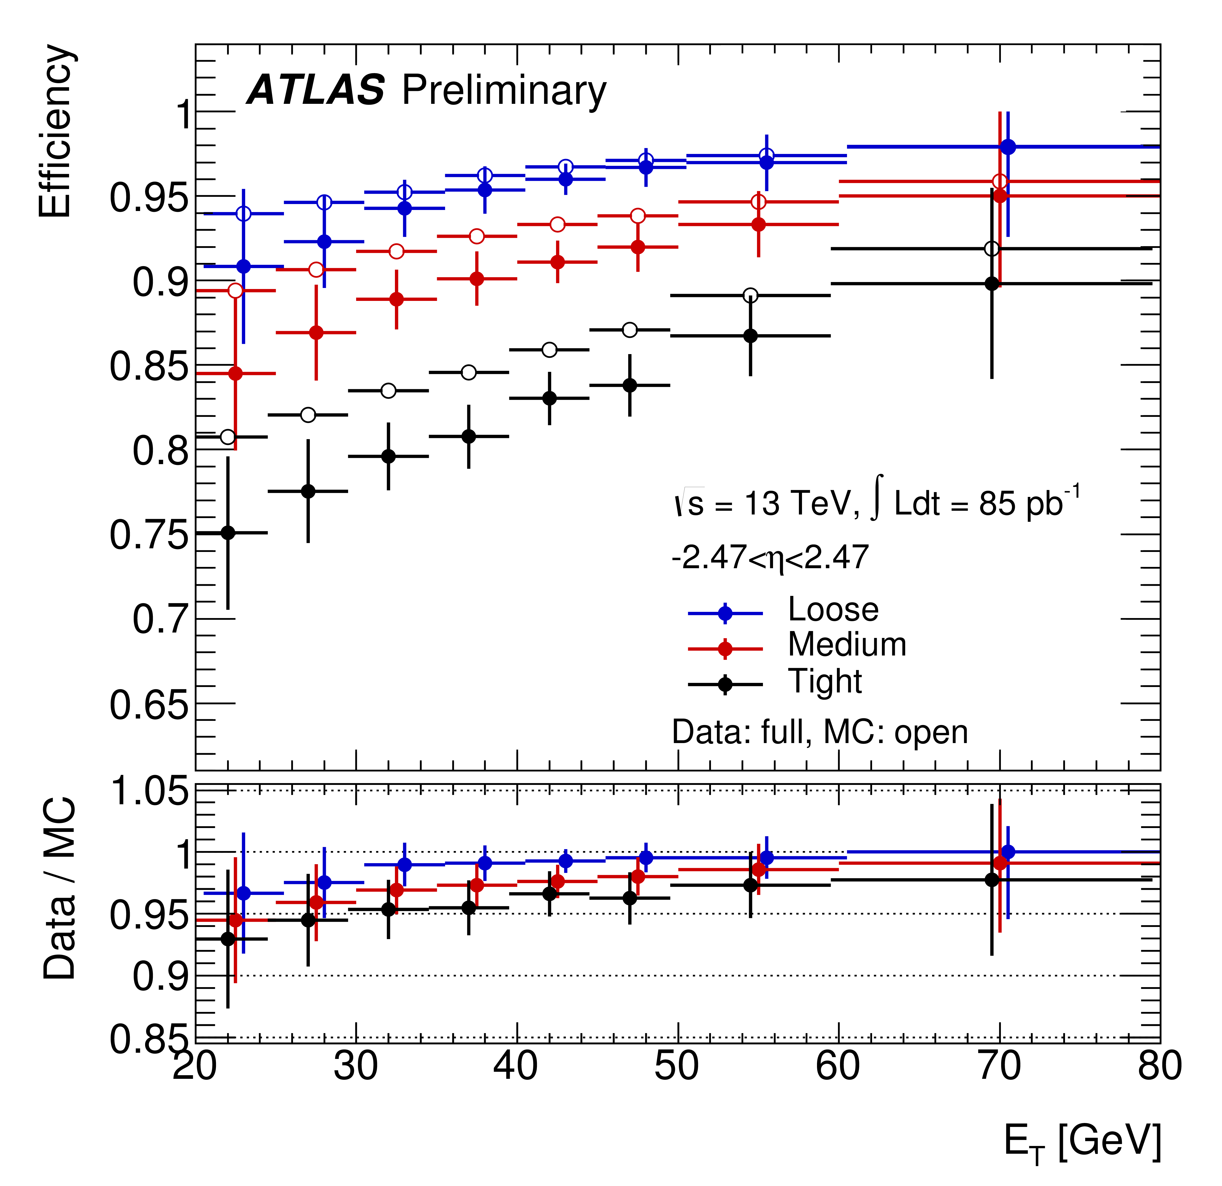
Electrons
Z and J/psi peaks used to evaluate electron energy scale & resolution
Electron identification
  Based on many variables combined in likelihood (details of detector)
  Efficiencies 75% - 95%
  Differences between data & MC corrected by in-situ calibration
  Uncertainty ~2%

Slide 40
Muons
High reconstruction efficiency
  Well modeled by simulation
  Uncertainty <1% for p_{T}>20 GeV
Momentum scale already understood with precision of 0.2%
  Resolution also understood to within 5% in this p range
ATL-PHYS-PUB-2015-037

Slide 41
Simulation and Experiment
Particle Four-Vectors
MC Event Generator
Digitized Readout
Detector & Trigger Simulation
Data for Analysis
Event Reconstruction
Unfolding & Data Correction: Test and evaluate

Slide 42
Simulation and Experiment
Particles
Collider!
Digitized Readout
Detector & Trigger
Data for Analysis
Event Reconstruction
Unfolding & Data Correction: Make the measurement!

Slide 43
Fiducial or not?
Difference between “efficiency corrections” or “unfolding”, and “acceptance corrections”.
  The first two generally mean correction for detector effects, which no one but the experimentalists can do.
  The third means extrapolating into kinematic regions which have not been measured at all
Beware of the third, especially as we go to higher energies…

Slide 44

Unfold

Slide 45


Slide 46
Increase acceptance

Slide 47
Increase acceptance

Slide 48
Extrapolate

Slide 49
Extrapolate

Slide 50
But how reliably?

Slide 52
Concept of a “fiducial” cross section
Defines a region in which acceptance is ~100%
Implies that some kinematic cuts must be implemented in whatever theory the data are compared to (easy for MC, less so for some high-order calculations)

Slide 53
Inaccessible. Removed by kinematics cuts, and not part of the fiducial cross section

Slide 54
Concept of a “fiducial” cross section
Defines a region in which acceptance is ~100%
Implies that some kinematic cuts must be implemented in whatever theory the data are compared to (easy for MC, less so for some high-order calculations)
Ideally of course, build an experiment which covers all the phase space of interest…

Slide 55


Slide 57
Concept of a “fiducial” cross section
Defines a region in which acceptance is ~100%
Implies that some kinematic cuts must be implemented in whatever theory is compared to (easy for MC, less so for some high-order calculations)
Ideally of course, build an experiment which covers all the phase space of interest…
Fiducial cross section should be defined in terms of the “ideal” or “true” final state

Slide 58
NB This has always been true, but becomes more relevant the more phase space you open. Hence at LHC, this now impacts electroweak-scale objects much more than it did at LEP or Tevatron

Slide 59
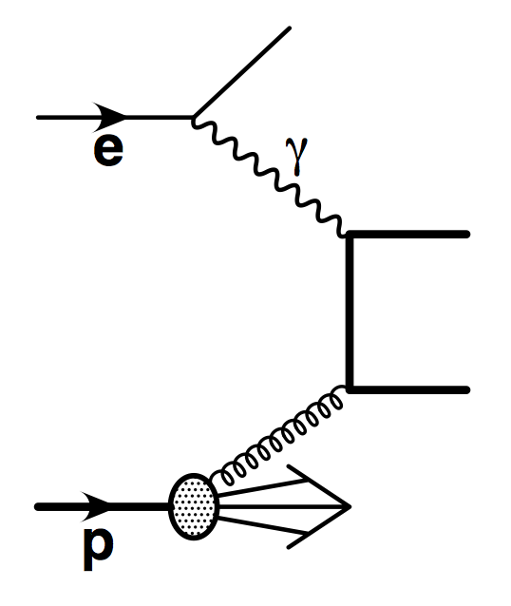
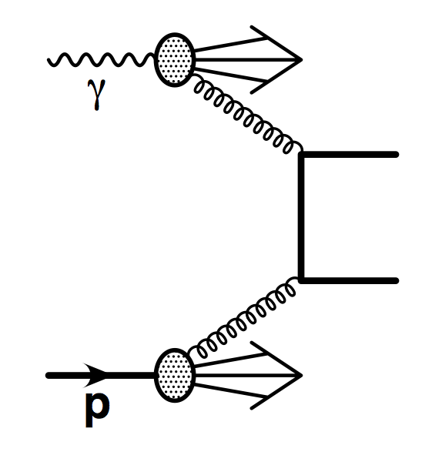
Real example: ZEUS charm photoproduction
Electron-proton collider, proton energy 820 GeV, electron energy 27 GeV
  Mean photon energy ~10 GeV.
  Photon proton CM energy ~100 to 300 GeV
  Kinematics highly boosted in the proton direction

Slide 60
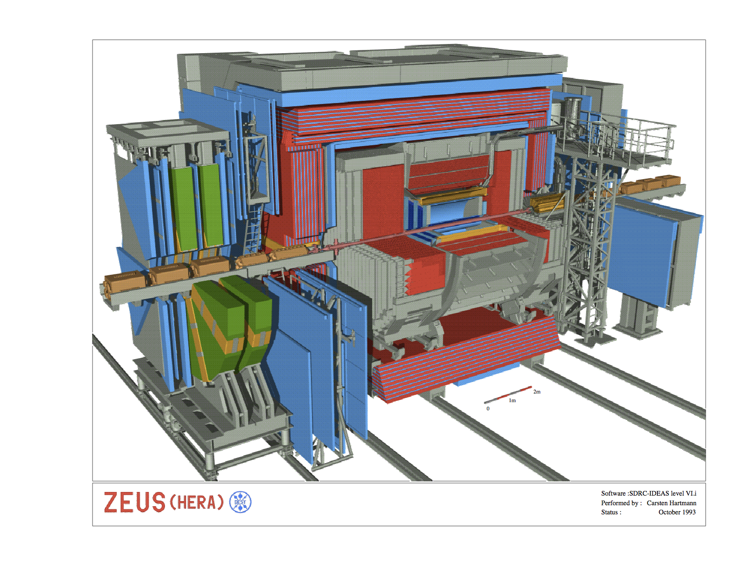
Real example: ZEUS charm photoproduction
Tagging of charm via D* decay
  →Highly dependent on track reconstruction, which has limited rapidity and p_{T} coverage.

Slide 61
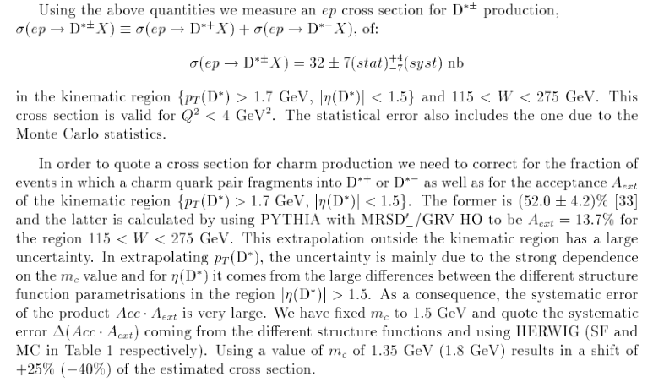

Slide 62
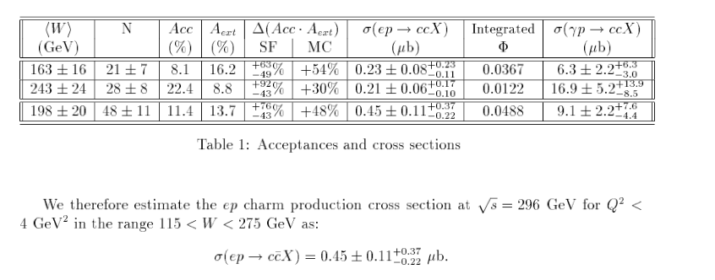
Real example: ZEUS charm photoproduction

Slide 63
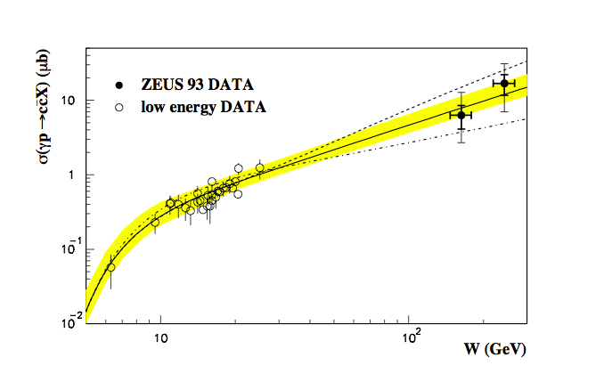
Real example: ZEUS charm photoproduction
Large energy extrapolation
Tiny acceptance → ~1.4% (and into tricky regions such as low p_{T} and high rapidity, hence high uncertainty)

