Slide 1
LHC Experimental Physics
Lecture 3
Jon Butterworth
University College London
Vietnam School of Physics
Quy Nhon
September 2016

Slide 2
Outline
Introduction
(a digression and then…)
First measurements
Jets and boosted objects
Higgs Discovery and Measurement
Measurements and Model Independence
Searches and the future

Slide 3

Digression: the public

Slide 4


Slide 5
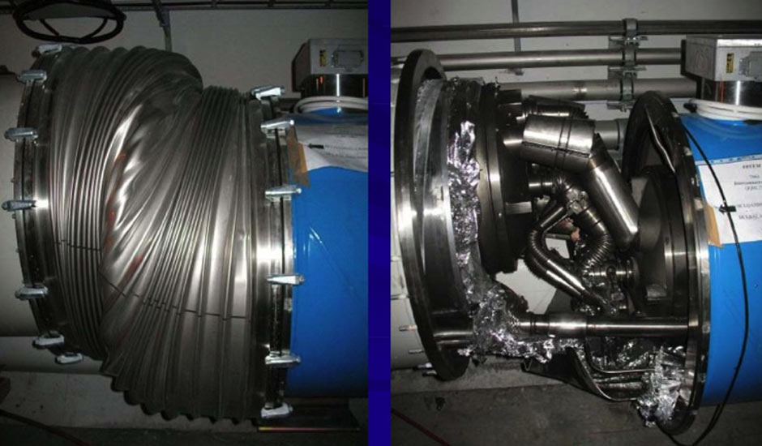

Slide 6
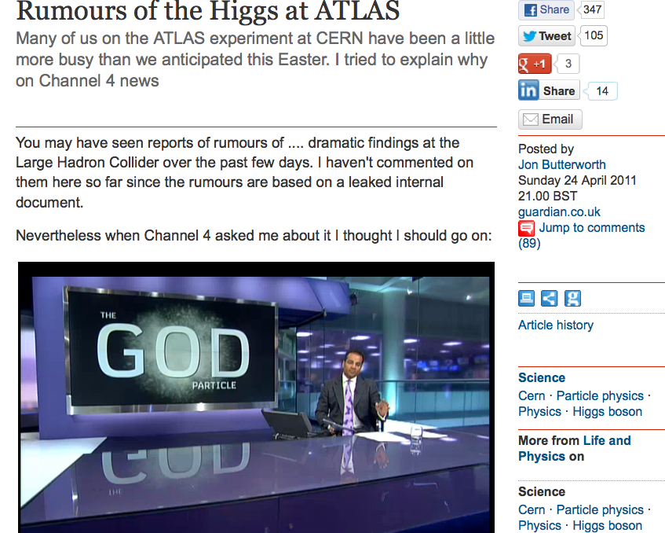

Slide 7
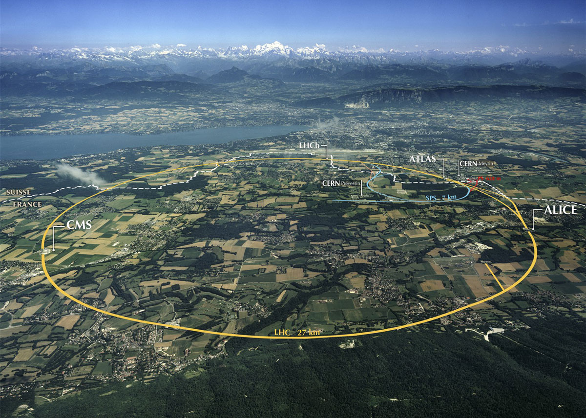

Slide 8

Notes:
Protons collisions at 14,000,000,000,000 eV
(eventually – currently at 7,000,000,000,000 eV)
Two “general purpose” experiments: ATLAS and CMS will detect the products of the collisions.
Why does it have to be so big? (weight on string)

Slide 9
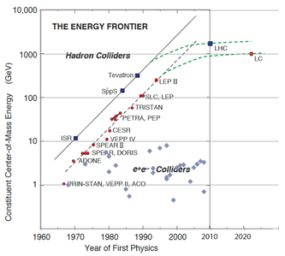
Notes:
Livingstone line

Slide 10
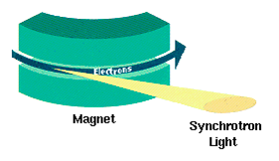

Different energy limitation on electron/positron colliders:

Slide 11
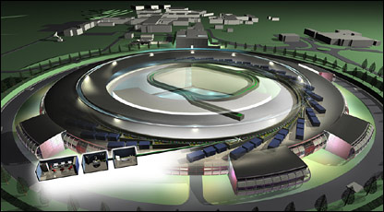
Different energy limitation on electron/positron colliders:

Slide 12
Why high energy?
Notes:
Protons collisions at 14,000,000,000,000 eV
(eventually – currently at 7,000,000,000,000 eV)
Two “general purpose” experiments: ATLAS and CMS will detect the products of the collisions.
Why does it have to be so big? (weight on string)

Slide 13
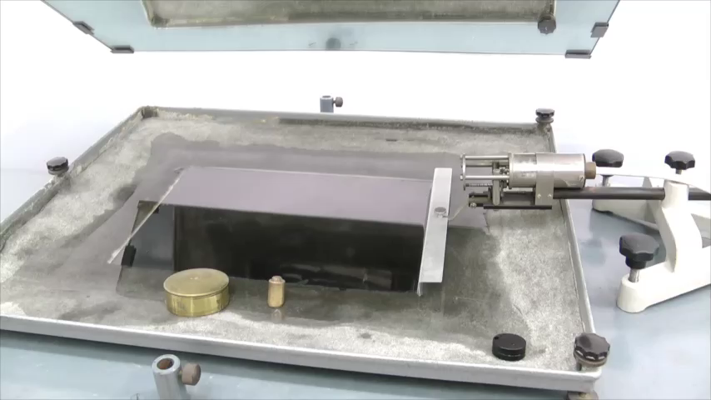
2
  High energy wave means small wavelength
  Low energy wave means long wavelength
Notes:
High energy means small distance

Slide 14
Energy Scales
10² Atomic binding energy
10¹¹ Electroweak symmetry breaking
W, Z, H, top mass
10⁷ Nuclear binding energy
Planck
0 − γ, g
10¹³ LHC CM energy
10⁶ Electron
10²⁵ Grand Unification?
10⁰
10¹⁴
10²⁸
electronVolts
10⁹ Quark confinement, proton mass, Λ _{QCD}
Neutrinos

Slide 15
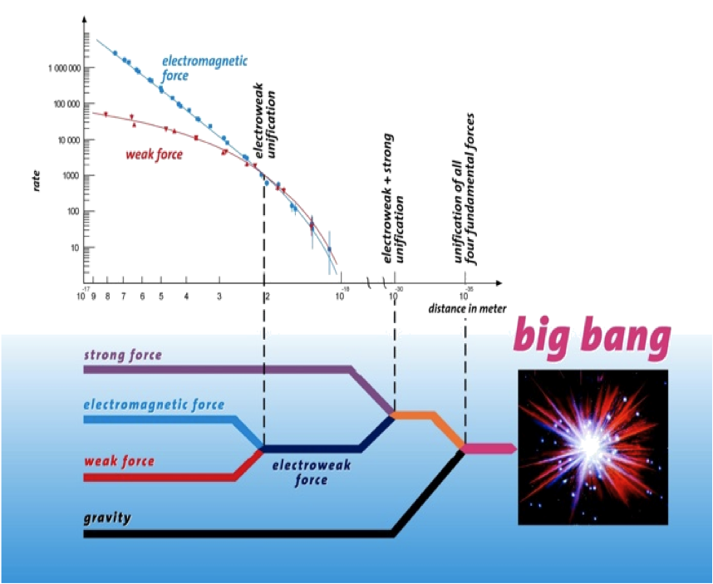
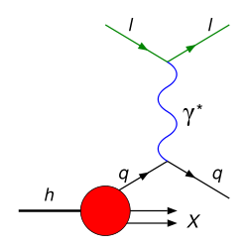
Notes:
The weak force (isnt) --- unification. We knew EW happened and where, but not the others (well, gravity has to before the planck scale if at all)

Slide 16
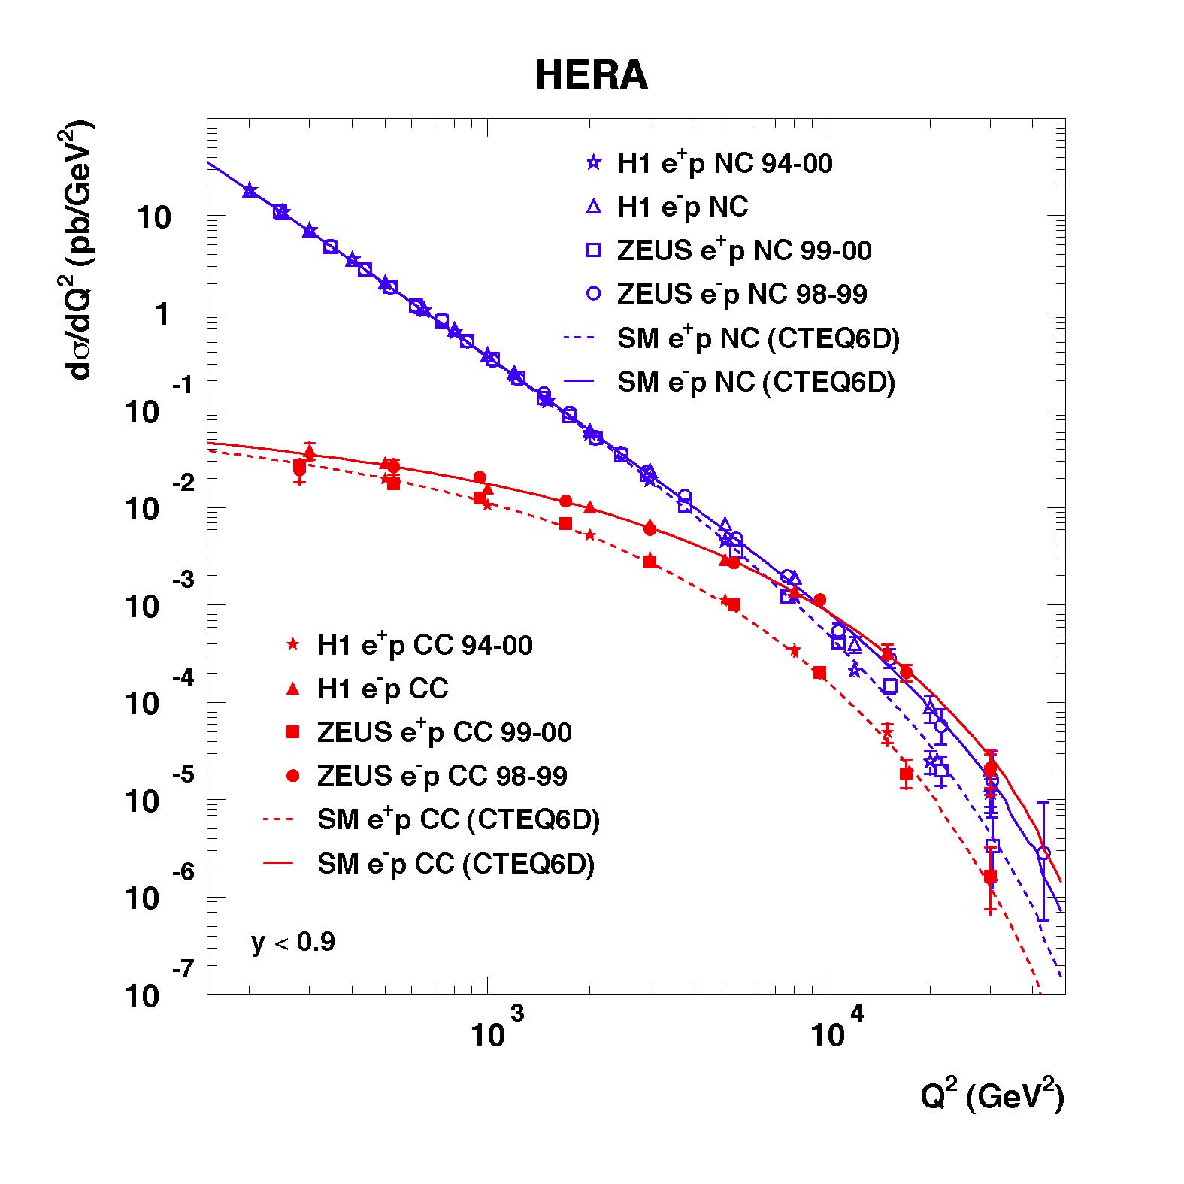
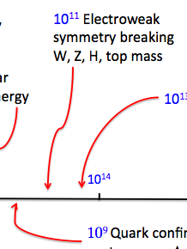
Notes:
The weak force (isn’t). Reminder of the short-distance physics.

Slide 17
First Measurements
Big cross sections first…

Slide 18
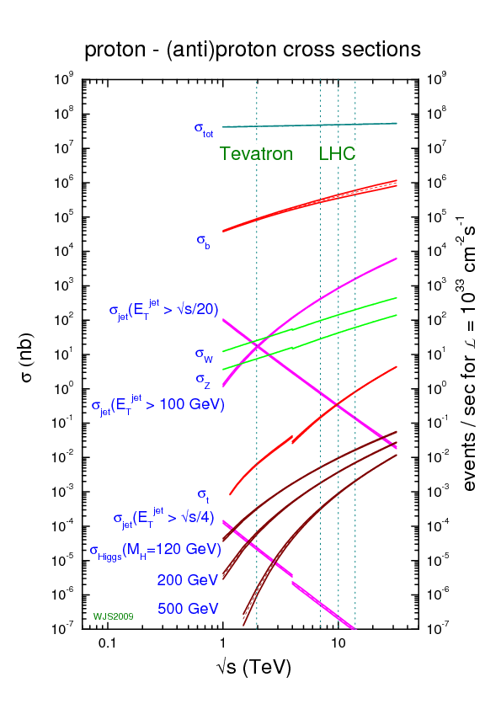

Slide 19
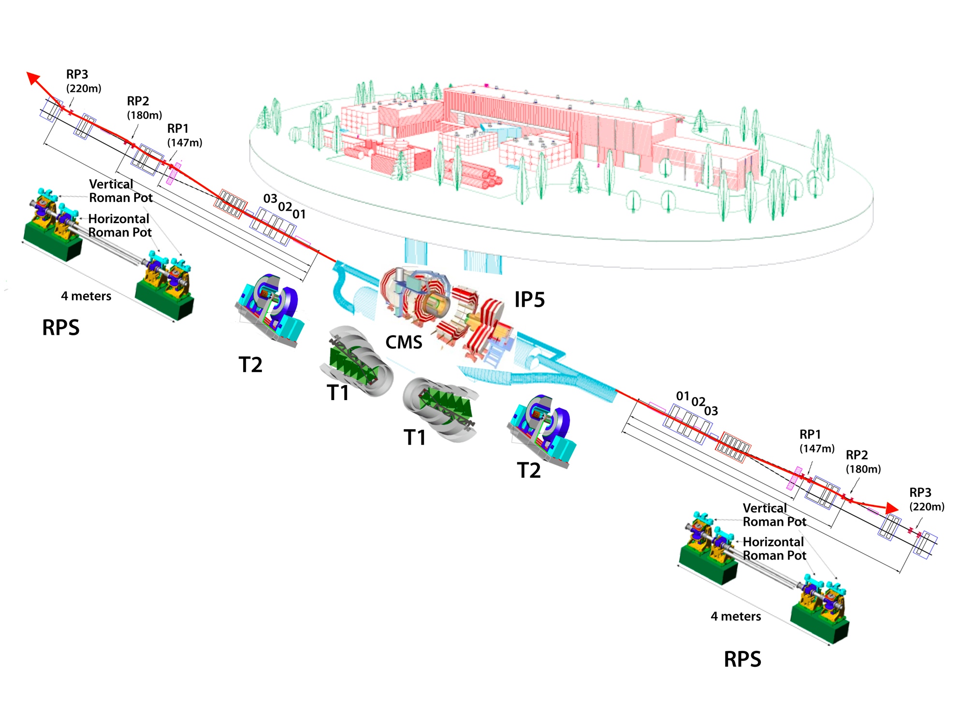
Forward detectors (ATLAS/ALFA, CMS/TOTEM)
arXiv:1408.5778

Slide 20
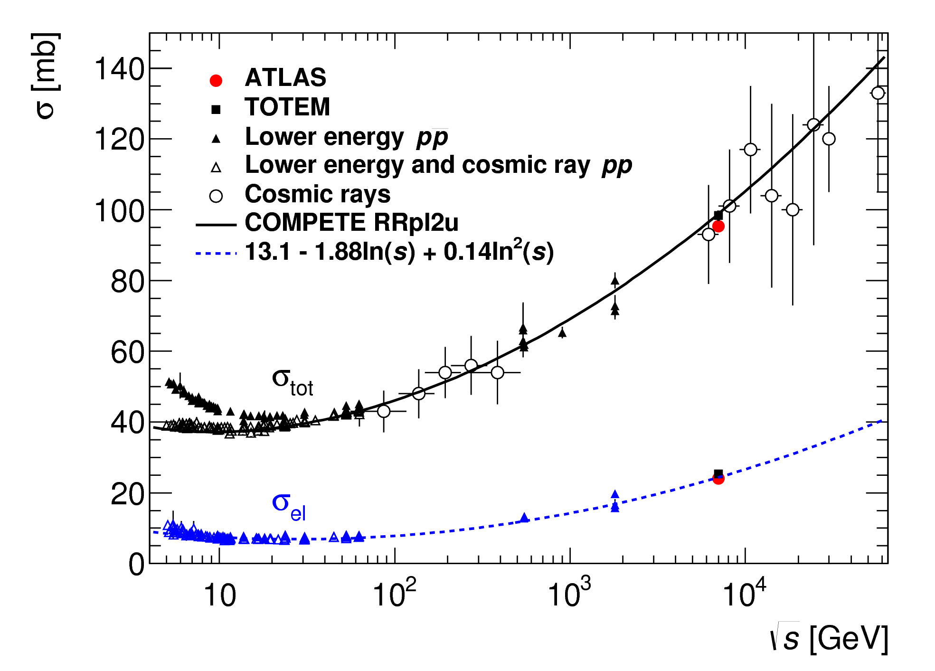
Forward detectors (ATLAS/ALFA, CMS/TOTEM)
arXiv:1408.5778

Slide 21
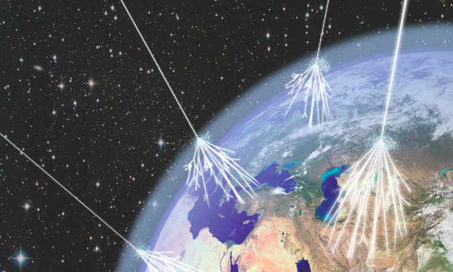
Forward detectors (ATLAS/ALFA, CMS/TOTEM)
arXiv:1408.5778

Slide 22
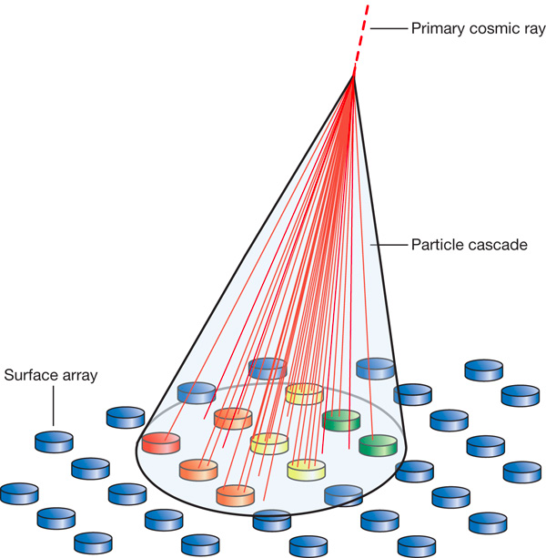
Forward detectors (ATLAS/ALFA, CMS/TOTEM)
arXiv:1408.5778

Slide 23
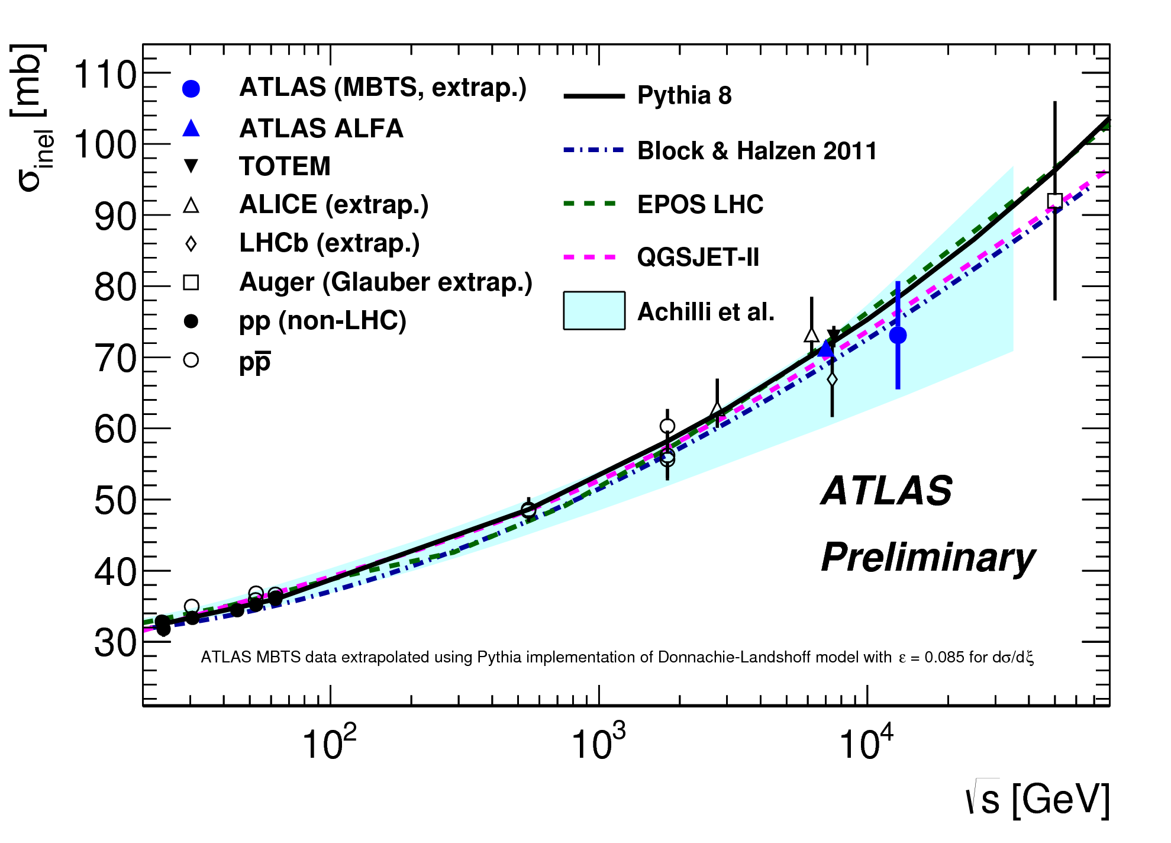
Forward detectors (ATLAS/ALFA, CMS/TOTEM)
13 TeV
MBTS
(inelastic,
extrapolated)
ATLAS-CONF-2015-038

Slide 24
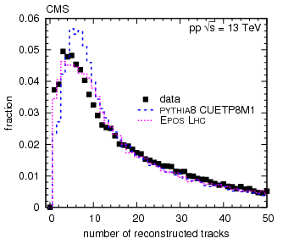
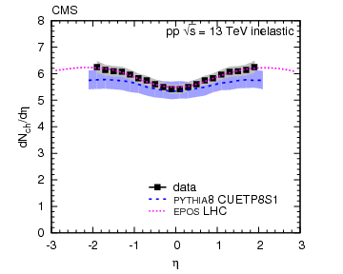
Particle Production
CMS, arXiv:1507.05915v1
13 TeV data, no magnetic field
  Reduces extrapolation to low p_{T}
  Multiplicity distribution of charged tracks →
Rapidity density of charged hadrons ←
Important input to minimum bias/pile up/cosmic ray shower modelling
Notes:
Add the eta range etc

Slide 25
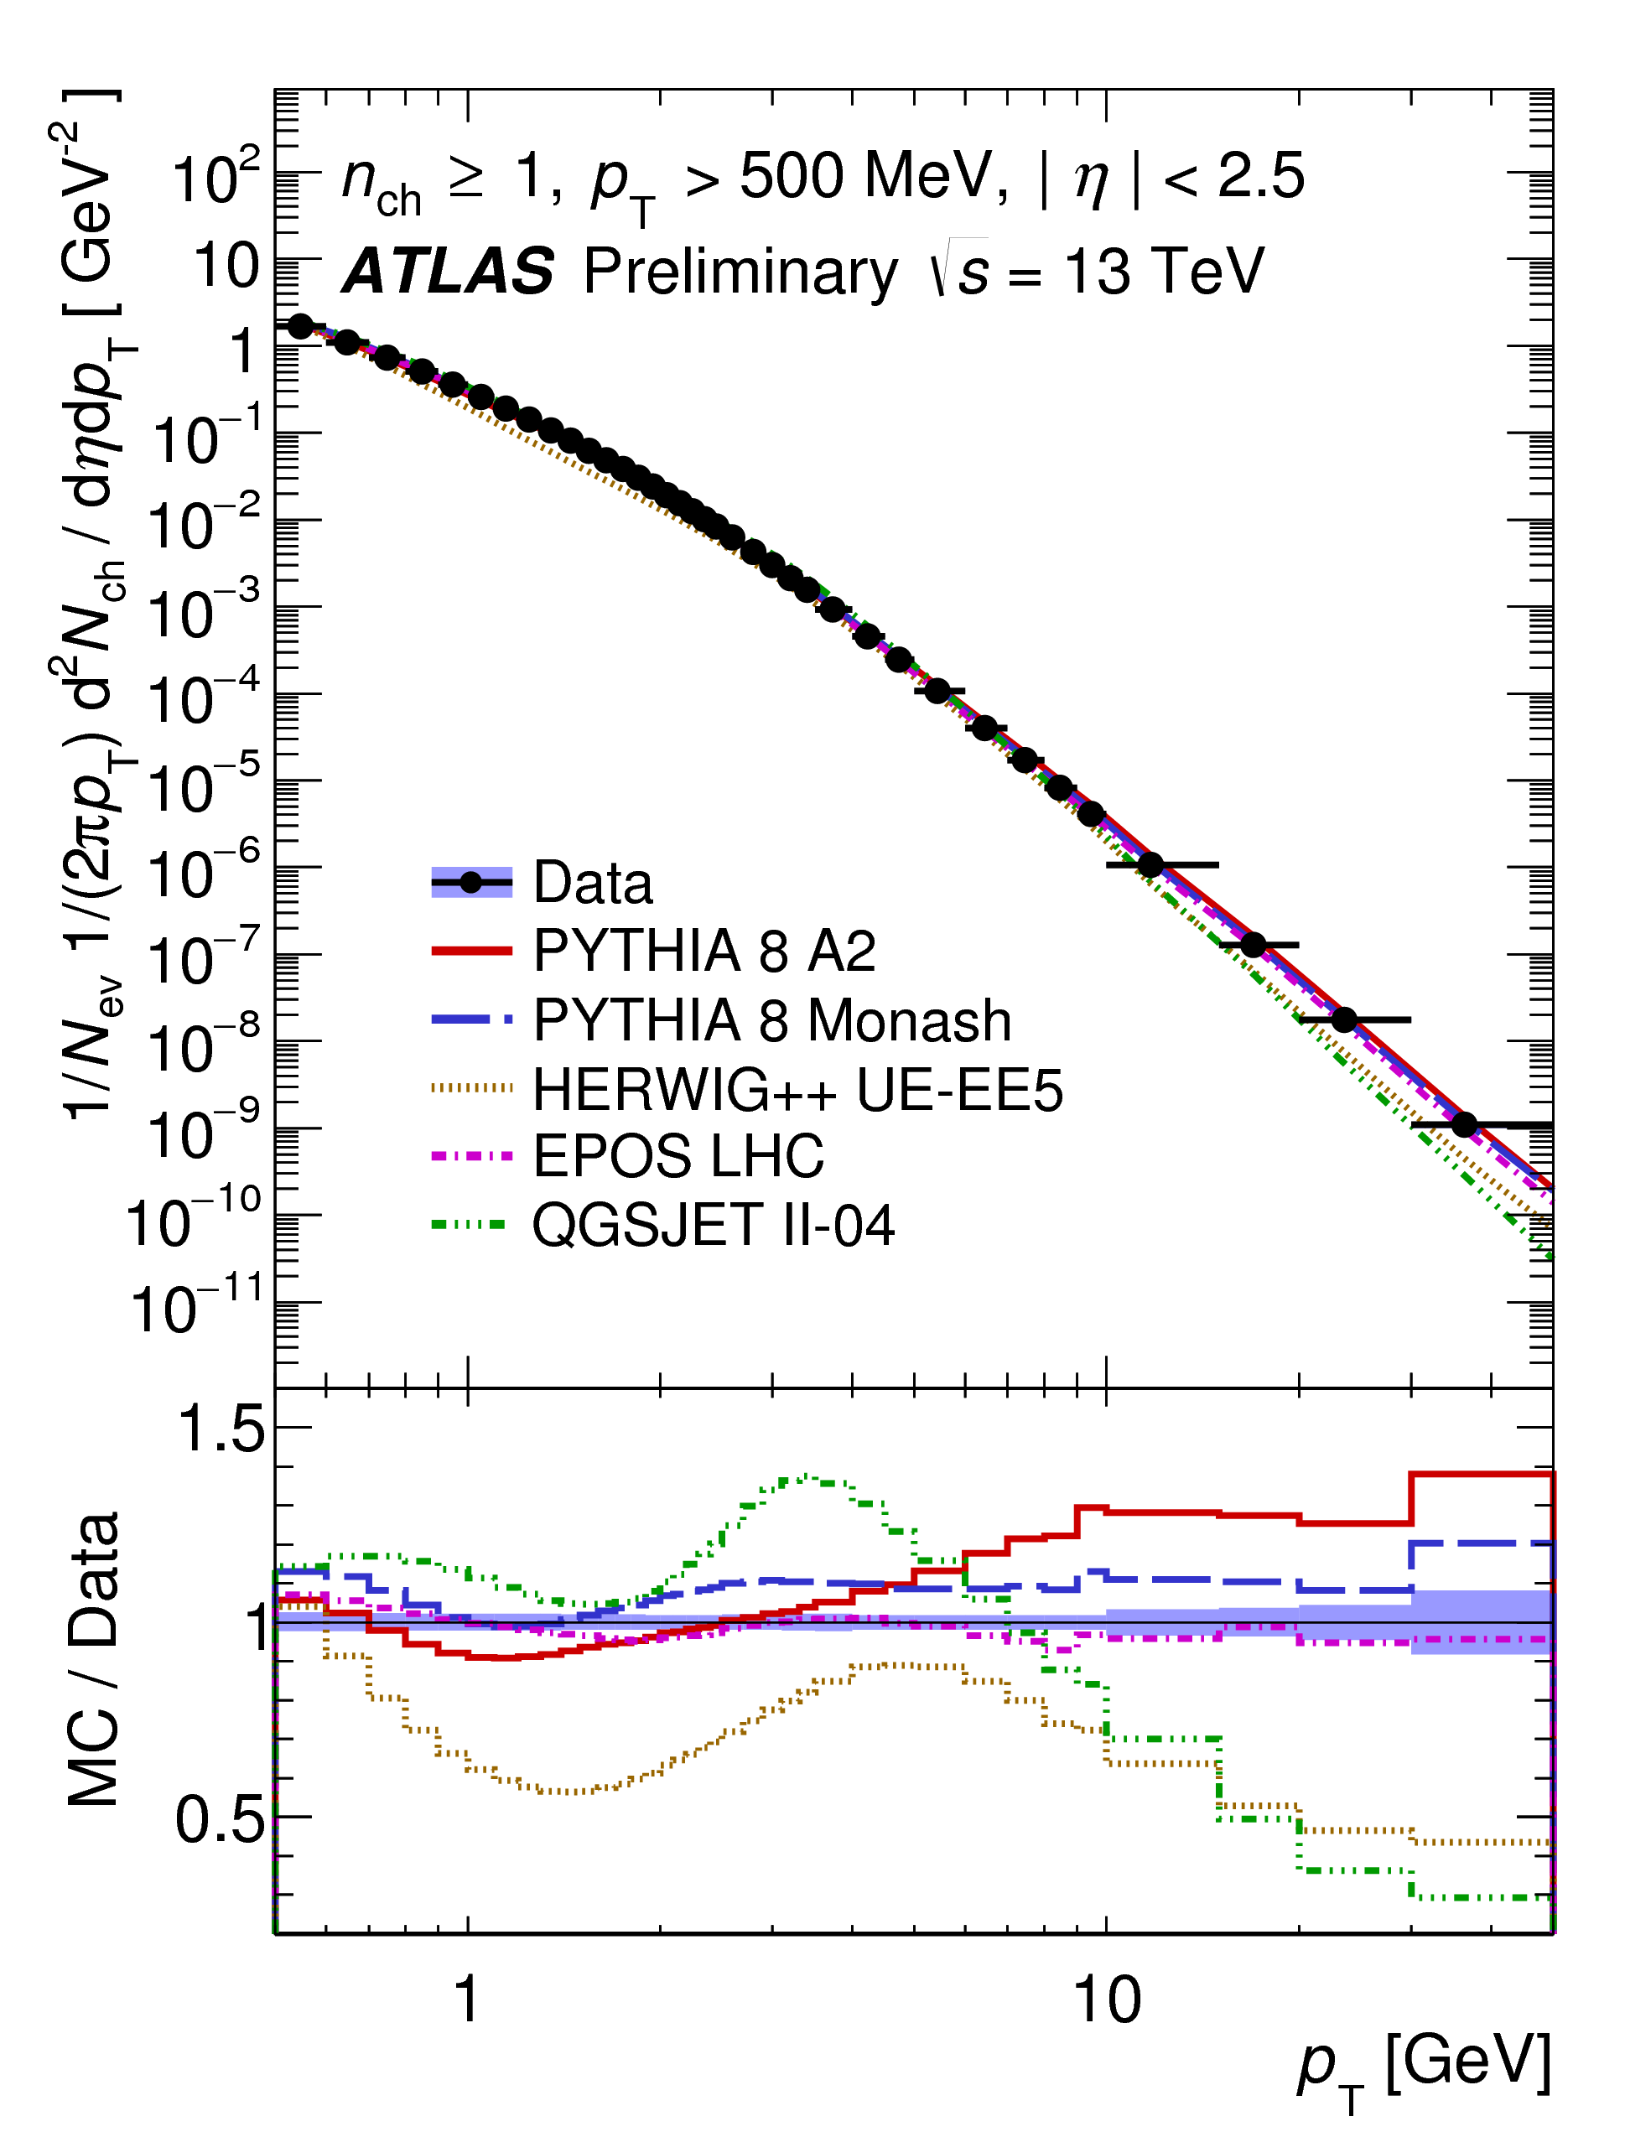
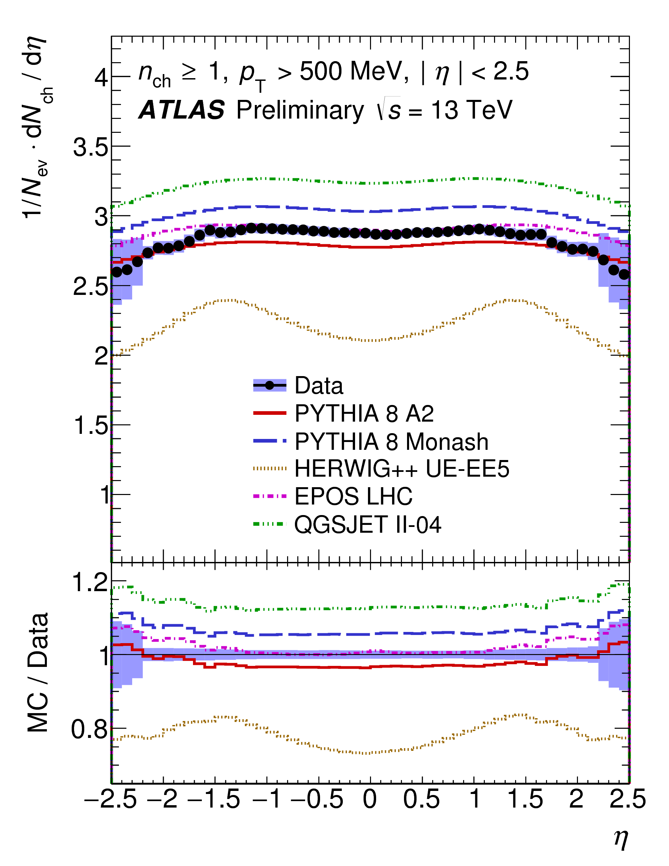
13 TeV data,
  ‘Traditional’ minimum bias analysis
ATLAS-CONF-2015-028

Slide 26
Diffraction
High-energy behaviour of total cross section driven by exchange of vacuum quantum numbers (Pomeron)
Also has implications for this final state
  Diffractive cross section,
  Rapidity gaps in particle production

Slide 27
Diffraction
CMS-PAS-FSQ-12-005

Slide 28
Diffraction
High-energy behaviour of total cross section driven by exchange of vacuum quantum numbers (‘Pomeron’)
    Or in perturbative QCD, by increasing parton density at low x?
Also has implications for this final state
  Diffractive cross section,
  Rapidity gaps in particle production
Can we see this behaviour in the perturbative regime?
  Study e.g. dijet configurations with large rapidity gaps/intervals

Slide 29
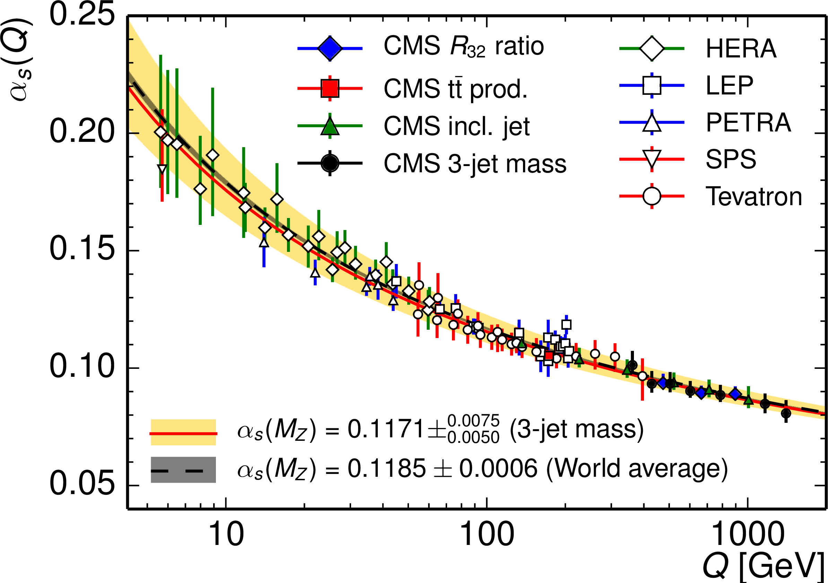
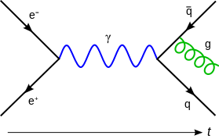
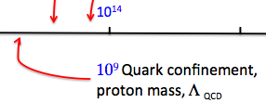
Perturbative or ‘Hard’ QCD
Asymptotic freedom at short distances/high energies… strong becomes weak(er)

Slide 30
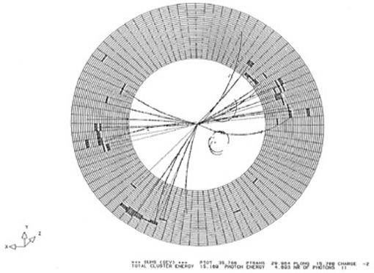
‘Hard’ QCD
When quarks and gluons make a break for it… Jets!

Slide 31
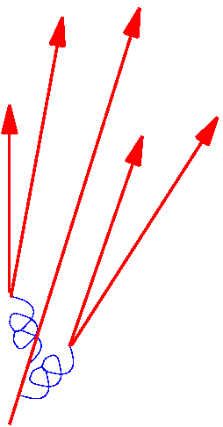
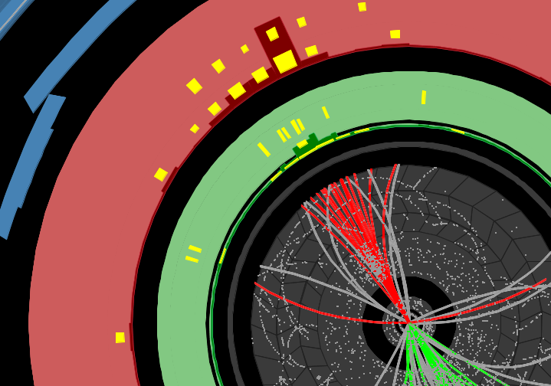
‘Hard’ QCD
When quarks and gluons make a break for it… Jets!

Slide 32
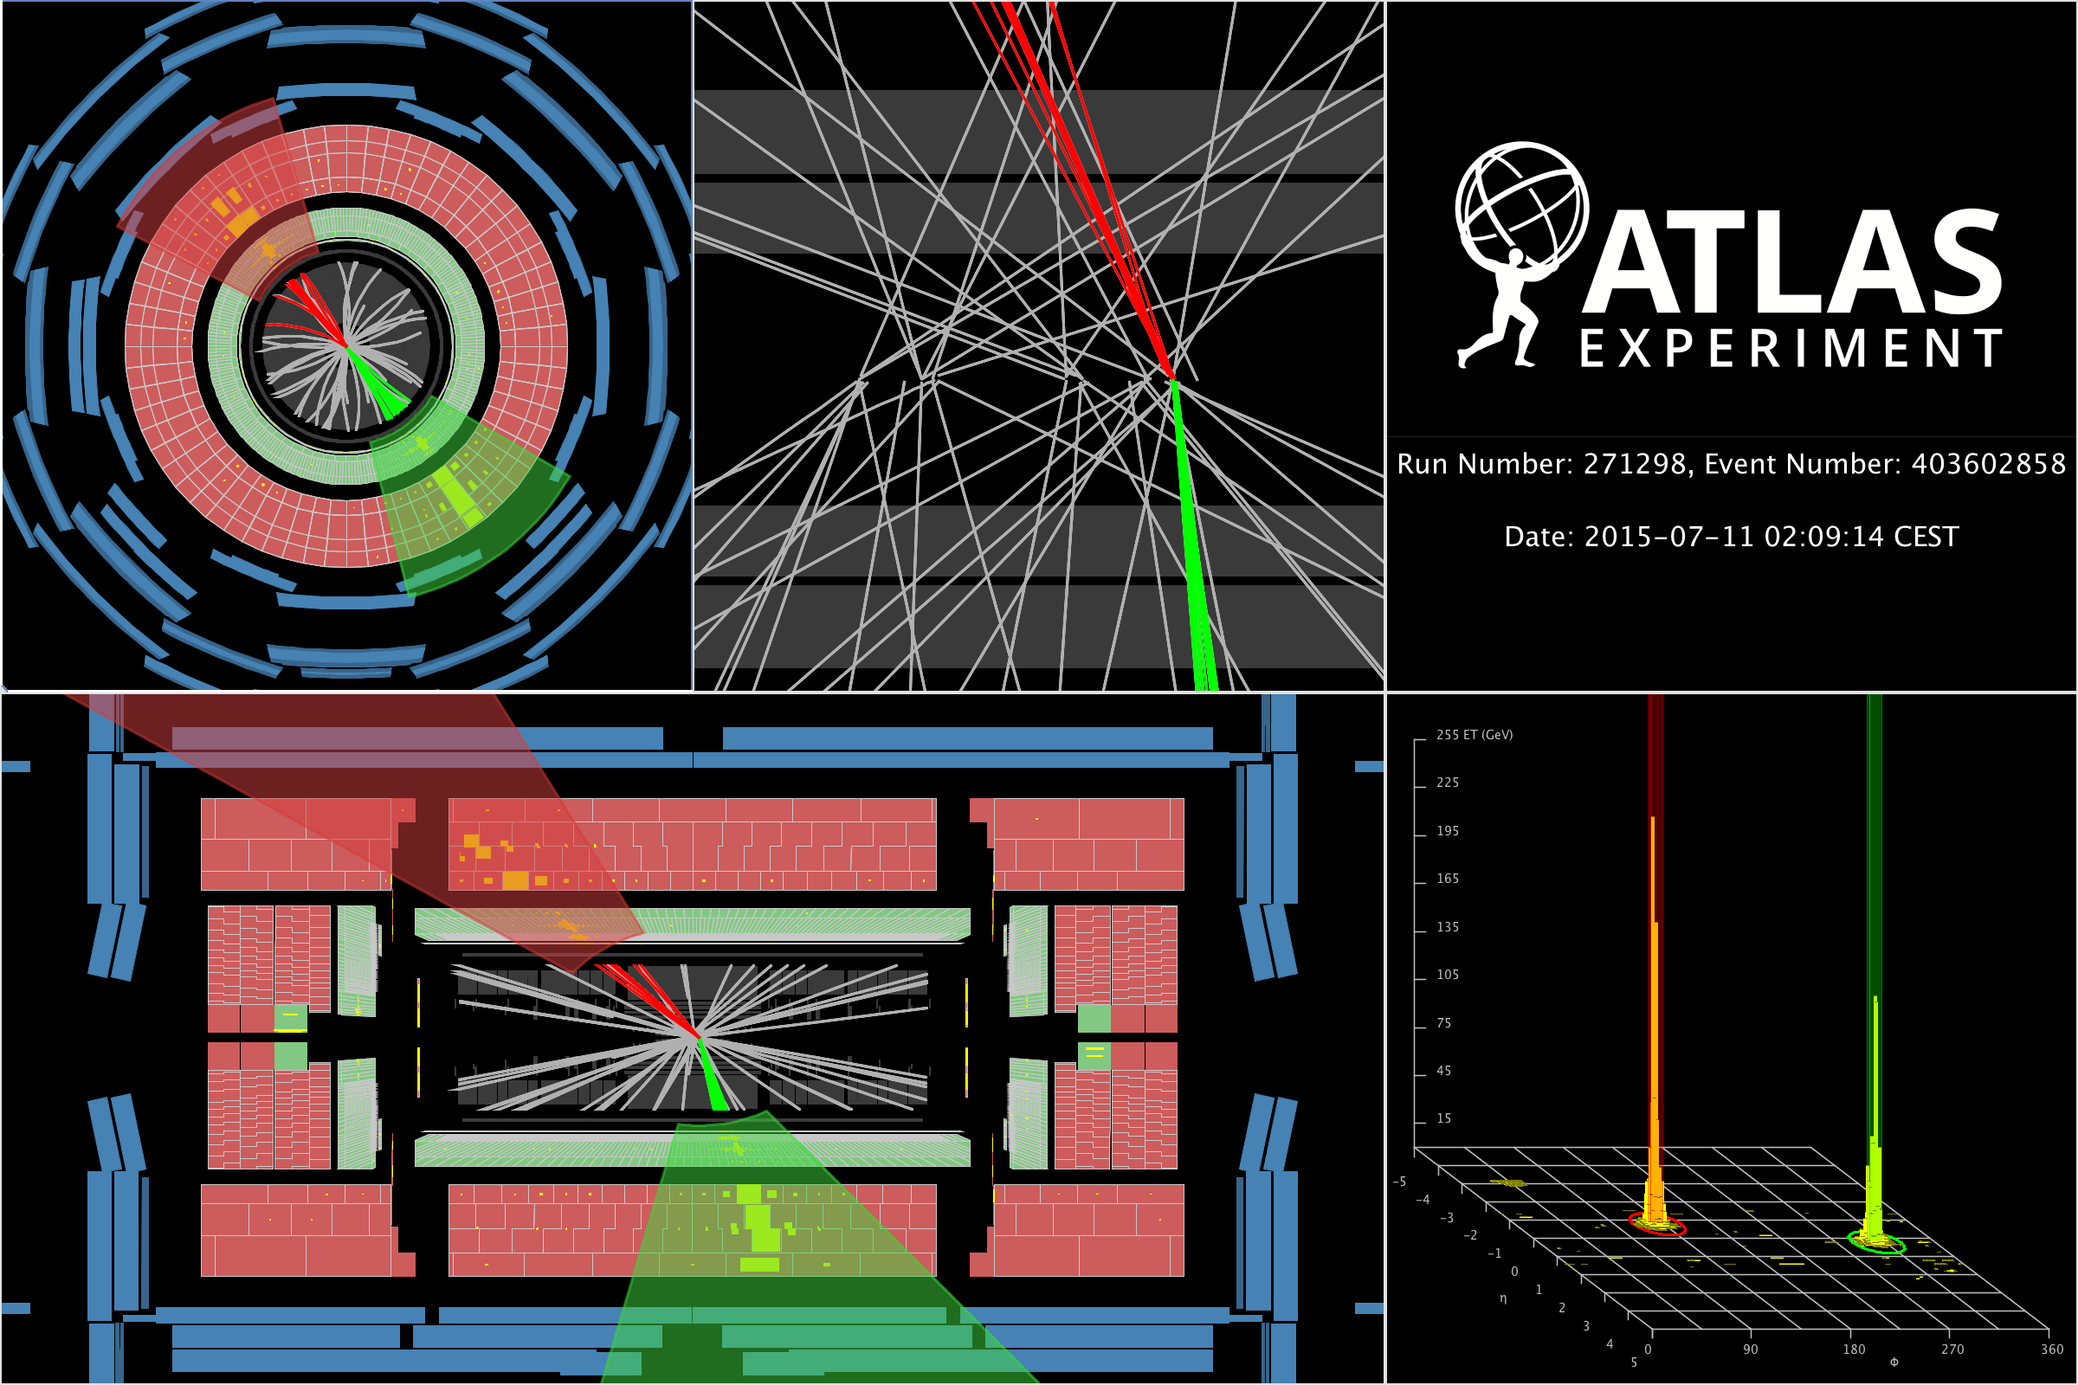
‘Hard’ QCD

Slide 33
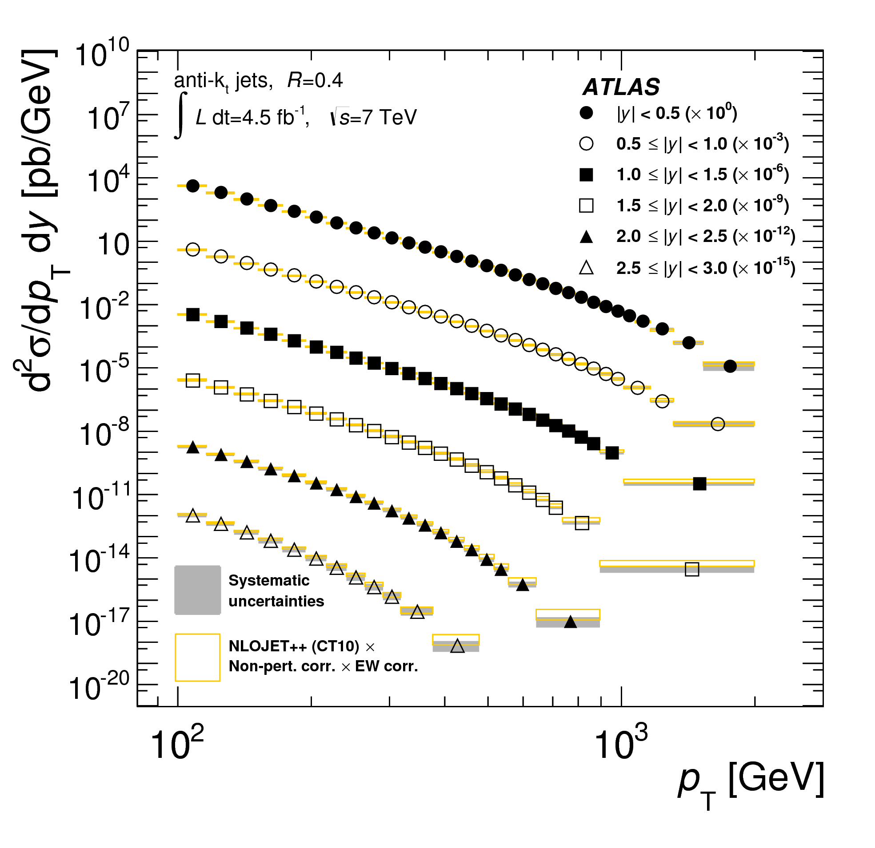
‘Hard’ QCD
When quarks and gluons make a break for it… Jets!

Slide 34
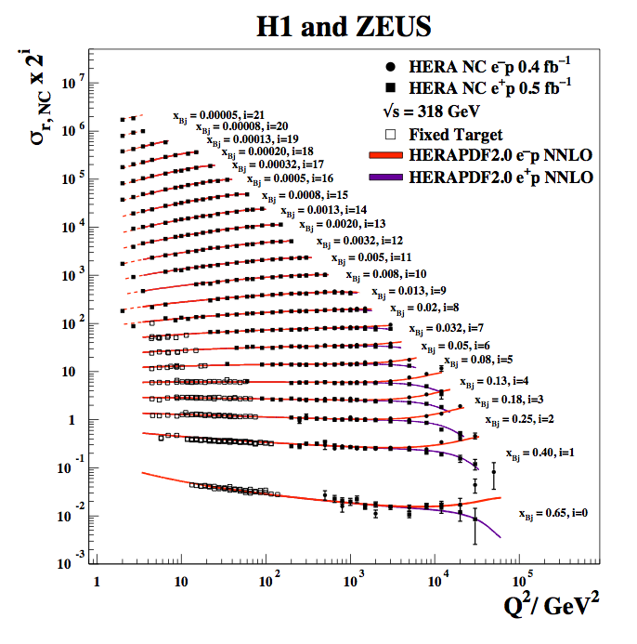
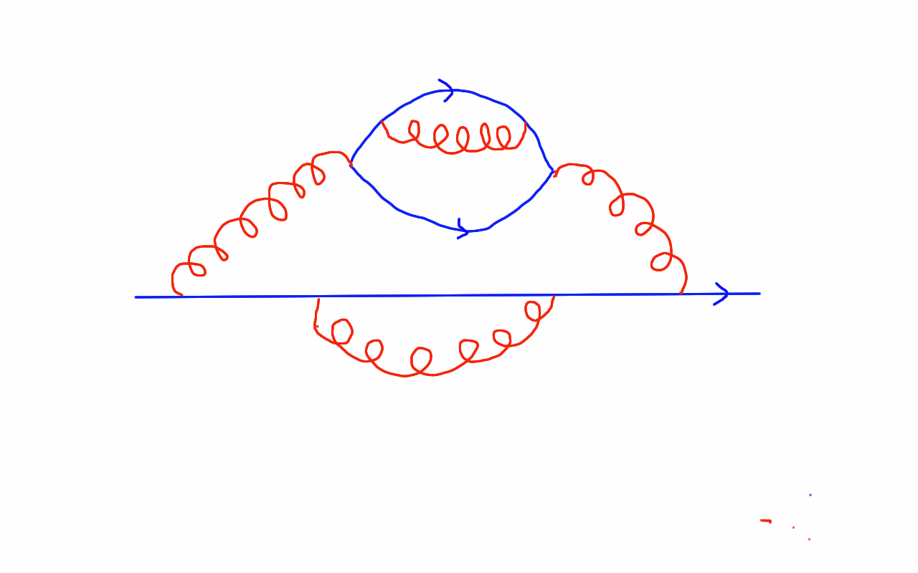
‘Hard’ QCD
Freedom inside the proton: scaling, and violations

Slide 35
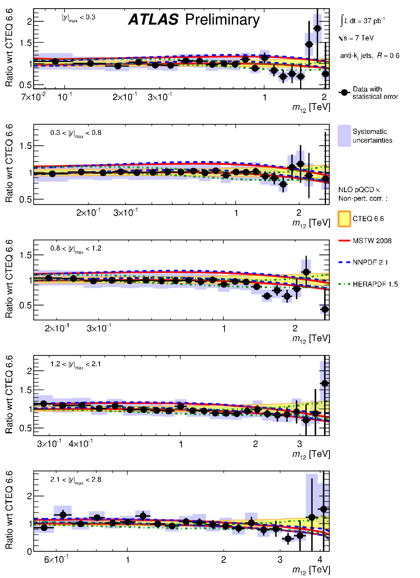
Dijets
Dijet cross section as a function of dijet mass, binned in rapidity of the more forward jet

Slide 36
Dijets
Dijet cross section as a function of dijet mass, binned in rapidity of the more forward jet
Much more on jets later!

Slide 37
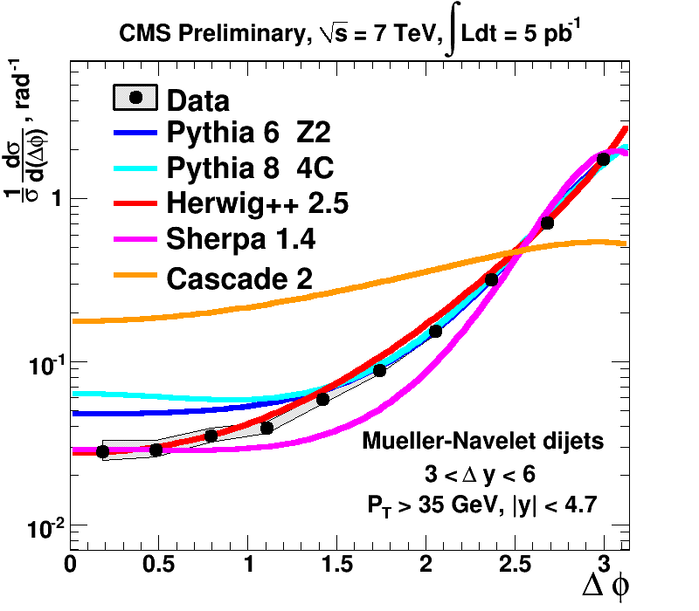
Dijet gaps & decorrelations
e.g. look at (de)correlation between dijets as rapidity interval increases
  Back-to-back, Δφ = π, cos(n (π−Δφ)) = 1
arXiv:1407.5756
CMS PAS FSQ-12-002

Slide 38
Dijet φ Decorrelation
Study how additional QCD radiation introduces an imbalance between the two highest p_{T} jets
Phys. Rev. Lett. 106, 172002 (2011)

Slide 39
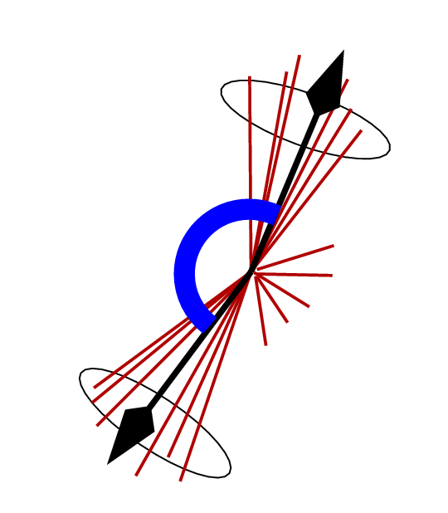
Dijet φ Decorrelation
Study how additional QCD radiation introduces an imbalance between the two highest p_{T} jets
Phys. Rev. Lett. 106, 172002 (2011)

Slide 40
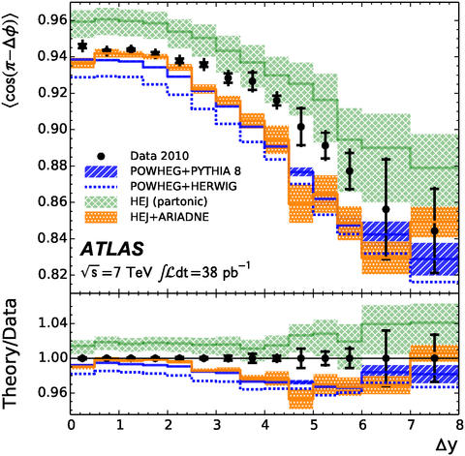
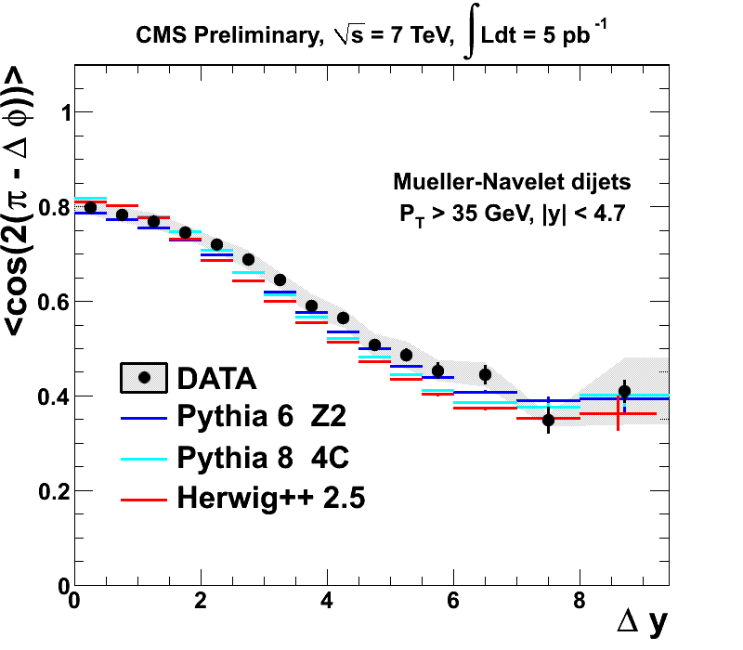
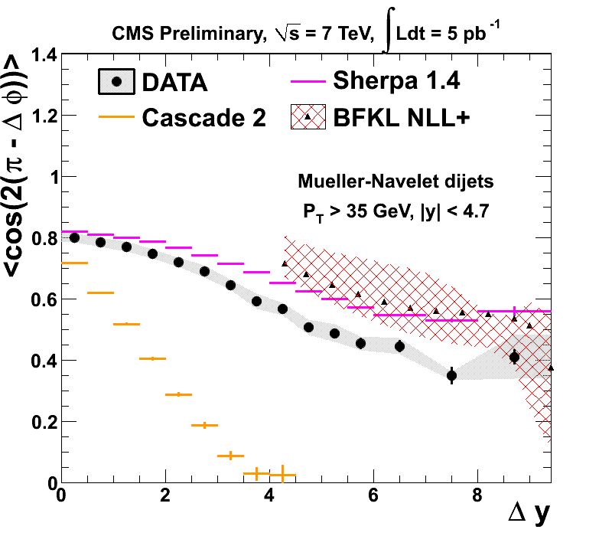
Dijet gaps & decorrelations
e.g. look at (de)correlation between dijets as rapidity interval increases
  Back-to-back, Δφ = π, cos(n (π−Δφ)) = 1
arXiv:1407.5756
CMS PAS FSQ-12-002

Slide 41
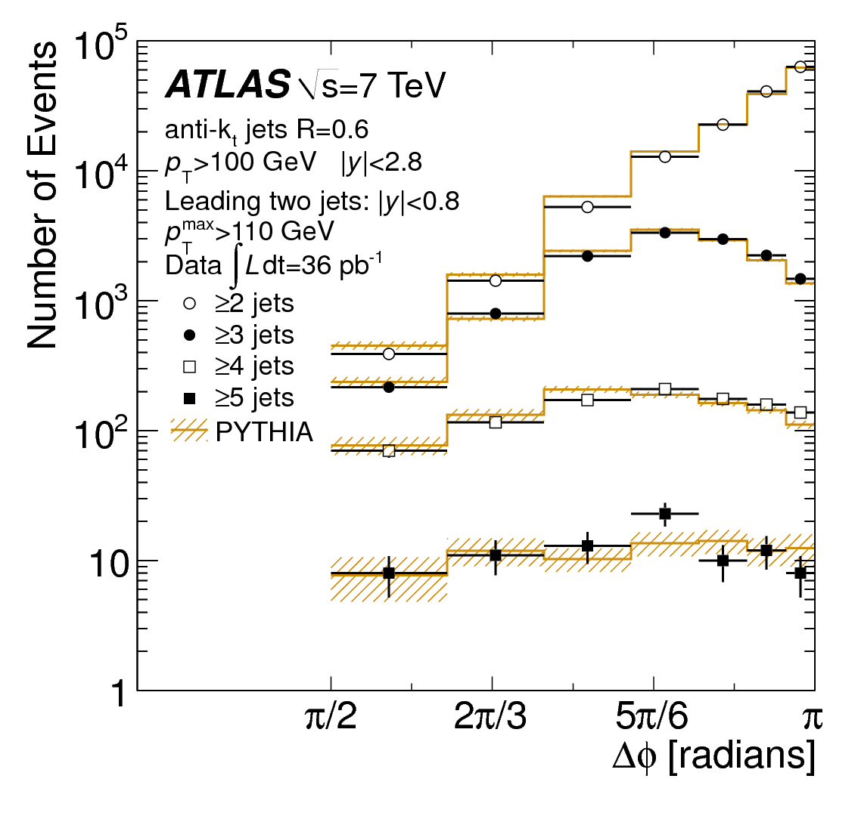
Dijet φ Decorrelation
Study how additional QCD radiation introduces an imbalance between the two highest p_{T} jets
Δφ
Phys. Rev. Lett. 106, 172002 (2011)

Slide 42
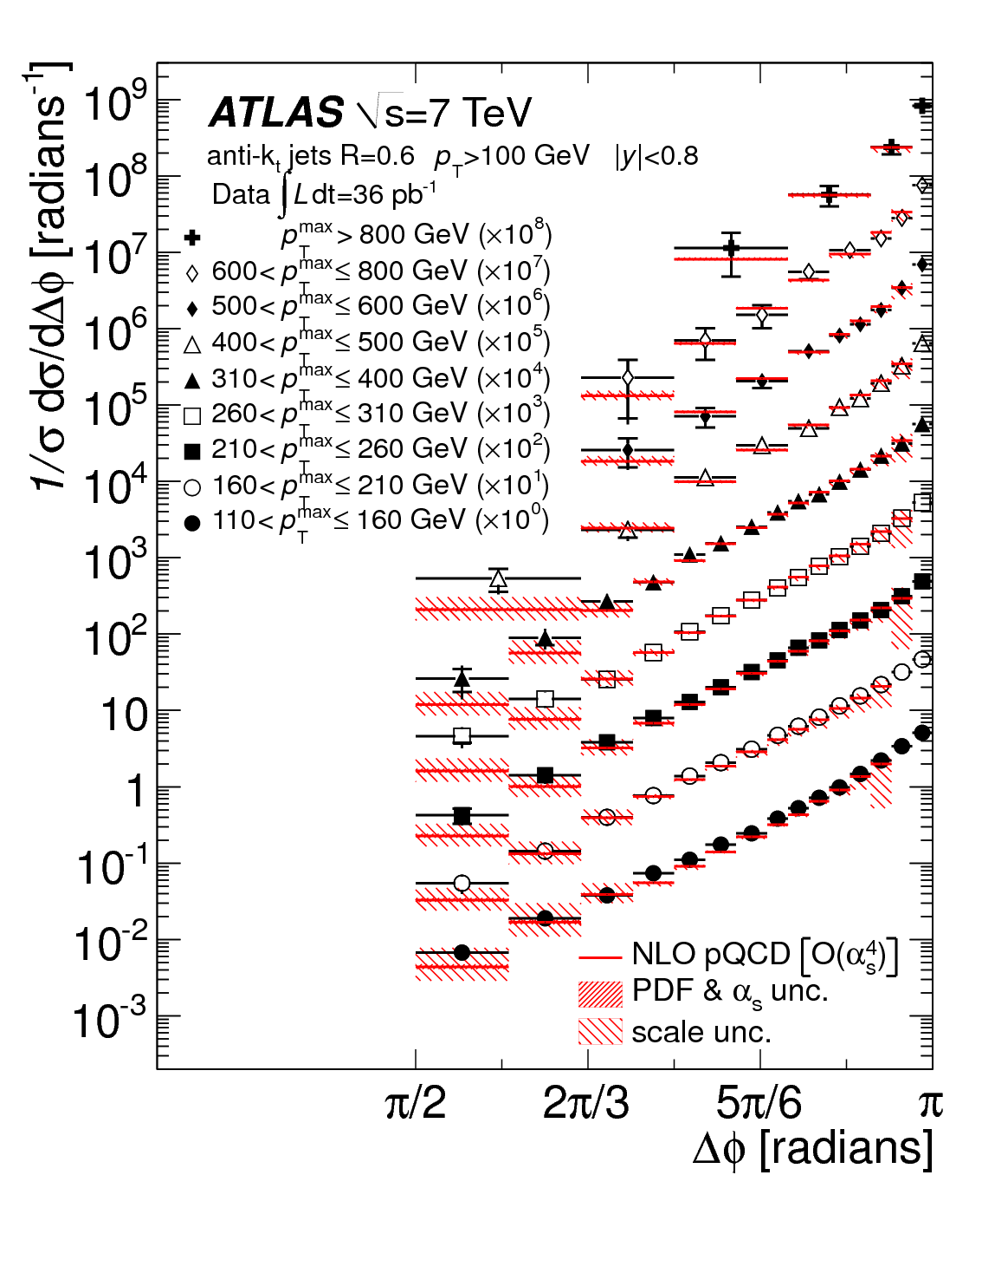
Dijet φ Decorrelation
Study how additional QCD radiation introduces an imbalance between the two highest p_{T} jets
Phys. Rev. Lett. 106, 172002 (2011)

Slide 43
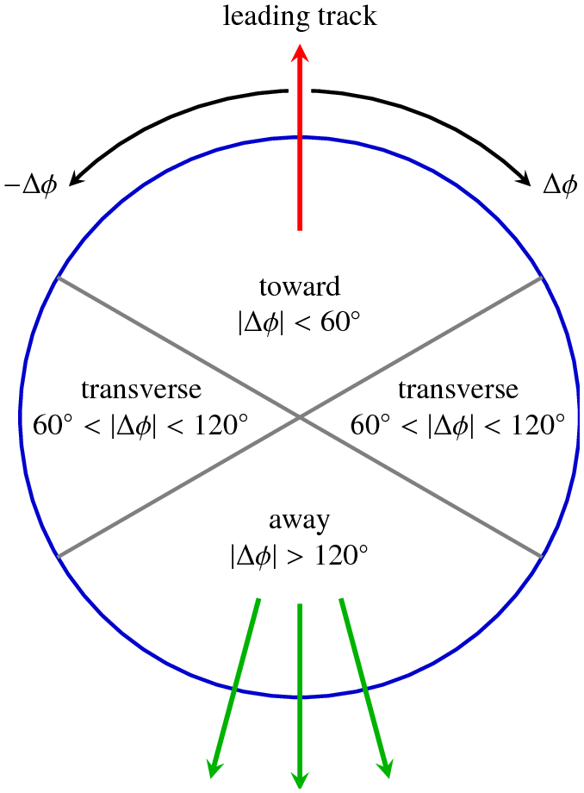
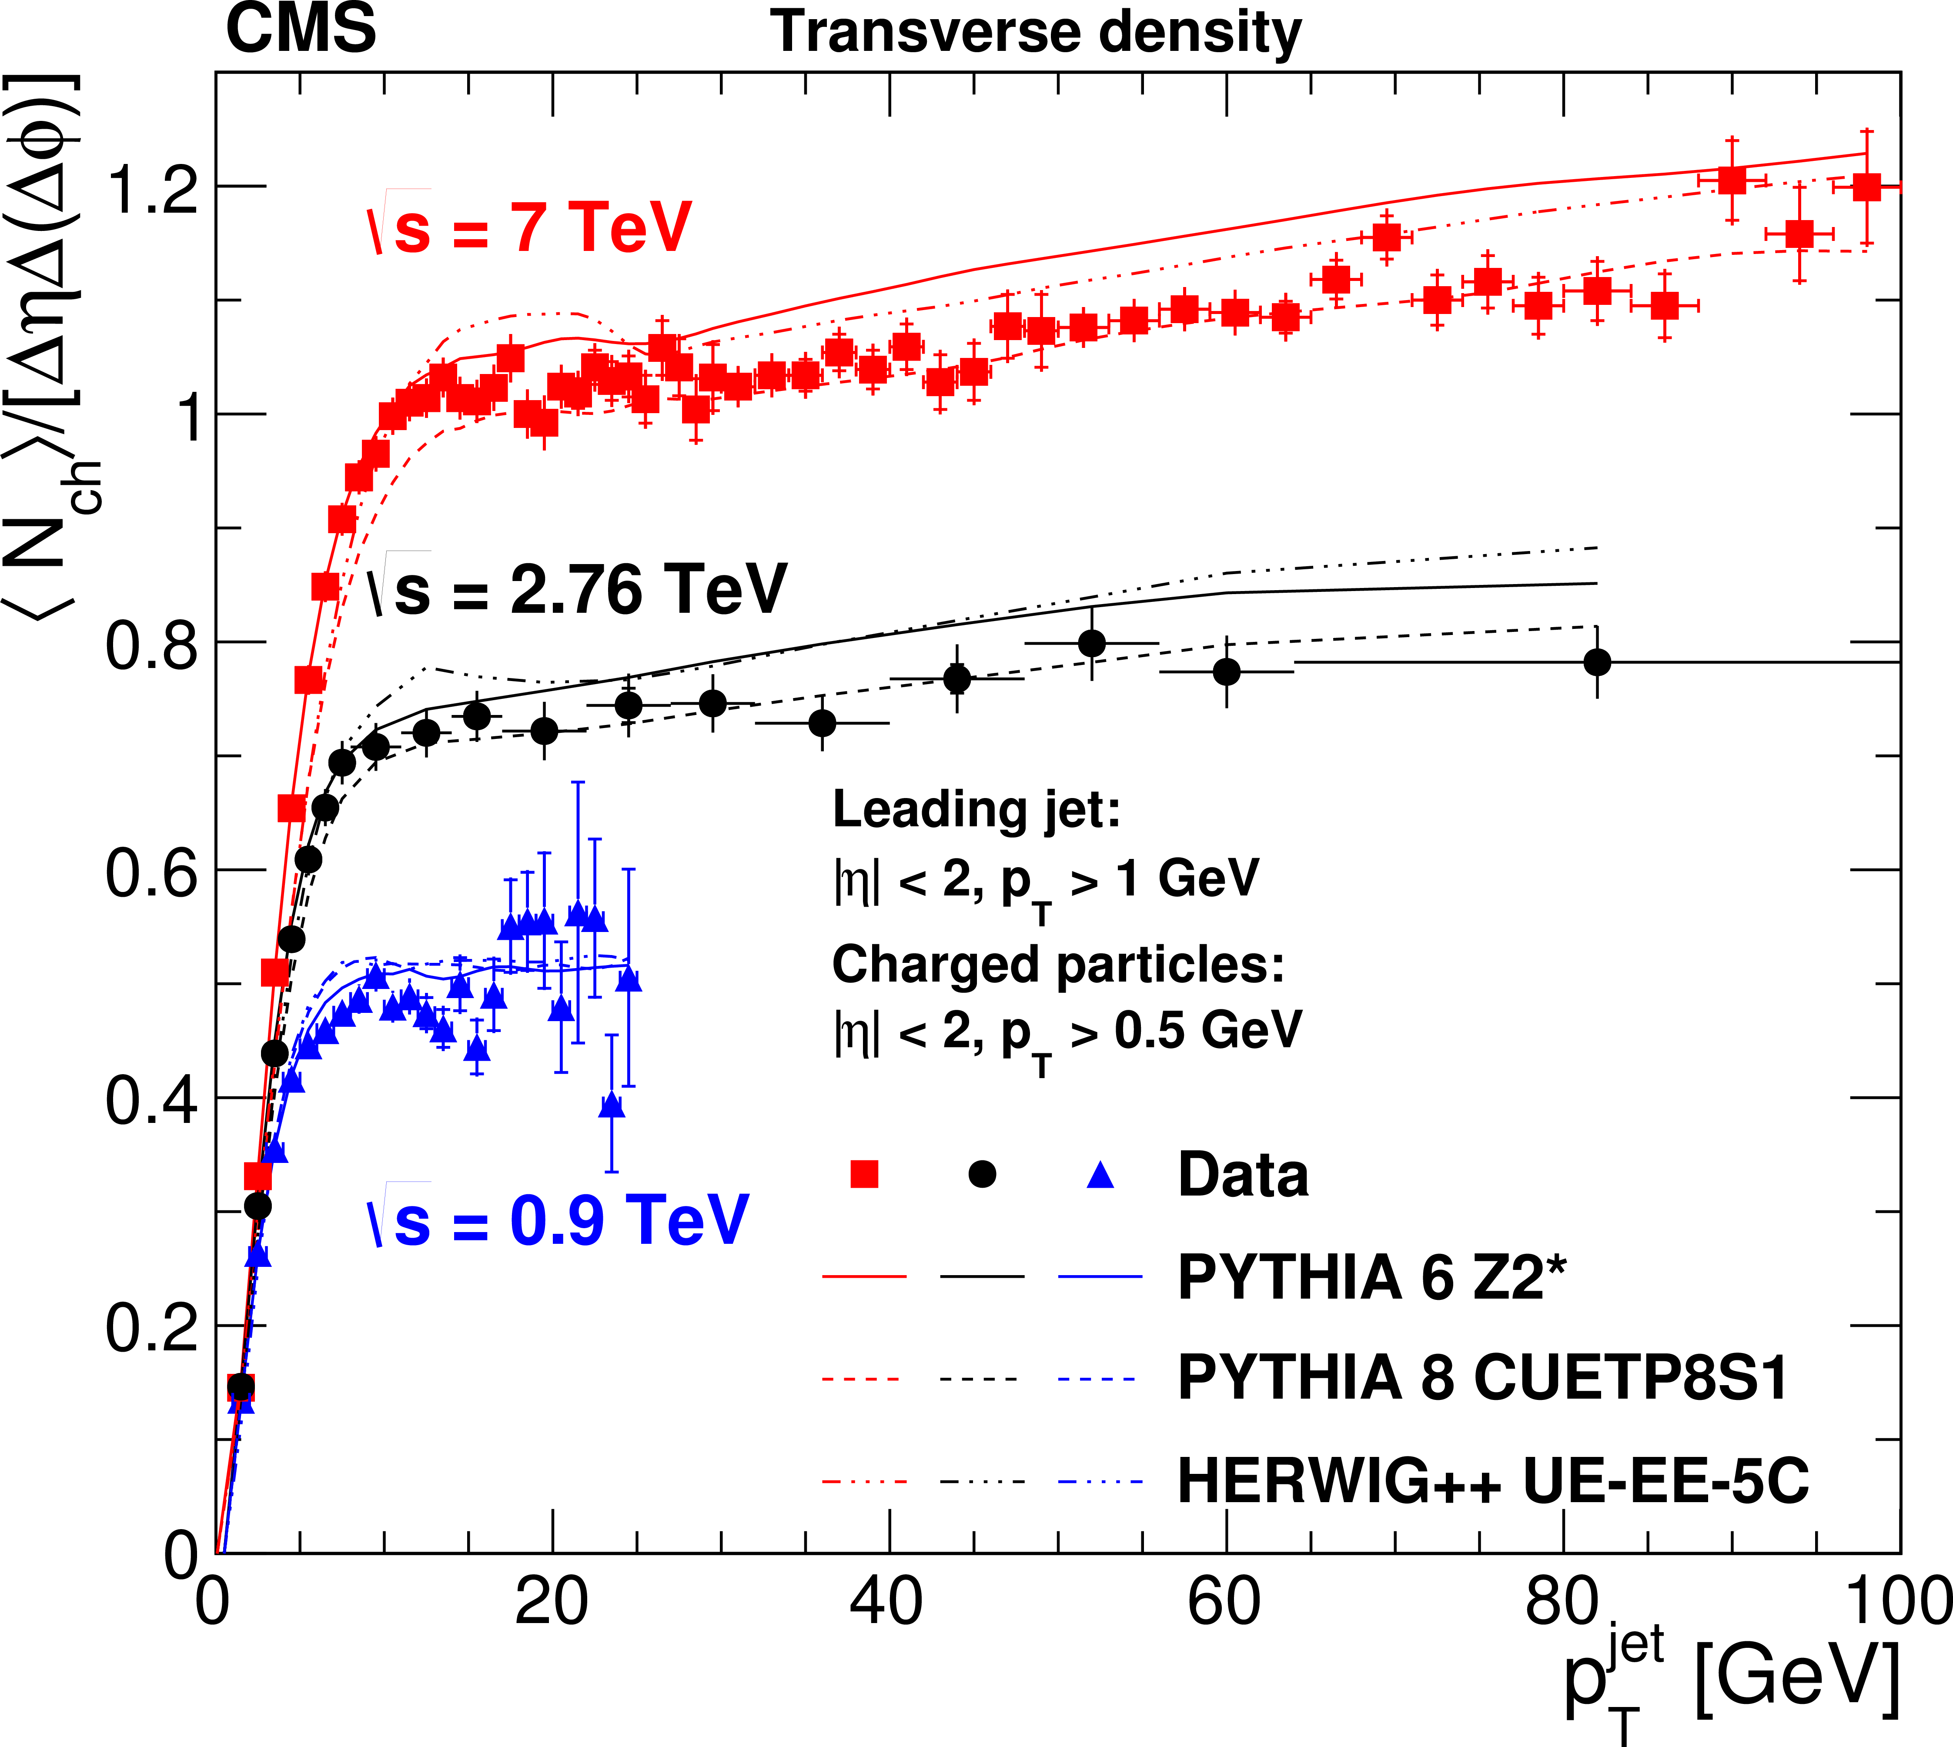
Underlying Event
jet
Use an object (track, jet, Z…) to select events with a hard process, and to define regions:
  e.g. leading jet →
Extensive library of fully-corrected results (Rivet), used to tune MC generators
This example, CMS, fully corrected, several CM energies
arXiv:1507.07229

