Slide 1
LHC Experimental Physics
Jon Butterworth
University College London
Vietnam School of Physics
Quy Nhon
September 2016

Slide 2
Outline
Introduction
First measurements
Jets and boosted objects
Higgs Discovery and Measurement
Measurements and Model Independence
Searches and the future
With thanks to Mario Campanelli, Monica Wielers, Wainer Vandelli (and of course many other colleagues too!)

Slide 3
Introduction

Slide 4
Introduction(s)
The accelerator, the detectors, some principles and digressions

Slide 5
Physics at the LHC
Energy reach
New particles
Shorter distance scales
High luminosity and excellent detectors
Cover the phase space opened
Study rare events
Energy opens more phase space
High multiplicities
QCD & EW radiation in events with objects at the electroweak scale
Boosted electroweak scale objects, rich perturbative structure inside jets
Surprises?

Slide 6
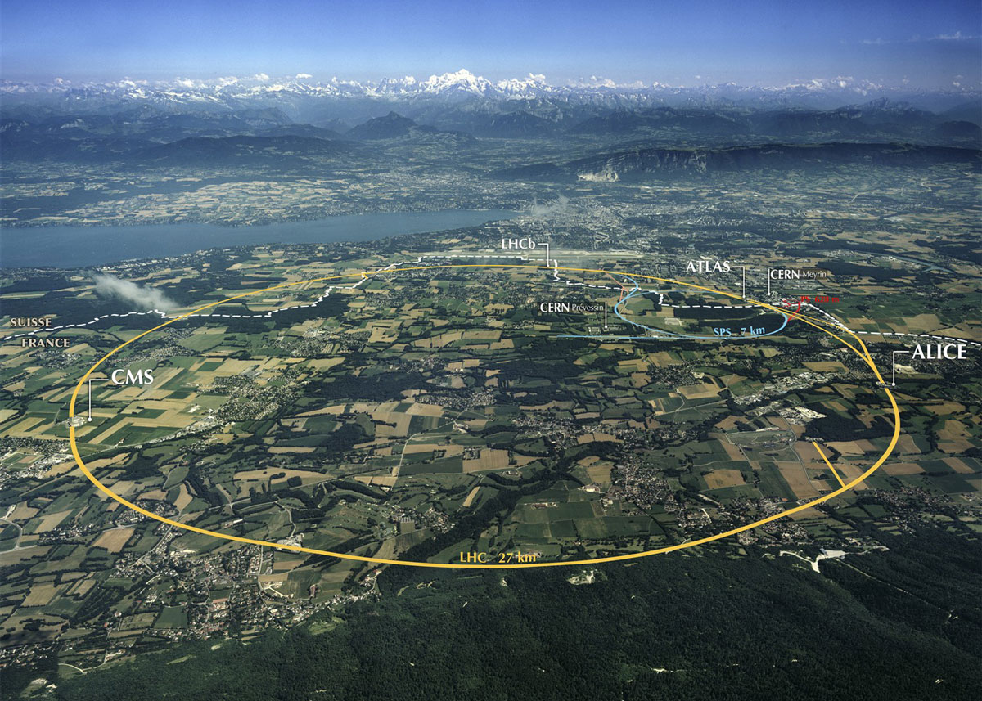
Notes:
Protons collisions at 14,000,000,000,000 eV
(eventually – currently at 7,000,000,000,000 eV)
Two “general purpose” experiments: ATLAS and CMS will detect the products of the collisions.
Why does it have to be so big? (weight on string)

Slide 7
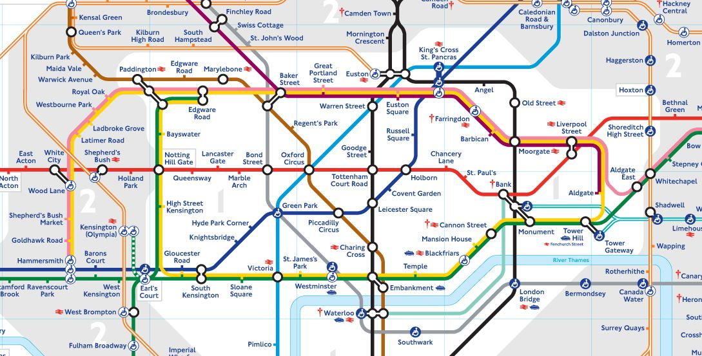

Slide 8
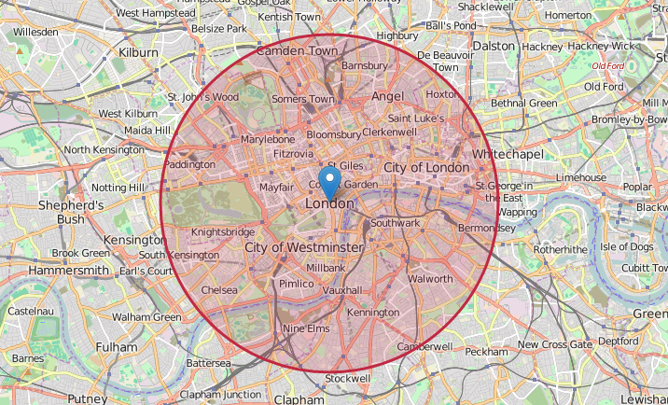
https://natronics.github.io/science-hack-day-2014/lhc-map/

Slide 9
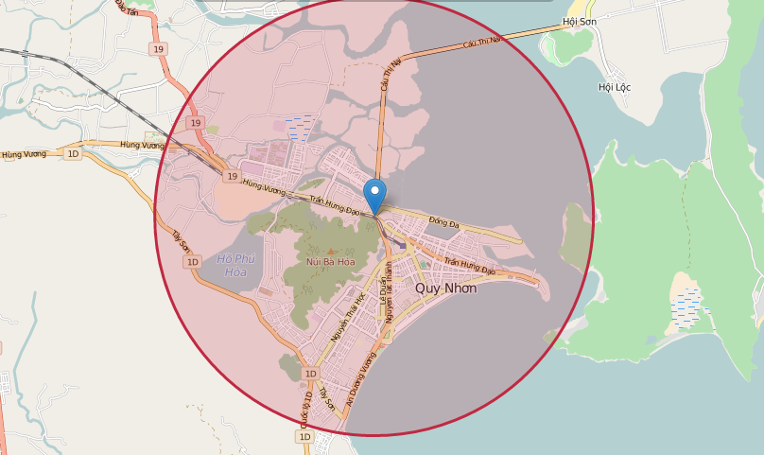
https://natronics.github.io/science-hack-day-2014/lhc-map/

Slide 10
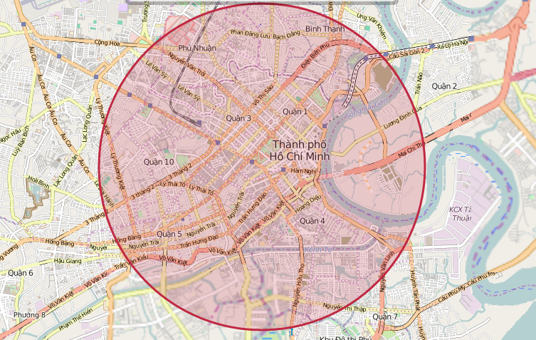
https://natronics.github.io/science-hack-day-2014/lhc-map/

Slide 11
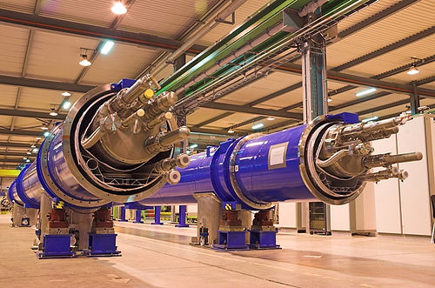
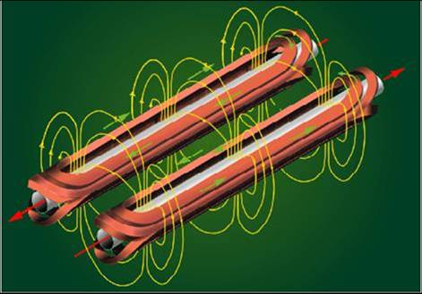
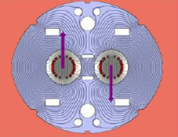
Unlike LEP or the Tevatron, the LHC is a proton-proton (matter-matter) machine
Technical difficulty: get a very accurate opposite magnetic field
So why?
Not possible to produce enough antiprotons to have the large luminosities needed for rare processes
Most of interactions will be gluon-gluon anyway →

Slide 12
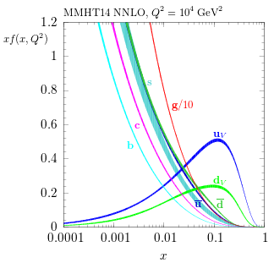
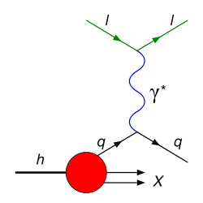
Parton Densities

Slide 13
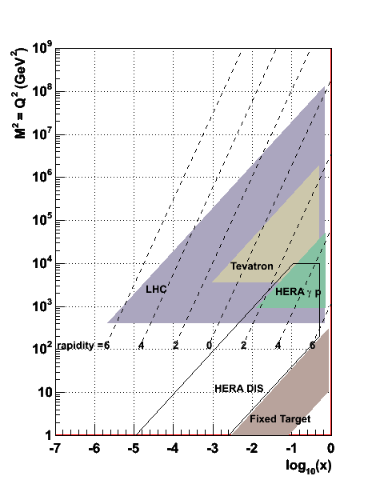
Parton Densities

Slide 14
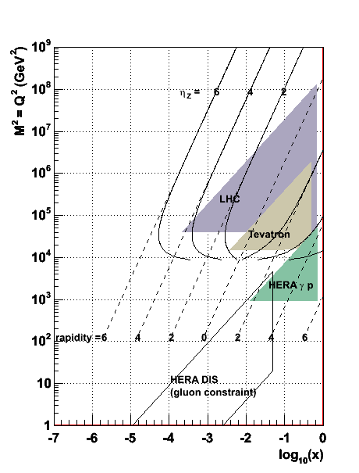
Parton Densities
More later….

Slide 16
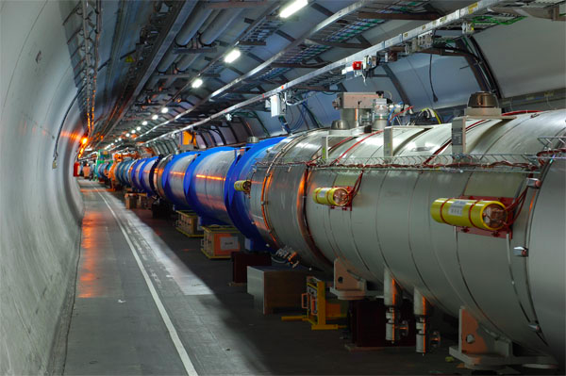

Slide 17
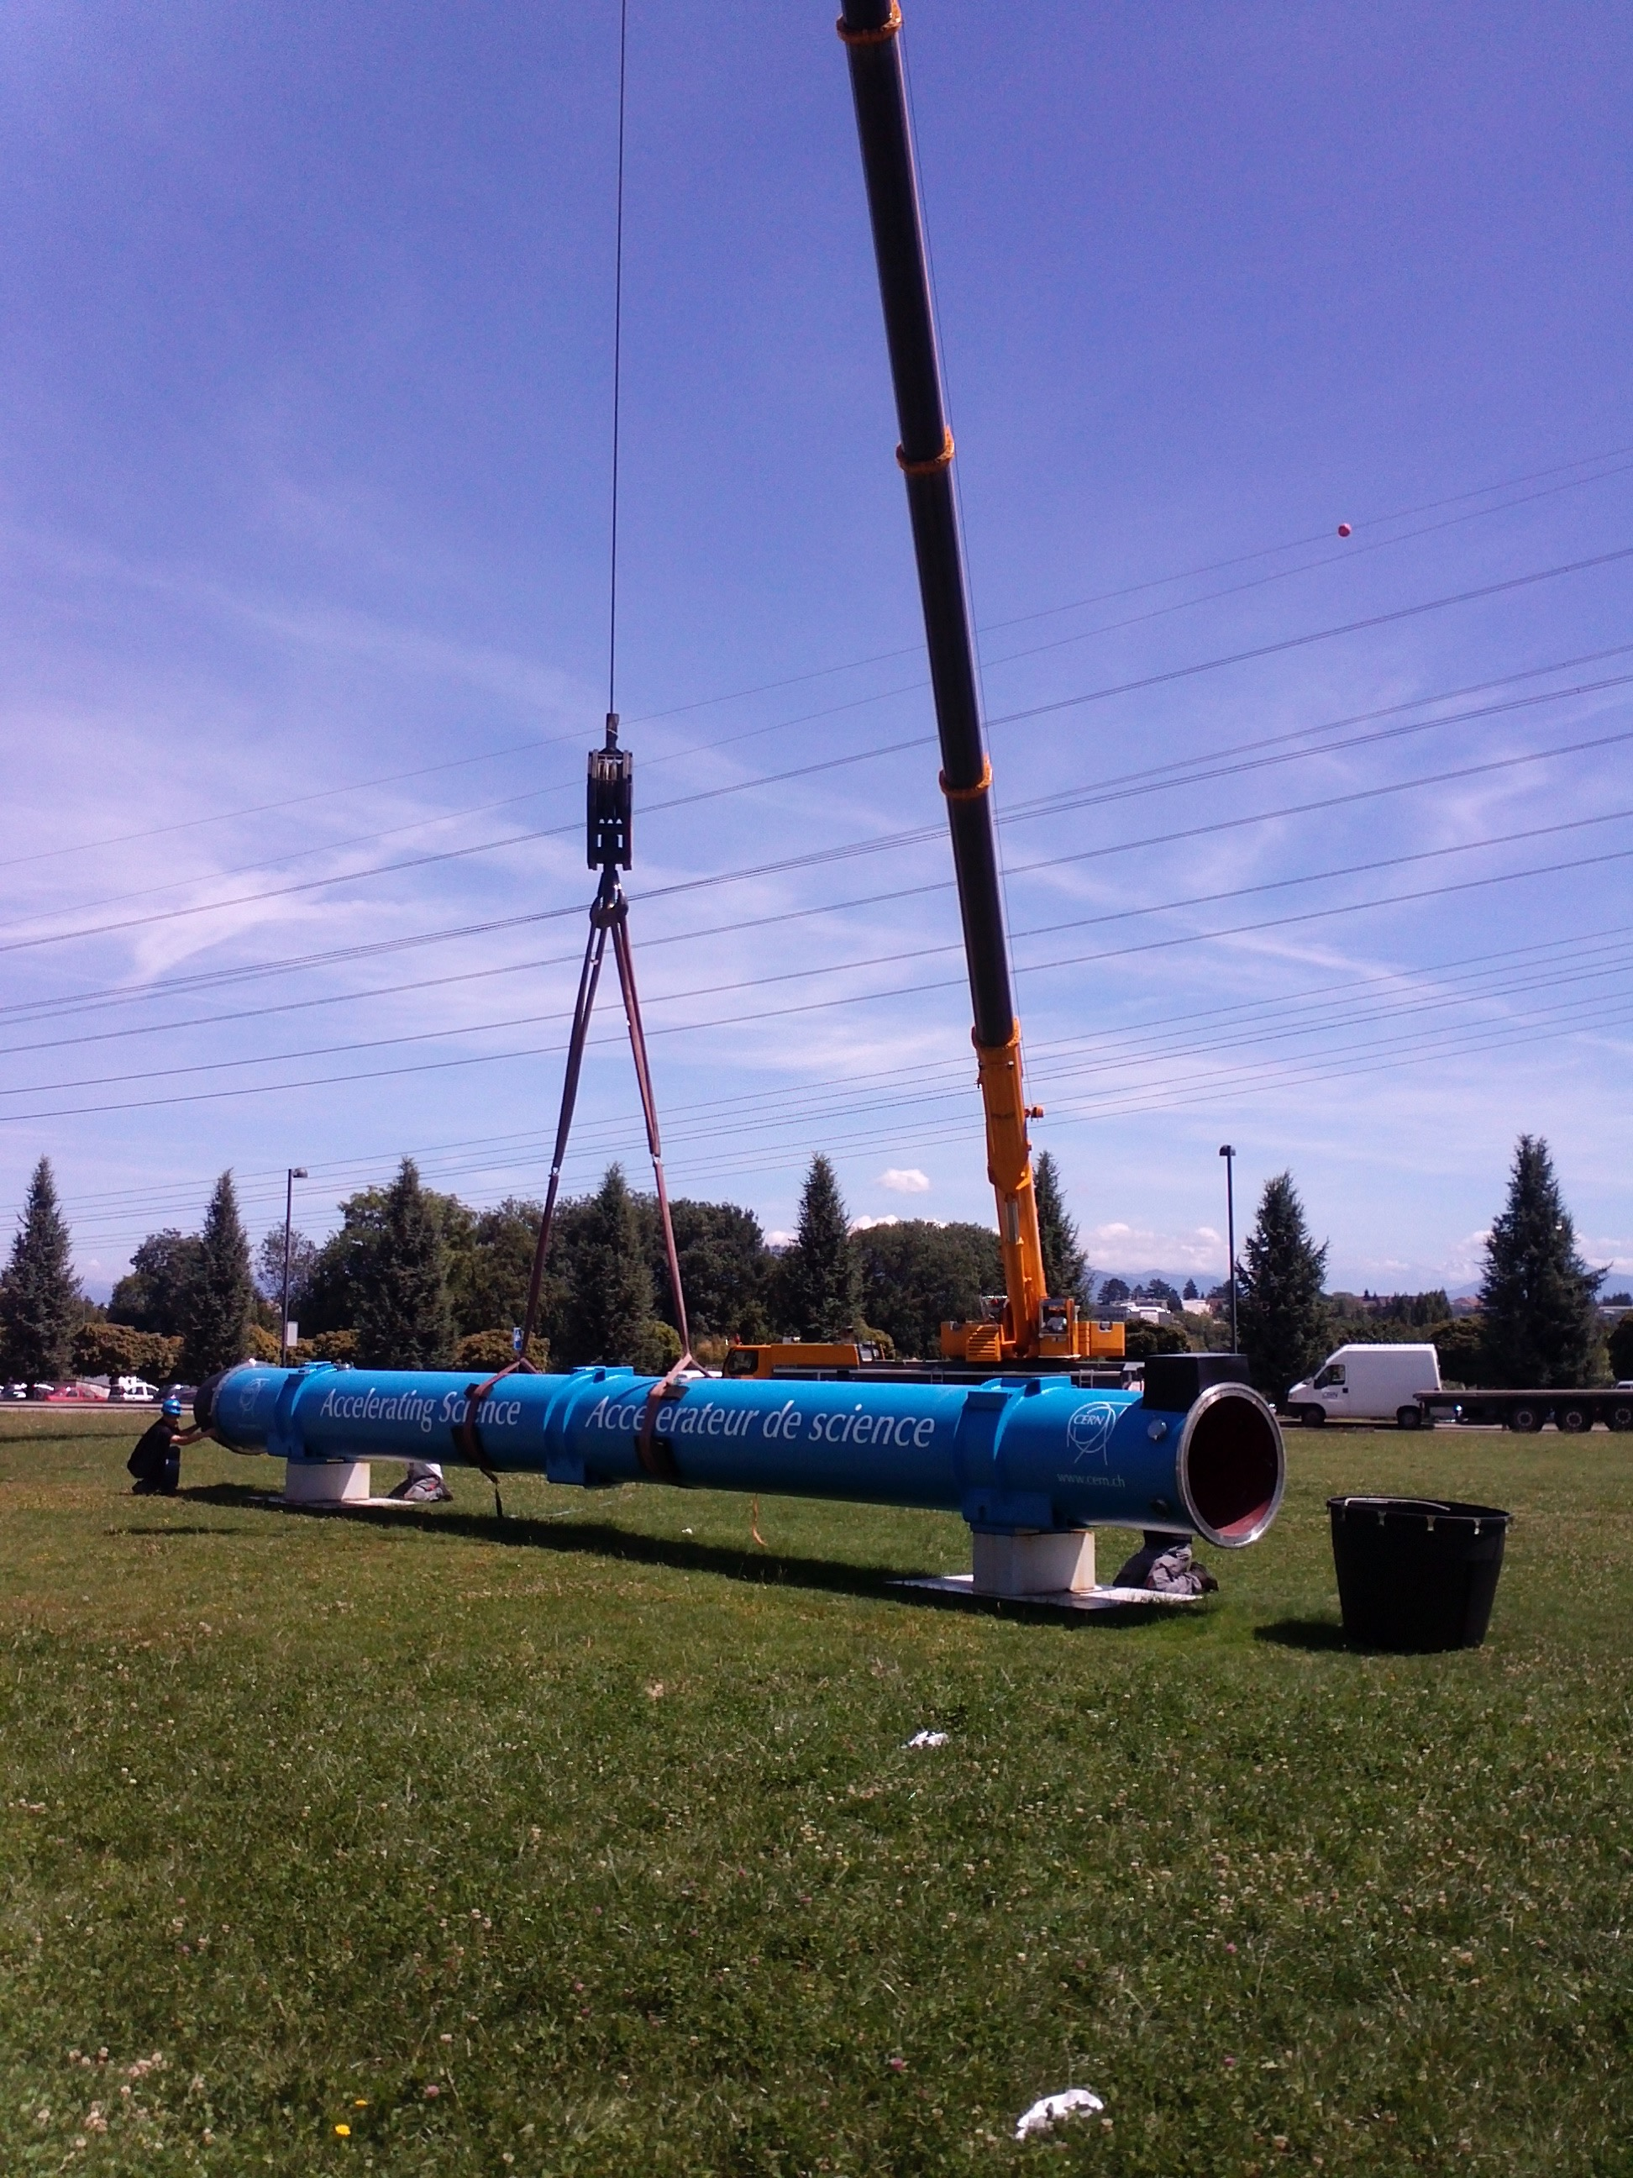

Slide 18
Some History and Politics

Slide 19
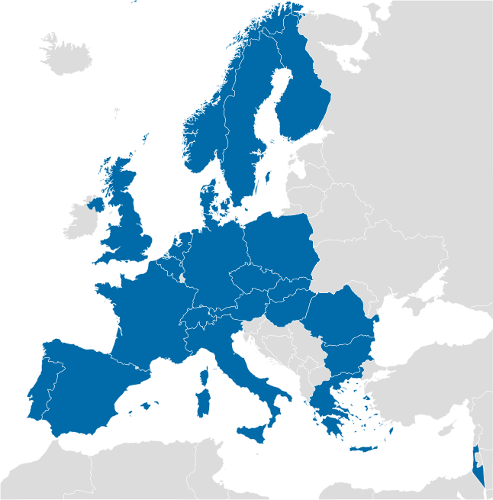

Slide 20
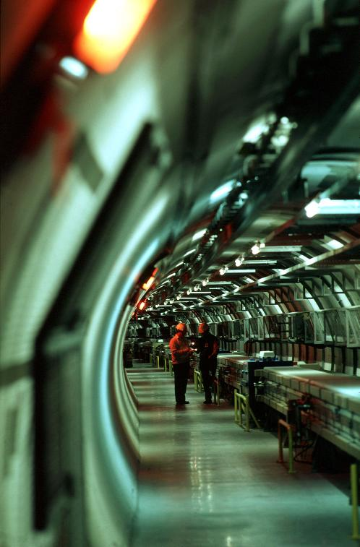
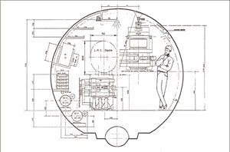
In the 1980s, CERN built LEP, the Large Electron-Positron collider, in a 26.6 km tunnel at average depth of 100m.
It was the largest civil-engineering project in Europe at the time.
Already in spring 1984 (5 years before LEP started operations!) a workshop was held on the possibility of building ”a Large Hadron Collider” in the LEP tunnel

Slide 21
At that time, the US was building a very ambitious hadron collider, the Superconducting Super Collider (SSC), in Texas.
In 1993 the US congress cancelled the SSC due to budget cuts. The LHC was the only viable project at the energy frontier, and approved in 1994)
...maybe not so bad for our health...
The discussion on detectors was well under way, and after many merges ATLAS and CMS were approved in 1995

Slide 22
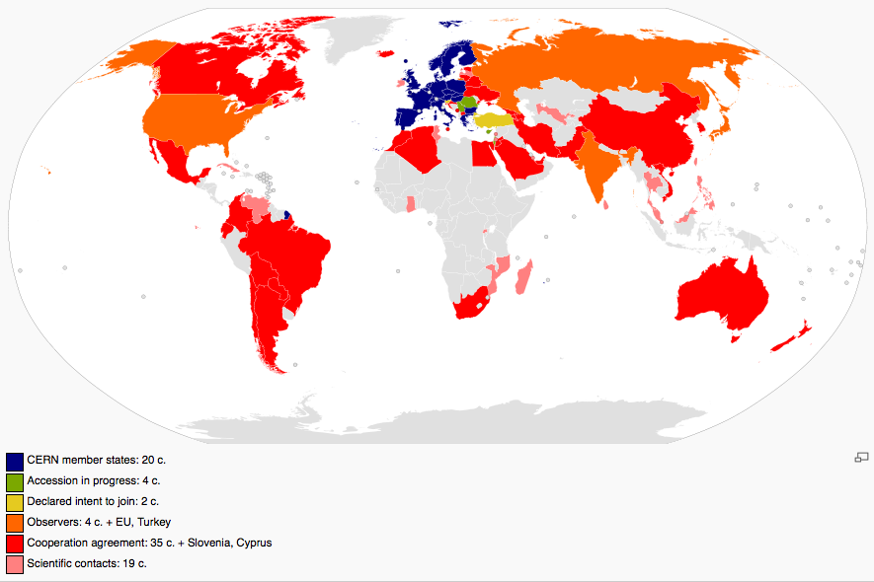
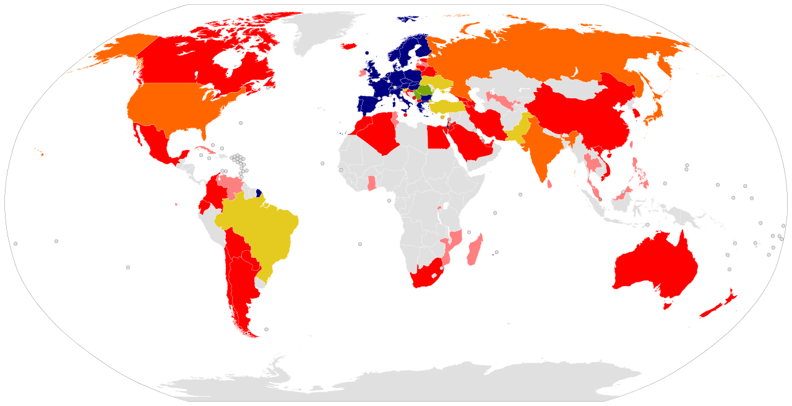

Slide 23
The Detectors

Slide 24
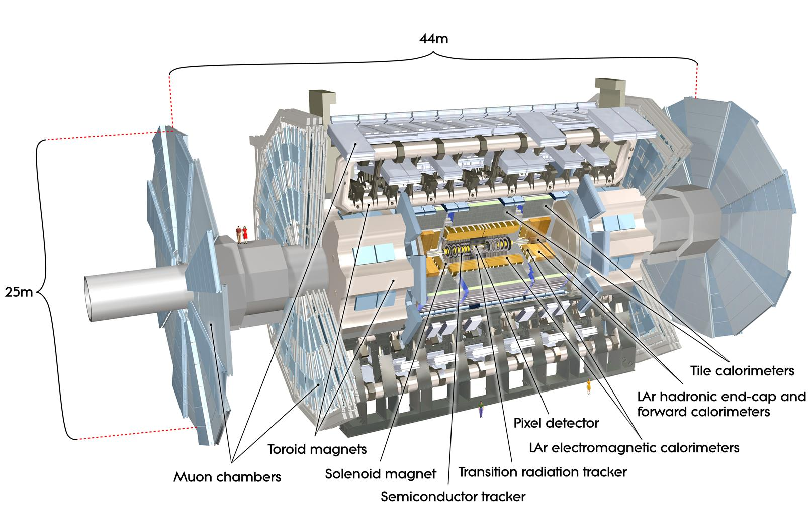
Notes:
CMS: 1 solenoid magnet (4T) creates field inside and outside
Muon chambers in return yoke
80000 PbWO₄ crystals as e.m. calorimeter

Slide 25
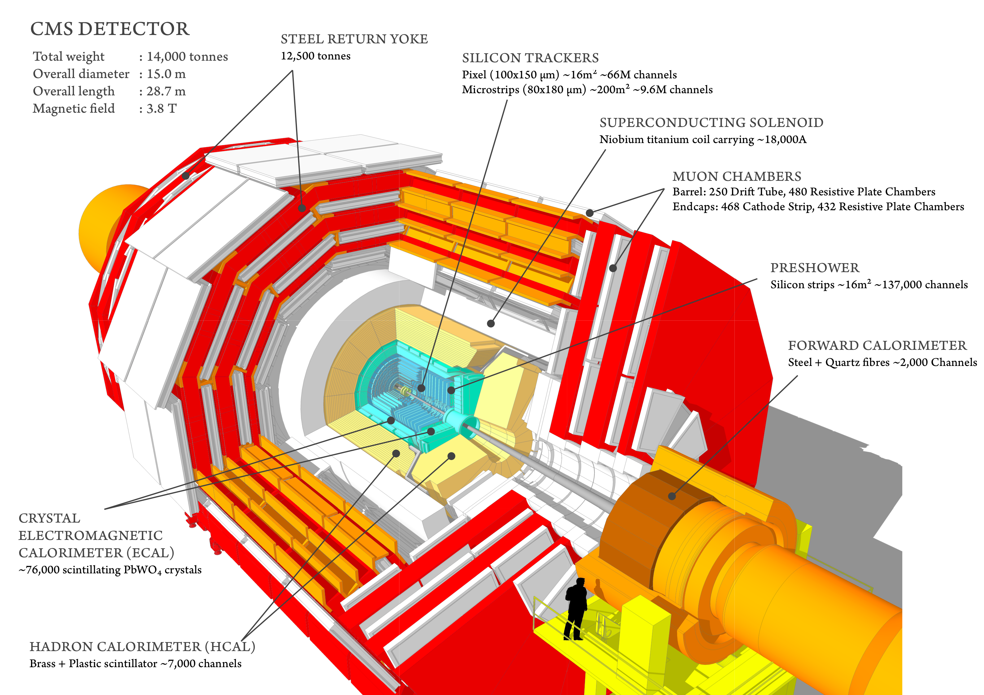
Notes:
CMS: 1 solenoid magnet (4T) creates field inside and outside
Muon chambers in return yoke
80000 PbWO₄ crystals as e.m. calorimeter

Slide 26
Notes:
LHCb dedicated to forward low-angle physics (especially b-quark production, rare decays) looks like a ”fixed target” detector.
Very good particle identification

Slide 27
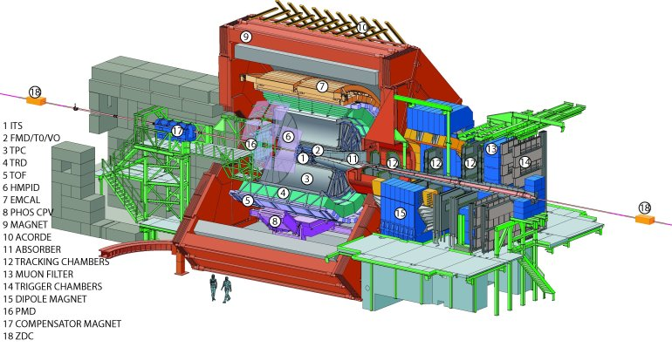
Notes:
Alice looks for high-multiplicity events in nucleus-nucleus collisions- the only LHC detector to have a gas tracker due to low-lumi and high-occupancy operation

Slide 28
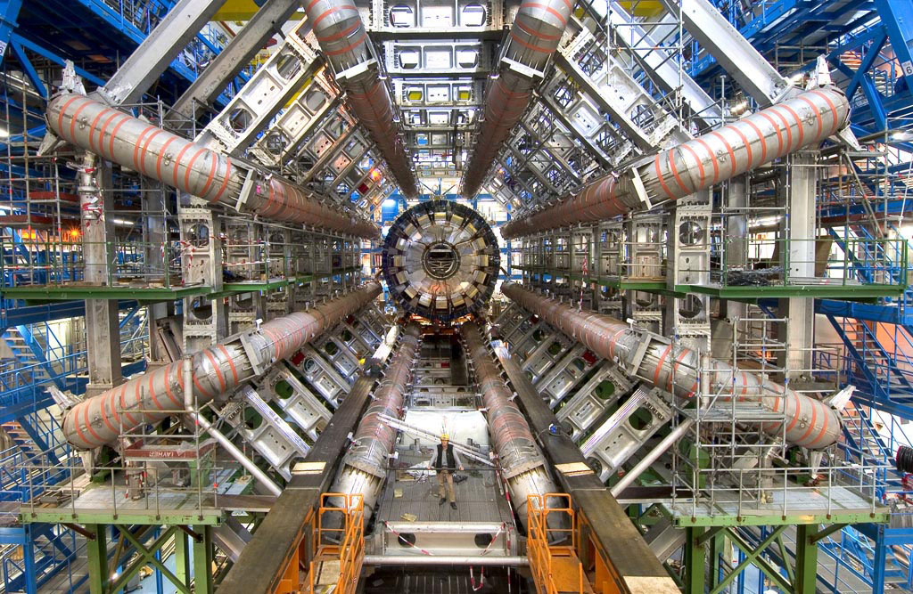
Notes:
FHM etc

Slide 29
Some Detector Principles

Slide 30
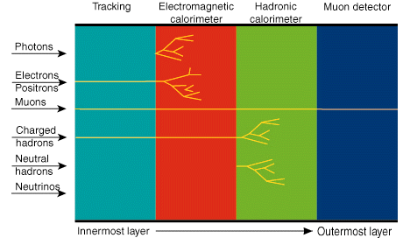
In a nutshell…

Slide 31
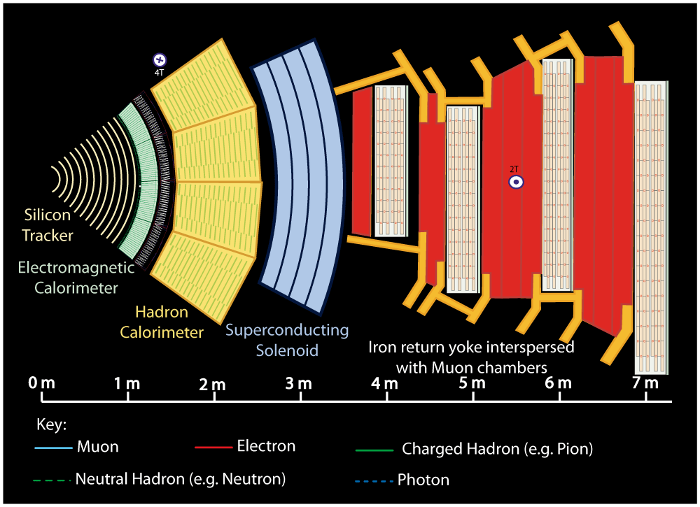
Notes:
Buttons. Click on any particle type to display the relevant slide with animations. Clicking again will return to this slide.
Recommend putting this slide in the middle of your presentation and putting the other 5 slides at the end.
If you have any difficulties, contact David.Barney@cern.ch

Slide 32
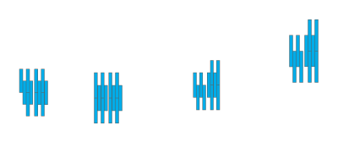
Notes:
Muon: passing through CMS, bending in the field (both ways, depending on when it is inside or outside of the solenoid) leaving hits in the Tracker layers and the muon chambers before escaping completely

Slide 33
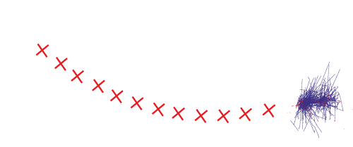
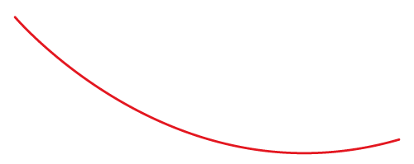
Notes:
Electron: Bending in the magnetic field, leaving hits in the tracker layers and being “stopped” by the electromagnetic calorimeter

Slide 34
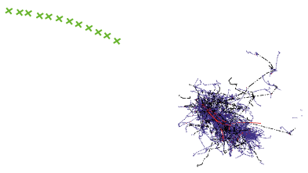
Notes:
Charged hadron: Bends in the magnetic field and leaves signals in the tracker layers; passes through the electromagnetic calorimeter leaving essentially no signal, and is “stopped” by the hadron calorimeter

Slide 35
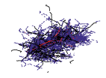
Notes:
Neutral hadron: Does not bend in the magnetic field and does not leave any signal in the tracker layers; passes through the electromagnetic calorimeter leaving essentially no signal, and is “stopped” by the hadron calorimeter

Slide 36
Notes:
Photon: passes through the tracker without bending in the magnetic field or leaving hits, is “stopped” by the electromagnetic calorimeter

Slide 37
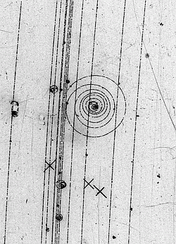
Momentum Measurement
Accurate measurement of particle path, including radius of curvature in magnetic field
Minimise multiple scattering
Minimise noise
Enough ‘hits’ and low enough occupancy to allow good pattern recognition

Slide 38
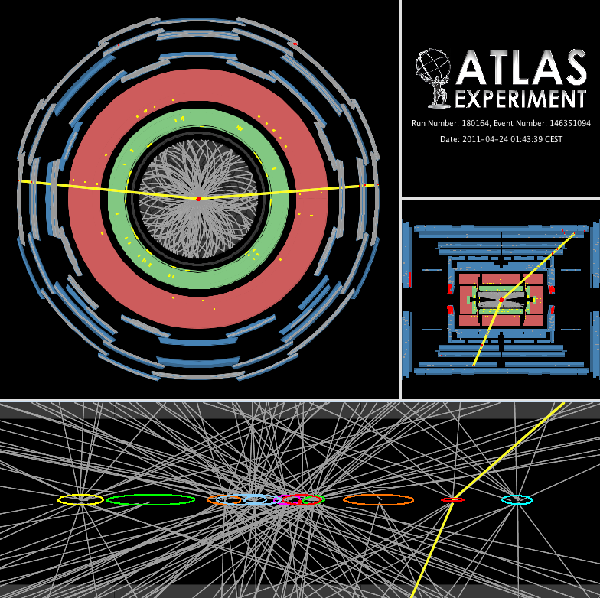

Slide 39
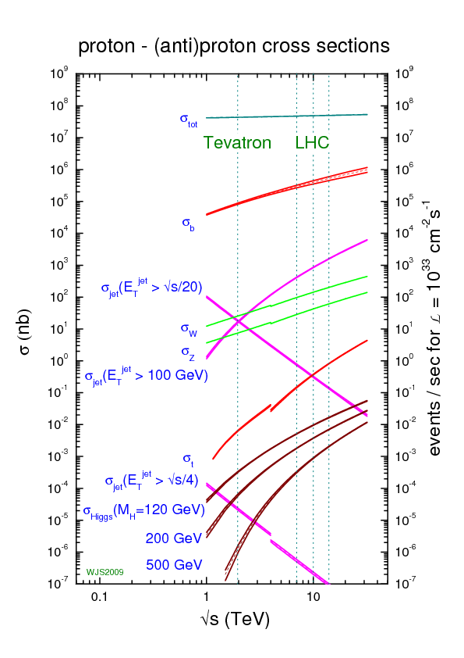
Data Acquisition and Triggering

Slide 40
DAQ and Trigger
What a trigger is and how it works
Tells you when is the “right” moment to take your data
Decides very rapidly what output to keep if you can’t keep all of it. The decision is based on some ‘simple’ criteria
Can be done in several levels

Slide 41
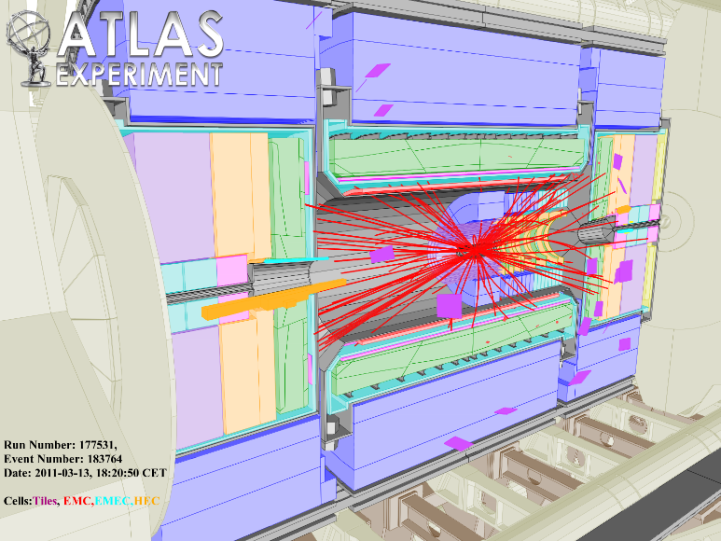
What is it about...
How to get from here…
Select HIGGS
To here.

Slide 42
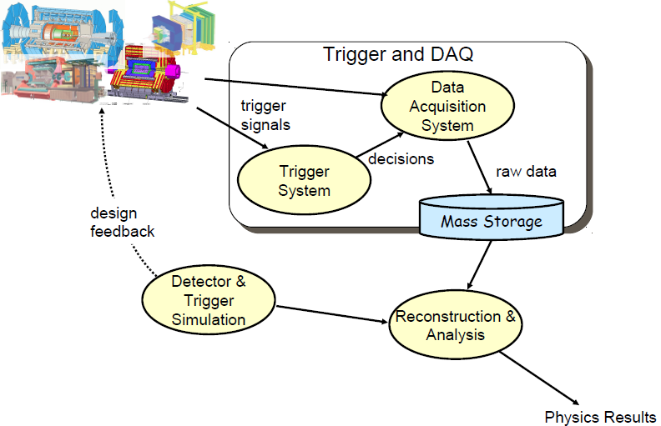
Or
Main role of Trigger & DAQ:
Process the signals generated in the detectors
Select the ‘interesting’ events and reject the ‘boring’ ones
Save interesting ones on mass storage for physics analysis

Slide 43
DAQ
Abbreviation for Data Acquisition System
Wikipedia:
Process of sampling signals that measure real world physical conditions and converting the resulting samples into digital numeric values that can be manipulated by a computer.
In HEP it consists mainly of electronics, computer science, networking and quite a lot of physics
Tasks
Gathers the data produced by the detectors (Readout)
Forms complete events (Event Building)
Possibly feeds (several) levels of deciding to keep the collision (called typically event in the following)
Stores event data (Data logging)
Provides control, configuration and monitoring facilities

Slide 44
Deadtime and Efficiency
Definitions
Average rate of physics phenomenon (input): f
Process rate: λ=1/f
Average rates of DAQ (output): 
Deadtime: 
Time the system requires to process an event, without being able to handle other triggers
Probability that DAQ is busy: P[busy] =  
Probability that DAQ is free: P[free] = 1 -  
Therefore
.
Efficiency:

Slide 45
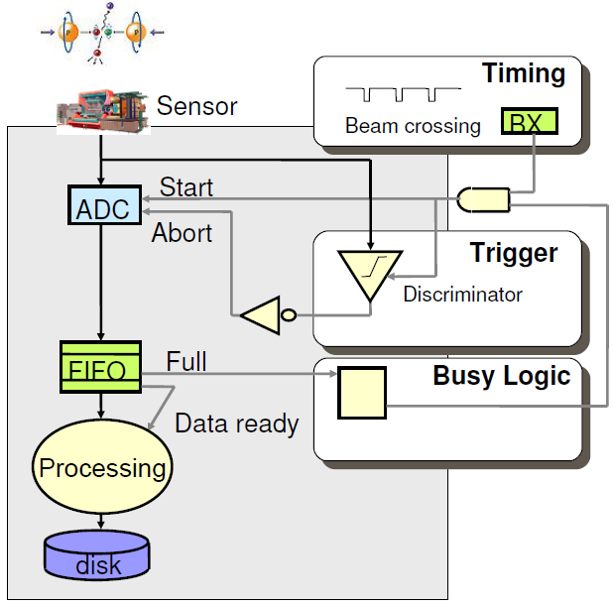
DAQ: Collider mode
Particle collisions are synchronous
Trigger rejects uninteresting events
Even if collisions are synchronous, the triggers (interesting events) are unpredictable
Derandomisation is still needed
No trigger deadtime if trigger latency below time between two beam crossings

Slide 46
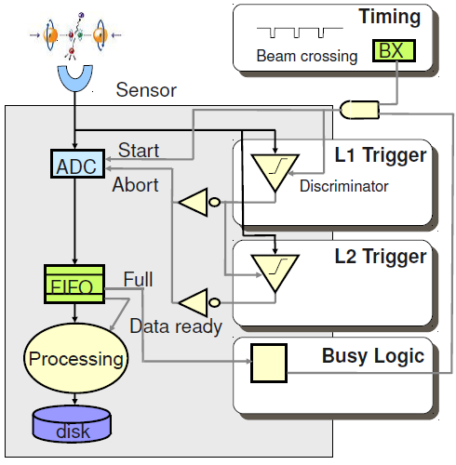
Multi-Level Trigger
For complicated triggers latency can be long
if τ_{trig}>τ_{BX}, deadtime>50%
Split trigger in several levels with increasing complexity and latency
All levels can reject events
with τ_{L1}<τ_{BX}, trigger deadtime only ν_{L1}·τ_{L2}

Slide 47
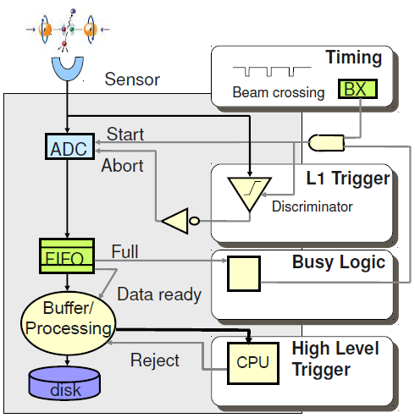
Multi-Level Trigger
For optimal data reduction can add trigger level between readout and storage (High-level trigger)
Has access to some/all processed data

Slide 48
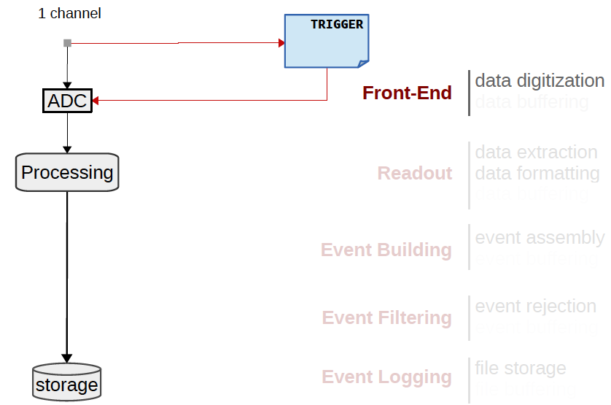
The increased number of channels require hierarchical structure with well defined interfaces between components

Slide 49
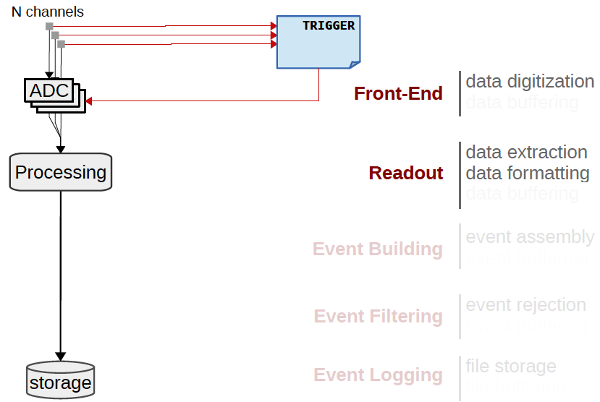
The increased number of channels require hierarchical structure with well defined interfaces between components

Slide 50
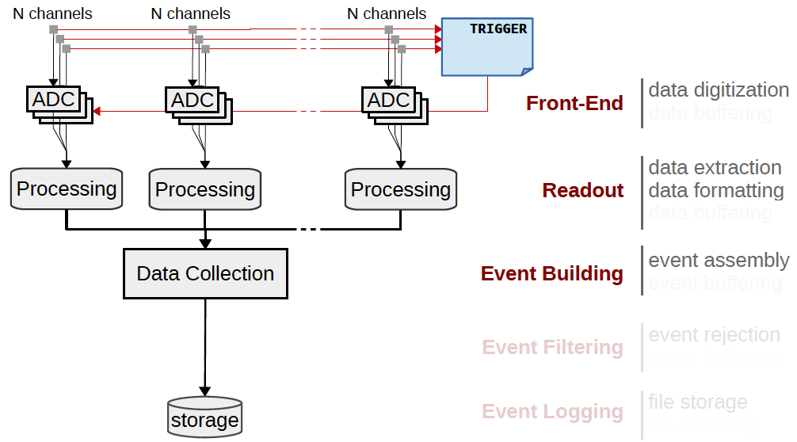
The increased number of channels require hierarchical structure with well defined interfaces between components

Slide 51
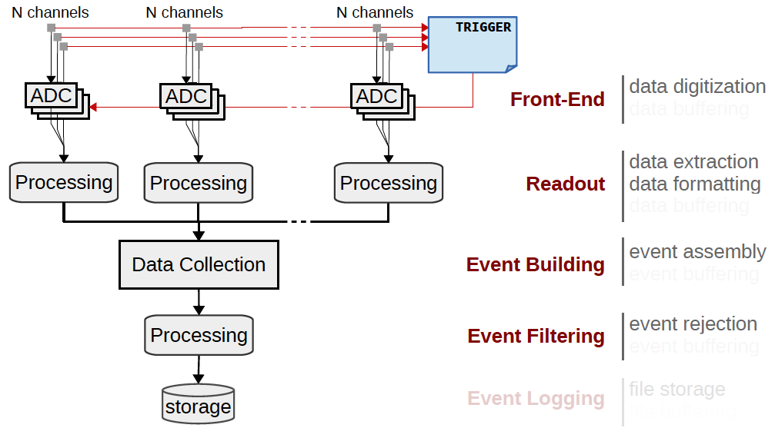
The increased number of channels require hierarchical structure with well defined interfaces between components

Slide 52
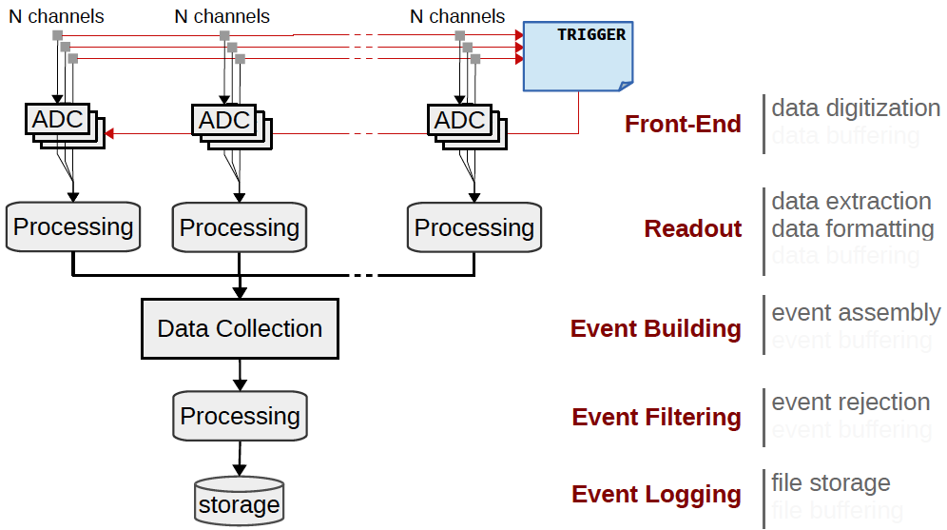
The increased number of channels require hierarchical structure with well defined interfaces between components

Slide 53
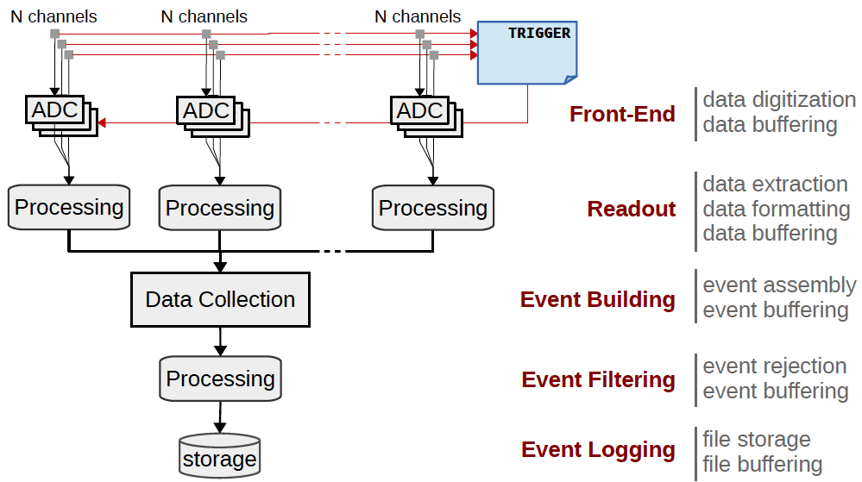
Buffering usually needed at all levels

Slide 54
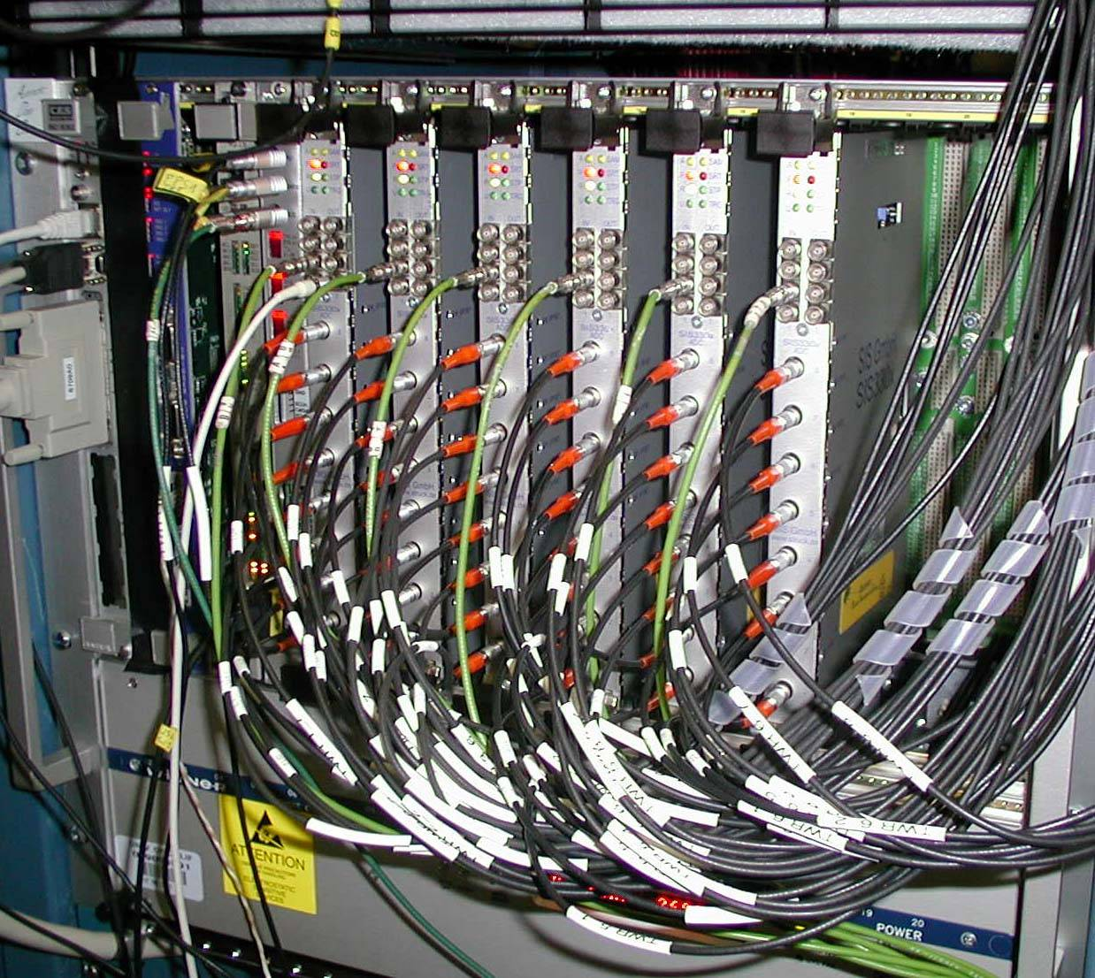
Read-out Topology
19”
Reading out = building events out of many detector channels
We define “building blocks”
Example: readout crates, event building nodes, …
Crate: many modules put in a common chassis which provides
Mechanical support
Power
A standardised way to access the data
Provides signal and protocol standard for communication
All this is provided by standards for (readout) electronics such as NIM or VME (IEEE 1014)
7U
Backplane Connectors
(for power and data)
VME Board
Plugs into Backplane

Slide 55
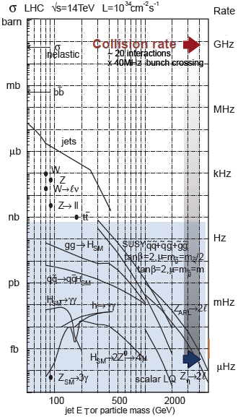
Huge incoming rate of common – and therefore eventually “uninteresting” – collisions
Huge rejection needed from ~10⁹ Hz to ~10² - 10³ Hz for offline storage (physics analyses)
Impossible to save all collisions
Would result in O(100000) PetaByte or O(1000) Exabyte per year of data per experiment
For comparison: 5 Exabytes: All words ever spoken by human beings.

Slide 56
Trigger = Rejection
Problem: We must analyse and reject most collisions prior to storage
Solution: Trigger
Fast processing
High efficiency for interesting physics
Huge rejection factor 10⁴ – 10⁵
If the incoming rate is very high, the trigger itself is a ‘severe’ physics decision –
Make sure your favourite physics channel is selected with high efficiency!
Many other triggers needed by other physics analyses will compete with you

Slide 57
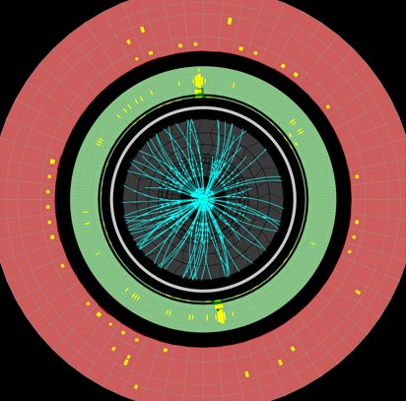
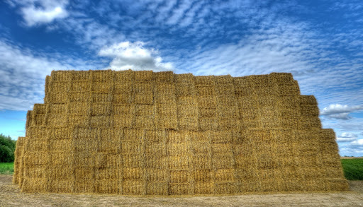
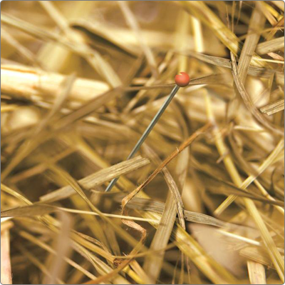
Example: H→γγ
Roughly one 125 GeV Higgs for every 10 billion pp interactions
H→γγ is rare decay with BR ∼10⁻³
Approx. 1 H→γγ per 10 trillion interactions
Make sure you select them all….

Slide 58
Other Challenges
Pile-up (overlapping collisions)
Bunch crossing frequency of 40 MHz
LHC produced up to 75 pileup events in Run 2. Every bunch crossing ~few 1000 particles are produced
It's on-line (cannot go back and recover events)
need to monitor selection - need very good control over all conditions
Any event thrown away is lost for ever!

Slide 59
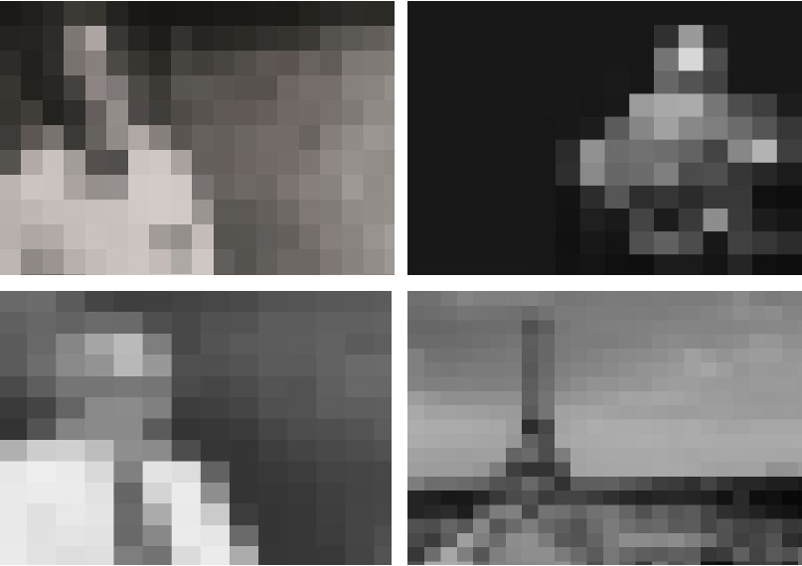
Example: Higgs
Level 1
Coarse granularity, very basic info available (and probably no overview of whole event/picture)

Slide 60
Example: Higgs
Level 2
More information available, improved reconstruction, improved ability to reject events

Slide 61
Example: Higgs
Level 3
High quality reconstruction, improved ability to reject events.
(But still leave the last steps for offline analysis)

Slide 62
Outline
Introduction
First measurements
Jets and boosted objects
Higgs Discovery and Measurement
Measurements and Model Independence
Searches and the future
With thanks to Mario Campanelli, Monica Wielers, Wainer Vandelli (and of course many other colleagues too!)

