Slide 1
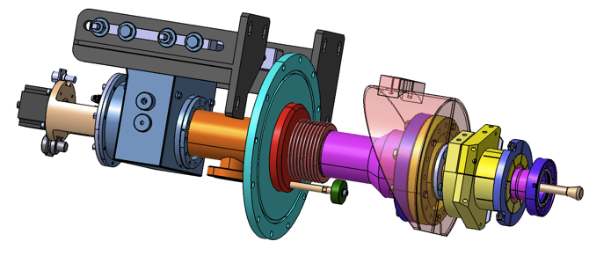
4th French Linear Collider Days
Coupler production for the European XFEL and extrapolation to ILC
Paris, March 23rd 2016
Walid KAABI- LAL/Orsay
Notes:
How to edit the title slide
Upper area: Title of your talk, max. 2 rows of the defined size (55 pt)
Lower area (subtitle): Conference/meeting/workshop, location, date,
your name and affiliation,
max. 4 rows of the defined size (32 pt)
Change the partner logos or add others in the last row.

Slide 2
Outlines:
Introduction
Industrial monitoring & quality control
Couplers preparation and RF conditioning at LAL
Project progress
Extrapolation to ILC

Slide 3
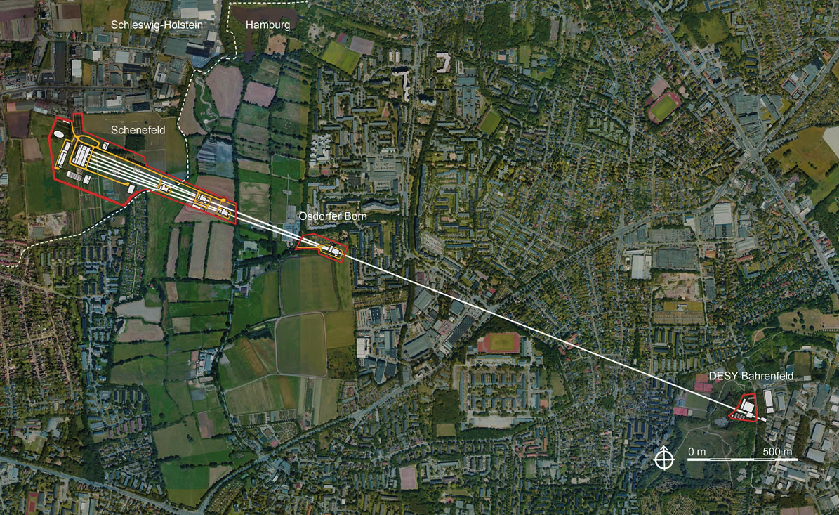
Introduction:
1.3 Km linac accelerating e- up to 17GeV

Slide 4
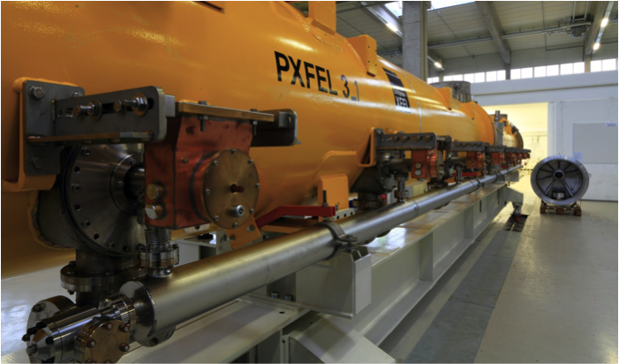
Introduction:
100 Cryomodules to be equipped with 8 couplers each → 800 Couplers needed

Slide 5
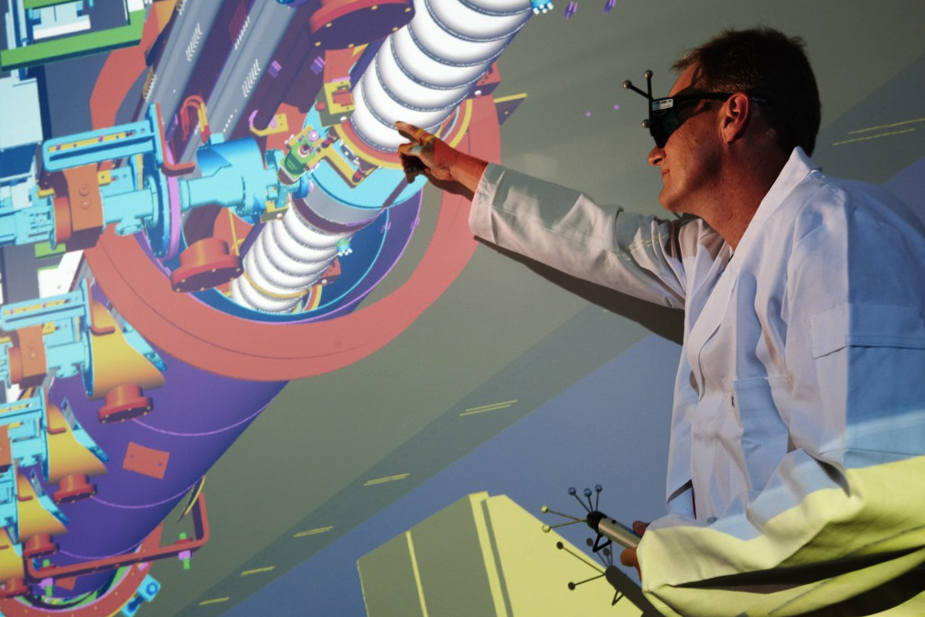
Introduction:

Slide 6
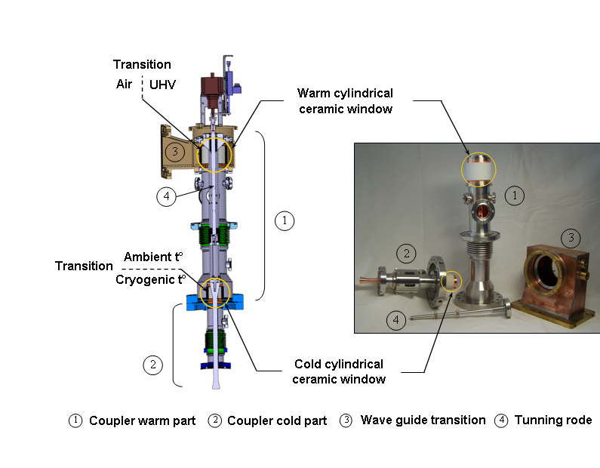
Introduction:

Slide 7
Introduction:
800 power couplers 1.3 GHz are needed to equip 100 XFEL cryomodules.
XFEL couplers are produced by 2 suppliers at 3 production sites:
Consortium Thales-RI (Thonon les bains-France and Koln-Germany): 670 units.
CPI (Beverly-Massachusetts-USA): 150 units.
Supported by DESY, LAL-Orsay has in charge:
The production monitoring and the quality control at Thales-RI sites.
The RF conditioning of all the couplers at Orsay and the weekly delivery of 8 couplers/week to IRFU-CEA (increased rate to 10 couplers/Week since January 2015) .

Slide 8
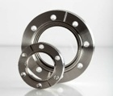
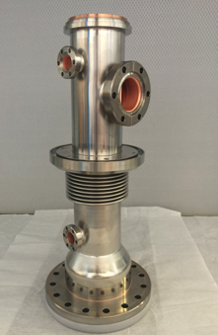

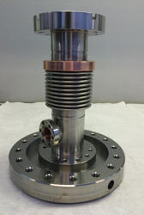
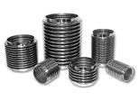
Industrial monitoring & quality control:
Thales-Thonon les bains production site:
Step 1: Internal and external conductor Brazing:
Step 2: Copper coating of RF surfaces on brazed parts:

Slide 9
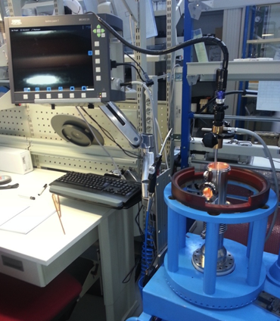
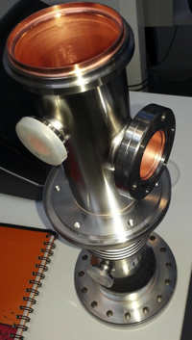
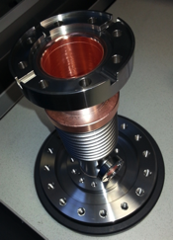
Industrial monitoring & quality control:
Inspection & control of all the produced parts at Thales-Thonon.
Double check during incoming inspection at RI with the same acceptance criteria.
Conducteur froid
Conducteur chaud

Slide 10
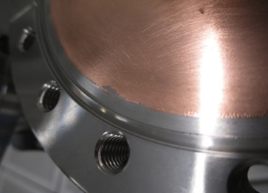
Industrial monitoring & quality control:
Example of copper coating defects:
→ Setting qualitative and quantitative acceptation criteria: classification by defect type, dimension et number. Agreement about corrective actions and validation tests.
Pitting
Blister
Copper peel off
X 20
X 30
Circular spots
X 22
Copper particle

Slide 11
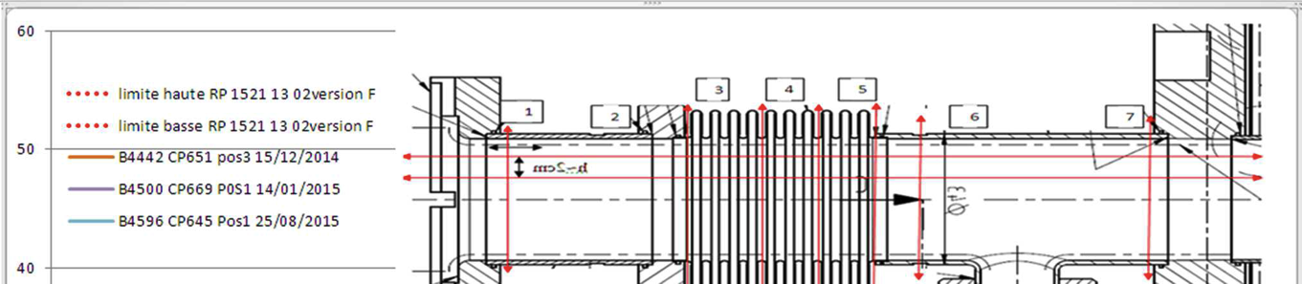
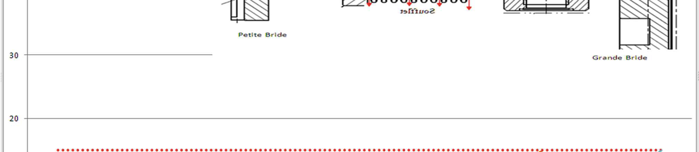
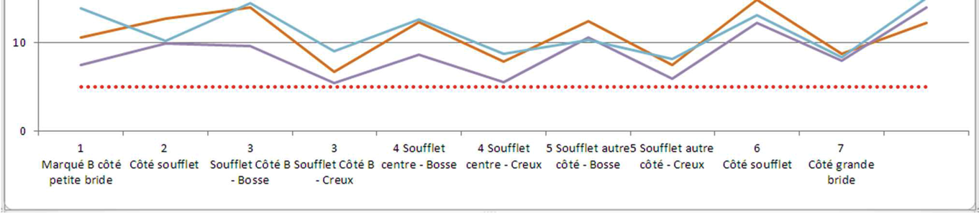
Industrial monitoring & quality control:
Copper thickness distribution in the cold conductor (specif. 10μm ± 20% in the cylindrical section & 10μm ± 30% in the bellow→ relaxed to 10μm ± 50% ):

Slide 12
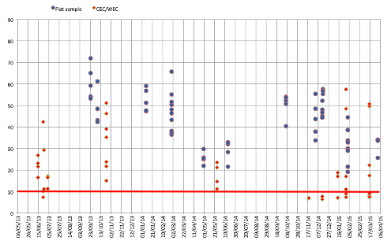
Industrial monitoring & quality control:
RRR measurements (Specif. 10<RRR<80)

Slide 13
Industrial monitoring & quality control:
RI production site:

Slide 14
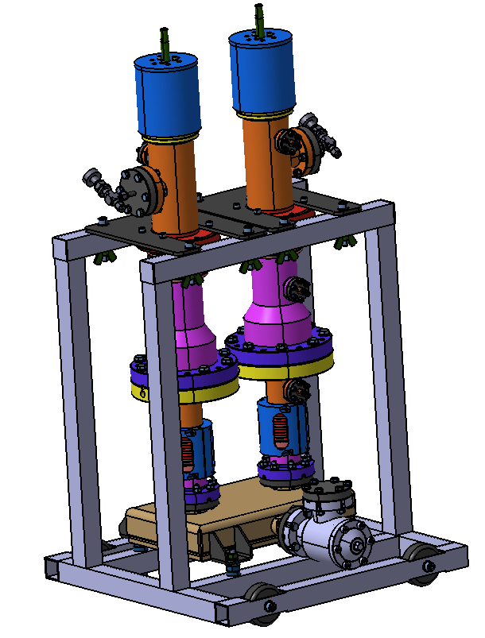
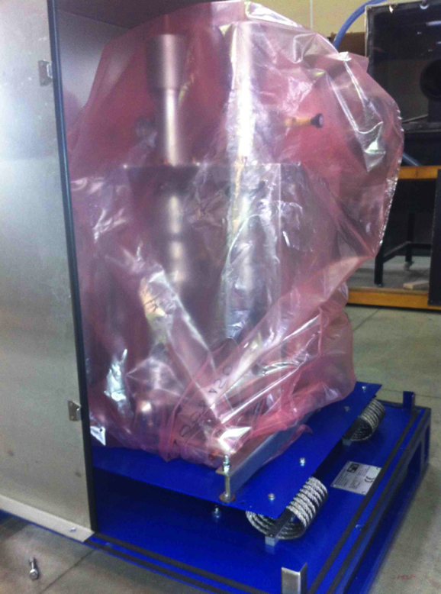
Industrial monitoring & quality control:
Delivery to LAL

Slide 15
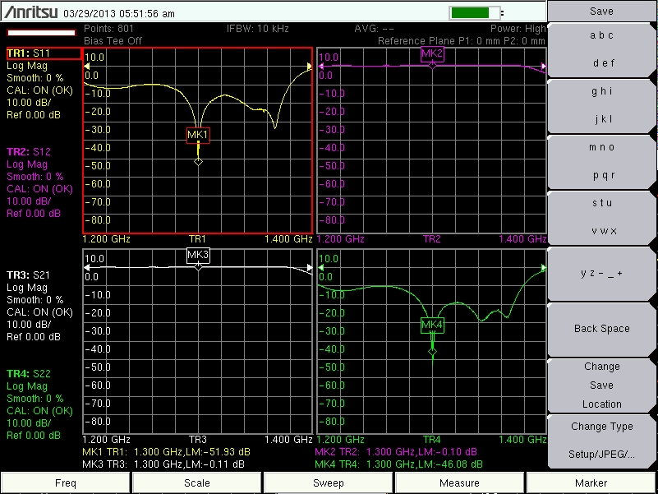
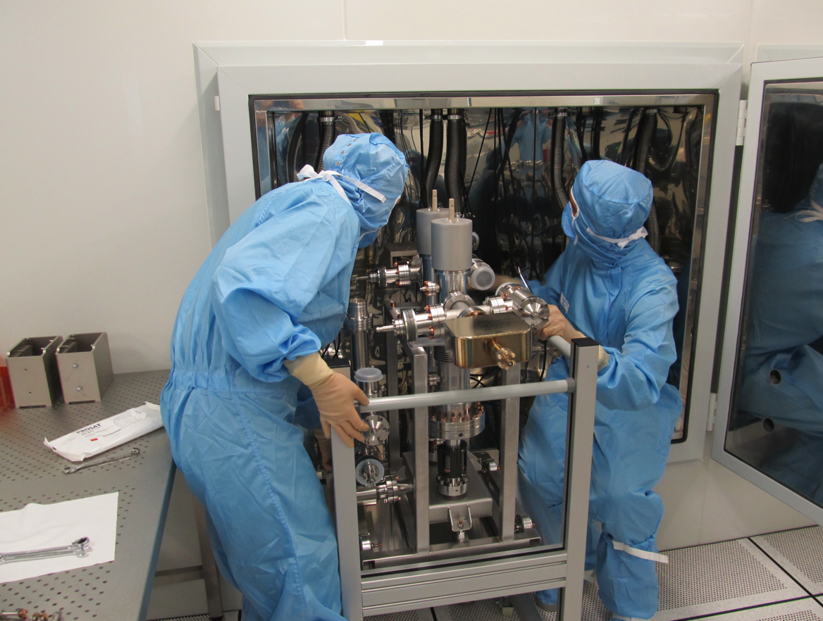
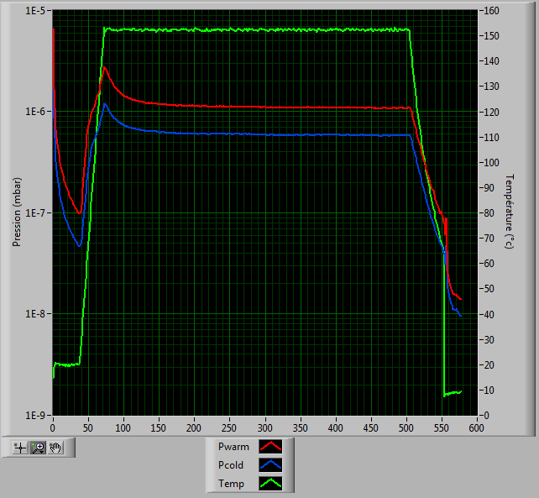
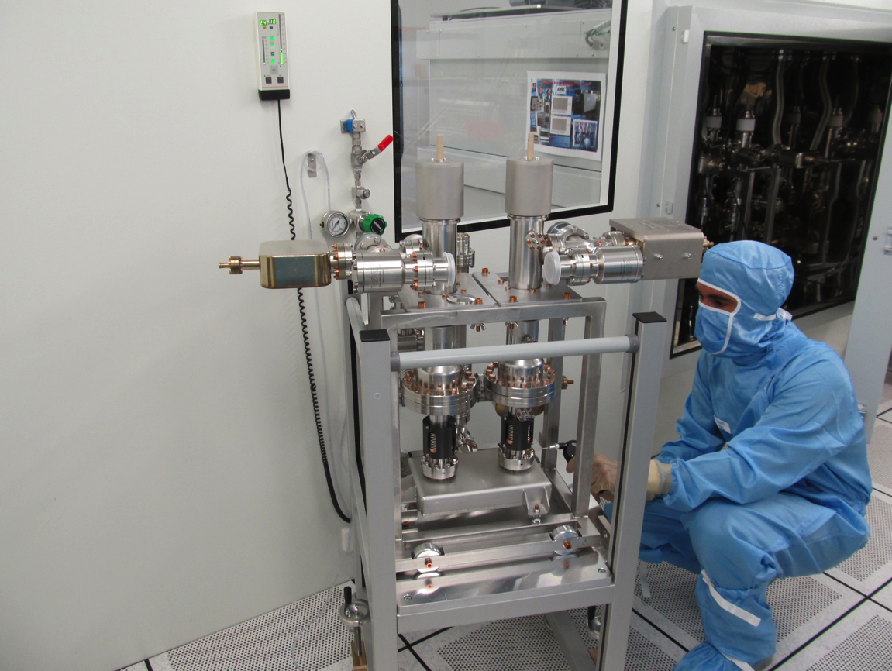
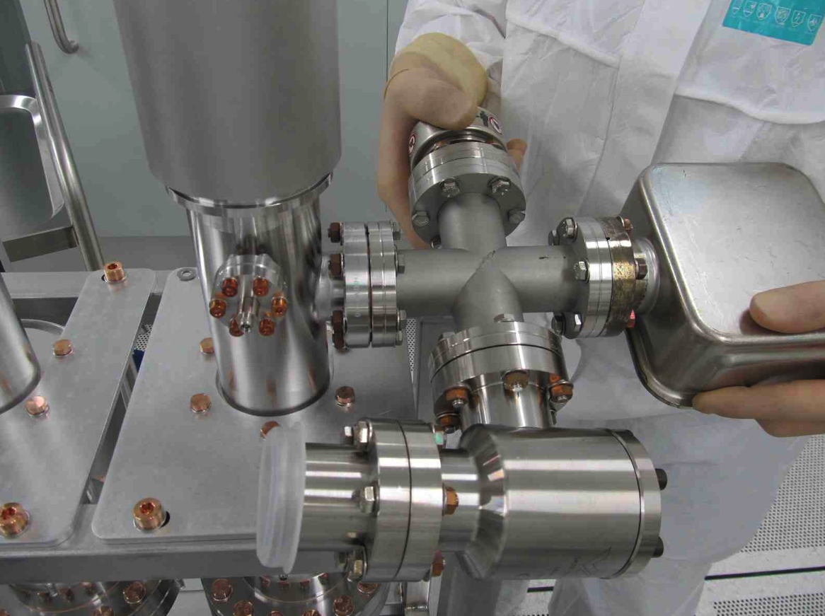
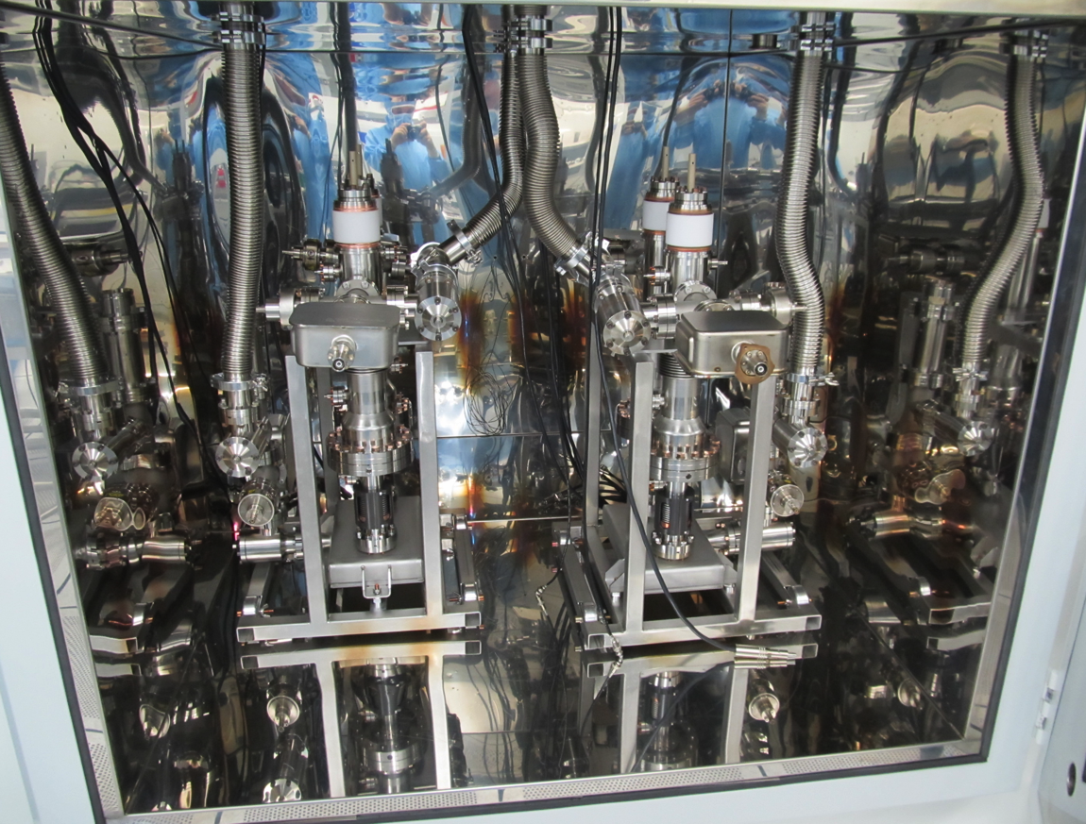
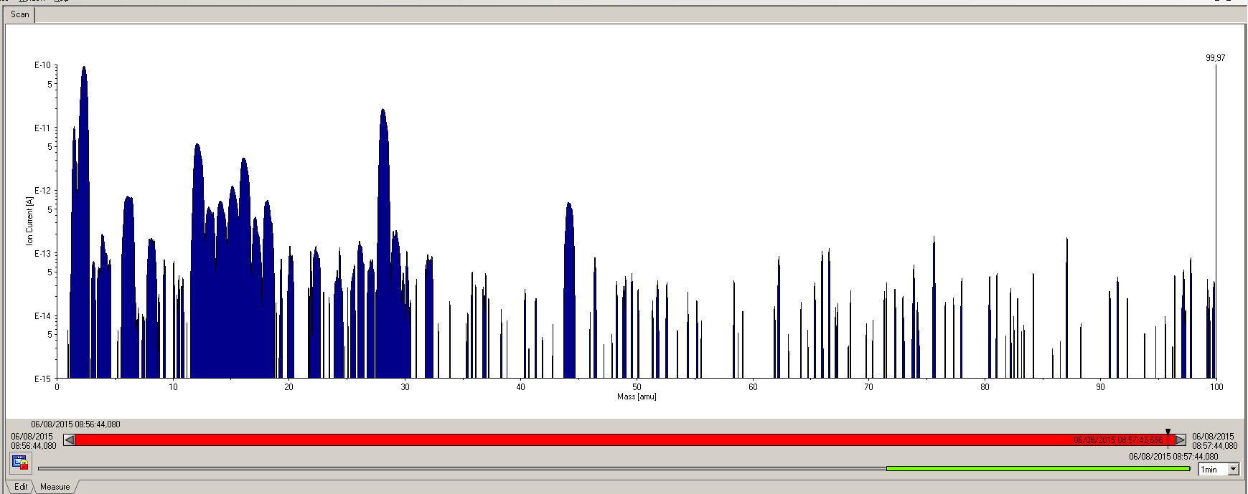
Couplers preparation and RF conditioning at LAL:
WGBs assembly
Capacitors assembly
Actuators assembly

Slide 16
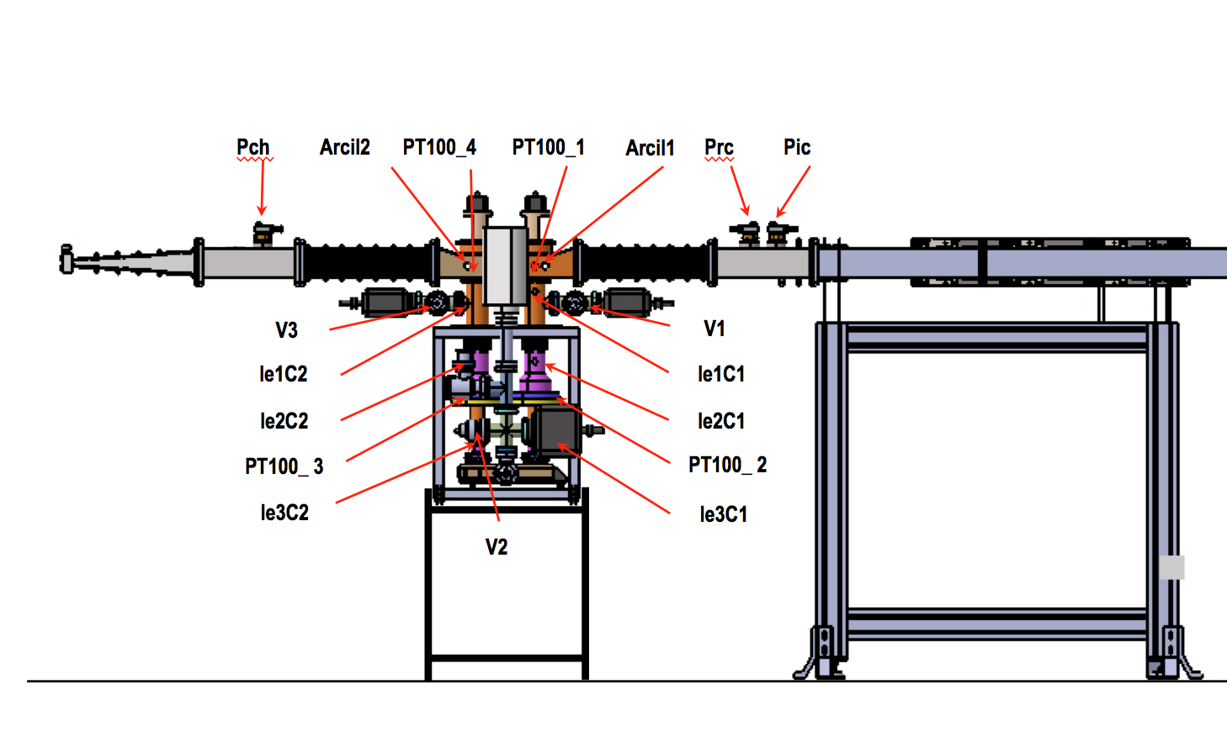
Couplers preparation and RF conditioning at LAL:

Slide 17
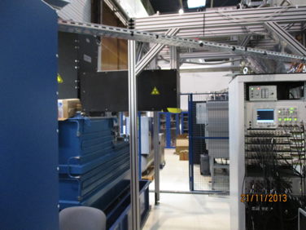
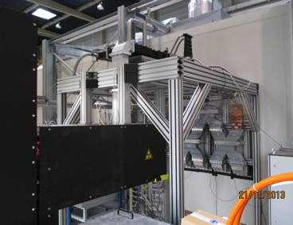
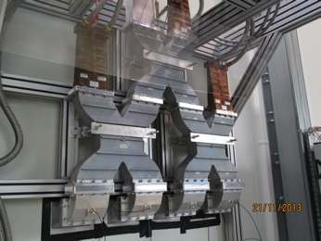
Couplers preparation and RF conditioning at LAL:

Slide 18
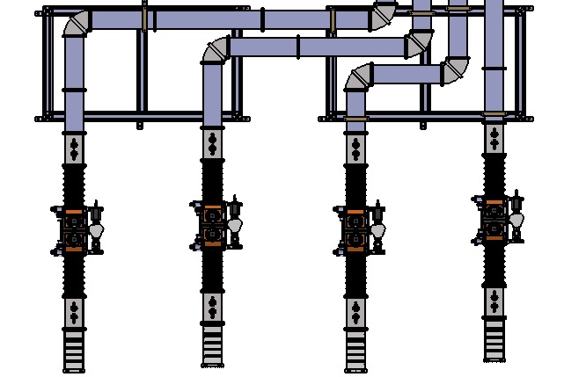
Couplers preparation and RF conditioning at LAL:
PicC
PicB
PicA
PicD
PrcC
PrcA
PrcD
PrcB
Arcil1D
Arcil1C
Arcil1B
V1A
Arcil1A
V1D
V1C
V1B
V2D
V2C
V2B
V2A
Arcil2D
V3C
Arcil2C
Arcil2B
V3A
Arcil2A
V3D
V3B
PchC
PchB
PchA
PchD
Ligne D
Ligne C
Ligne B
Ligne A

Slide 19
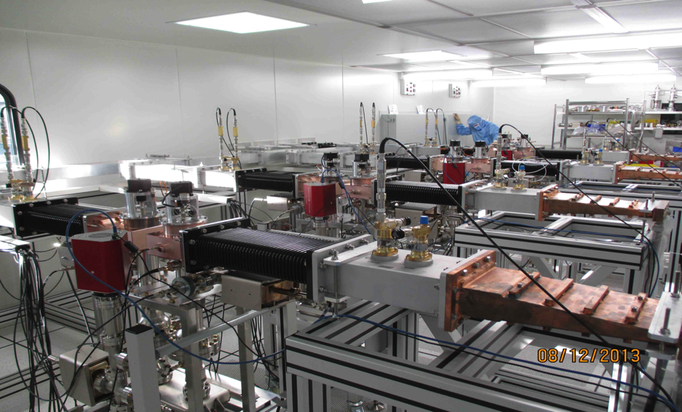
Couplers preparation and RF conditioning at LAL:

Slide 20
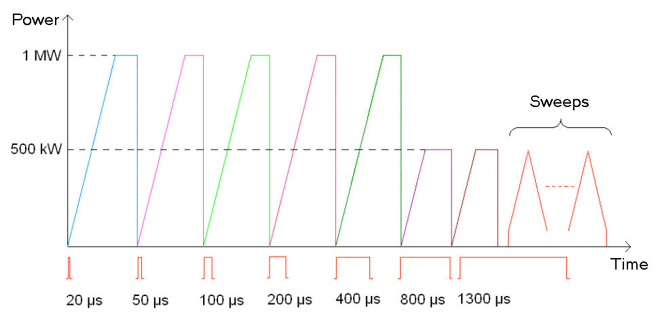
Couplers preparation and RF conditioning at LAL:

Slide 21
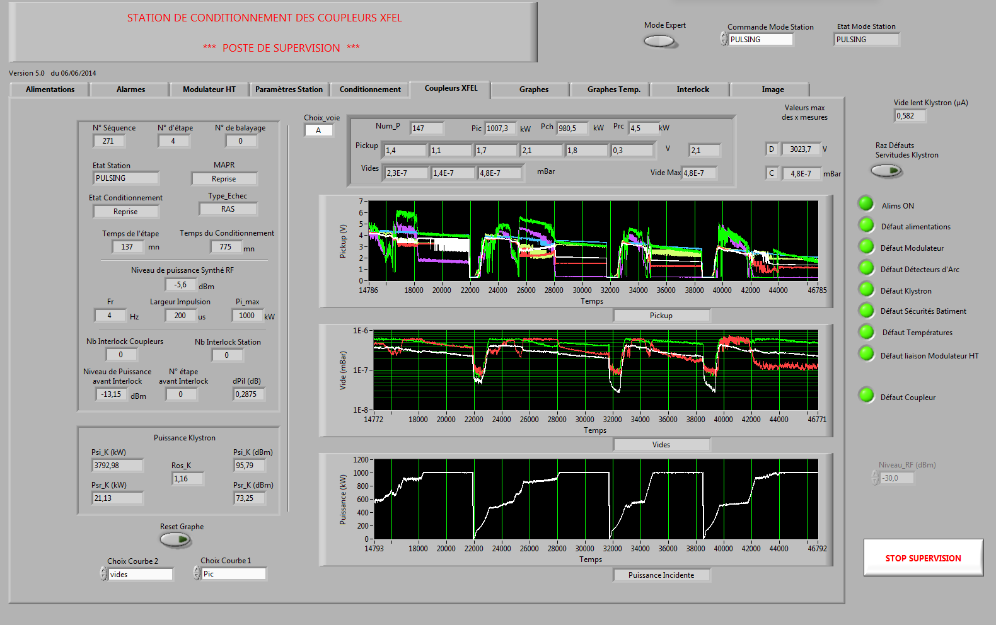
Couplers preparation and RF conditioning at LAL:

Slide 22
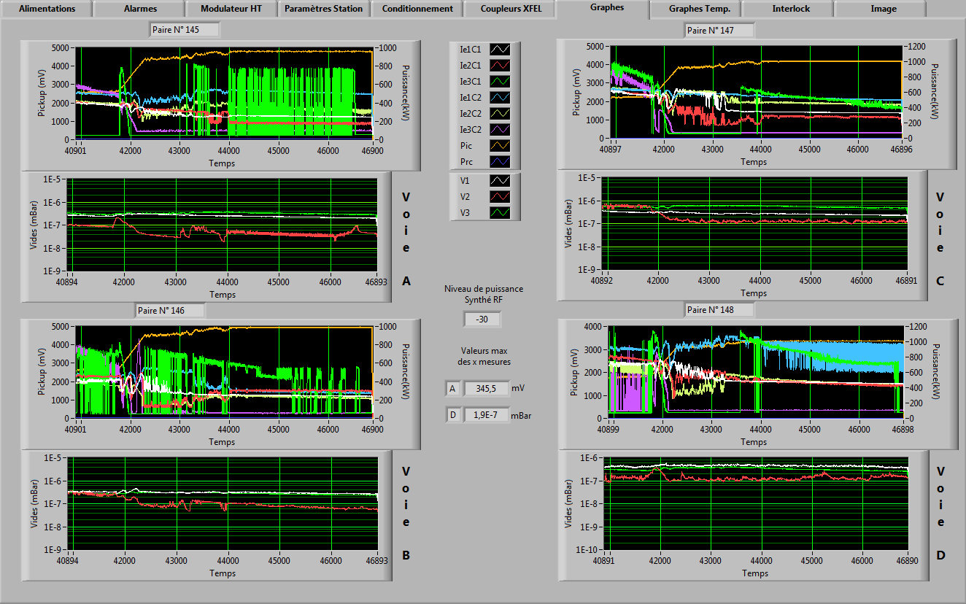
Couplers preparation and RF conditioning at LAL:

Slide 23
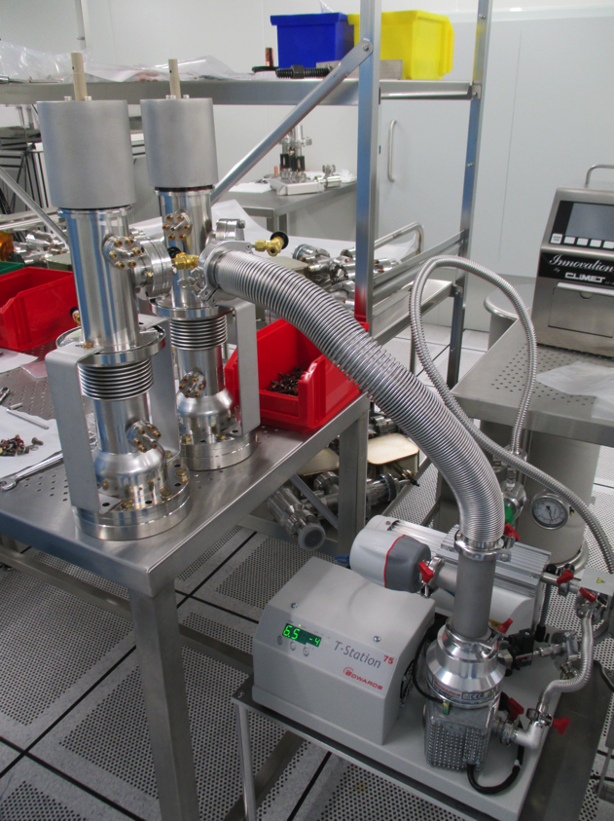
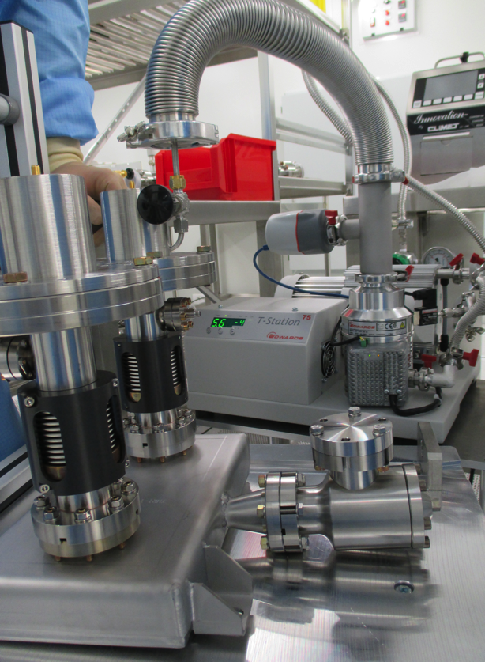
Couplers preparation and RF conditioning at LAL:

Slide 24
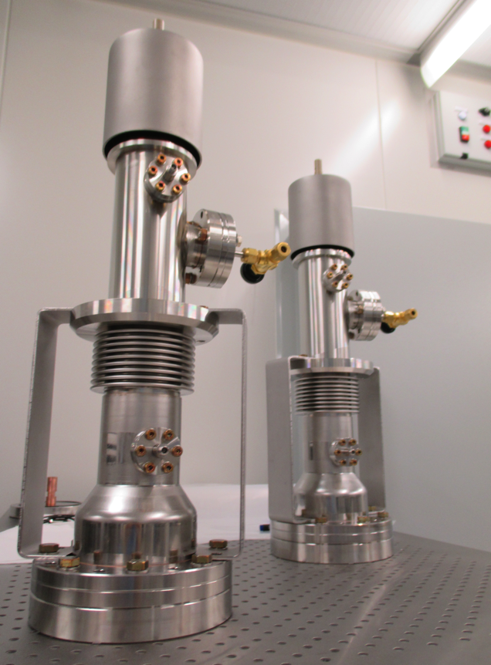
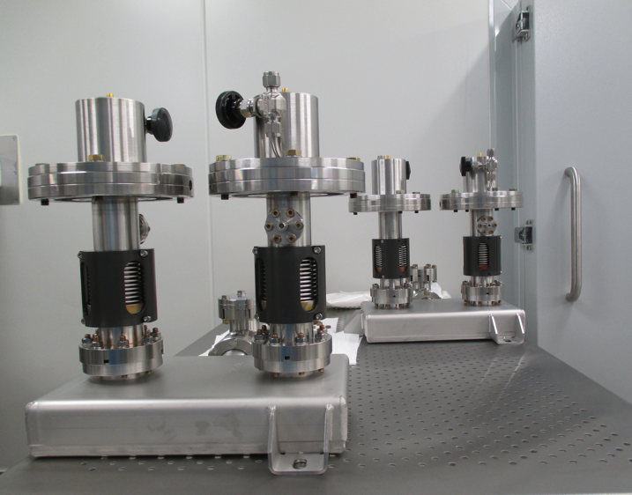
Couplers preparation and RF conditioning at LAL:

Slide 25
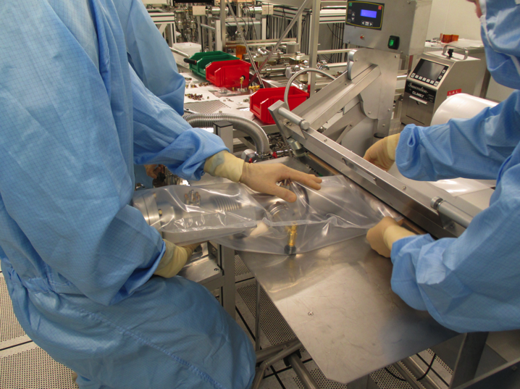
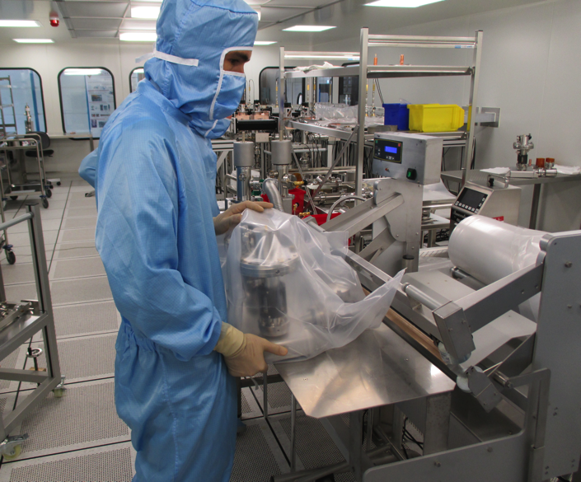
Couplers preparation and RF conditioning at LAL:

Slide 26
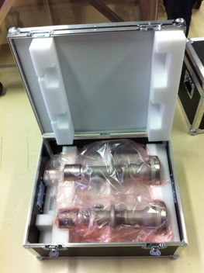
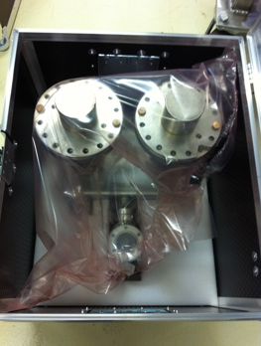
Couplers preparation and RF conditioning at LAL:

Slide 27
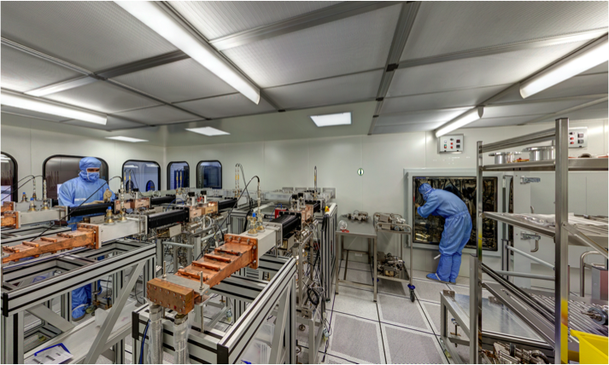
Project progress:
Process optimization (preparation and RF conditioning), infrastructure, equipment, tools and manpower allow LAL to process up to 12 couplers/week.

Slide 28
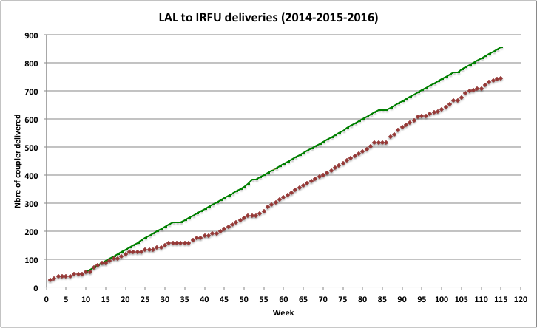
Project progress:
Xmas Break 2015
-- Nominal delivery rate
-- Real rate
Summer Break 2015
XM91
Xmas Break 2014
Summer Break 2014

Slide 29
Extrapolation to ILC:
 | XFEL | ILC
Energy | 17 GeV | 500 GeV
Modules | 100 | 2000
Couplers | 800 | 16000
XFEL is considered as a good training and a major asset for LAL-IN2P3/CNRS to be a key player in ILC construction.

Slide 30
Extrapolation to ILC:
Lessons we learned from the XFEL (1):
Importance to have more than one supplier for critical components, involved till the beginning of the project.
Part assembly process: Brazing instead of welding (No operator dependence, work in batches, scalable process).
Successful knowledge transfer from labs to companies (cleaning and coupler assembly in clean room)

Slide 31
Extrapolation to ILC:
Lessons we learned from the XFEL (2):
Copper coating is by far the most critical process: Even if specifications and acceptance criteria better definition is now possible, setting a detailed recipe ready for use will be extremely important (Harmonization between different production sites, saving time and money in companies trying to adjust their own process and tools to the coupler production).
For critical processes, the know-how is some thing “very volatile” in companies, especially when sub-contractors are involved…
Maintaining the infrastructures in labs is also an issue.

Slide 32
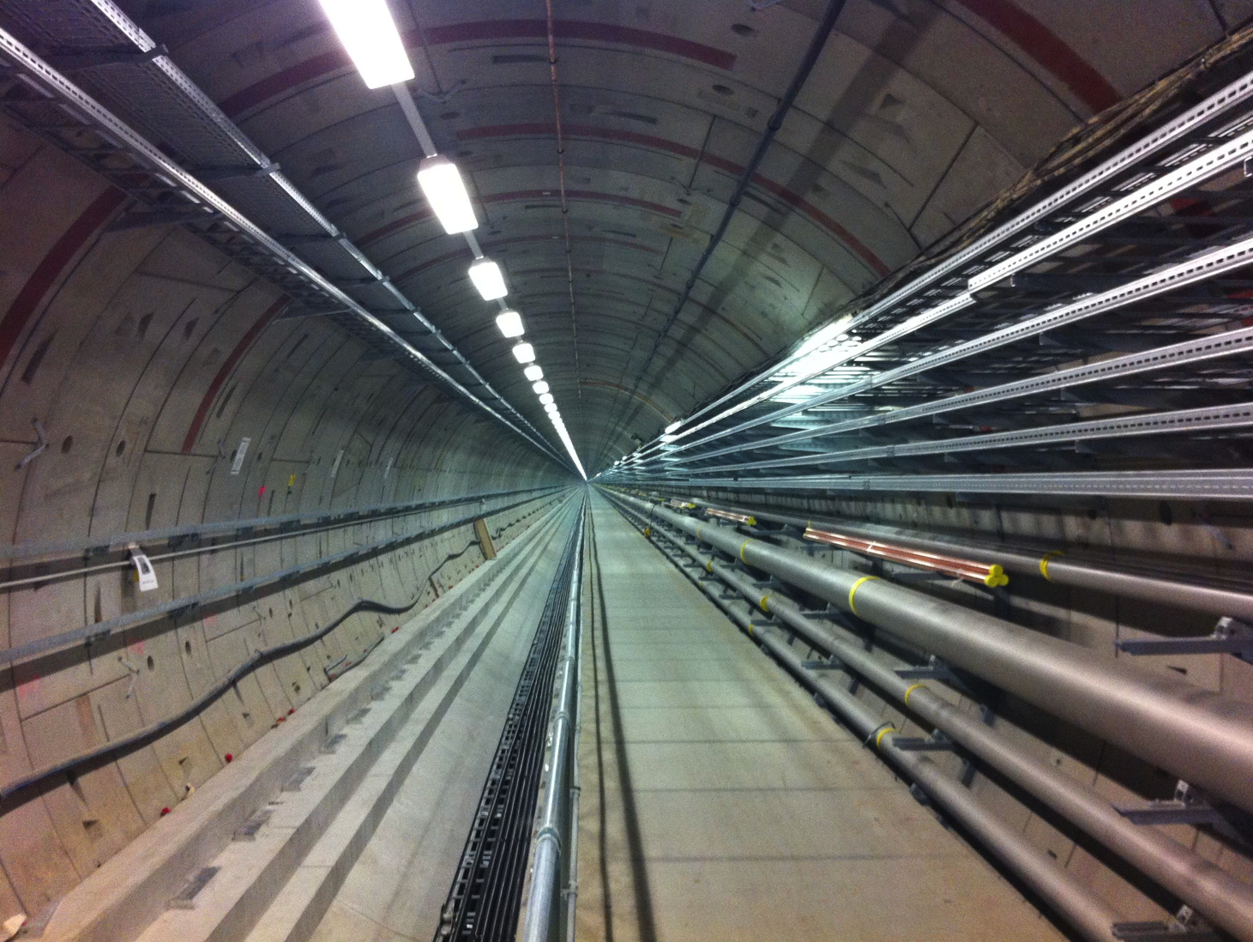


Thank you for your Attention!

