Slide 1
ILC Design Status & Goals
Design Update
Mike Harrison

Slide 2
Linear Collider Outlook
In the immediate term future the resources are expected to remain more or less constant. I suspect this will not change until decisions are taken in Japan and communicated with the rest of the world.
When will this happen ? It is possible that something may happen in calendar 2016. This is probably the earliest. More likely 2017 sometime.
What could change this state of affairs? International negotiations & LHC physics results to name two such items.
This is not a very well defined situation. How do we proceed to the best effect ?

Slide 3
Linear Collider Design Strategy
There are several medium term design goals:
Establish the ILC footprint at the Kitakami site.
Reduce costs
Improve the design (performance, tolerances, etc ….)
In addition there are a few general themes or guidelines:
Energy efficiency (pushed by CERN from CLIC)
Nanobeams (again pushed by CERN via CLIC)
Technology spin-offs (e.g. FEL’s)

Slide 4
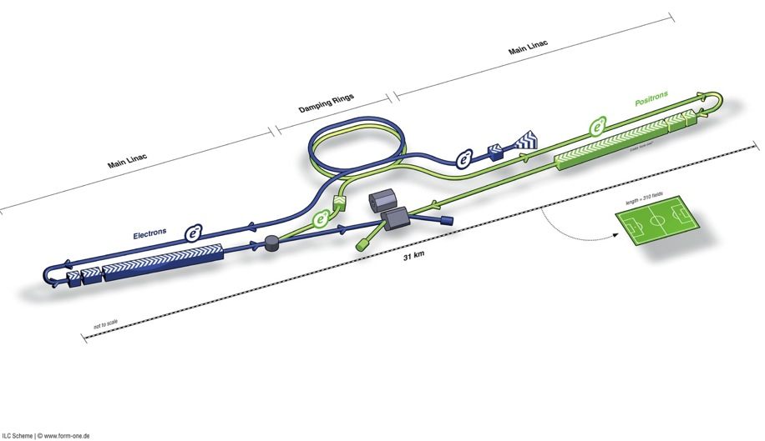
ILC Facility Design (Technical Design Report 2014)
Ring to Main Linac
(including bunch compressors → reduce σz to eliminate hourglass effect at IP)
Damping Rings
(reduce emittance
→ smaller transverse
IP size achievable)
Polarised Electron Source
(deliver stable beam current)
e+ Main Linac
Polarized e+ Source
(use e- to pair-produce e+ on target)
e- Main Linac
Parameters | Value
C.M. Energy | 500 GeV
Peak luminosity | 1.8 x10³⁴ cm⁻²s⁻¹
Beam Rep. rate | 5 Hz
Pulse duration | 0.73 ms
Average current | 5.8 mA (in pulse)
E gradient in SCRF acc. cavity | 31.5 MV/m +/-20% Q₀ = 1E10
Beam Delivery/Final Focus System
(compress and collide)
Two detectors (“Push-Pull” option)

Slide 5
The Main Linac

Slide 6
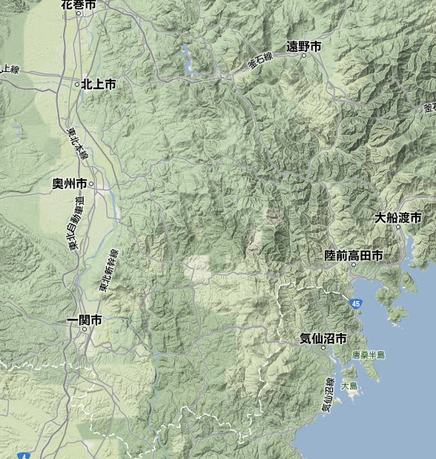
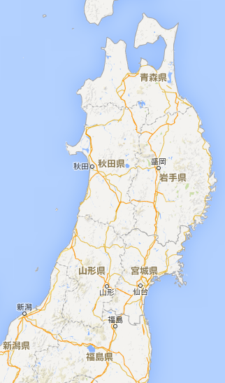
Site Specific design: the “preferred” site
Oshu
Ofunato
Kesen-numa
Sendai
Ichinoseki
IP Region

Slide 7
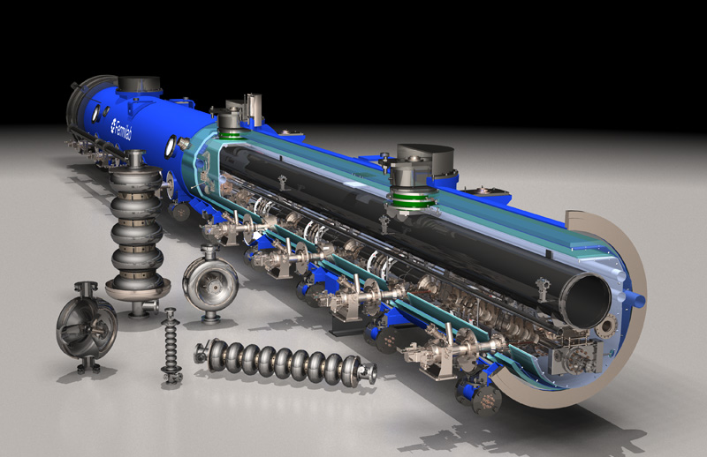
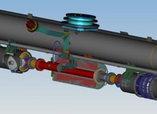
ILC Cryomodule Assembly
cavities (8)
SC quad package
12.6 m (slot length)

Slide 8
Changes approved in the last 12 months - CR 002: Equalization of L* for ILC and SID detectors

Slide 9
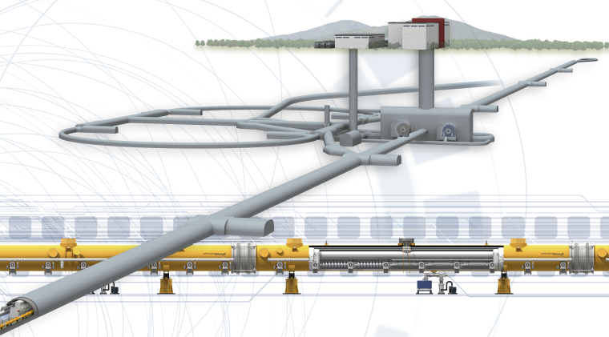
Changes approved in the last 12 months CR 003: Vertical shaft access to the detector hall at IP

Slide 10
Changes approved in the last 12 months: CR 004-Collision point timing adjustment
for both e+e- timing and more gradient/energy flexibility 500 GeV

Slide 11
ILC Goals for the next 6 months
Generic tunnel X-section CR will be finalised (CR 012)
The tunnel penetrations & RTML turnaround will be started
The cryogenic conceptual design will be completed (via CR 009)
Positron source layout compatibility with conventional electron driven source (CR 011)
Next up is the central region layout (new WG, Kaoru Chair)
positron area -> Masao et al.
The IP is “done”
Need the BDS, and beam lines/tunnel/dumps integration
No DR (Injection/extraction ??), No electron source, No RTML & turnaround

Slide 12
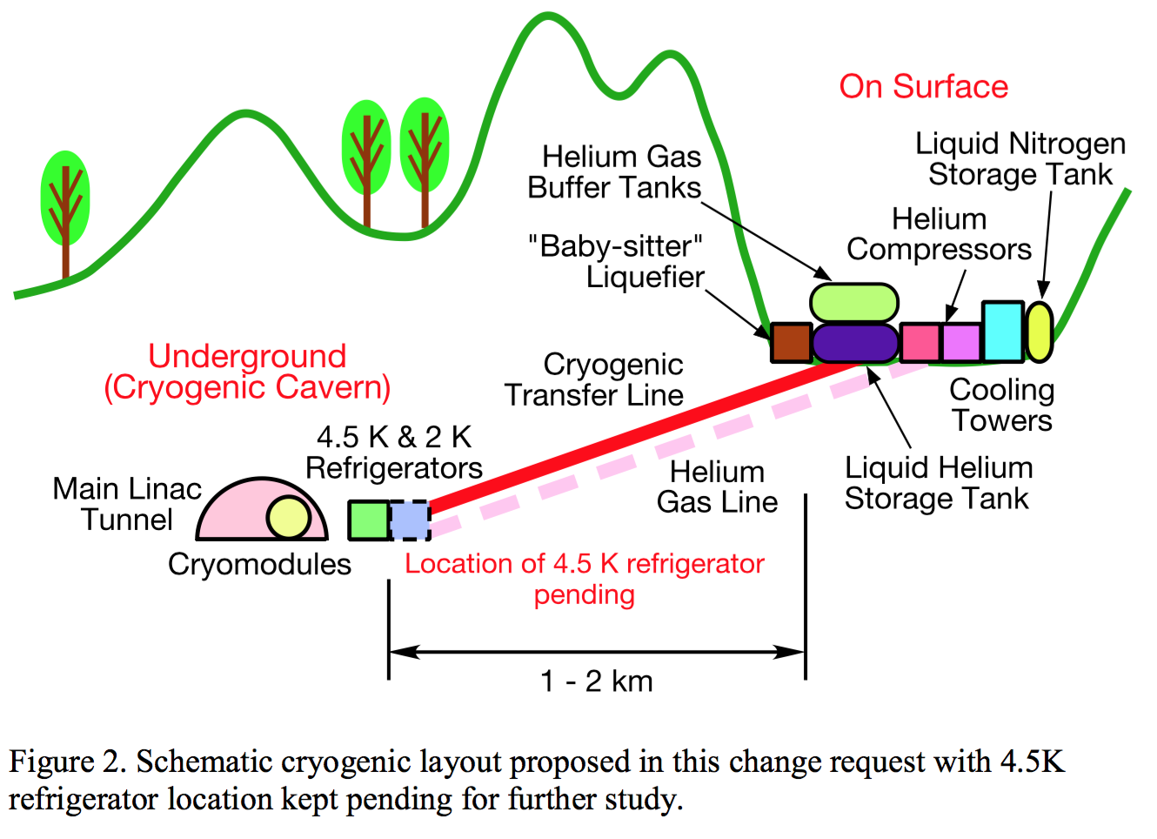
Design Update: CR-009
Cryogenic layout moves compressors & storage to the surface. Still considering the 4.5K cold box

Slide 13
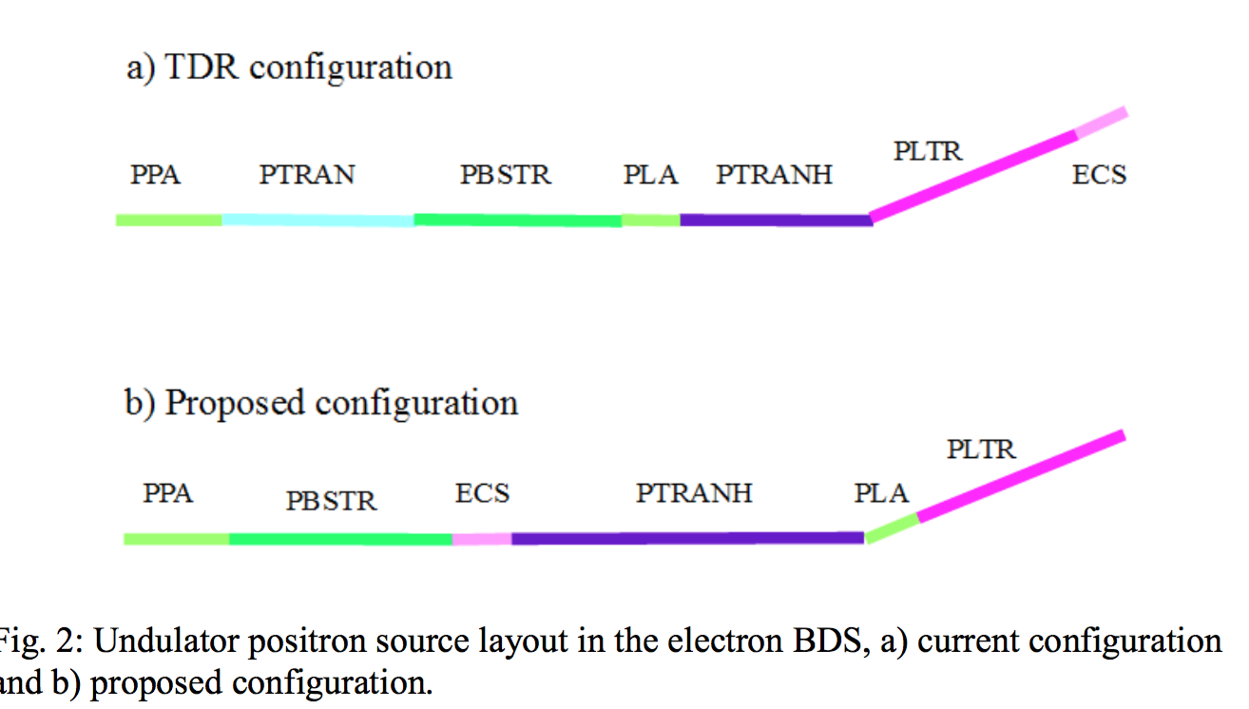
Design Update: CR-011
Change Requests 011 creates 1.1 km free space for a possible e-driven source

Slide 14
Main Linac Tunnel X-section
Based principally on reliability considerations the TDR ML was scoped for beam-on personnel access i.e. replace klystrons & modulators when necessary without shutting down.
Safety considerations, worst case scenario, resulted in a 3.5m wide shield wall. This looked excessive to many people.
We therefore decided to allow for power-on access but not beam-on. This re-introduced downtime hence MTBF as an issue

Slide 15
Design Update CR 012

Slide 16
Design Update: CR-012
Issues under scrutiny:
dark current worst case scenario
uptime ( HLRF MTBF)
utility layout in tunnel
crossover points design
Proposal for 1.5 m wall
With “2m” tunnel
Cost saving ~$130M

Slide 17
Central Region Working Group
Chaired by Kaoru Yokoya: Okugi, Kuriki, Miyahara, Paterson, White, List & Sanuki
“is charged to develop a conceptual design for the central region of the ILC at a level of detail consistent with a change request and sufficient to define the CFS features of this area of the machine. The central region is defined to be that part of the machine downstream of the two main linacs. It includes :
the e- source,
the undulator driven e+ source,
the damping ring transfer lines (but not the damping rings),
RTML,
the beam delivery system including associated hardware (dumps, collimators, spoilers etc..) and
the interaction region.
…....... You should plan towards having a working concept for the ECFA workshop in Santander, in June 2016.”

Slide 18
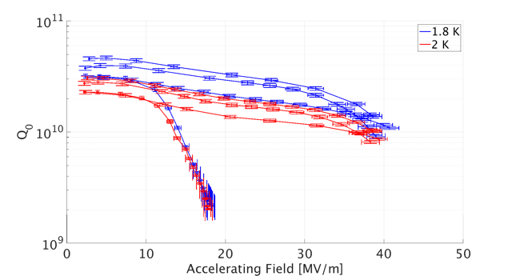
Operating Temperature 2K v’s 1.8K
Initial XFEL temperature dependence results. Testing on-going

Slide 19
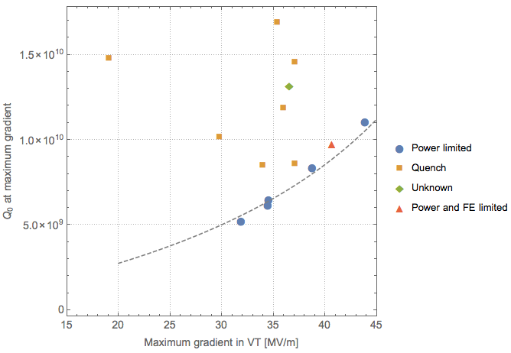
Operating Temperature 2K v’s 1.8K
test at 2K
15 cavities available for further R&D
Proposed to re-test down to 1.8K
ILC spec
200 W power limit
Look for improvements in Q₀ and E_{quench} i.e. increase gradient and/or reduce
cryogenic load

Slide 20
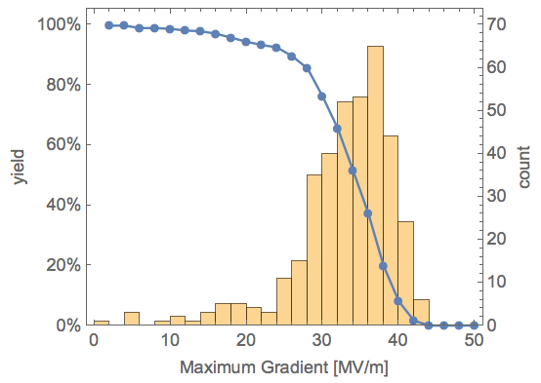
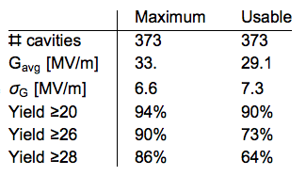
XFEL Final Cavity Data - RI cavities only
RI cavities only i.e. ILC processing cycle
with EP
Will likely exceed ILC gradient specs with ~20% reprocessing as in the TDR

Slide 21
Low Energy Operation: 200 Gev and below
Space for the red elements should be reserved
e-Linac end
undulator
Dog-leg for colliding electron
Pulsed V-bend
To BDS
Pulsed H-bend
To tune-up dump
Dog-leg for spent electron
If IP is considered to be the fixed point
Undulator must be shifted upstream by ~30m
Whether the space for linac extension (1.5km) be decreased by ~(30+5) m or not can be decided any time
Field of pulsed magnet (5Hz, 1ms flat-top)
1Tesla seems to be OK, but may be too strong

Slide 22
Nanobeams -> Technology
The issues involve:
Beam brightness (size & intensity)
Chromatic corrections of optical systems
Beam stabilization
Vibration suppression
Feedback systems
Mechanical alignment
Instrumentation accuracy
Equipment stability
Diagnostics
All of these elements give rise to technology development of one kind or another. All are state-of-the-art, some beyond that.

Slide 23
Conventional Facilities

Slide 24
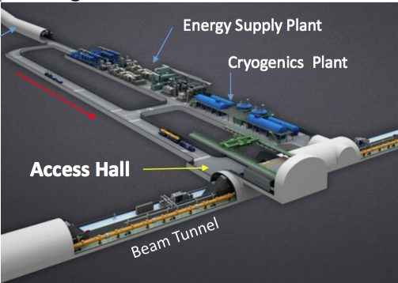
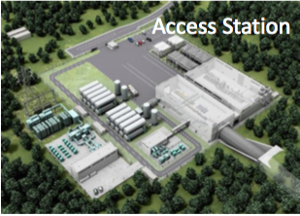
Access Points

Slide 25
Tunnel Access

Slide 26
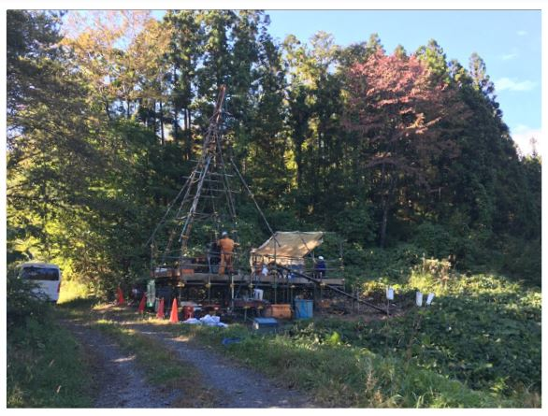
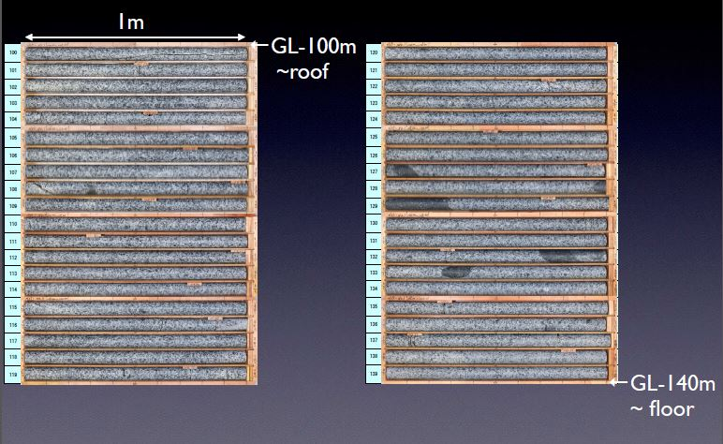
Alternate IP
IP at Soil Boring at Alternate Site Alignment and Sample Cores Indicating Consistency with IP Geology at Original Site Alignment – T Sanuki

