Slide 1
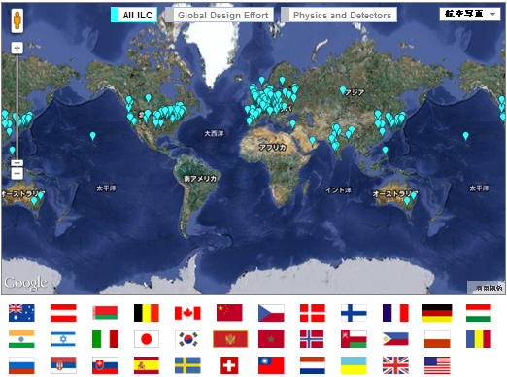
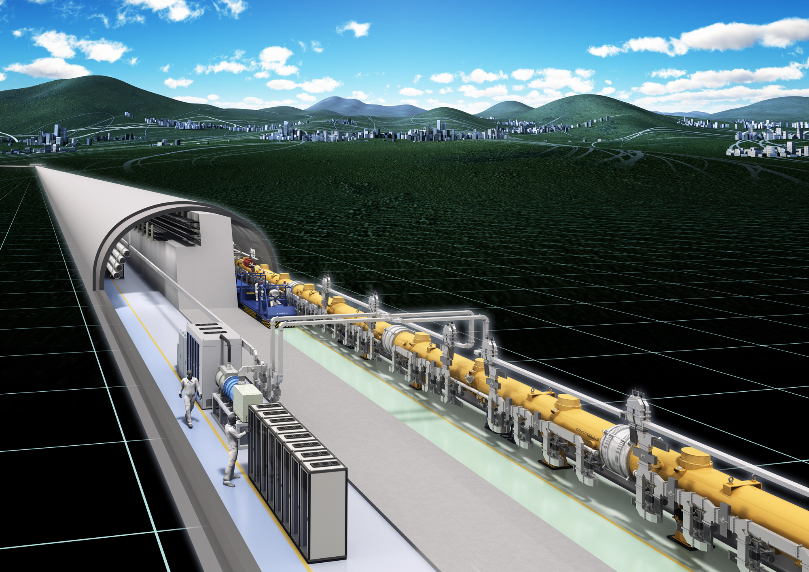
ILC status in Japan
Satoru Yamashita
ICEPP, Univ. of Tokyo
Mar.23, 2016
ILC days @ Paris

Slide 2
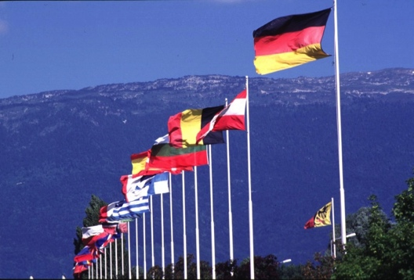
Timeline of ILC Where we are now
1980’s
Project Start
Design &
Manufacturing Processes
2004
Technology choice
OECD Ministerial Statement
Discussions w/ Funding Agencies
Site-related studies
by scientists/civil engineers
2007
Baseline Design
First Cost Estimate
Begin cooperation
Government/Industry/Academica
2008
International R&D
Site studies by
local groups
Global Design
XFEL Experience
Cost/Design Optimization
CERN/LHC
Higgs Discovery
Geological studies
2012
Technical
Design Report
2013
Science Council
of Japan Report
Domestic Site
Evaluation
2014
Government budget for project evaluation
Project reviews by MEXT start
2015
Site-specific design
International collaboration
Setting regulations
Engineering design
Preparing construction
Government reviews
Talks between governments
Site-specific design
Activities in Local area
Environmental assessment
Today
Feb.2016
Greenlight /
International Agreement
Establish International Laboratory
International
Laboratory
Construction (~9 yrs)
Operation (~20 yrs)

Slide 3
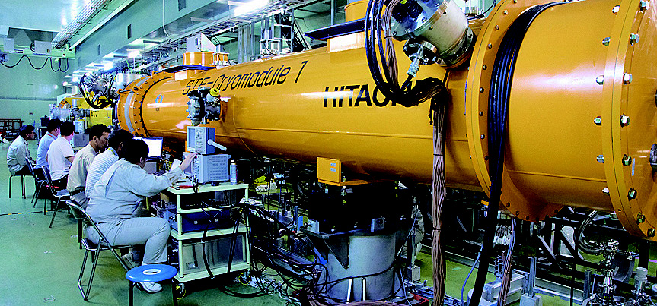
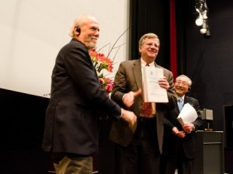
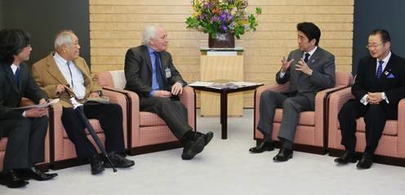
ILC Technical Design Report Completed
(December 2012)
Lyn Evans’ Courtesy visit as the LCC Director to
Prime Minister Shinzo Abe (March 2013)

Slide 4
Six bodies in Japan for ILC
6 bodies
Federation of Diet members supporting ILC
MEXT: Ministry of Education, Sports, Culture, Science and Technology
Advanced Accelerator Association promoting Science and Technology (AAA) Industry-Academia
Local Bodies in Tohoku (bureau of Economy, business association, prefecture/city local governments, Universities).
Japanese Researchers’ HEP society and KEK
Japanese Embassy in US and Ministry of Foreign Affairs

Slide 5
Summary of the Status of the ILC (1)
SUPPORTS: Federation of Diet members for ILC, industries (Advanced Accelerator Association), and local governments as well as business sectors strongly support ILC, and these supports are growing up
Recognitions of ILC project at high level of Japanese government:
  Prime Minister Abe, Minister of MEXT (Education, Sports, Culture, Science and Technology), Ministry of Foreign Affairs (MOFA) / Embassy, Ministry of Finance, Construction, etc..
Steps of Progresses at government level
2014-
The official investigation at MEXT(Ministry of Education, Sports, Culture, Science and Technology) in Japan for ILC is being carried out, following the recommendation of the Science Council of Japan (Sep. 2013). MEXT formed ILC Advisory Panel (2014. Apr.)
2015-
ILC Advisory Panel’s Interim Summary (Aug. 2015) reports that discussions is indispensable with foreign countries at the government level to obtains positive prospects (not the commitment) for the international sharing of the cost and human resources and that LHC results (〜2017) should be monitored closely and taken into account (prospects on maximum energy, SCRF is good or not)

Slide 6
Summary of the Status of the ILC (2)
International (Diplomatic actions)
2013-
First survey through Japanese Embassy in Countries in the world has been made by Ministry of Foreign Affairs (MOFA) → reported to Diet members
MEXT officers’ survey trips to European Countries
2014 July
EU-Japan-US inter-governmental discussion (officers level) has been tried (2014 Jul. )concerning the ILC project.
2015 Apr.
Japan-EU Parliamentary Assembly → discuss on ILC (Apr.,2015) @ Strasburg
2015 Apr - 2016 Feb.
Progresses first in US-Japan (→next slides)
2016-
Parliament-level and Governmental-level discussions will be expanded to Europe and Asia, Russia, south America and world. Need counterpart in each country.
(The 2nd) Survey by MEXT will be conducted through Embassy, visits, interviews.
Preparation by physicists’ side are essential for pushing government decisions

Slide 7
Summary of the Status of the ILC (3)
US-Japan (Diplomatic actions)
2014-
US-Japan Ministers (MEXT Minister and US Secretary of Energy) discussion (Jan. 2014)
DOE Undersecretary Dr. Orr in his position (Dec. 2014)
2015-
US-Japan Undersecretary-level discussion (Apr. 2015)
US-Japan High-Level meeting (Minister’s level) on S&T (Oct. 2015) Presidential Advisor Dr. Holdren’s visit Japan. US-Japan S&T framework, ILC is now in its annex.
2016-
CONGRESS-DIET: US-Japan Forum is formed among the members of US Congress and Japanese Diet for the collaboration in science and technology, including ILC, (Feb. 11th 2016)
Inter-GOVERNMENT: Following the US-DOE proposal (Oct. 2015) and Meeting at Washington DC (Feb. 12, 2016) among US-DOE Office of Science Director Dr. Murray, Dr. Siegrist, three Japanese Diet members, corresponding MEXT officer and us → US-Japan inter-government activities to be discussed between DOE & MEXT.

Slide 8
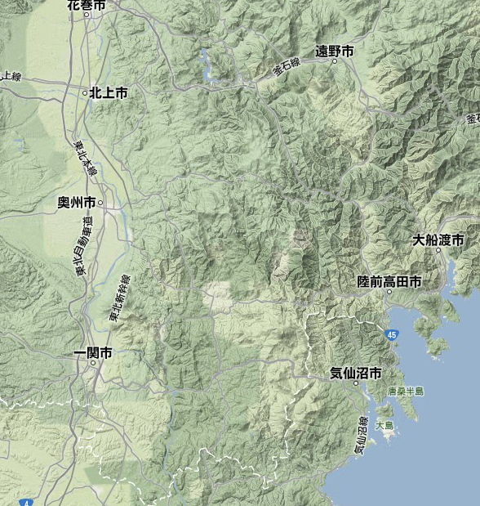
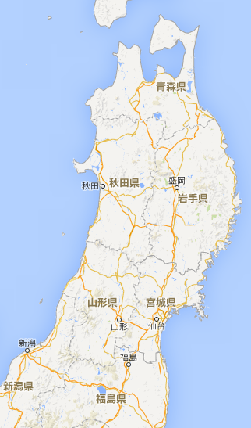
Kitakami
Researchers assessment result

Slide 9
Summary of the Status of the ILC (4) local area activities
Growing Support and ongoing preparations
in local regions
Very active efforts by local government, Universities, business groups, companies for preparation of ILC. Leadership by Business Bureau.
Almost once per day news on ILC in the local newspapers and medias
Progress in mapping (potentially) accelerator-related companies
Wide-area regional/urban development: specific proposals (blueprints→synergy with ILC project)
Intense analyses on the economic effects (Estimates by university and private sectors)

Slide 10
INDUSTRY SECTORS
Advanced Accelerator Association Promoting Science & Technology
AAA incorporated on December 3, 2014
Reformed as general incorporated company
>100 companies, 40 universities and research institutions
Key technology development and cost reduction
Promote public understanding
Promote industry application of accelerator technology from ILC, SCRF, nano-beam and others
Expanding the manufacturing process of accelerator projects in the private sector
Study urban development, maximizing ripple effects
Facilitate international actions in cooperation with Diet members, Government, Business sectors.

Slide 11
Multilateral vs Bilateral
First try was made through multilateral discussion in 2013, but not successful.
Multilateral is ideal but needs coherent moves and ground-work preparation in all countries at once.
US likes bi-lateral rather than multilateral.
→ Switch from Multilateral to Bilateral since 2014:
US-Japan first, then expand to European countries, Russia, Asian countries and other nations / regions

Slide 12
US-Japan
Starting from high-level
  Minister Level: (2013 Sep and 2014 Jan.)
  Minister of MEXT (Shimomura) and Secretary of Energy Dr. Moniz Top Officer (~undersecretary level) level
2014 Dec. Undersecretary Orr is in his position
Top Officer level (2015 Apr)
  MEXT deputy Minister Tsuchiya and US Undersecretary Dr. Orr
2015 July Mr. Tsuchiya in administrative vice Minister of MEXT (top of MEXT officers)
2015 Oct US director of OSTP, Presidential advisor Dr. Holdren visit Japan (US-J S&T) Working dinner with Diet members, undersecretary Mr. Tsuchiya of MEXT, Industry executives
2015 Dec. US Office of Science director assigned
2016 Feb. 12 – DOE Office of Science Director level
@DOE Washington DC. Director C.Murray, J.Siegrist + 3
Japan: 3 Diet Members, MEXT(Mr. Ikukawa), 4 researchers

Slide 13
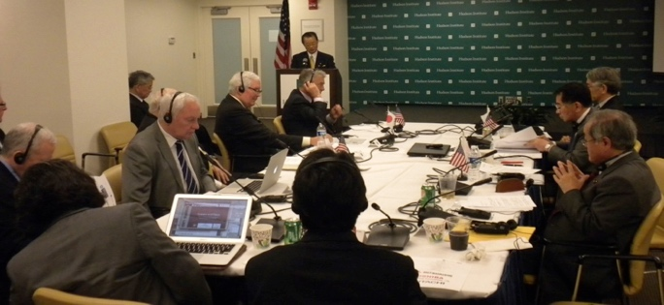
Japan-US Discussions at the Political Level
April 30 2013 at Washington DC: Symposium on Advanced Science and Technology centered on the ILC
  MEXT Minister, Secretary of Energy US, Federation of Diet members of Japan for ILC
January 2014, MEXT Minister met with Dr.Monitz (Secretary of Energy) at Washington DC
July 2014, Federation of Diet members visited Washington
Apr.2015, Federation of Diet members visited Washington
1st US Visit by federation of Diet Members of Japan for ILC
2nd US Visit by Federation of Diet Members
3rd US Visit by Federation of Diet members
Hon. Ryu Shionoya
Secretary General of Federation
Hon. Takeo Kawamura
Chair of Federation
Hon. Hirofumi Nakasone
President of Japan-US Parliamentary Friendship League

Slide 14
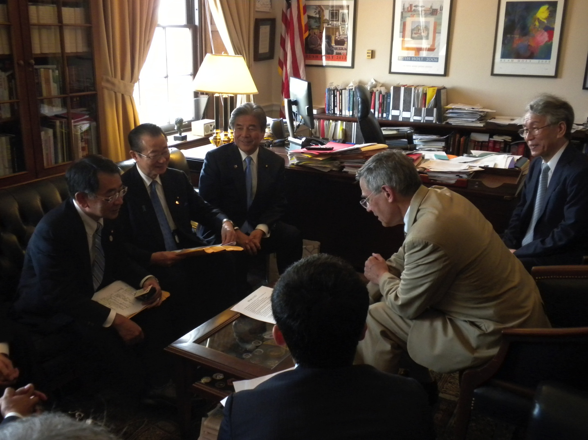
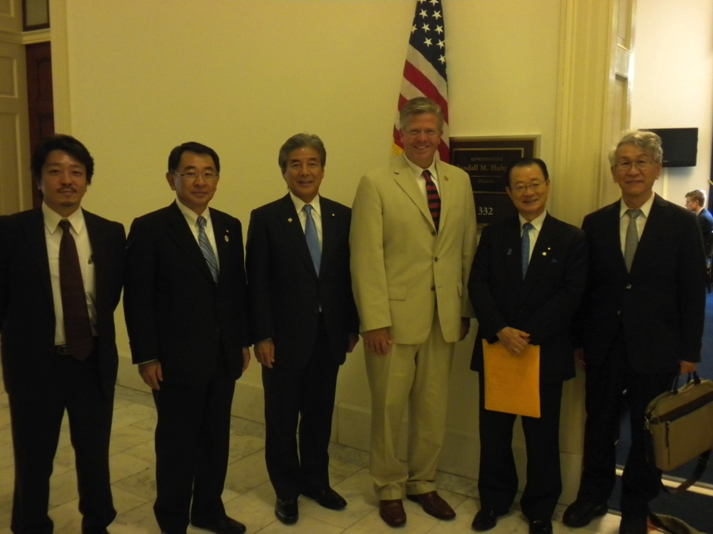
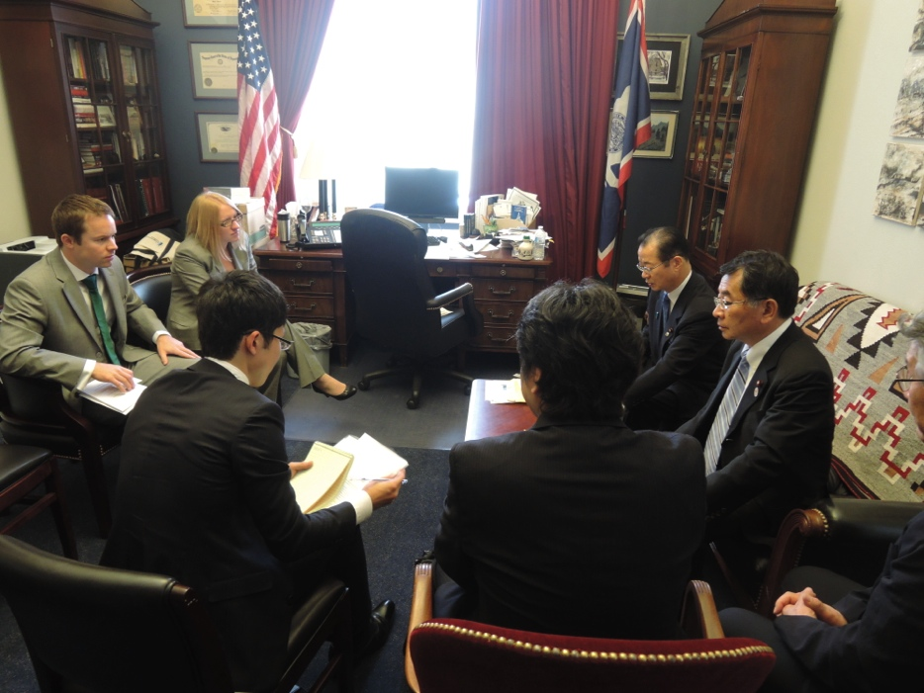
Meeting with
Congressman Rush Holt
(Former astrophysicist)
Features of US politics
Budget led by Congress
Coordination with Congress
is key
Congressman Randy Hultgren

Slide 15
Summary of Recent Activities 2015-2016
Apr. 2015: US visit by Hon. Kawamura, Hon. Shionoya, Hon. Suzuki
→ meetings with US Congress members, Government high levels
EU visit by Hon. Kosaka, Hon. Shina (EU-Japan Parliament Conference)
→ introduce ILC in the first session to EU parliament members
From Sep. 2015 US visits by officials (every month) for US-Japan
thru Jan. 2016: for coordination between parliaments & governments
Oct. 2015: Japan visit by Dr. John P. Holdren (S&T Adviser to US President Obama)
and Dr. Vaughan Turekian (S&T Adviser to Secretary of State)
Apr. 4, 2015: Meeting between MEXT Minister Hase, Hon. Kawamura (ILC Fed. Chair),
Hon. Shionoya (ILC Fed. Sec. General), Mr. Nishioka (AAA Chairman)
Dec. 9-11, 2015: US visit by Hon. Kawamura (ILC Fed. Chair), (Washington, DC)
Meetings with Congress members; towards S&T Forum in Feb. 2016
Feb. 11-12, 2016: US-Japan S&T Forum (Washington, DC)
US visit by ILC Fed. members Hon. Shionoya, Hon. Suzuki, Hon. Otsuka
Meetings with Congress members & DOE senior officials
Feb. 17, 2016: Japan visit by Congress members, Congressional Study Group on Japan
Feb. 24, 2016: FALC at KEK
Feb. 25, 2016: ICFA / LCB meeting at J-PARC (Researchers) ← report of the US-Japan
Mar. 4, 2016: General Meeting of ILC Fed. Diet Members (Tokyo) → report by Diet / MEXT
Mar. 16-24, 2016: Inter-Parliamentary Union (Zambia), Hon. Suzuki

Slide 16
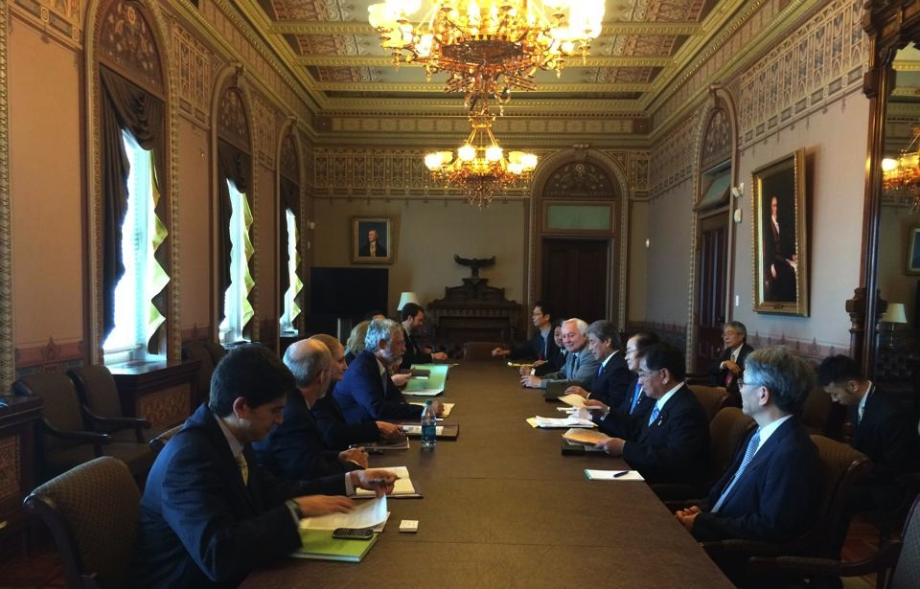
Meeting with Dr. John P. Holdren, Assistant to the President for S&T, Director of OSTP
July 23, 2014, White House, Eisenhower Executive Office Building

Slide 17
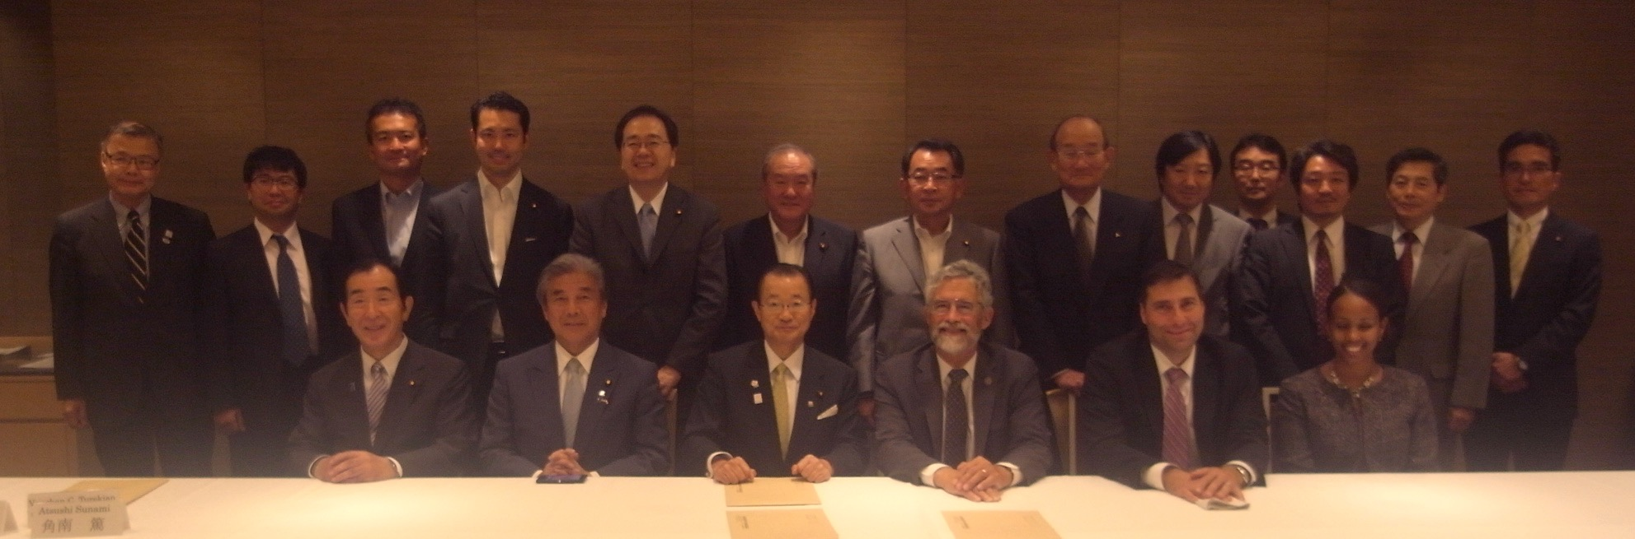
2015 Oct US director of OSTP, Presidential advisor Dr. Holdren visit Japan
  US-Japan S&T High-level meeting
  Working dinner with Diet members, undersecretary Mr. Tsuchiya of MEXT, Industry executives
Proposal of starting US-Japan Working Group (Joint Activity) for ILC
  Proposed by US DOE (Dr. Jim Siegrist) at 2015 Oct US-J S&T high-level meeting
Office of S&T Policy director Dr. Holdren‘s suggestion: 2 key actions for ILC in US-Japan
  Establishment of joint activity for ILC in the framework of US-Japan high-level meeting
  Facilitate supports from US Congress by Diet members’ actions
Meeting on 6 Oct. 2015 (TOKYO):
US Government
Dr. Holdren (Assistant to the President for Science and Technology, Director of OSTP) + OSTP Dr. Menfis (senior advisor)
Dr. Trikian (Assistant to the Secretary of State for Science and Technology) + US Embassy in TOKYO
Diet members
Ruling Parties: Hon. Kawamura, Hon. Nakasone, Hon. Shionoya, Hon. Suzuki, Hon. Otsuka, Hon. Saito (new-Komei)
Opposite Party: Hon. Takagi (democratic party), Hon. Tsumura (democratic party)
MEXT: Mr. S. Tsuchiya (administrative vice-Minister of MEXT)
Industry Exectives (AAA executive members):
Mr. Nishioka (Mitsubishi Heavy Industry, former President of MHI), Executives from Hitachi, Kyocera, Mitsubishi Electric, Toshiba

Slide 18
DEC 2015
Minister of MEXT replaced: Oct 7th
Mr. Shimomura → New Minister Mr.Hase (supporting S&T)
(Oct-Nov Settling down of scandal of 2020 Olympic preparation)
2015 4th of Dec. meeting among Minister Hase and Diet member, Industry executive → support ILC
2015 9th – 13th of Dec. Mr. Kawamura (ILC Diet federation chair, former chief cabinet secretary) visit to US
  Discussions with Congress members
  Setting a forum on Feb. 11 and 12 at Washington DC

Slide 19
Summary by NOW (Feb. 25th 2016) on US-Japan
US-Japan Government-government interactions have made high-level interactions concerning ILC between MEXT and DOE, at Minister (Secretary in US) level, undersecretary level, office of science director level, as well as OSTP director level.
We have made intense communications among members of Japanese Diet and US Congress, in S&T related and US-Japan related to facilitate / promote the ILC and S&T big projects.
We have a place “FORUM” between US Congress and Japanese Diet where ILC is on the agenda together with large scale international S&T projects. Japan Caucus, Japan Study Group, S&T related Congress Committee members (US), US-Japan Friendship league, ILC Diet federation (Japan) plays key roles.
US-Japan Government-Government activity “discussion group” is on the agenda of the discussion between DOE and MEXT. Careful preparation and operation of the discussion is necessary to have good start. Researchers can/should help in a good way.

Slide 20
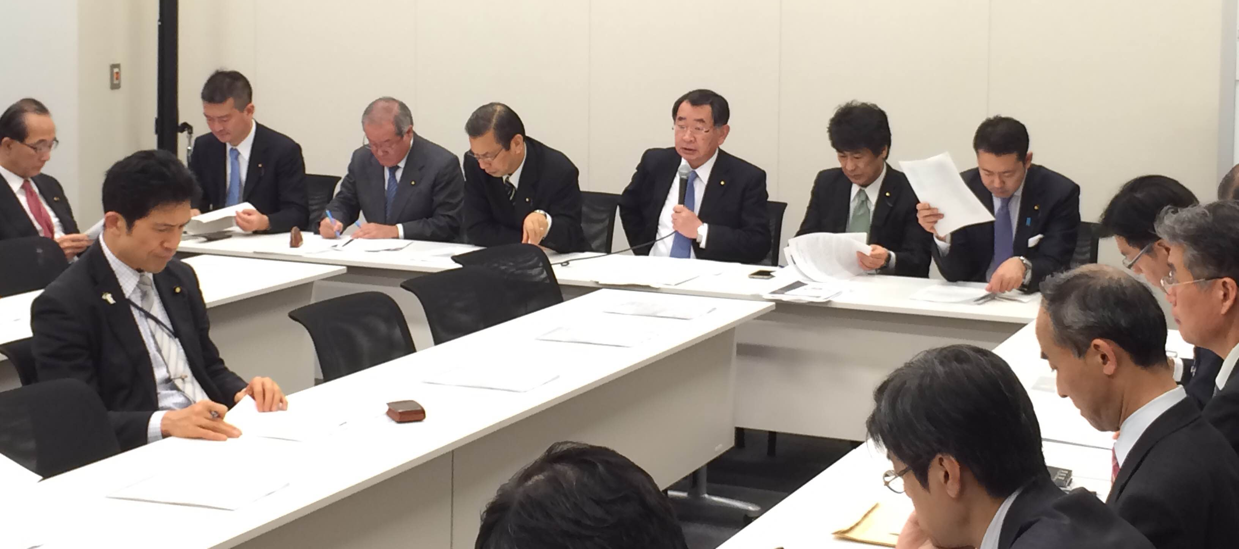
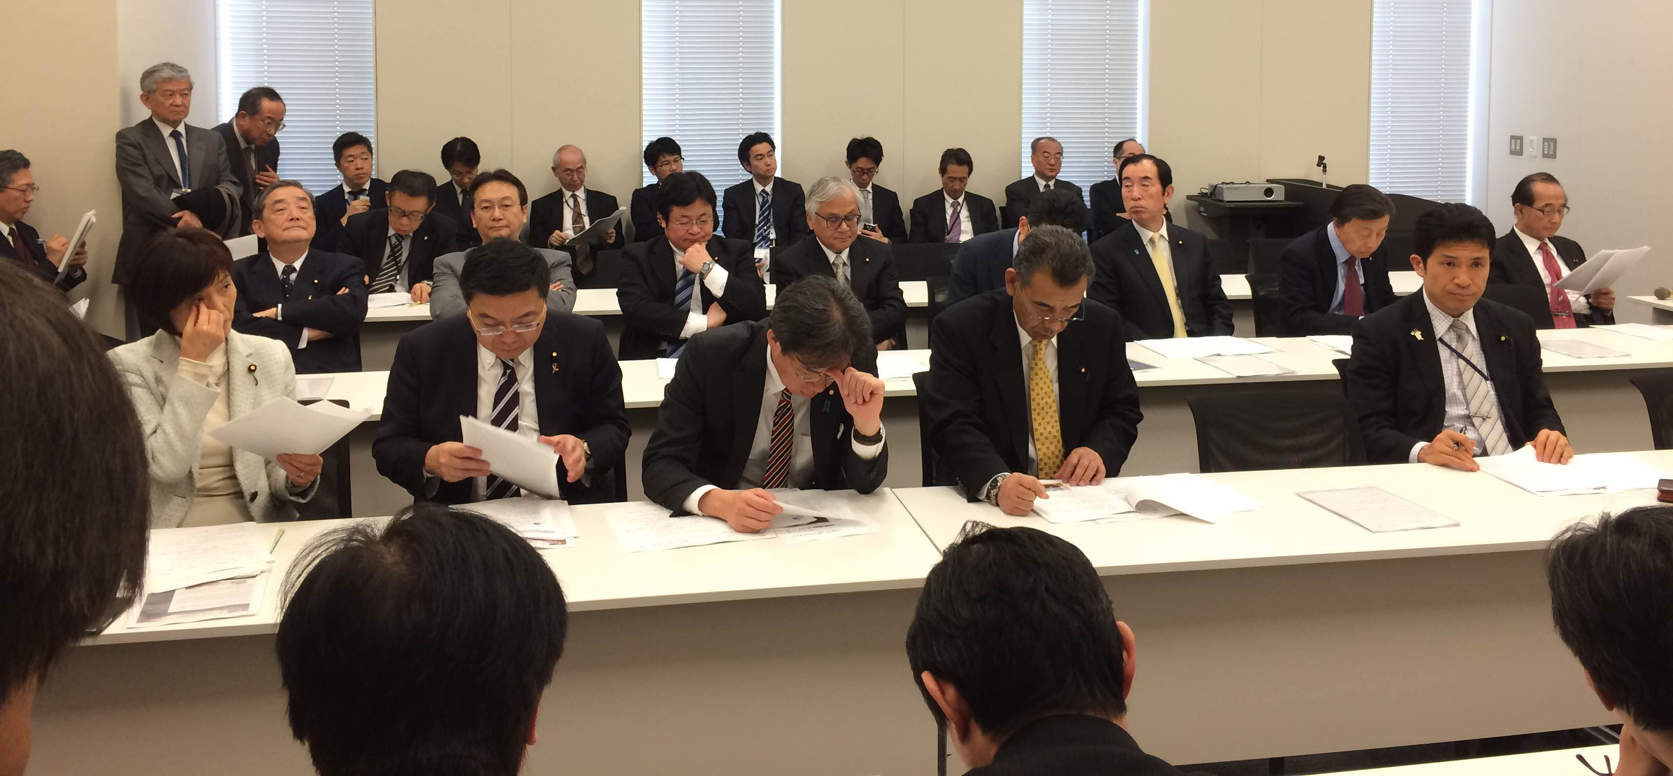
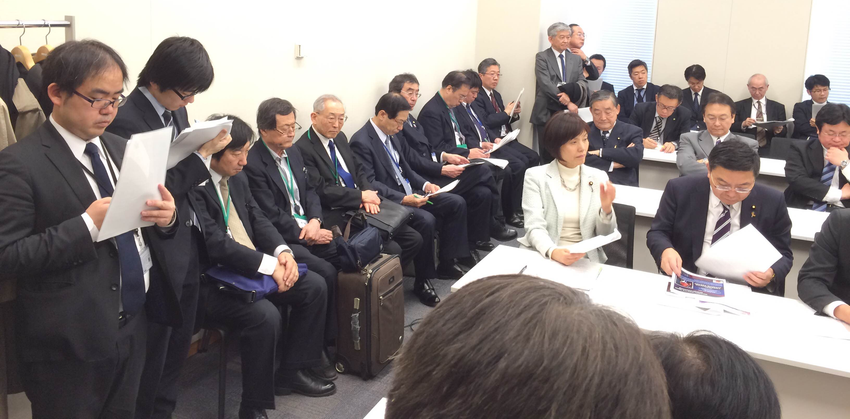
March 4, 2016: General Meeting of Diet Members for ILC
(23 Diet members, 33 staff members, ~15 Gov. officials, 10 researchers/industries)
Hon. Shionoya reported on US visit
Attendance from Ministries/Agencies
Ministry of Culture, Education, Sports, Science and Technology (MEXT):
Kazuo Todani Deputy Minister
Futoshi Sano Director-General for Policy Coordination
Yayoi Komatsu Director-General, Research Promotion Bureau
Hiroshi Ikukawa Deputy Director-General, Research Promotion Bureau
Masami Watanabe Director for Basic Research Promotion Division, Research Promotion Bureau
Sadahiro Hagiwara Director for Particle and Nuclear Physics Promotion Office, Basic Research Promotion Division,
Research Promotion Bureau
Cabinet Office
Takeo Nakagawa Deputy Director-General for Science, Technology and Innovation
Ministry of Foreign Affairs (MOFA)
Takahashi Noritsugu Director of International Science Cooperation Division, Disarmament,
Non-proliferation and Science Department, Foreign Policy Bureau
Ministry of Land, Infrastructure, Transport and Tourism (MLIT)
Toshihiko Takahashi Engineering Affairs Division, Secretary division of Minister of MLIT
Ministry of Economy, Trade and Industry (METI)
Kazuhiko Muto Director for International Affairs Office, Industrial Science and Technology Policy and Environment Bureau

Slide 21
US visit, February 11-12, 2016
(1) US-Japan Science & Technology Forum
US-Japan Political Leader’s Forum on Science & Technology was held, where coordination in S&T areas among US-Japan parliamentary members was confirmed. However, because the Congressional markup session held on that took longer than anticipated, Congress members were unable to attend the forum. In the messages delivered by Japan Caucus Co-chairs Rep. Joaquin Castro (D-TX) and Rep. Charles Boustany (R-LA), and by Hon. Kawamura (Chair, ILC-Fed.), Hon. Nakasone and Hon. Kosaka (Japan-US Parliamentary Friendship League, Chair and Vice Chair, resp.), as well as in private meetings with Co-chairs of Congressional Study Group on Japan, Rep. Diana DeGette (D-CO) and Rep. Billy Long (R-MO), it was agreed that US-Japan Forums will be held on a regular basis. The next forum is being planned to be held in Japan, which will ensure attendance by Congress members.

Slide 22
(2) Meeting with DOE
In a meeting with DOE, promoting further cooperation between the US and Japanese governments was discussed. The four areas in large-scale international projects were confirmed to be promoted through US-Japan cooperation. Concerning the ILC, it was recognized that the items that need to be currently discussed between the US and Japan are project management including the industry (specifically requested by the US side), costing including latest information, widening technological applications for further reduction in the cost, and spinoff effects in the US and Japan. DOE proposed to set up a working group, which will be discussed between the DOE and MEXT.
Attending from DOE: Dr. Cherry Murray, Director for Office of Science (Confirmed in Congress last December), Dr. Jim Siegrist, Associate Director for Office of High Energy Physics, three other members.
Attending from Japan: Hon. Ryu Shionoya, Hon. Shunichi Suzuki, Hon. Taku Otsuka, Mr. Hiroshi Ikukawa (Deputy Director-General, Research Promotion Bureau, MEXT), Prof. Hiroaki Aihara (U. Tokyo), Prof. Atsuto Suzuki (Iwate Pref. University), Prof. Hitoshi Murayama (Kavli IMPU / U.C. Berkeley), Prof. Satoru Yamashita (U. Tokyo), Mr. Toyoda (First Secretary, Embassy of Japan)

Slide 23
(3) Meeting with Sen. Mark Kirk
In a meeting with Sen. Mark Kirk (R-IL), he voiced strong support for promoting the ILC project. Sen. Kirk has a record of having led the increase of DOE’s S&T budget and is considered to be the key person in the Senate.
Attending from Japan: Hon. Ryu Shionoya, Hon. Shunichi Suzuki, Hon. Taku Otsuka, Mr. Hiroshi Ikukawa (Deputy Director-General, Research Promotion Bureau, MEXT), Prof. Hiroaki Aihara (U. Tokyo), Prof. Satoru Yamashita (U. Tokyo), Mr. Masanori Matsuoka (AAA/MHI), Mr. Toyoda (First Secretary, Embassy of Japan)
Present with Sen. Kirk were two aides, with whom a meeting was held back in January prior to this meeting. Sen. Kirk was thoroughly briefed by the aides, including prepared documents. It was agreed to continue with the communication.

Slide 24
Others: New move in Japan
GOOD for ILC
S&T national policy for 5 years plan (2016-2020) defined under the Prime Minister’s leadership implies the importance of S&T diplomacy, large scale project including accelerator projects. (presented by Prof. Sunami of GRIPS, expert of S&T policy and member of a committee for the 5 year plan at Hudson Institute)
(requested increase of S&T budget to >200B US $ / 5 years)
Promotion of Local area development and local economy is now one of the central issues in the national cabinet policy. Especially after Olympic2020 in Tokyo
Newly introduced the S&T advisor for Minister of Foreign Affairs (Dr. Kishi). New window of International protocol.
National budget still not healthy condition. First need increase consumer tax (8%→10% in April. 2017)
Note
HEP researchers direction is Not clear enough in general public level

Slide 25
issues
FY2011-2015 JSPS Grant (detector R&D)
FY2016 not passed (similar proposal as previous)
Main reason why it was not approved
  In principle the grant needs physics results in 5 years (2016-2020)
  Very similar proposal as of FY2011-2015
Trying Other resources
Added new positions in KEK and Univ of Tokyo. Trying also in Tohoku Univ and Kyushu Univ.

Slide 26
TIMING of the CONSTRUCTION PEAK
Construction period should care:
the Olympic game 2020 in Tokyo (for Japan)
Careful adjustment of the international budget profile not to overlap with cost peak of High Luminosity upgrades of LHC (especially for EU), and Neutrino program(s) (especially for US) (also human resources)
Also with S&T big project in other area,
notable example) ISS international Space station, ITER

Slide 27
Steps to come soon and beyond
Government: official reviews and investigations (on-going)
Government-to-government (started): discussions on issues and preparations (Now): NEED prospects (no commitment yet) of the international sharing the cost, human resources, technology
Surveys in individual countries by Embassy, MEXT (2016)
Preparation and studies of management structure, etc. in bi-lateral government-government joint-activities (2016-2017)
LHC run2 results (2016-2018) to come
A decision to proceed by the government
→ Official Negotiations for sharing
International agreement → International approval

Slide 28
BACKUP

Slide 29
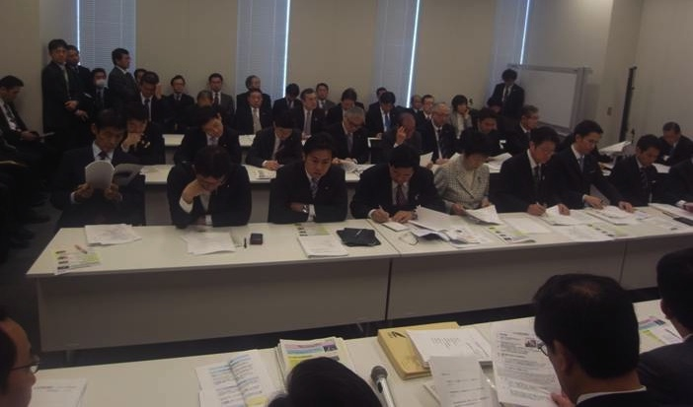
Support from policy-makers:
Federation of Diet Members (Multiple Parties)
Chair: Mr. Takeo Kawamura
Secretary-General: Mr. Ryu Shionoya
(150+ Diet Members, March 2014)
August 6, 2013 Presented Resolution and Policy Report to PM Shinzo Abe
“The ILC should be promoted as a Prime Minister project, to be funded separately from the normal government budget, in the growth-for-Japan framework in view of the national strategic areas” (partial translation of resolution)
Support from Business Communities
  Japan Association of Corporate Executives (April 2013, August 2013)
  Japan Chamber of Commerce and Industry (August 2013)
  Japan Business Federation (January 20, 2014)
Prime Minister Shinzo Abe (interviews by Media in Dec. 2014)
“Project merit is understood. Japanese government has started reviews on the project. Issues are cost and especially international sharing.”

Slide 30
The BODIES of ILC promotion in HEP researchers
ICFA: International Committee for Future Accelerators
  ICFA chair: Joachim Mnich
  LCB: Linear Collider Board (chair: Sachio Komamiya)
    LCC: Linear Collider Collaboration
      Director Lyn Evans
      Deputy director Hitoshi Murayama
Domestic in Japan
KEK ILC project preparation office
  Chair: Masanori Yamauchi (KEK DG),
  acting chair: Yasuhiro Okada (KEK executive director)
  KEK-ILC Action Plan released (Jan. 2016)
http://www.kek.jp/en/NewsRoom/Release/20160106140000/
JHEPC: Japanese High Energy Physics Committee
  Chair Hiroaki Aihara (vice president of Univ. of Tokyo)

Slide 31
Diplomatic actions in 2013
Trial in multi-lateral way
2013 July Japan-EU-US multilateral Gov discussion
  High level officers: Japan & EC
    MEXT: deputy Minister of MEXT
    EC: Director General of EC research & innovation
  CERN DG
  Others from director-level officers on HEP/large infrastructure divisions
    US, Germany, France, UK, Italy, Spain
  At that time, US: Undersecretary of Energy (Science), Director of Office of Science, both have not been assigned yet due to conflicts in Congress

Slide 32
Inter-governmental discussion
“High level” discussion is necessary
Each country needs “high-level” recognition and trigger
  Each country has its own domestic and/or on-going projects in wide area of S&T fields as well as High Energy Physics. ➔ Wider stakeholders (industry, economy, diplomacy, etc..) and recognitions of ILC project from wide area of government are desired (necessary) to obtain the EXTRA-Budget for the project.
Japan:
  TOP Prime Minister, Chief Cabinet Secretary, Minister of Finance all recognize the ILC project
  Many times discussions on ILC project has been made in Diet session.
  MEXT Minister, Chief Officer (vice Minister) keep supporting the ILC project

Slide 33
US-JAPAN
We need Scenario-C case in US P5 report for ILC
US P5: HL-LHC, LBNF(DUNE), then ILC
Scenario-C HEP budget, How can it happen? (our view)
Government support
  DOE Office of Science & OSTP
  President election 2016 Nov.
Congress support
  S&T related committee members, Appropriation Committee members.
  There is active move in Congress members team(s) to double the basic science budget in US, Hon. Alexander, Hon. Murkowski, et al.
+ For ILC, one more politics: deepening US-Japan alliance with S&T
  Japan Caucus (~80 members) in House of representatives
  Japan Study group (Senate, House, private sectors, Univ.)

Slide 34
US-Japan 2 Key Actions
Government – Government
  US: DOE and OSTP
  Japan: MEXT (and Ministry of Foreign Affairs MOFA, Embassy)
Congress Support
  Congress persons
  S&T, space committee, Appropriation committees (Budget)

Slide 35
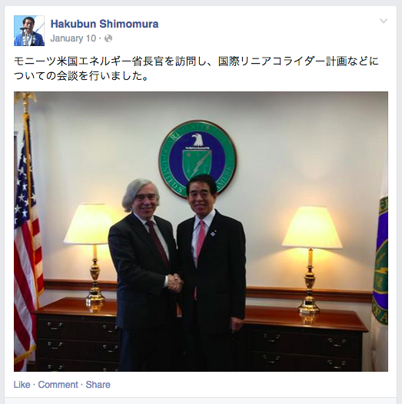
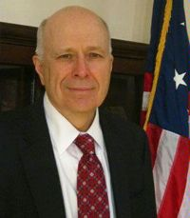
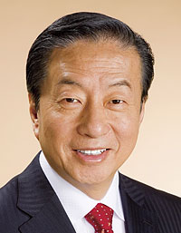
US - Japan
January 2014, MEXT Minister Shimomura @ Washington, DC
Meeting with Dr. Ernest Monitz, Secretary of Energy
December 2014
From the Facebook page of MEXT Minister Shimomura
January 2014, Washington DC
Mr. Kosaka meeting with Dr. E. William Colglazier, Science and Technology Adviser to the Secretary of State
Discussed with Secretary Monitz on ILC et al.
Recognize ILC as an important project
Mr. Kenji Kosaka
Vice-Chair, Federation of Diet Members for ILC

Slide 36
Federation of Diet Members for ILC
Chair: Hon. Takeo Kawamura
  Chair of Committee on Operation of the House of Representatives
  Director of Province Creation Headquarter of LDP¹
  Chair of Special Committee of LDP on Space and Marine Development
  Former Chief Cabinet Secretary (2008-2009)
  Former Minister of MEXT (2003-2004)
Senior advisor: Hon. Hirofumi NAKASONE
  Chairman of Japan-US Parliamentary Friendship League
  Former Minister of Foreign Affairs (2008-2009)
  Former Minister of Education and
  Director-General of the Science and Technology Agency (1999-2000) → unified as MEXT
  Former Special Adviser to the Prime Minister (2000)
Vice-chair: Hon. Kenji KOSAKA
  Chairman of Committee on Audit of the House of Councillors
  Chairman of Japan-EU Parliamentary Friendship League
  Acting Chair of Research Commission on Science, Technology and Innovation Strategy of LDP
  Former Minister of MEXT (2005-2006)

Slide 37
Meetings in January 2014 (Washington): Hon. Kosaka + Embassy
Hon. John Cornyn (Senator, Republican)
Hon. Lisa Murkowski (Senator, Republican)
Hon. Kelly Ayotte (Senator, Republican)
Hon. Colleen Hanabusa (Representative, Democrat)
Dr. William Colglazier (Science and Technology Adviser to the Secretary of State)
Meetings in July 2014 (Washington): Hon. Kawamura, Hon. Nakasone, Hon. Shionoya + Embassy + JP researchers
Hon. Tom Petri (Representative, Republican)
Hon. Paul Ryan (Representative, Republican)
Hon. Cynthia Lummis (Representative, Republican)
Hon. Diana DeGette (Representative, Democrat)
Hon. Jim McDermott (Representative, Democrat)
Hon. Rush Holt (Representative, Democrat)
Hon. Billy Long (Representative, Republican)
Hon. Randy Hultgren (Representative, Republican)
Dr. John Holdren (Assistant to the President for Science and Technology, Director of OSTP) (Diet members, Lyn Evans, JP researchers, Embassy)
Ms. Irene Hirano Inouye (President of US-Japan Council)
Dinner Meeting at Embassy by Ambassador Mr. Sasae: OSTP deputy director, NSF Director, US/JP/EU researchers
Meeting among Diet members, US researchers, LCC (L.Evans et al), Japanese Researchers @ Ambassador’s original residence
Meetings in April 2015 (Washington): Hon. Kawamura, Hon. Shionoya, Hon. Suzuki + Embassy + researchers
Hon. Eddie Johnson (Representative, Democrat)
Hon. Billy Long (Representative, Republican)
Hon. Randy Hultgren (Representative, Republican)
Hon. Diana DeGette (Representative, Democrat) @ Dinner Party hosted by Prime Minister Abe
Dr. John Holdren (Assistant to the President for Science and Technology, Director of OSTP) @ Dinner Party hosted by PM Abe
Dr. Ernest Moniz (Secretary of Energy) @ Dinner Party hosted by Prime Minister Abe
Hon. Caroline Kennedy (Ambassador Extraordinary and Plenipotentiary to Japan) @ Dinner Party hosted by Prime Minister Abe
  Dr. John Rivard (Assistant to Senator Lamar Alexander [Senator, Republican])
  Dr. Rush Holt (CEO of AAAS and Former Representative) @ AAAS
  Dr. William Colglazier (Former Science and Technology Adviser to the Secretary of State) @ AAAS

Slide 38
Dec. 2015 (Washington): Hon. Kawamura (chair of ILC Diet federation)
+ Embassy + SY + AAA (industry)
Preparation of establishment of US-Japan Congress – Diet collaboration Forum on large international projects: 4 main area = Space usge (ISS, GPS, etc), Fusion (ITER, etc), advanced Accelerator(ILC, etc), SuperComputing (next-next generation) → define the date of the First Forum: Feb. 11 at DC
Hon. Eddie Johnson (Representative, Democrat) Science & Technology RMM
Hon. Joaquin Castro (Representative, Democrat) Japan Caucus co-chair
Hon. Bill Cassidy (Senator, Republican) Science & Technology
Hon. Billy Long (Representative, Republican) Japan Study Group co-chair
Hon. Jim McDermott (Representative, Democrat) Japan Study Group former chair
Hon. Randy Hultgren (Representative, Republican) IL, supporting FNAL support P5: Neutrino in US, LHC in EU and ILC in Japan
Others: Keynote speech at a symposium on Space and Meetings with DOS for Space usage
Sep. 2015 – Jan.2016 Preparation of creation of the Forum (to be regularly held) among JP Diet members & US Congress members by AAA (Industry), Diet members’ offices, Congress members’ offices, Japanese Embassy, US Hudson institute, etc..
Meetings with Congress Committee Staff members (Science, Space & Technology, etc.. Senate & House, Majority & Minority Staffs)
Meetings with Japan Caucus office staff members, Japan Study Group office members

Slide 39
The BODIES of ILC promotion in HEP researchers
ICFA: International Committee for Future Accelerators
  ICFA chair: Joachim Mnich
  LCB: Linear Collider Board (chair: Sachio Komamiya)
    LCC: Linear Collider Collaboration
      Director Lyn Evans
      Deputy director Hitoshi Murayama
Domestic in Japan
KEK ILC project preparation office
  Chair: Masanori Yamauchi (KEK DG),
  acting chair: Yasuhiro Okada (KEK executive director)
  KEK-ILC Action Plan released (Jan. 2016)
http://www.kek.jp/en/NewsRoom/Release/20160106140000/
JHEPC: Japanese High Energy Physics Committee
  Chair Hiroaki Aihara (vice president of Univ. of Tokyo)

Slide 40
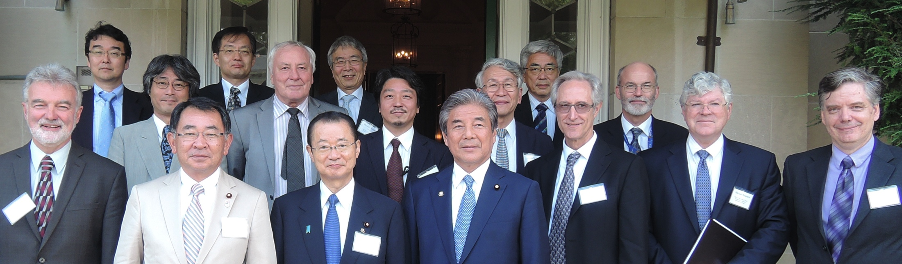
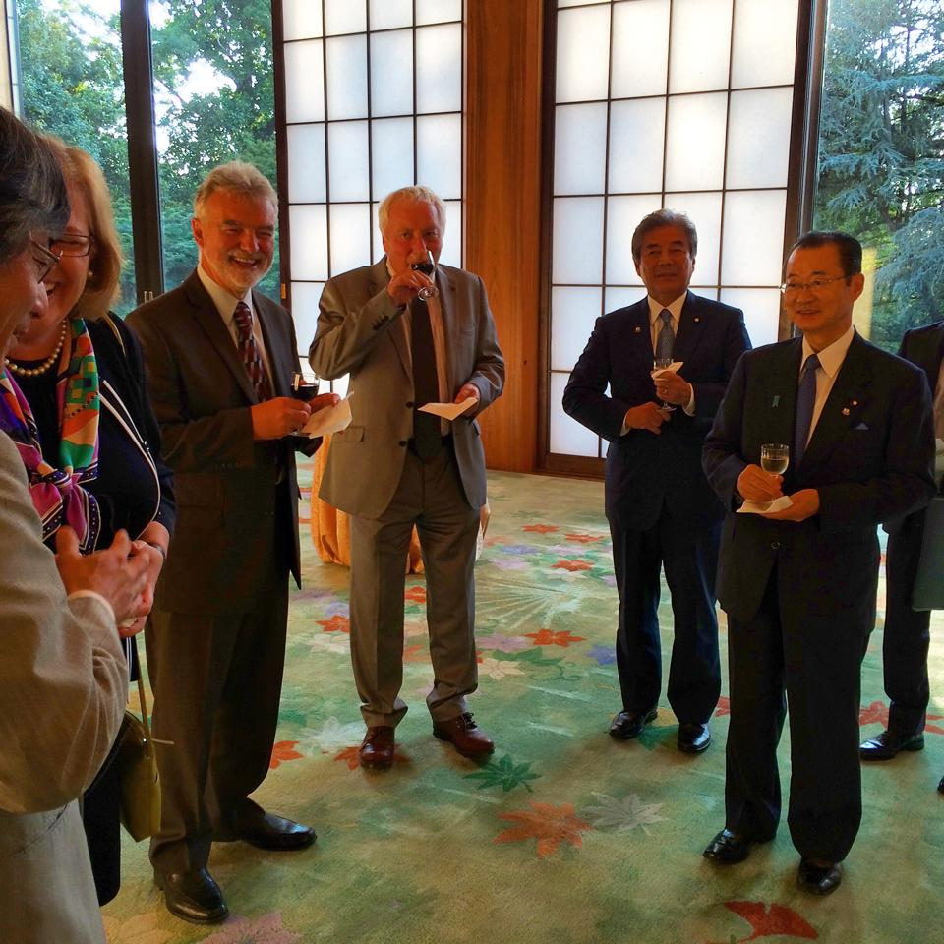
Federation of Diet Members for ILC
Visit to Washington, DC July 21-24, 2014
Mr. Ryu Shionoya
Secretary-General
of Federation
Mr. Takeo Kawamura
Chair of Federation
Mr. Hirofumi Nakasone
President of Japan-US
Parliamentary Friendship League
Roundtable Meeting
@ Former Ambassador’s Residence
  Office of S&T Policy
  DOE
  Scientists from Japan/US/Europe
@Japanese Ambassador’s Residence
  Dr. William Colglazier, Science and Technology Adviser to the Secretary of State
  Dr. France Cordova, Director of NSF
  Others

Slide 41
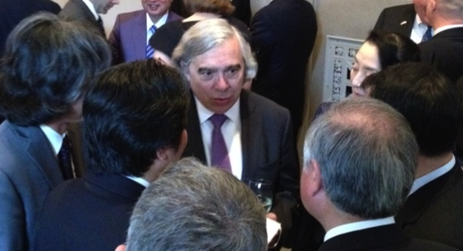
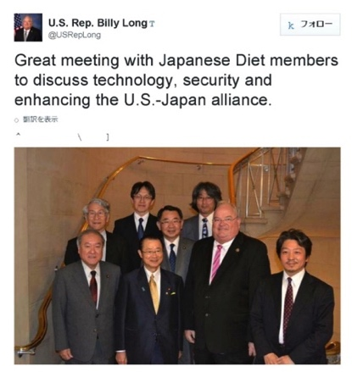
Visit Washington by Diet members on 26th – 30th April 2015
Hon. Takeo Kawamura Member, House of the Representatives of Japan
  Chair, Federation of Diet Members for ILC,
  Former Chief Cabinet Secretary of Japan, Former Minister of Education, Culture, Sports, Science and Technology.
  Director of Province Creation Headquarter and Space and Marine Committee of Liberal Democratic Party
Hon. Ryu Shionoya Member, House of the Representatives of Japan
  Secretary General, Federation of Diet Members for ILC
  Former Minister of Education, Culture, Sports, Science and Technology
  Acting Chair of Policy Research Council of Liberal Democratic Party
Hon. Shunichi Suzuki Member, House of the Representatives of Japan
  Vice Chair, Federation of Diet Members for ILC
  Former Minister of the Environment
  Vice Chair of Headquarter of Liberal Democratic Party for Recovery Plan for Tohoku Disaster
Accompany from Japan: 15 members from universities, research institutes, industry
  Advanced Accelerator Association promoting Science and Technology with Embassy.

Slide 42
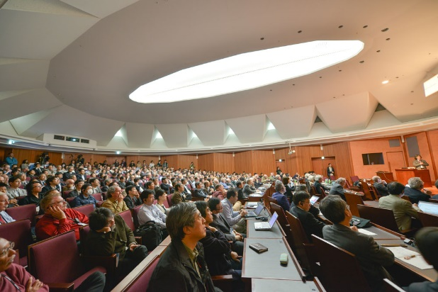
Recent Diplomatic activities: Political and governmental sectors, industrial sectors
US-Japan Minister level discussion (Jan. 2014)
US-Japan High level Japan-US officials discussions (April, 2015)
EU-Japan Parliamentary Assembly for ILC (April,2015) @ Strasburg
Main Bodies
Federation of Diet Members for ILC (since 2008, more than 150 members)
The 4th visit to US in Feb 2016 to facilitate the realization of the ILC project
Advanced Accelerator Association Promoting Science & Technology (AAA)
(since 2008, 100 companies and 40 universities and research institutions)
3rd US visit by Diet members
Round table discussion of S&T at Hudson Institute,
Washington DC in April 2015 during 3rd US visit
=>
Japan-US collaboration of S&T at the political level
being coordinated by the Hudson Institute and AAA
Researchers: ILC Tokyo Event on April 22, 2015 during ALCWS 2015

Slide 43
Japanese Delegation to Washington DC in Feb. 11-12, 2016
6 bodies
3 Diet members from the Federation of Diet members supporting ILC
MEXT one (high-rank) officer: Ministry of Education, Sports, Culture, Science and Technology
Advanced Accelerator Association promoting Science and Technology (AAA) Industry
Executives from Tohoku bureau of Economy, Iwate business association, prefecture local government
Japanese Researchers (~10 researchers)
Japanese Embassy in US

Slide 44
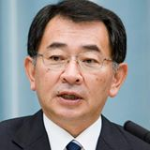
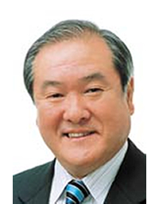
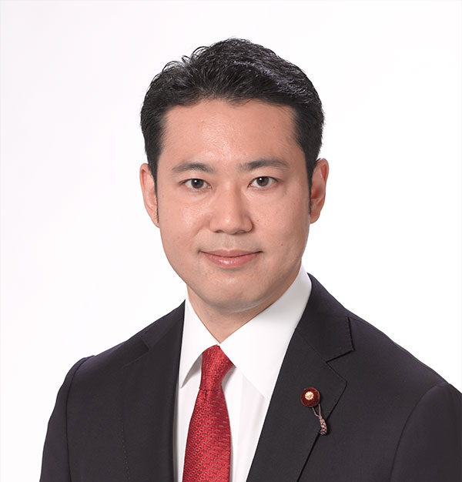
Japanese Delegation to Washington DC
11-12 Feb. 2016
3 Diet members
  Hon. Ryu Shionoya Director General of Federation of Diet members for ILC
1990 - Member of the House of Representatives
2008 - 2009 Minister of MEXT
2011 - 2012 Chairman of Executive Council of Liberty and Democratic Party (LDP)
2012 - 2014 Chair of Committee of LDP on Science-Technology-Innovation Strategy
Present: Acting Chair of Policy Research Council of LDP
Hon. Shun-ichi Suzuki Deputy-Chair of Federation of Diet members for ILC
1990 - Member of the House of Representatives
2002 - 2003 Minister of the Environment
2012 – 2013 Senior Vice-Minister for Foreign Affairs
Present:
Chair of Association of All-Tohoku block Diet members of LDP
Vice Chair of Headquarter of LDP for Recovery Plan from Tohoku Disaster
Hon. Taku Otsuka Deputy Secretary General of ILC Diet Federation
2005 - Member of the House of Representatives
2014 - 2015 Parliamentary secretary for Justice
Present:
Director of National Defense Division of LDP

Slide 45
Delegation from Japan and Meetings in Feb. 2016 (@DC):
Japanese Delegation (25 people):
Hon. Shionoya, Hon. Suzuki, Hon. Otsuka + MEXT
+ Embassy + JP researchers + AAA + Tohoku Business Executives
First starting with miserable situation due to overlap with voting in Congress, then
good occasion thanks to Ambassador, and finally in backyard actions GOOD
ACHIEVEMENTS and PROGRESS in two directions 1) Congress – Diet 2) with DOE
A. TWO OPEN EVENTS (not successful)
→ better than nothing, but to be honest, “disappointing” by absence of Congress members
due to a sudden “mark-up” process (sequential process from discussion to voting) in Congress
1. Congress – Diet FORUM “US-Japan Political Leaders’ Forum on Advanced S&T” (on 11th Feb)
@ House Office Building: on 11th Feb
Unfortunately Congress in markup process on 11th, then congress members could not attend due to
voting at Congress.
2. Symposium @ Hudson Institute 12th of Feb.
→ Diet members could attend only shortly due to meeting at DOE and with Senator Kirk
DOE, US-Japan Researchers, LCC Lyn Evans, Congress staff members, Tohoku Business Executives
presentations by researchers and industry, business bureau (apologies to US researchers for too short
(only a week) notice of the event due to a miscommunication with Hudson Institute)

Slide 46
VERY NICE OCCASION made by Ambassador Mr. Sasae:
Thanks to Ambassador, Embassy and Ministry of Foreign Affairs
@Japanese Ambassador’s resident on 11th Feb. Night:
Discussions on ILC and International S&T projects, Science Diplomacy
Dinner Meeting with Ambassador Mr. Sasae, Diet members, MEXT,
DOE (Dr. C. Murray), DOS (Dr. Trikian, et al), NSF, et al from US
& Dr. Kishi (S&T Advisor of Ministry of Foreign Affairs – new position)
(again, invited Congress members could not attend with voting)
C. ACHIEVEMENTS and PROGRESSES (see next page in detail)
1) DOE 12th of Feb
Dr. Cherry Murray (Department of Energy, Director of Office of Science)
2) Individual meetings with House members and Senator
Start the FORUM activity among members of US Congress and Japanese Diet
(Feb. 11th at Washington DC – Feb. 17^{th in} TOKYO)

Slide 47
Delegation from Japan and Meetings in Feb. 2016 (@DC): PROGRESSES in backyard (1)
1. @DOE 12th of Feb participants
Dr. Cherry Murray (Department of Energy, Director of Office of Science)
Dr. Jim Siegrist (DOE Associate Director), et al (in total 5 members from DOE)
Diet members: Hon. Shionoya, Hon. Suzuki, Hon. Otsuka
MEXT deputy director of research bureau Mr. Ikukawa + Embassy
Japanese researchers (A.Suzuki, H. Aihara, H. Murayama, S.Yamashita)
DISCUSSION and CONCLUSIONS
  Agrees upon keeping to increase supports on US-Japan collaboration in large international projects
  Facilitate formation of joint study between MEXT-DOE as “Discussion Group” on ILC (first DOE side proposed)
    Main issues to jointly study are 1) Management structure including Industry, 2) Cost assurance and reduction 3) Spin-off Merits
    High-level (Minister level agreement) US-JP framework on S&T involves ILC in its annex. (bi-lateral framework already exists)
    Each counterparts (officers in DOE side and in MEXT side) are introduced.
    This time was DOE-Diet meeting = facilitation → concluded that it will be discussed between DOE and MEXT. Note: Corresponding MEXT budget exists in Y2016 National Budget on study of large international S&T project management (to be activated from April). Careful operation is necessary (membership, items, timeline, etc..)
  Confirmed among all participants including DOE/MEXT that the facts discussed at DOE this time are all OPEN (not confidential)

Slide 48
2. THE FORUM “US-Japan Political Leaders’ Forum on Advanced Science and Technology”
→ Start the FORUM activity among members of US Congress and Japanese Diet
(Feb. 11th Washington – 17th TOKYO)
Japan Caucus: (11th Feb) Message from Japan Caucus co-chairs to support the Forum (Hon. Castro, Hon. Boustany) (Hon. Castro had to back in Texas for his baby birth)
Japan Study Group: (11th Feb) Assured by the individual meetings with co-chairs to activate the Forum
Individual Meetings with Congress members (Feb. 2016)
  Hon. Billy Long (Representative, Republican) Japan Study Group co-chair
  Hon. Diana DeGette (Representative, Democrat) ) Japan Study Group co-chair
  Hon. Mark Kirk (Senator, Republican) Appropriation, etc, IL, supporting FNAL; support Neutrino in US and ILC in Japan
  Package: SPACE (ISS), FUSION energy (ITER), Accelerator (ILC), SuperComputing
→ On 17th Feb. in TOKYO between members of US Congress and Japanese Diet
among Japan Study Group (US Congress) and US-Japan Friendship Federation (JP Diet)
Discussion on the Forum NEXT TIME: better to be held in Japan to assure the participation of
members of both Congress and Diet
Timing to be decided seeing the situation of US Presidential Election (Nov. 2016) &
Japanese Upper House election (July 2016)

Slide 49
Summary of Steps so far and to go
International concept and international investment on Key technology ~500 M US$ in total in world (2004-2013) (SCRF and nano-beam for ILC, XFEL, etc)
BIG Prototype = Euro-XFEL(EU), LCLS-II (US), ATF(Japan) + many R&D (world)
GDE CDR(2007) → Technical Design complete (2013) → LCB/LCC
LCB/LCC successfully facilitated official process in Japanese government
Japanese Government: MEXT official reviews and investigations started (2014→)
Government-to-government: discussions on issues and preparations (started): NEED prospects (no commitment yet) of the international sharing the cost, human resources, technology. (Mostly bi-lateral) Joint Study of project management structure including industry sector, sharing models of roles and cost, how to assure the cost size. Then prospects for sharing.
Surveys in individual countries by Embassy, MEXT (expected in 2016)
LHC run2 results (~2018) to be continuously monitored (to determine max energy = project scope and definition as the governments), Parallel processes in MEXT, MOFA, eventually MOF (finance)
A decision to proceed by the government cabinet (Prime Minister) backed by partner countries’ prospects → Official Negotiations for sharing
International agreement → International approval

Slide 50
A short summary of Year 2012-2015
Developments on Promotion of the ILC Project
October 2012: Japanese HEP community proposed to host the ILC in Japan
as a global project.
High Energy Physics RESEARCHERS: Statements on ILC hosted in Japan
  EU: The European Strategy for Particle Physics Update 2013
  ASIA: ACFA/AsiaHEP Statement on the ILC (September 2013)
  US: P5 report (May 2014)
  ICFA statements (January and July 2014)
ACADEMIA: September 2013: Science Council of Japan (SCJ) sent Report on the ILC Project to MEXT. → list of Issues to solve before GO
Japanese GOVERNMENT:
  Feb. 2013: MEXT ILC task force is formed (chair = vice Minister)
  May 2014: MEXT set up ILC Advisory Panel with two WGs (Physics, TDR Validation) ← Leadership of Minister of MEXT
    After the 4th meeting in June 2015, ILC Advisory Panel disclosed “Summary of ILC Advisory Panel’s Discussions to Date” in August 2015.
One of the biggest issues to clarify before the DECISION = PROSPECTS
of participation and cost sharing by international partners at Government level

