Slide 1
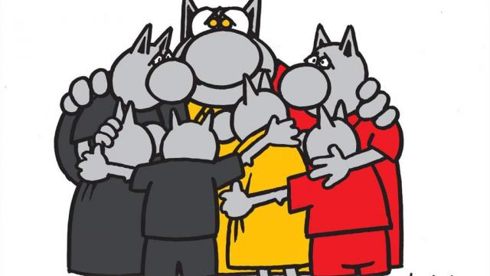
4th JCL
PARIS
We are all with Brussels today

Slide 2
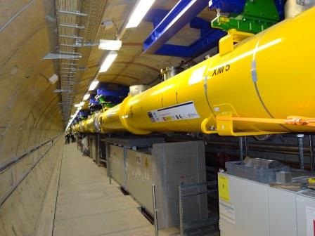
WELCOME

Slide 3
Group photo on the stairs in front of the building at 12:30
Restaurants : lots of restaurants, bistros, fast-foods, in the roads around (left: rue Gay-Lussac, rue St Jacques ; right : rue Descartes, rue Thouin, rue du Pot de Fer, rue Mouffetard

