Slide 1
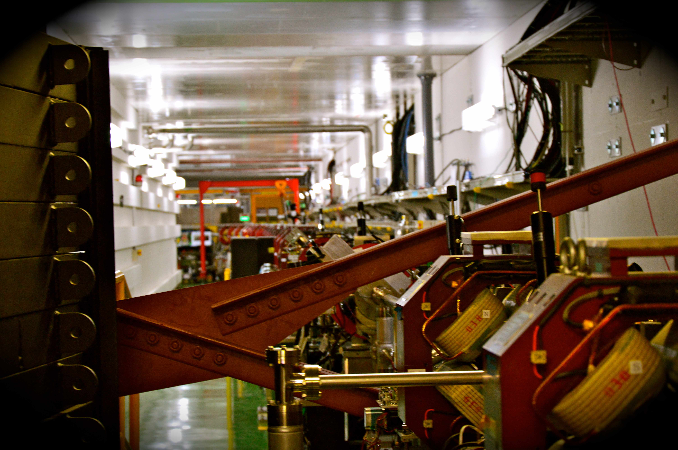
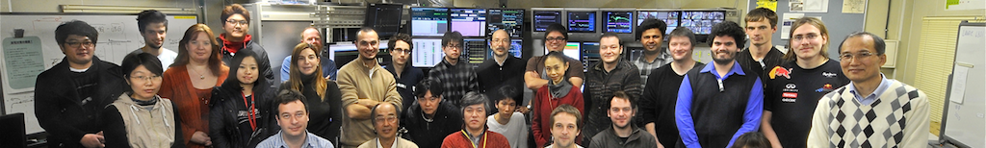
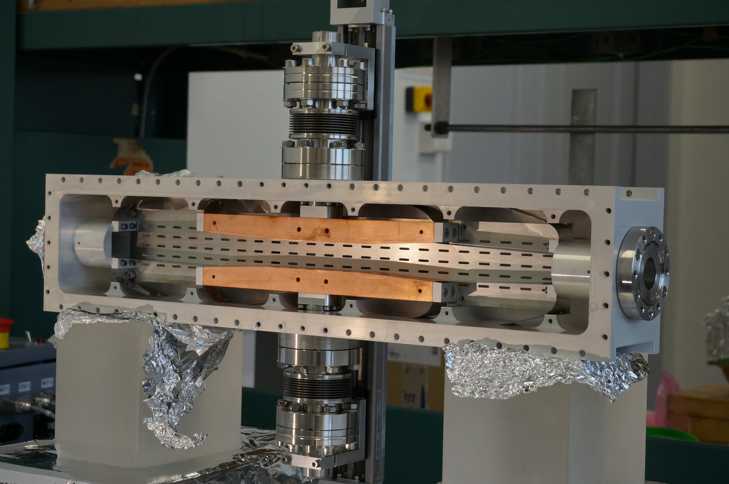
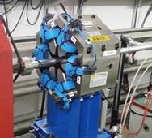
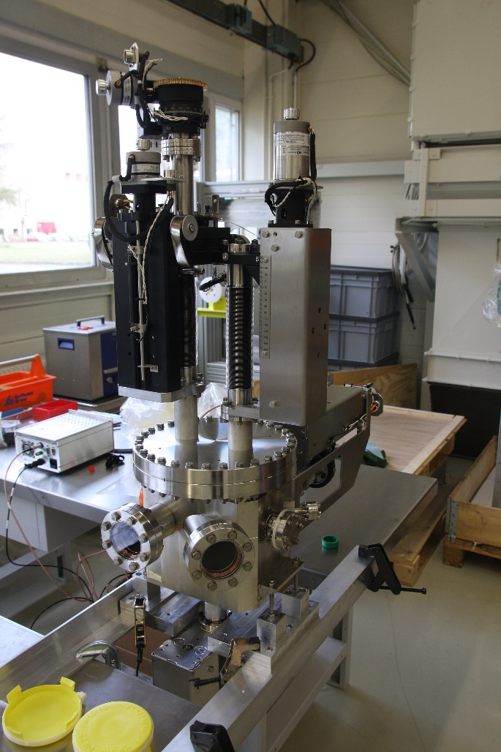
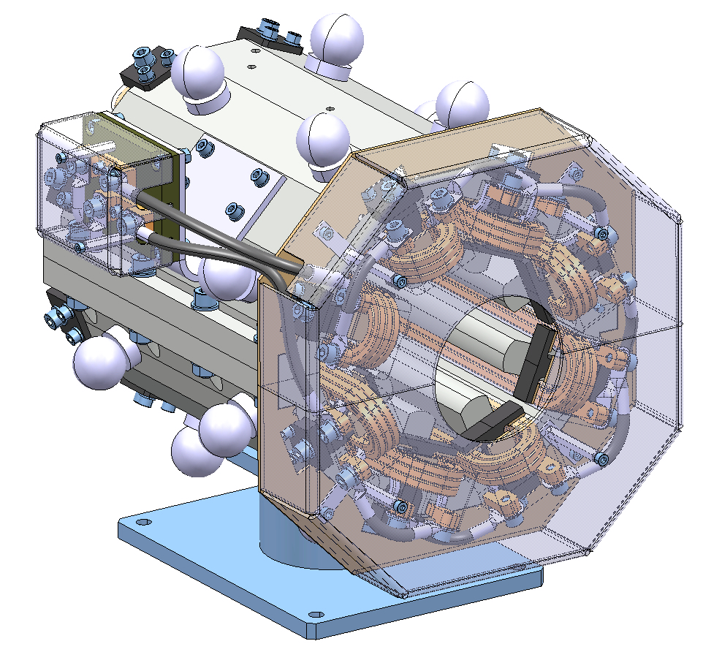
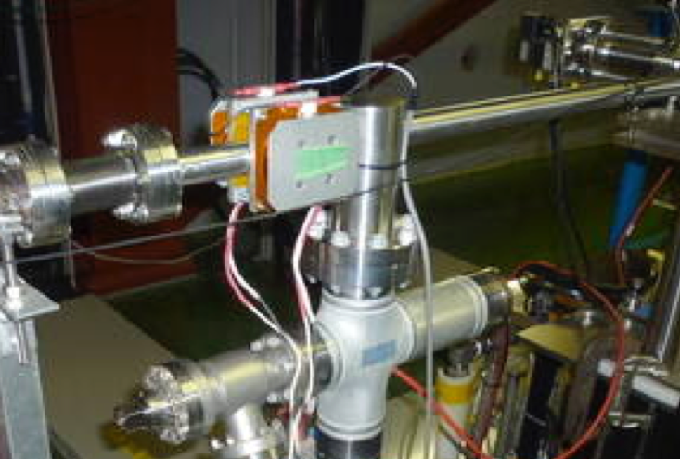
ATF2 Status and Plans
Notes:
Summary of the Technical Board held during the 19th ATF2 project meeting at LAL on 13-15 January 2016 and news and highlights from winter run 2016

Slide 2
Outline
  ATF2 FY2015
    Operational summary
    Hardware summary
    R&D issues and challenges:
      Beam tuning and low-beta optics
      Wakefields and beam orbit stabilization. High intensities issues
      IP-BPMs and nanobeam stabilization
  ATF2 FY2016
    Operational status and prospects
    Hardware status
    Highlights from winter run
      Background characterization: DS and collimator
      FONT upstream feedback and beam size measurement
      OTR/ODR first measurements
      m-OTR measurements
      Ground Motion
  International Collaboration Status and Future
  Final remarks and Summary
Notes:
Japanese fiscal year starts in April
In the R&D some highlights are presented about the ongoing activities

Slide 3
ATF2 FY2015 operational summary
Overview of FY2015 operations:
Several shifts were lost by failures but quickly/successfully fixed by the maintenance team.
No long failures more than a week.
The startup time is shorter compare to the past years, and is used for short R&Ds.
Most of the R&Ds were done at ATF2 beamline.
More than 80% of shifts were for ATF2 goal-1 and 2.
Non-KEK colleagues could recover a primary beam by themselves and keep R&Ds especially on owl shifts.
Total 142 shits from Apr–Dec 2015
Notes:
ATF2 FY2015 operational status (N. Terunuma)
During April to December 2015 a total of 142 shifts have been performed. A small number of shifts were lost by failures; the problems have been fixed in a period of time shorter than a week. The start-up time has been shortened compare to previous years, and could be used for short R&Ds. Most of the R&Ds were done at ATF2 beamline and 80% of the shifts were dedicated for ATF2 goal-1 and 2. Non-KEK colleagues could recover a primary beam by themselves; this fact gives the possibility of keeping the R&Ds programs especially on owl shifts.
Concerning the ATF operation budget during the FY2015, the cost of electricity continues to be the most important budget item, being paid mainly by KEK (twice cost since 2014). The maintenance budget is in consequence very limited, there is a lack of spare units especially for the expensive ones as: the injection/extraction kickers (thyratrons) and the LINAC klystrons. These two spares have to be purchased in FY2016, with high priority. Other maintenance as the cooling issues will be repaired when necessary.

Slide 4
ATF2 FY2015 operational summary
Budgetary issue for ATF operation in FY2015
Electricity cost (beam time) is still the higher level, ATF was maintained mainly by KEK (twice cost since 2014)
Maintenance budget is very limited. Lack of spare units especially for expensive ones as: Injection/extraction Kickers (new thyratrons) soon, LINAC klystrons (highly required in 2016), Cooling facility (repair when broken basis)
Notes:
Electricity is equivalent to beam time
Some beam stoppers as klystron, kicker or cooling…

Slide 5
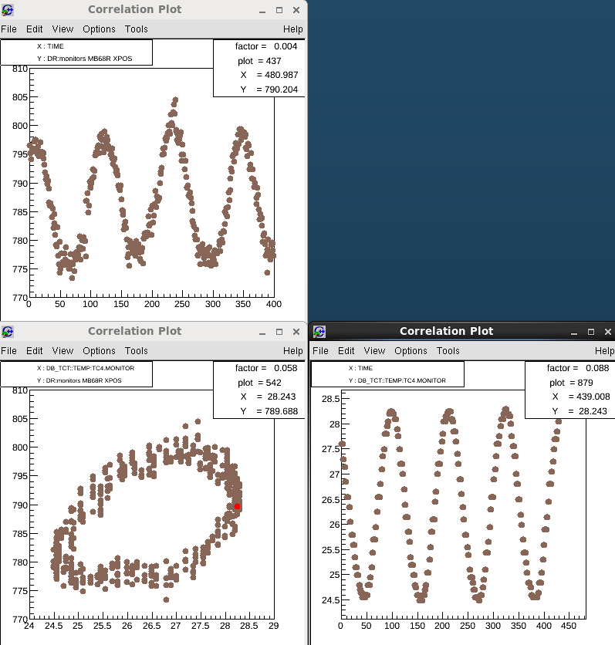
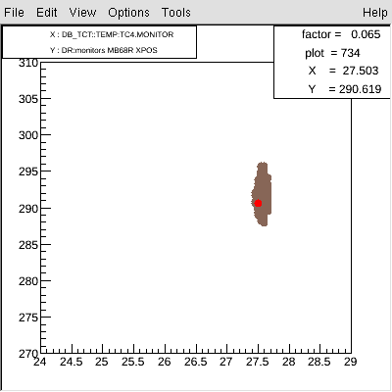
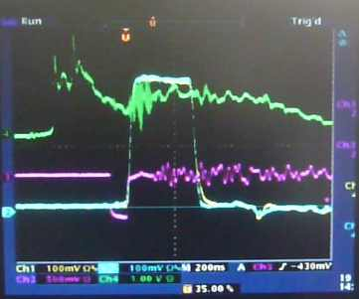
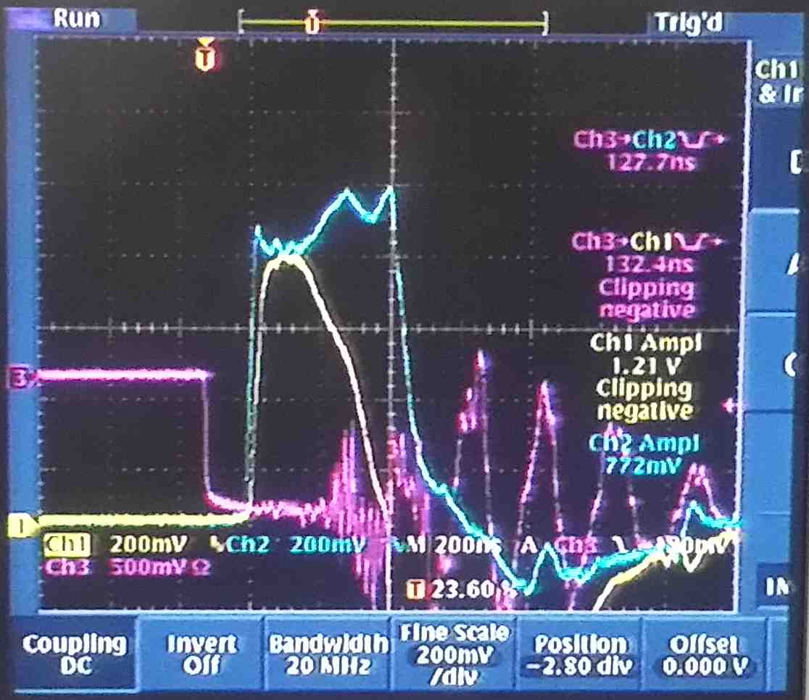
ATF2 FY2015 hardware summary
Orbit stabilization effort:
DR BPMs reading
DR temperature stabilization
Orbit oscillation in the DR due to the DR Cooling water temperature change
Orbit drift in FF due to the DR air-conditioner
Extraction Kicker
Extraction kicker trouble (2015.11~2015.12)
Study of a new proposal for the pulse stabilization of the extraction kicker
MB68R X-pos
Mag Cooling water temp
ch1(yellow) thyratron1 current
ch2(blue) thyratron2 current
Notes:
ATF2 FY2015 hardware status
Orbit stabilization (T. Naito)
An important effort has been made in orbit stabilization, in two aspects: the DR temperature stabilization and the extraction kicker. During 2014 operation time an orbit oscillation in the DR due to the DR cooling water temperature and an orbit drift in the FF due to the DR air-conditioner were observed. The two effects have been fixed with a more efficient control of the cooling tower and a new procedure of stabilization of the temperature in the DR. During November-December 2015 the extraction kicker experienced a problem that made the extraction of the beam from the DR very difficult. The kicker waveform changed suddenly, the thyratron 1 was changed by another one. Unfortunately, no new spare were available, so it has been replaced to an old one, which was working but giving unstable pulse timing. Two new spares has been ordered and will be delivered at the end of March 2016. Furthermore a modification of the extraction kicker Power Supply has been proposed to minimize the orbit jitter and to improve the maintenance.
Naito might mention about the quick delivery of SLAC spares but it was his thought and did not follow the present situation of SLAC. Later it was found to be realized after summer if possible.

Slide 6
ATF2 FY2015 hardware summary
New hardware installation
Strengthen the ATF2 skew sextupoles (KEK)
under installation for next beam runs
shorten a pole gap and widen the dynamic range for a beam tuning. φ160 → φ60
Air-core dipoles in EXT/FF (KEK)
  -a pair of vertical dipoles were successfully functioned in December run for slow orbit feedback and jitter studies.
  -a pair of horizontal dipoles will be installed before April.
Notes:
Old sextupoles was a loan from super KeK B
Air cole dipoles used as a controlled jitter source
New hardware installation (N. Terunuma)
New hardware is being or will be installed in next future:
- Skew sextupoles supplied by KEK and with higher strength are under installation and they will be operational for the next beam runs. The new skew sextupoles have a shorten pole gap (70mm diameter instead of 160mm) and widen the dynamic range for beam tuning, The strength has been increased of a factor 7.
- A pair of vertical air-core dipoles, supplied by KEK was successfully running since December 2015. These dipoles could be used for slow orbit feedback and jitter studies. Another pair of horizontal dipoles will be ready for the next beam runs .
- An OTR/ODR system supplied by RHUL and CERN will be installed in February 2016 and will be operational in a next future.
- A vertical collimator system supplied by IFIC and LAL will be shipped to KEK (?) mid-February 2016 and the installation and first calibration is planned in March 2016.
- A set of octupoles supplied by CERN will be installed in 2016 spring.
These dipoles were installed and operated in last week.

Slide 7
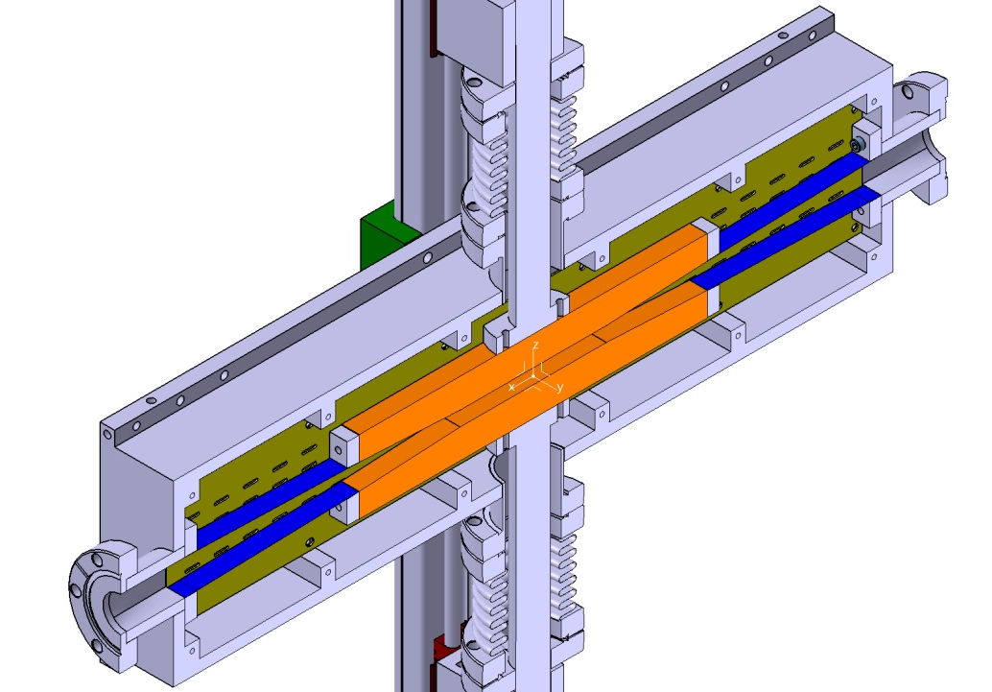
ATF2 FY2015 hardware summary
New hardware installation
OTR/ODR system (RHUL/CERN) Installation will be done in February.
Collimator system (IFIC/LAL)
Shipping and installation planned in March
Octupoles (CERN) Shipping and installation planned in Spring

Slide 8
ATF2 FY2015 R&D issues and challenges
    Beam tuning and low-beta optics (T. Okugi , M. Patecki 19th ATF2 Project Meeting, LAL January 2016 and CLIC 2016)
    Wakefields and High intensities (K. Kubo 19th ATF2 Project Meeting, LAL January 2016)
    Beam orbit stabilization (D. Bett 19th ATF2 Project Meeting, LAL January 2016 and CLIC 2016)
    IP-BPMs and nanobeam stabilization (T. Tauchi, N. Blascovick T. Bromwich, S.Jang, S. Wallon 19th ATF2 Project Meeting, LAL January 2016)
    Background characterization (N. Fuster Martinez CLIC 2016)
19th ATF2 Project meeting https://agenda.linearcollider.org/event/6939/
CLIC 2016 https://indico.cern.ch/event/449801/
Notes:
Some highlights of the R&D ongoing activities

Slide 9
ATF2 FY2015 R&D issues and challenges
Beam tuning and low-beta optics (T. Okugi)
A continuous effort in the IP beam size measurement for 20x1 and 10x1 optics has been made during 2015.
The minimum IP size was larger than the measured in 2014 spring operation, both from QD0FF scan and with a random jitter source.
The intensity dependence was larger than for 2014 even after the OTR2 optimization, symmetrisation and optimisation of the all the OTR chambers.
During 2016 the effort for goal 1 will continue with: a detailed investigation of the dependence with the random jitter source will be performed thanks to new air-core dipole, new skew sextupoles and the chamber modification (some bellows will be eliminated) of FD.
Notes:
Some highlights of the R&D ongoing activities
Goal 1 is obtained now in routine operation
FD final doublet

Slide 10
ATF2 FY2015 R&D issues and challenges
Ultra-low-beta tuning (M. Patecki)
A certain number of shifts during 2015 spring and December runs were dedicated to the test the ultra-low-beta scenarios similar to CLIC chromaticity level. The 10x0.5 optics was tested. The β_{y}* was correctly set, but β_{x}* was larger by a factor 2. The tools for β* values estimation has been implemented. The lowest measured vertical IP beam size was about 60 nm, some possible reasons has been identified: beam is more sensitive to imperfections due to larger β function in FF line, not optimized sextupoles strength or beam orbit fluctuations and drifts.
During 2016 the investigation of the ultra-low-beta will continue. The installation of the octupoles magnets in spring 2016 could improve the tuning for this kind of optics
Notes:
Some highlights of the R&D ongoing activities
Ultra-low-beta tuning (M. Patecki)
A certain number of shifts during 2015 spring and December runs were dedicated to the test the ultra-low-beta scenarios similar to CLIC chromaticity level. The 10x0.5 optics was tested. The β_{y}* was correctly set, but β_{x}* was larger by a factor 2. There was no time to correct β_{x}* but the correction procedure is known. The tools for β* values estimation has been implemented. The lowest measured vertical IP beam size was about 60 nm, some possible reasons has been identified: beam is more sensitive to imperfections due to larger β function in FF line, not optimized sextupoles strength (not enough number of nonlinear knobs applied) or beam orbit fluctuations and drifts. Beam size tuning in the 10x1 optics suffers from the same limitations, but lower beam size was measured (about 50nm) in 10x1 optics, which suggests the effect of optics on the beam size. During 2016 the investigation of the ultra-low-beta will continue with: a systematic study for few cases of well-controlled optics, which could help to distinguish optics impact from other effects, scanning the sextupoles strength independently to improve the tuning and with longer periods for continuous tuning operation mode. The installation of the octupoles magnets in spring 2016 could improve the tuning for this kind of optics.

Slide 11
ATF2 FY2015 R&D issues and challenges
Wakefields and High-Intensity dependence
Orbit change and beam size vs. Position of Wakefield sources
  Experiments and calculations are (almost) consistent
Beam size intensity dependence with optimized wake source (on movers) positions
  Still not understood
  It seems mostly from dynamic effect: orbit jitter + wakefield
  Experimental data analysis so far can not show clear results.
    Need more data?
    IPBSM with 2-bunch feedback data should give more information.
    Orbit change and beam size vs. Position of Wakefield sources
Effects of transverse wakefield in ILC will be much smaller than in ATF2, understanding of intensity dependence is
crucial to make a proper scaling
  High energy, short bunch length
  Beam pipe aperture will be similar, but careful design (except collimators)
Notes:
Wakefields and high-intensities issues (K. Kubo)
During 2015 measurements and calculation of the wakefields impact, orbit change and beam size, from sources on movers as C-band reference cavities and OTR chambers has been made. The comparison between the experiments and calculations are almost consistent, if the bellows and OTR chambers are included simultaneously in the 3D calculation of wakefields. The strong intensity dependence after optimizing cavity and chamber position is not understood yet. Orbit jitter in EXT-FF line about 0.3s of nominal beam size has been observed, if we take into account only the jitter effect the increase of the IP beam size will be only of 4%, but in a high-beta region adding the effect of wakefields could make this increase significant.
Experimental data analysis is not conclusive and more experiments in this sense will be performed during 2016.
Wakefield Free Steering (WFS) has been performed during December 2014, the method with intentionally increased wakefield (increased offset of wakefield source) has been demonstrated. The experiment in ATF2 is more difficult than in a linac, due to the no periodicity of the system and the multiplicity of the wakefield sources. New experiments will be made during 2016. The effects of transverse wakefield in ILC will be much smaller than in ATF2, due to the higher energy, shorter bunch-length and optimized design of the beam pipe and instruments from the point of view of wakefields. But the understanding of the intensity dependence and the comparison between observations and calculations are crucial to make a proper scaling for ILC.

Slide 12
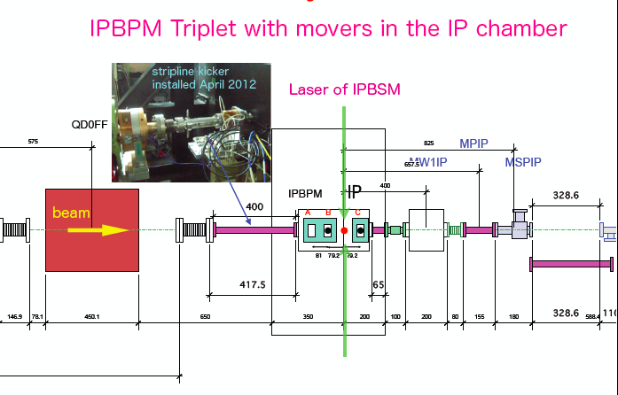
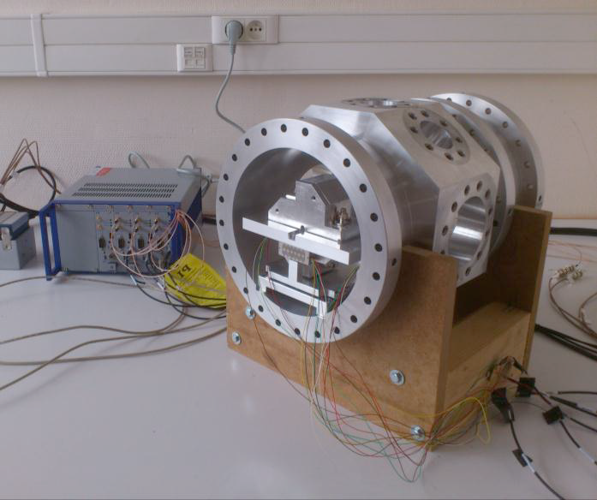
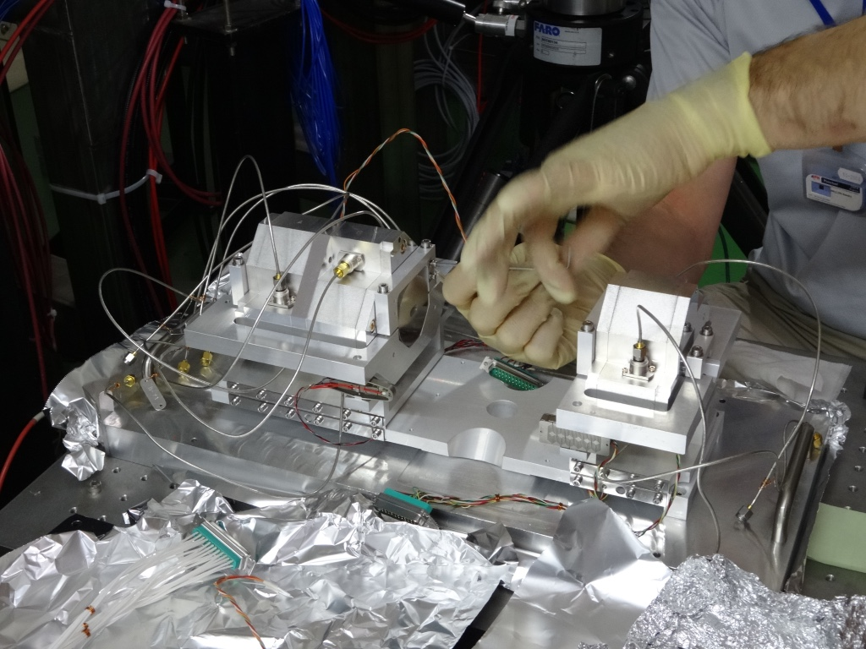
ATF2 FY2015 R&D issues and challenges
IPBPM resolution less than 2 nm for Goal 2
Notes:
Layout of the IP-BPMs, piezo devices under the cradle ( support of IPBPMs on the movers ).
IP-BPMs and nanobeam stabilization (T. Tauchi)
The control of the beam position at manometer level at the IP needs of BPMs at the IP with a resolution of less than 2nm. A complete system consisting on a triplet of IP-BPMs with movers in the IP chamber was installed in ATF2. The current IP-BPM resolution is of 27nm at 0.3 10¹⁰ beam intensity that is equivalent to 67nm of IP stabilization (resolution of 47nm). The possible sources of this poor resolution could be: the electronics noise, the low beam intensity e.g. poor calibration, the calibration e.g. IQ tuning and the static signals. These statics signals are only seen at the low Q IPBPMs, could be "filtered out" by the narrow band C-band pass filter and may be generated in the waveguide. Some measures has been taken to improve the resolution as the recovery of Q at IPBPM-C by re-fabrication and indium shielding in order to study the correlation between the Q and the static signals and a finer adjustment of IQ angle or detailed calibration in the nanometer range. During the 2016 runs different configurations of IPs (IP-BPM B or nominal IP) and full use of the IQ signal will be envisaged in order to get the 1nm resolution.

Slide 13
ATF2 FY2015 R&D issues and challenges
IP-BPMs and nanobeam stabilization
Present status:
  BPM resolution : 27nm at 0.3 10¹⁰ beam intensity
  IP stabilization at 67nm ( → resolution of 47nm )
What are sources of the poor resolution limit ?
  electronics noise
  low beam intensity, e.g. poor calibration
  calibration , e.g. IQ tuning
  static signals
    only seen at the low Q IPBPMs ?
    could be "filtered out" by the narrow band C-band pass filter
    may be generated in the waveguide
Measures to improve the resolution
  recovery of Q at IPBPM-C by re-fabrication and indium shielding to see a correlation between the Q and the static signals
  finer adjustment of IQ angle or detailed calibration in the nanometer range

Slide 14
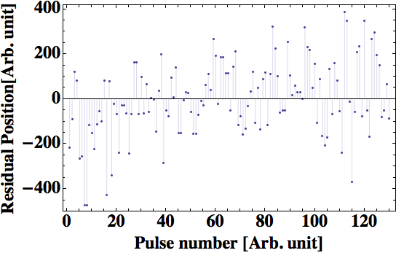
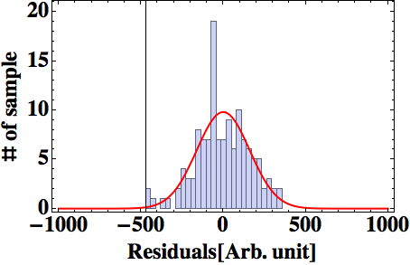
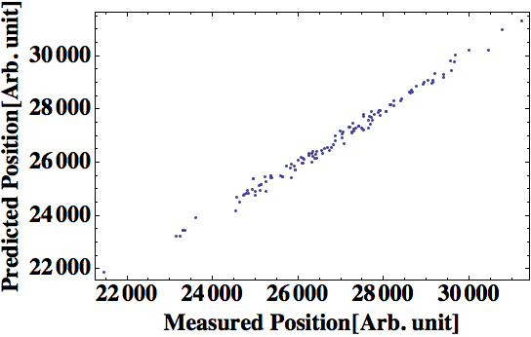
S.Jang, talk at 19th ATF2 project meeting, LAL, 13-15 Jan.2016
The results of IPBPM resolution test
at Dec 2015 in ATF2
X
X
X
Beam position prediction
Convert to
residual
Residual value
= measured position – predicted position
X
X
X
Measured resolution
= 15.0193nm
Measured beam charge
= 0.5423x1.6nC
~54% beam charge
Beam position measurement
( at 0.54 x 10¹⁰/bunch)
( 1 x 10¹⁰/bunch)

Slide 15
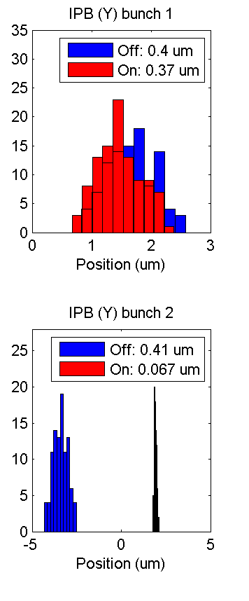
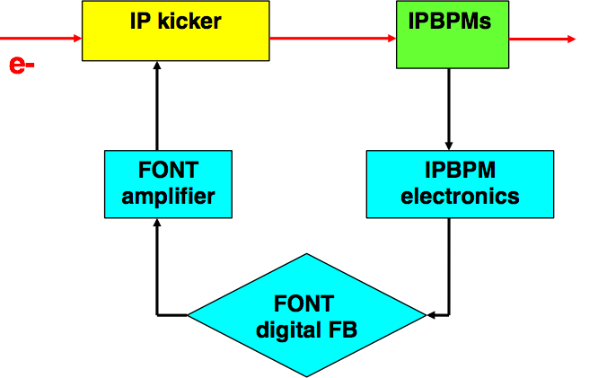
IPFB results
P.Burrows, talk at LCWS2015, Whistler BC Canada, 2-6 Nov. 2016
Bunch 1:
not corrected,
jitter ~ 400nm
Bunch 2:
corrected,
jitter ~ 67nm
Corrected jitter 67nm
→ resolution 47nm

Slide 16
ATF2 FY2016 operational prospects and prospects
Background of budget decision for ATF2 FY2016
KEK will receive a little bit more than 2015 but will not be sufficient for the commissioning of SuperKEKB; i.e., highly prioritized on-going project.
Electricity cost is still higher level (twice since 2014).
KEK DG wish to slim down the projects because KEK has a lot of satellite projects.
Of course, KEK has been leading the promotion of ILC but this promotion activity and R&D activity should be separately managed because of the budget.
KEK DG request ATF/STF to focus on the R&D for ILC. It means we may face very little room for general accelerator R&D.
We can/should show all of the plan at ATF are needed for ILC.
Notes:
ATF2 FY2016 Prospects (N. Terunuma)
KEK will receive a little bit more funds than in 2015 but they will not be sufficient for the commissioning of SuperKEKB, which is the highly prioritized on-going project. The cost of electricity continues to be the most important budget item, being paid mainly by KEK (twice cost since 2014). The
KEK DG wishes to slim down the projects because KEK has a lot of satellite projects. KEK has been leading the promotion of ILC since the beginning but the promotion and the R&D activities should be separately managed because of the budget. The KEK DG requests to ATF to focus the effort on the R&D for ILC. It means we may have in the next future very little room for general accelerator R&D. It is crucial to show that future activities of ATF have a strong synergy with ILC.
The operational budget in FY2016 will consider the proper balance between electricity cost and maintenance needs. An estimation of 21 weeks of operation for FY2016 has been submitted to KEK. The assignment of the electricity charge for ATF will be fixed in early March. Concerning maintenance some spares of the key components should be purchased during FY2016 (LINAC Klystron, Kicker Thyratrons).

Slide 17
ATF2 FY2016 operational status and prospects
Budgetary issue for ATF2 FY2016
Operational budget: Electricity charge + Maintenance
  We submitted estimation of the electricity in FY2016 to KEK about 12 weeks operation. Assignment of the electricity charge for ATF fixed in early March.
  Spares of the key components should be prepared (LINAC Klystron, Kicker Thyratrons)
We expect severe budget assignment then we should consider the trade off between a beam time and maintenance.

Slide 18
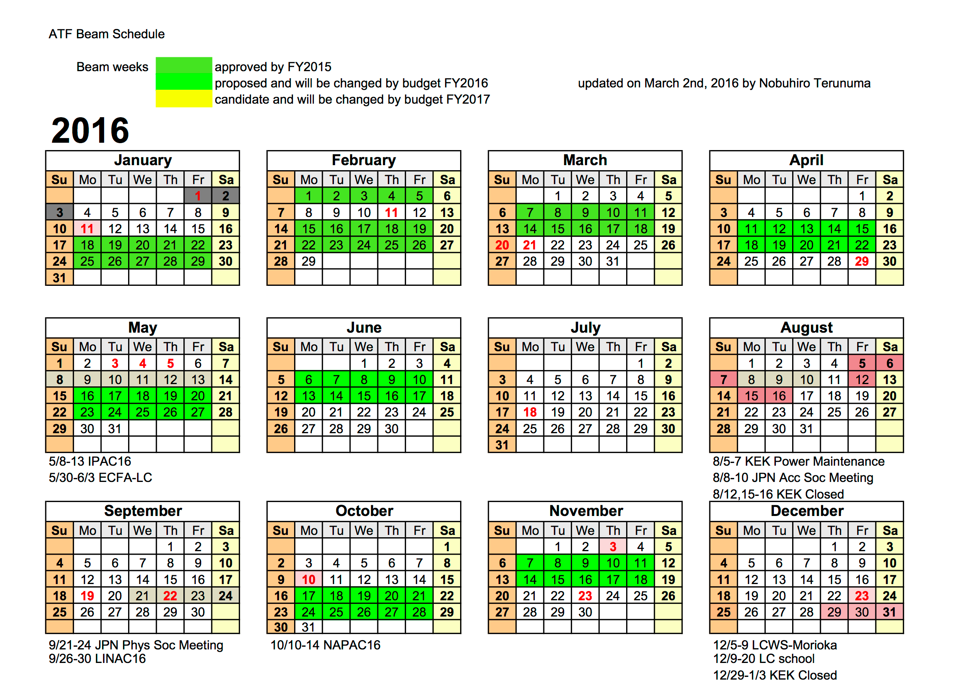
ATF2 FY2016 operational status and prospects

Slide 19
ATF2 FY2016 hardware status
New hardware installation
Air-core dipoles in EXT/FF (KEK) a pair of horizontal dipoles will be installed before April
OTR/ODR system (RHUL/CERN) made in February.
Collimator system (IFIC/LAL) made in in March
Octupoles (CERN) planned in Spring
Problems with IPBSM laser (KEK) repaired in April

Slide 20
ATF2 FY2016 Highlights from winter run
    Background characterization: DS and collimator
    FONT upstream feedback and beam size measurement
    OTR/ODR first measurements
    m-OTR measurements
    Ground Motion
Notes:
Some highlights of the R&D ongoing activities

Slide 21



Background studies:
Collimators and Diamond Sensors in ATF2 March 2016 runs
N. Fuster-Martínez, A. Faus-Golfe, P. Bambade, P. Cornebise, V. Kubytskyi, R. Yang, S. Wallon,
A. Schuetz
Collaboration of RHUL BDSIM team

Slide 22
  Introduction and objectives
ATF2 post-IP beamline
Last bending magnet (BDUMP)
Diamond Sensors V/H
Shintake monitor
Motivation and main objectives:
Beam halo control and study in the vertical and horizontal plane
Beam halo reduction to reduce the bremsstrahlung background that could be created at the last bending magnet (BDUMP)
Beam halo reduction, especially in the horizontal plane, to enable Compton electron measurements at the horizontal DS
Notes:
Background characterization (N. Fuster Martinez)
Beam halo is an important issue for beam loss and background control in ATF2 and Future Linear Colliders. In ATF2 different activities are been carried out in this context: beam halo measurements and modelling with Diamond sensors (DS) (post IP) and Yag screen (EXT line), validation of the BDSIM background simulation in a real machine and beam halo collimation for reduction and control of the halo including wakefield impact studies. An important effort has been made in all this aspects during 2015: Two DS have installed in the post-IP region of ATF2 in order to perform a dedicated halo investigation and first data has been taken. Some technical aspects as the pick-up signal still need to be understood and the data taking process automatized and integrated in the ATF2 control room. The investigation of the formation and transport of the beam halo in the ATf2 beam line will be investigated combining the DS (post-IP) and YAG screen (EXT line) measurements. The BDSIM ATF2 model has been updated and two Cerenkov detectors were installed in June 2015, some data has been taken to be compared with simulations. Detailed and validated model of ATF2 expected to be completed by February 2016. The vertical collimation system will be installed in March 2016 and the performance will be tested in terms of halo cleaning, background reduction and wakefield impact.

Slide 23
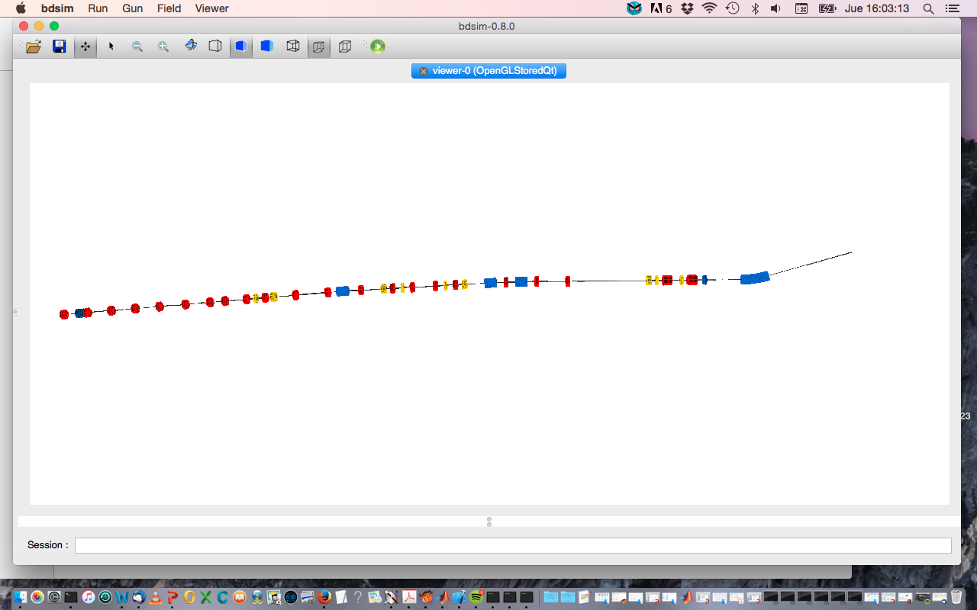
Transverse beam halo collimation at ATF2 March 2016
Installation and commissioning at ATF2 - 29/02 to 4/03 (IFIC-KEK-LAL)
  People working on the installation and commissioning:
  S. Wallon, P. Cornebise , P. Bambade, R. Yang, V. Kubytskyi (LAL)
  N. Fuster- Martínez (IFIC)
  A. Schuetz (DESY)
Collimator performance studies (4 dedicated shifts)
Beam-jaws alignment: Beam halo measurements with Diamond sensor
Background studies: Post-IP Cherenkov detector and RHUL Cherenkov detector
Collimator wakefied impact measurements by measuring the impact on the orbit
Diamond Sensor (DS)
ATF2 beamline
Las bending magnet (BDUMP)
Vertical Collimator
Beginning of the FF line
IPBSM background monitor
RHUL cherenkov detector (old laserwire detector)
Notes:
Two shifts per week.
First week:
7/03/2016: Beam jaws alignment by beam halo measurements with the diamond sensor
11/03/2016: Background measurements with at post IP and close to the collimator for different apertures of the collimator and intensities
Second week:
16/03/2016: Repeat background measurements and DS
18/03/2016: Background measurements with symmetric and asymmetric jaws displacement with the RHUL Cherenkov detector and take orbit data for different positions of the collimator in order to measure the wakefield effect with high intensity (nominal intensity 1x10^10)

Slide 24
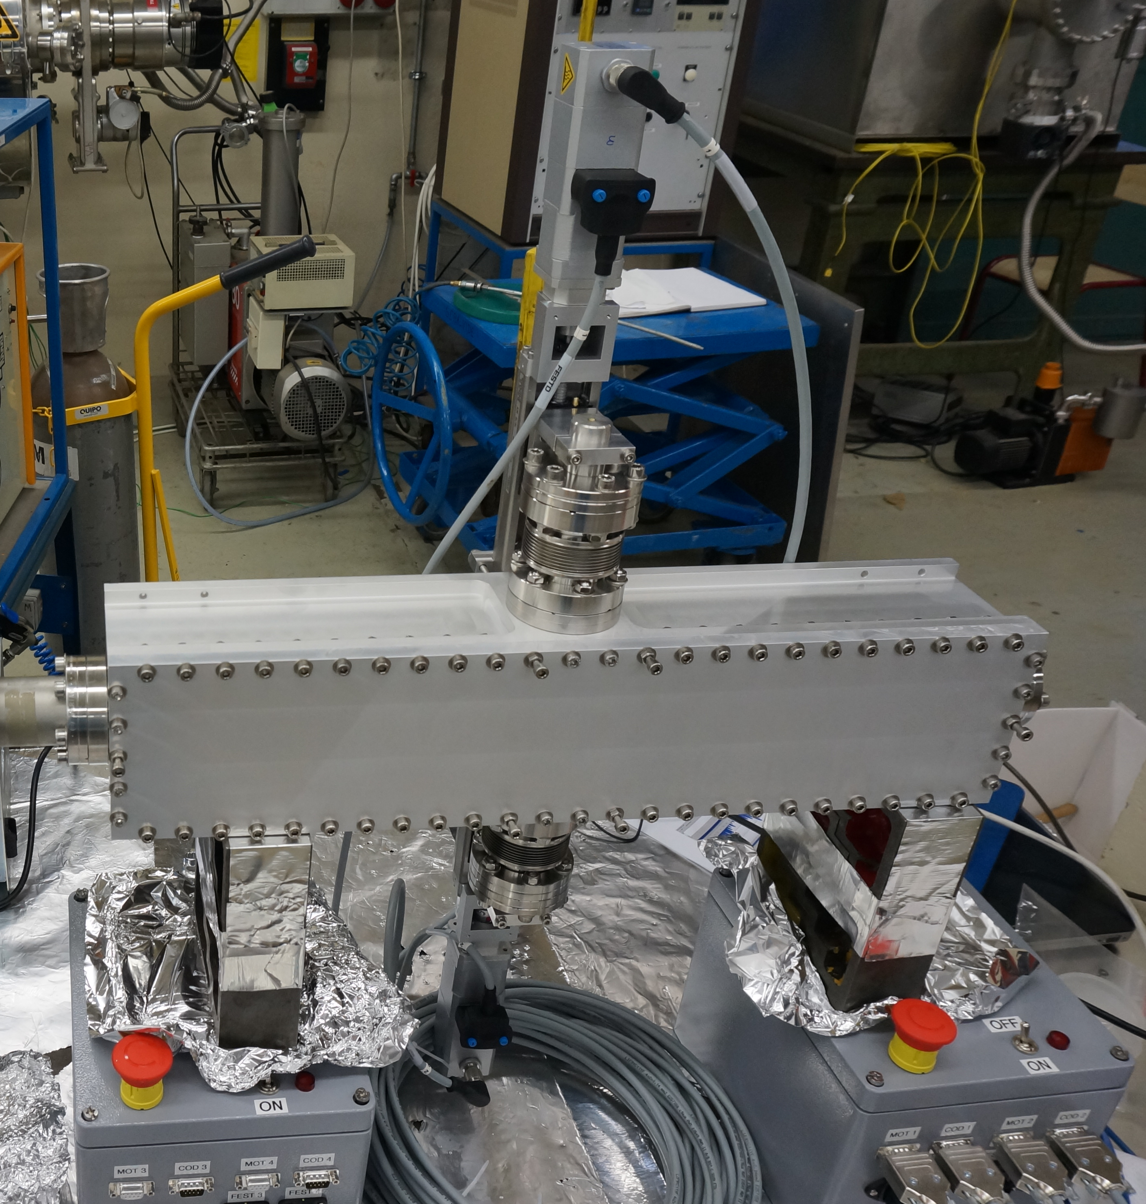
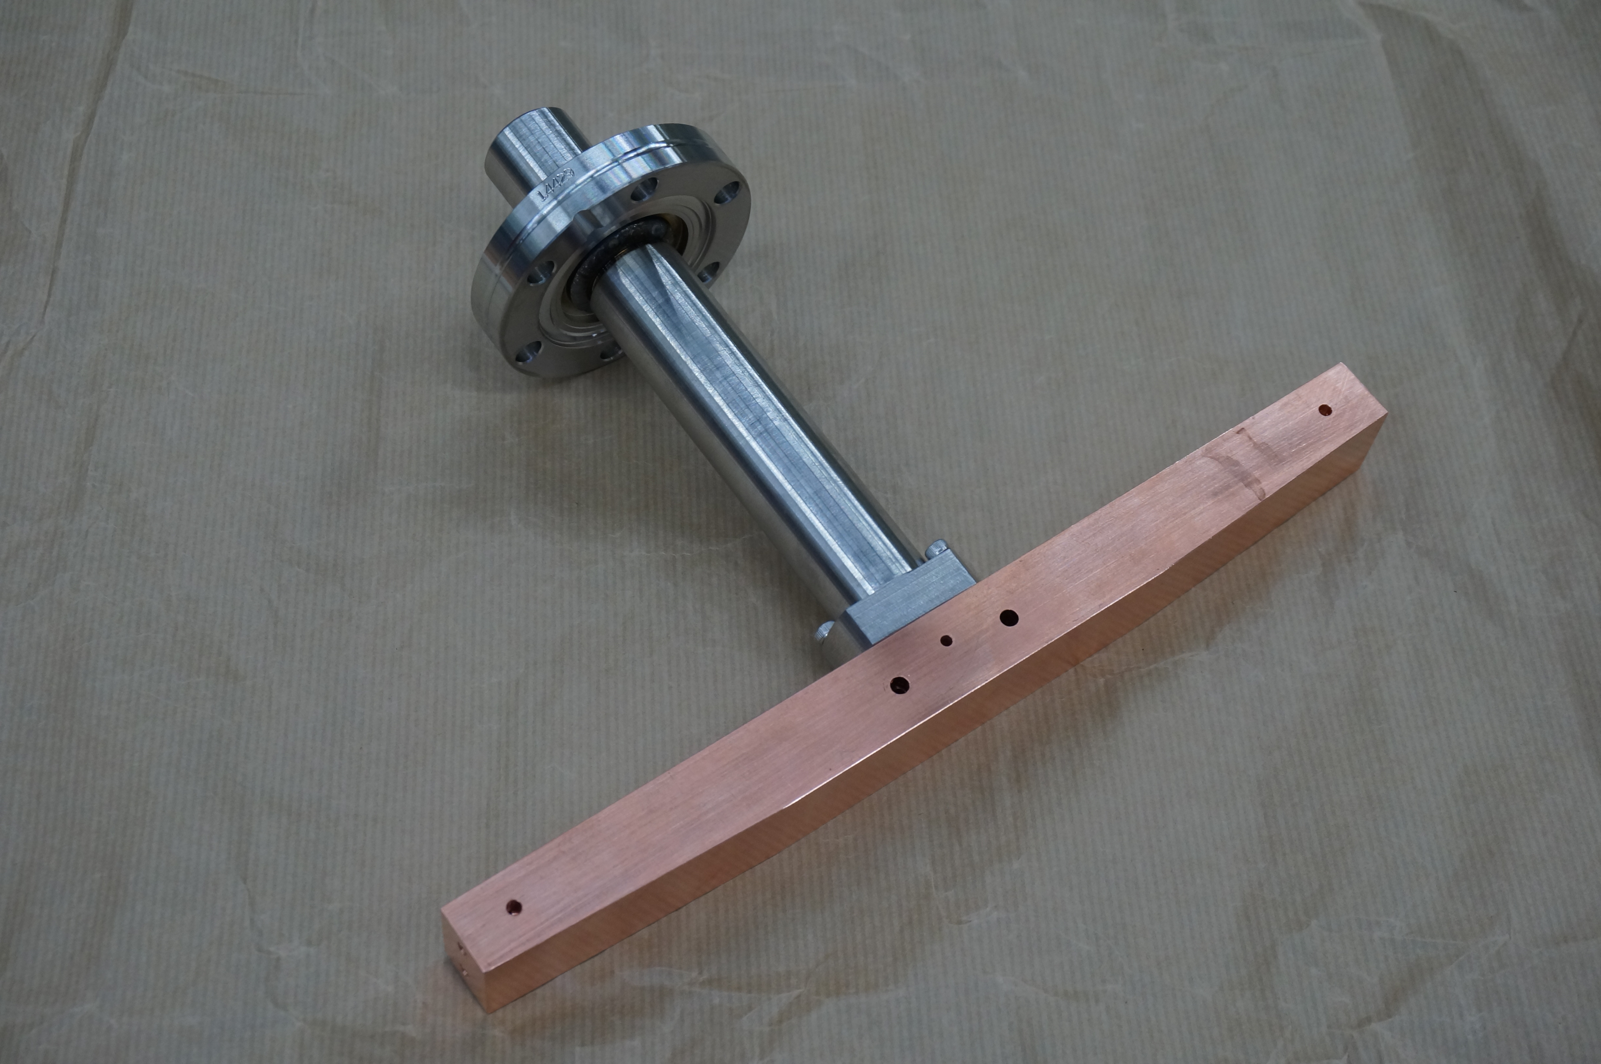
Vertical collimator prototype installation
Based on preliminary design for the ILC collimators, Full structure simulations of ILC collimators” J.D. A. Smith, Lancaster University/Cockcroft Institute, Warrington, UK, Proceedings of PAC09
Transition foil (elastic part)
Vacuum chamber
Transition pipe
848 mm
Jaw (mask)
600 mm
Notes:
Opened vacuum chamber at LAL before closing and sending the collimator to ATF2.
Cu jaws, and the rest of the collimator is made of SS

Slide 25
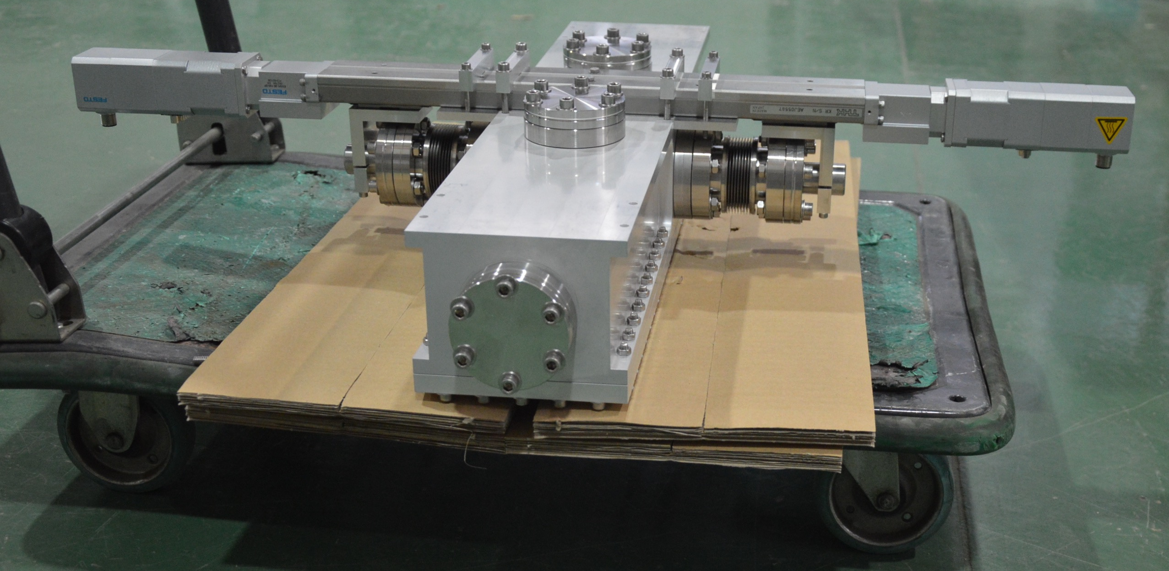
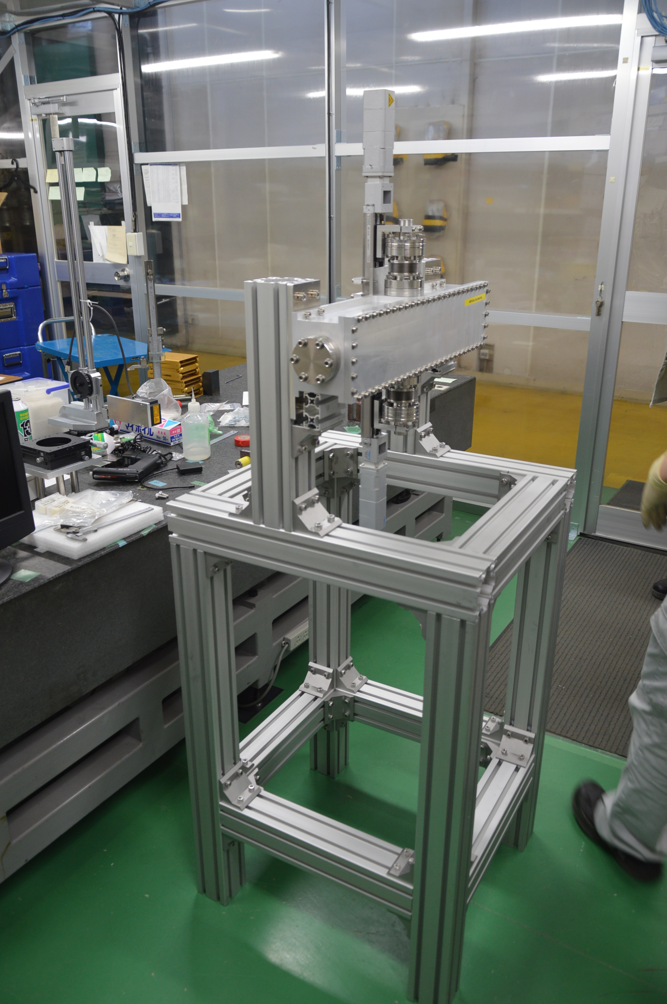
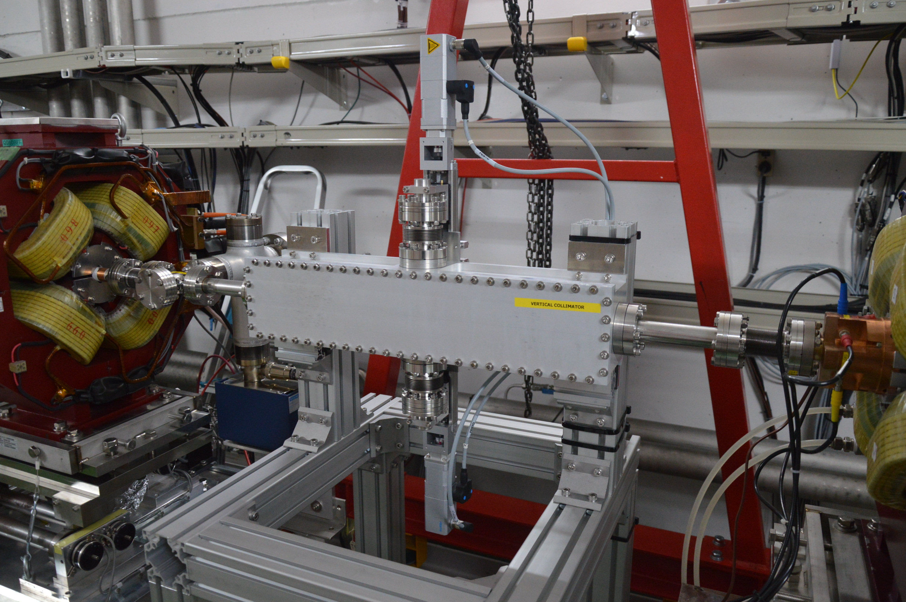
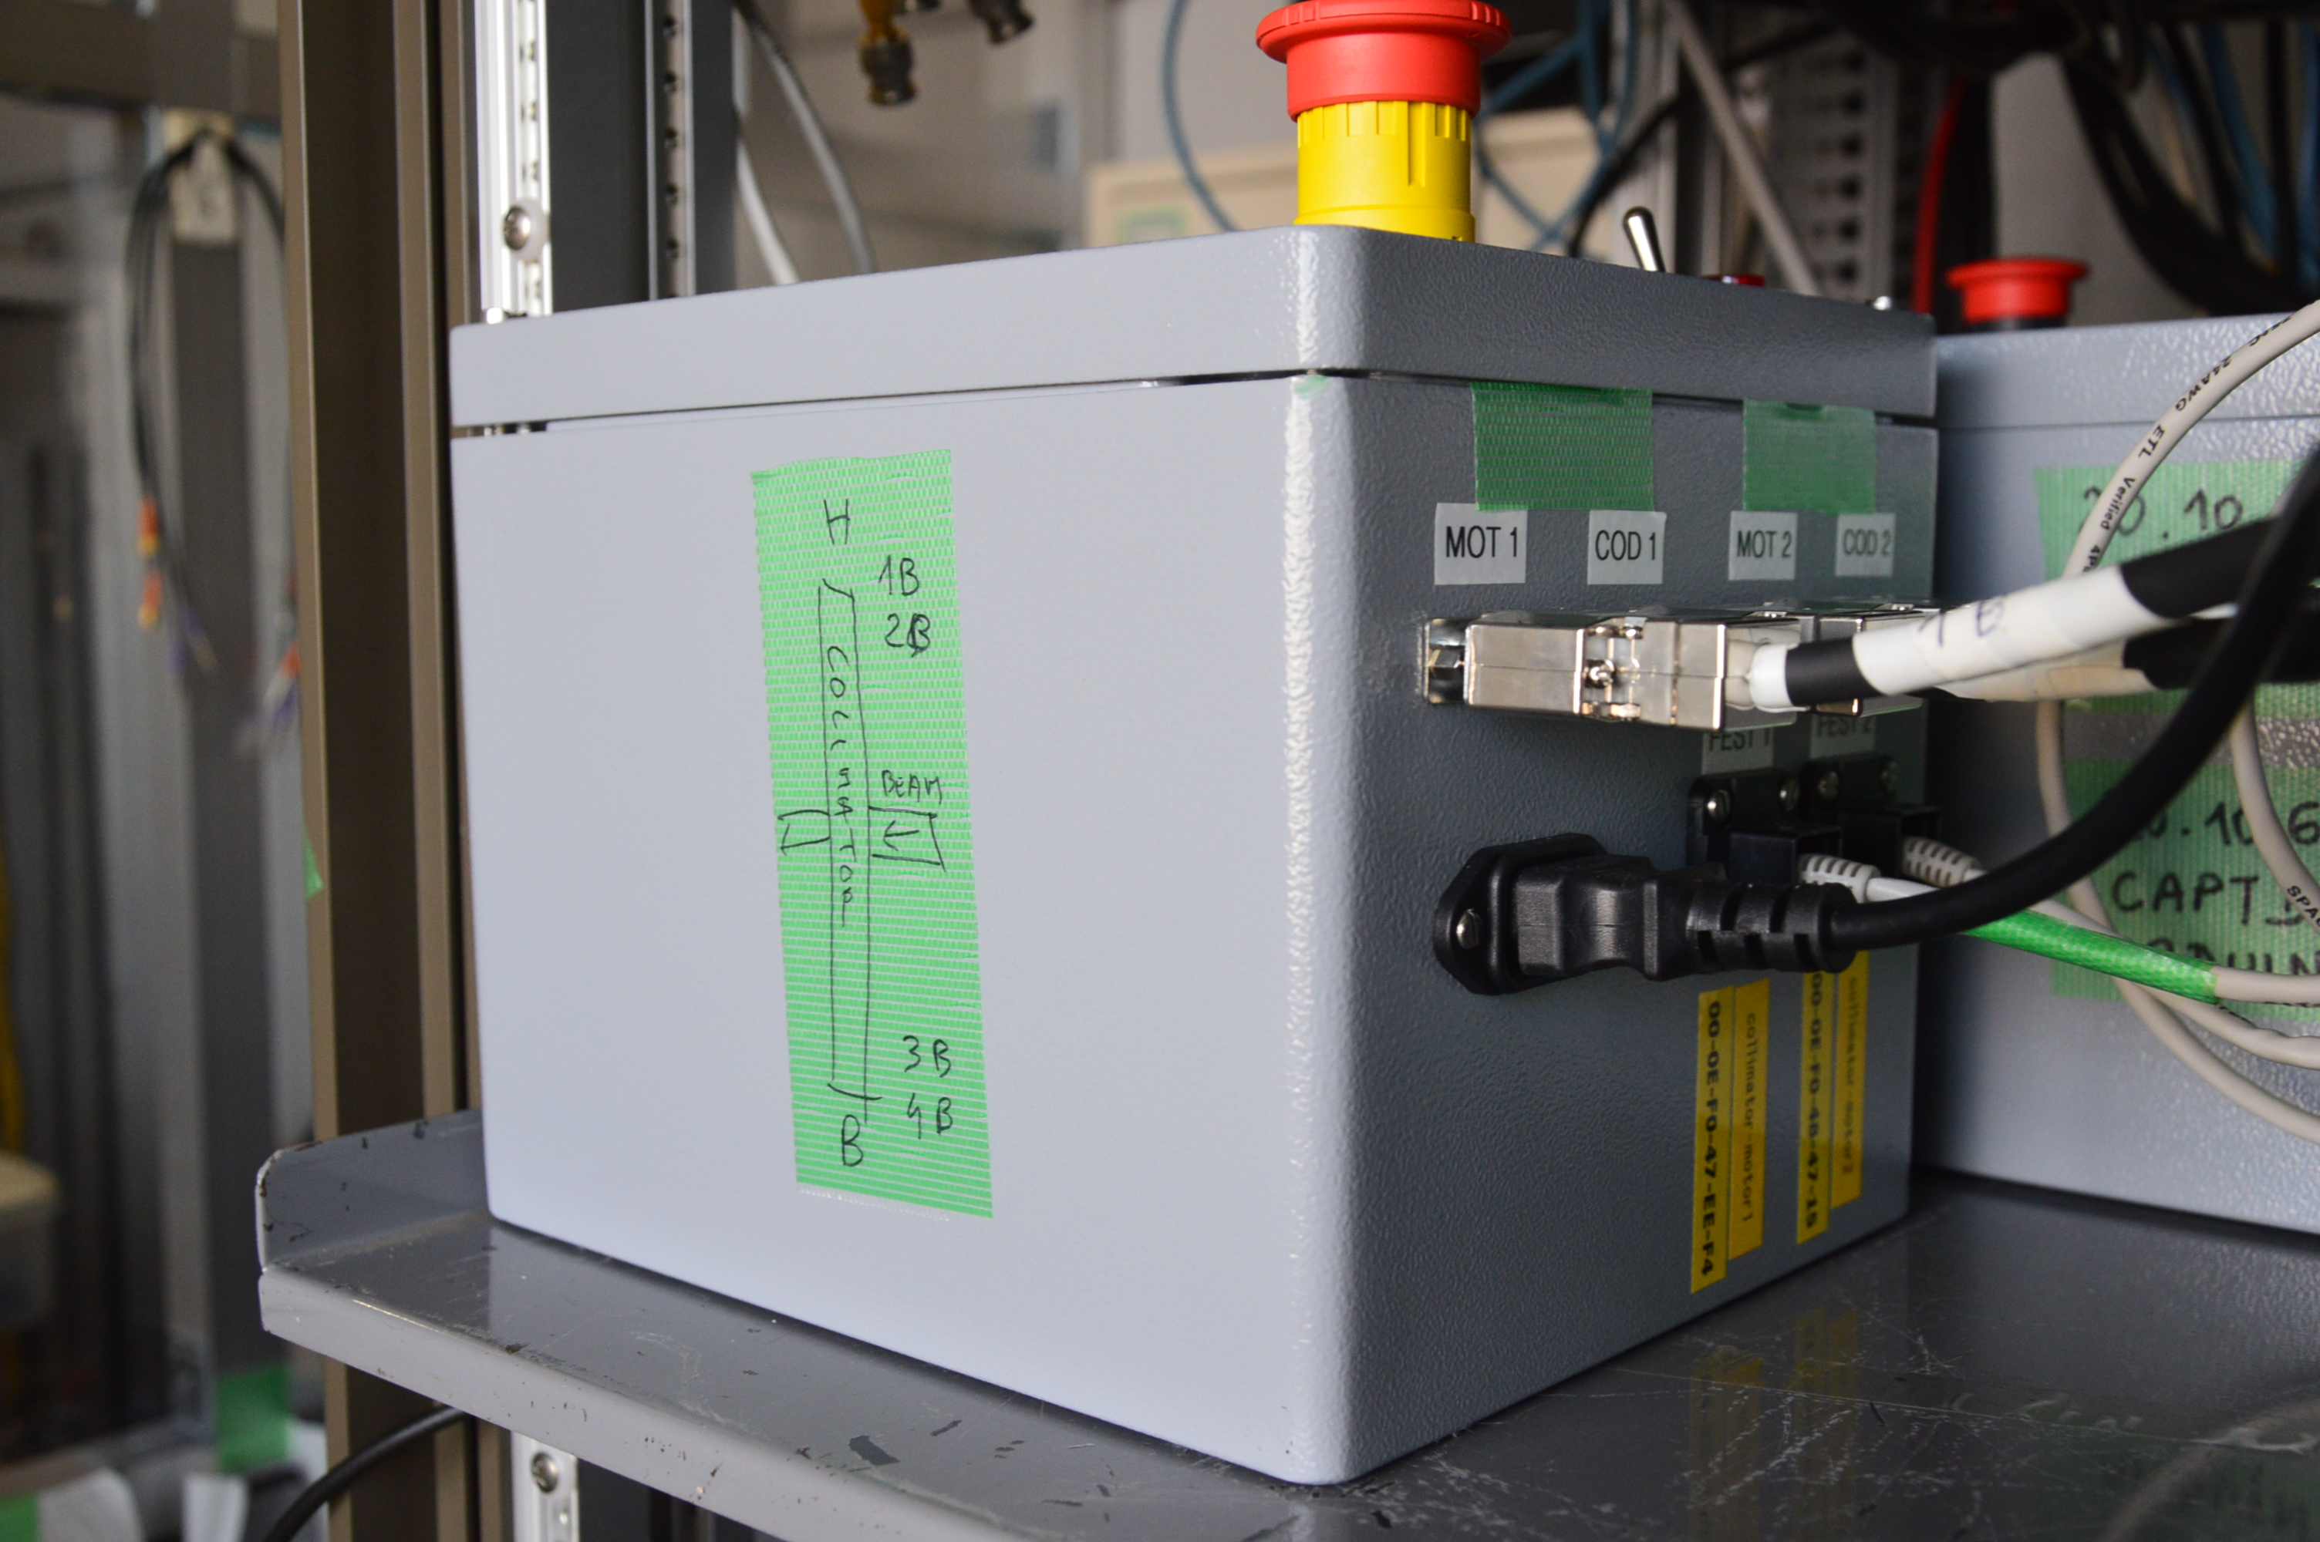
Support built by KEK staff
Mechanical stop
Control box
  Vertical collimator between QD10BFF-QM11FF (FF)
Notes:
Collimator mounted in the chassis built by the KEK staff at ATF2 in the FF between the quadrupoles QD10BFF and QM11FF

Slide 26
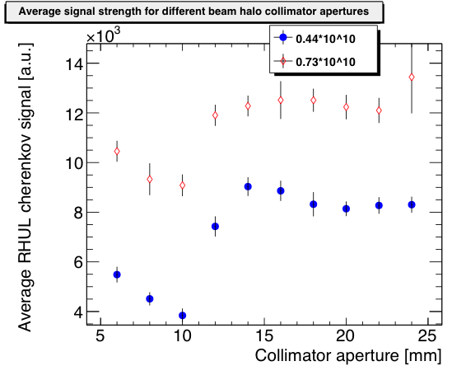
Transverse beam halo collimation commissioning
Background close to the IP
Background study using the post-IP background monitor to investigate the efficiency of the collimation system
Background measurements close to the collimator
Background study using the RHUL Cherenkov detector (B5FF-QD6FF) next to the collimator to investigate the background generated by the collimator
Detailed simulation to be done
Notes:
Post-IP background monitor (gamma detector in slide 2)
At the post-IP detector we can see a reduction of background when closing the collimator to 5 mm
In the Cherenkov detector the background is reduced when closing the collimator to 5 mm but the it increases, this has to be studied in detail by doing BDSIM simulations

Slide 27
Transverse beam halo collimation commissioning
Beam halo measurements were taken with both horizontal and vertical DS, with the collimator closed to 3 mm half aperture
Horizontal beam halo distribution
[mm]
[mm]
Symmetric cut is observed in the vertical plane
Beam halo signal level reduced on the left side
In the horizontal beam halo distribution we also observed a reduction of signal in the left side
Notes:
The horizontal axis correspond to the position od the diamond sensor when performing the scan

Slide 28
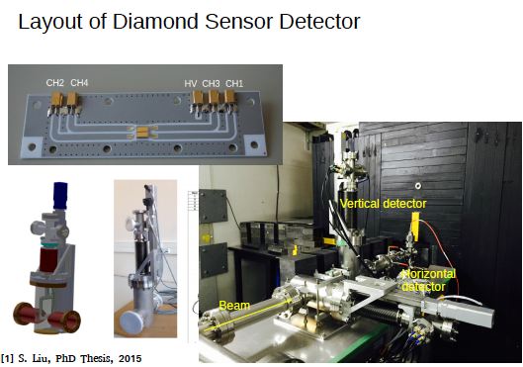
  Diamond sensors studies
Diamond sensors studies (1+1/2 dedicated shifts)
Beam Intensity dependence: Beam halo measurements with Diamond sensor
DR vacuum effects: Beam halo measurements with Diamond sensor
Notes:
½ shift: 16 March 2016, beam intensity dependence, no dependence of halo shape with the intensity
1 shift: 18 March 2016, DR vacuum studies

Slide 29
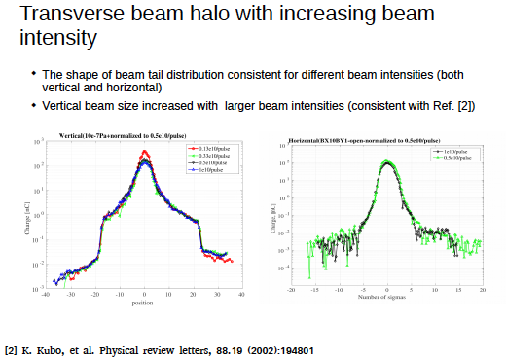
  Beam Intensity dependence studies
Notes:
½ shift: 16 March 2016, beam intensity dependence, no dependence of halo shape with the intensity
The vertical beam size increasing is shown in the peak, corresponding to the core of the halo.

Slide 30
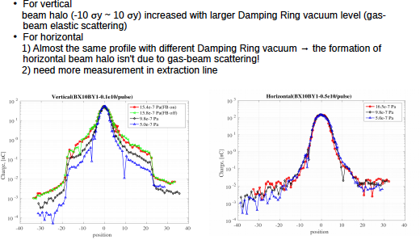
  Damping Ring Vacuum studies
Notes:
The +-10 sigmay is the equivalence in mm to the limits

Slide 31
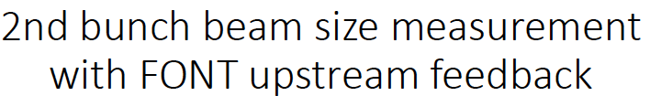
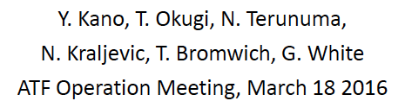
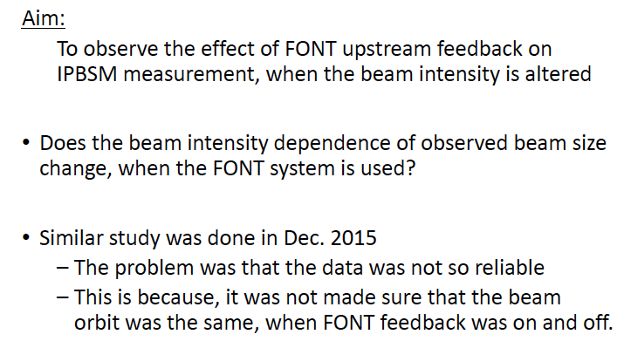
ATF2 FY2016 Highlights from winter run
Notes:
Some highlights of the R&D ongoing activities
Involves Goal1, Goal 2 and Goal 3

Slide 32
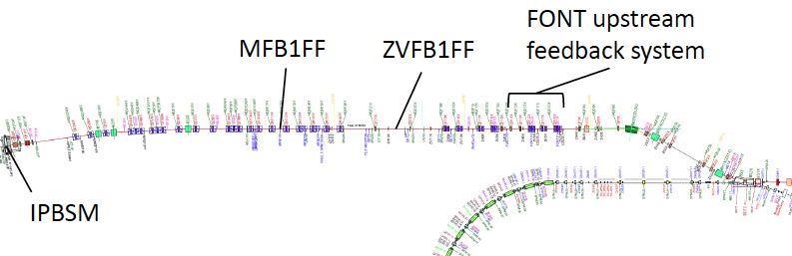
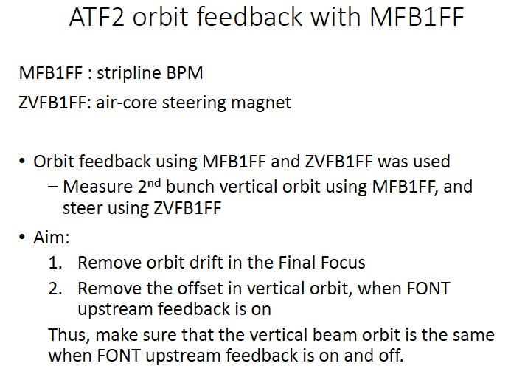
ATF2 FY2016 Highlights from winter run
Notes:
Some highlights of the R&D ongoing activities

Slide 33
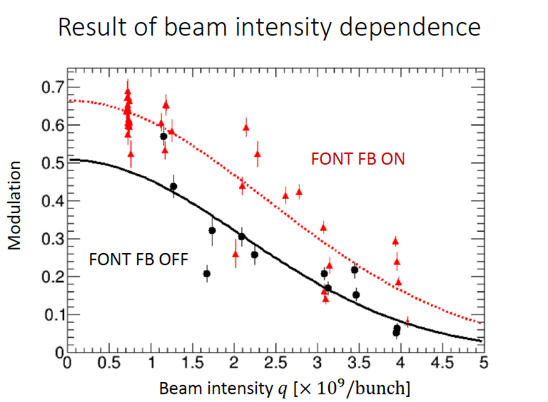

ATF2 FY2016 Highlights from winter run
Notes:
Some highlights of the R&D ongoing activities

Slide 34
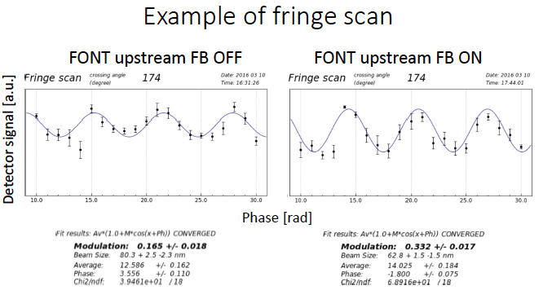

ATF2 FY2016 Highlights from winter run
Notes:
Some highlights of the R&D ongoing activities

Slide 35


OTR/ODR at ATF2
M. Bergamaschi, P. Karataev, R. Kieffer, K. Kruchinin,
S. Mazzoni, T. Lefevre
A. Aryshev, N. Terunuma

Slide 36
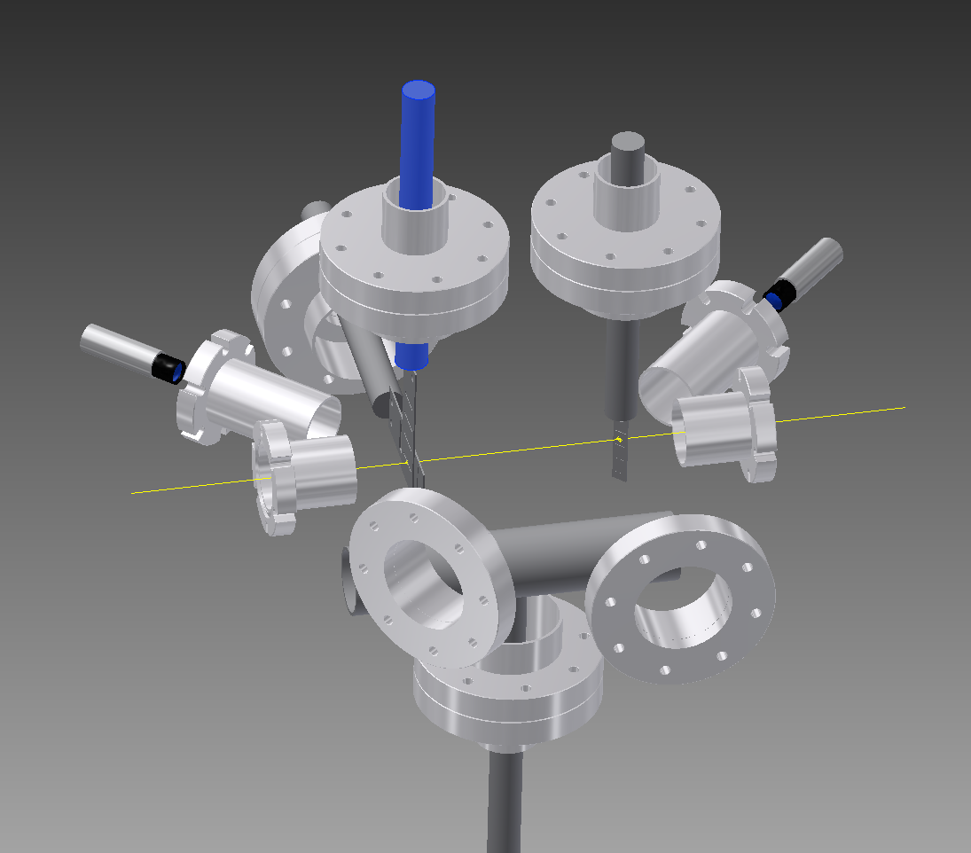
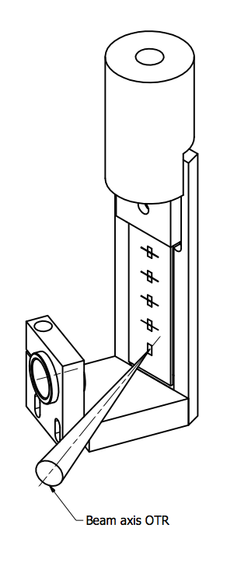
Experimental Set-up
Silicon Target
with 5 mirrored areas (Al coating)
45deg View Port
Target laser alignment
45deg View Port
Mask Camera
Target
Actuator
Mask
Actuators
4 Diffraction Radiation slits
Replacement chamber
Beam
BPM Flange
(Beam)
40 degrees
View Port on target
(OTR imaging)
1 Transition Radiation screen
90 degrees
View Port on target
(ODR imaging and far-field)

Slide 37
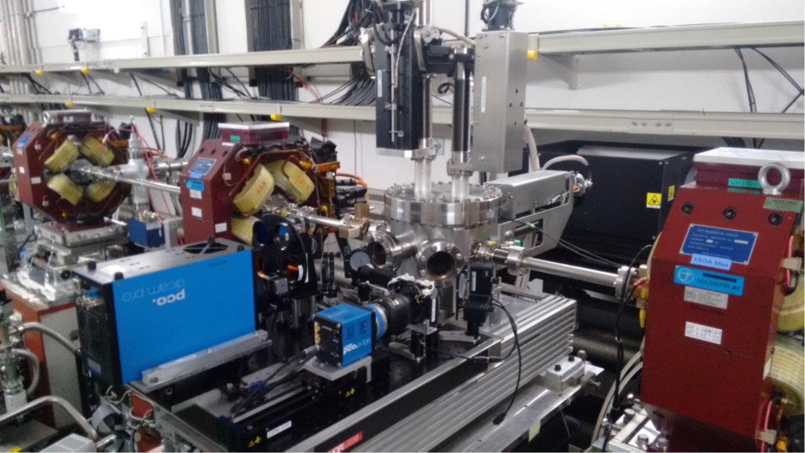
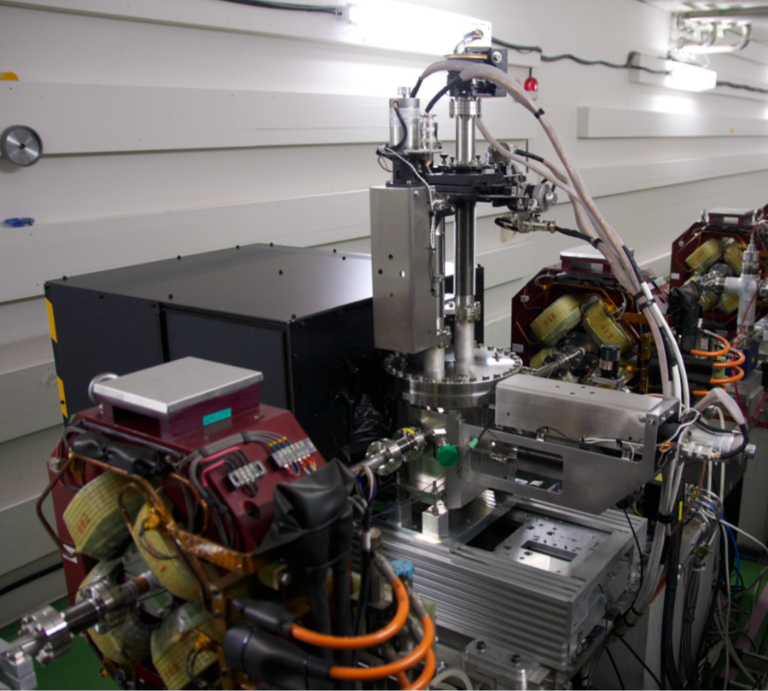
Set-up Installed
February 2016
ODR optical line
with Intensified CCD camera
OTR optical line
with sCMOS camera

Slide 38
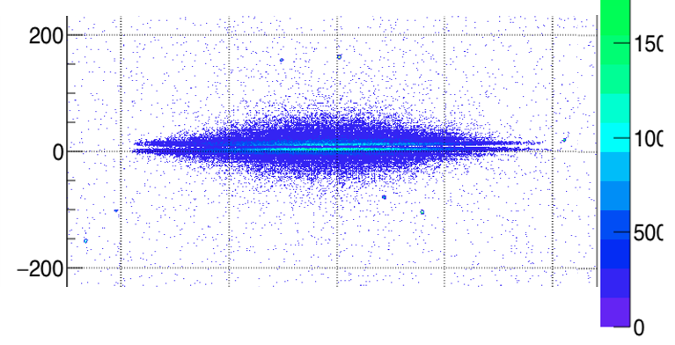
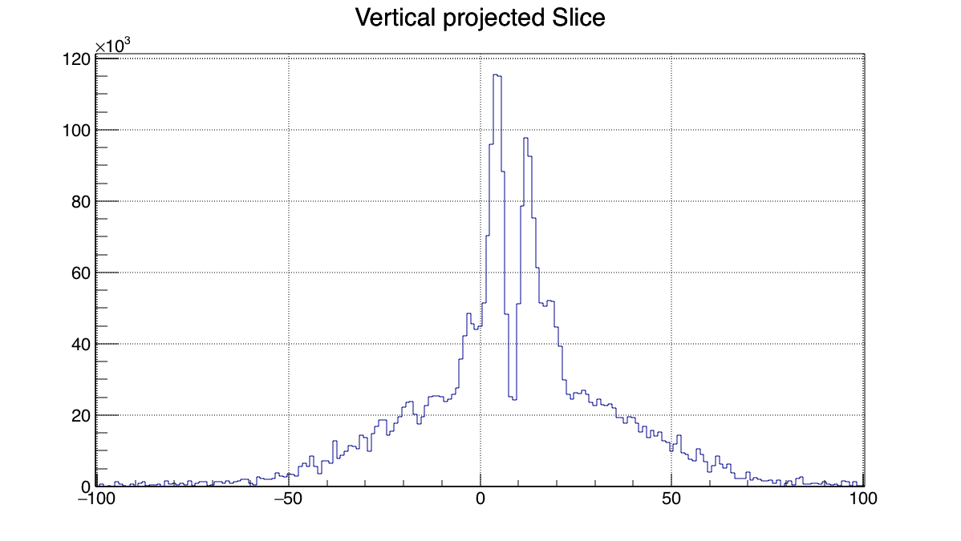
First Results:
OTR Imaging: Point Spread Function at 600 nm
First quad-scan (vertical beam size measure)

Slide 39
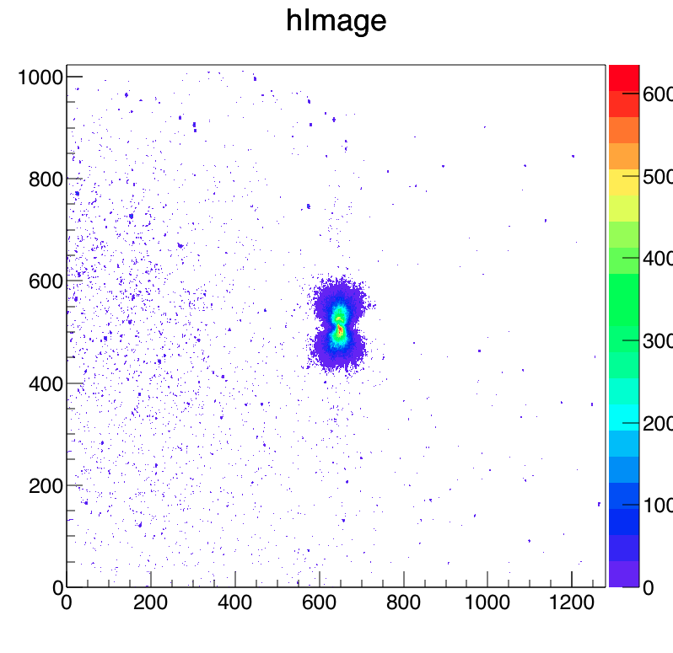
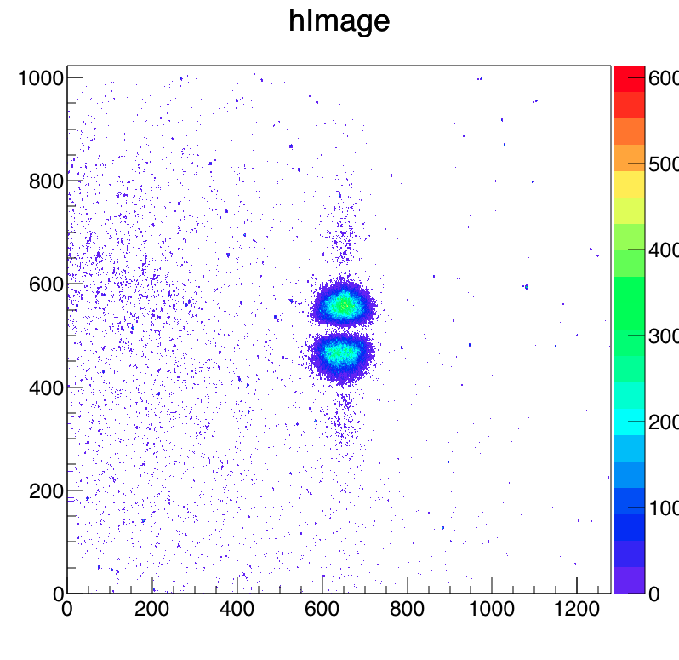
First Results:
ODR far-field (angular)
Target Slit Size = 80 µm
No Mask (No wavelength filter)
Target Slit Size = 80 µm
Interference with Mask size ≈ 100 µm (No wavelength filter)

Slide 40
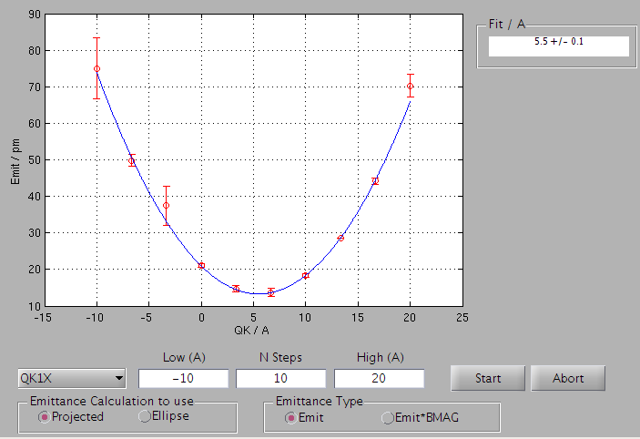
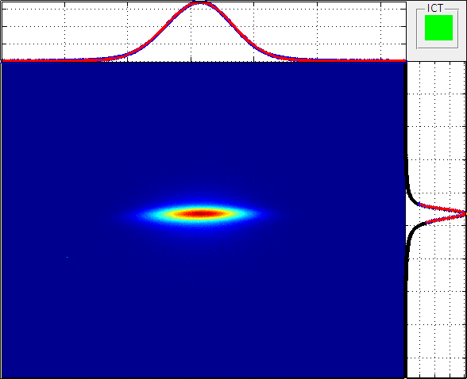
ATF2 FY2016 Highlights from winter run
EXT mOTR Emittance measurements: 2016/03/17 - OWL Shift
11.6 pm vertical emittance measurement at 1.0 x 10¹⁰ charge
( 9 pm measured in the DR on Monday at similar charge).
Notes:
Some highlights of the R&D ongoing activities
Noticed optical filters in OUT position: optical aberrations in OTR high in this configuration yielding higher systematic errors on emittance measurement
Move filters IN, optimize focus position and retake QK scan and emittance measurement @ 1E10 (DR XSR indicated spot size from monitor window = 4.4)
ex=2 x 10⁻⁹= 2 nm
ey=1.2 x 10⁻¹¹= 2 pm

Slide 41
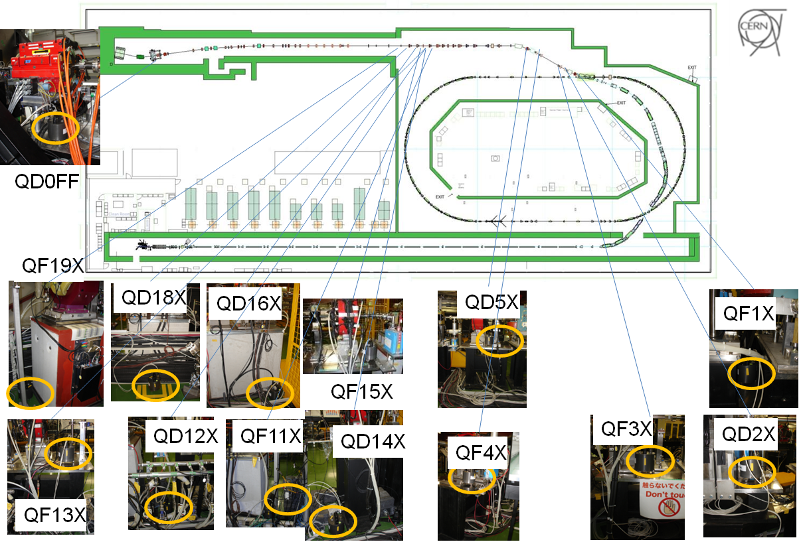
14 Guralp 6T sensors all along ATF2
Guralp 6T: 0,5Hz-100Hz, two directions connected (vertical and horizontal can be placed parallel or perpendicular to beam direction), mainly in Extraction line, 2 sensors easily relocated
Notes:
GM sensors installed and that they are useful and used for Vibration mitigation.
Silde 1: where the sensors are

Slide 42






Vibration source identification and mitigation
Cooling pipes
Beginning of extraction line
Repositioning of pipes: less vibration
Initial
New
Horizontal: 290 nm
Horizontal: 52 nm
Vertical: 21 nm
Vertical: 6 nm
Rel. Displ. RMS @ 1Hz QF1FF vs tabletop | Initial support | New support
Horizontal (~500 nm goal) | 290 nm | 52 nm
Vertical (~20 nm goal) | 21 nm | 6 nm
Comparison between initial QF1FF support and new support
Step after step: successful vibration source mitigation
Notes:
slide 2: 2 examples of successful vibration mitigation.

Slide 43


Ground motion feed-forward
Similar concept to orbit feedback but uses seismometers instead of BPMs to drive the correction
Sensor-BPM position correlations
ADVANTAGES
Cheaper than active stabilization systems.
Correct frequencies out of limits for orbit feedback systems.
Notes:
Beam orbit stabilization (D. Bett)
Ground motion, vibrations and drifts create beam oscillations that harm the beam quality and stability. The high beam quality requirements for future linear colliders make mitigation essential. The standard mitigation schemes are: the orbit feedback that can correct frequencies much smaller than the machine repetition rate, the intra-train feedback essential at the IP but global orbit distortions remain uncorrected and the active and passive stabilization too bulky and expensive for any but the most critical components. A novel mitigation idea that is being implemented in ATF2 is the ground motion feed-forward. The concept is similar to orbit feedback but uses seismometers instead of BPMs to drives the correction. A two-stage program consisting in demonstrate that beam position can be predicted from seismometer data and demonstrate that beam jitter can be reduced using a correction based on seismometer data is on-going. The expected performance of such a system using a 0.2 Hz high-pass filter doubles the correlation from 0.29 to 0.58 and increases the expected reduction in jitter from 5% to 20%. A 20% at the typical jitter levels of the FF BPMs corresponds to approximately 15 μm and thus should be easily measurable. This method is designed to suppress the effect of quadrupole vibrations at frequencies higher than those covered by orbit feedbacks. Furthermore additional beam-based alignment methods can be envisaged to improve orbit stability (e.g. DFS removes energy dependence from orbit, WFS removes charge dependence).

Slide 44






Reconstruction of orbit from sensor data
Feed-forward setup
seismometers
(mounted on quads)
stripline kicker “K2”
kicker
amplifier
FONT5
board
trigger
drive
pulse
drive
signal
feed-forward correction value
velocity
signal
CompactRIO
(processor)
trigger

Slide 45
International Collaboration Status and Future
The collaborators will maintain their contribution to ATF2 collaboration at the current level. Budgets approved for the next 3 years
Cooperation and sharing of resources/ skills/ synergies with other groups in the ATF collaboration is essential given the limited resources
Support from EU Project E-JADE (KEK, LAL, IFIC, LAPP, CERN, JAI) funds our travel and equipment
The educational aspect is crucial for all collaborators (PhDs: 4 LAL, 3 IFIC, 8 JAI, 1 LAPP, 3 CERN, KEK, 1 KNU)

Slide 46
Final remarks and Summary
ILC Research and Development activities are in progress using ATF2 aiming at establishment of generation and control technology of an ultra-high quality beam that is indispensable for the next generation linear collider ILC.
At present, development and design work are promoted by a worldwide cooperative study. Studies on accelerator are conducted by Asian, North American and Europe accelerator scientists and engineers forming a design team (LC collaboration).
ATF2 collaboration has a crucial role on this process, it is the unique facility in the world for the demonstration of the ILC FFS but it is also a successful example of world-wide collaboration mode, as could be envisaged for the future ILC.
Notes:
Final remarks and summary (A. Yamamoto)
ILC Research and development activities are in progress using the STF (Superconducting rf Test Facility), ATF (Accelerator Test Facility) and CFF (Cavity Fabrication Facility) aiming at establishment and industrialization of a superconducting acceleration system or establishment of generation and control technology of an ultra-high quality beam that is indispensable for the next generation linear collider ILC (International Linear Collider).
At present, development and design work are promoted by a worldwide cooperative study. Studies on accelerator are conducted by Asian, North American and Europe accelerator scientists and engineers forming a design team (LC collaboration). KEK is grappling with the study centring the Linear Collider Project Office. One of the main task of this group is to design a “ready to go” plan for ILC being realised in Japan. The ILC construction model envisages a 50% contribution in human resources from Japan and 50% contribution from abroad. ATF2 collaboration has a crucial role on this, it is the unique facility in the world for the demonstration of the ILC FFS but it is also a successful example of world-wide collaboration mode, as could be envisaged for the future ILC.

Slide 47



Thanks for all the help and material

Slide 48
Back-up slides

Slide 49
ATF2 History of ATF runs
History of ATF Beam Weeks
Electricity cost became twice.
CERN/CLIC supported 2 weeks. No beam for Jan-Mar.
Apr-Dec: 11 weeks,
Jan-Mar: 7 weeks are scheduled.
12
2016/Feb-Mar, evaluation and decision by KEK.

Slide 50
International Collaboration Status and Future
CERN
Current and Future activities:
      Ground Motion feed-forward
      Small beam tuning
      Ultra-low betas (topic thesis M. Patecki)
      Long L* (topic thesis F. Plassard)
      Octupoles
      Beam-based alignment
      OTR/ODR
CERN group consists of 5 senior physicists (part time, R. Tomas, A. Latina, M. Modena, T. Lefevre, E. Bravin), 3 postdocs (D. Bett, S. Mazzoni, R. Kieffer) and two PhD student (M. Patecki, until end 2016, F. Plassard 3 years). The group has support from mechanical engineering at CERN.

Slide 51

International Collaboration Status and Future
LAPP
Current and Future activities:
      Ground Motion studies, vibration source identification and mitigation, contribution to final doublet support mechanics
LAPP group consists of 1 senior physicist (part time, A. Jeremie). The group has support from mechanical engineering at LAPP.

Slide 52
International Collaboration Status and Future
IFIC
Current and Future activities:
      Halo Collimation and Collimation Wakefiels studies in ATF2 (thesis topic for N. Fuster Martinez)
IFIC group consists of one senior physicist (part time, A. Faus-Golfe) and one PhD student (N. Fuster Martinez, until end 2016). The group has support from mechanical engineering at IFIC and LAL.

Slide 53

International Collaboration Status and Future
LAL
Current and Future activities:
  Diamond sensor and collimation for beam halo and background control (thesis topic for Renjun Yang, also support for Nuria Fuster's thesis)
  Continued support for IP-BPM mechanical / mover / alignment work in the context of Goal-2 (but no new student or postdoc on this topic at the moment)
  General support for Goal 1 and 2 (however, also no students or postdocs on these topics at present)
LAL group consists of one senior physicist (part time, P. Bambade) and one postdoc (part time, until mid 2017, Viacheslav Kubytskyi). A new PhD student has also just started his PhD at LAL on ATF2 (Renjun Yang, 3 years). The group has support from mechanical engineering at LAL, also some limited electronics support (in the context of the diamond sensor R&D).

Slide 54

International Collaboration Status and Future
SLAC
Current and Future activities:
      Ongoing R&D activities (combined funding for ILC and ATF2 until end 2017)
      Current hardware and software maintenance of: multi-OTR, BPMs, Extraction Kicker and FFS magnets
SLAC group consists of 2 senior physicist (part time, G. White, D. McCormick). The group has support from mechanical engineering and electronics at SLAC.

Slide 55

International Collaboration Status and Future
JAI
Current and Future activities:
      BPMs
      Beam Based Feedback systems
JAI group consists of 5 senior physicist (part time, P. Burrows, C. Perry, L. Nevay, G. Christian, N. Blaskovic Kraljevic) and 2 PhD students (T. Bromwich, R. Ramjiawan). The group has support from mechanical engineering and electronics at JAI.

Slide 56
International Collaboration Status and Future
RHUL
Current and Future activities:
      Background studies
      OTR/ODR
RHUL group consists of 2 senior physicist (part time, S. Boogert. P. Karataev), 3 postdoc (J. Snuverink, K. Kruchinin, M. Bergamaschi). The group has support from mechanical engineering and electronics at RHUL.

Slide 57

International Collaboration Status and Future
KNU
Current and Future activities:
      IP-BPMs
KNU group consists of 1 postdoc (S. Jang). The group has support from mechanical engineering and electronics at KNU.

Slide 58


International Collaboration Status and Future
KEK-ATF
Current and Future activities:
  Support in all R&D activities: IP-BSM, alignment, small beam tuning, wakefields, backgrounds……
  Support in all the technical and operational aspects
ATF group consists of a team of seniors physicists (N. Terunuma, T. Tauchi, K. Kubo, T. Okugi, T. Naito, S. Araki, S. Kuroda…. ) and students (Y. Kano…). The group has support from KEK technical and maintenance groups
Notes:
This is the outline of my presentation. First I will introduce the project. Then I will talk about the location and optics considerations to decide where to put the collimation. After that I will summarize the tracking studies made with MADX. And I will report on the progress of the simulations that are being done with BDSIM. Then I will talk about the wakefield studies and I will finish with the installation and experimental program and the implications of this studies for ILC

