Slide 1
QA-QC Meeting Cosmic Bench
11 January 2016

Slide 2
Aim of the Cosmic Bench
Efficiency characterisation
Identify problems along the whole detection chain: dead strips, inefficiences, connexion problems …
Requirements: gas, HV, electronics cards (not the final VMM electronics, we will use the DREAM electronics

Slide 3
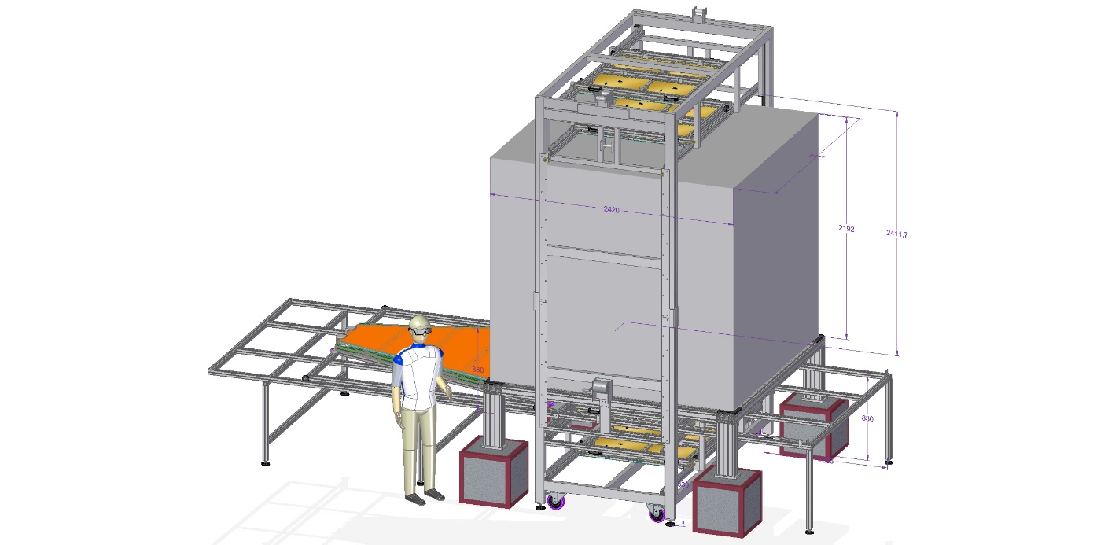
Set up
Re-use the cosmic bench of the M-Cube project with a modification of the structure that has already been designed

Slide 4
Procedure
Scanning region 1.5× 0.5 m² (a few days to scan the whole module),
5 steps ~5 days to scan a whole module~1 week
Use the M cubes modules in coincidence with our module
M cube is equipped with DREAM electronics
Our modules will be also equipped with DREAM electronics
We have already ordered the DREAM electronics corresponding to 1/5 of the surface~4096 channels→8 cards

Slide 5
To do list
Platform: finalise the design (with Didier, Christoph and Marc) and order it
Design and adaptation cards→ Zebra connectors to DREAM connecteurs Multiplexing (we will read only 1 over 2 strips)
Start looking at the data of the DREAM electronics to be familiarised with it

Slide 6
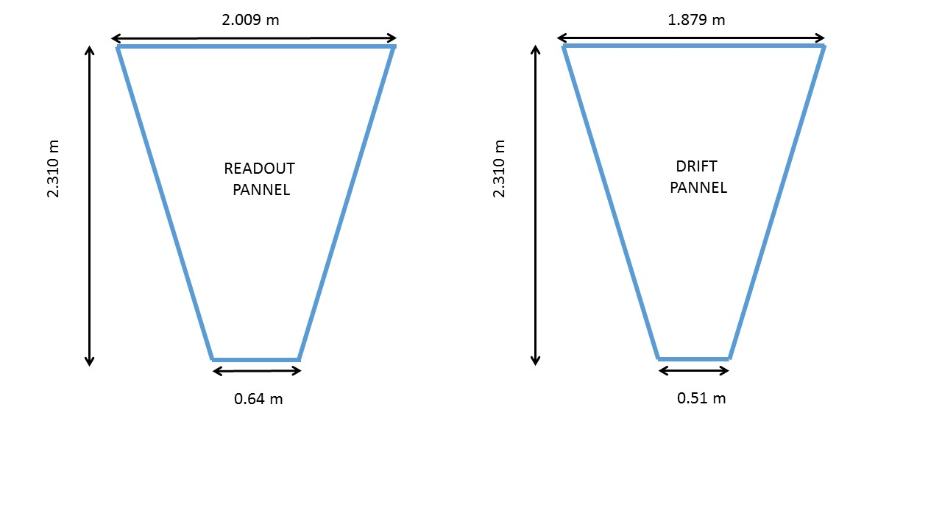
Dimensions des panneaux

Slide 7
Prix
Configuration souhaitée (1/5 de la surface équipé= 4096 channels)
Le cout total estimé est de l’ordre ~70 k€
Agrandissement plateforme existante: 5 k€
Détecteurs M-cube référence :
6 détecteurs x 5 k€ = 30 k€
DAQ Electronique pour équiper le 4 kcannaux du module NSW + électronique détecteurs M-cube:
4+2= 6 cartes FEU et tout leur environment : 35 k€

