Slide 1
LPCTrap Experiment
Status of Data Analysis
IKS-LPCCaen Collaboration Meeting
LPCCaen, 15th December 2015
Philippe Velten

Slide 2
Layout
Reminder on LPCTrap
Data analysis
New MC simulation – LPCTrapSW
To Do list

Slide 3
Reminder on LPCTrap

Slide 4
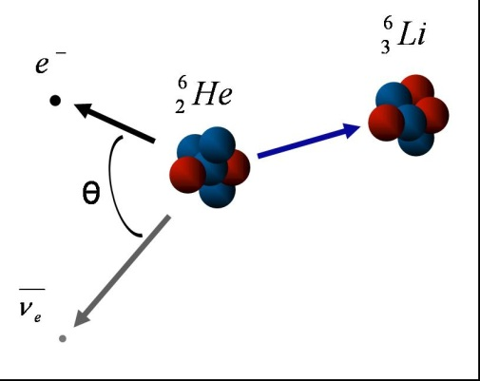
Reminder on LPCTrap
Tool to probe some fundamental symmetries of weak interaction
Perform high precision measurements of beta-decay:
β-ν angular correlation parameter:
β⁻
1) Test of the V-A structure of weak interaction
(search for tensor & scalar exotic couplings (C_{S} , C_{T}))
2) Test the unitarity of the CKM matrix, CVC
(measurement of V_{ud})

Slide 5
Reminder on LPCTrap
Test of the V-A theory:
  a_{βν} function of Lorentz inv. coupling constants: C_{V}, C_{S}, C_{A}, C_{T}
  in SM:
    No Scalar or Tensor couplings: C_{S} = C_{T} = 0
    Maximal Parity violation: |C_{i}| = |C’_{i}|
    Time reversal invariance: C_{i} , C’_{i} real
  Present limits:
    C_{T} / C_{A} < 9% and C_{S} / C_{V} < 7%
  Precision required to better constraints these limits:
    Δ a_{βν} / a_{βν} ~ 0.5% physics case for ⁶He
Pure Fermi transition:
a_{βν} = +1
Pure Gamow-Teller trans.:
a_{βν} = -1/3

Slide 6
Reminder on LPCTrap
Test of CKM matrix unitarity
  V_{ud} inferred from 0⁺ → 0⁺ transitions:
  With mirror transitions: ex: ³⁵₁₈Ar -> ³⁵₁₇Cl + β⁺
(Δ_{R}: radiative corrections )
(T_{1/2} , BR, M) measurements
+ mixing ratio ρ = C_{A}M_{GT}/C_{V}M_{F}

Slide 7
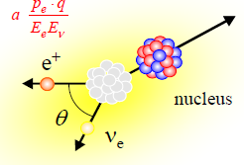
Reminder on LPCTrap
Test of CKM matrix unitarity with mirror transitions
  the mixing parameter is the least or even not known quantity!
  Precisely determined from
  correlations measurements:
adapted from Severijns et al PRC78(2008)
Only ρ has to be improved
Good production rate at SPIRAL-LIRAT
    Δ a_{m} / a_{m} ~ 0.5%
    would improve mirror data base for Vud

Slide 8
Reminder on LPCTrap
Method:
  measurement of the Recoil Ion (RI) momentum
  Very low kinetic energy (~1keV)
  Direct & clean momentum measurement:
    Trapping technique: Paul Trap
    E-fields: trap & post acceleration
β⁻
a=+1/3
a=-1/3

Slide 9
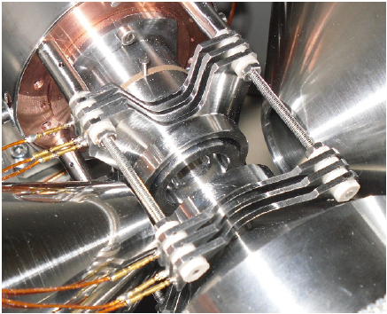
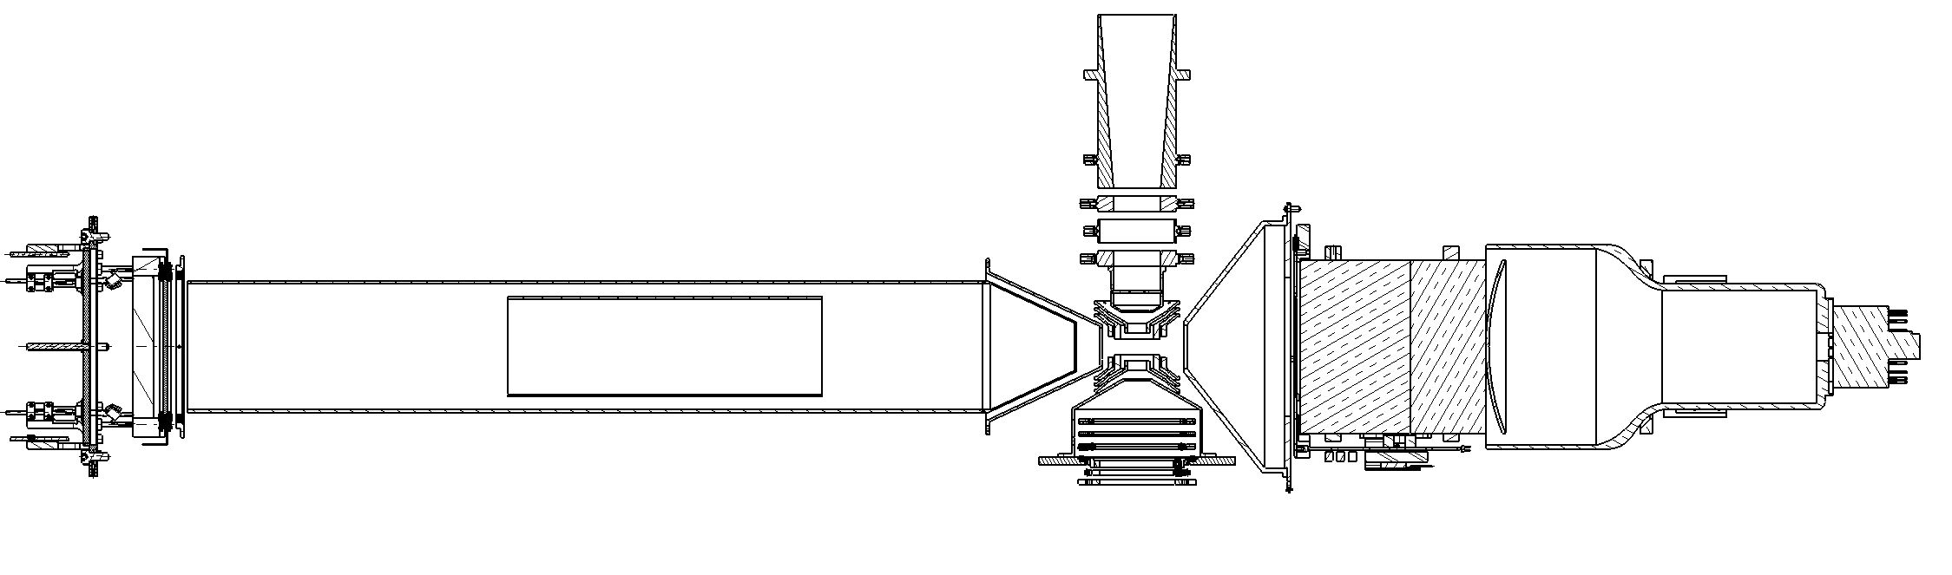
Reminder on LPCTrap
Principle:
  Injection & confinement of decay source in a Paul trap:
    Ion almost at rest in vacuum
    Large solid angle for detection
  Detection in coincidence RI & β particle
    a_{βν} extracted from Time of Flight distribution
6 concentric rings
V_{RF} 120Vpp @ ~1 MHz
Radioactive
bunch
Beta position
E_{β}
MCP
β telescope
Recoil ion
(RI)
β
Time of flight:
Free flight tube
Charge state separation:
Free flight tube @ -2kV
MCPPSD
Post-acceleration
Silicon + plastic scintillator + PMT

Slide 10
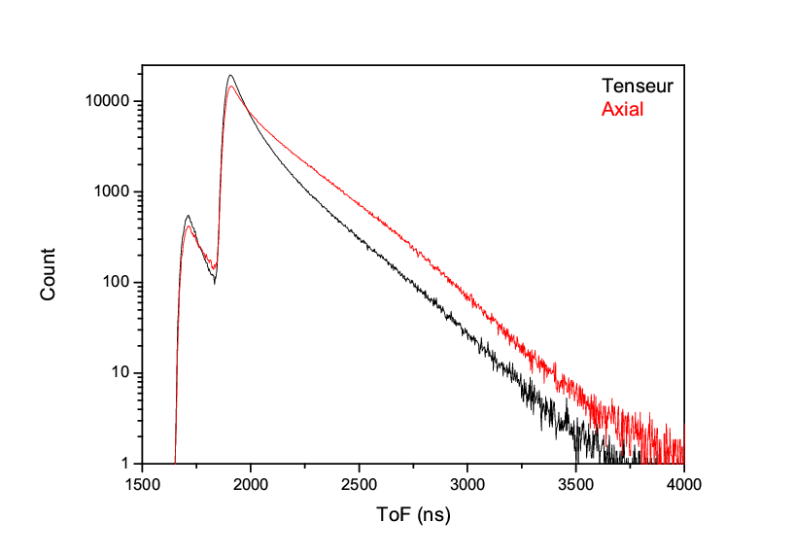
Reminder on LPCTrap
Principle:
  Injection & confinement of decay source in a Paul trap:
    Ion almost at rest in vacuum
    Large solid agle for detection
  Detection in coincidence RI & β particle
    a_{βν} extracted from Time of Flight distribution
6 concentric rings
V_{RF} 120Vpp @ ~1 MHz
Radioactive
bunch
simulation for ⁶He⁺ decay)
⁶Li³⁺
⁶Li²⁺
Beta position
E_{β}
a_{βν}=-1/3
a_{βν}=+1/3
MCP
β telescope
Recoil ion
(RI)
β
Time of flight:
Free flight tube
Charge state separation:
Free flight tube @ -2kV
MCPPSD
Post-acceleration
Silicon + plastic scintillator + PMT

Slide 11
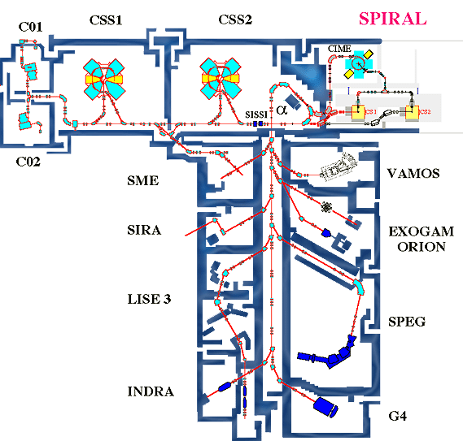
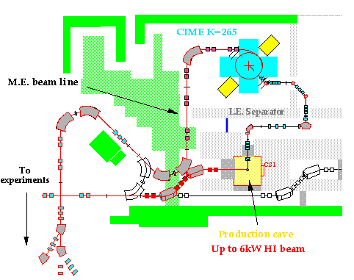
Reminder on LPCTrap
Data campaign performed on LIRAT@GANIL
Problem: LPCTrap requires cold, bunched and low energy ions
LIRAT
Beam characteristics
of SPIRAL ECR:
continuous
~10⁷ – 10⁸ pps
E = 10 keV
ΔE ~20 eV
80π mm.mrad
LIRAT
LPC-Trap
ECR source

Slide 12
Reminder on LPCTrap
Beam preparation:
RFQ
(Cooling & bunching)
Pulsed cavity
Pulsed cavity
Paul Trap
Beam from
LIRAT
HV
KE_{ion} :
10 keV
100 eV - <1 eV
1 keV
100 eV
0 eV
ΔKE:
~20 eV
~1 eV
~0.1 eV
~ 10⁸ ⁶He⁺/s
buffer-gas: H₂ / He
accumulation: 200ms (cycle)
~2 10⁴ ⁶He⁺ /cycle
Total efficiency: ~ 10⁻³-10⁻²

Slide 13
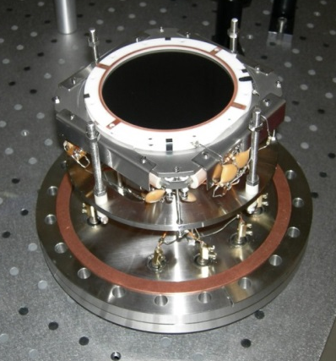
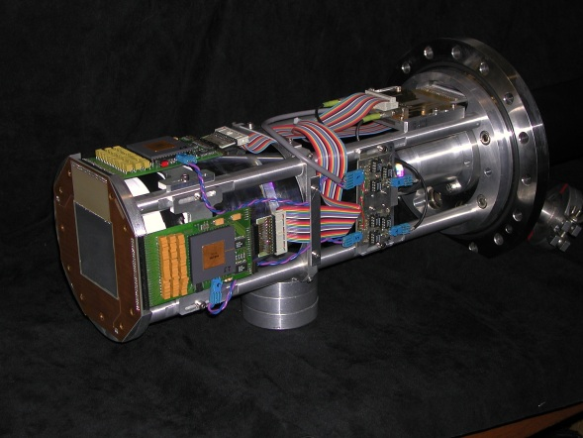

Reminder on LPCTrap
Detection setup:
DSS Silicon Detector
MCP
60 x 60mm x 300mm
Active Ø80 mm
1 mm resolution
σ_{T} ~ 200ps
Plastic scintillator
Delay lines
σ_{E} 10 % at 1 MeV
σ_{x},σ_{y} ~ 200μm
σ_{T} ~ 200ps
E. Liénard et al.
NIMA 551(2005)
Beta position
E_{β}
Trigger: β plastic scintillator
Parameters:
β energy
β position
recoil ion ToF
recoil ion position
timestamp in cycle
Trap RF phase
(systematic effects)
MCP
β telescope
Recoil ion
(RI)
β
Time of flight:
Free flight tube
MCPPSD
Ø 40mm MCPPSD
(ion cloud diagnostic)

Slide 14
Reminder on LPCTrap
Data campaigns:
  ⁶He⁺
  ³⁵Ar⁺
  ¹⁹Ne²⁺
Pure GT transition, 100% G.S. to G.S.
Reasonable T_{1/2} 0.806 s
Production rate: ~ 10⁸ ions/s
C_{T} = 0 ? a_{βν} = -1/3 ?
Mirror (F) transition, 98% G.S. to G.S.
Reasonable T_{1/2} 1.775 ms
Production rate: ~2 10⁷ ions/s
Measurement of ρ = GT/F
for V_{ud} unitarity test
Mirror transition, 99.99% G.S. to G.S.
T_{1/2} 17.34 s
Production rate: ~ 10⁸ ions/s

Slide 15
Reminder on LPCTrap
Data campaigns:
  ⁶He⁺
  ³⁵Ar⁺
  ¹⁹Ne²⁺
Pure GT transition, 100% G.S. to G.S.
Reasonable T_{1/2} 0.806 s
Production rate: ~ 10⁸ ions/s
C_{T} = 0 ? a_{βν} = -1/3 ?
Mirror (F) transition, 98% G.S. to G.S.
Reasonable T_{1/2} 1.775 ms
Production rate: ~2 10⁷ ions/s
Measurement of ρ = GT/F
for V_{ud} unitarity test
Mirror transition, 99.99% G.S. to G.S.
T_{1/2} 17.34 s
Production rate: ~ 10⁸ ions/s

Slide 16
Reminder on LPCTrap
Results with ⁶He decay
Experimental conditions (2010):
⁶He⁺ Intensity ~10⁸ pps
~ 1,5 nA of ¹²C²⁺ contamination (lost in RFQ)
~ 1.2 10⁶ « good » coincidences in ~ 4 days
p-value=0.37
Li²⁺
Li³⁺
First data analysis performed to extract
the electron shake-off probability:
Nearly complete Monte-Carlo simulation including
all relevant systematic effects
Fit of P_{shake-off} assuming a_{βν} = -1/3
Couratin et al., PRL108 (2012)
P_{shake-off} = 0.02339(35)_{stat}(07)_{syst}

Slide 17
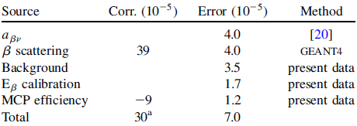
Reminder on LPCTrap
Results with ⁶He decay
Features that were lacking to extract a_{βν} :
  Realistic modelization of the trapped ion cloud
  New ion cloud simulation based on N-body calculations “CLOUDA” -> Xavier Fabian’s PhD
  Correct treatment of β tracking (multiscattering)
  New GEANT4 simulation with realistic geometry & tracking
  “LPCTRAPSW” -> My task with the help of F. Mauger and G. Quemener
Systematic error budget of SO analysis
the Shake-Off measurement was the “easy ” part
Analysis performed with fixed
a_{βν} = -1/3
-> treated as a systematic effect…

Slide 18
Reminder on LPCTrap
Results with ⁶He decay
Features that were lacking to extract a_{βν} :
  Realistic modelization of the trapped ion cloud
  New ion cloud simulation based on N-body calculations “CLOUDA” -> Xavier Fabian’s PhD
  Correct treatment of β tracking (multiscattering)
  New GEANT4 simulation with realistic geometry & tracking
  “LPCTrapSW” -> My task with the help of F. Mauger and G. Quemener
Systematic error budget of SO analysis
the Shake-Off measurement was the “easy ” part
Analysis performed with fixed
a_{βν} = -1/3
-> treated as a systematic effect…

Slide 19
Data analysis
Calibration
Background subtraction
Study of space charge effect

Slide 20
Data analysis
Calibration
Background subtraction
Study of space charge effect

Slide 21
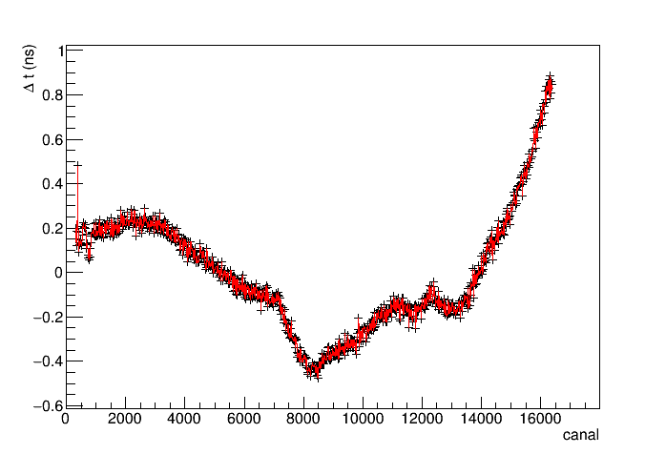
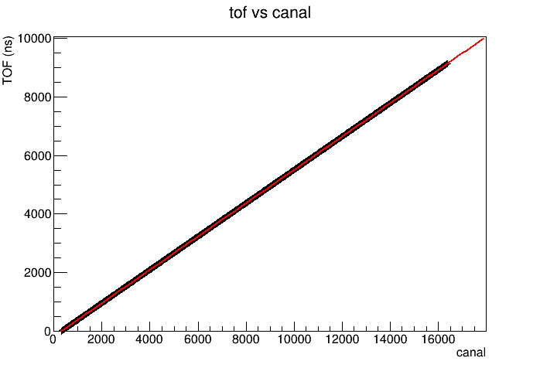
Calibration
TDC_TOF
  Time calibrator simulates a coinc. signal every 10ns
  Linear fit + non-linear corrections

Slide 22
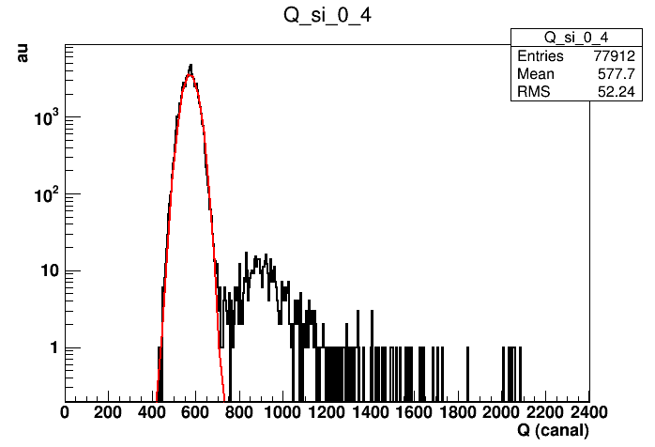
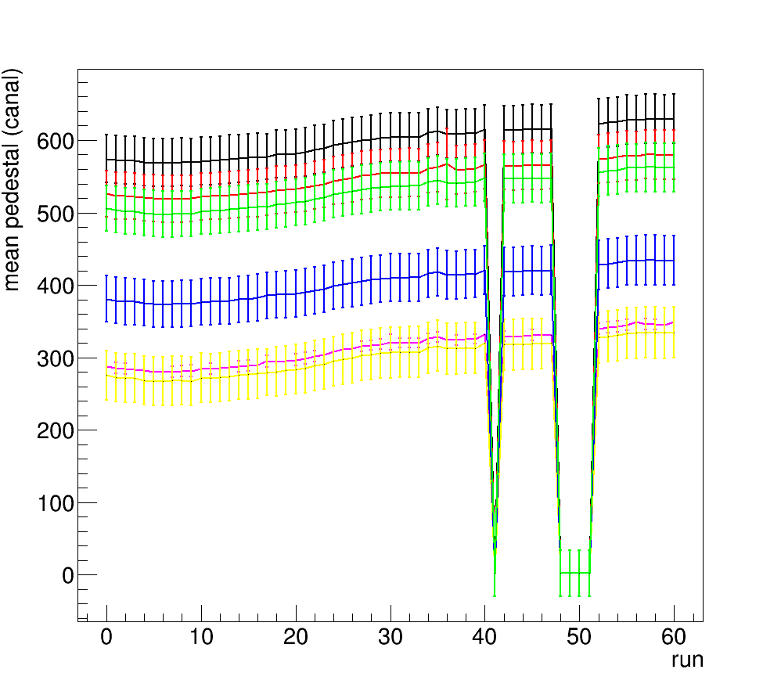
Calibration
Active surface: 60x60 mm
1mm wide channel
60 horizontal channels
60 vertical channels
DSSD channels
  Pedestal fit /channel / run

Slide 23
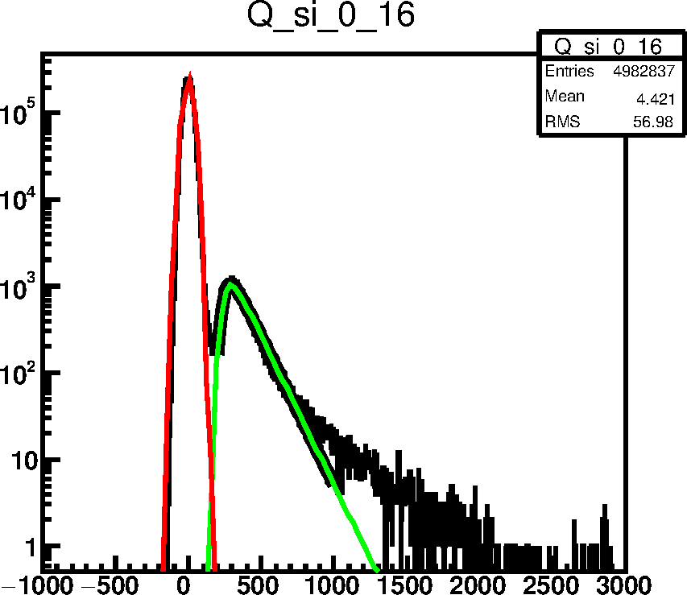
Calibration
Active surface: 60x60 mm
1mm wide channel
60 horizontal channels
60 vertical channels
DSSD channels
  Pedestal fit /channel / run
  Charge fit on centered spectrum /channel (run integrated)
    One calibration parameter (energy deposited/charge) for each channel
Other parameters recorded:
RMS pedestal
Sigma channel (resolution)
Signal over background ratio

Slide 24
Calibration
Active surface: 60x60 mm
1mm wide channel
60 horizontal channels
60 vertical channels
DSSD channels
  Pedestal fit /channel / run
  Charge fit on centered spectrum /channel (run integrated)
    One calibration parameter (energy deposited/charge) for each channel
Other parameters recorded:
RMS pedestal
Sigma channel (resolution)
Signal over background ratio

Slide 25
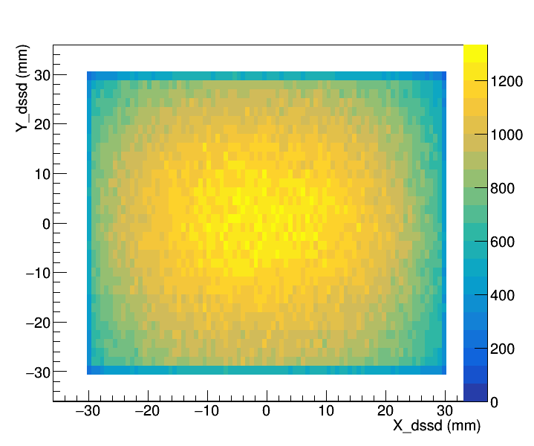
Calibration
Active surface: 60x60 mm
1mm wide channel
60 horizontal channels
60 vertical channels
DSSD channels
  Pedestal fit /channel / run
  Charge fit on centered spectrum /channel (run integrated)
    One calibration parameter (energy deposited/charge) for each channel
  Clusterization:
    handle multiple channel hits
    Validation of energy deposition
    Provide β particle validation
    + position

Slide 26
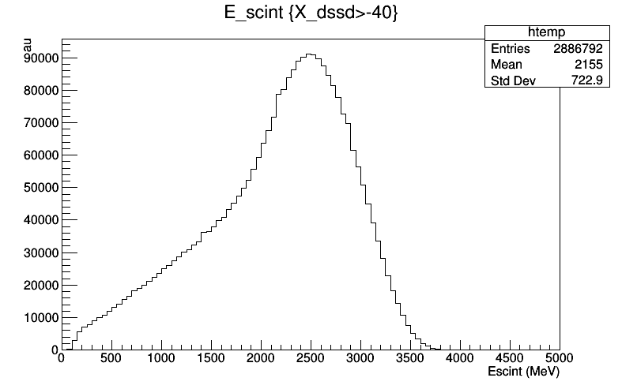
Calibration
Other parameters
  QDC_beta: signal in the plastic scintillator
    Response function will be approximated with G4 simulation
    The value of the low energy cut is a systematic effect

Slide 27
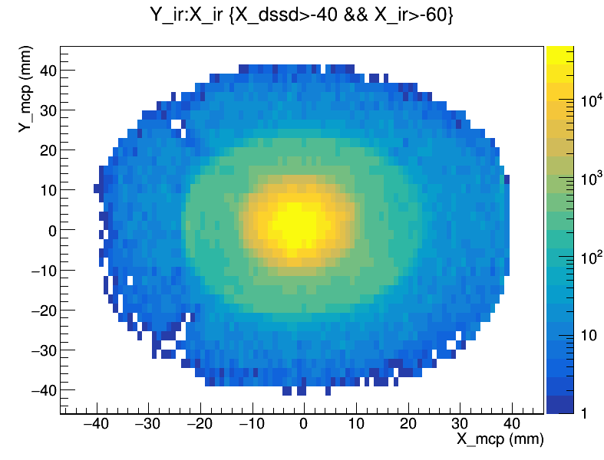
Calibration
Other parameters
  Delay lines MCP:
    Position sensitivity for the RI is not really relevant because of focalization
    Used calibration from previous experiment

Slide 28
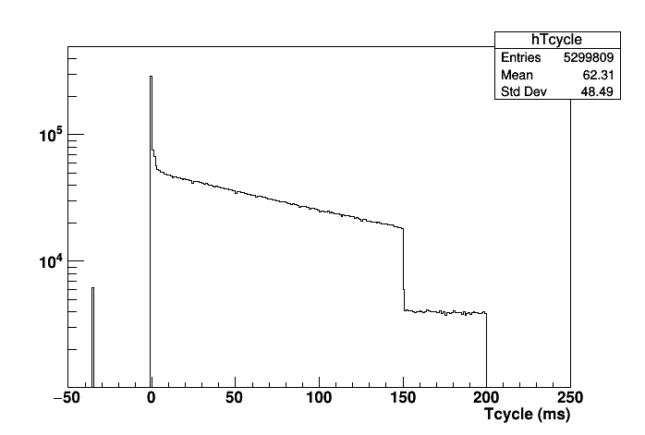
Calibration
Other parameters
  RF phase: recorded at coinc. trigger for comparison with simulation -> perturbation of recoil ion trajectory
  Tcycle: time stamping within a cycle
injection
ejection

Slide 29
Data analysis
Calibration
Background subtraction
Study of space charge effect

Slide 30
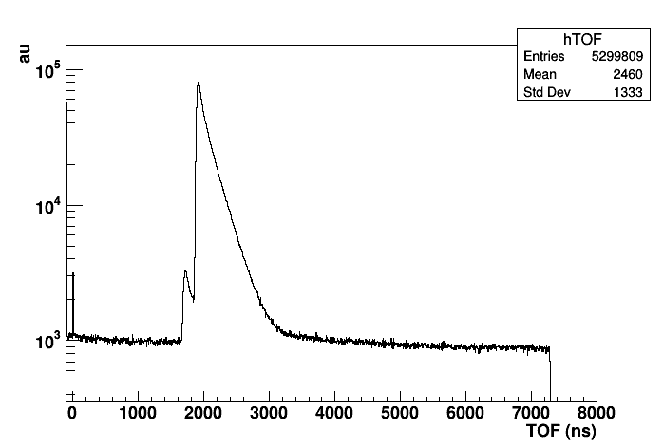
Background subtraction
Two types of background:
“False coincidence” (FC) & “Outside Trap coincidence” (OT)
Tail above background: no clear explanation
Only FC
Only FC
Background to remove:
FC + OT

Slide 31
Background subtraction
OT evt distribution is obtained with Tcycle selection:

Slide 32
Background subtraction
OT evt distribution is obtained with Tcycle selection:
“TRAP ON”
“TRAP OFF”
cloud at equilibrium
No more trapped ions after ejection,
Only OT … and FC (actually the majority)!
“hot” cloud,
ions on unstable trajectories

Slide 33
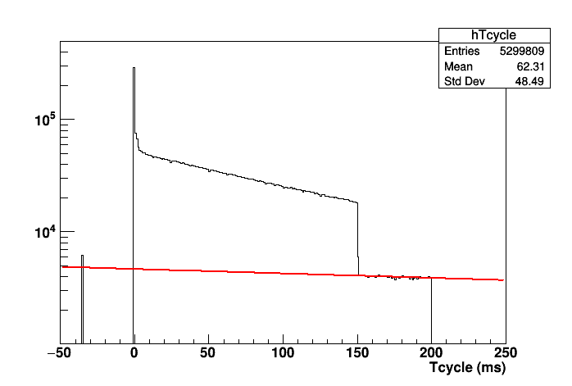
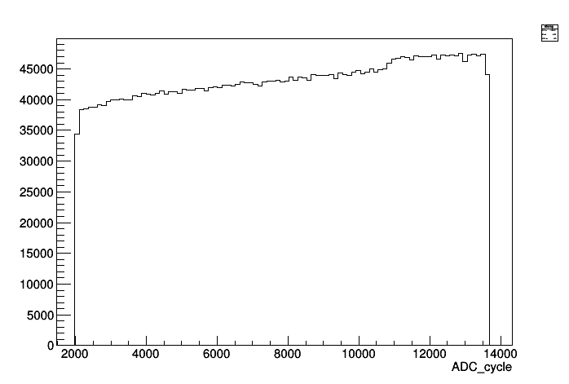
Background subtraction
“OT” normalization coefficient
“TRAP ON”
“TRAP OFF”
Negative exponential fit
to extrapolate during TrapOn
20Hz clock signal to monitor Dead Time

Slide 34
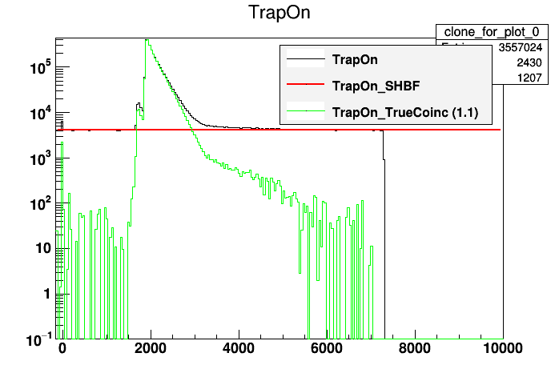
Background subtraction
First method: Remove first FC and then OT
  Subtract the FC from “Trap On” to get “Trap On / True Coinc” ( =TC In&Out trap)

Slide 35
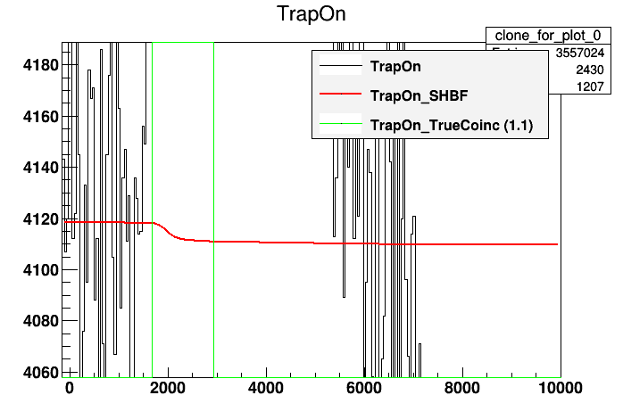
Background subtraction
First method: Remove first FC and then OT
  Subtract the FC from “Trap On” to get “Trap On / True Coinc” ( =TC In&Out trap)
Effect of Single Hit TDC

Slide 36
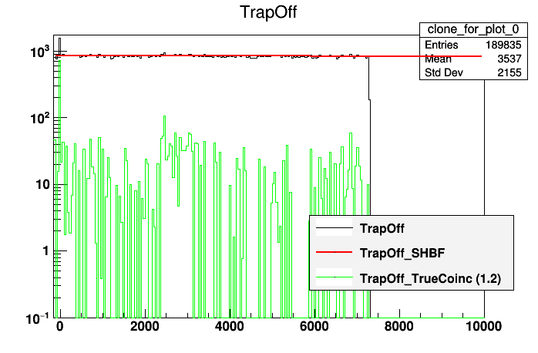
Background subtraction
First method: Remove first FC and then OT
  Subtract the FC from “Trap On” to get “Trap On / True Coinc” ( =TC In&Out trap)
  Subtract the FC from “Trap Off” to get “Trap Off / True Coinc” (=TC Out trap)

Slide 37
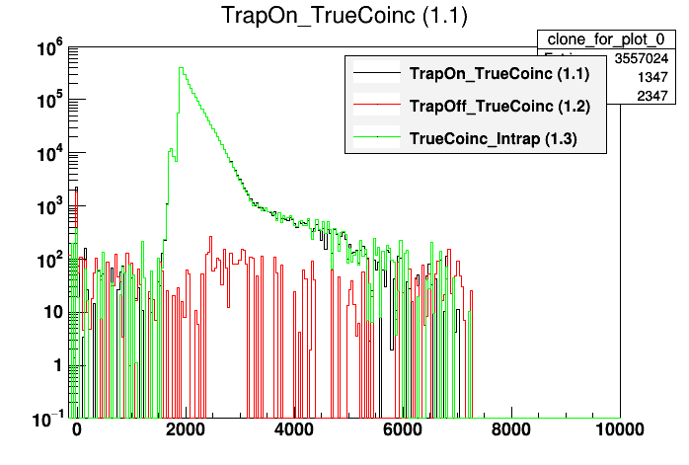
Background subtraction
First method: Remove first FC and then OT
  Subtract the FC from “Trap On” to get “Trap On / True Coinc” ( =TC In&Out trap)
  Subtract the FC from “Trap Off” to get “Trap Off / True Coinc” (=TC Out trap)
  Subtract “Trap Off – True Coinc” from “Trap On / True Coinc” to get
  True Coinc / In trap

Slide 38
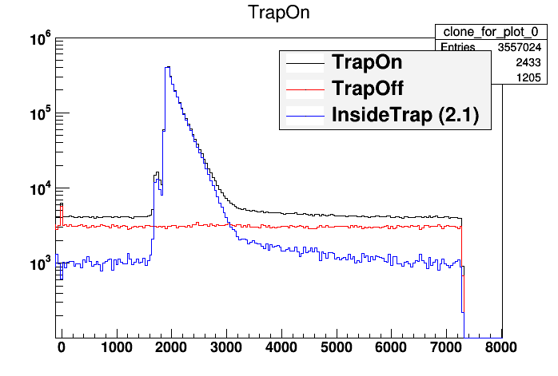
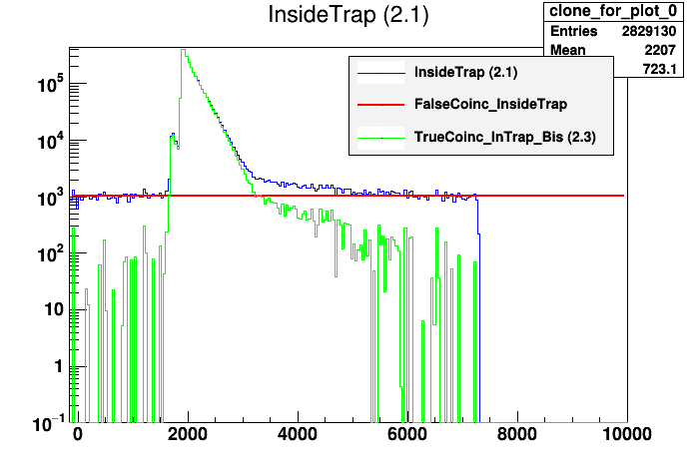
Background subtraction
Second method: Remove first OT and then FC
  Subtract “Trap Off” from “Trap On” to get “FC+TC In Trap”
  Make the difference between FC functions “TrapOn” & “Trap Off”
  Subtract this function from “FC+TC InTrap” to get “True Coinc / InTrap”

Slide 39
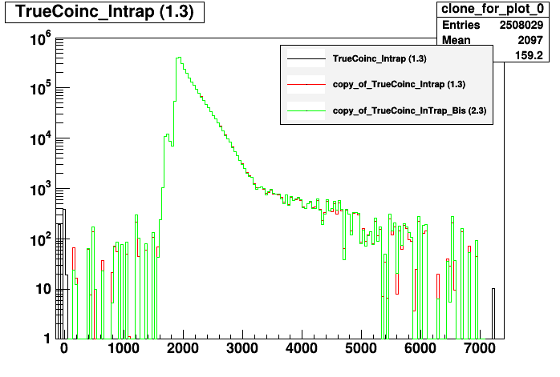
Background subtraction
Comparison of the two methods
OT contribution is very small
Background subtraction will be checked again during systematic effects study
Investigation on other variables (DSSD profiles)

Slide 40
Data analysis
Calibration
Background subtraction
Study of space charge effect

Slide 41
Study of space charge effect
CLOUDA simulation has shown a possible space charge effect on the trapped ion cloud after thermalization
  The size of the cloud impacts the TOF distribution, in particular the front edge part
  Hypothesis: “single event” detection rate should be proportional to the number of trapped ion in a given cycle
  Raw data has been rebuilt to time stamp each event and determine the total “single event” detection count per cycle

Slide 42
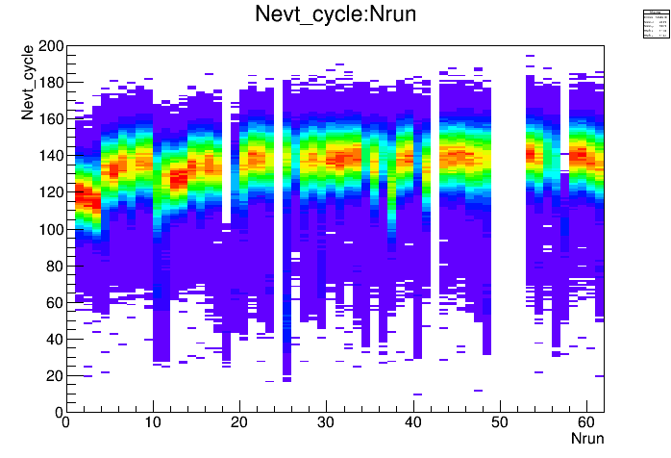
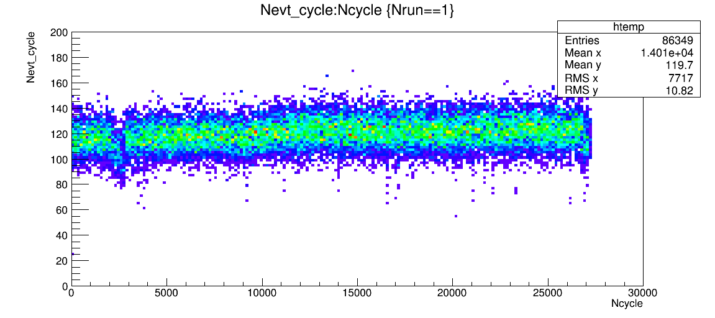
Study of space charge effect
  Nevt_cycle = “single” detection per cycle

Slide 43
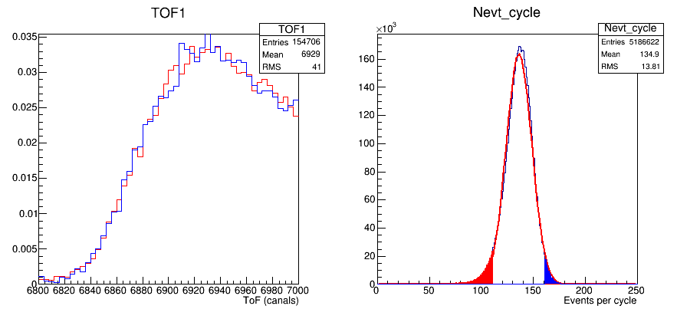
Study of space charge effect
  Effect on TOF
    Selection on “single” detection per cycle : “small”: Nevt_cycle<111 / “big”: Nevt_cycle>160
NO VISIBLE EFFECT ON TOF (statistically compatible)

Slide 44
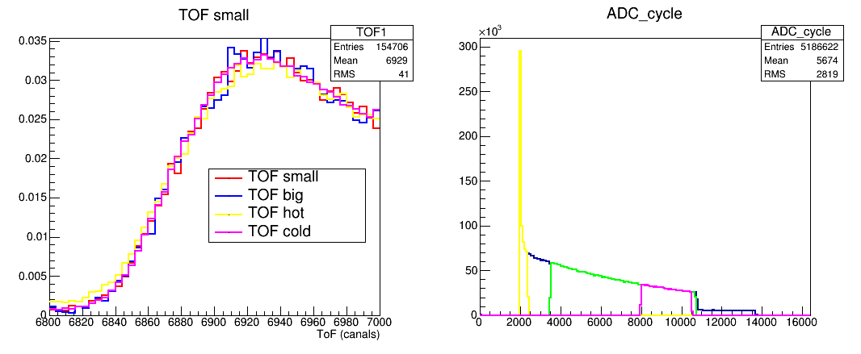
Study of space charge effect
  Effect on TOF: comparison between hot and cold cloud
  “small” and “big” compatible with cold but not hot cloud
confirmation that there is no visible space charge effect in 6He data

Slide 45
New MC simulation – LPCTrapSW

Slide 46
LPCTrapSW
New package based on Bayeux
  Geometry modelization
  Primary event modelization
  Direction Bias
  E-fields
  Event per event analysis
  Data processing
  Etc.

Slide 47
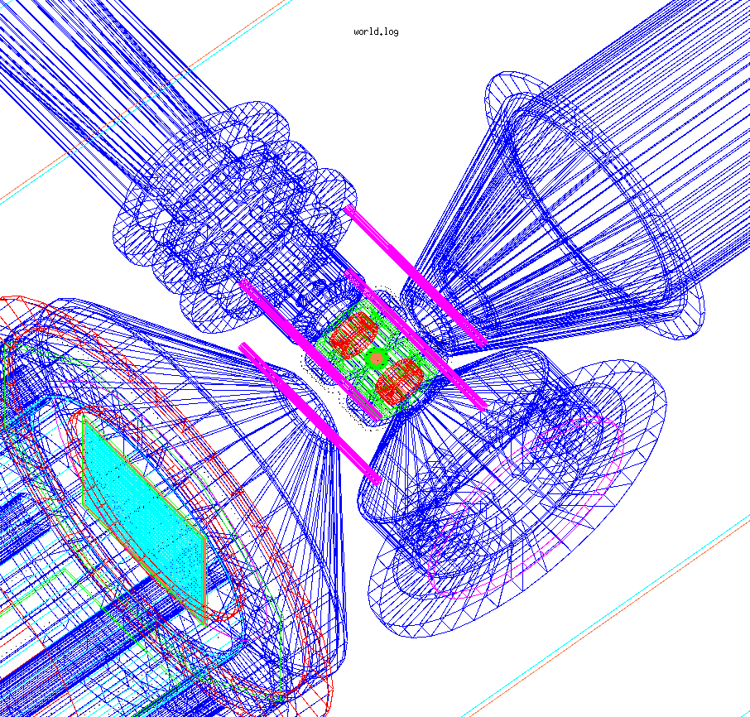
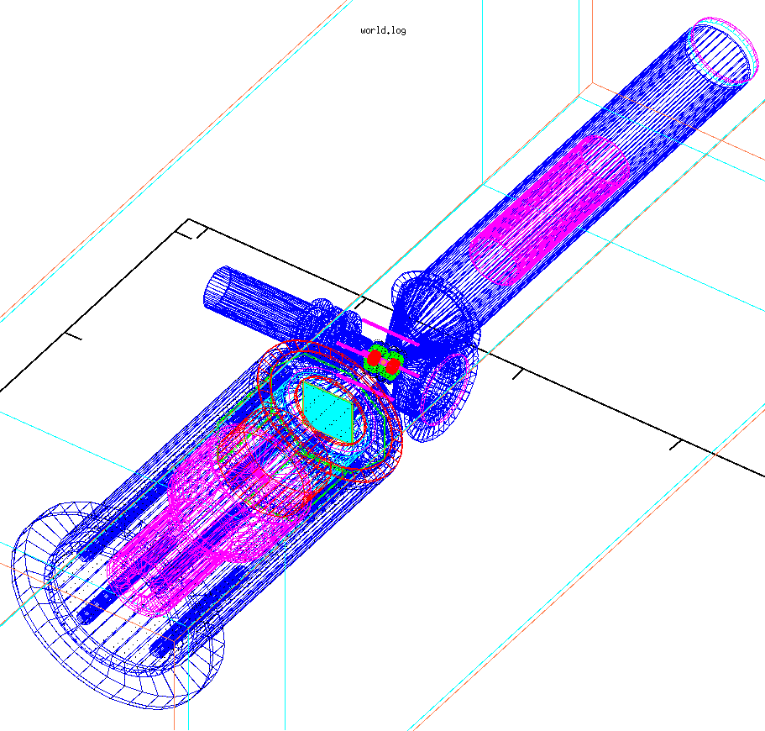
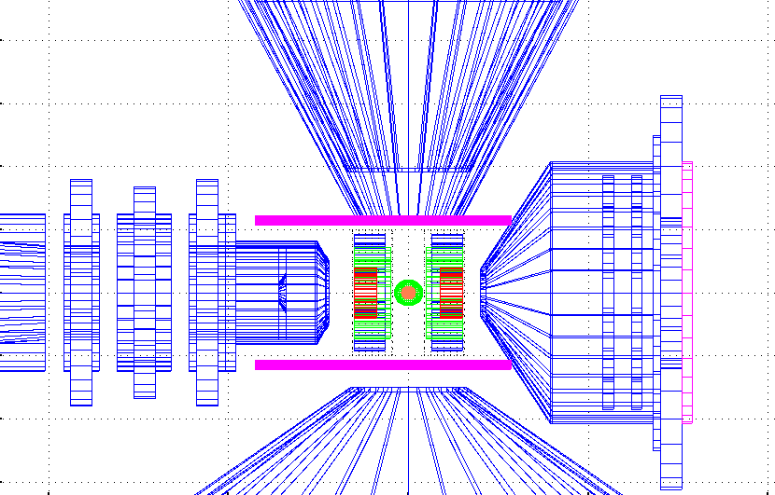
LPCTrapSW
Geometry

Slide 48
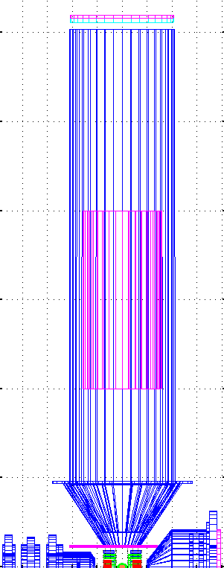
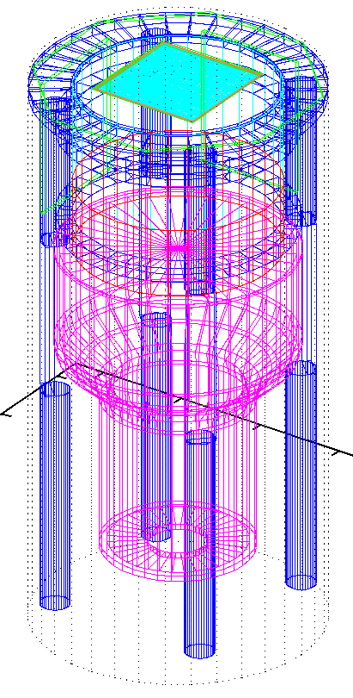
LPCTrapSW
Geometry

Slide 49
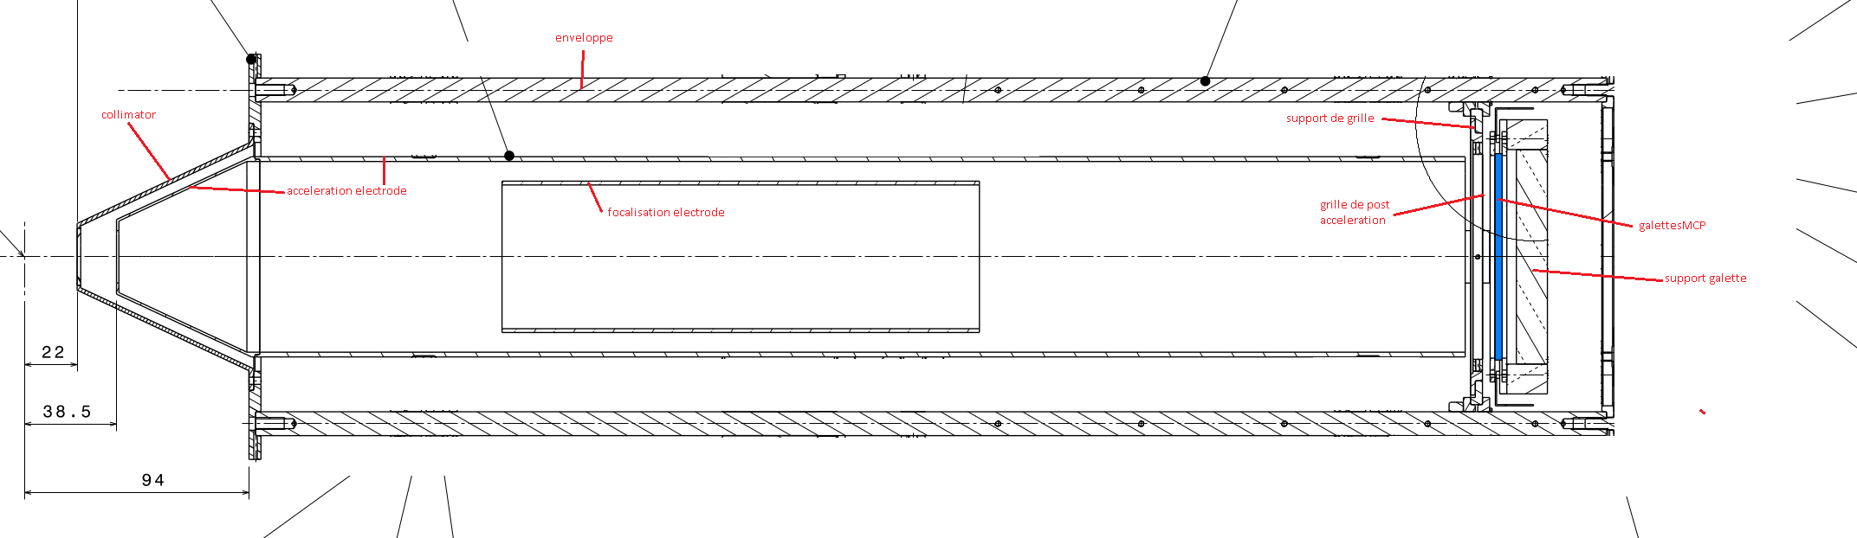
LPCTrapSW
Potential in RI detector
2kV accel.
Post-accel 4kV
-2000V
+250V
-2000V
-4000V
0V

Slide 50
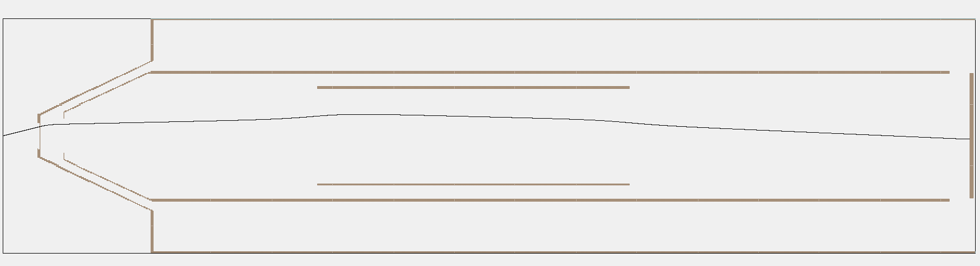
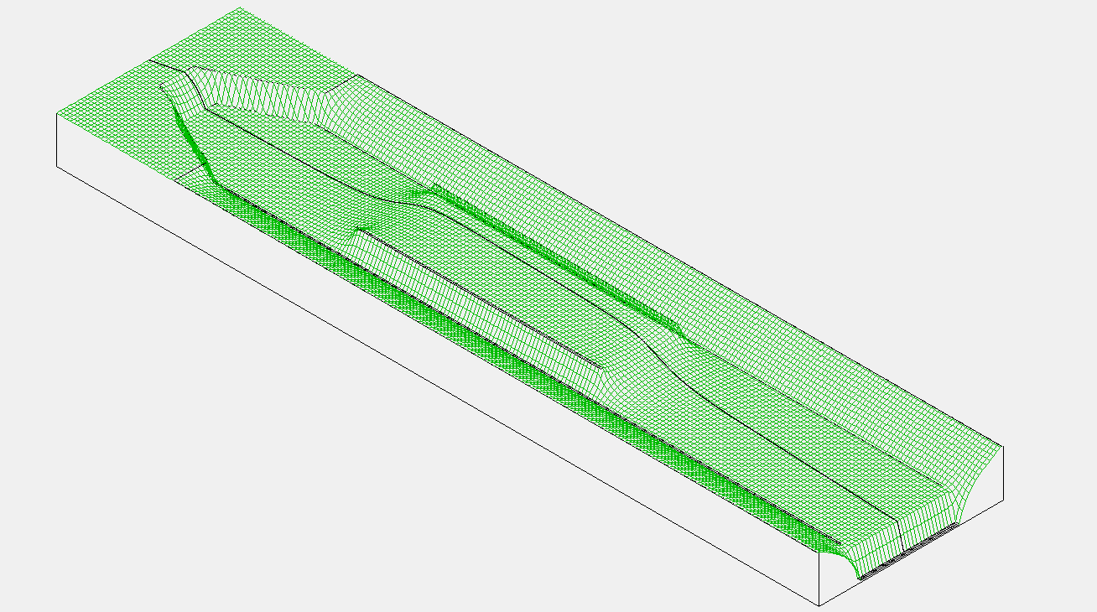
LPCTrapSW
E-field in recoil ion detector described by SIMION

Slide 51
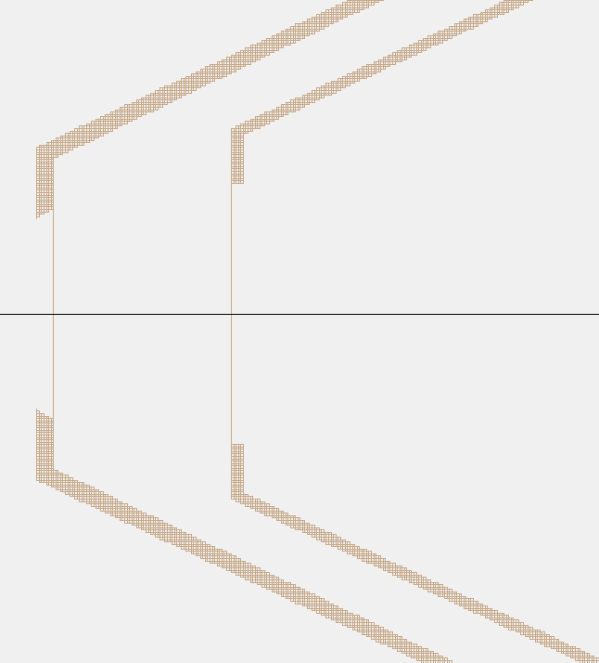
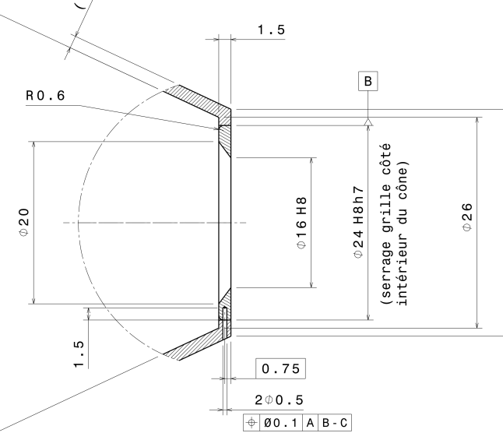
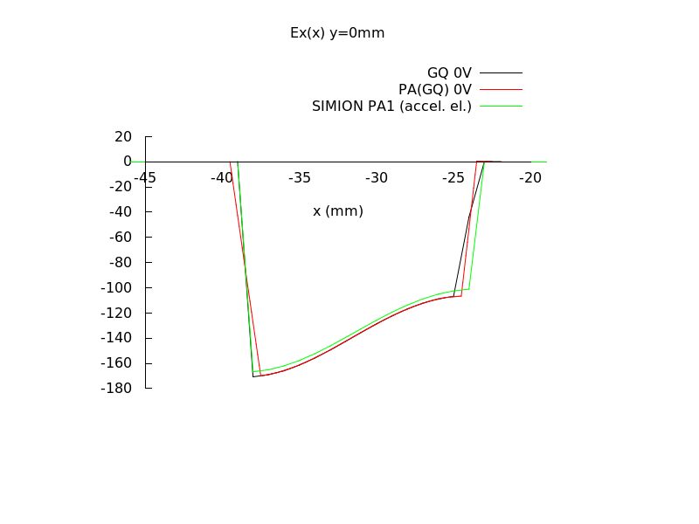
LPCTrapSW
E-field in recoil ion detector described by SIMION

Slide 52
LPCTrapSW
E-field in recoil ion detector described by SIMION
  Validation of ion tracking in Geant4 by comparison with SIMION

Slide 53
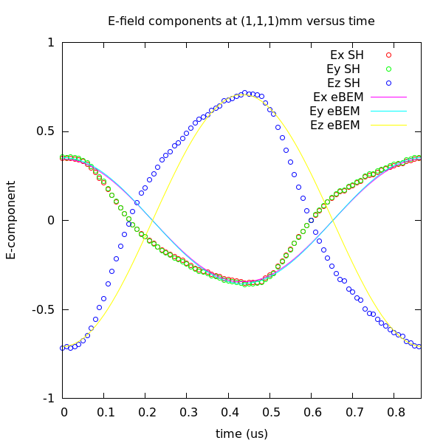
LPCTrapSW
E-field in recoil ion detector described by SIMION
  Validation of ion tracking in Geant4 by comparison with SIMION
RF trapping field calculated by eBEM (see Gilles Quemener presentation)
  More precise than SIMION (open geometry)
  Extends up to the detector collimators
  Dynamic field with realistic RF signal shape
  Synchronized with RF phase of primary vertex (CLOUDA)

Slide 54
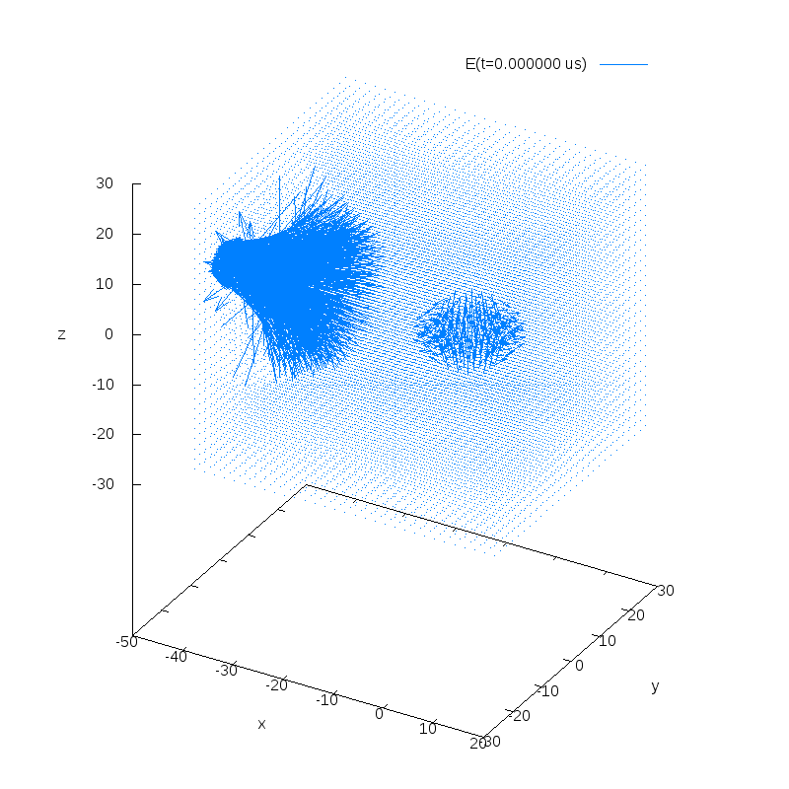
LPCTrapSW
RI field + RF field

Slide 55
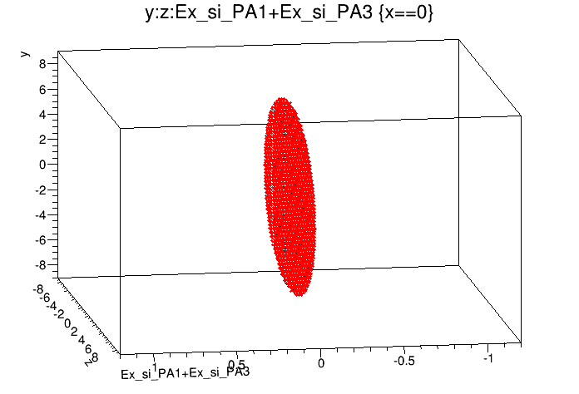
LPCTrapSW
Some difference between eBEM and SIMION RF field maps
Ex in the Y-Z plane
Ex component will accelerate/decelerate
the recoil ion as it is flying to the detector
Field component taken at its maximum value
( cos(wt)=1 )
eBEM
SIMION
X axis: recoil detector -> beta detector
Z axis: injection -> ejection
Y axis: floor -> ceiling
y
x
X = 0 mm
z
At x=0mm, both calculations agree on a null field

Slide 56
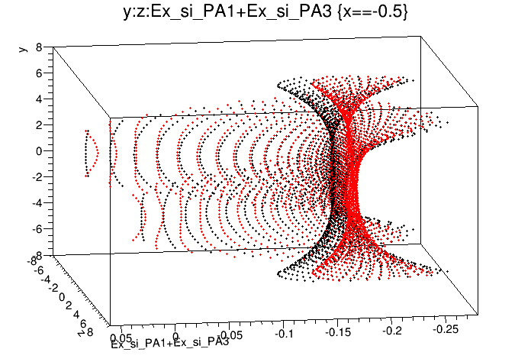
LPCTrapSW
Some difference between eBEM and SIMION RF field maps
Ex in the Y-Z plane
Ex component will accelerate/decelerate
the recoil ion as it is flying to the detector
Field component taken at its maximum value
( cos(wt)=1 )
eBEM
SIMION
X axis: recoil detector -> beta detector
Z axis: injection -> ejection
Y axis: floor -> ceiling
y
x
X = -0.5 mm
z
At x=0.5mm, Ex component is small, but significant relative difference:
  On the z=0mm plane :
    E_PA1+ E_PA3 = -0.175 V/mm
    E_60V = -0.19 V/mm
ΔE = 0.015 V/mm (8.5%)

Slide 57
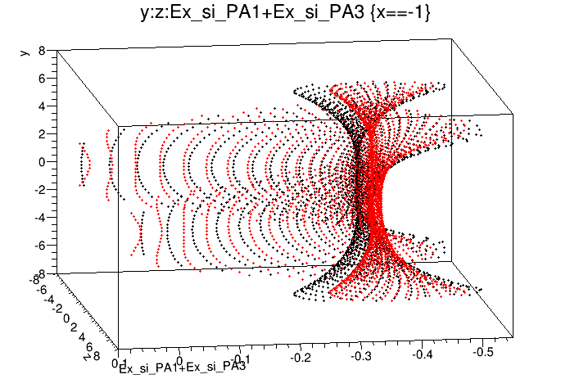
LPCTrapSW
Some difference between eBEM and SIMION RF field maps
Ex in the Y-Z plane
Ex component will accelerate/decelerate
the recoil ion as it is flying to the detector
Field component taken at its maximum value
( cos(wt)=1 )
eBEM
SIMION
X axis: recoil detector -> beta detector
Z axis: injection -> ejection
Y axis: floor -> ceiling
y
x
X = -1 mm
z
At x=1mm, Ex increased but relative difference is constant
  On the z=0mm plane :
    E_PA1+ E_PA3 = -0.35 V/mm
    E_60V = -0.375 V/mm
ΔE = 0.025 V/mm (7.1%)

Slide 58
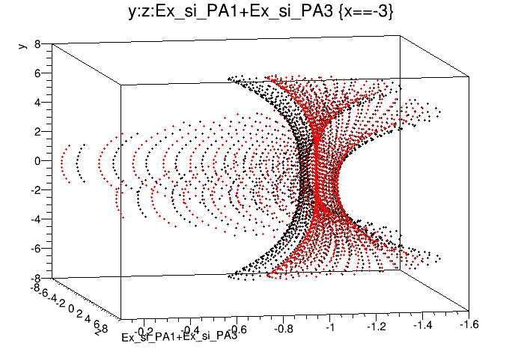
LPCTrapSW
Some difference between eBEM and SIMION RF field maps
Ex in the Y-Z plane
Ex component will accelerate/decelerate
the recoil ion as it is flying to the detector
Field component taken at its maximum value
( cos(wt)=1 )
eBEM
SIMION
X axis: recoil detector -> beta detector
Z axis: injection -> ejection
Y axis: floor -> ceiling
y
x
X = -3 mm
z
At x=3mm, same trend
On the z=0mm plane :
    E_PA1+ E_PA3 = -1.025 V/mm
    E_60V = -1.1 V/mm
ΔE = 0.075 V/mm (7.3%)

Slide 59

LPCTrapSW
Some difference between eBEM and SIMION RF field maps
Ex in the Y-Z plane
Ex component will accelerate/decelerate
the recoil ion as it is flying to the detector
Field component taken at its maximum value
( cos(wt)=1 )
eBEM
SIMION
X axis: recoil detector -> beta detector
Z axis: injection -> ejection
Y axis: floor -> ceiling
y
x
X = -5 mm
z
ΔE = 0.15 V/mm (9.4%)
At x=5mm, same trend:
  On the z=0mm plane :
    E_PA1+ E_PA3 = -1.6 V/mm
    E_60V = -1.75 V/mm
NEED TO BE CHECKED WITH
G4/SIMION TRACKING COMPARISON

Slide 60

LPCTrapSW
First results
Better match with CLOUDA than with Point Vertex but still not great

Slide 61

LPCTrapSW
First results
Selecting on RF phase doesn’t reproduce the TOF front edge shift seen in exp. data
  Problem in simulation:
    Bad RF field?
    Bad time synchronization between CLOUDA vertex and G4 time reference frame?
    Bad tracking?
    To be compared with SIMION

Slide 62
ToDo list

Slide 63
ToDo list
Validate G4 tracking in RF field
Check CLOUDA reader / GEANT4 primary event interface
Obtain large sample of CLOUDA input vertexes with correct statistical treatment
Investigate other observables than TOF
  DSSD profiles
Implement fit method to extract a_{βν}
Perform systematic effects analysis:
  Uncertainties on ion cloud / RI collimator distance & MCP distance
  Uncertainties on beta-detector relative position
  Validate background subtraction method
  Investigate tail in exp. TOF distribution with MC simulation

Slide 64

Electron shake-off in ⁶He⁺ decay
Why high precision can be interesting here?
What can contribute to the ionization:
Nuclear charge change
Recoil effect (the nucleus gets away from the bound electron)
Direct collision β – electron (very small)
Multi-electron processes (e-e correlation & Auger electrons)
⁶He⁺ is particularly interesting:
Only one electron system
No e-e correlation, no secondary process (Auger emission)
→ Pure electron Shake-off
Analytic full quantum calculation in sudden approximation is possible using hydrogen like wavefunctions
→Perfect textbook case for theory!
X. Fléchard Colloque GANIL, interdisciplinary research, 2015_13_10

Slide 65










shake-off theory for ⁶He⁺ decay
SA:
Monopole contribution
recoil contribution
Correction for direct collision (with β⁻ ):
or
(93% of charge)
collision contribution
so
No surprise….
But first precise test of theory for a shake-off process!!!
PRL « highlight », Couratin et al., PRL108 (2012)
X. Fléchard Colloque GANIL, interdisciplinary research, 2015_13_10

