Slide 1
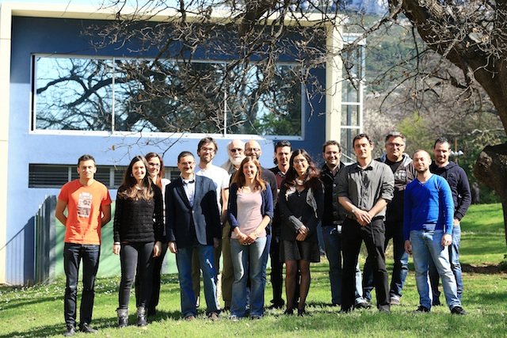
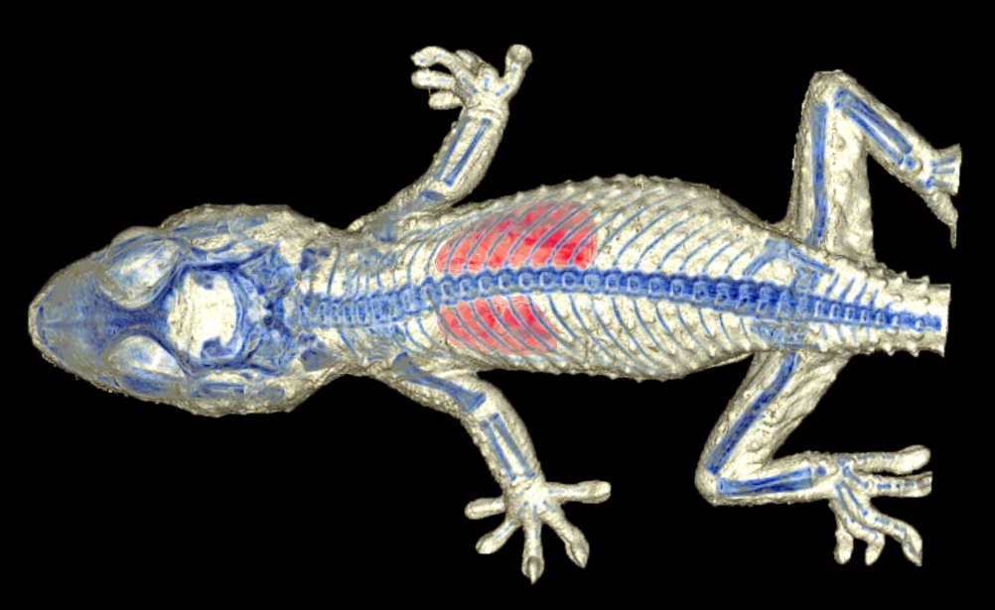
The team
imXgam

Slide 2
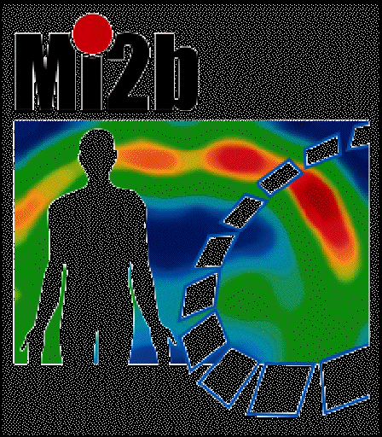
imXgam — X and gamma ray imaging
imXgam
Societal applications of nuclear physics : → Development of interdisciplinary projects using ionizing radiations
GDR Modélisation et Instrumentation pour l’Imagerie Biomédicale (MI2B) GDR Modelling and Instrumentation for Biomedical Imaging (MI2B)
Centre de Recherche en Imagerie Médicale Centre of Medical Imaging Research
Development of X-ray hybrid pixel detectors
XPIX, PIXSCAN, ClearPET/XPAD, CHiPSpeCT -> startup
Development of multi-pixel probes
PIXSIC
Monte Carlo simulation
GATE, fGATE, hGATE
Hadrontherapy
ENVISION et ENTERVISION (FP7), ClaRyS
Setting up of a research infrastructure for the development of biomedical imaging at CPPM
Irradiation systems, imaging room, tomXgam bench
Team imXgam
2
Notes:
2
Groupe Evaluation AERES 13-14 janvier 2011

Slide 3
Present team composition
imXgam
Permanents:
A. Bonissent (DR émérite), Y. Boursier (MC), C. Morel (PR)
M. Dupont (IR, 100%), F. Cassol (IR, 70%), J.-P. Cachemiche (IR, 10%)
J.-C. Clémens (IR, 10%), E. Vigeolas (IR, 10%)
CDD:
T. Fabiani (IR), M. Rodo Bordera (IR), M. Bautista (apprenti IR)
Post-Docs:
A. Habib (DEmON)
PhD students:
M. Hamonet (BDO), L. Portal (BDO), S. Tairi (BDO)
Trainees:
I. Bones (ClearPET/XPAD), I. Vilas-Boas (PIXSCAN)
Technical support:
electronics (0,2 FTE), mechanics (1 FTE)
Passed thesis (2010-2015):
S. Nicol (7.10, ClearPET/XPAD) -> HMR, Montréal (CDI)
A. Dawiec (5.11, XPIX) -> imXPAD (CDI) -> SOLEIL (IR, 4.13)
H. Ouamara (2.13, PIXSCAN) -> EOS imaging (CDI)
M. Dupont (4.14, PIXSCAN) -> ATER (AMU) -> Post-doc (FLI)
C. Kronland-Martinet (3.15, PIXSCAN)
Team imXgam
3
Notes:
3
Groupe Evaluation AERES 13-14 janvier 2011

Slide 4
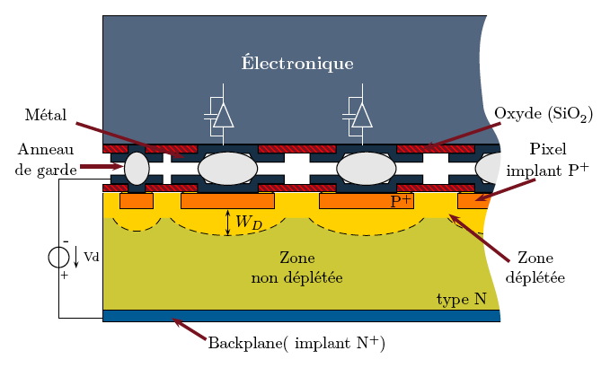
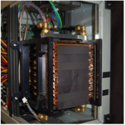
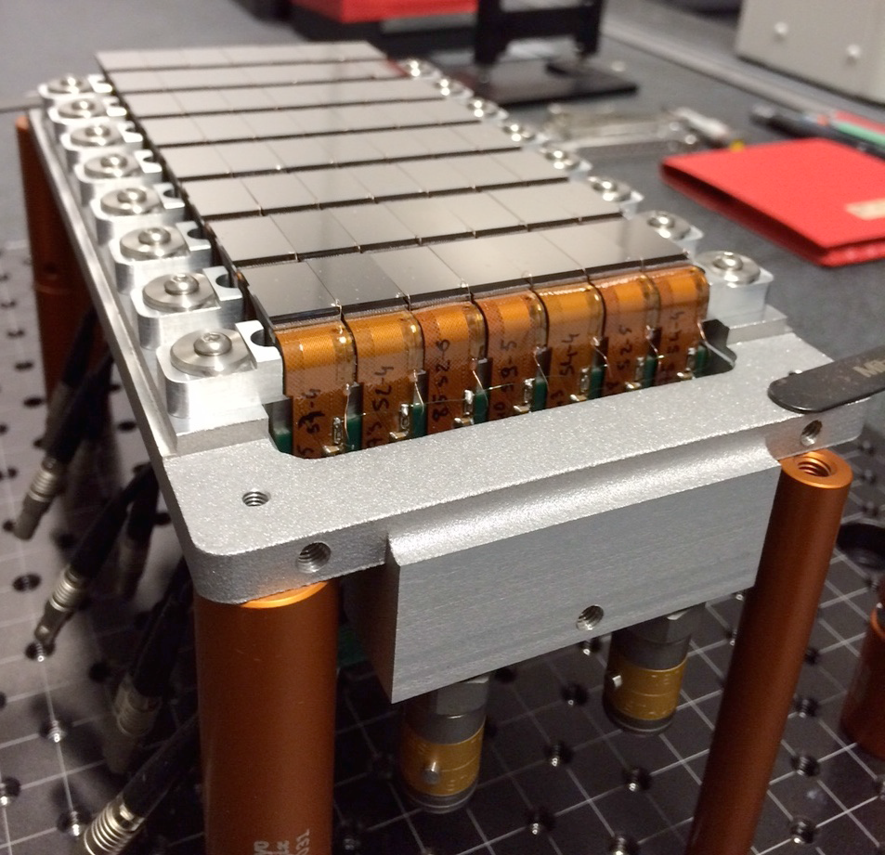
imXgam — X and gamma ray imaging
imXgam
X-ray hybrid pixel detectors
XPIX: Development of hybrid pixel detectors XPAD3-1 and XPAD3-2 hybridized on Si and CdTe
> 5 Mpixels 130 x 130 µm²
240 images/s
5-35 keV (XPAD3.1)
5-60 keV (XPAD3.2)
CHiPSpeCT (PhysiCancer 12)
Hybrides XPAD3.2/CdTe (D7)
Team imXgam
4
Notes:
4
Groupe Evaluation AERES 13-14 janvier 2011

Slide 5
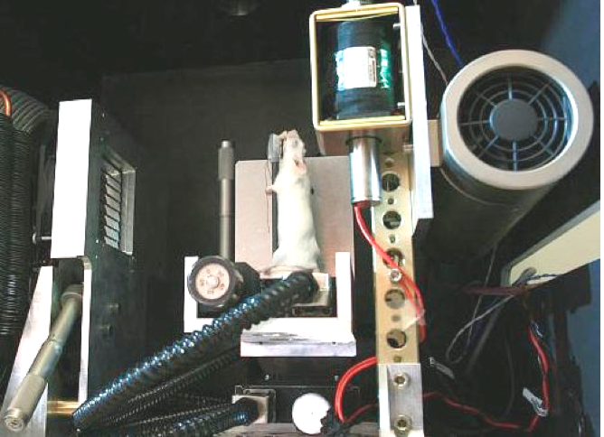
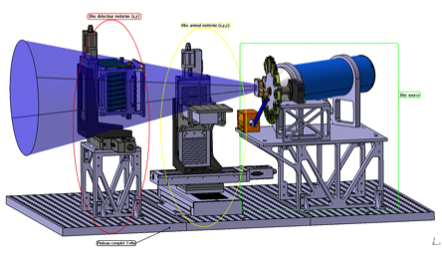
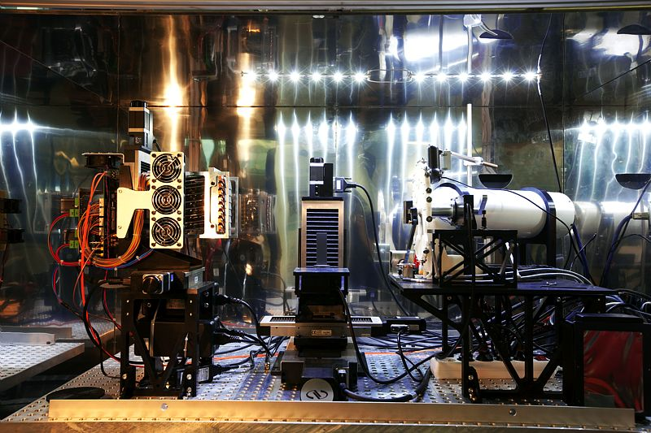
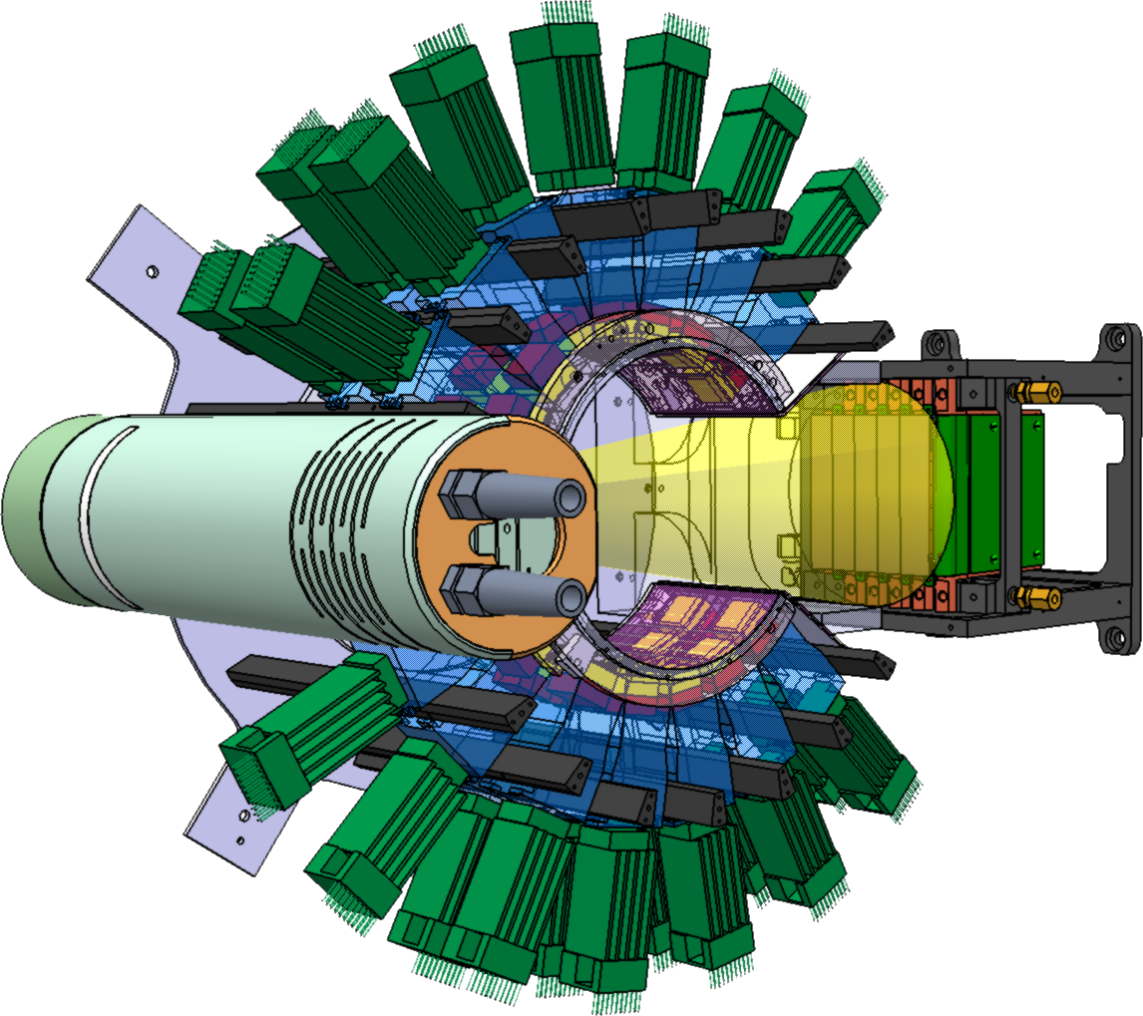
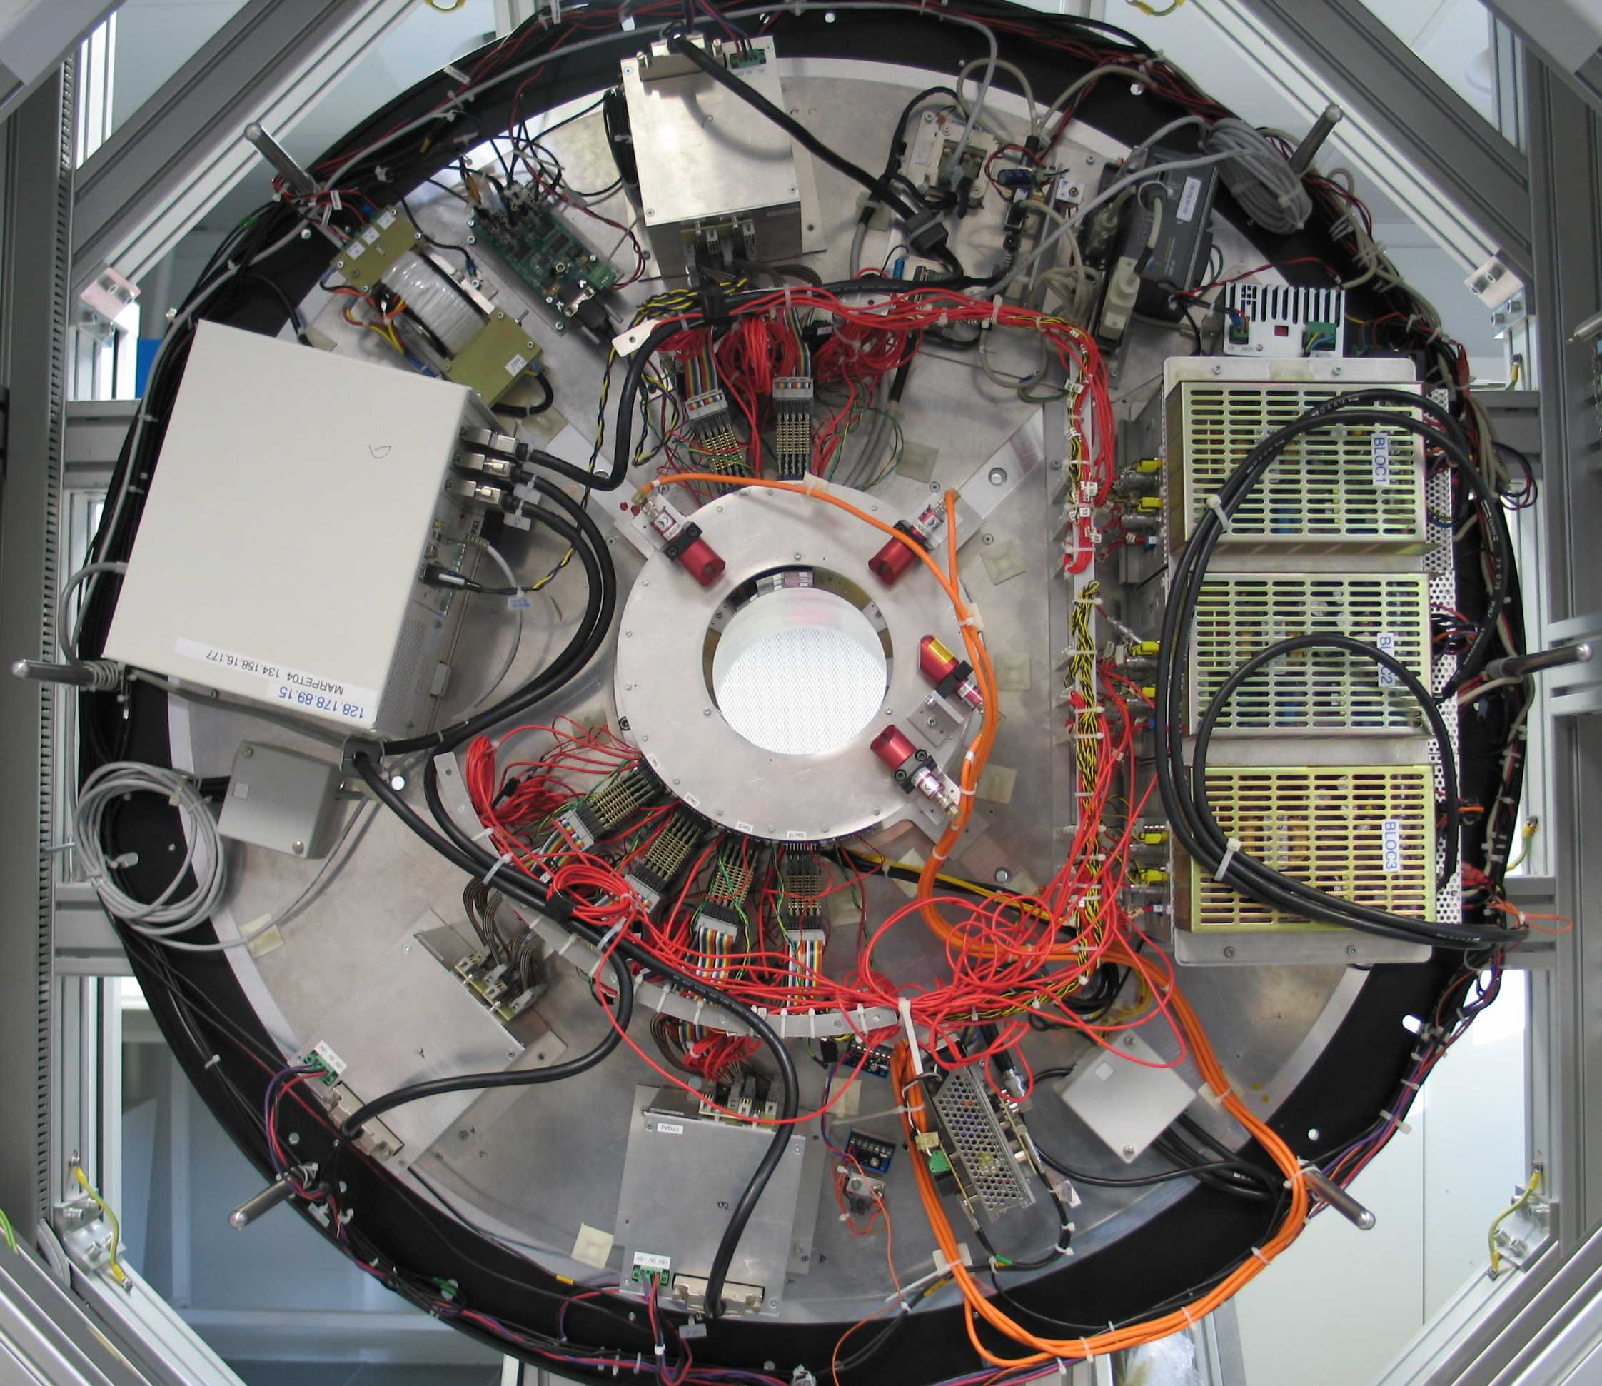
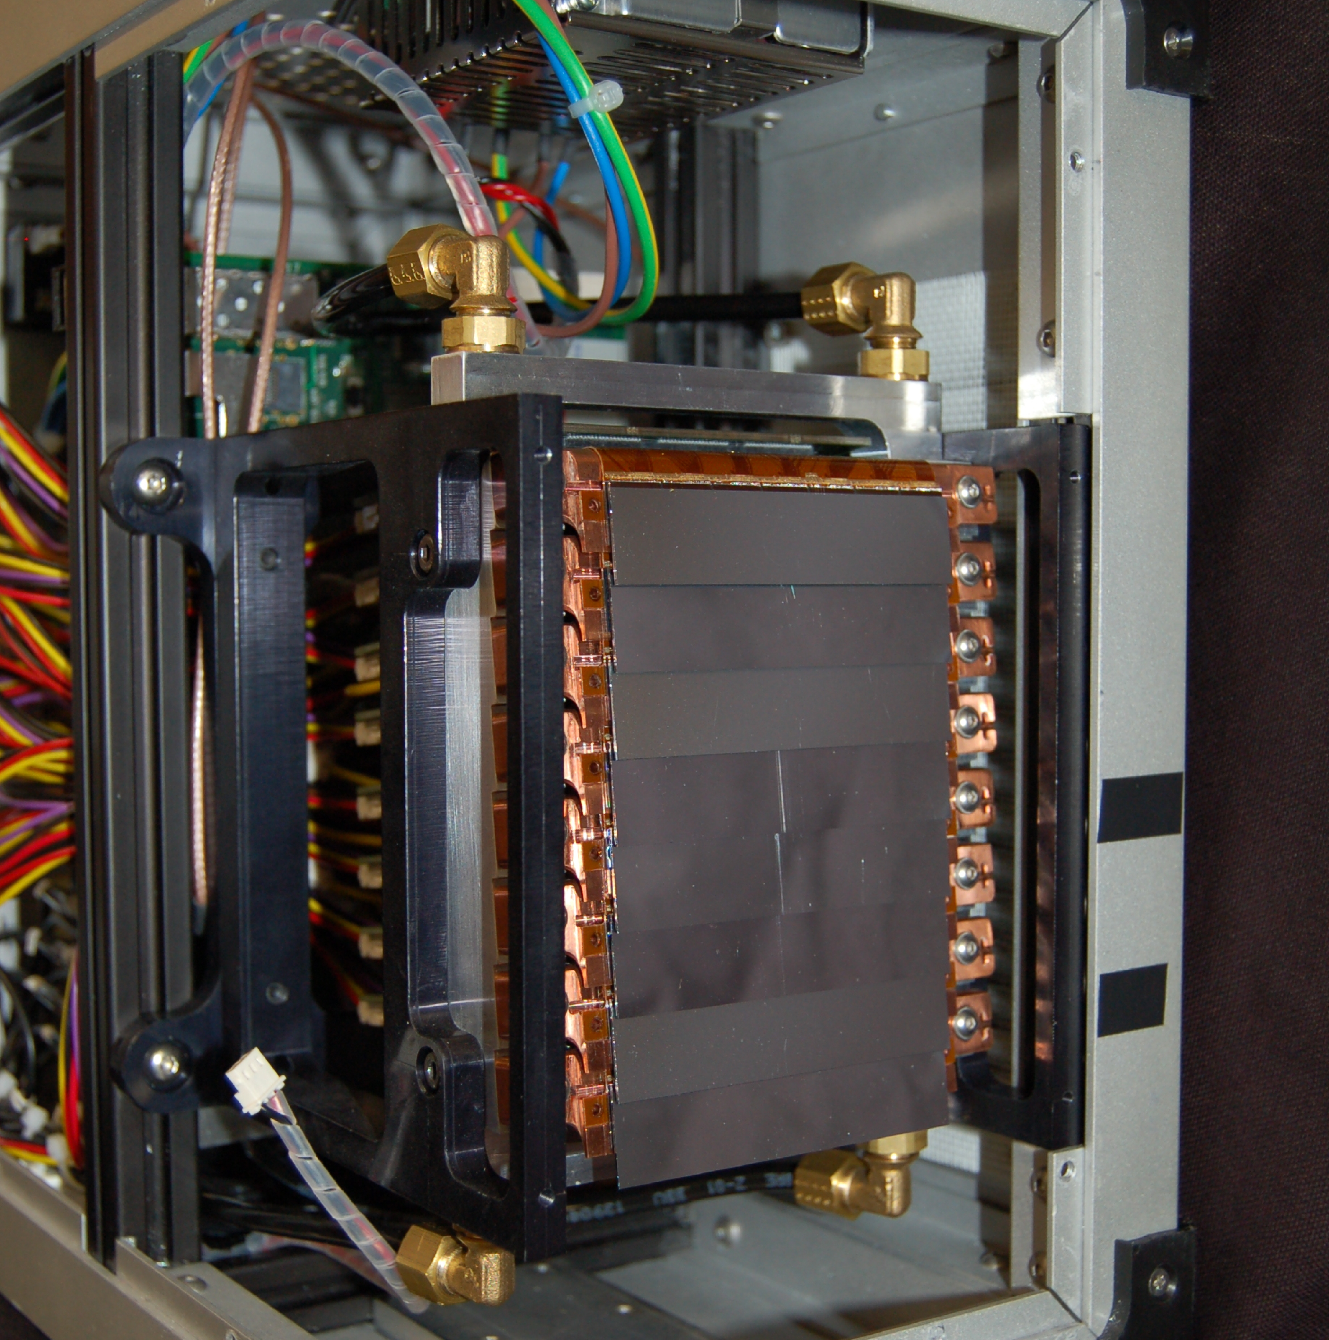
imXgam — X and gamma ray imaging
imXgam
PIXSCAN: Micro-CT prototype
Characterization of photon counting CT
Development of spectral CT
PIXSCAN I
XPAD2
PIXSCAN II
XPAD3
ClearPET/XPAD: Simultaneous PET/CT data acquisitions
ClearPET
(EPFL)
+
=
XPAD (CPPM)
Groupe imXgam
CleartPET/XPAD
5
Notes:
5
Groupe Evaluation AERES 13-14 janvier 2011

Slide 6
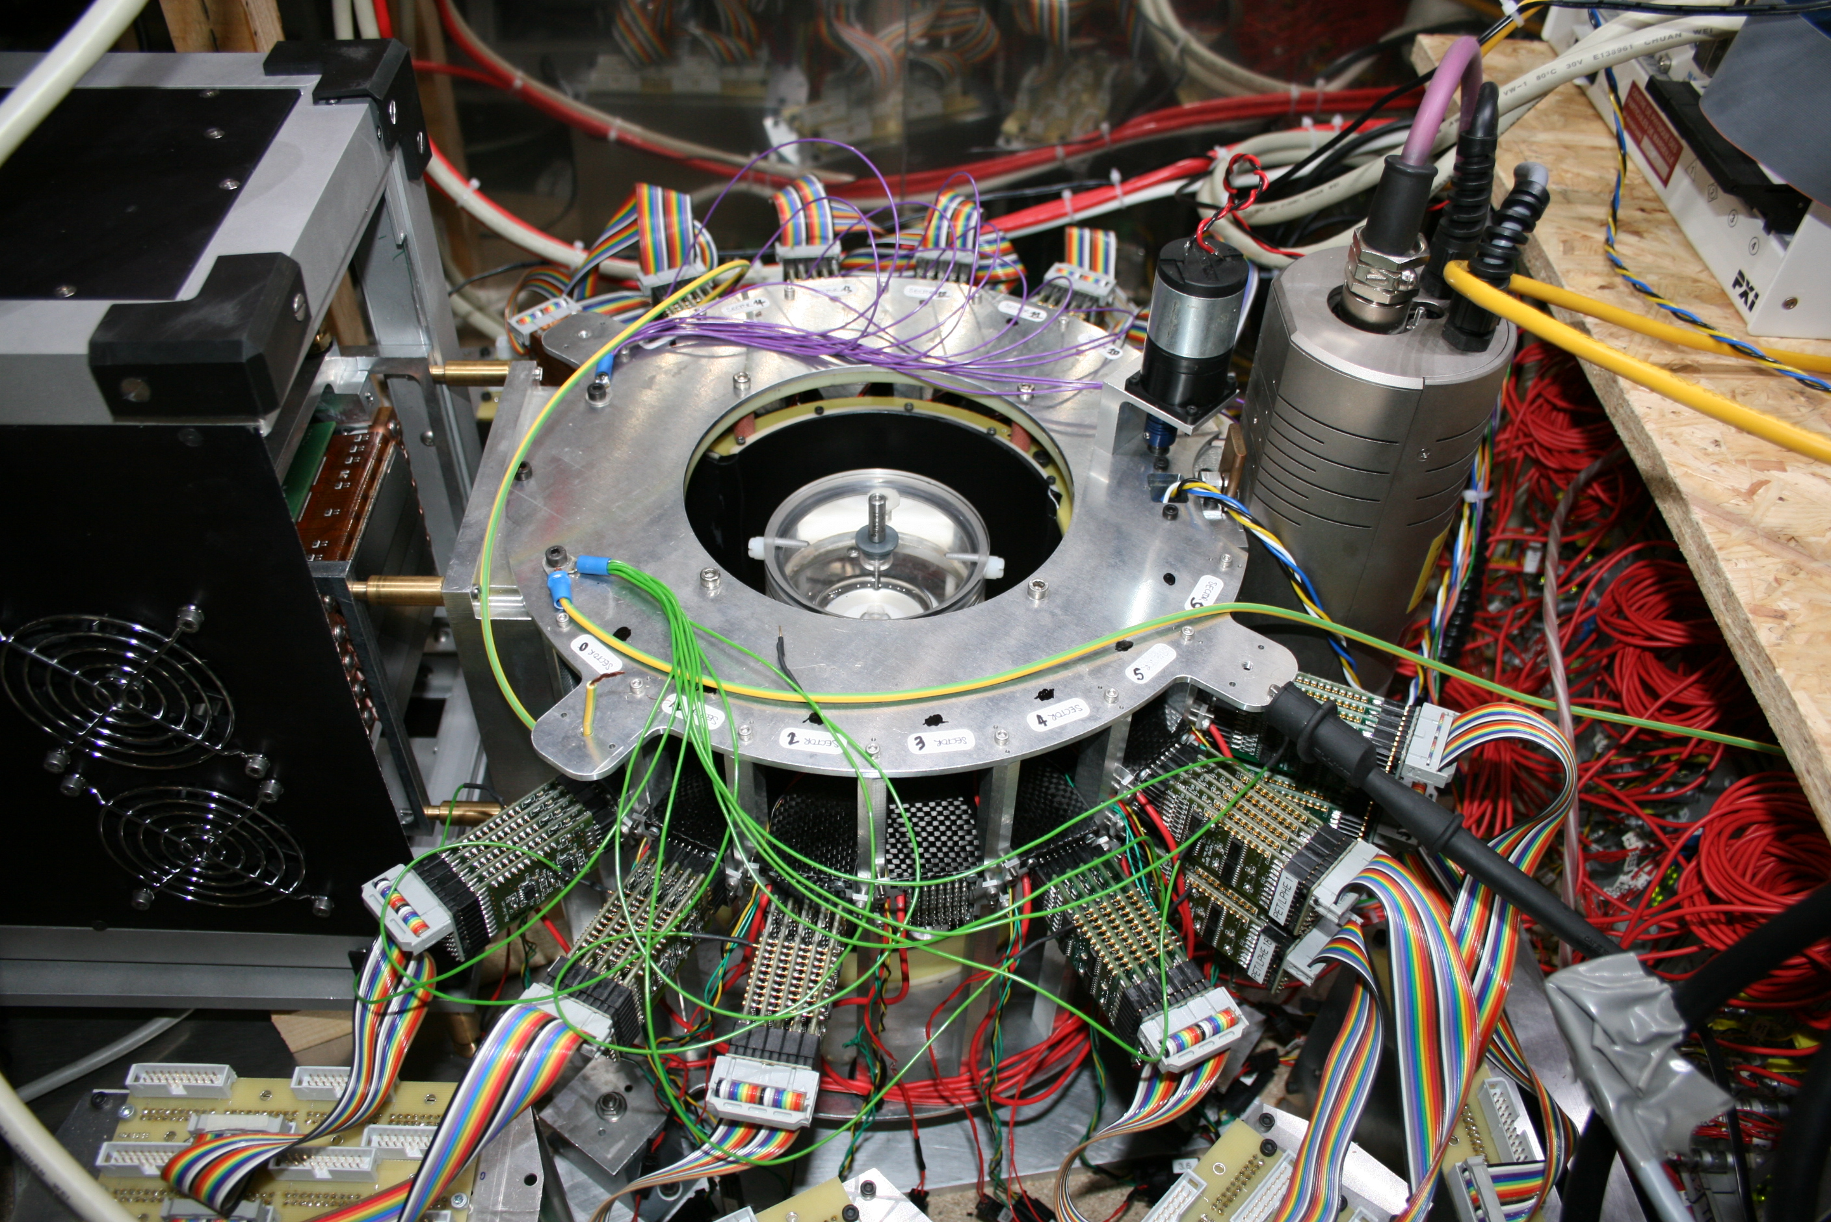
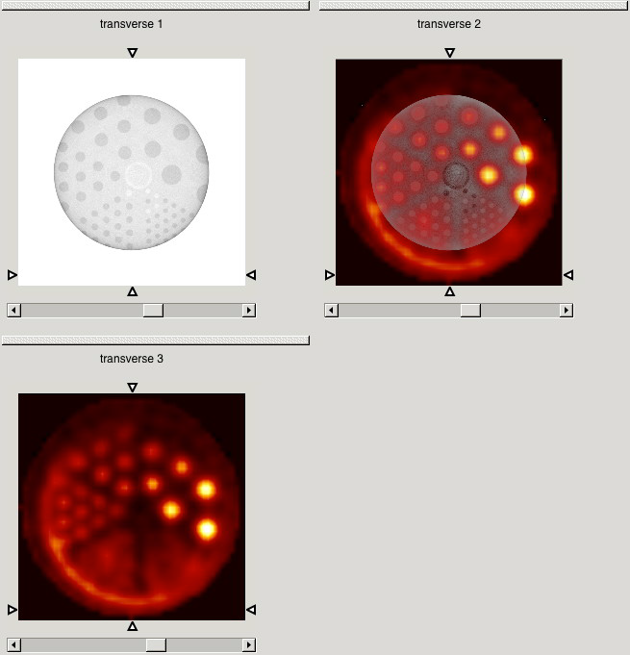
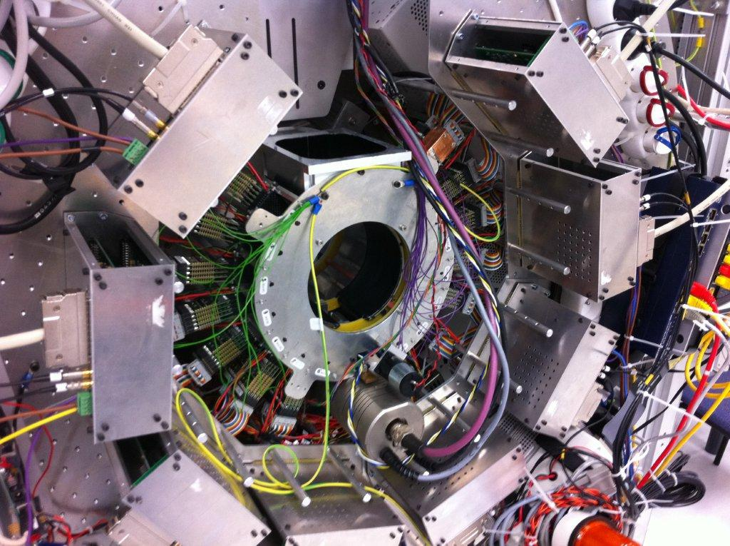
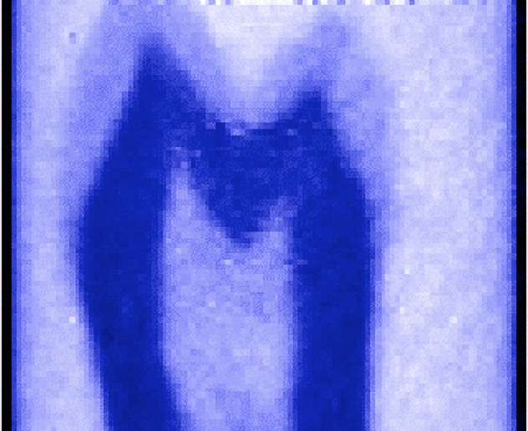
imXgam — X and gamma ray imaging
imXgam
ClearPET/XPAD
2009: Proof of concept of simultaneous PET/CT data acquisitions
M. Khodaverdi et al. Proc. IEEE NSS/MIC 2007
S. Nicol et al. Proc. IEEE NSS/MIC 2009
M. Hamonet et al. Proc. IEEE NSS/MIC 2015
Fantôme d’eau
Caméra
XPAD3
Tube à rayons X
Modules TEP
nPAD
2010: Neutron tomography of a tooth (HZ-Berlin)
F. Cassol et al. NIM A 634 (2011) 85-90
Team imXgam
6
Notes:
6
Groupe Evaluation AERES 13-14 janvier 2011

Slide 7
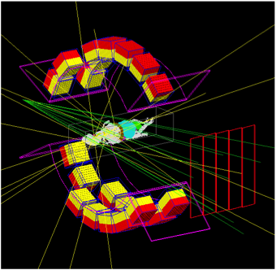
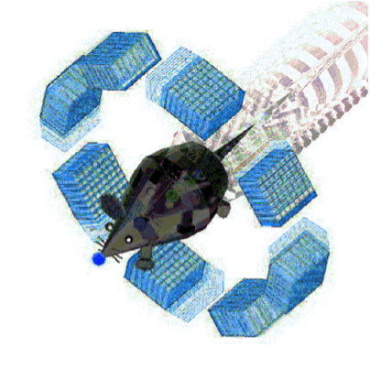
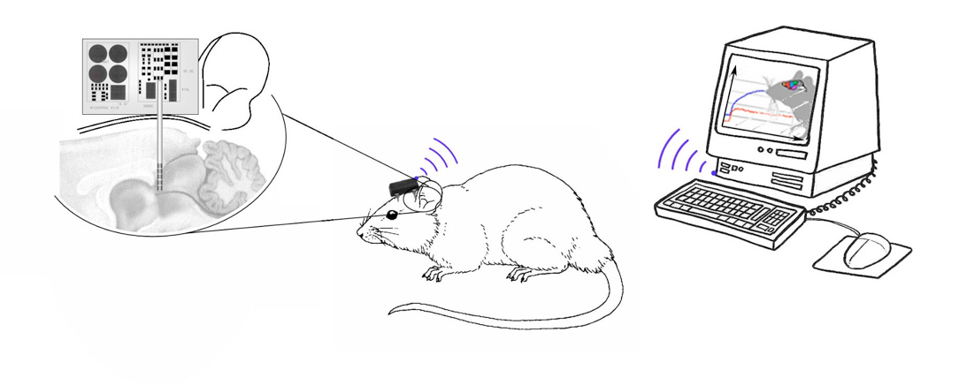
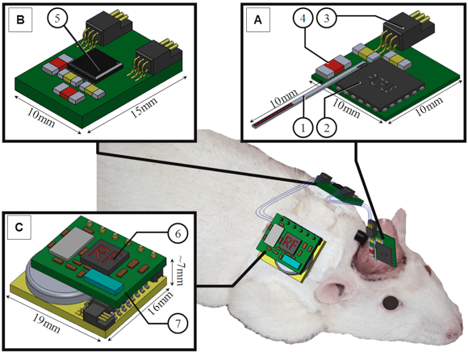
imXgam — X and gamma ray imaging
imXgam
Monte Carlo simulation:
fGATE: Optimization of the platform GATE
ANR CIS (2007-09)
IMNC, SHFJ, CPPM, Créatis
S. Jan et al. PMB 56 (2011) 881-901
hGATE: Monte Carlo simulation on GPU
ANR COSI, U2 (2010-12)
LaTIM, IMNC, SHFJ, CPPM, Créatis, IPHC
J. Bert et al. PMB 58 (2013) 5593-5611
Development of an intracranial multi-pixel Si probe
PIXSIC: Pixelized Si probe for the study of freely moving rats
ANR BLANC (2010-12)
IMNC, CPPM, CERMEP, CNPS
J. Maerk et al. PMB 58 (2013) 4483-4500
Team imXgam
7
Notes:
7
Groupe Evaluation AERES 13-14 janvier 2011

Slide 8
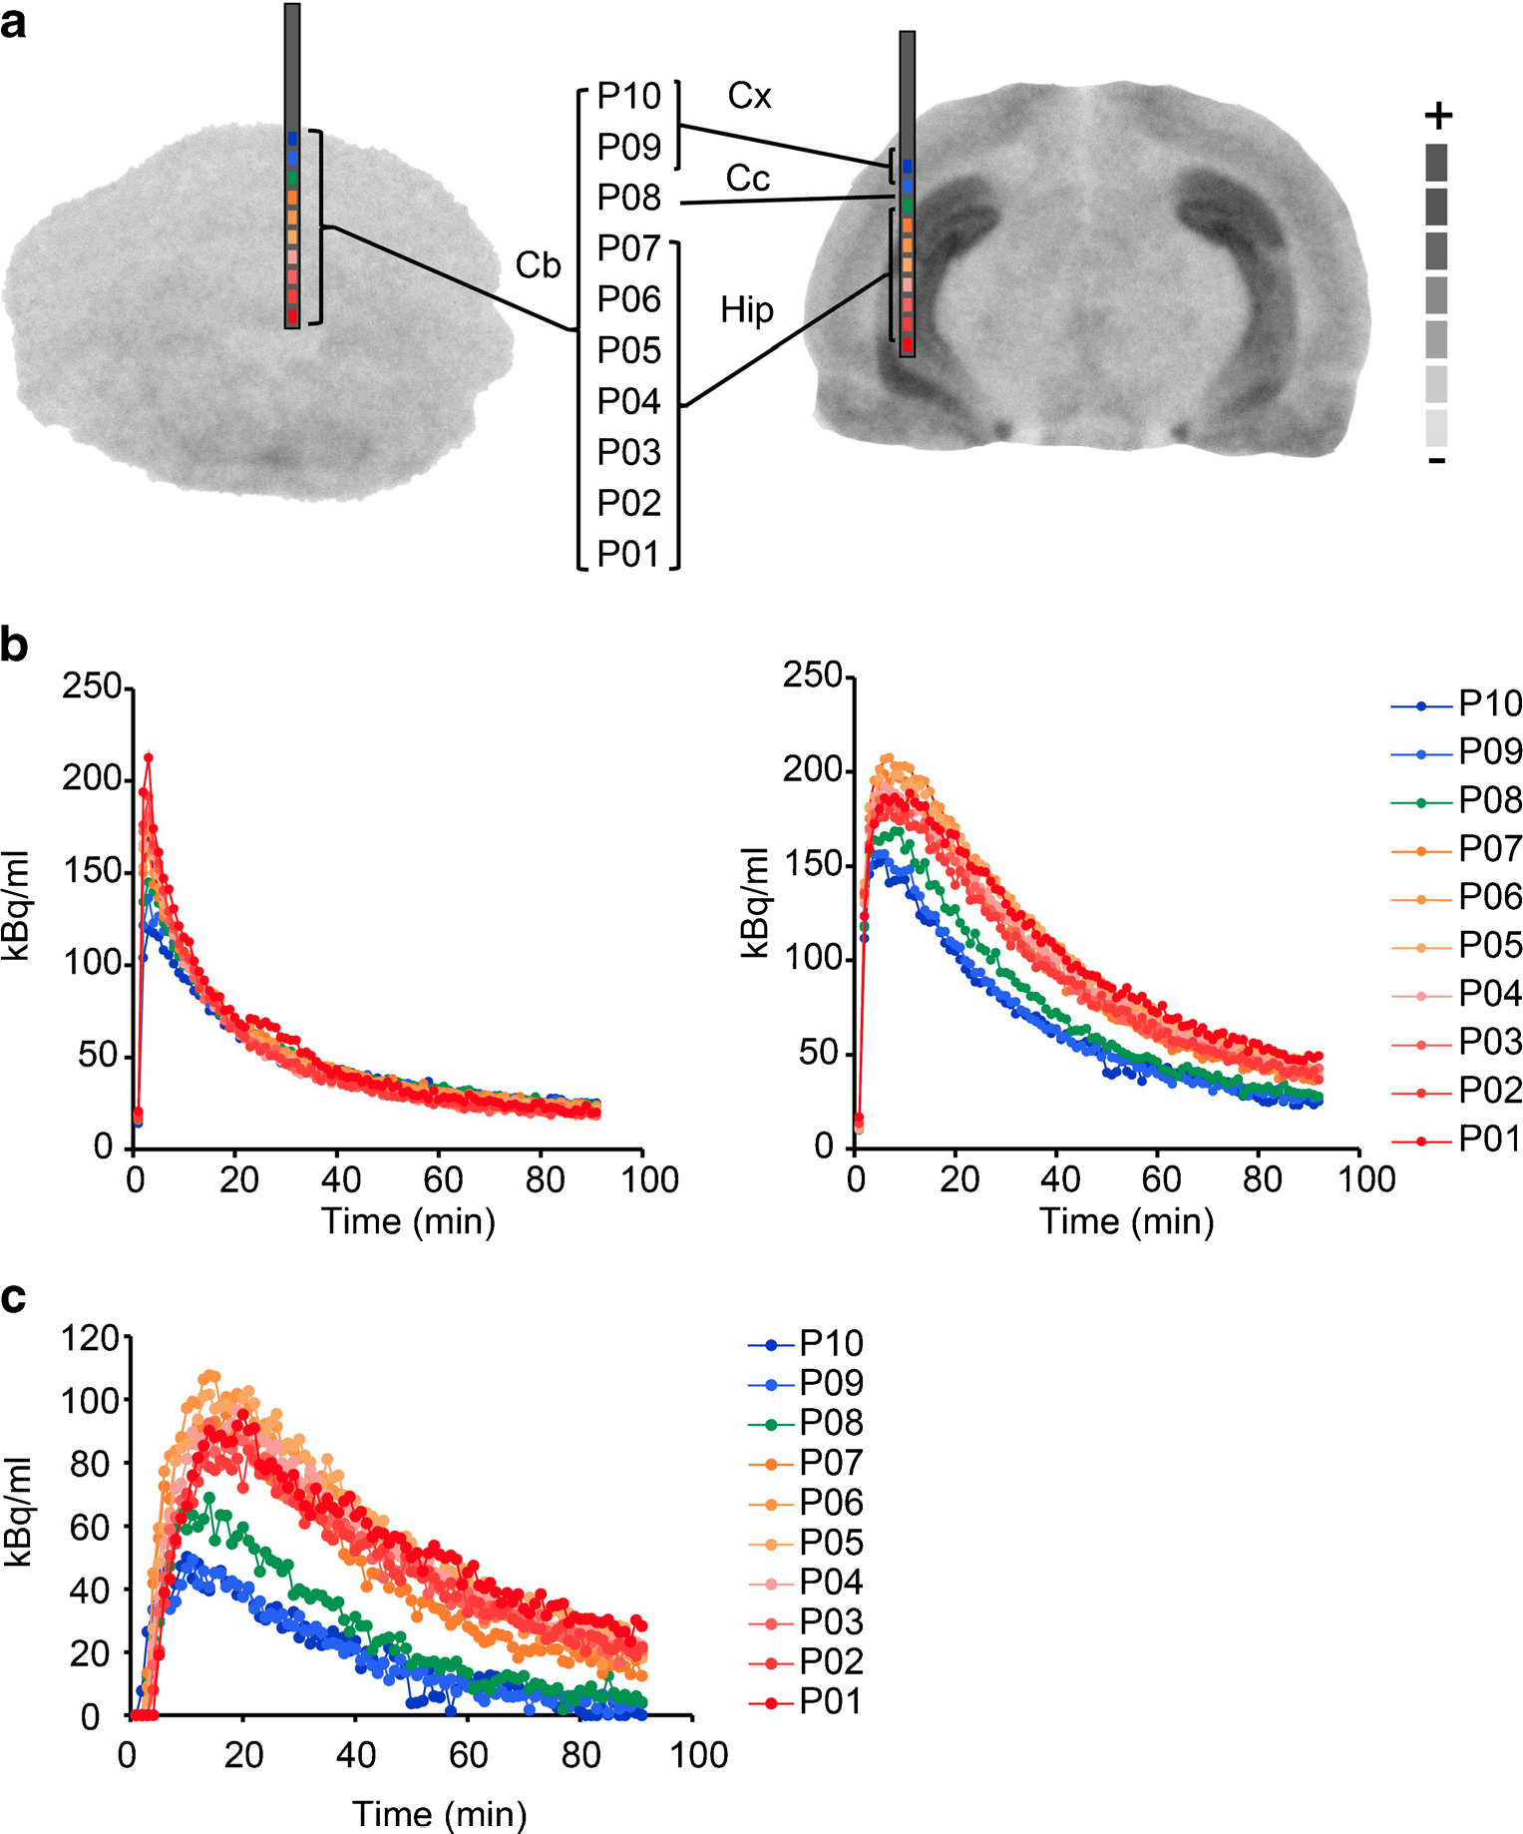
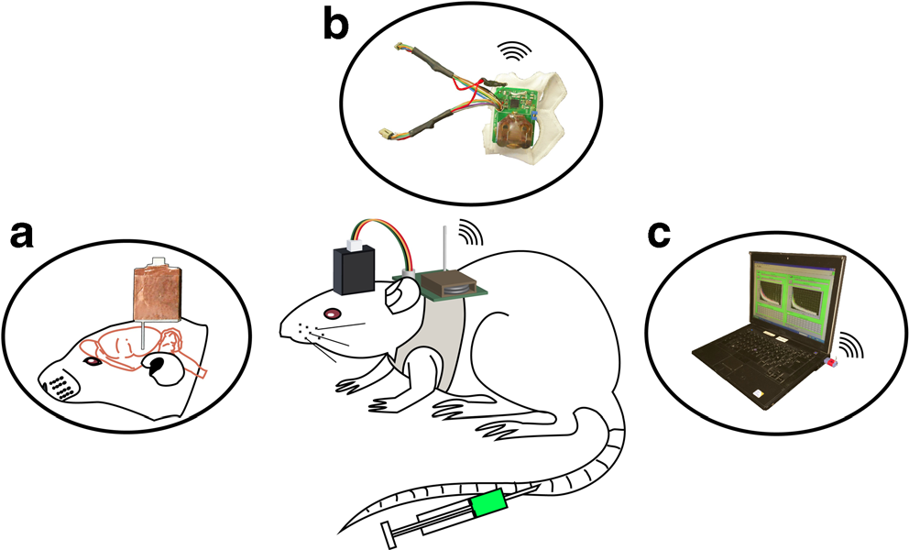
PIXSIC : multi-pixel positron probe
imXgam
Development of a multi-pixel Si probe for brain studies in awake and freely moving rats
Implantation hippocampus and cerebellum
[¹⁸F]MPPF serotonin receptor
L. Balasse et al. Mol Imaging Biol 17 (2014) 163-167
L. Balasse et al. Mol. Imaging 14 (2015) 484-489
Groupe imXgam
8
Notes:
8
Groupe Evaluation AERES 13-14 janvier 2011

Slide 9
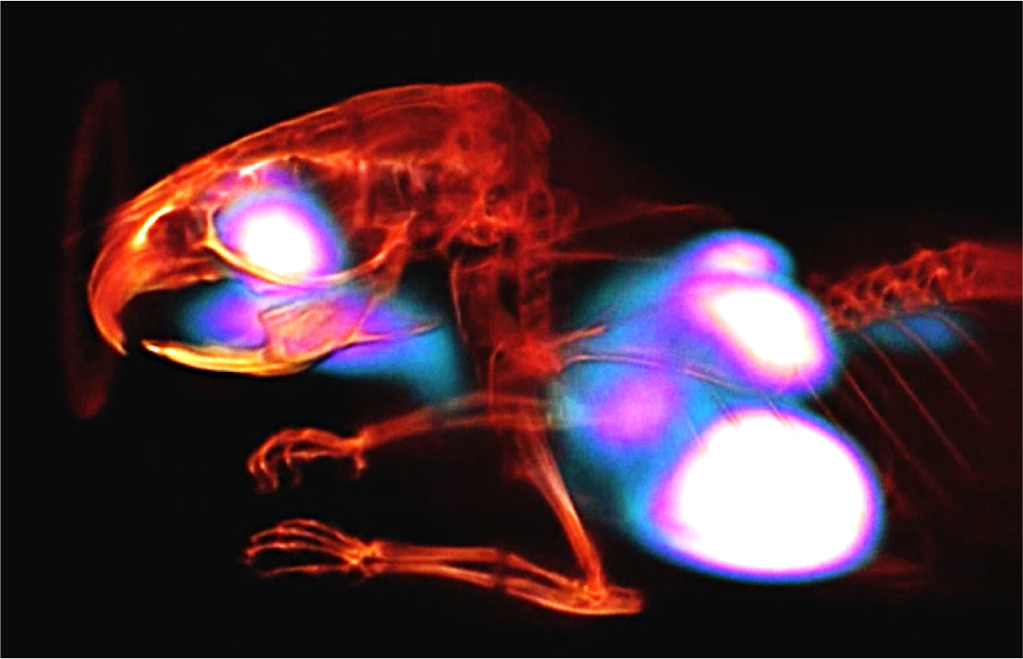
Team imXgam projects
imXgam
XPIX
2013: Livraison détecteurs D4-6 (XPAD3.2/Si)
2015: Premières images de D7 (XPAD3.2/CdTe) sur la ligne D2AM à l’ESRF
C. Buton et al. NIM A 758 (2014) 44-56
F. Cassol et al. JINST 10 (2015) C11010
PIXSCAN
2015: Comparaison de l’imagerie au K-edge avec du Si et du CdTe
F. Cassol et al. PMB 60 (2015) 5497-5511
F. Cassol et al. iWoRiD 2015, Jun 28-Jul 2, DESY, Hamburg, oral presentation
ClearPET/XPAD
2015: Premières images hybrides TEP/CT simultanées
M. Hamonet et al. Proc. IEEE NSS/MIC 2015, oral presentation best student paper session
Notes:
9
Groupe Evaluation AERES 13-14 janvier 2011

Slide 10
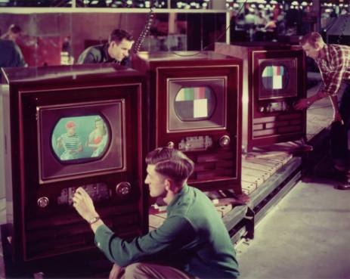
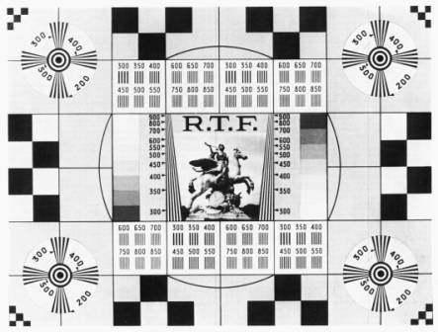
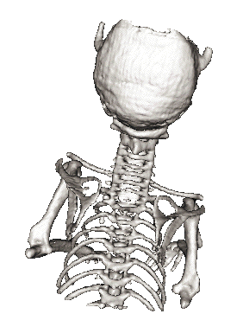
X-ray CT : soon from black and white to colour, thanks to hybrid pixels
Team imXgam
10

Slide 11
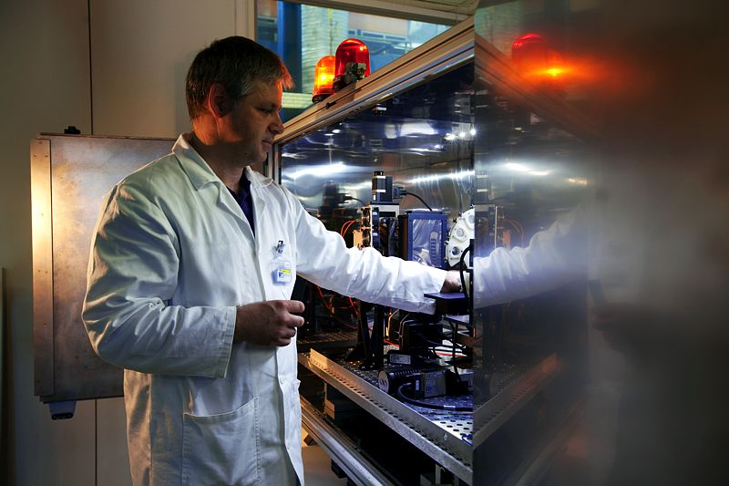
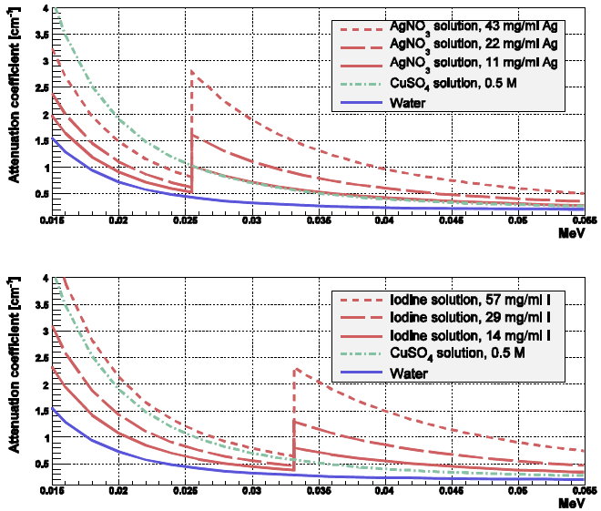
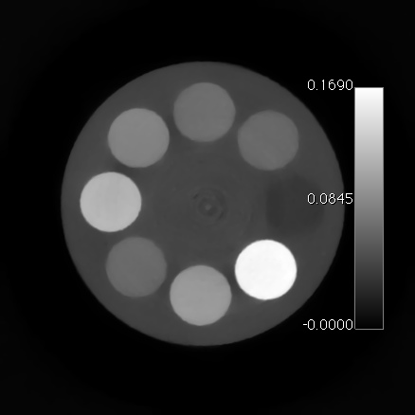
X-ray spectral-CT based on the detector XPAD3
I
CuSO₄
H₂O
AgNO₃
Team imXgam
11

Slide 12
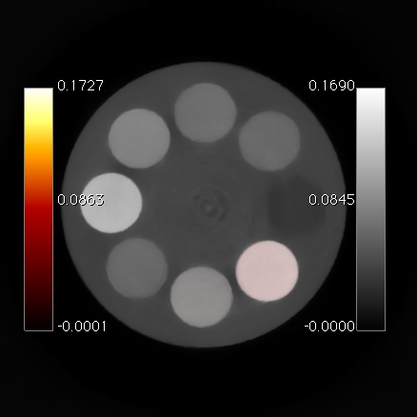
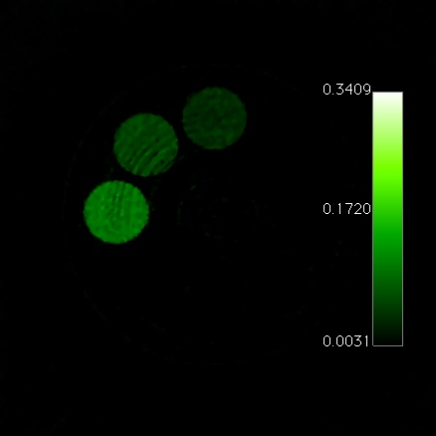
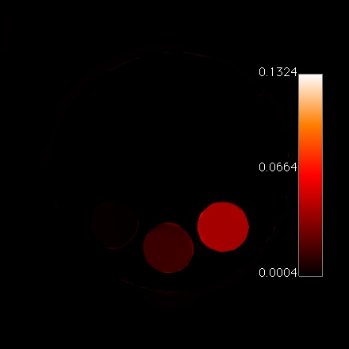
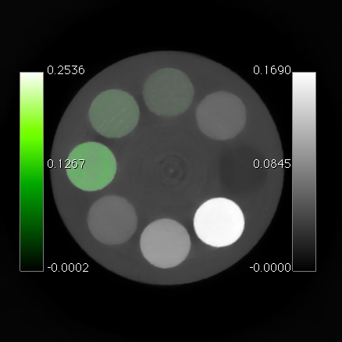
X-ray spectral-CT based on the detector XPAD3
Standard CT
K-edge imaging of iodine and silver
I
CuSO₄
H₂O
AgNO₃
(E_{2Ag}–E_{3Ag}) – (E_{1Ag}-E_{2Ag})
(E_{2I}–E_{3I}) – (E_{1I}-E_{2I})
Team imXgam
12

Slide 13
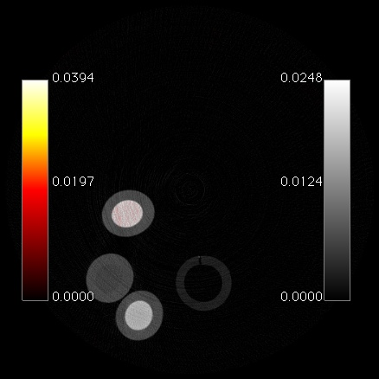
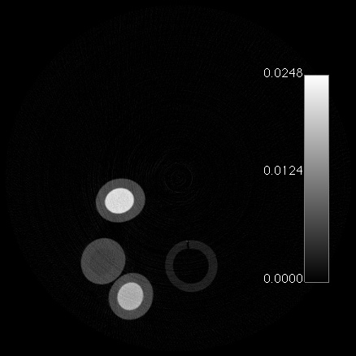
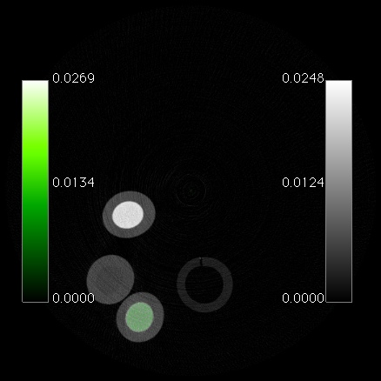
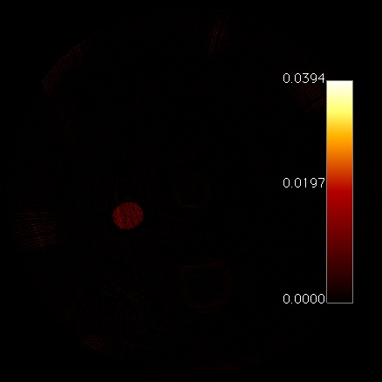
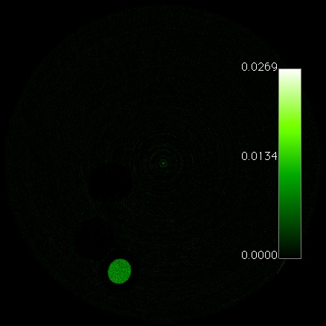
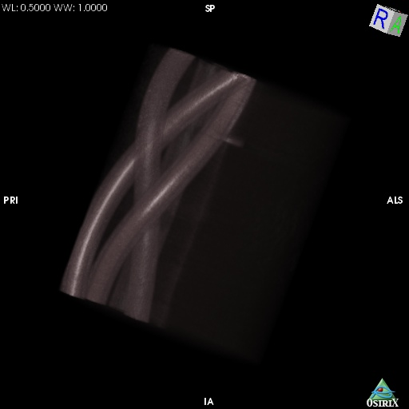
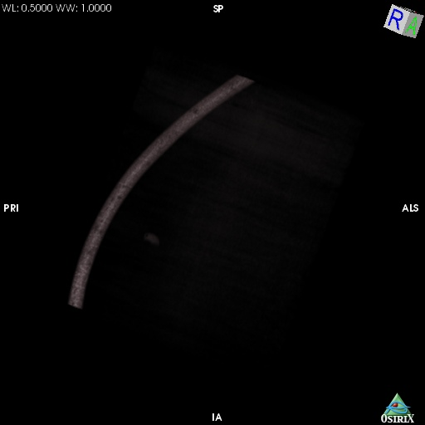
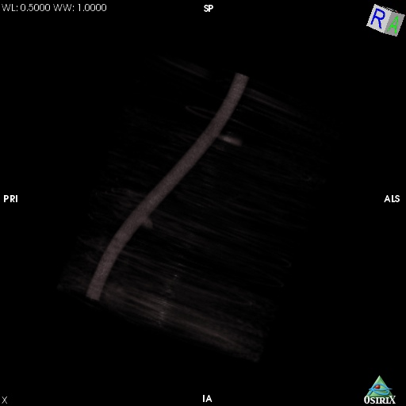
X-ray spectral-CT based on the detector XPAD3
Standard CT
K-edge imaging of iodine and silver
AgNO₃
(E_{2I}–E_{3I}) – (E_{1I}-E_{2I})
(E_{2Ag}–E_{3Ag}) – (E_{1Ag}-E_{2Ag})
CuSO₄
I
AgNO₃
I
Team imXgam
13

Slide 14
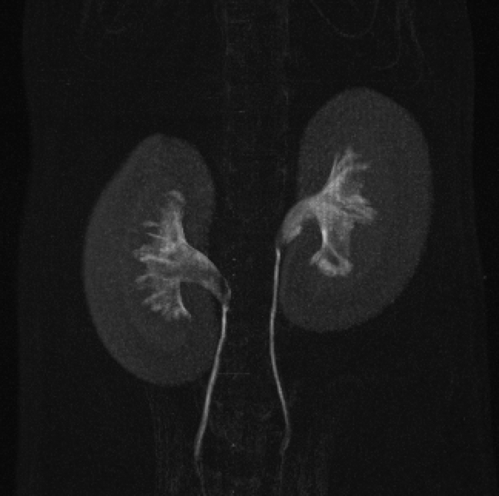
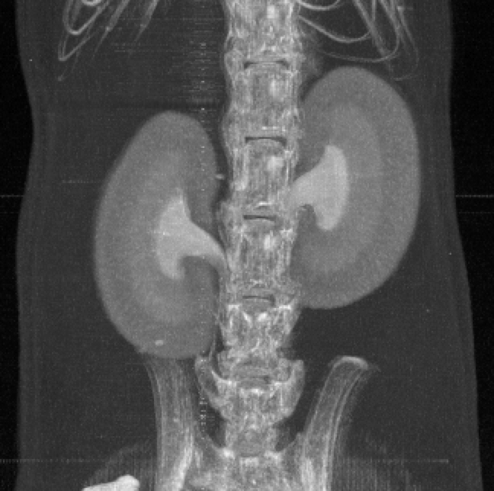
X-ray spectral CT using XPAD3
Standard abosprtion CT
Iodine K-edge imaging
Maxixmum intensity projection
Maxixmum intensity projection
200 µL injection of iomeron
Molybden anode X-ray tube
50 kVp, 30 W
100 µm Cu filtering
5 s/images
360 projections
Groupe imXgam
14

Slide 15
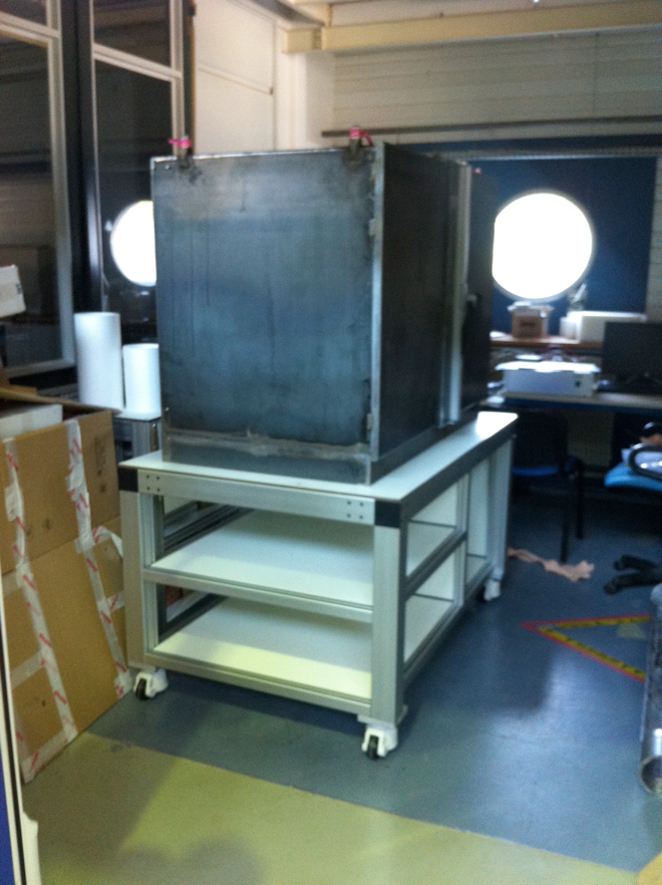
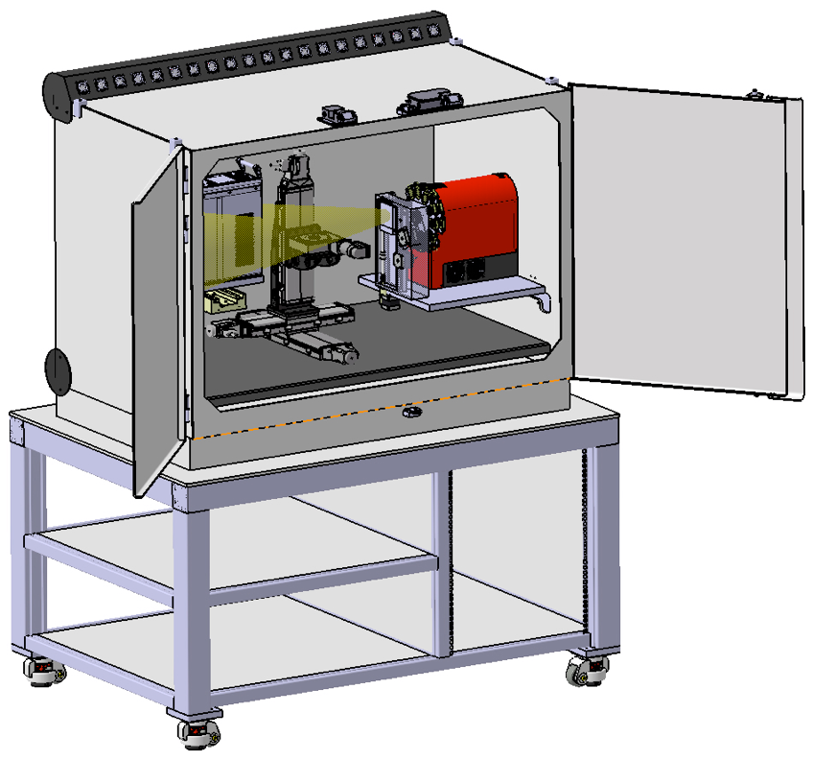
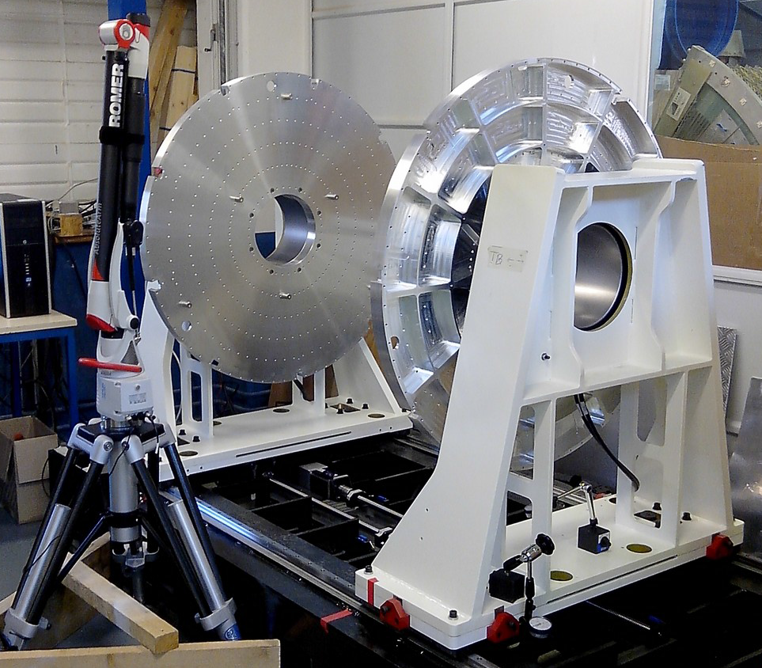
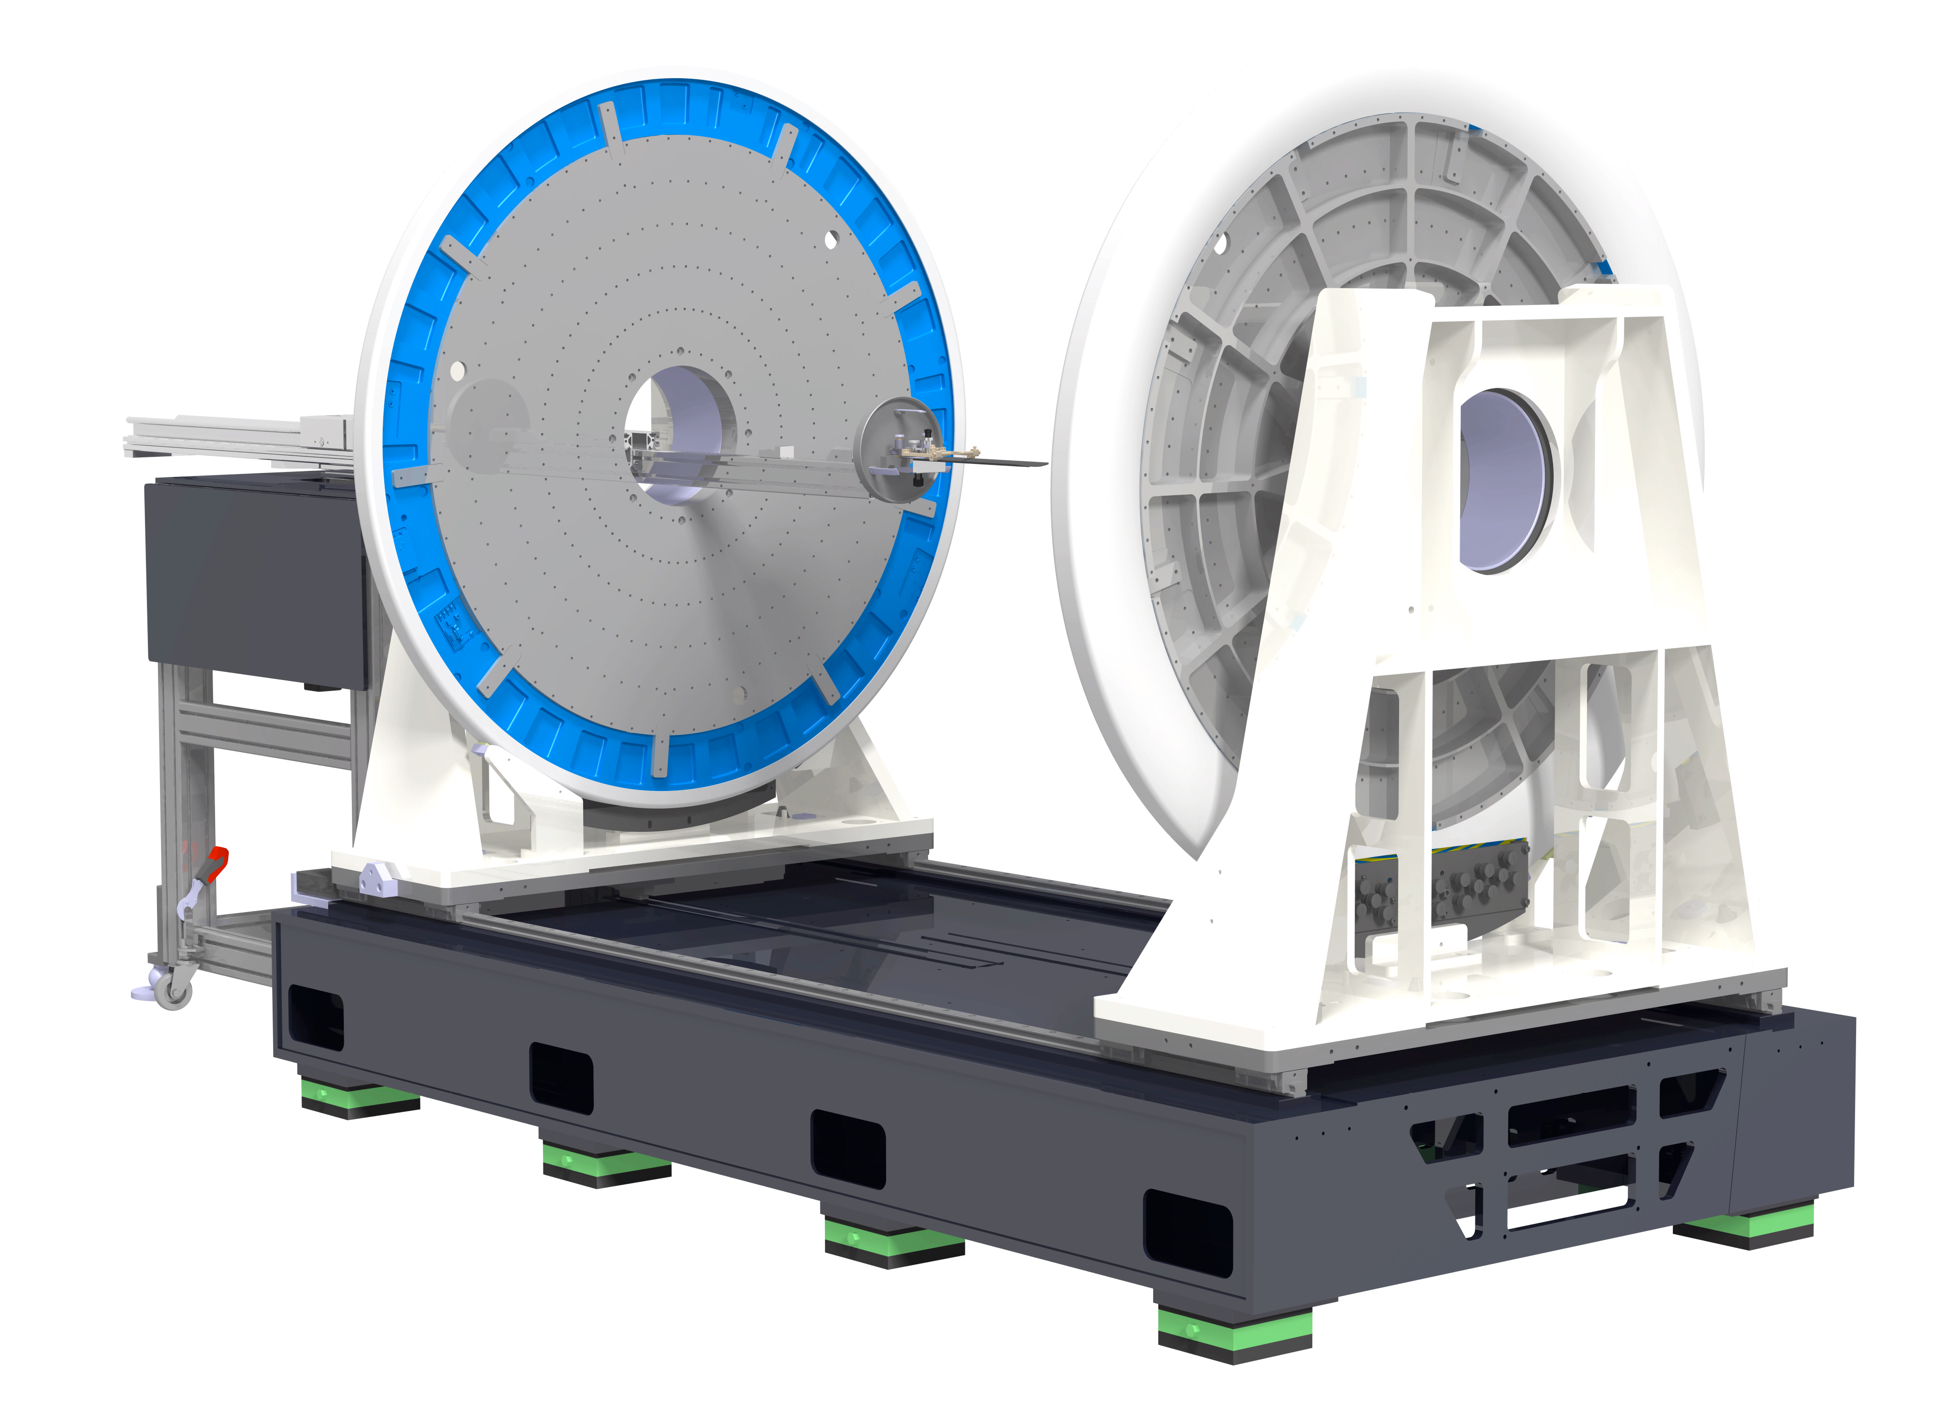
Team imXgam projects
imXgam
Infrastructure
Construction of the spectral micro-CT spectral prototype PIXSCAN-FLI → Post-doc: Mathieu Dupont (FLI, 2014-2016)
Construction of the rotating test bench tomXgam for experimentation in tomography
Team imXgam
15
Notes:
15
Groupe Evaluation AERES 13-14 janvier 2011

Slide 16
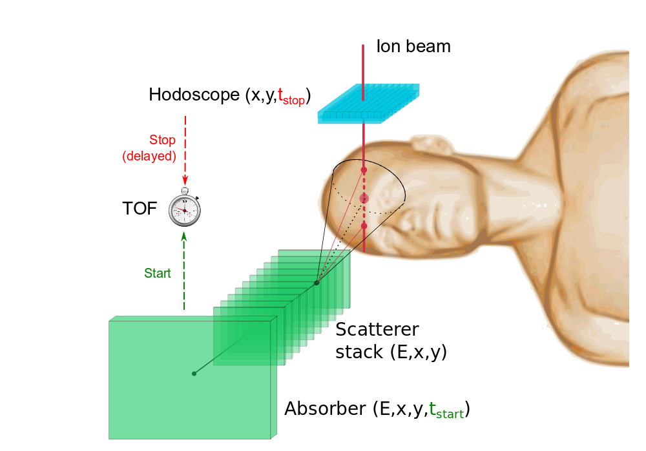
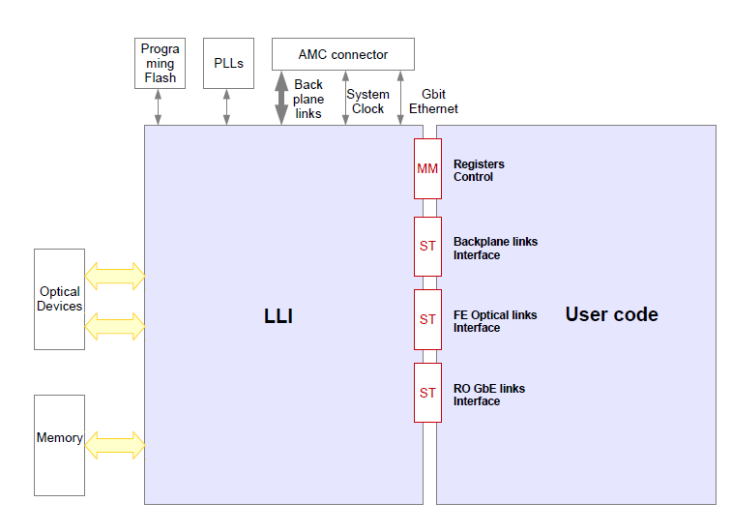
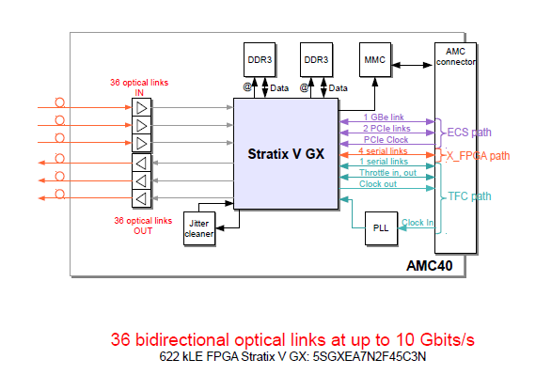
Team imXgam projects
imXgam
ENVISION/ENTERVISION/ClaRyS
2015: Programmation du Low Level Interface des cartes µTCA AMC40
M. Rodo Bordera, mémoire de stage de fin d’étude d’ingénieur Mines St-Etienne
Notes:
16
Groupe Evaluation AERES 13-14 janvier 2011

Slide 17
Team imXgam projects
imXgam
R&D imaging
Spectral CT
K-edge imaging of Gd and Au with the camera ChiPSpeCT (XPAD3.2/CdTe) → Thesis: Loriane Portal (BDO CNRS/Region, 2014-2017)
Image reconstruction of sparse data → Thesis: Souhil Tairi (BDO CNRS/Region, 2015-2018)
R&D instrumentation
Hybrid pixels
Development of a double-threshold circuit (2-8 keV) for the disgnostic of toroidal and ion tempeature in a tokamak (PIIM, IRFM Cadarache, CPPM) → Post-doc: Amr Habib (Amidex DEmON, 2015-2017)
Team imXgam
17
Notes:
17
Groupe Evaluation AERES 13-14 janvier 2011

Slide 18
Team imXgam projects
imXgam
R&D instrumentation
DAQ
Programing of the µTCA DAQ boards AMC40 for dose delivery imaging in hadrontherapy → H2020 PHC-11 GaIn (IPNL, CPPM, Créatis: 2015?)
Development of a front-end acquisition bpour la loard for the SiPM readout with the ASIC PetitROC linked to the AMC40 boards → ANR ANDRA TEMPORAL (DAMAVAN Imaging, UT Troyes, Weeroc, Canberra, CPPM, 2016-2020)
Development of an ultra-fast TEP/IRM insert using the AMC40 boards
Team imXgam
18
Notes:
18
Groupe Evaluation AERES 13-14 janvier 2011

