Slide 1
Commissioning of the Pixel Detector after the IBL Insertion, and SUSY search using the Two Same Sign Leptons Channel
Mahmoud I. Alstaty
Supervisors: Farès Djama and Pascal Pralavorio
CPPM PhD Days
November, 25, 2015

Slide 2
The Pixel Detector and the Insertable B-Layer
Innermost tracking detector of ATLAS.
A semiconductor detector made of hybrid silicon modules.
Composed of two parts: the 3-L ATLAS Pixel Detector (3 barrel layers and 2 x 3 endcap disks), and a recently added innermost layer: Insertable B-Layer (IBL).
IBL insertion required a reduction of the diameter of the beam pipe (radius = 29 → 23.5 mm).
The IBL was installed in the center of ATLAS in May 2014.

Slide 3
Motivations for the IBL Insertion
Preservation of high performance of the Pixel detector despite the radiation damage, especially relevant in the B-Layer, which was the innermost layer in Run 1.
Enhancement of tracking robustness and precision of the Inner Detector.
Improvement of vertexing and b-tagging performance, even in the foreseen conditions of higher radiation doses, pile-up and luminosity.
Requirement to get higher sensitivity for signals in physics channels involving b-jets.

Slide 4
The IBL Facts
14 staves, full azimuthal hermeticity.
Two sensor technologies:
Planar sensors (double chip sensors, 12 per stave), based on the Run 1 Pixel detector design, with slim edge and thickness of 200 μm (produced by CiS).
3D sensors (single chip sensors, 8 per stave), used for the first time in a particle detector with thickness of 230 μm (produced by CNM and FBK).
32 FE-I4 readout chips per stave:
designed to cope with high radiation and high hit multiplicity.
26880 pixels/FE-I4 .
Pixel Size: 250x50 μm².

Slide 5
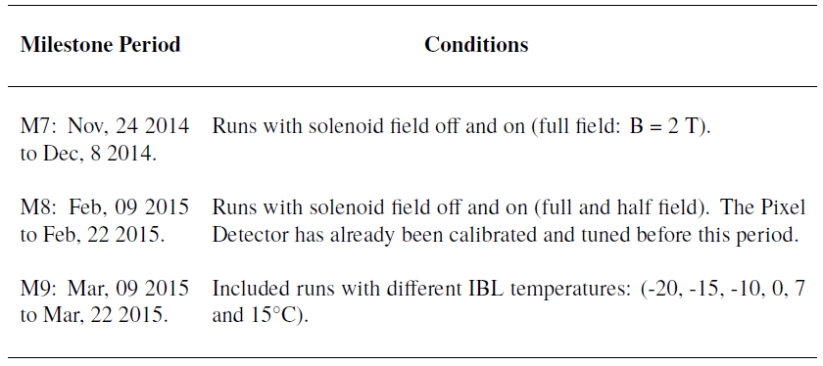
Cosmic Data Campaigns
Cosmic Data was analysed during several months on different detector conditions to test the detector response, and to help in the detector tuning and calibration.

Slide 6
Elements of the Analysis
Studying the different Pixel cluster properties, both in Pixel and IBL, such as:
Pixel Cluster Size: in eta and phi.
Pixel Cluster Charge: the charge collected in the silicon sensors after the passage of a charged particle.
Pixel Cluster Time over Threshold (ToT): measured in units of Bunch Crossing (BC), and it is defined as the time slot during which a pixel charge is higher than a given threshold.
Lorentz Angle: more details in next slides.

Slide 7
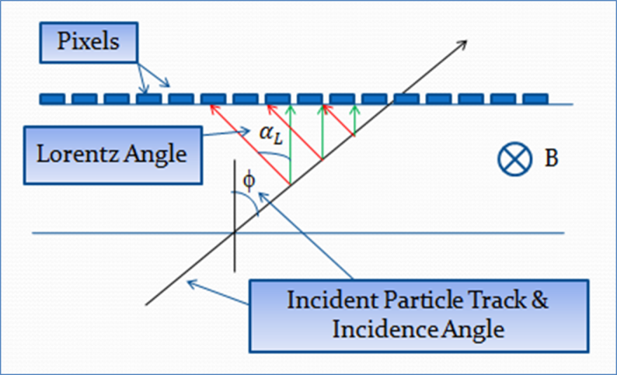
Lorentz Angle
Lorentz Angle $\left(α_{L}\right):$the angle by which the liberated electrons inside the silicon sensors are deflected by the magnetic field from their normal paths.
The electron mobility is temperature dependent. Consequently, $α_{L}$ is found to be inversely proportional to temperature.
Measuring $α_{L}$ is needed because it should be taken into account when determining the real particle track position depending on the pixel hits whose positions are affected by it.

Slide 8
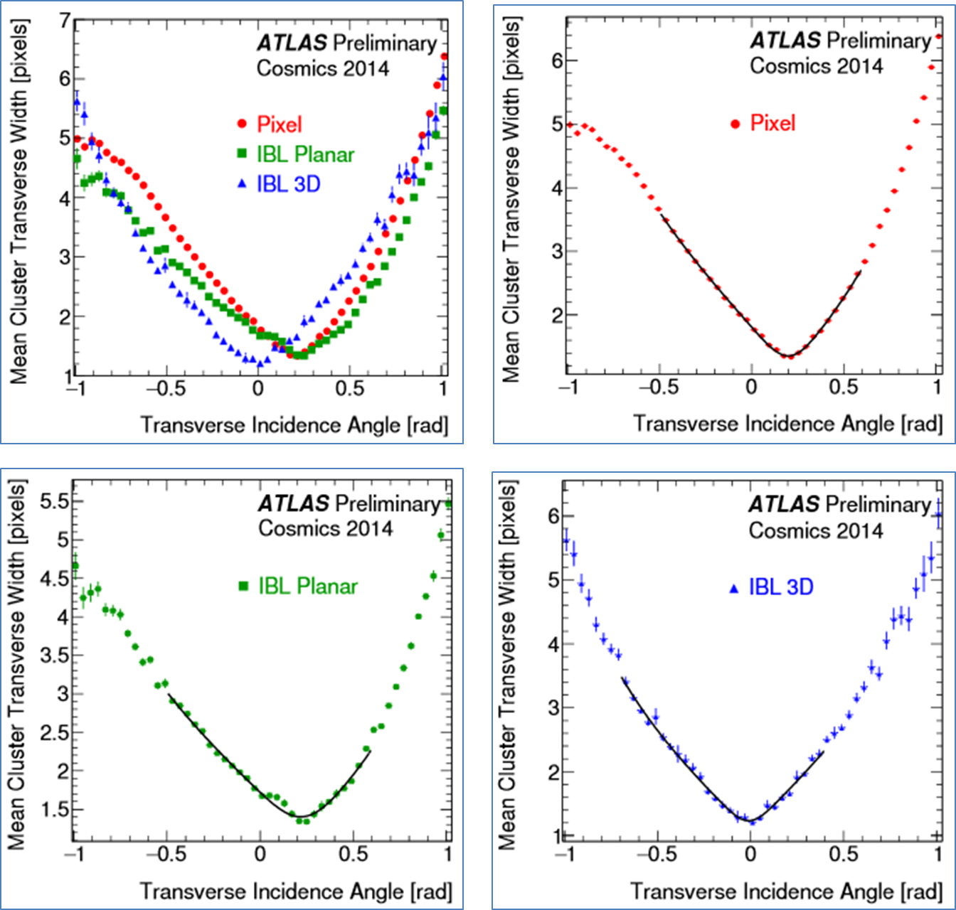
Measurement of Lorentz Angle (M7)

Slide 9
Lorentz Angle Fit (M7)

Slide 10
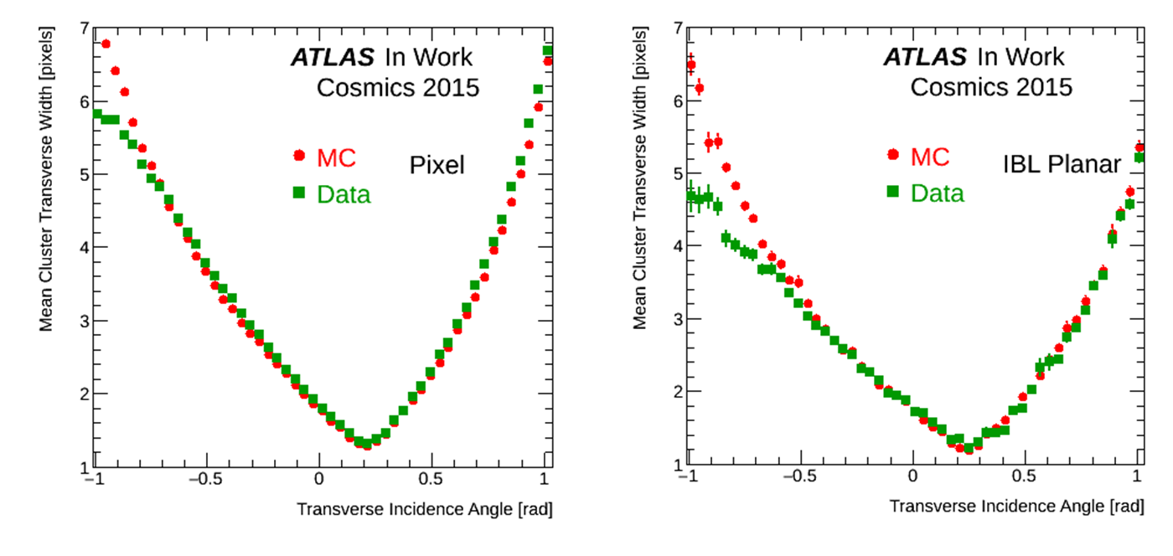
Lorentz Angle Data/MC (M9)
Comparisons between cosmic data and Monte Carlo (MC) is needed to tune MC and make it more realistic.
The Lorentz angle MC in Run 1 was scaled by 0.9 to match data. We confirmed that no additional scaling is needed.
The discrepancy between data and MC at large incidence angle is a well known observation from Run 1, and it shows that the cluster splitting due to threshold effect is stronger in data than in MC.

Slide 11
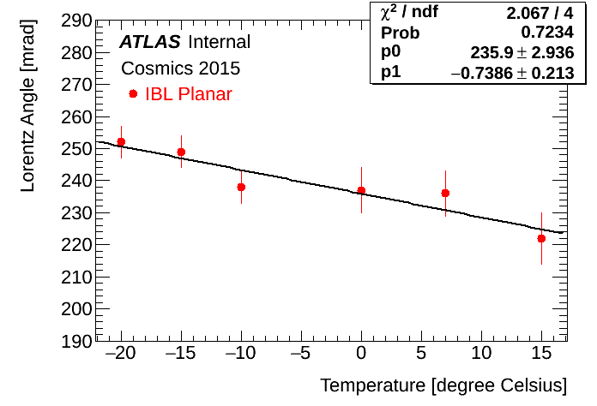
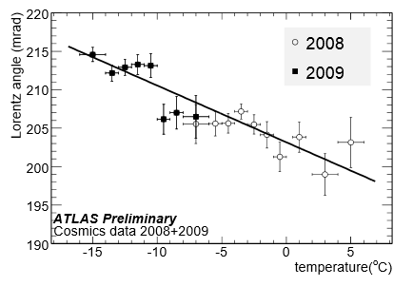
IBL Planar Lorentz Angle Vs Temp (M9)
Astonishing agreement:
The linear fit gives a slope of -0.74 ± 0.21 mrad/ºC for the IBL Planar in 2015.
The linear fit gave a slope of -0.74 ± 0.06 mrad/ºC for the Pixel layers in 2008-2009.

Slide 12
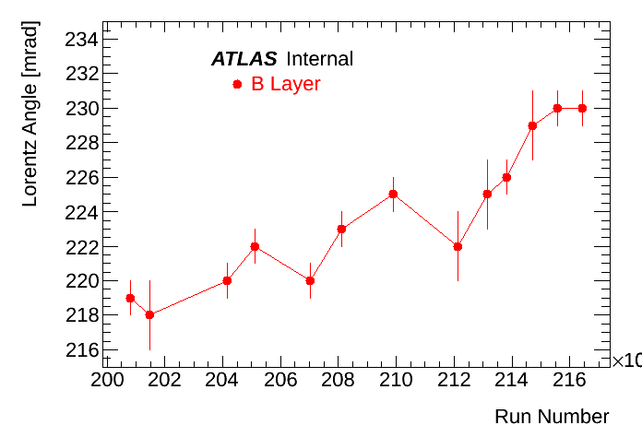
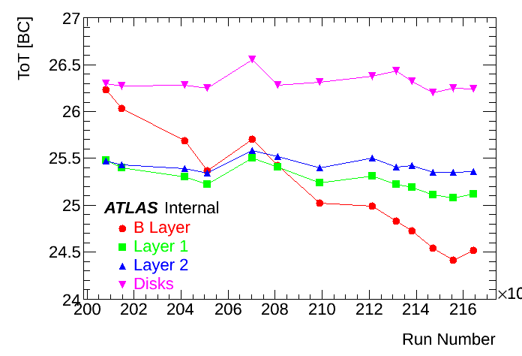
Ongoing study: The B Layer Evolution in Run 1
Some runs from 2012 (runs were chosen all along the 2012 data taking) were used. More runs from 2011 are to be added.
The depletion voltage increases with radiations. Lorentz angle increases with the total depletion voltage.
To study can the irradiation effect in the innermost layer at that time, and hence be able to test some irradiation models. We plan to write a note, which might become a paper, about this study.

Slide 13
Ongoing study: SUSY Analysis
Just started since two weeks in the SUSY Analysis (2lepton same-sign channel).
The two main subjects of my work will be :
Fake lepton estimation: one of the main background of this analysis.
Signal region optimization for 10fb-1.
My work is to be included in a CONF note with 10fb-1 of 13 TeV data at ICHEP 2016 conference.

Slide 14
Summary
Finished most of my detector oriented research (my qualification task). Already started writing this part of my thesis.
Just started my SUSY analysis part.
Goal is to produce some interesting SUSY results before next Summer, in order to show them in conferences.

