Slide 1
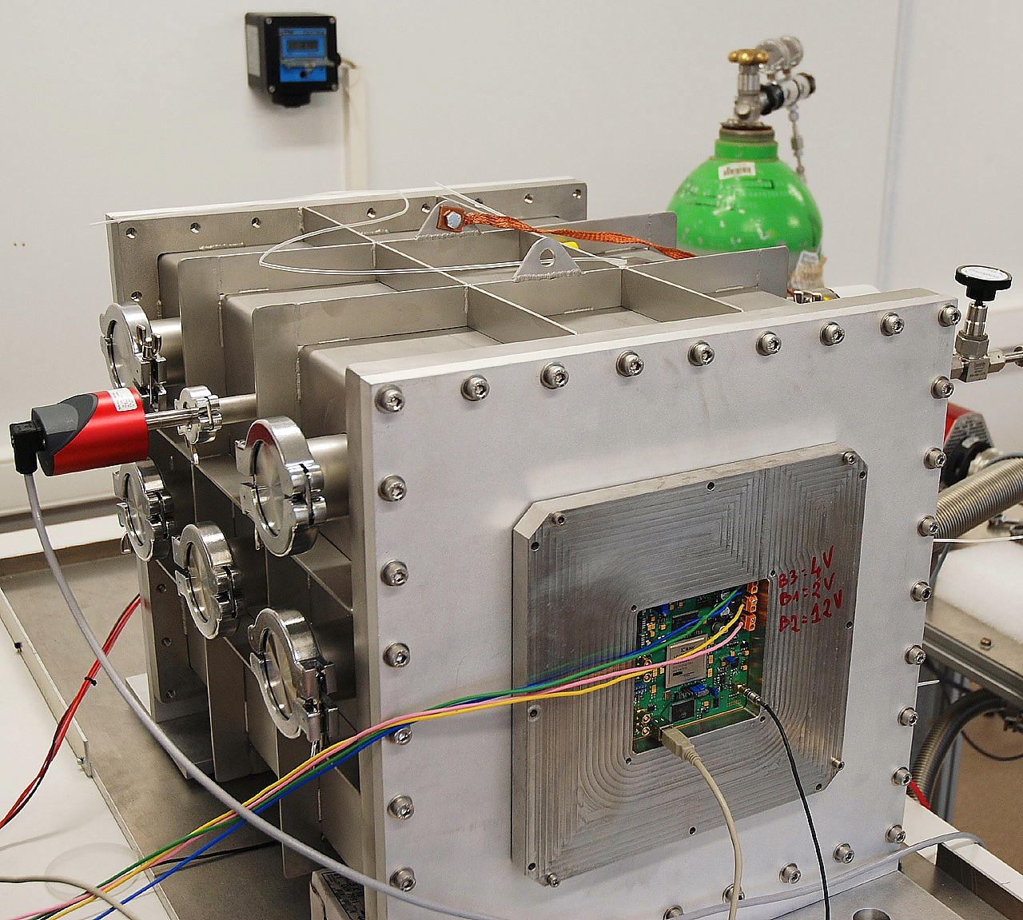
A portable and directional fast neutron detector MIMAC FASTn
Nadine Sauzet
Laboratoire de Physique Subatomique et de Cosmologie
(LPSC-Grenoble)
(UJF Grenoble 1, CNRS/IN2P3, Grenoble INP)
LABEX ENIGMASS –MIMAC valorization

Slide 2
Summary
Context
Valorization project strategy
Operational requirements overview
Technical development
Economic feasibility analysis

Slide 3
Project roots
MIMAC project (MIcro-TPC Matrix of Chambers) :
Instrumentation dedicated to directional non baryonic dark matter detection,
Developed at LPSC-Grenoble (electronics, gas system, data acquisition, mechanical structure, quenching measurements),
Fast neutrons constitute a background to reject.
So why not develop a fast neutron detector,
based on these concepts

Slide 4
Interest of a new fast neutron detector in the existing market
Presently, on the market, fast neutron detectors :
Require the use of ³He (limited supply) ou ⁶Li (regulated nuclear matter),
Require neutron moderation,
Can’t give quickly the energy of the fast neutron emitted,
Can’t give the emission direction,
Have a fix operation range.
MIMAC FastN can address all that !

Slide 5
Markets targeted
Homeland Security
Detection of neutron sources and fissile matters for customs
Medical sector
Neutron fields characterization (for BNCT or hadrontherapy)
Radioprotection
Radioactive area characterization,
Monitoring for mobile worksite,
Search of lost sources.
Nuclear physics
Neutron beams characterization
(for nuclear industry, neutronography, waste characterization )

Slide 6
Context
Valorization project strategy
Operational requirements overview
Technical development
Economic feasibility analysis

Slide 7
MIMAC valorization strategy (1)
Operational requirements
Technical specifications
Technical solutions, development, supply chain
DESIGN
Tests
Prototype assembly
Procurements
PROTOTYPE MANUFACTURING
Status today
Technological solutions validated
DEMO
for prospective customers

Slide 8
MIMAC valorization strategy (2)
Market analysis (competitors / customers)
Intellectual property
Economic feasability
Industrial prospective
Know-how transfer
?
Start-up

Slide 9
MIMAC valorization strategy (3)
Selected project in the frame of the DIRE prematuration program
Funding for :
A prototype manufacturing,
Market analysis and economic feasibility analysis support,
Software development.
Program duration :
One year
End : September, 2016

Slide 10
Context
Valorization project strategy
Operational requirements overview
Technical development
Economic feasibility analysis

Slide 11
MIMAC FastN requirements overview
Operation
Neutron spectrum reconstruction above 100 keV
Neutron source location
Energy range adaptable
Large detection volume
Adapted to industrial areas
Adapted to careless transport
Long duration operation
User friendly
Portable detector
Quick installation
« Press-button » operation
Limited maintenance
Manufacturing
No regulated matters
No high gas pressure
Industrial supplies

Slide 12
Fast neutrons detection principle (1)
Detection based on a nuclear recoil tracking, that results from the interaction between a neutron and a gas nucleus.
Gas mixture
Helium recoil
Neutron
Helium nucleus
Recoil _{Energy max} = 64 % _{Neutron Energy}

Slide 13
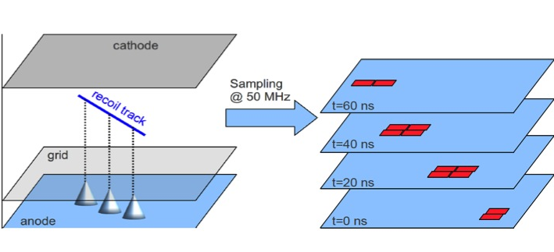
Detection principle (2)
Drift in a ionization chamber,
Gas amplification in a MicroMegas,
Readout on a pixelated anode, sampled roughly at 20 ns.

Slide 14
Gas choice (1)
MIMAC detector
MIMAC FASTn
Mixture of fluorinated gas and flammable gas
CF₄
CHF₃
C₄H₁₀
Mixture of non regulated and non-flammable gas
He
CO₂
Pressure around 700 mbar
Not compatible with industrial areas
Easy cheap supply

Slide 15
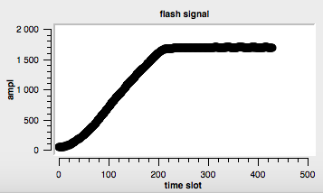
Gas choice (2)
Setting of the electrical parameters.
Typical neutron energy range = [120 keV ; 6 MeV]
Example of a recoil track with its associated measured energy in a He/CO₂ mixture :
Deposited energy

Slide 16
Helium recoils selection (1)
Objective :
Discriminate helium recoils (resulting from neutron/gas nucleus interaction), from electrons and other recoils
Origin of electrons :
Compton electrons resulting from gamma rays interaction with the detector walls,
β desintegration of nucleii intrinsic to the detector.
Origin of other recoils :
Carbon and oxygen recoils (constituent of the gas),
Protons recoils due to neutron reactions with aluminium.

Slide 17
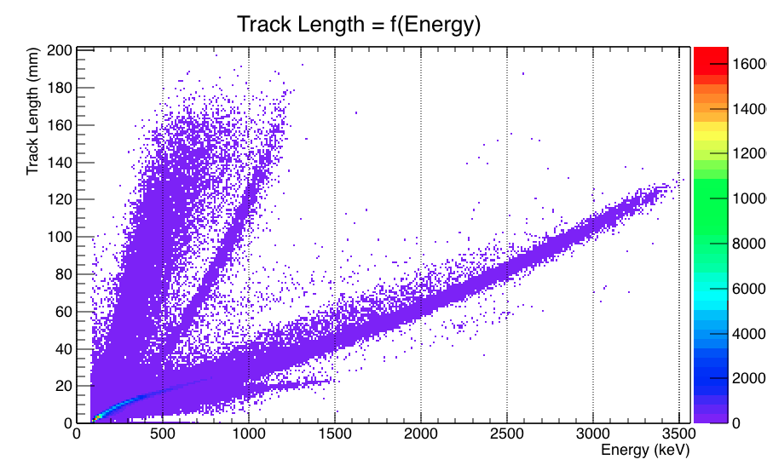
Helium recoils selection (2)
Neutron beam [ 100 keV ; 10 MeV ]
Proton recoils
Proton recoils
He recoils
Compton electrons
C and O recoils

Slide 18
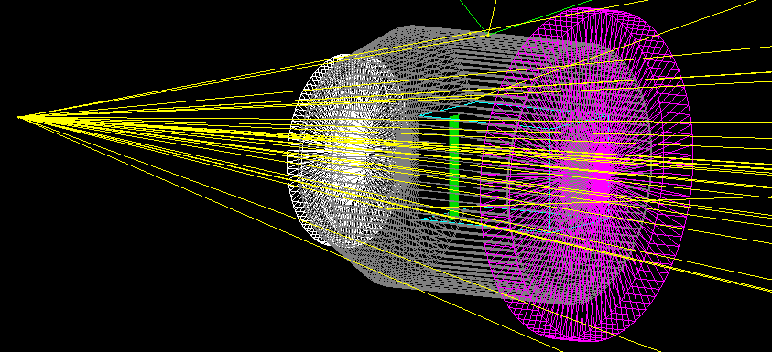
GEANT4 simulations (1)
Simulation set-up :
Cathode
Cage field
Neutron source
Micro-patterned detector

Slide 19
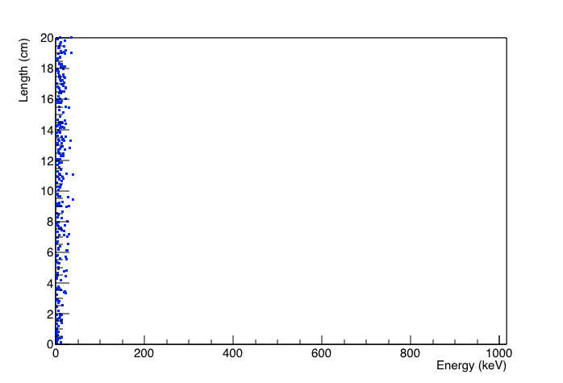
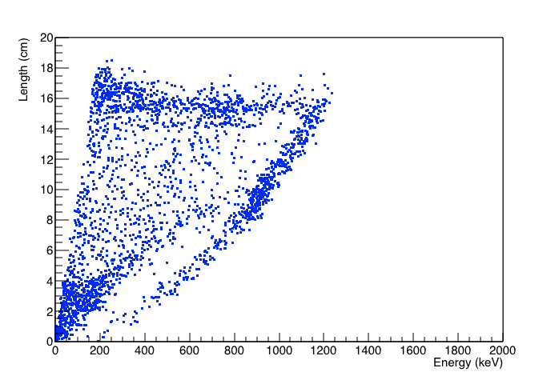
GEANT4 simulations (2)
Electron track length = f(energy)
Proton track length = f(energy)
Branch n° 1
Gamma induced branch
Branch n° 2

Slide 20
Energy calibration (1)
Exploitation of the neutron capture reaction : ¹⁰B(n,α)
with thermal and epithermal neutrons
¹⁰B + n ⁷Li* + α ⁷Li + α + γ (94 %)
¹⁰B + n ⁷Li + α (6 %)
Strategy :
Integration of a natural boron layer, inside the neutron detector,
Identification of the end-points of α and Li particles distributions.
Particule | Energy end-point | Track length max
94 %
α | 1,47 MeV | 4,1 cm
Li | 840 keV | 2,8 cm
6 %
α | 1,78 MeV | 5,2 cm
Li | 1,16 MeV | 3,3 cm

Slide 21
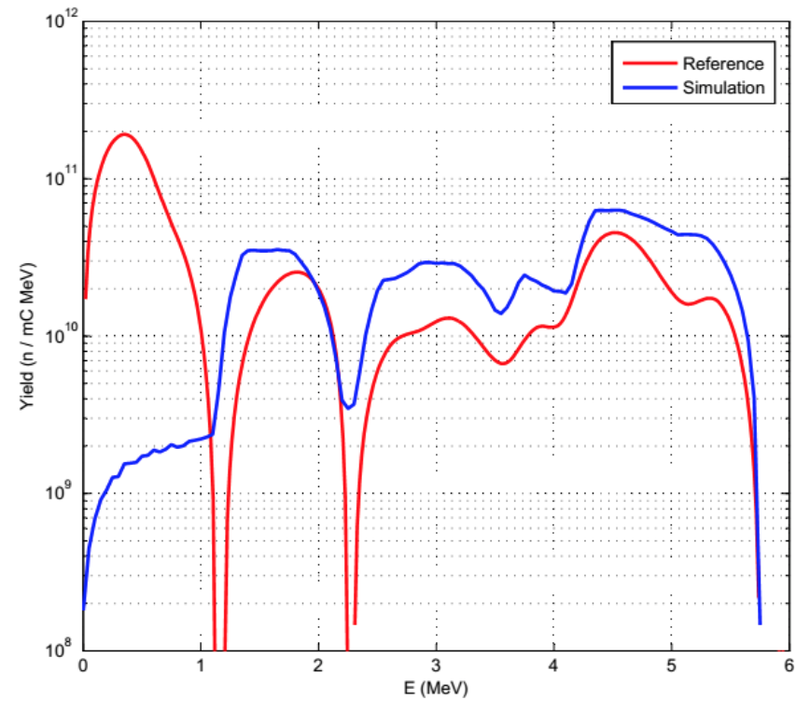
Energy calibration (2)
Experiment performed at INFN / Legnaro :
In collaboration with Buenos Aires, Grenoble, Cadarache, Legnaro, Sevilla
Objective :
Concept validation with a He/CO₂ mixture : faisability to build a fast neutron spectrum
Angular distribution measurement
Principle :
Deuteron beam of 1,45 MeV
A thin ⁹Be target of 10 μm
Neutron detector : IRSN detector, adapted for operation with He/CO₂ gas mixture.

Slide 22
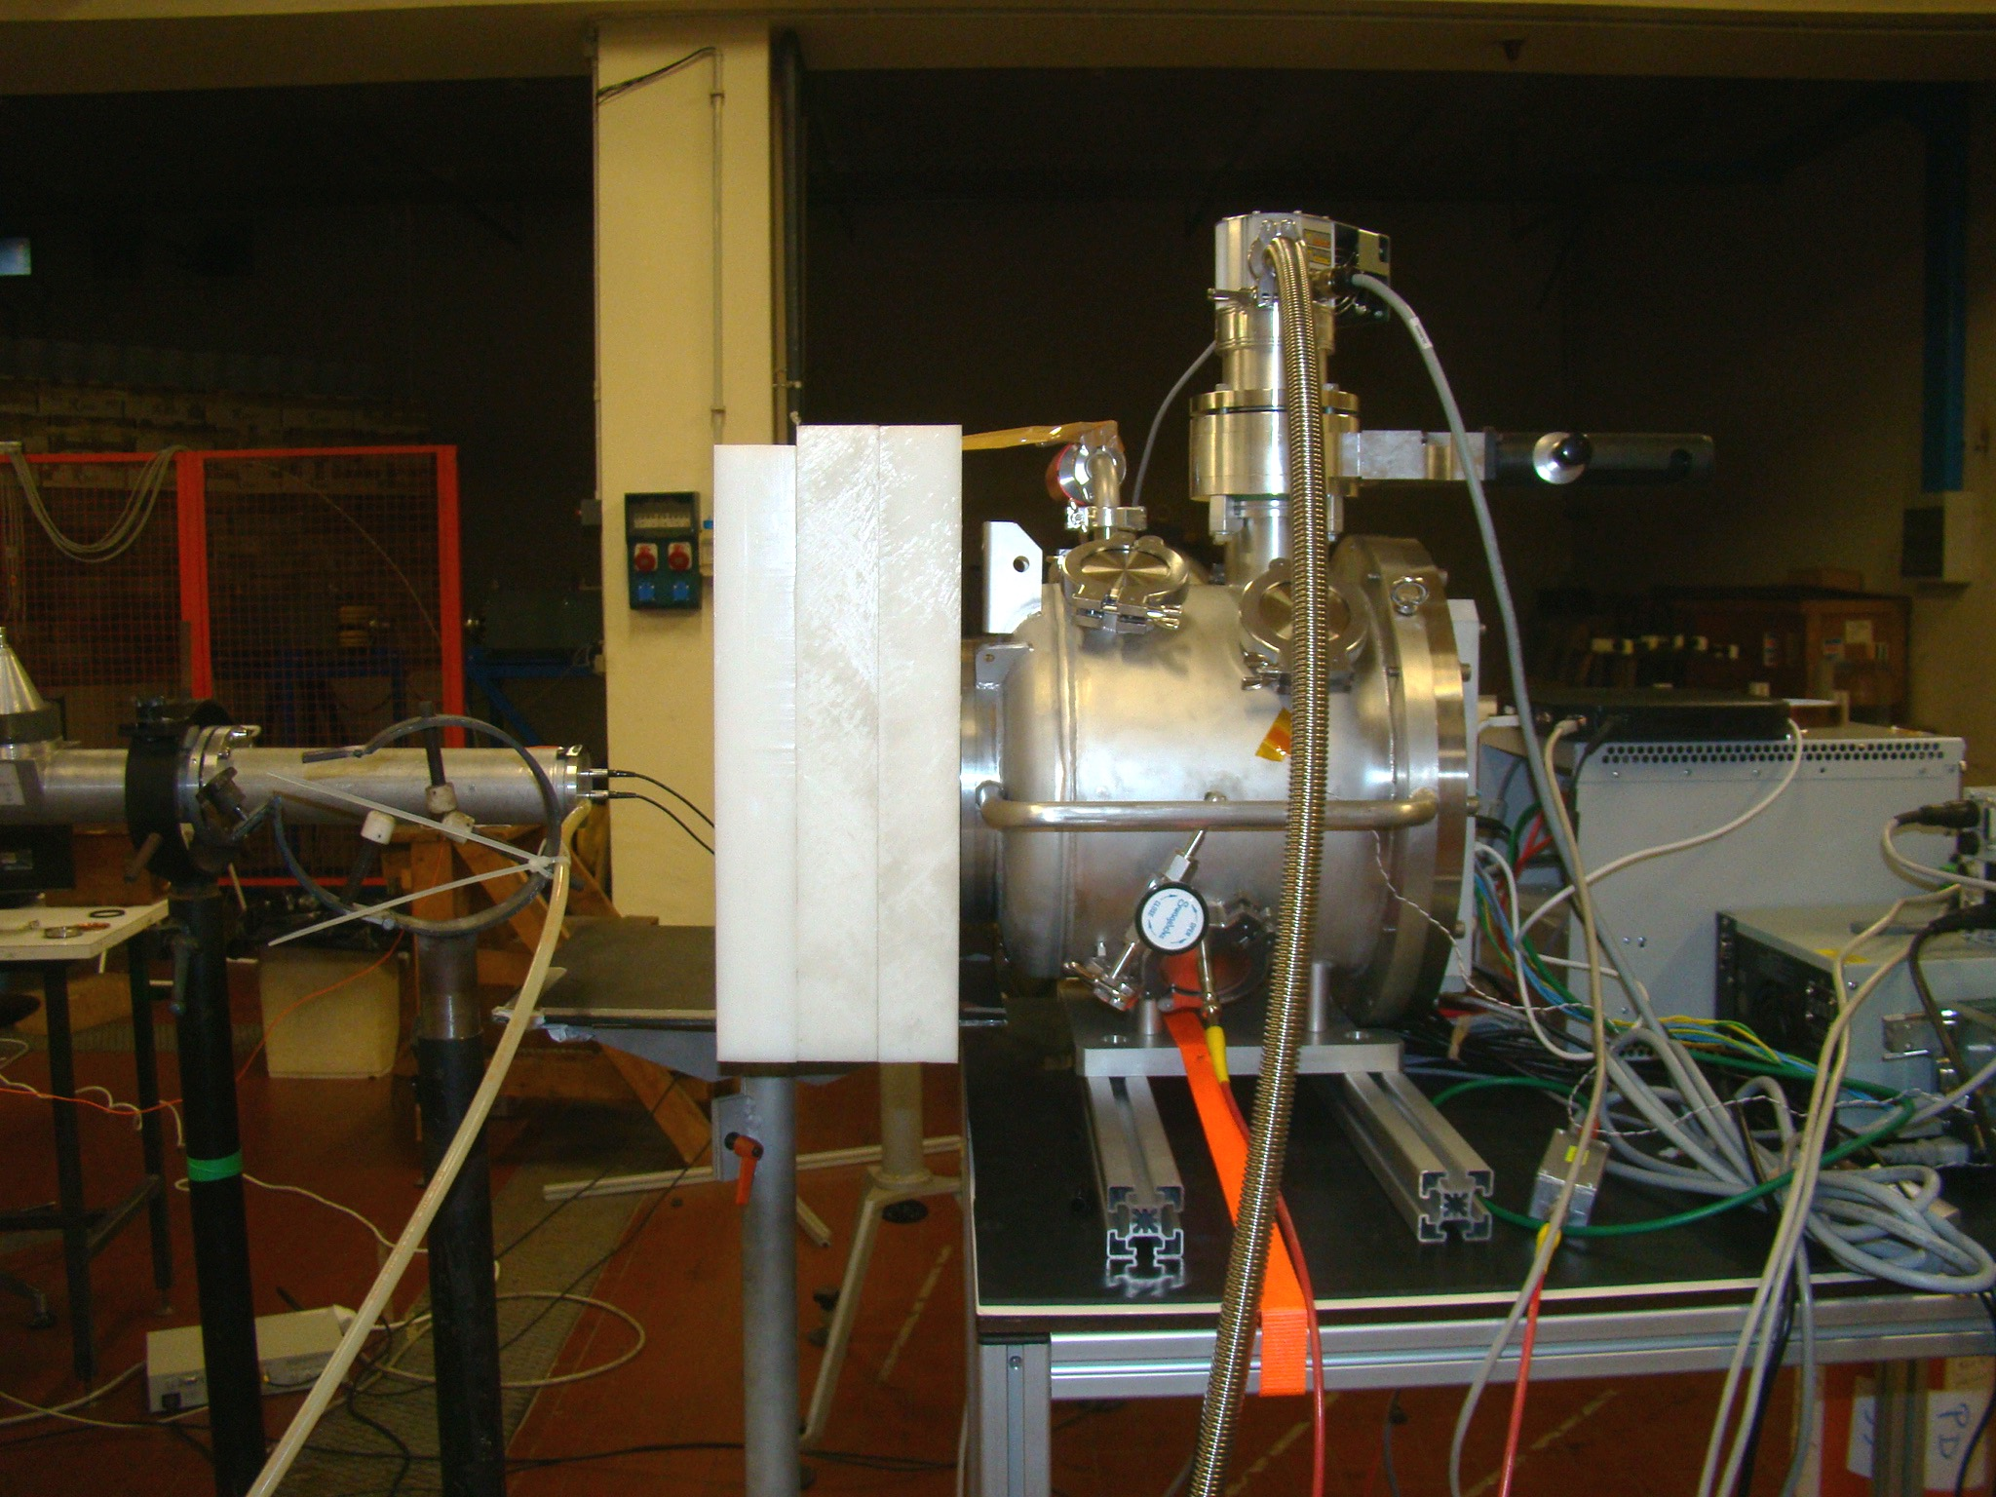
Energy calibration (3)
Configuration of the experiment :
Moderation of neutrons with polyethylene plates
15 cm
Neutron detector
⁹Be Target
Moderator

Slide 23
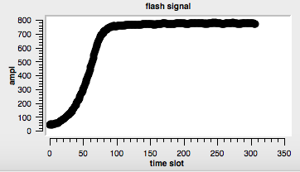
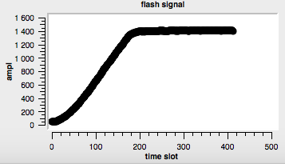
Energy calibration (4)
Lithium track and energy :
Alpha track and energy :

Slide 24
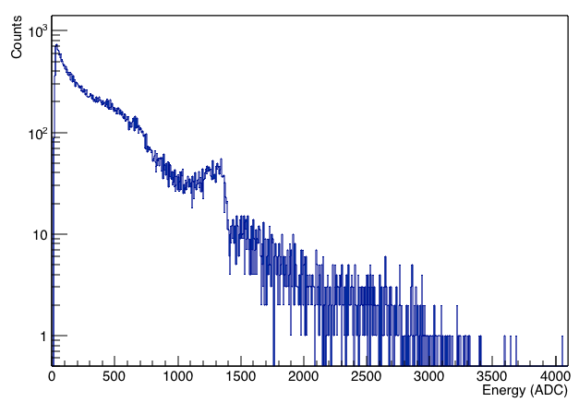
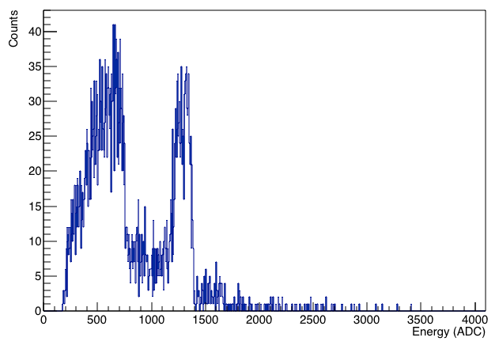
Energy calibration (5)
Energy spectrum with thermal neutrons :
Raw spectrum, after minimal cuts : After data selection :
Li (840 keV)
Li (840 keV)
α (1,47 MeV)
α (1,47 MeV)

Slide 25
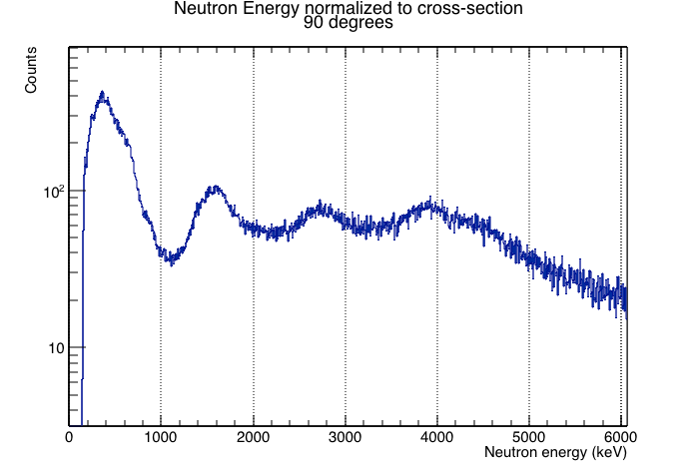
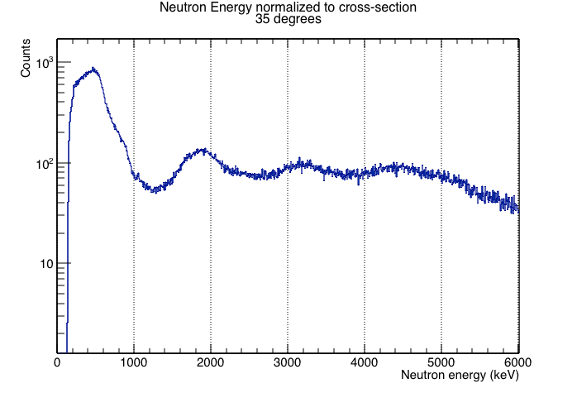
Detection of a few MeV neutrons
Preliminary spectra with ⁹Be(d(1,45 MeV),n) :
At 90° At 35° :
Structures emerge
Quantitative analysis to perform

Slide 26
Context
Valorization project strategy
Operational requirements overview
Technical development
Economic feasibility analysis

Slide 27
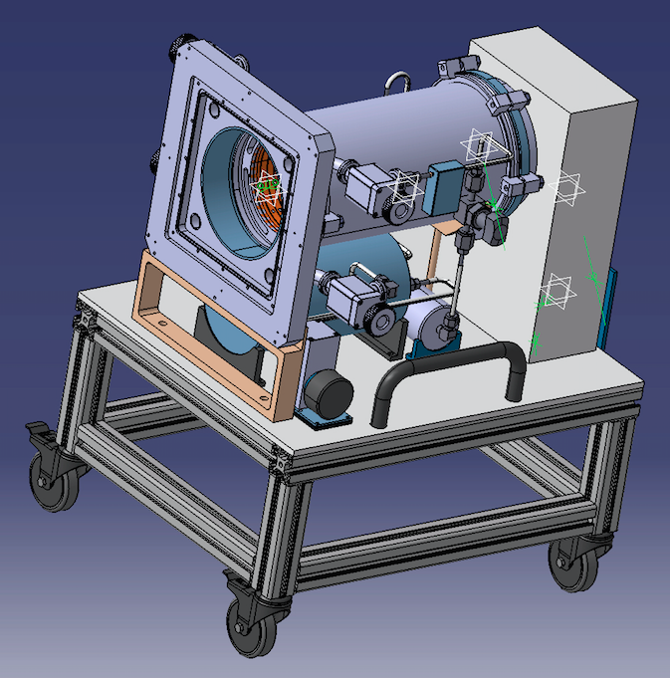
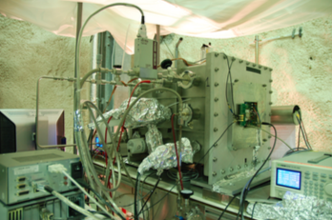
Detector preview
MIMAC detector
MIMAC FASTn
DIRE prematuration program

Slide 28
Context
Valorization project strategy
Operational requirements overview
Technical development
Economic feasibility analysis

Slide 29
Economic feasilibity analysis
Intellectual property analysis conclusion :
No patent,
Protection with a know-how license,
Software protection.
Market analysis :
First panorama of competitors, based on their application targets :
6 manufacturers identified, mainly focused on homeland security.
To be completed with the support of FIST contacts.
First contacts with potential users in the medical sector : fast neutron therapy, hadrontherapy.
First cost analysis with the prototype development.

Slide 30
Short term perspective
December 2015
February 2015
April 2015
June 2015
August 2015
Application field
Eneutron > 10 MeV
Assembly / tests
Prototype
Upgrade
Software
Development / Source location algorithm / tests
Economic feasibility analysis
Market study, cost analysis completion

