Slide 1

L’énigme de la masse
Le Labex ENIGMASS
15 Décembre, 2015
Yannis Karyotakis

Slide 2
L’union fait la force
Renforcer le poids de la discipline au sein d’une université de rang mondial, créer en France le second pole après Paris-Saclay pour la physique nucléaire, subatomique, et astrophysique.
Le labex ENIGMASS est l’outil, le laboratoire, qui permettra de faire émerger ce pole.
  PAGE Particules-Astroparticules-Geoscience-Ecologie

Slide 3
Le Labex Enigmass
Projet commun de 4 laboratoires du CNRS (IN2P3 and INP) + CEA LAPP, LPSC, LAPTh, LSM et les universités Université Savoie Mont Blanc, Université Joseph Fourrier
Trois buts stratégiques :
Renforcer les liens entre les 4 laboratoires, faire émerger un pole solide au sein de l’UGA
Créer un enseignement de haut niveau capable d’attirer les meilleurs étudiants
Renforcer les équipes par des nouvelles personnes pour maximiser l’impact
Favoriser le développent des nouvelles compétences de pointe.

Slide 4
Scientific strategy
Higgs properties studies, direct and indirect searches for new physics at LHC
  Prepare the detectors’ upgrade and profit to acquire new skills and expertise : Silicon tracking devices
Create a neutrino physics pole locally. Build and focus the effort on the mass hierarchy, CP violation, Sterile ν and double β decay questions.
Favour a multi-messenger analysis from different astroparticle observations. Focus on cosmology, dark matter, gravitational waves.
The key issue is manpower

Slide 5


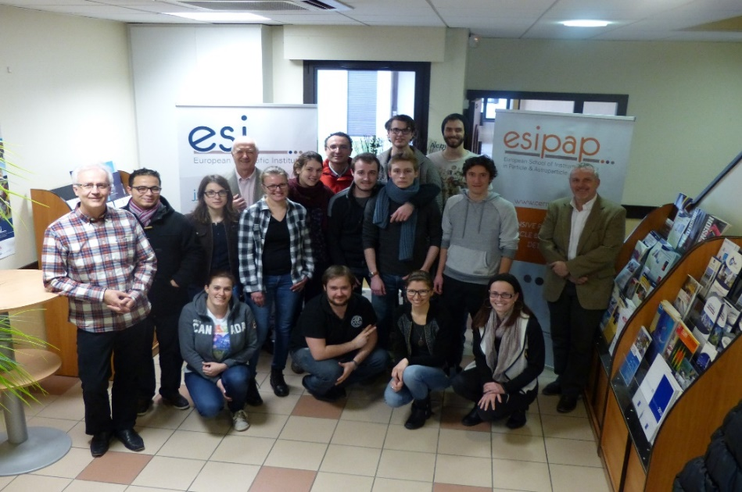
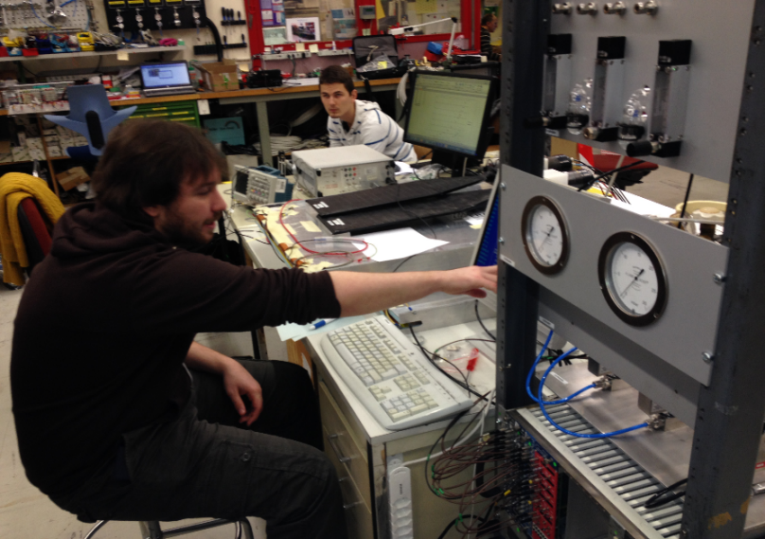
European School of Instrumentation in Particle and Astroparticle Physics
Mid-term objective :
  to become the reference European
  school of instrumentation in the
  discipline within 3-5 years
  train 32 students per year over 8
  weeks and 2 modules
2015 status :
8 students in 2014, 12 in 2015 and 7
countries, aiming at 20 students and 10 countries for 2016
2 independent 4-week modules ; 210 hours of lectures in all ; ~50 lecturers and lab session tutors.
budget 70 k€ (1/2 ENIGMASS, 1/2 ESI + Technopole Archamps + Haute-Savoie Council)
participating institutes : UGA, USMB, U of Strasbourg, CERN, CPPM, IRFU
lab sessions at CERN
http://www.esi-archamps.eu/Thematic-Schools/ESIPAP

Slide 6
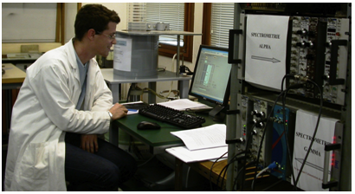
GraSPA Summer School
Why? Decrease in number of Physics students at university ⇒ Inspire and help 3rd and 4th year physics students to pursue a career in Particle Physics/Astro/Cosmo ⇒ Summer School!
How? 30 students, 1 week-long School
Outcome? Huge success in applications (137 for 30 places in 2014, similar in 2015), very good feedback from students.
Subatomic lab plateform in Grenoble
  Nuclear, particle physics and medical applications for engineers, doctors, …
500 master students per year, 19 laboratory setups

Slide 7
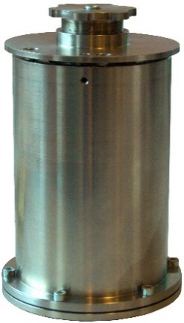
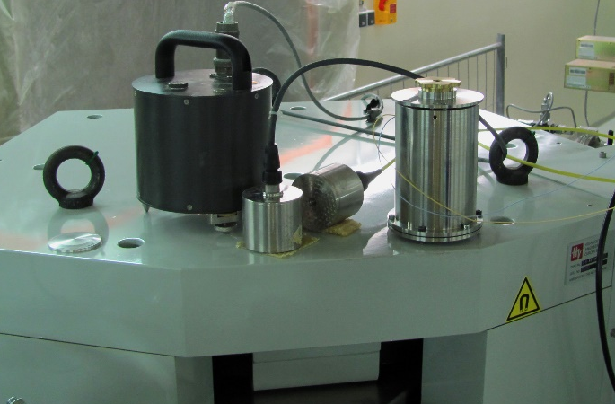
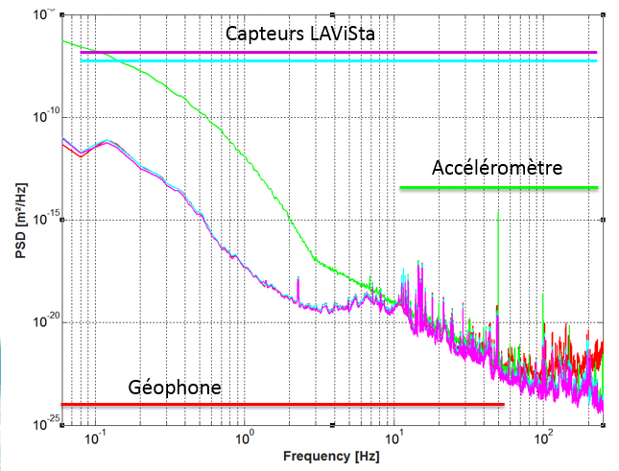
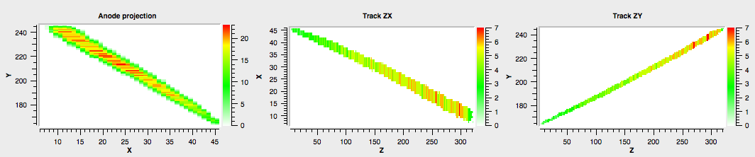
Valorisation
A sub-nanometer vibration sensor.
Measure nano-vibrations (<1nm) and stabilize magnetic elements of a future linear collider to maximize luminosity
  Measurements on experimental sites (CERN, IRSN)
  French patent : FR 13 59336, September 2013
Innovative integration for a portable fast neutron detector development.
Get spectrum and directionality of fast neutrons.
Directional dark matter detection (MIMAC)
  Medical therapies.
  Many other applications such as homeland security, radioprotection and nuclear physics.
Measurements for a micro-beam experiment (IRSN – 2015)
x,y
t_{x}
t_{y}
Example of a 3D nuclear recoil track, resulting from a neutron interaction in the detector
Comparison of measurements done at CERN

Slide 8
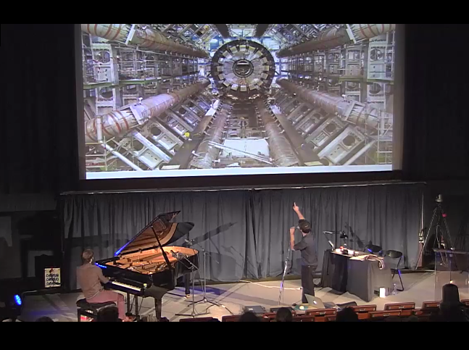
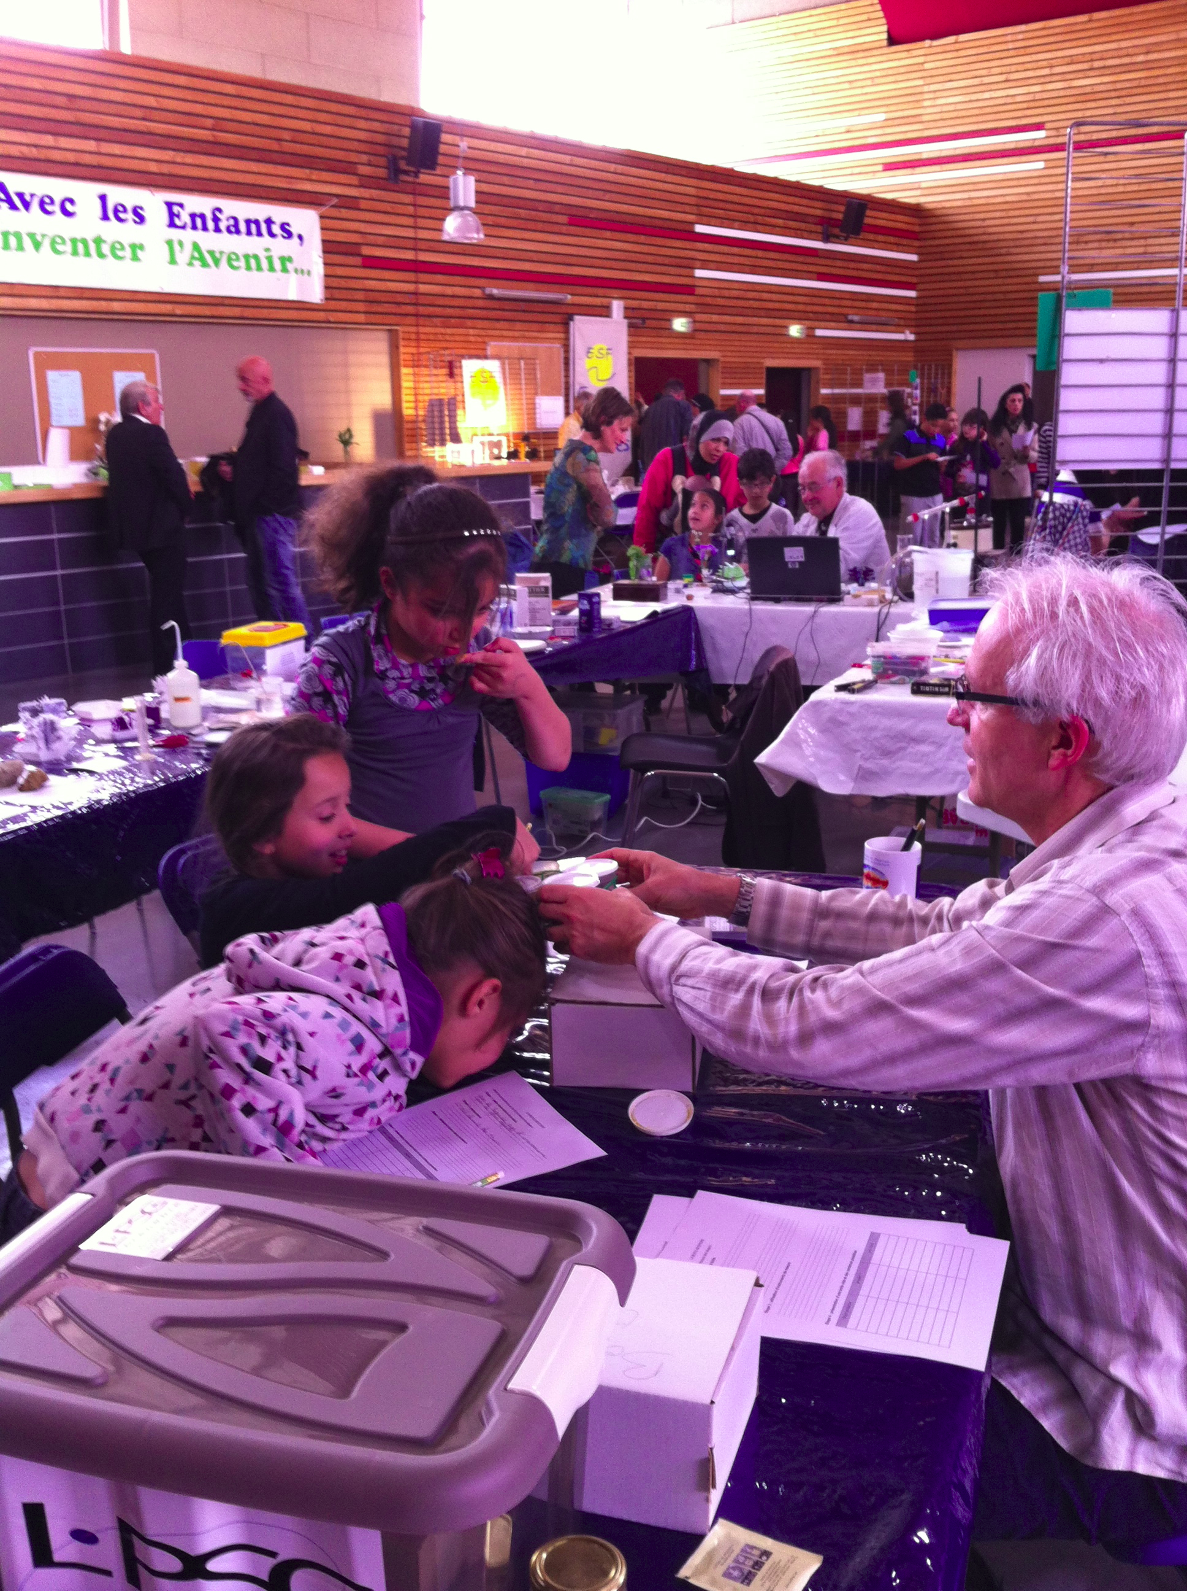
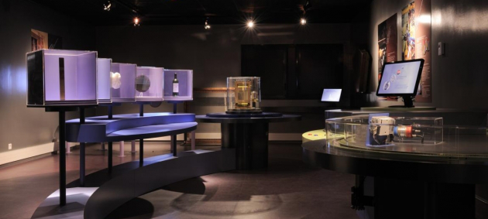
Outreach activities
The Night of the two infinities : annual event in duplex, involving Grenoble and Orsay (since 2012). Science, music & art event, 400-600 attendees each year in Grenoble
Annual National Science Festival : lab visits, conferences, stands...
General public books : Big-Bang et au-delà , Des univers multiples... Aurélien Barrau (Dunod)
Permanent exhibition : Carré des Sciences in Modane (LSM)
International masterclasses : hands on particle physics
Many grand public conferences
Many conferences, lectures and actions in elementary, secondary schools and high schools
Support to conferences and events
http://podcast.grenet.fr/episode/nuit-des-2-infinis-partie-13/
http://podcast.grenet.fr/episode/nuit-des-2-infinis-partie-23/
http://podcast.grenet.fr/episode/nuit-des-2-infinis-partie-33/

Slide 9

ENIGMASS within the Université Grenoble Alpes
University Grenoble Alpes’ application for an Idex has been selected for phase 2
It aims at creating a single world-class university that will be the figurehead of Grenoble’s innovation ecosystem
The labex are the backbones of the six research departments of University Grenoble Alpes
ENIGMASS has contributed on creating the PAGE department, reinforcing considerably the discipline
PAGE
Particles, Astrophysics, Geosciences, Environment and ecology
  500 faculty members
  400 Ph.D. students

Slide 10
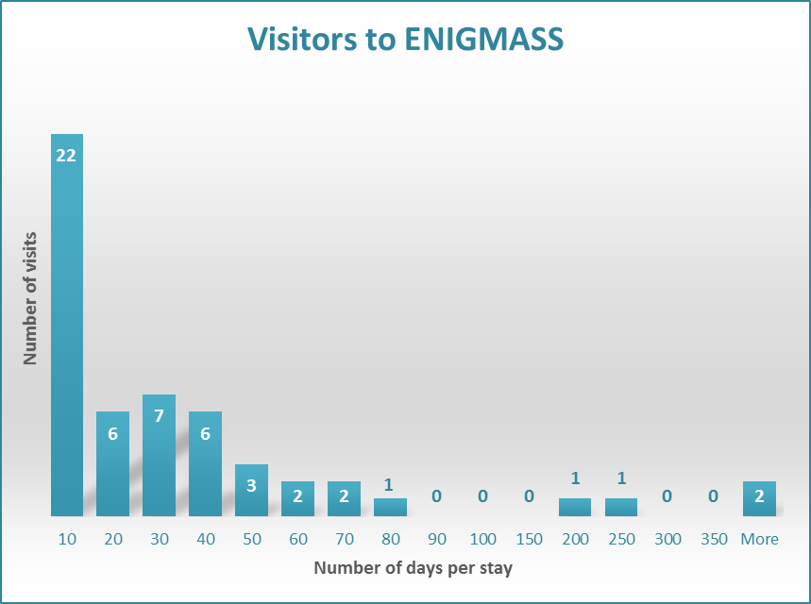
Visitors to ENIGMASS laboratories
64 Visits and a total of 2143 days

Slide 11
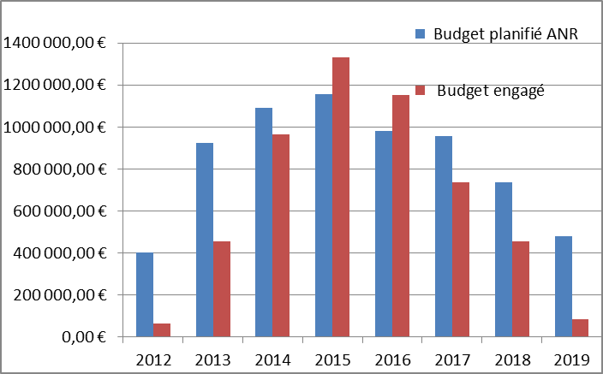
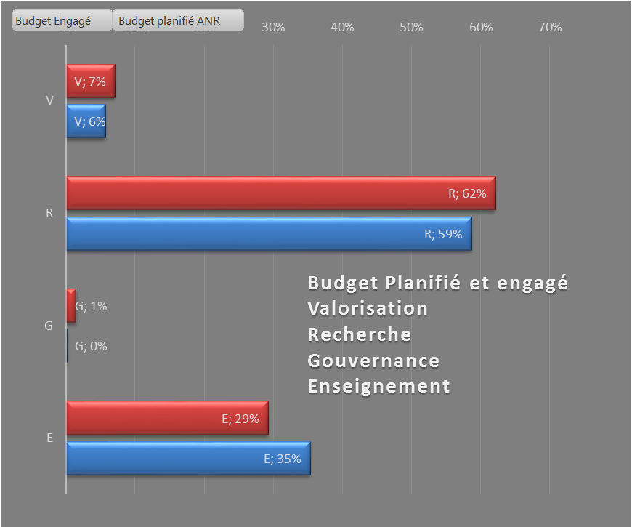
Some numbers
We have hired 35 people allowing to support the scientific strategy. This contribution from ENIGMASS is an order of magnitude higher than expected from usual sources.
Budget : 78% of the budget is committed

Slide 12
Budget (1)

Slide 13
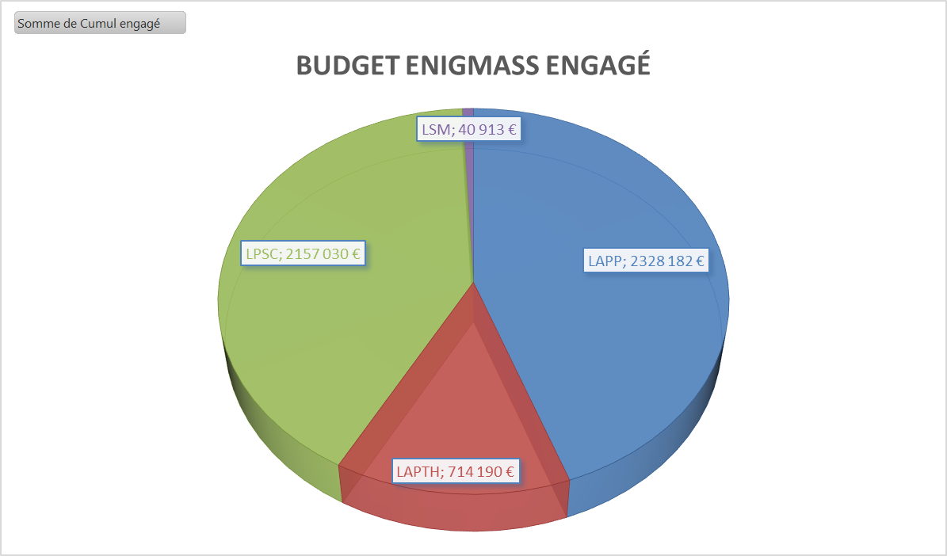
Budget (2)

Slide 14
Conclusion
The labex has allowed our teams to grow and have significant contributions to science.
  A neutrino physics pole is created
  New expertise on Si tracking devices
  Support to cosmology
  Support to innovative projects
It has strengthen the links between the 4 laboratories and has prepared them to face the new university structures
Particle and astro-particle physics is now a major player in the overall scientific strategy of the University of Grenoble Alpes.

