Slide 1
Large Beam CCOB for LSST
Barrau for the Grenoble Team
(A. Choyer, M. Migliore, J.S. Ricol, L. Eraud, C. Vescovi, M. Moneuse)

Slide 2
Two CCOB for LSST camera
2 benches
Large Beam (LB) | Thin Beam (TB)
Beam diameter ~ 20-40 mm | Beam diameter ~ 1mm
Scan entire FP | Overall comissionning
Deliver camera 1st light Dead & bad pixels | Coating transmission coefficient @ 1% precision
measure the pixel to pixel relative response @0,5% precision on entire FP, 0,2% at raft scale Flux control at 0,1 % | Optics study / optical alignment L1, L2 and L3 : overall alignement : tilt/tip, decenter and piston 20 µm precision on relative position Reflection coefficient (1% accuracy)
Delivery date : Q1 (?) 2016 | Delivery date : Q3 2019

Slide 3
Quite a lot of tests have been carried out with a « small » integration sphere, as expected from the first feedbacks we had on the BOT.
A new, larger, integration sphere has now been ordered and the tests will be carried out again.
The next slides show some of the tests made to date.

Slide 4
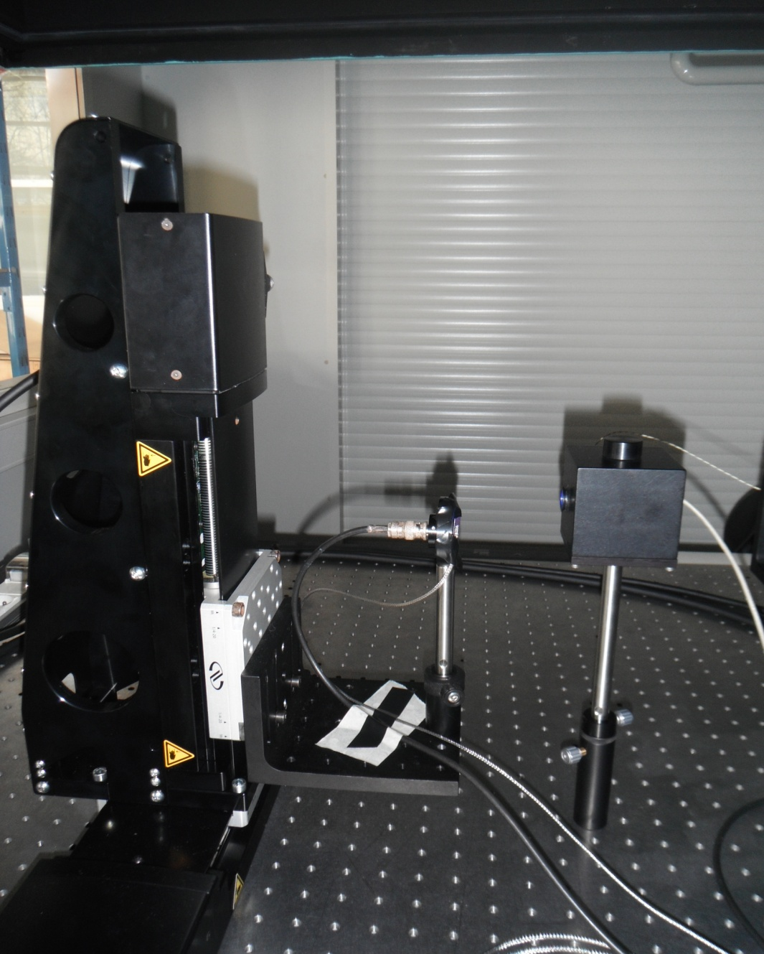
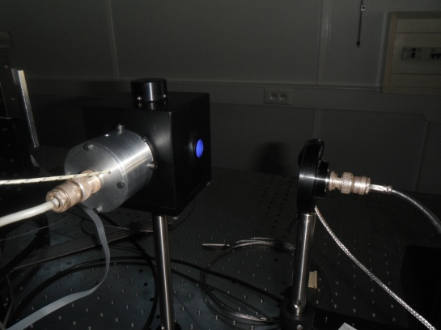
the measurements were carried out by mooving a photodiode
XY µ-positioning tables
LED source +
integrating sphere
Flux control photodiode site
LED adaptator
Spectralon® Integrating sphere
NIST photodiode + 100 µm pinhole

Slide 5
beam map – 100 μm pinhole
We have shown that beam variations at the required precision happen only at scales > 100 μm
  → we can use a 100 μm pinhole without loosing information
We have also shown that is is possible to use a bilinear interpolation method to reconstruct the map between those meaures with a scanning step of 0.5 mm without loosing information
Interpolated map
pinhole 100 μm
60x60 mm
step : 0.5 mm
time ≈ 8h

Slide 6
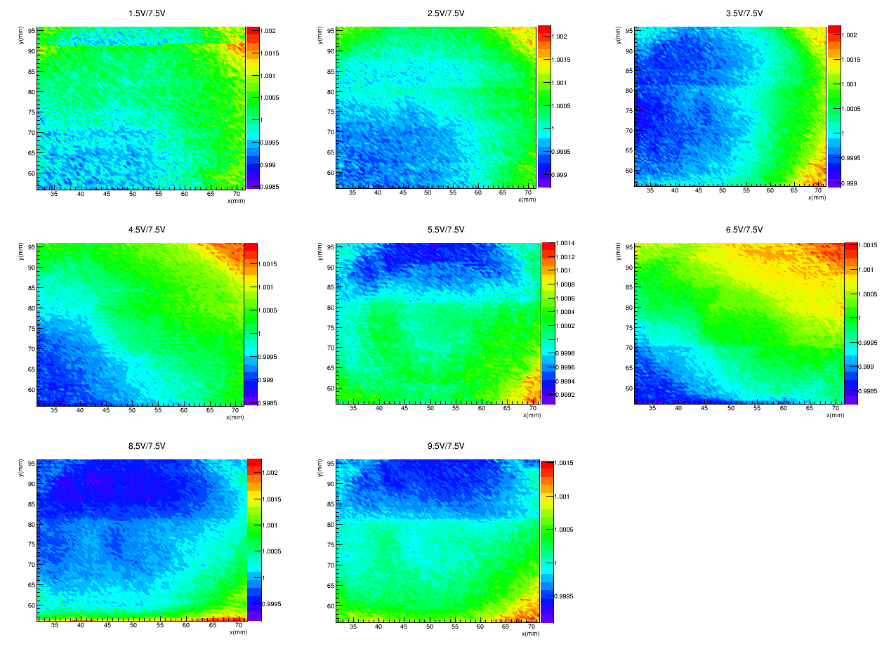
Beam shape as a function of intensity
The aim here was to show that when the light intensity changes the shape of the beam does not change so that it does not need to be fully calibrated again.
Variation of intensity from 1.5 V to 9.5 V, step of 1V
Reference map :
  U = 7.5 V, 40x40mm, scan duration ≈4h, reconstructed by interpolation
Comparison between each map :
  map normalisation over there current mean
  ratio between map
Intensity variation effect is not regular
globally map ratio < 10⁻³
At worst 2.10⁻³ at some points

Slide 7
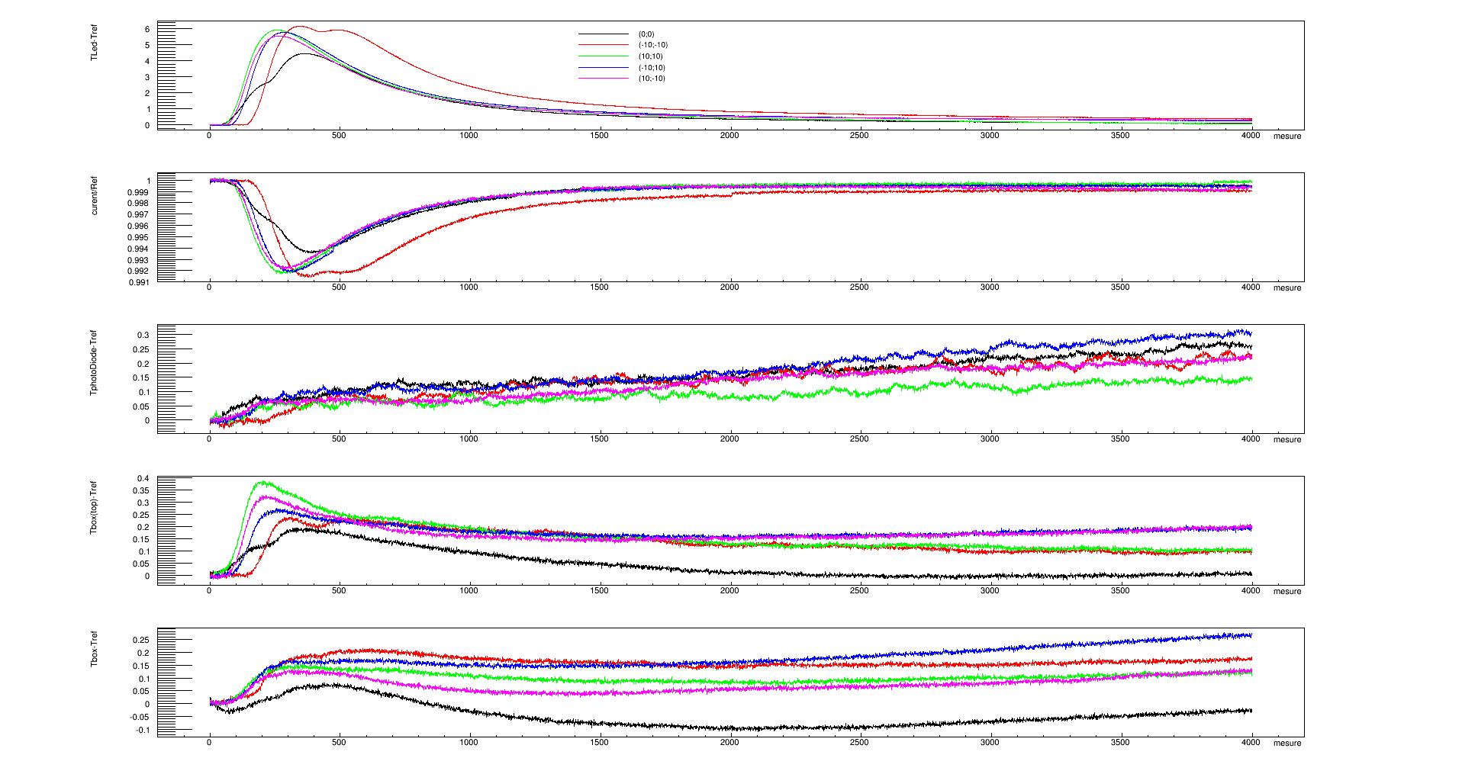
Stability as a function of temperature (1)
No scanning, measure duration ≈ 1h
temperature measurement using thermocouple (precision ≈ 0.1°C)
The heating source is around the LED adaptor. We have checked that the photodiode is not affected in any important way by the temperature changes
independent of temperature variation
due to the electronics
Expected high correlation between TLED and measured flux
ΔFlux ≈ 0.14% per deg

Slide 8

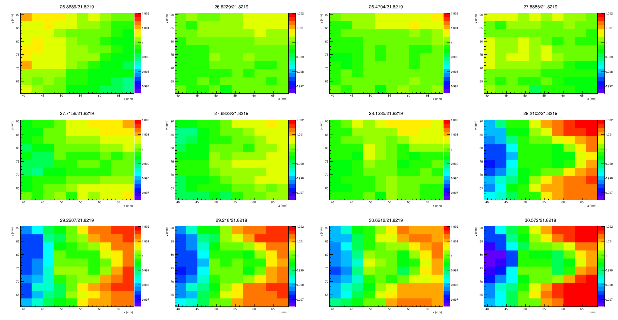
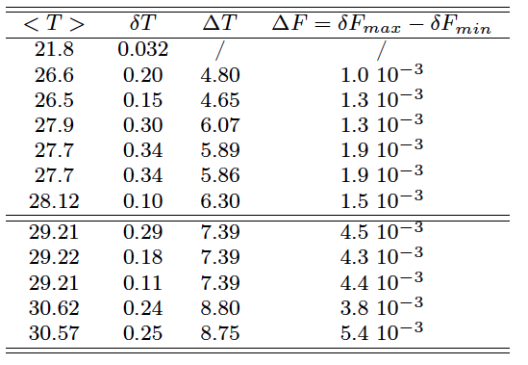
stability as a function of temperature (2)
Scanning, 30x30 mm, step = 3mm ≈ 3min,
12 + 1 measure (reference < T >= 21:8 )
For unknown reasons, the beam shape changes quite a lot with temperature

Slide 9
Many tests were carried out to understand the origin of variation of the beam profile with temperature (which exceeds what is expected from thermal dilatation).
Some non-understood effects remain. The behavior of the system has been tested into details with and without regulation (this later makes the LED more stable but induces larger temperature gradients).
The way out is to chose a scaning strategy so that each pixel sees the beam at different positions so that systematic effects will cancel out.
Basically this means that is the beam size is a and if we need b exposures per pixel, it suffices to moove the beam by steps of a/√b in the x direction and then of the same amount in the y direction.

Slide 10

Wavelength shift as a function of temperature
The LEDs central wavelength will be shifted by a change of temperature
As the CCDs spectral response is not flat, this may lead to an effect even if the overall change of intensity is corrected.
Considering that the quantum efficiency of LSST camera, we have computed:
as a function of temperature, with δT = ±5°C around T_{ref}.
We have considered many LEDs for which δλ/T have been measured for SNDice at LPNHE (SNDice Collaboration 2012).
  T_{ref} ≈25-26 °C.

Slide 11
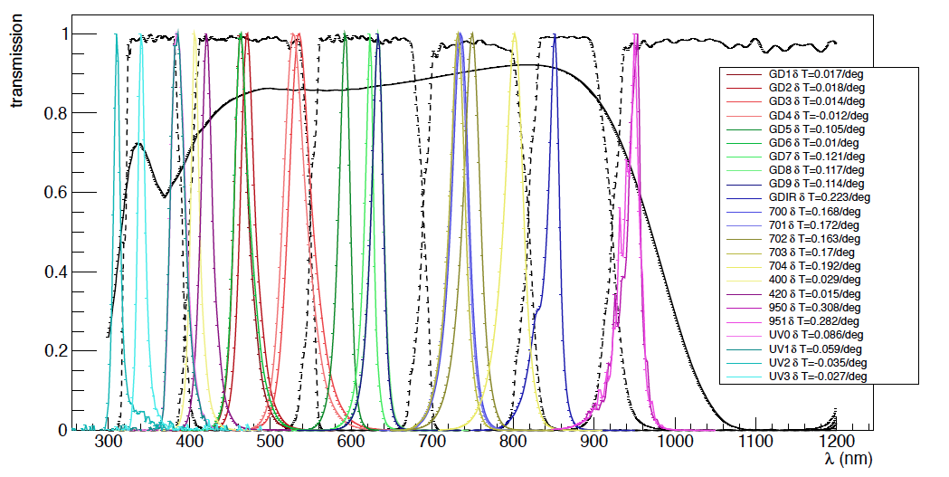
Tested LEDs
LSST filters
LSST camera QE

Slide 12
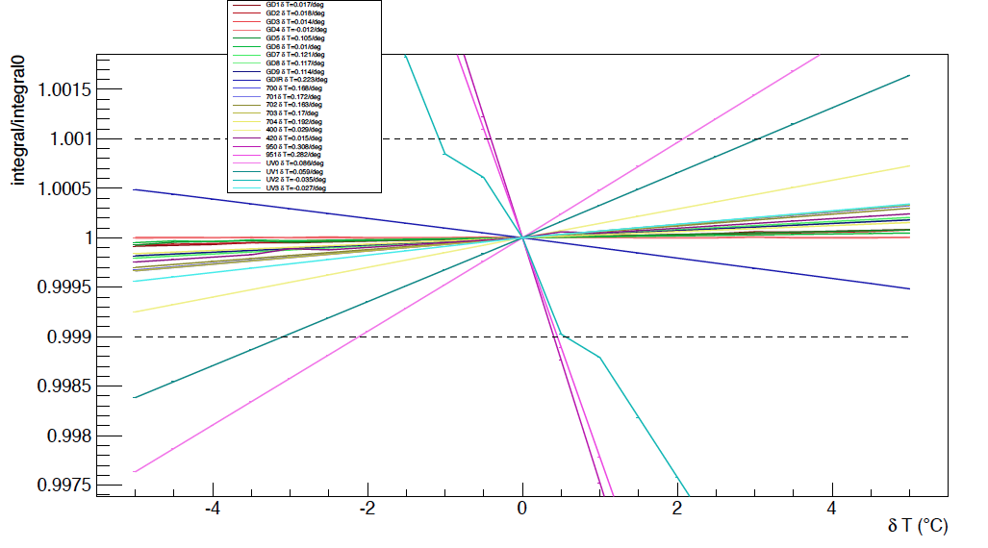
I as a function of δT due to wavelength effets. The chosen LED do meet the requirements
(UV2) out of the requirements
Should not be used for CCOB (y filter)
OK if δT<2°C (UV0 – u filter)
OK if δT<3°C (UV1) – u filter

Slide 13
  for g, r, I, z filters, it is easy to find LEDs that fit the requirements.
  in u and y filter the situation is more complicated. We might perform this measurements only if the room temperature is better controlled than expected. As stated since the beginning of the study, the requirements in the u and y band might not be fulfilled.

Slide 14
  Shutter effects
We need to use our own shutter. The key point is that the exposure time is long enough so that the variations in aperture and closure induce a small enough effect but short enough so that the time needed for the measurements remains reasonable → good compromise = 1s.
It might me that we don’t need a shutter and use electronic switch on/off. This is under study and implemented in the PCB.

Slide 15
Some numbers about time
Let us assume we have at least 30 000 e- per pixel per image. Then, we would need around 30 images to have a Poisson fluctuation of order 0.1%.
If the beam is approximated to be a 3mm*3mm square, this requires 12 000 images. If each image requires x seconds, the calibration needs around 3x hours per LED (there are 6 LEDs).
Some numbers about light
A filter will be placed at the output of the sphere so that the CCDs are not saturated while the other output, used for monitoring, gives enough light intensity in the monitoring photodiode. Theoretical estimates lead to an attenuation of around 10⁶.

Slide 16
Effect of the “flat L3” deflection
The maximum deflection of the L3 under vacuum load is 167 microns.
This can be estimated to lead to a displacement of the beam of around 40 microns. At this scale there no significant change in intensity.
.

Slide 17
Sotware
The migration from the Labview soft used @ lab for testing and the version used @ SLAC is in progress.

Slide 18
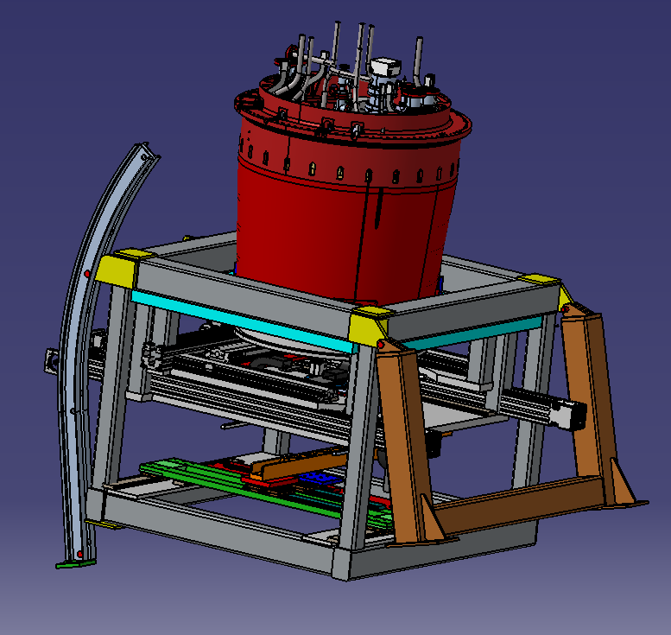
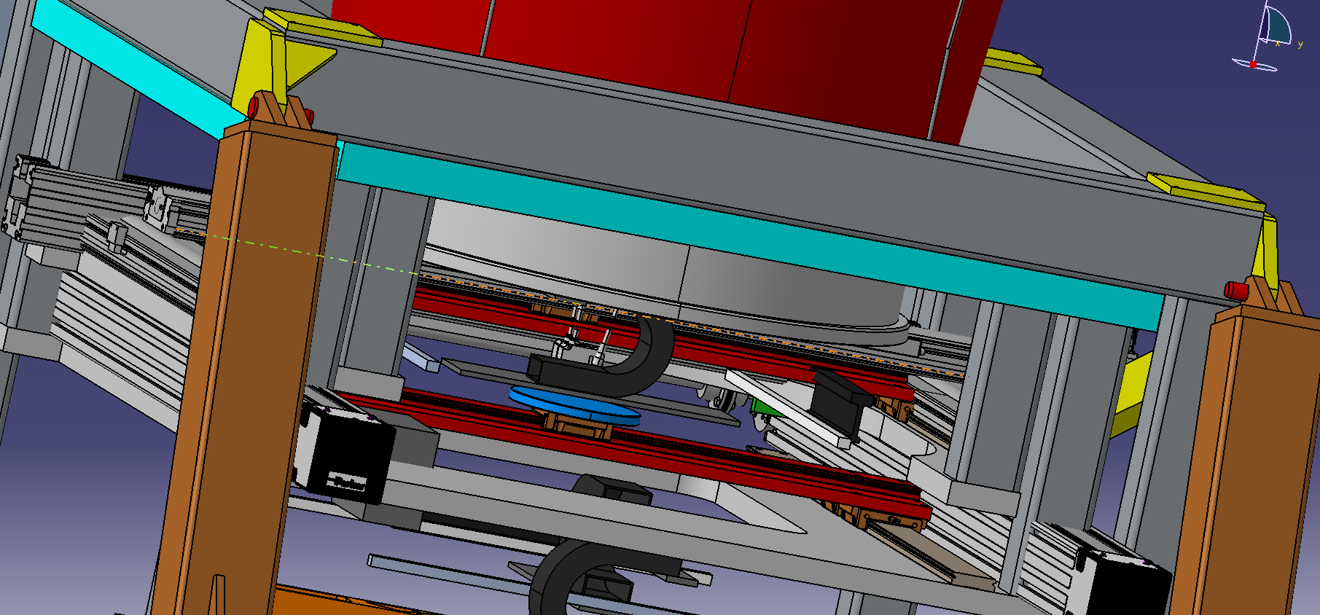
Some views
LB CCOB software incorporated in the CCS – (C/C++/Java)
LED source (6 LEDs minimum to cover the 6 LSST filters spectral range
Dark box in an ISO 5 clean room

Slide 19
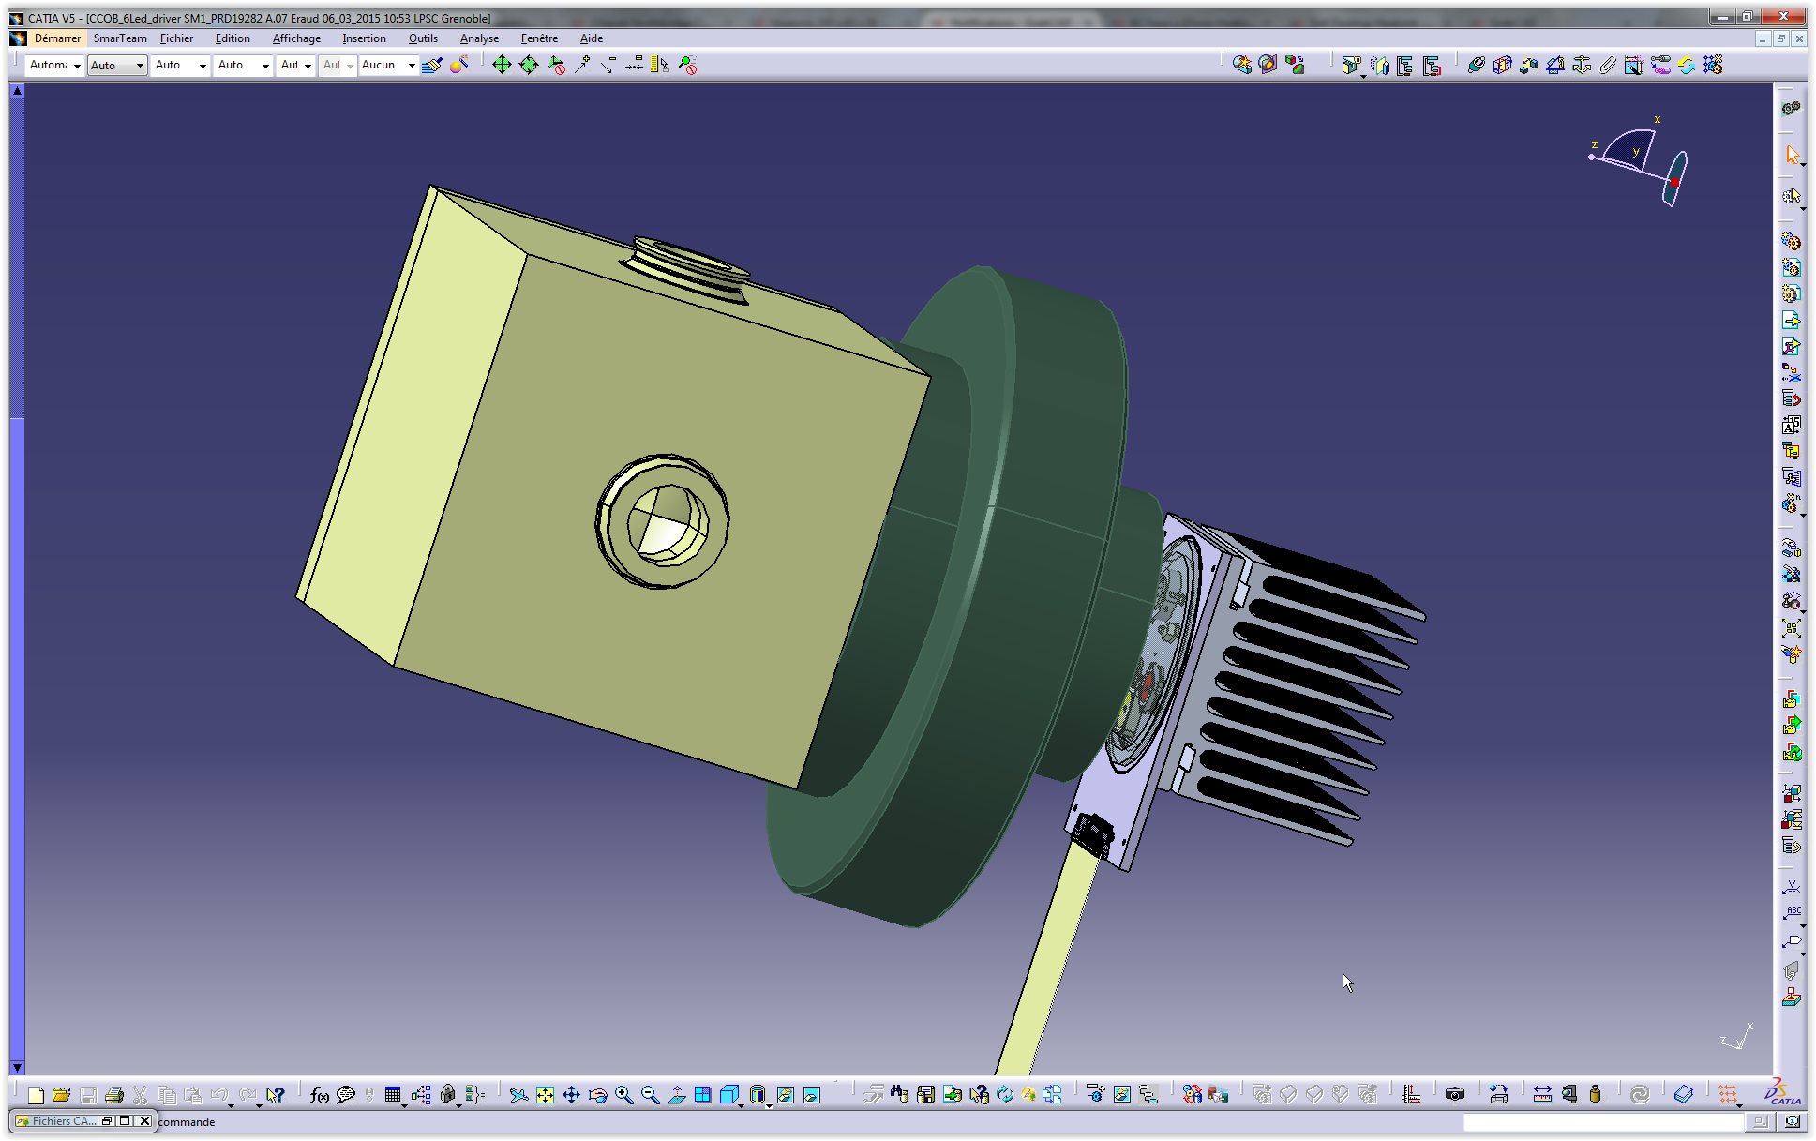
LB design

Slide 20
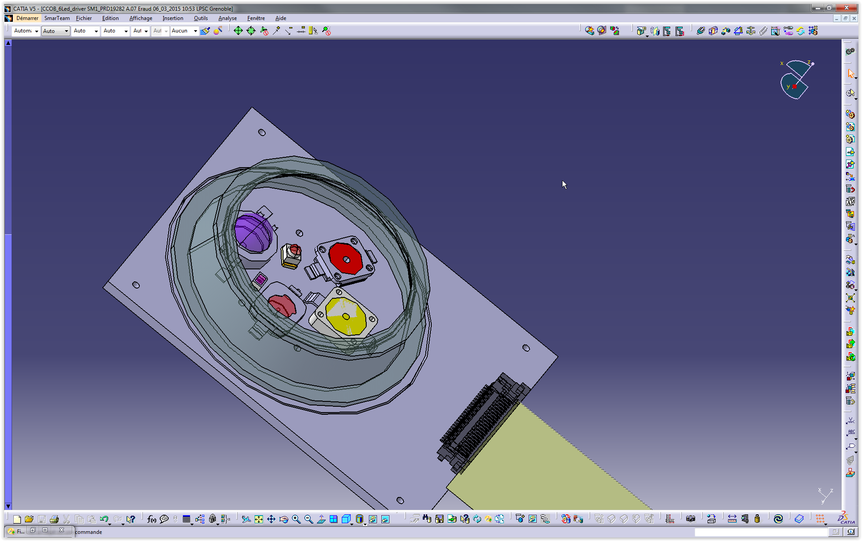
LB design

Slide 21
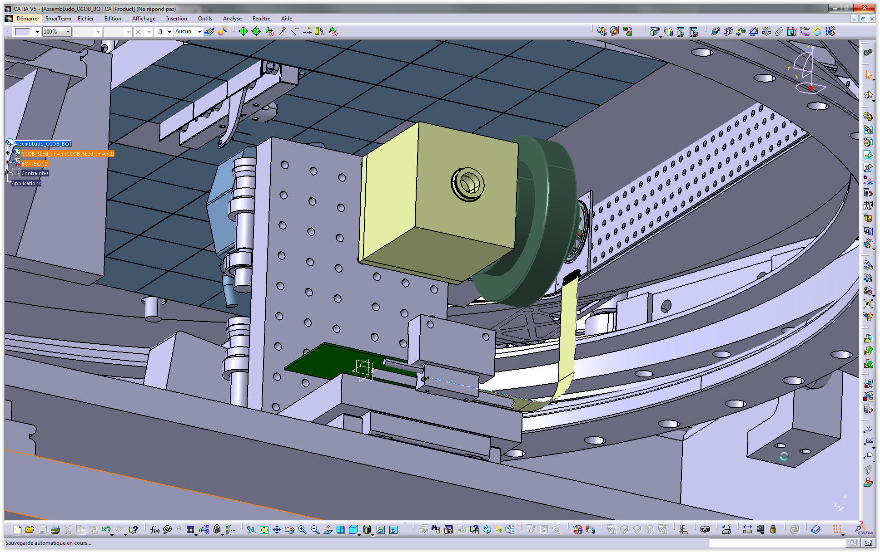
LB design

Slide 22
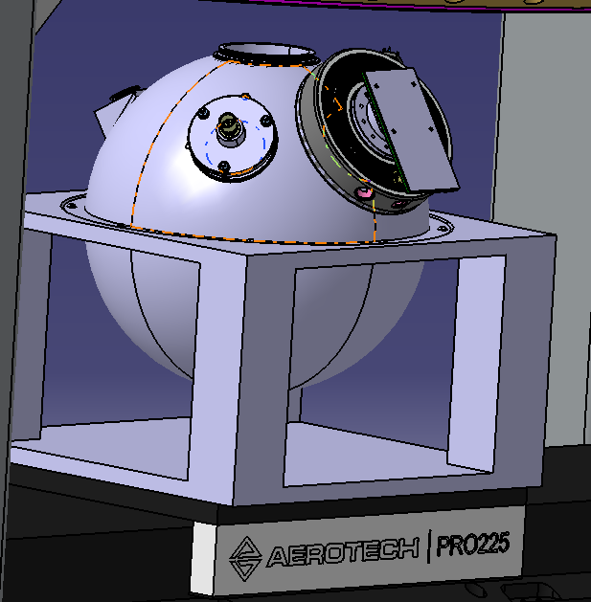
The new larger integrating sphere

Slide 23
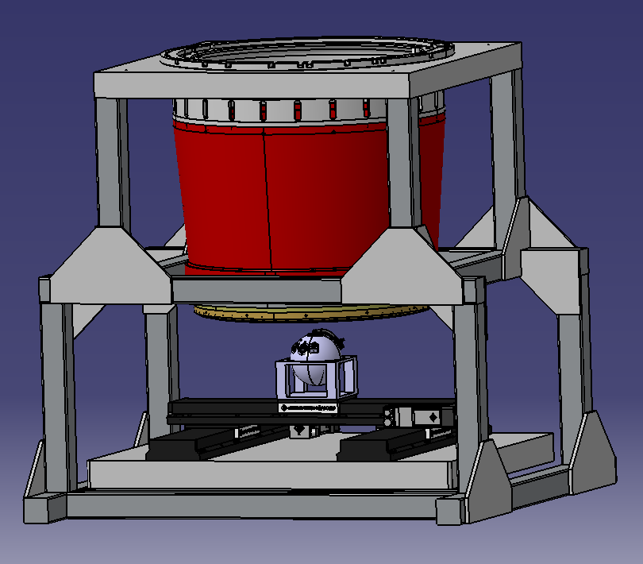
LB design

Slide 24
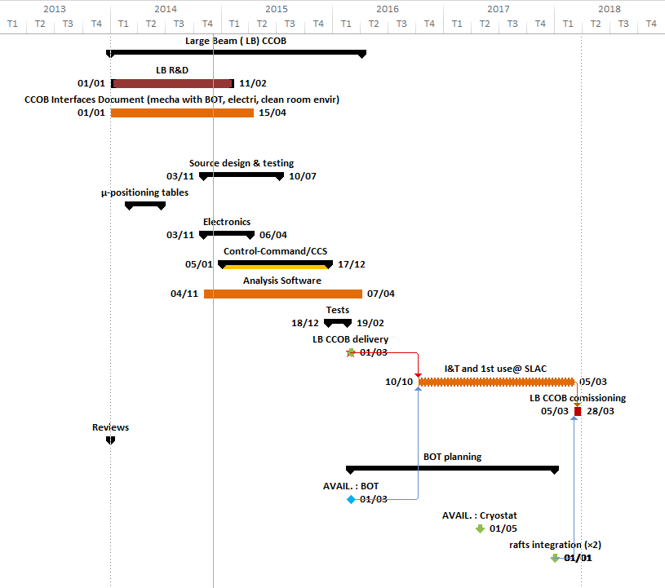
LB Planning
LB CCOB delivery (March 2016) :
LED source power supply
LED source mechanical support + interface w. BOT
Integration of LB CCOB software in the BOT CCS

Slide 25
Thin beam CCOB for LSST
Barrau for the Grenoble Team
(A. Choyer, M. Migliore, J.S. Ricol, L. Eraud, C. Vescovi, M. Moneuse)

Slide 26
Two CCOB for LSST camera
2 benches
Large Beam (LB) | Thin Beam (TB)
Beam diameter ~ 20mm | Beam diameter ~ 1mm
Scan entire FP | Overall comissionning
Deliver camera 1st light Dead & bad pixels | Coating transmission coefficient @ 1% precision
measure the pixel to pixel relative response @0,5% precision on entire FP, 0,2% at raft scale Flux control at 0,1 % | Optics study / optical alignment L1, L2 and L3 : overall alignement : tilt/tip, decenter and piston 20 µm precision on relative position Reflection coefficient (1% accuracy)
Delivery date : Q1 2016 | Delivery date : Q3 2019
⇒ light source profile and variation should be well characterised

Slide 27
Main design of the CCOB LB

Slide 28
Main design of the CCOB LB
- We will use an x-y table, presumably 2m * 2m. Discussions are in progress with manufacturers.
- On the mooving platform of the x-Y table, we will place engines for two rotations (already bought from Newport).
- On top will be placed a head with the output of an optic fiber.
- The light source will be a continuum LASER.
- After this LASER, a UV extender will be used.
- Then the wavelenggth will be chosen by either a standard tunable filter or an acousto-optic tunable filter.
- The light will be splitted, a portion will go to a monitoring photodiode and will enter an optic fiber.
- The fiber will be a monomode one with an apochromatic output optics, leading to a 1 – 2 mm beam.
- This beam will be sent to the CCD and a NIST calibrated diode will be alternatively put on the ligh path.

Slide 29
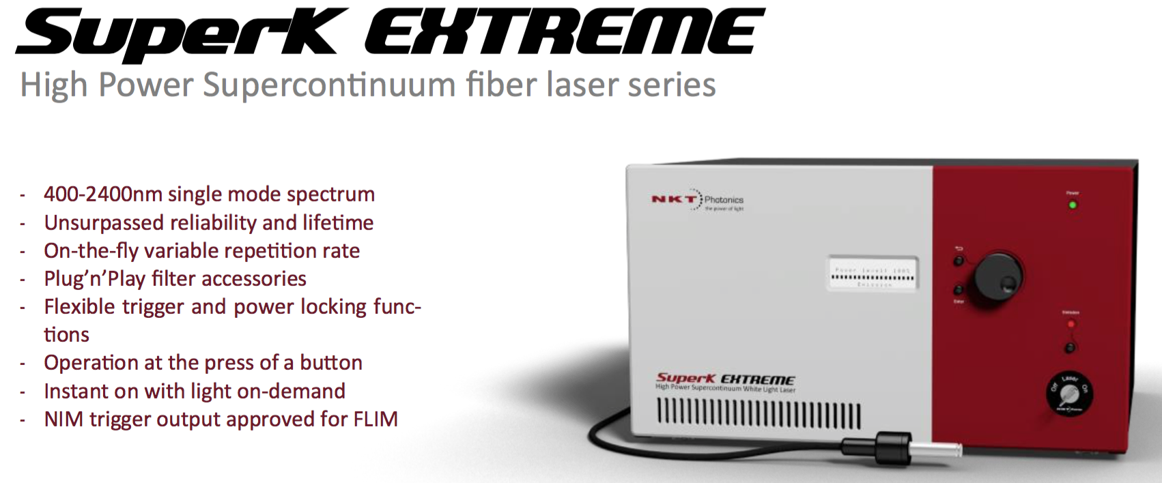
Examples of possible commercial solutions : 1. NKT
The source

Slide 30
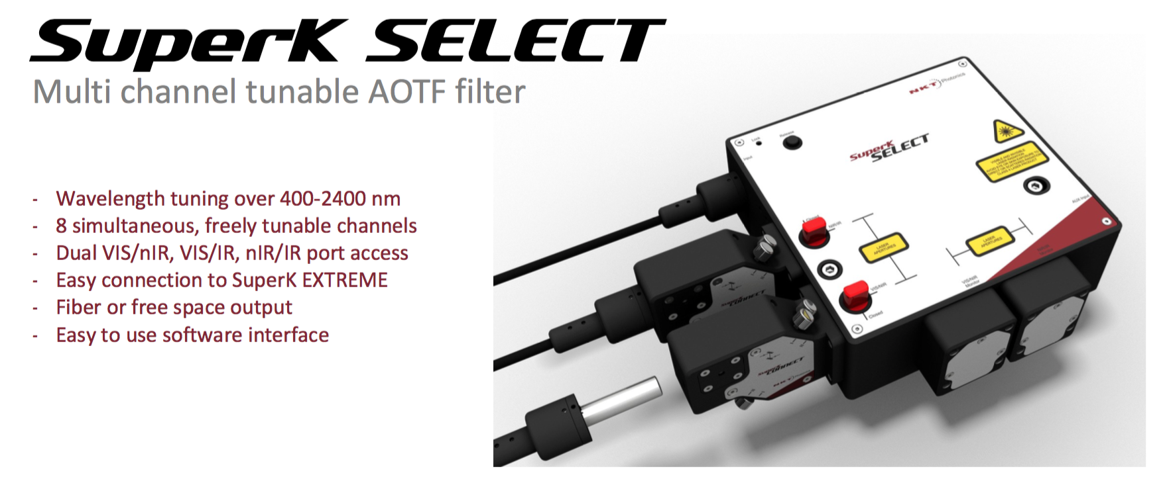
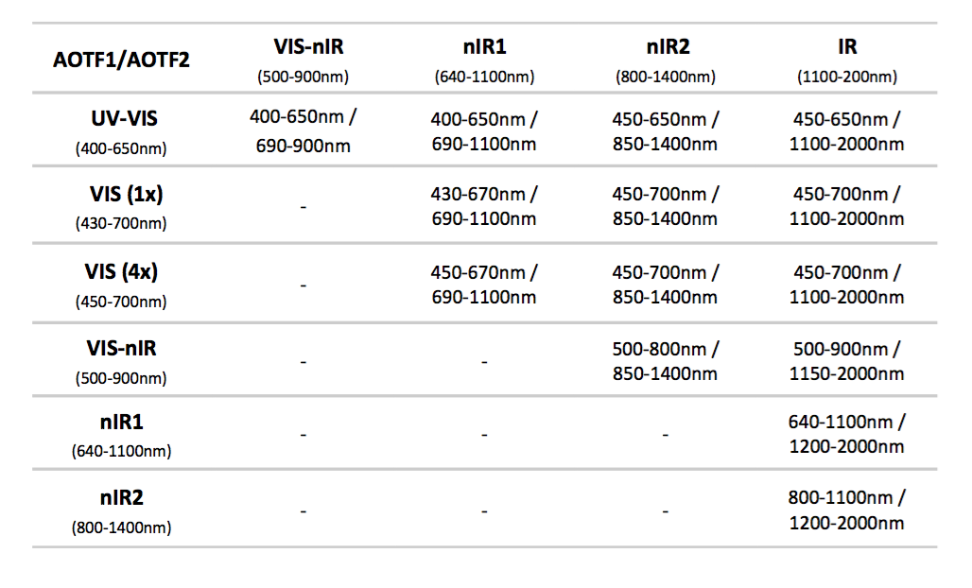
Examples of possible commercial solutions : 1. NKT
The wavelength selector

Slide 31
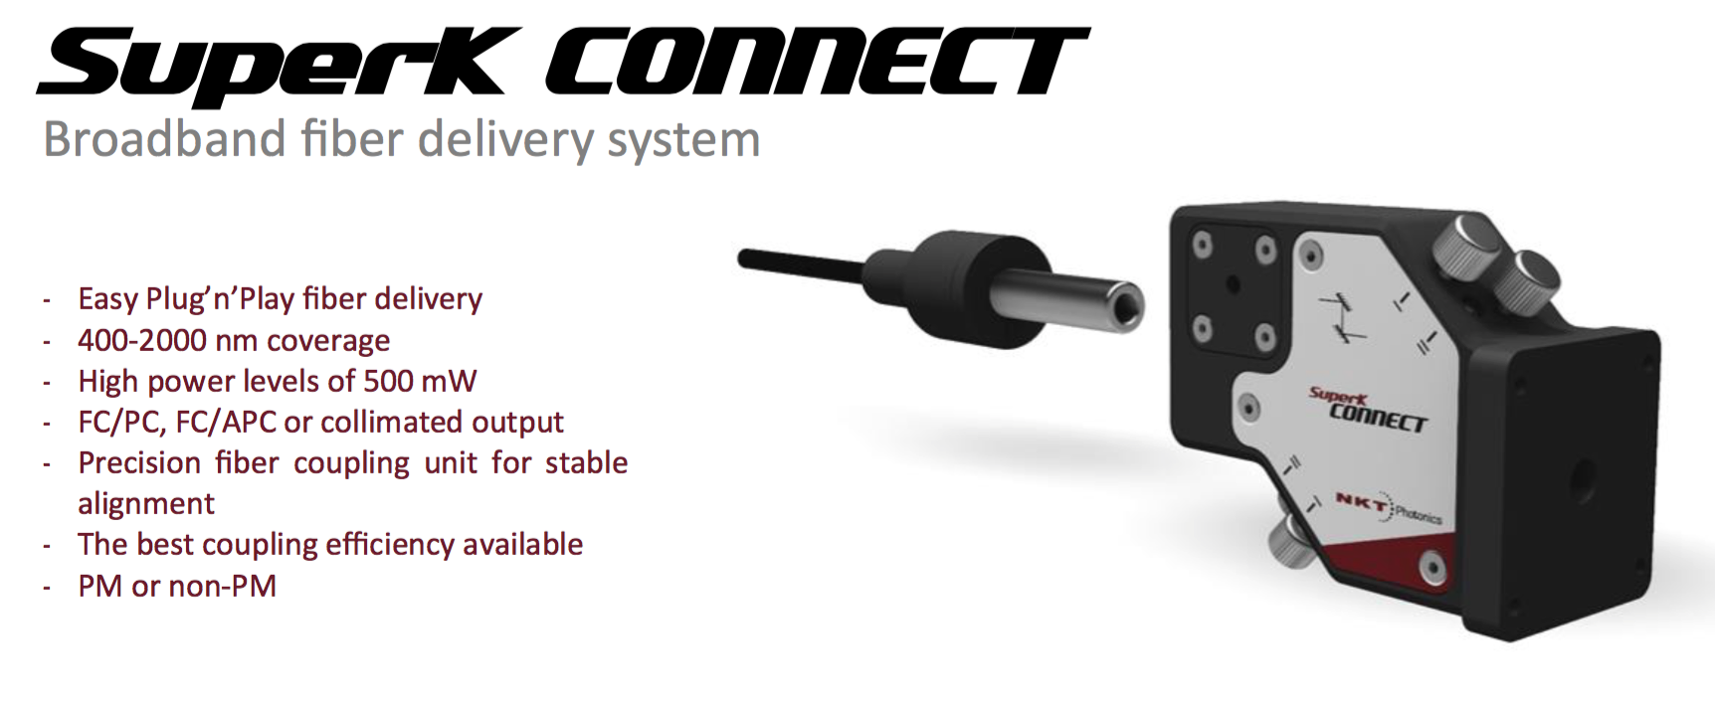
Examples of possible commercial solutions : 1. NKT
The connexion system

Slide 32
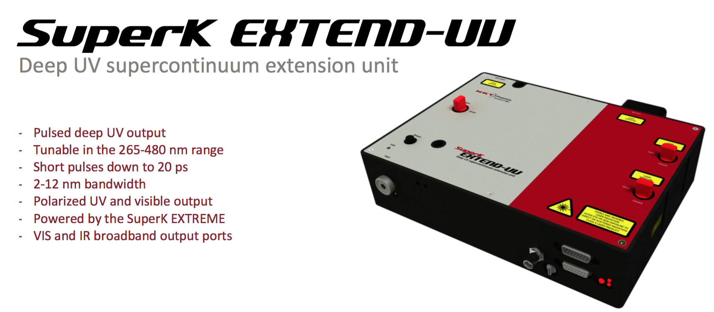
Examples of possible commercial solutions : 1. NKT
The UV extension module

Slide 33
Examples of possible commercial solutions : 1. NKT
The solution is mostly satisfactory. There 3 issues :
1 The source does not go far enough in the UV
2 The bandwith might a bit too large (up to 5 nm) for a very fine scanning in LSST filter edges
3 There are some gaps when combining the NKT filters.
Point (1) might be a severe limitation. As stated form the beginning we might not be able to meet the requirements in the u band. A possibility could be to use a white light source but the intensity will be very small. This is being discussed with Newport engineers.
Point (2) is a problem only in the y band.
Point (3) might be solved by a new commercial solution to be released soon (or by adding a third filter)

Slide 34
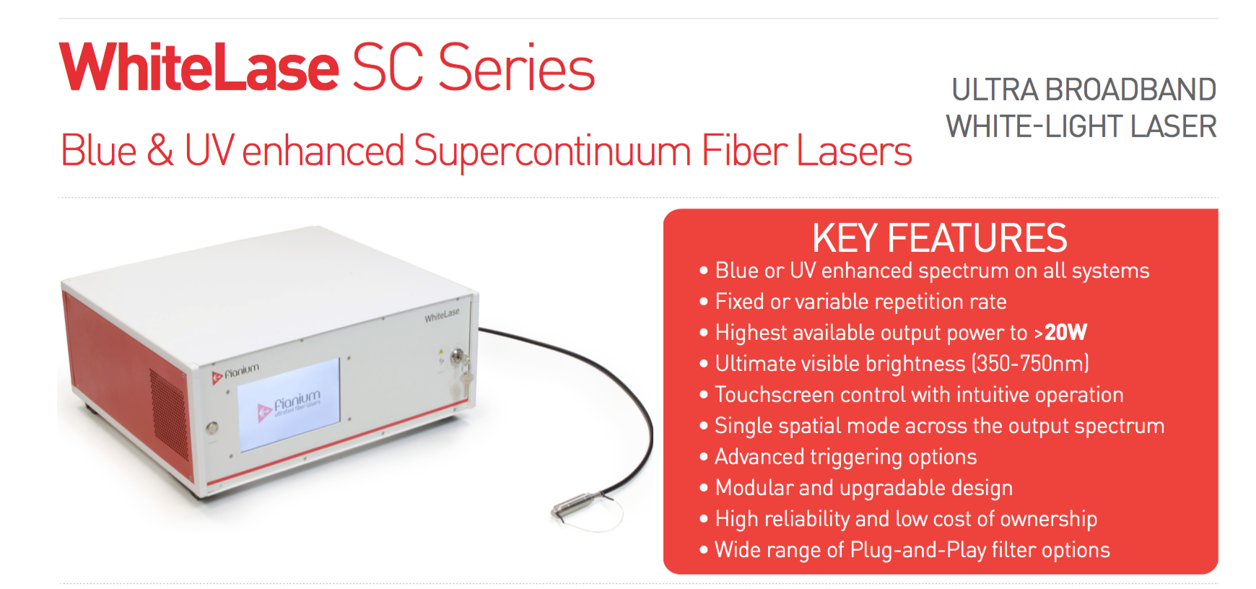
Examples of possible commercial solutions : 2. Optoprim
Discussions in progress. Comparable to NKT.

Slide 35
A possible difficulty
A possible difficulty is due to the fact that if light is not to saturate the pixels during a 1s exposure, it will not produce enough signal in the NIST calibrated photodiode to be accurately measured.
Solutions studied could be :
Increase the beam size
Decrease the exposure time
Average over a higher number of photodiode measurements

Slide 36
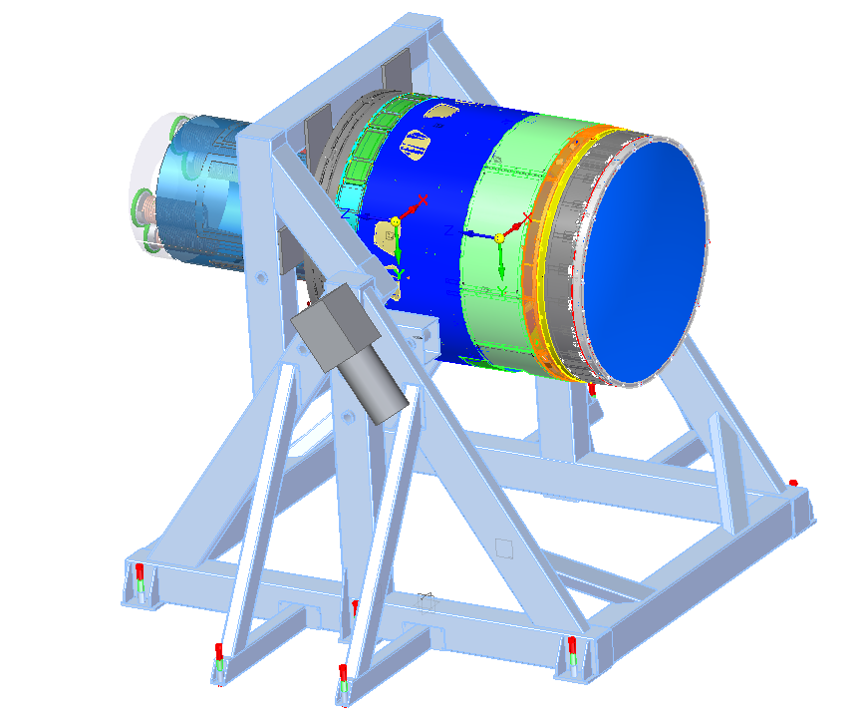
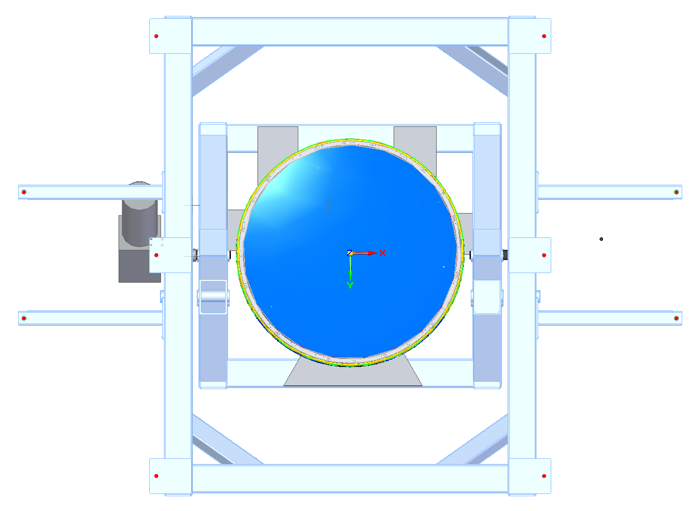
The system will be put below the camera integration stand

Slide 37
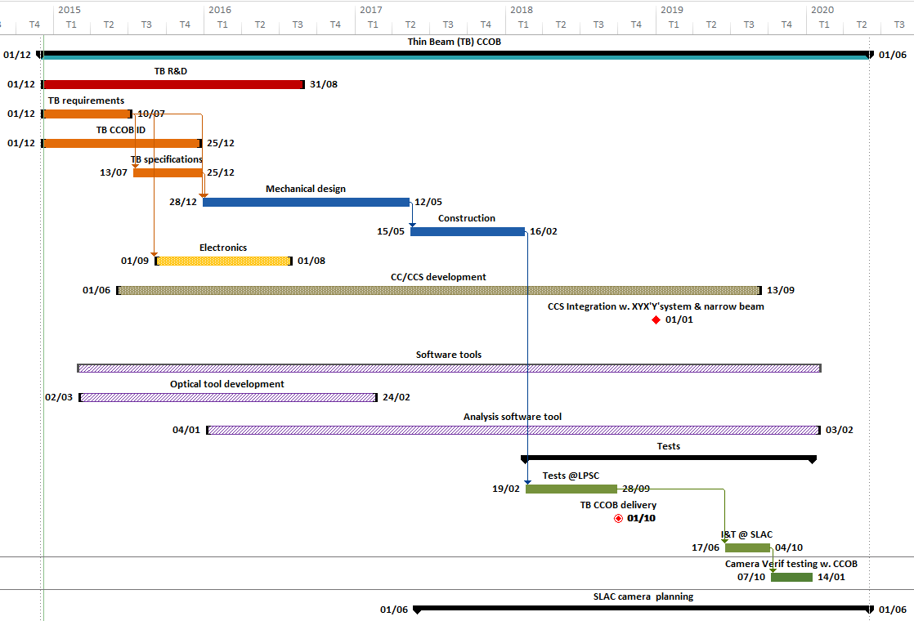
TB CCOB planning
TB CCOB delivery (October 2018) :
XYX’Y’ stages + mechanical support frame
interfaces with fully integrated LSST Camera mount (camera rotation)
TB CCOB CCS

Slide 38
The results will be used to measure the alignment of the lenses
Simulation results by Baumont et al.

