Slide 1
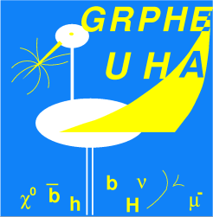
Searching tH with SS lepton pair
Cut-based analysis
1

Slide 2
Searching tH with SS lepton pair
Updates
K-factors for signal was NOT updated in my code: fixed
Fixed bug with cutFlow in the selection code
List of samples where the fake-lepton algo is by-passed: updated
Sample statistics used: all that we have in Strasbourg
→ Is the overtraining problem settled? Answer at the end of the talk
TTtoLHtoWW-Kappa-hct-NEW2
TTtoLHtoWW-Kappa-hut-NEW2
tHToWW-Kappa-hct
tHToWW-Kappa-hut
TTtoLHtoZZ-Kappa-hct-NEW2
TTtoLHtoZZ-Kappa-hut-NEW2
tHToZZ-Kappa-hct
tHToZZ-Kappa-hut
TTdilep_WToLNu_madspin
TTdilep_ZToLL_madspin
TTsemilep_WToLNu_madspin_1
TTsemilep_WToLNu_madspin_2
TTsemilep_ZToLL_madspin_1
TTsemilep_ZToLL_madspin_2
WZToLLLNu_madspin
THqToWW_t_4FS_had_madspin
THqToWW_t_4FS_lep_madspin
THqToZZ_t_4FS_had_madspin
THqToZZ_t_4FS_lep_madspin
Naïve question: is this by-pass a good idea ?
2

Slide 3
Searching tH with SS lepton pair
Cut-flow chart
Inclusive selection
Exclusive selection
3

Slide 4
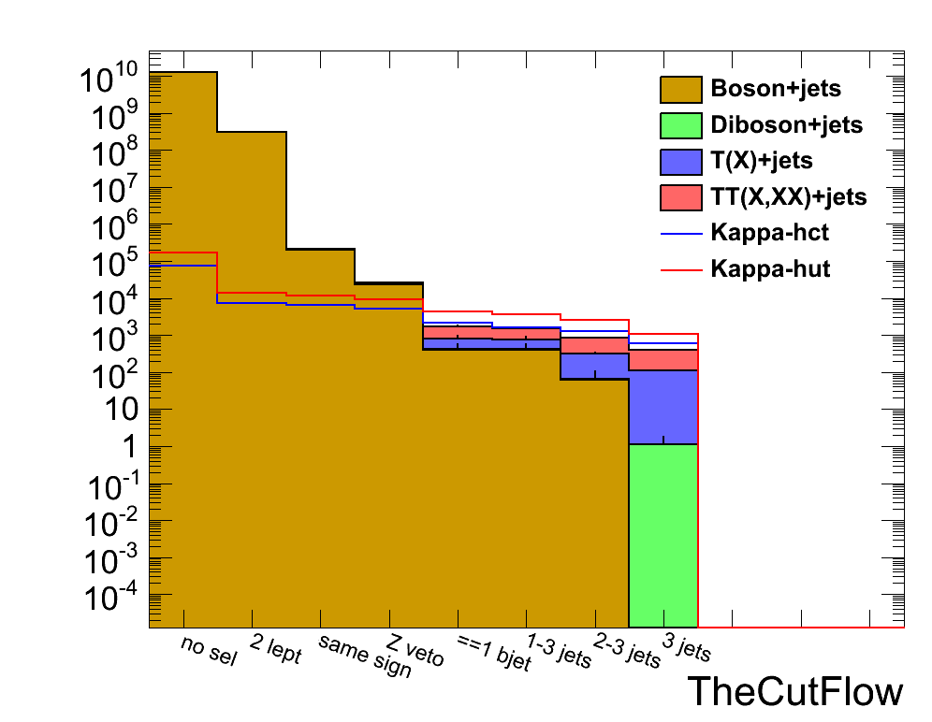
Searching tH with SS lepton pair
Cut-flow chart
4

Slide 5
Searching tH with SS lepton pair
Inclusive selection
significance
5

Slide 6
Searching tH with SS lepton pair
Synchronization
tt - t
6

Slide 7
Searching tH with SS lepton pair
Synchronization
Eric
Shimaa
7

Slide 8
Searching tH with SS lepton pair
Benchmarks for synchronization
sample name = TTtoLHtoWW-Kappa-hct-NEW2
luminosity = 100000
xsection = 0.525927
weight = 52592.7
0 initial : 52592.7 pm 229.331
1 2 leptons : 5389.7 pm 73.4146
2 cut on l pt : 4660.88 pm 68.2706
3 Mll>12 : 4647.7 pm 68.174
4 same sign : 4647.7 pm 68.174
5 Z veto : 3682.46 pm 60.6833
6 =1 bjet 30 GeV : 1507.47 pm 38.8261
7 1-3 jets : 1076.93 pm 32.8166
sample name = TTtoLHtoWW-Kappa-hut-NEW2
luminosity = 100000
xsection = 0.525927
weight = 52592.7
0 initial : 52592.7 pm 229.331
1 2 leptons : 5383.52 pm 73.3725
2 cut on l pt : 4660.39 pm 68.267
3 Mll>12 : 4646.3 pm 68.1638
4 same sign : 4646.3 pm 68.1638
5 Z veto : 3677.16 pm 60.6396
6 =1 bjet 30 GeV : 1587.99 pm 39.8496
7 1-3 jets : 1110.74 pm 33.3277
Units : section [pb], lumi^{int} [pb⁻¹]
Charge misidentification switch off
8

Slide 9
Searching tH with SS lepton pair
Benchmarks for synchronization
sample name = tHToWW-Kappa-hct
luminosity = 100000
xsection = 0.143191
weight = 14319.1
0 initial : 14319.1 pm 119.663
1 2 leptons : 1660.44 pm 40.7485
2 cut on l pt : 1410.79 pm 37.5605
3 Mll>12 : 1406.06 pm 37.4975
4 same sign : 1406.06 pm 37.4975
5 Z veto : 1128.1 pm 33.5872
6 =1 bjet 30 GeV : 538.188 pm 23.1989
7 1-3 jets : 484.371 pm 22.0084
sample name = tHToWW-Kappa-hut
luminosity = 100000
xsection = 0.963552
weight = 96355.2
0 initial : 96355.2 pm 310.411
1 2 leptons : 7660.86 pm 87.5263
2 cut on l pt : 6574.55 pm 81.0836
3 Mll>12 : 6552.96 pm 80.9504
4 same sign : 6552.96 pm 80.9504
5 Z veto : 5313.52 pm 72.8939
6 =1 bjet 30 GeV : 2579.96 pm 50.7933
7 1-3 jets : 2323.63 pm 48.2041
Units : section [pb], lumi^{int} [pb⁻¹]
Charge misidentification switch off
9

Slide 10
Searching tH with SS lepton pair
Benchmarks for synchronization
sample name = TTsemilep_madspin1
luminosity = 100000
xsection = 147.644
weight = 1.47644e+07
sample name = WWToLLNuNu
luminosity = 100000
xsection = 5.677
weight = 567700
Units : section [pb], lumi^{int} [pb⁻¹]
Charge misidentification switch on
10

Slide 11
Searching tH with SS lepton pair
Synchronization
Shimaa
sample name = TTtoLHtoWW-Kappa-hct-NEW2
0 initial : 52592.7 pm 229.331
sample name = TTtoLHtoWW-Kappa-hut-NEW2
0 initial : 52592.7 pm 229.331
sample name = tHToWW-Kappa-hct
0 initial : 14319.1 pm 119.663
sample name = tHToWW-Kappa-hut
0 initial : 96355.2 pm 310.411
Compatible
Why differences?
Float with single precision is used in Shimaa’s analysis
My prescription:
Used double instead float for weight
Used TH1D instead TH1F for cutFlow
11

Slide 12
Searching tH with SS lepton pair
Synchronization
Shimaa
The 2 codes are then comparable at this level
sample name = TTtoLHtoWW-Kappa-hct-NEW2
5 Z veto : 3682.46 pm 60.6833
sample name = TTtoLHtoWW-Kappa-hut-NEW2
5 Z veto : 3677.16 pm 60.6396
sample name = tHToWW-Kappa-hct
5 Z veto : 1128.1 pm 33.5872
sample name = tHToWW-Kappa-hut
5 Z veto : 5313.52 pm 72.8939
Not Compatible
Eric has about 2 times more than Shimaa.
Investigation on going …
12

Slide 13
Searching tH with SS lepton pair
Synchronization
More synchronization???
Change the selection code for comparison (ongoing)
13

