Slide 1
Can we detect a marble tomb with cosmic muons ?
Corinne Goy, Max Chefdeville, Jean Jacquemier, Yannis Karyotakis
21 December 2015

Slide 2
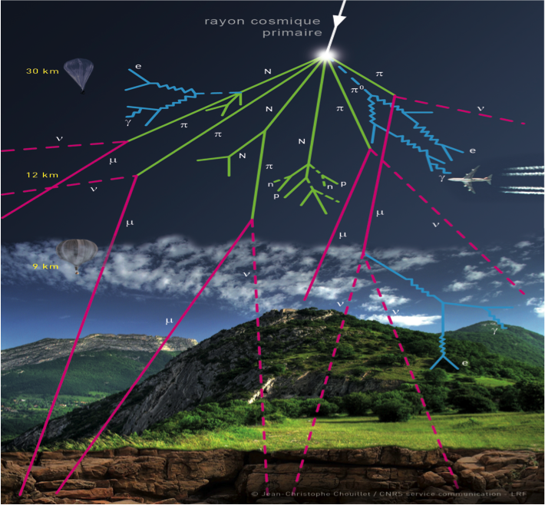
Primary Cosmic rays
Showering in atmosphere →
Destruction

Slide 3
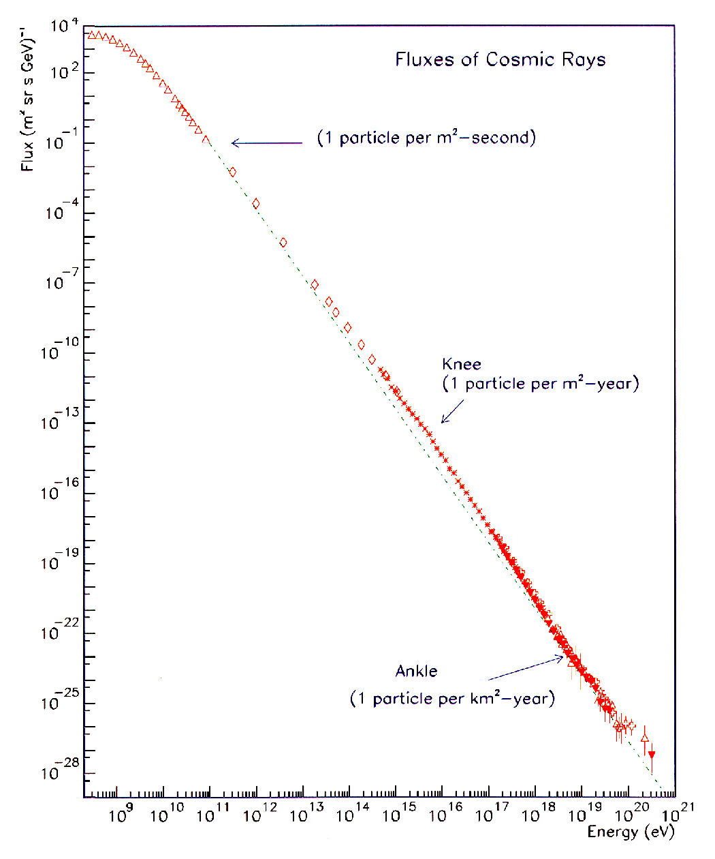
Flux de rayons cosmiques
Flux (m².sr.s.GeV)⁻¹
Flux on top of the atmosphere
1 GeV = 10 ⁹ eV

Slide 4
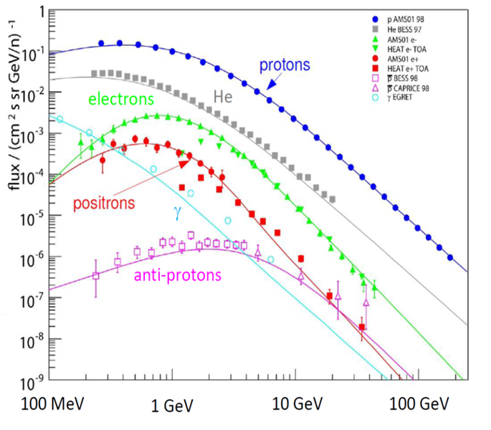
Composition of primary cosmic rays
90 % protons
10 % Helium
1 % electrons
0.1 % positrons

Slide 5
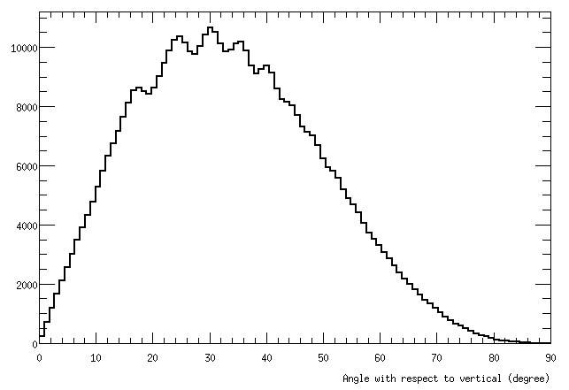
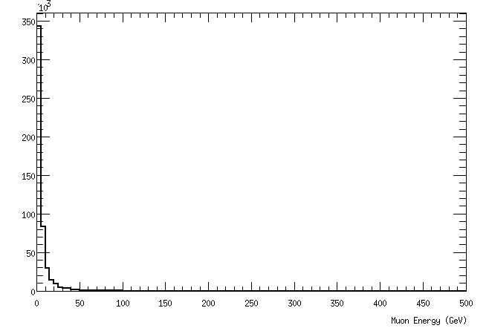
Sea – level : remnants of primary CRs – essentially muons (and neutrinos)
Few Horizontal muon
Low energy
Angle with respect to the vertical
Muon Energy (GeV)

Slide 6
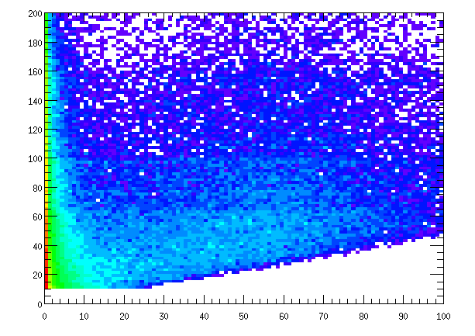
We are interested in rather high energy muons , otherwise they are absorbed in the tumulus before reaching the detector
Muon Energy (GeV)
Distance crossed by the muon in Tumulus (m)

Slide 7
Acceptance Studies
Methods and prelim. Results

Slide 8
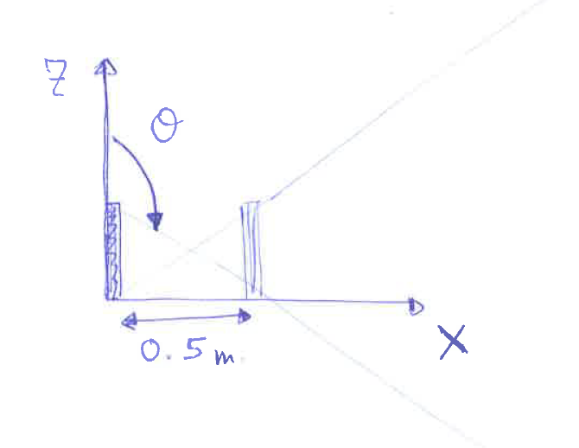
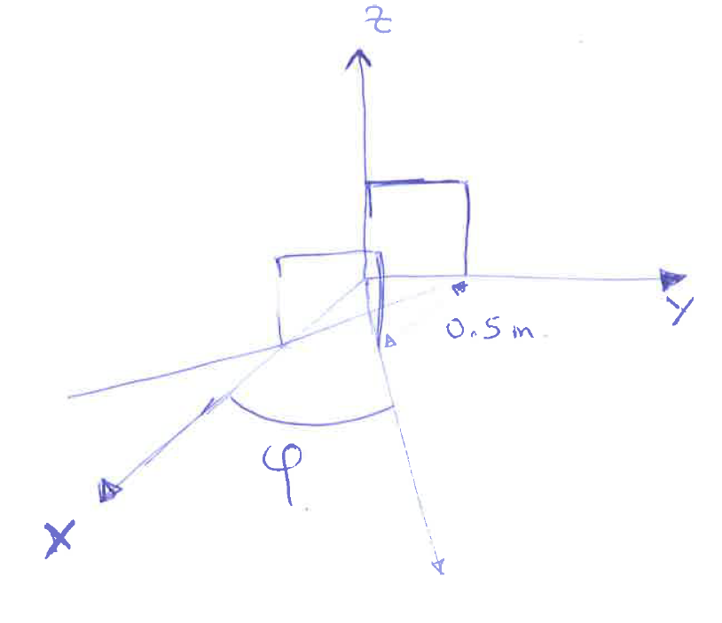
Toy MC
Generate random Y & Z on a 1 square meter. (~= 1 chamber) at X = 0.
Generate φ in [-π;+π]
Generate θ in [0;π ]
Extrapolate track to X = 0.5 m (resp 2 m)
Retain tracks that crosses the second chamber ie
0 < Z < 1m
0 < Y < 1m @ X =0.5 m (resp 2m)

Slide 9
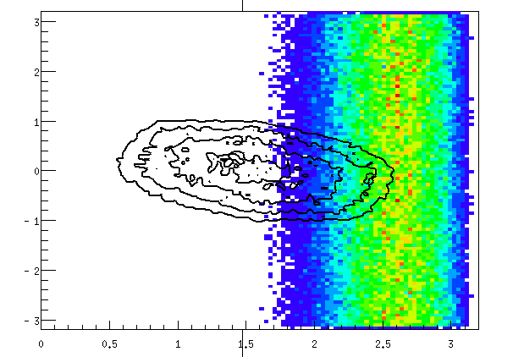
2 det. with 50 cm spacing (for illustration)
Θ and φ of generated CRs (CRY simulation)
Phi
Detector acceptance
Projected
Theta
Inclined detector will move the pattern to the right

Slide 10
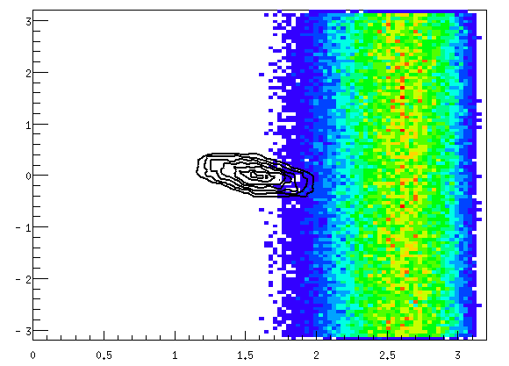
2 det. with 2m spacing (for illustration)
Phi
Theta

Slide 11
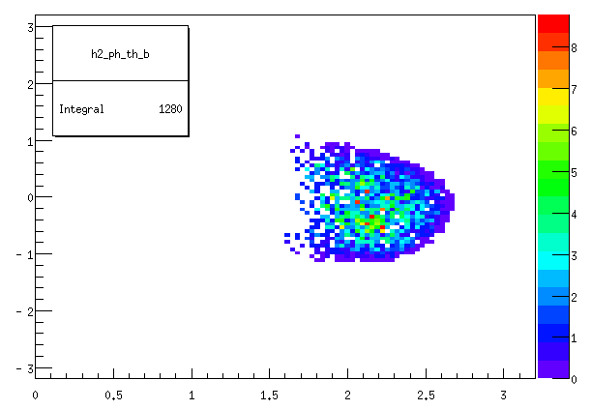
Number of muons per (θ,φ) bin = Number of generated * efficiency of the detector normalized by the time (gen.SimulatedTime /CRY)
Muons (E>20 GeV ) per hour in the “toy” detector
Detector horizontal

Slide 12
Exp Muons per hour in the det acceptance (w/o tumulus)
Emin (GeV) | Lbox = 300 m Horizontal | Lbox =10m Horizontal | Lbox = 300 m Det @ 20deg
8 | 3830 | 4920 | 9107
10 | 2980 | 3910 | 6920
15 | 1830 | 2470 | 4095
20 | 1280 | 1740 | 2785
25 | 900 | 1220 | 1907
50 | 300 | 430 | 600
100 | 70 | 110 | 135

Slide 13
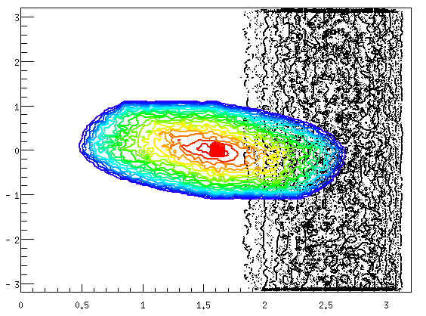
Solid Angle of the monument (seen from the detector)
Det @ y = 31.5 m x = 49.0 m z = -0.5 m
The monument

Slide 14
Full simulation
Define geometry : Tumulus, monument, detectors
Generate muons using an energy parametrization from CRY, and limited θ and φ range
Track each muon through matter, tumulus soil, marble air, detector material etc and record hits on the detectors if any.
Reconstruct the muon track if detected inside the detector layers

Slide 15
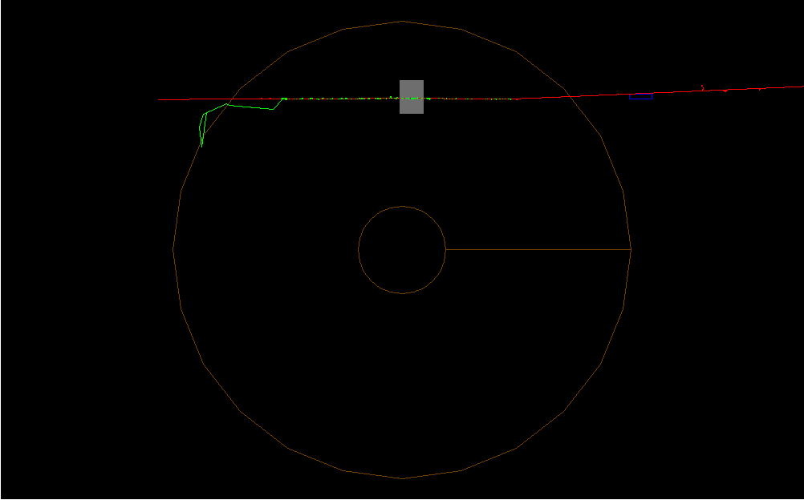
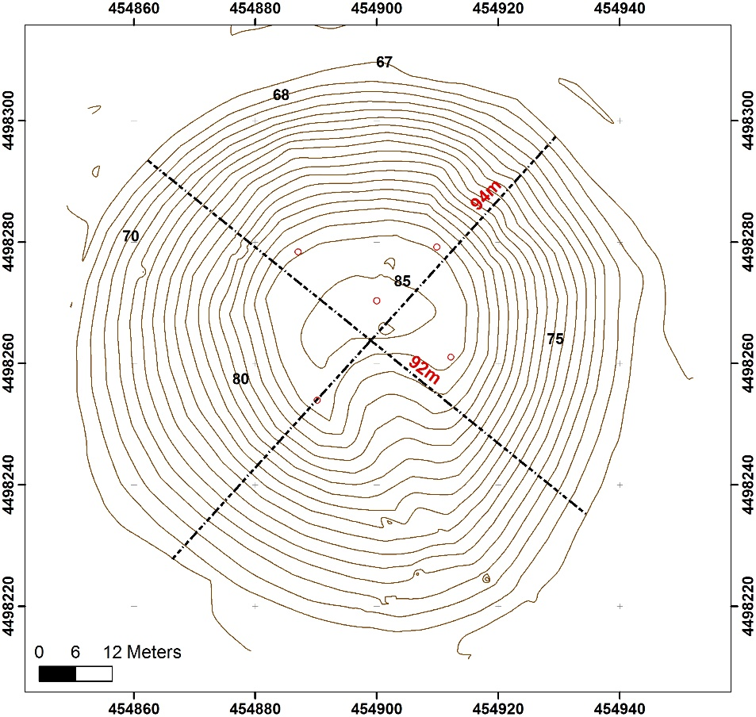
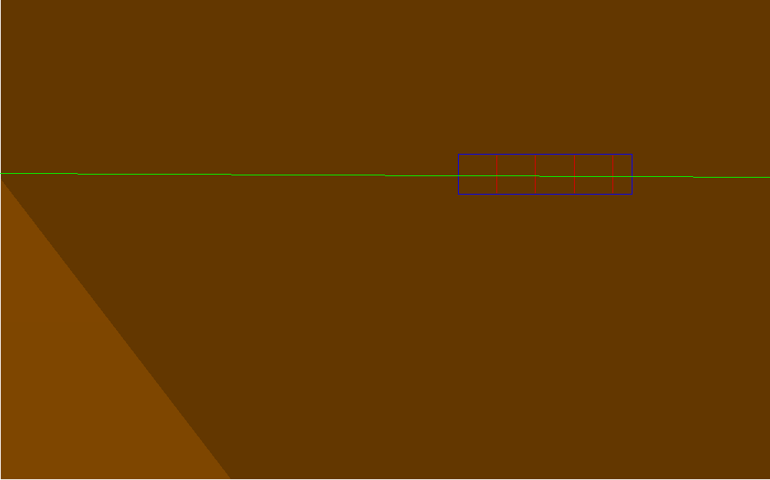
Simulation layout
Tumulus : Cone R_bottom =47m R_top = 9m Dirt with d=2.3gr/cm3
Tomb: Size5x5x7 m, walls 1m thick (CaCO3 or Pb!) placed inside tumulus at R=31.5m and 2.5m below the ground. Air inside tomb
Detector : 4 1x1 m2 layers placed at R=49m in front of the tomb

Slide 16
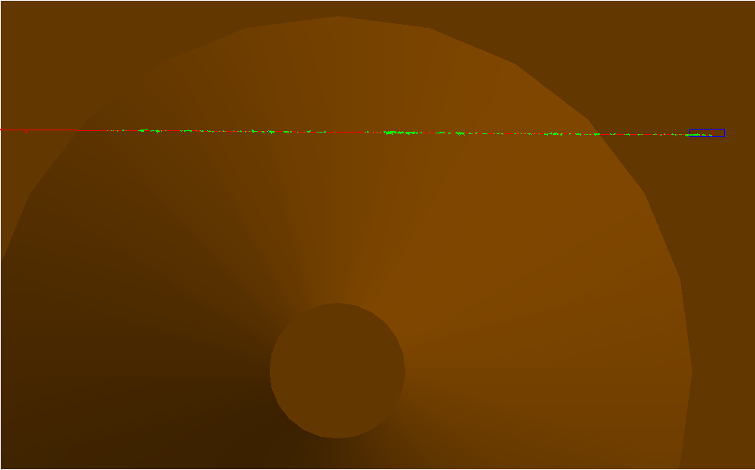
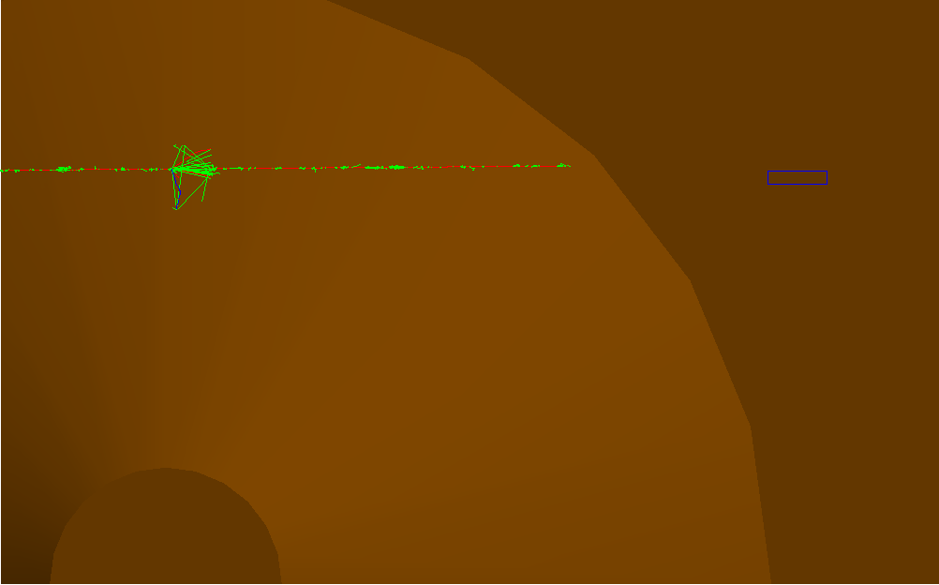

Slide 17
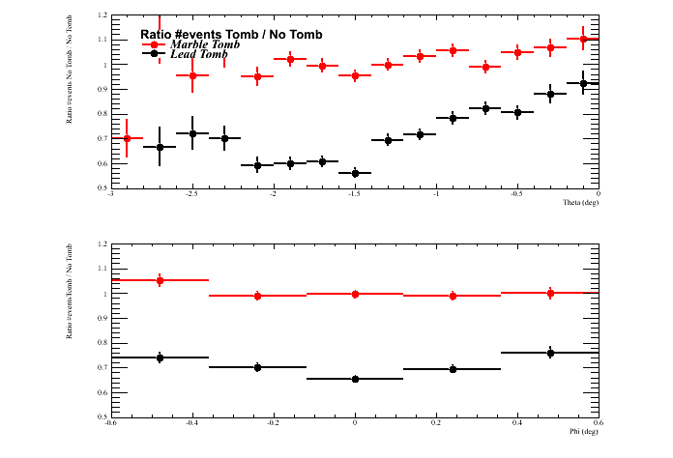
Two tombs were simulated :
A marble tomb
A lead Tomb !
1.2 M events generated to cross the monument if it is there
87 ° < θ < 90° and -0.6 ° < φ < 0.6 °
3 runs : 2 with tombs and 1 without any monument

Slide 18
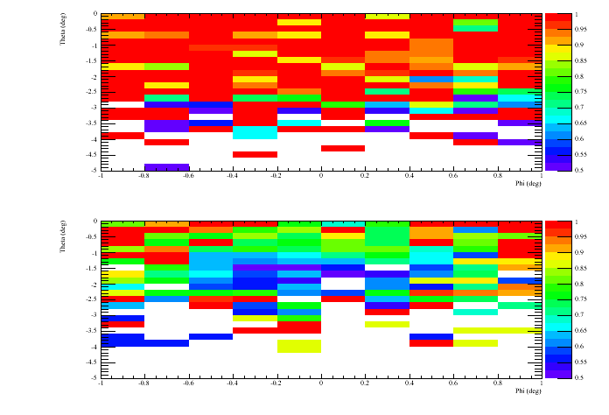

Slide 19
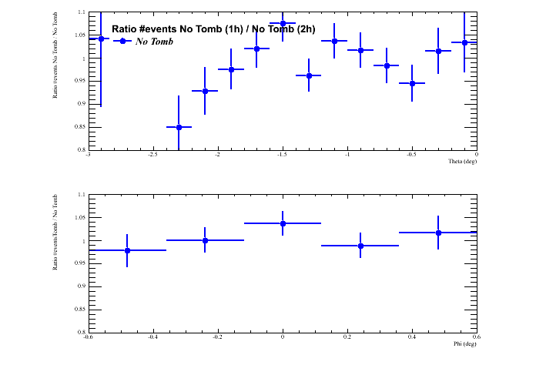
We have 1.2 M events without any monument.
Using 1st half (1h) of them to compare with second half (2h)

Slide 20
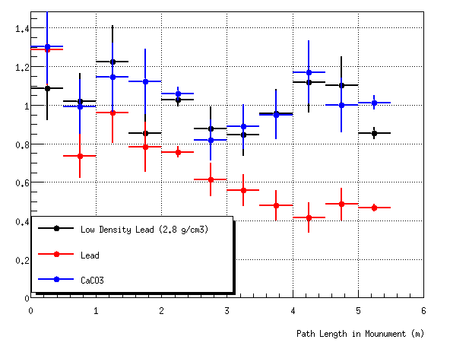

Slide 21
Conclusion
Detecting a monument inside a tumulus will not be an easy task
Low statistics
Standard dirt and marble not very different
Impove simulation
Use a different model (Fluka) for cross check
Input real soil composition. Need some chemical analysis.
Compare with data
My proposal :
We have already one or two set of detectors. It is worthwhile to deploy them after March and make an exploratory run until summer.
Depending on findings, improve simulation and decide on a longer campaign

