Slide 1
CNRS COOPERATION WITH CHINA

Slide 2
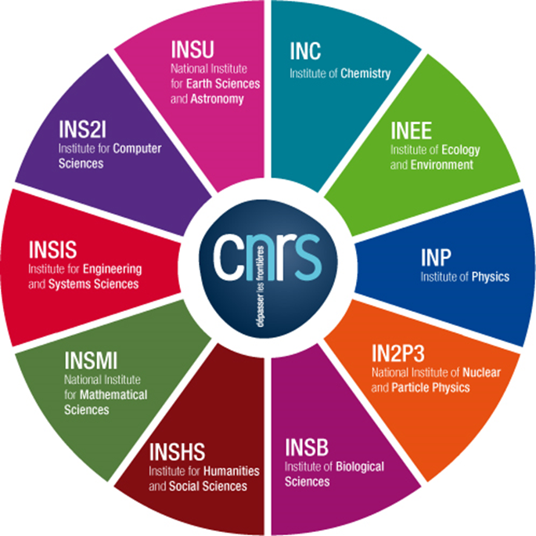
CNRS ORGANISATIONAL DATA
I Scientific & technological public organization, under administrative authority of the French Ministry of National Education, Higher Education and Research
I The largest fundamental research organization in Europe
I Research carried out in all fields of knowledge:
● Chemistry | ● Biological sciences
● Physics | ● Ecology & environment
● Mathematical sciences | ● Engineering
● Information sciences & technologies | ● Humanities & social sciences
● Earth Sciences & Astronomy | ● Nuclear & Particle Physics

Slide 3
RESOURCES & RESULTS UP TO OBJECTIVES
| A 33,000-strong workforce, including :
11,200 researchers and
13,700 engineers, technicians and administrative staff
I Over 1,100 research and service units - 95% joint research units (UMR)
I 43 000 publications per year on average
I 20 Nobel Prize laureates & 12 Fields Medal Winners
I 2014 budget: 3.272 billion €, including 701 m€ of CNRS-generated income

Slide 4
AN IMPORTANT ACTOR IN ECONOMIC LIFE
The CNRS develops productive relationships with industry, helps laboratories enhance their research and transfers technology to the business world
I The CNRS has entered into 25 framework agreements with large industrial groups. It has set up 84 associated research laboratories with businesses.
I A portfolio of 4,535 patent families
I More than 1,000 start-ups have been launched, stemming from research carried out in CNRS laboratories since 1999.

Slide 5
INTERNATIONAL RANKINGS
I Scopus/Scimago :
CNRS 1st, before the Chinese Academy of Science (CAS), the Russian (RAS), then Harvard
I Thomson Reuters/Web of Science :
CNRS 4th, after CAS, Max Planck & Harvard (but CNRS is 1st in citations number)
I Nature Index :
Nature Index
Institution Output
Article Count
Feburary 2014-
January 2015
20 first institutions, in publications number

Slide 6
CNRS & Innovation The world’s most innovative research institutions (Thomson Reuters 2015 ranking)

Slide 7
CNRS on the international scene

Slide 8
20 000 INTERNATIONAL COPUBLICATIONS PER YEAR (57 % of all CNRS publications)
CNRS copublications breakdown per country (2012-2013 average)
Data SCI Expanded --CPCI-S (Thomson Reuters) – processed by CNRS SAP2S & INIST

Slide 9
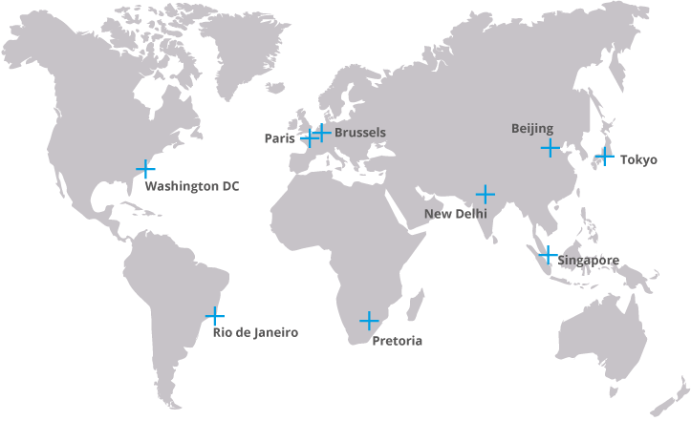
8 CNRS OFFICES ABROAD

Slide 10
KEY FIGURES OF CNRS-CHINESE COOPERATION
1223 visits of CNRS researchers in China in 2015
Humanities & Social sciences
Chemistry
Nuclear & Particle Physics
1360 Chinese PhD students in CNRS units
First represented nationality among foreign postdoc

Slide 11
A STRONG INTERNATIONAL PRESENCE
Through an active partnership and cooperation policy with other European and international research organizations, the CNRS:
I Contributes to promoting French research worldwide through 35 International Joint Units (UMI, 4 in partnership with industry), 22 research centers in the humanities and social sciences outside France
I Is involved in 172 International Associated Laboratories (LIA) and 101 International Research Networks (GDRI)
I Participates in 392 International Programs for Scientific Cooperation (PICS) and 49 Joint Research Projects (PRC)

Slide 12
Prospective cooperation tools: PICS & PRC
PICS: International Programmes for Scientific Cooperation
| based on an ongoing collaborative relationship
| researchers must respond to an annual call for proposals
| funding is dedicated to mobility: visits, meetings and small equipment | 3-year duration, not renewable PRC: Joint Research Projects
| researchers must respond jointly to a call for proposals
| implementation after a positive bilateral co-evaluation | 2 to 3 years, not renewable
participation of young researchers (Ph.D.s and postdocs) is strongly encouraged

Slide 13
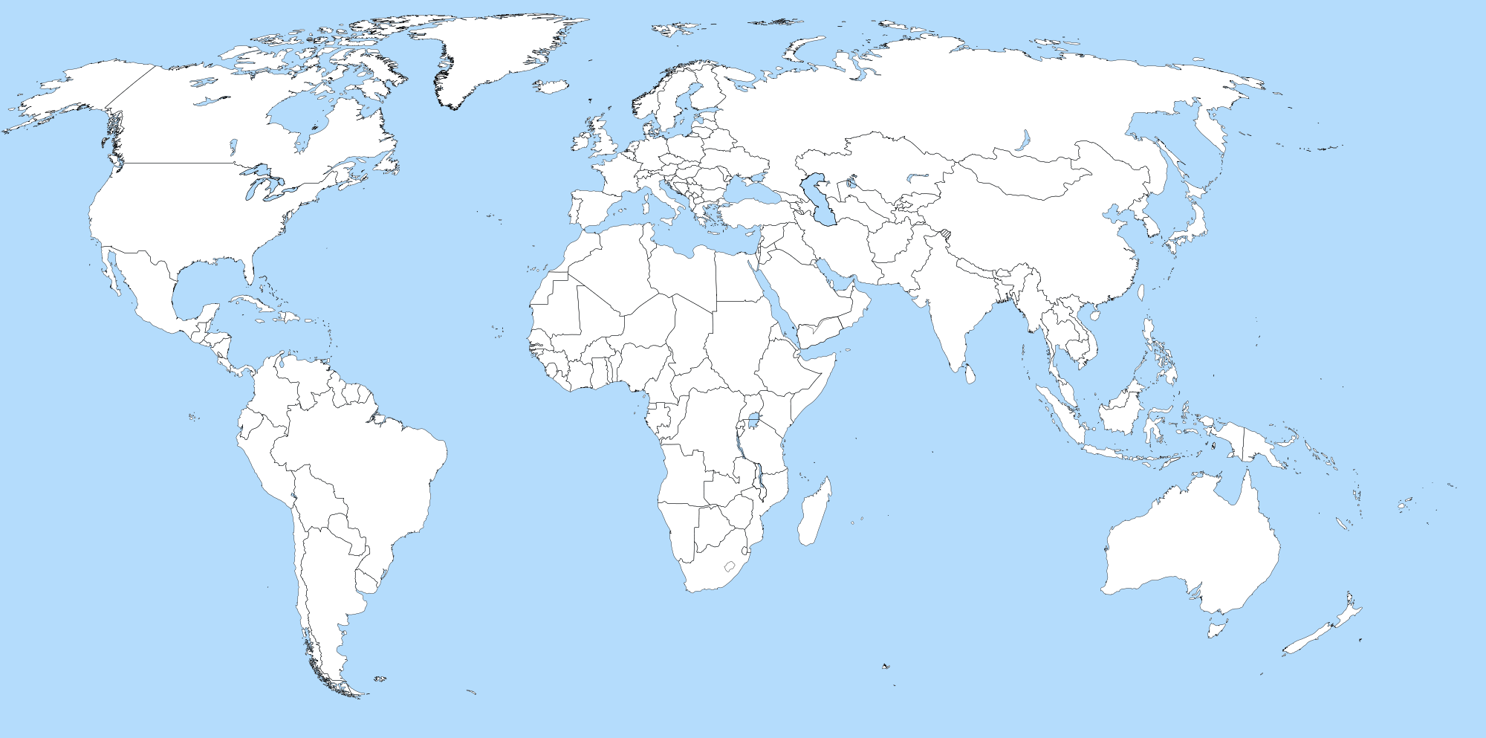
392(+54) PICS & 49 PRC in 55(-4) countries
18 PICS 13 PRC
Nb of PICS & PRC
1 to 2
3 to 7
8 to 14
15 to 26
27 to 38

Slide 14
Structuring cooperation tools: GDRI & LIA
GDRI: International Research Network
| brings together several laboratories from two or more countries to coordinate research on a specific topic
| funding is used mainly for mobility, seminars & workshops | 4 – 8 years
LIA: International Associated Laboratory
| brings together partner institutions which contribute human & material resources to a jointly-defined project
| the LIA is coordinated by 2 P.I. | joint funding for mobility, small equipment | 4 – 8 years

Slide 15
101(-2) INTERNATIONAL RESEARCH NETWORKS (GDRI) 3 countries involved on average
5 GDRI
Nb of GDRI
1 to 3
4 to 9
10 to 19
20 to 33

Slide 16
FOCUS ON GDRI WITH CHINA
Ecology & Environment
GDRI EHEDE
GDRI RFCCT
Chemistry
GDRI CeSMeR GDRI Photonet
Engineering
GDRI EuroAsiaTradeNet
Humanities & Social Sciences

Slide 17
172(+11) INTERNATIONAL ASSOCIATED LABORATORIES (LIA) in 46(+2) countries
18 LIA
Nb of LIA
1 to 2
3 to 6
7 to 14
15 to 19

Slide 18
FOCUS ON LIA WITH CHINA
LIA SCSD-FCLAB,
LIA METISLAB
LIA FOM
LIA BioMNSL,
LIA FCPPL,
LIA MONOCL,
LIA ORIGINS,
LIA CHINE Q,
LIA POSTWESTSOCIO,
LIA G-quadruplex-HELI
LIA PER,
LIA SFMA,
LIA VIRHOST,
LIA Hematology & cancer
LIA LSFM
LIA LMTM
LIA NanoBioCatEchem,

Slide 19
UMI
UMI: International Joint Unit
| joint lab in single location
| Staffed by personnel from both the CNRS and the partner country
| located either in France or in another country | headed by a Director, jointly appointed by CNRS & partner institution | 4 years possibly renewable twice after evaluation of the UMI activity
Mirror structure: associated labs in France to facilitate cooperation & reciprocal exchange of scientists

Slide 20
35 INTERNATIONAL JOINT UNITS (UMI) in 17 countries
UMI E2P2L
Number of UMI
1
2
4
5
6

Slide 21
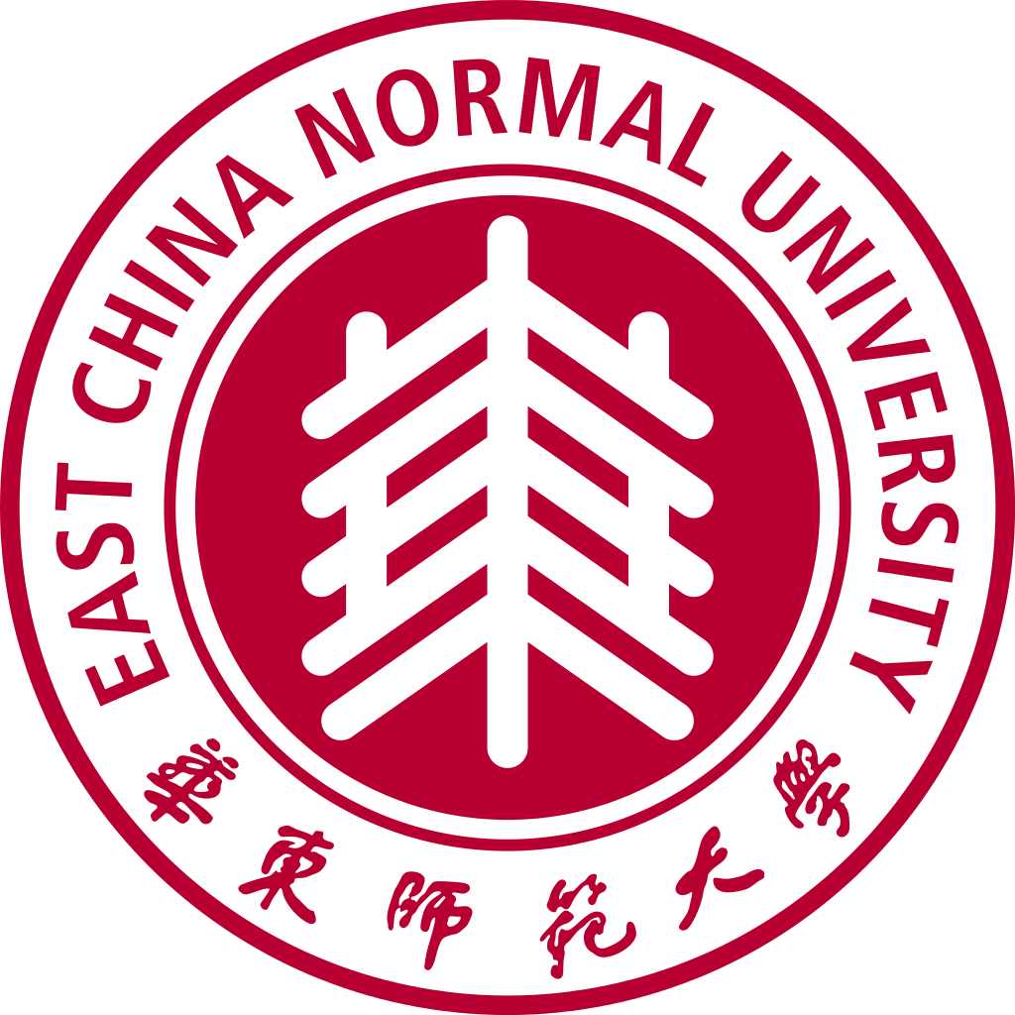
UMI E2P2L (Eco-Efficient Products & Processes Laboratory)
Established in 2011 (CNRS Institute of Chemistry)
STAFF
11 permanent staffs
5 postdocs
4 PhDs
15 interns
Mirror laboratory in Lille

Slide 22
International cooperation budget 2015 per country including UMI salaries

Slide 23
Thank you for your attention

