Slide 1
Le cycle du carbone et le changement climatique
Philippe Ciais and Chris Sabine

Slide 2
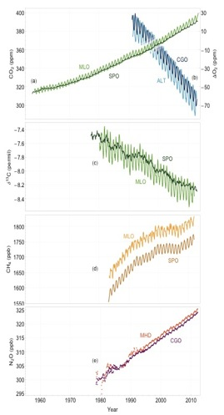
CO₂, CH₄ and N₂O increase in the Industrial Era
Ice core records
Atmospheric monitoring

Slide 3
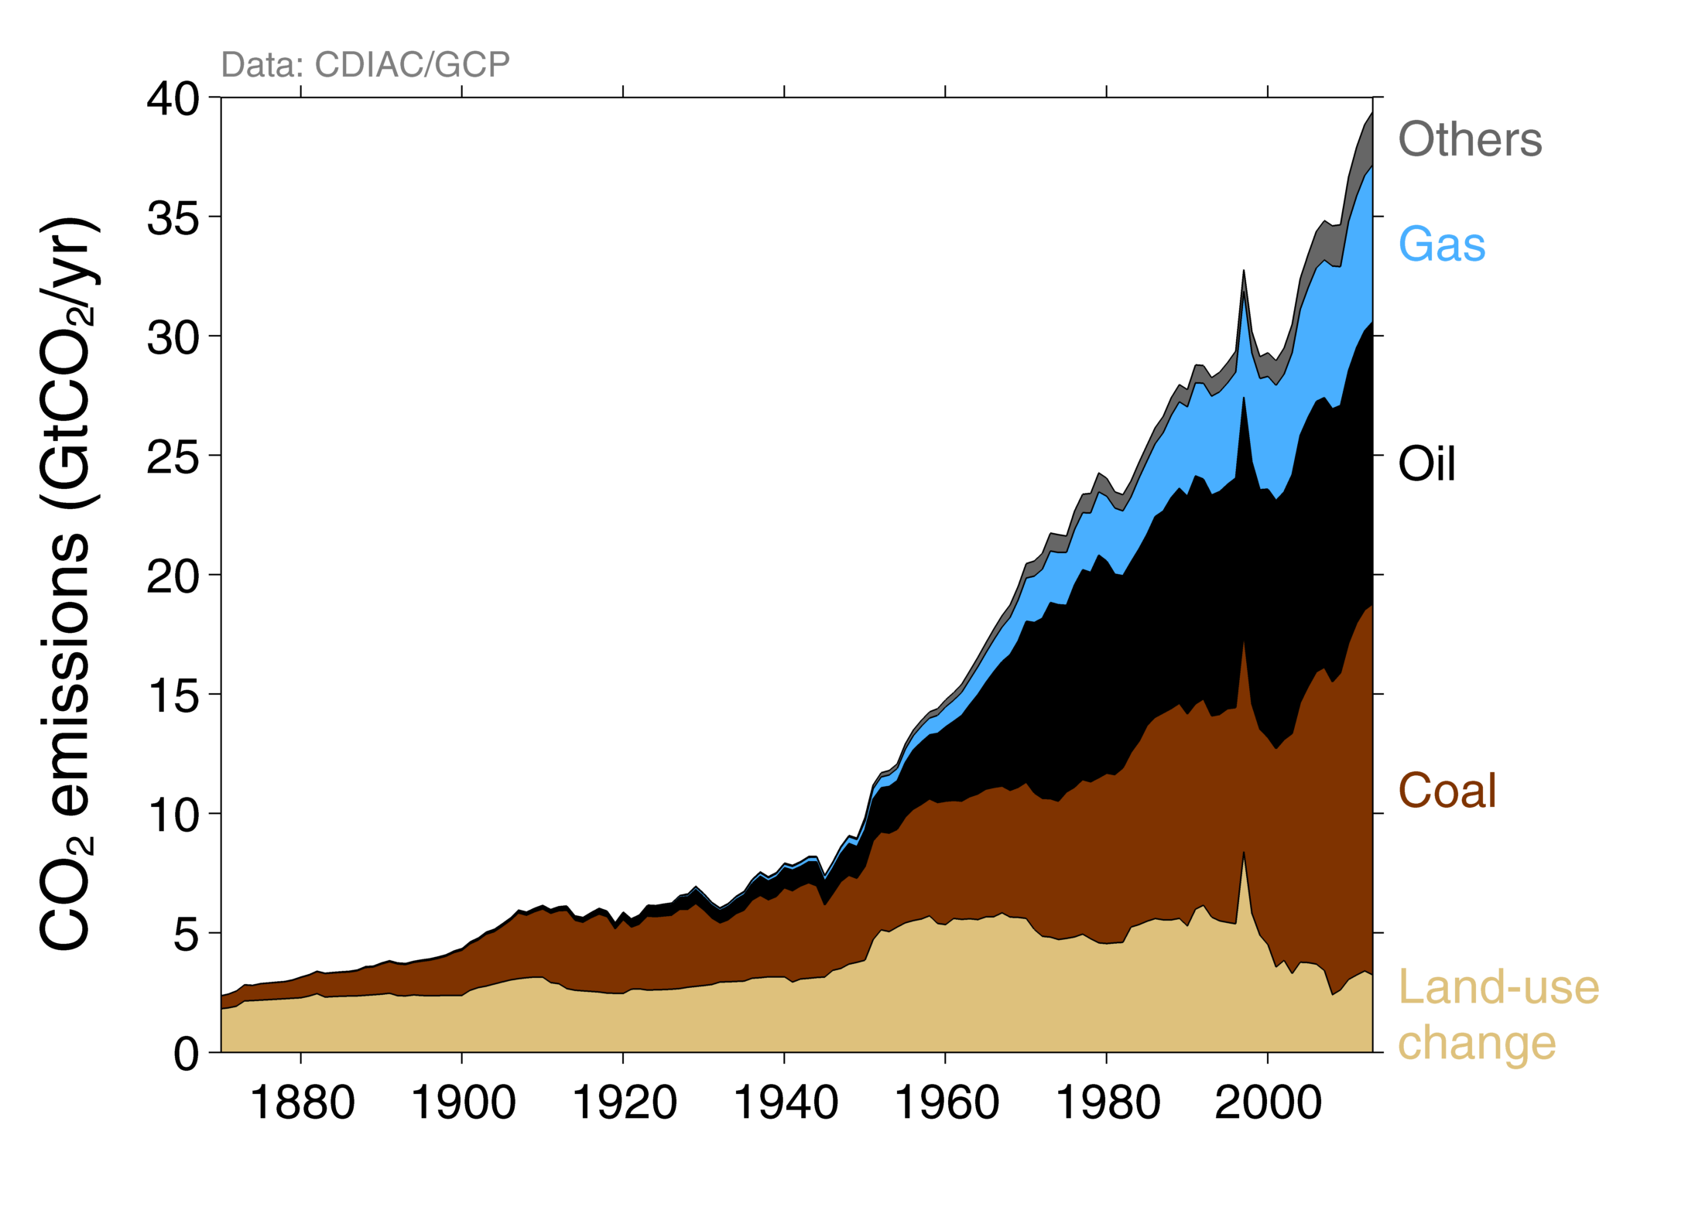
Historical anthropogenic CO₂ emissions
Land use change has been the main contribution to emissions before 1950
Acceleration after WW2, with no substitution between fuels
Others: Emissions from cement production and gas flaring
Source: CDIAC; Houghton et al 2012; Giglio et al 2013; Le Quéré et al 2014; Global Carbon Budget 2014

Slide 4
CO₂ remains in the atmosphere long after emissions

Slide 5
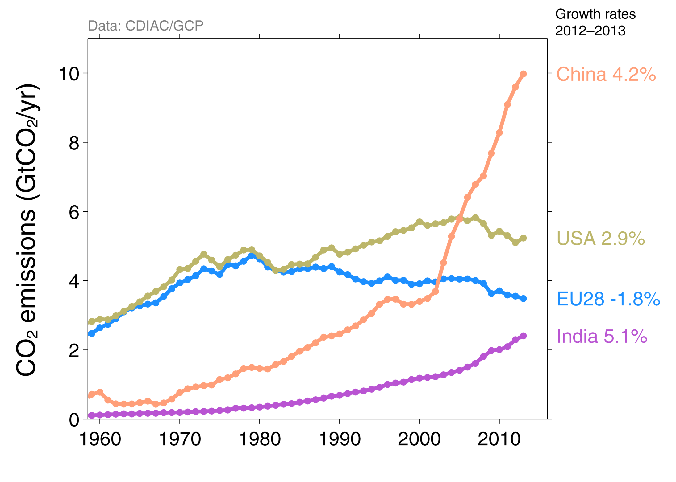
Top Fossil Fuel Emitters (Absolute)
The top four emitters in 2013 covered 58% of global emissions
China (28%), United States (14%), EU28 (10%), India (7%)
Bunkers fuel used for international transport is 3% of global emissions
Statistical differences between the global estimates and sum of national totals is 3% of global emissions
Source: CDIAC; Le Quéré et al 2014; Global Carbon Budget 2014

Slide 6
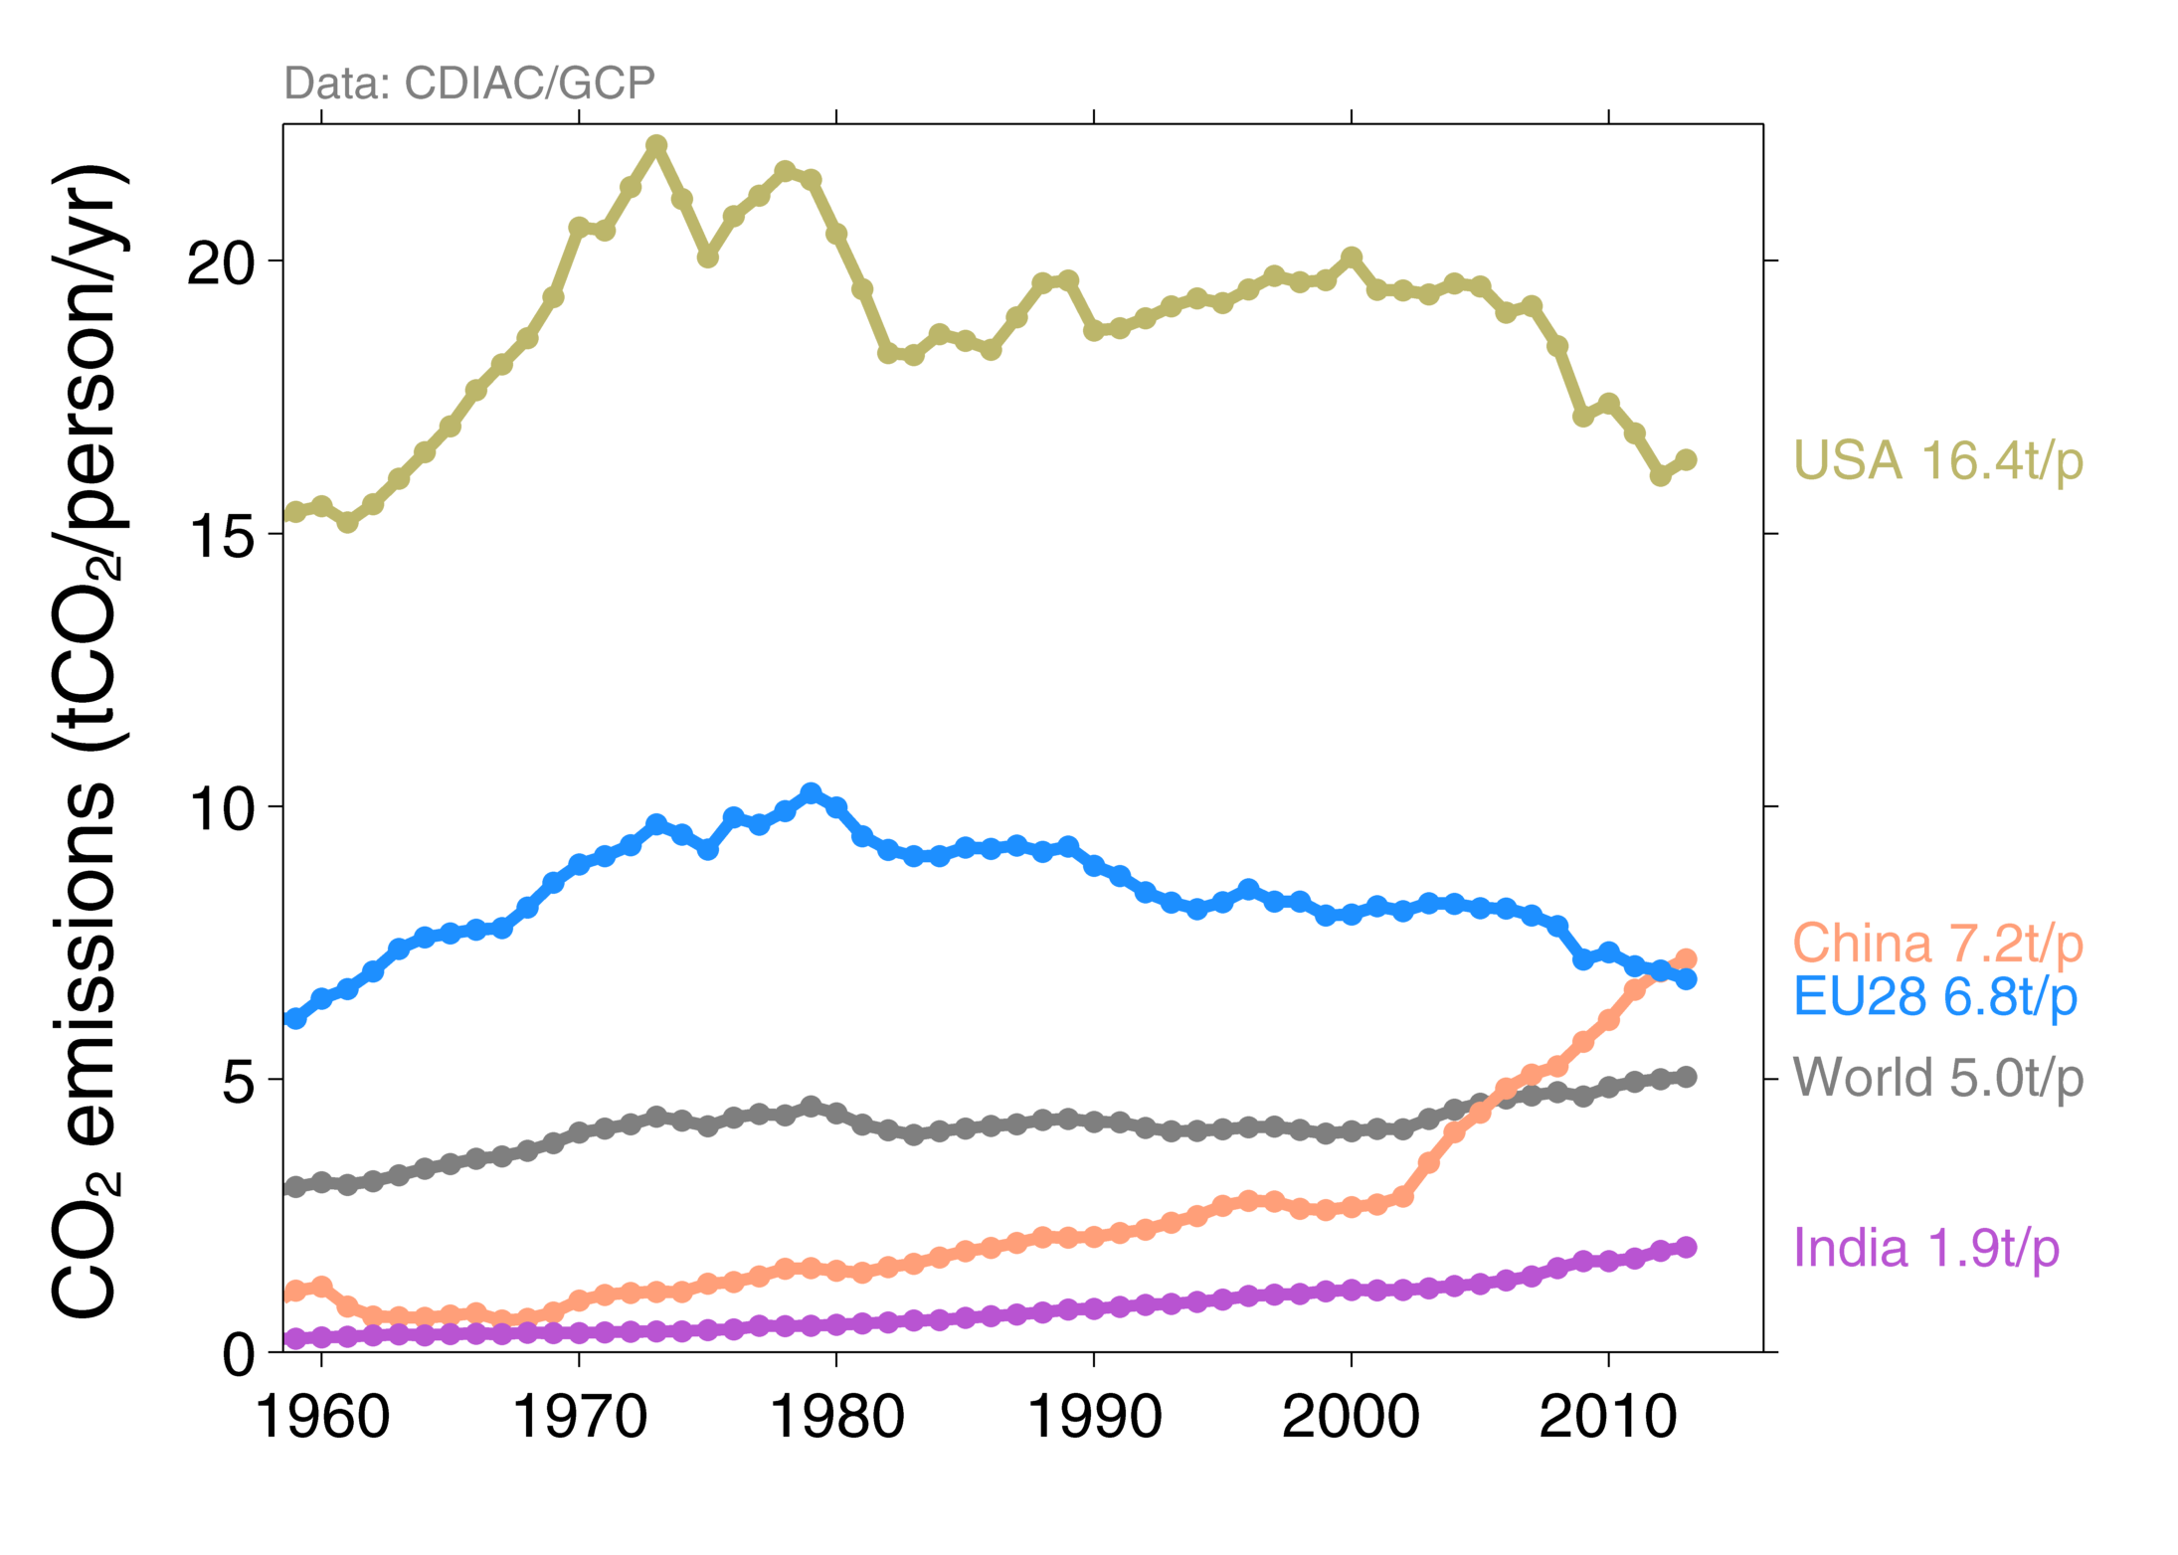
Top Fossil Fuel Emitters (Per Capita)
China’s per capita emissions have passed the EU28 and are 45% above the global average
Per capita emissions in 2013
Source: CDIAC; Le Quéré et al 2014; Global Carbon Budget 2014

Slide 7
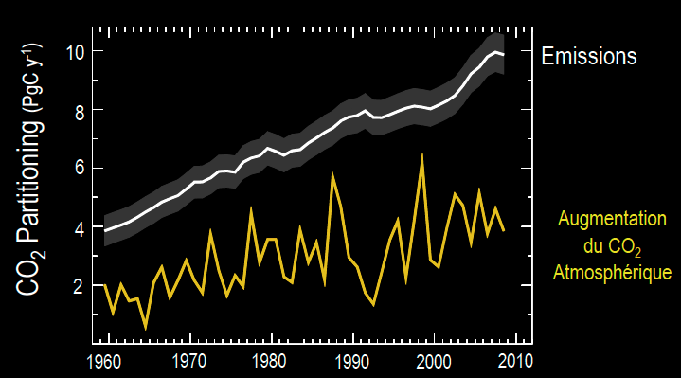
Only half of emissions accumulates into the atmosphere

Slide 8
The global carbon budget
Emissions of fossil fuels are estimated from energy use statistics
After Lequéré et al., 2014
The global ocean sink is constrained by ocean interior measurements
But the global land sink cannot be quantified by land observations
Notes:
In the global carbon budget, fossil fuel emissions are only known from statistical data reported by emtting countries themselves, land use emissions are approximated using for instance satellite imagery about forest loss. The best known term, is the atmospheric increase (the fraction of emissions which increases the Earth greenhouse effect) is really very well known, thanks to continuous and accurate in-situ monitoring of atmospheric CO2. The ocean sink is partly constrained by observations in the ocean interior, and models. But the land sink cannot be directly measured, because ecosystem fluxes are very heterogeneous and temporally variable, and is deduced as a residual. The land sink is the most uncertain carbon flux today in the global carbon budget

Slide 9

Where are the uncertainties on current carbon fluxes ?
Fossil fuel emissions
Their uncertainty is increasing with time – we are losing our anchor.
No reliable information about spatial & temporal patterns.
Ocean fluxes
Models disagree on the magnitude and trends of regional fluxes
Land fluxes
Long lasting controversy about the exact location of land sinks
Without accurate regional budgets, we cannot separate processes
Sensitivity of land fluxes to climate
Globally, the land sink is highly sensitive to climate variability
The contribution of each region to this signal is uncertain
Extreme climate events may switch sinks into sources in some regions
Notes:
What are the key uncertainties in the carbon budget ?
Well, first of all, an important point is that emissions no longer have a “small” uncertainty : their uncertainty increased with time, as emerging economies contribute today most of the emissions and have less accurate energy use statistics. So we are “losing the anchor” of the global budget. Further, no reliable information about the spatial details of emissions
For the ocean, the broad patterns of the fluxes are globally known, but models disagree about the magnitude and trend of regional fluxes, even at the scale of large gyres. For land, we still have a controversy on whether the largest sink lies in intact tropical or in northern forests, and land data are so sparse that without accurate regional budgets, we cannot separate the processes driving fluxes
Further, as seen before, the land sink is highly sensitive to climate variability, but the contribution of each biome and region to this signal is uncertain. Further, several recent discoveries have shown that extreme climate events may even turn a sink region into a source

Slide 10
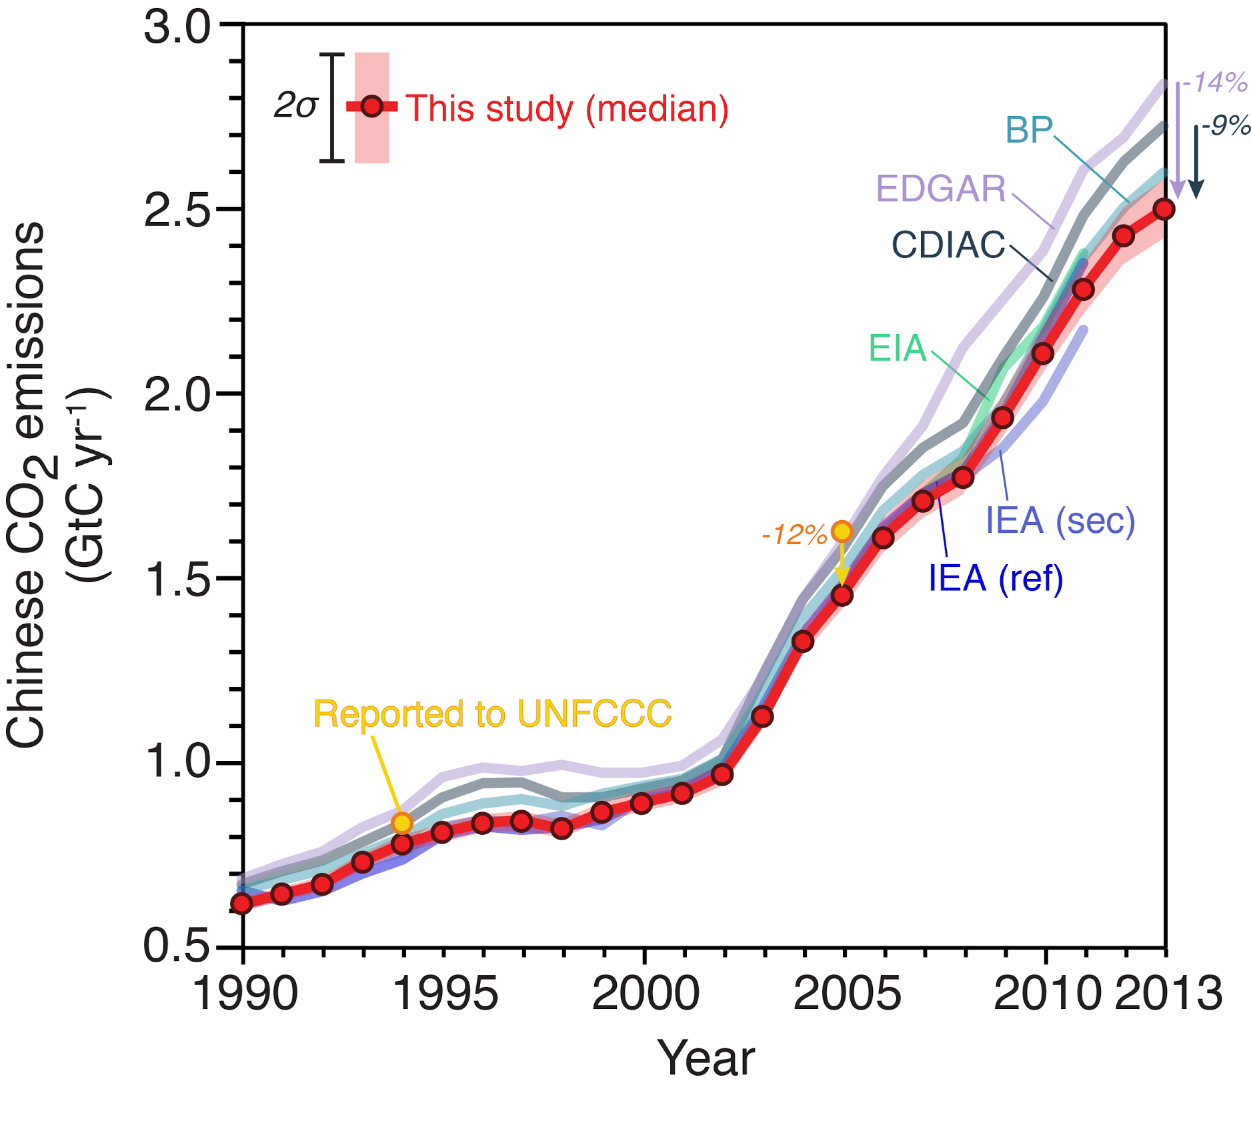
Country scale : Uncertainty of CO₂ emissions from China …
Liu et al.
based on new coal carbon content measurements from Chinese mines and coal samples
Liu et al. Nature, 2015
This 14% correction of emissions translates into adjusting the global land sink (residual) by 0.4 GtC yr⁻¹ (~30%)
Notes:
Now, some examples to illustrate this. This graph is from a very recent publication from this summer. Using new data about the carbon content of coal fuels, Chinese emissions were revised downward by 9 to 14%. This 14% reduction in the emissions of the largest emitter translates in the budget into a lower land sink by 0.4 PgC. This is about the size of the entire forest sink in the US !

Slide 11
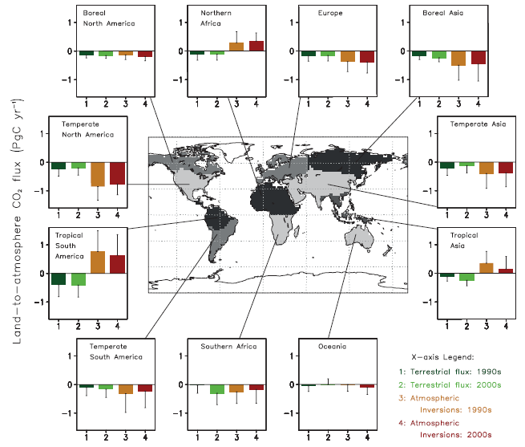
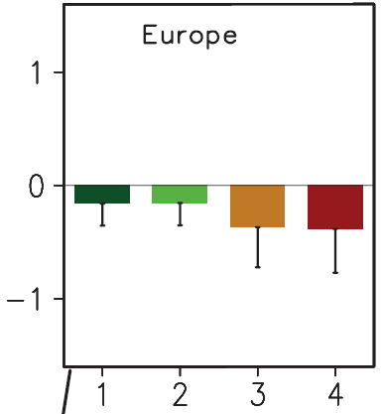
The global carbon cycle can only be understood by quantifying regional fluxes
Ecosystem models poorly represent mortality and land-use change
No atmospheric station in this region
Bottom-up
Top-down
1990s
2000s
CO₂ flux GtC yr⁻¹
Ecosystem models did not include land management and nitrogen deposition
Even over Europe, too few atmospheric stations result in large errors
Source – IPCC AR5
CO₂ flux GtC yr⁻¹
Source – IPCC AR5
Source – IPCC AR5
Large discrepancies between bottom-up models and atmospheric inversions
Tropics and high latitudes regions have almost no observation
Large uncertainties ~100% on regional budgets !
Notes:
The mechanisms controlling fluxes differ between regions, but unfortunately, regional budgets (here sub-continental scale) are poorly known. For instance in Europe, ecosystem models ‘bottom up’ tend to produce lower sink estimate than ‘top-down’ inversions. On the one hand, ecosystem models often lack key processes important in this region such as land management and nitrogen deposition effects. On the other, even in this regions with several atmospheric stations, inversions have an uncertainty as large as the mean. In the Amazon, the situation is worse. Bottom up and top-down disagree on the sign of the carbon flux of this region. Up to recently, there was no atmospheric station in South America. Clearly, the Tropics and the high latitudes are “hot-spot” of the carbon cycle but their budget is not known because of two few observation

Slide 12
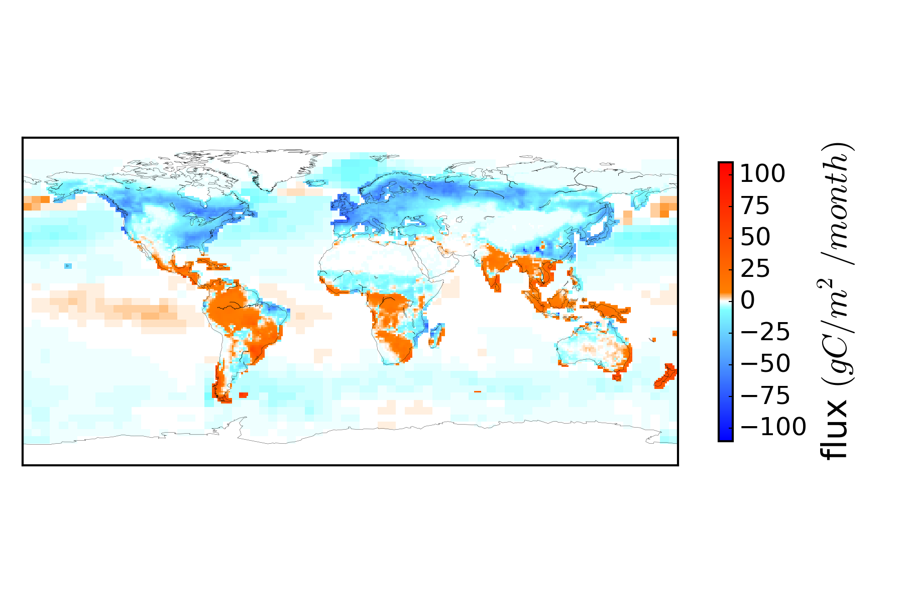
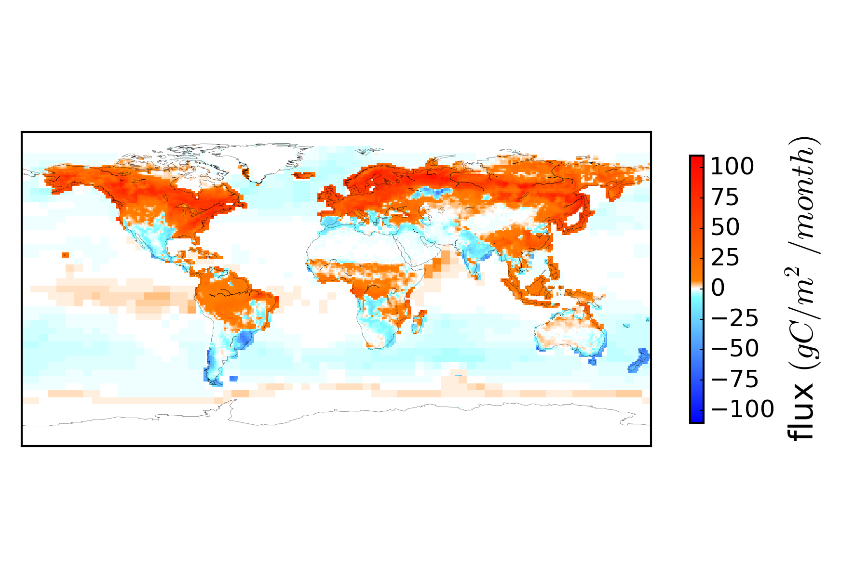
… and how they vary in time
CO₂ fluxes in summer (Jul-Sep)
CO₂ fluxes in winter (Jan-March)
CO₂ release
Soil respiration
CO₂ release
Fire emissions
Uptake by land biosphere
Equatorial
upwelling
source
Land use change
Southern
Ocean uptake
CO₂ uptake
CO₂ uptake
Northern lands are net sources in winter (respiration)
And net sinks in summer (photosynthesis > respiration)
Knowledge of photosynthesis alone will not tell us if a region is a net source or sink of CO₂
Northern lands are net sources in winter (respiration)
Notes:
Further, annual budgets result from time varying processes and fluxes. The northern land are emitting CO2 to the atmosphere because of soil respiration, whereas in summer these regions take up CO2 as photosynthesis exceeds respiration. This, measuring photosynthesis only will not give us much clue on whether a region is a net source or sink of CO2

Slide 13
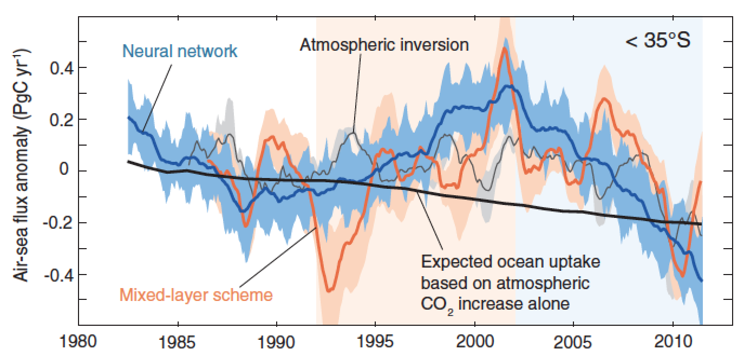
Decadal changes in the southern ocean uptake of CO₂
(Landschutzer et al. 2015)
Cycle du Carbone très dynamique ?
Suivi de long-terme nécessaire ?

Slide 14
Global Carbon Budget
Since 1750, human activities have emitted 555 ± 85 PgC from fossil fuel burning and land use change
Fossil fuel CO₂ emissions were 10 PgC yr⁻¹ in 2015, 61% above their 1990 level
Over the past 50 years, a fraction of 44 ± 6 % of emissions remains in the atmosphere, increasing the Earth’s greenhouse effect

Slide 15
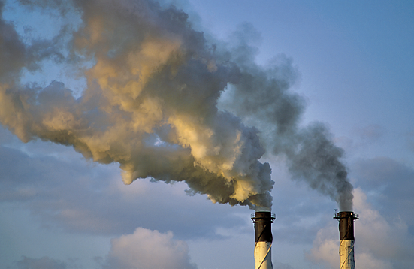
Future projections of the carbon cycle
Use of emission scenarios determined by contrasted socio-economic trajectories
Pg C y⁻¹
Emissions
Fortes
Emissions
Contrôle des
Emissions

Slide 16

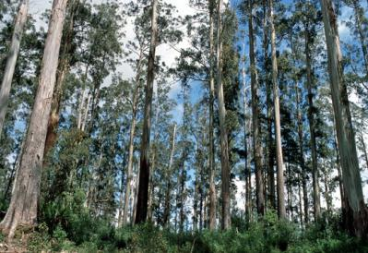

Future projections of the carbon cycle
Emissions
CO₂ atmosphérique
+
+
+
Continents :
Fertilisation
des ecosystèmes
Océan :
Dissolution du CO₂
en excès

Slide 17
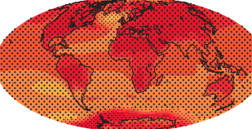
Future projections of the carbon cycle
Emissions
CO₂ atmosphérique
Changement Climatique
+
+
+
+
Continents :
Fertilisation
des ecosystèmes
Océan :
Dissolution du CO₂
en excès

Slide 18
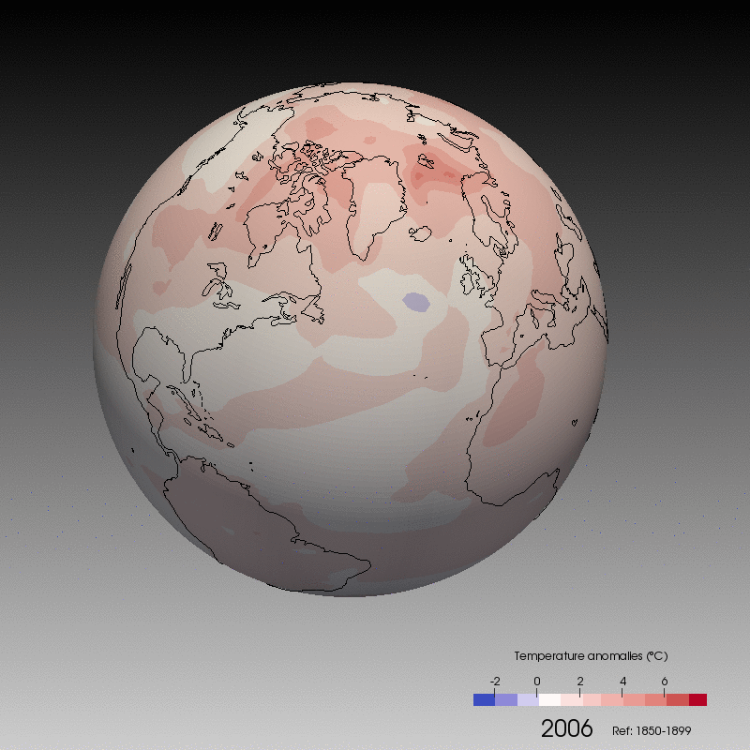
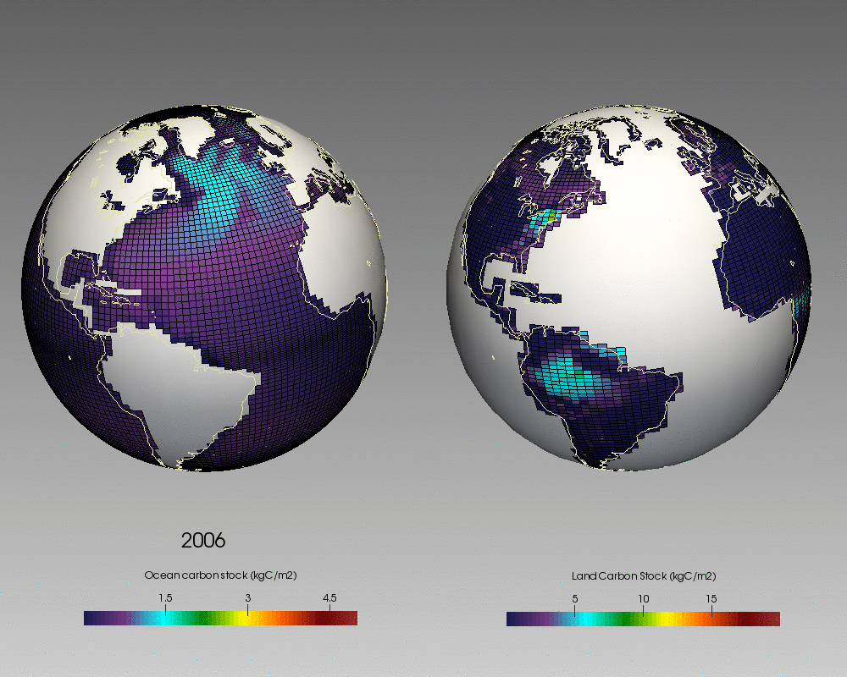
Future projections of the carbon cycle
Simulation Climat-Carbone avec le modèle de l’IPSL (RCP8.5, 21ème siècle)
Carbon stocks
Stocks de Carbone
Surface temperature anomalies
Videos : P. Brockman, LSCE

Slide 19
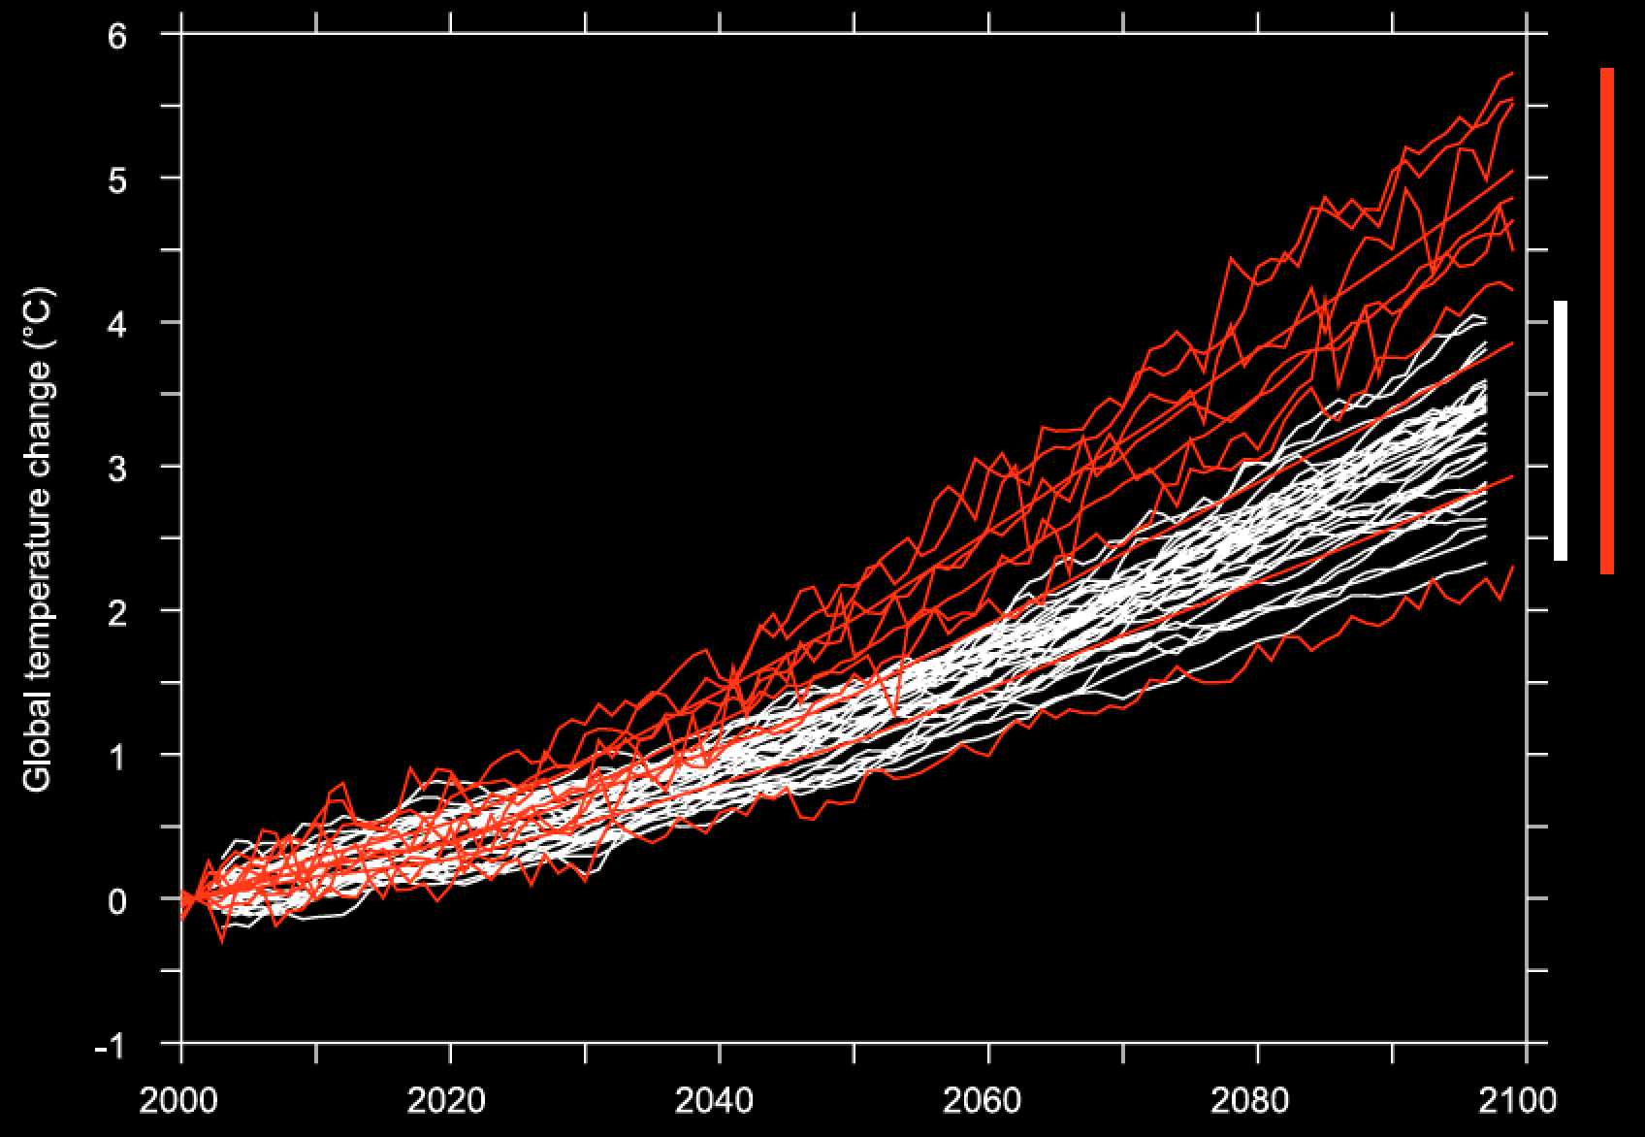
Future projections of the carbon cycle
L’amplitude de la rétroaction est estimée (avec les modèles)
3 et 15 ppm/°C → Forte incertitude !
?
Emissions
CO₂
Climat
Puits
Estimation du réchauffement
sans et avec
la rétroaction
climat-carbone
(Cadule et al. 2009)
Changement de Température (°C)

Slide 20
Compatible emissions for given concentration pathways
Uncertainties in modeled land and ocean carbon storage translate into uncertain compatible emissions

Slide 21
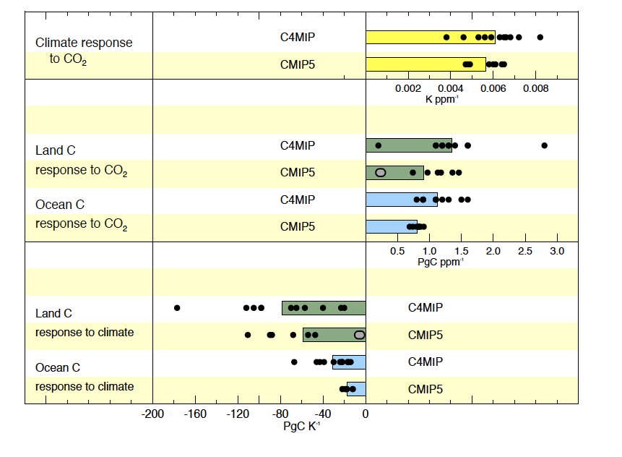
Positive carbon climate feedbacks confirmed in AR5
Climate response to CO₂
Sinks response to CO₂
Sinks response to climate
Climate change will affect carbon cycle processes in a way that will exacerbate the increase of CO₂ in the atmosphere (high confidence)

Slide 22
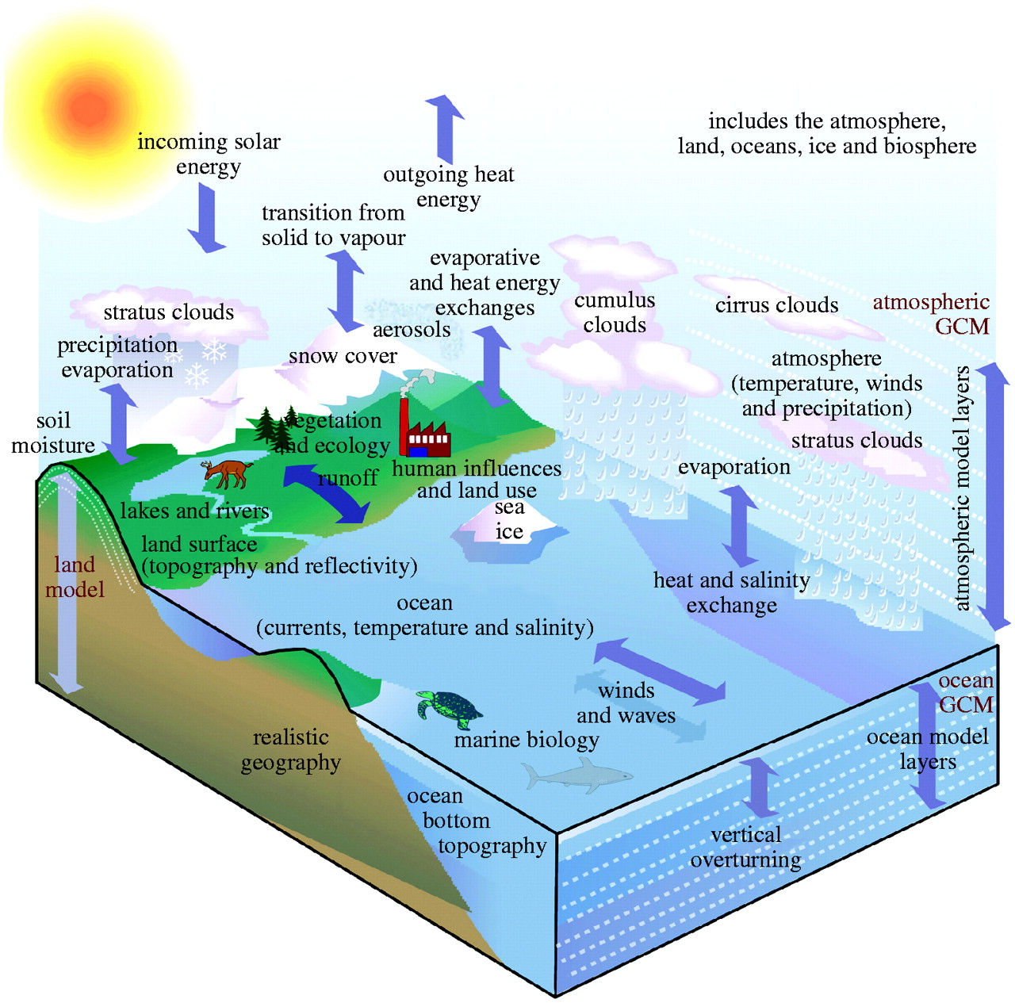
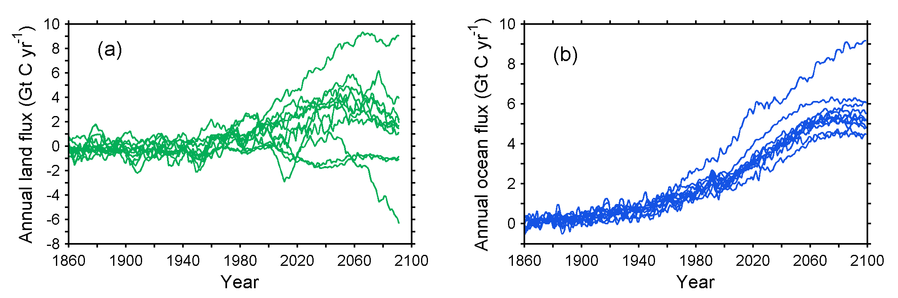
  Natural sinks and sources will change under climate change pressure
Earth System Models
Land flux projections
Ocean flux projections
All coupled carbon cycle climate models project a weakening of sinks in response to climate change
Models strongly disagree with each other – their bias for the future are correlated with their bias for the present
Notes:
In the future all coupled carbon climate models (ESMs) consistently project that sinks over lands and oceans will become weaker in response to climate change, a positive feedback on global warming. When forced by the same emission economic scenario. Current models strongly disagree on the magnitude of this feedback. The future bias of models has been shown however to correlate with their present-day bias, which gives us the possibility to use current observations on regional budgets to reduce the spread of future projections. For this, we need global maps of net CO2 fluxes in each region, and of their variability. This is exactly what CarbonSat will deliver

Slide 23
Carbon vs physical parameters uncertainty

Slide 24
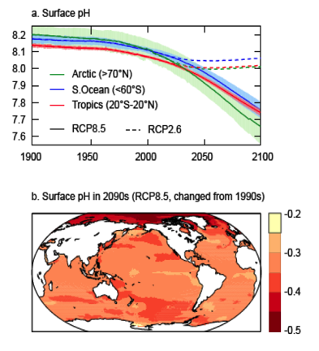
Ocean acidification
Surface pH
Surface pH change in 2090s from 1990s
Further uptake of carbon by the ocean will increase ocean acidification Virtually certain
Aragonite vulnerable in parts of the Arctic and some coastal upwelling systems within 1 decade, in parts of the Southern Ocean within 1-3 decades
How will ocean acidification affect marine ecosystem services?
Notes:
continuing the observed trends of the past decades
Aragonite – surface water and seasonaly

Slide 25
land-use emissions scenarios & evaluation
Land use emissions were not separated from other land fluxes in Earth System Models for the previous IPCC assessment
All RCP pathways have low land use emissions

Slide 26
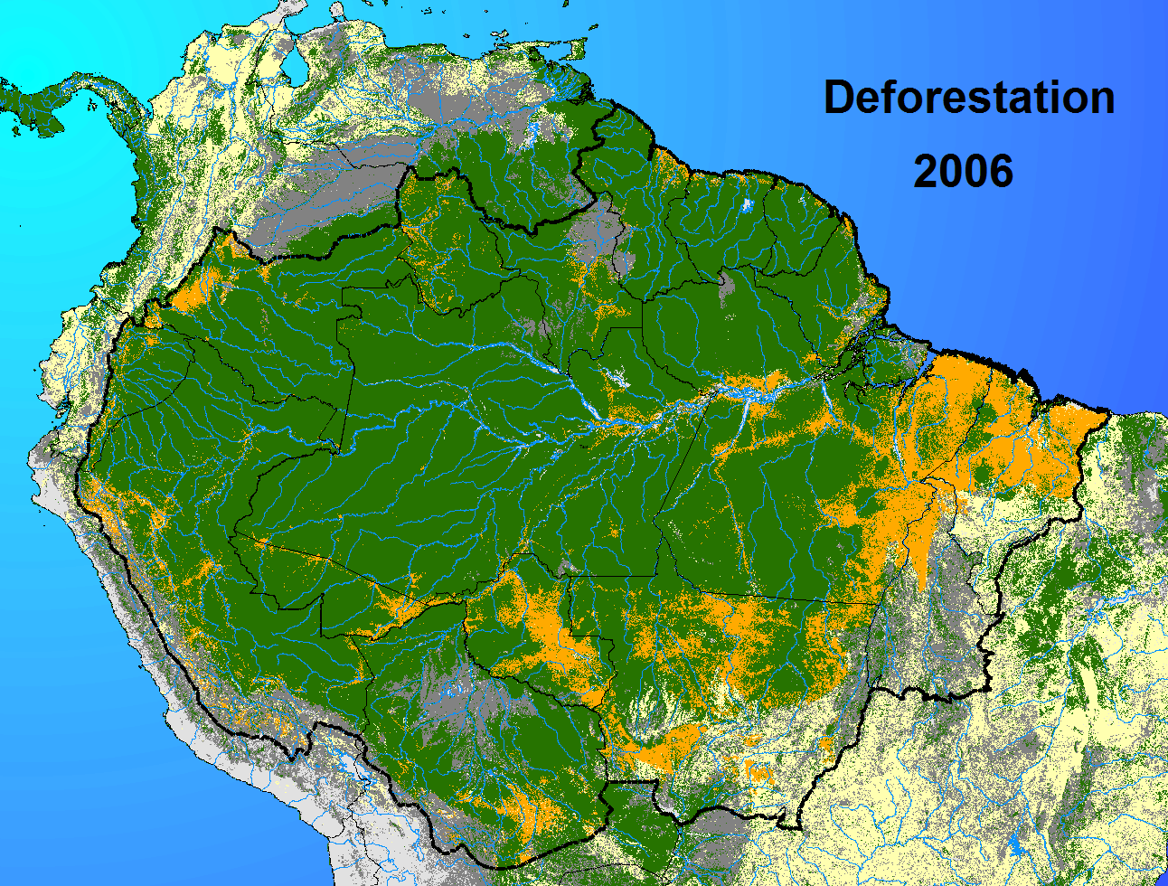
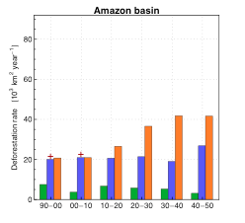
Understand differences between global and regional land use scenarios
Reconcile food security scenarios (MA) with climate scenarios (IPCC)
Future of the assessment : land-use emissions scenarios & evaluation
Green : RCP8.5 scenario over Amazon Blue & Orange : Brazilian projections (LUCCME in blue and SIMAMAZONIA)
Soares Filho et al., 2006

Slide 27

Nutrients limitations of terrestrial carbon storage
Future biomass C storage
From an offline model with N & P limitations
Future soil C storage
Only 2 Earth System Model included N-limitations in CMIP5 and found a smaller sink response to CO₂ and climate
Goll et al. 2012

Slide 28
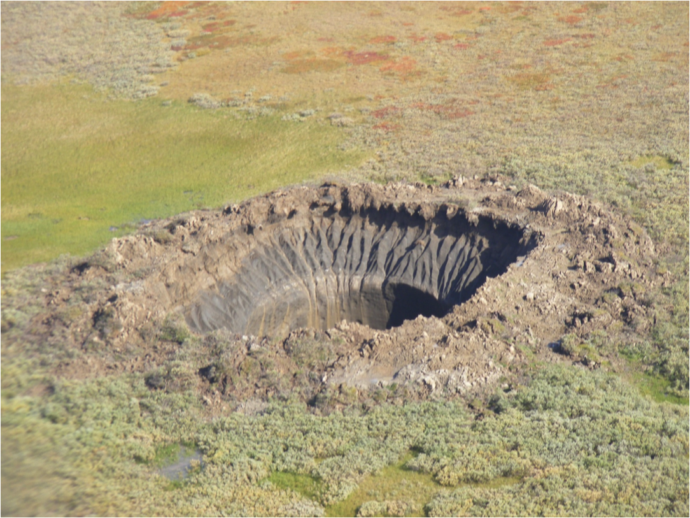

CH₄ and N₂O climate feedbacks
CH₄
Temperature
Inundated
area
Feedbacks that were not included in CMIP5 models:
Climate sensitivity of wetland CH₄ emissions
Stability of ocean CH₄ hydrate pools
Response of soil N₂O emission processes to climate and elevated CO₂
Response of ocean N₂O emissions to changes in O₂ & circulation

Slide 29

‘cold’ carbon processes, permafrost C
1670 Pg C
In permafrost
Mc Dougall et al. 2013
Here an Earth System Model with permafrost carbon processes was driven forward by RCP emissions
Result: higher projected warming (0.13 to 1.7°C) and CO₂ release (70 to 500 PgC)
Key « missing » processes : soil ice, soil C vertical distribution, soil C pools decomposition rates [C:N], fire & thermokarst

Slide 30
Conclusions, future challenges
The carbon cycle, a complex system presently offering us a 50% attenuation of the forcing of climate change
Regionally different fluxes and processes, and yet a first order linear emerging response to emissions over the last 50 years
Non linear response of sinks to emissions in future simulations of the coupled climate carbon system (Earth System Models)
Projections of ocean sinks less uncertain than land sinks
A single process causes increased land storage in models, many processes susceptible to negate land carbon storage are not represented in current models

Slide 31
Thank you for your attention

Slide 32
Simulated historical and future land and ocean carbon storage using CMIP5 models
Historical
RCP future
pathways
Very large uncertainty on projected changes in land carbon storage

Slide 33
Projecting future changes with Earth System Models
Concentration driven
Emission driven
Policy relevant
objectives
Free running coupled climate – carbon system
Used in AR5 : CMIP5
Used in AR4 :C4MIP

Slide 34
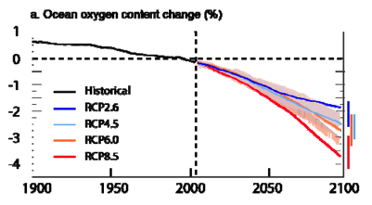
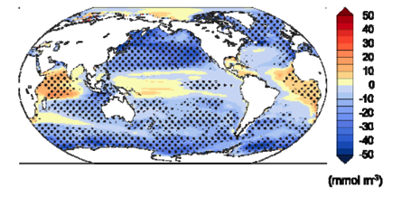
Ocean de-oxygenation
Ocean O₂ content change (%)
Surface O₂ change in 2090s from 1990s
Further research need:
How will ocean deoxygenation affect marine ecosystem services?
Further research need:
How will ocean deoxygenation affect marine ecosystem services?

Slide 35
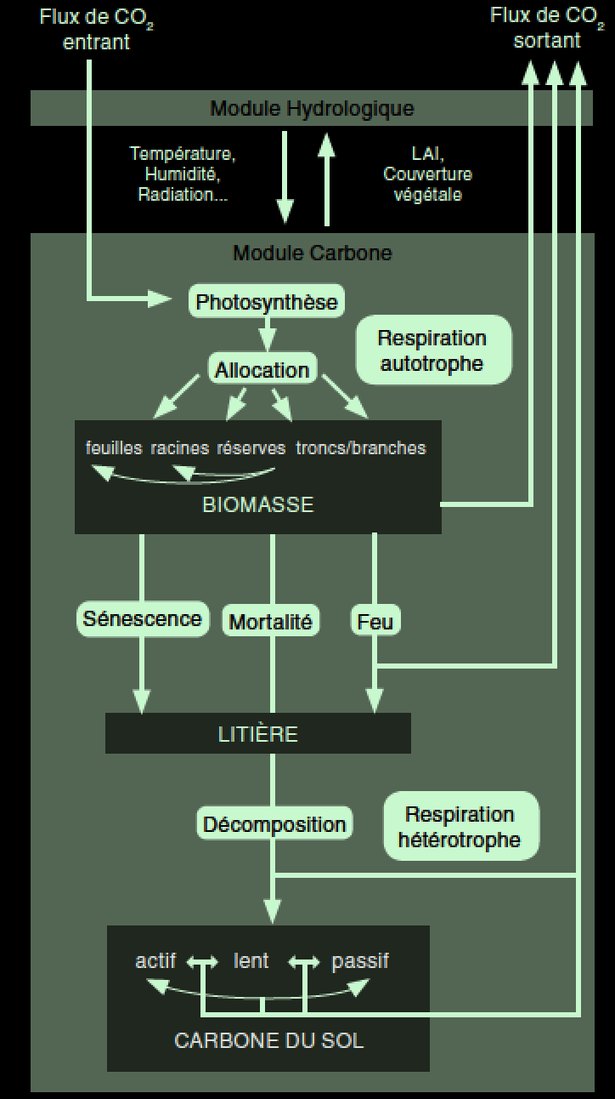
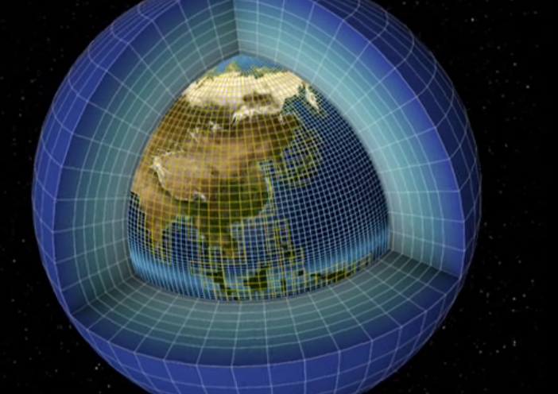
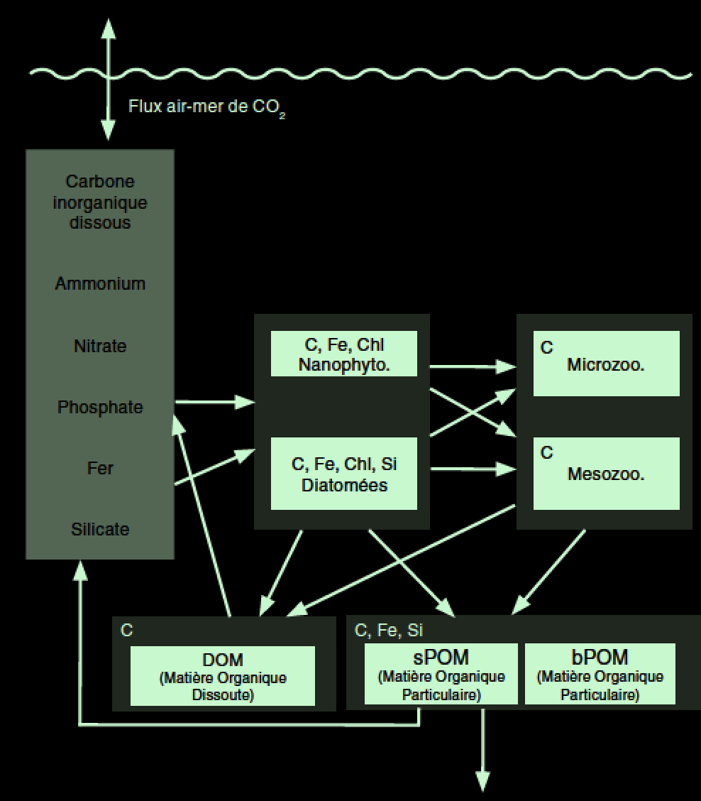
Projections Futures du Cycle du Carbone
Modèles Climatiques et Modèles
du Cycle du Carbone
Océan et Continents
Laurent Bopp – Cycle du Carbone - Académie des sciences – 22 septembre 2015

Slide 36
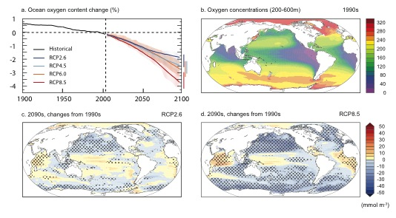
Simulated changes in dissolved oxygen

Slide 37
Positive carbon-climate feedbacks means less compatible emissions

Slide 38
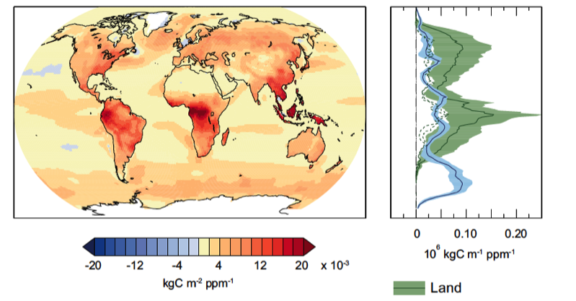
Response to atmospheric CO₂ only
land
ocean
decreasing sink
increasing sink
source: Ciais et al. 2013 IPCC AR5

Slide 39
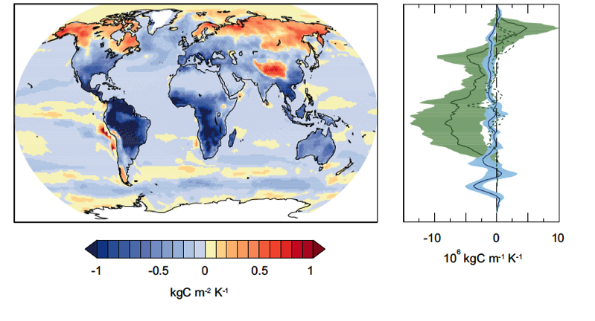
Response to climate change only
land
ocean
models do not include the release of permafrost C
decreasing sink
increasing sink
source: Ciais et al. 2013 IPCC AR5

