Slide 1
The bolometric way
towards the inverted hierarchy
of the neutrino mass:
CUORE-0 → CUORE → CUPID
Claudia Nones
CEA/IRFU/SPP
GDR Neutrino Meeting – Saclay – 4/11/15

Slide 2
Outline
Neutrinos and Double beta decay in a nutshell
The bolometric technique and TeO₂ detectors
CUORE-0: detectors, background, results
CUORE: state of the art and sensitivity
CUPID: Next-generation bolometric tonne-scale experiment
3 ongoing CUPID-related R&Ds and results
Conclusions

Slide 3
Neutrino physics
What we do know
What we do not know
Neutrinos are massive fermions
There are 3 active neutrino flavors
Neutrino flavor states are mixture of mass states
We have measured 2 independent squared mass splittings (Δm_{ij}²)
The moduli of the elements of the mixing matrix have been measured
What is the neutrino mass hierarchy?
What about the CP violating phases?
Are neutrinos Dirac or Majorana particles?
What is the absolute neutrino mass scale?
Double Beta Decay

Slide 4
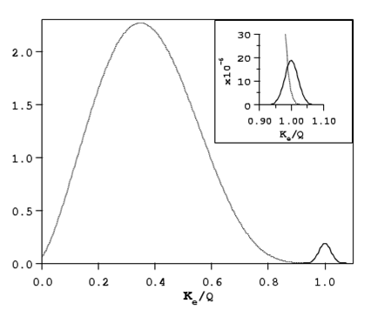
Double beta decay in a nutshell
①
2ν Double Beta Decay
allowed by the Standard Model
already observed – τ ∼10¹⁸ – 10²¹ y
(A,Z) → (A,Z+2) + 2e⁻ + 2ν_{e}
②
Neutrinoless Double Beta Decay (0ν-DBD)
never observed
τ > 10²⁵ y
(A,Z) → (A,Z+2) + 2e⁻
Process ② would imply new physics beyond the Standard Model
violation of total lepton number conservation
2ν double beta decay
continuum with
maximum at ~1/3 Q
0ν double beta decay
peak enlarged only by
the detector energy resolution
sum electron energy / Q

Slide 5
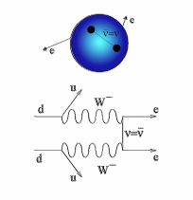
The rate in the mass mechanism
THE RATE IN THE MASS MECHANISM
neutrinoless
Double Beta Decay rate
Phase
space
Nuclear
matrix elements
Effective
Majorana mass
⟨m_{ββ}⟩ = ||U_{e1} | ²m₁ + e^{iα1} | U_{e2} | ²m₂ + e^{iα2} |U_{e3} | ²m₃ |
can be of the order of ~ 50 meV in case of inverted hierarchy

Slide 6
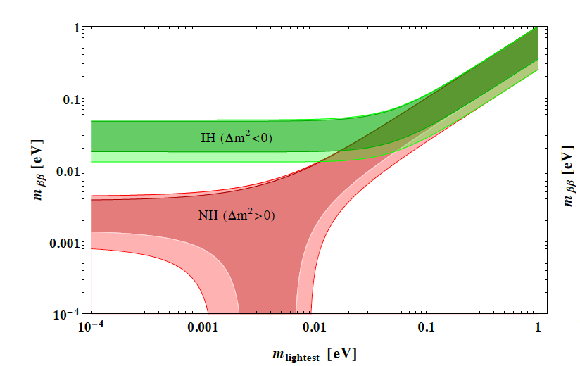
An important plot for 0νββ
⟨m_{ββ}⟩ = ||U_{e1} | ²m₁ + e^{iα1} | U_{e2} | ²m₂ + e^{iα2} |U_{e3} | ²m₃ |

Slide 7
How difficult is it?
∼ 100 - ∼ 1000 counts / y ton
∼ 5 - ∼ 50 counts / y ton
∼ 0.5 - ∼ 5 counts / y ton

Slide 8
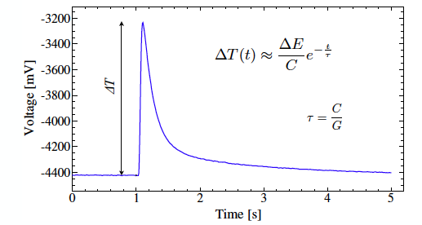
The bolometric technique
Heat sink - T_{b}
Thermal link
Thermometer
Crystal absorber
Released
energy
Main features:
high energy resolution
wide versatility (few constrains on absorber material)
the detector is fully sensitive (no dead layer)
To develop high pulses the detector has to work at very low temperatures.

Slide 9
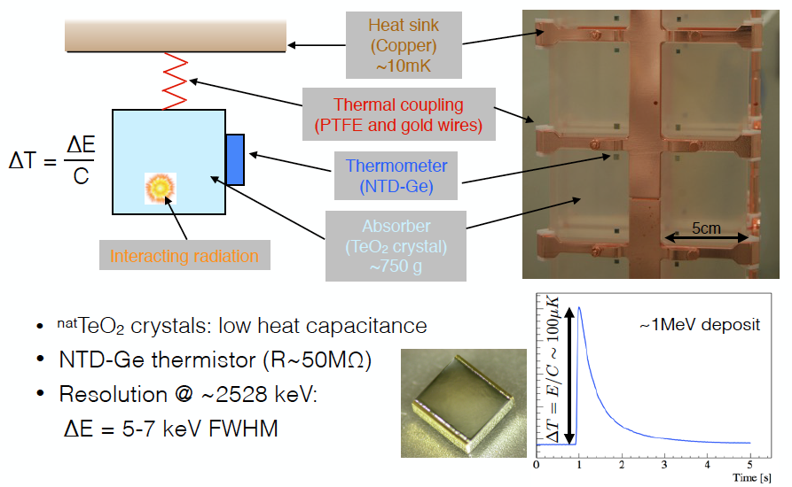
TeO₂ bolometers
Source=detector approach
Candidate: ¹³⁰Te – A.I. 34%

Slide 10
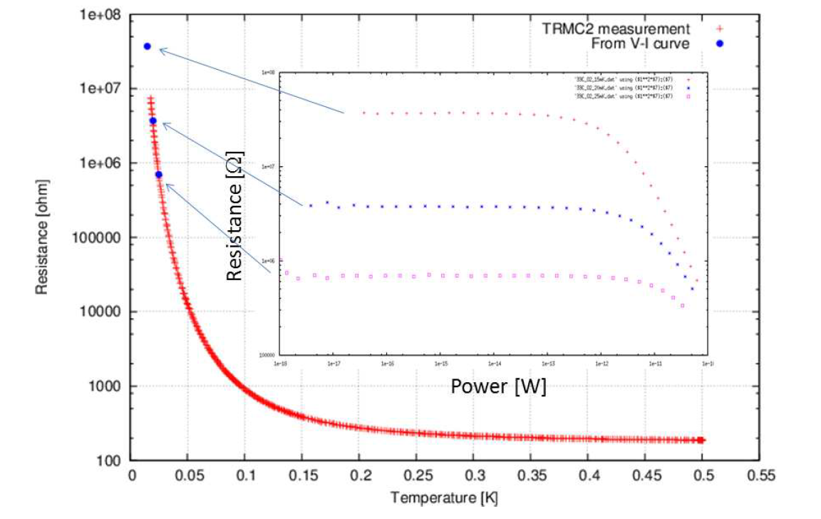
TeO₂ bolometers: the thermometer
Characterization of the CUORE NTD-Ge thermistors at CSNSM (Orsay)
T₀ = 4.5 K
R₀ = 0.9 Ω

Slide 11
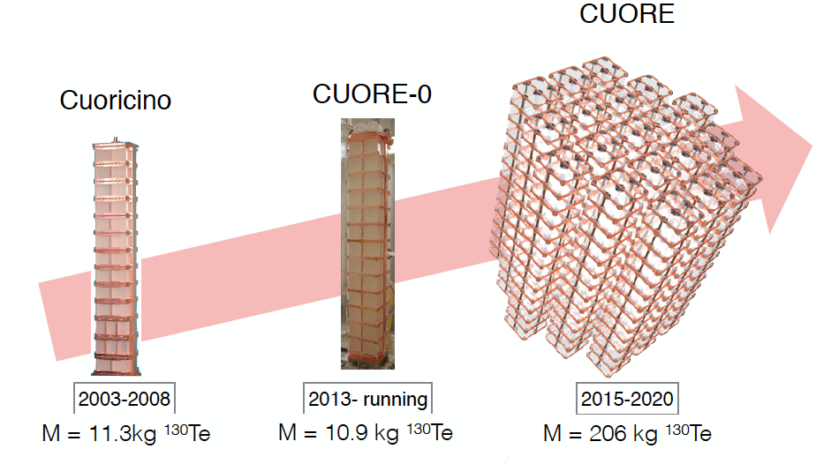
The TeO₂ bolometer history

Slide 12
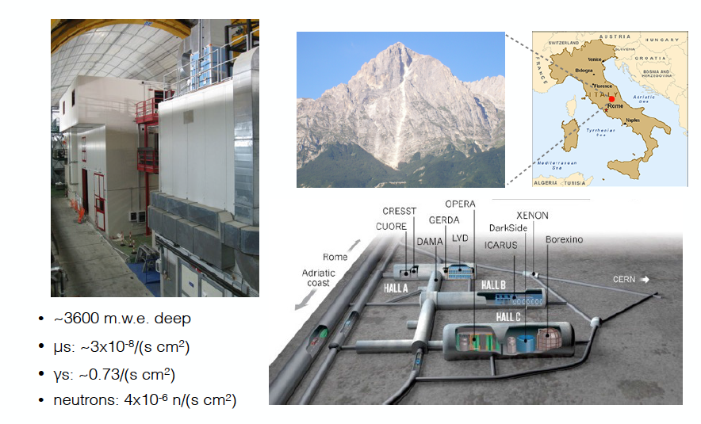
CUORE-0 & CUORE at LNGS

Slide 13
CUORE-0

Slide 14
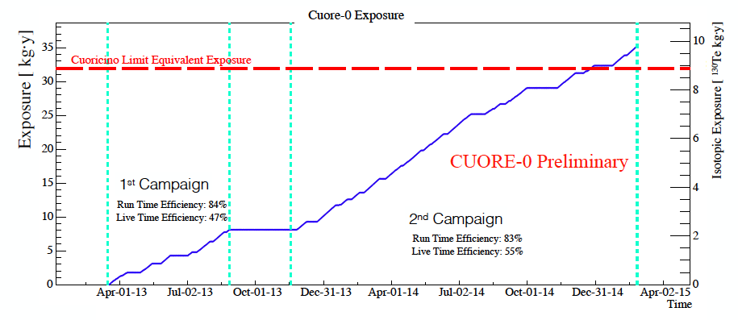
Experimental setup & exposure
Same cryostat as Cuoricino experiment
Inner shield: 1 cm of Roman Lead (4 < mBq/kg)
External shield: 20 cm of Modern Lead
Nitrogen flushing
Gamma backgorund from cryostat shields not expected to change
(test of alpha background)
Acquired statistics for 0νββ search:
35.2 kg y TeO₂
9.8 kg y ¹³⁰Te

Slide 15
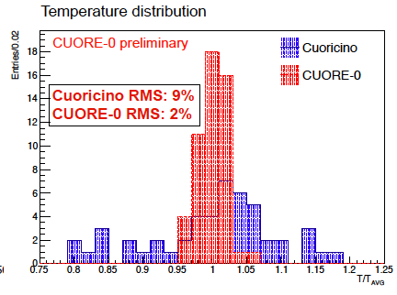
CUORE-0: calibration energy resolution
Improvement in the reproducibility of the detector construction

Slide 16
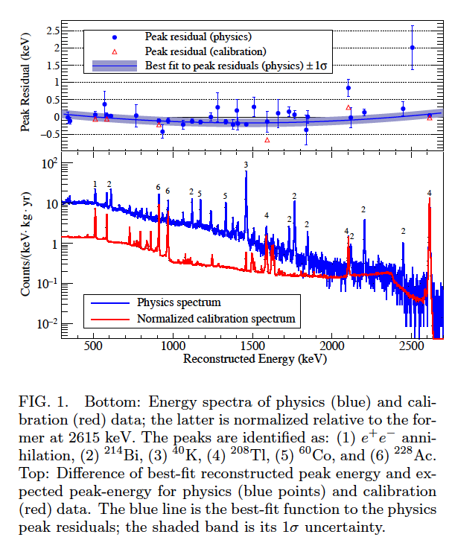
CUORE-0 background (1)
Detectors have been calibrated using two thoriated tungsten wires source placed in between the outermost cryostat shield and the external lead shield.
Typical event rate per crystal:
1 mHz during physics data taking
60 mHz during calibrations
Calibration function: quadratic function with zero intercept

Slide 17
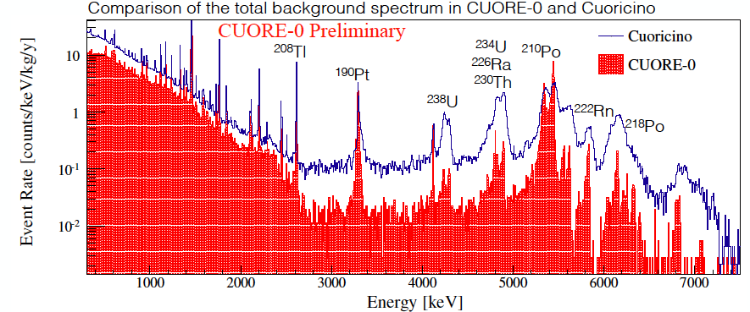
CUORE-0 background (2)
²³⁸U and ²³²Th α lines reduced thanks to the new surface treatement of detectors
²³⁸U γ lines reduced by a factor 2 (better control of Radon)
²³²Th γ lines not reduced (they come from the cryostat which is the same in both cases)
Factor 6 reduction in the α continuum region

Slide 18
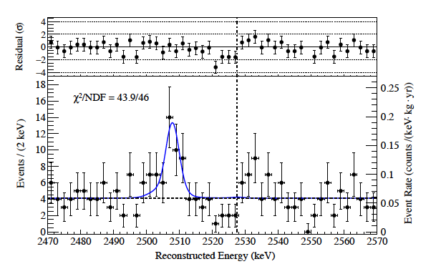
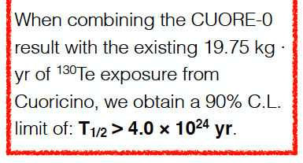
CUORE-0: ROI fit
The yield of 0νββ events has been determined by performing a simultaneous unbinned extended maximuum likelihood fit in the region 2470-2570 keV.
The used fit has 3 components:
The hypothetical 0νββ peak at the Q-value of 130Te (2527 keV)
A peak floating around 2505 keV due to sum of gamma events from ⁶⁰Co in the nearby copper
A flat continuum bkg, attributed to multi scatter Compton events from ²⁰⁸Tl and surface α events.
¹³⁰Te 0νββ Q-Value
⁶⁰Co double-gamma line
0νββ 130Te Bayesian 90% C.L. limit: 2.7x10²⁴ y
Phys. Rev. Lett. 115, 102502

Slide 19
Limit on m_{ββ}

Slide 20
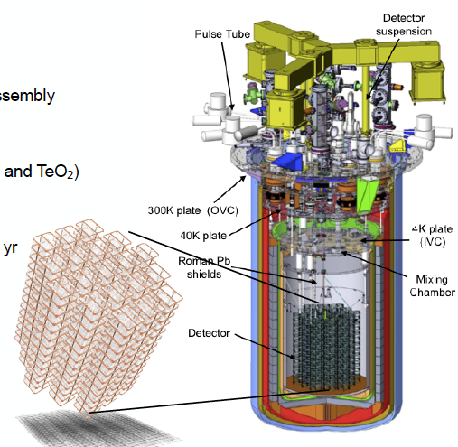
CUORE
Closely packed array of 988 TeO₂ crystals (19 towers of 52 crystals 5x5x5 cm³, 0.75 kg each)
TeO₂ total mass: 741 kg (~ 206 kg of ~¹³⁰Te)
Energy resolution: 5 keV @ 2615 keV
Operating temperature: ~ 10 mK
Total mass to be cooled down: ~ 15 tons
Stringent radiopurity controls on
materials and assembly
Stable ultra-low temperatures
Extremely low vibrations

Slide 21
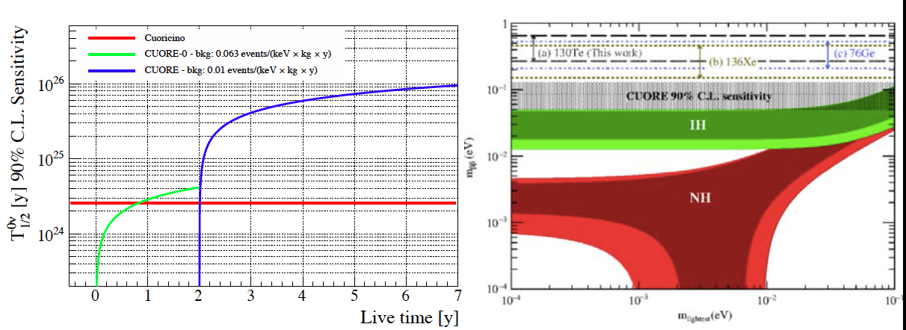
CUORE sensitivity
Main goals:
Background rate: 10⁻² counts/ (keV kg y)
dominated by surface α background
5 keV FWHM
5 years of live time
CUORE projected sensitivity (90% C.L.)
S_{1/2}(0νββ)= 9.5 x 10²⁵ y
m_{ββ}: 50-130 meV
Physics cases:
0νββ
Dark Matter
Axions
Rare nuclear decays

Slide 22
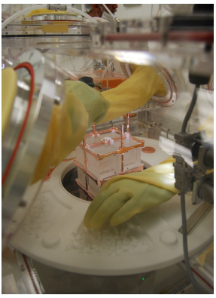
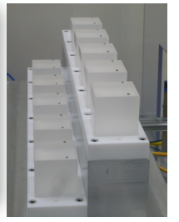
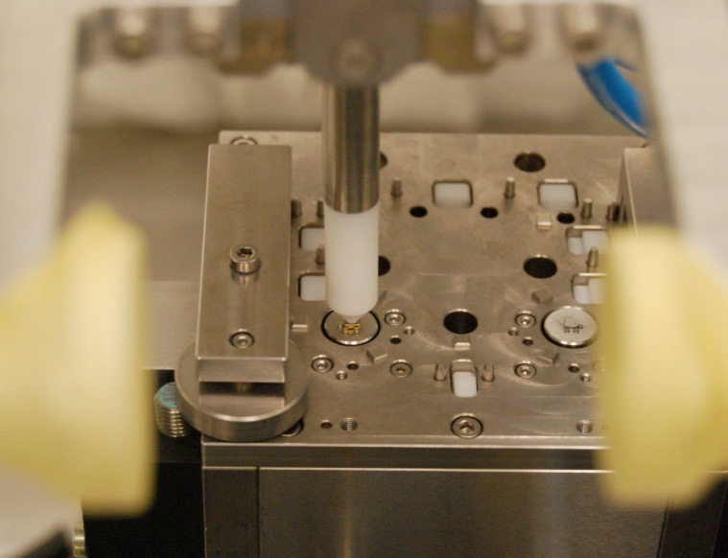
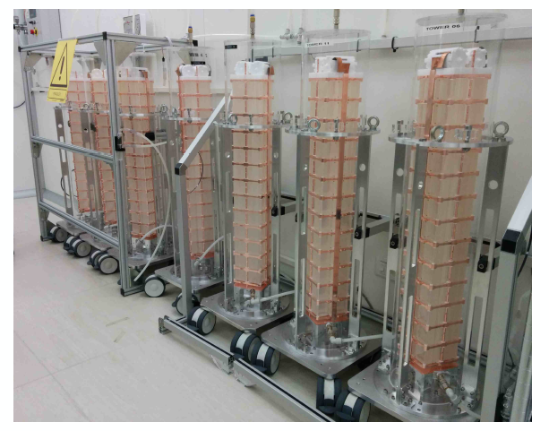
CUORE status (1)
Assembly line improved thanks to CUORE-0 experience
988/988 NTD connected
988/988 heaters connected
New semi-automatic system
Highly-reproducible
Fully performed under N₂ atmosphere to minimize radioactive recontamination.
Assembly of all the 19 CUORE towers completes in 2014

Slide 23
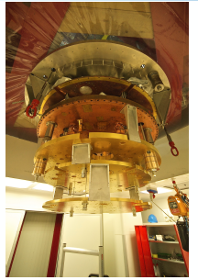
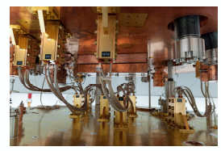
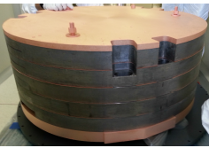
CUORE status (2)
The commissioning of the cryogenic system has been done adding complexity at each step.
Phase1: tests on individual systems
Outer/inner vacuum chamber
Cryostat
Dulition unit
Phase2: system integration
Wiring
Top Pb shield
Detector calibration System
Tower support plate

Slide 24
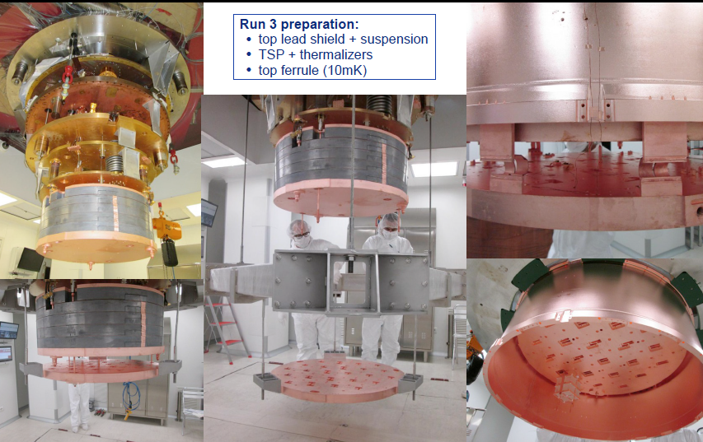
Some pictures from last tests
Top lead shield & suspension
Thermalizers
Top ferrule (10 mK)

Slide 25
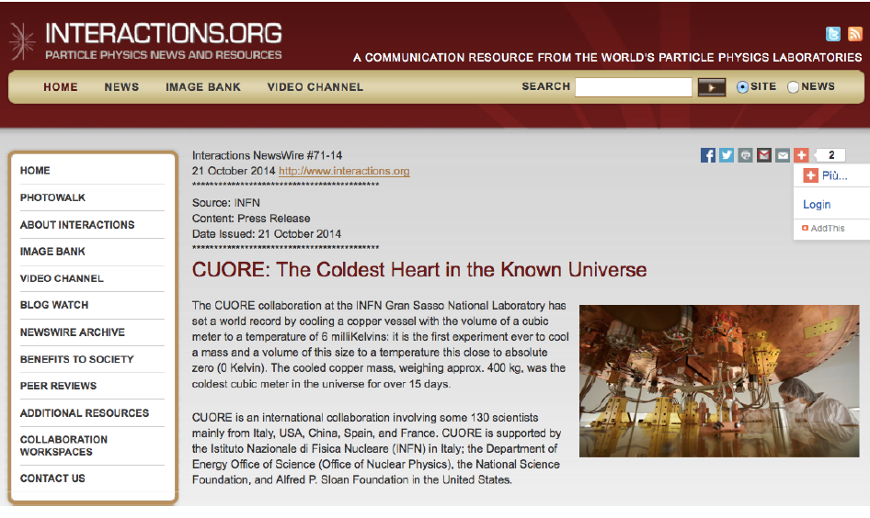
The coldest place in the Universe

Slide 26
Current-generation experiments
FROM HERE…
τ_{0ν} ∼ 10²⁶-10²⁷ y

Slide 27
What’s next…
TO THERE…
?
τ_{0ν} ∼ 10²⁷-10²⁸ y
O (1 ton)
+
∼zero background

Slide 28
What’s next…
TO THERE…
?
O (1 ton)
+
∼zero background
A bolometric approach: CUPID

Slide 29
CUPID
CUORE Upgrade with Particle IDentification
Main idea:
Use CUORE infrastructure (after completion of CUORE programme) with:
enriched crystals (sensitive mass: 210 kg – 550 kg)
upgraded technology to get 0 background at ton × y scale (10-15 meV sensitivity)
Technology selection + CDR in ∼two years

Slide 30
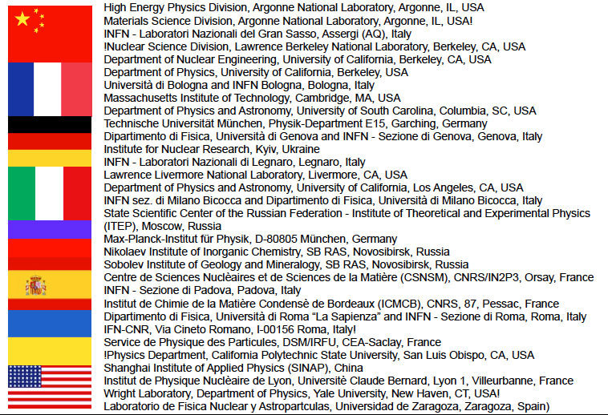
The CUPID group of interest
8 countries
∼ 30 laboratories
∼ 100 persons from CUORE
∼ 30 persons from outside
White papers:
arXiv: 1504.03599
arXiv:1504.03612

Slide 31
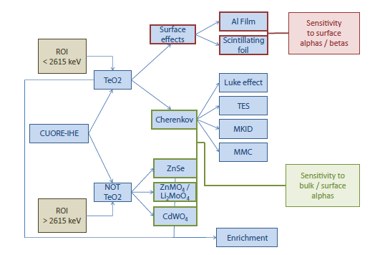
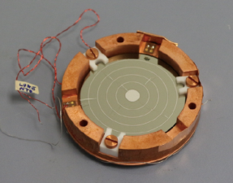
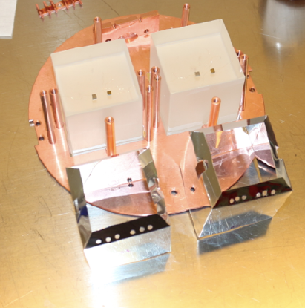
R&D for 1-ton bolometric experiment
Important goal: get rid of the currently dominant surface α background
I will show three main results

Slide 32
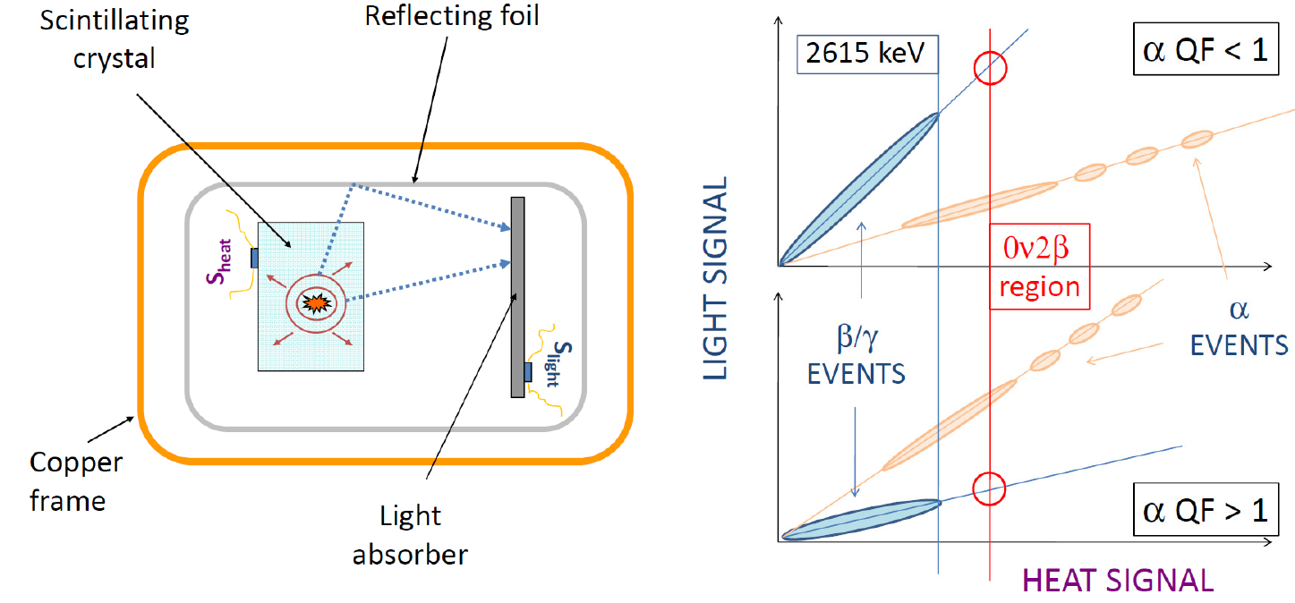
Central role of luminescent bolometers in CUPID

Slide 33
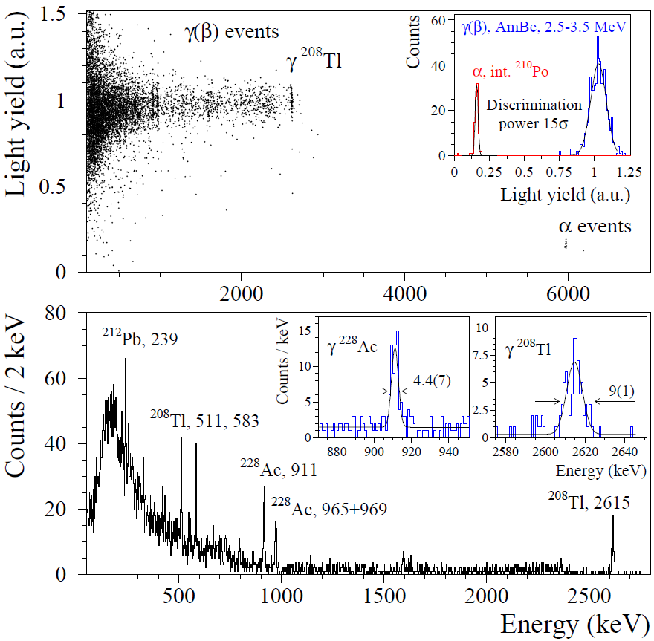
LUMINEU & LUCINEU
Scintillating bolometers with ZnMoO₄ crystals and simple pure NTD light detectors
Very promising results – mature technology (LUMINEU, LUCIFER-ZMO achievements)
High sensitive CUPID demonstrator with 7 kg of Mo in preparation (LUCINEU)
(IN2P3-CEA-INFN-ITEP-KINR-Heidelberg) (in LNGS and LSM) (M_{ββ} < 90 – 300 meV)
334 g detector tested in Modane
(in the EDELWEISS setup)
JINST 10 (2015) P05007
Excellent α/β separation
Satisfactory energy resolution
Excellent crystal radiopurity
< 4 μBq/kg in ²²⁸Th
compatible with background index
< 0.3 counts/(keV ton y)
Advanced successful protocol for enrichment – purification – crystallization chain → < 4 % of irrecoverable losses of Mo
JINST 9 (2014) P06004
Eur. Phys. J. C74 (2014) 3133

Slide 34
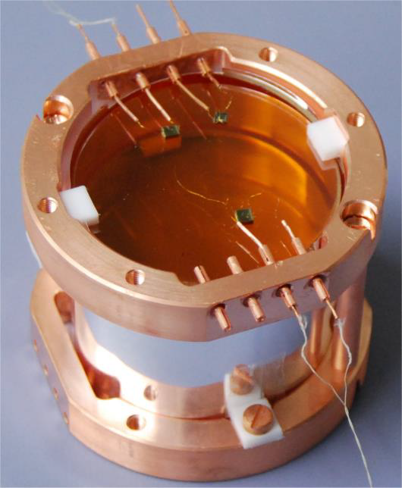
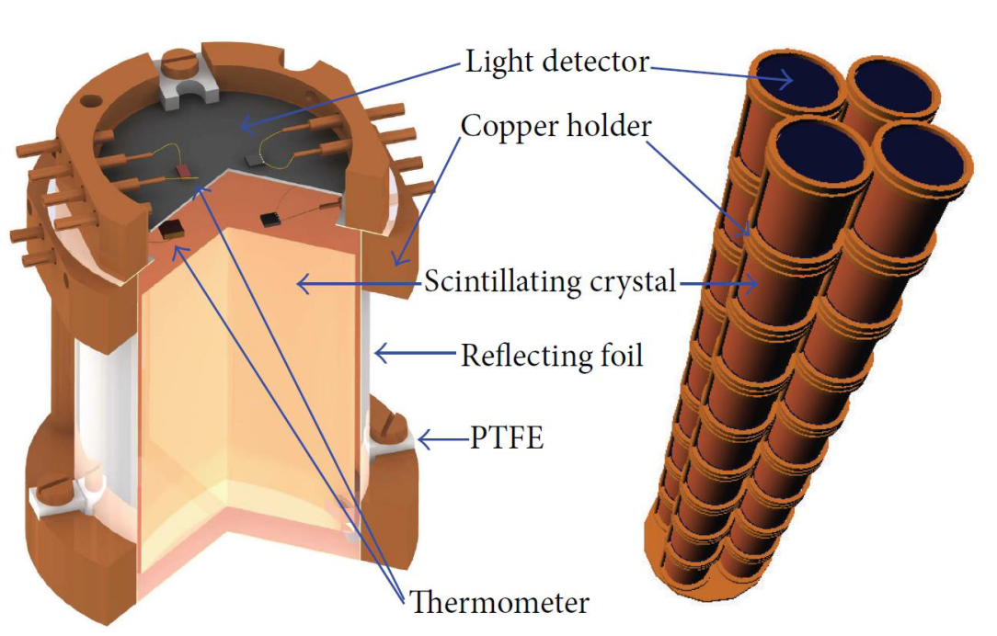
LUCIFER
Scintillating bolometers with ZnSe crystals and simple pure NTD light detectors
Intense R&D for detector optimization – complicate crystallization technology
Technique now mature for demonstrator experiment (LNGS)
15 kg of chemically pure ⁸²Se (enriched in western Europe) available for crystals
Array of 32 enriched (96%) Zn⁸²Se crystals
Expected background index ∼ 1-2 c/(keV ton y)
Energy resolution: ∼ 10-20 keV FWHM
M_{ββ} < 100 – 300 meV
Adv. High En. Phys. 2013 (2013) ID 237973
JINST 8 (2013) P05021

Slide 35
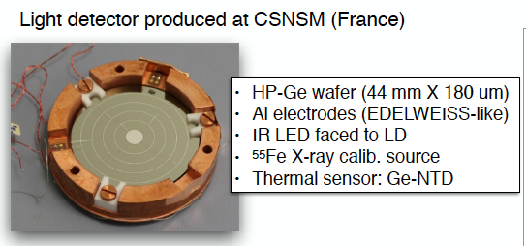
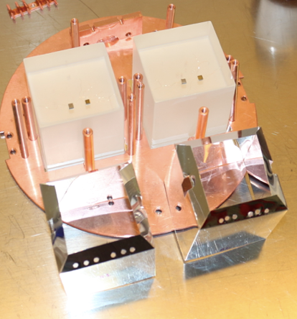
TeO₂ Cherenkov light emission (1)
(Same sensor as in CUORE)
Luke amplification of the thermal signal: electron-hole pairs generated by Cherenkov light drift in the electric field and produce additional heat
Tested with a real size CUORE TeO₂ crystal: 5 x 5 x 5 cm³

Slide 36
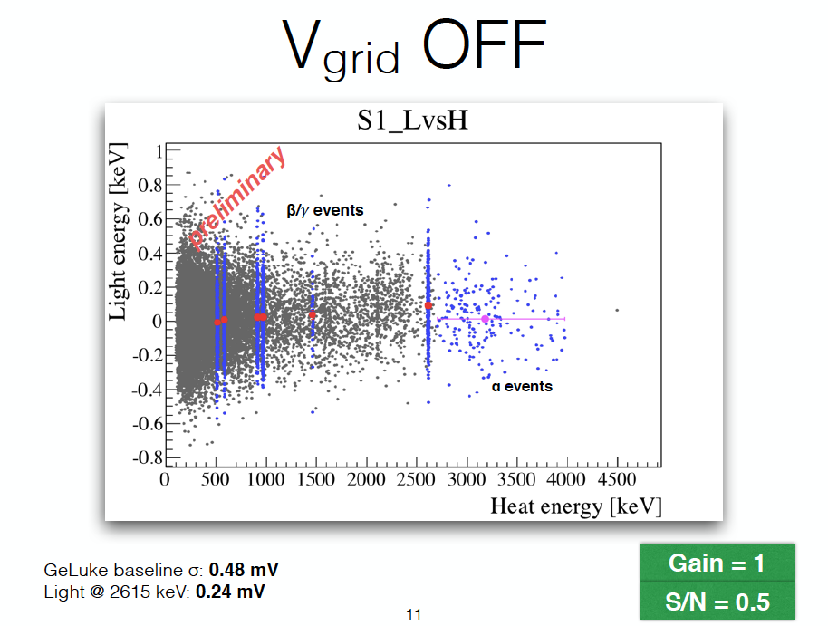
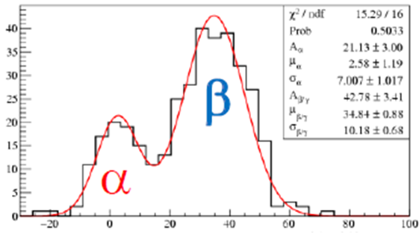
TeO₂ Cherenkov light emission (2)
Discrimination power in the region of interest:
2.7 σ
http://arxiv.org/pdf/1510.03266v1.pdf

Slide 37
Conclusions
TeO₂ bolometers are a well-established and competitive technique for the search of 0νββ
CUORE-0 has achieved its goals in terms of energy resolution and background level
CUORE-0 data has significantly improved the limit set by Cuoricino, without any evidence of a 0νββ peak
CUORE will be able to probe the region m_{ββ} ~ 50-130 meV
CUORE data-taking beginning 2016
CUPID, successor of CUORE, will be a one tonne experiment with particle identification (m_{ββ} ~ 6-15 meV)
Extensive ongoing R&D for a down-selection
STAY TUNED!!!

