Slide 1
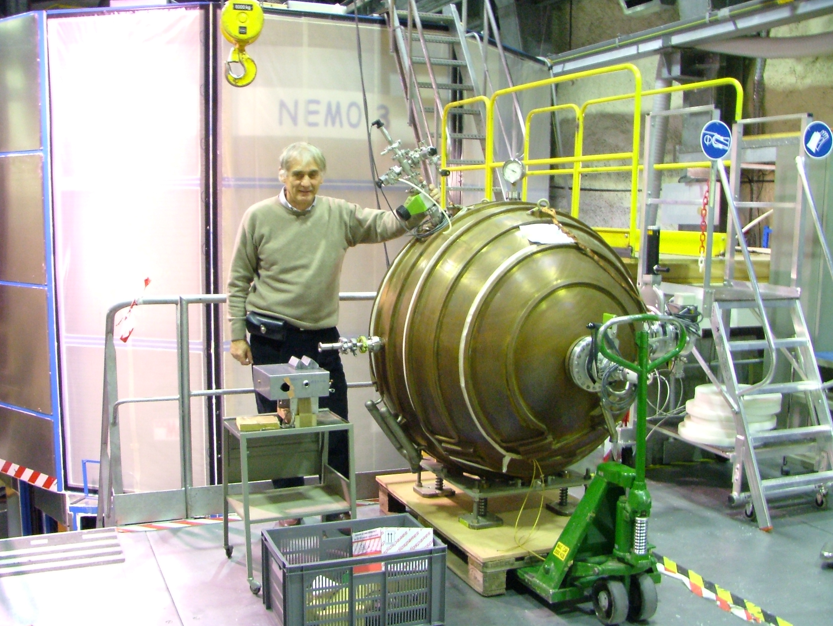
SPHERE : detector for dark matter, double beta, supernovae neutrino and coherent neutrino diffusion
I. Giomataris CEA-Saclay
Notes:
1

Slide 2
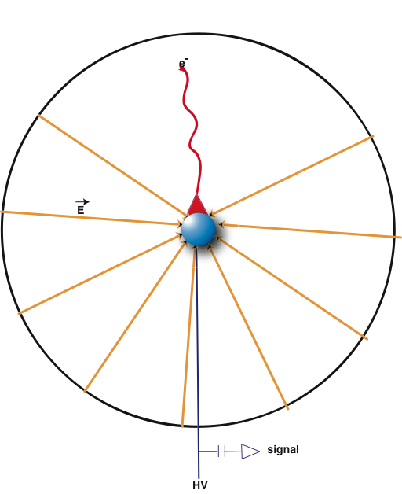
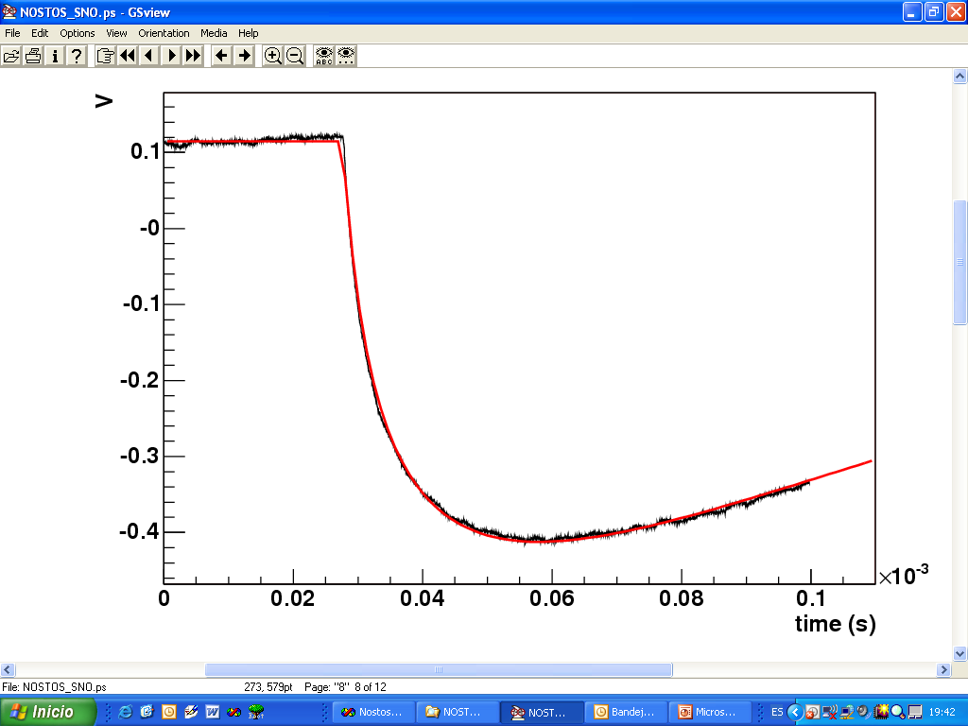
Radial TPC with spherical proportional counter read-out
Saclay-Thessaloniki-Saragoza
A Novel large-volume Spherical Detector with Proportional Amplification read-out, I. Giomataris et al., JINST 3:P09007,2008
5.9 keV ⁵⁵Fe signal
E=A/R²
20 μs
2-15 mm
Simple and cheap
Large volume
single read-out
Robustness
Good energy resolution
Low energy threshold
Efficient fiducial cut
Low background capability
C≈ R_{in}= 7.5 mm < 1pF

Slide 3
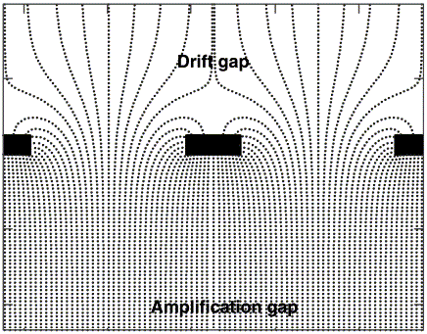
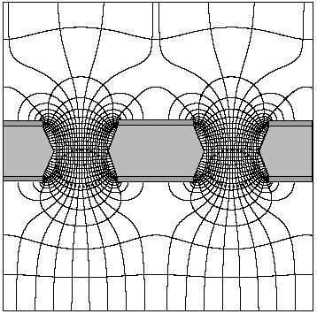
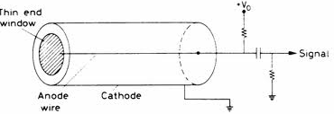
Parallel Plate Detector
GEM
Micromegas
E= constant
C ≈ S > 1nF
Cylindrical Proportional Counter
E=V/ln(b/a)r L = length and a=radius of the wire, b = tube radius
C =2πL/ln(b/a)>> 10 pF
Spherical Proportional Counter
E=1/r²
≈V/R_{i} close to the ball
C ≈ R_{in}< 1pF

Slide 4
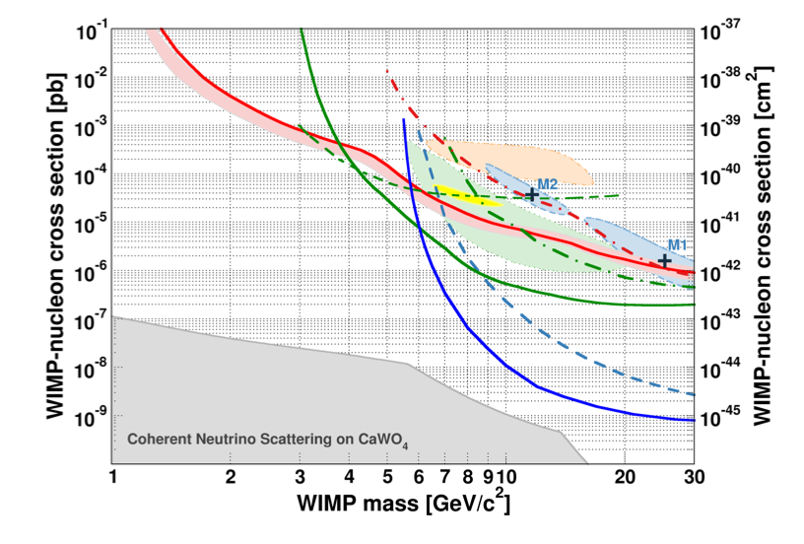
NEWS
Light dark matter search using the spherical detector
Goal: explore DM masses down to 100 MeV
Motivated by:
Sub-keV energy threshold of the detector
Versatility of the low-Z target (H, He, Ne)
Low background capability of this design
CRESST II
CDMSlite
EDELWEISS
NEWS
SuperCDMS
LUX
XENON100
100 MeV
Notes:
4

Slide 5
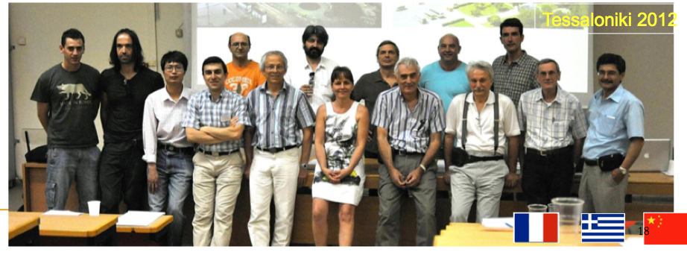
NEWS collaborating Institutes and people - Spherical detector project
IRFU Saclay, E. Bougamont1, J. Derre, A. Dastgheibi-Fard, J. Galan, I. Giomataris, G. Gerbier, M. Gros, P. Magnier, J. P. Mols, X.F. Navick, B. Paul, P. Salin, G. Tsiledakis
LSM MODANE, P. Loiza, F. Piquemal, Univ. of Thessaloniki, I. Savvidis
NCR Dimokritos Athens, G. Fanourakis, Univ. of Ioannina, J. D. Vergados
Univ. of Saragoza, P. Iguaz, I. Irastorza, IHEP, Zhimin Wang, Ruiguang Wang
Univ. of Tsighua, C. Tao,Univ. of Shanghai Jiao Tong, K. Giboni, K. Ni
Bibliography
I Giomataris et al., JINST 3:P09007,2008., I Giomataris and J.D. Vergados, Nucl.Instrum.Meth.A530:330-358,2004, I. Giomataris and J.D. Vergados, Phys.Lett.B634:23-29,2006.
I. Giomataris et al. Nucl.Phys.Proc.Suppl.150:208-213,2006., S. Aune et al., AIP Conf.Proc.785:110-118,2005.
J. D. Vergados et al., Phys.Rev.D79:113001,2009., E Bougamont et al. arXiv:1010.4132 [physics.ins-det], 2010

Slide 6
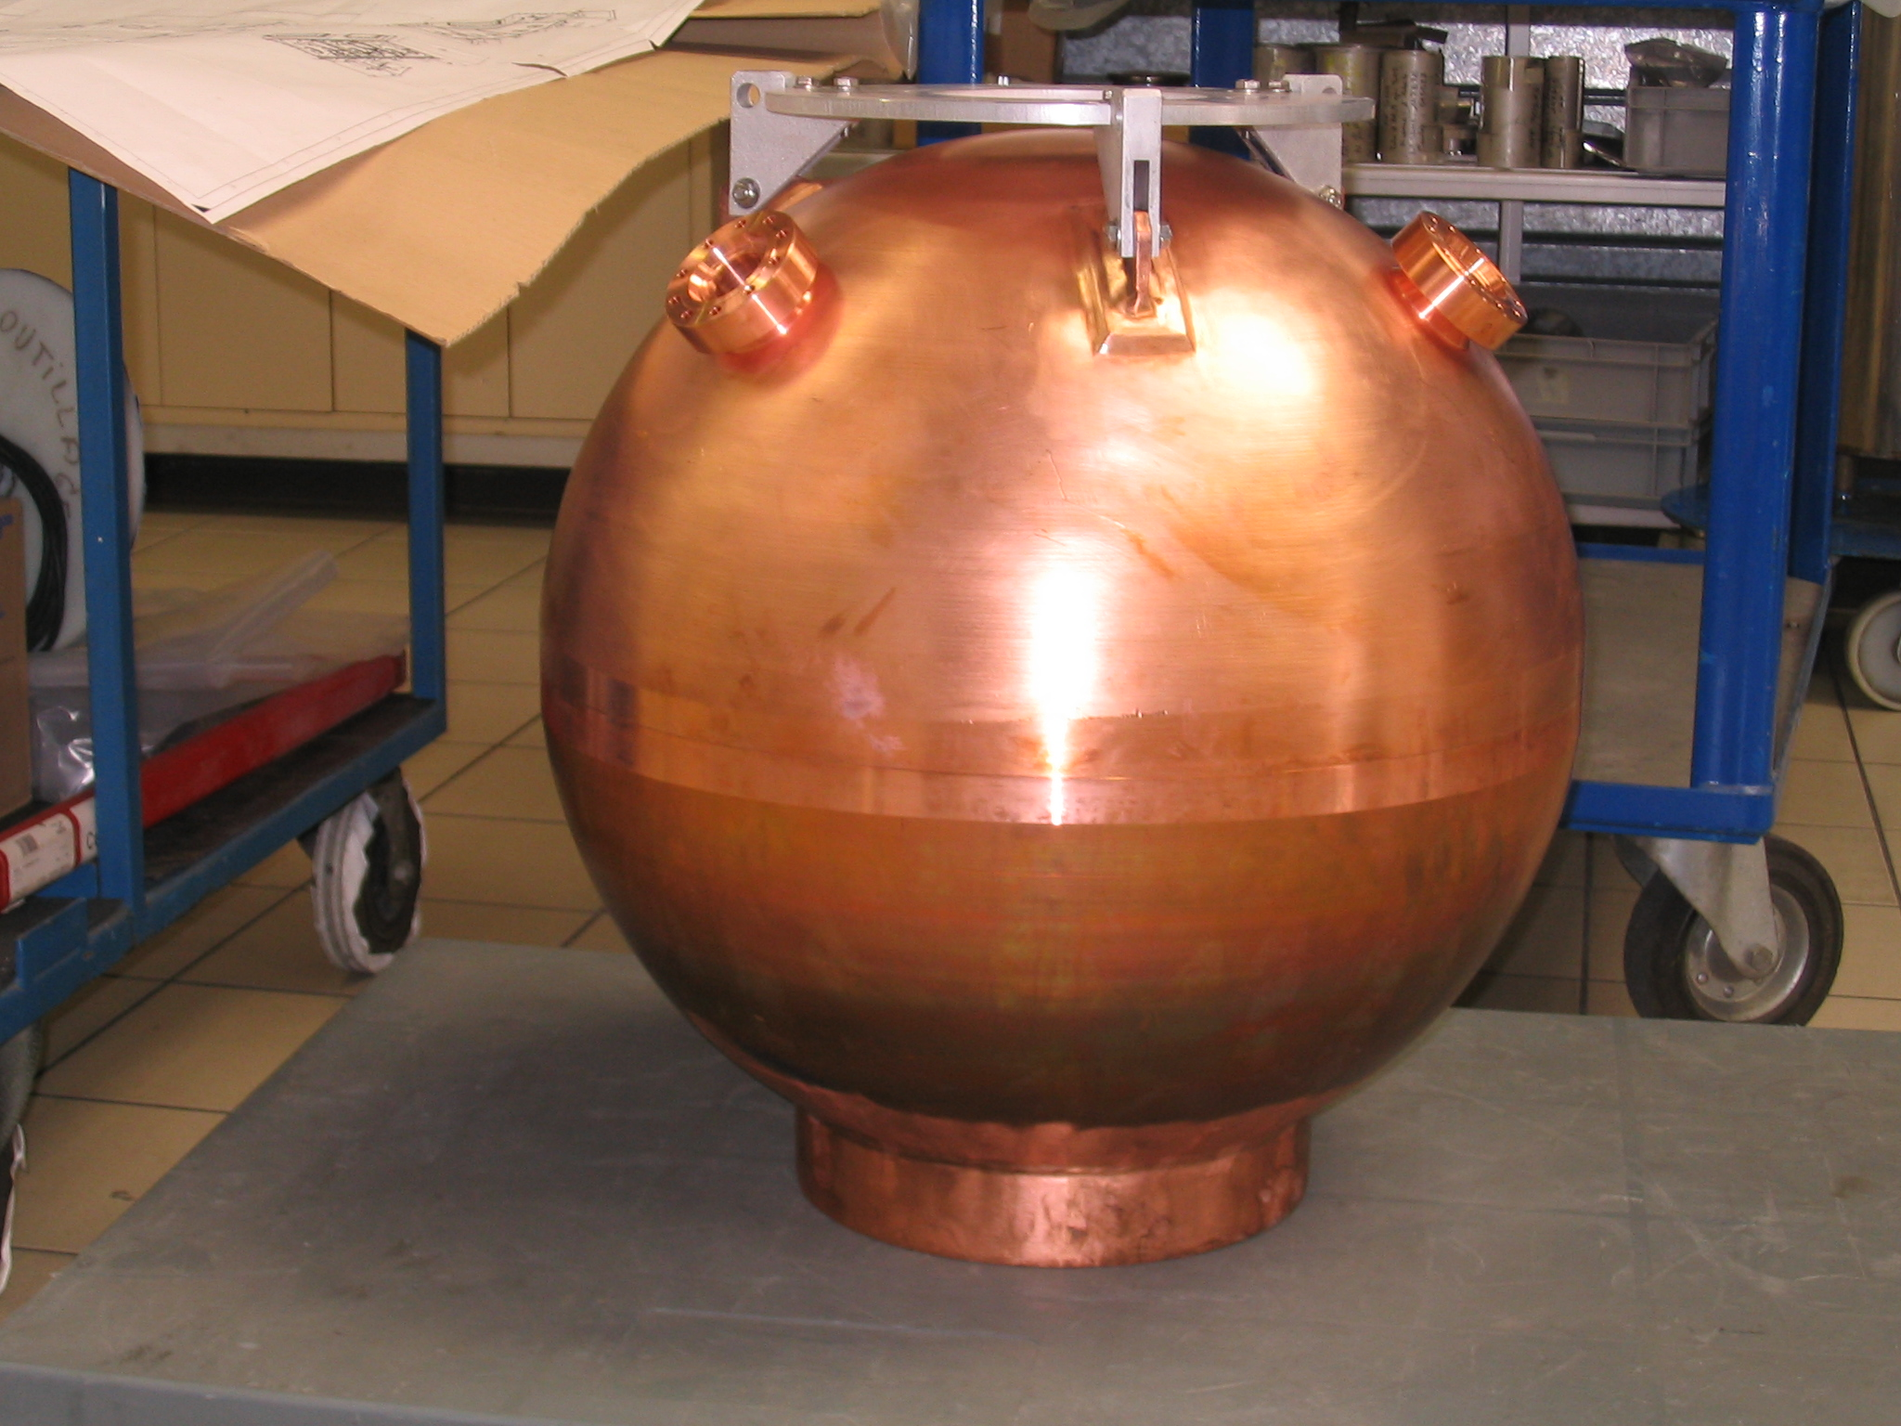
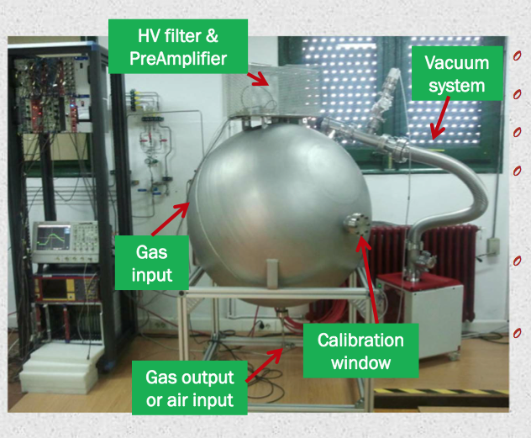
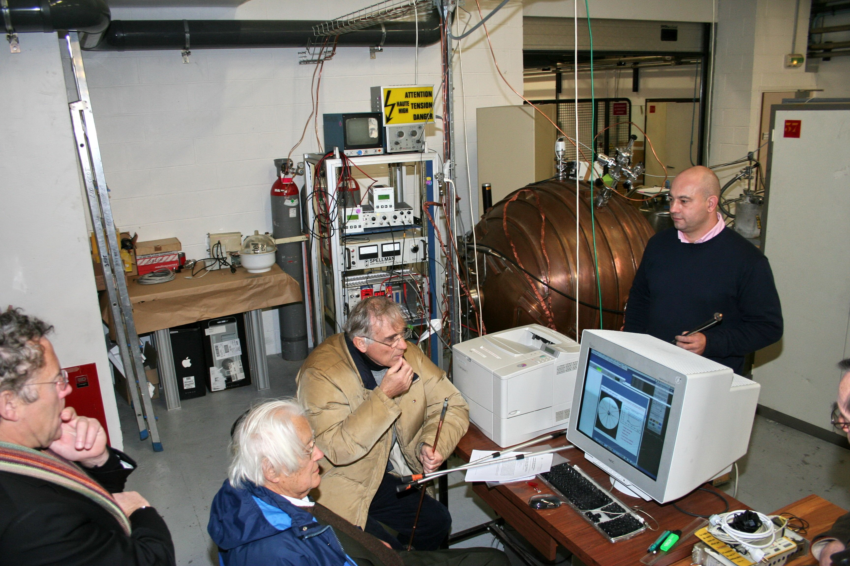
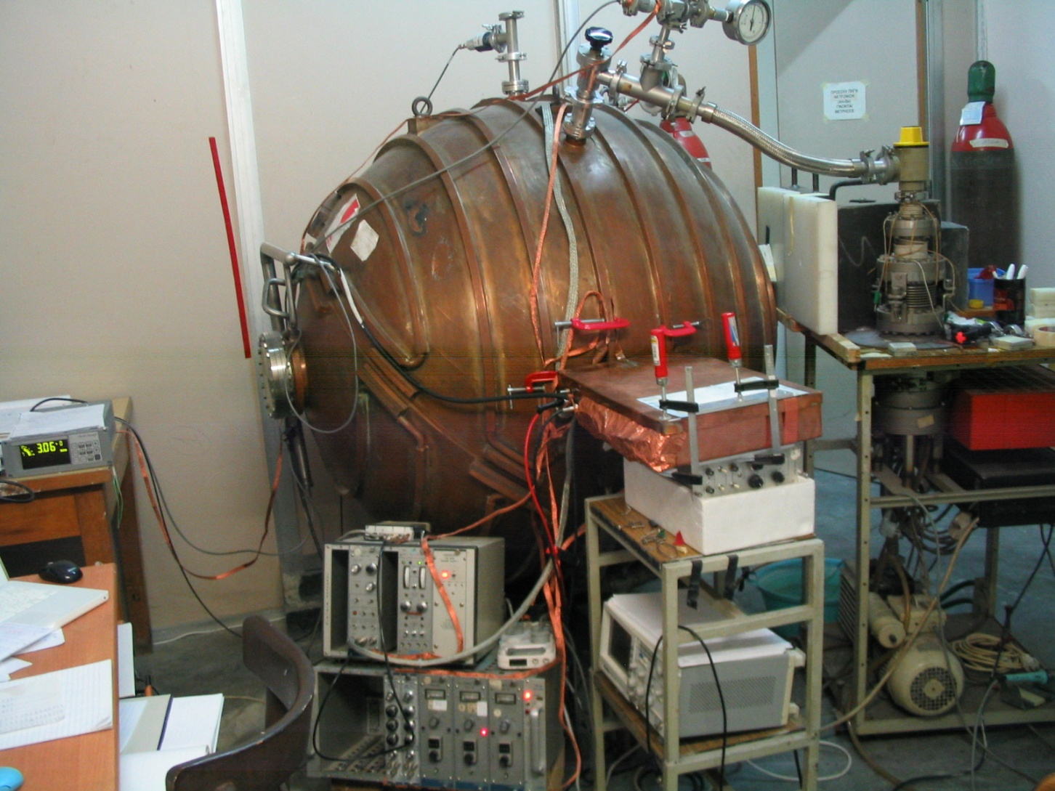
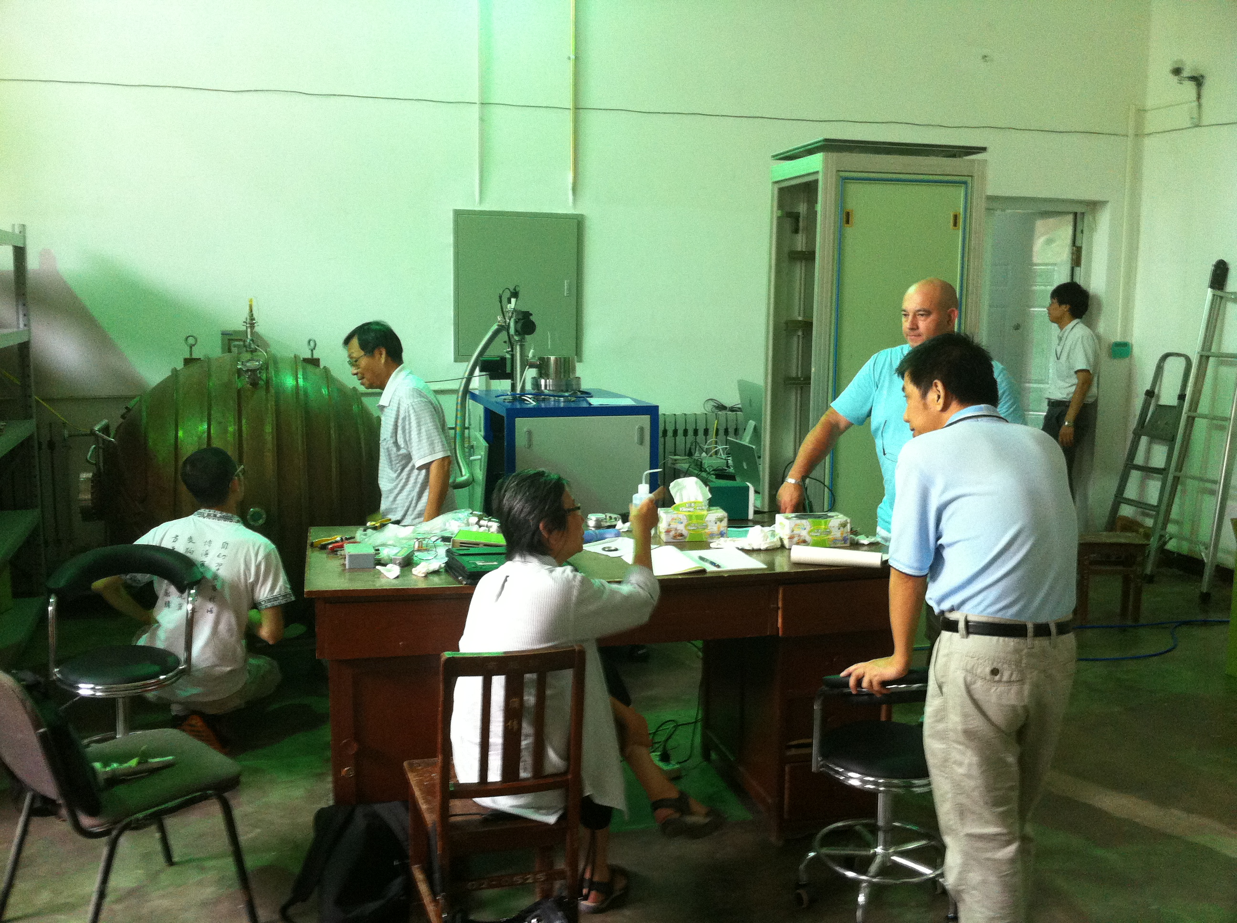
Low background detector d=60 cm p=10 bar
University of Saragoza detector
Spherical detector propagation
Basic R@D detector in Saclay
Future project
2m detector will be developed
At SNOLAB (G. Gerbier et al.)
University of Thessaloniki detector
University of Tsinghua - HEP detector

Slide 7
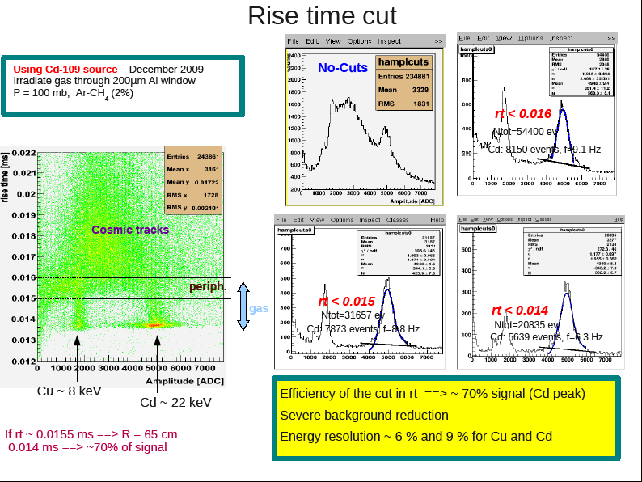
Rejection power
04/11/15
I. Giomataris

Slide 8
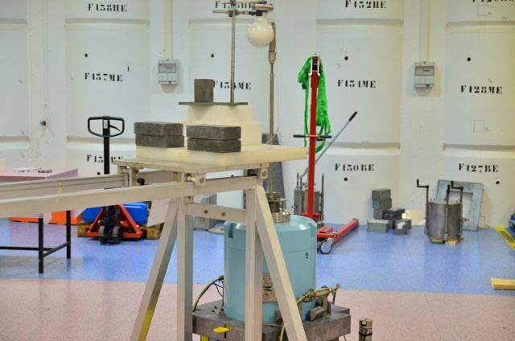
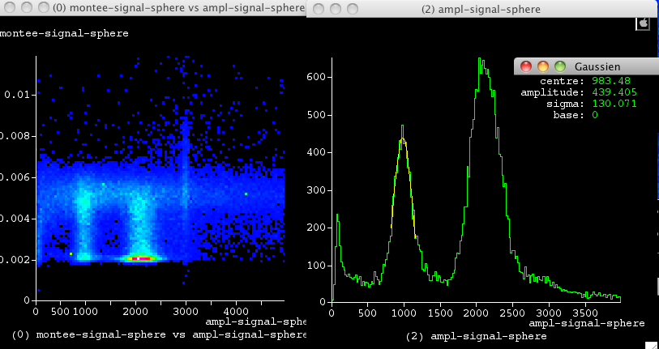
New low-energy calibration source Argon-37
Home made Ar-37 source: irradiating Ca-40 powder with fast neutrons 7x10⁶neutrons/s
Irradiation time 14 days. Ar-37 emits K(2.6 keV) and L(260 eV) X-rays (35 d decay time)
Installation near the spherical detector
Argon 37
First measurement
with Ar-37 source
Total rate 40 hz
in 250 mbar gas, 8 mm ball
240 eV peak clearly seen
A key result for light dark matter search
5.9.keV
2.4 keV
260 eV

Slide 9
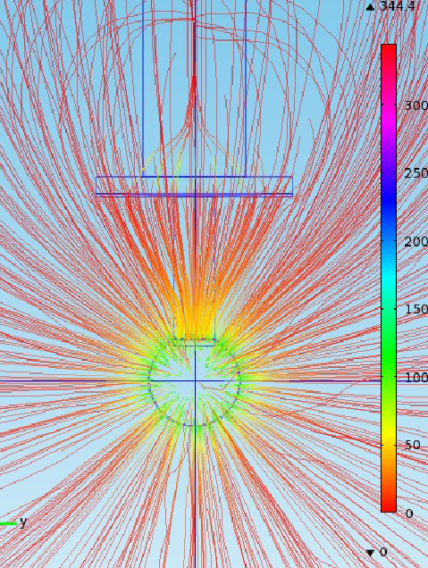
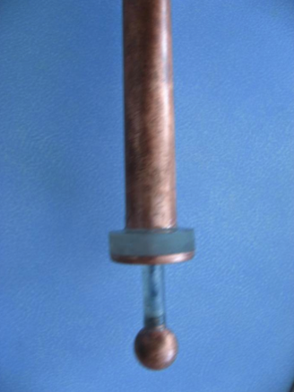
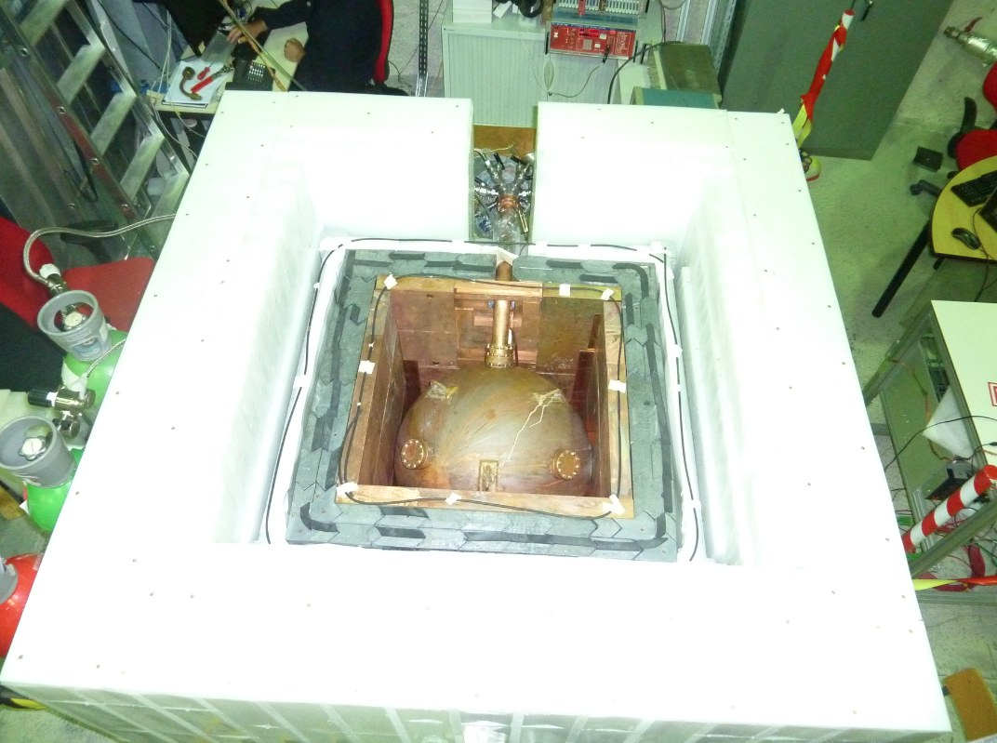
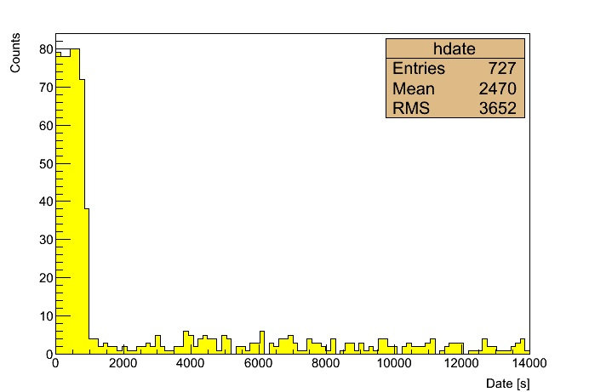
Search for light dark matter
Detector installed at LSM end 2012: 60 cm, Pressure = up to 10 bar
Gas targets: Ar, Ne, He, CH4
Polyethylene
30 cm
80
Effect of the cup
Rate [Hz]
Lead
10 cm
Copper
5 cm
Decrease of factor 20 for
Energy range 1 – 200 keV
4
Date [s]

Slide 10
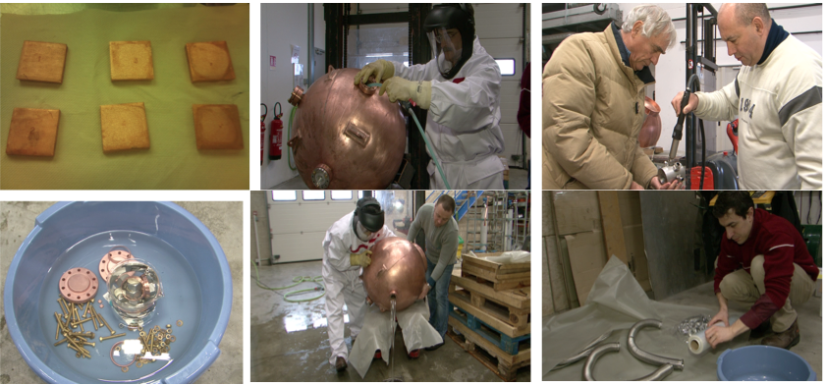
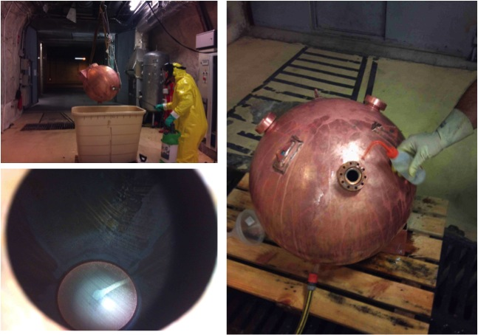
Internal contamination cleaning
Goal: remove Po-210, Pb-210
1st chemical cleaning of sphere
Conditions :
Nitric acid (17 %)
Temperature 10° C
Cleaning by filling
the spherical cavity
Washing by pure water
Drying by hot nitrogen
2nd chemical cleaning of sphere
Conditions :
Nitric acid (30 %)
Temperature 30° C
Cleaning by spray
Washing by pure water
Drying by hot nitrogen

Slide 11
Backround evolution of the detector
Alpha rate evolution
β/γ rate evolution
1st chemical cleaning
1st chemical cleaning
α rate
2nd chemical cleaning
Sensor cleaning
β/γ rate
2nd chemical cleaning
Sensor cleaning
Copper shielding added
Decreasing factor = 45
180 mHz => 4 mHz
Decreasing factor = 20
400 mHz => 20 mHz

Slide 12
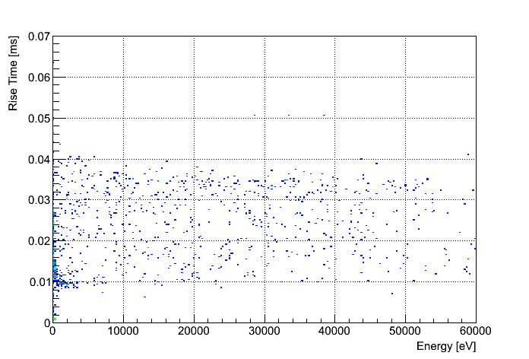
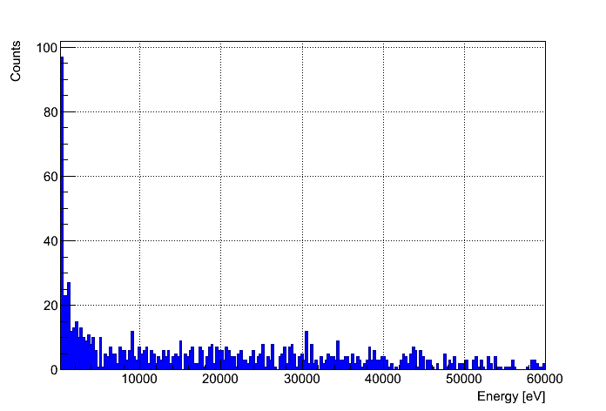
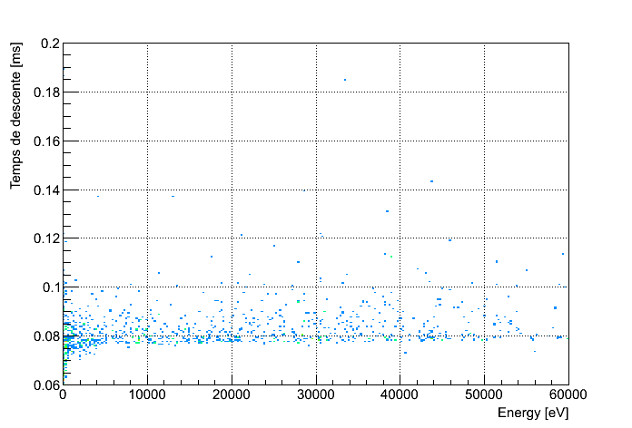
Analysis – optimization of cuts
Calibration with neutrons (²⁴¹Am-Be) source
Ne + CH₄ (0.7 %) P = 3 bar T = 4455 s
Rise Time [ms]
Rise time [ms] / Energy [eV]
Count
Energy spectrum [eV]
0.04
0.0105
Point like energy deposits
Energy [eV]
Energy [eV]
Pulse width[ms] vs Energy [eV]
Temps de descente [ms]
0.086
0.075
Energy [eV]

Slide 13
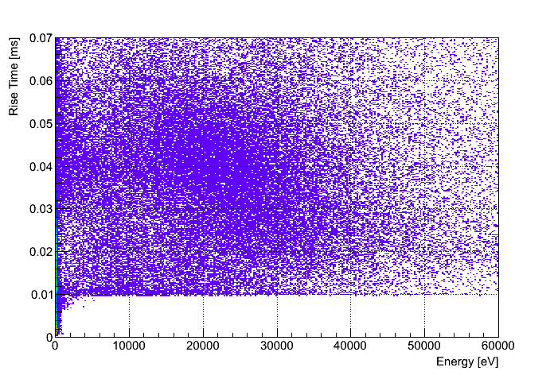
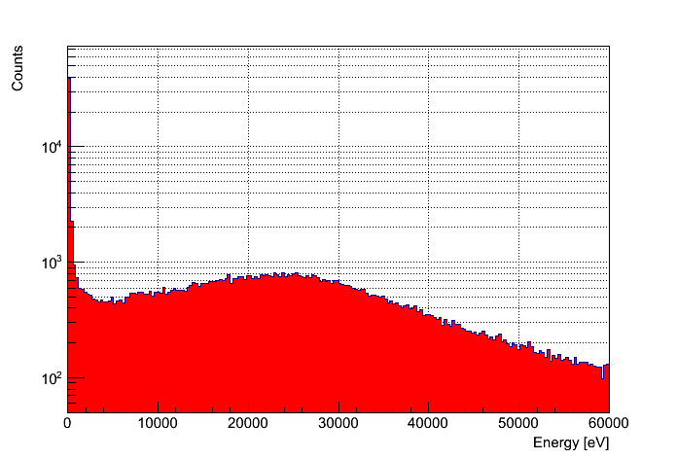
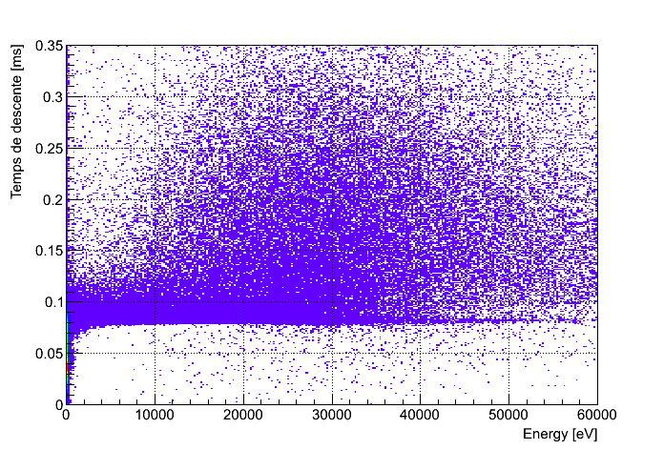
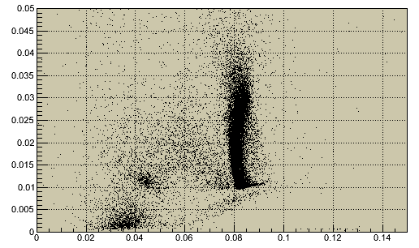
Physic run (light-WIMPs research)
Ne + CH₄ (0.7 %) P = 3 bar T = 30.5 jours
Rise time [ms] / Energy [eV]
Energy spectrum [eV] before cut
Rise Time [ms]
Count
0.04
0.0105
Energy [eV]
Energy [eV]
Temps de descente [ms] / Energy [eV]
Rise Time [ms] / Temps de descente [ms]
Temps de descente [ms]
Rise Time [ms]
0.086
0.075
Energy [eV]
Temps de descente [ms]
13

Slide 14
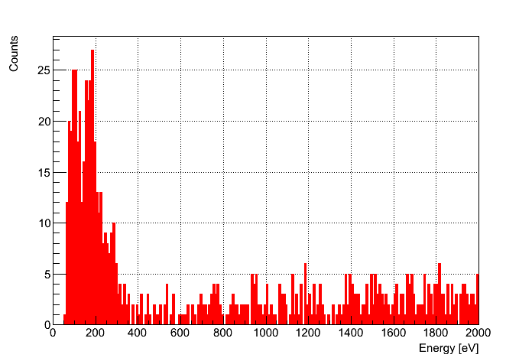
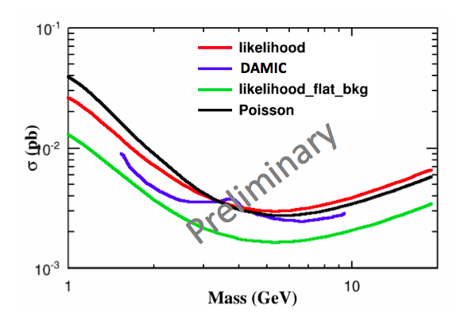
Light WIMP search results
Count
Energy spectrum [eV] at low energy
Excess not yet understood
30.5 days
3 bars Ne + CH₄ (0.7%)
300 – 1300 eV
18 Évén./jour/keV/kg
NEWS (Ne 3bar)

Slide 15
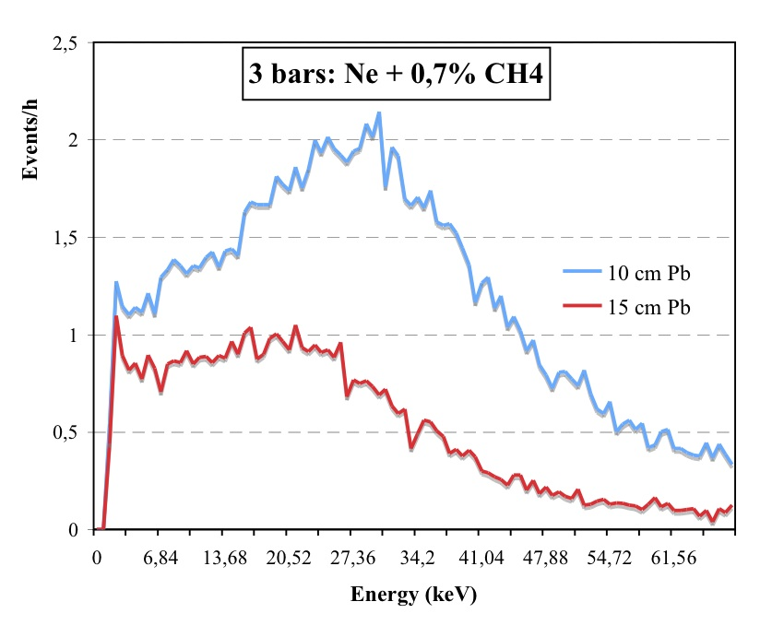
Shield improvement
During last month intervention (May 2015)
New platform fabricated and installed to carry detector and shield
Chemical cleaning of internal copper shield plates
Total lead thickness = 15 cm (from 10cm)
Total copper thickness= 7 cm (from 5 cm)
Improved anti-radon tent
Summary:
background level among the best experiments
Achieved with modest budget and manpower
Combined with the low energy threshold and low-Z targets:
Sensitivity for very-light WIMPs of this experiment is out of competition
Reduction

Slide 16
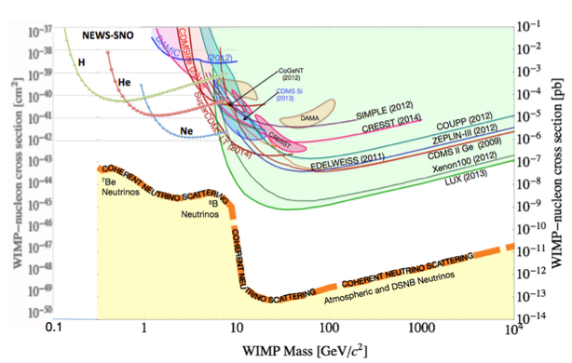
NEWS-SNOLAB project
Kingston, Saclay, Grenoble, LSM, Thessaloniki…..
2 m detector at 10 bar
Pure water shield
Funded by Canadian grant of excellence
LOI recently approved by SNOLAB committee

Slide 17
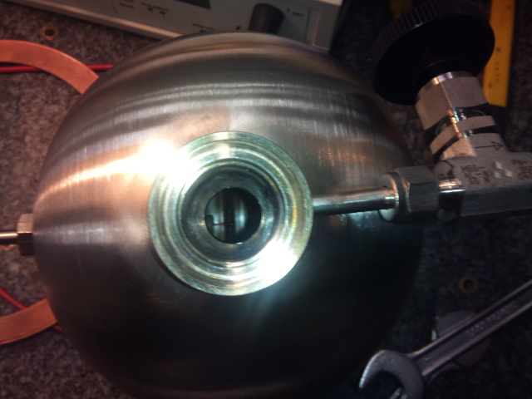
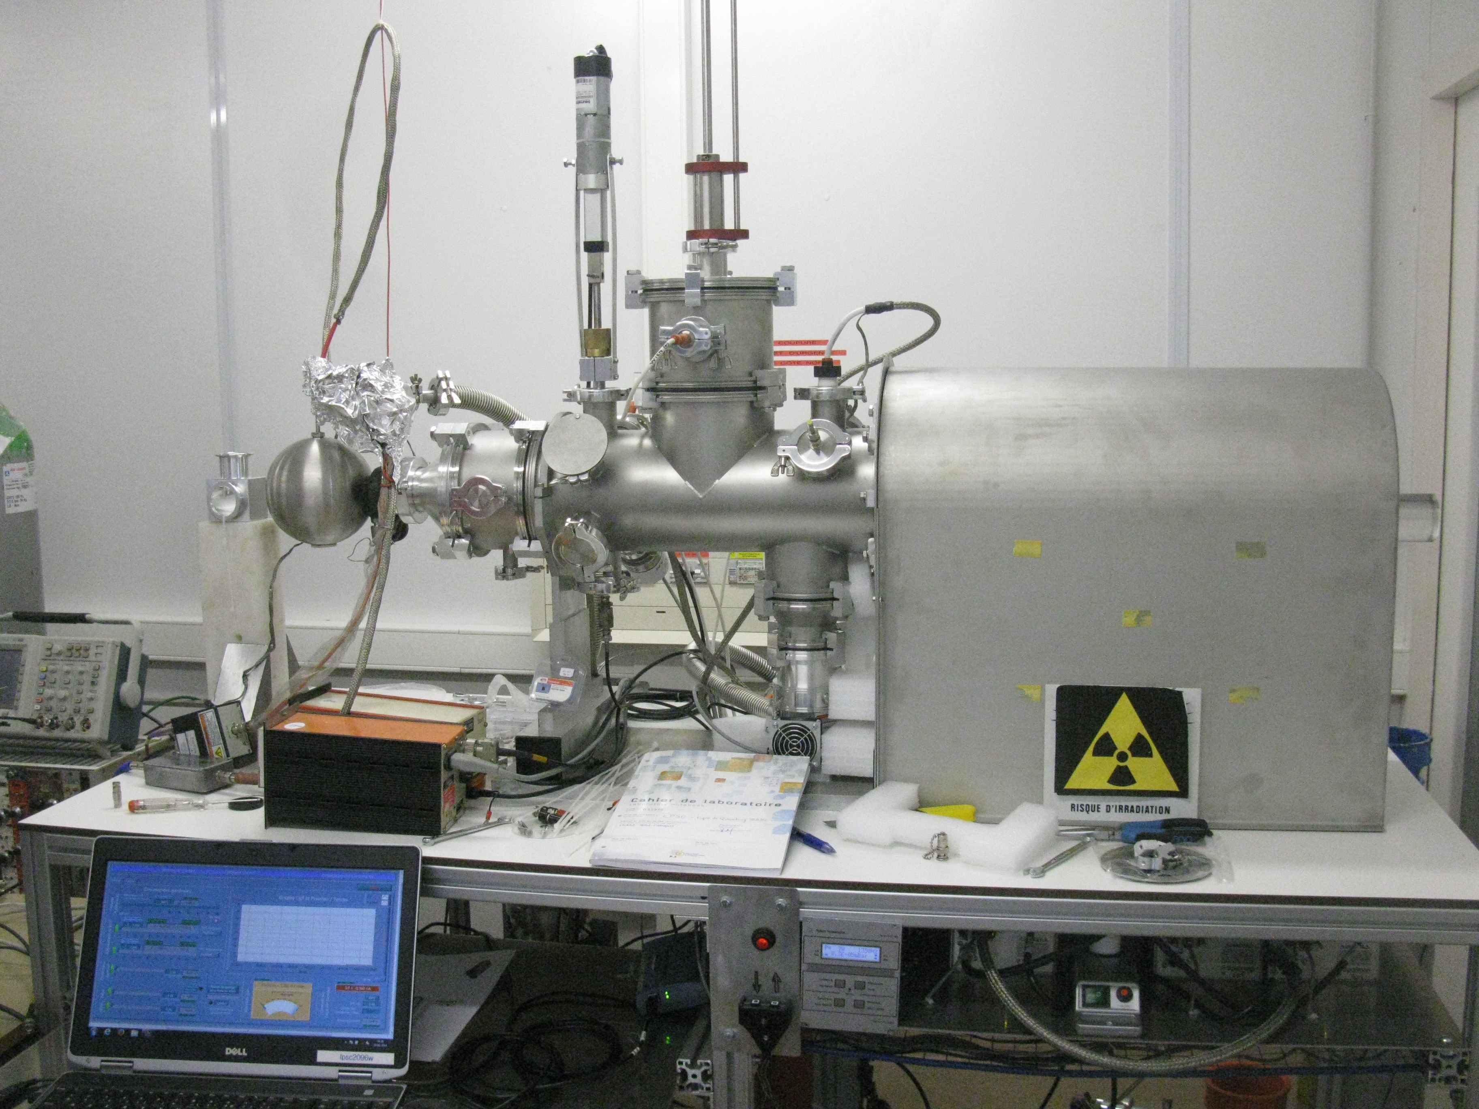
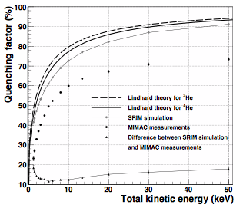
Quenching factor measurements
Goal: measure QF down to 500 eV ion energy using the Grenoble MIMAC facility
for H, He, Ne, CF4, Ar, Xe at various pressures
Earlier measurements
D. Santos et al., arXiv:0810.1137
Recent investigations with a 15 cm sphere
show the capability to measure 500 eV He-4 ions
with an estimated QF of about 25%
Saclay, Grenoble, Thessaloniki, Queen’s-Kingston
He-4 700 mbar

Slide 18
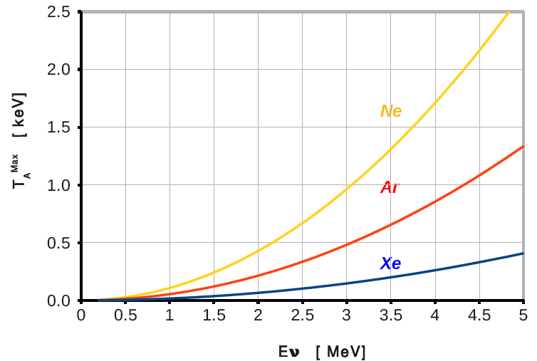
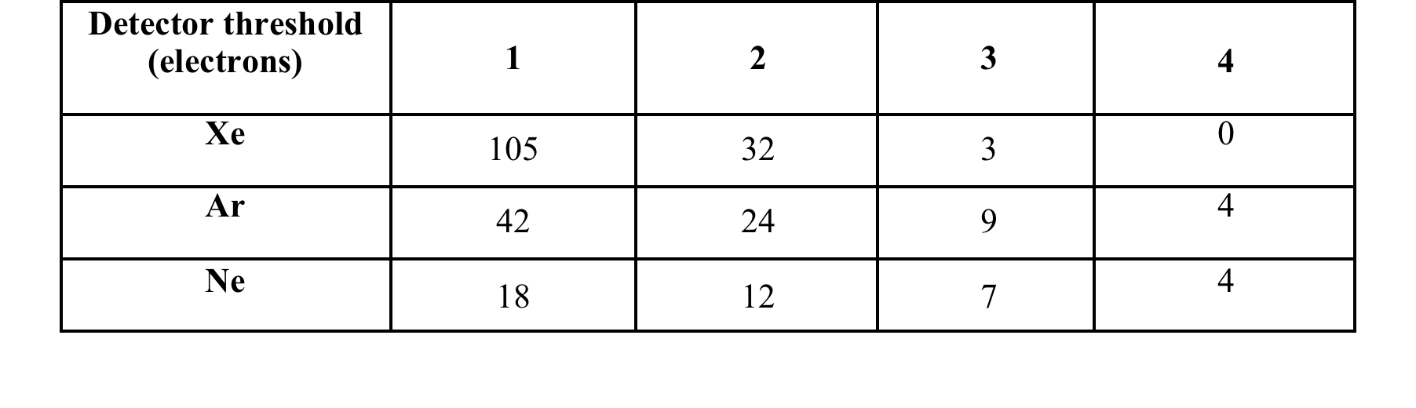
Neutrino-nucleus coherent elastic scattering
ν + N --> ν +N σ ≈ N²E ², D. Z. Freedman, Phys. Rev.D,9(1389)1974
A. Druikier, L. Stodolsky, Phys.Rev.D30:2295,1984, JI Collar, Y Giomataris - NIMA471:254-259,2000, H. T. Wong, arXiv:0803.0033-2008, PS Barbeau, JI Collar, O Tench - Arxiv preprint nucl-ex/0701012, 2007
High cross section but very-low energy nuclear recoil
Illustration: using the present prototype at 10 bar and at 10 m from the reactor, after 1 day run
T_{N} =2 m_{N}(E_{n} cosθ)²/{(m_{N} + E_{n})² − (E_{n} cosθ)²}
Argon and Ne are good candidate
Challenge : Very low energy threshold
We need to calculate and measure the quenching factor
Application : Remote control of nuclear reactor

Slide 19
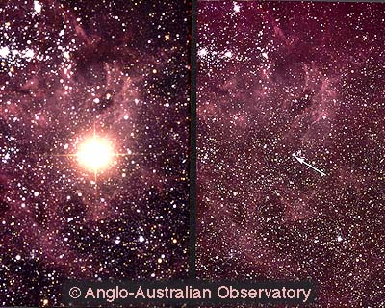
A dedicated Supernova detector
Simple and cost effective - Life time >> 1 century
Through neutrino-nucleus coherent elastic scattering
Y. Giomataris, J. D. Vergados, Phys.Lett.B634:23-29,2006
Sensitivity for galactic explosion
For p=10 Atm, R=2m, D=10 kpc, U_{ν} =0.5x10⁵³ ergs
# Number of events (no quenching, zero threshold)
He Ne Ar Kr Xe Xe (with Nuc. F.F)
.16 3.95 19.1 76.8 235 179
# Number of events (after quenching, E_{th} =0.25 keV)
He Ne Ar Kr Xe Xe (with Nuc. F.F)
0.08 1.5 6.7 23.8 68.1 51.8
Idea : A world wide network of several (tenths or hundreds) of such dedicated Supernova detectors robust, low cost, simple (one channel)
To be managed by an international scientific consortium and operated by students
Destruction of massive star initiated by
the Fe core collapse
10⁵³ ergs of energy released
99% carried by neutrinos
A few happen every century in our Galaxy, but the last one observed was over 300 years ago

Slide 20
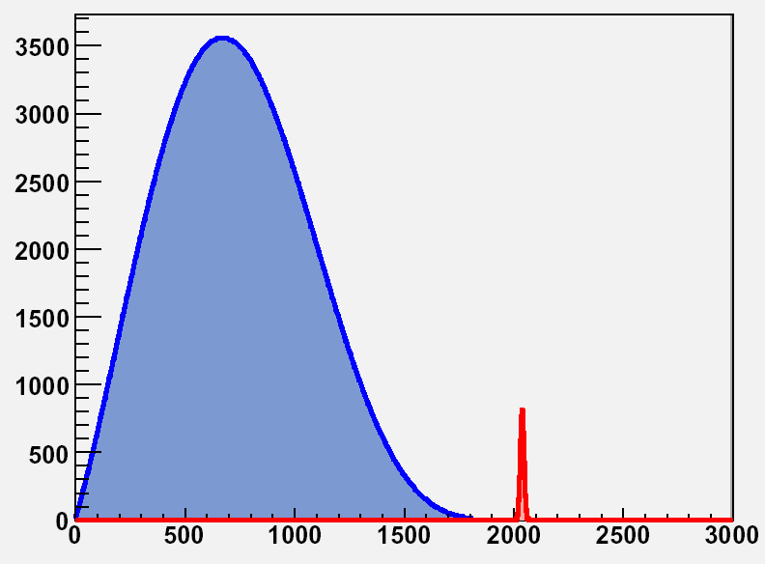
Neutrinoless double beta Decay process
If 0-v decays occur, then:
  Neutrino mass ≠0
  Decay rate measures effective mass ⟨m_{v} ⟩
  Neutrinos are Majorana particles
  Lepton number is not conserved
Great impact in physics.
Target >> 1000 Kgr and zero background
d(n)
u(p)
W
e
ν
e
W
ν
d(n)
u(p)
T_{1/2} (2νββ): ~ 1.15 x 10¹⁹year
d(n)
u(p)
W
e
ν
ν
e
W
d(n)
u(p)
T_{1/2} (0nbb): > 10²⁴year

Slide 21
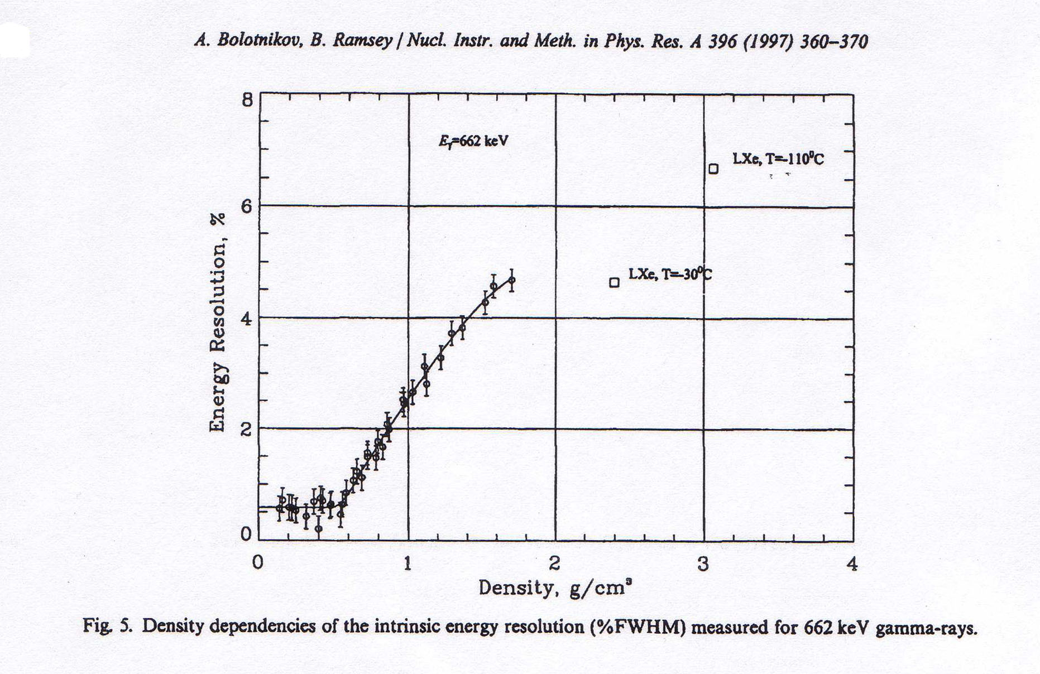
Why Xenon-136
Xenon is relatively safe and easy to enrich
Natural abundance of ¹³⁶Xe is ~ 8%
EXO and NEXT have 200 kg highly enriched in ¹³⁶Xe
Low cost
Why gaseous Xenon-136
Pressure variation
High density is desirable to contain event
Moderate density helps to reject Compton backgrounds
Energy resolution is good up to  < 0.55 g/cm³
Beyond this density, E/E deteriorates rapidly!

Slide 22
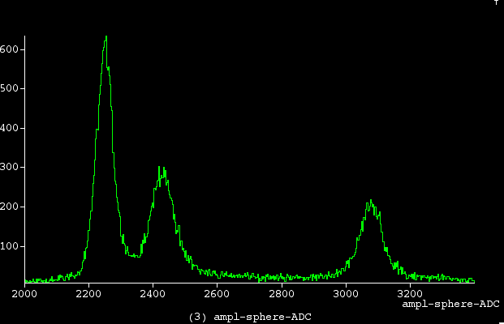
Why a gaseous high-pressure spherical detector
Ultra-low radioactivity detector
Easy to build for high pressures up to 50 bar
Good Compton background rejection
Good energy resolution reached in Argon .5%
Very good energy of .25% at 2.4 MeV has to be demonstrated
(low capacitance-low electronic noise would be precious)
Spherical vessel and shield is an economical structure
Spherical detector energy resolution with radon gas
²²²Rn
RMS = .5%
²¹⁸Po
²¹⁴Po

Slide 23
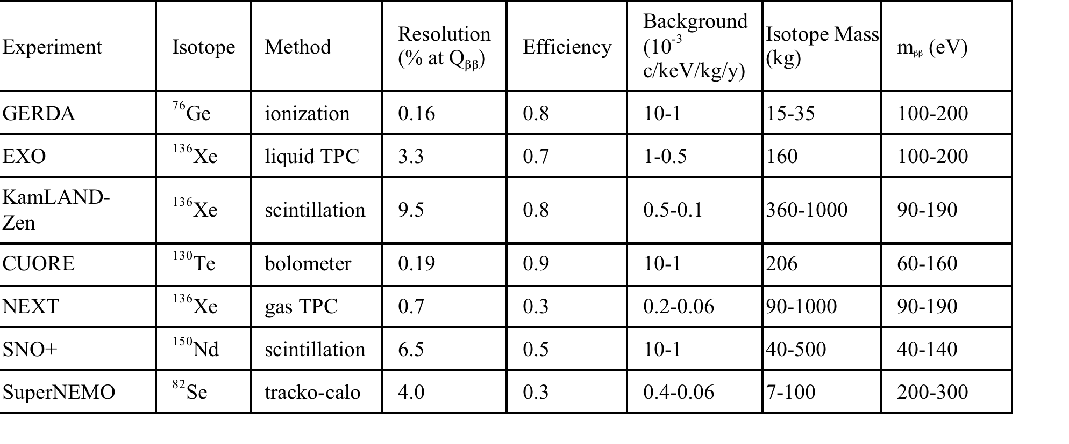
Current and future projects
ANEMOS project: Development of a high-pressure spherical detector demonstrator for neutrino less double beta decay search
In collaboration with CNBG ( F. Piquemal et al.,), CPPM (J. Busto et al.,)
The goal is to reach a record low background level << 10⁻⁴/keV/Kg/y and an energy resolution of .3%
We target a sensitivity of m_{bb} <50 meV better than other experiments

Slide 24
ANEMOS strategy
Demonstrate the ultra-low background capability with a small size
60 cm detector at a pressure of 50 bar
The 2 m dark matter detector at SNOLAB will demonstrate the scaling
(2 m detector ) needed for the double beta decay experiment (1 ton scale Xe-136)
The combination of the two detectors and the good energy resolution
to be reached in the R@D phase, will give the proof of principle
of an optimized DBD experiment as required for the next generation projects
A main idea is to take advantage of the detector simplicity to severely reduce backgrounds emitted from surrounding materials
ANEMOS demonstrator
Identical size to SEDINE (60cm)
Made of ultra-pure copper
Transported with special castle to avoid
radon contamination and activation
Installation inside the current LSM shield (improved)

Slide 25
ANEMOS Sensitivity
Simulation model
Sphere diameter: 2 m
Xenon gas at 50 bar (1272 Kg)
Vessel: Electroformed copper (PNNL) μBq/kg ²³²Th=.034, ²³⁸U=.13
Commercial copper (Aurubis) μBq/kg ²³²Th=1., ²³⁸U=1.
Shield 30 cm copper PNNL
GEANT simulation by J. Galan
We assume complete suppression of external backgrounds
Backgrounds are generated by ²³²Th and ²³⁸U contamination
of detector and shield
Results
Background rate in the region of Q_{bb} (2.46 MeV)
1.54x10⁻⁵/keV/Kg/ year
8.x10⁻⁵/keV/Kg/ year with commercial copper
(compared to 2x10⁻³/keV/Kg/ year of running experiments)

Slide 26
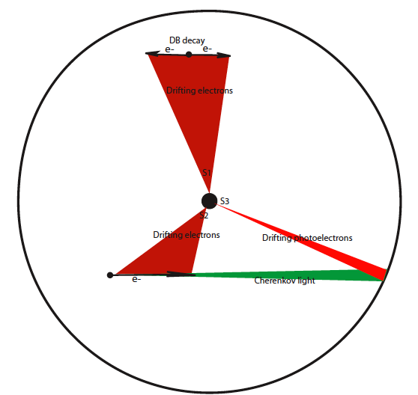
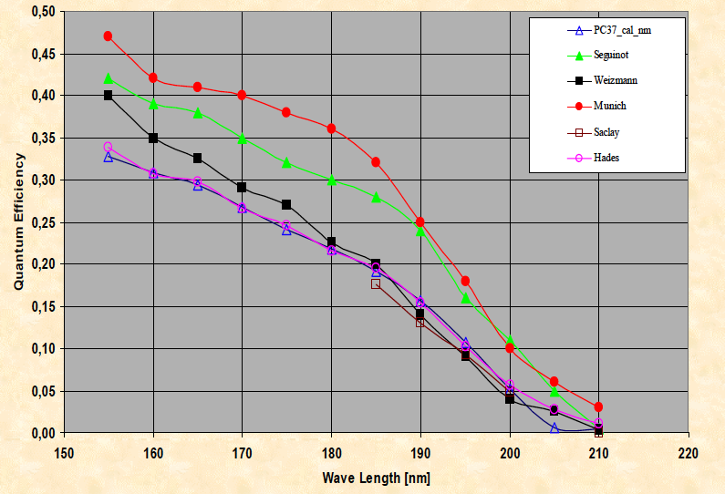
Double beta decay experiment with the spherical detector
If additional rejection is required: new idea
Background free double beta decay experiment, I. Giomataris, arXiv:1012.4289
The idea is to detect Cherenkov light emitted by two electrons and then reject background
from single electrons (Compton scattering etc..)
Xenon-136 at high pressure of about 25-40 bar is ideal to keep high efficiency for double electrons,
Good enough electron path and reduce multiple scattering
A simple read-out is the standard spherical detector signal combined with
CsI photocathode layer deposited at the internal vessel surface, inducing a delayed signal
UV QE CsI
S₂ (S₁) is the charge signal collected and amplified
S₃ is the delayed Cherenkov light signal

Slide 27
CONCLUSIONS
A promising novel low-background detector
Light dark matter search down to 100 MeV
Neutrino elastic coherent scattering could be detected
Ultra low-background double beta decay experiment

