Slide 1
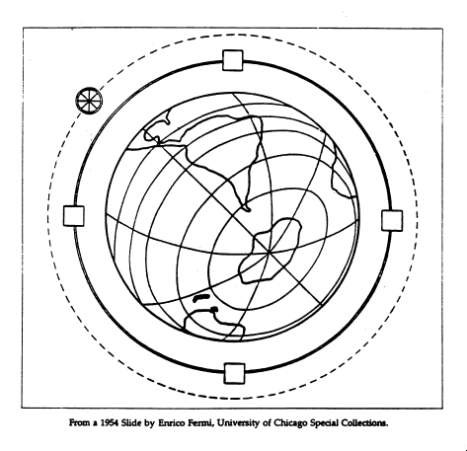
Future Colliders, Fermilab Plans
Dmitri Denisov, Fermilab
CPPM Seminar October 8 2015

Slide 2
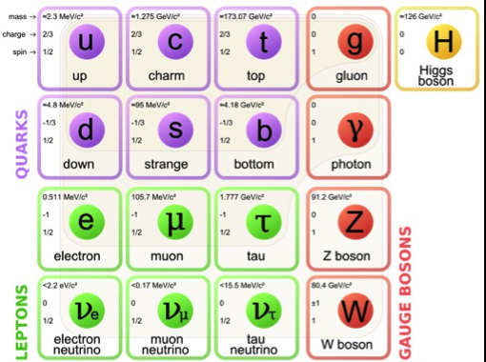
Particle Physics
Standard Model is the theory of elementary particles and interactions
  Describes majority of phenomena in Nature
  Makes everything of a small number of objects
    Quarks and leptons
  Forces are carried by
    photon - electromagnetic
    gluons - strong
    W/Z bosons - weak
  Higgs boson provides mass
  Accurate to a very high precision
    Better than 10⁻¹⁰
Addresses 1000’s of years hunt of mankind to understand
  What everything around us is made of
But our current understanding is incomplete
  Can’t explain observed number of quarks/leptons
  Model parameters can’t be predicted
Nothing is “wrong” with the Standard Model
  The goal is to define limits of applicability and find what lies beyond

Slide 3
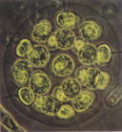
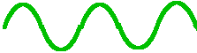
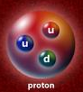
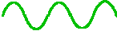
Why High Energy and Why Colliders
Cell
Accelerators are built to study the Nature smallest objects
  Wavelength = h/E
  ~2 .10⁻¹⁸ cm for LHC
Accelerators convert energy into mass
  E = mc²
  Objects with masses up to
  Mass = 2E_{beam} could be created
Proton
E_{beam} Mass E_{beam}
Collider center of mass energy is 2E_{beam} instead of √(2mE_{beam}) for fixed target
To get to the next step in understanding of Nature - at both smaller distances and higher masses - higher energy is the only way to succeed

Slide 4
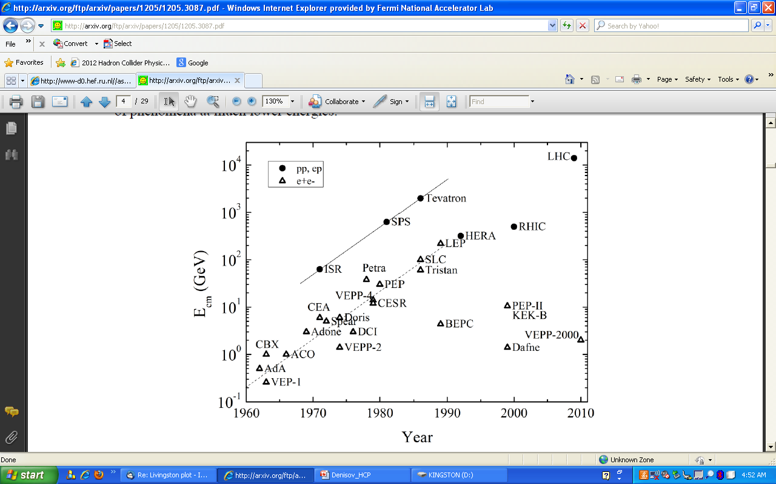
Colliders
of first physics
First e⁺e⁻ colliders started operation in early 1960’s with hadron colliders (storage ring) first collisions in 1971 with the completion of the ISR
Large number of e⁺e⁻ colliders, while few hadron colliders
Hadron colliders provide higher center of mass energy, while colliding “composite” particles

Slide 5
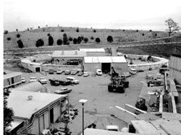
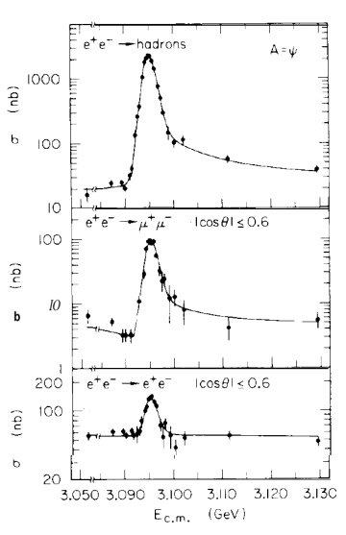
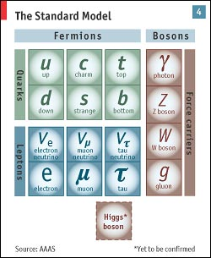
SPEAR e⁺e⁻ Collider at SLAC: start 1972
SPEAR construction
J/Psi discovery
Started in 1972 with ~3 GeV center of mass energy
Opened extremely productive energy range
  Co-discovery of c-quark (J/Psi meson) in 1974
  Discovery of τ-lepton in 1975
One of the most productive colliders in the world

Slide 6
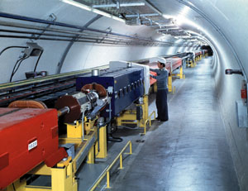
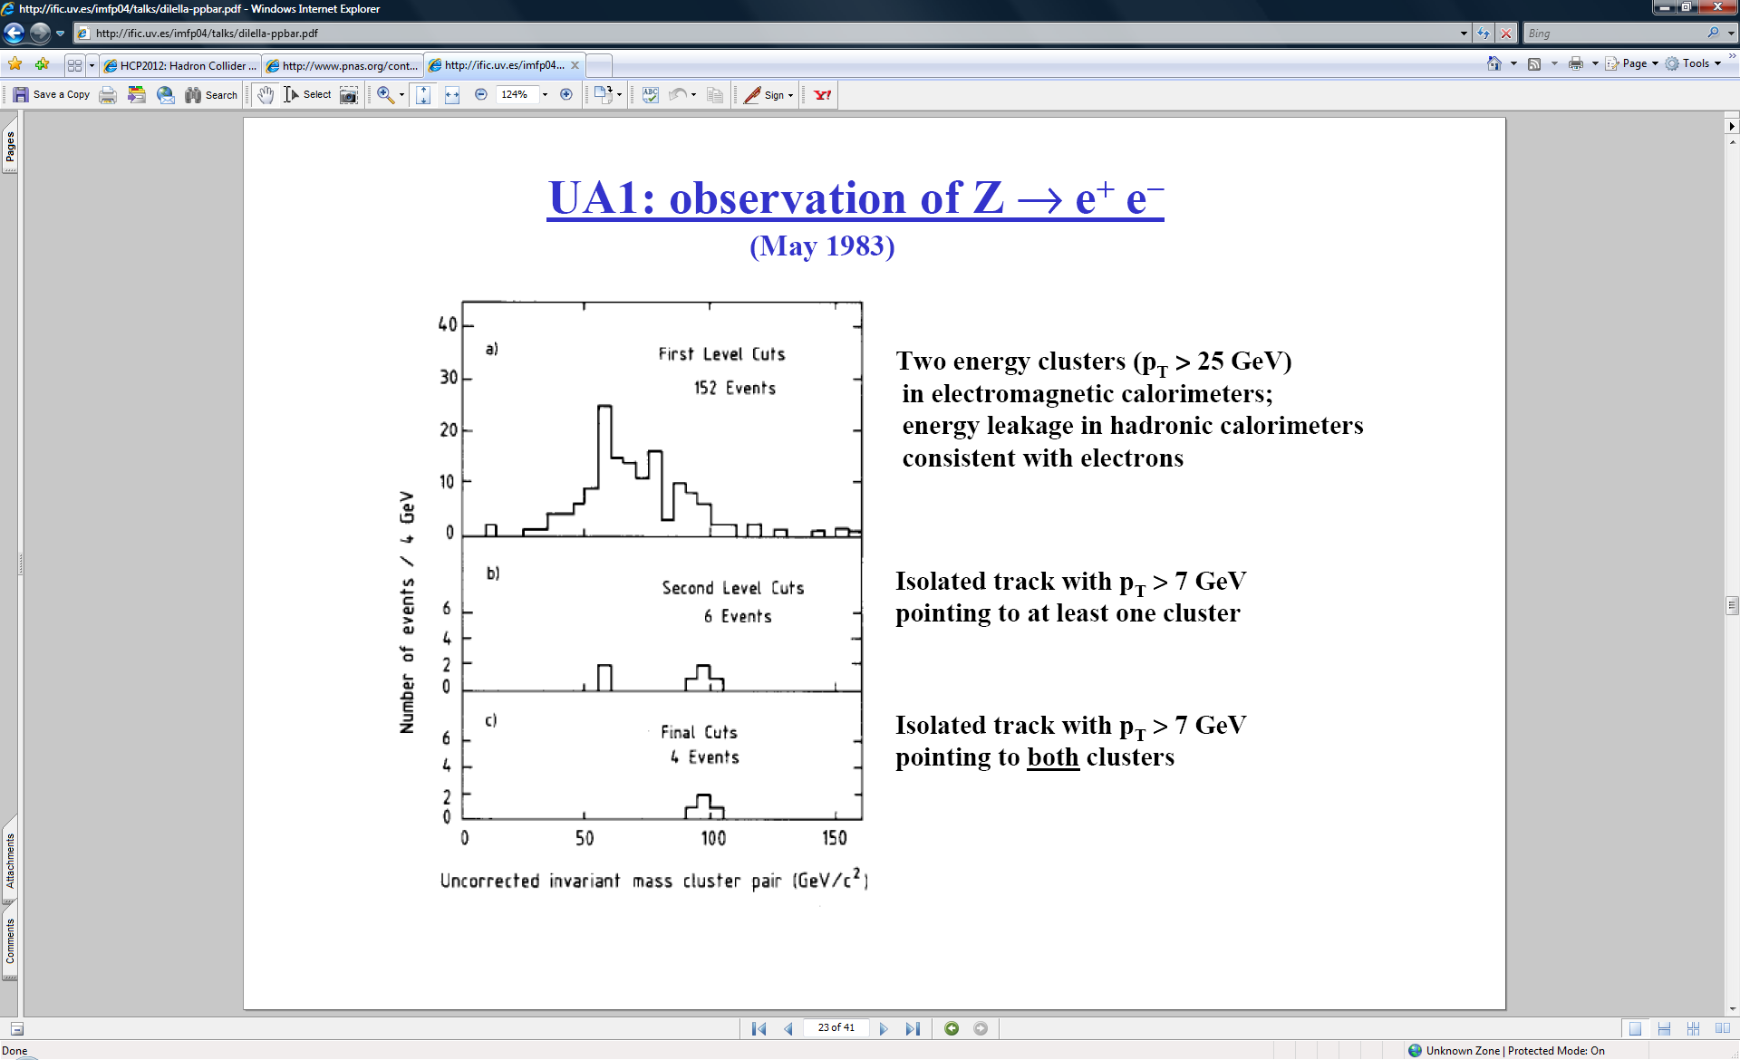
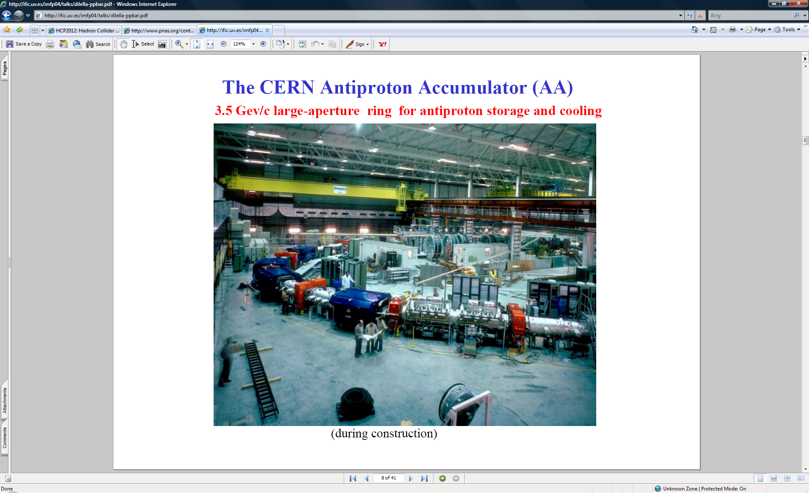
SppS Collider at CERN: start 1981
Z boson discovery
SppS
630 GeV
Antiproton source
Use of antiprotons in the existing fixed target accelerator
Provided next step in the understanding of the standard model
  W/Z bosons discovered

Slide 7
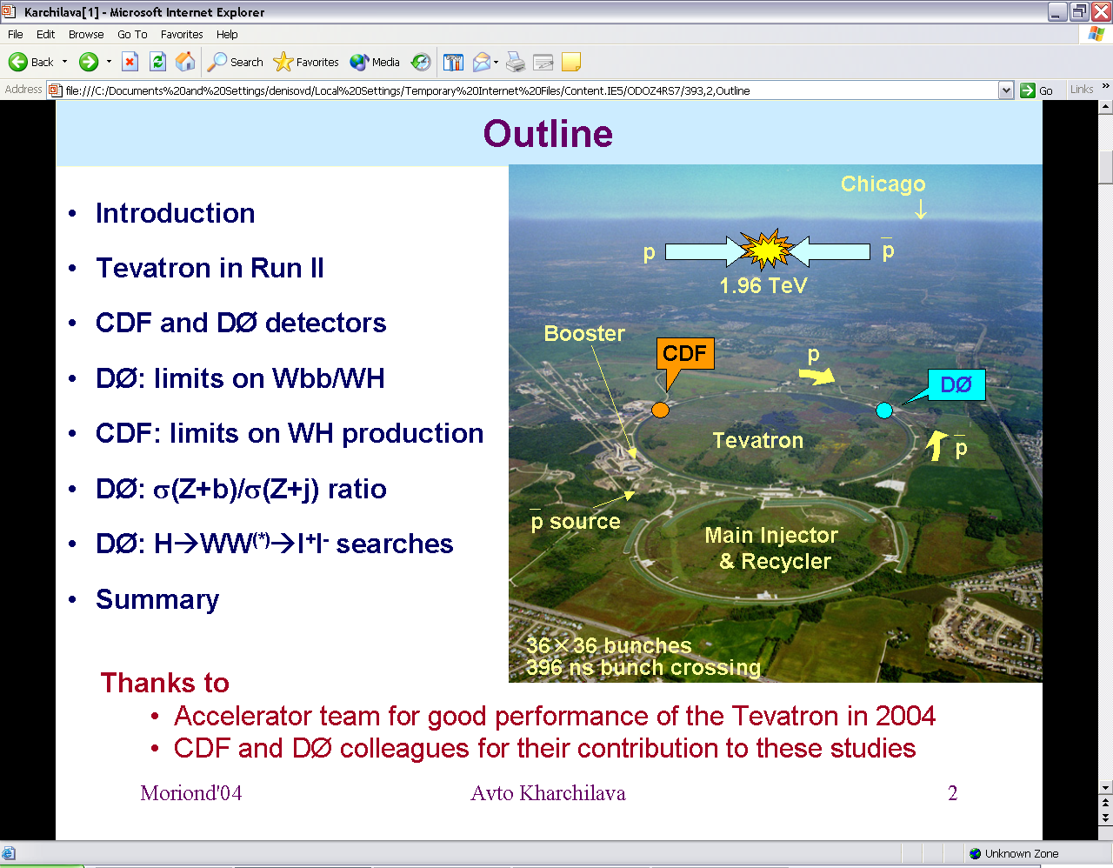
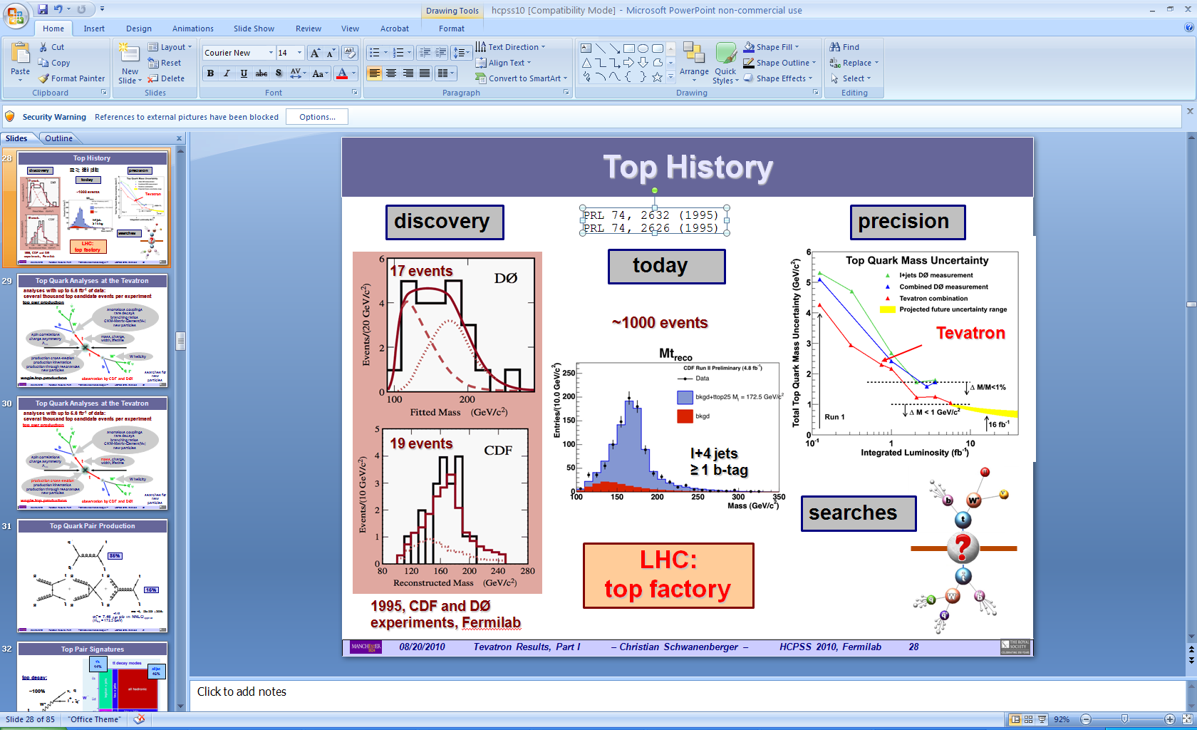
The Tevatron: start 1985
Top quark discovery
First superconducting accelerator with 2 TeV center of mass energy
Discovered last standard model quark – the top quark

Slide 8
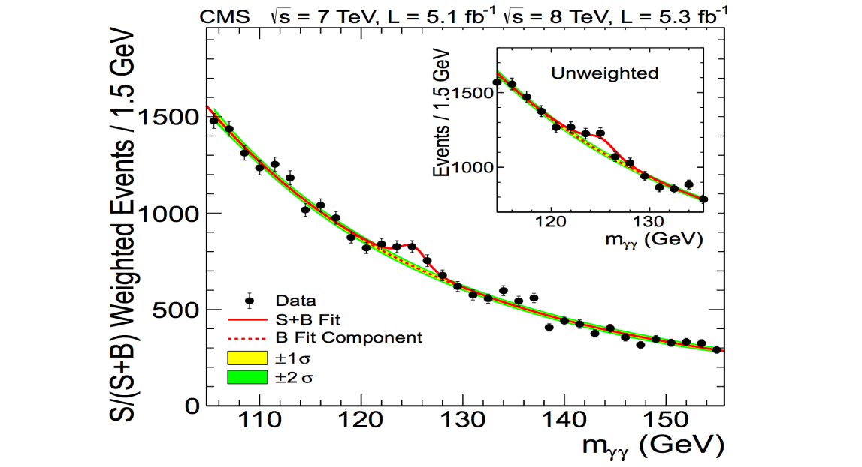
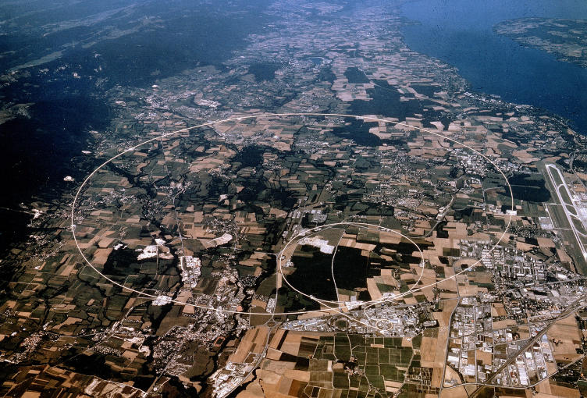
The LHC – the History in the Making
Re-use of the LEP tunnel
  With superconducting magnets
Discovered last missing piece of the standard model - the Higgs boson
Extensive searches for physics beyond the standard model
Many more exciting results expected

Slide 9

Accelerators and the Standard Model
Progress in particle physics over past 40 years was closely related to discoveries at ever more powerful colliders
  e⁺e⁻ colliders
    c quark, tau lepton, gluon
  Use of antiprotons in the same ring as protons
    W and Z bosons
  Superconducting magnets
    Top quark and the Higgs boson
All expected standard model elementary particles have been discovered at colliders
  Tau neutrino in fixed target experiment at Fermilab
At every step new accelerator ideas provided less expensive ways to get to higher beams energies and higher luminosities

Slide 10
Operating or Soon to be Operating Colliders
of first physics
Single high energy hadron collider – the LHC, now at 13 TeV
  RHIC at BNL – nuclear studies
DAFNE (Frascati), VEPP (Novosibirsk), BEPC (Beijing) – low energy e⁺e⁻ colliders
SuperKEK-B – b-factory at KEK to restart in 2016 with ~40 times higher luminosity
  studies of particle containing b-quarks

Slide 11
Physics Goals and Challenges of the Future Colliders
Physics interests often drive colliders development
  Like colliding antiprotons in the already existing ring of SpS at CERN to discover W and Z bosons
Today there are two areas where new colliders are especially important
  “Higgs factory” – a collider (most probably e⁺e⁻) with a center of mass energy 250 GeV and above and high luminosity to study the Higgs boson properties
  “~100 TeV” pp collider to get to the “next energy frontier” an order of magnitude above LHC
    Study distances up to ~10⁻¹⁹ cm and particles masses up to ~50 TeV
What are challenges in building next generation of colliders
  Progress in new acceleration methods aimed to reduce cost of the colliders was relatively slow over last ~20 years
  Colliders are becoming rather expensive and require long time to build

Slide 12
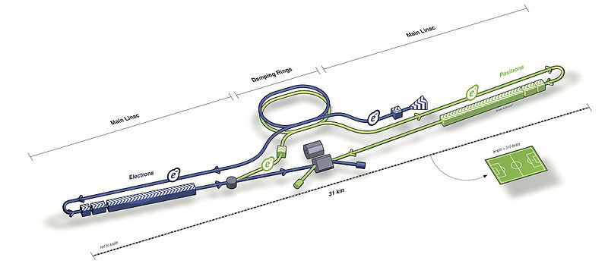
e⁺e⁻ Colliders
Circular and linear
  Large Electron Positron (LEP) collider
  International Linear Collider (ILC) and SLAC linear collider
Major limitations of circular e⁺e⁻ colliders
  Synchrotron radiation causes electrons constantly loosing energy
    Energy loss is proportional to γ⁴
    Power consumption is 100’s MW
  Limit energy to ~0.5 TeV even for ~100 km long ring
Major limitation of linear colliders
  Need to add energy to electron in “one path”
  Rate of adding energy is limited to ~30 MeV/meter, requires ~30 km long tunnel to reach ~1 TeV energy

Slide 13
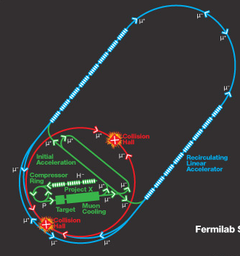
μ⁺μ⁻ Colliders
Muons are “heavy electrons”, they do not have high synchrotron radiation making circular accelerator viable for multi TeV energies
  γ factor at the same energy is ~200 times less than for electrons
Muons are unstable with life-time of 2.2 micro seconds
  Decay to an electron and a pair of neutrinos
Main accelerator challenge
  To make large number of muons quickly and then “cool” them to focus into small diameter beam to collide
Another issue are decays and irradiation by electrons from muon decays
  and neutrinos irradiation!
2x2 TeV

Slide 14
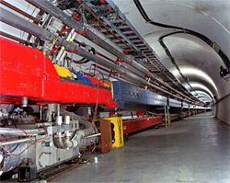
Hadron Colliders
Radius of the accelerator
  R~E_{beam} /B where B is magnetic field and E_{beam} is beam energy
To set the scale
  LHC has 27 km long tunnel and ~9 T magnets
There are two options to increase energy of a hadron
collider
  Increase magnetic field in the bending magnets
    Not easy beyond ~10-12 Tesla
  Increase radius of the tunnel
    New underground tunneling methods

Slide 15
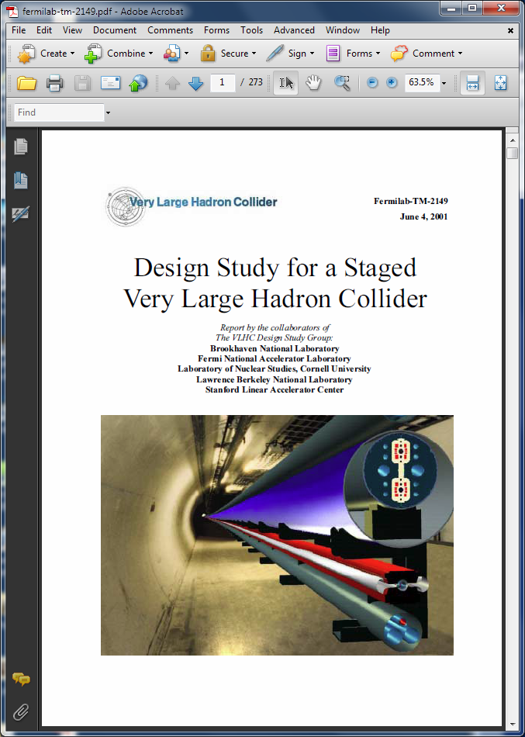
Design Study for a Staged Very Large Hadron Collider
International design group
Main goals
  New ideas
  Technical design and feasibility
  Cost estimate
“Staged” means first stage of 40 TeV and second stage of 175 TeV

Slide 16
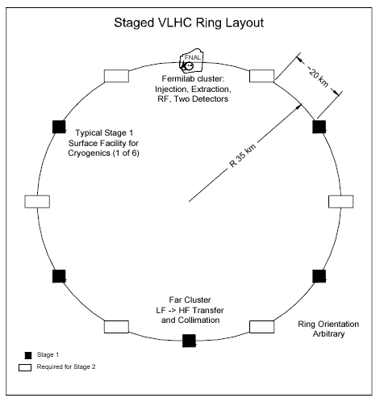
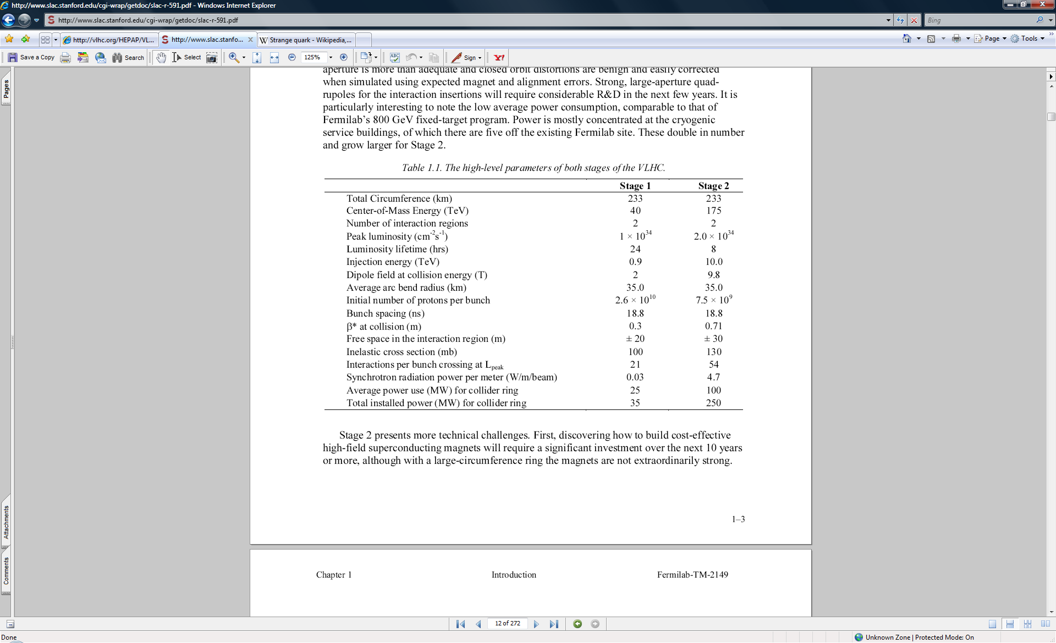
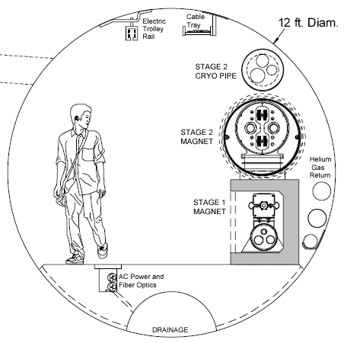
Parameters of 40-175 TeV Collider

Slide 17
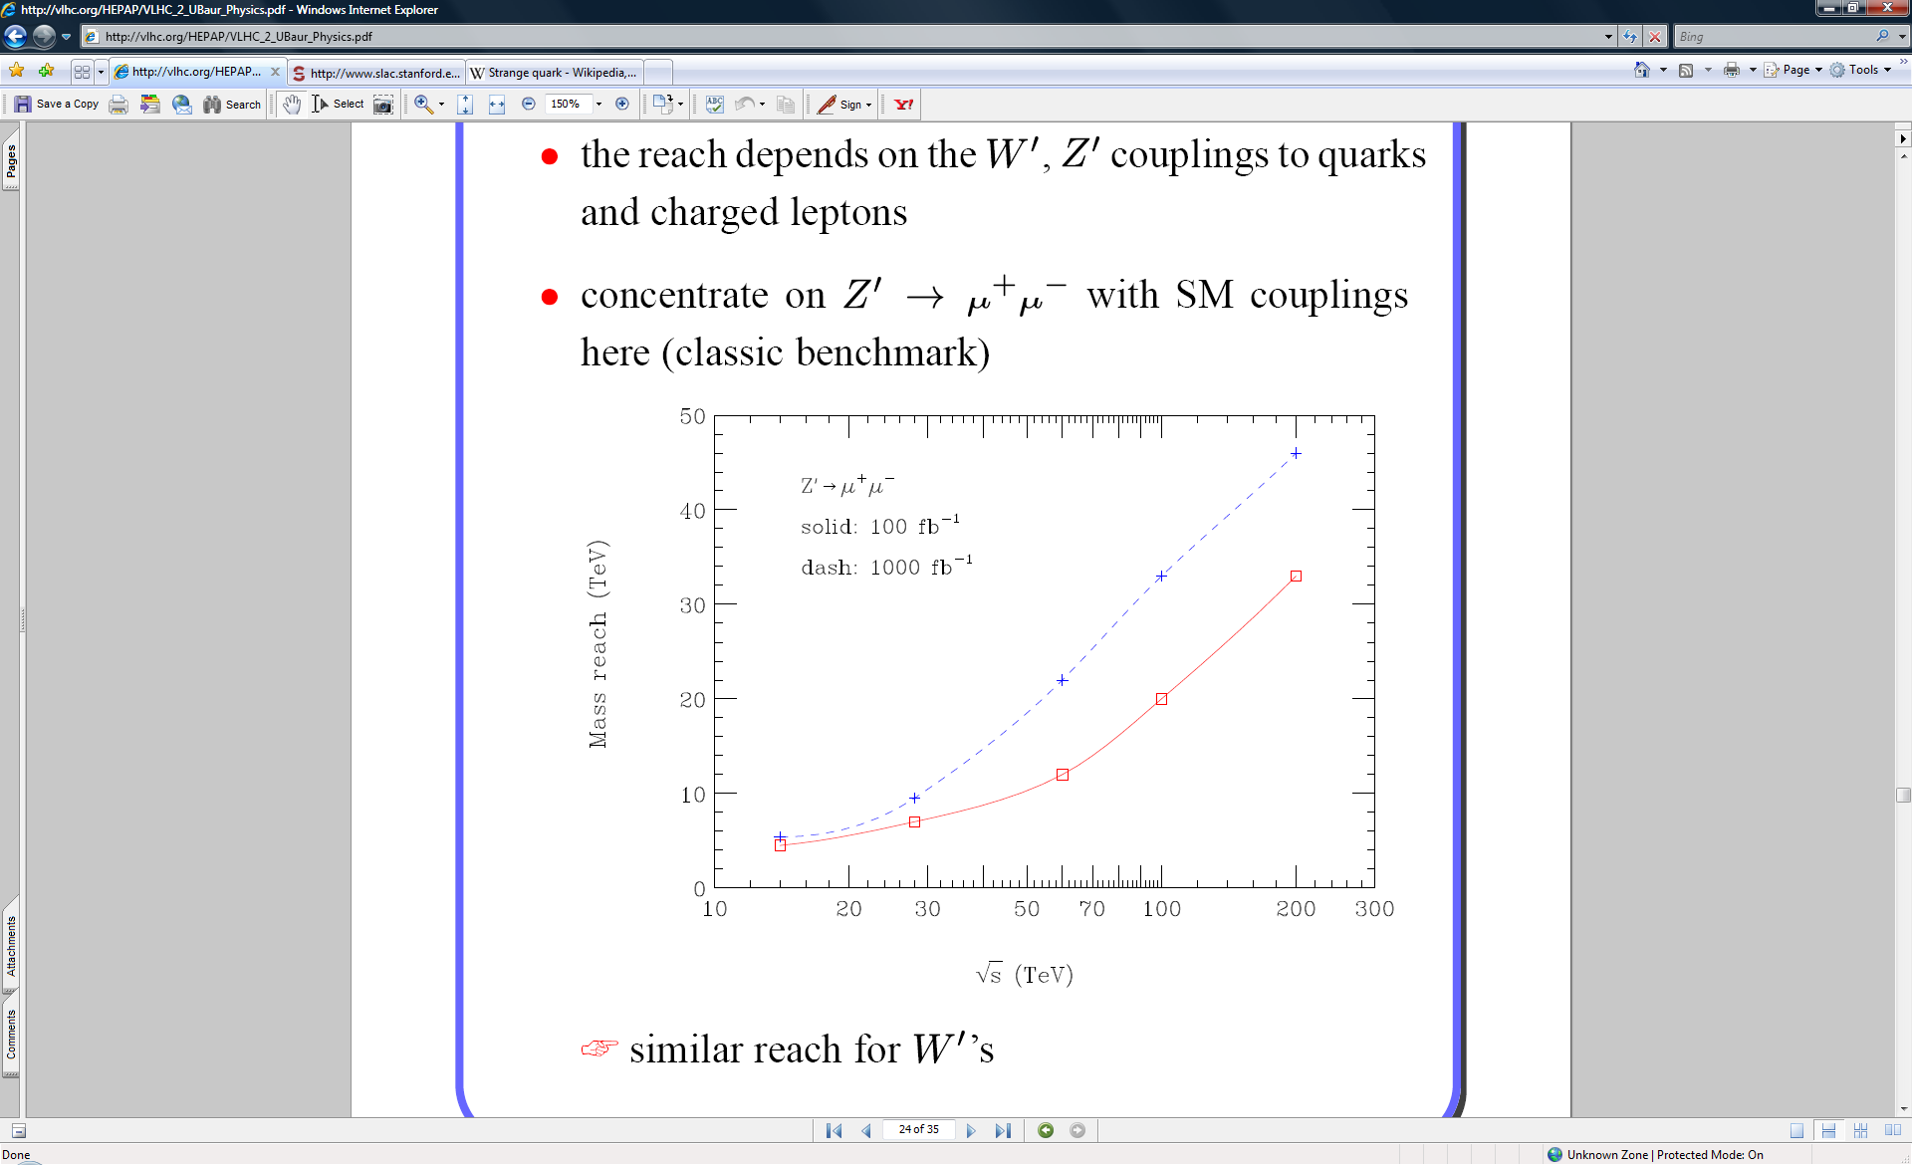
Collider Energy and Mass Reach
Many studies done on the reach of high energy hadron colliders
With reasonable luminosity mass reach for direct searches of ~1/2 of the full collider energy is achievable
There is no well defined “energy needed” for VLHC yet
  20 TeV machine could be about twice less expensive than 40 TeV (could saved SSC?)
  But don’t want to miss major discovery due to a few % lower energy (LEP)

Slide 18
Detectors for 100 TeV Collider
We would like to detect all “well know” stable particles which including products of short lived objects decays: pions, kaons, muons, etc.
  Need 4π detector with layers of tracking, calorimetery and muon system
Central tracker
  Most challenging is to preserve momentum resolution for ~10 times higher momentum tracks
Calorimetry
  Getting better with energy: hadronic energy resolution ~50%/√E, 2% at 1TeV
  Length of shower increase has log(E) dependence – not a major issue
Muon system
  Main challenge is momentum resolution and showering of muons as they are becoming “electrons” due to large γ factor
Occupancies and radiation doses
  Up to 10³⁵ cm⁻² sec^{–1} looks reasonable, challenging for above both due to pileup and radiation aging

Slide 19
Medium Term Future Colliders Projects
ILC - International Linear Collider
  500 GeV linear e⁺e⁻ collider (upgradable to 1 TeV)
  Higgs factory (and top quark factory)
  Location – Japan
  Start of construction ~2019
  Estimated cost ~$10B
CepC – Circular Electron Positron Collider
  ~250 GeV circular e⁺e⁻ collider (the tunnel could be later used for pp collider)
  Higgs factory
  Location – China
  Start of construction ~2021
  Estimated cost ~$3B
FCC – Future Circular Colliders
  350 GeV e⁺e⁻ and/or ~100 TeV pp
  Higgs factory and/or next energy frontier
  Location - CERN
  Start of construction - ?
  Estimated cost - ?
P5: No muon collider
studies in US for now

Slide 20
International Linear Collider
ILC or International Linear Collider is e⁺e⁻ linear collider with the following main parameters
  Center of mass energy ~500 GeV
  Luminosity >10³⁴ cm⁻²s⁻¹
No synchrotron radiation, but long tunnel to accelerate to ~250 GeV/beam
  Excellent Higgs factory with many Higgs production and decay channels accessible

Slide 21
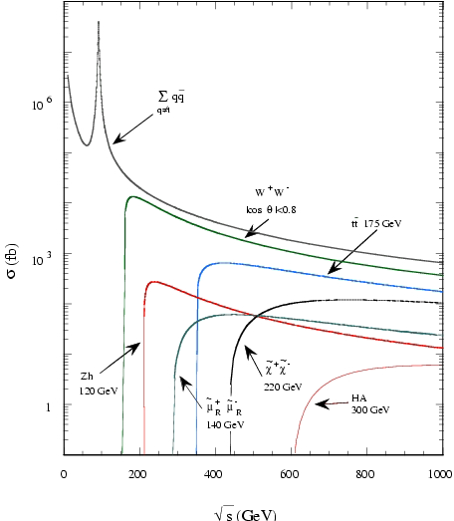
ILC Physics
Low cross sections
  High luminosity needed
Low rate of interactions
  Collect all events
  High efficiency needed
Point like particles colliding
  Sharp thresholds
  Can be used for precision measurements including top mass
Large number of different production/decay channels
  Have to detect all “standard objects” well
  Jets/photons, leptons, charged tracks, missing energy

Slide 22
ILC Status and Plans
After success of SLAC’s linear e⁺e⁻ collider in 1990’s (SLC) various proposals developed to go to even higher colliding energy
  Among them NLC(SLAC), TESLA(DESY), “ILC at Fermilab”
Starting in 2008 Global Design Effort (GDE) progressed developing
  Technical design of the ILC
  Cost estimate and international cooperation plan
GDE concluded in 2012
  Including TDRs for the accelerator and detectors
  Physics case strengthened with a Higgs discovery
In 2012 Japan expressed strong interest to host the ILC
Over last two years
  Substantial progress in technical developments
  Development of cooperation between participants on “Governments level”
All involved agree that ILC project should be international project with Japan as the host country
  Challenges in establishing high level agreements between countries are substantial
  Funding for this international project, including in Japan, is expected to be “in addition to the existing particle physics funding”

Slide 23
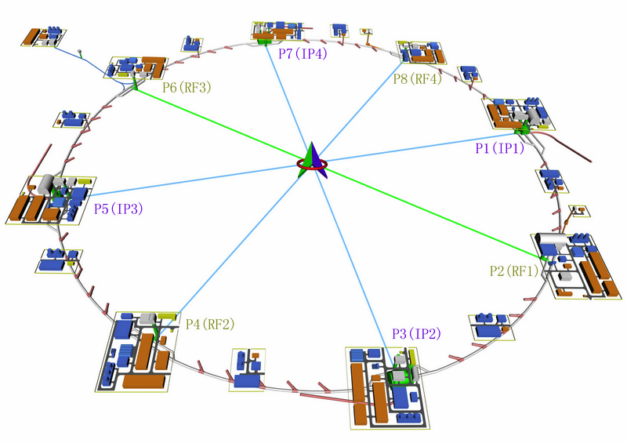
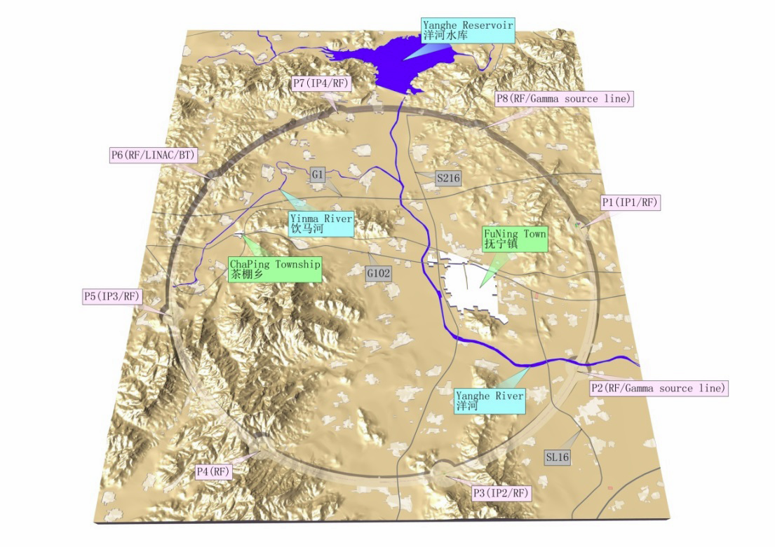
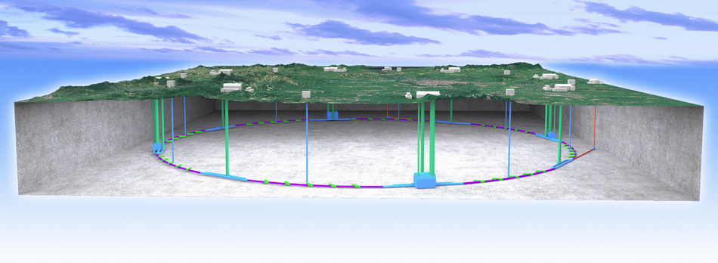
Proposals for Colliders in China: CepC and SppC
CepC – Circular Electron Positron Collider
  ~50 km long ring
  90-250 GeV in the center of mass
  Z boson and Higgs factory
SppC – Super Proton Proton Collider
  In the same ring as CEPC
  ~50 TeV with 12 T magnets, ~70 TeV with 20 T magnets

Slide 24
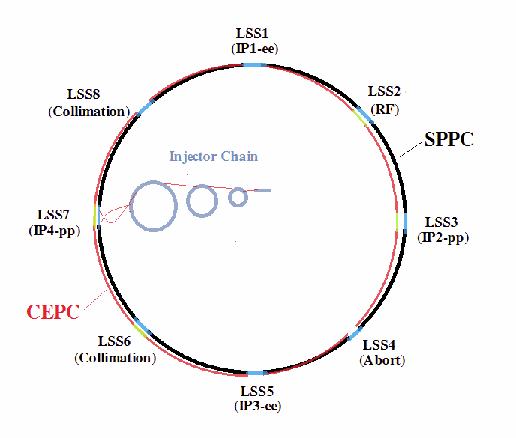
Future Colliders in China
Very active progress with the CepC and SppC design over last two years
  International reviews (positive) of the conceptual proposals in Spring of 2015
Plan is to get funding for detailed technical design report by later this year
  ~$50 million per year effort
  Completed by 2020
Construction of CepC to start in 2021
  Completed in 2027
  Data collection 2028-2035
SppC time line
  Design 2020-2030
  Construction 2035-2042
  Physics at ~70 TeV starting in 2043
The proposal is based on
  Experience with BEPC e⁺e⁻ collider
  Relatively inexpensive tunneling in China
  Strong Government interest in scientific leadership – both CepC and SppC are “national projects with international participation”
  Setting realistic goals based on the expected availability of resources

Slide 25

FCC – Future Circular Colliders
FCC activity follows European particle physics strategy recommendation to develop future energy frontier colliders at CERN
  “…to propose an ambitious post-LHC accelerator project….., CERN should undertake design studies for accelerator projects in a global context,…with emphasis on proton-proton and electron-positron high-energy frontier machines..…”
There are three options in ~100 km long tunnel
  pp collider with energy of ~100 TeV
  e⁺e⁻ collider with energy of ~350 GeV
  ep collider
Similar to “LEP then LHC” option of starting from 350 GeV e⁺e⁻ collider and later going to 100 TeV pp collider is considered
  But in no way decided

Slide 26
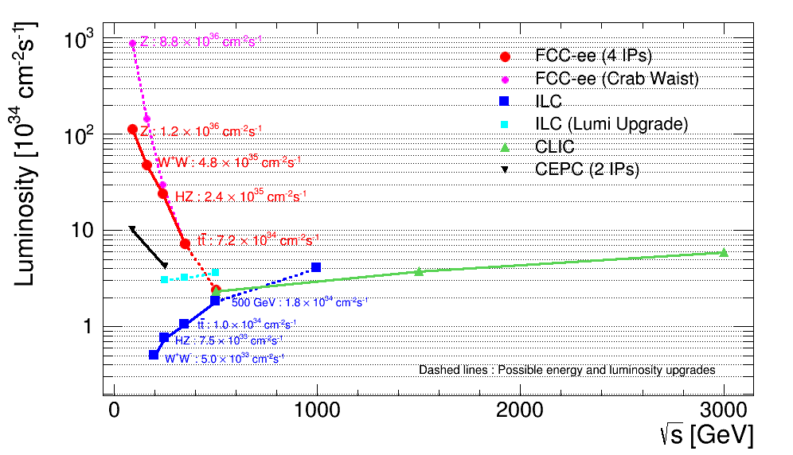
FCC e⁺e⁻ Collider
Parameter | FCC-ee |  |  | LEP2
Energy/beam [GeV] | 45 | 120 | 175 | 105
Bunches/beam | 13000- 60000 | 500-1400 | 51- 98 | 4
Beam current [mA] | 1450 | 30 | 6.6 | 3
Luminosity/IP x 10³⁴ cm⁻²s⁻¹ | 21 - 280 | 5 - 11 | 1.5 - 2.6 | 0.0012
Energy loss/turn [GeV] | 0.03 | 1.67 | 7.55 | 3.34
Synchrotron Power [MW] | 100 |  |  | 22
RF Voltage [GV] | 0.3-2.5 | 3.6-5.5 | 11 | 3.5
Circular e⁺e⁻ collider has substantially higher luminosity at lower energies vs linear collider
Main challenges: long tunnel and high synchrotron losses requiring demanding superconducting RF system and high electricity consumption

Slide 27
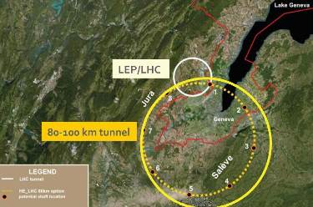
FCC pp 100 TeV collider
Parameter | FCC-pp | LHC
Energy [TeV] | 100 c.m. | 14 c.m.
Dipole field [T] | 16 | 8.33
# IP | 2 main, +2 | 4
Luminosity/IP_{main} [cm⁻²s⁻¹] | 5 - 25 x 10³⁴ | 5 x 10³⁴
Stored energy/beam [GJ] | 8.4 | 0.39
Synchrotron rad. [W/m/aperture] | 28.4 | 0.17
Bunch spacing [ns] | 25 (5) | 25
Main challenges
  Long tunnel
  High field magnets
  High synchrotron radiation load
Tevatron and LHC experience demonstrate feasibility of such a collider
FCC study is expected to take ~4 years and to provide technical proposals and cost estimates for all three options: pp, ee and ep

Slide 28
Future Colliders - Summary
Colliders played major role in establishing and understanding the standard model
  Discovered all expected standard model particles!
Future proposed colliders are of two types
  e⁺e⁻ colliders as “Higgs factory”
  pp colliders at the next energy frontier
Three proposals are under active discussion
  ILC (Japan)
  CepC and SppC (China)
  FCC (CERN)
Key for the future colliders is to reduce cost dramatically
Next ~5 years will be exciting to see what project(s) will materialize

Slide 29
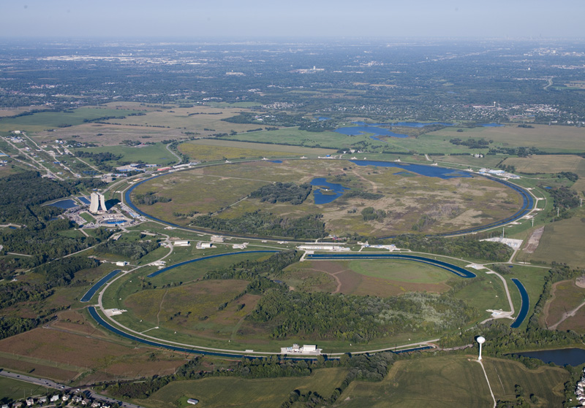
Fermilab Program and Plans

Slide 30
Fermilab
Fermilab plans are closely related to the overall plans for the particle physics field in US
  The only remaining high energy physics laboratory in US
  BNL is mainly nuclear physics
  SLAC is general energy science
  CEBAF is nuclear physics
  Argonne involved in many different activities, no local (particle physics) accelerator
  Lawrence Berkley Laboratory is now mainly not high energy physics
Fermilab plans
  Complete Tevatron program
  Participate in the CMS program at LHC (not covered in this talk)
    Fermilab is lead US laboratory on CMS
    Detectors and some accelerators upgrades
  Continue program of short and long baseline experiments
  Construct muon to electron conversion and g-2 experiments
  Develop new long baseline neutrino program – LBNF/DUNE
  Upgrade accelerator complex to provide higher intensity beams to experiments
    No changes to the maximum energy
  Develop plans for future accelerators and colliders

Slide 31
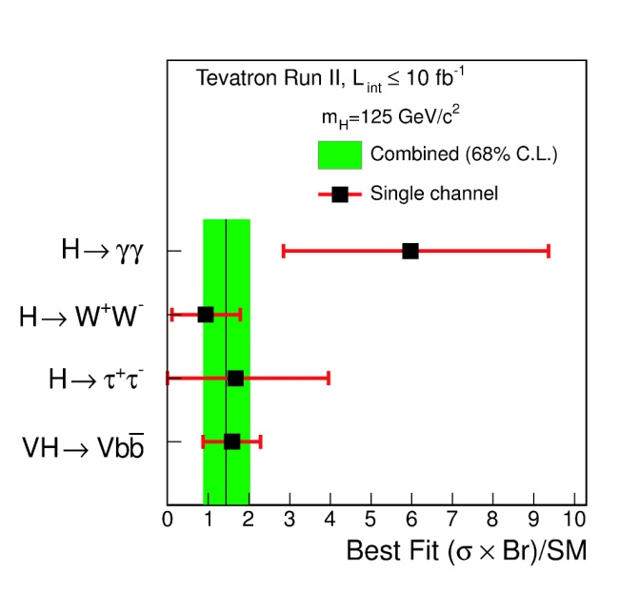
Tevatron program
Top Quark Discovery
Higgs Boson Evidence
From the top quark discovery to Higgs boson evidence – 25 years program
Over 1000 papers cementing the standard model

Slide 32
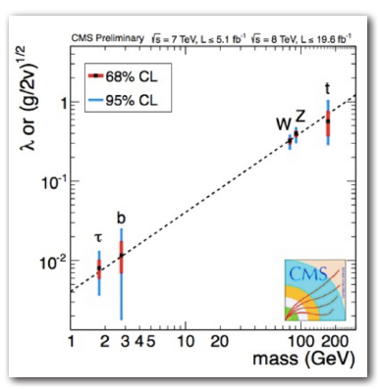
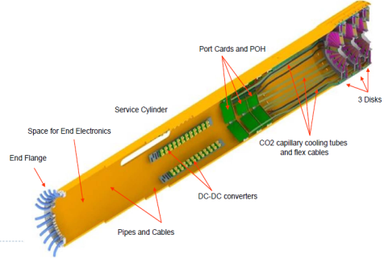
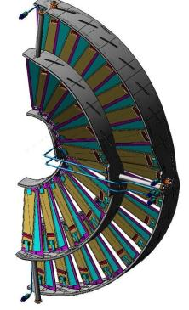
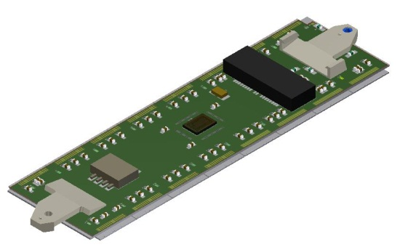
Fermilab and LHC
Fermilab is actively involved in LHC program: CMS and LHC upgrades
Critical to study of all properties of the Higgs
  Mass, width, spin, couplings, etc.
Search for new particles and interactions
Forward Pixel Detector
New detector technologies are critical for “high luminosity LHC”
  ~5.10³⁵ cm⁻²sec⁻¹ and above
Fast, radiation hard detectors needed

Slide 33
Fermilab Leads US-CMS Program
FNAL was deeply involved in extensive detector improvements during recent shutdown
  Forward pixels: repaired to recover channels - now >99% operational
  Hadron calorimeter: improved photodetectors installed in accessible sub-detectors
  Forward muons: machined new panels
  Ongoing improvements in computing multithreading implemented for reconstruction to control memory consumption
  CERN⟷FNAL transfer rates tested extensively for Run 2 data volume
Fermilab is actively involved in CMS Phase upgrades
Phase 2 upgrade is under development
LHC Accelerator Research Program (LARP) is developing interaction region quads for the high luminosity LHC

Slide 34
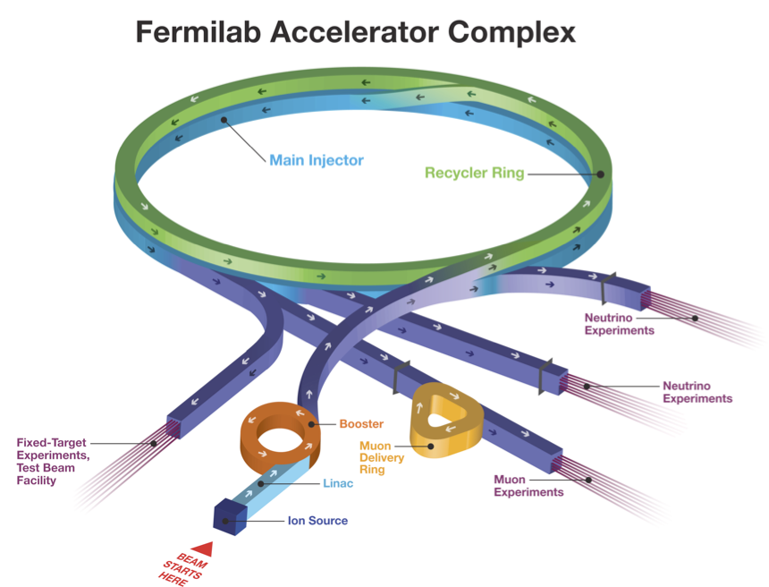
8 GeV proton booster - MicroBooNE neutrino experiment
Main Injector 120 GeV: MINOS, MINERvA, NOvA – neutrino experiments
Fixed Target: SeaQuest, Test Beam Facility – nuclear structure and test beams
Future muon experiments: g-2, Mu2e

Slide 35
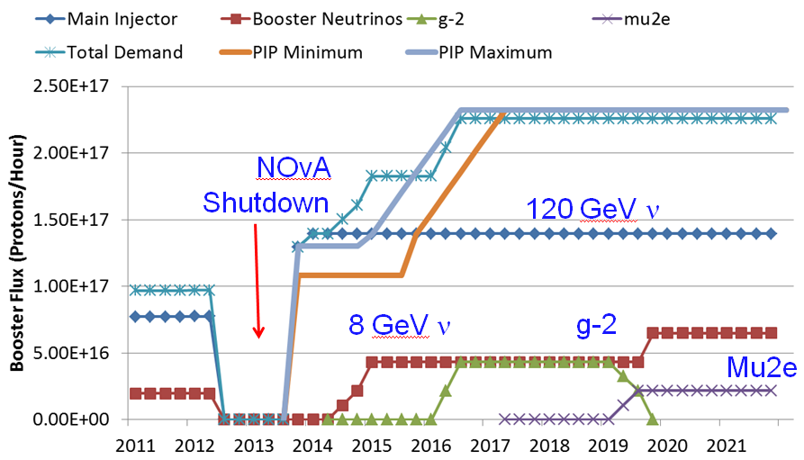
Beams Delivery Plans
For the next ~7 years accelerator complex is focusing on delivering beams to
  Neutrino, fixed target, high intensity muon beams and test beam experiments

Slide 36
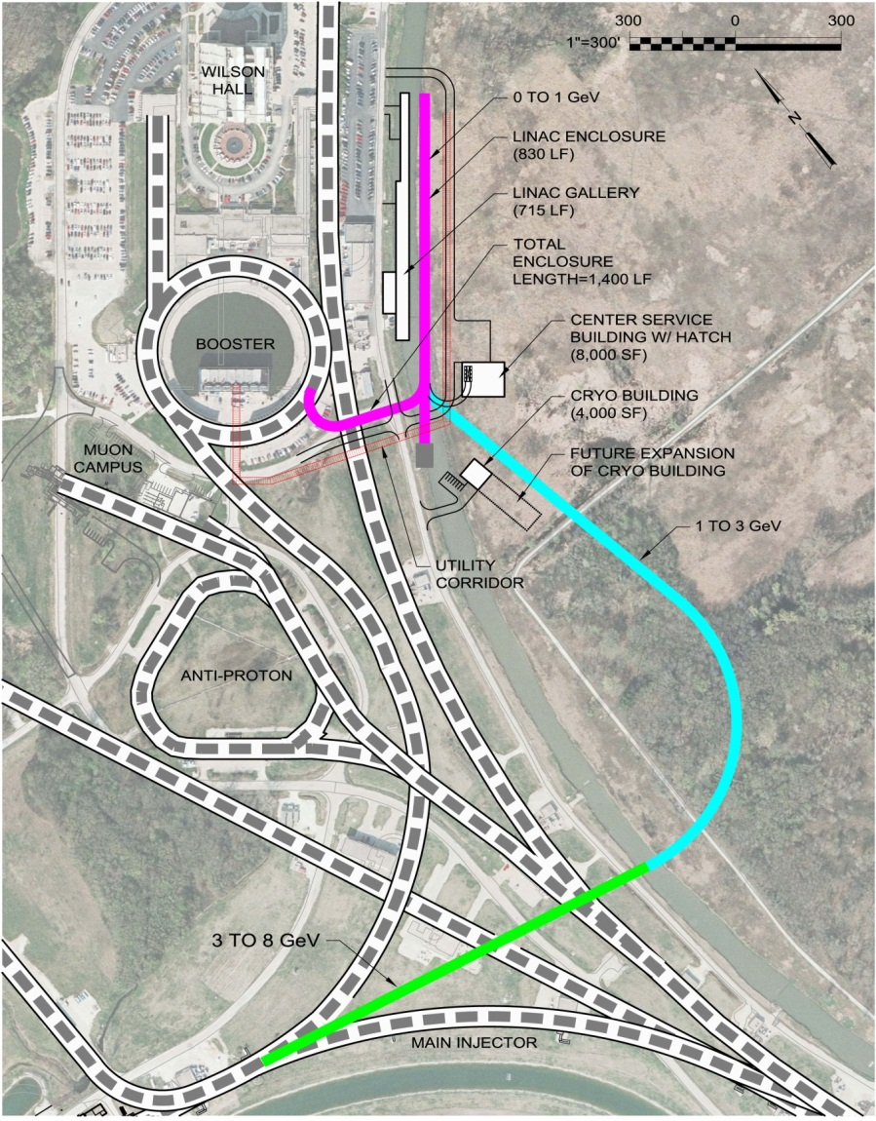
Next Accelerator Upgrade – “PIP II”
Proton linear accelerator with flexible beam structure based on SCRF technology
  Increase of beam power to ~1 MW
  In June 2015 decision made to start the project
Platform for future neutrino and muon facilities

Slide 37
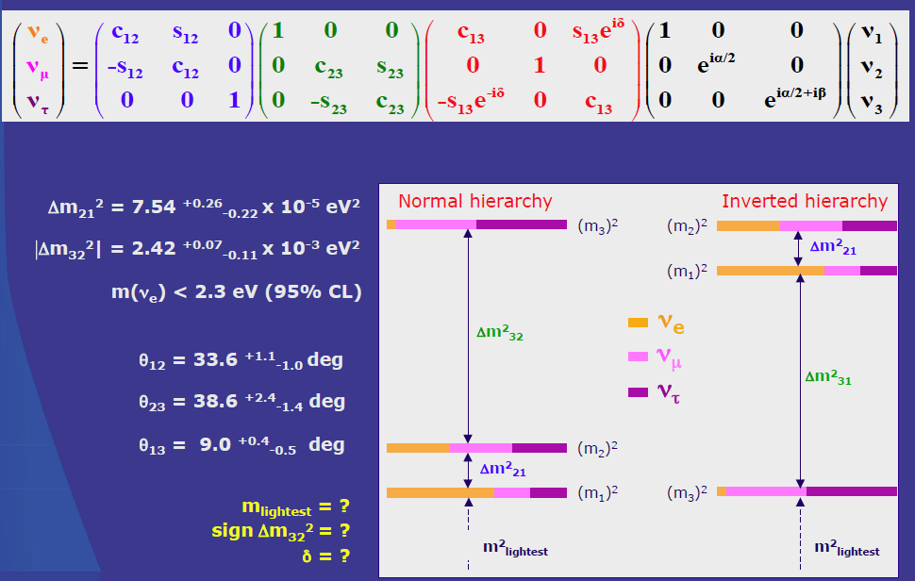
Studies of the Neutrinos
Neutrinos remain one of the most puzzling particles of the standard model
Studies of its properties, including mixing matrix parameters, could shed light on many interesting topics, including matter-antimatter asymmetry of the Universe

Slide 38
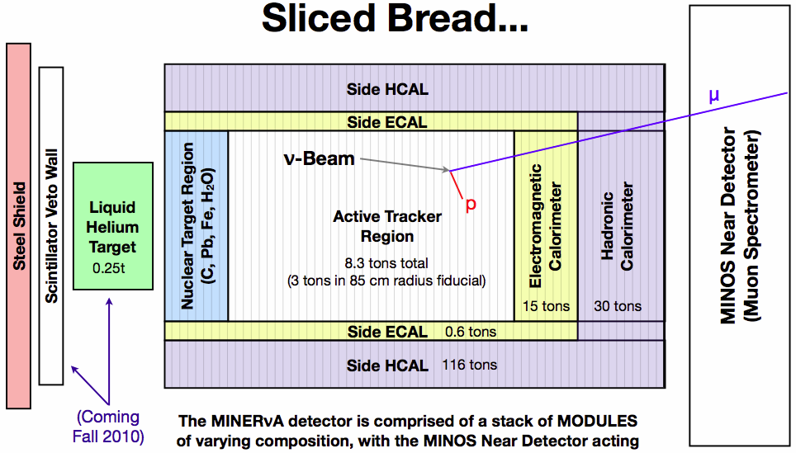
MINERvA Experiment
MINERvA (just in front of MINOS) is studying neutrino interactions in details on a variety of different nuclei – He,C,CH₂,H₂O,Fe,Pb
Important information for all neutrino based experiments

Slide 39
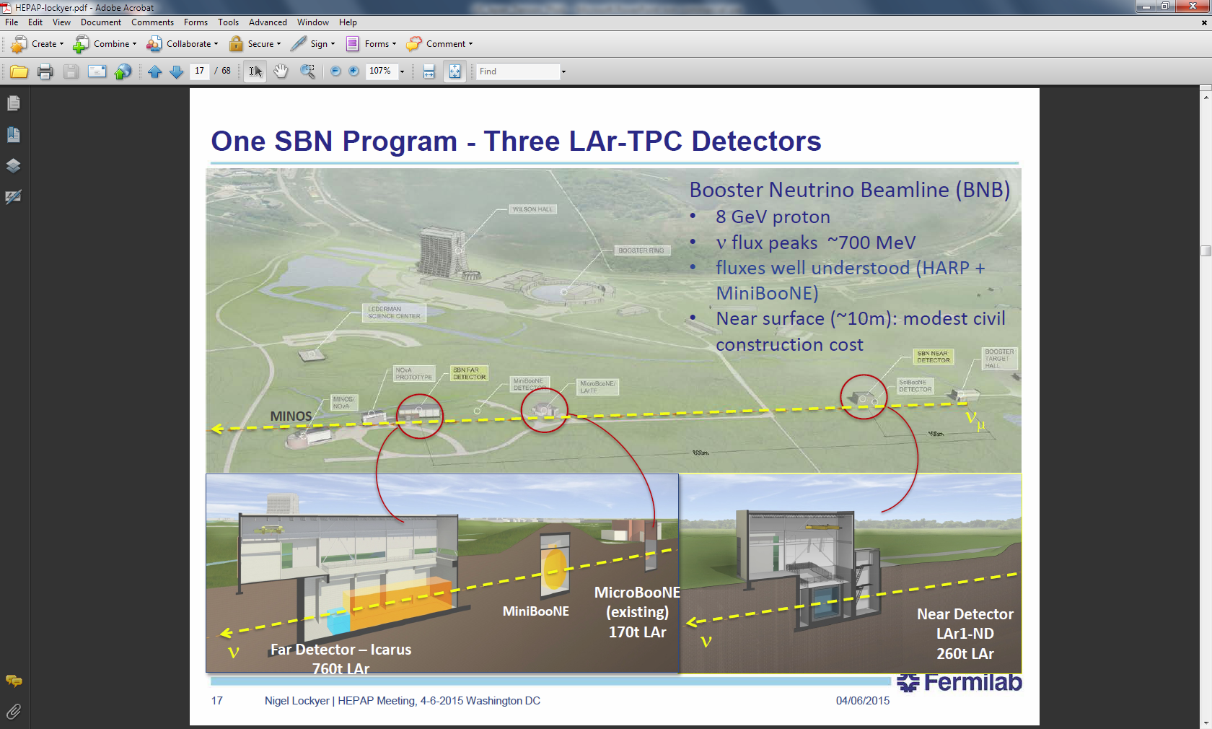
Short Baseline Neutrino Program
The three detector SBN program can make a definitive statement on the LSND anomaly with the potential for discoveries in neutrino physics and development of near detector for DUNE

Slide 40
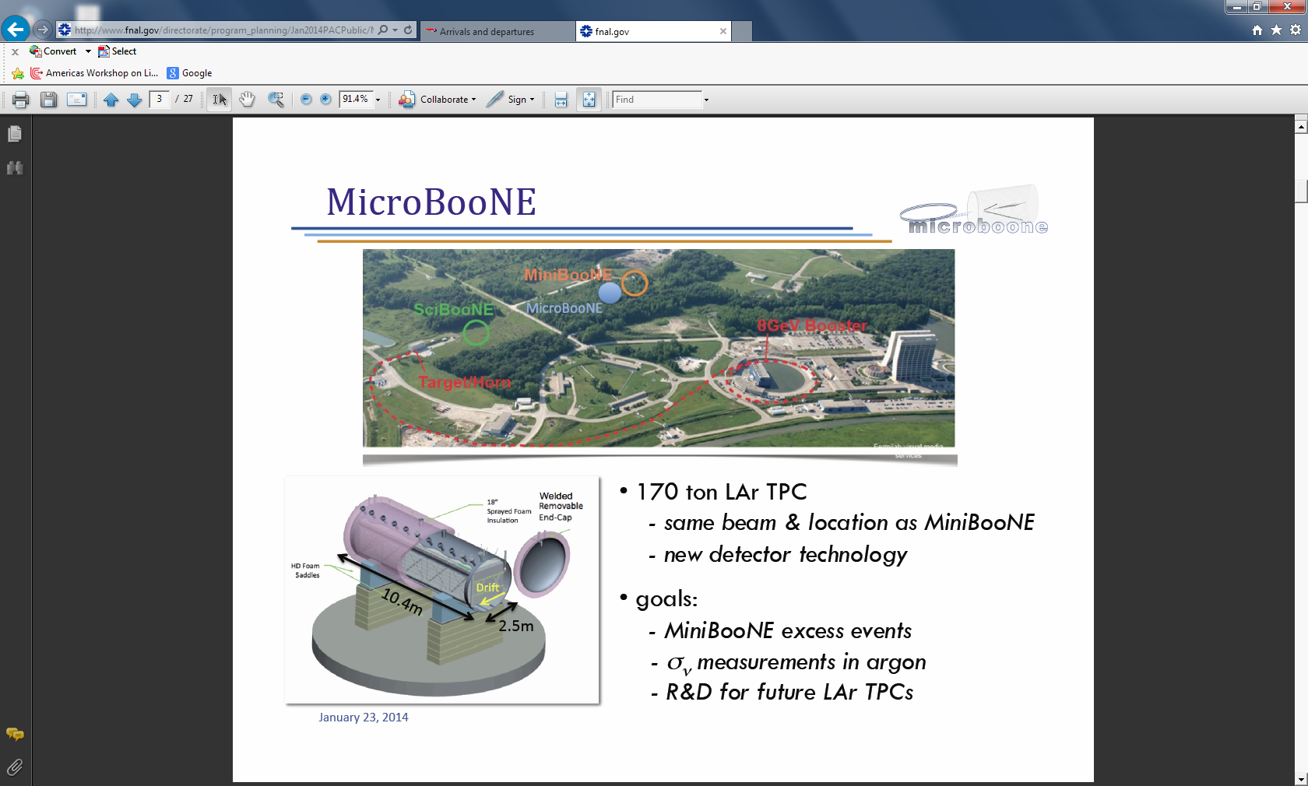

Slide 41
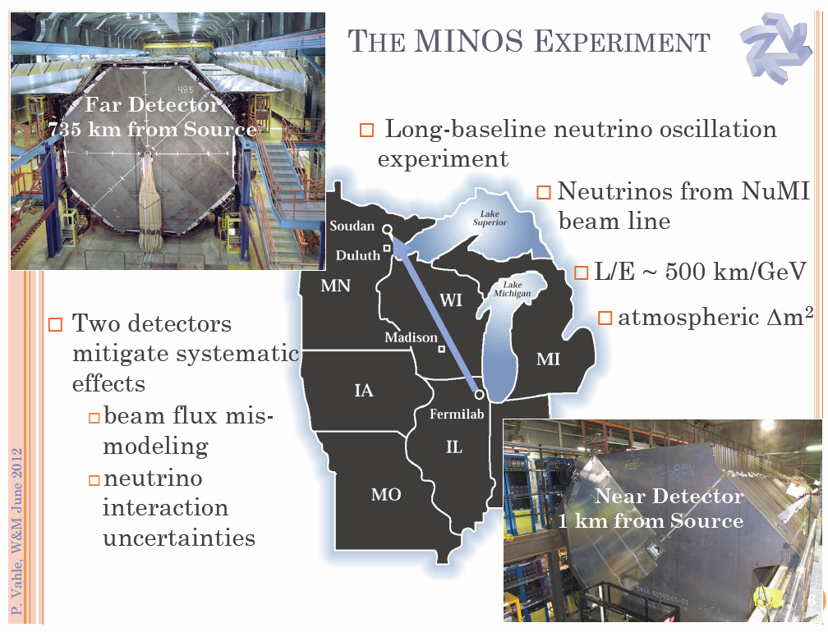

Slide 42
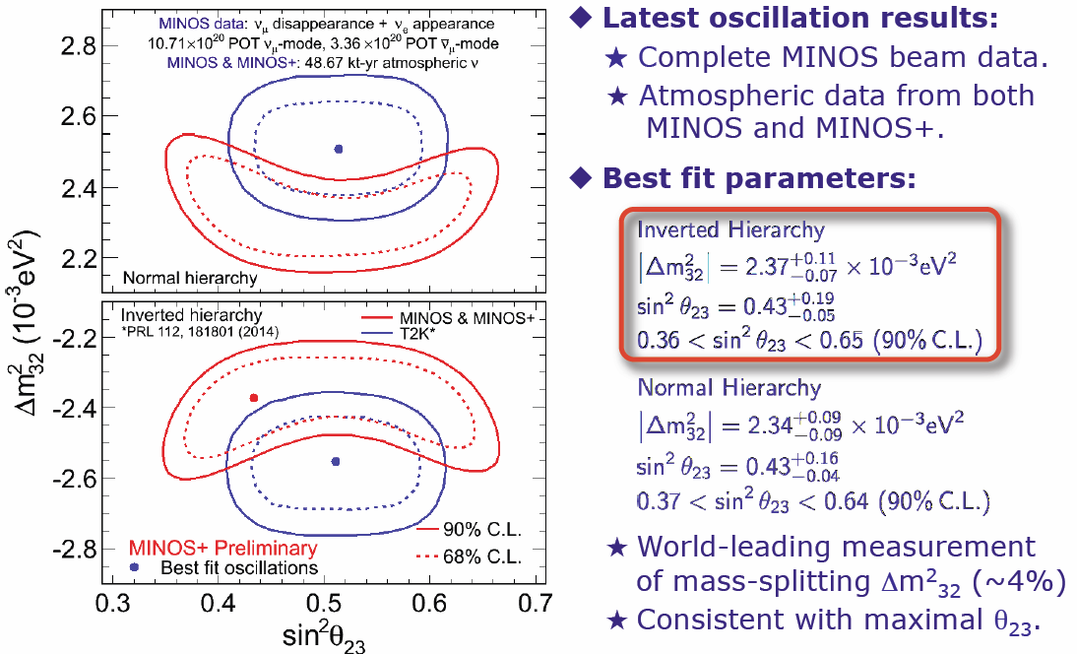
Recent MINOS Results
Measured that the speed of neutrino is not faster than a speed of light…

Slide 43
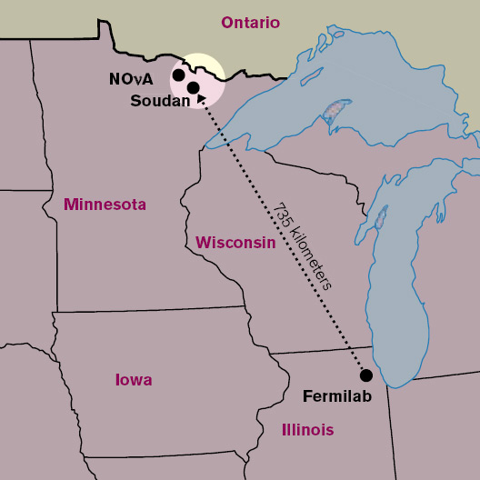
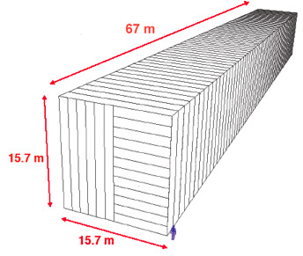
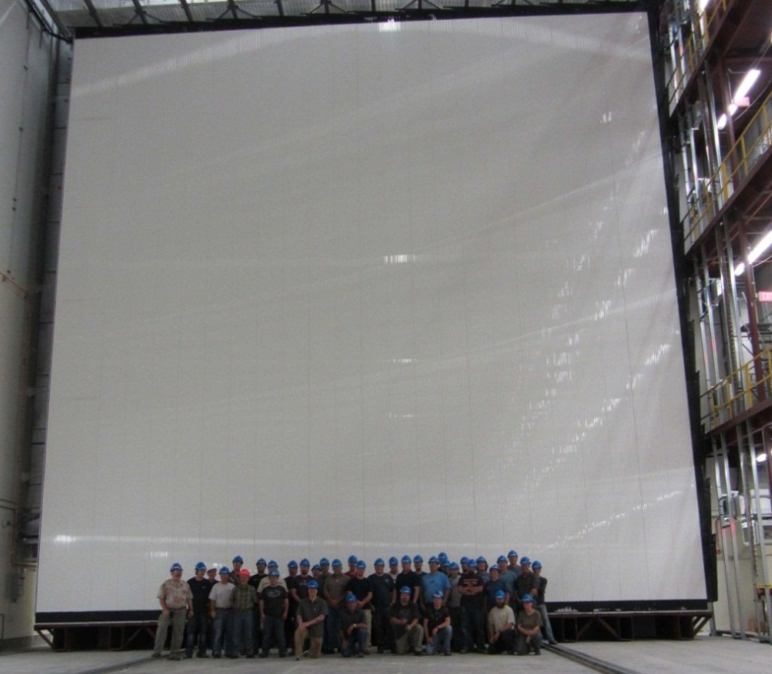
NOvA Experiment at Fermilab
Plastic extrusion with liquid scintillator and WLS fiber with APD readout
“Off axis” neutrino experiment with
15 kton far detector and 300 ton near detector: 3σ mass hierarchy sensitivity
Started data collection last year

Slide 44

NOvA Experiment at Fermilab

Slide 45


Long Baseline Neutrino Experiment – LBNF/DUNE
DUNE (Deep Underground Neutrino Experiment) is LAr ~30 kton experiment deep underground using neutrino beam from Fermilab
Goals: neutrino mass hierarchy and CP violation as well as supernova detection and proton decay (up to 10³⁵ years)
LBNF (Long Baseline Neutrino Facility) is a beam line to create intense flux of neutrino to the DUNE experiment

Slide 46



Long Baseline Neutrino Experiment - DUNE
Normal
Inverted
Superior option to resolve mass hierarchy
Find proton decay up to lifetime of 10³⁵ years
Detect supernova neutrinos

Slide 47

Muon Program at Fermilab
Construction of intense muon beams for mu2e and g-2 is actively progressing
g-2 (to confirm or not BNL ~3σ effect) experiment to start data collection in 2017
Mu2e start of data taking is 2020

Slide 48



Muon Magnetic Moment g-2 experiment
~3σ puzzle from BNL 2004 result
  New physics?
  Experimental effect?
Coil moved to Fermilab in 2013
  Higher intensity beam
  Better systematics
~4 times better accuracy

Slide 49



Lepton Flavor Violation: Mu2e
New experiment Mu2e at Fermilab
  High intensity muon flux stopped on a nuclear target
Monochromatic electron emission from μ to e conversion
  ~4 orders of magnitude improvement vs today’s limits

Slide 50



ILC Activities at Fermilab
Fermilab hosts many ILC realted events
Full size ILC cryomodule reached design parameters late 2014 at Fermilab

Slide 51



Dark Matter Direct Detection
Many models expect dark matter to consist of heavy WIMP particles
Multiple methods used to detect elastic scattering of WIMPs: ionization, scintillation, phonons. Results mixed…
Fermilab is actively involved in CDMS experiment in Soudan mine (and others)
9kg SuperCDMS is currently operating at Sudan
Observed best low mass WIMP limit

Slide 52


Dark Energy Survey - DES
Left: cutout of DES image
Right: the stars from one of the dwarf galaxies
  DES goal is to create scans of night sky using 4 meters telescope and 570 megapixels camera (camera made at Fermilab) located in Chile
  Started data collection in September of 2013
  20+ papers already published
  8 new Milky Way Satellite “Dwarf” galaxies discovered
Major scientific areas: studies of dark matter, dark energy, supernova, solar system survey and many other topics

Slide 53
Concluding Remarks
Particle physics in US is undergoing changes after shutdowns of SLAC ‘s B factory and Fermilab’s Tevatron
Recently developed ~10 years plan for US high energy physics
  Fermilab is a strong part of these activities
  Transition to accelerator based neutrino program
Large new upgrades/experiments planned at Fermilab
  g-2, Mu2e, LBNF/DUNE, CMS upgrades, dark matter searches
There is wealth of experience at Fermilab in both accelerators and experiments and interesting program ahead

Slide 54



Higgs Studies at the ILC
The precision couplings measurements at LHC in the 2—10% range can be potentially reduced at the ILC by an order of magnitude, while providing a model independent determination of Higgs partial widths

Slide 55
Brief ILC History
After success of SLAC’s linear e⁺e⁻ collider in 1990’s (SLC) many proposals developed to go to even higher colliding energy
  Among them NLC(SLAC), TESLA(DESY), “ILC at Fermilab”
Since ~2008 Global Design Effort (GDE) was progressing developing
  Technical design of an ILC
  Cost estimate and international cooperation plan
GDE concluded in 2012
  Including TDRs for the accelerator and detectors
  Physics case strengthened with a Higgs discovery
In 2012 Japan expressed strong interest to host the ILC
  Part of Prime Minister Abe plan
Over last two years
  Substantial progress in technical developments
  Development of cooperation between participants on “Governments level”

Slide 56


LEP e⁺e⁻ collider at CERN: start 1989
Z boson factory
27 km long tunnel for up to ~200 GeV center of mass energy
  Started operation in 1989 as “Z factory”
  Wide range of extremely precise measurements, including Z boson mass measurement and determination of the number of neutrino generations
SLC linear collider Z factory at SLAC operated at about the same time
LEP needed less than 5% extra center of mass energy to discover the Higgs…

Slide 57


Attempts to Reach Higher Energies: 90’s
For higher energy machines, as partonic cross sections decrease with energy, higher luminosities are required
  Challenges producing large number of anti-protons
  Proton-proton colliding beams for dedicated hadron collider
Larger rings and higher field superconducting magnets to achieve beam energies well above 1 TeV
Cancelled
3x3 TeV, UNK
20x20 TeV, SSC

Slide 58
Hadron Colliders
What particles to collide: pp or ppbar ?
  Using antiprotons in the first high energy colliders was “quick” way to get to higher center of mass energy by using existing(!) rings designed for fixed target accelerators: SPS (CERN) and Tevatron (Fermilab)
  If accelerator complex is designed from the start as a collider, it is better to have proton-proton collisions
    An order of magnitude or more higher luminosity
    No complex antiproton sources
All hadron colliders designed since early 1980’s are proton-proton colliders
  Two separate beam pipes
Point-like vs not point-like colliding particles
  Only fraction of the beam energy is utilized in the collision: up to ~50%
  Lack of precision knowledge about event kinematics is a challenge

Slide 59


Many Studies for ~100 TeV Accelerators/Detectors Exist
SppS, UNK, SSC, LHC studies/proposals/experiences are invaluable

Slide 60
Main Idea: Long Tunnel vs Highest Field Magnets
Tunnel length proposed is 233 km, small diameter, deep underground, only few shafts
Two stages: “stage 1” is 2 Tesla warm steel magnet at 40 TeV, “stage 2” is 10 Tesla dual core magnet at 175 TeV
Over last ~20 years long and deep tunnels technology was greatly advanced

Slide 61

Fermilab’s Complex as Injector
Fermilab’s accelerator complex is used as an injector with two main collision points located under Fermilab’s site

Slide 62



Idea of “one turn” Magnet
The idea is to use warm iron (means 2 Tesla) with “single turn” coil
All parts of the magnet are “very simple”, like extruded vacuum chamber
Number of “parts” in cross section is ~10, vs ~100 for high field magnets

Slide 63

SiD Detector
SiD rationale
– A compact detector designed to make precision measurements, with sensitivity to a wide range of new phenomena
Design choices
  – Compact design with 5 T field
  – Robust silicon vertexing and tracking
  system with excellent momentum
  resolution
  – Time-stamping for single bunch
  crossings
  – Highly granular Calorimetry
  for Particle Flow
  – Iron flux return/muon identifier is part
  of the SiD self-shielding

Slide 64

Fermilab’s ILC Contributions
SCRF accelerating cavities
  Synergy with PIP-II and LCLS accelerating cryomodules
R&D in accelerator systems, including controls
Design of the ILC detectors
Two excellent results for SCRF cavities obtained at Fermilab recently
  Substantial Q factor increase of the cavities with nitrogen doping
  Fermilab’s cryomodule reached ILC specification of 31.5 MV/m

Slide 65

P5 Outcome
P5 provided ~25 recommendations covering all main topics of the US particle physics
They are grouped around “science drivers”
  Use the Higgs boson as a new tool for discovery
  Pursue the physics associated with neutrino mass
  Identify the new physics of dark matter
  Understand cosmic acceleration: dark energy and inflation
  Explore the unknown: new particles, interactions, and physical principles
There are two major recommendations which drive medium time scale US program
  Highest short term priority is the contribution to the LHC program
  Medium term priority is the development of neutrino center at Fermilab

Slide 66

ILC Detectors
Two detectors are planned: ILD and SiD
“Push-pull” operation
  One experiment collects data at a time
General purpose collider detectors for wide range of physics studies
  Similar to the Tevatron or LHC
Excellent tracking, calorimetry and muon systems
  Separate W/Z in hadronic decays to a pair of jets – excellent jet resolution
  Charged tracks momentum resolution
    Silicon tracker for SiD
    TPC for ILD
Substantial R&D efforts during GDE initiative
  TDRs available for both detectors
  While detectors will benefit from an optimization
    There are no technical show-stoppers

Slide 67



W Boson Mass
Projections for CDF
W boson mass is a fundamental parameter of the standard model
  Input for the standard model self-consistency check
With newer PDFs (W asymmetry measurements) ~5 MeV PDF uncertainty (leading systematic) could be reached
Projections demonstrate ~10-12 MeV uncertainty per experiment with 10 fb⁻¹ data set
  Both experiments are working on the analysis

