Slide 1





FATALIC:
A Dedicated Front-End ASIC
for the ATLAS TileCal Upgrade
L.Royer, S.Manen, N.Pillet, H.Chanal, R.Vandaële,
R.Bonnefoy, R.Madar, D.Pallin, F. Vazeille
Laboratoire de Physique Corpusculaire, Clermont-Ferrand – France
(on behalf of the ATLAS Tile Calorimeter system)

Slide 2
Outline
Readout electronics of the Tile Calorimeter of Atlas
The FATALIC ASIC
Performance of FATALIC
Summary and Outlooks

Slide 3
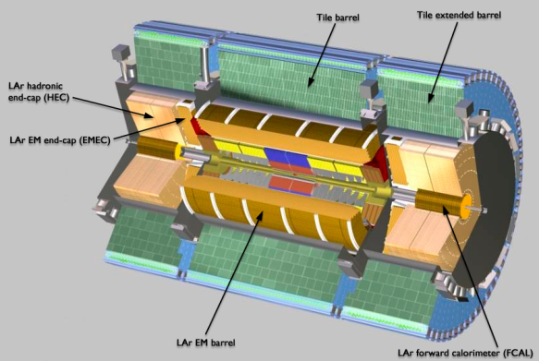

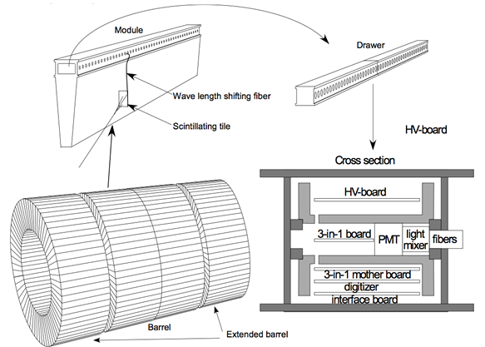
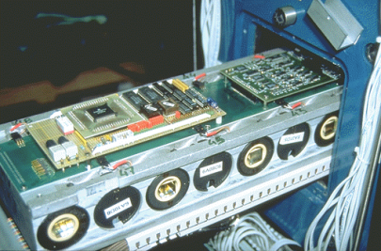
The ATLAS Tile Calorimeter
The TileCal in a few words:
  the central hadronic calorimeter of the ATLAS experiment;
  segmentation: modules grouped in barrels,
  active sensors: plastic scintillator tiles embedded in a steel absorber structure;
  readout chain located in drawers:
  fibers → PMTs → readout electronics
  about 16-bit dynamic range (single PMT):
    16 MeV (1pe) → few TeV
    24 fC → few nC
Tile barrel
Tile extended barrel

Slide 4
Motivations for the Tile upgrade
Two key issues:
to cope with HiLumi-LHC constraints expected in 2023:
  2023: end-of-life of the current system (obsolescence of electronics)
  A better radiation tolerance (≈ TID of 50 krad at the barrel level)
  A more powerful trigger across whole ATLAS detector
to improve the current system:
  simplify the operation of the detector
  improve the reliability: maintenance more difficult due to higher radiation level
  facilitate the operation of maintenance, increase serviceability
  increase the dynamic range to be able to observe very high energy events in each cell

Slide 5
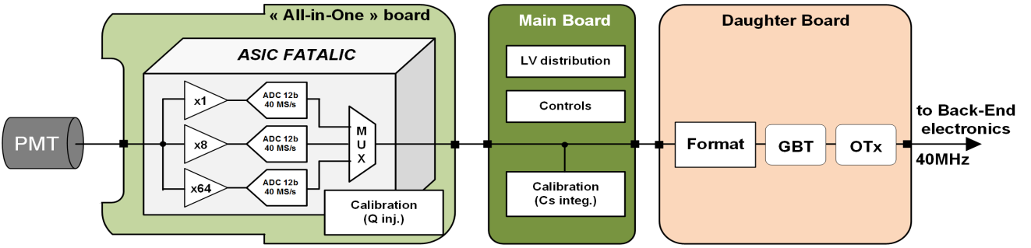
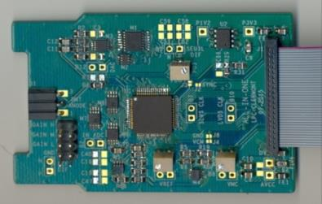
The Read-out electronics upgrade
Simplified view of the proposed upgraded readout electronics
Readout electronics composed of 3 boards: "All-in-One" → Main B. → Daughter B.
"All-in-One" board: PMT signal processing thanks to a Tile-Specific Integrated Circuit: FATALIC
  key issues: performance, reliability, rad-tolerance, energy-efficiency
  3 gain-channels with at least 10-bit precision ADC to extend the dynamic range up to 1200 pC
  early embedded digitization reduce constraints on cabling and on MB
Main Board: data coding + LV distribution + controls + Cs calibration
  "pure" digital board: no transmission and "handling" of analog sensitive signal
  simplified design, reduced cost, increased robustness
Daughter board (C.Bohm's talk):
  → high speed optical communication for transmission of full data at 40 Mbps out of the detector
"All-in-one"
This system allows a digital triggering and a digital integration for Cs calibration

Slide 6
Outline
Readout electronics of the Tile Calorimeter of Atlas
The FATALIC ASIC
Performance of FATALIC
Summary and Outlooks

Slide 7
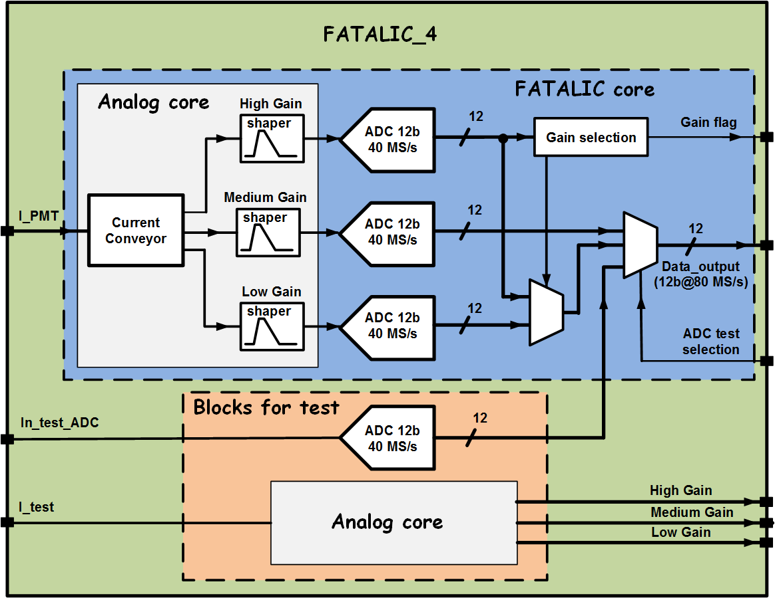
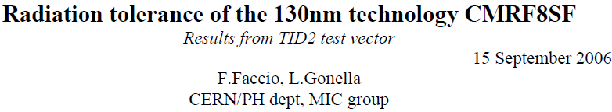
The FATALIC ASIC
The FATALIC chip embeds:
An analog-processing block with:
  a current conveyor which "reads" and "duplicates" the PMT current pulse to cover the dynamic range with 3 gain-channels
  3x RC-shapers (one per channel)
An analog-to-digital conversion
  12-bit 40 MS/s ADC
  one single ADC per channel
A digital processing
  Pipeline ADC data processing (1.5bit/stage algo.)
  An auto-selection of the data to be transmitted
  → Medium gain AND (Low OR High gain) data
  80Mb/s output data multiplexing
Two replica blocks for test purpose: analog core and one ADC
Power consumption limited to 205mW with a single power voltage (1.6V)
FATALIC has been designed with the IBM CMOS 130nm, characterized for his rad-tolerance by Cern

Slide 8
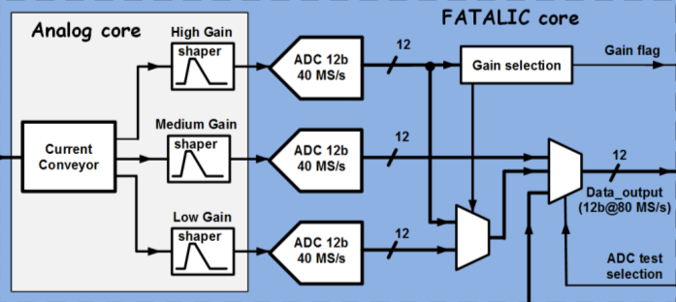
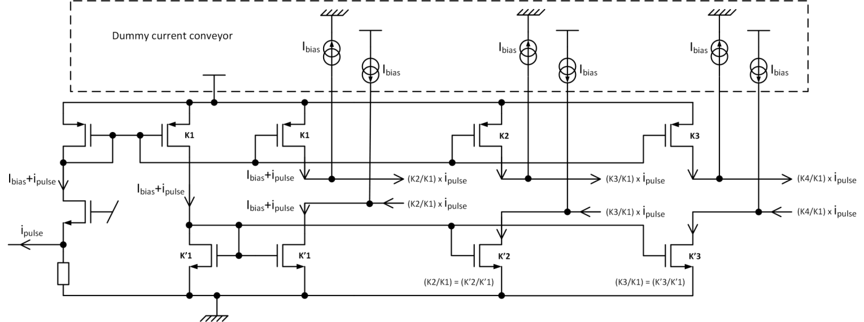
The current conveyor
The input stage:
  a low impedance common-gate input (<20Ω)
  A copy of the current to the amplifying stages
3 current-amplification stages:
  factor of amplification given by the size ratio between master and slave transistors (Kx/K1)
  differential output
A dummy structure of the current conveyor is used to remove the biasing current
Low Gain
Medium Gain
High Gain
Input stage

Slide 9
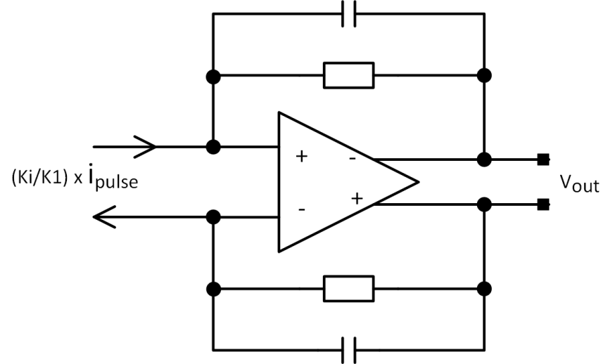
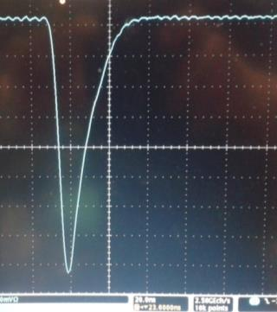
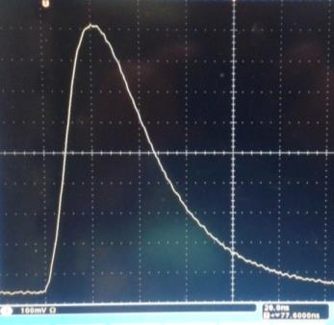
The shaper
The shaper has a dual function:
  Transimpedance amplifier
  Integration of the PMT-pulse
Peaking time (with typ. PMT pulse): ≈ 22ns
Identical shaper for the 3 gain-channels
Noise (Current-Conveyor + Shaper): < 500µV rms (7 fC rms)
PMT pulse
Shaper signal
20ns
20ns

Slide 10
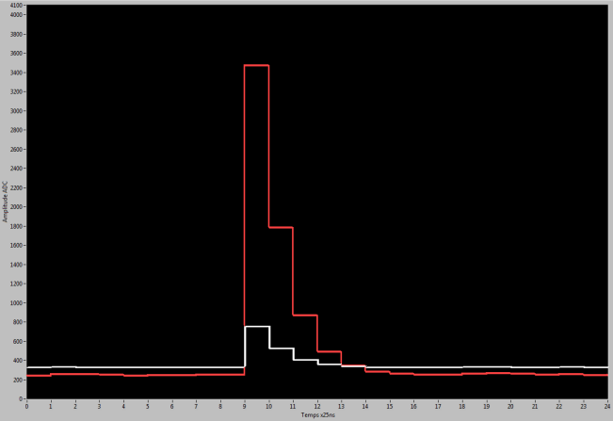
The Analog-to-Digital Converter
and the digital block
A "classical" 1.5bit/stage pipeline ADC architecture
  12-bit resolution @ 40MS/s
  < 0.1% error amplification (x2) precision required:
    high performance OTA
    good capacitor matching
A Digital block:
  digital correction of the digital code (1.5bit/stage algorithm)
  selection of the data to be outputted between high-gain and low-gain channels
High gain
PMT pulse
digitization
Medium gain
Pipeline ADC architecture

Slide 11

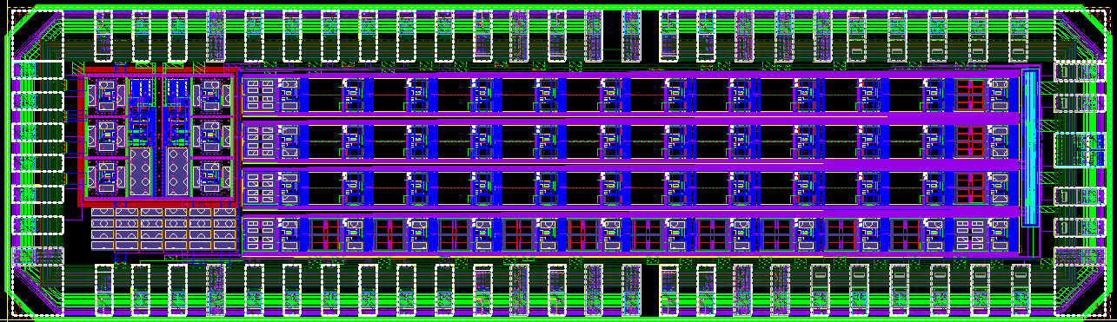
The floorplan
FATALIC CORE
FATALIC CORE
2.3mm²
11

Slide 12
Outline
Readout electronics of the Tile Calorimeter of Atlas
The FATALIC ASIC
Performance of FATALIC
Summary and Outlooks

Slide 13

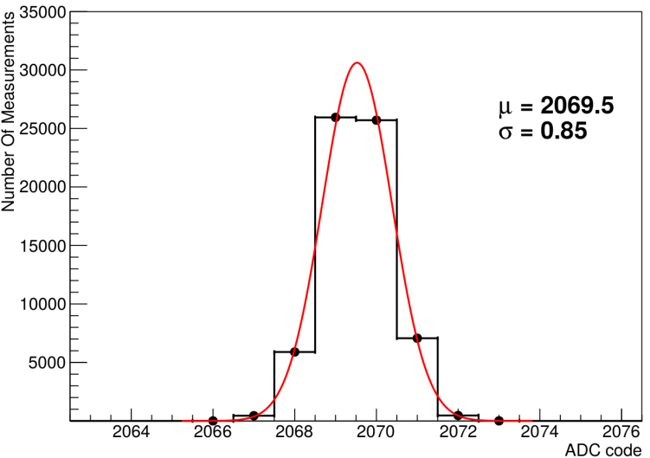
Performance: noise
Noise of the ADC
Measurements on the extra-ADC; same environment as the 3 other ADC (clock, power supplies)
Histograms of output code fluctuation (no input signal):
  Mean Value = 2069.5
  Std Deviation = 0.85 LSB
ADC noise

Slide 14
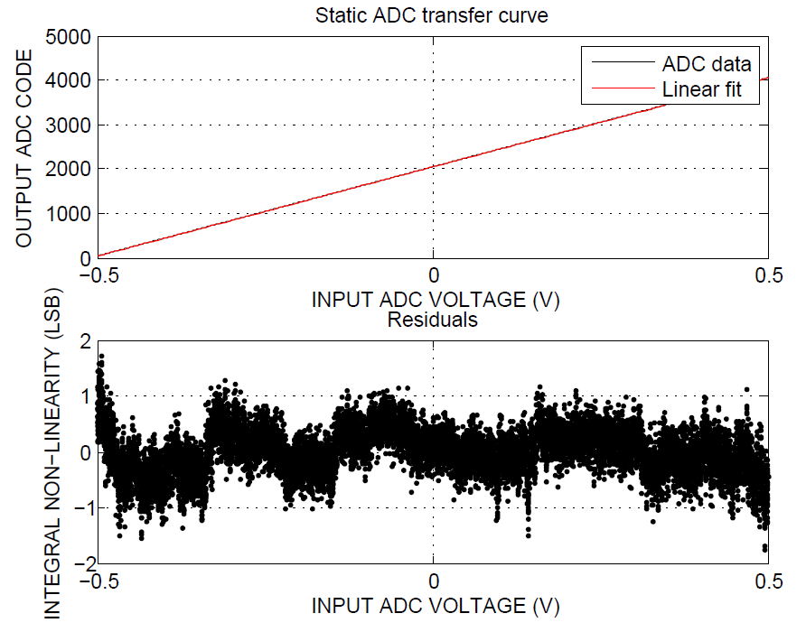
Performance: linearity Integral Non-Linearity of the ADC
Integral Non-Linearity (measurement with ramping generator):
  INL= ± 1 LSB → 11-bit precision ADC → 10-bit required

Slide 15
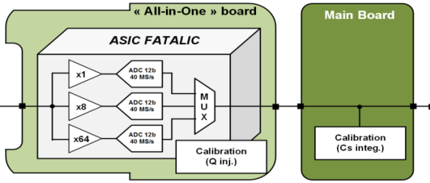
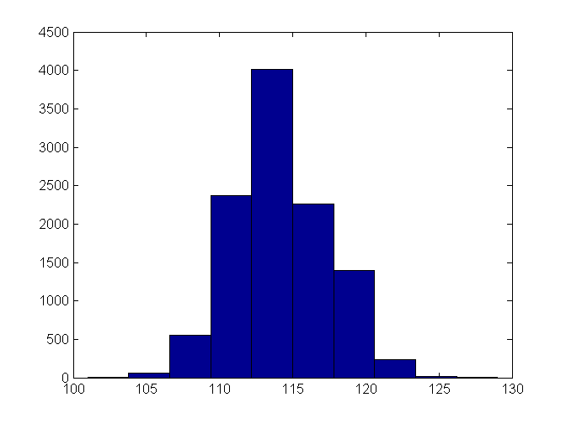
Performance: noise
Complete channel
Noise Requirement: "The intrinsic noise of the electronics, as measured through the digitization path, expressed in terms of equivalent input charge, shall not be greater than 12 fC rms at pedestal. "
Complete channel
σ = 3 LSB
High Gain
Measurements on the high sensitive channel (High gain)
Histograms of output code fluctuation (no input signal):
  Std Deviation = 3 LSB → σ= 10 fC rms
Thanks to the early digitization, noise performance guaranteed at the MB output
Output digital code (LSB)

Slide 16

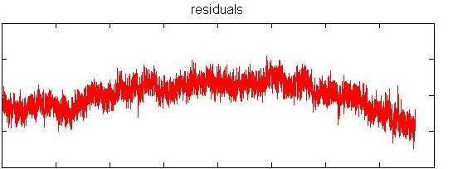
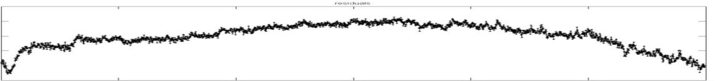
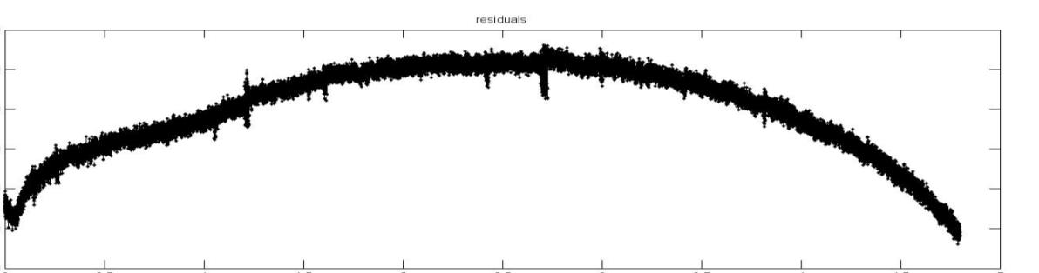
Performance: linearity
of complete channel
Test with slow (static) ramping current signal
Readout of the 3 gain-channels (digital data) over their respective ranges
+20
High Gain
0
± 0.25 %
-20
+10
Medium Gain
0
± 0.25 %
Linearity Error in LSB
-15
+20
Low Gain
0
± 0.5 %
-40
ADC output code: 0 to 4095

Slide 17
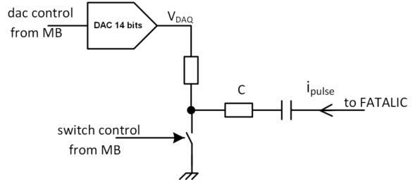
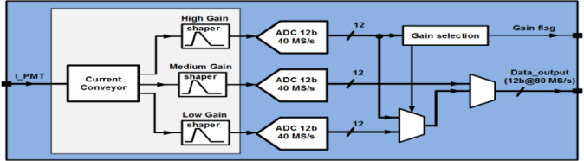
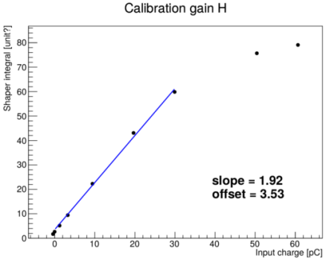
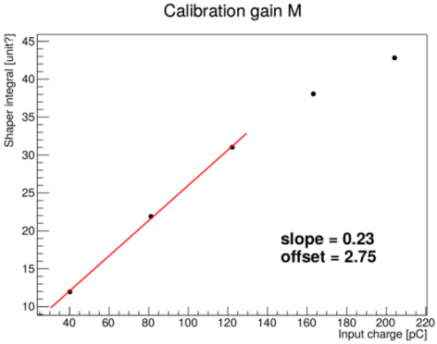
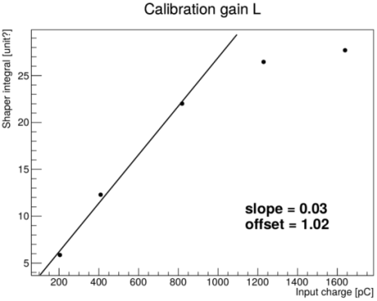
Performance: dynamic range
Designed by
Univ of Chicago
Test with the charge injection system
→ PMT-like pulses
Integral of the signals at the shaper outputs
Preliminary results: few points and no precise calibration of the injector, but:
  working quite well in each validity range
  dynamic range limited to 800pC (1200pC expected)
Gain ratio: H/M = 8.3 , M/L = 7.6 → OK with simulations
High Gain
Medium Gain
Low Gain
  30pC
  120pC
  800pC

Slide 18
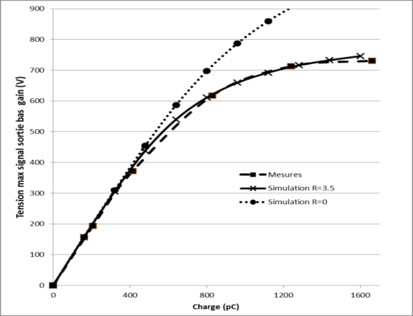
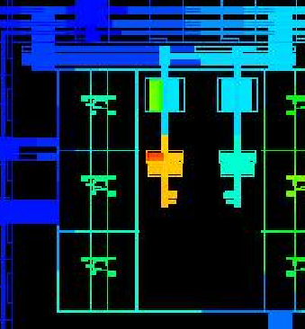
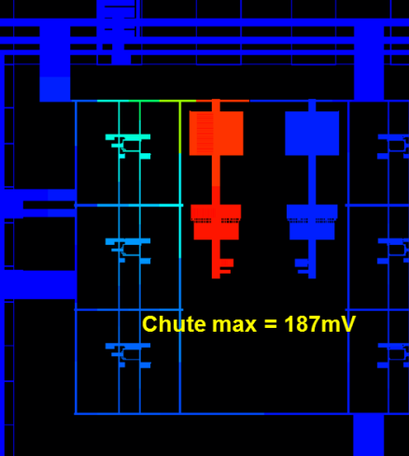
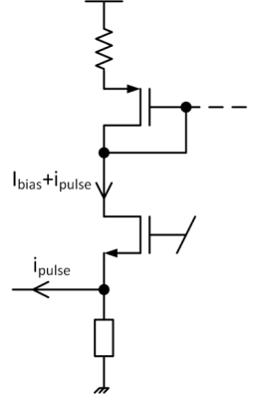
FATALIC:
improvements (v4b)
With PMT-like pulses, FATALIC-v4 exhibits a compression of its response over ≈ 800pC.
  current conveyor: 3.5Ω parasitic resistor on a power rail
  up to 200mV voltage drop for high peak input current (tens of mA) (measurements fit with parasitic simulations).
  corrected in FATALIC-v4b
New feature in V4b:
  extra pin (input) to force the low-gain data as output information
Chip delivered last week, tests in progress …
V4b: simulation (extracted)
V4: simulation (extracted) and measurement
FATALIC4b
FATALIC4
parasitic resistor
R=3.5Ω
Input stage of the
current conveyor
IR drop simulation
IR drop simulation

Slide 19
Outline
Readout electronics of the Tile Calorimeter of Atlas
The FATALIC ASIC
Performance of FATALIC
Summary and Outlooks

Slide 20
Summary and Outlooks
The FATALIC ASIC is one of the three options dedicated to the upgrade of the VFE electronics of the ATLAS-TileCal.
It performs the full processing of the PMT signal, including the analog-to-digital conversion.
FATALIC fulfills the requirements in terms of noise, and the embedded digitization guarantees an optimal signal-to-noise ratio all along the readout chain.
The linearity is validated up to a dynamic range of 800 pC. It is extended to 1200 pC with FATALIC-v4b (to be measured).
More exhaustive measurements in physic conditions (PMT-like pulses) will be carried out thanks to:
  the charge injector system embedded in the "All-in-One" board
  a dedicated LED+PMT system
Performance of FATALIC, as the two other options, will be evaluated on a demonstrator during test beams in 2015-2016 (1st period next week).
THANK YOU !
20

