Slide 1
FCNC search in single top involving hard photon
Phenomenological investigations @ 13 TeV
Eric CONTE

Slide 2
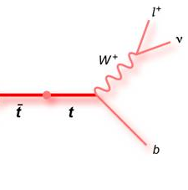
Single top & hard photon
Feynman diagrams :
γ
γ
$$\frac{κ_{γqt}}{Λ}$$
Single top topology
γ
TTbar topology
E. Conte
FCNC search in single top involving hard photon
slide 2

Slide 3
First selection
Cut-flow
L^{int} = 100pb⁻¹
All background source are not showed !
But the dominant one are there!
E. Conte
FCNC search in single top involving hard photon
slide 3

Slide 4
Single top & hard photon
MVA: toward a list of variables
First attempt (Kappa_act)
# jets
Photon PT
Lepton PT
B PT
Top PT
W PT
Charge asymmetry
Top MT
W MT
DeltaR between b and photon
DeltaR between lepton and photon
DeltaPhi between b and photon
DeltaPhi between lepton and photon
DeltaPhi between MET and photon
DeltaPhi between W and photon
Remove less useful and strongly correlated variables: W PT & MET
E. Conte
FCNC search in single top involving hard photon
slide 4

Slide 5
Single top & hard photon
MVA : Kappa_aut
--- BDT : --------------------------------------------
--- BDT : Rank : Variable : Variable Importance
--- BDT : --------------------------------------------
--- BDT : 1 : pt_a : 1.183e-01
--- BDT : 2 : n_jet : 1.156e-01
--- BDT : 3 : mt : 8.950e-02
--- BDT : 4 : dr_b_a : 8.134e-02
--- BDT : 5 : mw : 7.516e-02
--- BDT : 6 : dphi_w_a : 7.461e-02
--- BDT : 7 : pt_t : 7.396e-02
--- BDT : 8 : dr_l_a : 6.357e-02
--- BDT : 9 : dphi_b_a : 5.685e-02
--- BDT : 10 : asym : 5.558e-02
--- BDT : 11 : dphi_met_a : 5.379e-02
--- BDT : 12 : pt_b : 4.937e-02
--- BDT : 13 : dphi_l_a : 4.707e-02
--- BDT : 14 : pt_l : 4.534e-02
--- BDT : --------------------------------------------
Reliable variable?
E. Conte
FCNC search in single top involving hard photon
slide 5

Slide 6
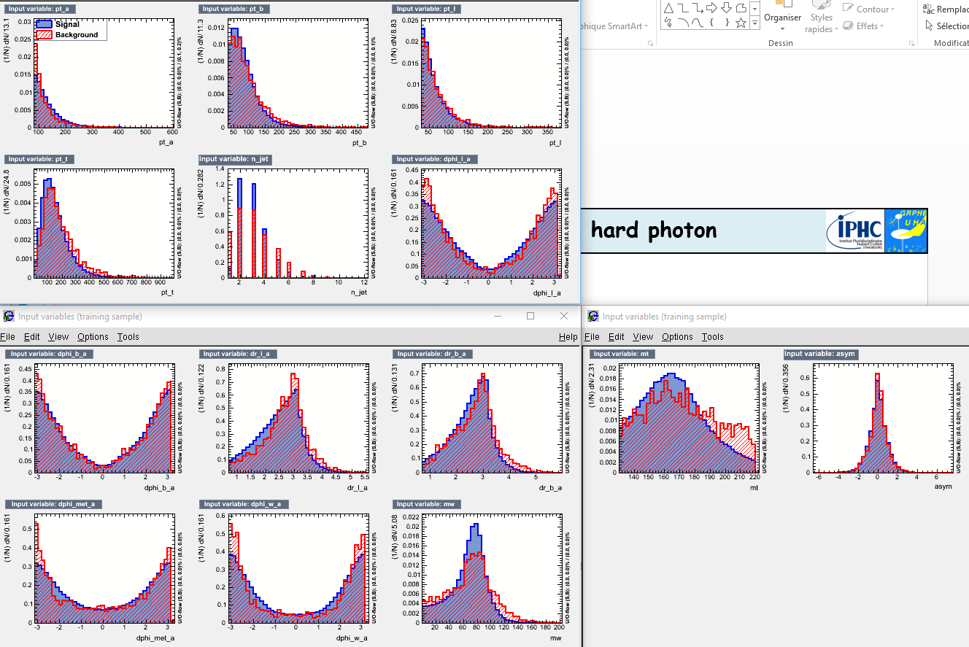
Single top & hard photon
MVA : Kappa_aut
E. Conte
FCNC search in single top involving hard photon
slide 6

Slide 7
Single top & hard photon
MVA : Kappa_aut
E. Conte
FCNC search in single top involving hard photon
slide 7

Slide 8
Single top & hard photon
MVA : Kappa_aut
E. Conte
FCNC search in single top involving hard photon
slide 8

Slide 9
Single top & hard photon
MVA : Kappa_aut
E. Conte
FCNC search in single top involving hard photon
slide 9

Slide 10
Single top & hard photon
MVA : Kappa_act
--- Factory : Ranking input variables (method specific)...
--- BDT : Ranking result (top variable is best ranked)
--- BDT : --------------------------------------------
--- BDT : Rank : Variable : Variable Importance
--- BDT : --------------------------------------------
--- BDT : 1 : n_jet : 1.342e-01
--- BDT : 2 : pt_a : 1.157e-01
--- BDT : 3 : pt_t : 8.961e-02
--- BDT : 4 : dr_b_a : 8.264e-02
--- BDT : 5 : mw : 7.964e-02
--- BDT : 6 : dr_l_a : 6.603e-02
--- BDT : 7 : dphi_w_a : 6.290e-02
--- BDT : 8 : mt : 6.288e-02
--- BDT : 9 : dphi_met_a : 6.063e-02
--- BDT : 10 : dphi_b_a : 6.016e-02
--- BDT : 11 : pt_l : 5.790e-02
--- BDT : 12 : pt_b : 4.826e-02
--- BDT : 13 : asym : 4.385e-02
--- BDT : 14 : dphi_l_a : 3.554e-02
--- BDT : --------------------------------------------
E. Conte
FCNC search in single top involving hard photon
slide 10

Slide 11
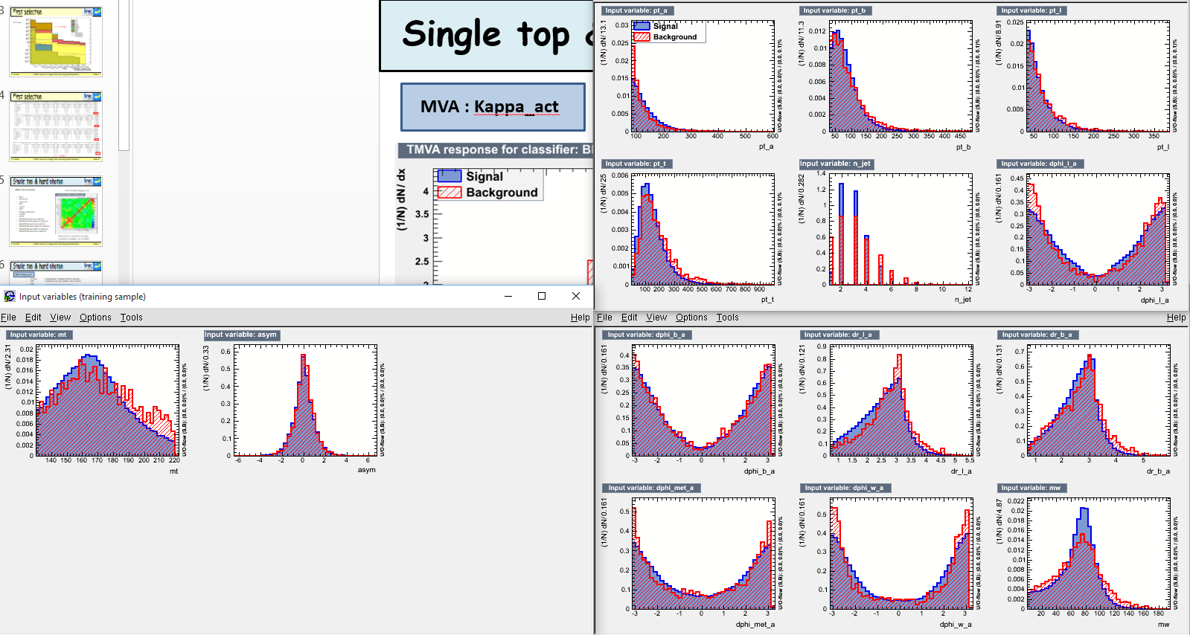
Single top & hard photon
MVA : Kappa_act
E. Conte
FCNC search in single top involving hard photon
slide 11

Slide 12
Single top & hard photon
MVA : Kappa_act
E. Conte
FCNC search in single top involving hard photon
slide 12

Slide 13
Single top & hard photon
MVA : Kappa_act
E. Conte
FCNC search in single top involving hard photon
slide 13

Slide 14
Single top & hard photon
MVA : Kappa_act
Overtraining?
E. Conte
FCNC search in single top involving hard photon
slide 14

Slide 15
To-do list
What remains to do since the last meeting:
Fix the problem of normalization: OK
Some photon background sources are underestimated: not yet
Cross-check and understanding of photon isolation: not yet
Implementing TMVA: OK
Exclusion limit plot for
Cut-and-count analysis: not yet
MVA analysis: not yet
E. Conte
FCNC search in single top involving hard photon
slide 15

