Slide 1
Analysis p p > t a
Improvement ongoing (TMVA)
MadAnalysis 1.2 is to be released: validation of photon isolation soon

Slide 2
Analysis p p > t h where h > a a
a preview
Results obtained with not all the statistics (update is ongoing)
Bad ttbar samples (no taus) + bad scale factor for single top
L^{int} = 100 fb⁻¹

Slide 3
Object definition
Analysis twinned with Tae Jong’s one → synchronizing object definition
Synchronization also with tA analysis
Tight electron : pt > 30 GeV, |η| < 2.5, rel isol 0.1 (combined algo ΔR=0.4)
Loose electron : pt > 20 GeV, |η| < 2.5, rel isol 0.2 (combined algo ΔR=0.4)
Tight muon : pt > 30 GeV, |η| < 2.1, rel isol 0.1 (combined algo ΔR=0.4)
Loose muon : pt > 10 GeV, |η| < 2.1, rel isol 0.2 (combined algo ΔR=0.4)
Tight b-jet : pt > 30 GeV, |η| < 2.5, CSVT benchmark point
Loose b-jet : pt > 20 GeV, |η| < 2.5, CSVL benchmark point
Tight photon 1 : pt > 60 GeV, |η| < 2.5, rel isol 0.1 (combined algo ΔR=0.4)
Tight photon 2 : pt > 30 GeV, |η| < 2.5, rel isol 0.1 (combined algo ΔR=0.4)

Slide 4
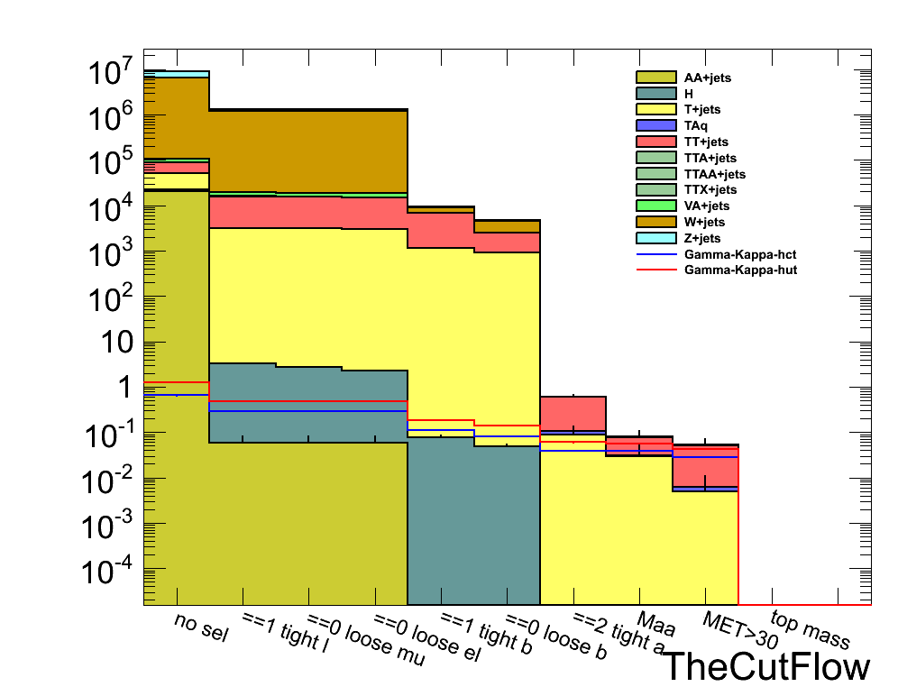
The selection

Slide 5
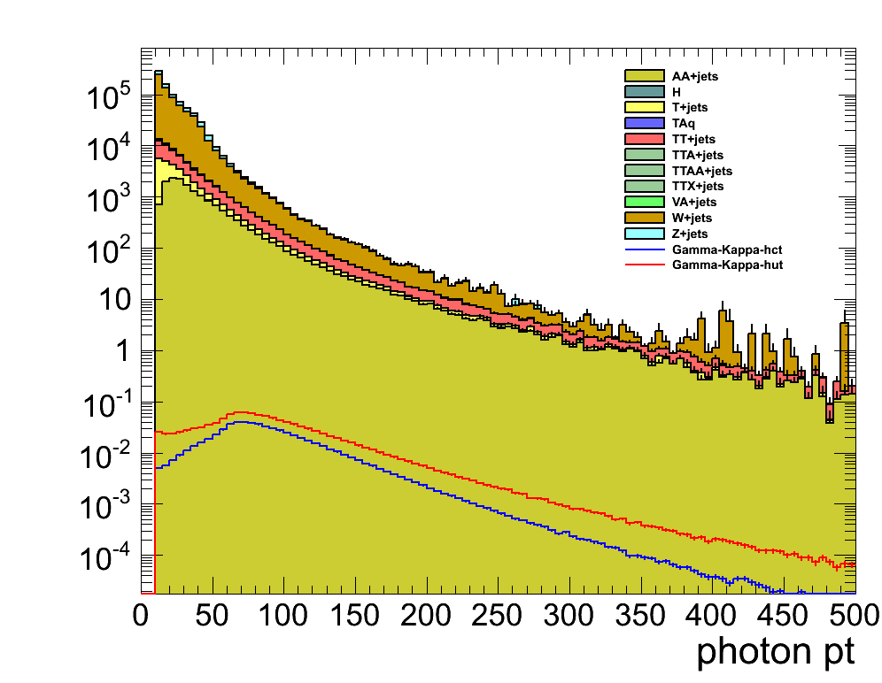
PT(a1) [GeV]

Slide 6
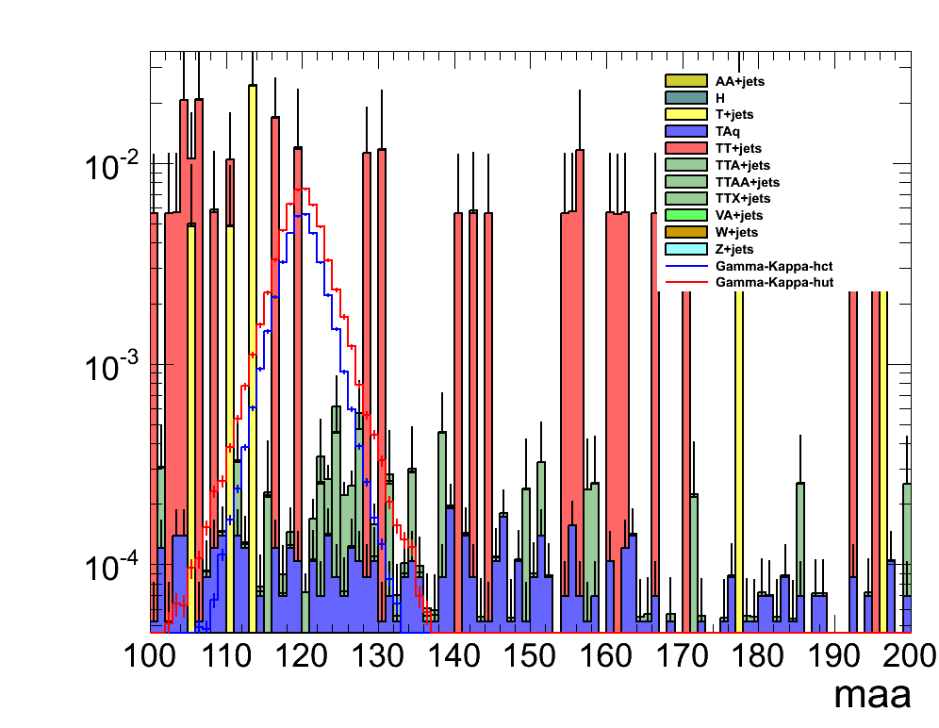
M(aa) [GeV]

Slide 7
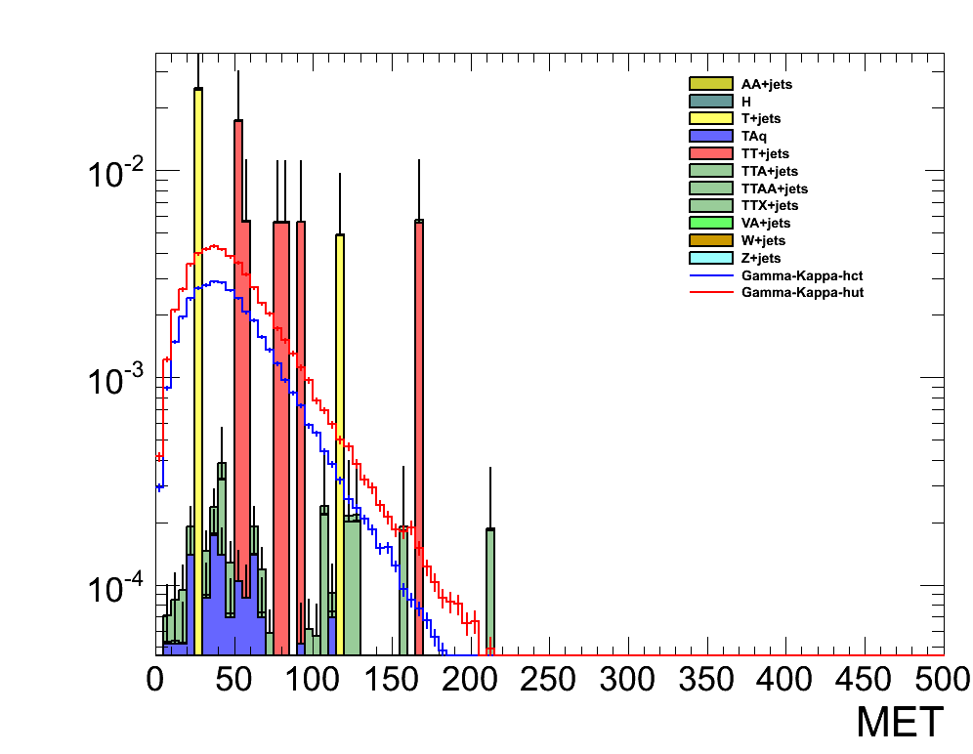

Slide 8
First CutFlow chart
Bkg
Signal

