Slide 1
ATLAS Lar Calorimeter trigger electronics phase I upgrade LDPB Firmware Development Environment (ABBA, LATOME)

Slide 2
Revision history
Version | Date | Author | Description
0.1 | 14/01/2015 | Nicolas Chevillot | First draft
0.2 | 03/03/2015 | Nicolas Chevillot
0.3 | 01/06/2015 | Nicolas Chevillot | Updated with latest changes

Slide 3
Agenda
Description of ABBA/LATOME(AMC) working group
Description of development environment
e-group
JIRA project
GIT repository
Simulation and compilation

Slide 4
ABBA/LATOME(AMC) working group
Multiple projects
→ Have a common environment for all projects
Developers spread across the world
CPPM/LAPP (France)
University of Dresden (Germany)
University of Tokyo (Japan)
University of Arizona (USA)
Budker INP and Novosibirsk State University (Russia)
→ Need to have a way to share code
Developers organized in teams working on dedicated parts of the design
→ Need to be able to protect areas of code

Slide 5
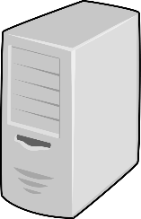
Development environment
CERN provides multiple tools
JIRA project
GIT repositories
Can be accessed from anywhere
atlas-lar-ldpb-firmware
e-group
CERN
Registered member of atlas-lar-ldpb-firmware e-group
ATLAS LAr LDPB firmware
JIRA project
atlas-lar-ldpb-firmware
GIT repository
gitolite-admin
GIT repository
Local computer(s)
Remote computer(s)

Slide 6
e-group
CERN e-group: atlas-lar-ldpb-firmware
Need to be member of the e-group to be able to access the JIRA and GIT
Request access to e-group owner:
Nicolas Chevillot: nicolas.chevillot@lapp.in2p3.fr
https://e-groups.cern.ch/e-groups/Egroup.do?egroupId=10158278&searchValue=atlas-lar-ldpb-firmware
Current members:
Aad, Georges
Camplani, Alessandra
Chevillot, Nicolas
Dinkespiler, Bernard
Dumont-Dayot, Nicolas
Duval, Pierre-Yves
Enari, Yuji
Hentges, Rainer Guenter
Johns, Kenneth
Starz, Steffen
Tanaka, Junichi
Wingerter, Isabelle
Zhulanov, Vladimir

Slide 7
JIRA Project
CERN JIRA Project: LDPBFW
https://its.cern.ch/jira/browse/LDPBFW
Tasks/Bugs tracking system
Used to plan for tasks, i.e. implement such feature, or improve something
Used to track bugs in the firmware
GIT commits can be linked to JIRA
Simple workflow with 4 state: Open, In progress, Closed and Reopened
create issue
Open
start progress
close issue
stop progress
Reopened
start progress
In progress
close issue
close issue
reopen issue
Closed

Slide 8
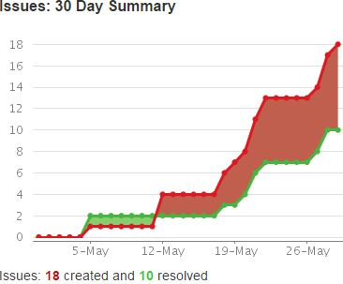
JIRA Project
CERN JIRA Project: LDPBFW
Issue are classified in components:
env, doc
ABBA: abba-back-all, abba-front-all (need maybe to split into multiple components)
LATOME: latome-doc, latome-fpga, latome-ipctrl, latome-istage, latome-lli, latome-mon, latome-osum, latome-remap, latome-ttc, latome-user
undecided: in case component is not yet known
Issues are assigned to component owner
Can be reassigned to a particular developer

Slide 9
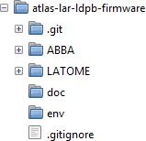
GIT repository
CERN GIT repository: atlas-lar-ldpb-firmware
Need to be member of e-group
Web access: https://git.cern.ch/web/atlas-lar-ldpb-firmware.git
GIT clone: https://git.cern.ch/web/atlas-lar-ldpb-firmware
Tracks different revisions of the firmware
Allows to share code between group members
Restricts access to parts of the firmware (using the CERN gitolite-admin repository)
Contains:
doc: working environment documentation
env: working environment scripts
ABBA, LATOME: current projects
.git: GIT specific files
.gitignore: GIT list of files that cannot be committed in the repository (i.e. temporary files, …)
Could hold more projects related to LDPB!

Slide 10
GIT repository
GIT workflow
GIT is using clone, pull, add, commit, push commands
Using a simple no branch workflow. Might need to reconsider this option if complexity increases
CERN
master
clone
clone
push
pull
push
add / commit
Local user 1
Feature/Bug correction
add / commit
Local user 2
Feature/Bug correction

Slide 11
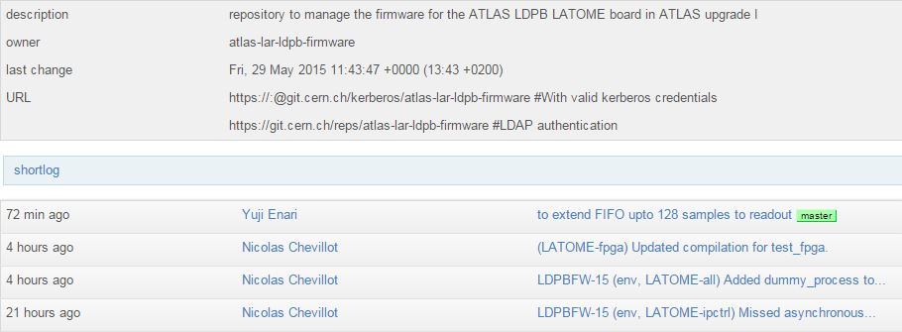
GIT repository
GIT commits
Need to identify clearly which JIRA issue and component(s) the commit applies to
Commit header should follow the convention:
LDPBFW-<JIRA issue number> (<comma separated list of components>) <Description>
Example:
LDPBFW-15 (env, LATOME-ipctrl) Missed asynchronous reset.
As much as possible each commit should be linked to a JIRA issue

Slide 12
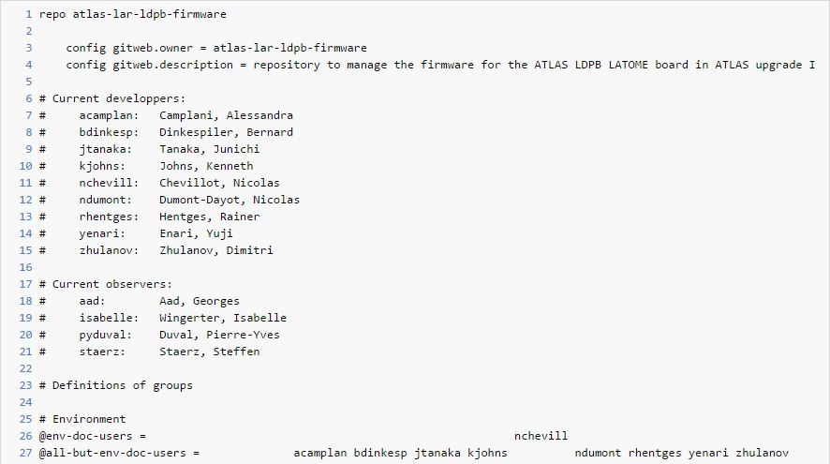
GIT repository
Access rights
Each folder’s access rights are handled in the CERN gitolite-admin repository
Request to e-group owner to update access rights:
Nicolas Chevillot: nicolas.chevillot@lapp.in2p3.fr
https://git.cern.ch/web/gitolite-admin.git/blob/HEAD:/conf/subs/atlas-lar-ldpb-firmware.conf

Slide 13
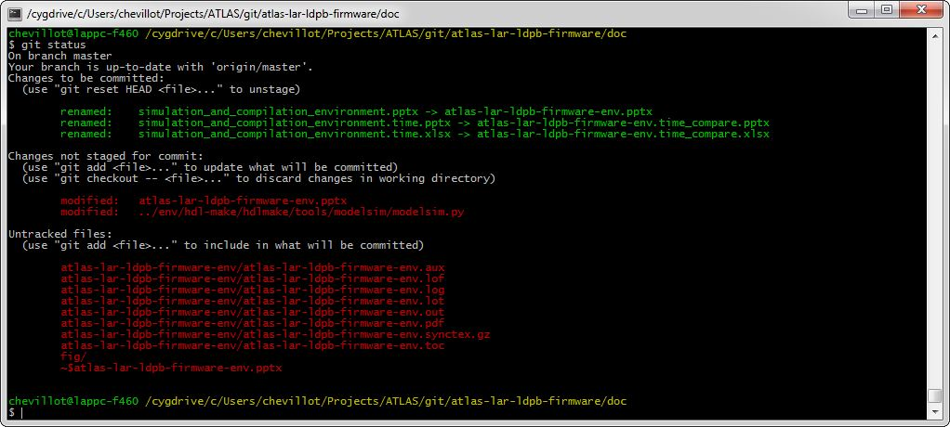
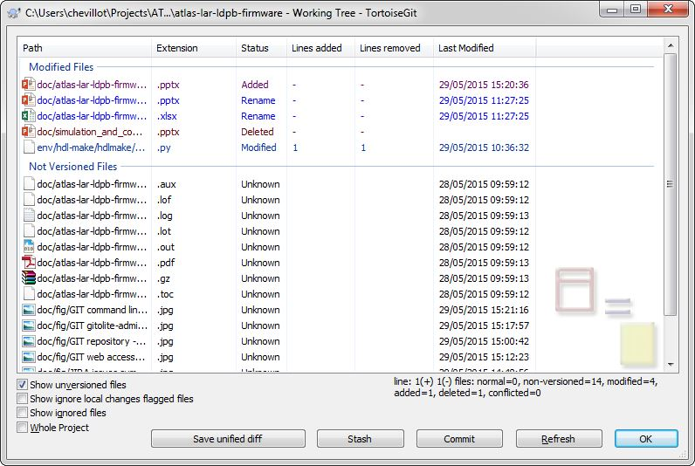
GIT repository
Tools
GIT can be used either on Windows through Cygwin or in linux environment
Command line tool or GUI, i.e. Tortoise GIT (Windows)

Slide 14
Simulation and compilation environment
Environment based on makefile/python/TCL scripts
Based on hdl-make (CERN Open Hardware): http://www.ohwr.org/projects/hdl-make
Handle dependencies to minimize compile time
Concept of modules, can be used to batch build projects (i.e. testbenches) for regression testing
Supports Cygwin ≥ v1.7.33 (Windows) or Linux environment (tested on SciLinux v6.1):
Git ≥ v2.1.1
Make ≥ v4.1
Python ≥ v2.7.8
Strongly recommends using Linux based environment (much faster)
Note: the structure of the environment is inspired from LHCb project. Work from Guillaume Vouters and others.
Simulation environment
Based on Modelsim/Questa tool ≥ v10.2c
Dependencies are built automatically
Faster rebuild
Optional GUI, can be used to remotely build project on faster machine
Synthesis environment
Based on Quartus II ≥ v13.1. ABBA using v13.1, LATOME using v15.0.
Optional GUI, can be used to remotely build project on faster machine

Slide 15
Simulation and compilation environment
Each project holds multiple sub-projects
A sub-project is a simulation testbench, design to be compiled or a design unit
Described using a python file: Manifest.py
# Simulating the design
action = "simulation"
# Simulation tool is Modelsim v10.2c
sim_tool = "modelsim"
#sim_tool_version = "10.2c"
# Compilation tool is Quartus v14.1, used in simulation for Altera primitives
#comp_tool = "quartus"
#comp_tool_version = "14.1"
# Top module used for simulation
top_module = "fpga_tb.fpga_tb(struct)"
# Waveforms for simulation
sim_do_cmd = "wave.do"
# Additional options for modelsim
vcom_opt = ""
vsim_opt = "-voptargs=+acc -i -multisource_delay latest -t ps +typdelays"
# List of modules
modules = {
"local" : [
"$PROJECT_ROOT_PATH/src/fpga",
"$PROJECT_ROOT_PATH/src/testbench",
],
}
# Default library
library = "fpga_tb"
# List of source files for the 'fpga' module testbench
files = [
"fpga_tb.vhd",
]

Slide 16
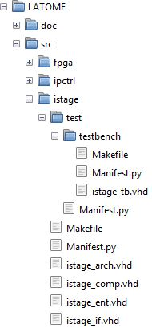
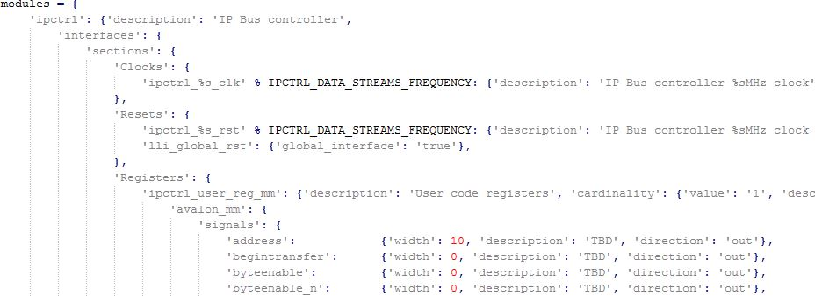
Simulation and compilation environment
Top-level interfaces are described in a python file: top_level.py
Interfaces are either:
Signals
Altera Avalon Streaming (Avalon ST) or Avalon Memory Mapped (Avalon MM)
Custom interfaces (combination of Altera Avalon ST/MM and or signals)
Python file used to automatically generate:
Documentation, i.e. interfaces tables for LAr-LATOME-FW
https://git.cern.ch/web/atlas-lar-ldpb-firmware.git/blob/HEAD:/LATOME/doc/LAr-LATOME-FW/LAr-LATOME-FW.pdf
VHDL Code skeleton for each modules, including testbench
VHDL code skeleton documented using doxygen comments

Slide 17
Simulation flow
Environment targets:
clean, relations, generating libraries, simulation
Input files
Build environment
Modelsim
Source files
(.vhd, .v, …)
Compiled
Libraries
VHDL/Verilog compiler
Relations makefile and manifests
VHDL/Verilog Parser
Configuration files
(manifests, makefile)
Modelsim
simulator
Makefile generator
Simulation makefile

Slide 18
Compilation flow
Environment targets:
clean, quartus_project, quartus_gui, ..., compilation
Input files
Build environment
Quartus
Source files
(.vhd, .v, .tcl, …)
Compiled
FPGA
Synthesis
Configuration files
(manifests, makefile)
Makefile generator
Compilation makefile

Slide 19
Synthesis flow
Synthesis of ABBA_PH0 project: (time in minutes)

