Slide 1
Test Beam Special runs :
shapes of particle signals with FATALIC
and run procedures
Tile upgrade demonstrator weekly meeting
2015 July 1st
Roméo Bonnefoy and François Vazeille,
on behalf of the Clermont-Ferrand team
Some propositions …
● Goal: reference particle pulses.
● Open problem: the true energy seen by PMTs.
● Hardware for recording the pulses.
● Run procedure (Could be applied to other studies).

Slide 2
Goal
● To fill the PMT signal library (as defined in Giulio’s talk),
but not exactly at the PMT output (See below)!
● To build a database of particle pulses from the Test Beam
- Different particles: p, π, e, µ.
- Different energies.
● To use them as reference pulses in the optimal filtering method
that reconstructs the pulses from the ADC data.
● In the case of FATALIC:
to record the analog pulses from the 3 gain outputs,
and so just before the 3 ADC’s, but in the test part of the chip.

Slide 3
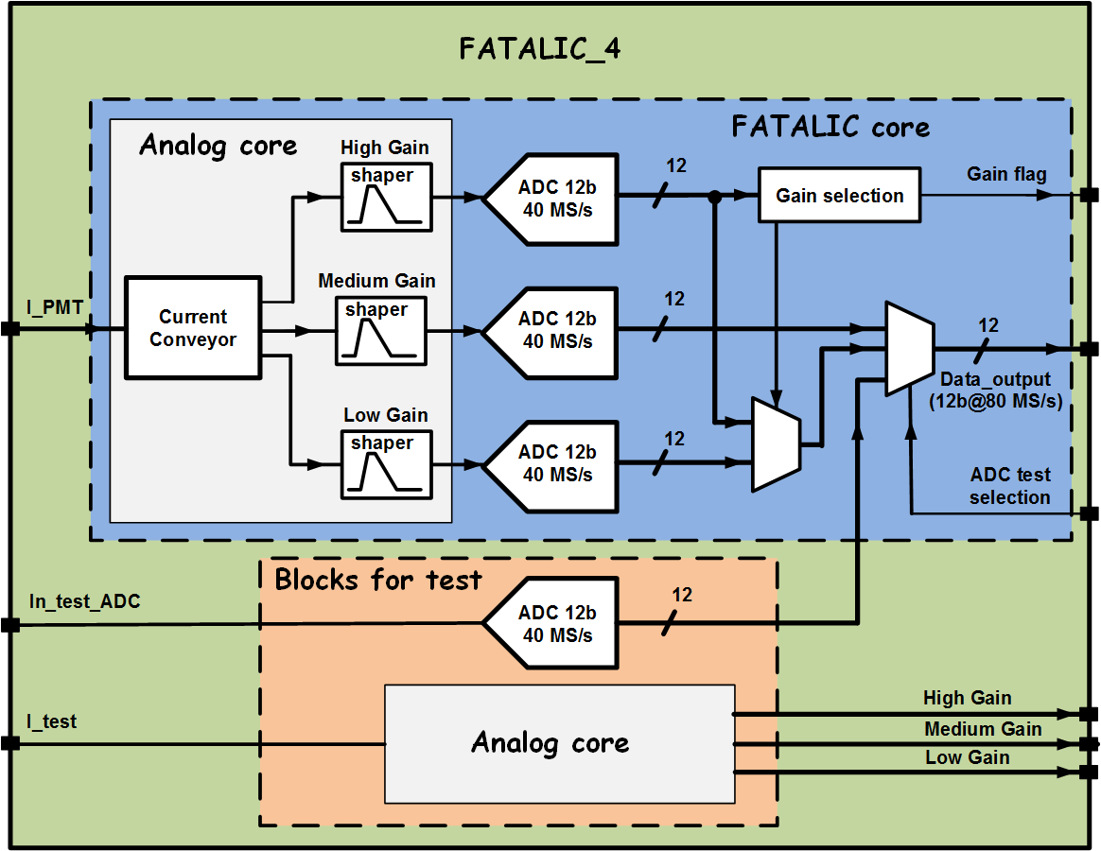
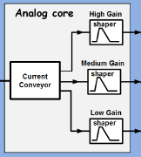
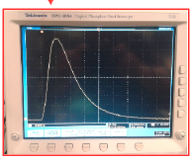
Chip core + 2 other blocks:
FATALIC Chip core
3
Gains
3 Gains + 3 ADCs
4th ADC for tests
2 independent blocks
for individual tests:
- Fourth ADC.
- Analog part 3 gains.
Recorded shapes
(Romain’s talk
June Tile week)

Slide 4
Open problem:
the true energy seen by the PMTs
or rather by the FE electronics
at the individual channel level
● PMT intercalibration: no Cesium calibration in Test Beam
→ Made in the Bld 175
… but not using the same FE electronics if it is not ready at this time.
● The use of muons will be a good alternative in Test Beam.
● Energy deposit in cells:
- Depending from the cell size.
- Easier for electrons/muons entering on the Module side.
- Monte Carlo simulation needed with hypothesis on the yield pC/GeV.
● It will be difficult to say: this pulse corresponds to a particle of X GeV.
● It will be rather a way to cover the widest dynamics with true particles.

Slide 5
Hardware
for recording the pulses
● We will not reproduce what we made … many years ago:
direct PMT pulses, without Trigger selections.
H8 zone
PMT
The shortest
possible cable
Safety grid
Corridor
Scope
Counting room

Slide 6
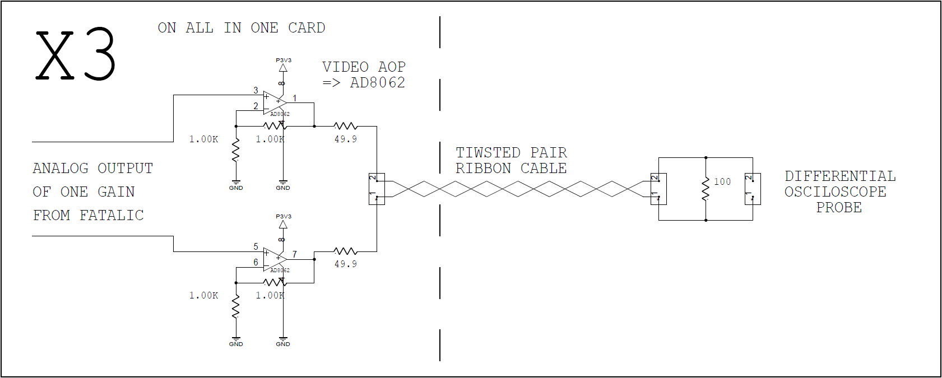
● Use of special buffers on the All-in-One cards + Beam Trigger.
H8 zone
Beam
Trigger
3 Analog’s FATALIC
Possible use
of longer cable
1 ribbon cable/Gain
Counting
room
Scope

Slide 7
●Test Beam infrastructure request
- Routing of 3 additional ribbon cables/channel:
Open question: how many channels ?
- Digital scope.
Provided by
Clermont-Ferrand
● Preliminary tests at Clermont-Ferrand in order to check
that the pulse shapes are not affected by the set-up
← Comparison of shapes at the shaper outputs (short cable)
and at the ribbon cable outputs (longer cables)
by using the FATALIC Test Bench (LED/PMT).

Slide 8
Test Beam Run procedure:
this proposition could be applied to other studies
● Allocated time must be clearly specified for these kinds of special runs.
● Any special runs must be organized and performed by the experts,
in the presence of the official shifters.
- Works on the TileCal modules/Drawers.
- Preliminary adjustments and recording of data.

