Slide 1




Diboson at LHC ?
F. RICHARD
LAL Orsay
In collaboration with A. DJOUADI and G. MOREAU
LPT Orsay
GDR terascale
23-25 November 2015 LPSC Grenoble

Slide 2
Introduction
Since many years we have been working with the Randall Sundrum model to interpret two discrepancies AFBb and AFBt at LEP & Tevatron
From these effects on could predict that RUN1 could observe resonances decaying in two bosons W_{L}W_{L}, Z_{L}W_{L} & W_{L}h (Arxiv 1203.1762)
The recent indications observed at ATLAS and CMS have renewed our interest in the matter
This talk is purely informal meant for discussion and information exchange
I am fully aware of the very marginal character of the effects that I am discussing
I was hoping that this year data could provide confirmation/invalidation

Slide 3
Starting point
The RS model postulates KK excitations of γ/W/Z called γkk Zkk and Wkk which couple mainly to h/ZL/WL and t/b (+gluonKK)
To avoid T/S and flavour constraints extended symmetry groups are assumed (custodial) which predict W’/Z’ with similar masses but different couplings
The AFBb effect was interpreted by assuming Z’-Z mixing
To reproduce AFBt we need a light gluonKK with mgluonKK~1.5 TeV
gluonKK should couple asymmetrically to qL and qR while usually one assumes a symmetric coupling which goes like Q(qL)=Q(qR)=-0.2 times the SM coupling

Slide 4
ZL,WL

Slide 5
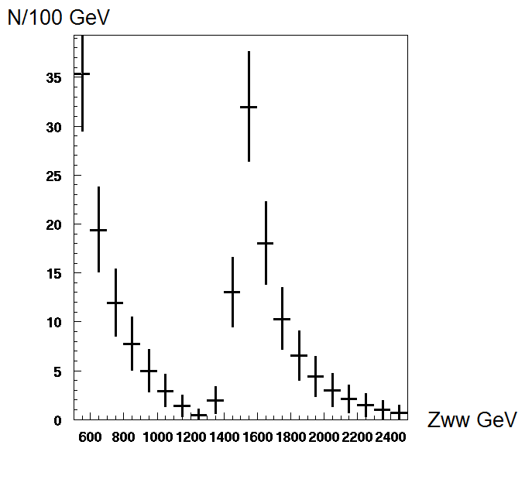
Predictions 1.5 TeV LHC7 20 fb-1
F. Richard 1203.1762
Assumes only leptonic detection
1.5 TeV resonances gives a large cross section (this low mass is now questionable given the Higgs measurement)
no contribution from KK quarks (narrow resonance)

Slide 6
Visibility
Mode | Leptonic | Semi-leptonic | Hadronic
WW | 5% | 30% | 44%
ZW | 2% | 47% | 47%
Purely leptonic modes were assumed but for LHC7 with 20fb-1 and Mkk=1.5 TeV
~10 times less cross section for Mkk=2 TeV which can be recovered using SL and hadronic modes
Purification of W/Z jets is achieved by ATLAS with an efficiency ~35%
One would expect a signal in SL (mass resolution ?) for WW and ZW
CMS ‘sees’ indications ~2 sd for llqq and lνqq

Slide 7
Hypoteses
Formalism can be found in 0810.1497
ATLAS indications correspond to narrow resonances therefore one assumes that Z’/Zkk does not couple to KK quarks
For Z’ this width is dominated by the resolution function (σ/M~4%)
For W’ where t’b type channels could contribute widening the BW
Main parameters Q(qL)=0.3 Q(qR)=-0.2 gZ=gZ’
Makk | MZkk | MZ’ | ΓAkk | ΓZkk | ΓZ’
1950 | 2000 | 1962 | 68 | 98 | 95

Slide 8
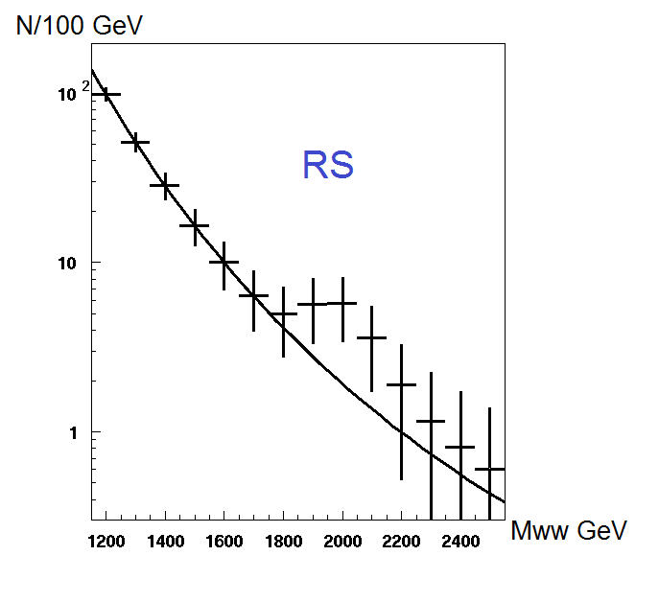
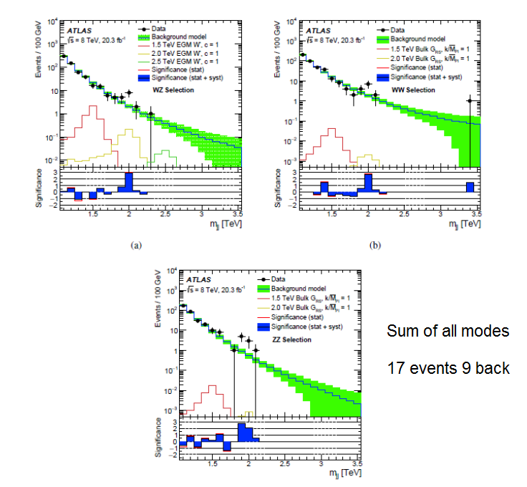
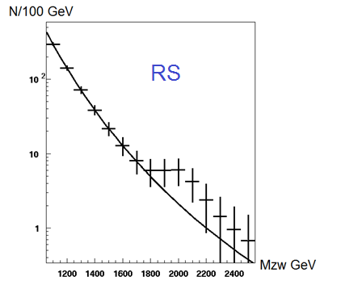
ATLAS 1506.00962

Slide 9
Caveats
While there is a good separation of W/Z jets from QCD jets, the W and Z jets cannot be cleanly separated
WZ events can easily be selected as ZZ and WW
One cannot therefore prove the presence of the 3 final states WW, ZW and ZZ
For instance it could well be that only W’->WZ is real and that this channel permeates into WW and ZZ creating ‘ghost peaks’
As a consequence to compare our WW prediction to the experimental data one should not only include the genuine WW events but also the ZW events which are accepted as ‘WW’ by the ATLAS analysis

Slide 10
Only in ATLAS ?
1405.1994v2
Jet- Jet Semi-leptonic

Slide 11
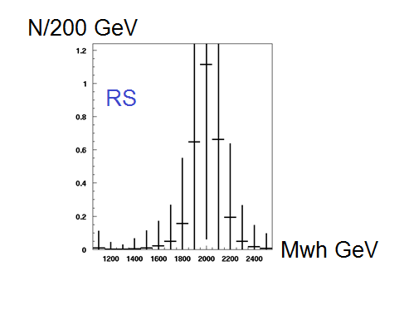
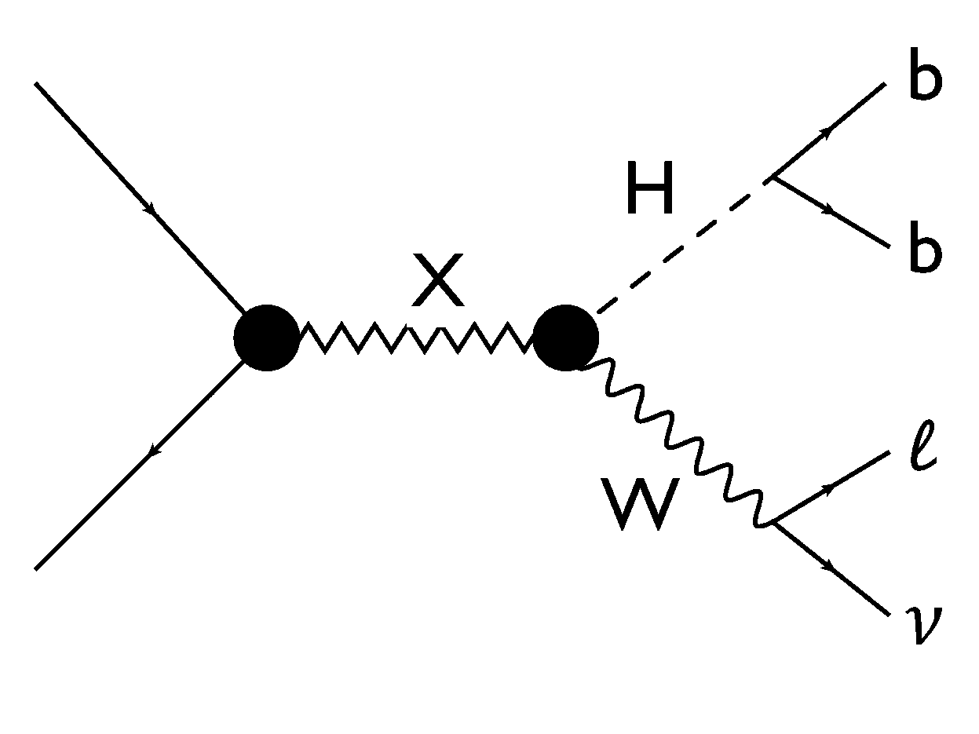
WH

Slide 12
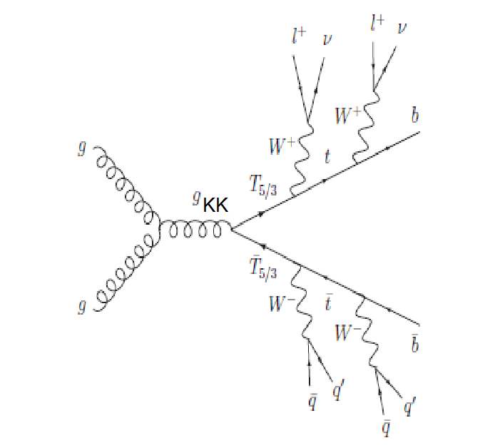
Gluon-KK and KK quarks
One expects a gluon-KK at 2 TeV which couples strongly to to top and KK quarks which are expected at b ~1 TeV
Contrary to Zkk this resonance can be wide
No structure has been found in ttbar
This can be blamed on the width Γtt/M~0.2 (while only a few % for Z’)
This width could be even larger Γ/M~0.5 if KK quarks have a mass ~ 1 TeV
Cross section as large as ~100 fb are expected which could extend the reach on t’/b’/T_{5/3} up to a TeV
Strong signatures are expected with t’->tH b’->tW- T_{5/3} ->tW+

Slide 13
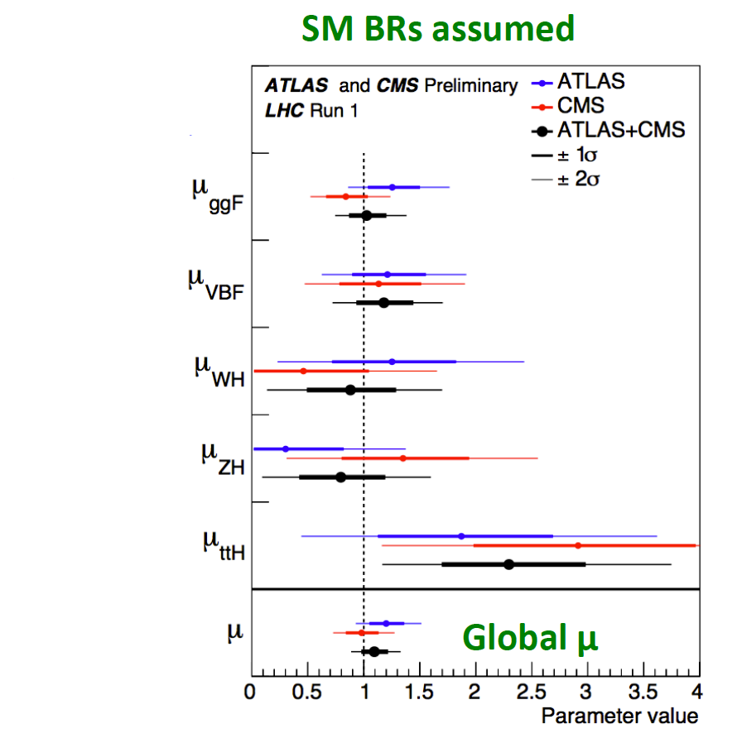
ttH, ttW
Modest excess in ttH and ttW are observed however seen by both ATLAS and CMS
For ttH gluonkk->t’t’ or t’t with t’->tH gives ~ the right amount of events for mt’~1 TeV
ttW uses like sign leptons which naturally occur in b’b’ final states

Slide 14
What can we hope for with 4fb-1 ?
At LHC13 qqbar luminosity increases by ~6 at 2 TeV which gives about the same number of signal events for 4fb-1
The QCD background (1508.04162) due to qq, gq and gg is uncertain but will be soon measured allowing to estimate the expected significance (qq lumi increases by 3, gq by 8, gg by 18)
Same sign leptons are promising
It will presumably take 2016 data to confirm/reject this interpretation

Slide 15
THAT’s ALL FOLKS

Slide 16

Great expectations (if true)
Recall that within the RS model one expects:
Detection of vectorlike quarks and leptons with masses ~1 TeV
Detection of higher order KK resonances, typically around 4.5 TeV
Detection of GravitonKK at 3 TeV
Detection of rare decays, in particular Zkk/Akk into lepton pairs
Detection of a radion with final states similar to h
RS also provides DM as a stable fermion ~TeV
…

Slide 17
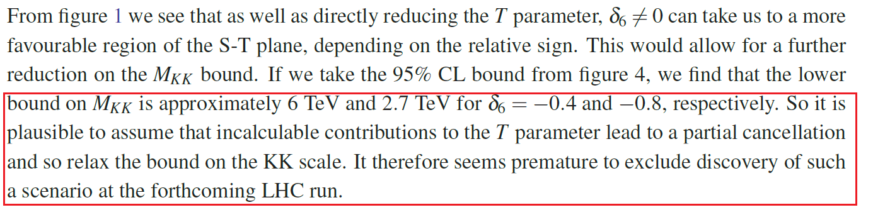
T/S constraints
Common wisdom states that due to T/S , RS bosons are beyond the reach of LHC
It is however true that at present RS does not allow a full calculation of these variables
Recently this was commented in ref 1511.03427 where one reads:

Slide 18
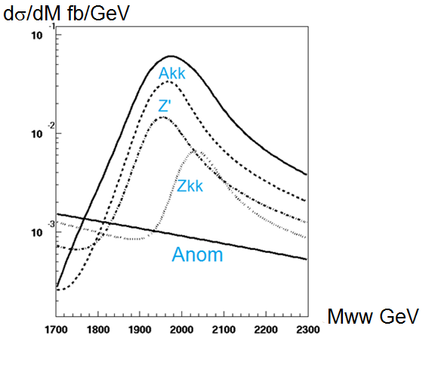
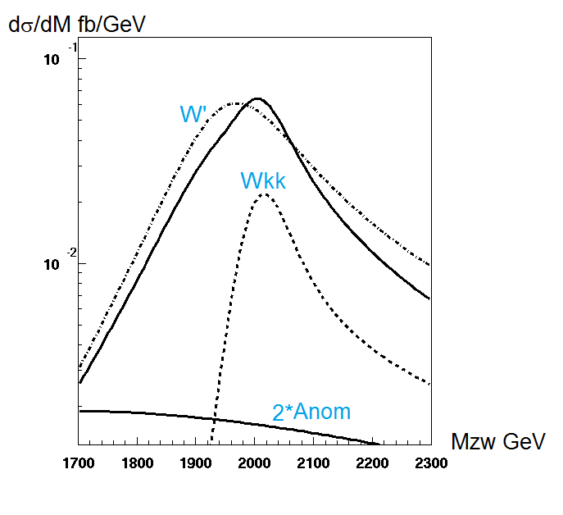
How does it work ?

Slide 19
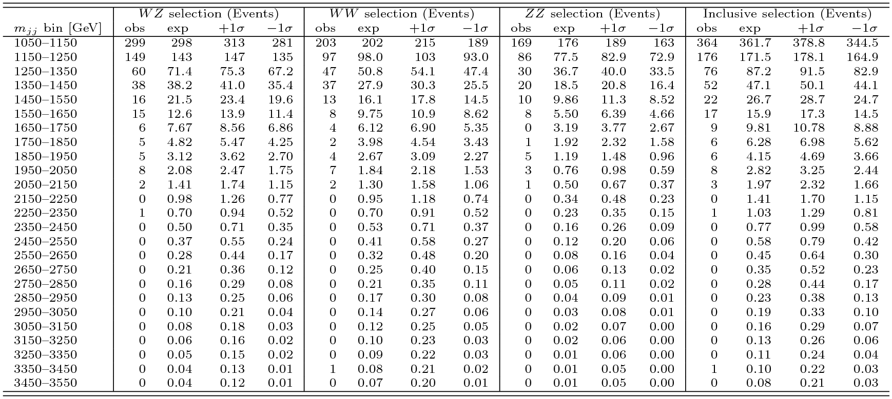

Slide 20
ee/µµ
Present ‘indication’ is ~50 times less than Z’SSM
Suppression on light fermion couplings is 1/5 hence (1/5)⁴ hence ~500 times less but this prediction is flexible

Slide 21
ATLAS

Slide 22
e+e-jj (not µµjj)
CMS sees 2.8 sd à 2.1 TeV
Could be a W’ cascading into eN_{R} with N_{R}->eW’*
Extended groups with new heavy fermions are generic to xtra-dimension
1508.04129 predict states with taus

Slide 23
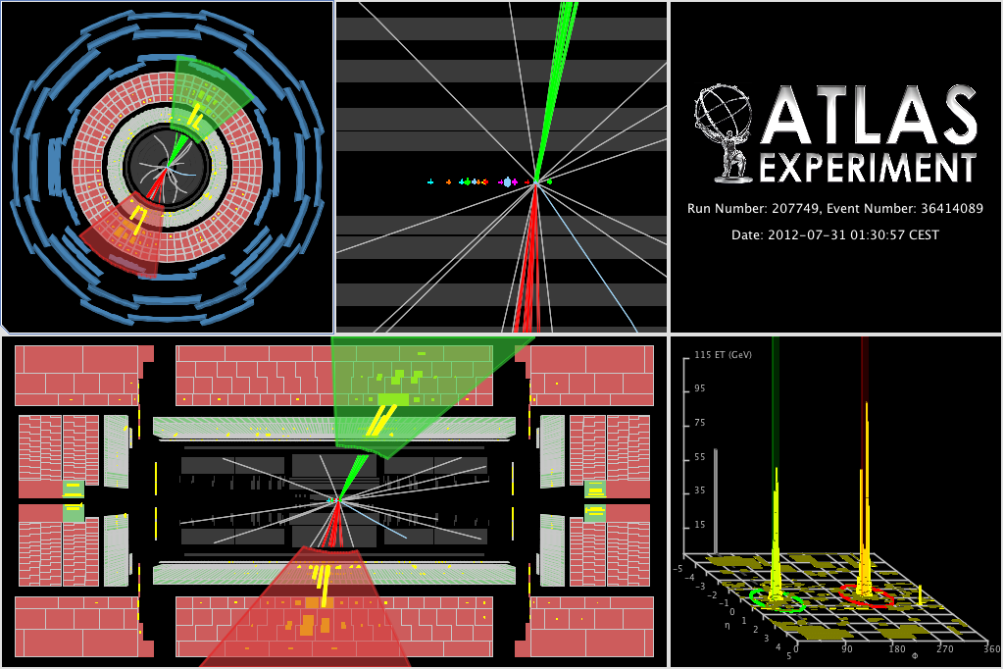
Figure 1:
Event Display of Event 36414089 in Run 207749, which is selected by the WZ selection. newline The dijet invariant mass m_{jj} is 2.26 TeV, the leading jet has p_{T}^{j1} = 1.1 TeV and m^{j1} = 104 GeV, and the subleading jet has p_{T}^{j2} = 1.1 TeV and m^{j2} = 71 GeV.

Slide 24
ttbar case

Slide 25
Exotic modes
GravitonKK couples to gluon-gluon and therefore its cross section will be increased by ~20 at 13 TeV
GravitonKK seems difficult to prove without purely leptonic events : LHC13 with ~300 fb with 10 fb-1 gives ~7 events background free
With ZZ->llνν 2*7%*20%=2.8% visibility increased by 5 (but WZ with W->τν )
Recall that ttbar will be mainly produced through gluonKK as a very wide resonance difficult to observe
gravitonKK into 2 photons mode could be seen if ZZ is real
Radion (scalar boson produced with a much larger cross section than the SM Higgs)

Slide 26
ATLAS DIBOSONS

Slide 28
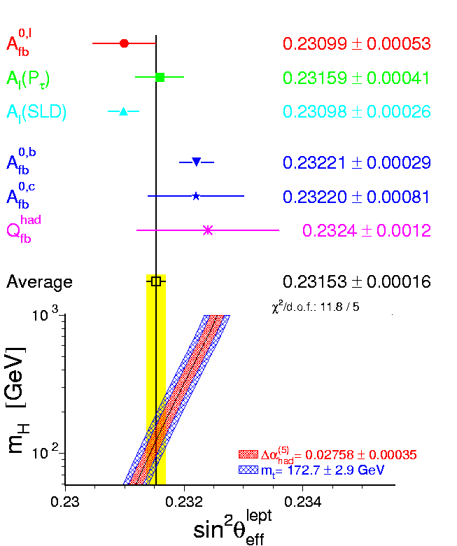
AFBb

Slide 29
References
F. Richard eprint:hep-ph/1203.1762
LHC Signals for Warped Electroweak Charged Gauge Bosons
Agashe et al 0810.1497
LHC Signals for Warped Electroweak Neutral Gauge Bosons
Agashe et al 0709.0007

Slide 30
Recent references
Cheung et al 1506.06064
Brehmer et al 1507.00013
Aguilar-Saavedra 1506.06739
Hisano et aél 1506.03931
Dobrescu et al 1506.06736
….

Slide 31
Radion/Higgs

Slide 32
Display

