Slide 1
Status of the Remote HV System
10 June 2015
TileCal week, upgrade session
Roméo Bonnefoy, Romain Madar and François Vazeille
● Summary of performances
● Next actions

Slide 2
Summary of performances
● All the details in a recent ATLAS Note
"Performances of a Remote High Voltage Power Supply for the Phase II
Upgrade of the ATLAS Tile Calorimeter"
ATL-COM-TILECAL-2014-082 (April 15, 2015)
Romeo Bonnefoy, Robert Chadelas, Christian Fayard, Daniel Lambert,
Romain Madar, Marie-Lise Mercier, Eric Sahuc and François Vazeille
All the results were shown in previous TileCal meetings,
but for the preliminary noise measurements at the readout level
shown today.

Slide 3
● Preliminary noise measurements at the readout level
Made on the Demonstrator in the building 175, on the Drawer D1.
HV
Crate
Internal cable
2.22 m long
100 m long
cable
LV power supply inside the HV crate, HV Source from Tesla crate.
Noise measurements from pedestal values
given by Main Board/Daughter Board set, without/with HV switched on.
- DCS data recorded by standard ATLAS DCS on laptop in Building 175.

Slide 4
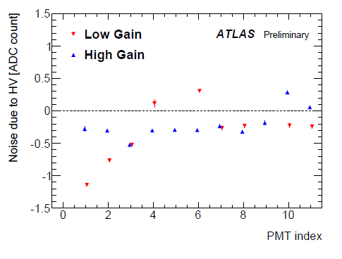
Running conditions
(Launching of the noise studies at the previous expert week)
▪ PMTs at 700 V.
▪ Short pedestal run HV Off (162 seconds).
▪ Long stability run HV On (13 hours) with pedestal runs of 2 hours.
⇒ Noise level for the 2 gains induced by the HV system
(Some PMT channels are suppressed
← No data or incoherent data between High and Low gains).
◊ "Negative noise“:
rms lower when HV On !
Good indication of systematic errors
in the pedestal measurements:
High gain: from 0.24 to 0.52 channel
Low gain: from 0.22 to 1.10 channel
→ The readout working is no so bad !
“Positive noise“: ≤ 0.31 channel
always below the systematic errors
First conclusion on the HV induced noise: very low
and within systematic measurement errors.

Slide 5
HV stability during the 13 hours: from 55 to 89 mV over the 12 channels.
Conclusion on the HV stability: very good,
in agreement with the whole studies as described in the internal Note.
Comment: It is actually the HV stability at the PMT input
(See the Note for more explanations).

Slide 6
● Summary of performances (More details in the Note)
in the ATLAS conditions (100 m long cable)
- HV noise
▪ At the PMT input: Below 2.5 mV at 700 V,
and constant ratio (noise/HV) = 2.6-2.7 10⁻⁶ in the range of 300 V.
▪ At the readout level (preliminary results): ≤ 0.31 channel
within the systematic uncertainties of the measurements.
- HV stability: ≤ 90 mV, slightly better than in ATLAS running.
- No correlation stability/noise,
even in the most noisy conditions with the not recommended set-up.
- HV drop at the 100 m long cable output: 5 mV.
- Other points in relation with the whole electronics in counting room:
▪ Irrelevant points at the detector level:
radiations, humidity, temperature, falling materials, handling and
access to the electronics.
▪ Easy access and easy connections to the HV Bus boards.
▪ Permanent access to the electronics.

Slide 7
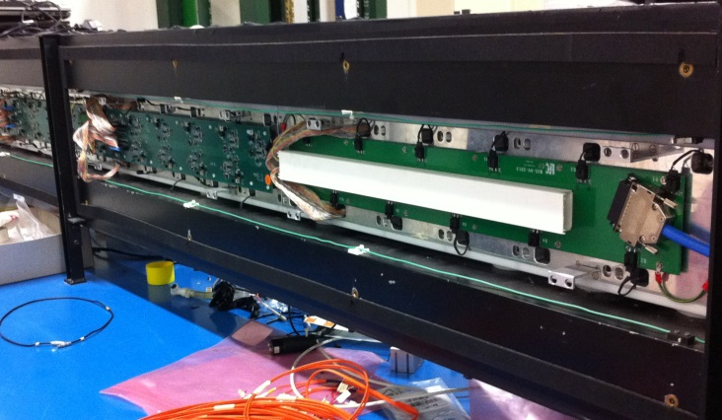
Next actions
● Short term actions
- Yesterday: second 100 m long HV cable in the Building 175
⇒ We will be able to supply 2 Mini-Drawers,
preferentially D3 and D4 at the Patch Panel side (At least at Test beam)
in order to take benefit of the cable tray routing of internal HV cables
(→ No fixation problems of HV flat connectors).
- Making of an additional 50 m long cable
→ Possibility of tests with 150 m long cable (Motion of the Extended Barrels).
- In view of the ATLAS test beam installation, works on the HV Test bench:
return to Clermont-Ferrand of the 2 HV Opto cards scheme 1 in Bld 175
for a “cleaning” + preparation of other equivalent cards (as spares)
+ test of transformation of ATLAS cards (Scheme 2) into Scheme 1 cards.

Slide 8
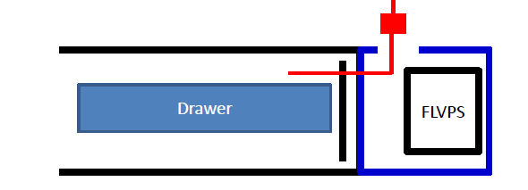
- Modification of the Patch Panel: slot for routing the 4 HV cables.
→ Only space for the Blue cable (Diameter of 1.12 cm each).
→ Locking system.
⇒ Information will be given to Gabriel.
Slot at the HV side
and locking
Patch
Panel
● Medium term actions
- Restart systematic tests of the 2 HV options in a good control of experts
← Good readout channels, including good PMTs.
← Stable readout.
- Qualification of present Multiconductor cables or new ones.
- Test beam program: from the installation of the set-up
(new 100 m long cables, DCS) to the tests.

Slide 9
● Long term actions … with studies already in progress
→ to come to the final design by following the practical propositions
as described in the Note, mainly:
- Routing of services in the cavern: only the long HV multiconductor cables.
- Minor improvements of the HV Bus boards (Noise killers locations).
- Optimization of the space and of the density of cards inside the
HV regulation crate: Suppression of support cards recovering the mapping
with the prototype cards, implementation of LV and HV commercial bricks,
etc.
- Individual straps inside regulation crate to switch off failing PMT blocks.
- Choice of the final DCS.

Slide 10
● New information
Interest of the Lisbon team:
- Progressive participation aiming the final design as proposed in the Note.
- First work: making of an HV Opto card fitting the present support boards
of the regulation crate.
- Then:
▪ Going to the final designs of HV Bus card and of HV regulation crate,
including services (cables) and DCS.
▪ Final goal: to take over this project from the Clermont-Ferrand team,
who would play the role of consultant.

