Slide 1
Main Board Status MB2 v1 for FATALIC & QIE
Roméo BONNEFOY
François Vazeille
LPC Clermont-Ferrand

Slide 2
Functionalities MB2 v1
Read the digital data from VFE options 2&3
Option 2 VFE LPC : FATALIC on All-In-One board
Option 3 VFE Argonne : QIE on dedicated board
Prepare Data and Transmit to the DB
MB2 v1 compatible with DB v3 & DB v4
Digital processing for Cs Data (could be performed downstream in DB in future)
Transmit clock and the orders of the DB to the VFE card
Supply the VFE cards
General Remark : There’s no analog part on the MB, all the ADCs are on VFE card.

Slide 3
Design MB2 v1
Keeps, as much as possible, the same solutions as Chicago to make simpler the FPGA DB software changes
Architecture with the 4 quarters (and 4 FPGA ALTERA Cyclone IV)
Same serial link (SPI) for sending commands and for exchanging settings
Same solution for the Voltages monitoring and the FPGA JTAG
Data transmission of the digital sum for cesium calibration, identical to the MAX1169 ADC used by Chicago, in I2C
Use the same connector for power supply : 2 for input and one dedicated for the DB
By definition directly compatible with DB v4
Compatibility with the DB v3 needs a power cable welded above
Find a transfer protocol of the data similar to that of the MB1 of Chicago :
High data transmission rates identical to the TLC2264 ADC used by Chicago, BUT:
Transmission rate slower than this one on Chicago MB1
Mode “2-Lane Output, 14-Bit Serialization”

Slide 4
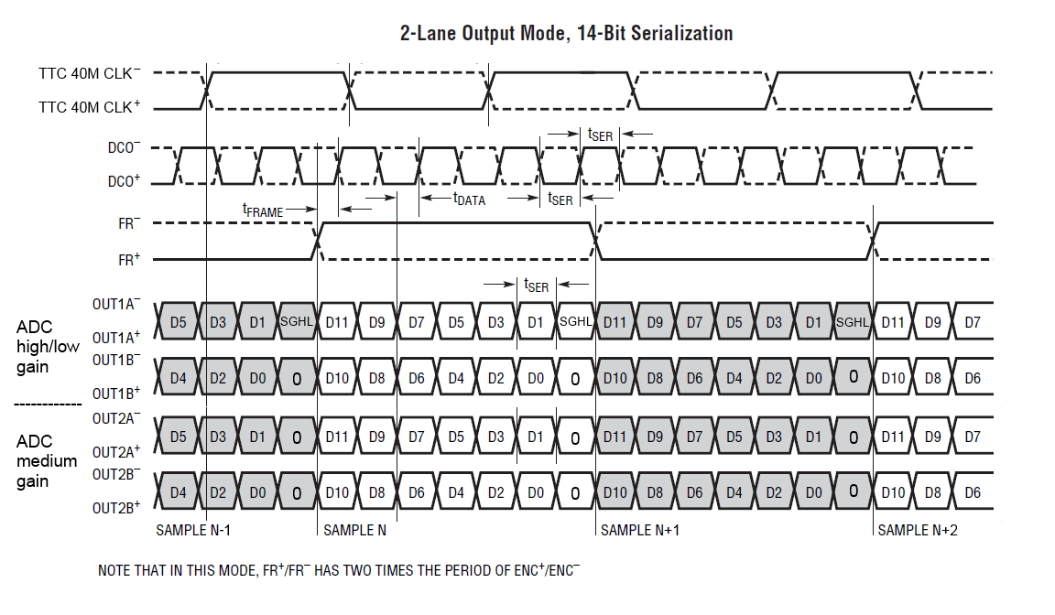
Data Transfert MB2 v1 to DB v3 or v4
To send data from 2 gains of one channel, we use 4 LVDS pairs.
The clock and synchronizing signal are common to the 3 channels of the same FPGA.

Slide 5
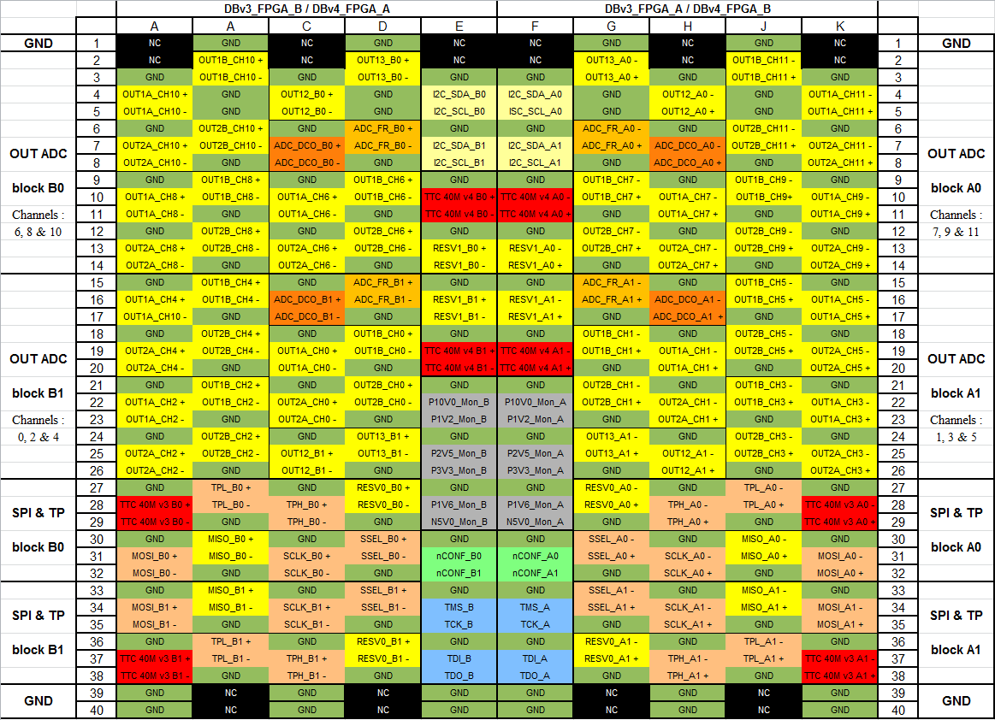
FMC Signal Definitions : for DB v3 & v4 Modified and Approved by Stockholm

Slide 6
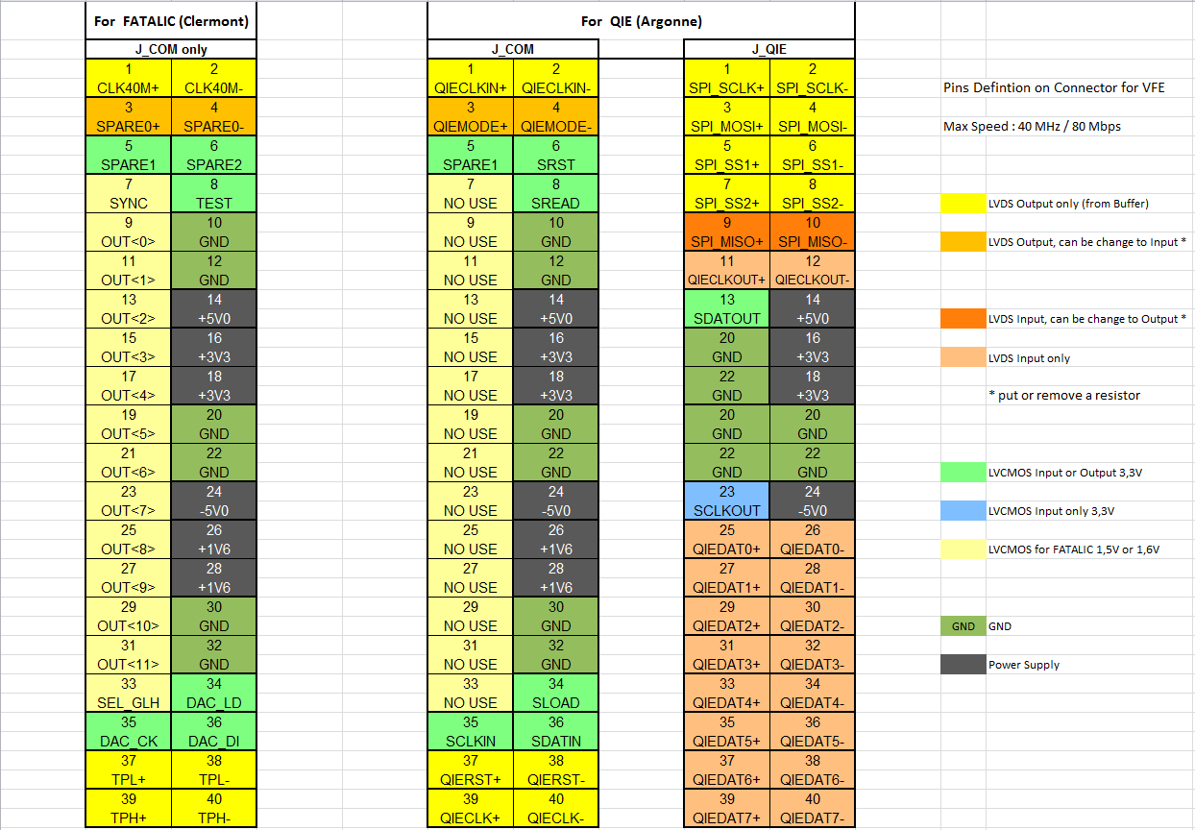
VFE Signal Definitions : For FATALIC and QIE

Slide 7
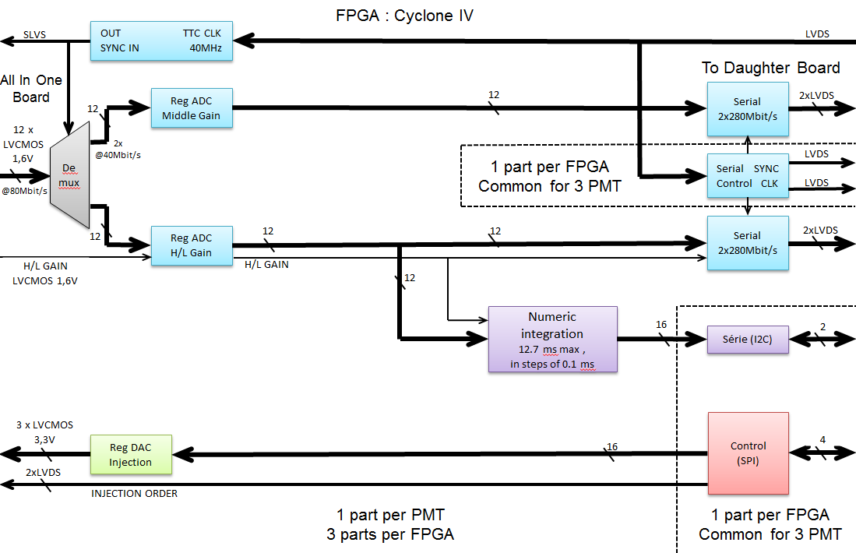
Digital processing in FPGA in MB2 for one channel
Here : Scheme for Fatalic; very close scheme for QIE

Slide 8
PCB : The problematics differ from that one of the MB1 Chicago
No analog part
Data Transmission: Flow signals MB to DB 280Mbits/s and compatible with DB v3
Slower than Chicago (560Mbits/s)
But the number of signals is somewhat higher : 56 LVDS pairs, against 48 on Chicago MB
So less sensitive to noise
Fewer supply layers and fewer GND layers needed:
Choice: 6 supply layers and 2 GND layers
DATA from VFE: Many lines of digital input signals
The handling of the 2 solutions All In One and QIE increase also the number of input lines
So more layers of signals than Chicago MB:
Choice: 8 signal layers
Total : 16 layers

Slide 9
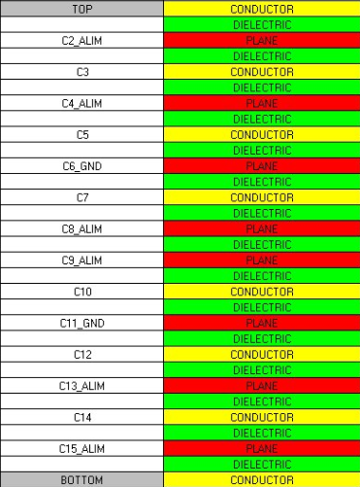
16 Layers on PCB
8 layers planes : 6 Power supplies & 2 GNDs
8 layers signal : single lines and differential lines
c2 : P5V
c4 : N5V
c6: GND c8 : P1V6
c9 : P3V3 c11 : GND c13 : P2V5 c15 : P1V2& P10V

Slide 10
MB2 v1 PCB dimensions
Dimension : 655 mm x 100 mm (covering of the DB)
Holes location :
The location of these holes stay identical to the previous MB1 v1 Chicago version
2 holes added on each side of the FMC connector
1 hole added for the DBv4
3 Power supply connectors :
2 for +10V Input
1 for +10V Output for DB

Slide 11
Test interface MB2 v1 with DB v3
Adaptation needed for the existing Stockholm VHDL code on its DB v3.
Document ready before the end of this week, to explain in detail the transmission of various data and commands.
It is necessary to test the interface between our MB2v1 and one DBv3 before the test beam.
We have : All In One, MB2 v1, VC707, optical fiber and PC.
We need : DB v3 with the VHDL code adapted
and the software for VC707 and for PC.

Slide 12
Production & Tests planning
Date | Action | Note
June 2 | Sends manufacture of 3 MB2v1 PCBs
June 19 | Sends cabling of one MB2v1 PCB
June 26 | Sends manufacture of 30 All-In-One PCBs
July 13 | Reception of one MB2v1 | First tests at Clermont
July 17 | Beginning cabling of 28 All-In-One PCBs at LPC
July 22 | Sends cabling of 2 MB2v1 PCBs
July & September | Many tests MB2v1 and DB(v3) with Stockholm | Organize with Stockholm
September 21 | Tests the 28 All-In-One FATALIC4B
End of September | Installation for Test Beam
7 October | Beginning of the Test Beam

Slide 13
Future evolution of MB2
Dedicated MB2 for FATALIC and MB3 for QIE
Dedicated MB2-FATALIC would be simpler :
Removing regulators for + 5V and -5V, only for Argonne
Removing the second connector for each VFE channels
Removing USB modules and test pins
Less signal lines on the FPGA and less power supplies = the number of layers can be reduced from 16 to 12 layers
Possibility to use FPGA with less pins and more radiation tolerant, for example the new ALTERA MAX 10

Slide 14
Thank you!

