Slide 1
Data storage services at CC-IN2P3
Jean-Yves Nief

Slide 2
Agenda
Hardware:
  Storage on disk.
  Storage on tape.
Software:
  Storage services.
Pitfalls and lessons learned.
Storage needs in the near future.
Prospects.

Slide 3
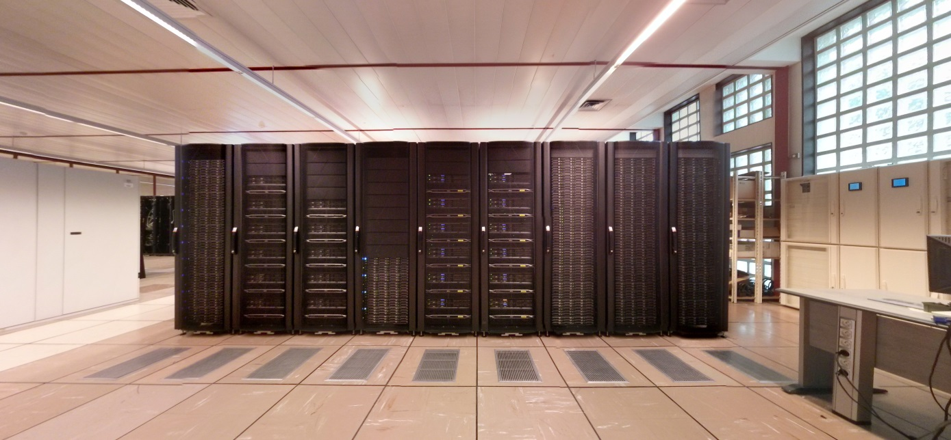
Storage at CC-IN2P3: disk
Hardware
Software
Direct Attached Storage servers (DAS):
  Dell servers (R720xd + MD1200)
  ~ 240 servers
  Capacity: 15 PBs
Disk attached via SAS:
  Dell servers ( R620 + MD3260)
  Capacity: 1.9 PBs
Storage Area Network disk arrays (SAN):
  IBM V7000 and DCS3700, Hitachi HUS 130.
  Capacity: 240 TBs
Parallel File System: GPFS (1.9 PBs)
File servers: xrootd, dCache (14 PBs)
  Used for High Energy Physics (LHC etc…)
Mass Storage System: HPSS (600 TBs)
  Used as a disk cache in front of the tapes.
Middlewares: SRM, iRODS (840 TBs)
Databases: mySQL, PostGres, Oracle (57 TBs)

Slide 4
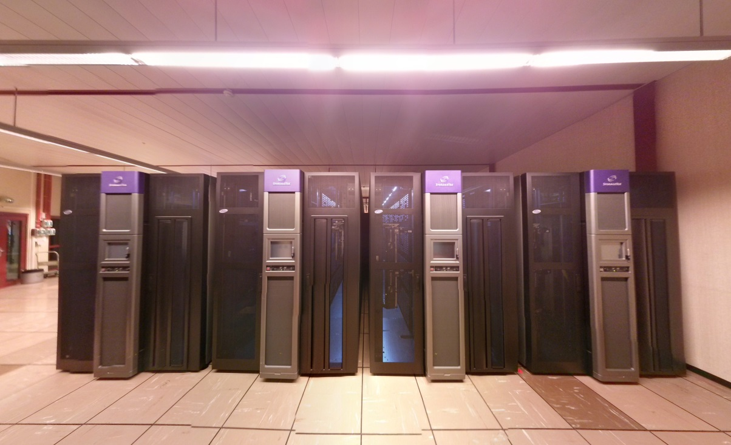
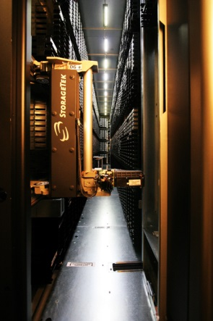
Storage at CC-IN2P3: tapes
Hardware
4 Oracle/STK SL8500 librairies:
  40,000 slots (T10K and LTO4)
  Max capacity: 320 PBs (with T10KD tapes)
  111 tape drives
1 IBM TS3500 library:
  3500 slots (LTO6)
Software
Mass Storage System: HPSS
  25 PBs
  Max traffic (from HPSS): 100 TBs / day
  Interfaced with our disk services
Backup service: TSM (1 PB)

Slide 5
Storage hardware as of today
4 Oracle/STK SL8500 libraries (4 x 10000 slots) for HPSS and TSM.
1 IBM TS3500 library (3500 slots) for TSM.
Tape media:
Media | Capacity | Max Bandwidth | Number of drives | Service
T10K-B | 1TB | 120 MB/s | 59 | HPSS
T10K-C | 5 TB | 240 MB/s | 21 | HPSS
T10K-D | 8.5 TB | 252 MB/s | 31 | HPSS
LTO4 | 800 GB | 120 MB/s | 20 | TSM
LTO6 | 2.4 TB | 160 MB/s | 6 | TSM

Slide 6
How experiments are dealing with the storage ?
Client apps
(local or distant apps)
File servers / filesystem
(local access)
Middlewares
(wide area access)
xrootd
GPFS
SRM
iRODS
dCache
Mass Storage System
HPSS
TSM
Backup

Slide 7
Local access: distributed filesystem
Purpose:
  For heavy I/O operations by many batch jobs in //.
  Not a permanent repository.
60 servers, 1.9 PBs of disk space.
1000 GPFS clients installed on our
Used by:
  up to 25% of the batch farm.
  84 groups.
Max activity observed: 500 TBs read in 5 days (Planck)
To do:
  Migration of metadata storage to flash technology (NetApp EF560).
  Reduction of the number of space (35 right now) down to 4.

Slide 8
Local access: dCache-xrootd
Purpose:
  Data access by batch jobs (local + grid).
  Pattern: remote access (random I/O, sequential).
  Interface with HPSS:
    Using Treqs (Tape request scheduler).
  dCache service part of the Atlas and CMS federations:
    xrootd proxy servers (gateway to our local dCache service).
  dCache head nodes db: use of SSD.
To do:
  xrootd: lots of tape staging (eg: 20k requests per day) ➔ « automatic » prestaging for some large « productions » needed.
service | # servers | capacity | experiments | # clients in // | access protocol
dCache | 165 | 8.5 PiB | LCG + « EGEE » VOs (17) | 15000 | dcap, xrootd, WebDAV, gsiftp
xrootd | 44 | 2.5 PiB | Alice + HEP + astroparticle (13) | 8000 | xrootd, http

Slide 9
Local access (xrootd/dCache)
T1.root
HPSS
(5)
(4) + (5):
dynamic staging (TreqS)
Data servers
(4)
Data server:
Xrootd
Data server:
Xrootd
(6): random access
(6)
(3)
Redirector server:
Xrootd
redirectors
(1)
(etc…)
Client
(2)
(1) + (2): load balancing
/hpss/in2p3.fr/T1.root ?

Slide 10
Mass Storage service: HPSS
Purpose:
  Interface to our back end storage: tapes (main storage).
29 servers (disk + tape movers).
Massive activity:
  27 PiB on tapes (rank #12 in HPSS world), 597 TiB of disk space (Dell R510, R720 servers).
  Up to 100 TiB in 22h between HPSS and other storage services.
New drive technology every 30 months.
Life cycle of a tape generation 8 years:
  Ramping up in 4 years.
  4 more years in production.
T10KB decommissionning:
  20000 tapes to be repacked until end 2017 ⬄ 5 PiB / year.
  Represents:
    1000 T10K-T2 ➔ T10K-C
    Or 750 T10K-T2 ➔ T10K-D
Tape lifetime: avg 7 years (max 10 years).
Redefine the class of services.
Refactoring of Treqs (Tape request scheduler) by our dev team.

Slide 11
Local access: pitfalls and lessons learned
Dynamic staging may result in:
  Massive staging requests.
  Long delays to access the files.
  Tapes capacity is getting bigger!
  Increased job inefficiency.
To leverage these drawbacks:
  Big files on tapes (several GBs).
  Reordering of file requests per tape id (reduce # of mounts/dismounts): up to 10000 per day.
  Prestaging.
  Avoid file scattering on a large amount of tapes (tape families ?).
Refactoring of Treqs (Tape request scheduler) by our dev team.

Slide 12
Middleware: SRM, iRODS
Purpose:
  Data management (storage virtualization, policies).
  Data sharing, access, archival etc… in a distributed and heterogeneous environment.
SRM:
  Used by Atlas, CMS, LHCb + EGEE/EGI virtual organizations.
iRODS:
  Managing > 9 PBs of data (HEP, astro, biology, Arts & Humanities): includes data stored on tapes.
Web interfaces, HTTP/REST, webdav.

Slide 13
Focus: LSST storage usage
GPFS:
  130 TB (50% being used at the moment)
HPSS:
  78 TB
iRODS:
  90 TB

Slide 14
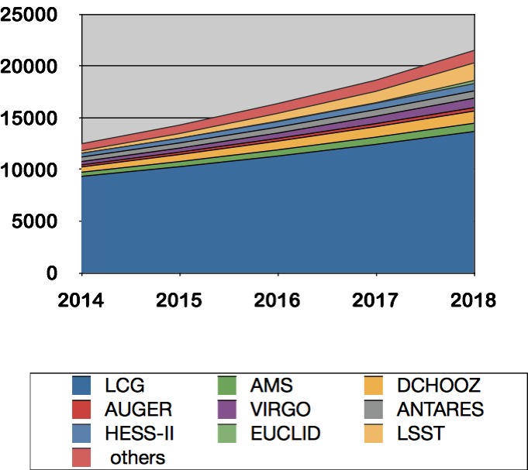
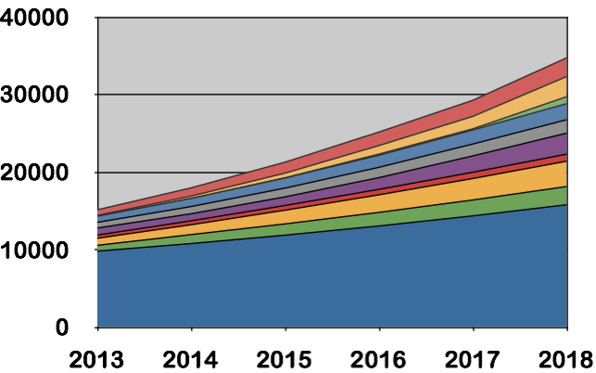
Future storage needs (Hard Sci Fi)
Cumulated Disk (TB)
Cumulated Tape (TB)
Hypothesis:
  LCG: +10% / year
  HEP like experiment: ratio disk/tape = 30%
CTA not included
Credit: Rachid Lemrani

Slide 15
Qserv
Used to debug Qserv.
1 interactive node:
  1 virtual machine ccqservbuild.in2p3.fr.
  Mainly used for:
    the compilation of the Qserv software.
    the deployement of Qserv on the cluster.
  Accessible from SLAC.
50 Qserv nodes:
  Dell / CC-IN2P3 partnership.
  ccqserv{100..149}.in2p3.fr.
  Dell servers R620 and R630
    Intel Xeon, 16GB RAM
    7 TB of usable storage
  run the Qserv software (1 master, 49 slaves).
  private subnetwork (nodes accessible from ccqservbuild only).
(Credit: Yvan Calas)

Slide 16
Storage prospects
Tape will still have a major role:
  Balance between nearline and pure archive storage ?
Hard drives still preferred to SSD:
  prices will converge in the next couple of years.
  SSD usage limited at the moment for key apps (GPFS metadata, HPSS and dCache databases etc…).
Heavy I/O still and even heavier:
  Lots of « random » I/O: still strong needs for seek, read, write.
  Simple put/get interaction not sufficient.
Big metadata challenge (storage system metadata).
Data life cycle improvements:
  > 100 groups, 5000 users (~ 2000 active users).
  Data Management Plan.
  archival service beyond simple bit preservation ?
  OAIS, dublin core metadata.
Provide interfaces for Open data ?
Notes:
Seen with grid projects that put/get can be primitive

Slide 17
Storage prospects
Assessment of object storage:
  Swift: testing it at the moment.
  Swift extra value wrt what we already have: to be proven.
  Ceph (but it can be more than an object storage): evaluation starting in the next couple of months.
Hadoop, MapReduce type of systems: no plans yet as not much needs expressed by our user community.
Metadata: will increase massively with increased storage.
  Limit the amount of files => increased file size.

